Slide 1
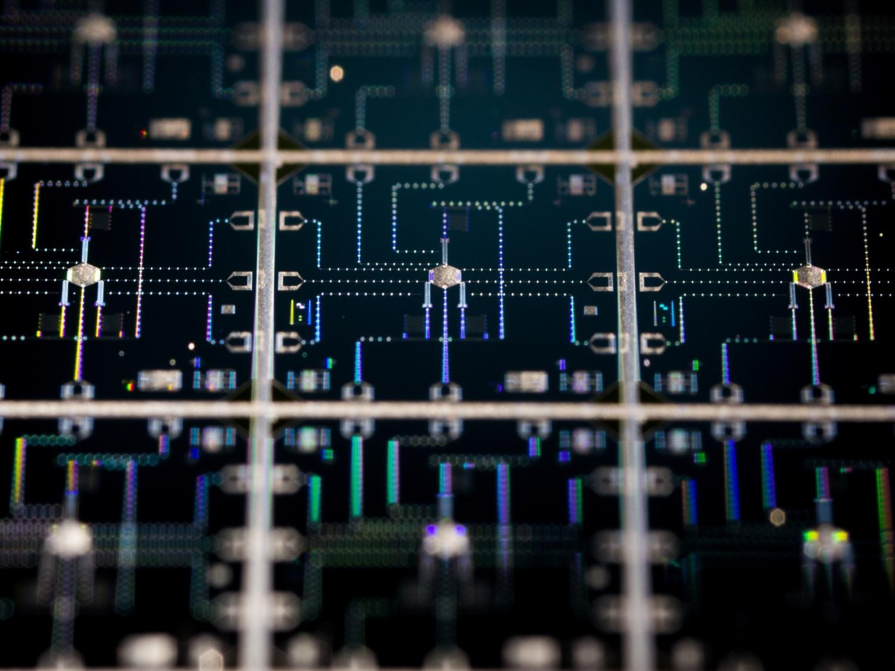
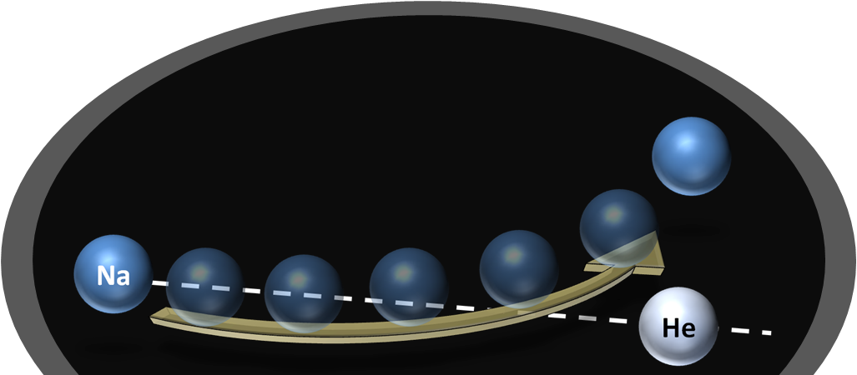
Simulating Quantum Chemistry with a
Fully Coupled Quantum Processor
Molecular Collision of Na and He
John Martinis
UC Santa Barbara
Google

Slide 2
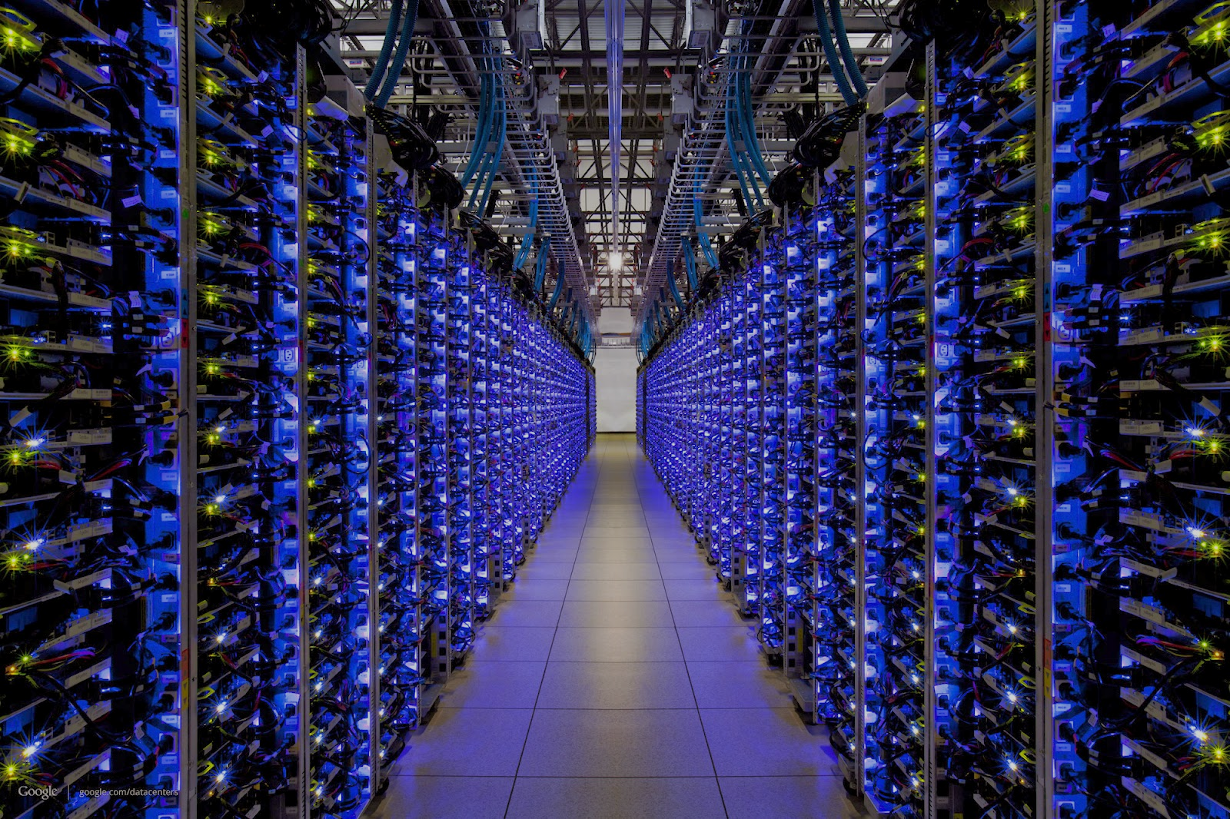
Big Data
10⁶ cores
10¹² transistors/core

Slide 3

Really Big Data
( |0⟩+|1⟩ )³⁰⁰
more states than
atoms in universe

Slide 4
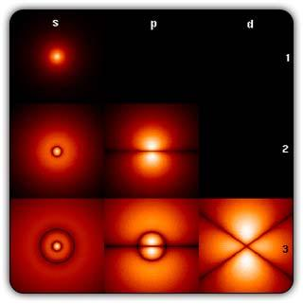
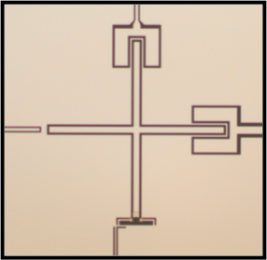
Encoding of quantum bits
H atom:
quantum circuit:
|0)
100 𝜇m
|1)
orbitals
6 GHz microwave oscillator

Slide 5
Technology Challenges
Software - need special algorithms (only n output bits)
Quantum chemistry
Machine learning
Hardware - qubits need coherence, scalable, good control …
Quantum IC with superconductors
Analog quantum annealing
Analog quantum simulation
Digital quantum computation – need error correction

Slide 6
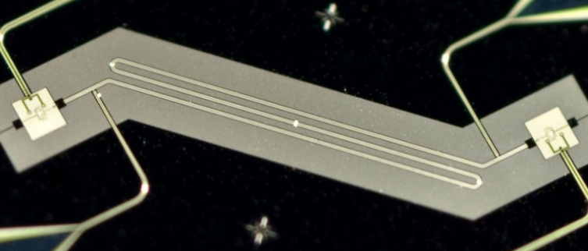
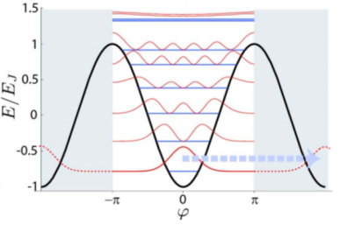
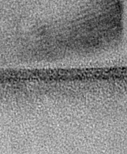
Superconducting Qubits
Quantum circuit: quantize I and V, 5 GHz >> 20 mK
LC oscillator (linear): memory and communication
U(Φ)
1
λ/2
0
Josephson junction: non-linear inductance with 1 photon
(+ low loss)
I
Al
AlOx
Al
1.7 nm
1.7 nm
Notes:
6
Quickly discuss dissipation, thermal noise
Linear oscillator – no qubit

Slide 7
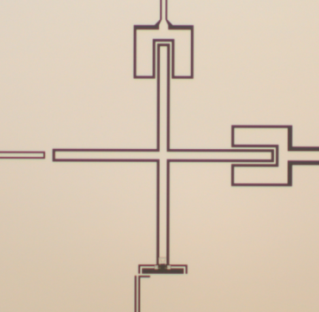
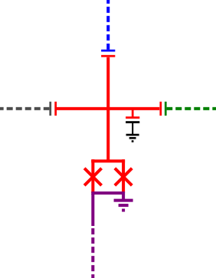

Xmon Circuit
Readout resonator
μwaves (X,Y)
AC drive
Bus
Self capacitance
Variable L
ground
plane
Flux Bias
Frequency (Z)
Transmon is non-linear LC oscillator
Notes:
modular
7

Slide 8
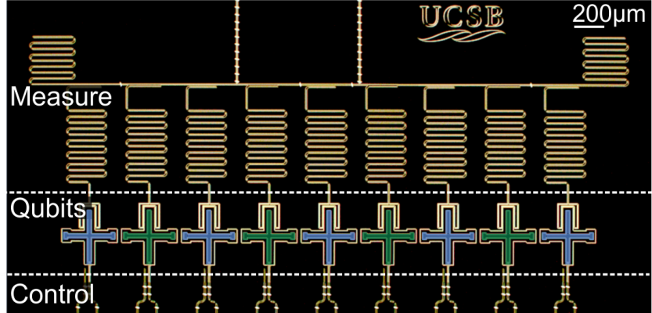
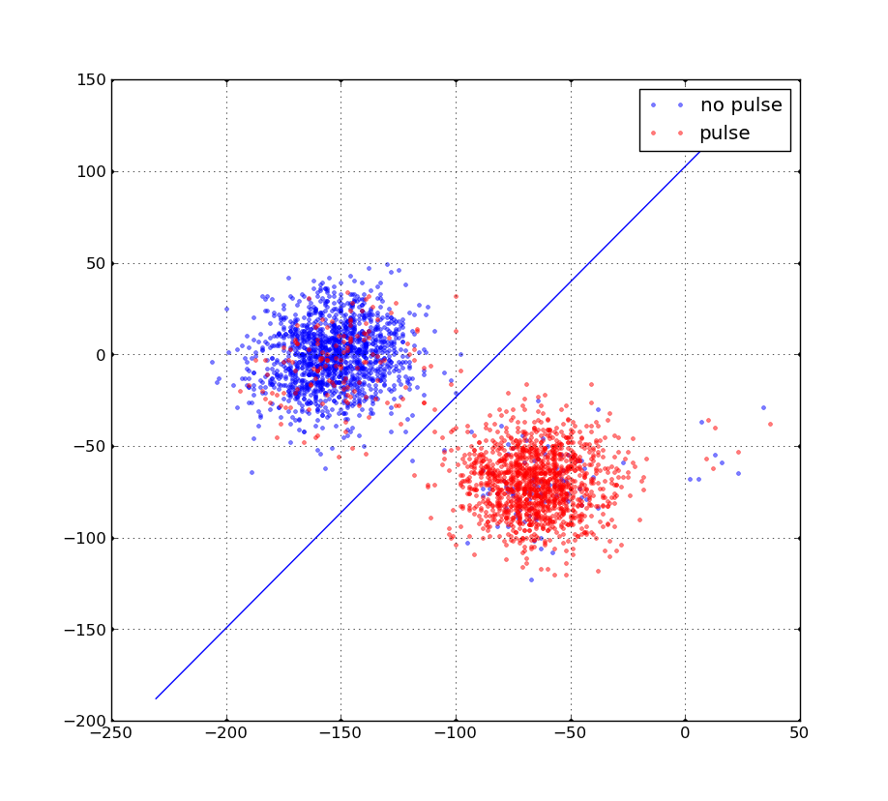
Measurement: Single Shot, QND, Hi-Fi, Mux’d
Microwave tone
measures qubit
For coupled oscillators:
Change in qubit frequency
shifts resonator frequency
Measure frequency by change in
phase from microwave tone
readout S
λ/2 resonator
(7 GHz)
3
|0>
|1>
2
1
Imag[S]
0
-1
xmon
(5.8 / 6 GHz)
-2
-3
-3
-2
-1
0
1
2
3
Real[S]

Slide 9
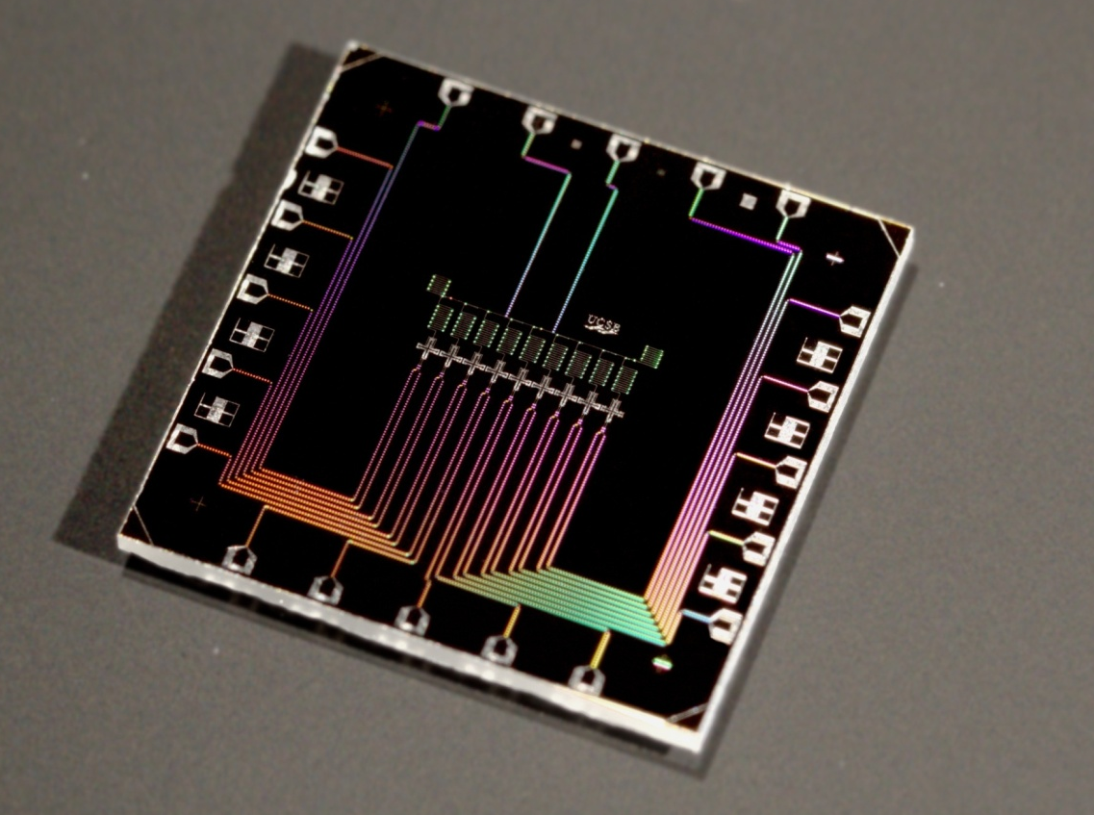
9 Xmons:
hifi gates
fast readout
surface code compatible

Slide 10
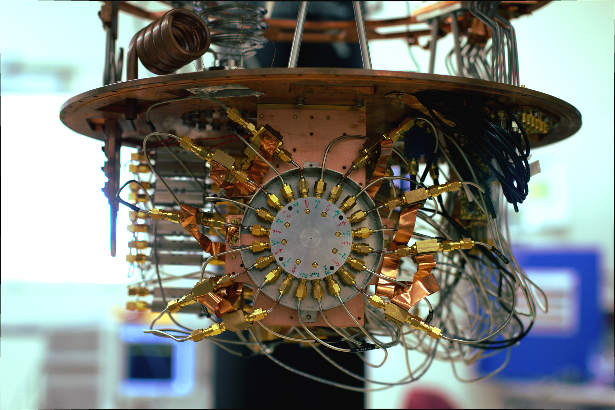

Slide 11
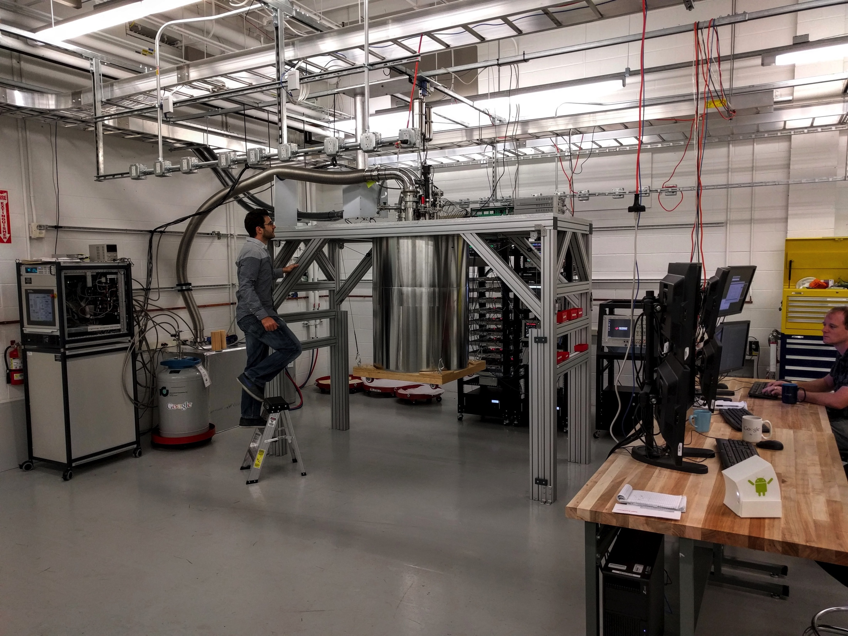

Slide 12
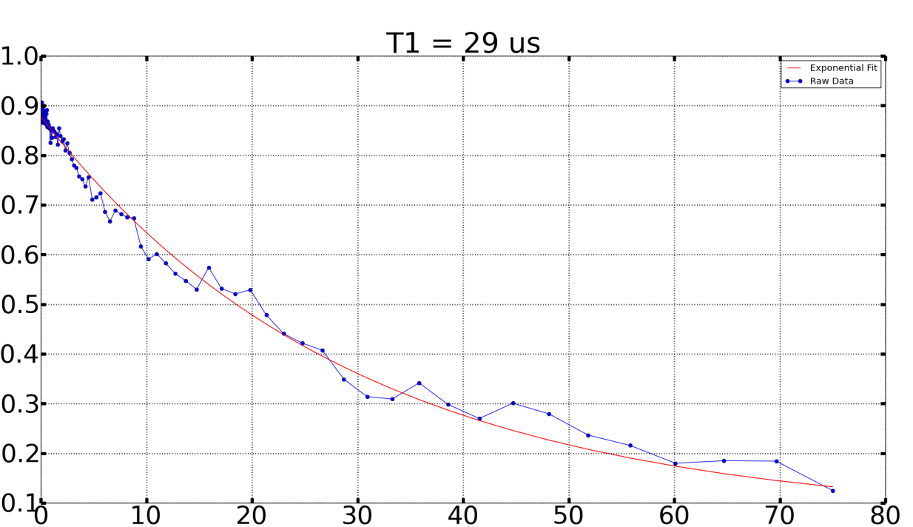
Qubit Operation
NOT
Rabi
0
{0,1}
time
Meas.
time [ns]
T1=29 μs
lifetime
(T2=10 μs)
x_{π}
probability 1 state
0
1
time
Meas.
time [μs]

Slide 13
Simulating Quantum Chemistry with a
Fully Coupled Quantum Processor
Molecular Collision of Na and He

Slide 14
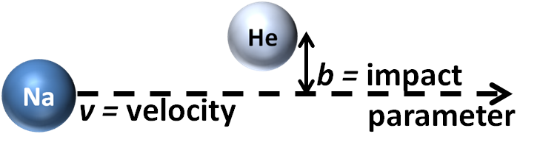
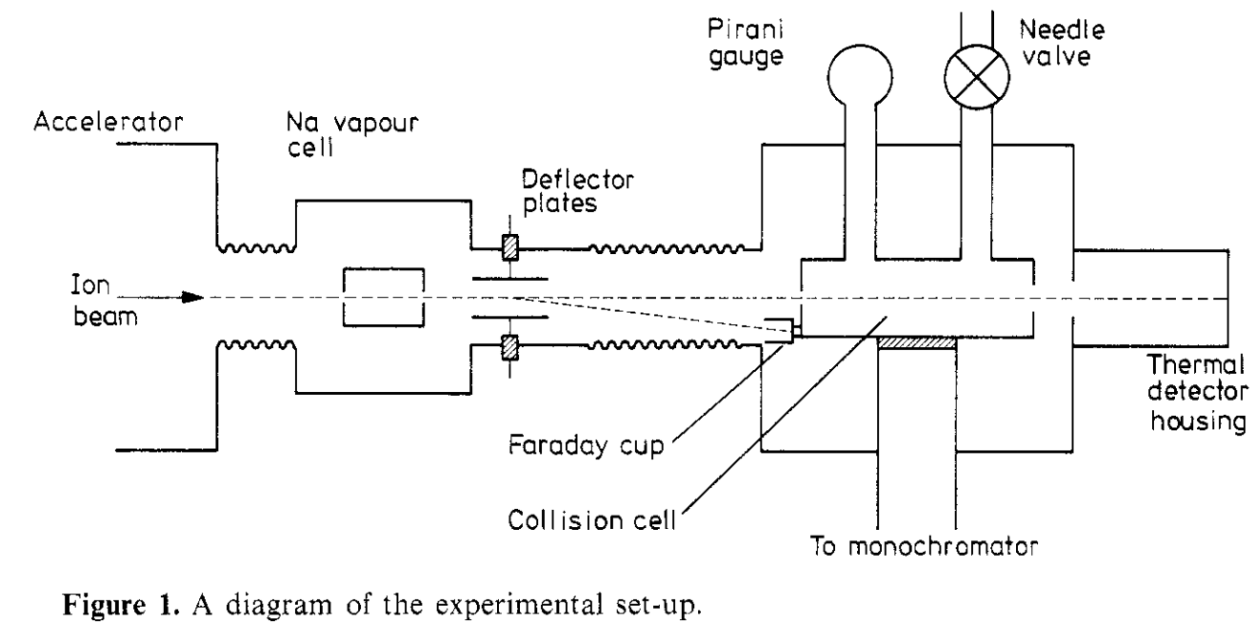
Inelastic Scattering of Na & He:
Experiment
[Olsen 1977]
Ionization
0
3P
2.1 eV
Energy (eV)
2S
-5
3S
He: 1s²
-25
1S
Na: [Ne]3s¹
He
Na
Notes:
Point: Real Experiment, quasi 1 electron, 3 channel problem
Na exicted state lifetime = 16.1 ns. Reference ‘Measurement of the Radiative Lifetimes of the First Excited States of Na, K, Rb, and Cs by Means of the Phase-Shift Method*’ by John K. Link
2 He -24.59eV
11 Na -5.14eV

Slide 15
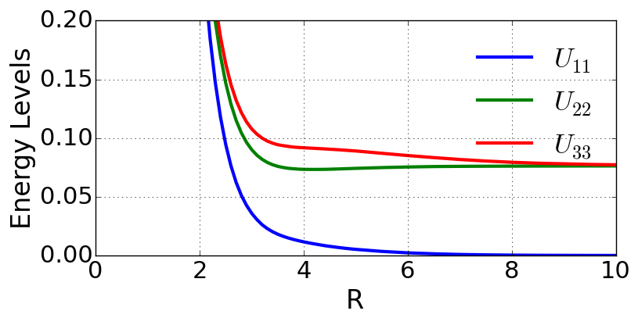
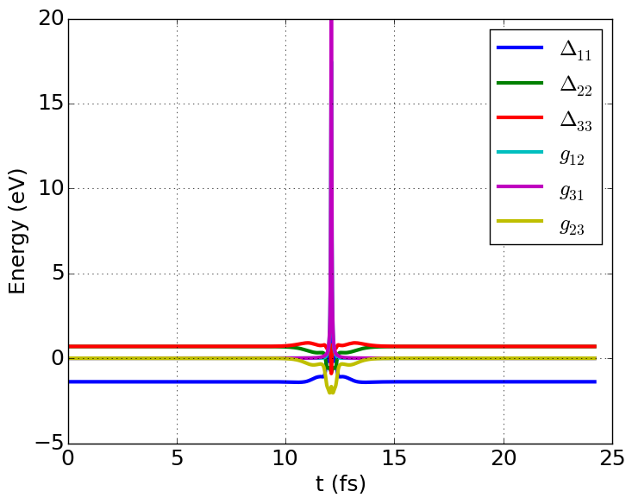
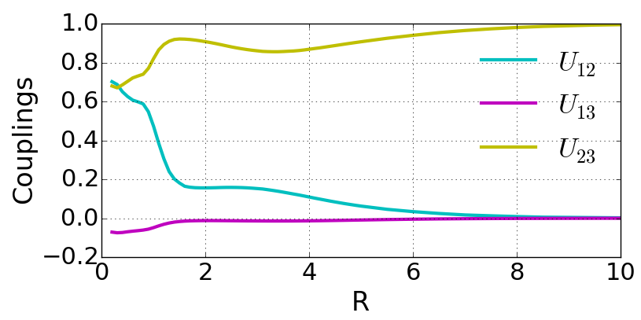
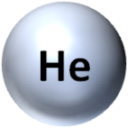
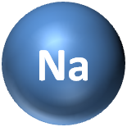
Inelastic Scattering of Na & He:
Numerical Computation
Diabatic Potentials & Couplings (a.u.)
Molecular Collision H(t)
0.2
Na(3s) orbital
Na(3p) orbitals
0.1
0
1.0
0.5
0
b = impact
parameter
v = velocity
C. Y. Lin et al, Phys. Rev. A 78, 052706 (2008)
Notes:
Point: Potentials and Couplings as functions of R, converted to H(t) which is too high energy & too fast for our system.
a.u. – atomic units Hartree for Energy, bohr radius for R

Slide 16
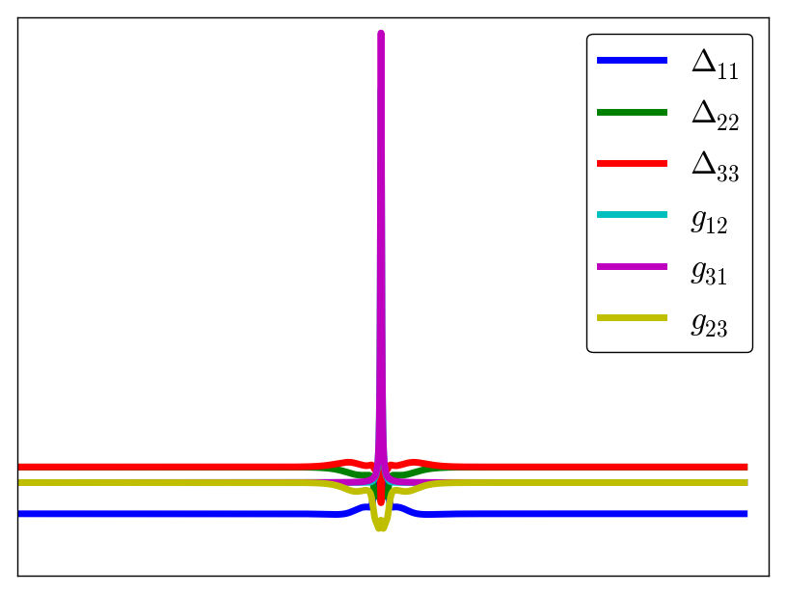
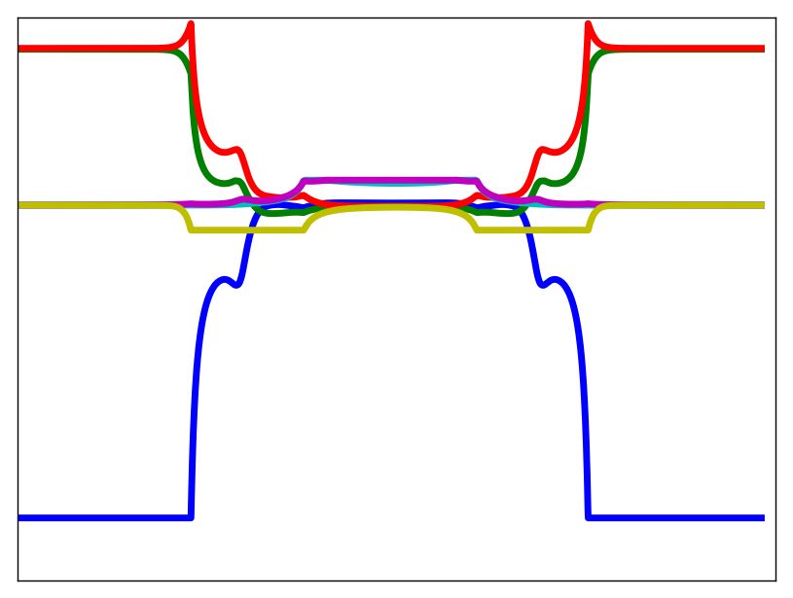
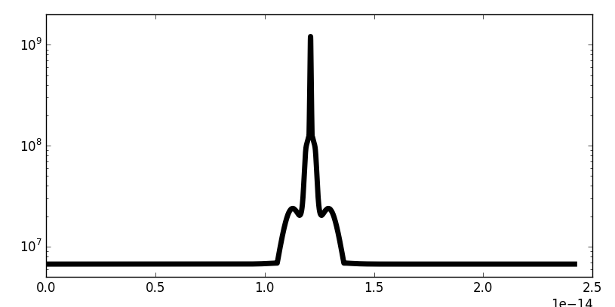
Inelastic Scattering of Na & He:
Scaling H(t) for QC
Molecular Collision H(t)
H_{qc}(t) Scaled for QC
H_{qc}(t) Efficiently Scaled for QC
20
5
30
|g (t)| < 5MHz
E (eV)
E/h (MHz)
0
E/h (MHz)
|g (t)| < 5MHz
0
0
|Δ (t)| < 50MHz
-50
0
t (fs)
25
0
t_{qc} (us)
25
0
t_{qc} (ns)
300
λ=10⁹
λ=λ(t)
10⁹
H_{qc}=H(t) / λ
λ(t)
10⁸
dt_{qc}=dt * λ
10⁷
0
t (fs)
25
Pritchet et al, arXiv:1008.0701 (2010)

Slide 17
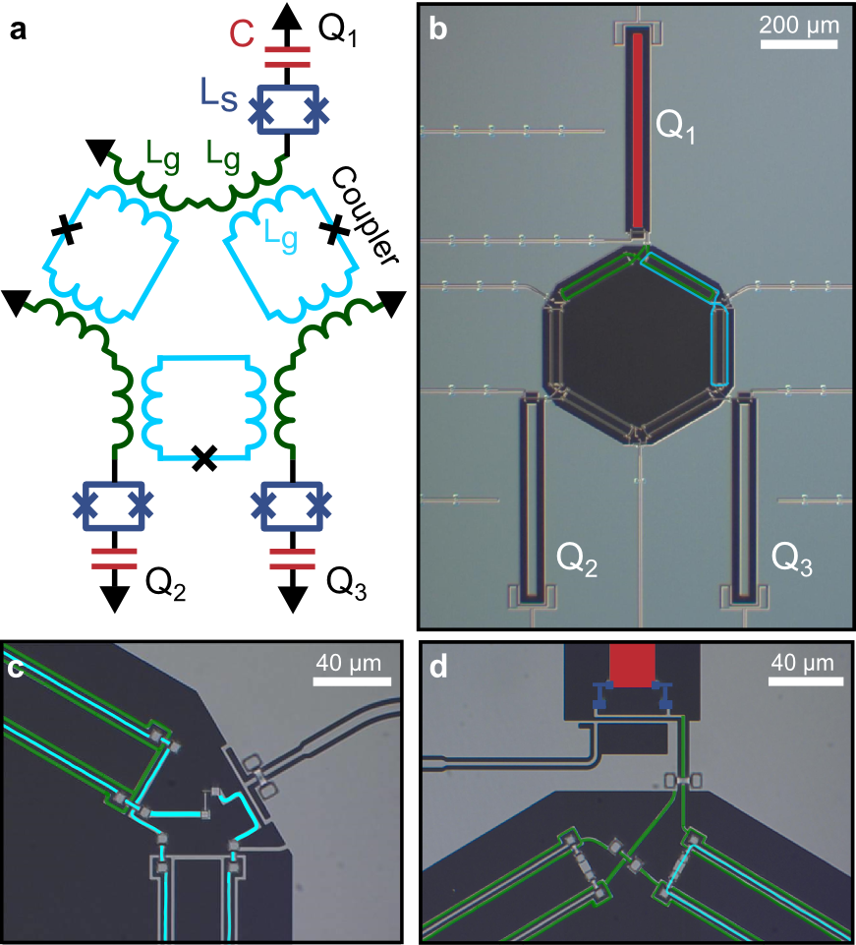
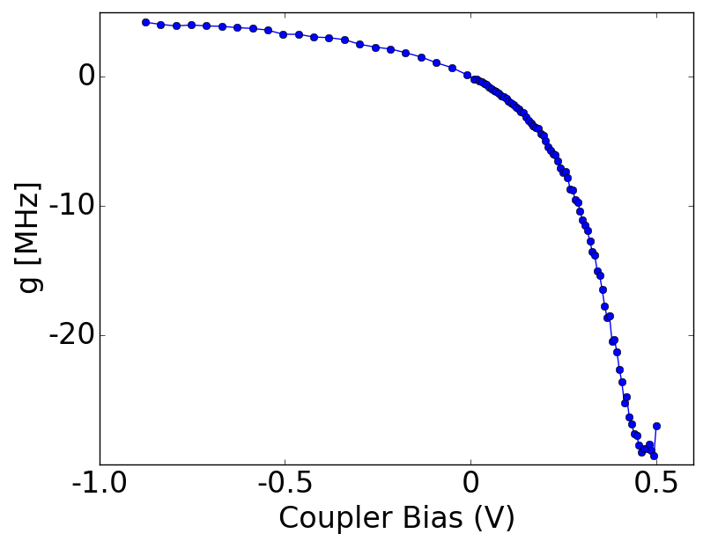
3 Qubit Quantum Processor
with Full Connectivity & Full Controllability
Modulate g in ~ ns
0
0.5
gmon Architecture
High Coherence: T1~20us
T2~12us
C. Neill et al. In preparation
Tunable qubit frequency
Tunable coupling
Yu Chen et al. PRL (2014)
Notes:
I have the cartoon in the upper right because I need to introduce it at some point to use it as a legend for the pulse sequence. Let me know if you think of a better way.

Slide 18
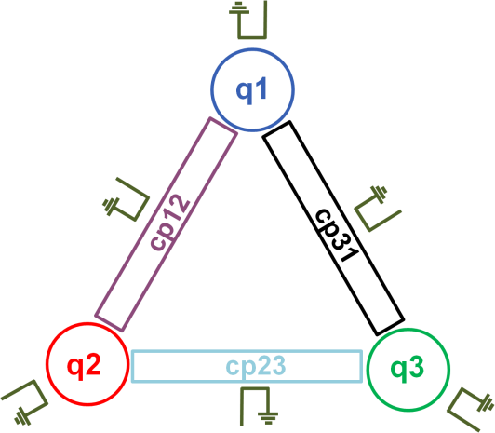
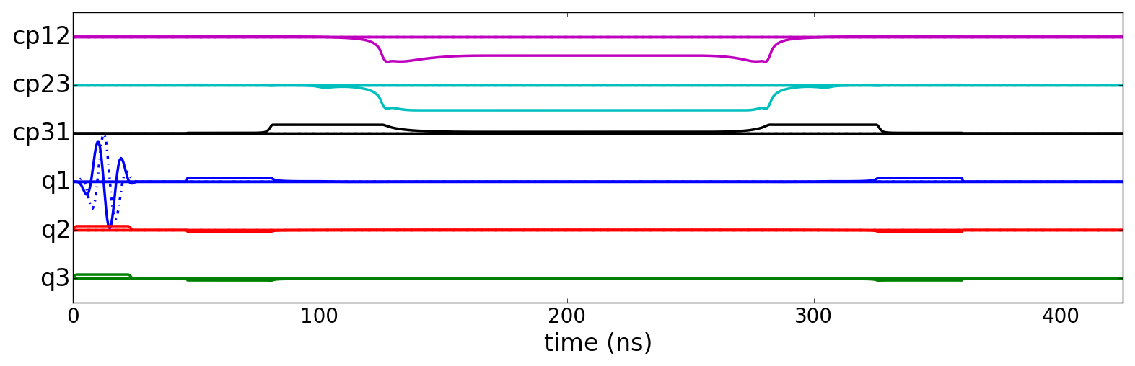



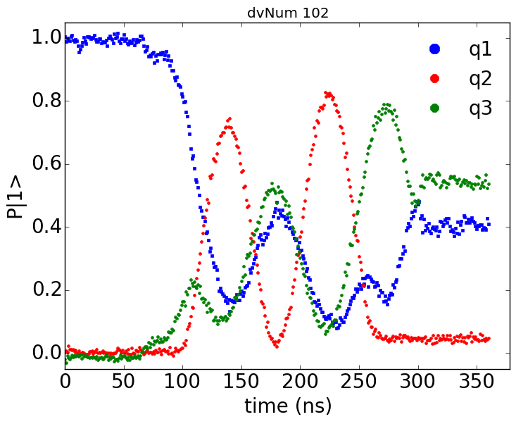
Inelastic Scattering of Na & He: Quantum Simulation
Simulation Conditions
Initial Channel = |1>
v/c = 7.3x10⁻⁴
b = 0.053 Å
53%
41%
3%

Slide 19
Inelastic Scattering of Na & He: Quantum Simulation
Simulation Conditions
Initial Channel = |1>
v/c = 7.3x10⁻⁴
b = 0.053 Å

Slide 20
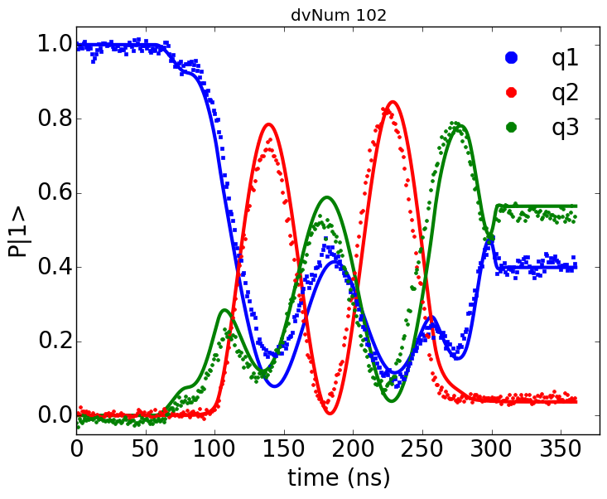
Inelastic Scattering of Na & He: Q. + Num. Simulation
Simulation Conditions
Initial Channel = |1>
v/c = 7.3x10⁻⁴
b = 0.053 Å

Slide 21
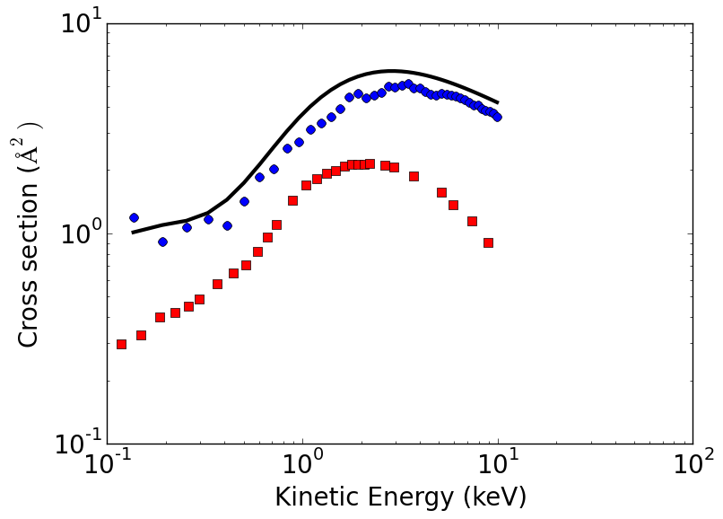
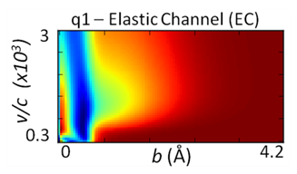
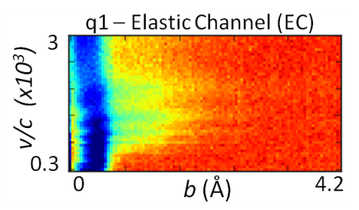
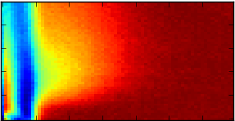
Inelastic Cross Section:
Comparing Simulation to Experiment
Numerical
Computation
Quantum
Simulation
Experiment
[Olsen 1977]

Slide 22
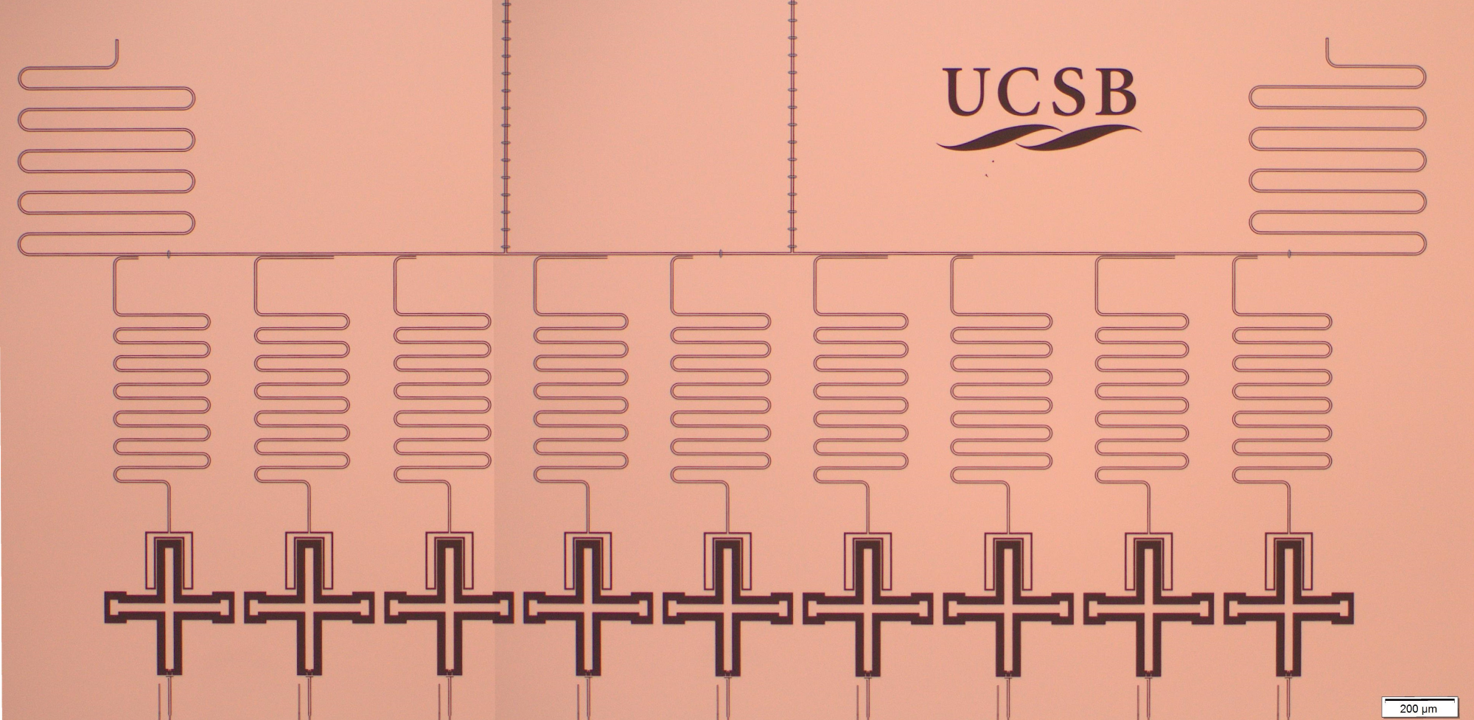
Summary & Outlook
Xmon qubits are high-fidelity technology
1 qubit: 99.93(3)%
2 qubit: 99.45(5)%
Repetitive measure: 99%
Improvements ongoing, with scaling
all at once
With fidelity and control, perform computations at thresholds
Digital: Bit-flip error correction
Analog: Computation power for chemical simulation
Technology in hand to scale up to ~100 qubits, soon…

