Slide 1
Track 2 highlights
Debbie Bard,
David Lange,
John Marshall
Track 2 conveners, CHEP 2016

Slide 2
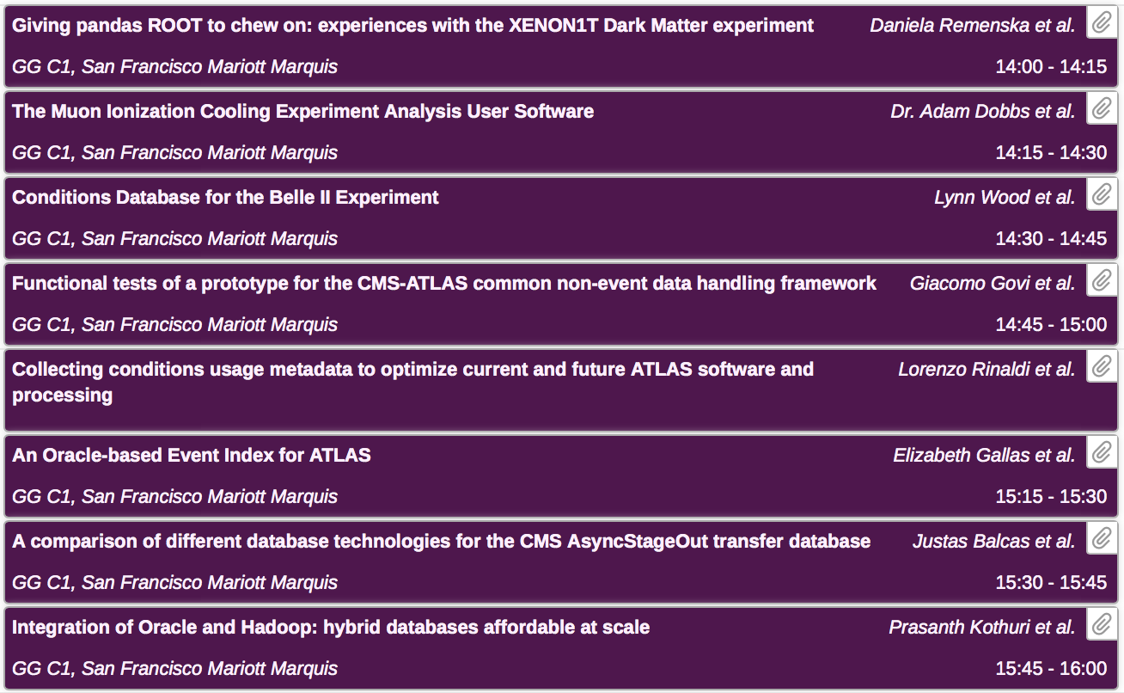
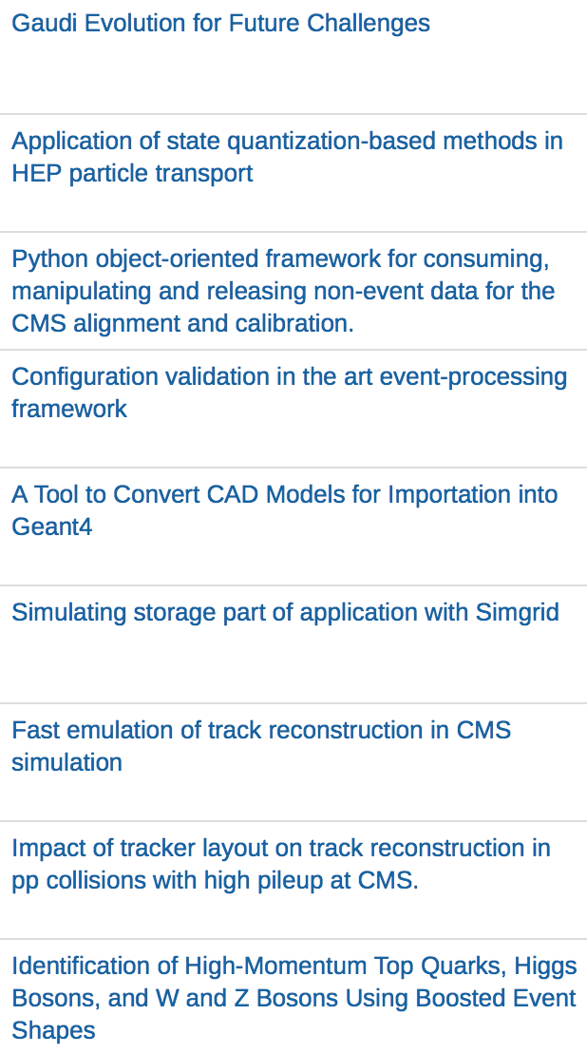
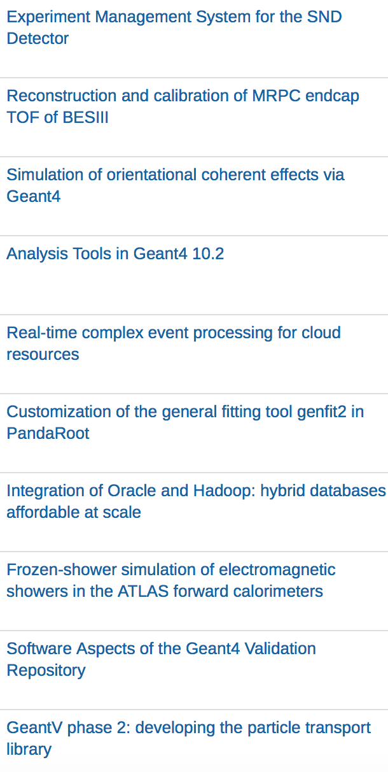
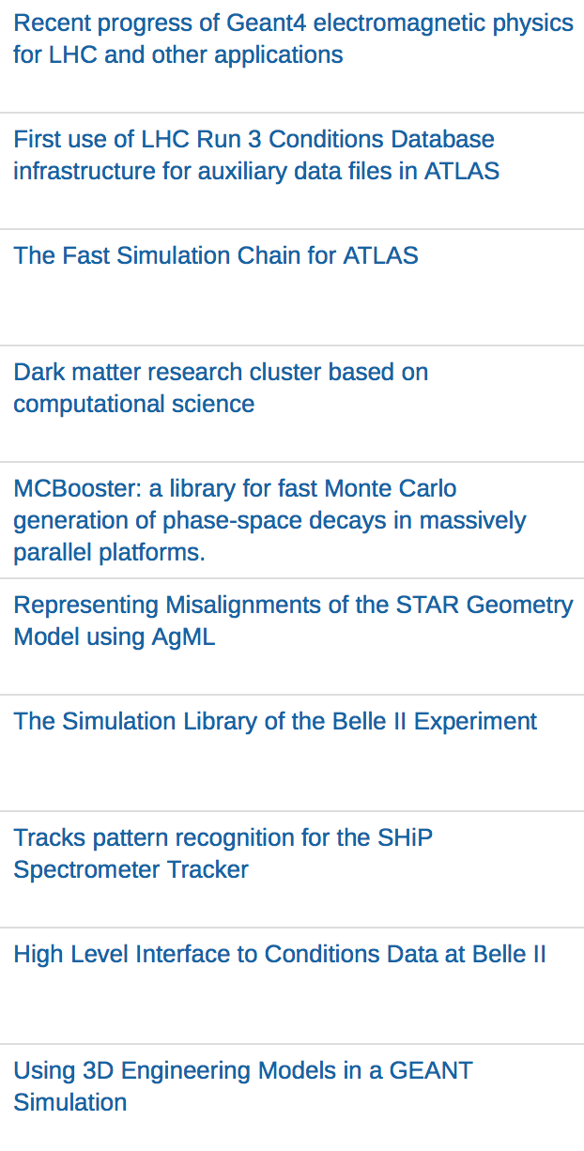
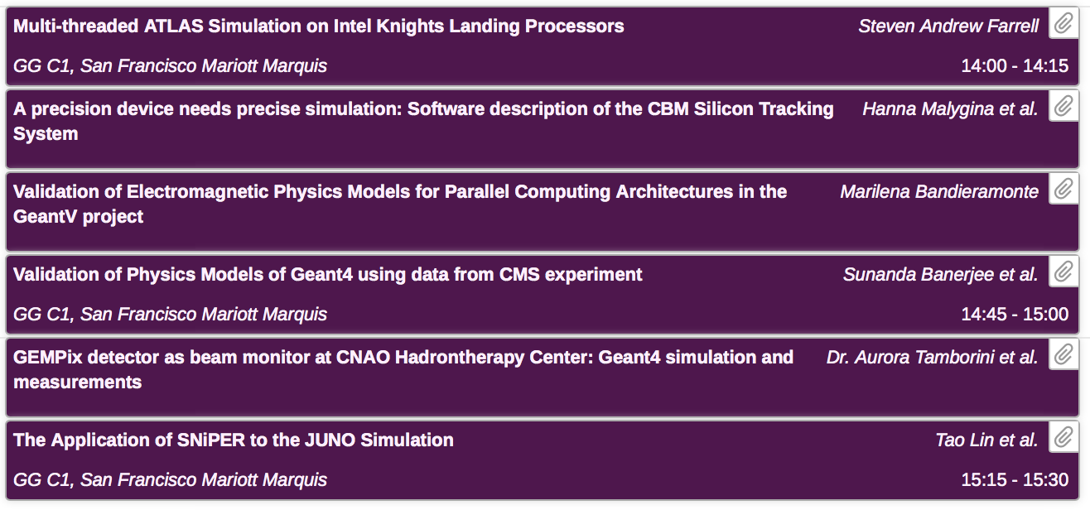
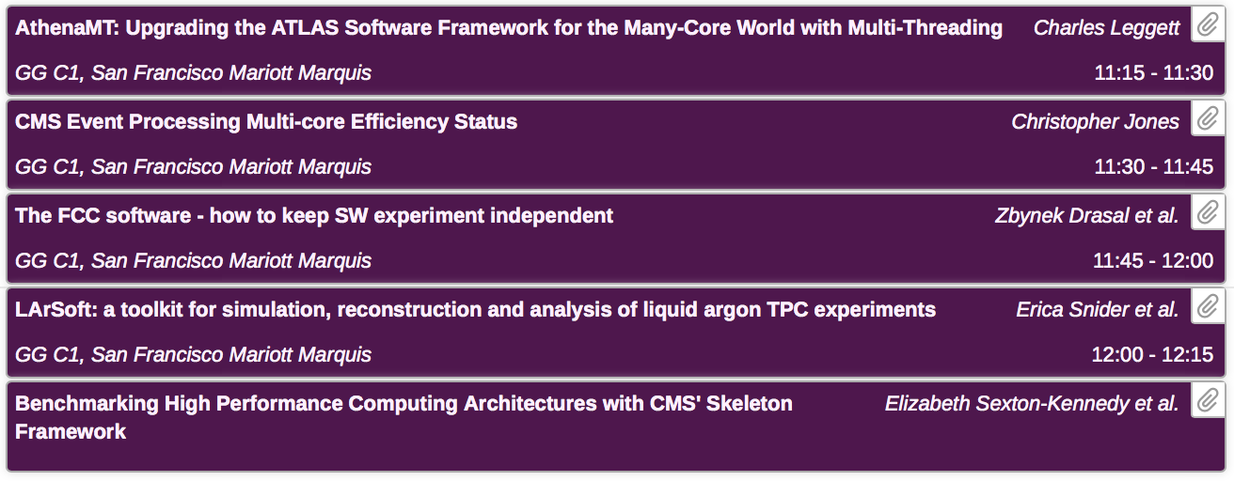
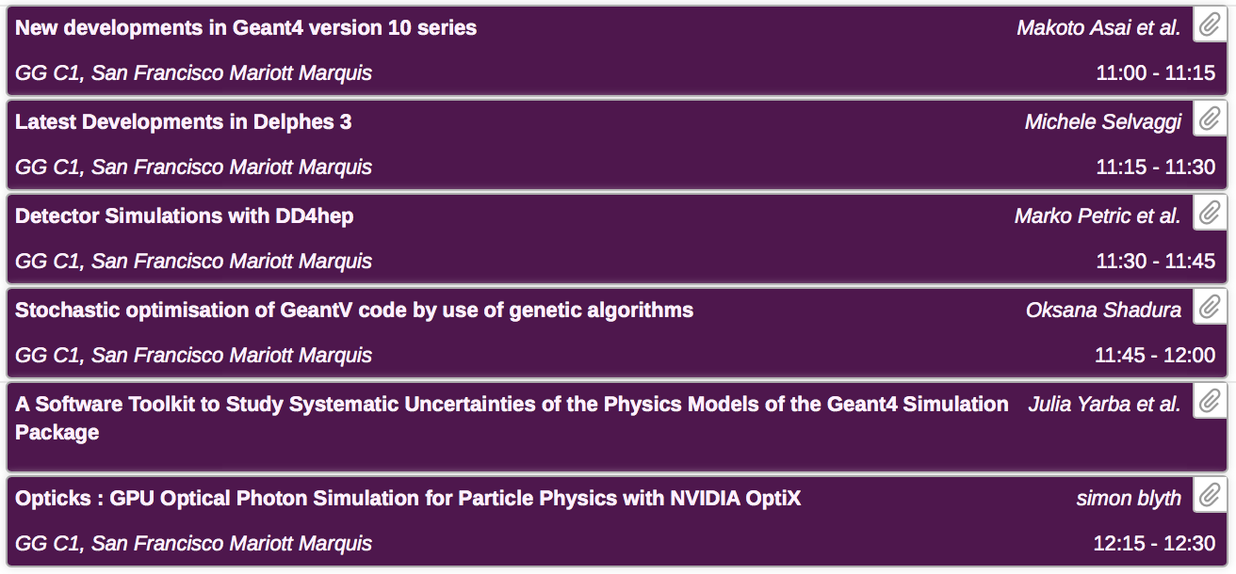
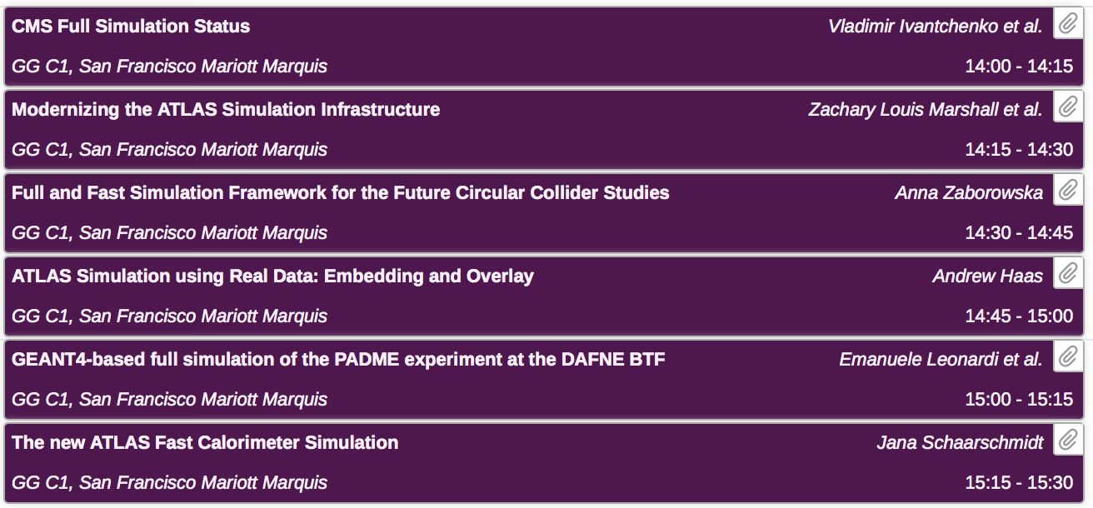
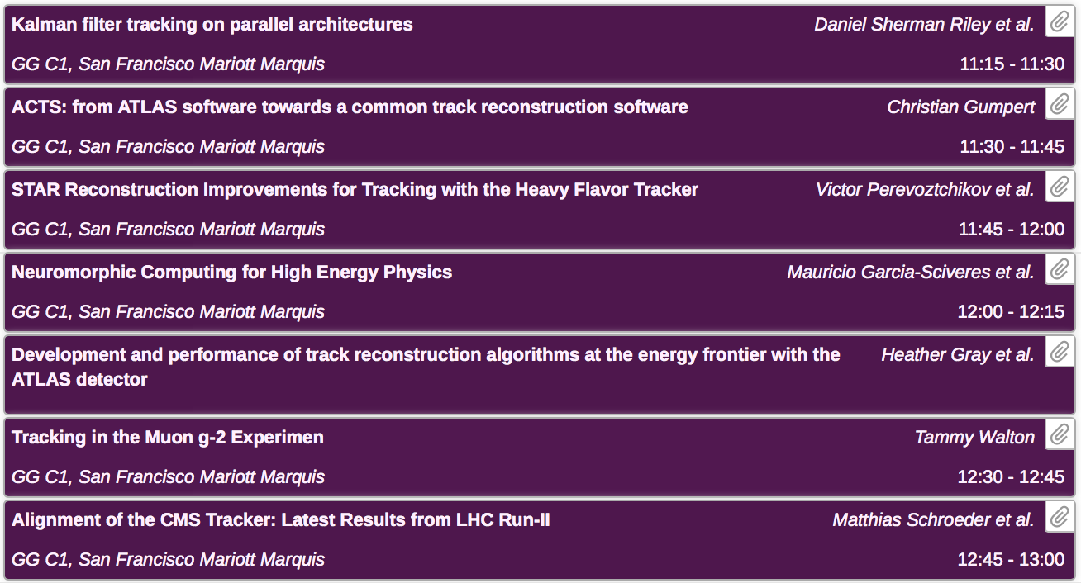
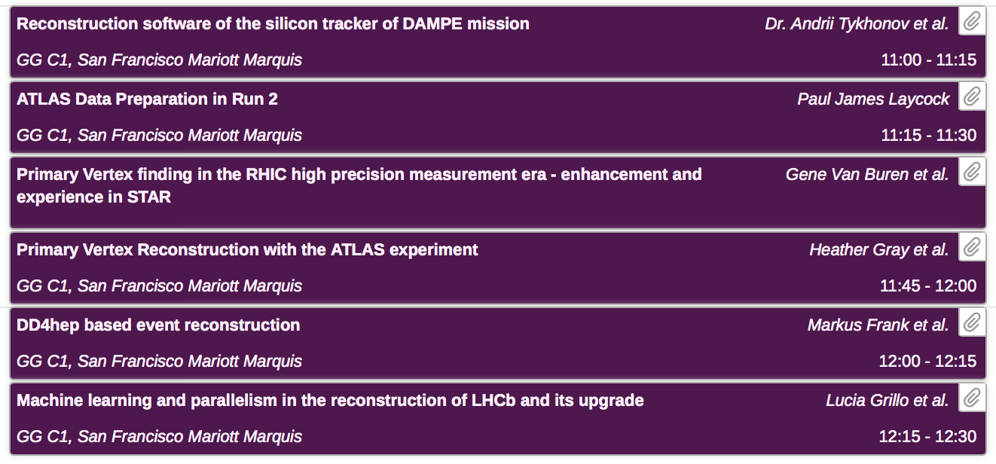
Track 2: Offline Computing
81 abstracts
44 talks
~30 posters
Thank you to our presenters
and audience for very interesting sessions

Slide 3
Intended topics for Track 2
Event generation
Simulation and reconstruction
Detector geometries
Tools and techniques for data classification and parameter fitting
Frameworks for event processing
Artificial Intelligence and machine learning in such system
Describing and managing offline condition database, HPC in such system
Given the abstracts in our track, we had
a somewhat imbalanced but very interesting program

Slide 4


Presentations from a wide set of experiments
*Apologies if we forgot yours!
Now I will briefly discuss a handful of the results
from each session (plus some posters). All credit goes to the presenters, all mistakes are mine..

Slide 5
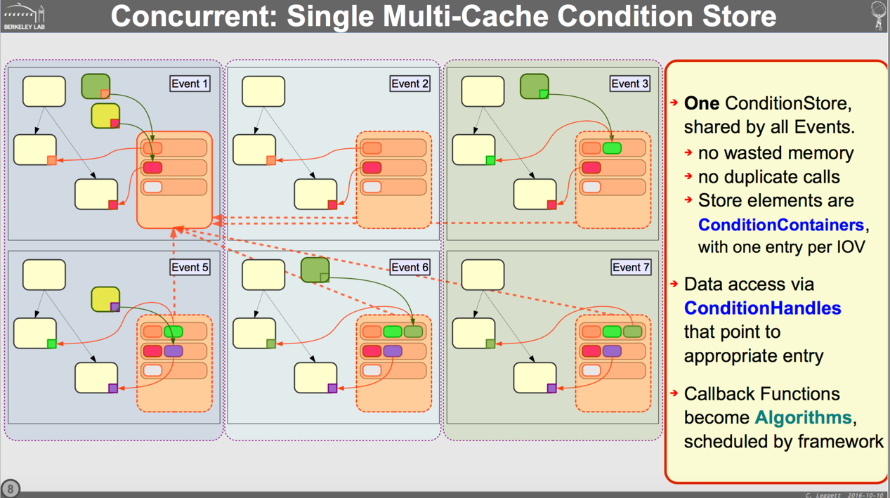
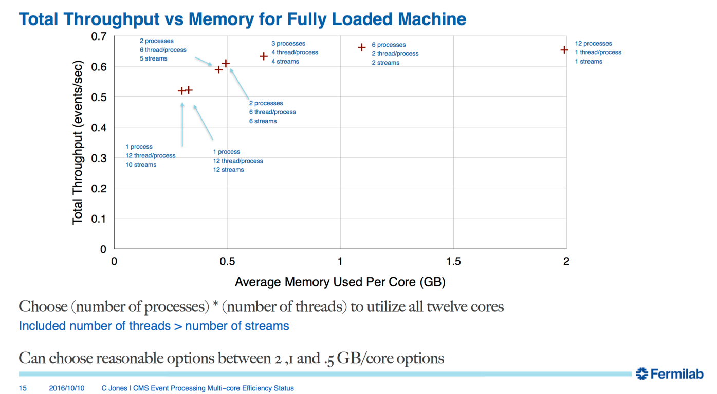
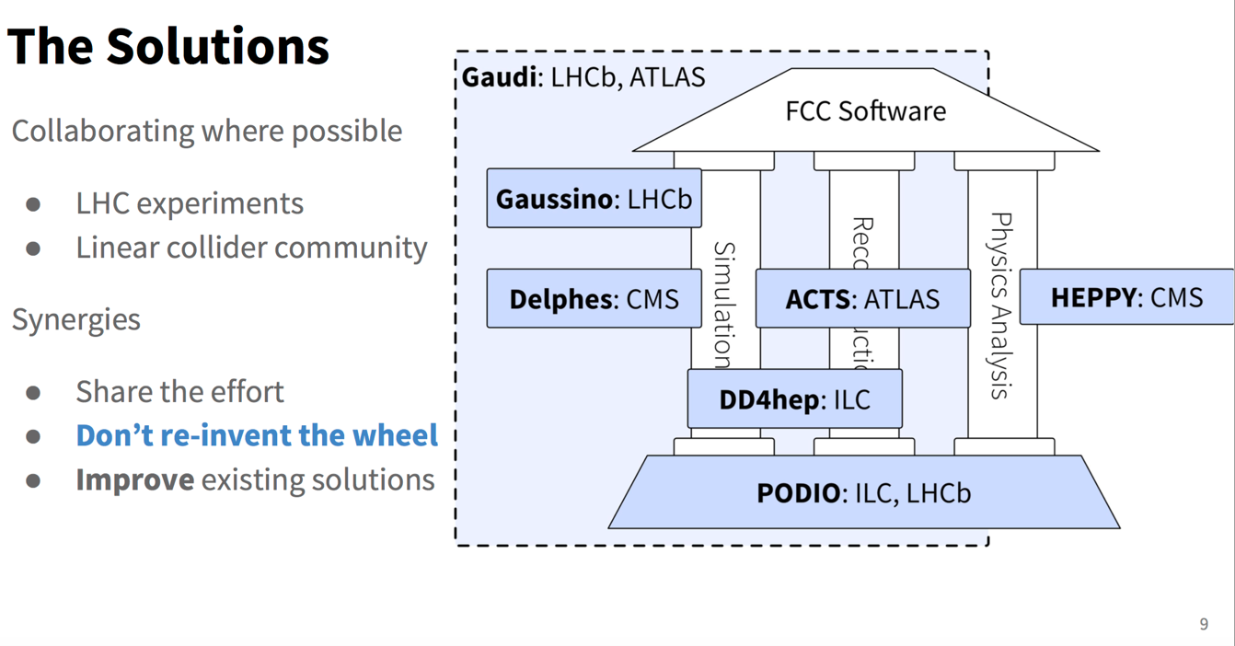
Monday morning: Event processing frameworks
Themes:
  Extend frameworks to multithread.
  Then improve their performance (and application performance)
  New projects are using existing frameworks not thinking about new ones

Slide 6
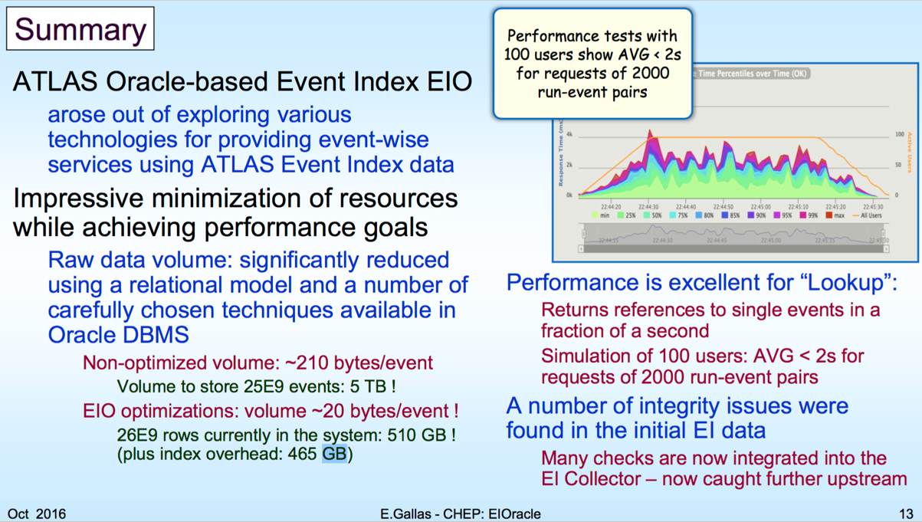
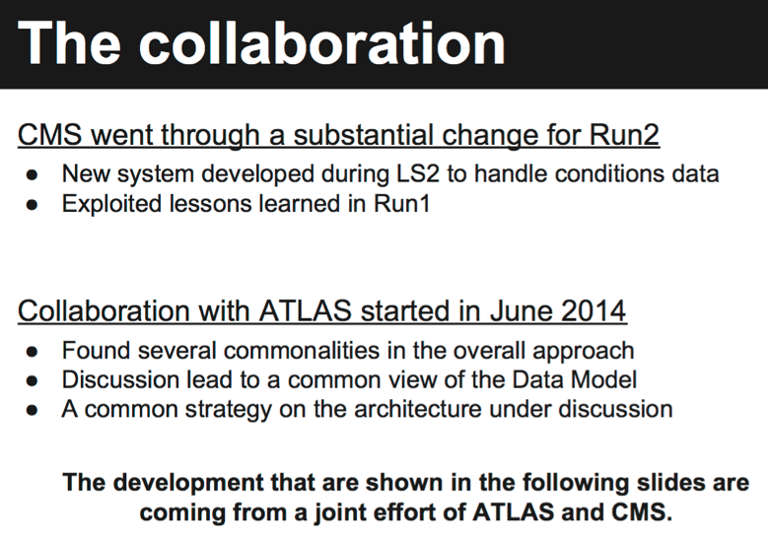
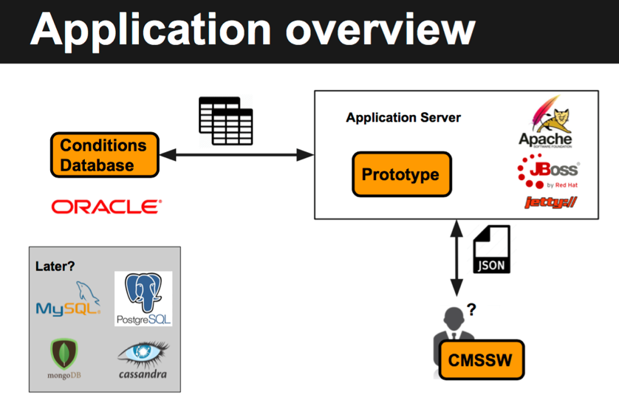
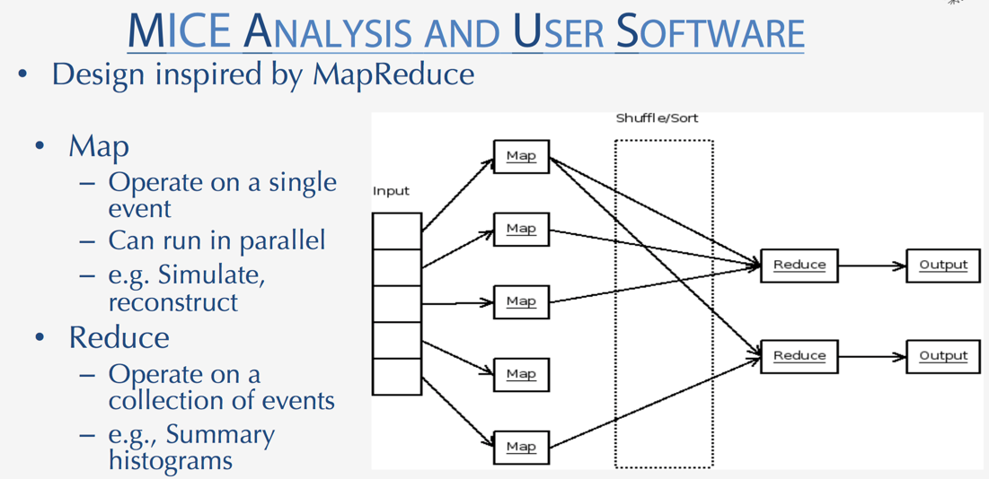
Monday afternoon: Conditions / Databases
CMS / ATLAS collaboration building on CMS conditions database
Map/Reduce data analysis methods
Very efficient Hadoop+Oracle event lookup service developed in Atlas

Slide 7
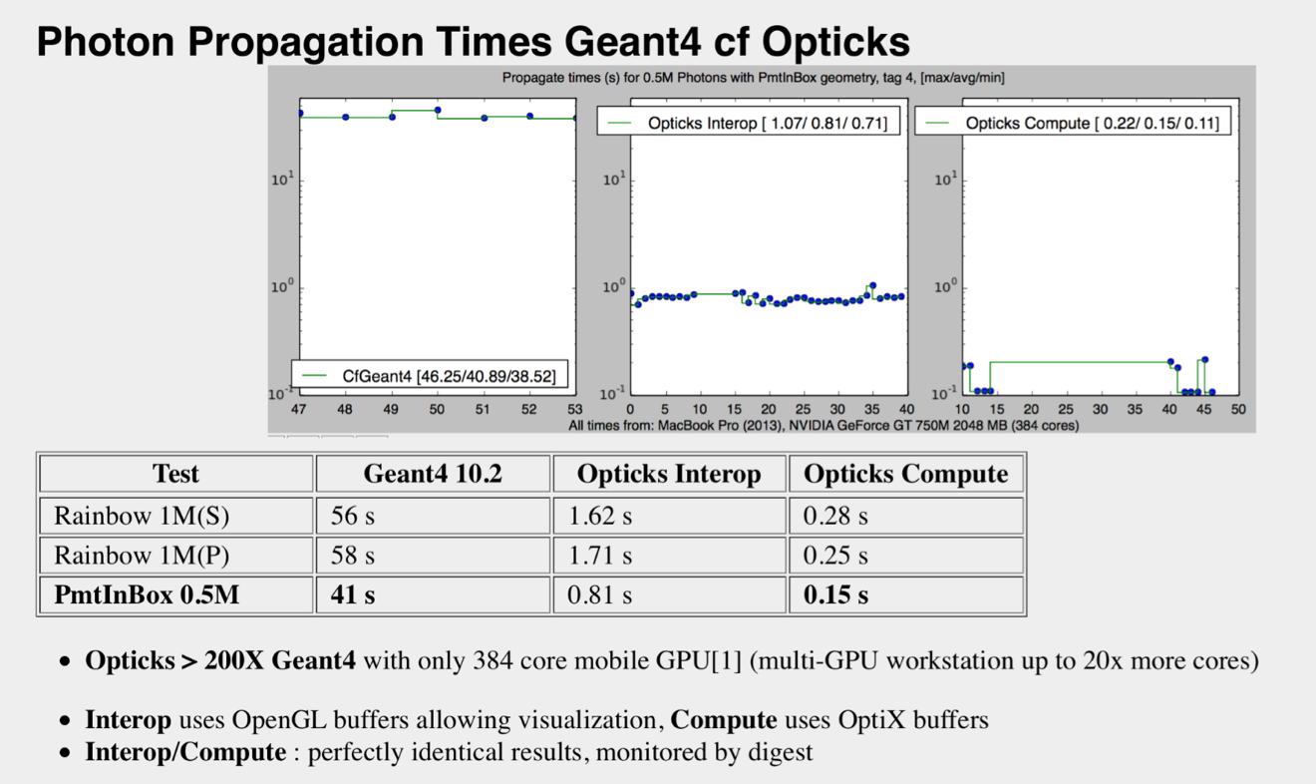
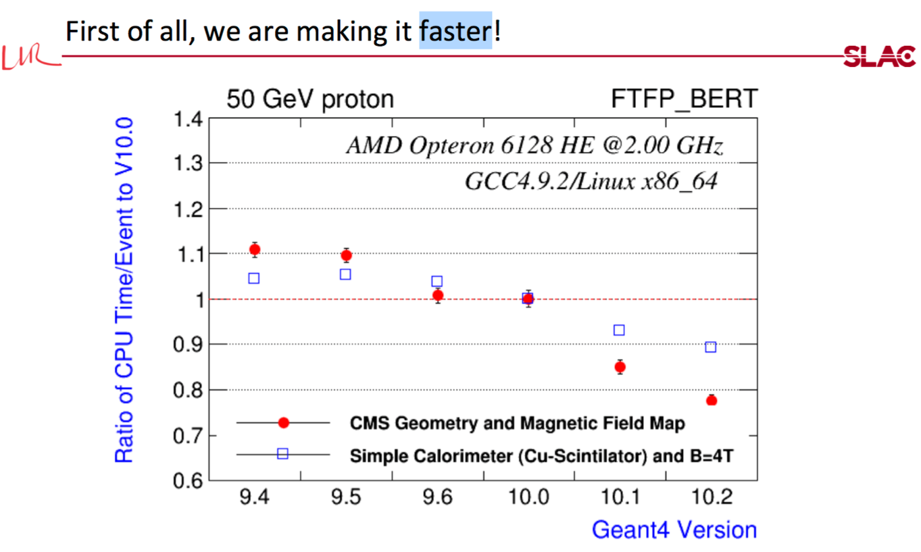
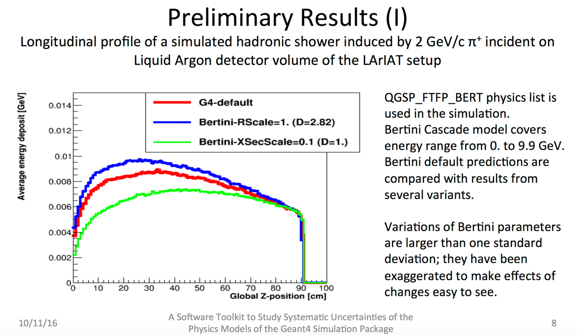
Tuesday morning: Simulation toolkits
Geant4 technical performance improvements continue.
Opticks: GPUs to optimize photon transport
Systematic error analysis capability for Geant4

Slide 8
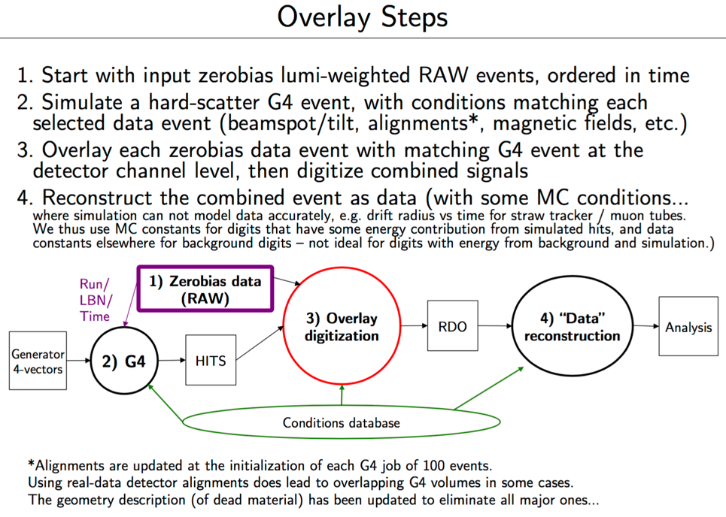
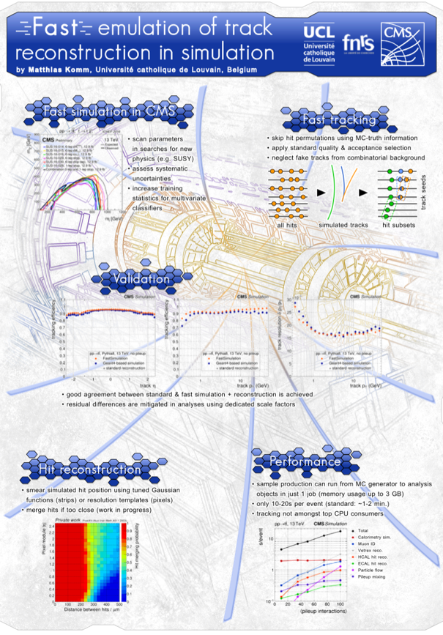
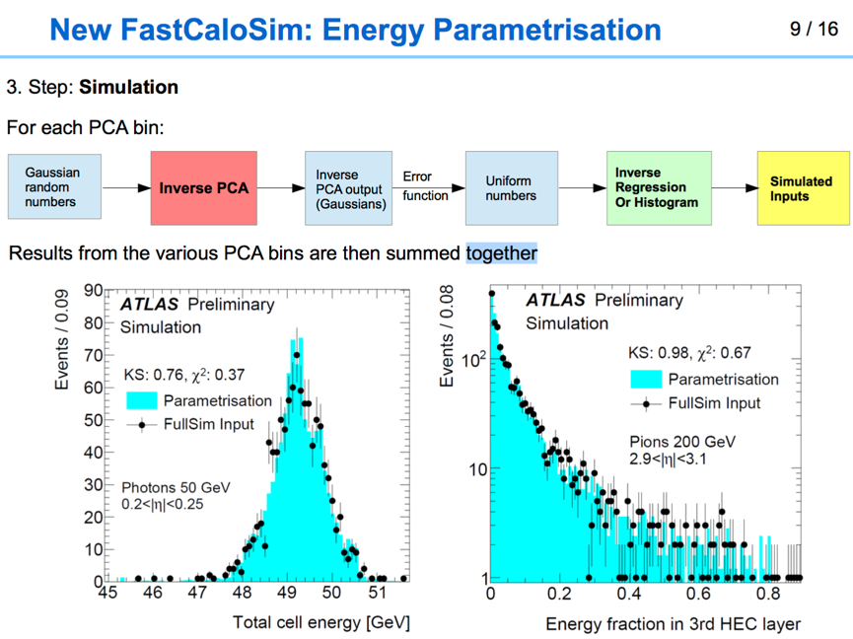
Tuesday afternoon: Experiment simulation developments
New data event overlay capability in Atlas simulation
Fast “simulation” includes more and more “fast” or emulated reconstruction
Calorimetric response with PCA and NN approaches

Slide 9
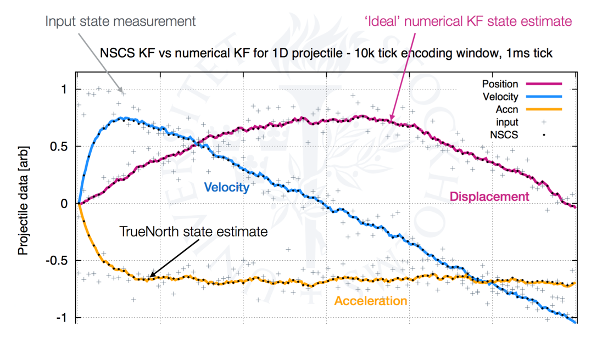
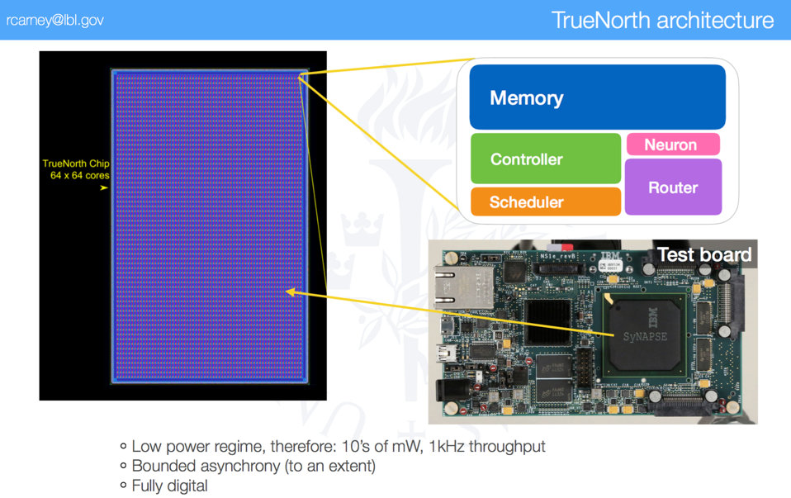
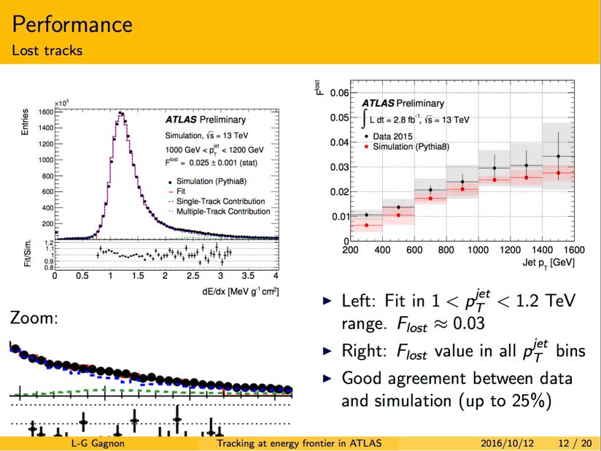
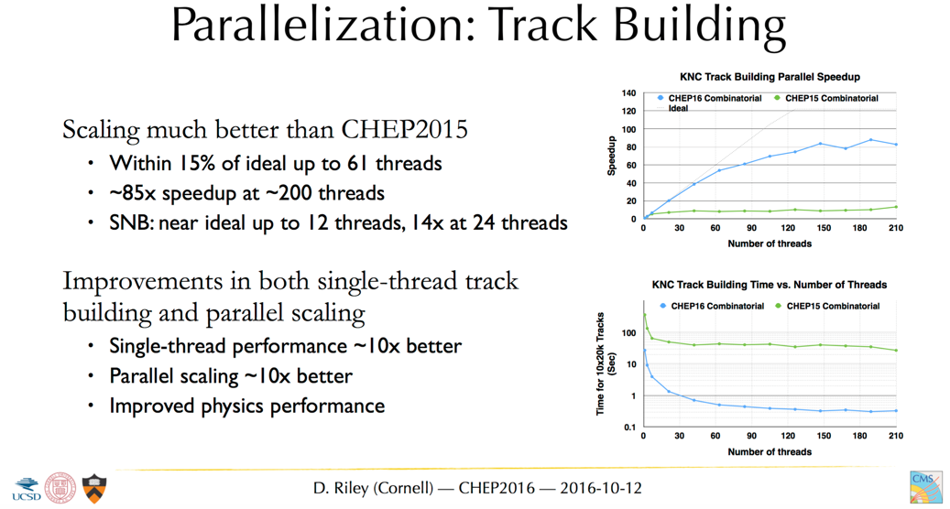
Wednesday morning:
Track finding/reconstruction
Track seeding on KNL
Tracking for dense regimes
Neuromorphic Computing for Kalman filters

Slide 10
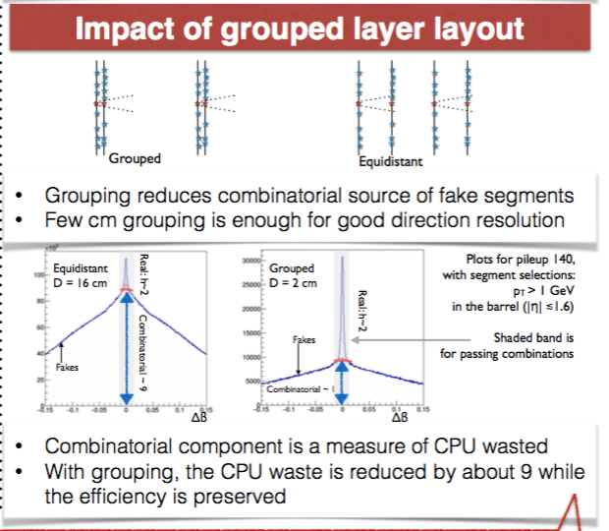
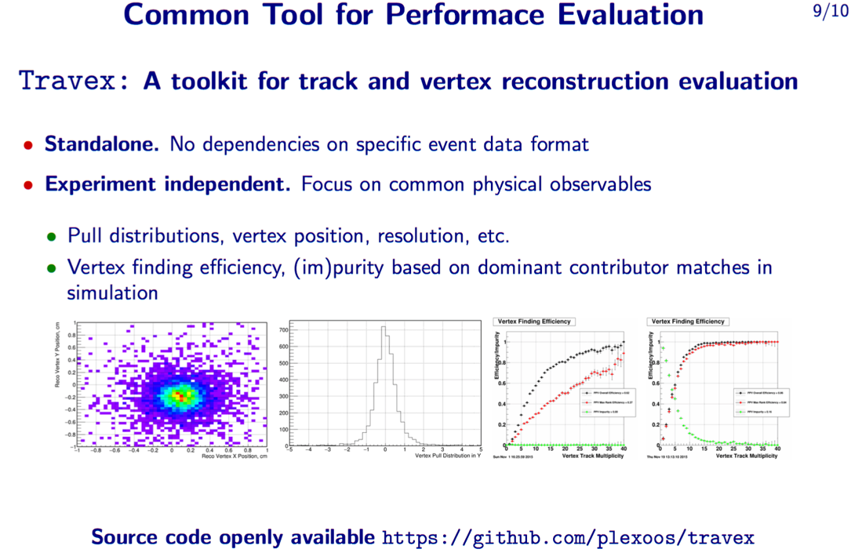
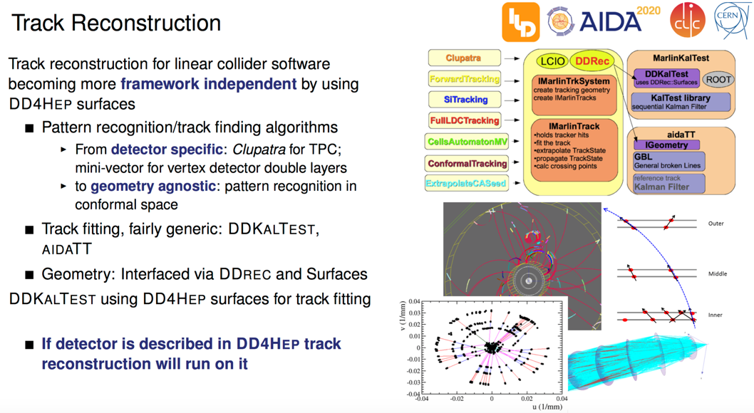
Thursday morning: Track and vertex reconstruction
DD4HEP track reconstruction
Computing needs vs detector design
Primary vertex reconstruction algorithms

Slide 11
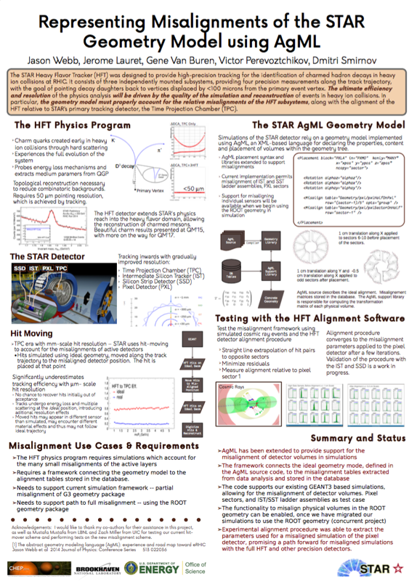
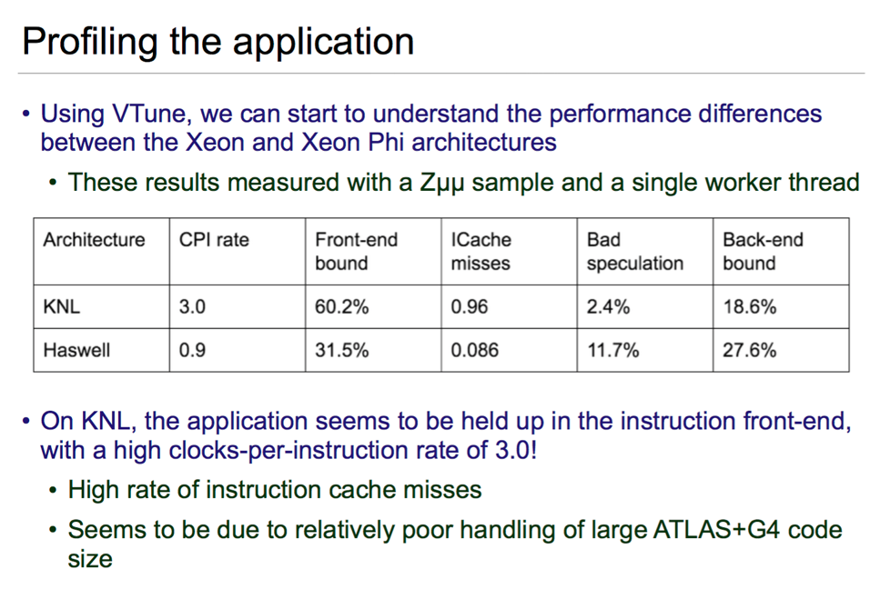
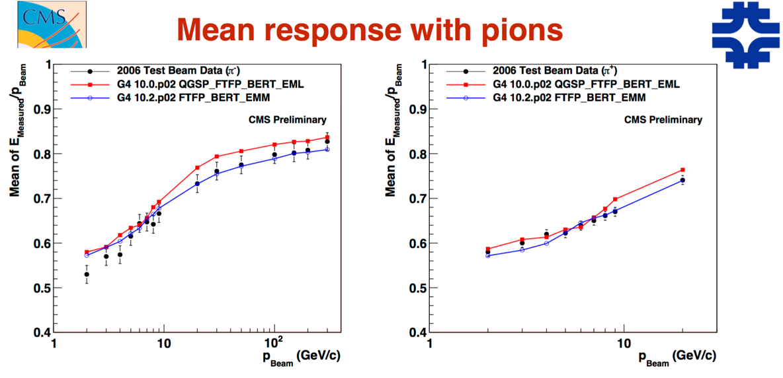
Thursday afternoon: Simulation performance and validation
Performance on KNL vs Xeon
Adding realism in simulation
Verification and validation with new data sets

Slide 12
Some of the overall themes in Track 2
Major efforts underway across offline areas
to adopt to architectures of all types
(and some already in production!)
Lots of commonalities in development. Future projects typically are looking to use existing or common tools

Slide 13
Challenges for CHEP 2018
We discussed a lot about the evolution of software. Not surprisingly, we can benefit from an evolution in the software tracks
  To recognize the change in focus in effects across the software community
  To make areas more coherent
Generate interest in CHEP in important but currently under-represented areas of nuclear / high-energy physics software

