Slide 1
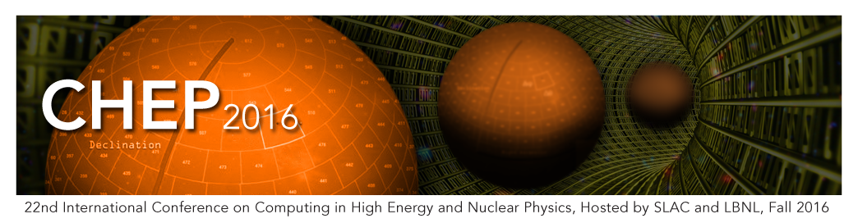
Track 3 summary
Distributed Computing
Latchezar Betev for T3
14 October 2016

Slide 2
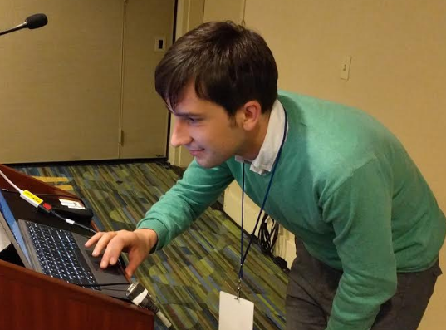
Track 3
Conveners
  Tanya Levshina (FNAL), Weidong Li (IHEP), Latchezar Betev (CERN)
Session chairs
  Andreas Peters, Barthelemy von Haller, Maarten Litmaath, Miguel Pedreira, Xavier Espinal Curull
Many thanks to the student
helpers for the efficient
support!

Slide 3
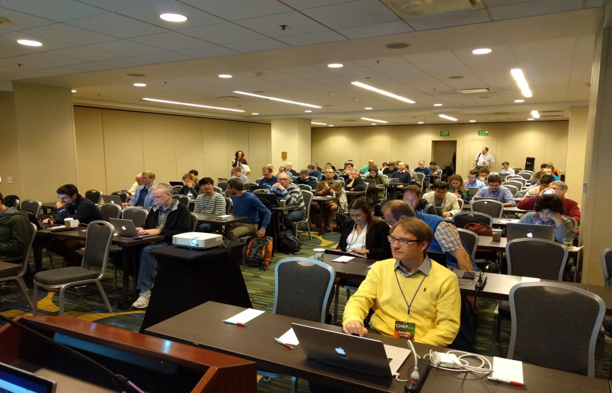
T3 stats
55 abstracts
38 oral, 17 posters
  As usual, very difficult to make the oral/poster decision
Room occupancy
– almost full –
45-55 participants

Slide 4
General notes on T3
What it was not
  Presentation of high-level all-encompassing frameworks design
Common themes:
  Adaptation and tuning of said ‘high-level…’ to targeted local / opportunistic / someone else’s (LHC@HOME) / Commercial Cloud resources + making the Grid work better
  Introduction of more efficient and compact workflows
  Inclusion of external information sources to boost performance

Slide 5
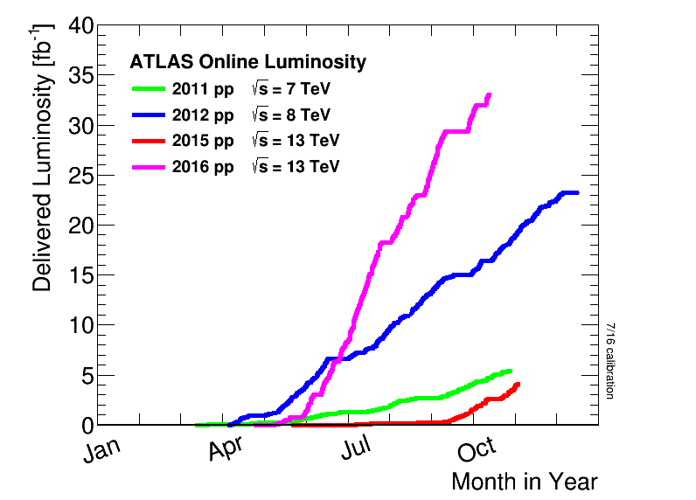
General notes (2)
Goals
  Getting the remaining 10-15% efficiency out of the existing Grid
  Aggressive inclusion of new resource types
  Looking into all corners to get what is needed for LHC and non-LHC computing…
  … in a progressively tighter resource market
  as more computing is
  needed to get the job done
    Thanks a lot LHC*!
  …and the upcoming upgrades
  …and other projects
* - a very welcome problem

Slide 6
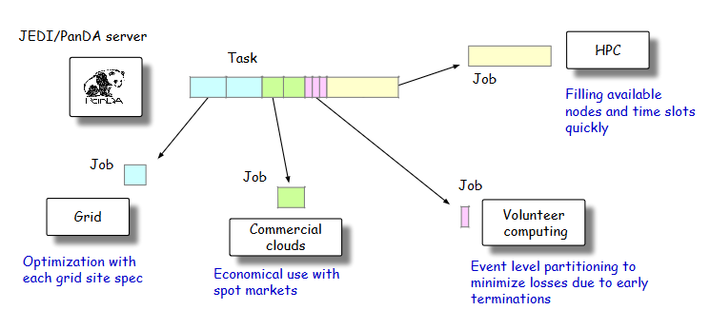
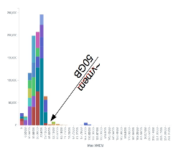
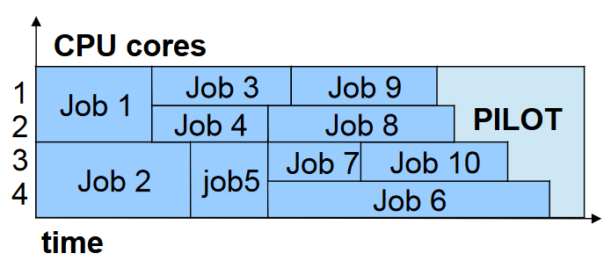
Central and internal job brokering
Matching to fit resources types, availability and limits
HLT farms, HPC+Supercomputers, Cloud, @HOME (and the Grid)
  - Memory limits management and internal brokering for multicore processing

Slide 7
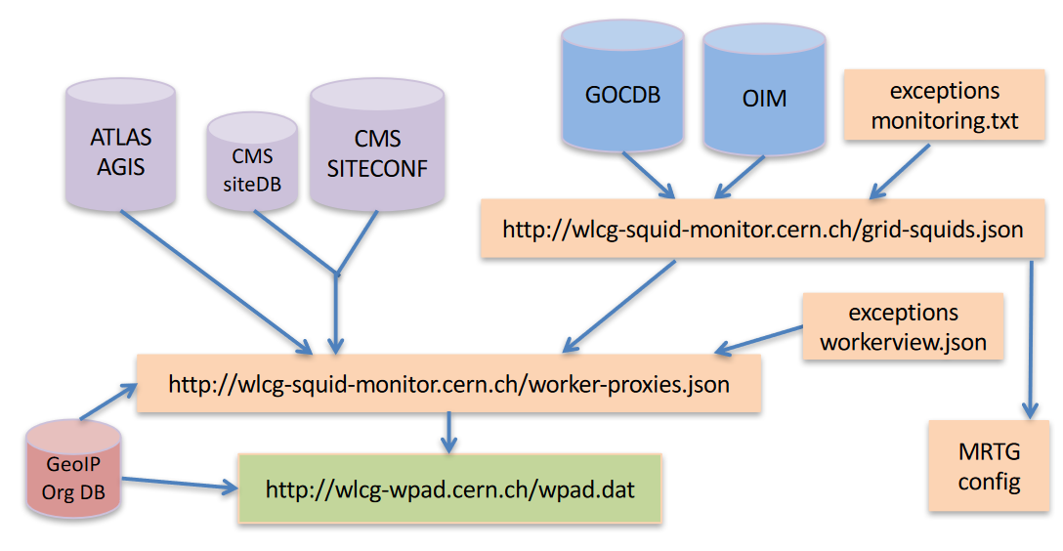
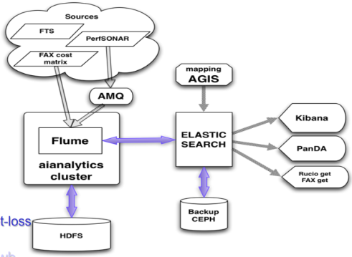
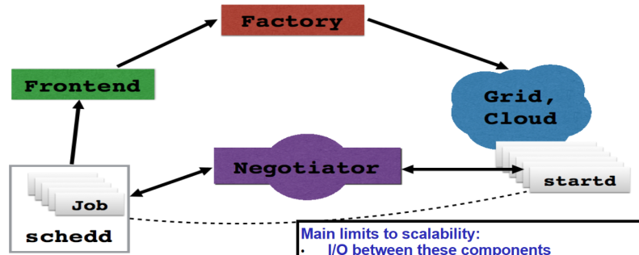
Fabric management and global pools
WEB proxies discovery standardization
‘Global pools’ for all
resources and tasks
Network-aware brokering:
treat as resource and adjust
the workload

Slide 8
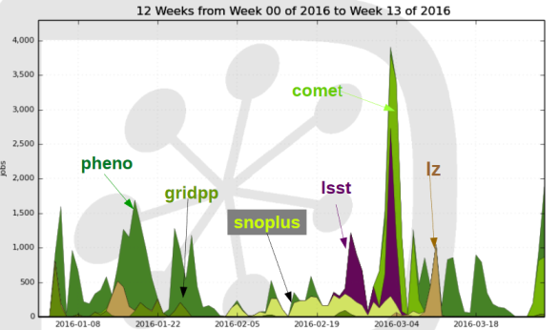
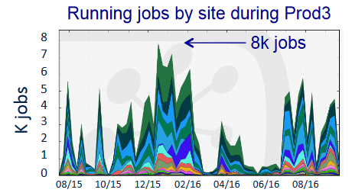
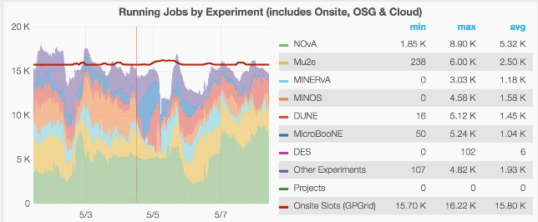
Non-LHC VO support models
Medium- and small collaborations, no knowledge of distributed computing, no manpower to develop own
Robust, common, modular
set of tools – reuse existing
set as much as possible
Cherenkov Telescope Array

Slide 9


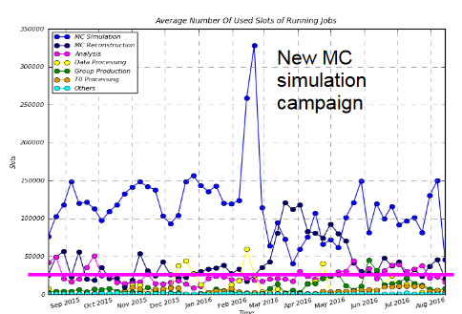
User support
Advanced tools for end-user analysis and small site operation as solution to many of the large-frame systems shortcomings
Adapting the existing tools to support better central analysis activities – output formats and job priorities

Slide 10

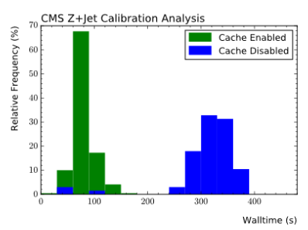
Fabric evolution in response to evolving workflow
Analysis of fabric parameters, feedback to the experiments to improve the upstream submission tools
Coordinated data caches to improve analysis efficiency (between batch and data servers)

Slide 11

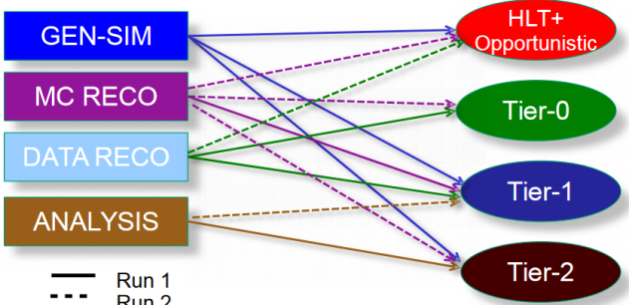
Bye Tiers!
Tiers not mentioned a lot, but the dissolution is almost complete
Excellent site and network performance are to blame
…and that’s all I have to say about that

Slide 12

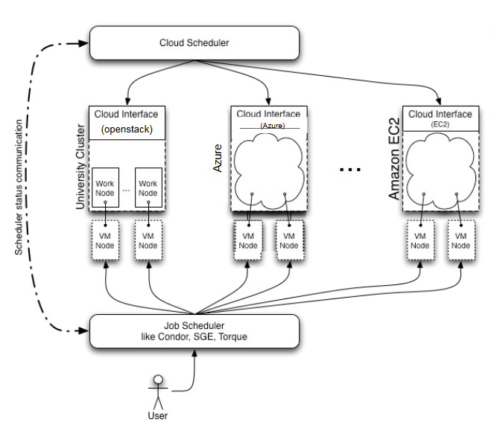
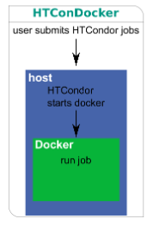
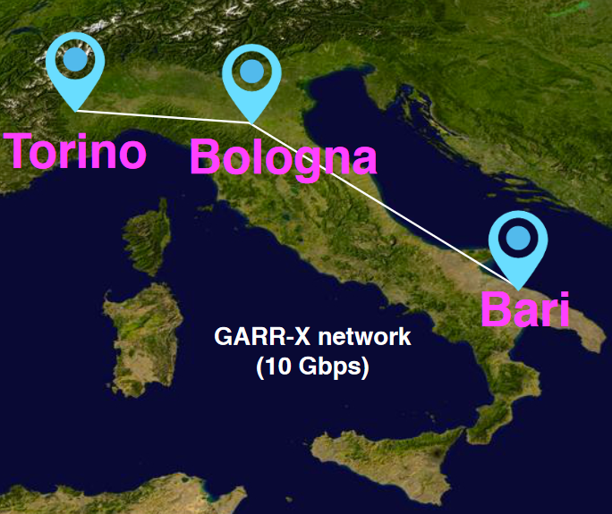
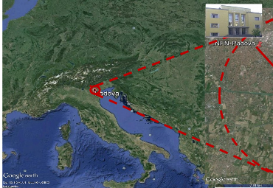
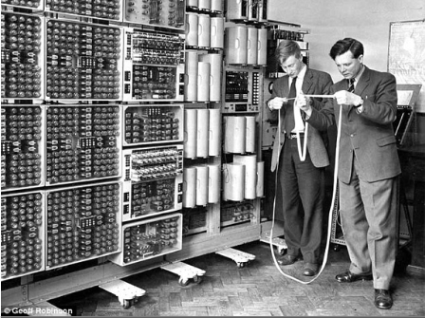
To Clouds!
Clouds from single site, several geographically close centres, Cloud of clouds and heterogeneous resources (HPCs)
Common theme – enabled for multiple user communities
CERNVM, Containers, Mesos, Marathon, Calico, Docker, HTCondor - plenty of enabling technology
New context-aware cloud scheduling
Cloudy (bright) future

Slide 13

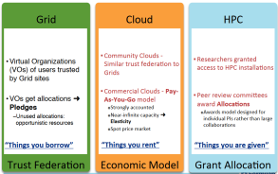
Cost of (commercial) Clouds
From theory to practice - find the right bidding strategy for commercial clouds (AWS)
Apply in practice – get many cores for full simulation workflow
  On premise resources still cheaper, but Cloud is a viable strategy if properly approached – need to do smart bidding
  Commercial Cloud prices are decreasing

Slide 14

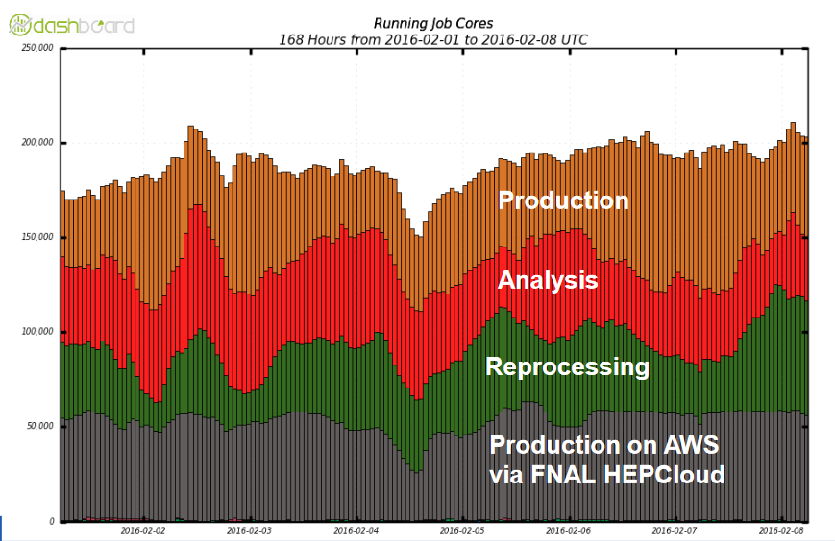
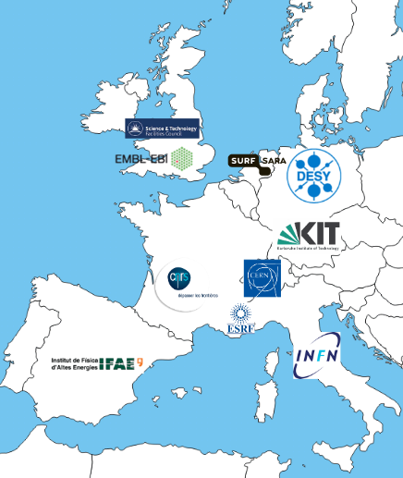
More clouds
Significant bursting capabilities, on par with large T1s (not really news)
  Acquiring the resources is becoming simpler and faster
  Several large-scale projects for commercial cloud procurement – to be used directly in production

Slide 15
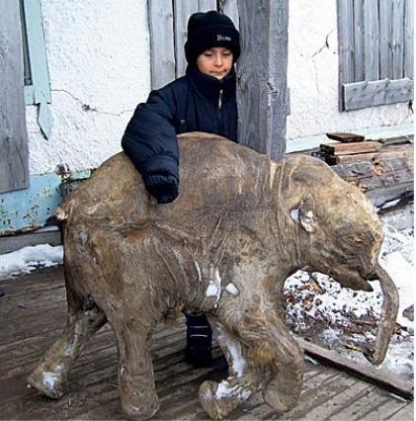
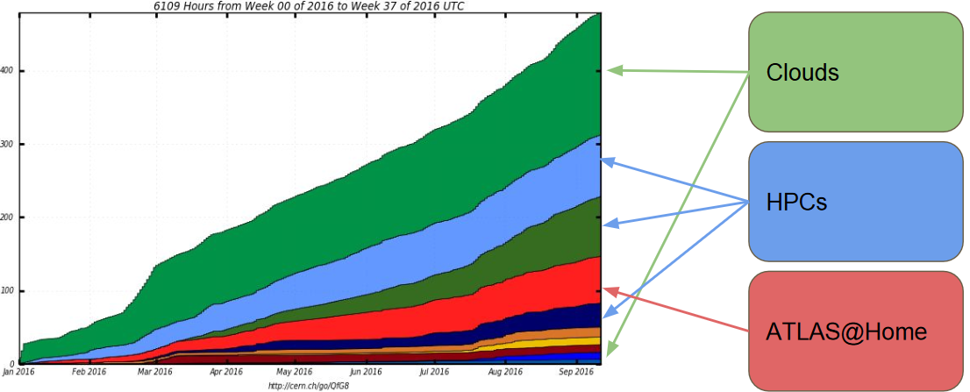
Supercomputers and volunteering
Sparse network (if any), may require specific SW porting, missing software delivery, non-x86 resources
Access for non-LHC VOs through same tools
Challenges abound, but developers are optimistic
Getting resources ‘for free’
Very willing participants, great PR
Up to 1-2% of total CPU resources
Steady growth

Slide 16
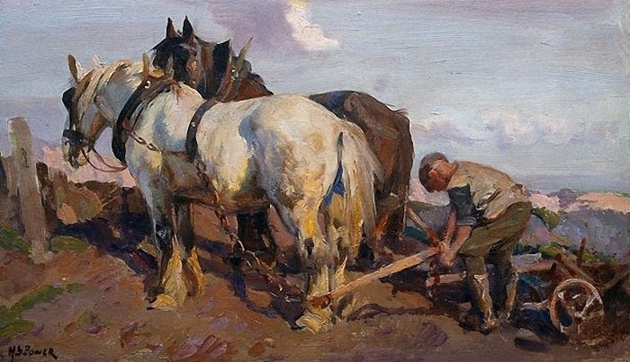
From past
‘The End of the Day’ by Harold Septimus Powers

Slide 17
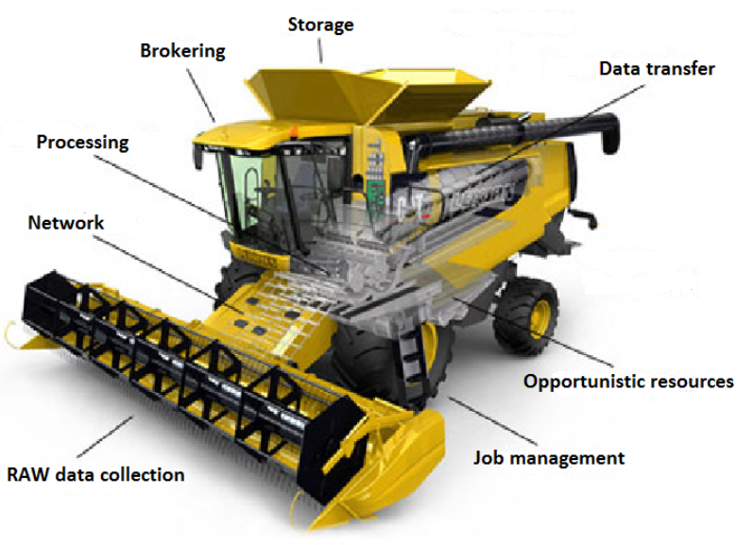
…to today

Slide 18
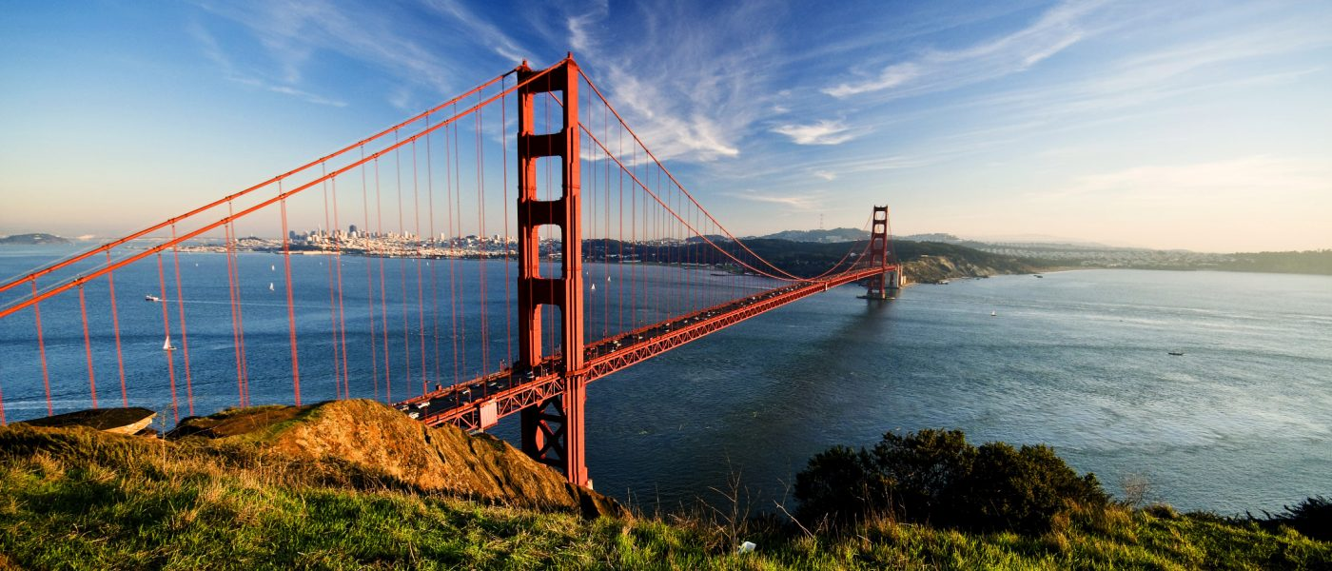
Thanks to all presenters for the interesting and engaging talks and posters (and largely sticking to the time limit)
Many thanks to our LBNL and SLAC hosts for the great organization and support throughout the T3 sessions

