Slide 1


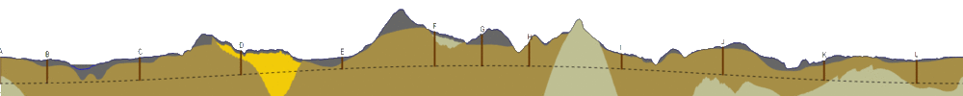
SMB
FCC Underground Infrastructure
FCC-ee MDI 2nd Meeting
04-04-2016
C. Cook, J. Osborne
C. Cook

Slide 2
FCC Civil Engineering
Outline
History of the FCC civil engineering study
Study of options for position of FCC
    - Intersecting vs. Non-intersecting
FCC underground civil structures
    3D Schematic
    Cross-sections
    - Single and double tunnel proposals
    - Transfer lines
    - Combining FCC-hh and FCC-ee requirements
    Construction methods, rates and risks
    Inclined access tunnels
MDI and civil engineering
    - Experimental area layout
FCC-he civil engineering
Main challenges and future steps (costing)
C. Cook

Slide 3
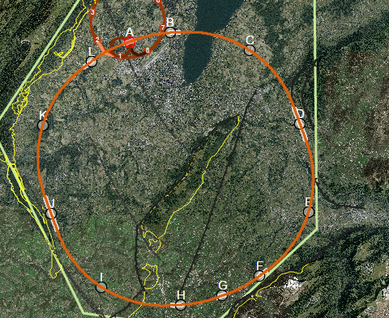
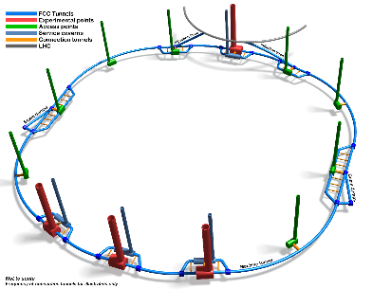

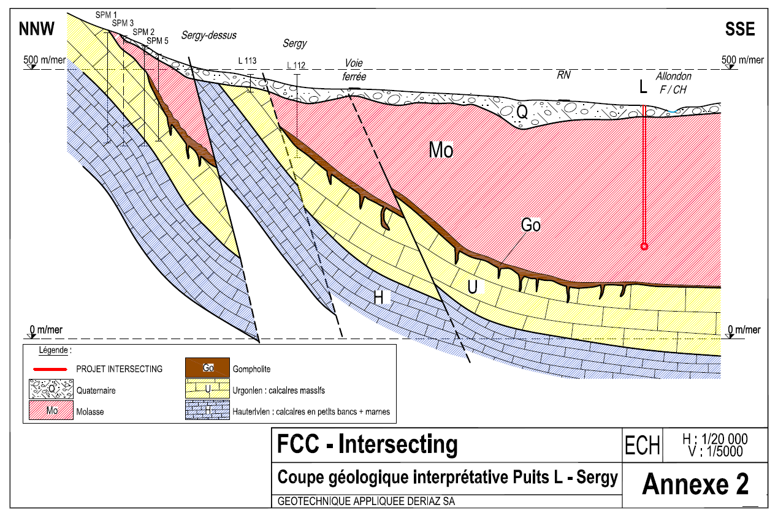
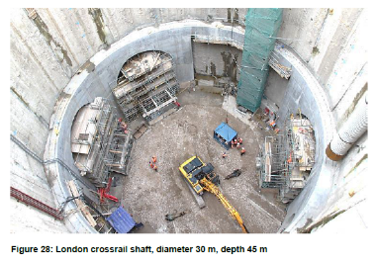
Study recent history
FCC CE study presented at FCC week, Washington 2015
Footprint, positioning and planarity assessed by review panel – Decision taken to focus on 100km, planar FCC machine
Extension of study into Prealps region. Updated contours for Jura, Vuache, Voirons-Faucigny.
Inclusion of new geological data within the Tunnel Optimisation Tool (TOT). Three engineering studies by AMBERG.
Working with Infrastructure & Operation and Machine Detector Interface groups on underground infrastructure requirements.
March 2015
July 2015
July – August 2015
August 2015 – March 2016
CERN’s FCC Review
Engineering studies & TOT updates
(ARUP & AMBERG)
FCC Week 2015,
Washington
New geological interpretations (GADZ)
CERN internal studies
C. Cook

Slide 4
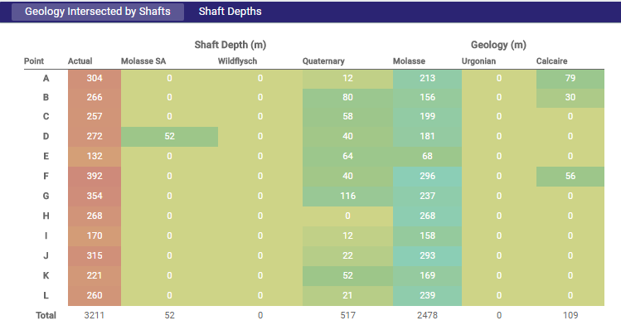
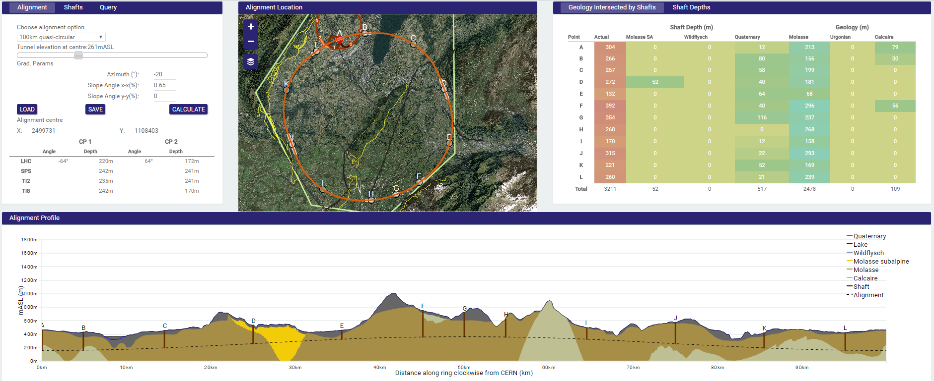
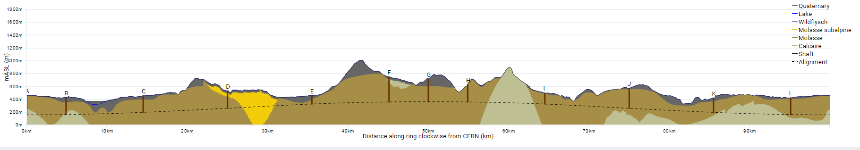
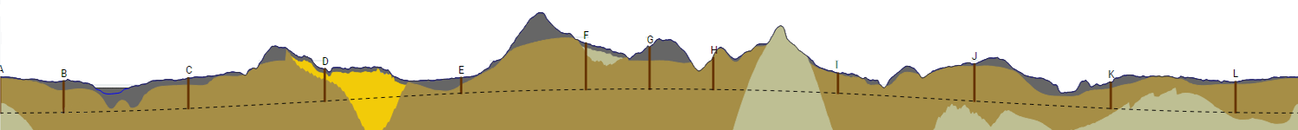
‘Intersecting’ vs. ‘Non-intersecting’ FCC Position
100km ‘Intersecting’ option
Limestone region: Jura
Max overburden: 650m
Deepest shaft: 392m
% of tunnel in limestone: 13.5%
Total shaft depth: 3211m
Challenges:
7.8km tunnelling through Jura limestone
300m-400m deep shafts and caverns in molasse
C. Cook

Slide 5
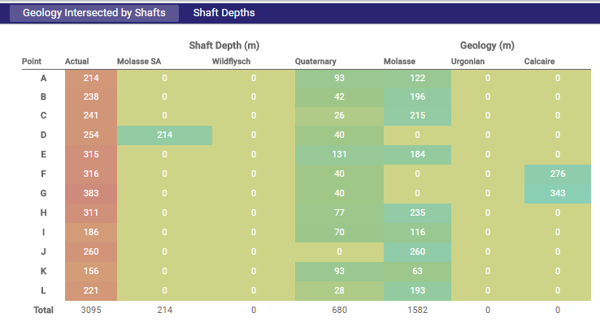
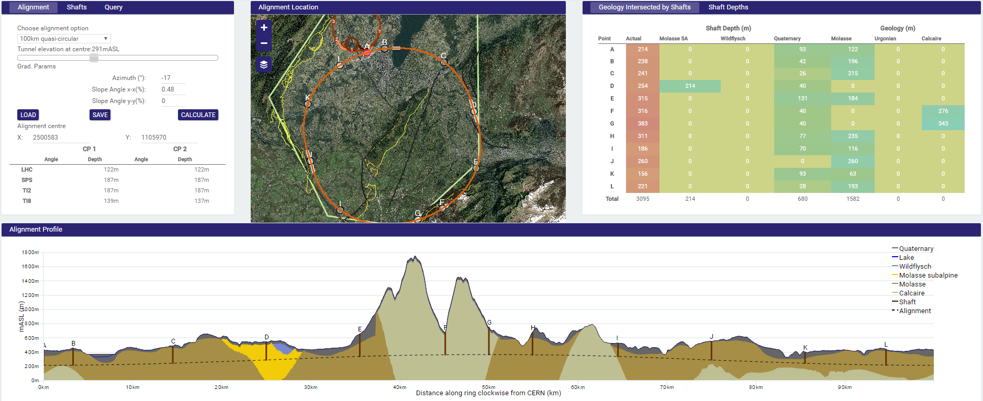
‘Intersecting’ vs. ‘Non-intersecting’ FCC Position
100km ‘Non-Intersecting’ option
Limestone region: Prealps
Max overburden: 1350m
Deepest shaft: 383m
% of tunnel in limestone: 4.4%
Total shaft depth: 3095m
Challenges:
11.6km tunnelling through Prealps geology
1.35km maximum tunnel overburden
300m-400m deep shafts and caverns in molasse
C. Cook

Slide 6
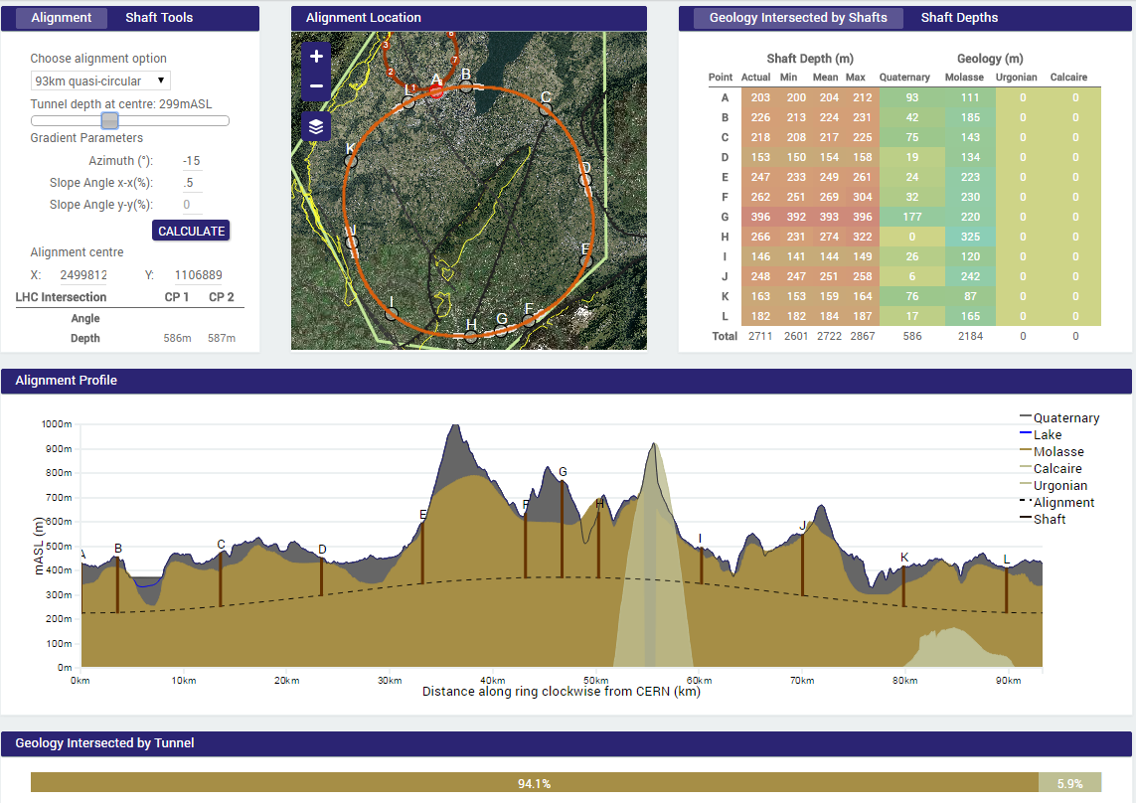
‘Intersecting’ vs. ‘Non-intersecting’ FCC Position
93km option
C. Cook

Slide 7
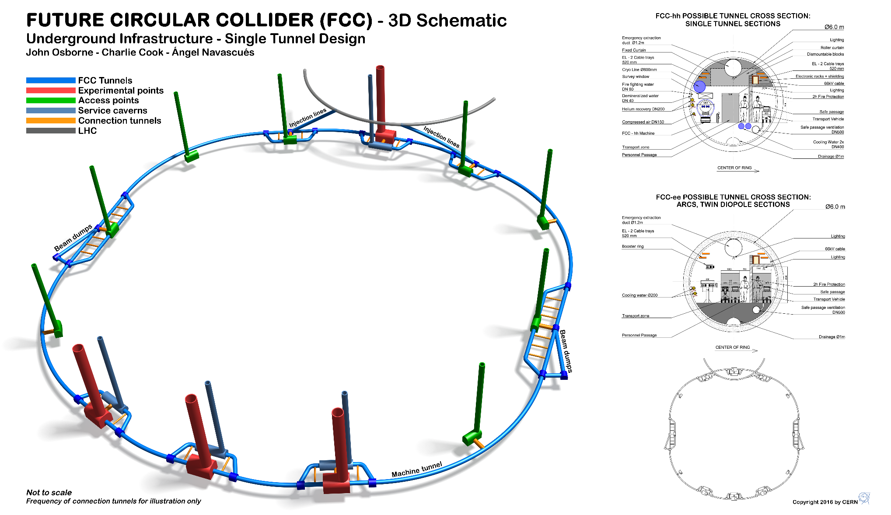
Naming Convention
TO BE UPDATED
C. Cook

Slide 8
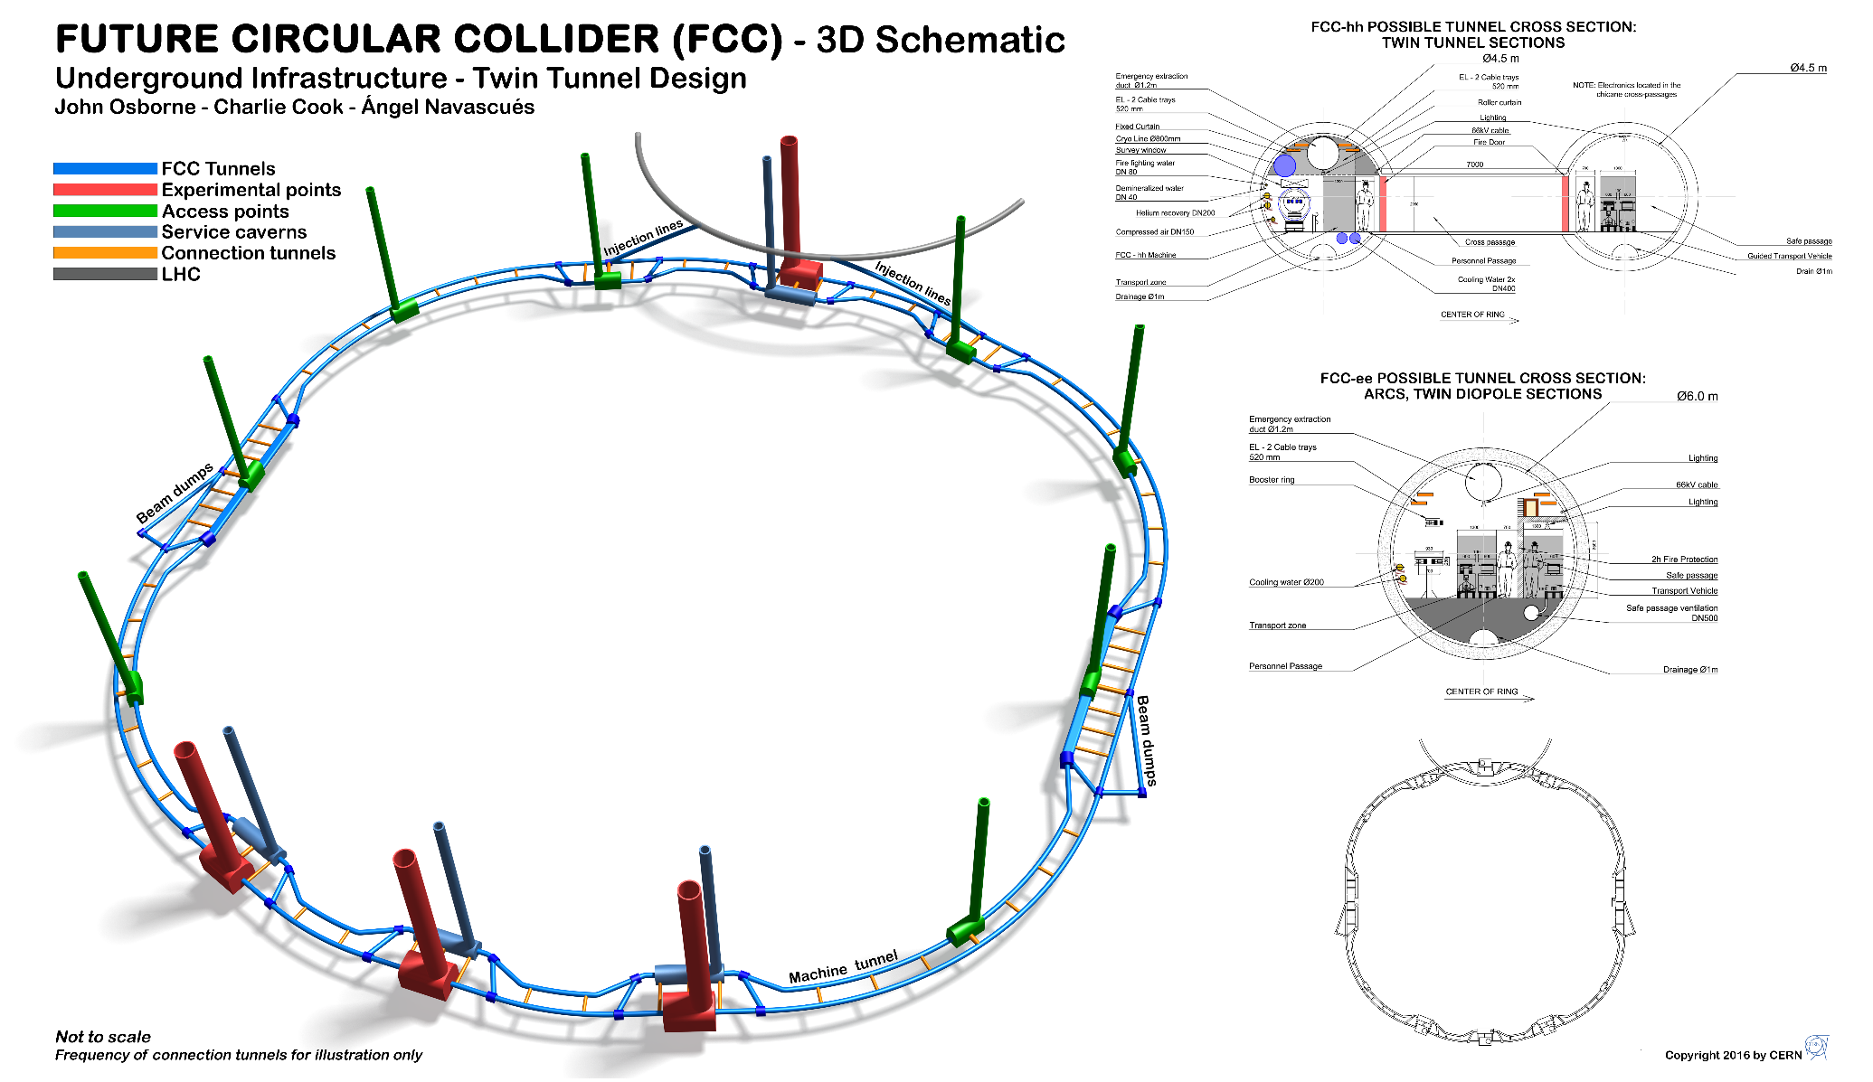
Double Tunnel Proposal
TO BE UPDATED
C. Cook

Slide 9
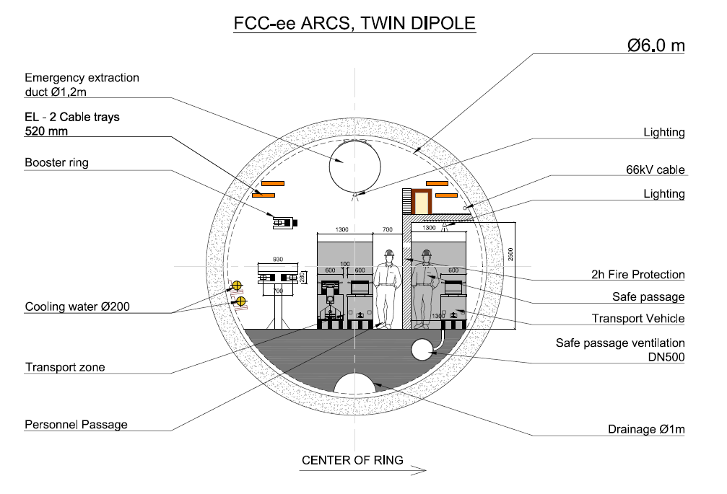
Cross-sections
C. Cook

Slide 10
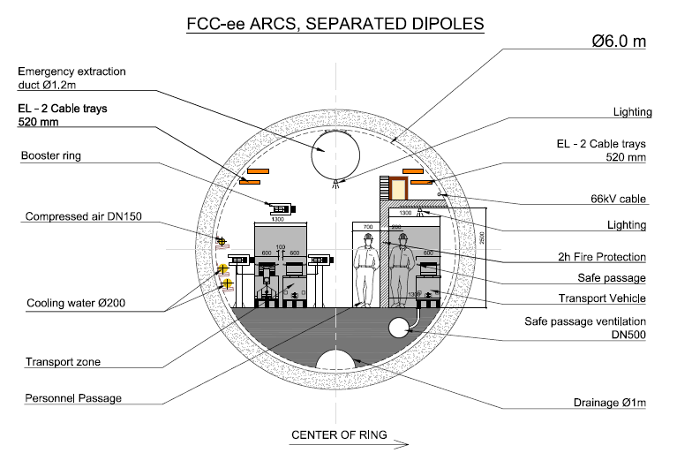
Cross-sections
C. Cook

Slide 11
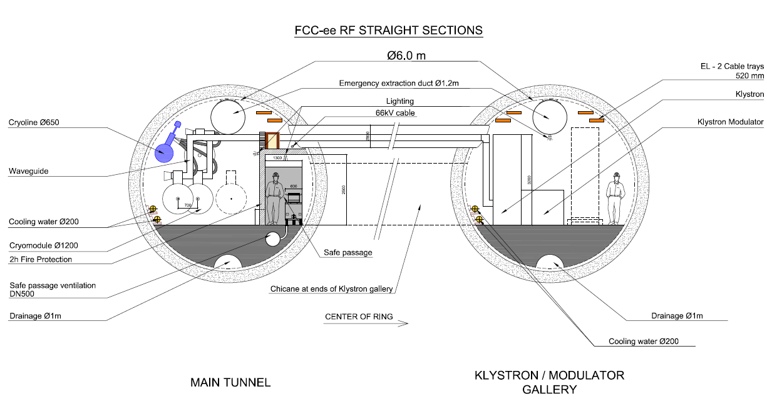
Cross-sections
C. Cook

Slide 12
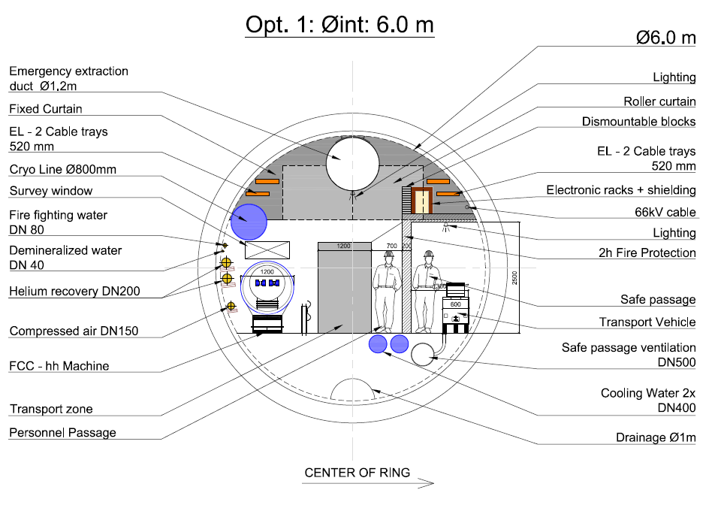
Cross-sections
C. Cook

Slide 13
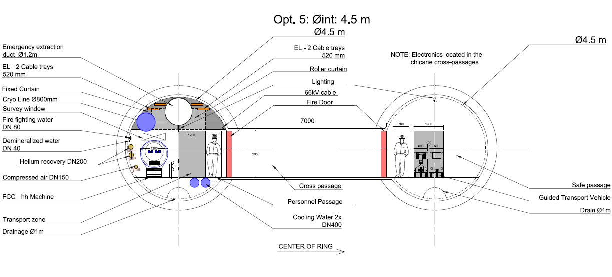
Cross-sections
C. Cook

Slide 14
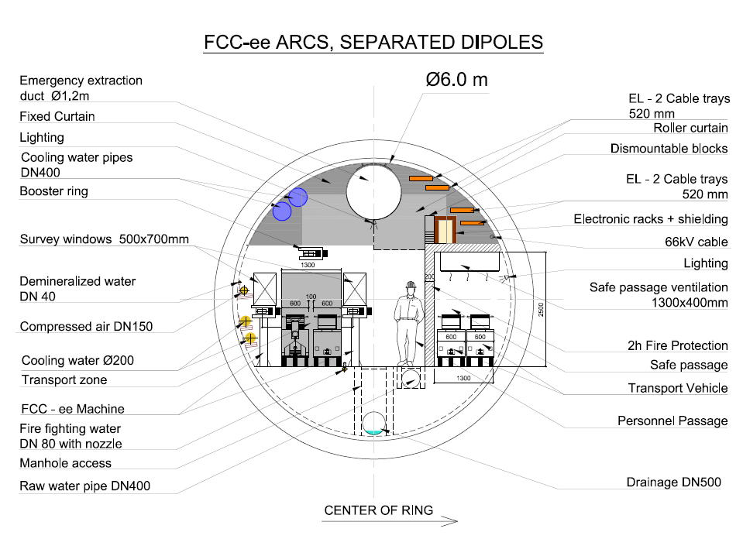
Cross-sections
In work drawings
C. Cook

Slide 15
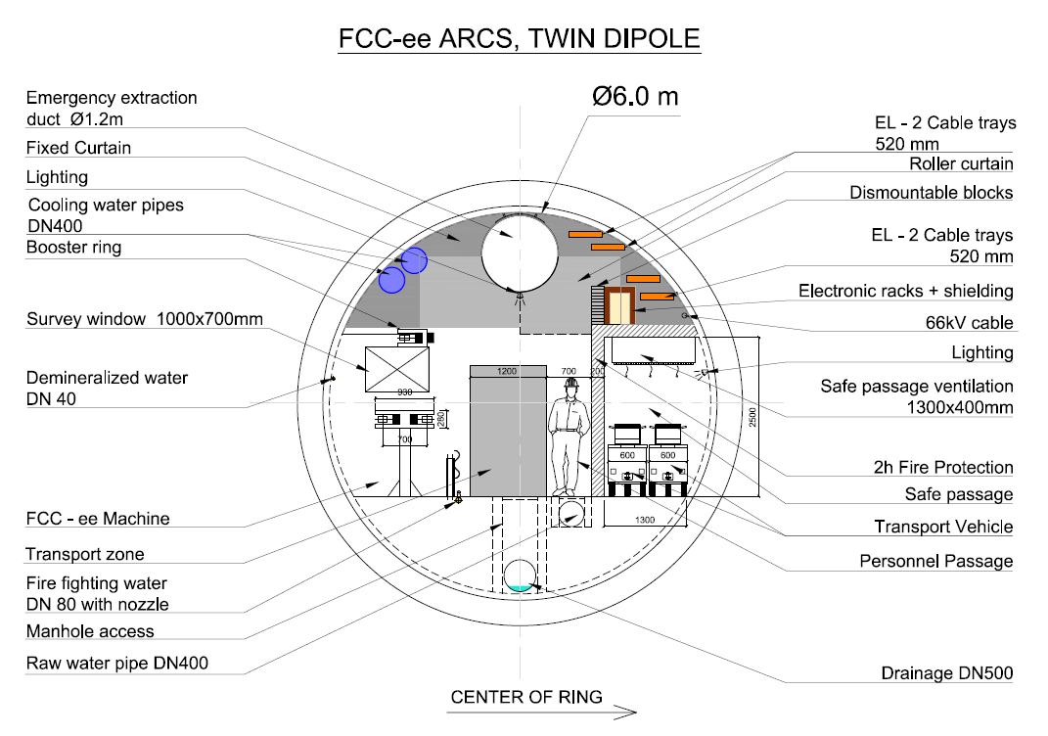
Cross-sections
In work drawings
C. Cook

Slide 16
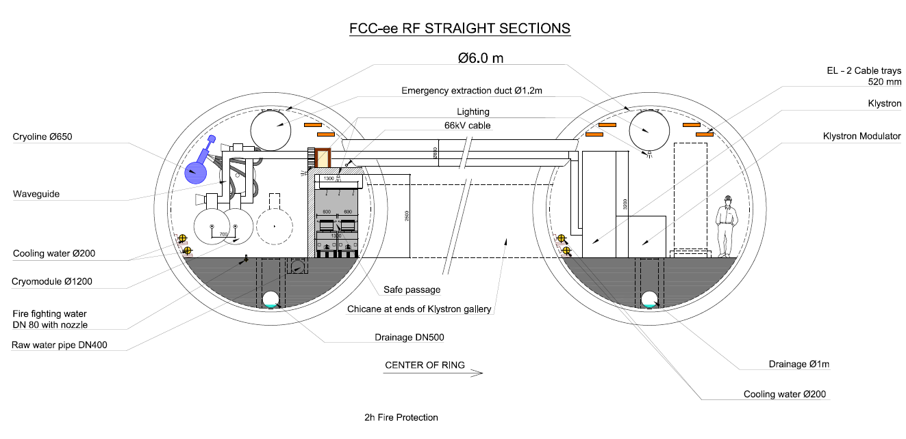
Cross-sections
In work drawings
C. Cook

Slide 17
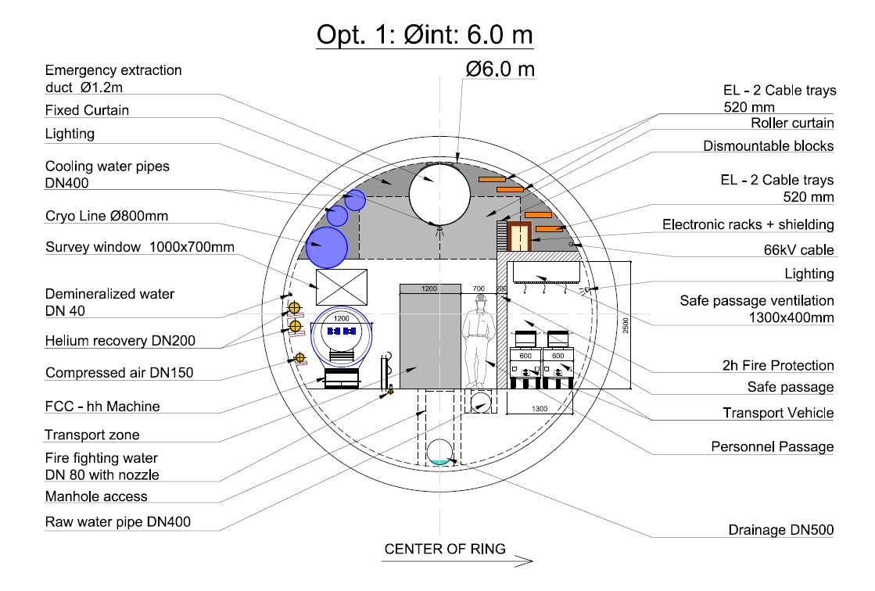
Cross-sections
In work drawings
C. Cook

Slide 18
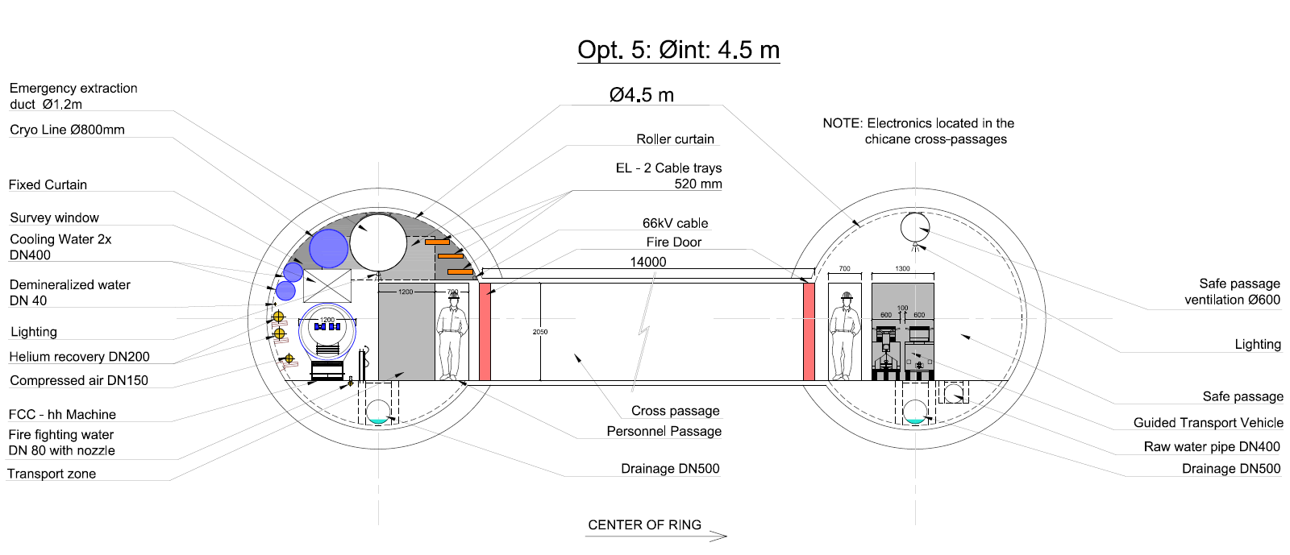
Cross-sections
In work drawings
C. Cook

Slide 19

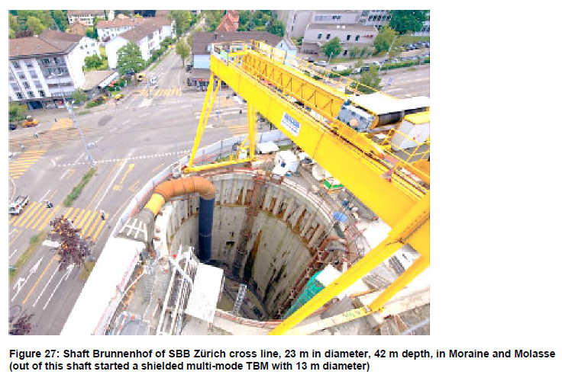
FCC Construction – Methods, Rates & Risks
Shaft Construction
Experimental Shafts
Through moraine layer
If moraines is firm, cohesive or consolidated => conventional excavation. Lattice girder rings, shotcrete and steel mesh as support
If loose or below water table => pile walls up to 25m deep, diaphragm walls >25m
Through molasse layer
Drill & blast recommended. Support similar to moraines but less required
C. Cook

Slide 20
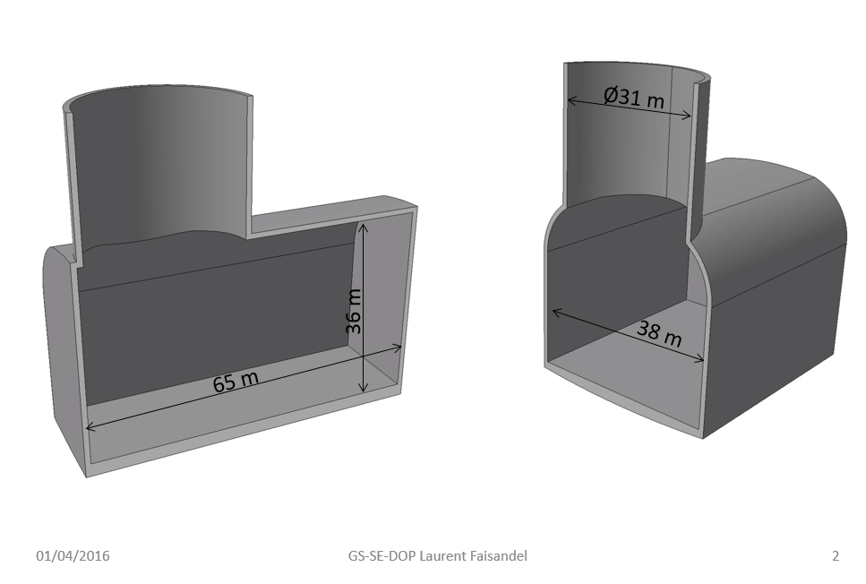
FCC Construction – Methods, Rates & Risks
Experimental Caverns
First Draft
C. Cook

Slide 21
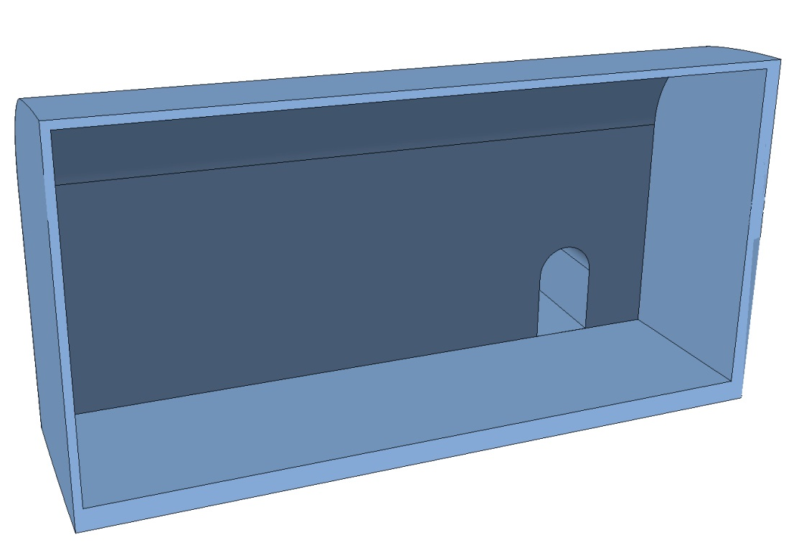
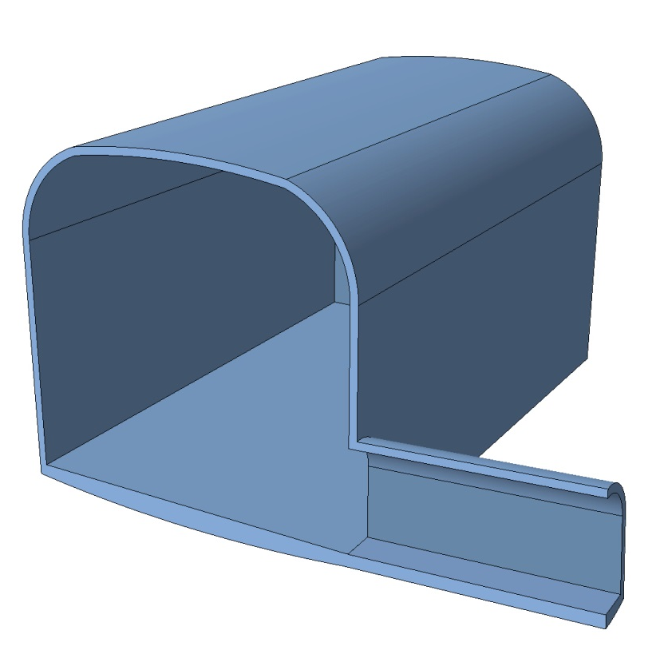
FCC Construction – Methods, Rates & Risks
Experimental Caverns
First Draft
44 m
42 m
86 m
13 m
? m
C. Cook

Slide 22
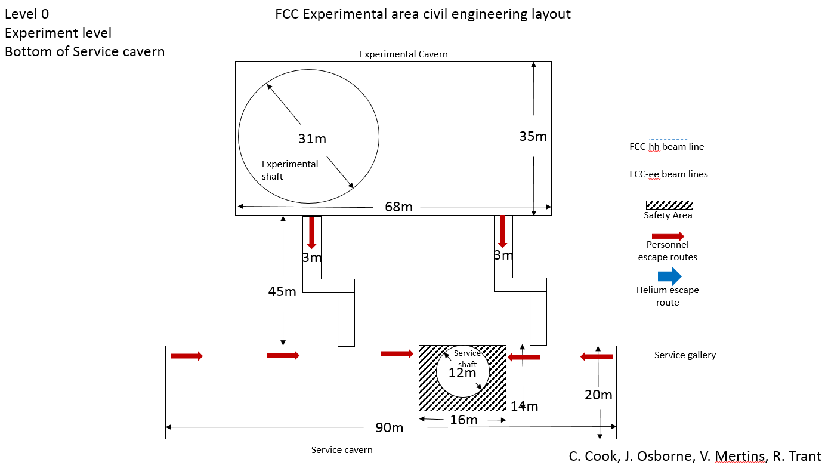
Machine Detector Interface (MDI)
TO BE UPDATED
Thanks to MDI-hh, MDI-ee, HSE
C. Cook

Slide 23
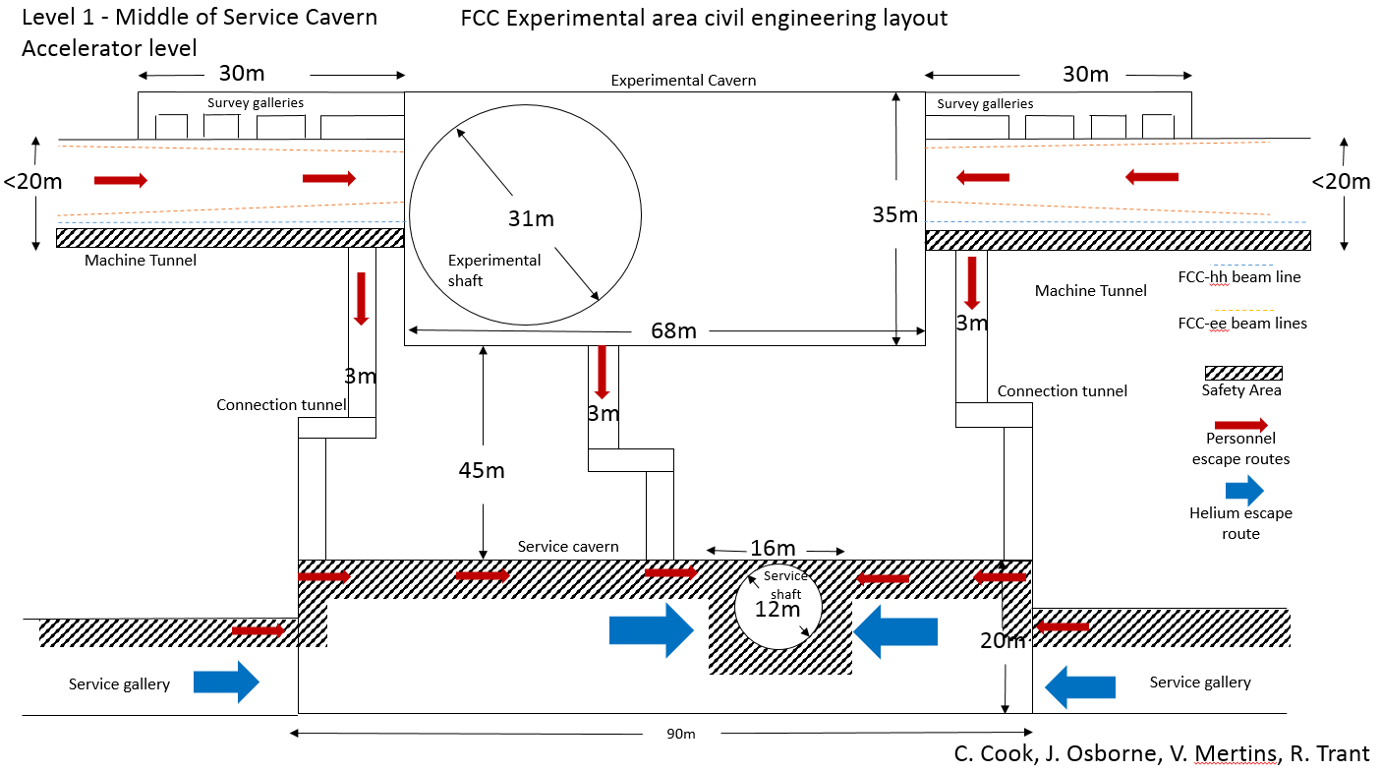
Machine Detector Interface (MDI)
TO BE UPDATED
Thanks to MDI-hh, MDI-ee, HSE
C. Cook

Slide 24
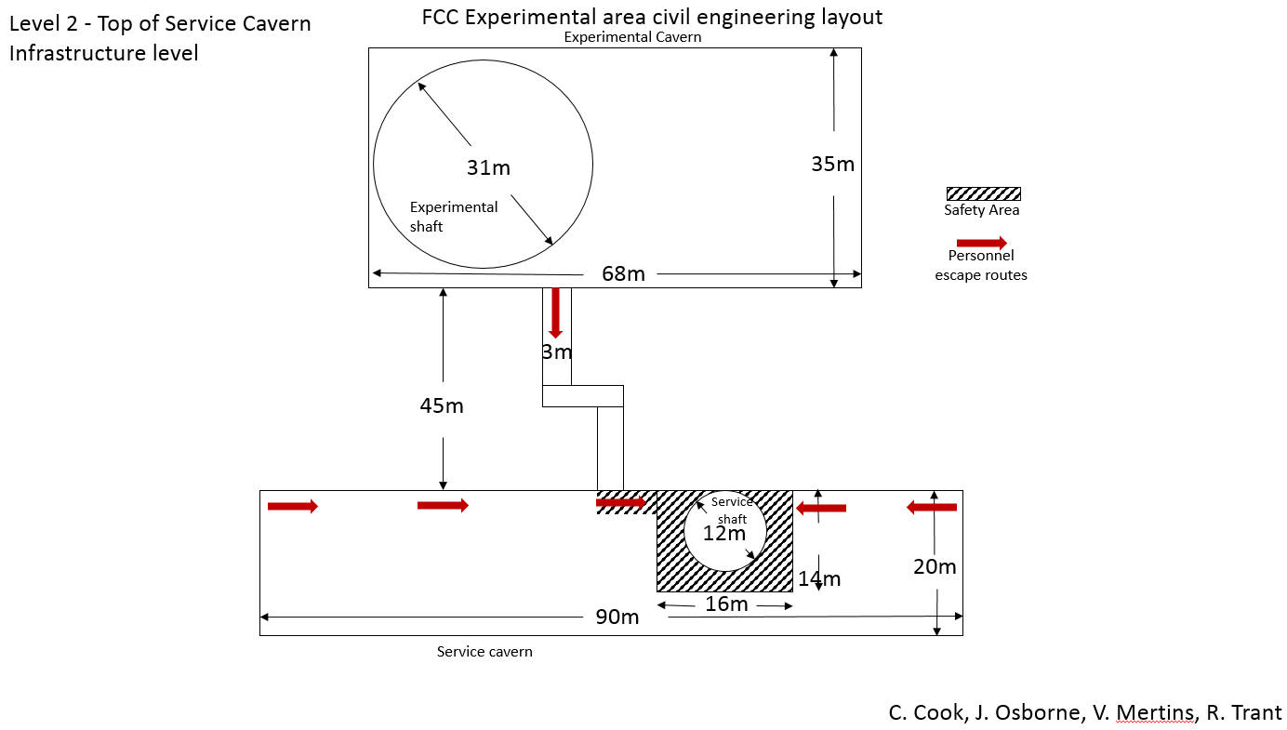
Machine Detector Interface (MDI)
TO BE UPDATED
Thanks to MDI-hh, MDI-ee, HSE
C. Cook

Slide 25
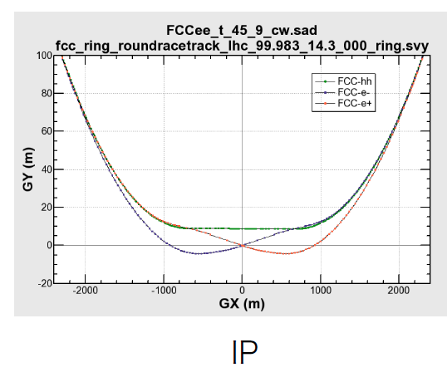
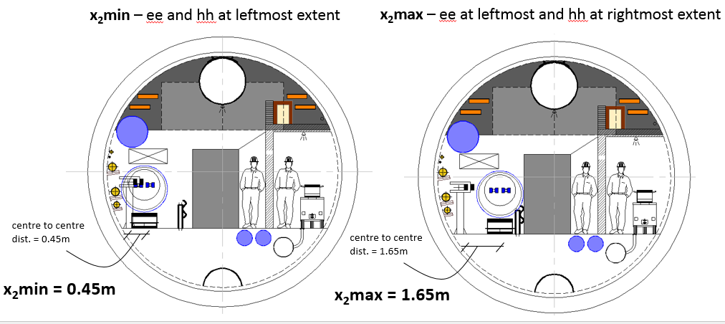
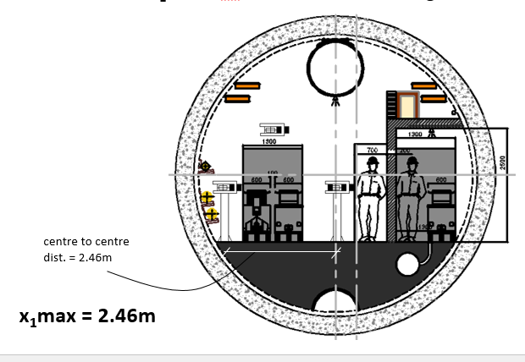
Combining FCC-hh and FCC-ee
Infrastructure must be designed to house both machines at different times
Boundary conditions established for FCC-hh and FCC-ee beam separation. FCC-ee lattice adjusted.
Result: Widening of tunnel around FCC-ee IPs necessary (~4km total)
Max. separation FCC-ee beams
Min. & max. separation FCC-ee & FCC-hh beams
C. Cook

Slide 26
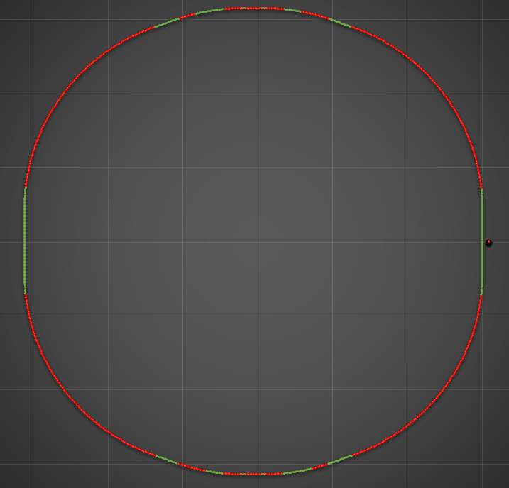
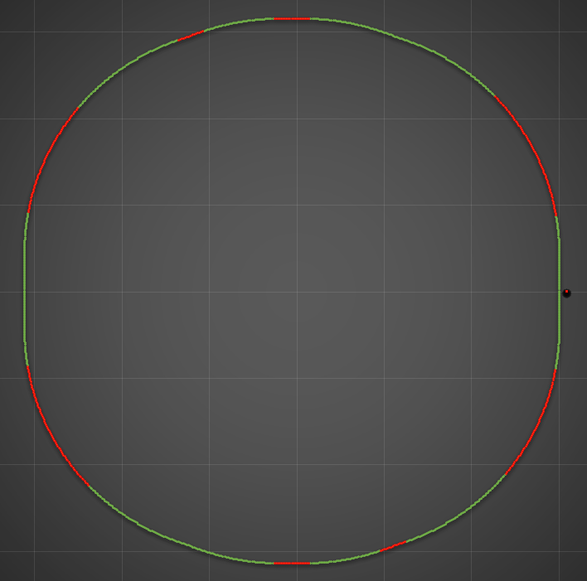
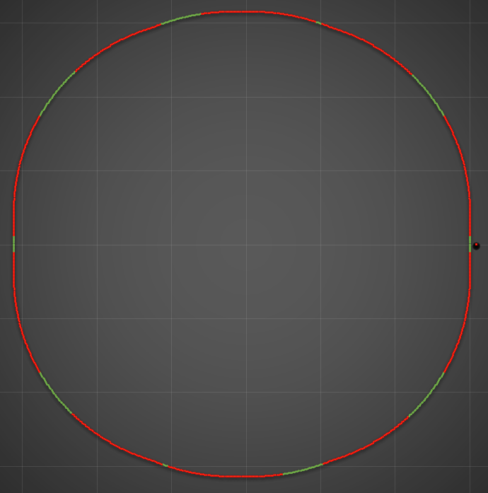
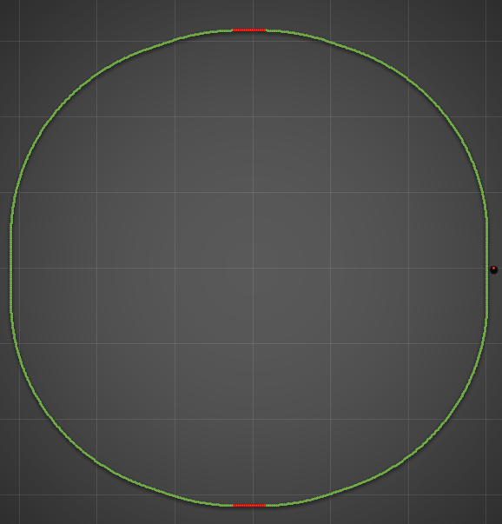
Combining FCC-hh and FCC-ee
Adjustment of the FCC-ee lattice
K. Oide
C. Cook

Slide 27

Inclined Access Tunnels
Shaft (vertical) vs. Inclined tunnel?
395m
Shaft
~400m
2800m
3º
C. Cook

Slide 28
Inclined Access Tunnels
Shaft (vertical) vs. Inclined tunnel?
395m
Inclined tunnel
2800m
3º
6%
~3000m
C. Cook

Slide 29
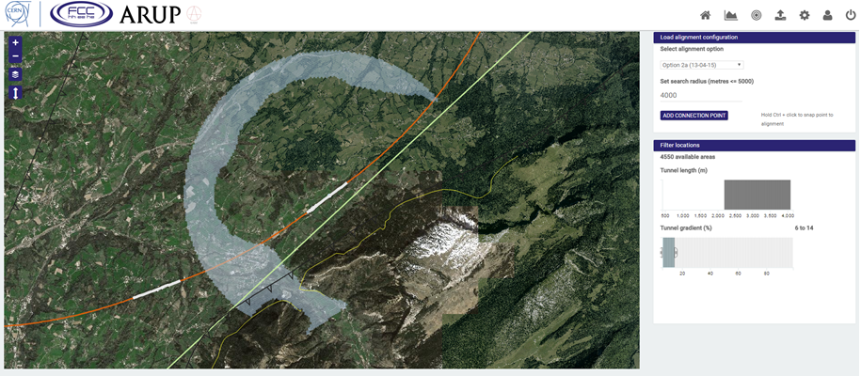
Inclined Access Tunnels
New inclined tunnel search function – Tunnel Optimisation Tool
Select point on ring and set search radius.
Possible locations for access portal highlighted on map
Filter results by tunnel gradient and tunnel length
Find optimum access portal location giving minimum tunnel length with given maximum gradient
C. Cook
C. Cook

Slide 30
Future Steps
Post-Rome
Required
Study of widened tunnels – layout that works with FCC-ee, FCC-hh & HSE
Continued integration of MDI-ee and MDI-hh needs
- Iterations of experimental hall layout – new ideas from MDI-hh
More detailed cost & schedule study – all CE structures
Finalise FCC Naming Convention
Possible
Detailed cavern study – engineering challenge, detailed look at construction methods
C. Cook

