Slide 1
Welcome to the Engineering Department at CERN
Markus Brugger, EA Group Leader, 3rd March 2016

Slide 2
Who are we ???

Slide 3
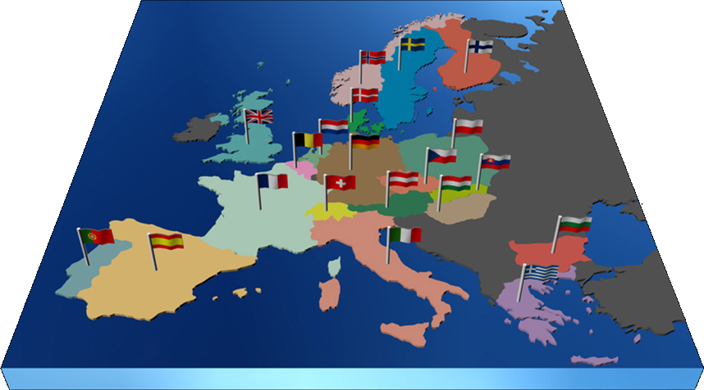
Conseil Européen pour la Recherche Nucléaire
World largest Particle Physics Laboratory (1954)
Yearly Budget
~1100 MCHF (~ 1000 MEUR)
Experiments financed
externally.
Personnel
2300 Staff
730 Fellows & Associates
200 Students
11000 Users from 500 universities
2000 External
companies
21 Member Countries
Austria, Belgium, Bulgaria, Check Republic, Denmark, Finland, France, Germany, Greece, Italia, Israel, Hungary, Holland, Norway, Poland, Portugal, Slovakia, Spain, Sweden, Switzerland, UK.
7 Observers Countries
EU, USA, Russia, India, Japan, Turkey, UNESCO
2 Candidate Countries
Romania and Serbia
1 Associate Country
Pakistan
Notes:
Mayor experimento y el mayor instituto de investigacion del mundo del mundo
Mas de 85 paises, y mas de 10.000 cientificos e Ingenieros trabajando para una meta comun

Slide 4
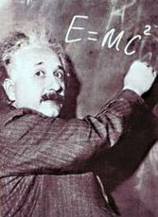



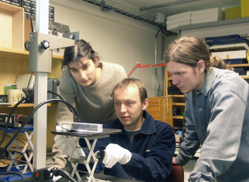
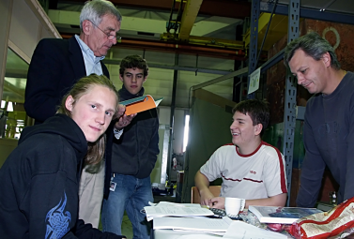
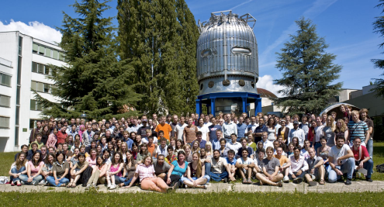
The Missions of CERN
Push forward the frontiers of knowledge
  e.g. the secrets of the Big Bang … what was the matter like within the first moments of the Universe’s existence?
Develop new technologies for accelerators and detectors
  Information technology - the Web and the GRID
  Medicine - diagnosis and therapy
Train the scientists and the engineers of tomorrow
Unite people from different countries and cultures

Slide 5
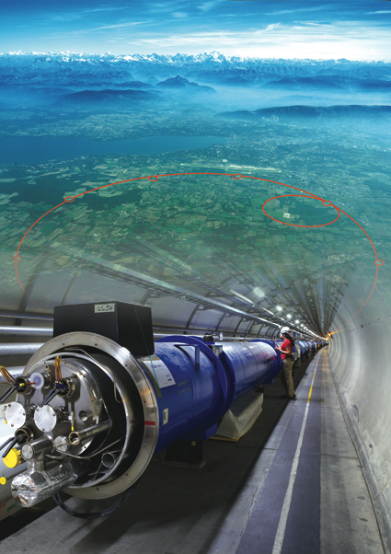
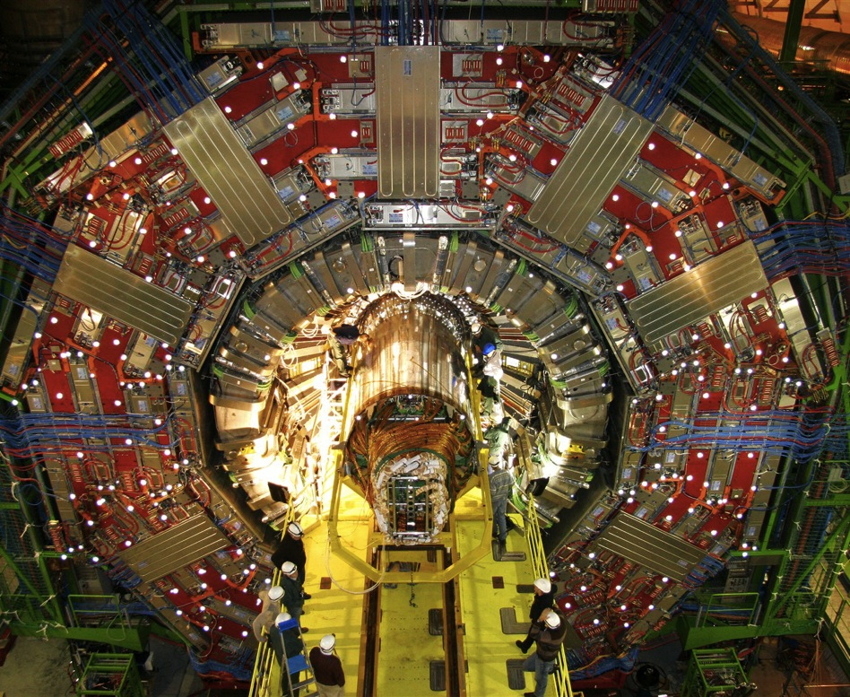
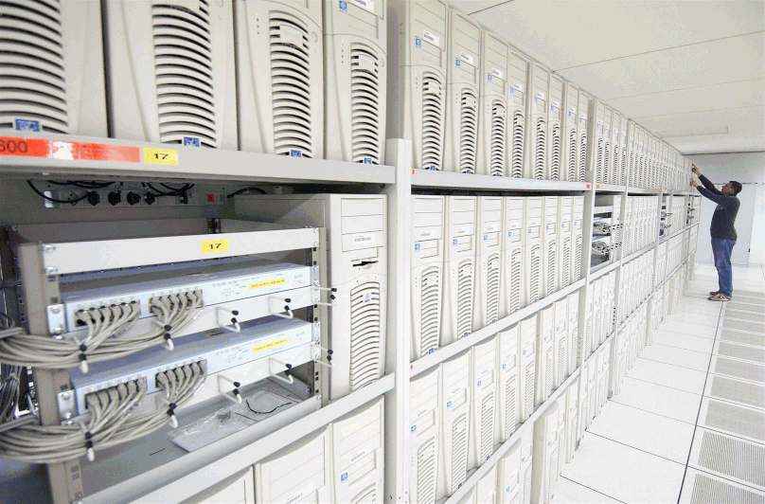
The instruments used
1. Particle accelerator :
Boost particles to high energies and make them collide
2. Detectors :
Gigantic instruments that observe and record the results of the collisions
(particle trajectories, energy, charge…)
3. Computers :
Collect, store, and send around the world the big quantity of data received from the detectors for data analysis

Slide 6
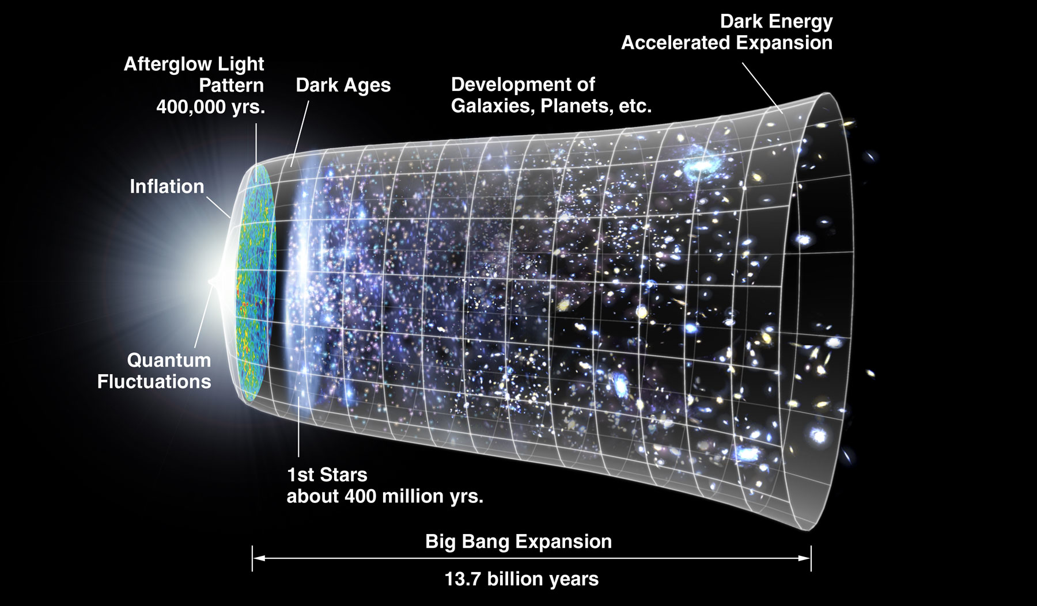
The next scientific challenge is to understand the very first moments of our Universe after the Big Bang
LHC
10⁻¹⁰s

Slide 7
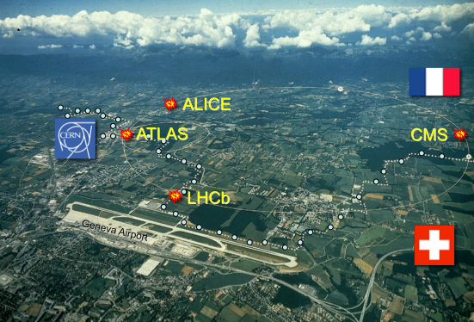

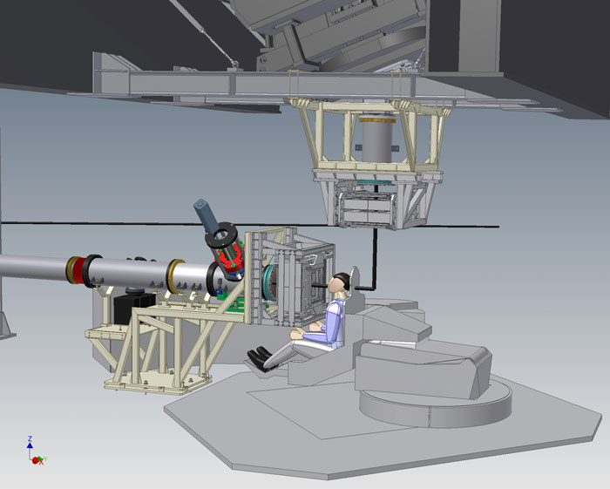
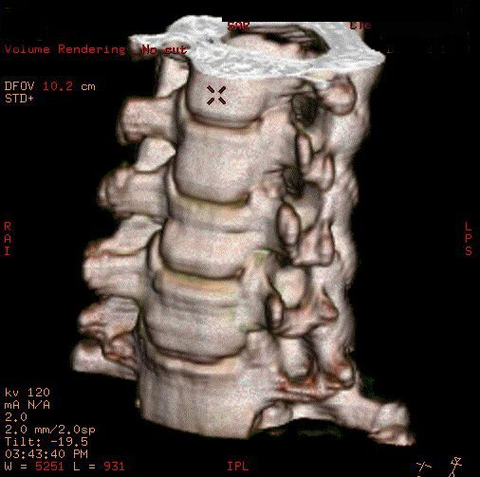
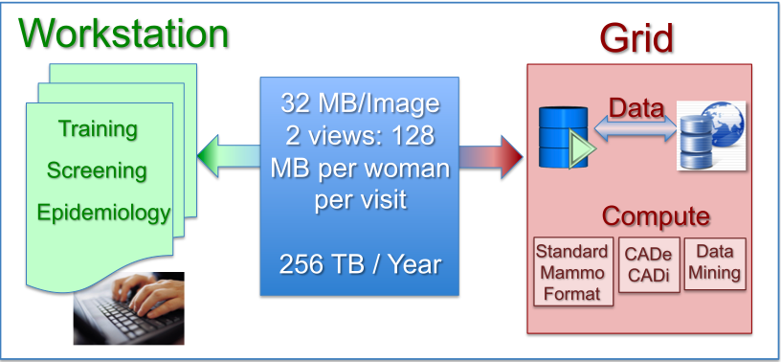
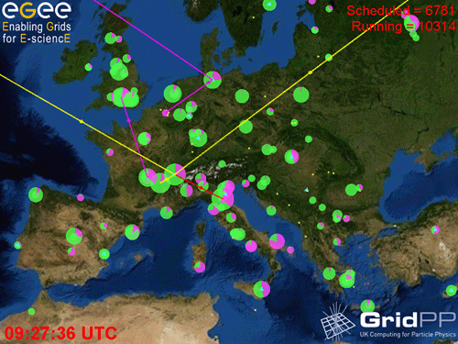
The technologies developed at CERN generate innovation
Accelerators
Detectors
CAT
Hadron therapy
The Computing Grid

Slide 8
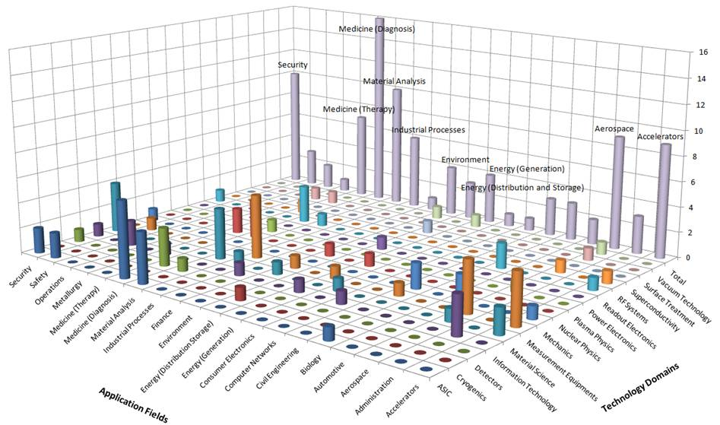
The impact of the technologies developed at CERN

Slide 9
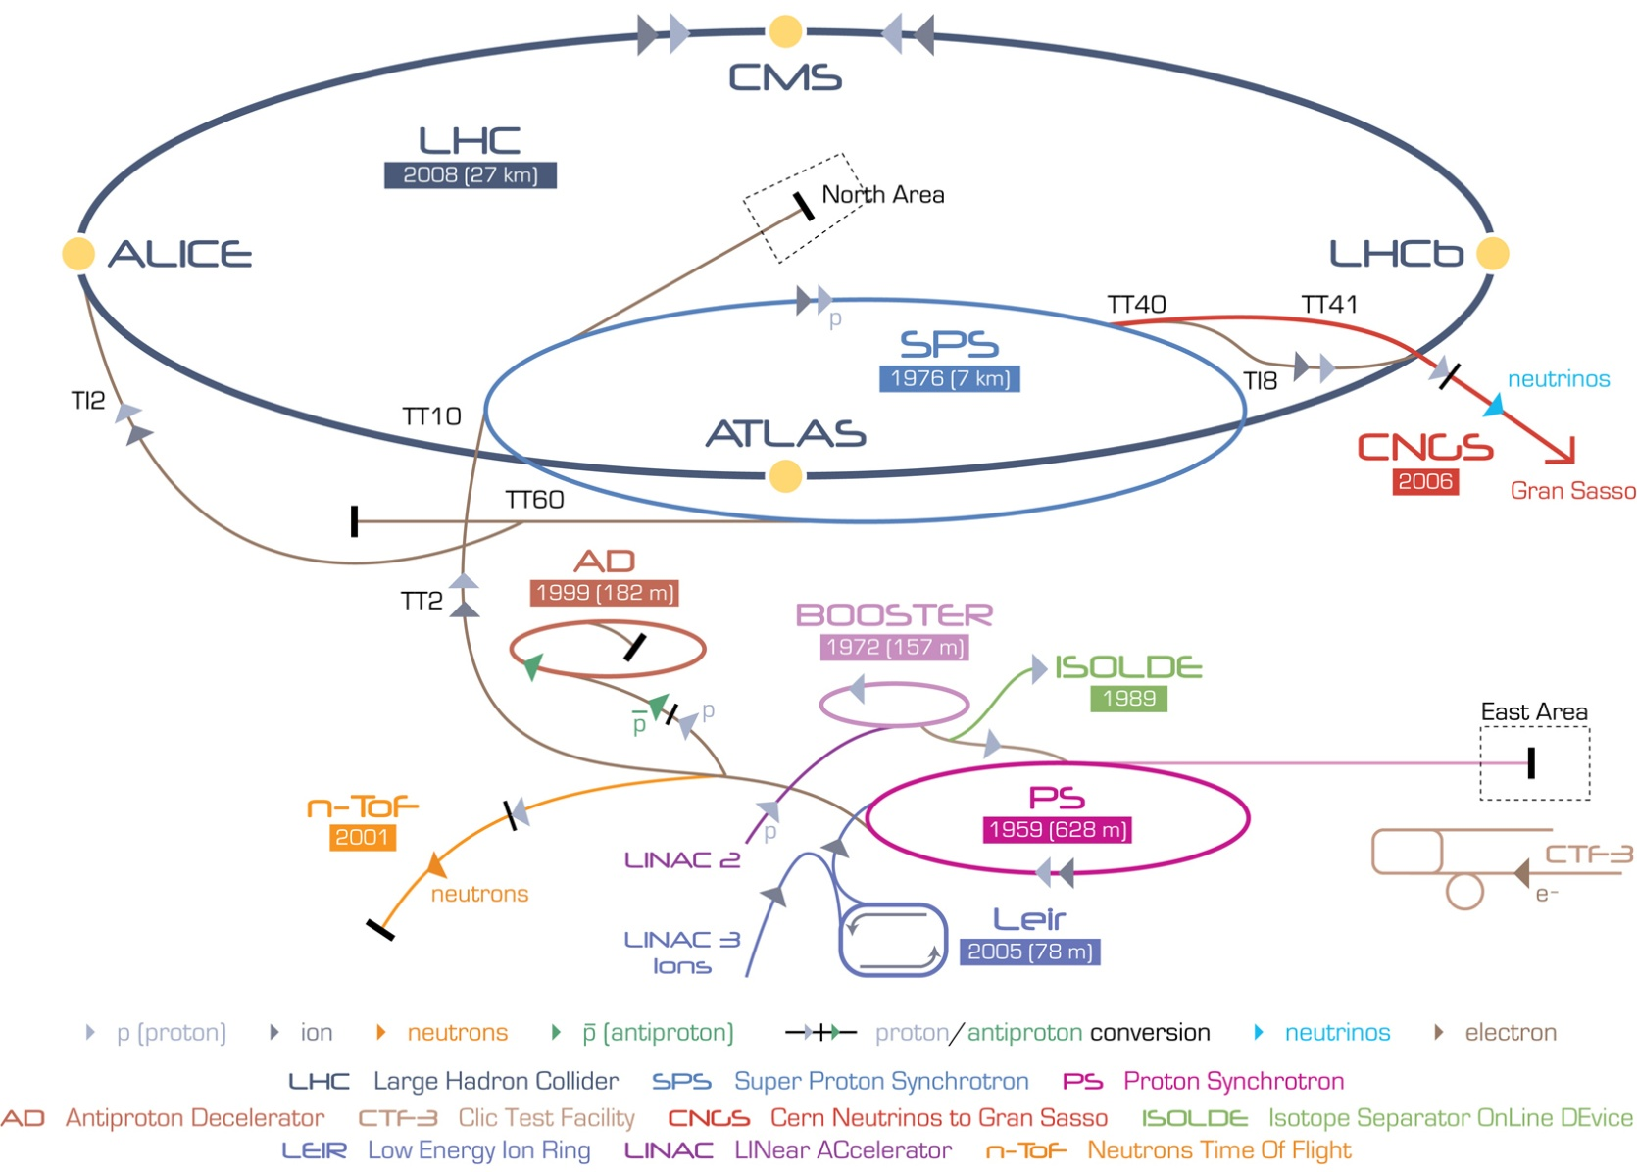
The CERN Accelerator Complex
LHC, A huge machine accelerating tiny particles...
?
?
?
?

Slide 10
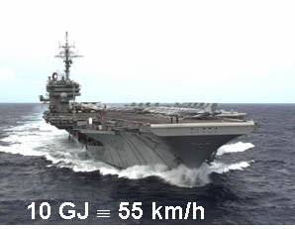
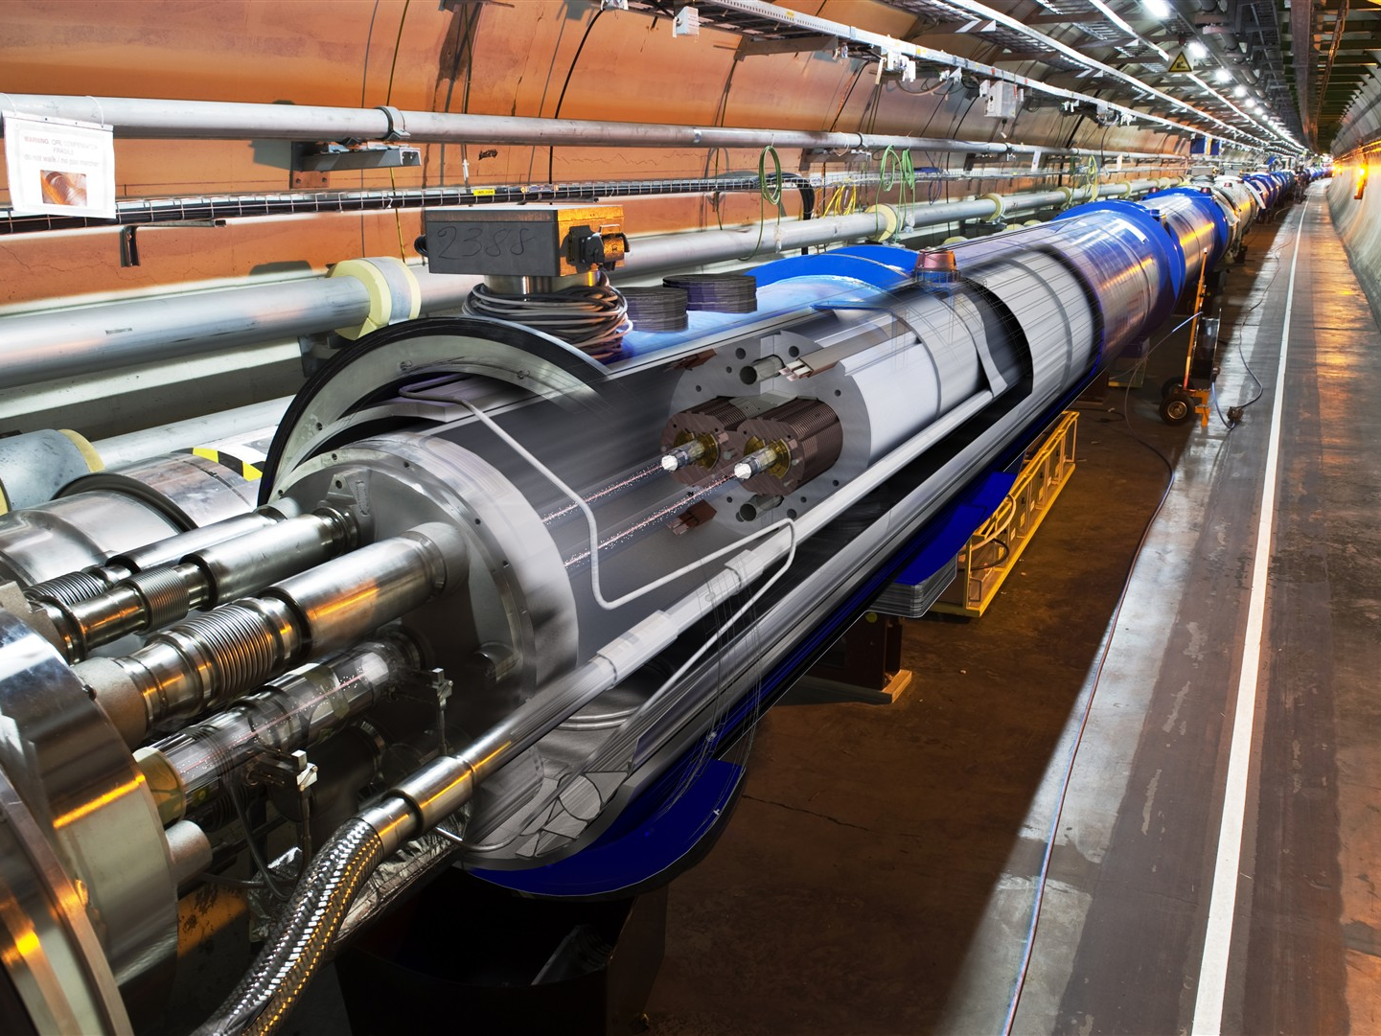

The LHC
A collider situated in an underground 27 km in an almost circular tunnel designed to accelerate two proton beams to 7 TeV
1982 : First studies
1994 : Project Approved by the CERN Council
1996 : Final Decision and start of the construction
2004 : Installation Starts
2006 : Hardware Commissioning Starts
2008 : End of Hardware Commissioning
2009-2030: Physics
10 GJ = 55 km/h
+ than 25 years

Slide 11
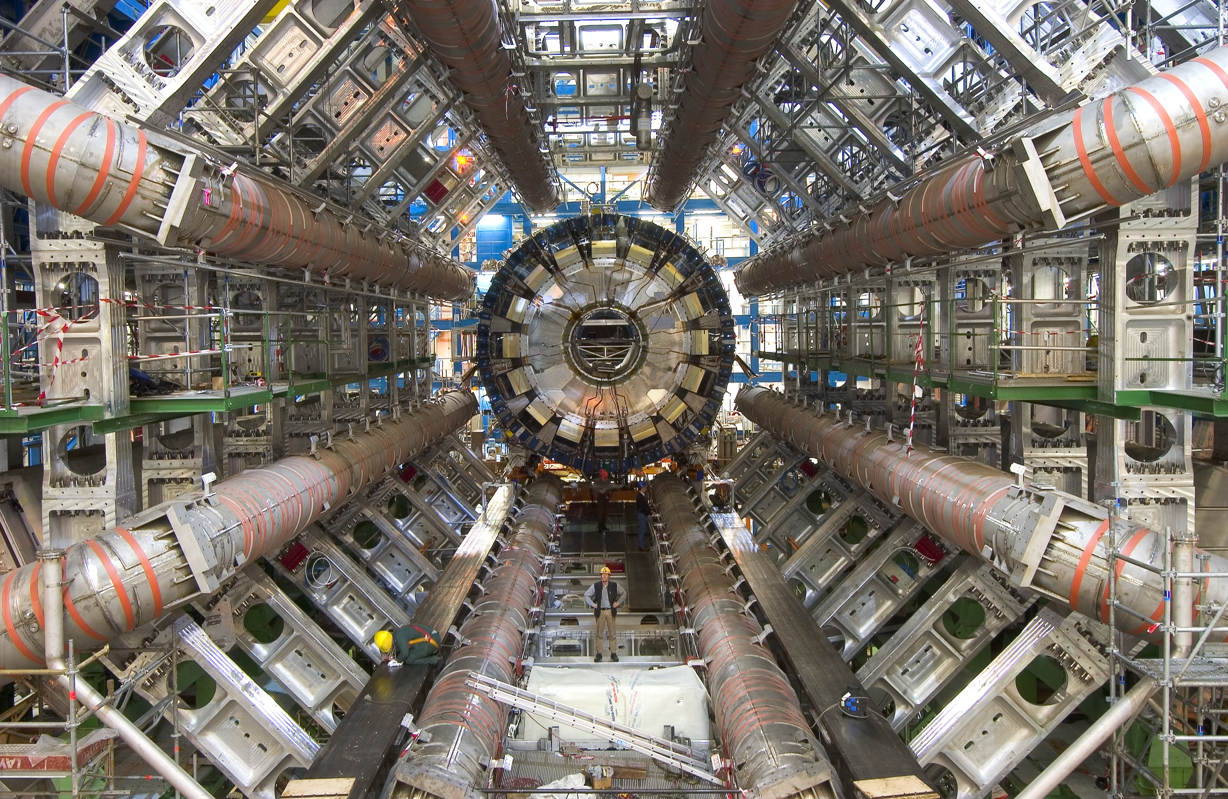
A Big Experiment at the LHC : ATLAS

Slide 12
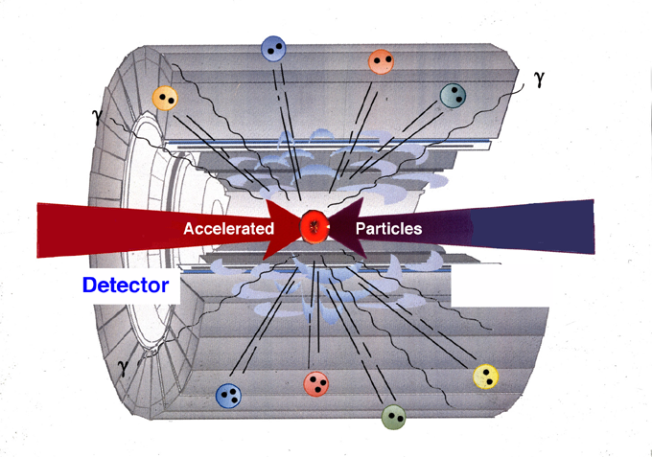

How do we study the elementary particles?
1) Accelerate protons or ions to high energy
3 Identify the particles created in the collisions
2) Collide these head-on to recreate the conditions of the Big Bang
4) Collect and analyze the data from many collisions

Slide 13

H ➔ γ γ

Slide 14
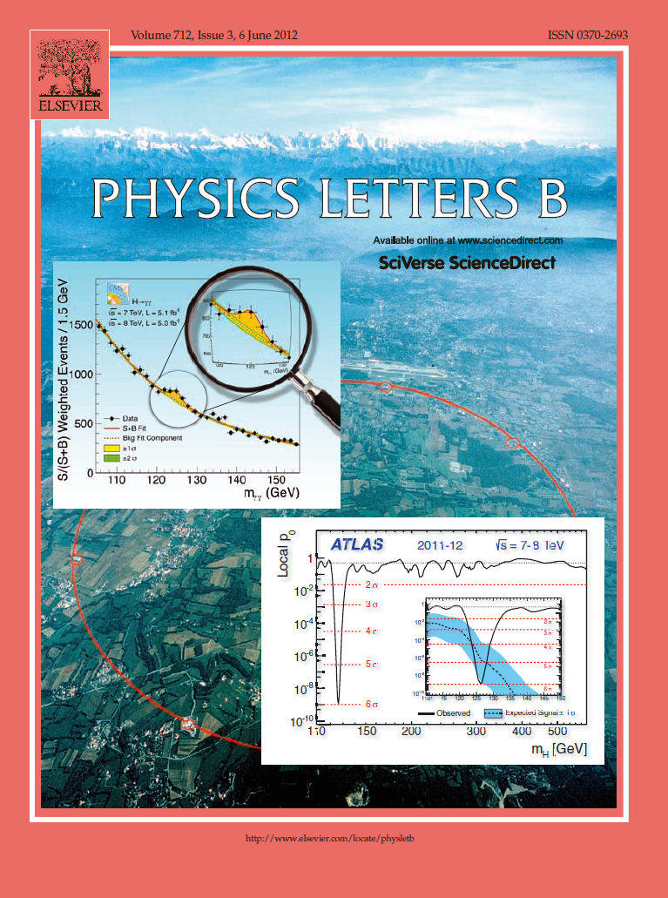

2012 : The year of the Higgs Boson

Slide 15
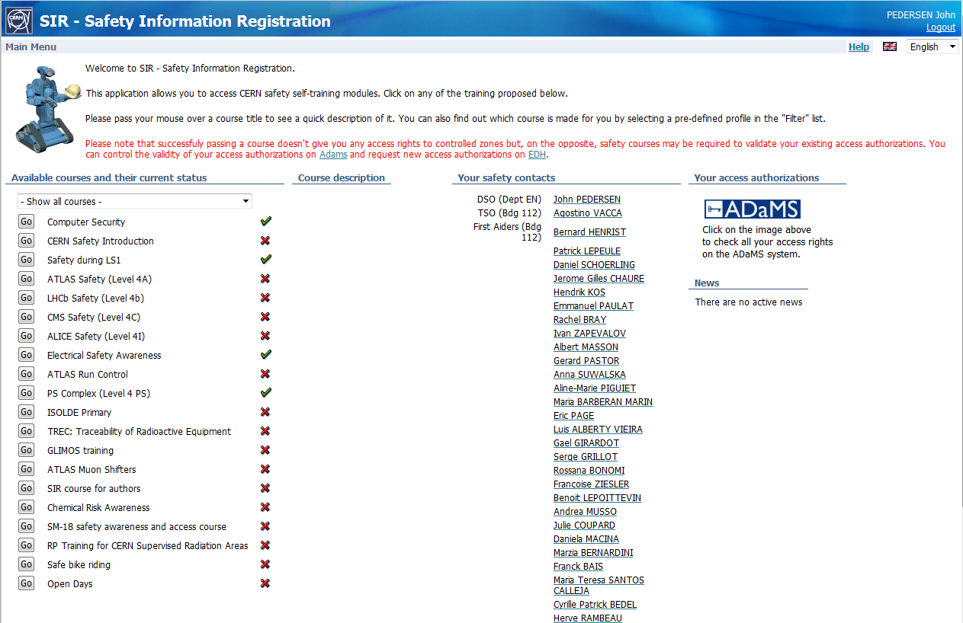

Occupational health and safety in EN
At CERN Safety is our highest priority!
To be allowed to work on CERN sites you must complete basic safety training.
You find it in the Safety Information Registration application, Type SIR in your browser’s address window.
More advanced safety training is
needed to perform certain tasks
or to access certain areas.
The list is found in the HR web-page

Slide 16


Occupational health and safety in EN
Your role in safety:
You are responsible for your own safety! If you take risks you are at fault.
By taking up work at CERN you agree to work at minimum risk, and do everything to obtain the information that you need to do so.
Your supervisors role in safety:
Your supervisor is responsible for the safety of your activities. Do not make his life difficult: Respect the rules; respect the signs!
So why ignore
this one?
This is also for
your safety
Surely you would
not ignore this sign?

Slide 17

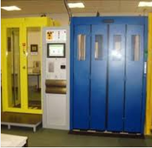
Occupational health and safety in EN
Radiation safety
In the EN department there is a Radiation Safety Officer, or RSO.
Each group has Radiation Support Safety Officers, or RSSO. Their
job is to help their colleagues to prepare interventions in radiation
areas.
Access Control
The access to many areas at CERN, in particular underground,
is controlled. In order to access these areas you need to complete the required safety training. Once you have done so, you must request access. When access has been granted by the
access controller of the area, you may access.
Do not forget the obligatory Personal Protection Equipment!

Slide 18
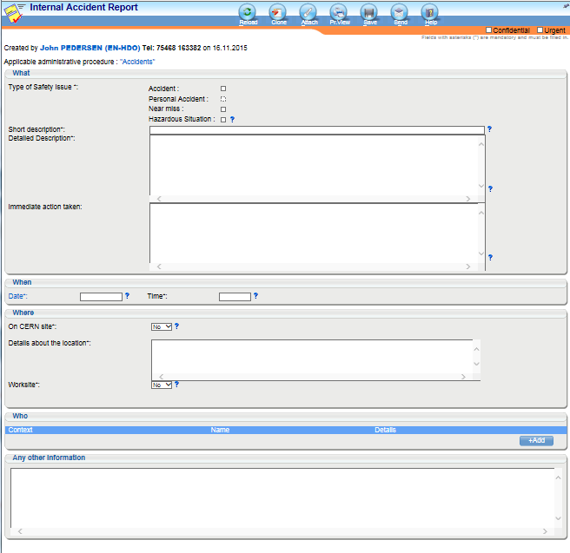
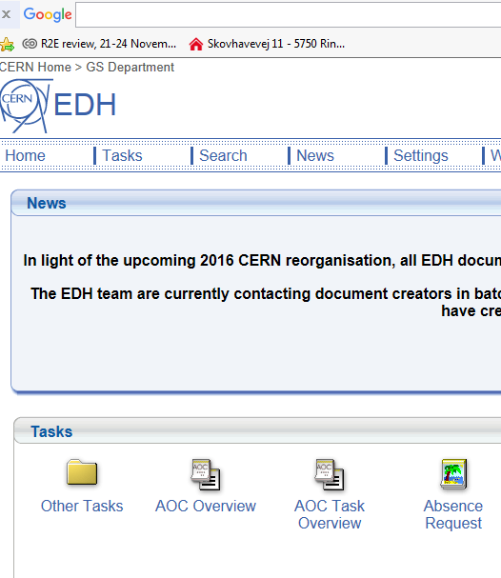
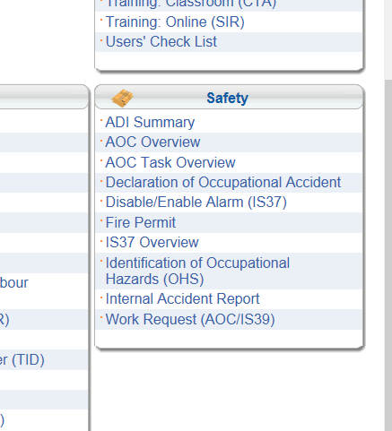
Occupational health and safety in EN
Should you witness, or be part of an accident or a near miss:
Notify immediately your supervisor, your group leader and the DSO of your department.
Find out who they are, so you know it when you need it.
If you need the fire Rescue and Fire Service, call 7 44 44 and wait for them.
Never ever transport an accident victim in your own car!
As soon as possible, and within 24 hours, you must fill in the Internal Accident Report.

Slide 19
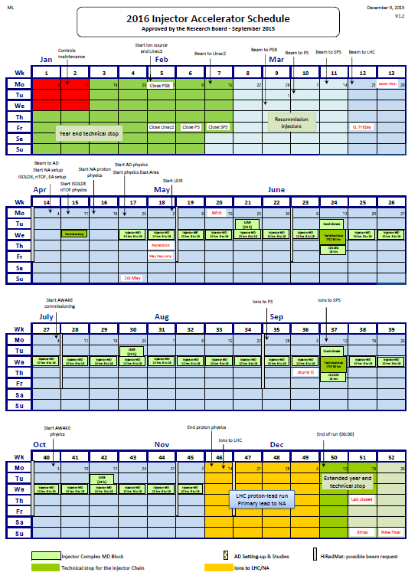

Slide 20
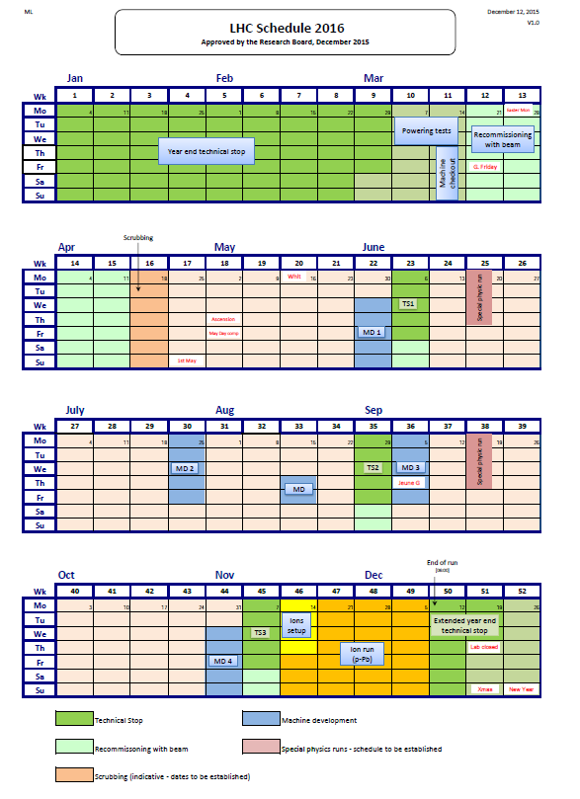

Slide 21
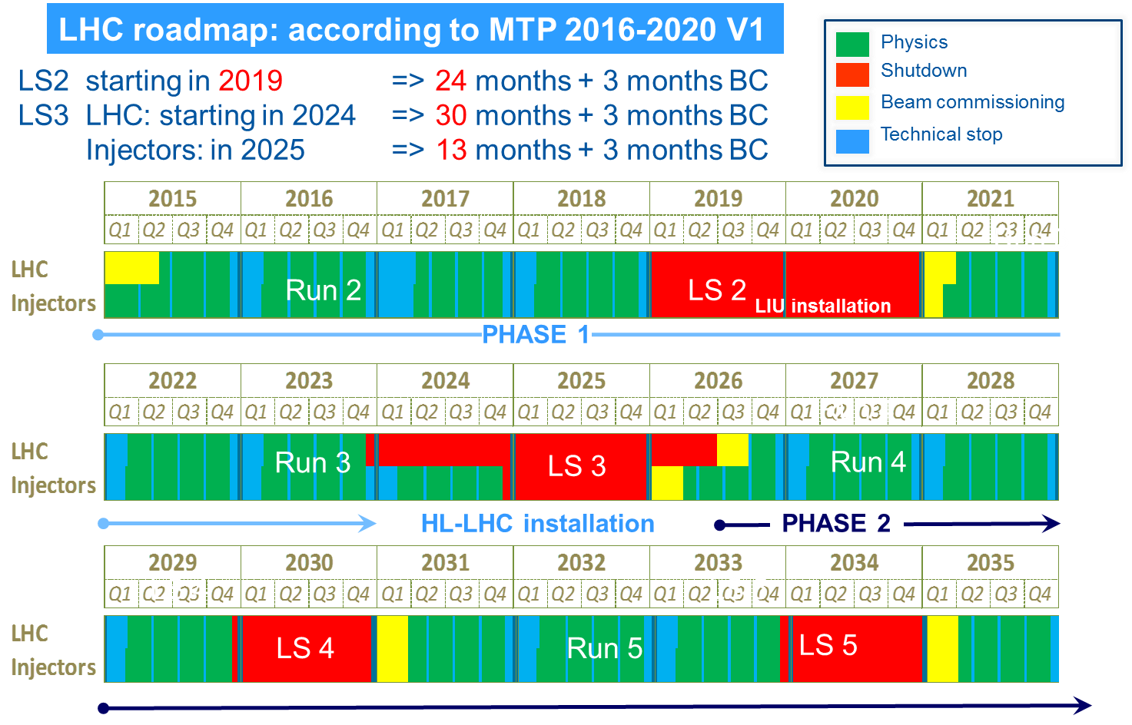
A longer term perspective

Slide 22
CERN Structure
Directorate in 2016
Director-General Director of International Relations | Fabiola Gianotti Charlotte Lindberg Warakaulle
Director for Research and Computing | Eckhard Elsen
Director for Accelerators and Technology | Frédérick Bordry
Director for Finance and Human Resources | Martin Steinacher

Slide 23
CERN Structure
Directorate in 2016
Director-General Director of International Relations | Fabiola Gianotti Charlotte Lindberg Warakaulle
Director for Research and Computing | Eckhard Elsen
Director for Accelerators and Technology | Frédérick Bordry
Director for Finance and Human Resources | Martin Steinacher
Heads of departments in 2016
Experimental Physics Theoretical Physics | Manfred Krammer Gian Giudice
Information Technology | Frederic Hemmer

Slide 24
CERN Structure
Directorate in 2016
Director-General Director of International Relations | Fabiola Gianotti Charlotte Lindberg Warakaulle
Director for Research and Computing | Eckhard Elsen
Director for Accelerators and Technology | Frédérick Bordry
Director for Finance and Human Resources | Martin Steinacher
Heads of departments in 2016
Beams – BE | Paul Collier
Technology – TE | José Miguel Jimenez
Engineering – EN | Roberto Losito

Slide 25
CERN Structure
Directorate in 2016
Director-General Director of International Relations | Fabiola Gianotti Charlotte Lindberg Warakaulle
Director for Research and Computing | Eckhard Elsen
Director for Accelerators and Technology | Frédérick Bordry
Director for Finance and Human Resources | Martin Steinacher
Heads of departments in 2016
Human Resources Finance and Administrative Process | Anne-Sylvie Catherin Florian Sonnemann
Industry, Procurement and Knowledge Transfer | Thierry Lagrange
Site Management and Buildings | Lluis Miralles

Slide 26
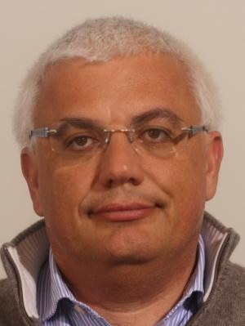
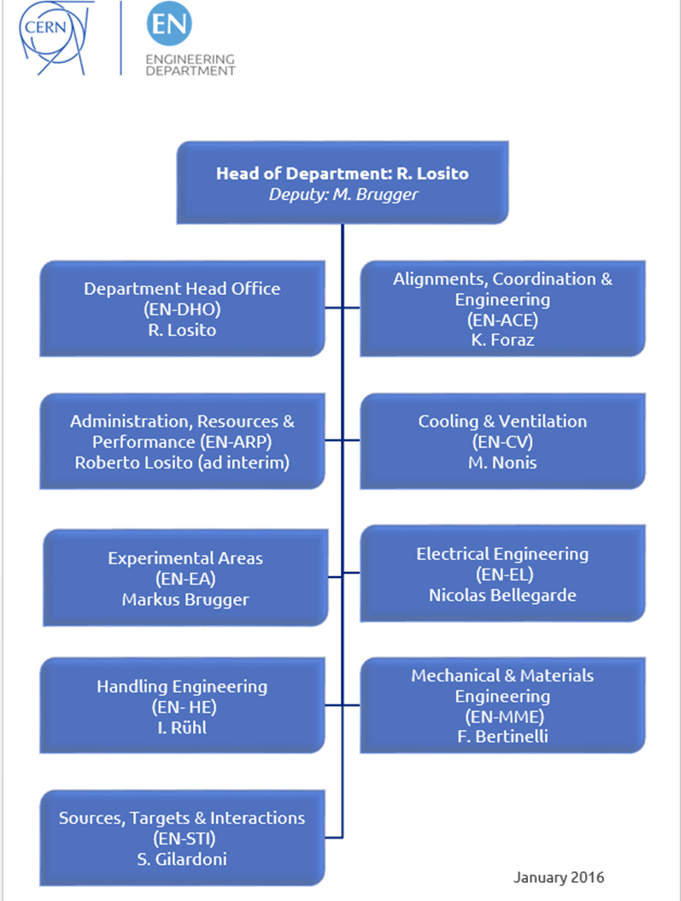
Head of Department:
Roberto Losito
Operation
  Infrastructure
  Accelerators
  Experimental Areas
Projects
  Consolidation
  Upgrades
  New facilities
  Design & Manufacturing
Studies
5
61
67
11
27
32
78
76
37

Slide 27
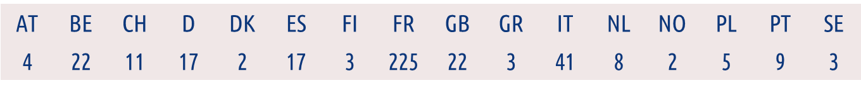
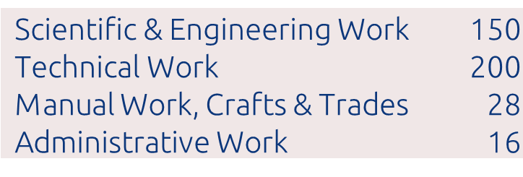
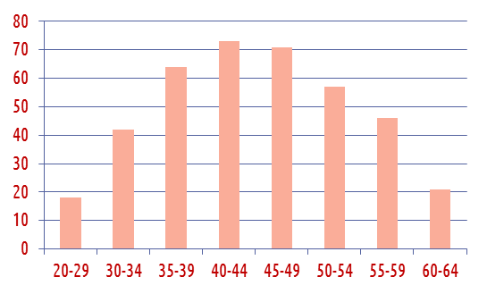
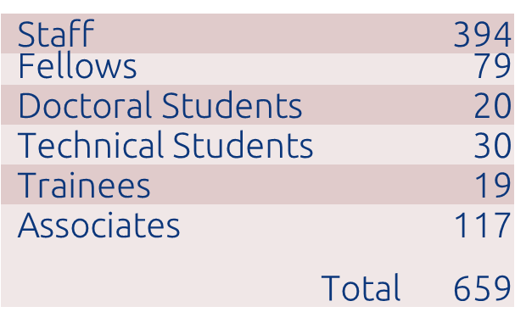
Who are we, in EN?
38%
F | M
11% | 89%
58%
4%
+ many colleagues in industrial
support contracts
+46 with respect to 2014

Slide 28
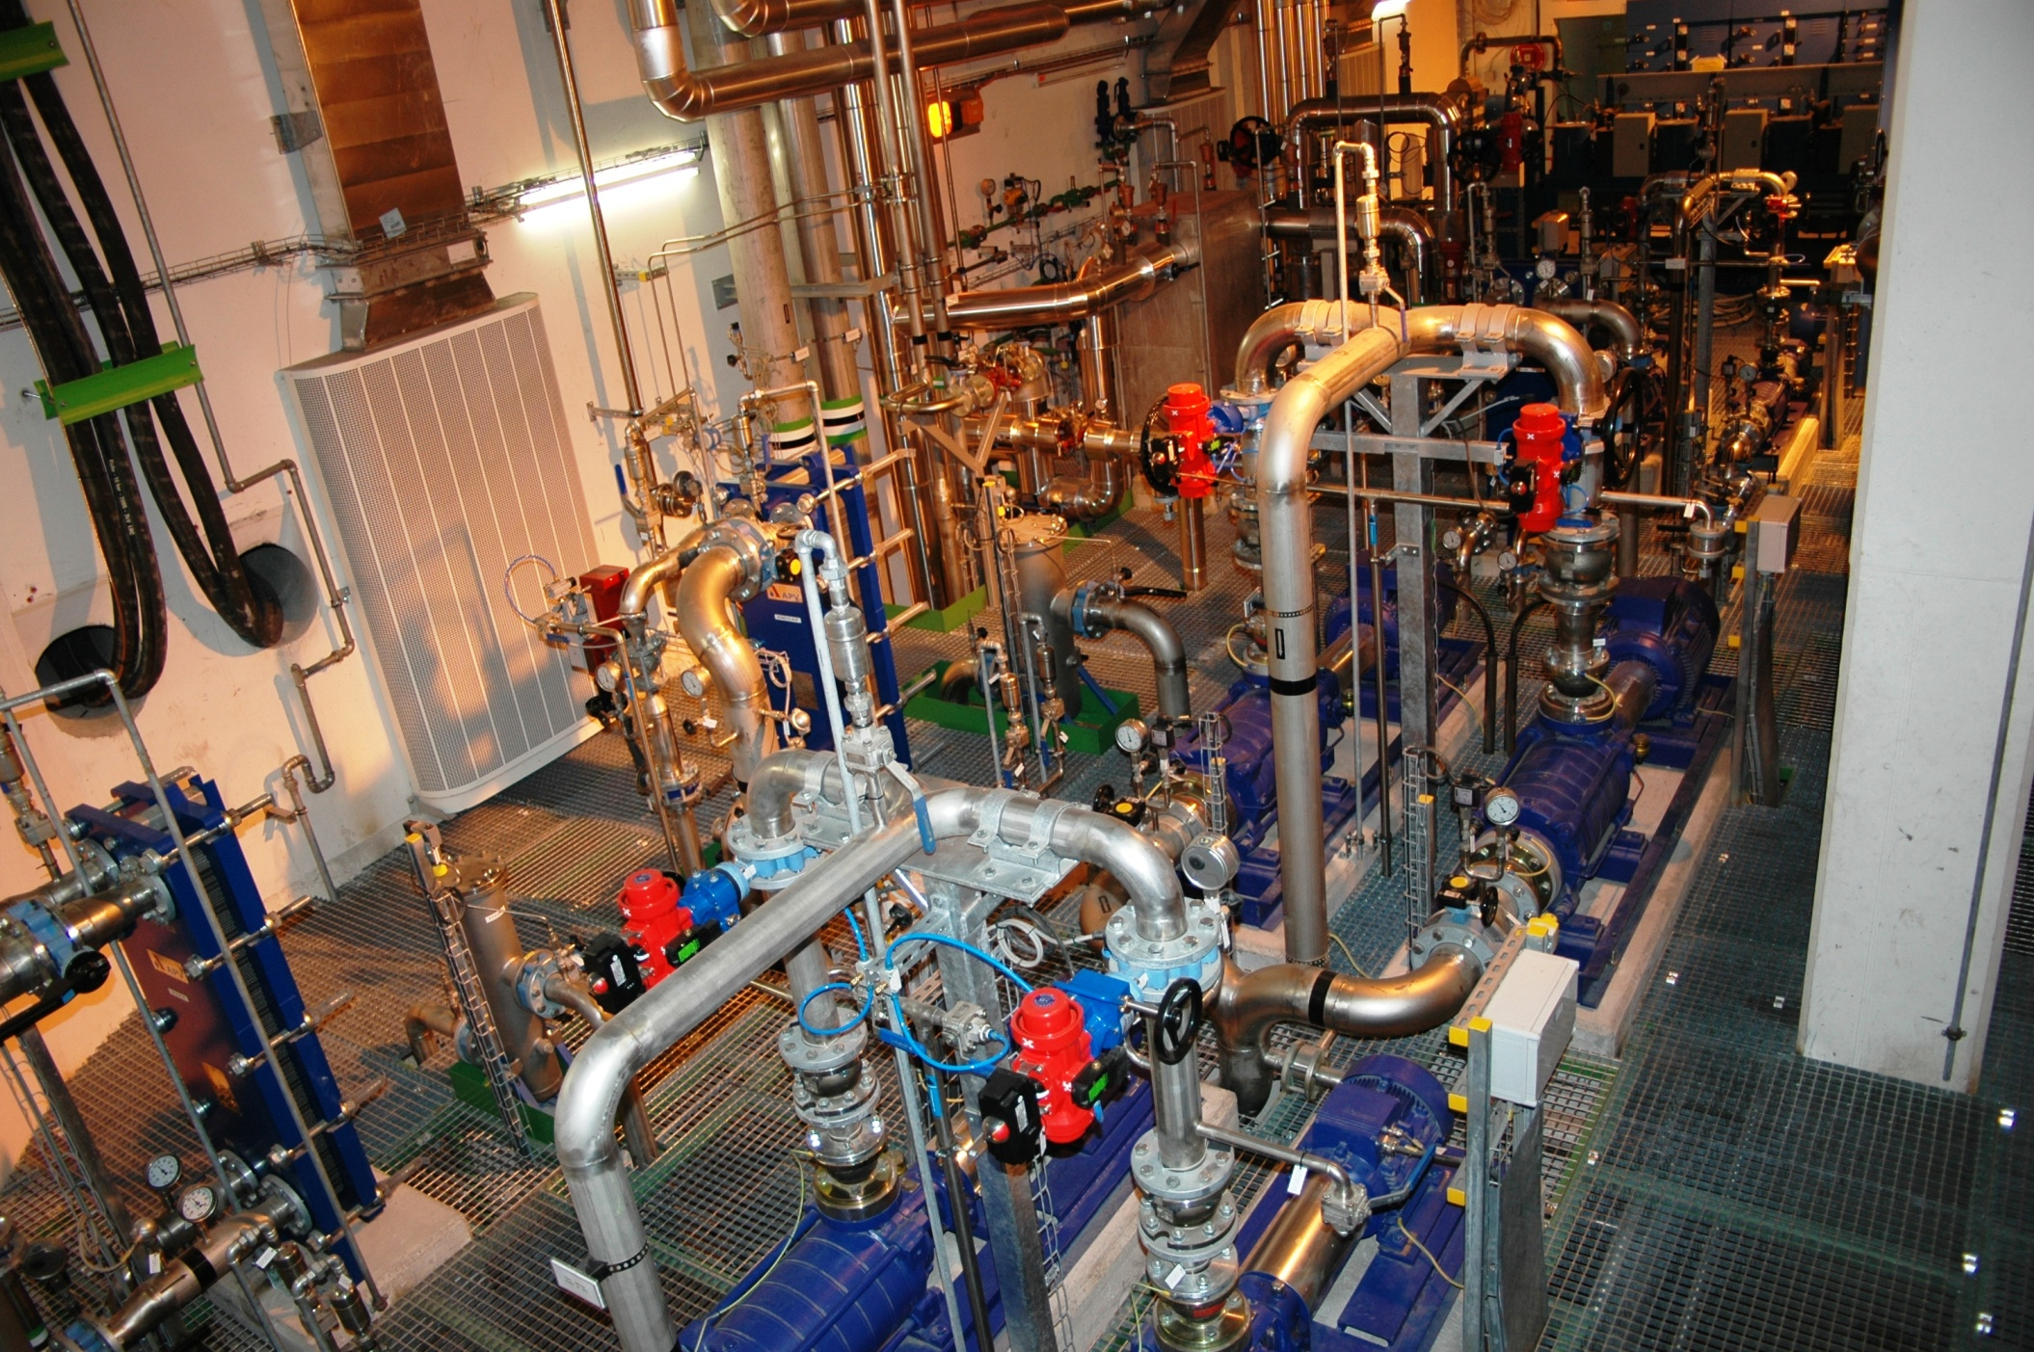
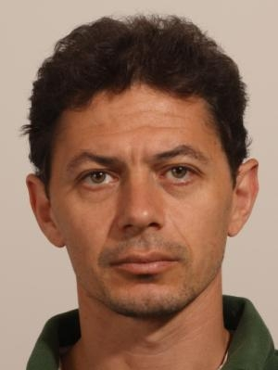
CV: The Cooling and Ventilation Group
The mandate The operation and maintenance of the cooling systems, pumping stations, air conditioning installations and fluid distribution systems for the PS, SPS and LHC including their experimental areas and special cooling systems of LHC sub-detectors. It also provides service to the Computer Centre and some miscellaneous installations.
Group Leader
Mauro Nonis
Cooling station
Notes:
Cooling & Ventilation Group (Groupe Refroidissement et Ventilation):
is in charge of the operation, maintenance and innovation of cooling systems, pumping stations, air conditioning installations.

Slide 29
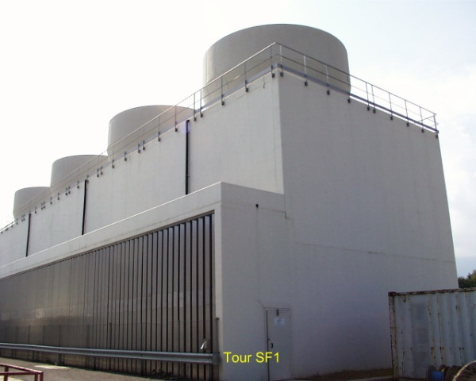
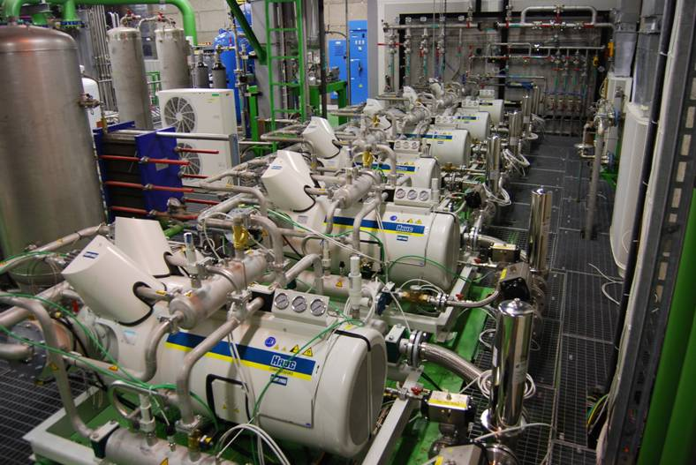
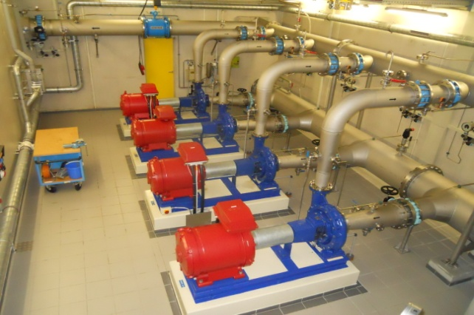
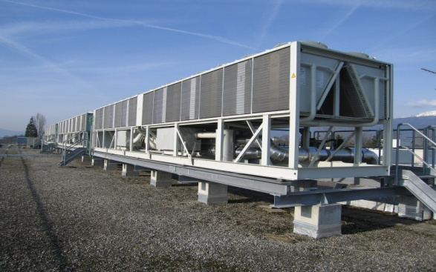
Cooling
Cooling plants (raw, demineralised water, C₃F₈, C₆F₁₄) | 150
Pipelines | 800 km
Hydrants | 800 points
Cooling towers (450 MW) | 22
Chilled water plants 6-12 °C (73 MW) | 35
Water network with three pumping stations | 5’400 m³/h
Equivalent to a small town of 45’000 inhabitants
10% of the water needs of Geneva

Slide 30
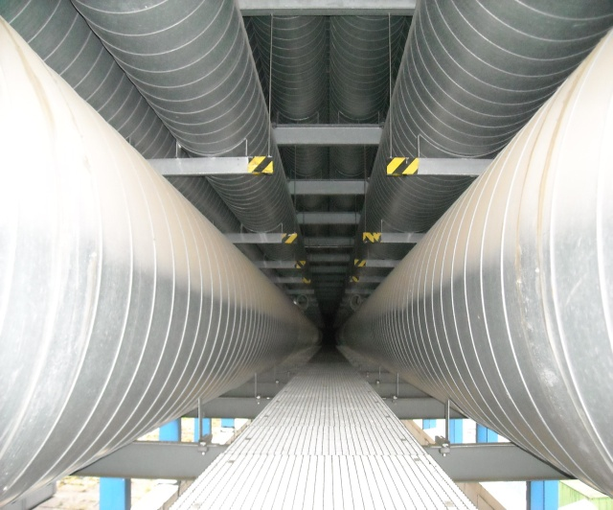
Ventilation
Heating, ventilation and air conditioning | 1’500 units from 2’000 to 120’000 m³/h each
Compressed air | 14 stations 200 km network
 | km | m³/h
Eurotunnel | 50 | 540’000
LHC | 27 | 290’000

Slide 31
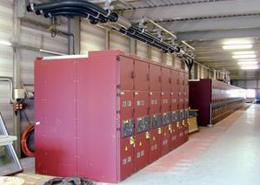
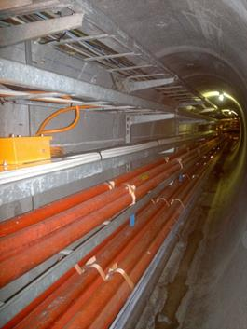
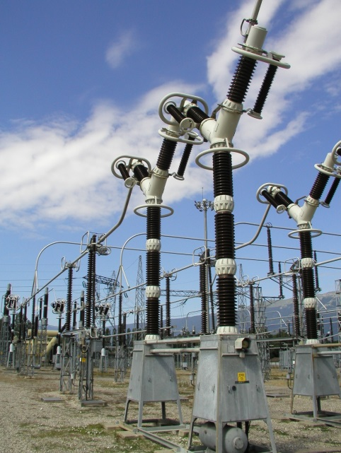
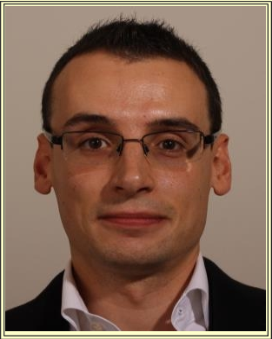
EL : The Electrical Engineering Group
The EL group is responsible for the CERN electrical distribution network from 400 kV to 400/230 V. Its main missions are to operate, maintain, extend and renovate the network, analyse and make projections for CERN electrical energy consumption and manage relations with the energy suppliers.
Group Leader
Nicolas Bellegarde
Notes:
Electrical Engineering Group: is responsible for the CERN electrical distribution network from 400kV to 230V including all CERN cabling and fiber optic activities.

Slide 32
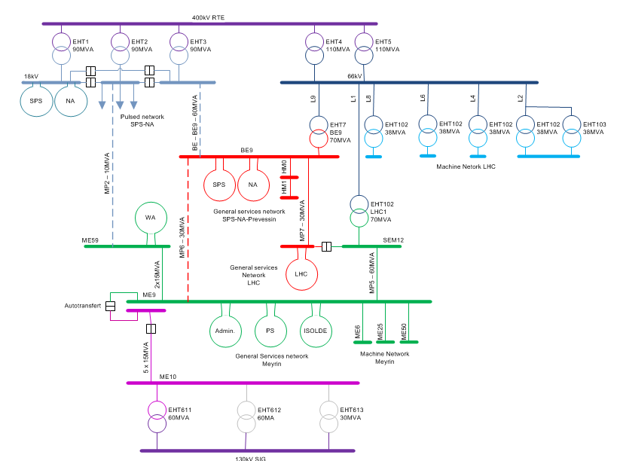
Electricity Distribution
Normal source EDF > 300 MW
    Annual Consumption 1.26 TWh
    ⅙ of Geneva
Instantaneous Power 180 MW
½ - ⅓ of Geneva
Emergency source SIG/ALPIQ ≤ 60 MW

Slide 33
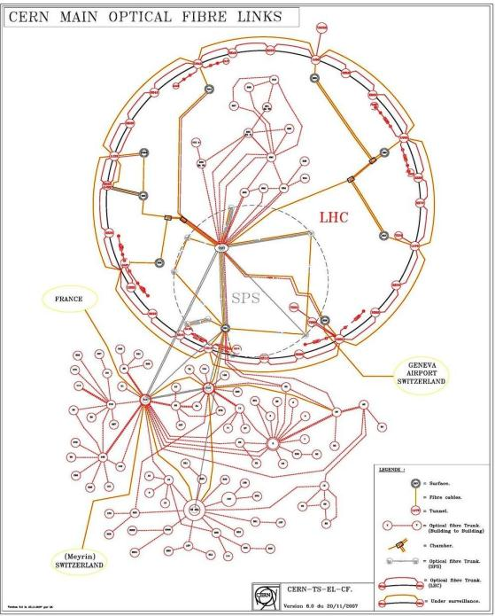
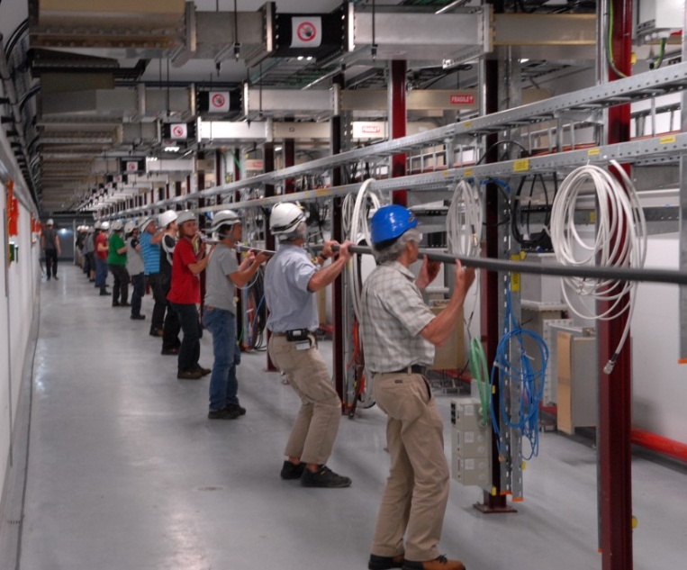
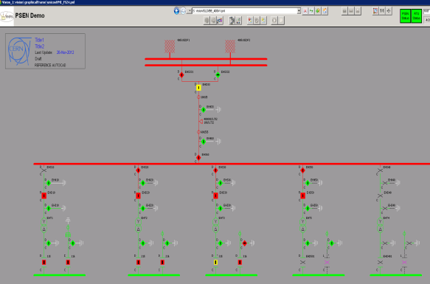
EL : The Electrical Engineering Group
The EL group is also responsible for the cabling activities. Its main missions are to install control cables, Water cooled cables and fibre optics for users. This activities include the management of infrastructures (cable trays, ducts, patch panels,...) and the necessary removal of old and unused installations.
EL is also in charge of the control of it’s distribution network including a SCADA system and automation of process.

Slide 34



ARP : Administration, Resources and Performance group
The ARP group is in charge of the management of department resources in terms of personnel, material, industrial support, as well as group secretariats.
Group Leader
Roberto Losito (ad-interim)
Notes:
General Management & Secretariat Group: is in charge of the management of department resources in terms of personnel, budget, space, as well as group secretariats.

Slide 35



HE : The Transport and Handling Group
The mandate : provide transport and handling services for the technical infrastructure of CERN, accelerators and experiments. This includes the design, the tendering/procurement, the installation, the commissioning, the operation, the maintenance and decommissioning of standard industrial and custom built transport and handling equipment.
Group Leader
Ingo Ruehl
Notes:
Handling Engineering Group: provides transport and handling services for the technical infrastructure of CERN, the accelerators, the experiments.

Slide 36







Transport and Handling Equipment
350 Cranes / 800 Hoists
400 Lifting Equipment
130 Lifts
100 Tractors
2000 Lifting Beams
50 Special
Vehicles
80 Working Platforms
About 4000 assets in Total

Slide 37





EA : Experimental Areas Group
The EA Group in the Engineering Department is responsible for the beamlines, infrastructure and management of CERN’s experimental areas and provides engineering support and services including associated contracts. EA is furthermore supporting the LHC experiments and managing the respective ATS interface, as well as participating in and partly hosting the management of a number of CERN-wide projects (AWAKE, R2E, etc.).
Group Leader
Markus Brugger
Notes:
Industrial Controls & Engineering: develops solutions and provides support in the domain of industrial control systems.

Slide 38

















EA : Experimental Areas Group
EXPERIMENTAL AREAS
BEAMLINES
FACILITIES
PROJECTS
EHN1-Extension
AD-ELENA
SUPPORT ACTIVITIES
MECHANICS, VACUUM, CABLING, SCAFFOLDING, INTEGRATION, GAS,
INSTRUMENTATION, DESIGN, PROTOTYPING, SHIELDING,
PLANNING, COORDINATION, SAFETY
Notes:
Industrial Controls & Engineering: develops solutions and provides support in the domain of industrial control systems.

Slide 39

ACE : Alignment, Coordination and Engineering Group
The ACE group is responsible for
Providing overarching project coordination for the accelerator complex, including layout management, integration, scheduling, work and safety coordination, as well as for different projects.
Providing support and expertise in matter of project, risks and quality management as well as organizational process.
Developing and supporting the Organization's engineering, equipment data, maintenance management tools and mechanical CAD systems.
The metrology and alignment of the accelerators, of their associated beam transfer lines and of the detectors, for the whole CERN site.
Group Leader
Katy Foraz
Notes:
Machines & Experimental Facilities: is responsible for planning and coordinating all maintenance and installation activities in the CERN Accelerator Complex, providing support to the experiments using the CERN accelerators.

Slide 40






ACE : Alignment, Coordination and Engineering Group

Slide 41





MME : The Mechanical and Materials Engineering Group
The mandate : provide to the CERN community specific engineering solutions combining mechanical design, production facilities and material sciences. This group owns, maintains and develops the know-how on the mechanical constructions in the accelerators and the physics detectors.
  Inermet : comparison Autodyn (SPH) between simulation and experiment
Beam
Group Leader
Francesco Bertinelli
Notes:
Mechanical & Materials Engineering: provide the CERN community specific engineering solutions combining mechanical design, production facilities and material sciences.

Slide 42
MME : domains of activities
Engineering & Design
Fabrication
Machining & Maintenance
Preparation & Subcontracting
Assembly & Forming
Materials & Metrology
Internal Design Office facilities, 40 designers (Staff and Industrial Support)
CATIA / SmarTeam, ANSYS
Mechanical measurements lab
4000 m² of internal workshop facilities, 50 technicians (Staff and Industrial Support): CNC machining, sheet metal work & welding, electron beam & laser, vacuum brazing
External subcontracting service
Free access Users workshop
Material selection, analysis & metallurgy: microscopy, mechanical testing
NDT: US, radiography, tomography
350 m² of internal metrology facilities: CMM

Slide 43




STI : The Sources, Targets and Interactions Group
The Sources, Targets and Interactions Group has as common ground the study of beam interactions with matter, aiming to apply its know-how to particle generation (ISOLDE Radioactive beam sources, CLIC photoinjectors and polarized e+ e- sources), and to particle interception (collimators, absorbers and dumps).
Group Leader
Simone Gilardoni
Notes:
Sources, Targets & Interactions: studies beam interactions with matter (like the FLUKA simulation) and manages some accelerators equipment that aims to intercept particles.
.

Slide 44
Welcome !
Presentation prepared by:
  S.Baird, F.Bertinelli, O.Capatina, K.Foraz R.Losito, M.Nonis, J.Pedersen, E.Piemonti Spalazzi, I.Ruehl, G.Richaud, R.Saban, E.Perrin, M. Brugger,
  S. Gilardoni.

