Slide 1
EN Computing Environment
Emanuele Piemonti Spalazzi & Gaetan Richaud
EN-GMS-Adm
01.03.2016

Slide 2

Computing Service in EN Department
EN Desktop
  Installation
  Troubleshooting
  Advice
  Management of the EN computing equipment inventory
In case of problems with your computer, contact the EN Desktop Support (169807 or En-desktop@cern.ch)

Slide 3
Computing Services at CERN
General Support (including software):
Helpdesk Support => help.desk@cern.ch or 77777
For printers (installation & troubleshooting):
Printer Support => Printer.Support@cern.ch or 77777
For CAD (Computer Aided Design) softwares:
CATIA Support => catia.support@cern.ch or 77777
For workstations (installation & troubleshooting)
GS Support => GS-Desktop.Support@cern.ch or 77777
In case of doubt, call EN Desktop (169807 or
En-desktop@cern.ch)

Slide 4
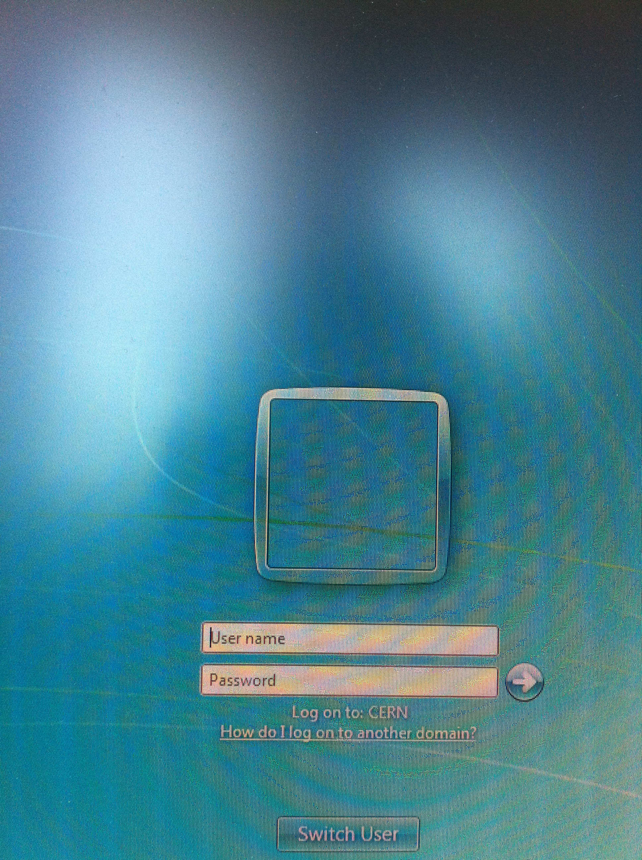
NICE Account
Use your login and password to connect to the CERN computing environment
How to get it
  Go to bldg. 55
  Give a personal e-mail address
  Pass the computer test

Slide 5


Connecting to the CERN Network
Via CERN Computer
  Login with your NICE login & password
  Windows7 and CERN network are already configured
  Via Personal Computer and Phone
  Connection from Outside CERN
Computing guide
Computing guide

Slide 6
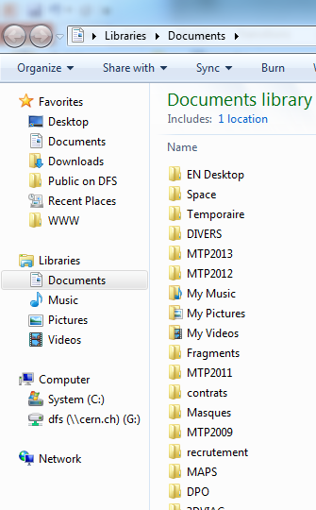

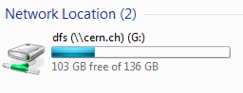
  DFS
  Distributed File System
DFS is a data storage space
For personal data
  Backs up data stored in desktop and libraries
  Associated to your NICE login
  A “Public” folder
  Memory quota is 2 Go
For shared data
  Gives access to CERN data servers (folders
  for applications, departments,
  groups, projects, workspaces, etc.)

Slide 7
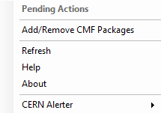
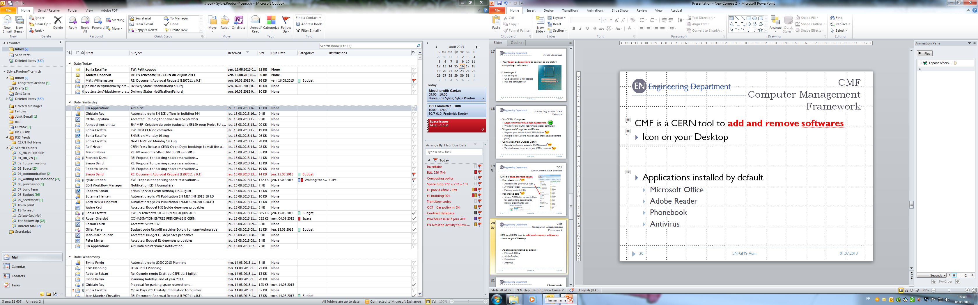
  CMF
  Computer Management Framework
CMF is a CERN tool to install and remove softwares
Icon on your Desktop
Applications installed by default
  Microsoft Office
  Adobe Reader
  Phonebook
  Antivirus

Slide 8
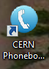
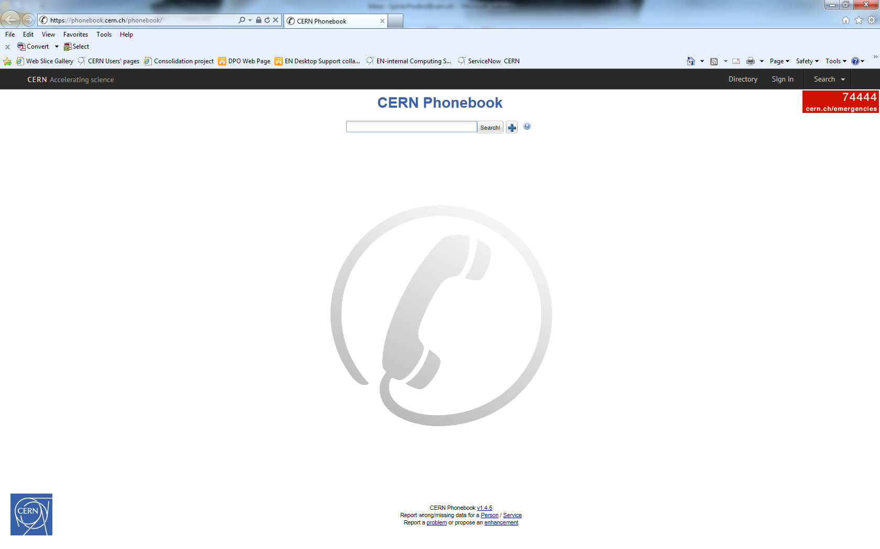
  CERN Phonebook
To search
  A phone number
  An office number
  An organic unit
Available on your desktop

Slide 9
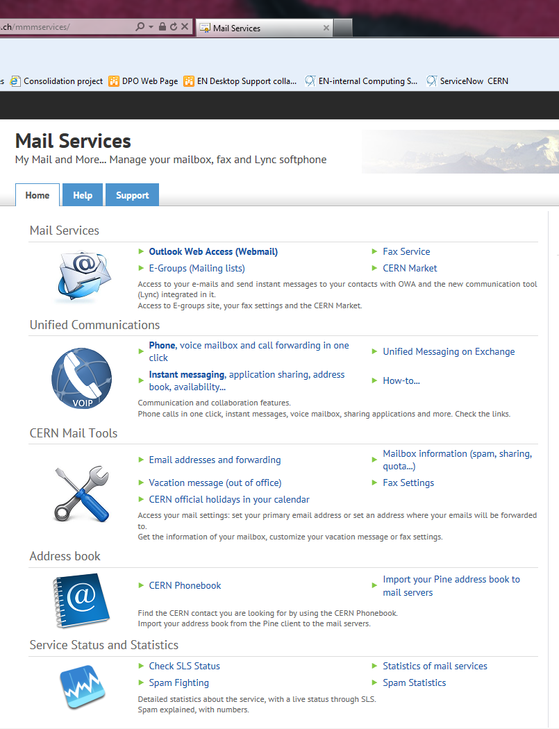
E-Mail
Two ways to access CERN E-Mail:
Microsoft Outlook: in the Start Menu
Outlook Web Access (https://mmm.cern.ch/owa/)
  Mail Services (https://mmmservices.web.cern.ch/mmmservices/)
    Vacation message (out of office)
    CERN holidays in the calendar
    Quota: 2Go

Slide 10
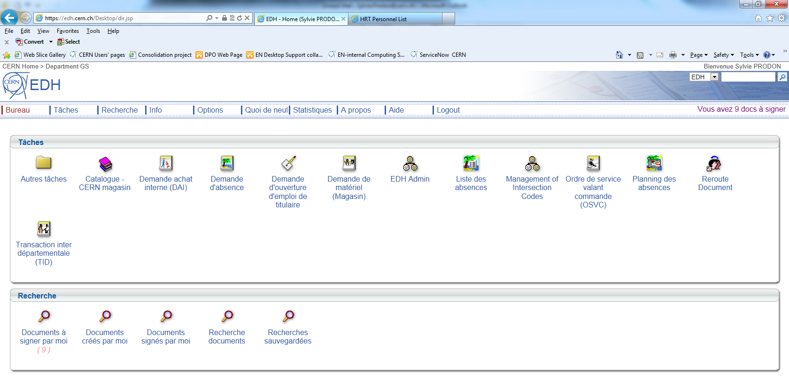
  EDH
  Electronic Document Handling
EDH is a CERN tool containing electronic forms with an approval signature circuit
Access: https://edh.cern.ch/Desktop/dir.jsp
Require two passwords:
  To access the system: NICE login
  To sign a document: "EDH authorization password"
    Different from NICE login
    Request for EDH password through Helpdesk
Examples of forms
  Absence Request
  Access Request
  Driving Request
  CERN Catalogue
For more information, a dedicated training is available

Slide 11
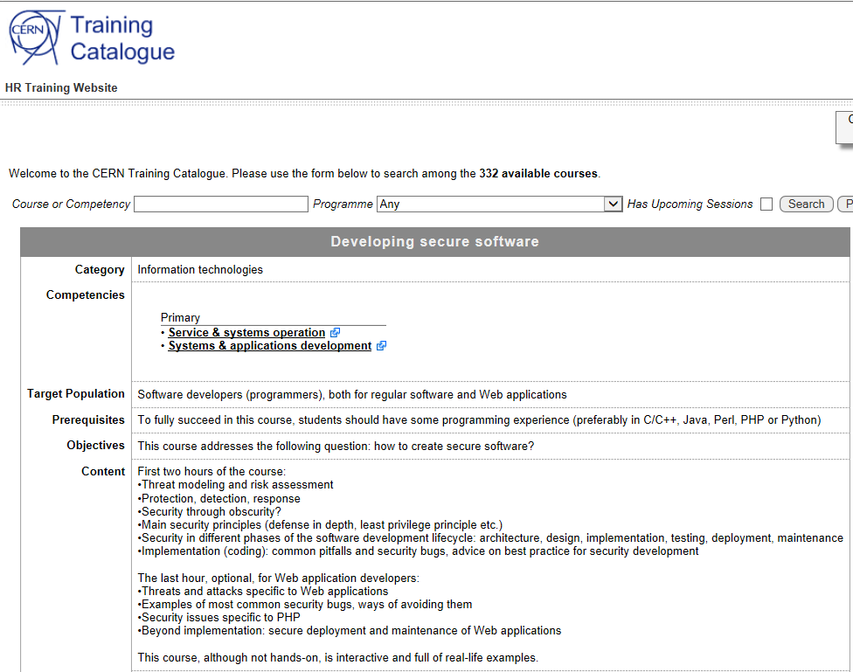
"Developing secure software"
All software developers and system administrators at CERN must follow the “Developing secure software” course available in the CERN catalogue:

Slide 12
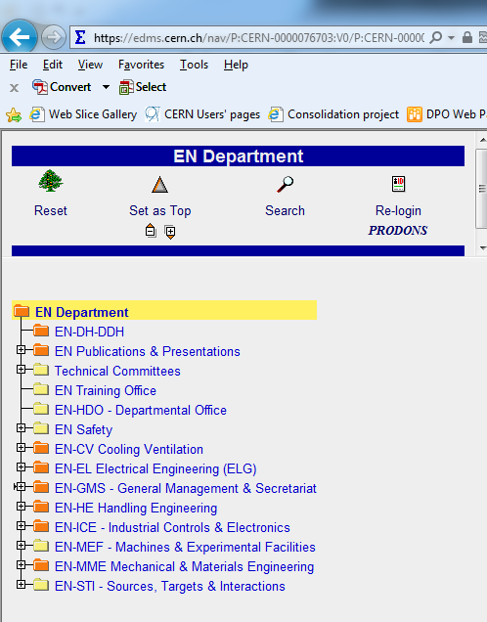
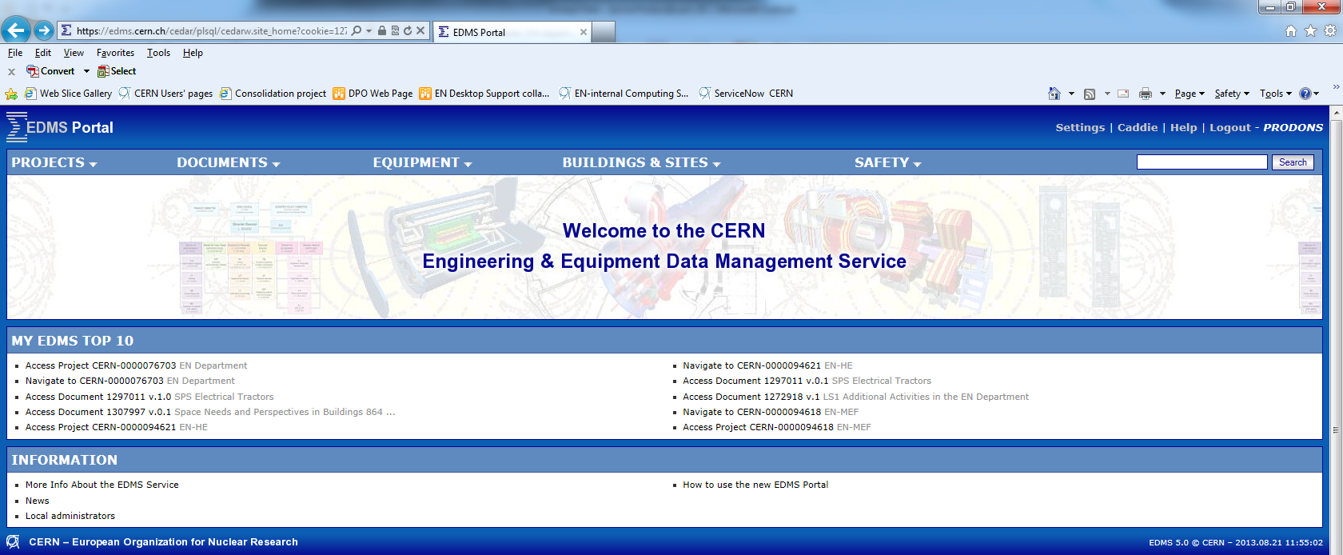
EDMS
Engineering & Equipment Data Management Service
EDMS is a CERN tool for the approval, archiving and follow up of technical documents
Access: https://edms.cern.ch/cedar/plsql/cedarw.site_home
To access the system & approve documents: NICE login
EN Department EDMS structure available
For more information, a dedicated training is available

Slide 13
  Additional Sources of Information
CERN Directory WebPage
  Phone numbers and Buildings
  Departments, Experiments and Projects
  Applications
IT Department WebPage
  Account Management
  Mac Support
  Linux Support
  NICE services

Slide 14
EN Services
http://en.web.cern.ch/for-en-members
Office & Space Logistics
Official Travels
Education Fees
English Proofreading
EN Desktop Support
EN Workshops
Useful tips: Templates are available on our website
For any problem/request, contact the Service Desk (77777)

Slide 15
Useful links
In order to make you comfortable with:
The CERN environment (Bank, Post Office, restaurants, etc.)
Useful services provided by CERN (HR, shuttles, maps, car sharing, Bikes, CERN clubs, etc.)
Useful info (public transports, accommodation, CERN Market, etc.)
We have prepared a EN Newcomers’ Leaflet and there is a link to a EN Quick Guide on our website.

Slide 16
  In Case of Need
Consult the EN Computing guide for Newcomers
  Contains links and snapshots
  Additional information not presented today
Call EN Desktop Support : Gaetan Richaud, tel. 169807 or email: en-desktop@cern.ch

Slide 17


