Slide 1
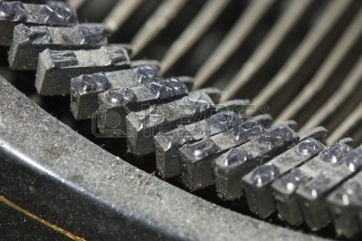
The blogging researcher: social value, opportunities, challenges
AMVA4NewPhysics Scientific Kick-Off – March 3rd 2016
Tommaso Dorigo
INFN, Sezione di Padova

Slide 2
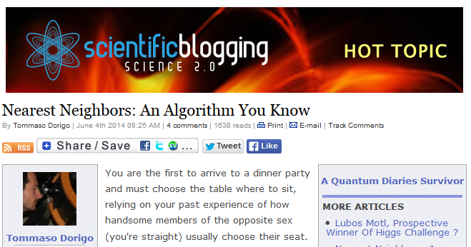
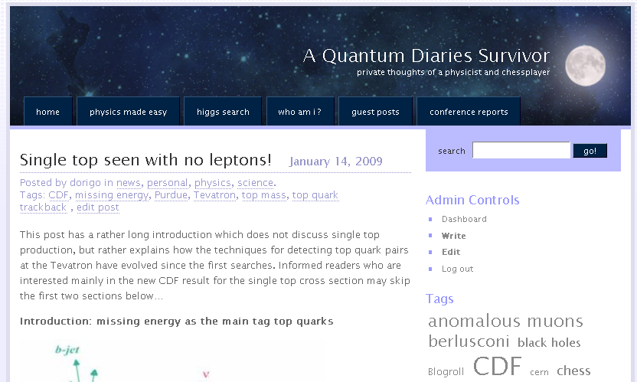
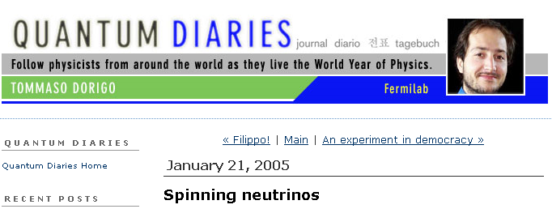
Personal blogging history
In 2005 (International year of Physics) I was asked along with 25 other researchers to blog for a project called "Quantum Diaries"
Since 2006 I moved to a personal blog on the wordpress platform, “A Quantum Diaries Survivor”, where I speak about my job and I do science outreach, explaining particle physics to attentive but unarmed readers
The blog moved to a bigger container (Science20) in 2009. The blog contains overall about 2000 posts and receives over 1,000,000 visits per year
In 11 years of career as a science blogger I experienced in person the pros and cons of blogging activities for a research scientist
I would like to propagate some of that information
to you here today, hopefully as an incentive

Slide 3
Contents
0) Introduction: the instrument
  microstory of blogging
  tools
1) Social value
  Science popularization and the fight of pseudoscience
  Reduction of the gap between hard science and the public
  Justifying investments in science
2) Opportunities
  Interactions with colleagues, growth of one's work connections
  Cultural enrichment
  Visibility gains
3) Challenges
  Popularization of one's research
  Serious publishing opportunities
4) Problems
  Frictions with collaborators, damage to one's career
  Libel causes and other issues
5) A few tips

Slide 4
What is a blog
A blog is a web site designed for periodic updating with hypertexts and other media (pictures, videos) on a topic of interest of the owner
The site allows readers to discuss in a suitable "comments thread" every article, and to interact with the author and with other readers
It is a versatile instrument, allowing a horizontal communication means between author and users
It lends itself to be configured as a “live journal” if many authors cooperate to produce articles
The material can usually be of personal nature and of exclusive choice of the author/s. This has engagement power.

Slide 5
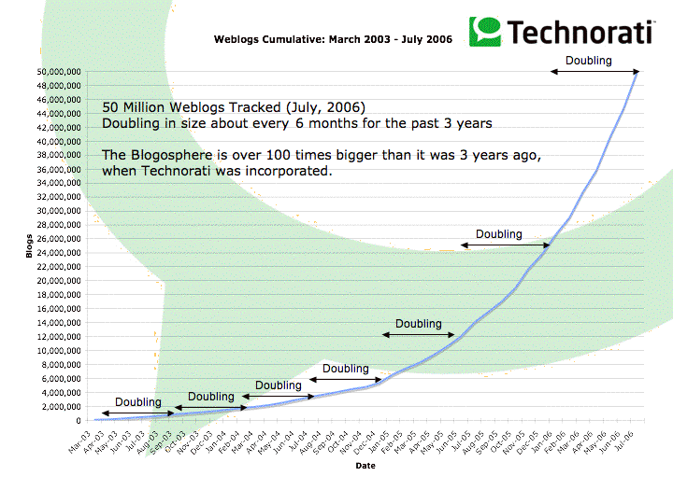
How did we get here?
Blogs exist in the form we know today since about 15 years.
Before them there were usenet newsgroups, online diaries, personal web pages periodically updated with "what's new" sections, “zines”, etc...
Blogs became an explosive phenomenon since 2002
    People like to write about themselves, about what they do, what they consider themselves experts on, and to express opinions
    Forums are okay, but feeling "moderated" pushed many toward opening their own personal discussion sites
    Internet came to the help providing simple platforms for these activities
    The constant increase in internet usage caused a constant increase of local traffic in every site, motivating bloggers to continue writing
    A blog answers different needs with respect to other communications means like Facebook, Twitter, Instagram, Myspace….

Slide 6

The Influence of Blogs
  In 2002 the influence of blogs starts to be felt – a telling example is American politics
  Trent Lott is forced to resign from leader of Senate majority after blogs point out his support to segregationist ideas of Thurmond
  (see http://drmatthewashton.com/2011/02/11/great-mistakes-in-politics-no13-trent-lott-praises-strom-thurmond/ )
    In 2004 Dan Rather in “60 minutes” shows false documents on GW Bush activity in the National Guard, and is proven false by pundits on their blogs
In the last 10 years blogs have become impossible to ignore for the distribution of information and the shaping of opinions, for comments, insight…
In Italy we can cite Beppe Grillo's blog, which became the second (or first) political party, M5S

Slide 7
Technology of blogs: interfaces and tools
Initially who wanted to publish on the web had to write html code from scratch
Soon a large number of products – usually free – made the creation of blogs a matter of minutes: Typepad, Wordpress, Blogger, LiveJournal...
Communication requires visibility – this can be addressed by aggregators, reddit, syndication, blogrolls, trackbacks, permalinks, blog search engines...
Bloggers want to be read, and want to trace how many readers they have and where they come from: hence statistics and information on readership became important features of the services offered
  Technorati and later other sites offer "rating" for blogs, based on traffic and number and quality of links that blogs receive, with techniques similar to those used by scientific articles metrology

Slide 8
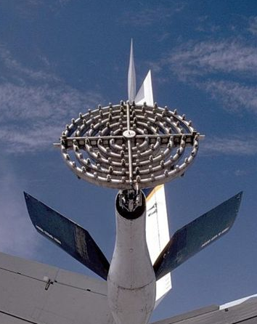

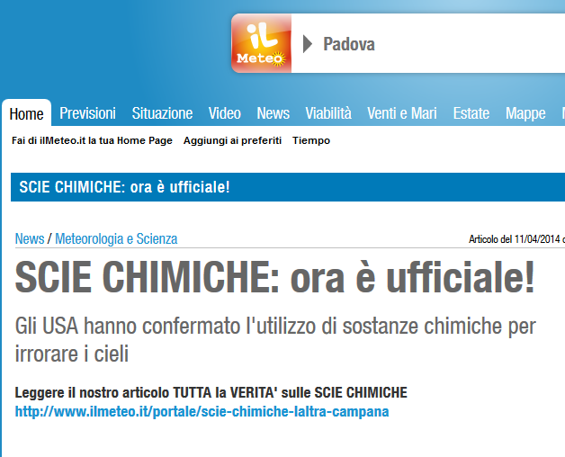
Why to blog ? The social value
To a researcher the production of popularization texts in the net may look like a waste of time or even a harmful activity. However the social value of the popularization and dissemination of science must not be underrated
One must note that the diffusion of knowledge has moved to the web in the last 20 years – the Encyclopaedia Britannica is now dwarfed by wikipedia
Information on the web is usually fragmentary, potentially incorrect, and subject to exploitation
Internet favoured enormously the diffusion of pseudoscience. One may cite hundreds of false myths, some of them of colossal nature (eg. Chemical trails). These may become easy instruments to control minds and shape opinions, also with political goals
It is then clear the need of a common effort to counter these trends and occupy the net with correct and useful information

Slide 9


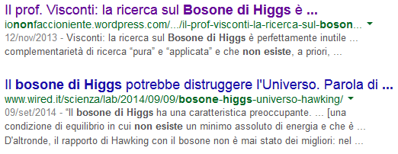

A simple example
The Higgs boson discovery is a colossal success of humanity, and had much resonance also thanks to coordinated efforts of research agents
However if one looks for "Higgs boson" in the net one easily falls prey of sites offering incorrect information, often produced by individuals with an agenda and personal interests, or simply distributing false myths and incorrect claims
Unfortunately the press seconds if not even fosters these tendencies, riding sensationalism, fear, the news for the news' sake

Slide 10
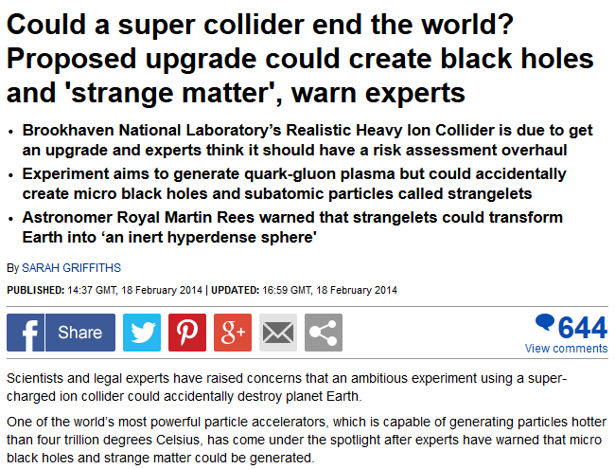

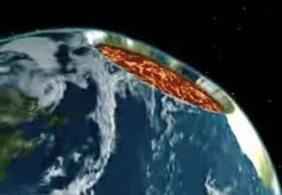
Another one: the end-of-the-world machine
Before LHC started, a media attack forced CERN to take legal action, containment measures, dedicated studies (Mangano and Giddings)
The question was if it was possible to create black holes that would later grow and eat out the Earth
The diffusion of this fear caused serious damage. Ignorance generates fear and loss of trust in science must be countered. If not you, who ?
We cannot claim that this is not our job but the official media – this would be very short-sighted. We need a more capillary action

Slide 11
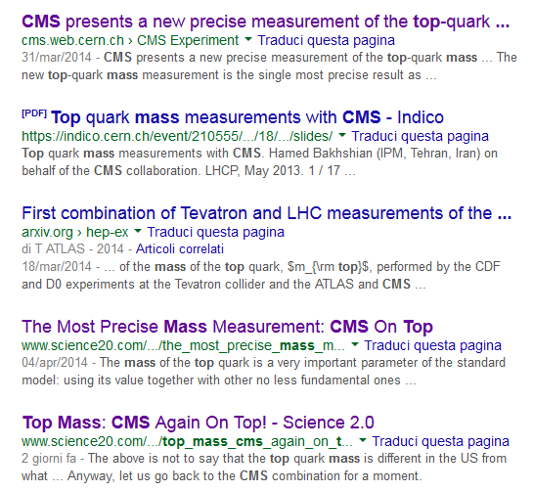
Competing for the first page on search engines
The way to fight pseudoscience diffusion is to publish correct, visible information on the web
But how ? And who ?
Who does research has the moral obligation to take part, as a keeper of insider knowledge on the topic, authoritative and credible
Can a researcher compete with official news channels, newspapers, paid outreach ? Yes.
One example: some time ago if you looked for "top mass CMS" two links among the first five were to my blog

Slide 12
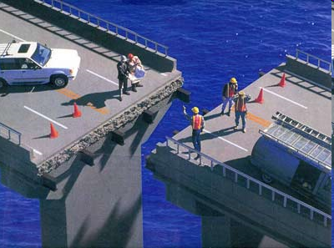
Bridging the gap
A serious problem of science communication is the lack of a direct, two-way channel between who does research and the public at large
The "publish or perish" rule forces us to publish on high-IF scientific magazines, omitting outreach
A gap results as there is nothing between JHEP and information that reaches the non-proactive public: there is a dearth of channels to distribute correct science information, and what's worse, there is no way to get feedback and change wrong ideas
Serious blogging activities are but a band-aid on a dying body so far. Yet a small percentage of scientists have understood that part of their work must consist in offering to laymen a communication channel allowing the distribution of the idea of why their research is useful to society

Slide 13
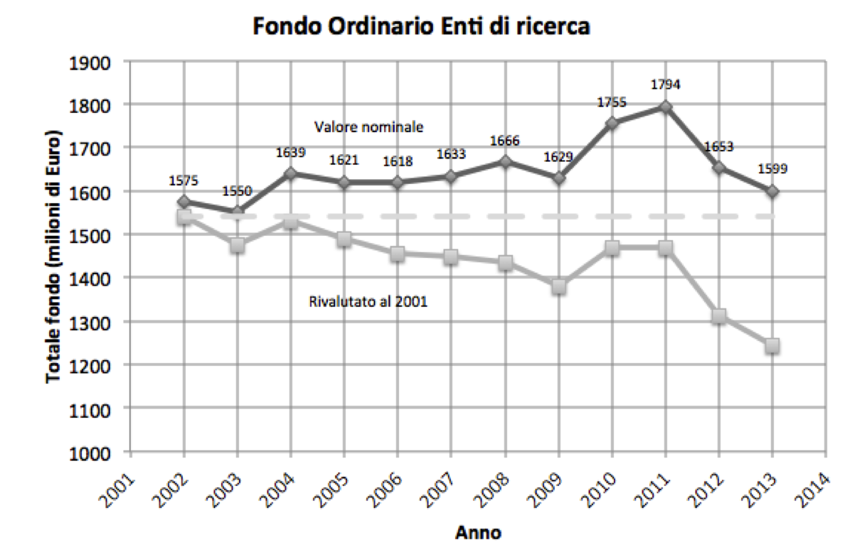
Why funding research ?
The reduction of funding to scientific research is not only a tendency: it is a fact
The less important basic research is perceived by citizens, the more governments will cut it – can you blame them ?????? Blame yourself instead, as you managed to create a consensus against the importance of what you do
To counter these phenomena we must go to the roots. Trying to convince politicians of the important of basic research is a faulty strategy.
LHC cost 7 Gigaeuro. Newspapers feed this info to the people and you get the response: my taxes could decrease if we did not spend money for these gadgets. Newspapers have no interest in remarking that the sum is actually quite modest (e.g. smaller than the amount spent yearly in Italy to pay healers, crooks and tarot readers)

Slide 14
Opportunities
Blogging involves writing on research topics belonging to one's personal interests – it should not cost too much effort
Writing of one's work with a wide target of readership (laypersons with no ex-ante knowledge) brings to interact with the public, but also sometimes with scientists from different areas of research
In my personal case I soon discovered that my blog, dealing with HEP results, was being read by theorists, as well as colleagues from other fields of physics
  This allowed me to build ties with colleagues I would otherwise not have met
  In some cases this brought to new collaborations and working opportunities
  In other cases I got direct help for my own research
  Today if I have a problem I can't solve, or I seek a reference, or have a nagging theory question, I go to my blog and formulate the issue, and I get an answer, usually exhaustive and to the point – in no time

Slide 15
Cultural enrichment
The blog is a tyrant: once you start it is hard to stop, as you build a readership to whom you feel you owe some reading material day by day
This leads you to increase your attention to what goes on around and stay informed.
The interaction with other bloggers on hot topics brings you to deepen your understanding.
It is obviously time-consuming, but it is also an enrichment of one's knowledge base that is otherwise hard to foster
In addition, writing on scientific topics requires you to "digest" the matter (you can’t explain something to your grandma unless you’ve really understood it). The process is a growtho of one's knowledge through asking yourself questions such as "how can I explain this to somebody who does not know QM?" or "what analogy can I find to make this phenomenon intuitive?"

Slide 16
Other benefits
A blog allows the researcher a chance to publish ideas, results, studies without the need to go through peer review. Of course this is limited in scope and should not be misused (see what we said about garbage on the web) but it has a very clear use case inasmuch as it allows one to expose one's ideas to the world without screens, when one can easily create interactions with other researchers interested in the matter under study
Writing on one's published works, explaining them to the public, has the benefit of increasing the pool of readers of one's true scientific production, increasing citations.
Writing about science and being identified as a trustable source attracts media attention. This cuts both ways if you are a member of a scientific collaboration, as I will explain later
A well-visited blog may generate income
It will also generate invitations, job offers, etcetera
Finally, becoming a recognized blogger may be a door to the world of publishing

Slide 17
Reasons NOT to blog
Obviously there is a dark side to blogging for a researcher
  Writing good pieces (and interacting with readers) requires time, so blogging usually fights our usually overcrowded agendas
  The time spent will be perceived by obtuse colleagues as a waste. This perception can and will damage your career, if you don't pay attention to clarify that it is your free time that goes into it.
  Scripta manent – at times you'll write stupid things and you will be nailed by the censor on shift
  Colleagues may not appreciate the way the content is presented; they may resent not having been cited for their contribution to the discussed research topic; or they may resent being cited (of all the above I have ample experience, of course).

Slide 18
Nocuous interactions
  Popularity and success of a blog may lead to the envy of those colleagues who are not immune to this kind of feeling
    They may not accept that the blogger is interviewed, quoted by newspapers, contacted by journalists in place of the spokesperson of the experiment
    They may resent that the blog allows the owner to comment in public results of their experiment before they themselves have a chance to do so at a conference
  The researcher who blogs may be also accused to be "speaking on behalf of the collaboration" without a specific endorsement to do so. Disclaimers of liability are of little use. As much as one fights for one's right of speech, the battle is lost from the start. It appears that members of collaborations have fewer rights than other people…

Slide 19
The threat of “bad press”
HEP blogs have grown to be perceived as a threat by large scientific collaborations (much of the responsibility for that reaction is mine) as their inertia in publishing results exposes them to the risk of seeing their results manipulated
In the end what worries scientific collaborations the most is the output on science pop magazines and newspapers, the direct means of communication with funding agents (especially in the US) and opinion-makers
I grew up in the CDF experiment (Fermilab, Chicago) where this was a very sensitive issue. What burned CDF staff's fingers was a 1993 episode, an article on the New York Times by Malcolm Browne titled “315 Physicists Report Failure in Search for Supersymmetry”
What was it about ?

Slide 20
315 Physicists Report Failure in Search for Supersymmetry
“[...] despite this arsenal of brains and technological brawn assembled at the Fermilab accelerator laboratory, the participants have failed to find their quarry, a disagreeable reminder that as science gets harder, even Herculean efforts do not guarantee success.” [...]
“Some regard such failures as proof that high-energy physics, one of the biggest avenues of big science, is fast approaching a dead end.” [...]
“Failed experiments of such a grandiose scale offer easy marks to critics who contend that "big science" produces too meager a crop of knowledge for what it costs.” [...]
“all these projects soak up more human talent and more public money than society should permit, skeptics argue.”
9 months afterwards, the SSC was canceled.

Slide 21
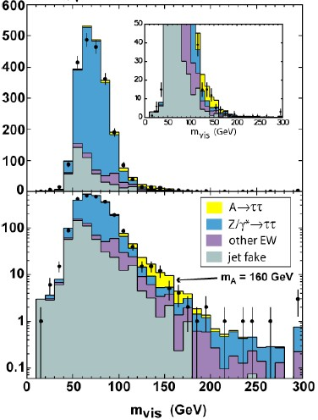
The perfectible communication flow between exp’ts and science magazines
Another “storm in a glass” was initiated by myself and a fellow blogger in February 2007.
The CDF collaboration, operating a particle physics experiment at the Fermilab Tevatron collider, produced a 2-standard deviations signal of a supersymmetric Higgs boson
Blogs discussed the matter in a bit more detail than some collaborators would have felt comfortable with, and got media attention.
There followed interviews and mis-reported pieces on New Scientist and The Economist. Some in CDF resented that, feeling disowned of a direct communication channel with their funding agencies.
As a direct consequence, CDF redacted “blogging rules” for its collaborators. Later CMS imported them

Slide 22
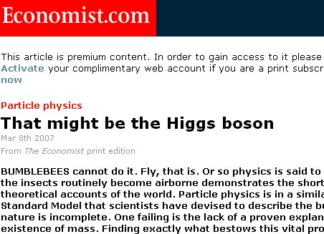
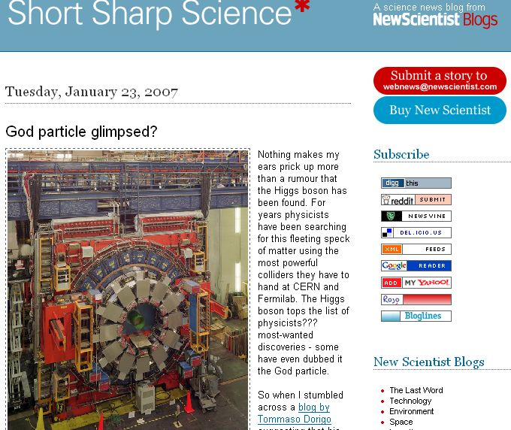
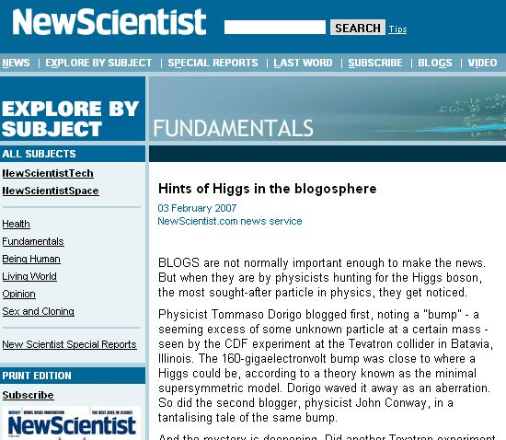
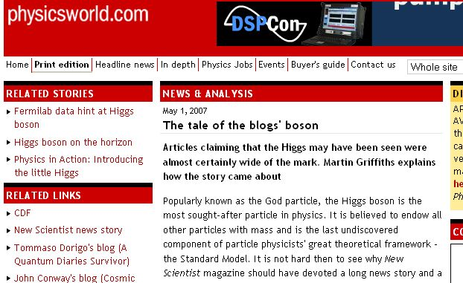

Slide 23
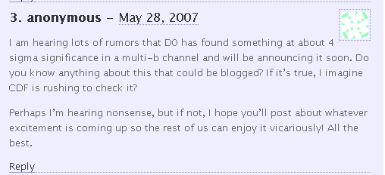
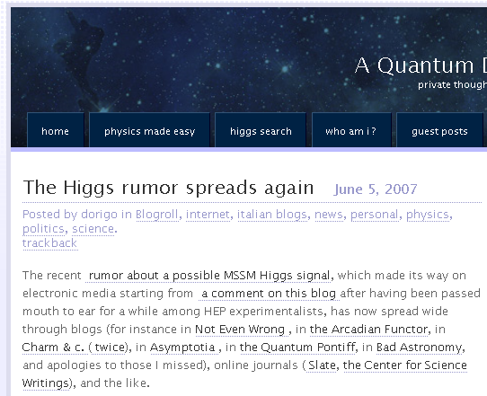
The multi-B MSSM Higgs signal by DZERO, circa 2007
In May 2007, news leaked about a preliminary result from DZERO, which could be the first observation of a supersymmetric Higgs boson
It leaked through an anonymous comment in my blog
I discussed freely the fact in a post, pointing out its highly dubious nature but also explaining the possible implications...
There followed some media hype
DZERO wasn’t happy at all
Eventually they did not publish the effect –it was not a real signal- and people forgot about it
IMHO nobody was hurt ...
But this showed the weakness of the system
Note that if the leak had gone directly to a science journalist, the outcome could have been different – in this sense I could rightly be criticized for my decision to run the story
My stand: these are wonderful occasions to capture readers and teach them science, and to provide readers with the same kind of sceptical vision we as scientists have in our genes

Slide 24
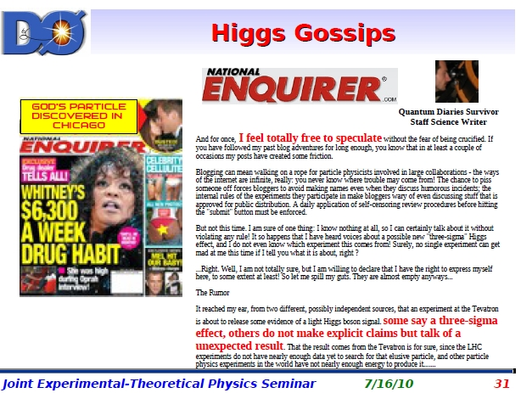

In 2010 a similar thing happened, and Marco Verzocchi likened me to the National Enquirer

Slide 25
A few tips on communicating science through a blog
I wish to finish this talk with a few bits of wisdom on how to write scientifici pieces on the web – be it on a blog or on a web site of a science pop magazine, or a research institute's site
  Writing on paper is entirely different, and undergoes different rules
I expect my "tips" are well-known or trivial, but it is worthwhile to spend 5' on a quick-and-dirty list of what I learned in 11 years of blogging, 2000 articles, 8M hits.

Slide 26
The title
The title of an online piece is possibly more important than the one of a print article
  Often it becomes part of the url → it is visible in searches
  It appears in aggregators, so the content of the title becomes important to get clicks from intrigued readers
  Alas – sensationalism thus pays even more dividends in online media
The question of whether sensationalist titles belong or not to correct scientific journalism is a tough one
I am pragmatic: what works must be used, if pros outweigh cons
  Sensitivity may vary on what can be considered an acceptable distortion of the real content of a piece
  Typical example: I itch at “Einstein was wrong!” for OPERA superluminal neutrinos; yet “An exception to special relativity?" may do
  Another example: “The Universe might be unstable" is ok for me, but “The Higgs boson might destroy the universe" becomes crackpottish
  The question is: how much do we accept to deform information in the title, to patch it up in the body of a piece and make it visible ?
IMHO: A slightly deceiving title is not a mortal sin if it increasses the reached readers who later find the content interesting and informative

Slide 27
  Writing style, layout, images, and the five lines rule
  Readers' attention online is a volatile commodity. Be concise and direct: the first 10 lines of your piece must give the reader a reason to read the rest
    This by itself kills two thirds of my favourite incipits: historical introductions, technicalities, jargon, "today I woke up and I thought about this…" are a no-no
    Begin with a light story can instead be a good idea, if it hits the right chords. But mind to create expectations and suspence!
    Another good way to start is to ask the reader a question, writing in second person. This has proven engaging power
    Remember that the name of the game is to get your readers as far down your piece as possible. This implies that the technical level of the post should be a monotonously increasing function. Leave the details for the three readers who reach the end of the piece!
    Use links sparingly! Lest your readers will fly away. Many columnists choose to put all references and links at the bottom, for this reason.
      If you really need a link, make it an "open in new page" one – readers will have a better chance to come back to your piece at the end of the digression

Slide 28
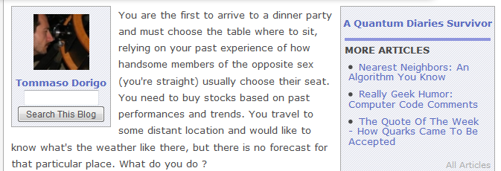
Layout
Make the layout as relaxing and easy to read as possible, as you have to do with a bunch of challenged lazy bums who will soon lose their patience if they lose track of the line of text they're reading
  Choose a nice font, big enough and with not too tightly packed letters. Use a generous interline spacing
  Do not use every square inch of space. Do not right-justify!!
  Break the text in sections if the text is long, and choose subtitles appropriate and catching subtitles (in boldface). This gives a chance of seeing the interesting part is coming to bored readers who start fiddling with the scrollbar

Slide 29
The five lines rule
Each of us has his or her line of conduct on how to break paragraphs
I have mine, grown out of the feedback of 11 years of blogging
Ideally paragraphs should be 5 lines long.
Here's why.
  Shorter paragraphs fragment the text too much
  Longer paragraphs tend to bore readers and make their reading tougher
  Visually it is not attractive to start a 12 lines long paragraph, and it will be hard to read it fast
  A 5 lines paragraph can be "absorbed" at a glance. The reader captures the essence of what is contained and decides whether to skip it or read it in full; a longer paragraph does not lend itself to this quick evaluation, and many distracted readers get lost
  You cannot say it in 5 lines ? And twitter then ? Try harder – do not leave the effort on the shoulders of your readers: make their job easier!

Slide 30
Lower the level or strive for correctness at all costs ?
A very important choice in communicating a scientific news is the choice of how much detail to give
  This needs not be constant throughout the piece
There are definite advantages in over-simplification: higher readability; readers think they got it and they get a gratification
Of course this causes trivializations and inaccuracy. It is a "necessary evil" to keep under control
My take: lowering the level is okay, if the reader is made aware of the simplification, and if an alternative is offered to those who can take it (e.g. at the bottom of the article…)

Slide 31
Engaging readers
Be personal – people who start reading your pieces on a regular basis will be interested to know you personally, so if you offer them some information about your own life this will attract a stable readership
Get off the pedestal; admit your ignorance; be horizontal as you discuss in the comments thread. Be one of them when you discuss things other than your specific expertise topic.
Answer *all* meaningful comments – people want to be acknowledged for their contribution to your column
Ask your readers for help; ask opinions. Ask them what they would like to read about.
Visit blogs of colleagues and link good stuff they produce – they will pay you back. Getting linked is a sure way to increase your readership

Slide 32
Conclusions
Scientists – at least those for which writing is not a torture – should blog regularly on their research activities, to help creating a communication channel with taxpayers
Blogging activities can become gratifying and yield advantages, broadening one's professional network and one's competences, and offering working opportunities, and visibility
Blogging can also be dangerous, especially if you are part of a scientific collaboration and you want to remain independent and free thinkers
Blogging is a must in our network as we promised it to the EU and there are two connected deliverables. We get money from doing it, so we need to be serious about it

Slide 33
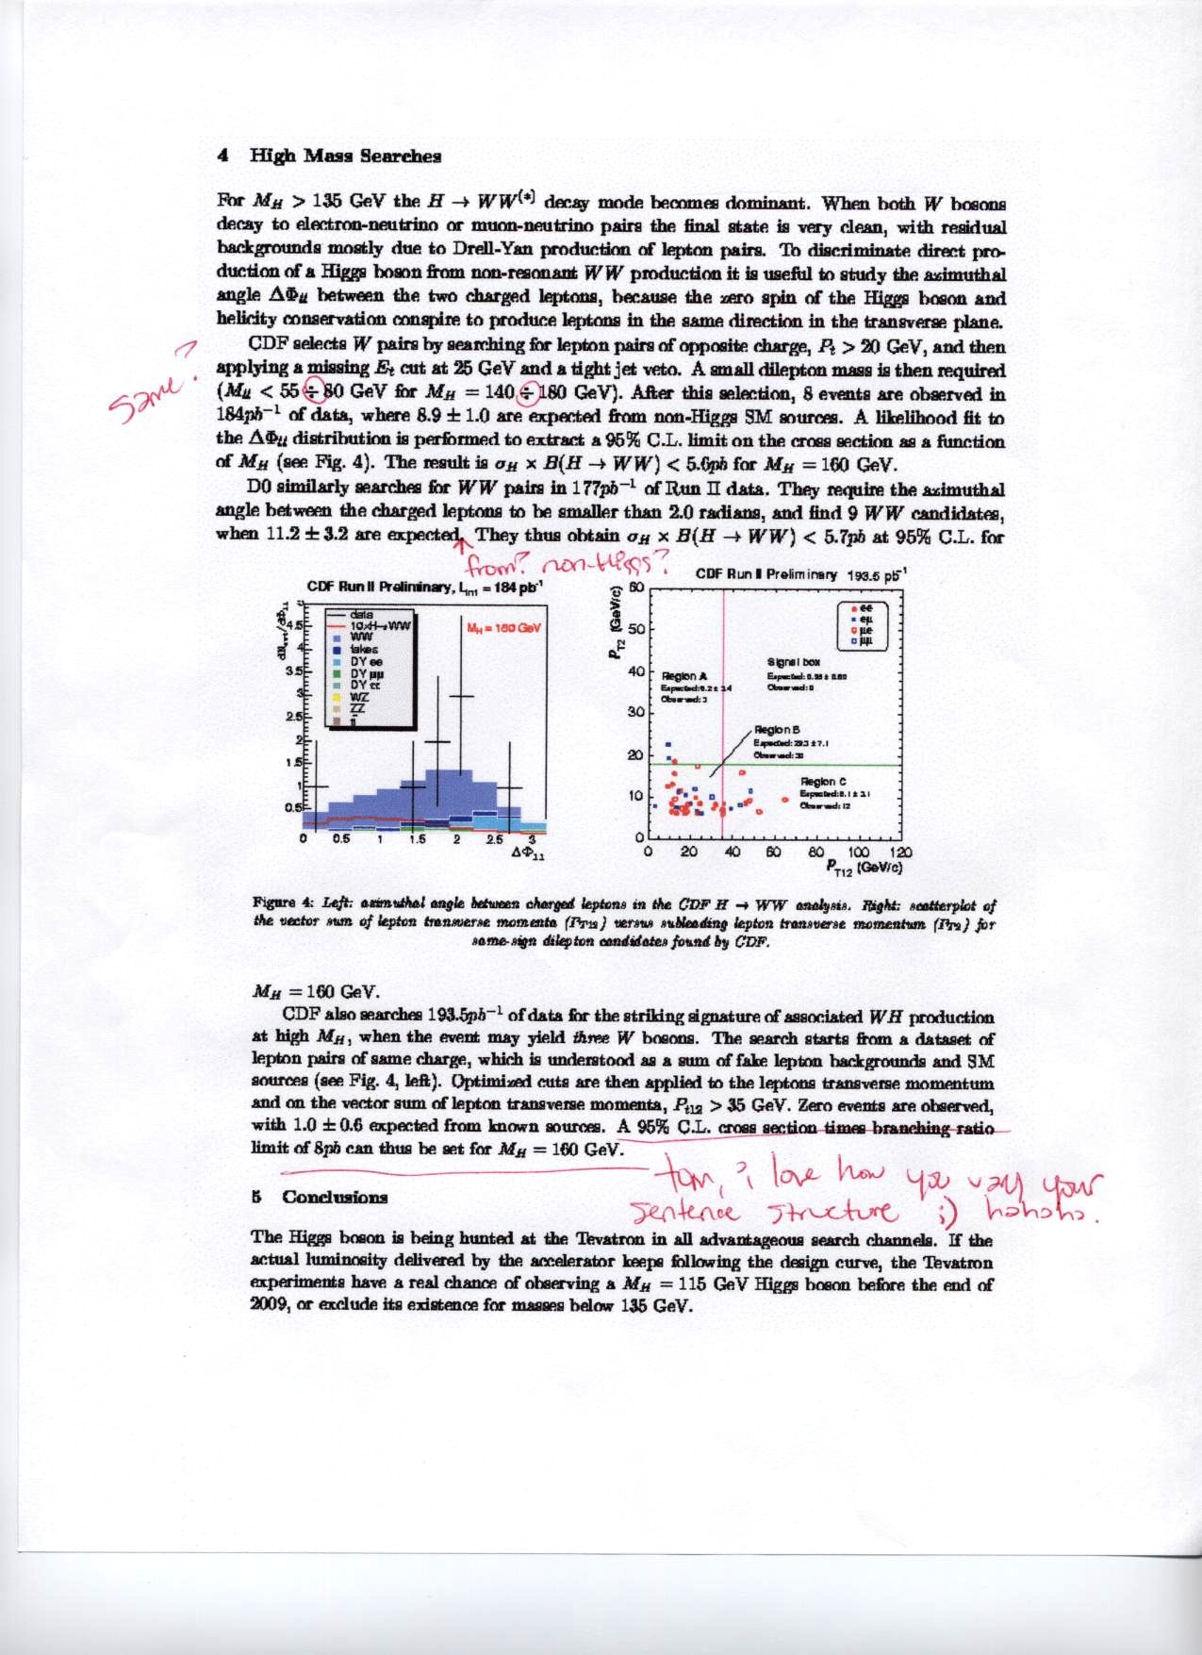
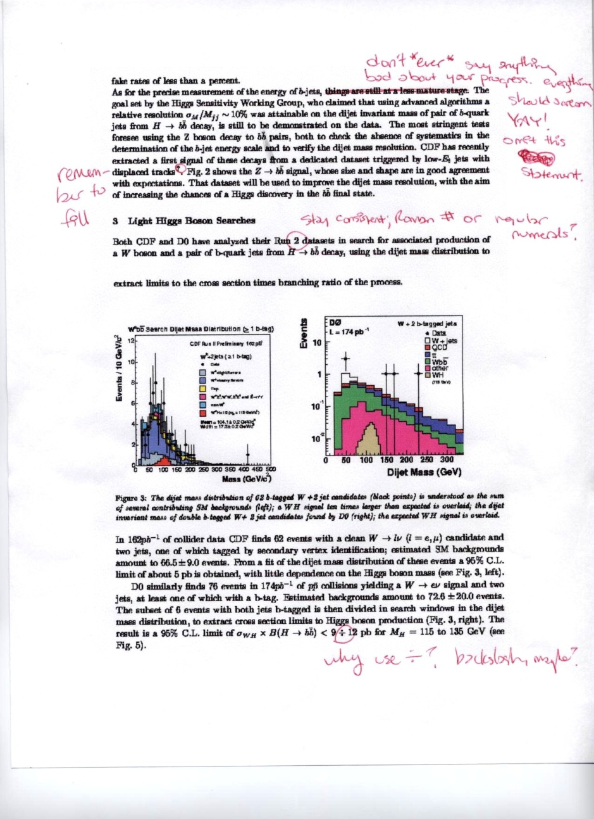
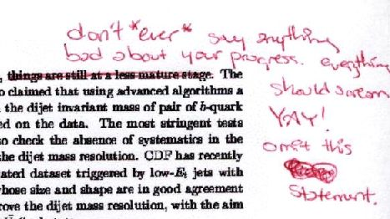
Proofreading del draft di un mio proceedings da parte di un lettore di 14 anni
del mio blog (che ho doverosamente ringraziato negli Acknowledgements)

