Slide 1

Magnet cost model and targets
D. Schoerling, CERN
Maria Durante, Clement Lorin, CEA
Teresa Martinez, Fernando Toral, CIEMAT
April 14th, 2016

Slide 2
Distribution of the work
CERN | CIEMAT | CEA
Coordination Parameter studies Extrapolating of cost from LHC magnet cost Scaling for cos-theta Cost of conductor as a function of magnet design relevant input parameters (Cu/Non-Cu, diameter, etc.) | Analytical model of a “typical” FCC-hh high-field magnet (cost of individual components as a function of magnet size & design) Scaling for common-coil | Assembly cost Scaling for block design

Slide 3
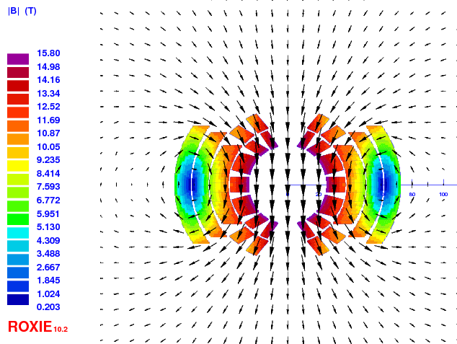
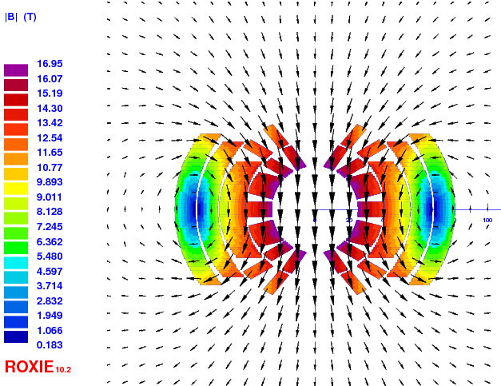
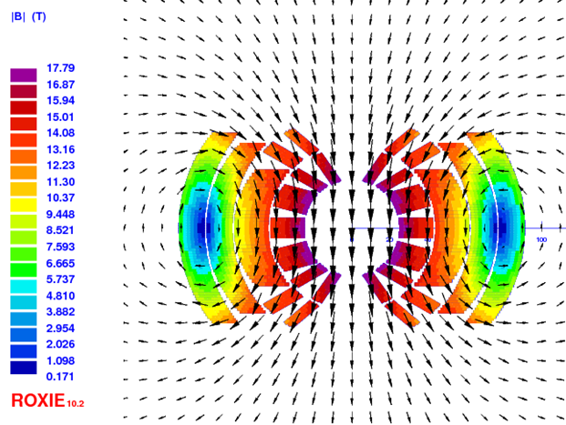
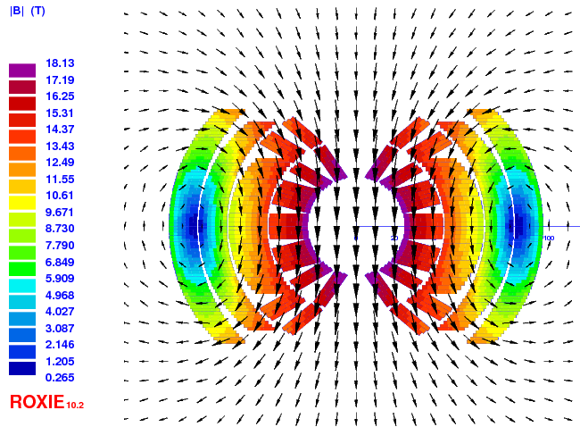
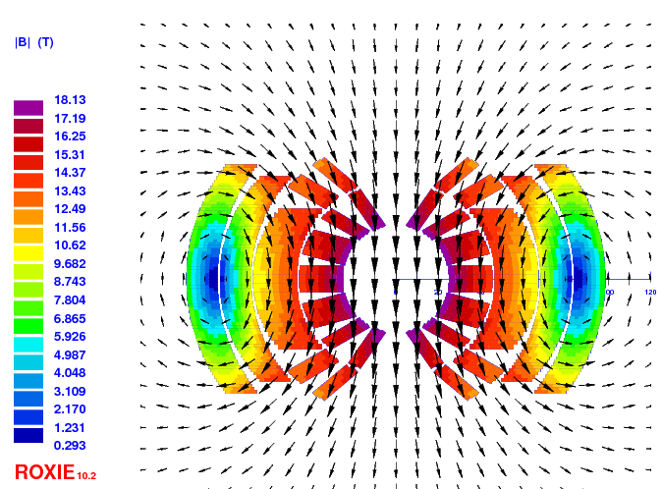
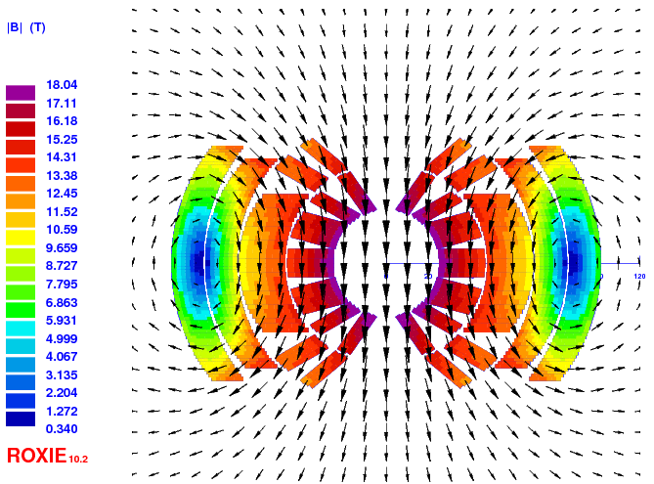
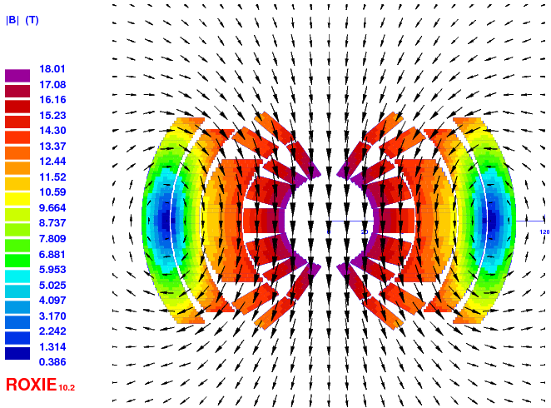
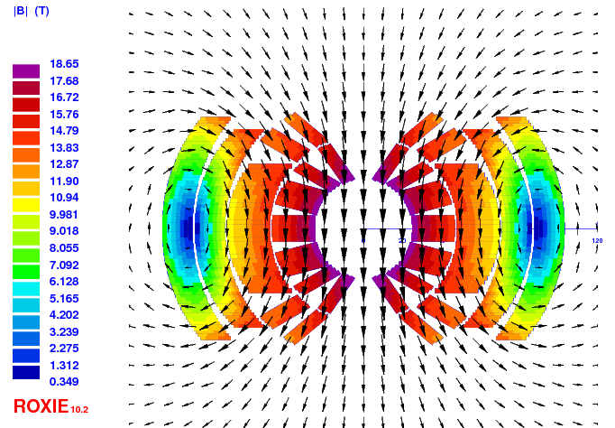
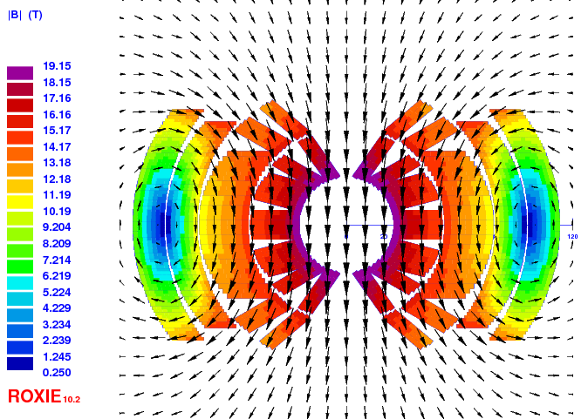
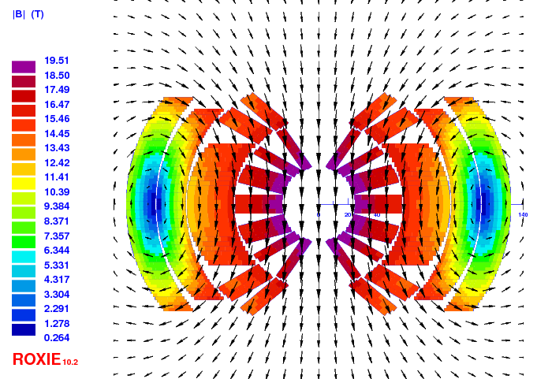
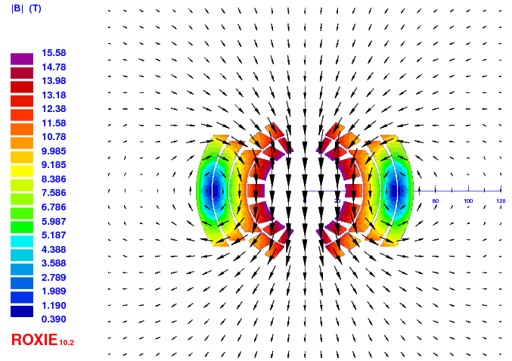
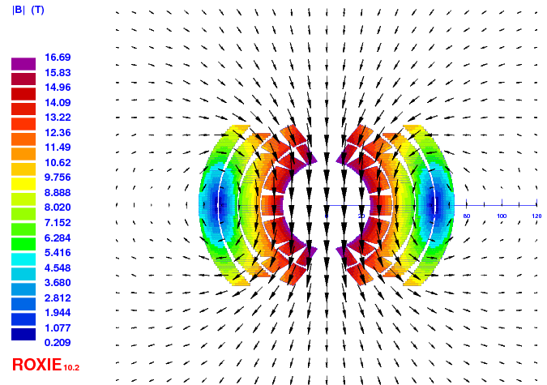
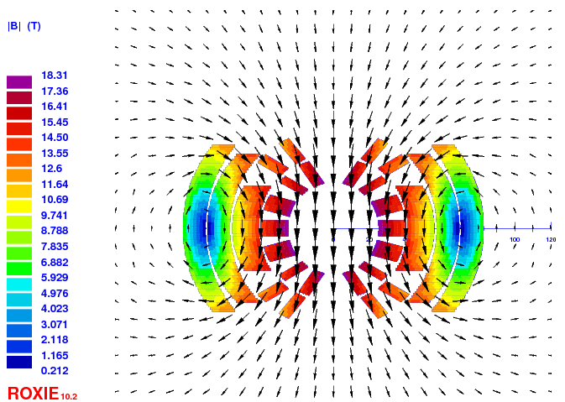
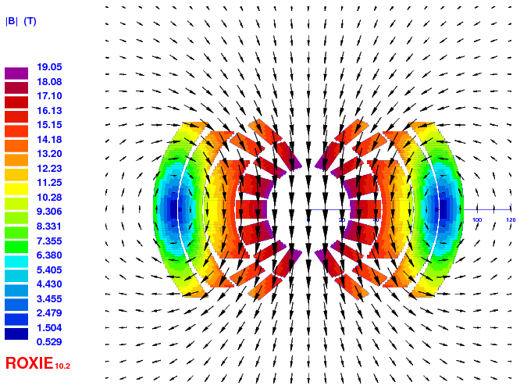
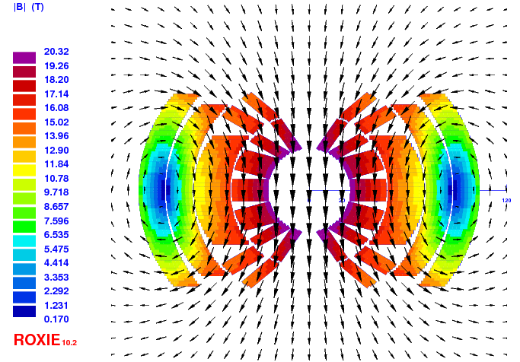
Status
Goal: Provide preliminary estimates of the cost of the dipole magnets as a function of field and temperature based on cross-sections scaled from the EuroCirCol 16 T dipole design and from LHC magnet cost
Reference parameters: 50 mm aperture, 4578 magnets, 14.3 m long, 16 T

Slide 4
Target cost of magnet
Cost of LHC dipole magnet taken as reference and target
LHC dipole cost was around 1 MCHF/dipole, 2000 (around 660 kEUR/dipole, 2000)
The conductor cost was around 200 kEUR/dipole, 2000
Assuming 2% inflation over 16 years for the dipoles one finds 900 kEUR/dipole, 2015
The cost of the LHC dipole without conductor is 630 kEUR/dipole, 2015
Manufacturing process involves more steps due to heat treatment, different insulation technique, etc., but number of units is larger (detailed study started with CEA & CIEMAT).

Slide 5
Target cost of magnet
FUTURE WORK OF CIEMAT, DETAILED DESCRIPTION

Slide 6
Target cost of conductor
Discussion between mass and performance based cost is on-going
Target performance is set to J_{c}(4.2 K, 16 T) = 1500 A/mm²
Mass based cost is calculated from performance based cost with minimum allowed Cu/Non-Cu ratio of 1/1
Due to grading the outer layers require large Cu/Non-Cu ratios
Performance based cost c_{p} | Mass based cost c_{m}
c_{pt} = 5 EUR/kA.m at 4.2 K and 16 T | c_{mt} = 420 EUR/kg
c_{pp} = 10 EUR/kA.m at 4.2 K and 16 T | c_{mp} = 840 EUR/kg
C_{p} = c_{p} x J_{c} x A_{SC} x N x L = c_{m} x 2m_{SC} | C_{m} = c_{m} (A_{SC} + A_{Cu}) x ρ x N x L = c_{m} (m_{SC +} m_{Cu})
J_{c} (4.2 K, 16 T) =1500 A/mm²
A_{SC &} A_{Cu} : Total area of SC and Cu in conductor
m_{SC} m_{Cu}: Total mass of SC and Cu
N = 4578 units
L = 14.3 m : Length of per magnet unit
ρ = 8.96 kg/dm³

Slide 7
Estimate of conductor amount
Assumptions:
Based on EuroCirCol cross-section for 16 T with ~10% margin (without LSELF) at 4.2 K
J_{cu} ≤ 1200 A/mm² (magnet protection at short sample) and Cu/Non-Cu ≥ 1:1(optimized strand production)
Field quality (b₃ ≤ 100 units), non-optimized, no insulation, NOGRAD, LSELF

Slide 8
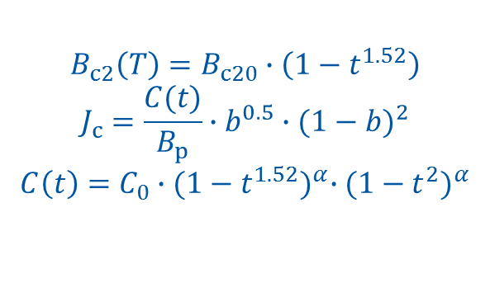
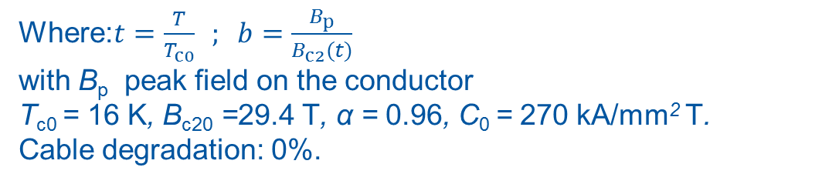
Conductor J_{c}-fit
Fit for the target value of J_{c}(4.2 K, 16 T) = 1500 A/mm²
$$B_{c2}\left(T\right)=B_{c20}∙\left(1−t^{1.52}\right)$$
$$J_{c}=\frac{C(t)}{B_{p}}∙b^{0.5}∙{(1−b)}^{2}$$
$$C\left(t\right)=C_{0}∙{(1−t^{1.52})}^{α}∙{(1−t^{2})}^{α}$$
Where:$t=\frac{T}{T_{c0}} ; b=\frac{B_{p}}{B_{c2}(t)}$
with B_{p} peak field on the conductor
T_{c0} = 16 K, B_{c20} =29.4 T, α = 0.96, C₀ = 270 kA/mm² T.
Cable degradation: 0%.

Slide 9
Conductor amount vs field @ 1.9 K
Conductor amount is sensitive to the operational field and margin!
Common-coil to be added
Conductor amount in kt for cos-θ
 | 15 T | 16 T
10% | 6 | 7
15% | 7 | 9
20% | 9 | 12

Slide 10
Conductor amount vs field @ 4.2 K
Conductor amount is very sensitive to the operational field and margin!
Common-coil to be added
Conductor amount in kt for cos-θ
kt | 15 T | 16 T
10% | 7 | 10
15% | 10 | 16
20% | 15 | >25

Slide 11
Performance vs mass based cost
Considerable difference between mass and performance based design in cost
Performance based cost is calculated on the basis of the SC amount
Ex: For a magnet with an operating field of 16T with 15% of margin the mass based cost model accounts around 2000 t more conductor (~25%): 840-1680 MEUR.
Ex: For a magnet with an operating field of 16T with 10% of margin the mass based cost model accounts around 1500 t more conductor (~15%): 630-1260 MEUR.

Slide 12
Conductor amount vs operating temperature
If we assume the enthalpy margin is meaningful to compare the margin to quench:
  The magnet shall be re-designed because the margin in the outer coil is 15% smaller than in the inner layer (the grading is too aggressive)
  Experience makes it difficult to believe that a magnet with 11.7% at 1.9 K is as reliable as a magnet with a margin of 8.7% at 1.9 K
  If we consider a magnet with 1.9K, 15% margin and 4.2 K, 10% as baseline design (similar amount of conductor) we find that the enthalpy margin at 1.9 K is ~30% larger
4.7 K point to be added (DANIEL)
EuroCirCol reference design
8.1%
8.7%
 | Coil 1 |  | Coil 2
Temperature | LL | MQCE1 | LL | MQCE1
K | % | mJ/cm3 | % | mJ/cm3
1.9 | 17.2 | 16.3 | 16.4 | 13.2
4.2 | 9.1 | 10.9 | 8.7 | 9.2
4.7 | 6.7 | 9.0 | 6.4 | 7.8
14.9%
11.7%
Assumptions: J_{Cu} < 1090 A/mm²

Slide 13
Conductor amount vs aperture
To be done (DANIEL)

Slide 14
Total cost of FCC-hh dipoles
FCC with LHC magnet cost without conductor: 630 kEUR/unit x 4578 unit= 3 GEUR
 | Cable mass, kt | SC mass, kt
15 T, 4.2 K, 10% | 7 | 3
15 T, 1.9 K, 15% | 7 | 3
16 T, 4.2 K, 10% | 10 | 4
16 T, 1.9 K, 15% | 10 | 4
Total cost, GEUR | 15 T | 16 T
C_{mt} with 420 EUR/kg | 6 | 7
C_{mp} with 840 EUR/kg | 9 | 11
C_{pt} with 5 EUR/kA.m | 4 | 6
C_{pp} with 10 EUR/kA.m | 6 | 10

Slide 15
Total cost of HE-LHC dipoles
Total cost, GEUR | 15 T | 16 T
C_{mt} with 420 EUR/kg | 1.6 | 1.9
C_{mp} with 840 EUR/kg | 2.4 | 3.1
C_{pt} with 5 EUR/kA.m | 1.2 | 1.7
C_{pp} with 10 EUR/kA.m | 1.5 | 2.6

Slide 16
Conclusion
The difference in cost of operating at 1.9 K or 4.7 K is TBD
Operating at 15 T instead of 16 T represents a cost reduction of ~1-2 GEUR
Difference between cos-θ, block design and common coil is ~1-2 GEUR
Margin is very expensive especially at 4.2 K
  5% (10%->15%) margin at 4.2 K => 40% more conductor cost (~ 3 GEUR)
  5% (15%->20%) margin at 1.9 K => 25% more conductor cost (~ 1.5 GEUR)
Difference between performance and mass based conductor cost is ~1 GEUR

