Slide 1
Bruker Energy & Supercon Technologies (BEST)
BRUKER HTS – EUCARD2 SUMMARY: video-conference
CERN, BHTS March 18th 2016
Notes:
Title picture can be exchanged in the masterslide.

Slide 2

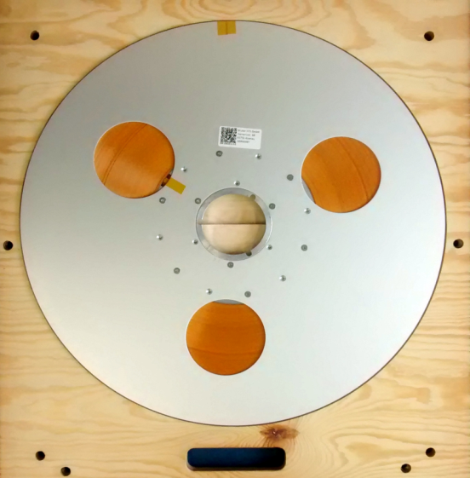
BRUKER HTS
Capabilities of BHTS pilot-lines
BHTS main mission: manufacturing of 2G HTS coated conductors
Two production lines in Alzenau:
  Pilot-line for 4mm wide HTS tapes with the capability to process a max. single piece tape length of 600m
IN OPERATION
  Pilot-line for 12mm wide HTS tapes with the capability to process a max. single piece tape length of 100m
RAMP-UP IN PROGRESS
Comprehensive testing devices for process and quality control of coated conductors
4mm wide HTS tape without insulation
4mm wide HTS tape with insulation on a 20“ reel
CONFIDENTIAL PAGE 2

Slide 3
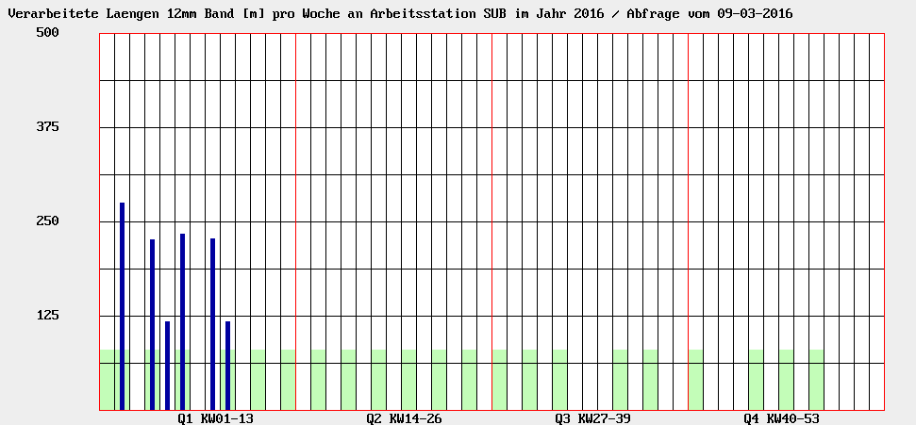
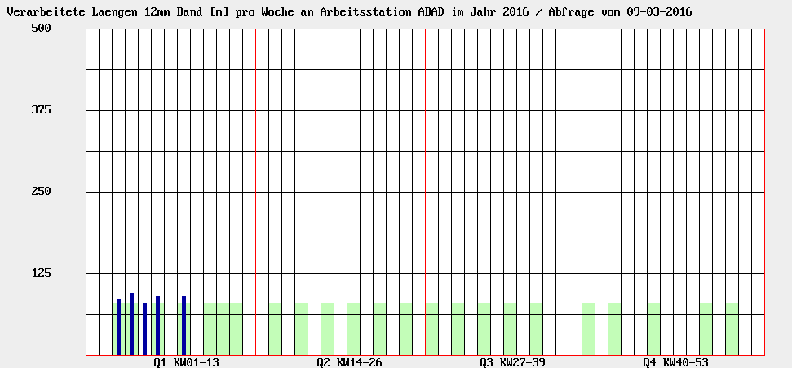
BRUKER HTS
EUCARD2 Summary
A12 pilot-line ramp-up
Starting in Jan 2016 a continuous flow of 12mm wide substrates has been established on the workstations SUB (substrate preparation) and ABAD (YSZ coating)
Several 12mm wide YSZ coated substrates have been quality checked and are now awaiting for being processed on workstation PLD (HTS coating)
SUB
ABAD
Page 3
CONFIDENTIAL PAGE 3

Slide 4
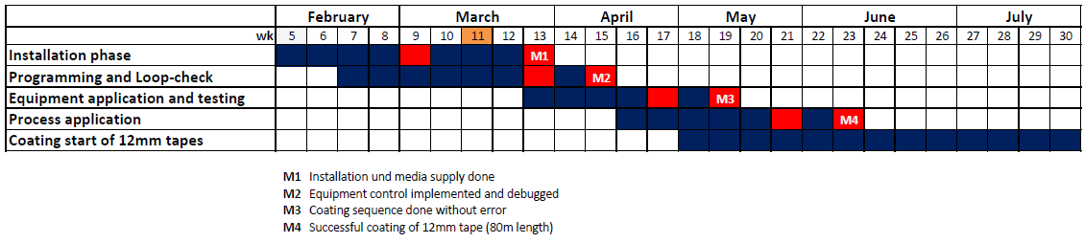
BRUKER HTS
EUCARD2 Summary
A12 pilot-line ramp-up
At workstation PLD the built-up of the PLD300 coater is in progress
  New processing chamber and heater with chopper are intergated in PLD300
  Installation of power feeding, controllers, vacuum and optical adapters is in good progress, nevertheless, installation got interrupted, heater needs to be reworked, target manipulator delivery date postponed to wk12
Milestone M4: first A12 coating done
Page 4
CONFIDENTIAL PAGE 4

Slide 5
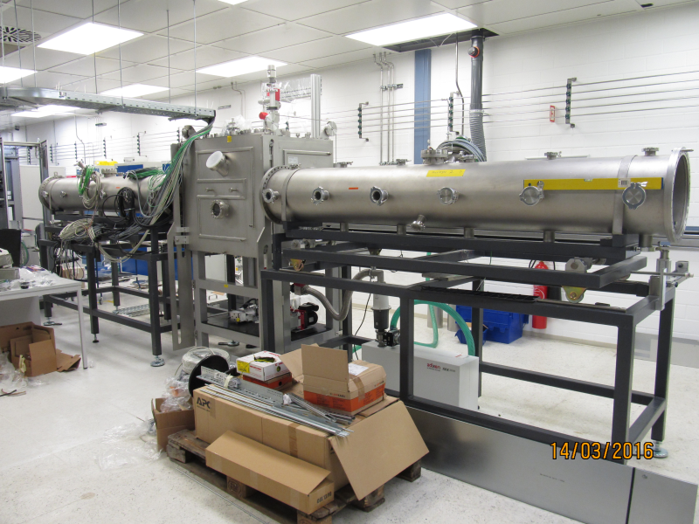
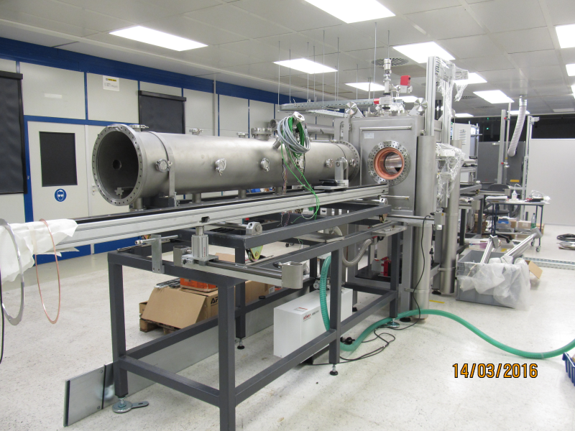
BRUKER HTS
EUCARD2 Summary
A12 pilot-line ramp-up
PLD300 – Installation phase in progress
  Electrical wiring in progress, power ON planned in wk11
  LABVIEW SW control programming in progress
  Connection to media supply and facility installations in progress
Page 5
CONFIDENTIAL PAGE 5

Slide 6
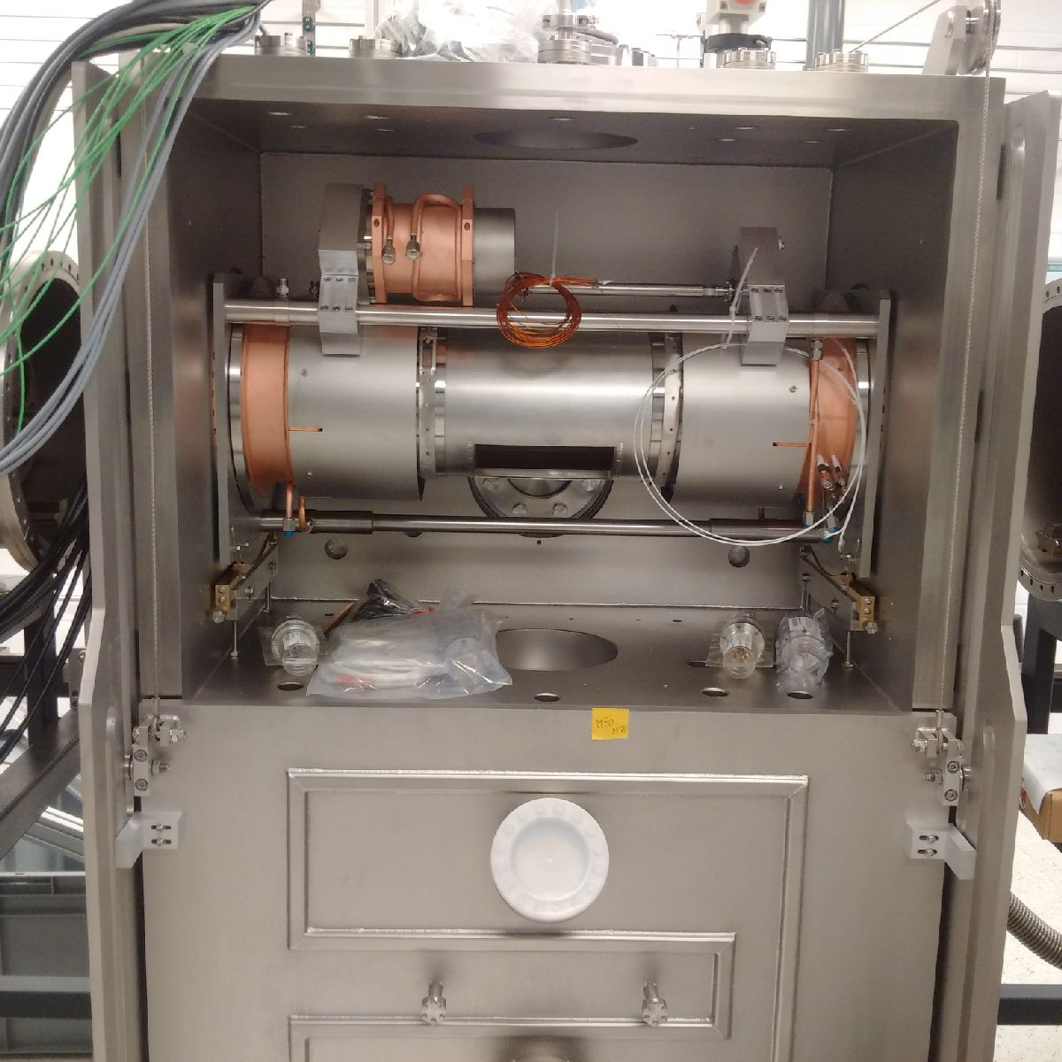
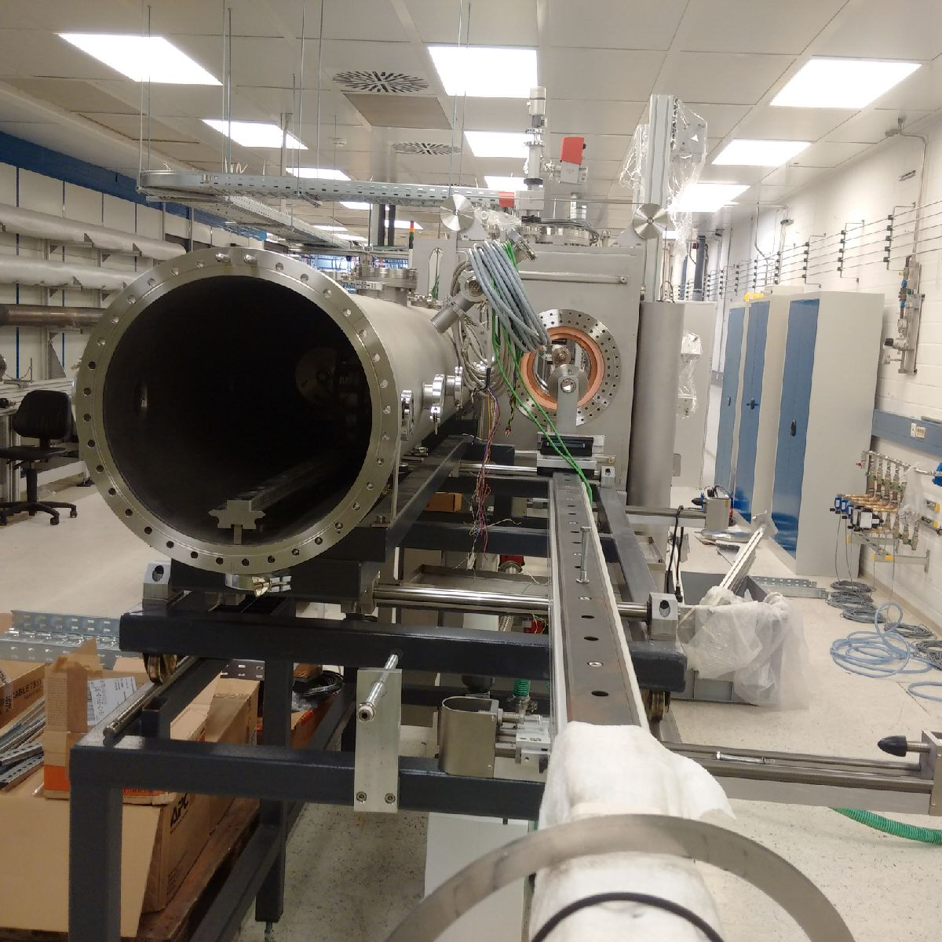
BRUKER HTS
EUCARD2 Summary
A12 pilot-line ramp-up
PLD300 – Installation phase in progress
Page 6
CONFIDENTIAL PAGE 6

Slide 7
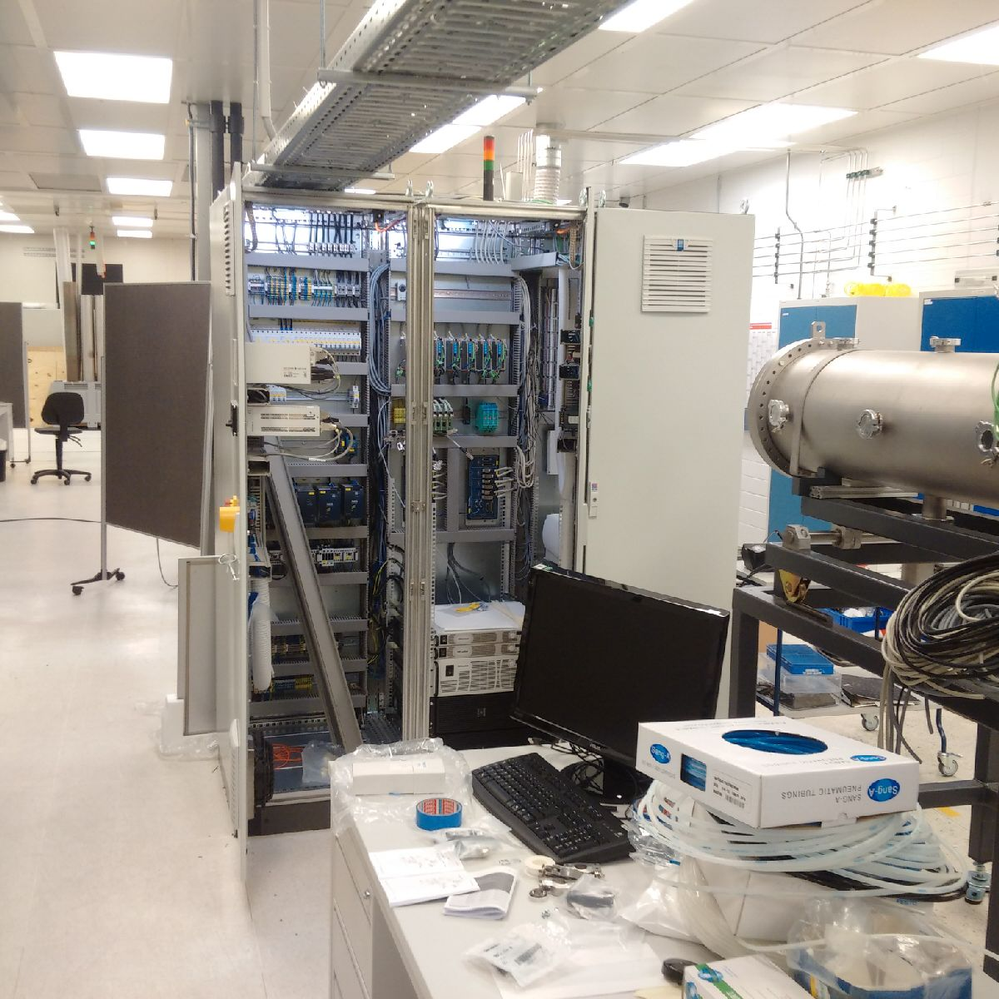
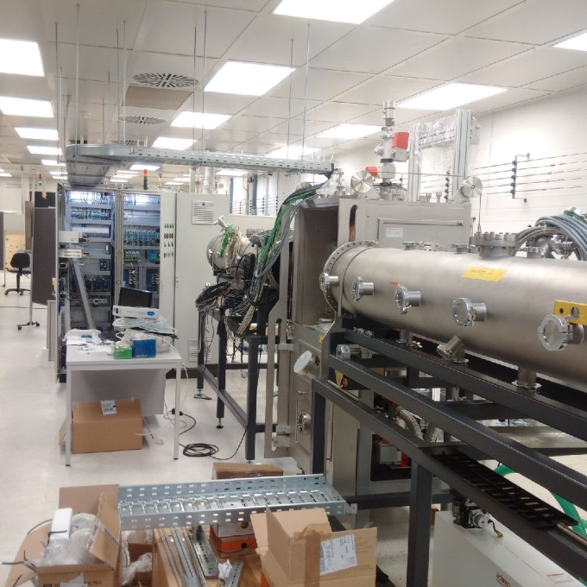
BRUKER HTS
EUCARD2 Summary
A12 pilot-line ramp-up
PLD300 – Installation phase in progress
Page 7
CONFIDENTIAL PAGE 7

Slide 8
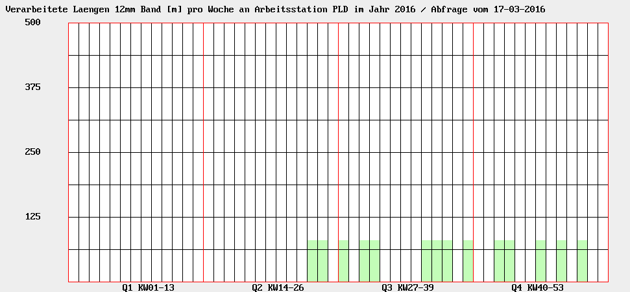
BRUKER HTS
EUCARD2 Summary
A12 pilot-line ramp-up
Due to the late availability of PLD300 a continuous production flow of 12mm tapes can only start from June on
Temporary approach to have 12mm wide tapes available earlier: YSZ coated substrates will be coated with PLD600
PLD
PLD300
Page 8
CONFIDENTIAL PAGE 8

Slide 9
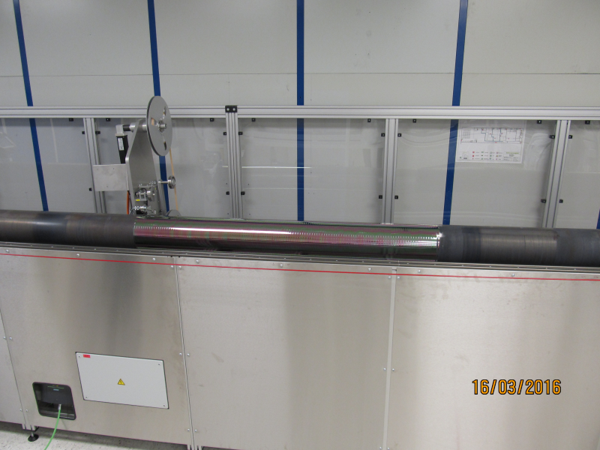
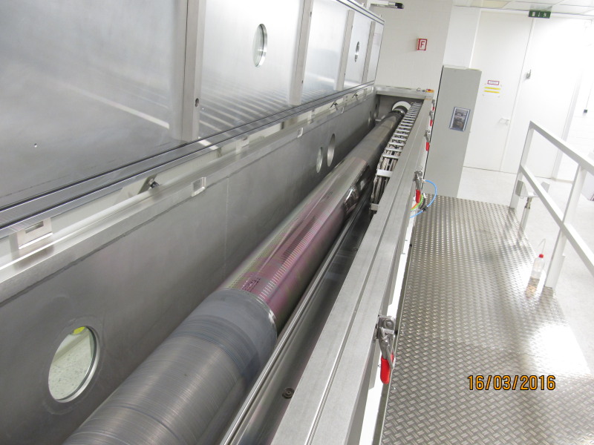
BRUKER HTS
EUCARD2 Summary
A12 pilot-line ramp-up
Temporary approach to have 12mm wide tapes available earlier: YSZ coated substrates will be coated with PLD600
Winding of 80m long 12mm wide tape Substrate drum with 12mm tape loaded
on substrate drum with HEX600 in PLD600 ready for process
Page 9
CONFIDENTIAL PAGE 9

Slide 10
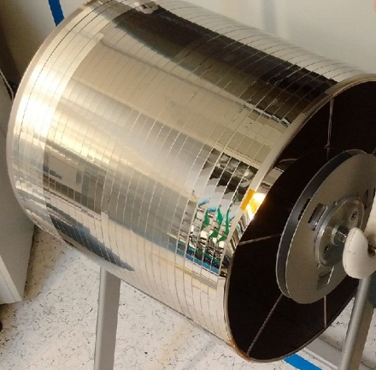
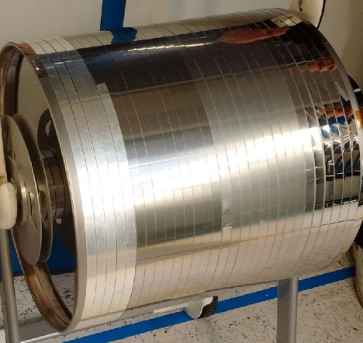
BRUKER HTS
EUCARD2 Summary
A12 pilot-line ramp-up
Ag-metallization: temporary drum solution for 12mm wide tapes
Page 10
CONFIDENTIAL PAGE 10

Slide 11


Innovation with Integrity
Copyright © 2014 Bruker Corporation. All rights reserved. www.bruker.com
Notes:
No pictures on last slide!

