Slide 1

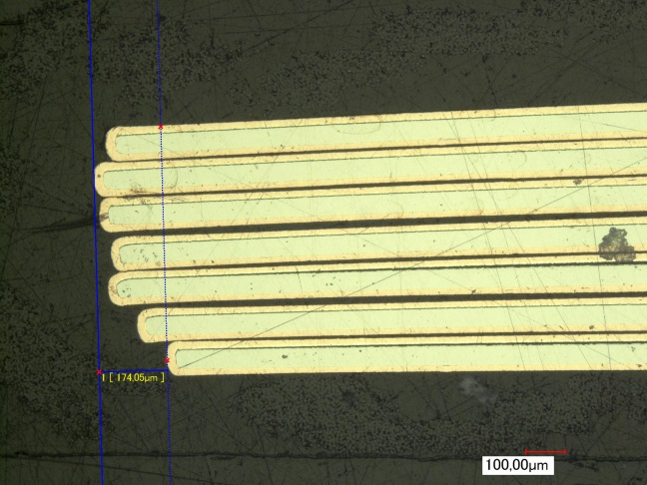
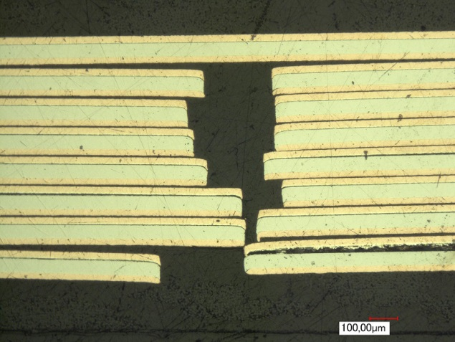
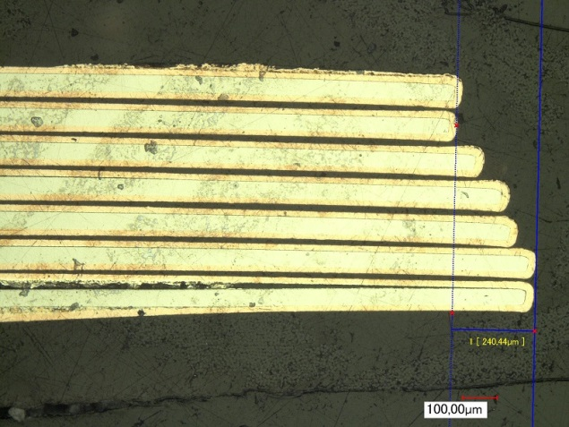
Cable production at KIT
A. Kario, S. Otten, A. Kling, A. Jung, R. Nast, W. Goldacker
Institute for Technical Physics, Karlsruhe Institute of Technology, Karlsruhe

Slide 2
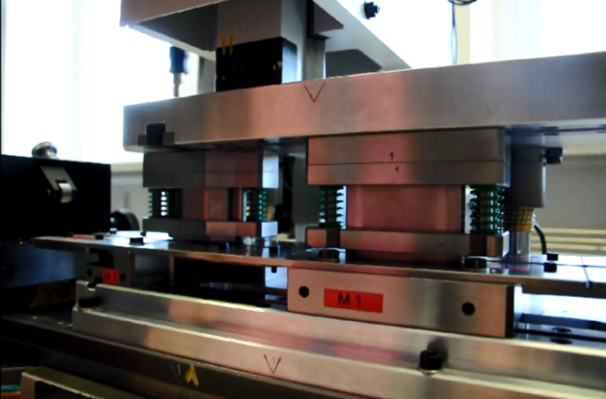
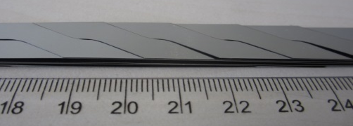
Outline:
Tape material delivered from CERN
Cables/punch material deliveries
Punching tool upgrade
Mechanical test with CEA Saclay
Discussion

Slide 3
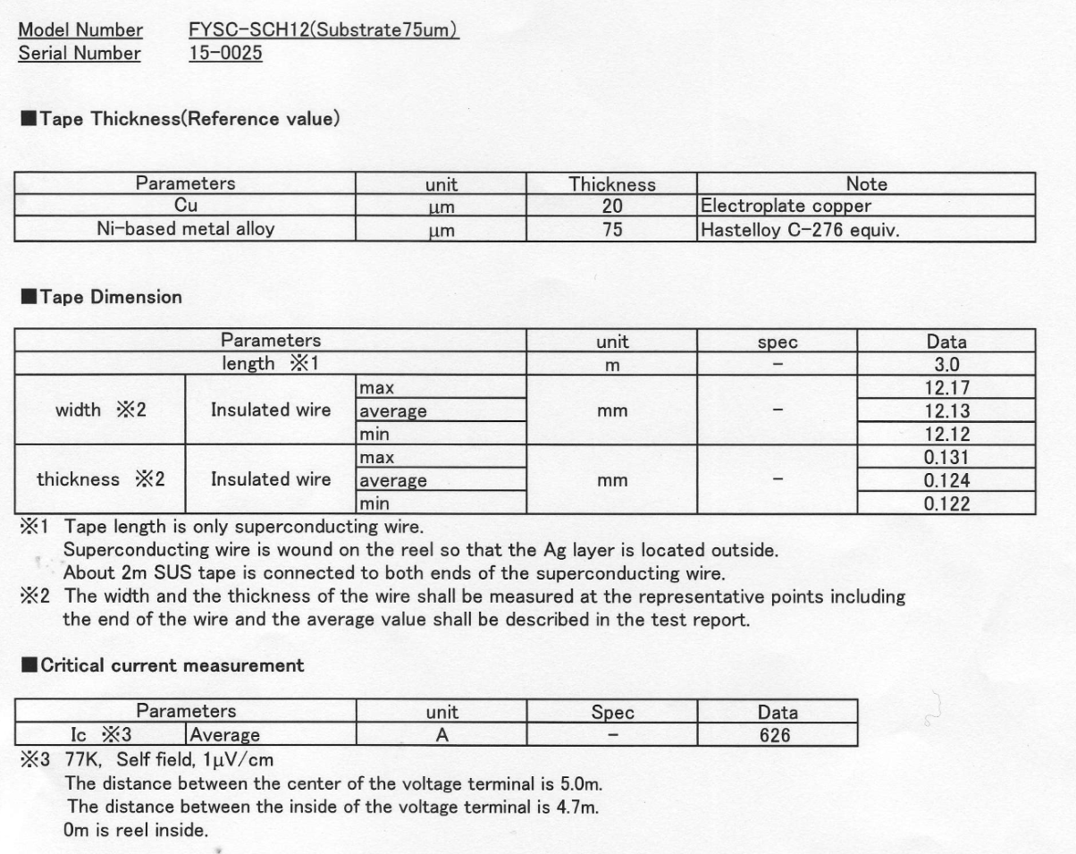
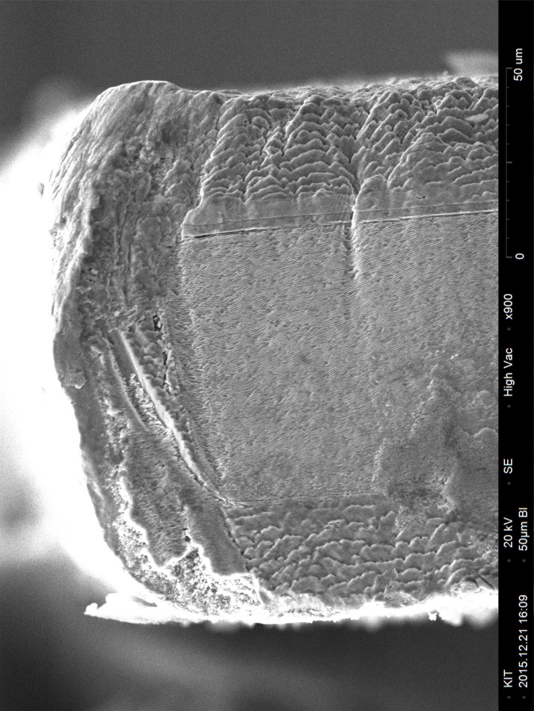
Fujikura – Cu – KIT:
Cu 20 µm
REBCO 3-6 µm
Sample provided by Fujikura.
Hastelloy 75 µm
Cu 20 µm
electroplating

Slide 4
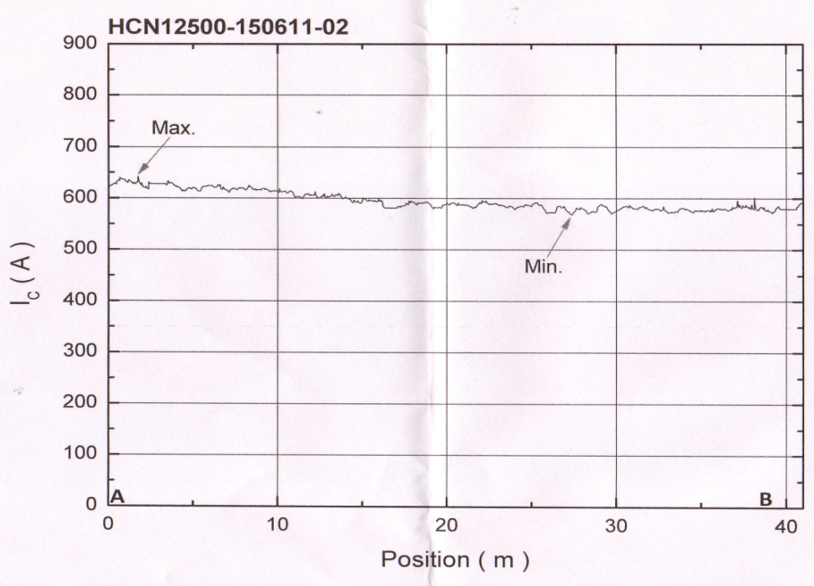
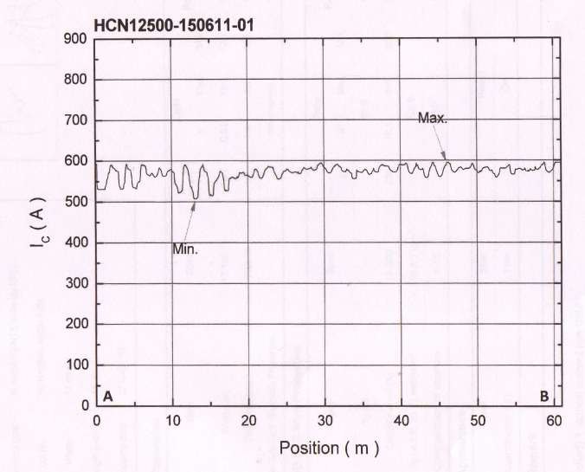
SuNAM- CERN:
Delivered from CERN
to KIT for punching test 40 m
Change in punching tool
needed (tape width)

Slide 5
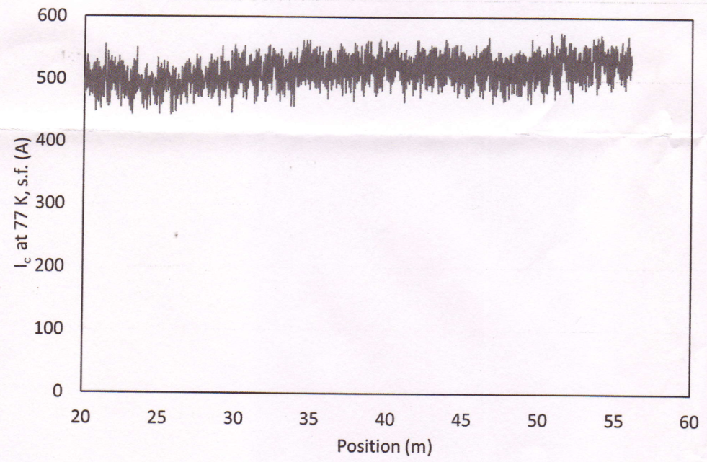
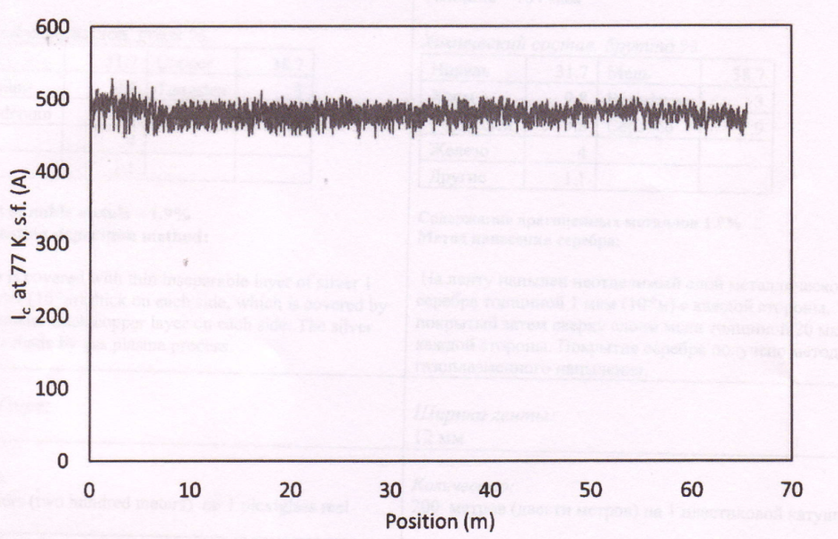
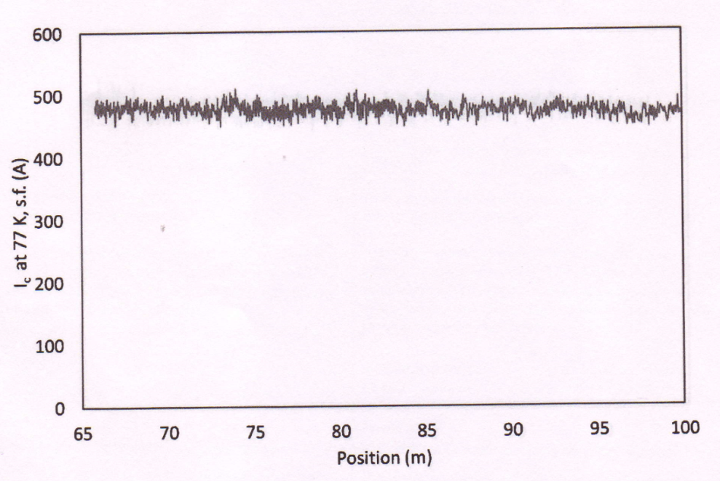
SuperOx- CERN:
28 µm
29 µm
26 µm
*cross-section of one of the previous samples

Slide 6
Punching possibilities:
Transposition lenght (mm) | Strand width (W_{l})/ Bridge width (W_{c}) (mm) | Tape width (mm)
226 (old) | 5.5 | 12.1(SP, SOx) 12.4 (Bruker)
300 (new - multipunching) | 5.85 | 12.1(SP, SOx, Bruker Ag) 12.2 (SuNAM)
300 (future - in one step) | 5.85 | Ag or Cu tapes? 0.05 or 0.1 mm thick?
W_{c}
T_{p}
W_{l}

Slide 7
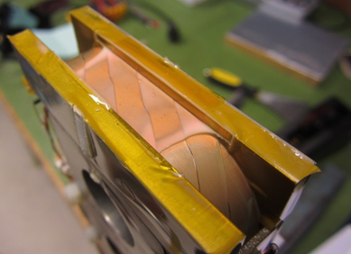
Roebel cable for transverse stress at U. Twente:
Roebel cable: 226 TL, 15 strands:
1. SuperPower CC + KIT impregnation
2. SuperPower CC + CERN impregnation
3. Bruker CC + CERN impregnation
CERN: delivers resin and glass fibre to UT
KIT: Bruker (ready) and 2 SuperPower cables (in preparation)
UT: experiments planned 2016
Old experiment:
Roebel cable: 126 TL, 10 strands
SuperPower tape, 20 µm Cu (per site)
KIT impregnation

Slide 8
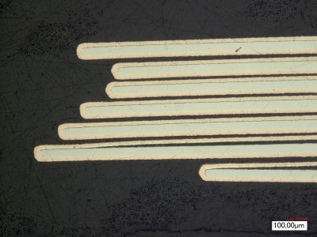
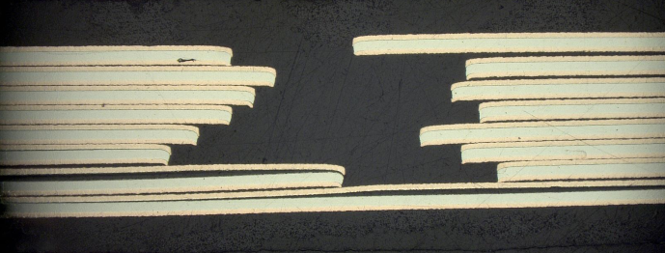
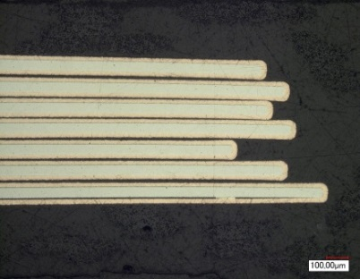
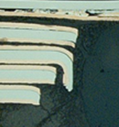
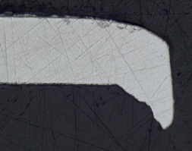
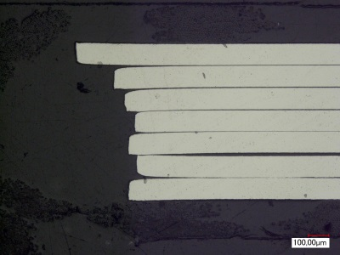
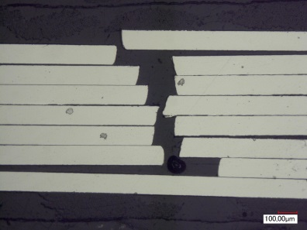
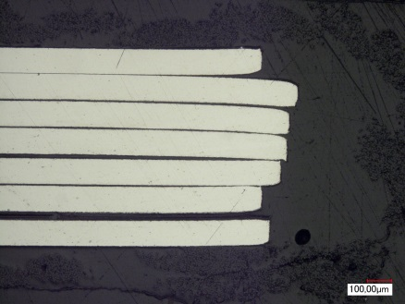

Roebel cable with old and new design:
Horizontal spacing error in standard cable (5.5 mm wide strands) and the burr
0.1 mm
870 µm
0.1 mm
421 µm
Error reduced by widening strands to 5.9 mm (laser-cut cable)
279 µm
151 µm

Slide 9
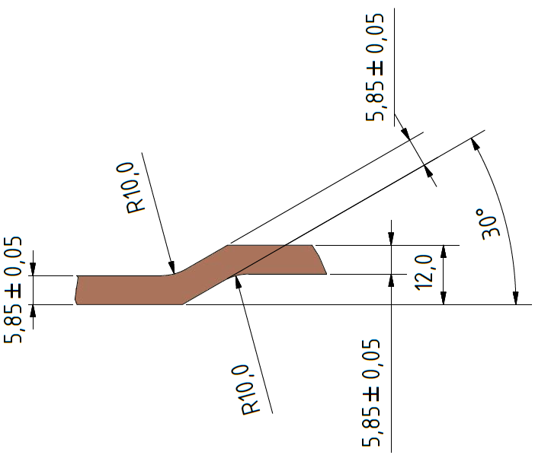
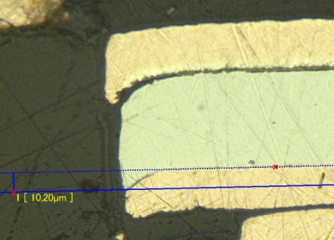
New punching tool and cable geometry:
New geometry now possible in punching tool
  5.85 mm strand width
  300 mm transposition length
Baseline for next EuCARD-2 cables
174 µm
240 µm
Cross-section of first punched cable with new geometry
(15 strands)
10.2 µm

Slide 10
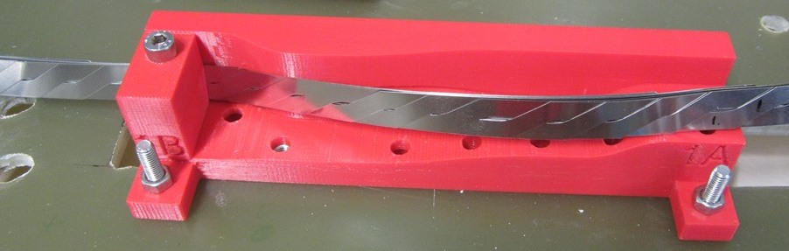
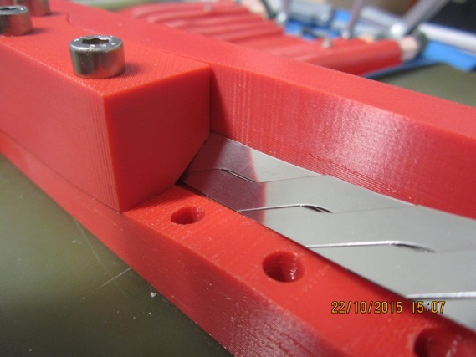
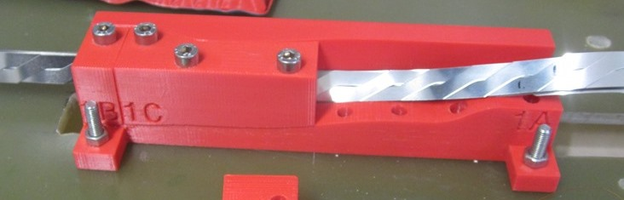
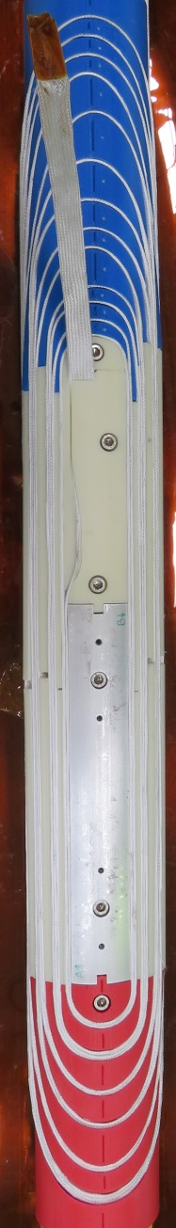
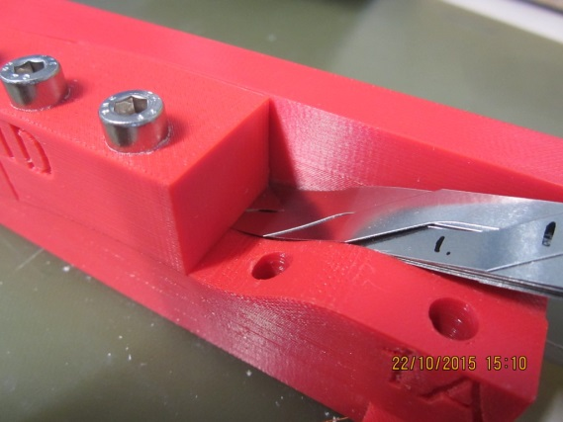
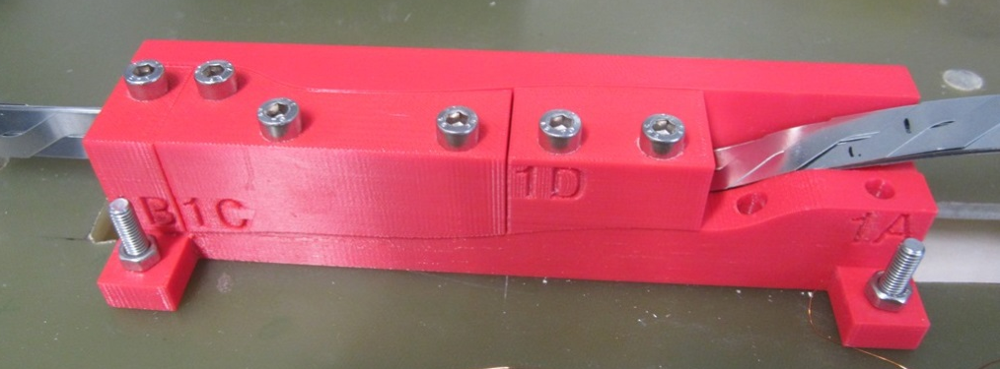
Mechanical test of the cos-theta coil end geometry
(CEA Saclay + KIT):
Measurement at KIT with
CEA Saclay (77 K, s.f.)
CERN-3D form print
Courtesy of M. Durante

Slide 11
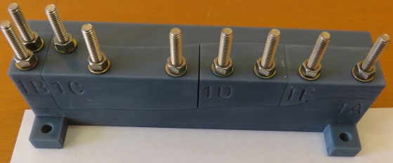
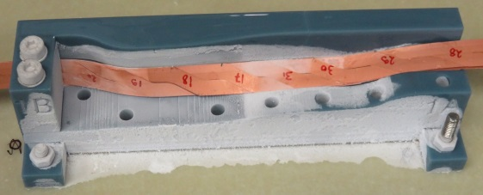
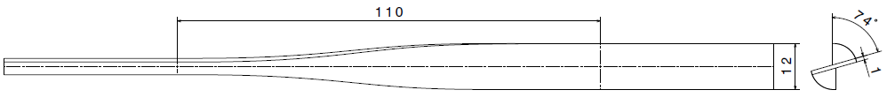
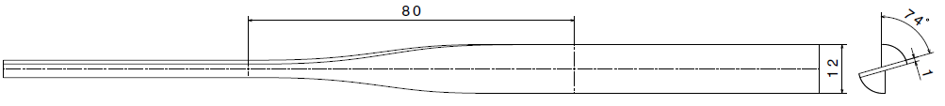
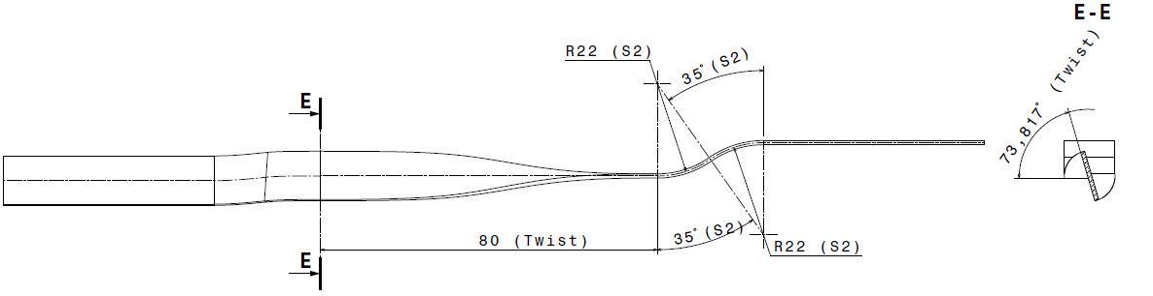
Experiment: 3D-printed Molds
Designed at CEA Saclay
Printed at CERN in Bluestone resin (suitable for low T)
Experiment order: mold 3, 2, 1
Mold 3:
  Twist: 74° over 110 mm
  (T_{p} = 535 mm)
  No bend
Mold 2:
  Twist 74° over 80 mm
  (T_{p} = 389 mm)
  No bend
Mold 1 (coil shape):
  Twist: 74° over 80 mm
  (T_{p} = 389 mm)
  Bend: R = 22 mm
170 mm
Images by C. Lorin

Slide 12
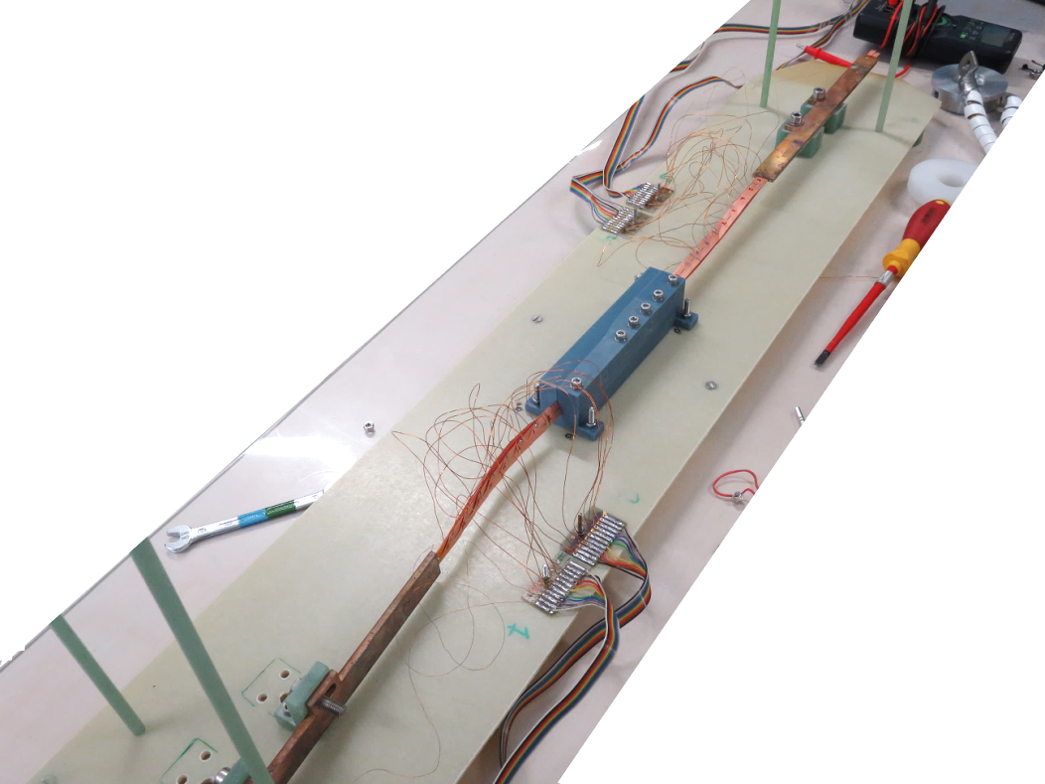
No degradation of I_{c} with all used molds:
 | Twist pitch [mm] | Bending radius [mm]
Mold 3 | 535 | -
Mold 2 | 389 | -
Mold 1 | 389 | 22
No degradation observed
Small I_{c} increase (reversible in cable 2)

Slide 13
Progress and plans:
Bruker substrate tape (200 m) -> new geometry dummy Roebel cable - delivered
Punching test (short lenght) – in progress
- SuNAM, SuperOx (delivered by CERN)
Two Roebel cables for U. Twente test from SuperPower – in progress
Roebel cable for contact test -> CEA Saclay - finished
Roebel with filaments (U. Southampton) - to be done
CEA Saclay and CERN dummies requirements?
Cables from delivered tape (SuNAM, SuperOx)
Fresca test (Bruker punch and coat cable)?
Feather0 test?
Tapes - new procurement (Ag cap?)

