Slide 1
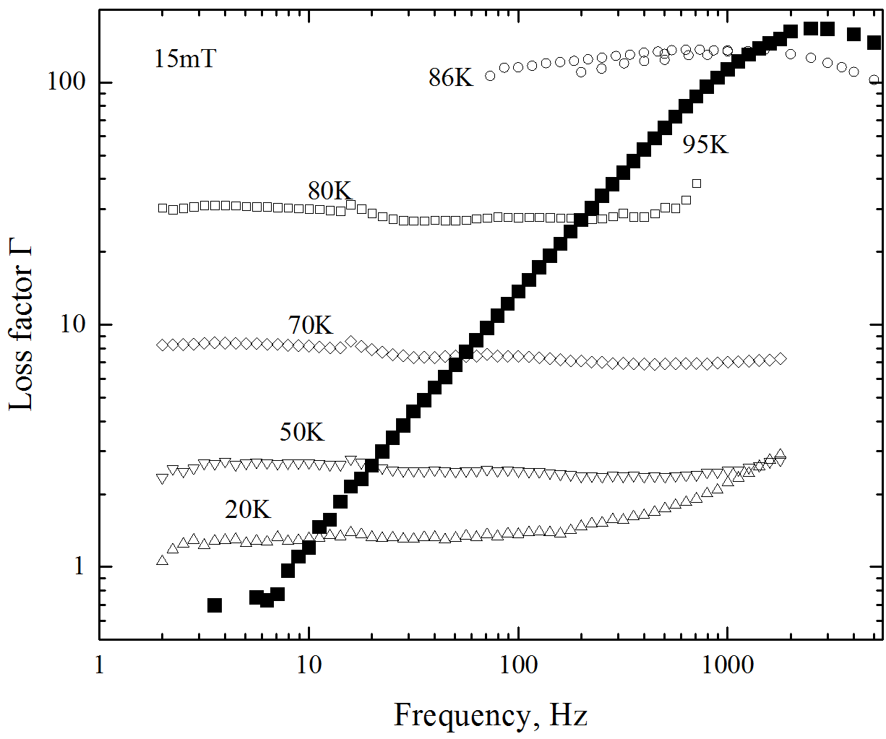
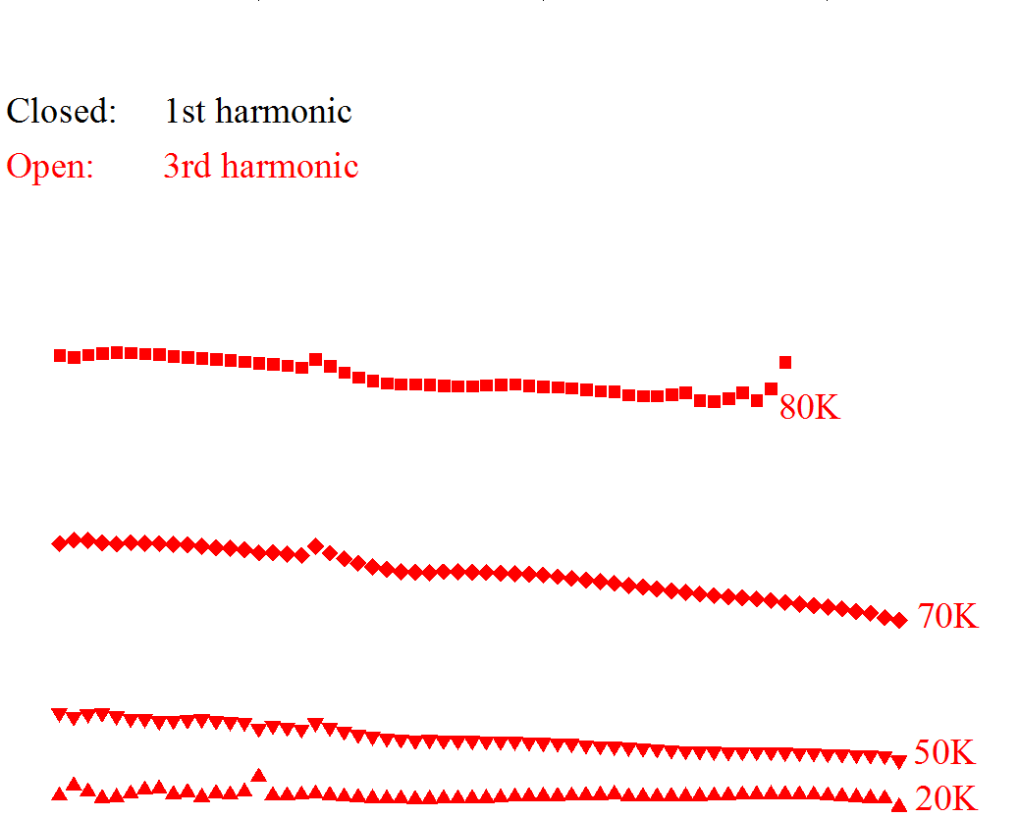
Frequency dependence:
CERN Insulated Sample
Mostly hysteresis dominated, in contrast to pure eddy current in normal state;
Eddy current start appear at lower temperature, as expected.
No evidence for interplay between superconductor magnetisation and eddy-current.
3rd harmonic confirms the superconductor magnetisation remains power-law/critical state like.

Slide 2
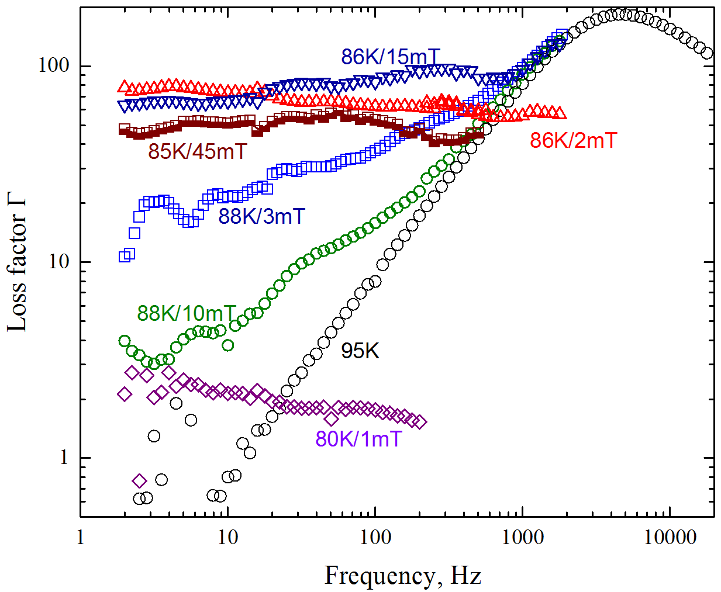
Frequency dependence:
KIT Uninsulated
There is evidence of eddy-current interplay with superconductor magnetisation when saturated.
The effect has to be measured at high temperature due to field/frequency limitations.

