Slide 2
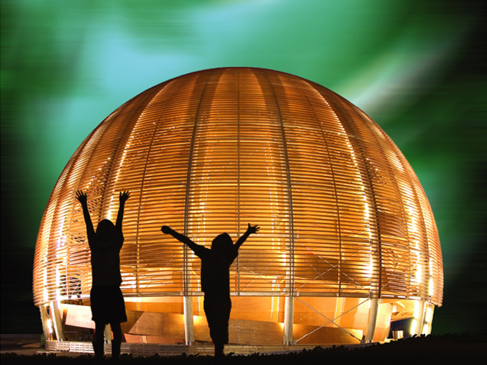
Introduction to the work group on:
Gender Inclusive Teaching
Geneviève Guinot and Kristin Kaltenhäuser
5 July 2015

Slide 3
Women in SET and at CERN
Source: 2015 CERN Personnel Statistics

Slide 4
Work Group Goals
  WHAT?
  Identify aspects and alert points to ensure gender inclusive teaching in the physics classroom
  HOW?
  Review studies and other material
  Sharing experiences
  Input from experts – Isabelle Collet (University of Geneva), CERN Diversity Office
  Interviewing physicists at CERN
  GOAL
  Produce communication tool (e.g. brochure/leaflet) with recommendations on gender inclusive teaching to distribute to participants of the HST 2016

Slide 5
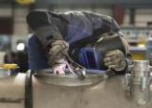
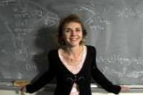
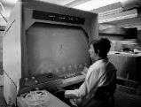
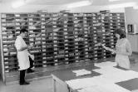
Timeline
Session 1
6 July
Session 5
19 July
Final presentation
21 / 22 July
Give an awesome presentation and present your findings
Presenting first draft of alert points
Exchange of experiences
Celebrate
Clarifying goals and oganisation of the work group

Slide 6
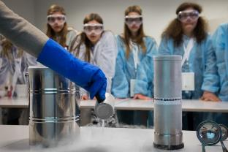
If you want to…
… learn about the latest research on how to teach gender inclusive
… want to share your own experiences with boys and girls in the physics classroom and discuss them
… produce a tool that can be passed on to other teachers to share what you learned
Then this work group is perfect for you!

