Slide 1
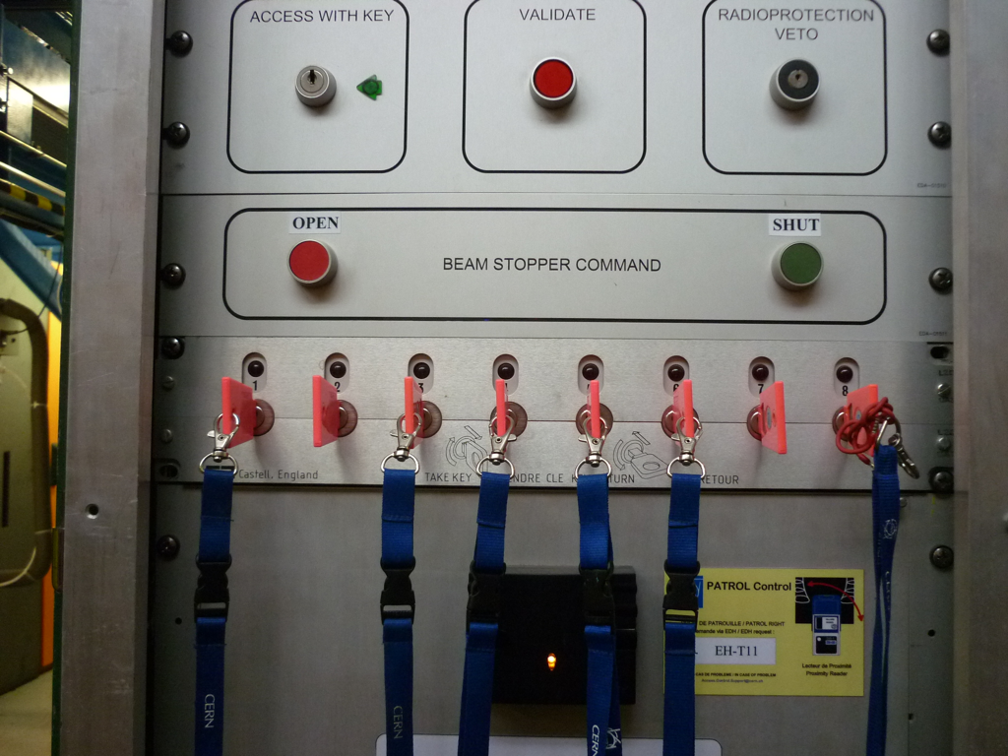

Beamline for Schools
Misconception analysis

Slide 2
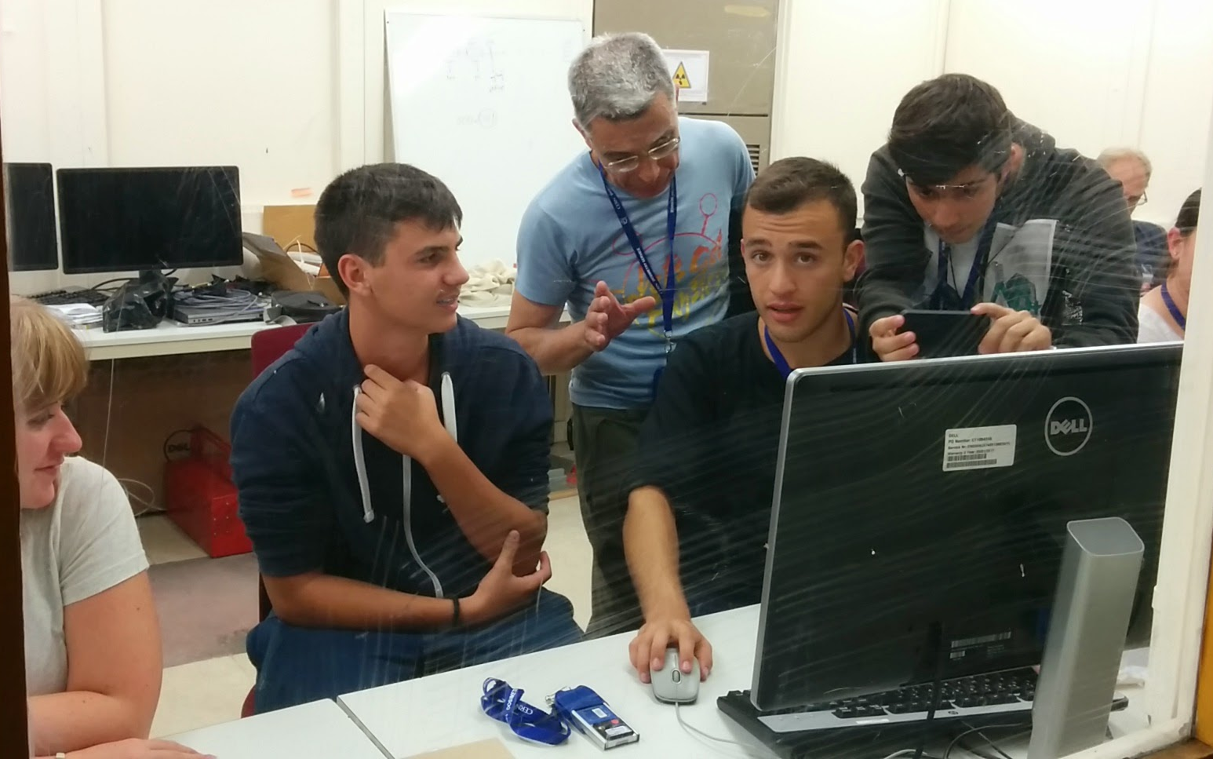
Motivation
The best way of learning is to involve experience
Idea of the Beamline for Schools competition: pupils become scientists

Slide 3
Idea
Worldwide competition among schools for beam time at CERN
Teams phrase scientific question for an experiment which uses a particle beam
  Written proposal (max. 1000 words)
  1 minute video
Students should “drive” the team
  Teachers and external experts should give guidance
  Experts may propose a subject and teach the students
A scientific committee at CERN selects two proposals
  Feasibility of the proposal is important
Student teams come to CERN to do their experiment
Teams write up results (if possible results are published)
As close as possible to real science life
BL4S 2017 is approved

Slide 4
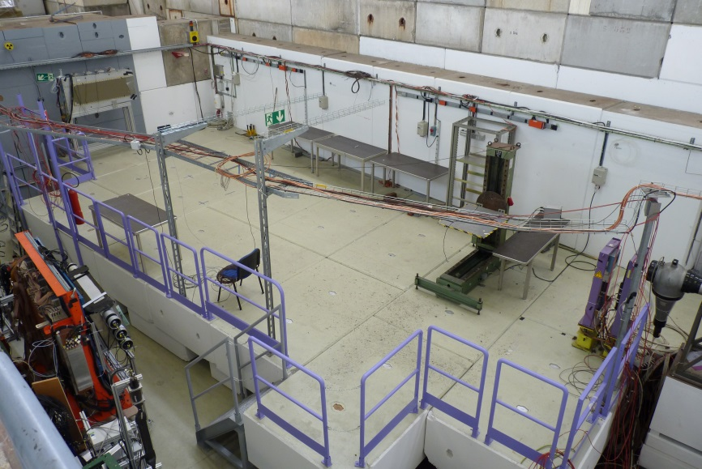
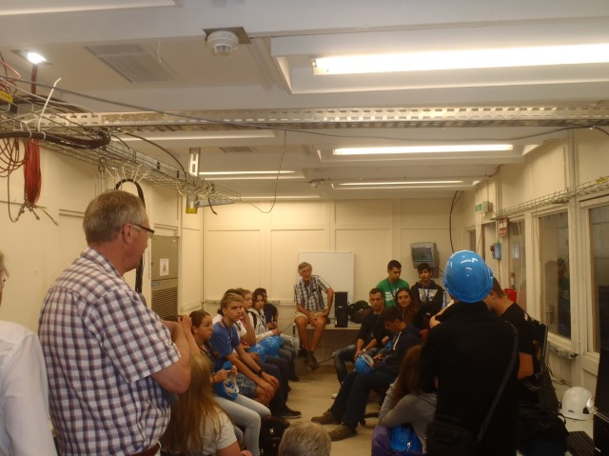
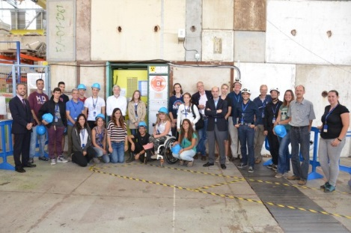
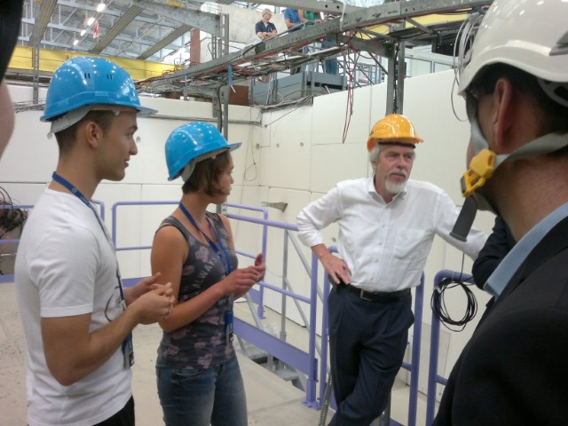
T9 Beam line @ PS East Area
PS East Area
typical CERN beam line
excellent experimental conditions and reliable performance

Slide 5
T9 Beam parameters
Particle momentum: 0.5 - 10 GeV/c
Main Target: Made of 20 cm beryllium, followed by 3 mm of tungsten
  (target composition has only a small effect on the beam composition)
Charged particles: protons, electrons, (decay)muons, pions, kaons (as well as their anti-particles)

Slide 6
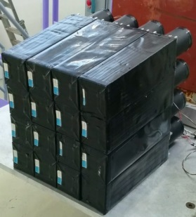
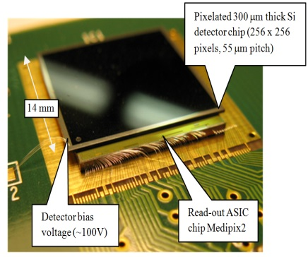
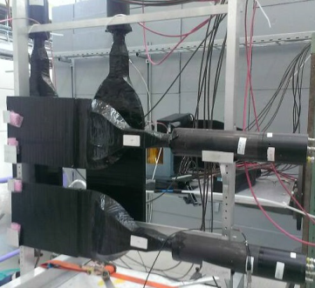
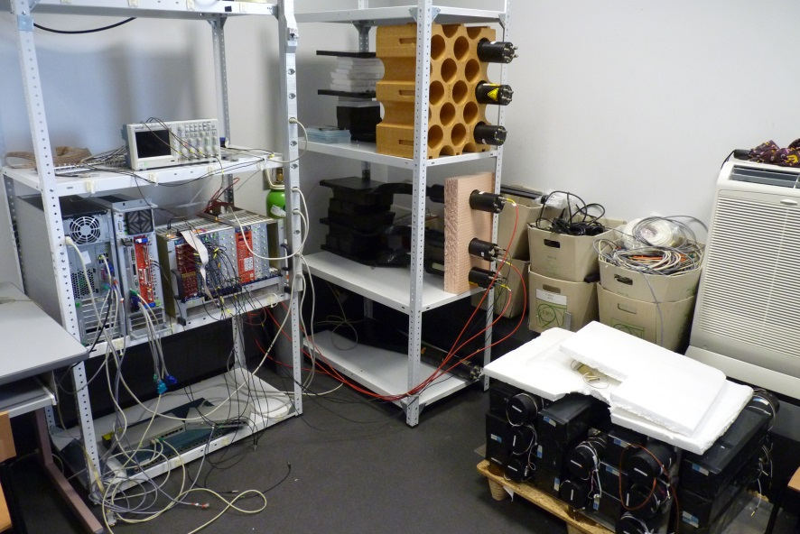
The building blocks: Detectors, magnets, DAQ system
Detectors:
Scintillator
  6 available (more if needed)
  Trigger
  Halo detector
Cherenkov
  Particle identification
Delay wire chamber
  Tracking
Timepix
  Small (2x2 cm), high resolution tracking and energy measurement
Lead Crystal Calorimeter
  20 elements
Multi-gap Resistive Plate Chamber
  Precise time of flight measurement
Read-out ASIC Timepix
Data Acquisition:
Based on the S/W used by ATLAS
Capable of recording 1000-5000 events per second
On-line monitoring and histograms
Magnets:
Several types of magnets available for separating particles
Absorbers:
Iron blocks to absorb all particles but muons

Slide 7
Documentation and support
The students teams get several documents:
A description of the beam and the detectors (12 pages)
8 – 10 example experiments
The winner proposals of the previous years
The teams can get in touch with professional physicists:
Members of IPPOG
Members of the BL4S team
Additional volunteers
http://beamline-for-schools.web.cern.ch/useful-documents
http://beamline-for-schools.web.cern.ch/contact

Slide 8
Success factors
Motivated teachers
  Yes, it takes time on top of the teaching duties………
  The teacher (team coach) may have to educate himself
Good documentation
  Complete and comprehensible but not too long
Publicity
  There are 480 million students of the right age….
Good communication
  BL4S is not for privileged schools
Attractive prizes
  Invitation to CERN
  Particle detectors for the school (http://cosmicpi.org)

Slide 9
Your job….
Remember: Every participating team will learn something
But: Successful teams (winners, short listed) must avoid misconceptions
Examples taken from proposals from 2016:
Quote from the proposal | Problem / misconception
It is possible to discover the difference between the beamline protons and the antiprotons as particles of different mass having different flight times | Protons and antiprotons have the same mass
For this experiment we would use the T9 beam line since we would need the proton collision to produce the gravitational waves | What should I say….
Dos neutral kaon oscillation tend to a particular particle composition and if so which one | There are no neutral kaons in the T9 beam
Employing the Biot-Savart’s law from a 4 mm gap from the beam and an electrical beam current of 1 A…. | The actual current of the PS beam is orders of magnitudes lower
We intend first to identify antiprotons and discriminate them against other particles of the beam | The detectors available to the students do not allow to identify protons
We would like you to screen the proposals for popular misconceptions and propose improvements to the existing documentation or additional material that can help to prevent them

