Slide 1
Computing at CERN
International High School Teacher Programme 2016
Niko Neufeld, CERN/EP

Slide 2
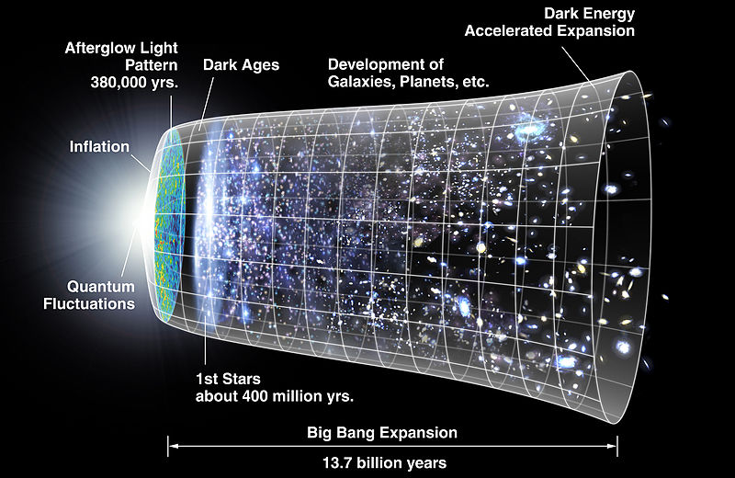
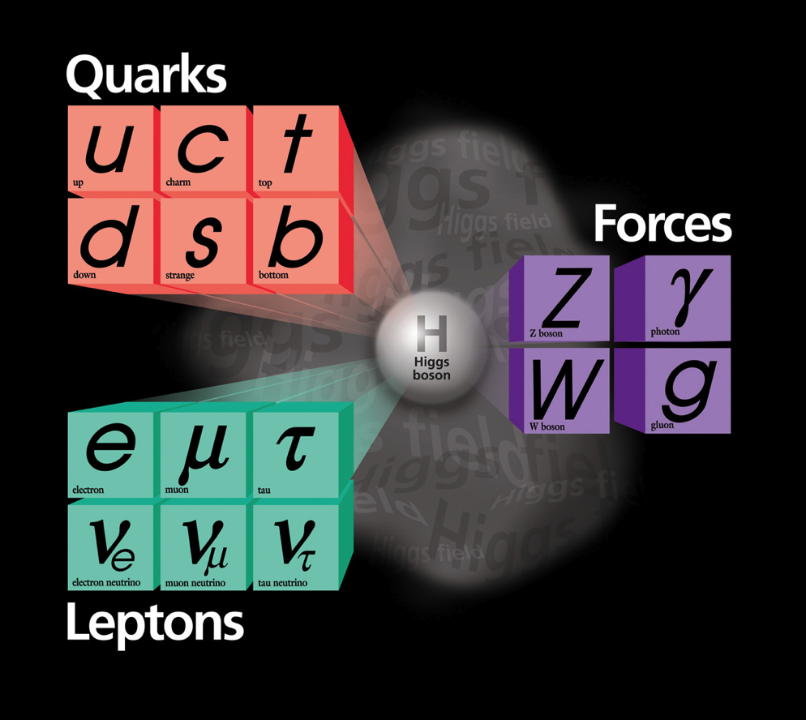
Fundamental questions…
How to explain that particles have mass?
  Theories and accumulating experimental data…getting close
What is 96% of the Universe made of?
  We only observe 4% of the apparent mass
Where is all the anti-matter?
  Why is Nature not symmetric?
What was the state of matter just after the Big Bang?
  “Soup” of quarks and gluons before they condensed into matter?

Slide 3

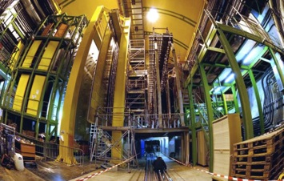
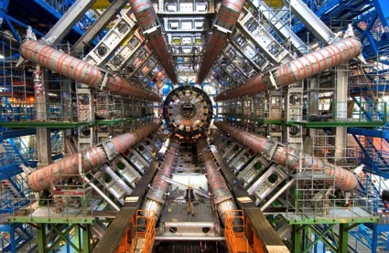
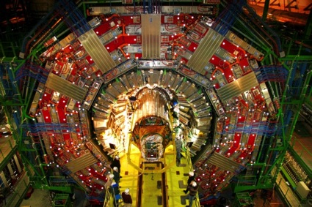
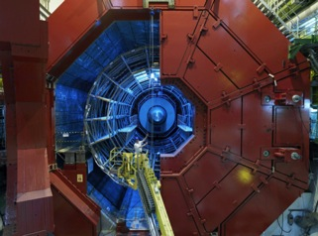
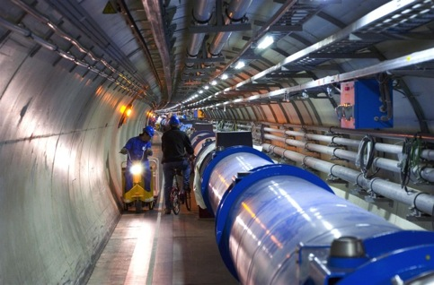

Tools: LHC and detectors
pp, B-Physics, CP Violation
(matter-antimatter symmetry)
LHCb
CMS
ATLAS
Exploration of a new energy frontier
in p-p and Pb-Pb collisions
ALICE
General Purpose,
proton-proton, heavy ions
Discovery of new physics:
Higgs, SuperSymmetry
LHC ring:
27 km circumference
Heavy ions, pp
(state of matter of early universe)
Notes:
3

Slide 4
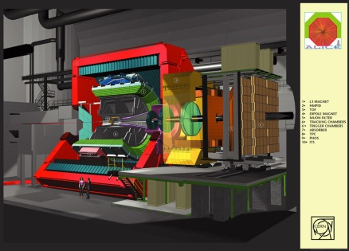
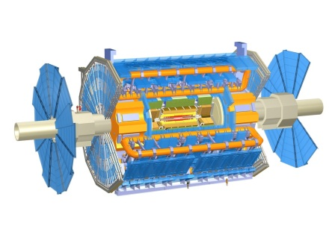
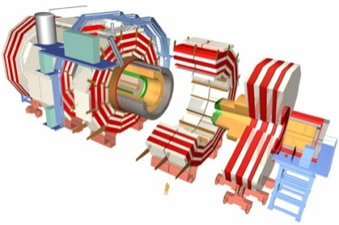
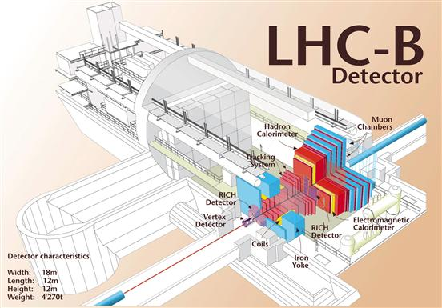
The LHC Experiments today
ALICE – “A Large Ion Collider Experiment”
  Size: 26 m long, 16 m wide, 16m high; weight: 10000 t
  35 countries, 118 Institutes
  Material costs: 110 MCHF
ATLAS – “A Toroidal LHC ApparatuS”
  Size: 4 6m long, 25 m wide, 25 m high; weight: 7000 t
  38 countries, 174 institutes
  Material costs: 540 MCHF
CMS – “Compact Muon Solenoid”
  Size: 22 m long, 15 m wide, 15 m high; weight: 12500 t
  40 countries, 172 institutes
  Material costs: 500 MCHF
LHCb – “LHC beauty” (b-quark is called “beauty” or “bottom” quark)
  Size: 21 m long, 13 m wide, 10 m high; weight: 5600 t
  15 countries, 52 Institutes
  Material costs: 75 MCHF
Regular upgrades … next 2019/20 (Long Shutdown 2)
1 CHF ~ 1 USD

Slide 5
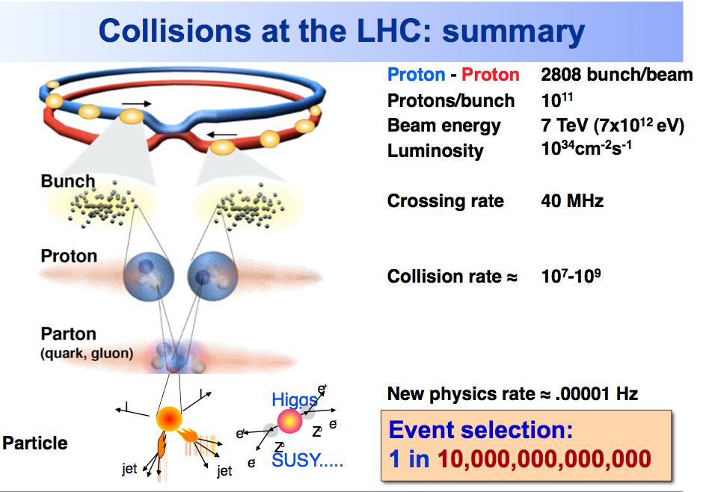

Slide 6
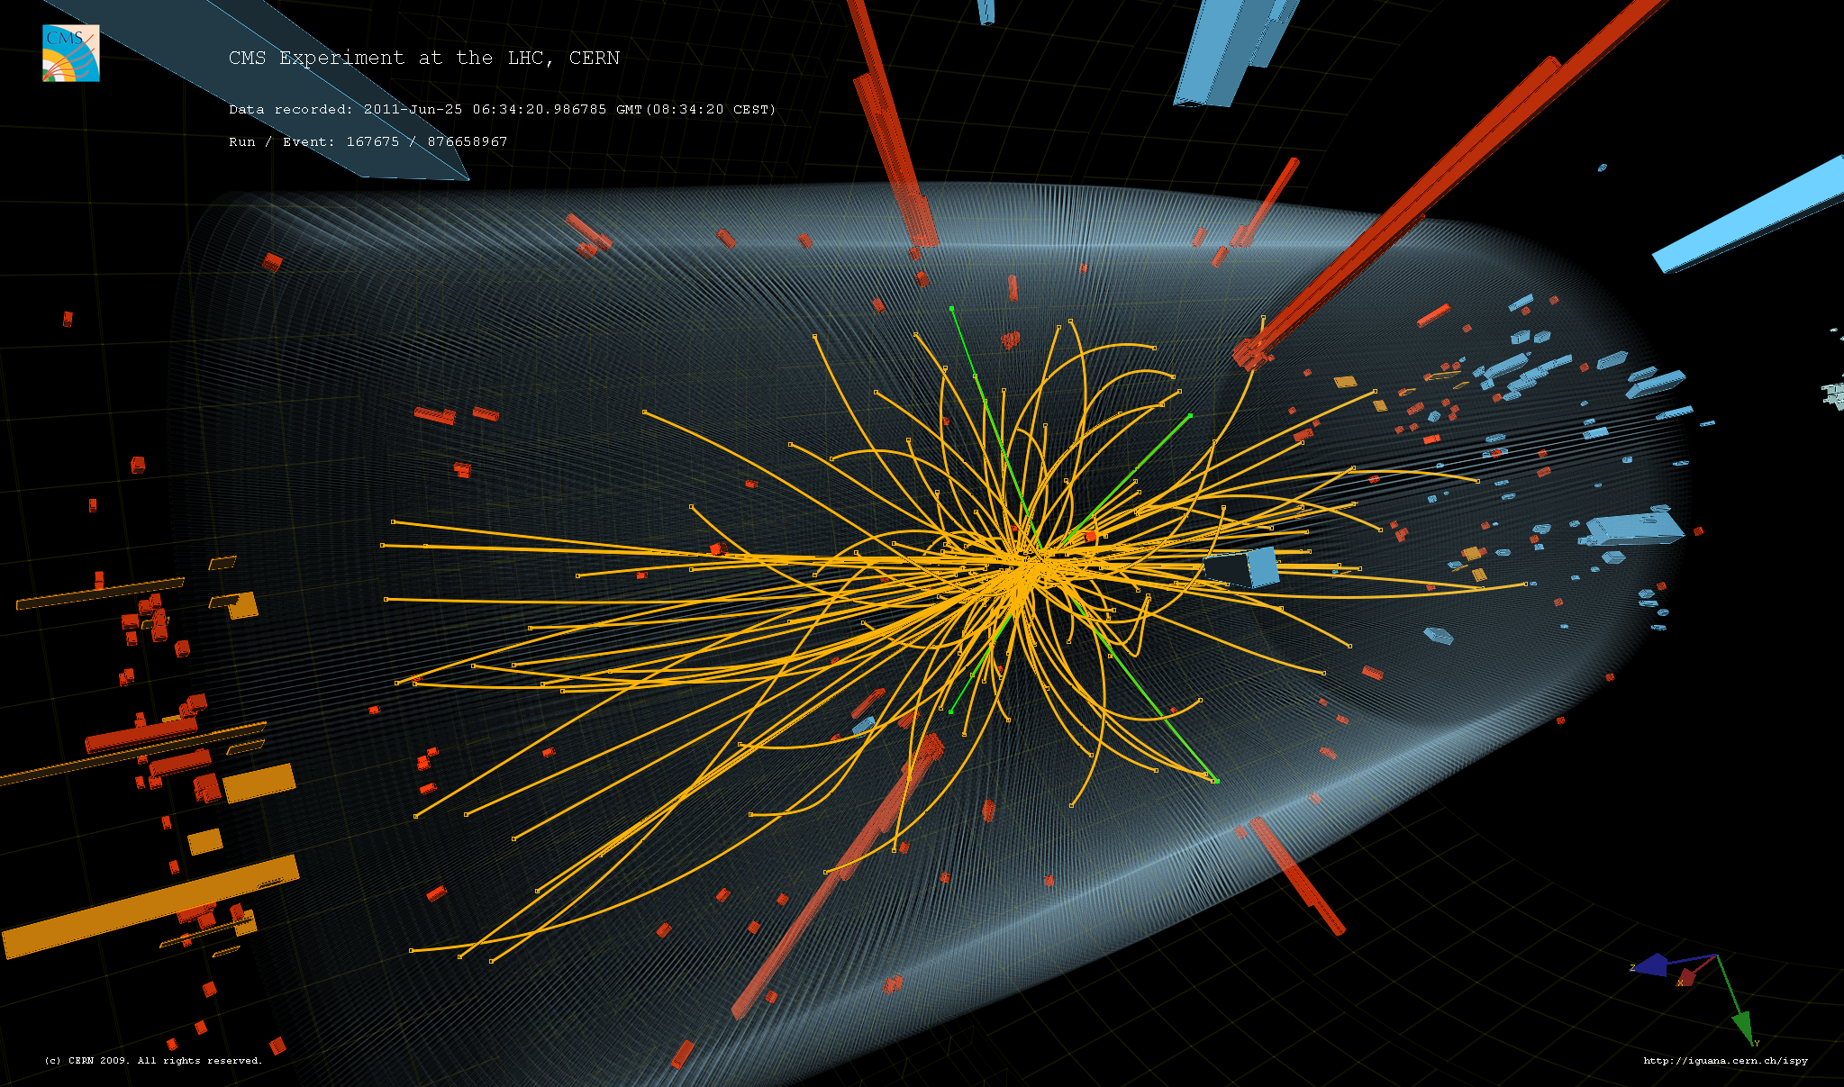
Higgs-boson in CMS

Slide 7
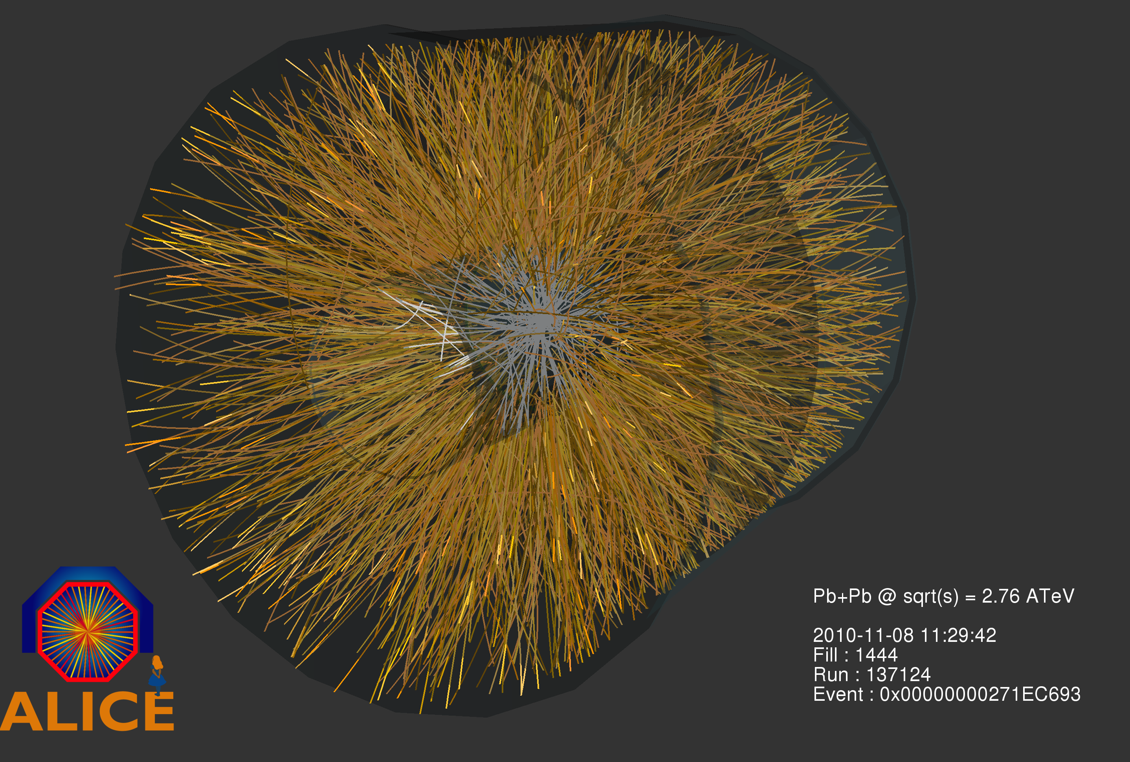
Lead meets lead in ALICE

Slide 8
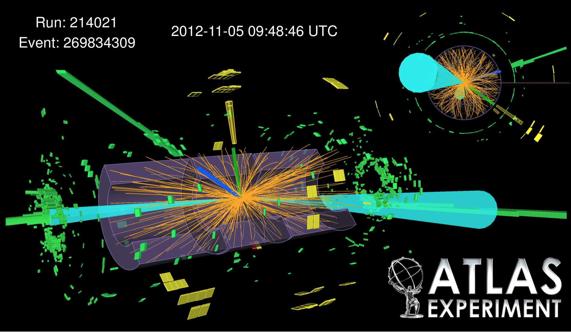
Mr. Higgs’es boson is also in ATLAS

Slide 9
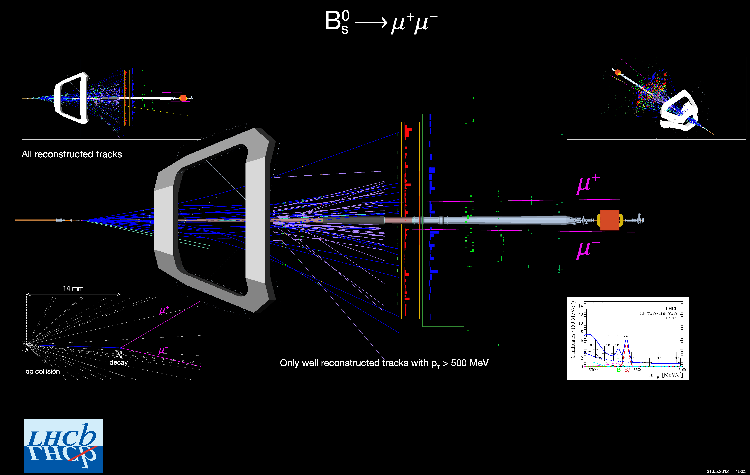
An extremely rare event in LHCb

Slide 10

And much more than just the LHC…

Slide 11
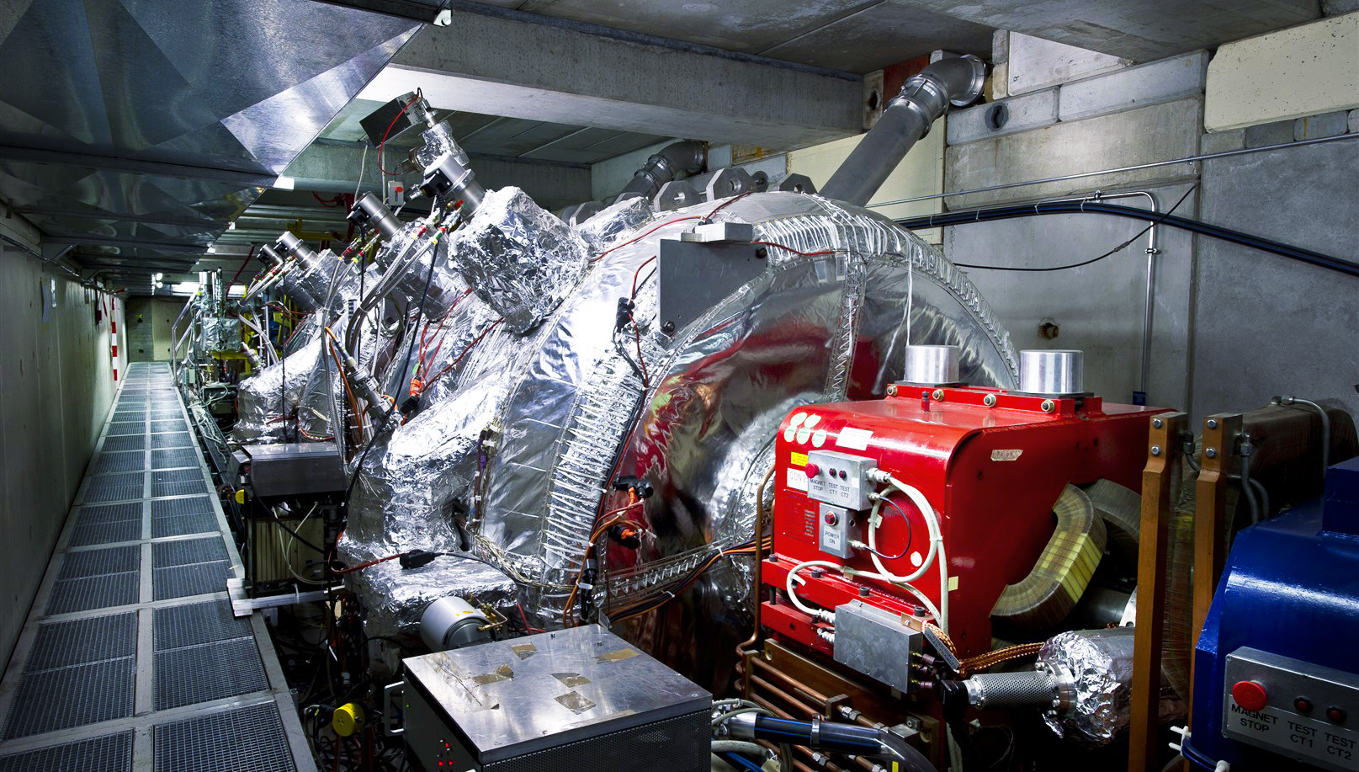
Anti-matter factory

Slide 12
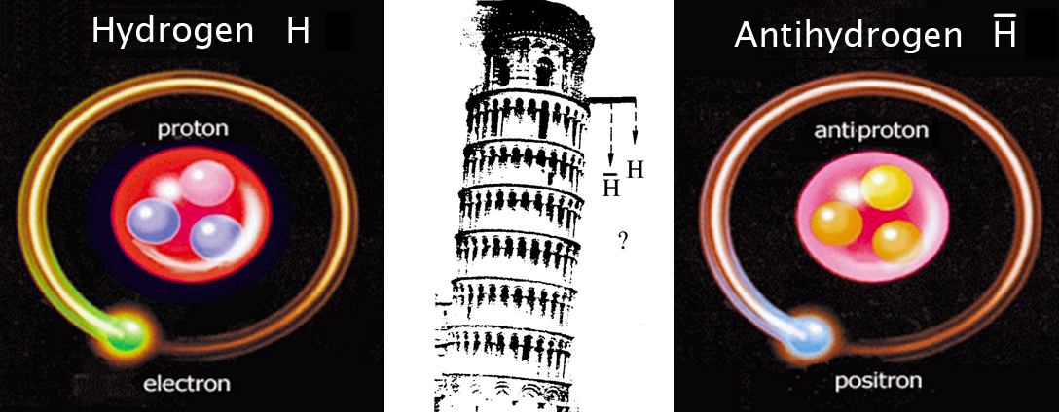
So apart from hunting daemons…
What are we doing with the anti-matter?

Slide 13
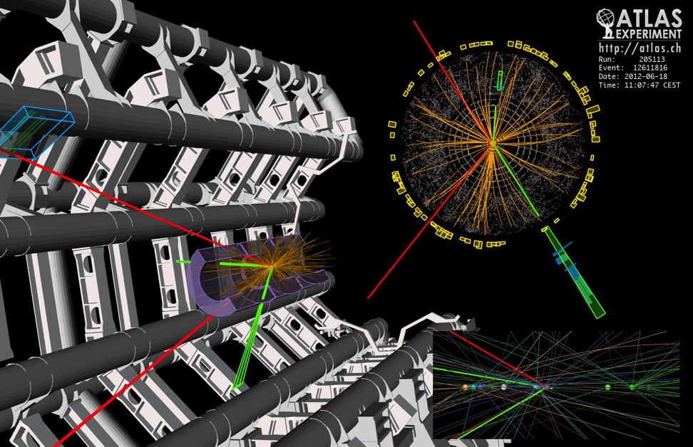
What are these data?
Raw data:
  Was a detector element hit?
  How much energy?
  What time?
Reconstructed data:
  Momentum of tracks (4-vectors)
  Origin
  Energy in clusters (jets)
  Particle type
  Calibration information
  …
150 Million sensors deliver data … 40 Million times per second
Up to 6 GB/s to be stored and analysed after filtering

Slide 14
Data and Algorithms
HEP data are organized as Events (particle collisions)
Simulation, Reconstruction and Analysis programs process “one event at a time”
  Events are fairly independent → Trivial parallel processing
Event processing programs are composed of a number of Algorithms selecting and transforming “raw” event data into “processed” (reconstructed) event data and statistics
RAW
Triggered events
recorded by DAQ
Detector digitisation
~2 MB/event
ESD/RECO
Reconstructed
information
Pseudo-physical information:
Clusters, track candidates
~100 kB/event
AOD
Physical information:
Transverse momentum,
Association of particles, jets,
id of particles
Analysis
information
~10 kB/event
TAG
Classification
information
Relevant information
for fast event selection
~1 kB/event

Slide 15
Know Your Enemy: pp Collisions at 14 TeV at 10³⁴ cm⁻²s⁻¹
σ(pp) = 70 mb --> >7 x 10⁸ /s (!)
In ATLAS and CMS* 20 – 30 min bias events overlap
H→ZZ
Z →μμ
H→ 4 muons:
the cleanest
(“golden”)
signature
And this
(not the H though…)
repeats every 25 ns…
^{*)}LHCb @4x10³³ cm⁻²-1 isn’t much nicer and in Alice (PbPb) is even more busy

Slide 16
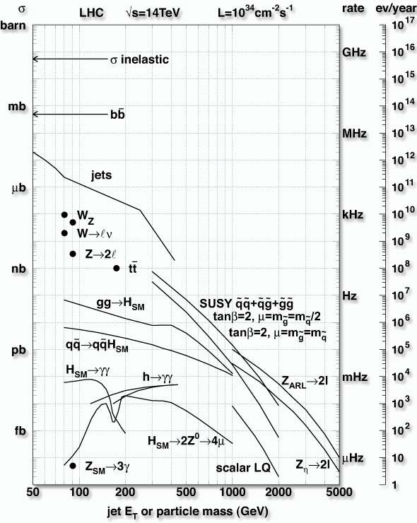
What’s mother nature’s menu?
A typical collision is “boring”
  Although we need also some of these “boring” data as cross-check, calibration tool and also some important “low-energy” physics
Interesting physics: one in a million to one in 100 million collisions
Exciting physics involving new particles/discoveries: one in a billion or less
➔ Need to efficiently identify these rare processes in the overwhelming background, such that we need to store only a “smaller” highly enriched subset of the raw data
Nobel dreams are here

Slide 17
Data Rates
Particle beams cross every 25 ns (40 MHz)
  Up to 25 particle collisions
  per beam crossing
  Up to 10⁹ collisions
  per second
Basically 2 event filter/trigger levels
  Data processing starts at readout
  Reducing 10⁹ p-p collisions per second
  to O(1000)
Raw data to be stored permanently: >15 PB/year
Physics Process | Events/s
Inelastic p-p scattering | 10⁸
b | 10⁶
W → eυ ; W → µυ ; W → τυ | 20
Z → ee ; Z → µµ ; Z → ττ | 2
t | 1
Higgs boson (all; m_{H} = 120GeV) | 0.04
Higgs boson (simple signatures) | 0.0003
Black Hole (certain properties) | 0.0001
 | Incoming data rate | Outgoing data rate | Reduction factor
Level1 Trigger (custom hardware) | 40000000 s⁻¹ | 10^5 – 10^6 s⁻¹ | 400-10,000
High Level Trigger (software on server farms) | 2000-1000000 s⁻¹ | 1000 -10000 s⁻¹ | 10-2000

Slide 18
Defeating the data-torrent
Thresholding and tight encoding
Real-time selection based on partial information
Final selection using full information of the collisions
These selection systems are called “Triggers” in high energy physics

Slide 19
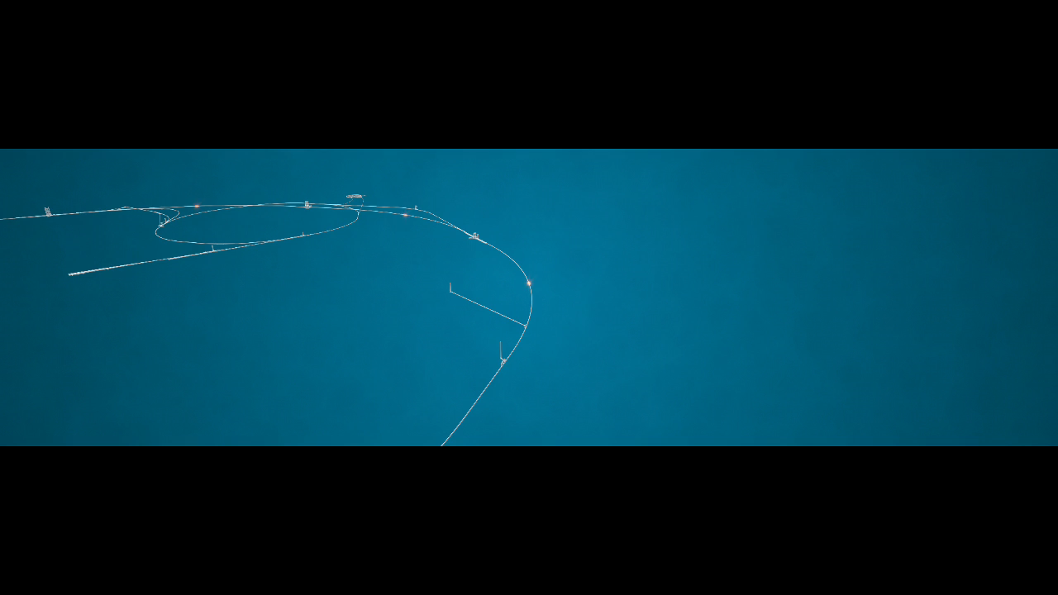

Collisions in motion ☺

Slide 20
The first level trigger

Slide 21
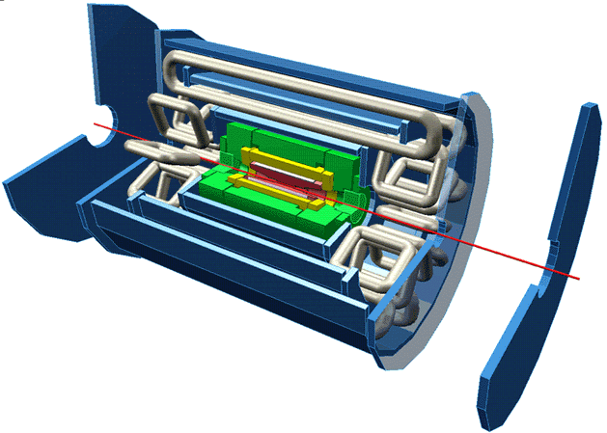
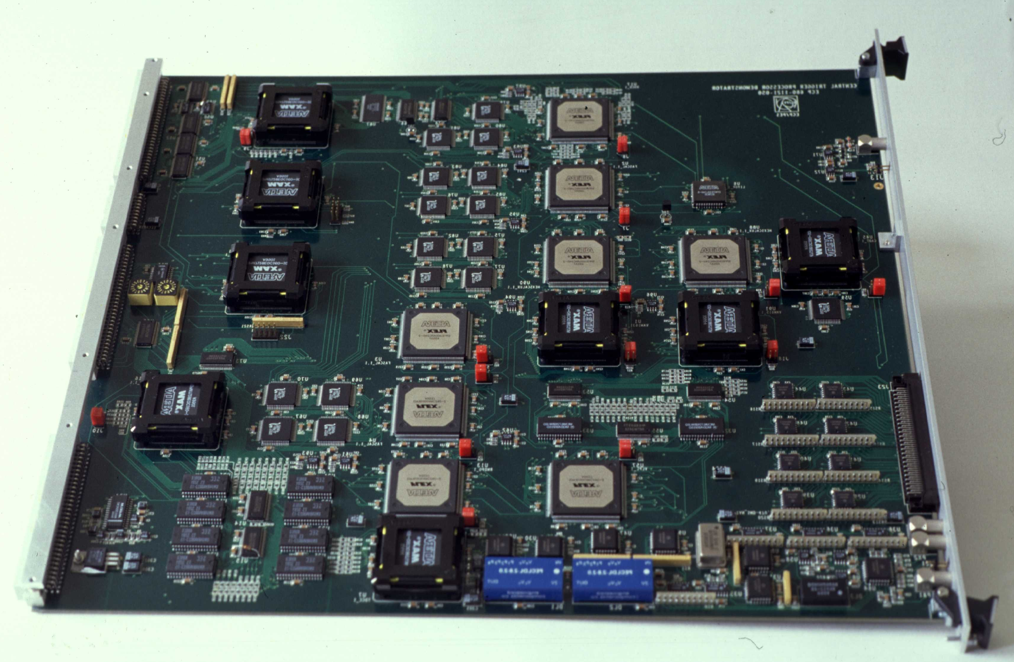
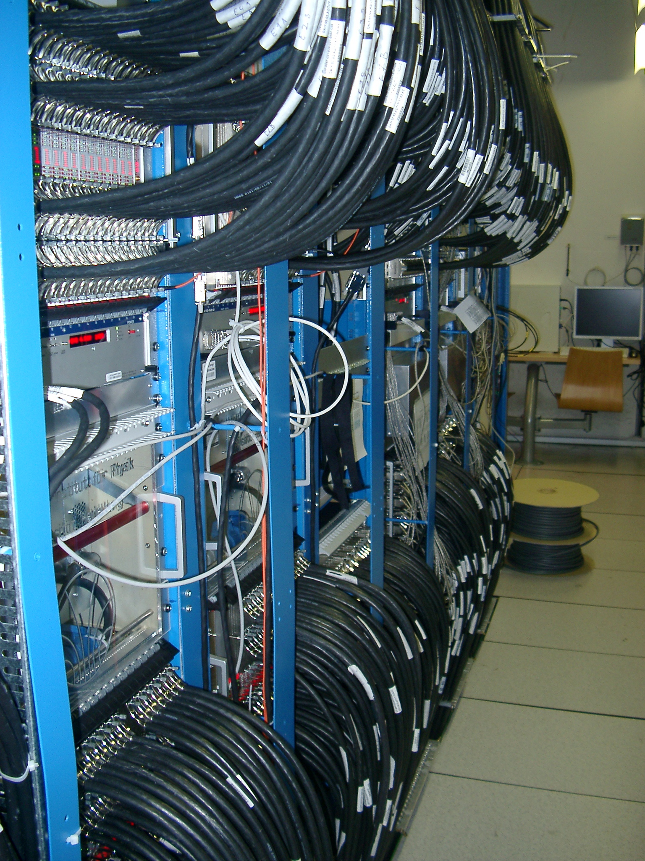
Selection based on partial information
A combination of (radiation hard) ASICs and FPGAs process data of “simple” sub-systems with “few” O(10000) channels in real-time
  Other channels need to buffer data on the detector
this works only well for “simple” selection criteria
long-term maintenance issues with custom hardware and low-level firmware
crude algorithms miss a lot of interesting collisions
Notes:
No single computer or electronical system can process the enormous amount of data produced in the LHC experiments.
A divide and conquer approach is used.
The many regions of the large LHC experiments are treated separately and in parallel. Sophisticated custom-built electronics (top right-hand picture from ATLAS) is connected to a small part of the detector. From there it reads out the collision data in this region only but 40 Million times a second. Many, many such electronics modules are needed to cover the huge LHC detectors. The bottom left picture shows a small part of the trigger electronics of ATLAS, where in each column there are 40 modules as shown above.
Since the information is limited, because it only comes from a small segment, only a preliminary decision can be taken. The filtering can only tell the difference between collisions which look quite different to the electronics (to the naked eye they still look the same, of course).
The number of collisions retained after this step is still enormous: between 100.000 and 1.000.000 every second. But the filtering, which is needed to select the interesting events out of these 100.000 needs to be much more sophisticated.

Slide 22
Level 1 Trigger
The Level 1 Trigger is implemented in hardware: FPGAs and ASICs → difficult / expensive to upgrade or change, maintenance by experts only
Decision time: ~ a small number of microseconds
It uses simple, hardware-friendly signatures → looses interesting collisions
Each sub-detector has its own solution, only the uplink is standardized →

Slide 23
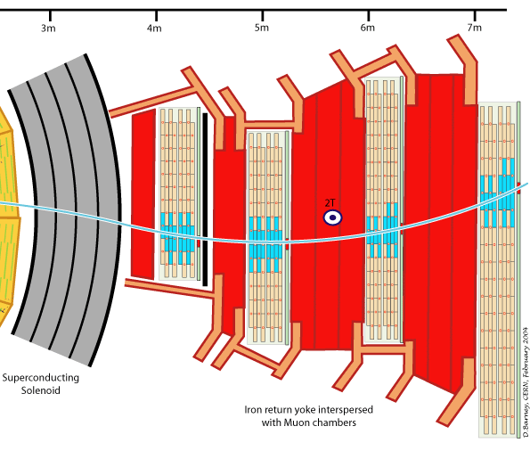
Finding Muons (2d view)

Slide 24
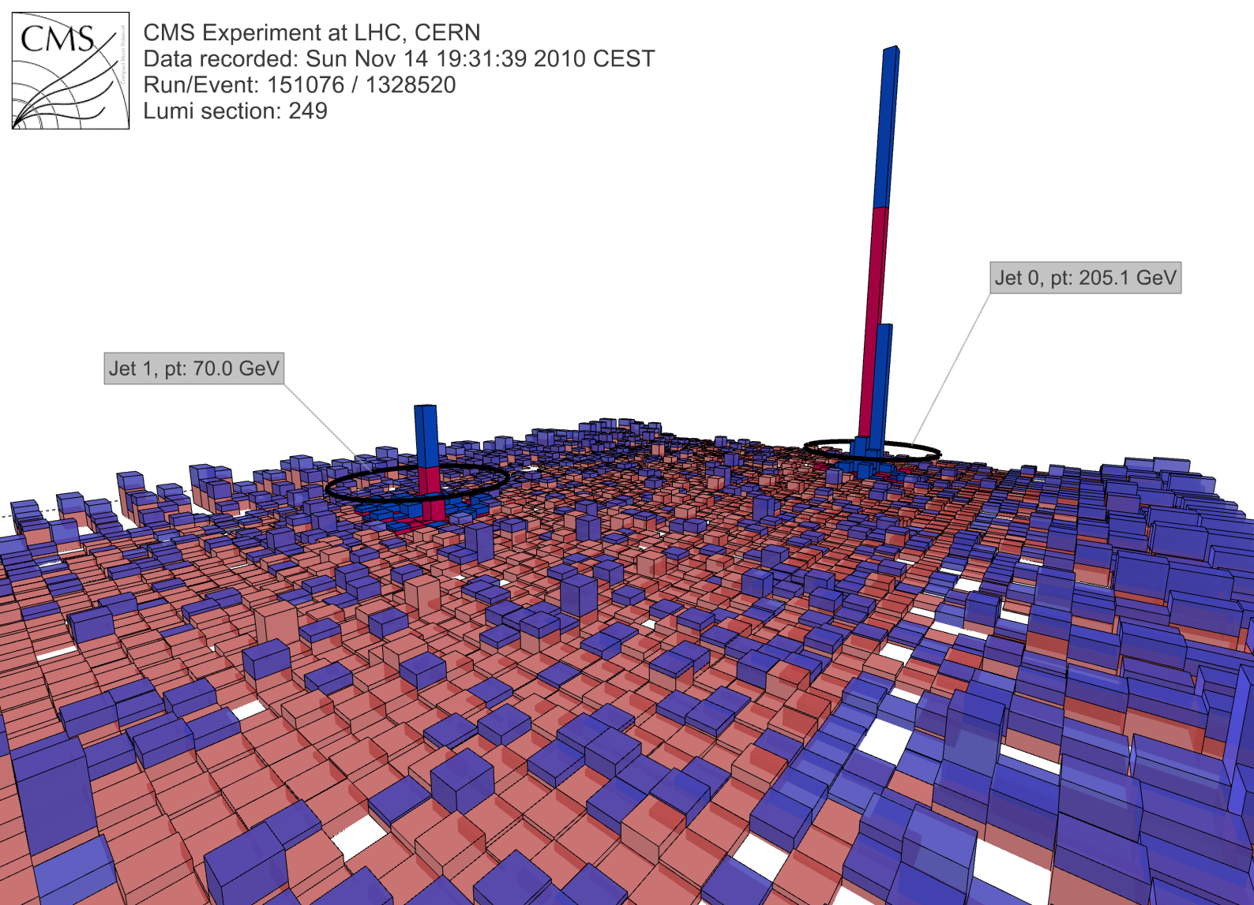
Calorimeter data

Slide 25
Data Acquisition

Slide 26

Data Acquisition (generic example)
Every Readout Unit has a piece of the collision data
All pieces must be brought together into a single compute unit
The Compute Unit runs the software filtering (High Level Trigger – HLT)
Detector
10000 x
Readout Units
~ 1000 x
DAQ network
GBT: custom radiation- hard link from the detector 3.2 Gbit/s
DAQ (“event-building”) links – some LAN (10/40/100 GbE / InfiniBand)
Links into compute-units: typically 10 Gbit/s (because filtering is currently compute-limited)
100 m rock
~ 3000 x
Compute Units

Slide 27
Future LHC DAQs in numbers
 | Data-size / collision [kB] | Rate of collisions requiring full processing [kHz] | Required # of 100 Gbit/s links | Aggregated bandwidth | From
ALICE | 20000 | 50 | 120 | 10 Tbit/s | 2019
ATLAS | 4000 | 500 | 300 | 20 Tbit/s | 2022
CMS | 4000 | 1000 | 500 | 40 Tbit/s | 2022
LHCb | 100 | 40000 | 500 | 40 Tbit/s | 2019

Slide 28
High Level Trigger

Slide 29
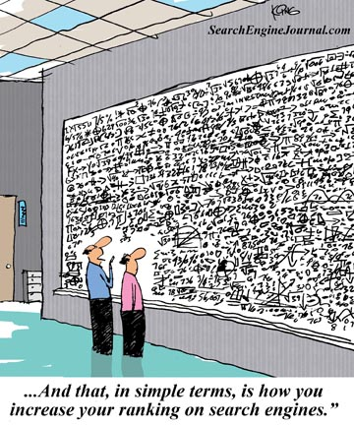
High Level Trigger
Pack the knowledge of tens of thousands of physicists and decades of research into a huge sophisticated algorithm
Several 100.000 lines of code
Takes (only!) a few 10 - 100 milliseconds per collision
“And this, in simple terms, is how
we find the Higgs Boson”
Notes:
To find the Higgs Boson or other rare events among the remaining 100.000 or so collisions we need the collected knowledge of the physicists working at LHC. All this physics knowledge brought together over generations is incorporated in huge, highly sophisticated computer programs, which despite their size take only a fraction of a second to run on a modern computer.
These programs will select the most promising collisions. The selected collisions will be written to permanent storage and kept for further analysis by physicists.
Despite the speed of the algorithms a huge number of computers is required to perform this selection, because so many collisions need to be decided upon every second.

Slide 30
High Level Trigger: Key Figures
Existing code base: 5 MLOC of mostly C++
Almost all algorithms are single-threaded (only few exceptions)
Currently processing time on a X5650 per event: several 10 ms / process (hyper-thread)
Currently between 100k and 1 million events per second are filtered online in each of the 4 experiments

Slide 31
Reconstruction & Analysis

Slide 32
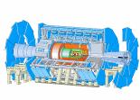

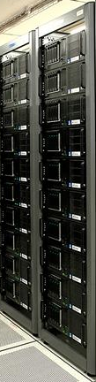

Data Handling and Computation for Physics Analysis
Online
Offline Reconstruction
Online trigger
and filtering
Selection &
reconstruction
detector
Processed
Data (Active tapes)
Event
summary
data
Offline Analysis w/ROOT
Raw
data
10%
100%
Batch
physics
analysis
Event
reprocessing
1%
Offline Simulation
w/GEANT4
Event
simulation
Analysis objects
(extracted by physics topic)
Interactive
analysis

Slide 33
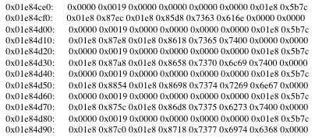
Reconstruction
Small part of a collision
Address = which detector/sensor has read these data?
Data = what was detected?
Reconstruction = Conversion of electronic signals into physical „objects“
Track: φ = 0.23, η = 0.75, p_{T} = 2.3 GeV/c
Probability to be a Pion: 70%, Kaon: 28%, Proton: 2%

Slide 34
Reconstruction steps
Abstraction of electronic signals from the detector
  Detector-element 1244 has measured a signal of 120 at time 1333096259.344245
  → Signal at position x = 1.2 cm, y = 4.5 cm, z = 3.2 cm, deposited energy of 100 keV
  Requires precise information about location of the detector element (alignment) and of its signal sensitivity (calibration)
Particles frequently create signal in adjacent detetor-elements These signals are combined into “clusters”
The clusters are combined into “tracks” (pattern-recognition)
Tracks are combined to reconstruct collision points (“primary vertices” == where an orignal beam-proton has hit another beam-proton) and decay (“secondary” and “tertiary”)) vertices

Slide 35
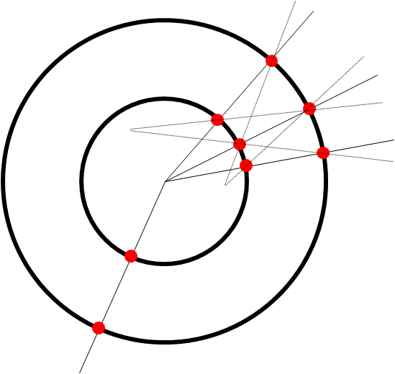
Pattern recognition
Recognition of tracks
  Straight in the direciton of the magentic field
  Deviation on a curved trajectory in a normal plane around the magentic field
  → radius of curvature allows to determine the momentum
Primary vertex
Secondary vertices
  Allows detection of particle decays

Slide 36
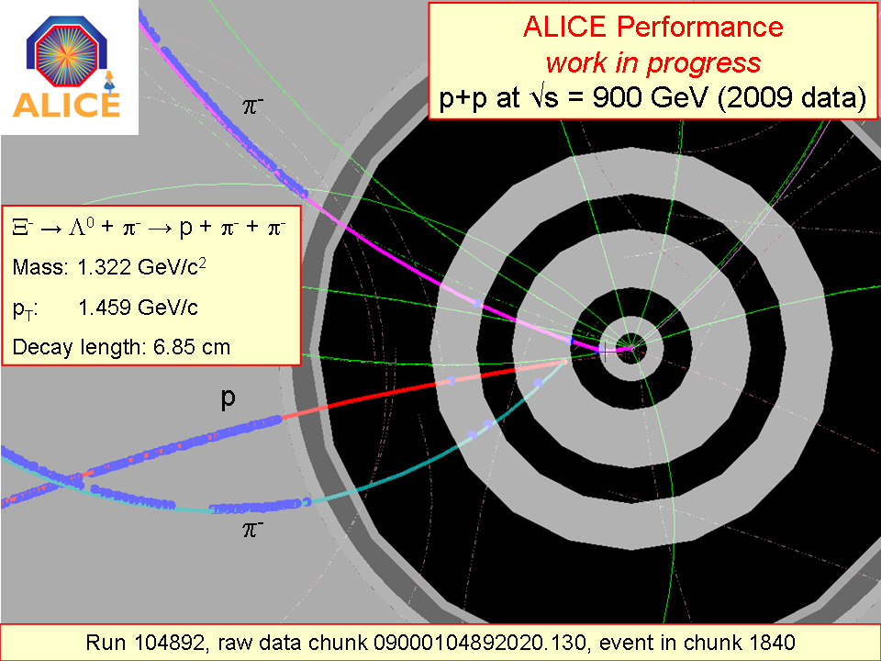
Pattern-recognition(2)
π
p
Ξ
Λ
π

Slide 37

Combination of detector-systems

Slide 38
Simulation
Understanding the detector-response requires a detailed simulation
A detector-simulation tries to reproduce the behaviour of the detector as faithfully as possible
HEP simulation software consists of
  Physics simulator: simulates which elementary particles are created by a collision in the detector: e.g. Pythia
  Geometry: detailed description of all active(= capturing signals) and passive (= mechanical support, cooling, power-supply, …) elements in the detector
  Particle transport: simulates the interactions of particles with the material of the detector. E.g. GEANT4
    Particles can be deflected, absorbed, they can decay or even be created
    Energy-transfer is recorded in detail
Afterwards the simulated signals are passed through the exact same reconstruction chain as the “real” data

Slide 39
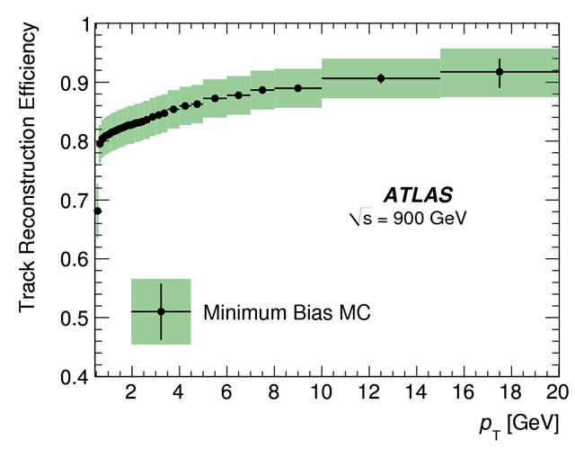
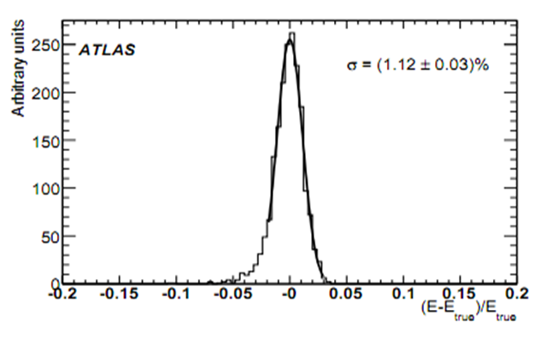
Simulation (2)
Simulation results allow to estimate the influence of the detector itself on the measurements
Important examples
  Track reconstruction efficiency – how probable is it to actually find a track?
  Resolution – how precise is a known quantity being measured?
  Error-rate / ghost-rate ("fake rate") – how often do we reconstruct a particle where there actually was none?
Effizienz
p_{T} (GeV/c)
Relative Abweichung der Energie

Slide 40
Analysis
Interpretation of reconstruction results (tracks, vertices, calorimeter information)
  Processing of many collisions to get a statistically significant result
  Most frequent task for the (research) physicist
Work-flow:
  Selection of suitable collisions
  Combination of required quantities extracted from the collisions (often in histograms)
  Correction of detector effects
  Extraction of physical quantities
  Estimation of uncertainties
  Comparision of results with theoretical predictiosn
Sociology: while reconstruction is usually a “central” task done by a relatively small team of dedicated “experts”, analysis is being done by many (almost) all groups and/or individuals collaborating in an experiment.

Slide 41
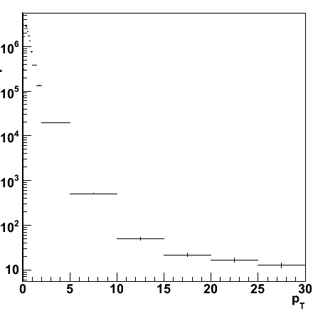
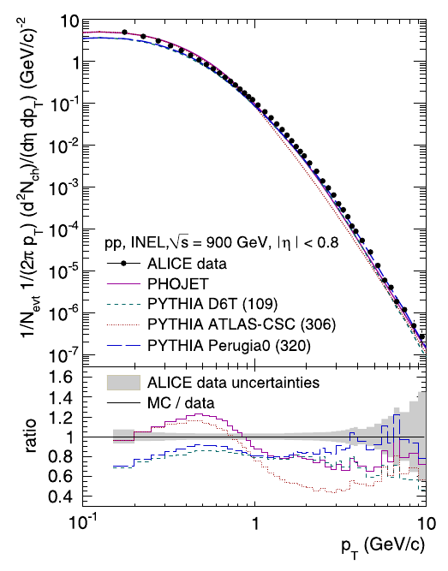
Analysis – Example: momentum distribution
Reconstruction-
efficiency
(from simulation)
Question: How many particles have
which momentum and how often?
efficiency
Reconstructed
collisions
extraction of
measurements in
a “histogramm"
result+ comparison
with model
p_{T} (GeV/c)
Correction
of detector-
effects
Particles per GeV/c
Momentum distribution
p_{T} (GeV/c)
This is of course simplified ☺
p_{T} (GeV/c)

Slide 42
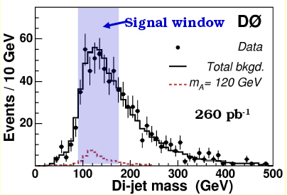
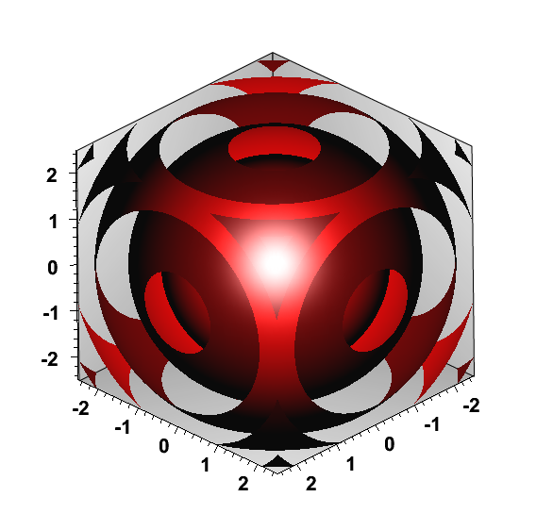
The ROOT framework
Histogramm:
ROOT is a large, object-oriented framework for data-processing and analysis
Being developed at CERN with a core team of professional developers and many contributions from the community
Implemented in C++
Comprehensive 2D and 3D Tools for visulalization of data
Libraries for mathematics and statistics
Can be used as a library (from scripts and applications) or as a stand-alone program for data-analysis
Available for Linux, Mac, Windows
3D Funktion:
Information & Download
→ http://root.cern.ch

Slide 43
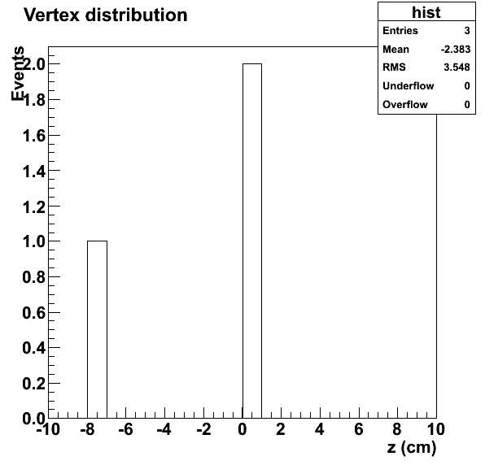
Example: ROOT histogram
Histogramms store data in value intervals (“bins")
  A measurement value is “put” into a bin
  of appropriate width
  This allows visualization and statistical
  analysis
Histogrammbeispiel (C++ code)
hist = new TH1F("hist", "Vertex distribution
;z (cm);Events", 20, -10, 10);
hist->Fill(0.05);
hist->Fill(-7.4);
hist->Fill(0.2);
hist->Draw();

Slide 44
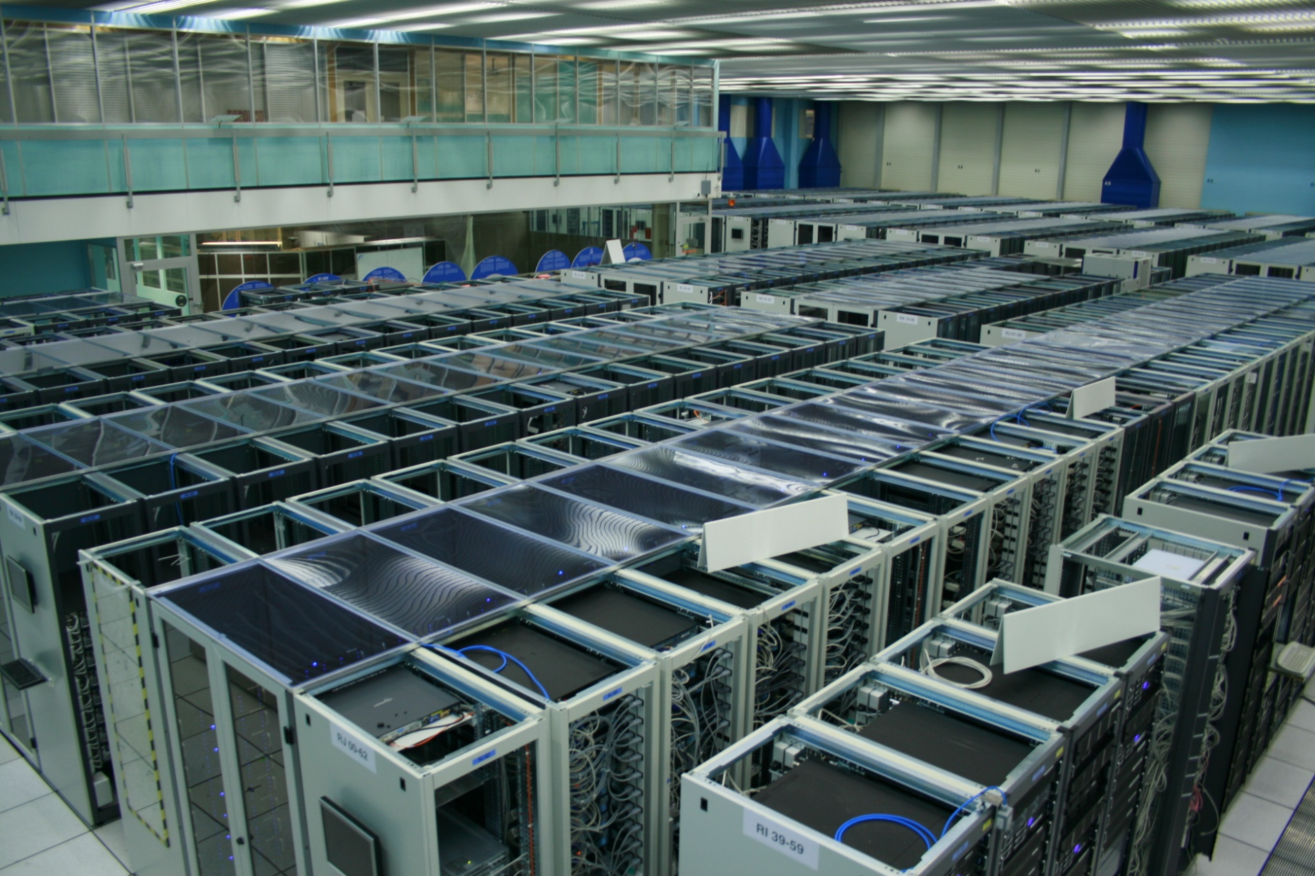
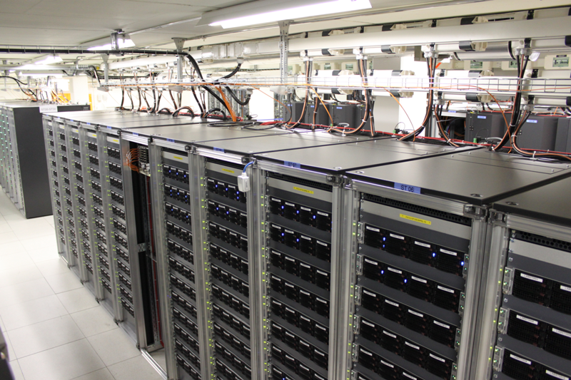
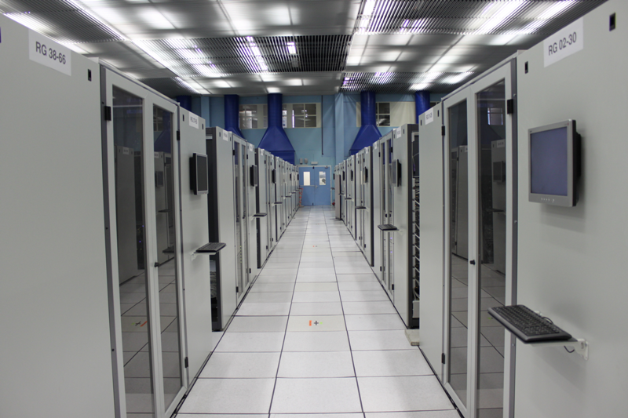
IT facility

Slide 45
Data to keep

Slide 46
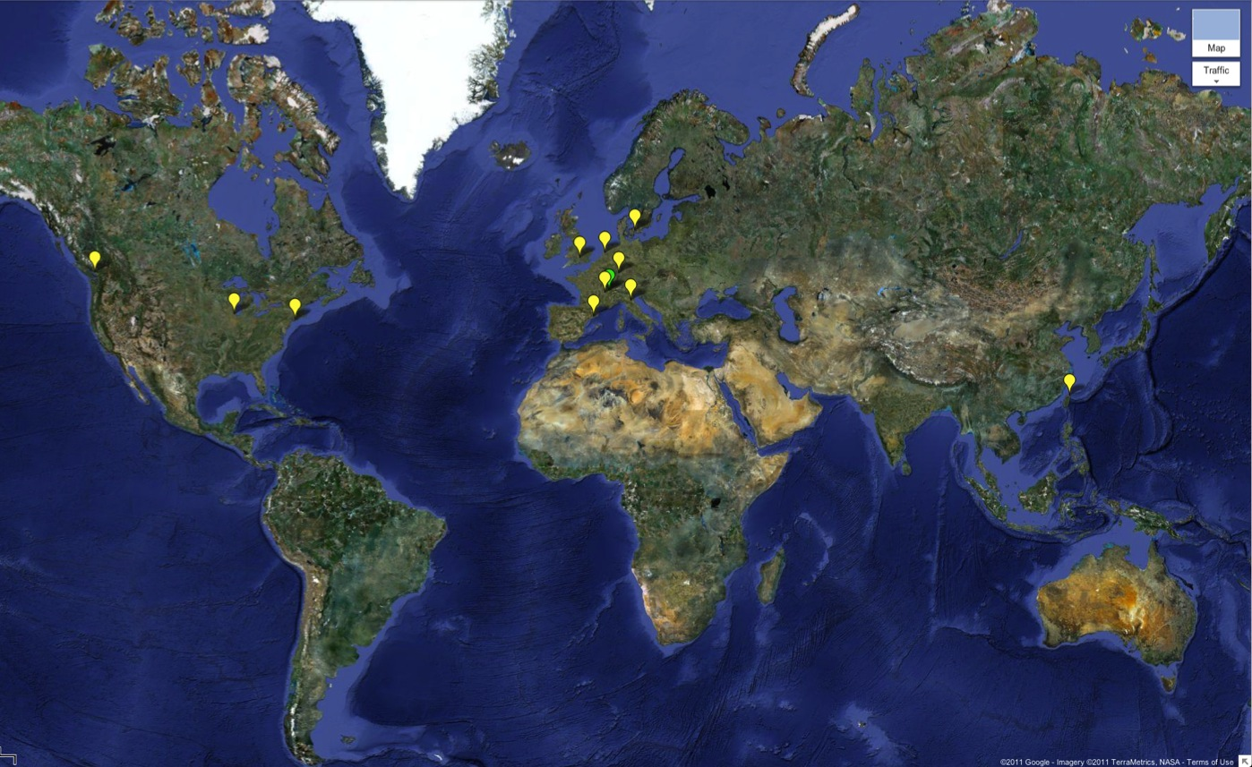

WLCG: A global collaboration…
Tier-0 (CERN):
Data recording
Initial data reconstruction
Data distribution
Tier-1 (11 centres):
Permanent storage
Re-processing
Analysis
Tier-2 (~140 centres):
Simulation
End-user analysis
~150 sites
>250k CPU cores
>150 PB disk
Tier 0
Tier 1
Tier 2

Slide 47
Summary
CERN is the leading particle physics laboratory in the world hosting more than 100 experiments
The flagship programme is the LHC, whose experiments produce an unprecedented amount of data
Sophisticated IT is needed at all stages to cope with these data
The IT needs of the experiments are always growing and (often) more interesting physics requires more networking and more computing, while budgets stay constant ☺

