Slide 2
CERN
Outreach in the International Context
Dr. Sascha Marc Schmeling
CERN

Slide 3
@CERN – A New Sector is Born
International Relations
Education, Communication, and Outreach
Audiovisual Production Service
Design and Visual Identity Service
Stakeholder Relations
Member States
Editorial Content Development
Media and Press Relations
Global Constituency Engagement
Visitors and Local Engagement
Teacher and Student Programmes
Non-Member States
Host States
International Organizations
Partnerships and Fundraising
Protocol Office

Slide 4
Activities
Education, Communication, and Outreach

Slide 5
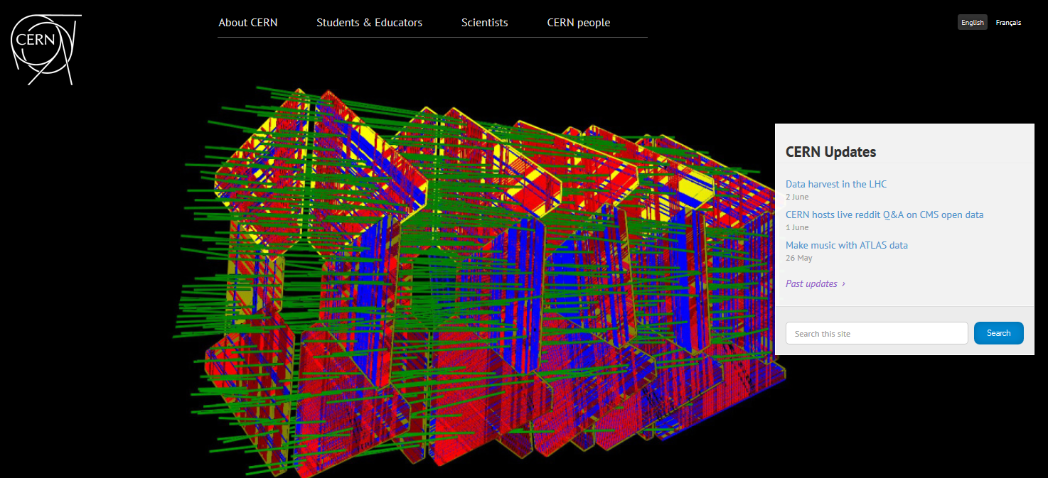
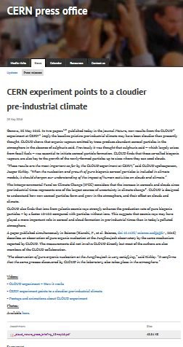
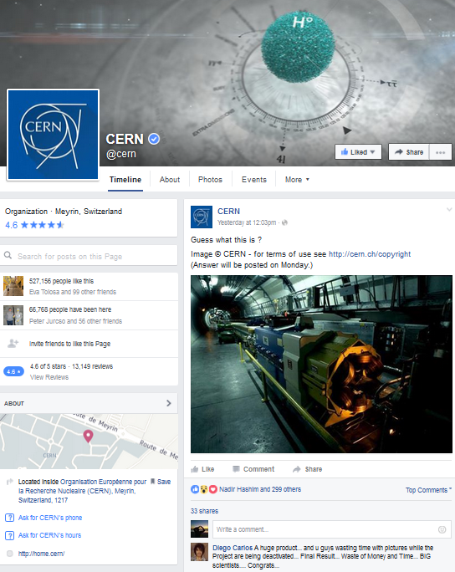
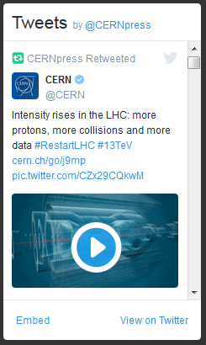
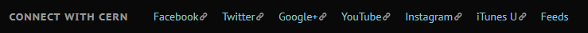
Press & Media • Editorial Content

Slide 6
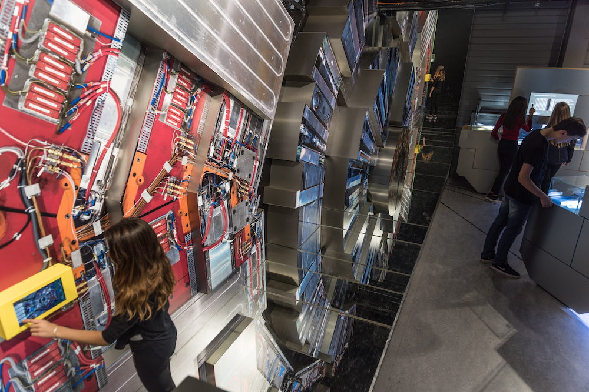
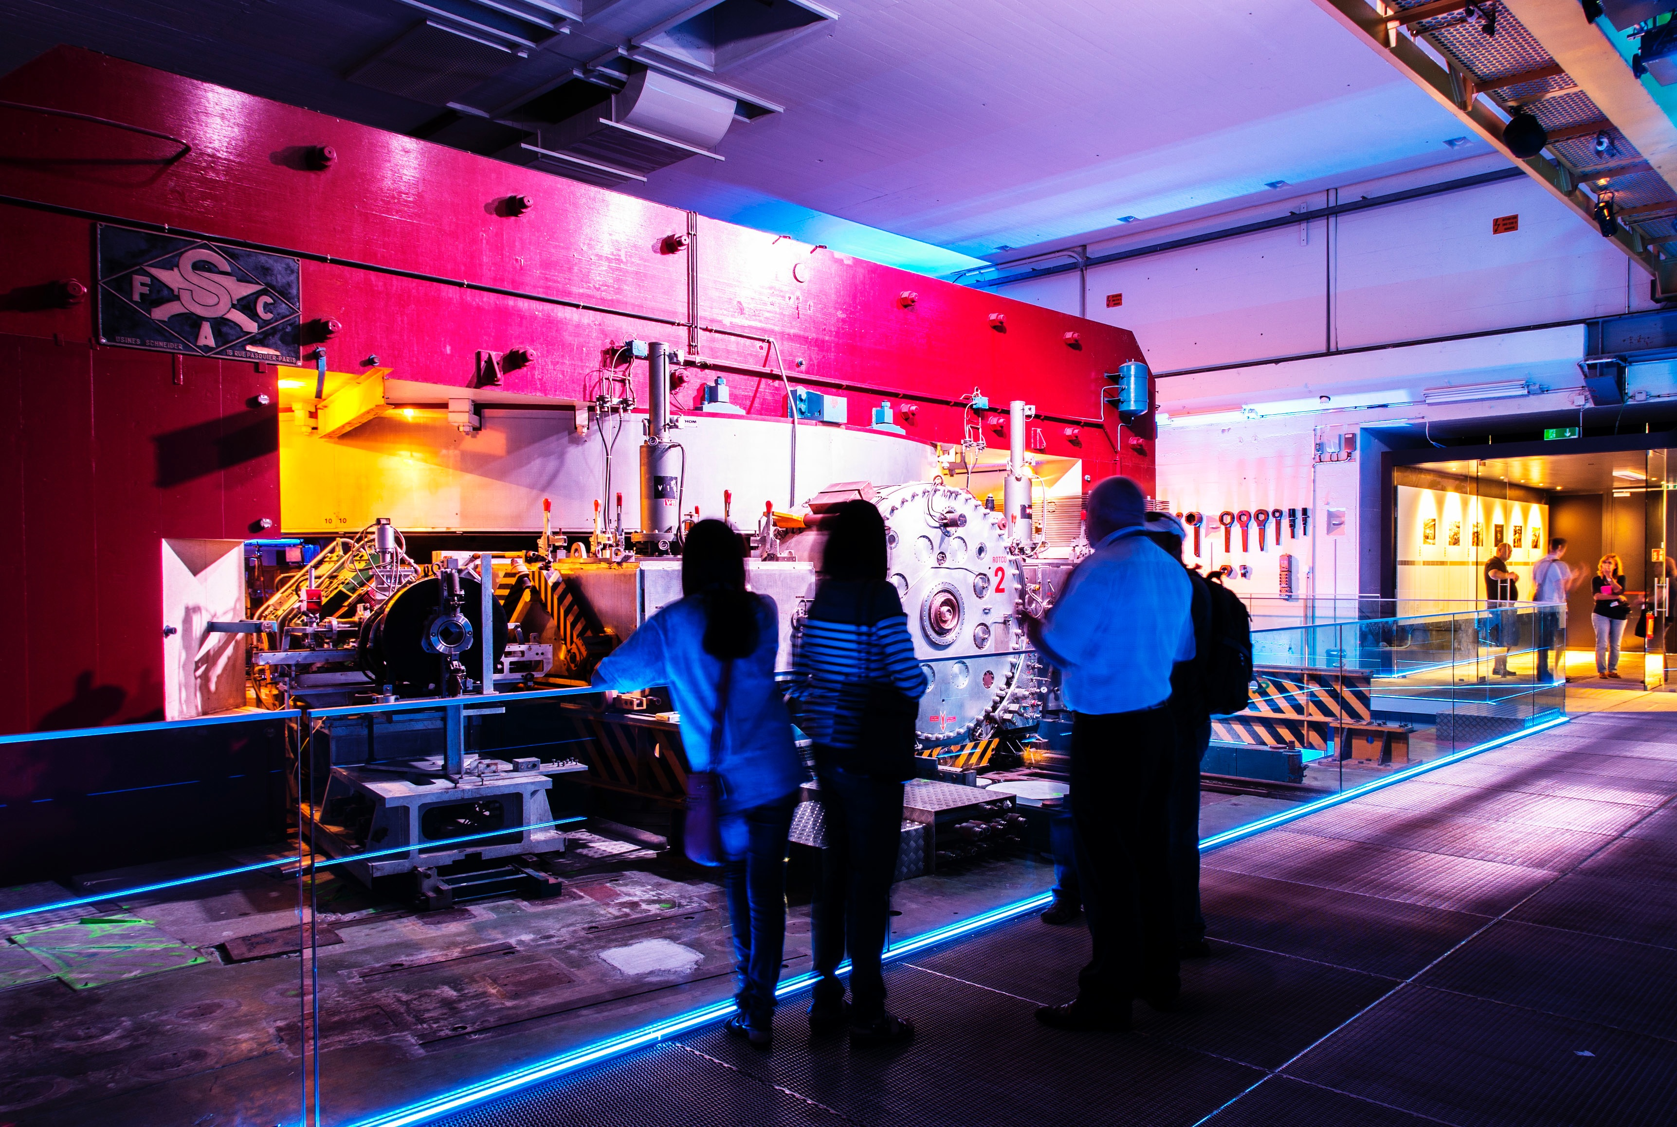
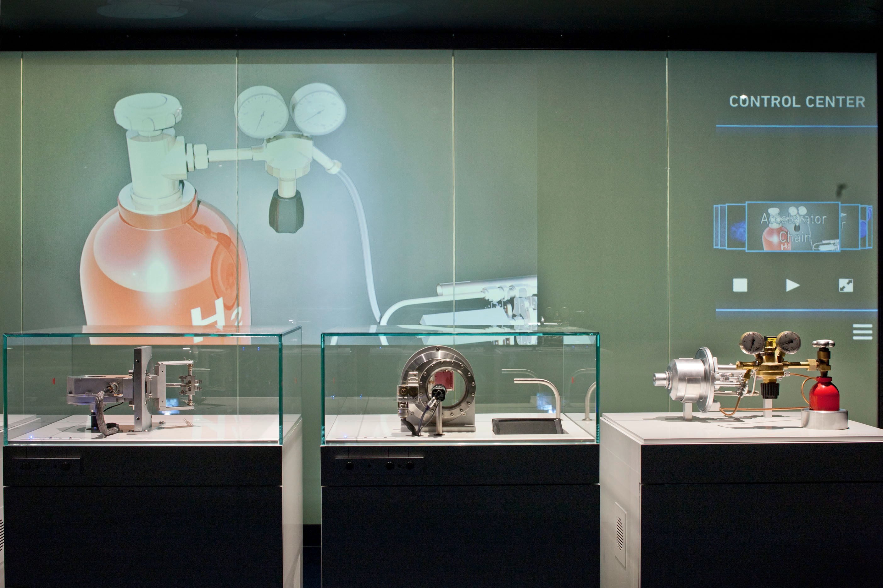

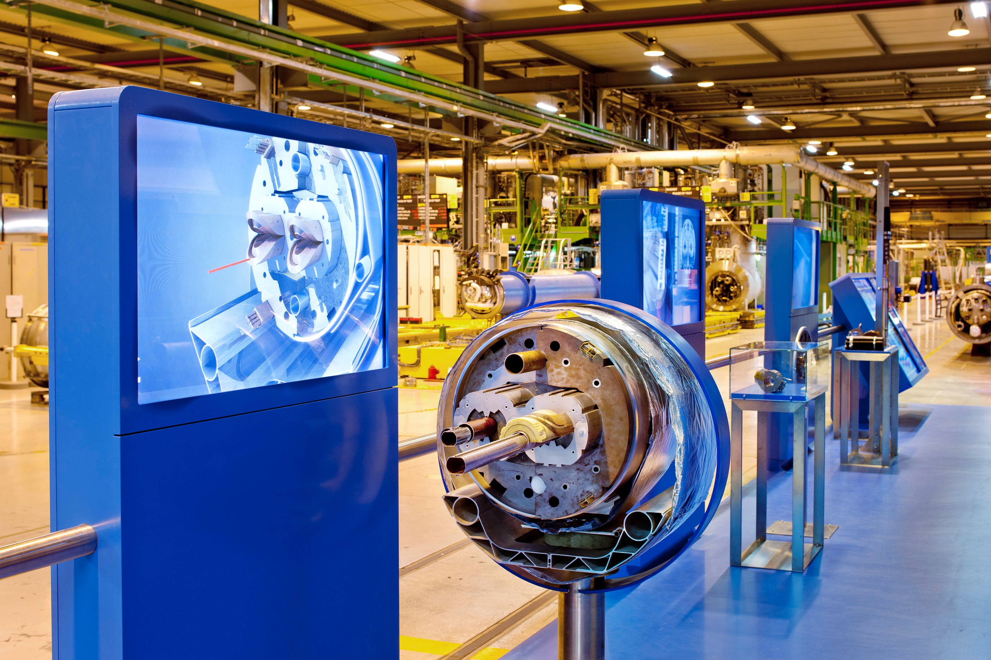
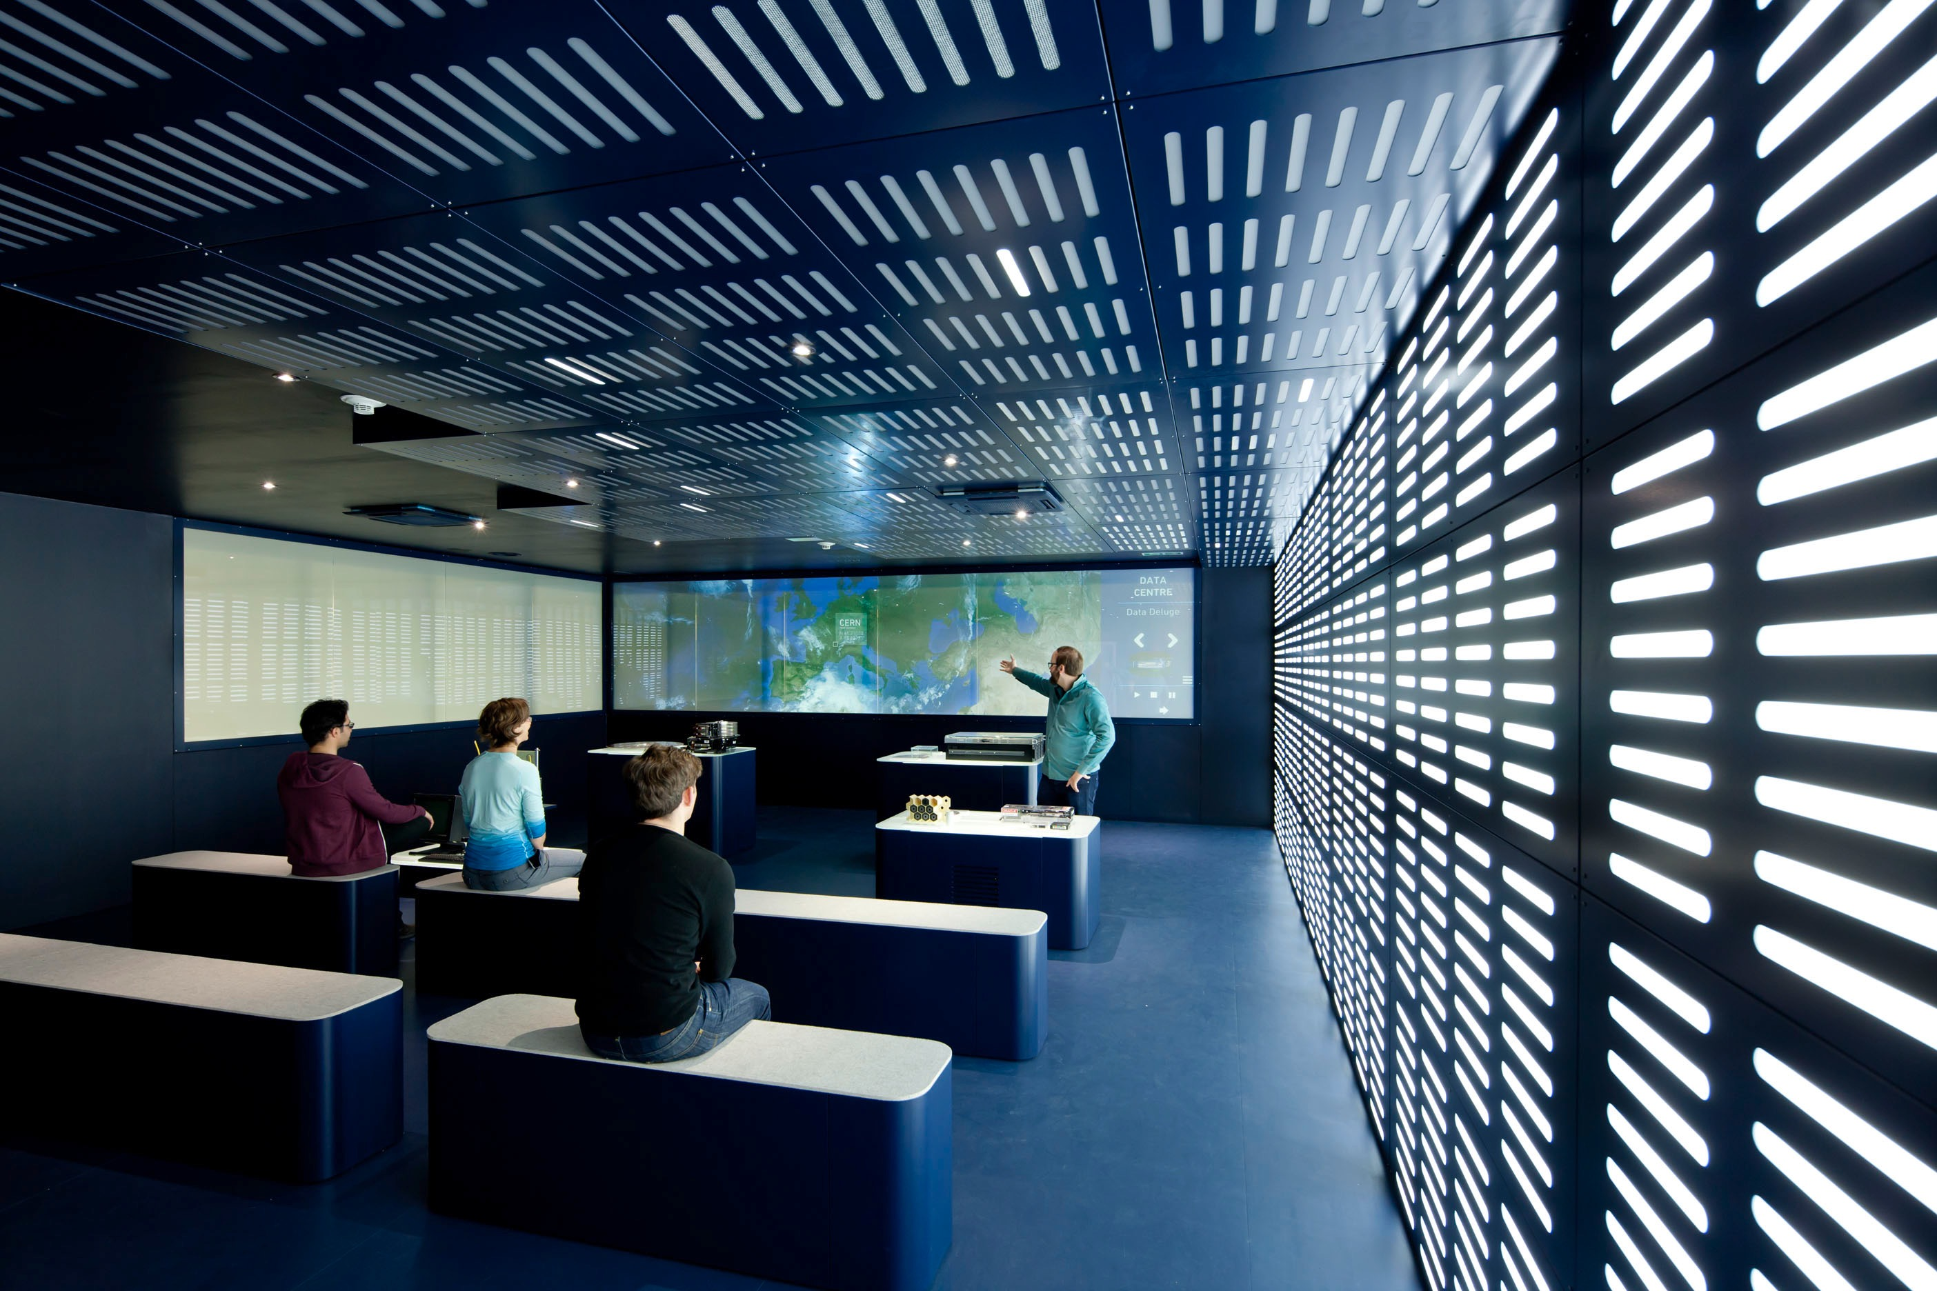
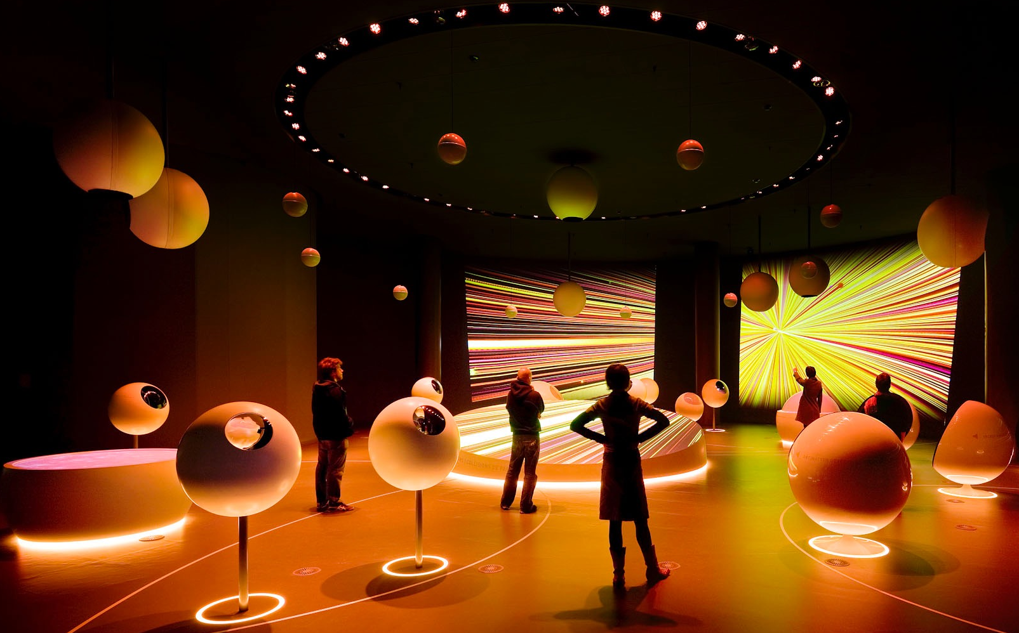
Global Constituency Engagement
Universe of Particles
SynchroCyclotron
CERN Control Centre
Universe of Particles
SM18
Data Centre
Creation of
immersive exhibitions
interactive visits points

Slide 7


Slide 8
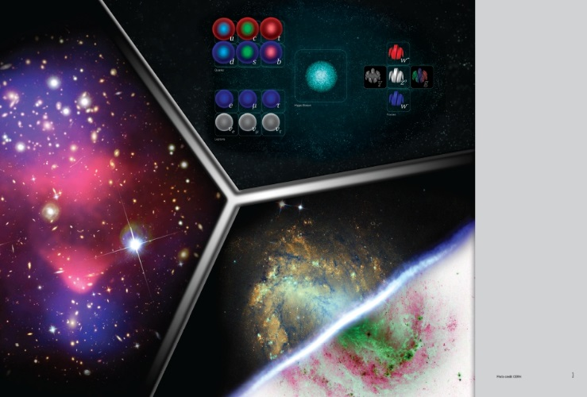
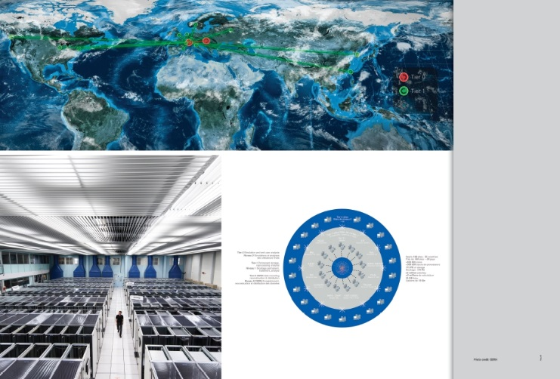
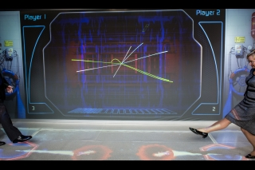
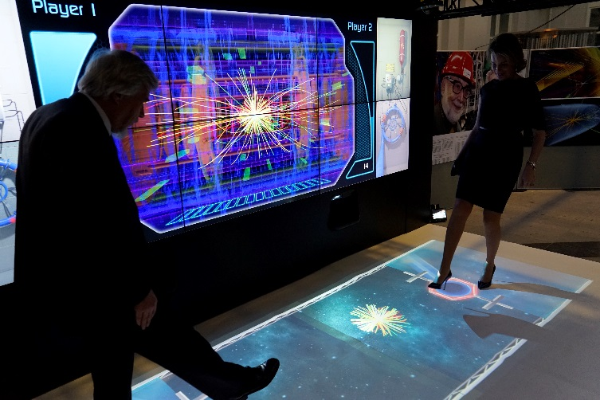
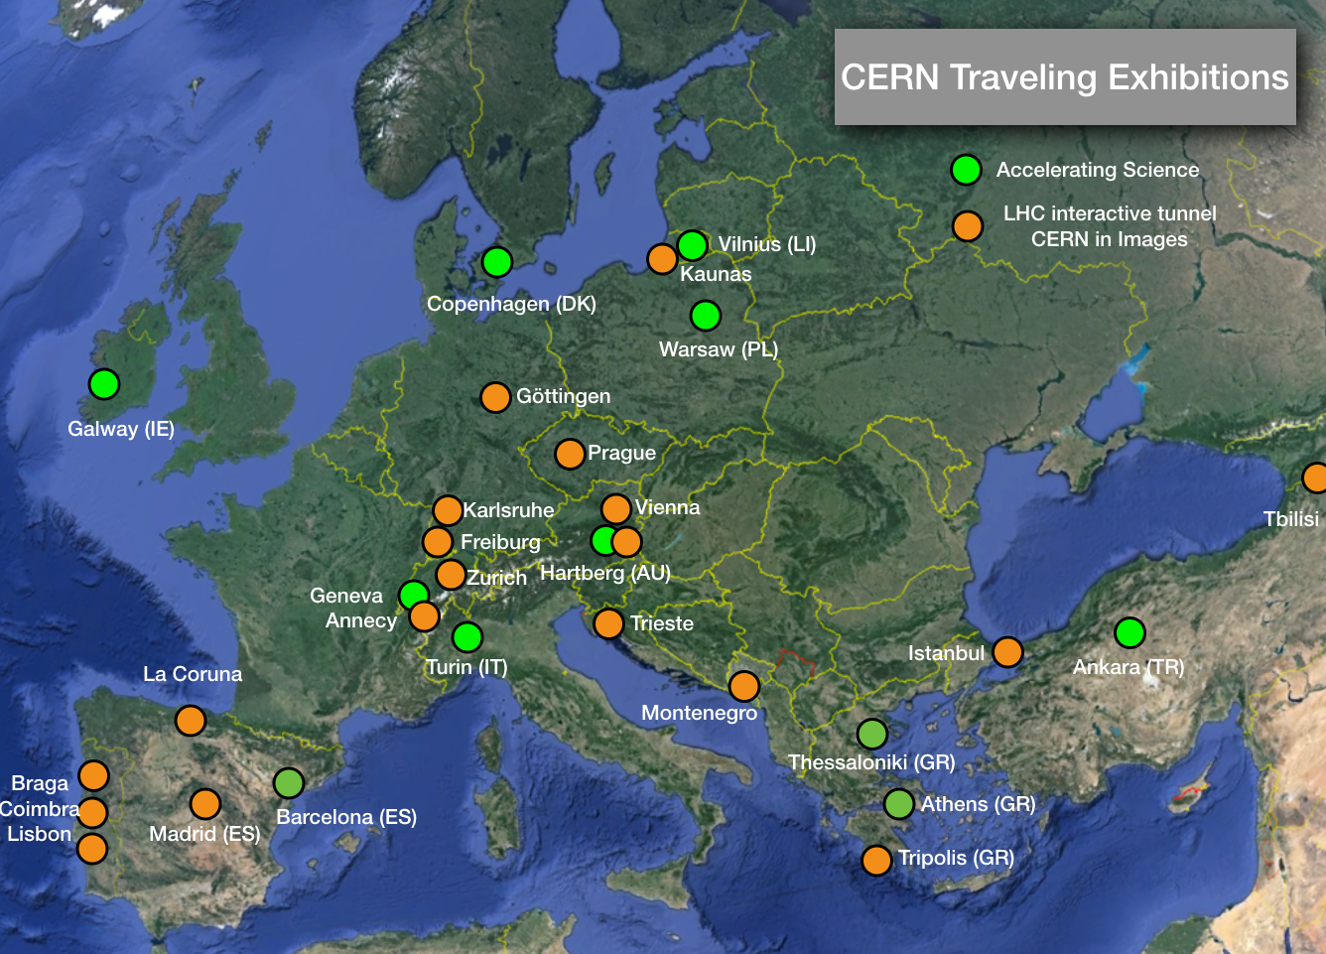
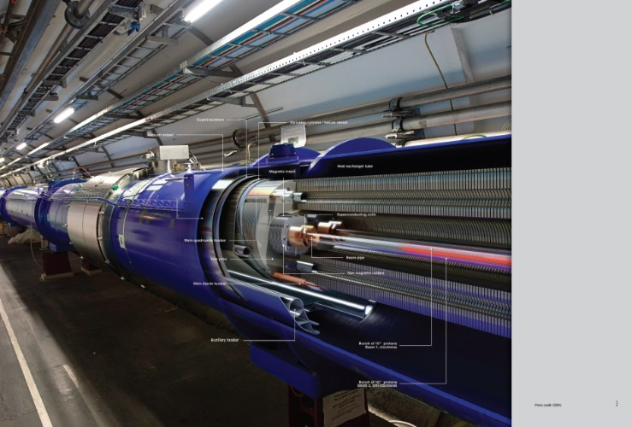
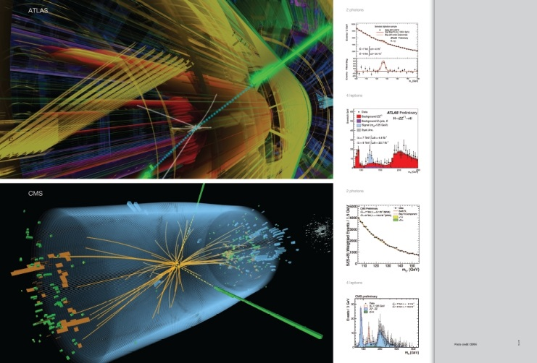
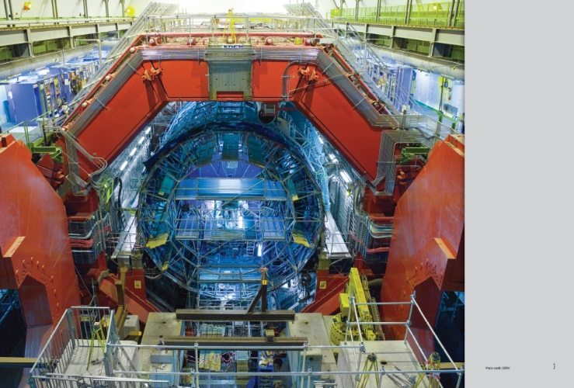
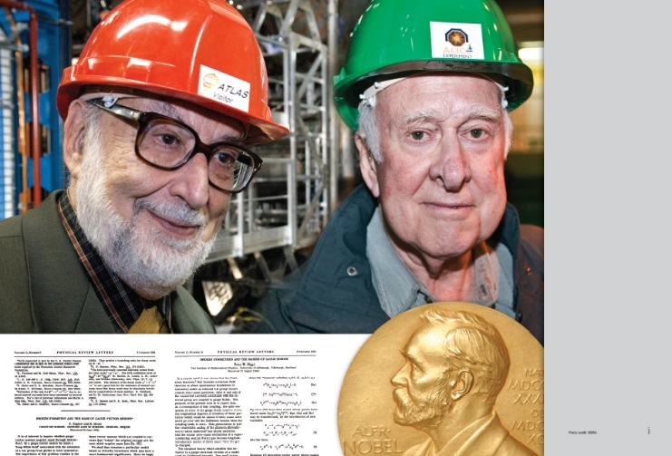
CERN in Images • LHC Interactive Tunnel

Slide 9

Arts@CERN – Science & Art meet in three Ways
Collide@CERN – 3 months residency • since 2011
  explores elements even more elusive than the Higgs Boson: human ingenuity, creativity, and imagination
  competitive open calls - fully funded residency
  Accelerate@CERN – 1 month residency • since 2014
  two artists from two different countries
  in cooperation with partner countries
  (e.g. Austria, Taiwan, Lithuania, UAE)
  Visiting Artists programme – 1-2 days CERN visit
  up to 12 artists are invited on self-funded tours
  programme fully booked until 2017

Slide 10
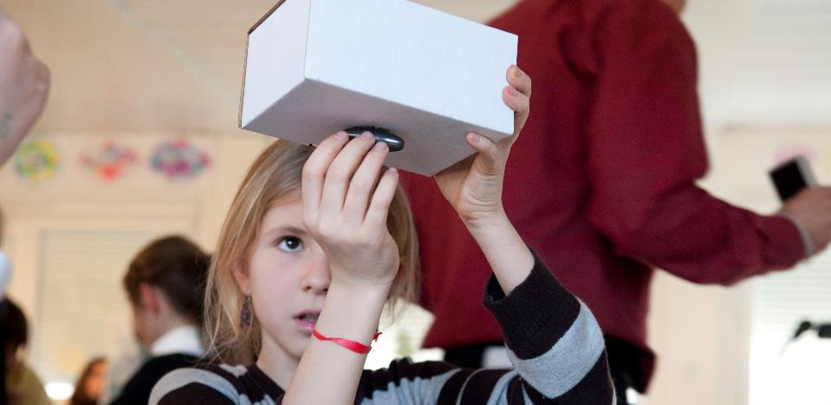
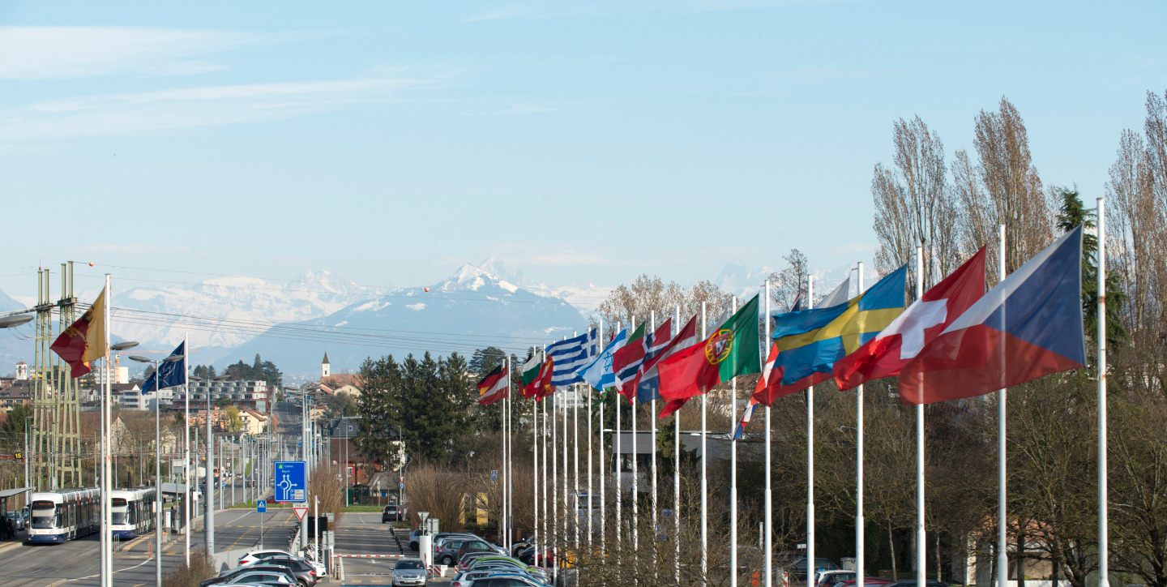
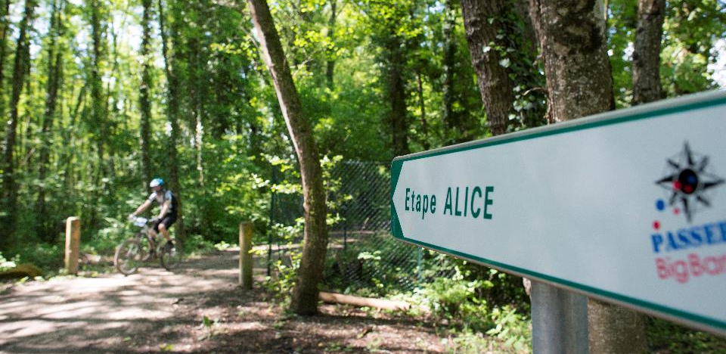

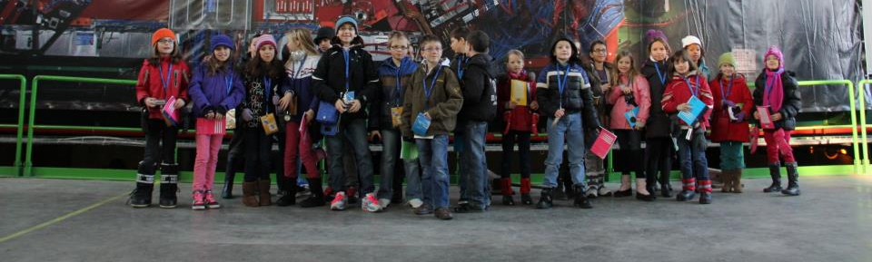
Visiting CERN • Local Engagement
Various activities for locals, regionals, and internationals at the CERN site.
Thanks for your support!

Slide 11
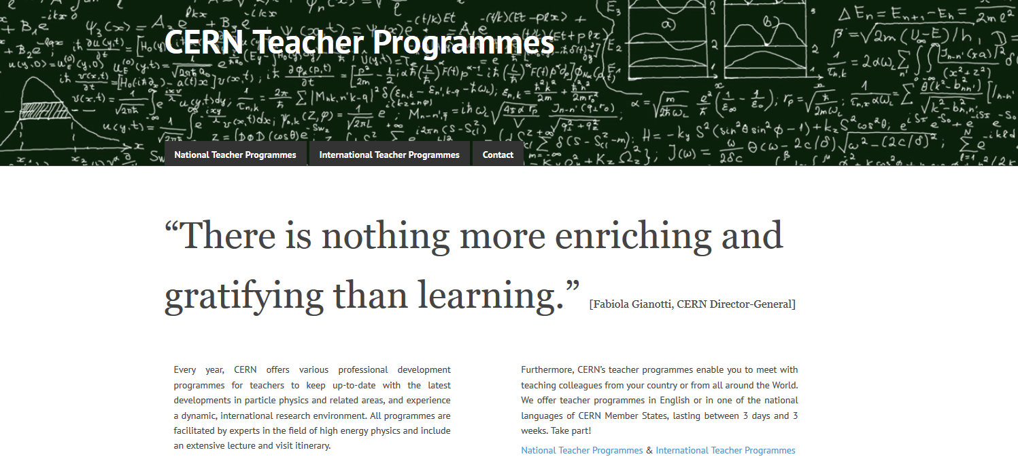
Teacher Programmes

Slide 12
Teacher Programmes
National Teacher Programmes in the language of the country | 4-6 days
focus on visits and lectures
International Teacher Weeks in English | 2 weeks
focus on visits and lectures
International Teacher Programme “HST” in English | 3 weeks
focus on collaboration
new
starting in 2017

Slide 13
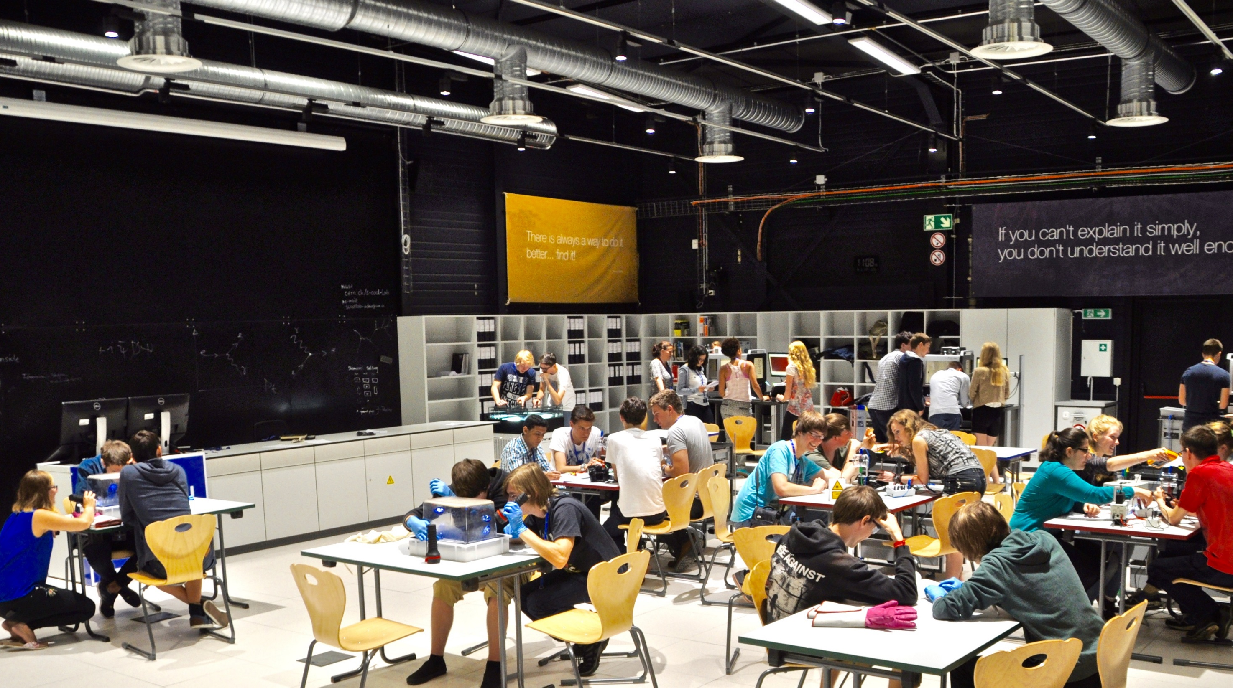


Slide 14

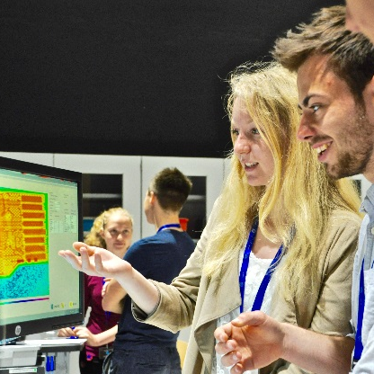
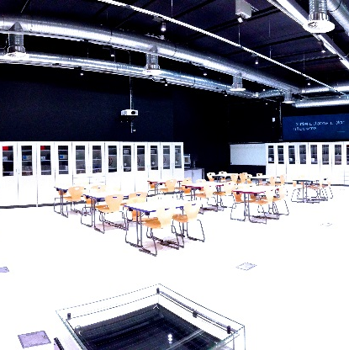
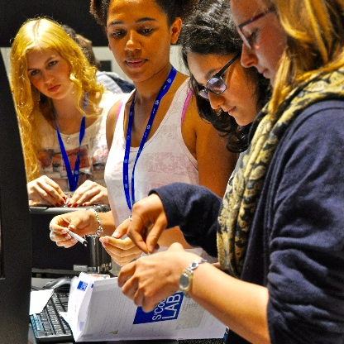
What is S’Cool LAB?
Notes:
Use new pictures

Slide 15
hands-on particle physics learning laboratory
For high-school students and teachers
International audience from more than 20 countries
Independent experimentation in small groups
Notes:
40 000 students per year
570 from Czech rep.

Slide 16
200 m² modular laboratory space at CERN
State-of-the-art IT equipment incl. videoconferencing
Showcase for experiments for schools linked to CERN’s scientific programme and technologies

Slide 17
test bed for physics education research
Development and evaluation of student activities accompanied by research in physics education

Slide 18


Aims of S’Cool LAB
UNDERSTAND
DISCOVER
Make CERN’s physics and technologies understandable to students through hands-on experimentation
Give insights into the working methods, technologies, and research of the world's largest particle physics laboratory

Slide 19
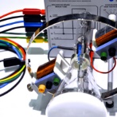
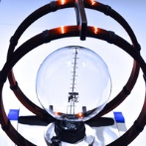
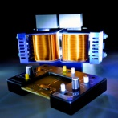
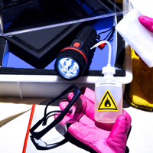
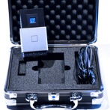
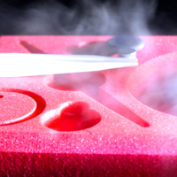
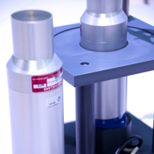
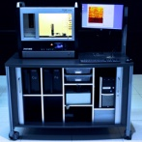
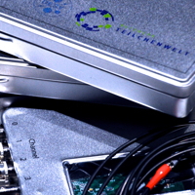
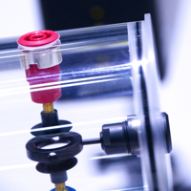
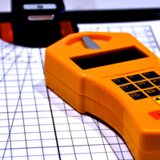
Experiments
Particle Acceleration
Basics & Applications
Particle Detection
electrons & electric fields
HALL effect
FRANCK-HERTZ experiment
cloud chambers
supercon-ductivity
electrons & magnetic fields
PET
scintillation detectors
pixel detectors (MEDIPIX)
particle traps
RUTHER-FORD experiment
PLANCK’s constant
X-ray
machines
ionisation chambers
… and many more to come

Slide 20

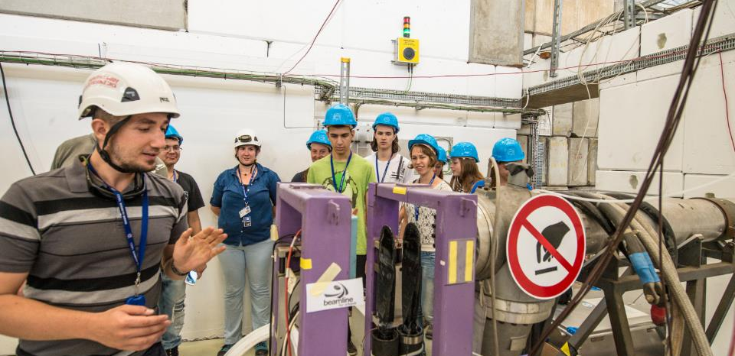
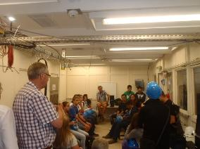
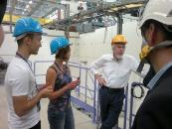
Beamline for Schools
international competition
selection by a large team of evaluators
followed by a complete approval process through the appropriate scientific committee
2016:
  151 teams
  1260 students
  ⅓ girls
  ⅓ non-member states
  2 winning teams

Slide 21
Services
Education, Communication, and Outreach

Slide 22


Slide 23


Slide 24
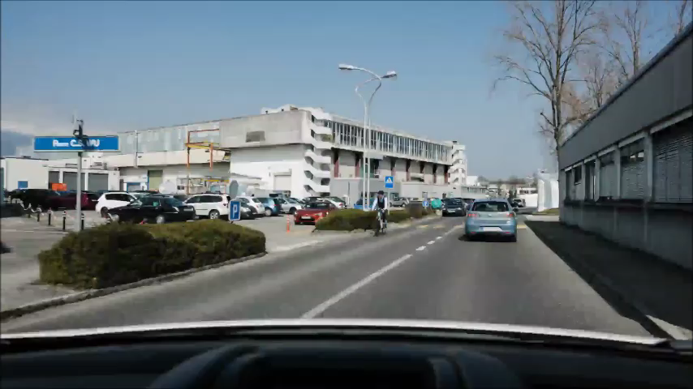
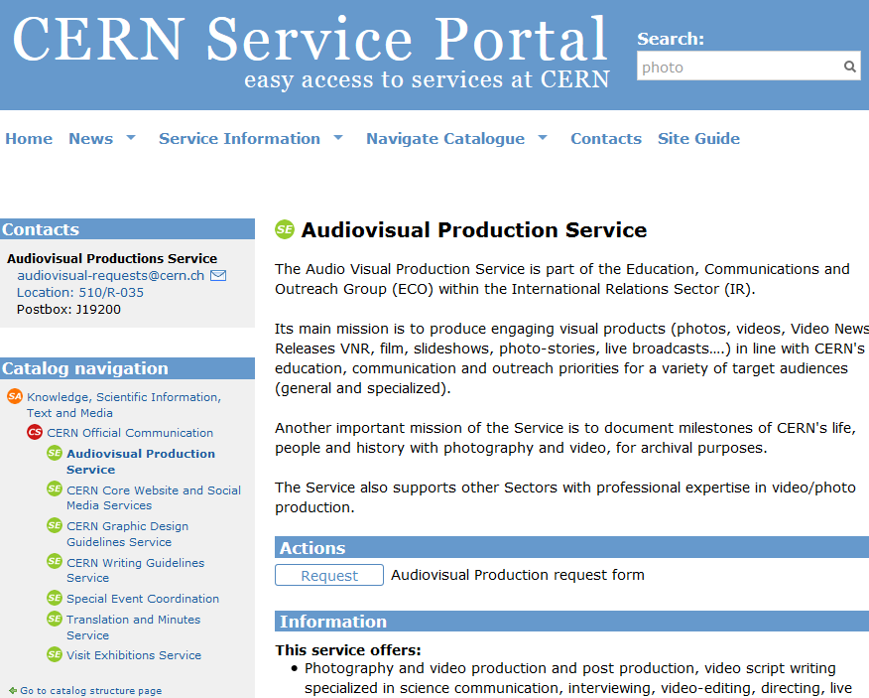
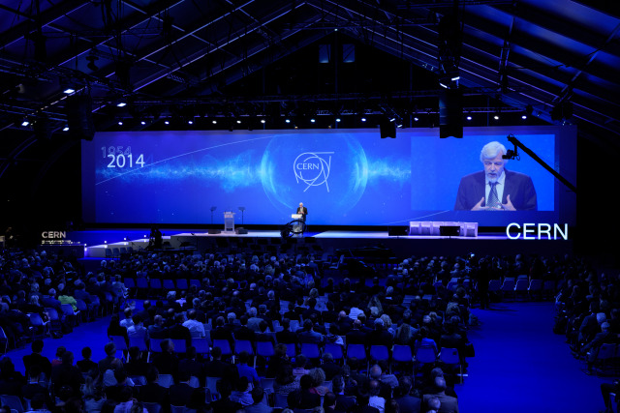
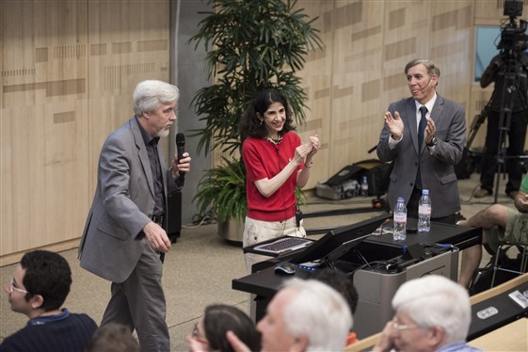
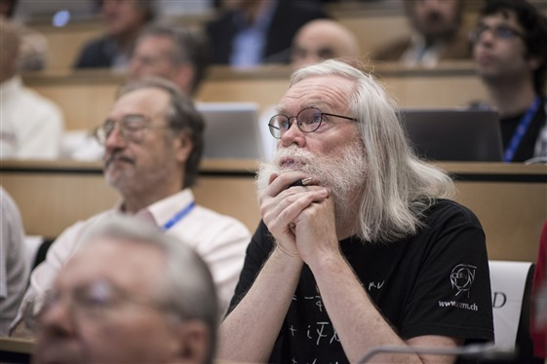
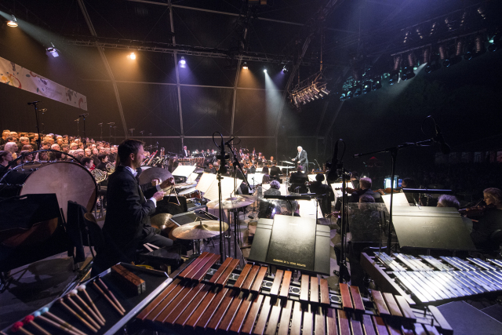
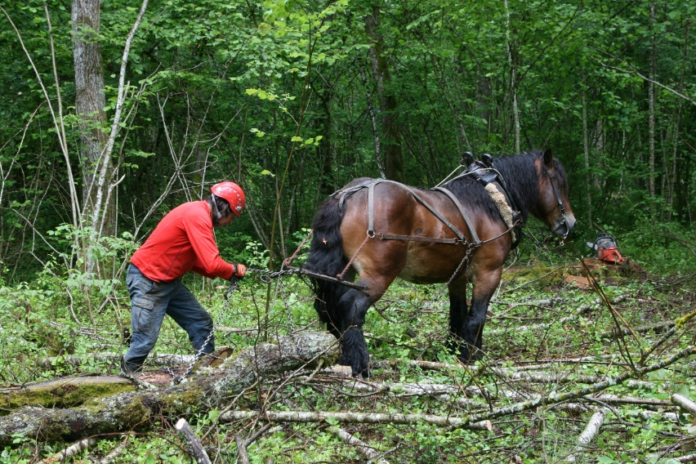
Audiovisual Production Service

Slide 25
Protocol
… a very special visits service …
International Relations

Slide 26







Protocol – A very special Challenge
Create an Emotion
sometimes
acrobatic
Create a
memorable
moment

Slide 27

Big Outreach Events … on the Horizon
two “big” outreach events coming up these years
OpenDays in 2019 during LS2
(May or October)
one new event format in 2017
stay tuned!

