Slide 1
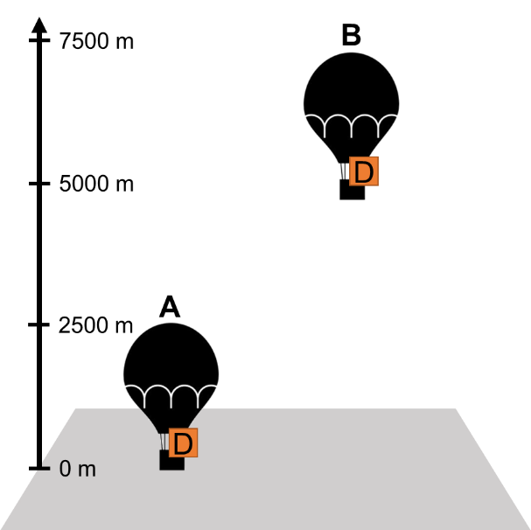
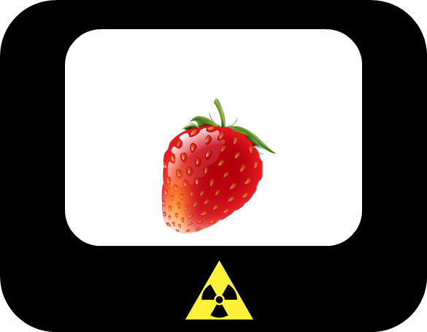

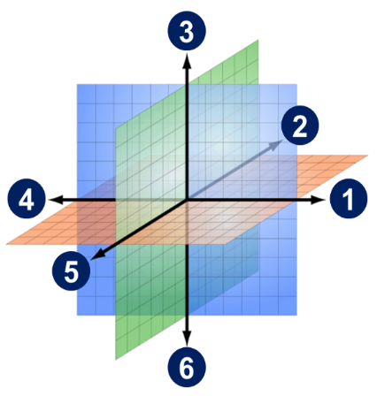
Students‘ conception of particle physics – part II
julia.woithe@cern.ch

Slide 2
Outline
Electromagnetism / Lorentz force
  Students‘ conceptions
  Idea behind the items
  Results students
  Results HST 2016
Cosmics
Radiation (X-rays / gamma radiation)
Some links

Slide 3
Electromagnetism

Slide 4

Students‘ conceptions – electromagnetism
Students mix up electric fields and magnetic fields (Maloney 1985), (Maloney, O’Kuma, Hieggelke & Van Heuvelen 2001), (Scaife & Heckler 2011)
Students think that the poles of a magnet have an electric charge (Maloney, O’Kuma, Hieggelke & Van Heuvelen 2001)
Students think that the magnetic noth pole / south pole attracts / repells electrically charged particles (Maloney, O’Kuma, Hieggelke & Van Heuvelen 2001)
Students think that electrically charged particles are only deflected in a magnetic field if they move exactly perpendicular to the magnetic field (Bagno & Eylon 1997) vs. electrically charged particles are always affected by a magnetic field no matter whether they are in rest or move parallel to the field
Mechanics: objects only move when a force acts on them
Advanced: spin of the neutron (1/2) causes magnetic moment -> force
$$\vec{F}=∇\left(\vec{μ}∙\vec{B}\right)$$

Slide 5
Literature – electromagnetism
Bagno, E., Eylon, B. (1997). From problem solving to a knowledge structure: An example from the domain of electromagnetism. American Journal of Physics, 65
Maloney, D. (1985). Charged poles. Physics Education, 20
Maloney, D., O’Kuma, T., Hieggelke, T., Van Heuvelen, A. (2001). Surveying students conceptual knowledge of electricity and magnetism. American Journal of Physics, 69
Scaife, T., Heckler, A. (2011). Interference between electric and magnetic concepts in introductory physics. Physical review special topics – Physics education research, 7

Slide 6
Does a force act on the proton due to the bar magnets?
Students before S‘Cool LAB (N=39)
Teachers (N=47)
67% force | 33% no force
  If force: ① 48% ② 22%
avg. confidence: 58%
Students after S‘Cool LAB (N=38)
32% force | 68% no force
avg. confidence: 74%
43% force | 57% no force
  if force: ① 58% ② 32%
avg. confidence: 70%
avg. difficulty: 65%

Slide 7

Does a force act on the proton due to the bar magnets?
Students before S‘Cool LAB (N=35)
Teachers (N=44)
34% force | 66% no force
  If force: ① 58% ④ 42%
avg. confidence: 57%
Students after S‘Cool LAB (N=37)
30% force | 70% no force
  If force: ① 54% ④ 15%
avg. confidence: 74%
18% force | 82% no force
  if force: ① 43% ② 29% ④ 14%
avg. confidence: 74%
avg. difficulty: 62%

Slide 8

Does a force act on the proton due to the bar magnets?
Students before S‘Cool LAB (N=33)
Teachers (N=45)
97% force | 3% no force
① 30% ② 20% ⑤ 27%
avg. confidence: 55%
Students after S‘Cool LAB (N=37)
97% force | 3% no force
① 14% ② 14% ⑤ 67%
avg. confidence: 78%
91% force | 9% no force
① 10% ② 17% ⑤ 57%
avg. confidence: 67%
avg. difficulty: 63%

Slide 9

Does a force act on the electron due to the bar magnets?
Students before S‘Cool LAB (N=35)
Teachers (N=45)
100% force | 0% no force
①25% ② 21% ④18% ⑤18%
avg. confidence: 64%
Students after S‘Cool LAB (N=37)
100% force | 0% no force
① 8% ② 58% ④ 11% ⑤ 18%
avg. confidence: 75%
91% force | 9% no force
①10% ② 58% ④3% ⑤18%
avg. confidence: 70%
avg. difficulty: 64%

Slide 10

Does a force act on the neutron due to the bar magnets?
Students before S‘Cool LAB (N=17)
Teachers (N=45)
6% force | 94% no force
7% force | 93% no force
avg. confidence: 81%
avg. difficulty: 58%

Slide 11
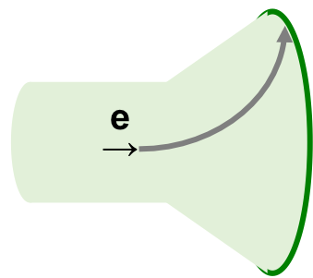
Students before S‘Cool LAB (N=24)
Teachers (N=43)
② 29% ③ 29% ⑤ 29%
avg. confidence: 64%
Students after S‘Cool LAB (N=37)
② 29% ③17% ⑤ 43%
avg. confidence: 75%
② 12% ③ 26% ⑤ 51%
avg. confidence: 73%
avg. difficulty: 67%

Slide 12
Summary
Items are difficult for students even after intruction
Students seem to learn something in S‘Cool LAB
Wording of the item needs to be improved

Slide 13
Cosmic particles

Slide 14
Students‘ conceptions – cosmic particles
Natural background radiation unknown (e.g. cosmic radiation, Radon) [R10]
Historical misconception (Victor Hess Nobelprize 1936):
only radioactive rocks are a source of natural radiation
Atmosphere is needed to produce secondary particles, otherwise the detector wouldn‘t measure something
Particle come mainly from the sun (solar wind 1.5 - 10 keV !)
Problems: particle, particle detector, radiation – a lot of knowledge!

Slide 15

Imagine a particle detector is placed in a balloon that travels to a height of 5000 m. Is the number of detected particles at 5000 m (B) higher than at the start at 0 m height (A)?
Students before S‘Cool LAB (N=19)
Teachers (N=46)
Yes 42% | No 53%
avg. confidence: 67%
Students after S‘Cool LAB (N=36)
Yes 92% | No 8%
avg. confidence: 88 %
Yes 65% | No 35%
avg. confidence: 61%
avg. difficulty: 71%

Slide 16
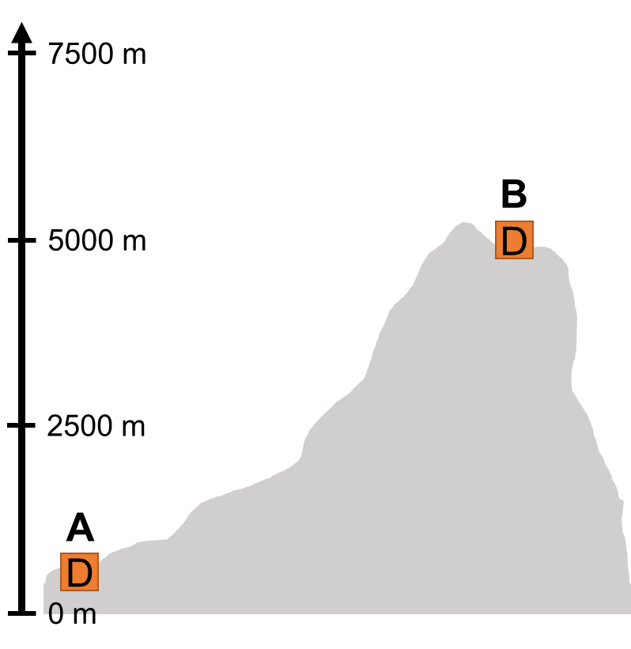
Imagine a particle detector is placed on top of a mountain at 5000 m height. Is the number of detected particles on top of the mountain (B) higher than in the valley (A)?
Students before S‘Cool LAB (N=17)
Teachers (N=43)
Yes 59% | No 41%
avg. confidence: 63%
Students after S‘Cool LAB (N=36)
Yes 86% | No 14%
avg. confidence: 81%
Yes 65% | No 35%
avg. confidence: 82%
avg. difficulty: 72%

Slide 17
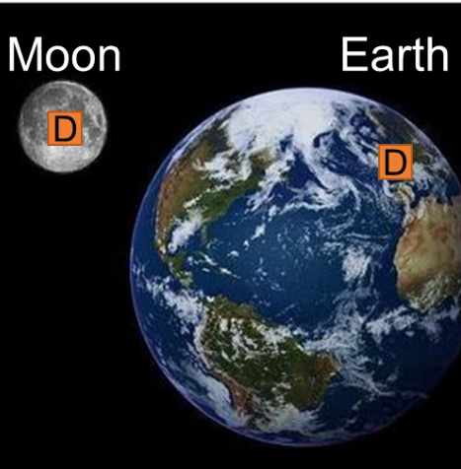
Imagine a particle detector is placed on the Moon. Is the number of detected particles on the Moon (B) higher than on the surface of the Earth (A)?
Students before S‘Cool LAB (N=16)
Teachers (N=44)
Yes 63% | No 37%
avg. confidence: 66%
Students after S‘Cool LAB (N=34)
Yes 74% | No 27%
avg. confidence: 73%
Yes 73% | No 27%
avg. confidence: 63%
avg. difficulty: 73%

Slide 18
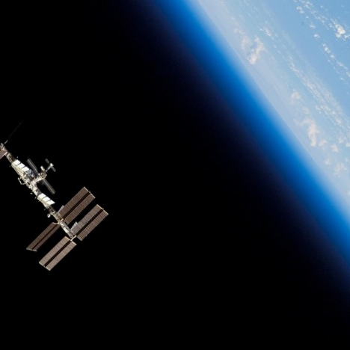
Imagine a particle detector is placed outside on the International Space Station. Is the number of detected particles on the Space Station higher than on the surface of the Earth?
Students before S‘Cool LAB (N=24)
Teachers (N=45)
Yes 67% | No 33%
avg. confidence: 64%
Students after S‘Cool LAB (N=36)
Yes 85% | No 15%
avg. confidence: 73%
Yes 82% | No 18%
avg. confidence: 65%
avg. difficulty: 70%

Slide 19
Summary
Items are difficult for students because they don‘t know about cosmic particles
Items are very similar, but there are some differences in the difficulty
Students learn a lot in S‘Cool LAB > rather knowledge than understanding ?!
Wording of the items needs to be improved (ISS not known, „both the same“ option needed)
Students‘ and teachers‘ answers will be used to design multiple choice items

Slide 20
Radiation

Slide 21
Students‘ conceptions – radiation
Students show lack of distinction between concepts associated with radioactivity and ionising radiation [R1-6]
Depending on the context students think that radiation is safe e.g. in hospitals [R3], [R5], [R7] vs. radiation is always dangerous, especially if artificial [R4]
Contamination
Radioactivity
Irradiation
Source
Ionising radiation
Receiver
Concepts associated with ionising radiation [R1]

Slide 22
Contamination
Radioactivity
Irradiation
Source
Ionising radiation
Receiver
Radioactive Material
Activity depends on external conditions e.g. temperature [R4]
Half-live is the dangerous timespan, after that no danger is left [R4]
Properties of Radiation
Without source, radiation lingers a while [R4]
Properties of ionising radiation are similar to those of light e.g. reflected by screen [R6], transparency of material is the same [R11]
Radiating particles [R7]
Types of Radiation
Lack of distinction between α, β, γ, X radiation [R3], [R4]
Natural background radiation unknown (e.g. cosmic radiation, Radon) [R9], [R10]
Gamma rays are more dangerous than X-Rays [R8]
Absorption / Interaction
Radiation can be stopped not at all or 100% [R6]
Receiver accumulates / contains radiation after irradiation [R4],
Receiver becomes radioactive after irradiation [R3], [R4],
Material of the receiver is important for the „activation“: live/organic vs. dead/anorganic

Slide 23
Literature – radiation
[R1] Millar, R., Klaassen, C., Eijkelhof, H. (1990): Teaching about radioactivity and ionising radiation: an alternative approach. Phys Educ, 25, 338-342 [R2] Kaszmarek, R., Bednarek, D. R., Wong, R. (1987): Misconceptions of medical students about radiobiological physics. Health Physics, 52, 106-107 [R3] Eijkelhof, H. (1990): Radiation and risk in Physics Education. Dissertation, Utrecht: Center for Science and Mathematics [R4] Eijkelhof, H., Klaassen, C., Lijnse, P., Scholte, R. (1990): Perceived Incidence and Importance of Lay-Ideas on Ionizing Radiation: Results of a Delphi-Study Among Radiation-Experts. Science Education 74(2), 183–195 [R5] Millar R. (1994): School students’ understanding of key ideas about radioactivity and ionizing radiation. Public Understand Sci, 3, 53-70 [R6] Riesch, W., Westphal, W. (1975): Modellhafte Schülervorstellungen zur Ausbreitung radioaktiver Strahlung. Der Physikunterricht, 9(4), 75-85 [R7] Neumann, Hopf (2012): Students' Conception About 'Radiation': Results from an Explorative Interview Study of 9th Grade Students. J Sci Educ Technol 21, 826-834 [R8] Mubeen, S. M., Abbas, Q., Nisar, N. (2008): Knowledge about ionising and non-ionising radiation among medical students. J Ayub Med Coll Abbottabad, 20(1) [R9] Boyes, E., Stanisstreet, M. (1994). Children‘s Ideas about Radioactivity and Radiation: sources, modes of travel, uses and dangers. Research in Science and Technological Education, 12(2), 145–160 [R10] Rego, F., Peralta, L. (2006): Portugese students’ knowledge of radiation physics. Physics Education, 41(3), 259-262 [R11] Clément, P., Fisseux, C. (1999): Opacity of Radiography, Perplexity of Teachers and Pupils in Primary School. Research in science education in Europe, 15-21

Slide 24
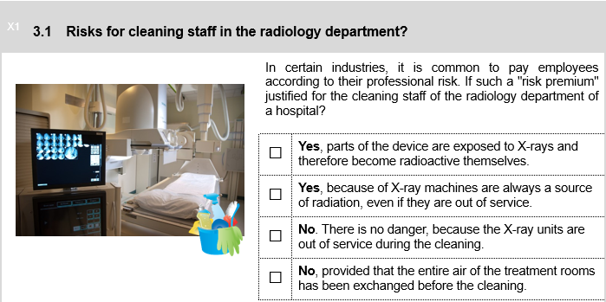
Students (N=17) | Teachers (N=46)
18% | 11%
24% | 17%
60% | 67%
0% | 4%
Avg. Confidence:
65% | 69%

Slide 25
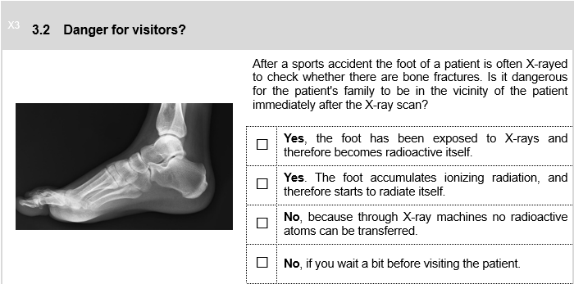
Students (N=17) | Teachers (N=46)
0% | 2%
0% | 11%
88% | 77%
12% | 11%
Avg. Confidence:
62% | 70%

Slide 26
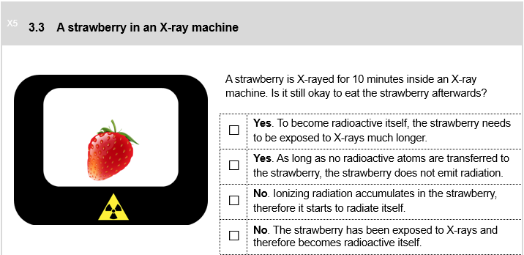
Students (N=17) | Teachers (N=46)
12% | 7%
35% | 64%
47% | 18%
6% | 11%
Avg. Confidence:
51% | 61%

Slide 27
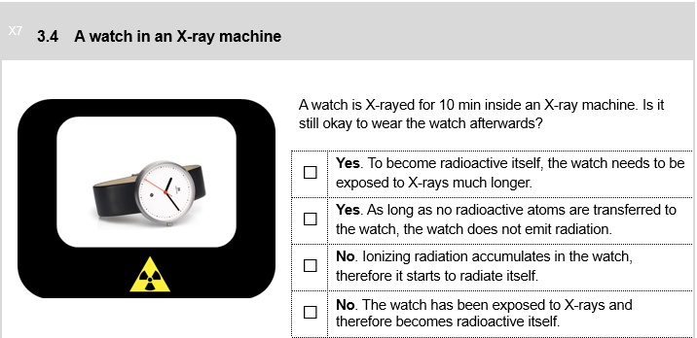
Students (N=17) | Teachers (N=46)
12% | 12%
44% | 68%
44% | 9%
0% | 12%
Avg. Confidence:
49% | 61%

Slide 28
Summary
Items work quite well, wording of some options needs to be improved
Radiation is a very difficult topic, many people have misconceptions of radiation, which are extremely hard to change through teaching
In S‘Cool LAB we noticed 2 interesting things:
  Students believe that some materials are affected differently by X-rays depending on whether they are organic vs. inorganic / alive vs. dead
  Students know only very little about the interactions of photons with matter, they mix up ionisation and activation for example

Slide 29
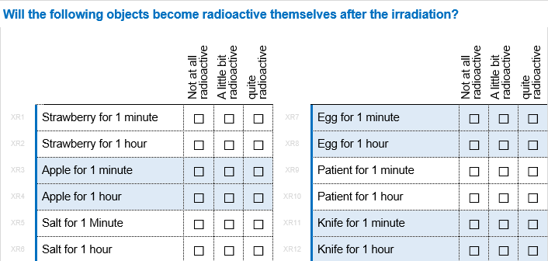
Students‘ results (N=17)
More radiation – more radioactive
X-rays (avg. confidence 49%)
  39% = patient < strawberry < apple < knife < salt < egg =71% (1 minute)
  73% = salt < knife < strawberry < apple = egg = patient = 93% (1 hour)
Gamma radiation (avg. confidence 52%)
  69% = salt < knife < patient = apple = strawberry < egg = 100% (1 minute)
  61% = salt < knife < egg < strawberry = patient = apple = 100% ( 1 hour)
Interviews necessary!

Slide 30
Teachers‘ results (N=47)
More radiation – more radioactive
X-rays (avg. confidence: 51%)
  55% nothing happens | 45% (some) objects become radioactive
  Gamma radiation (avg. confidence: 50%)
  51% nothing happens | 49% (some) objects become radioactive

Slide 31
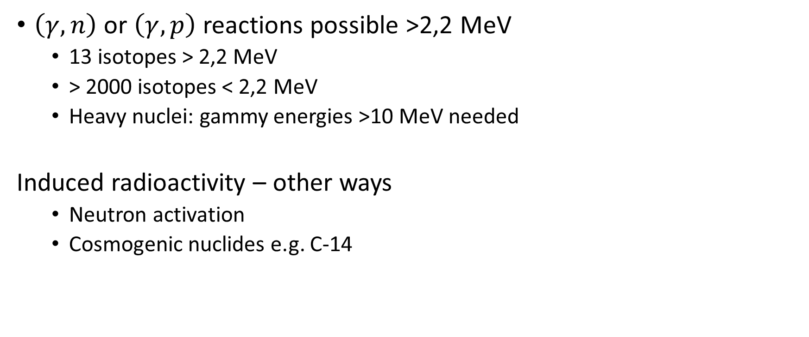
Photodisintegration / Kernphotoeffect
$\left(γ,n\right)$ or $\left(γ,p\right)$ reactions possible >2,2 MeV
  13 isotopes > 2,2 MeV
  > 2000 isotopes < 2,2 MeV
  Heavy nuclei: gammy energies >10 MeV needed
Induced radioactivity – other ways
  Neutron activation
  Cosmogenic nuclides e.g. C-14
E(keV) | Intensity | Nuclide
2235.37(13) | 6.900e-02 | P-30 (B+ 2.498 M)
2312.593(11) | 99.388 | O-14 (B+ 70.606 S)
2318.968(10) | 1.800e-03 | Y-90m (B- 3.19 H)
2392.11( 4) | 34.6 | Kr-88 (B- 2.84 H)
2441.1( 3) | 43. | Se-86 (B- 15.3 S)
2450.9( 1) | 0.99 | Tc-91 (EC 3.14 M)
2571.1( 2) | 0.521 | Rb-76 (EC 36.5 S)
2610 | 100. | Bi-208 (EC 3.68E+5 Y)
2610(20) | 2.598 | Po-212m (A 45.1 S)
2614.533(13) | 99.16 | Tl-208 (B- 3.053 M)
2644.6( 3) | 13.041 | Tc-93m (EC 43.5 M)
3084.4( 1) | 92.1 | Ca-49 (B- 8.718 M)
3103.36 | 94. | S-37 (B- 5.05 M)
Notes:
2 mev for deuterium

Slide 32
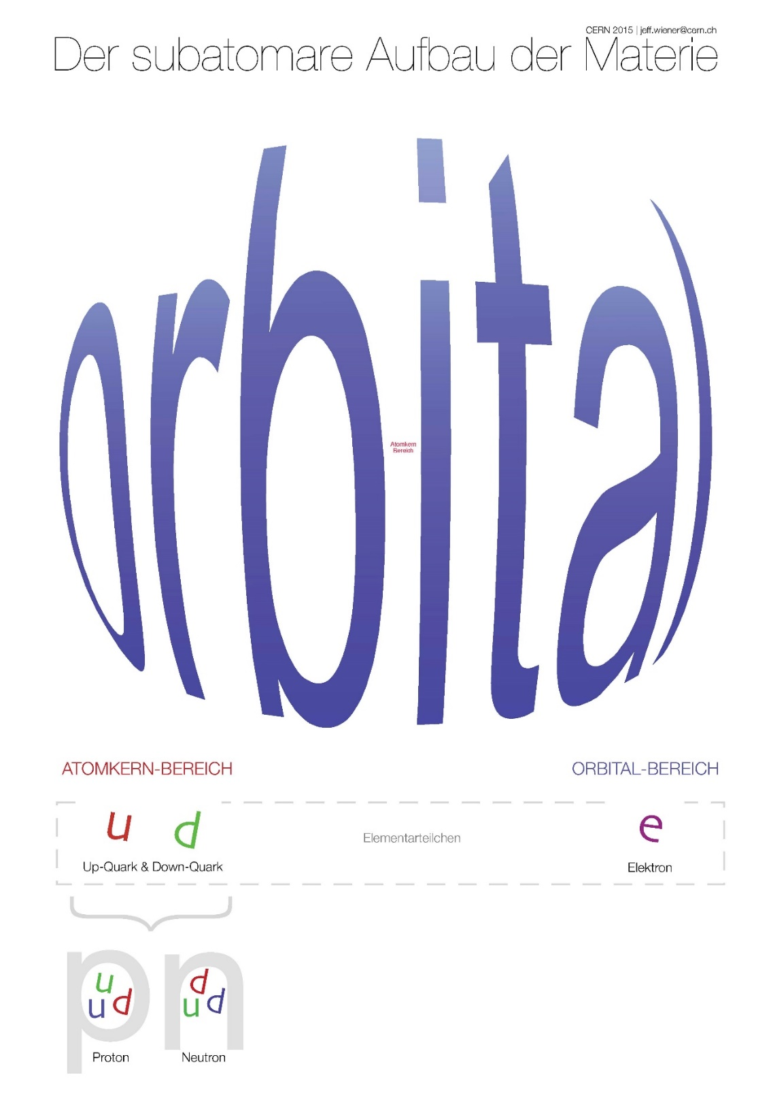
Where do the problems come from?
Students show “sever difficulties with the atomic and sub-atomic level explanation of radioactive phenomena which is prominent in most treatments of the topic, because they do not have a secure understanding of the particulate model of matter”
Klaassen, C. W. J. M., Eijkelhof, H. M. C., & Lijnse, P. L. (1990). Considering an alternative approach to teaching radioactivity. Relating macroscopic phenomena to microscopic particles: A central problem in secondary science education, 304-316.
Hafele, A. (2012). Exploring Learning Difficulties Associated with Understanding Ionizing By Radiation. 2012 NCUR.

Slide 33
A plastic sheet is irradiated with sunlight for a short time and glows greenish in the dark afterwards. Where does the green light come from?
Orbital space (56%) Nucleus space (38%) Neither of the two (6%)
Green light hits the atoms in a material and is absorbed there. Where is the light absorbed?
Orbital space (38%) Nucleus space (63%) Neither of the two (0%)
X-ray radiation hits the atoms in a material and is absorbed partially. Where are the X-rays absorbed?
Orbital space (22%) Nucleus space (67%) Neither of the two (11%)

Slide 34
Some links
Netzwerk Teilchenwelt, Prof. M. Kobel: Teaching material Netzwerk Teilchenwelt (GERMAN ONLY) : https://tu-dresden.de/Members/michael.kobel/dateien/teilchenwelt_schulmaterialien_version1.pdf
Alice Gasparini, Andreas Müller: Cosmology Teaching Material (ONLY FRENCH) https://www.dropbox.com/sh/8j4g33tz0eazct1/AABCcp60WHEw4RiK2S68y_F6a?dl=0
Questionnaire: online, see INDICO, password: see CERN treasure hunt

Slide 35
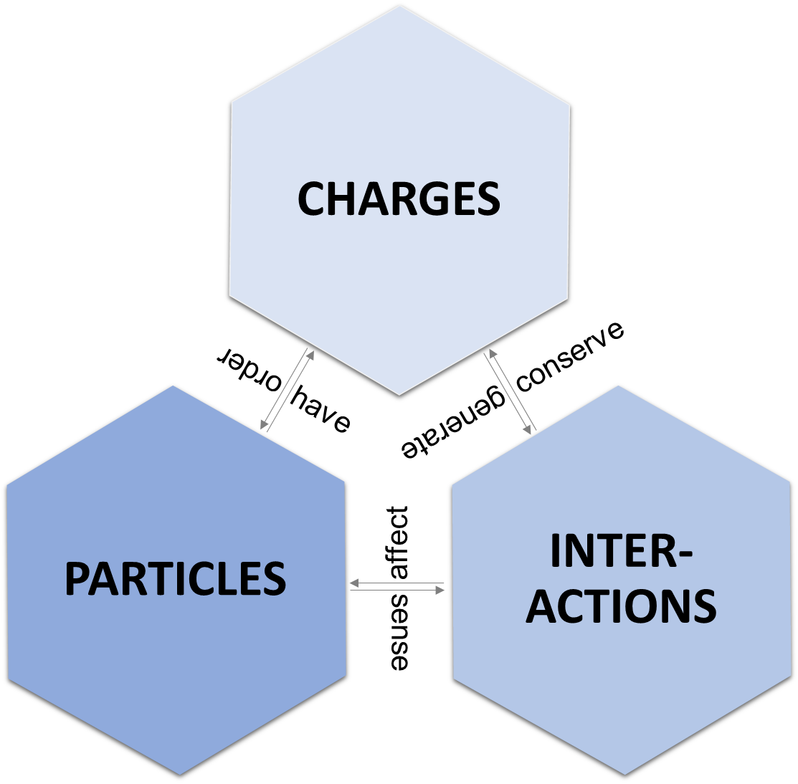
The fundamental concepts of particle physics, Prof. M. Kobel

Slide 36
Interactions affect Particles – Particle feel Interactions
Photon in el&ma field → deflection?
Same for electron/neutrino/positron
Charge as “quantum number”
Is it possible to change the electric charge of an elementary particle?
Can an up-quark change its color charge from red to green?
How do you ”build” Anti-Hydrogen atoms?
What is the difference between electron and positron?
If you change all particles in the universe with their antiparticles – would the physics laws change?
Interactions conserve charge
Which of the following processes are possible? (Photon → Electron + Electron, up-quark → down-quark + electron, …)
During the big bang, a large number of electrons has been created from energy (E=mc^2). What do we expect for the number of positrons?

Slide 37
Charges generate Interactions
Which interactions are possible between electrons and up-quarks?
Is it possible to accelerate neutrons (Hydrogen-Atoms) in electric fields?/magnetic fields?
Is it possible to detect photons directly in a detector (e.g. cloud chamber), that means could we see the “track” of a photon?
Fundamental Interactions
When you sit on a chair, you don’t fall “through it” – which fundamental interaction is responsible?
Which fundamental interactions is responsible for friction, sound, beta transformations, …
An electron travels through water – due to which interaction is it decelerated?
Elementary particles
Do you think that the number of different elementary particles is endless?

