Slide 1
Experience with diagnostics
at
50 MeV
Mukesh Kumar
U. Raich
17 March 2016

Slide 2
Beam signal and halo
Summation of signals on all the wires, for given sample number (over a given row), gives a quantity which is proportional to the beam current (addition of noise signal too).
Two bunches are seen:- Main bunch and small bunch (halo !).
Analysis for horizontal SEMGRID is given below
The ratio (peak to peak) of small signal (halo) to main bunch~0.014
Ratio of Sum of integrated signal (corresponding to charge) for small signal (halo) to main bunch is ~0.006
Similar things have been observed with vertical SEMGRID but shape of main bunch in the beginning is different.

Slide 3
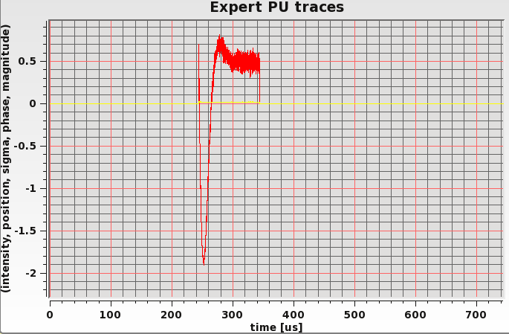
Variation of beam position with time
Horizontal SEMGRID; File Name :-bsgh0421-1
For main bunch
  In the beginning, position varies significantly from ~-2.7 mm to -0.55 mm (2.15 mm)
  After ~40 µs, the beam position varies within ~-0.55 mm to ~-0.7 mm (0.15 mm).
For small bunch/halo
  In the middle of the small bunch/halo, the beam varies within ~-0.95 mm to ~-1.38 mm (0.43 mm).

Slide 4
Variation of beam Size (r.m.s.) with time
Horizontal SEMGRID; File Name :-bsgh0421-1
For main bunch
  The bunch size varies from ~1.7 mm to ~1.83 mm with time/sample-number
  Beam size varies significantly (~7%) for first ~35 µs
Beam profiles for main bunch
For small bunch/halo
  In the beginning and end of the bunch/halo, the beam size very high (~7 mm).
  In the middle of the bunch/halo, beam size varies within ~1 mm to ~1.4 mm
Beam profiles for small bunch/halo

Slide 5
Variation of beam position with time
Vertical SEMGRID; File Name :-bsgv0421-1
For main bunch
    It varies from -4.3 mm to -4.53 mm (Δ=0.13 mm) for main bunch
For small bunch/halo
    In the middle it varies from -3.43 mm to -3.8 mm for small bunch

Slide 6
Variation of beam size (r.m.s.) with time
Vertical SEMGRID; File Name :-bsgv0421-1
For main bunch, bunch size varies from
  0.74 mm to 0.6 mm over entire main bunch (variation ~20%)
  0.7 mm to 0.64 mm over middle (~90 µs) portion of main bunch
Beam profiles for main bunch
For small bunch, bunch size varies from
  In the beginning and the end of the bunch/halo beam size is ~ 2mm
  In the middle it varies from 0.87 mm to 0.64 mm
Beam profiles for small bunch/halo

Slide 7
Comparison: SEMGRID and Wire Scanner (Vertical)
There are 5 sets of measurements with SEMGRID for horizontal and vertical planes.
At the same beam setting, there are 3 sets of measurements with WS for horizontal and vertical planes.
~5%
<-1.3%
Overall ~0.45%
The comparison of variation of r.m.s. beam size with time over main beam pulse obtained using WS and SEMGRID for vertical plane

Slide 8
Comparison: SEMGRID and Wire Scanner (Horizontal)
Overall ~0.068%
~3.6%
< 1.25%
The comparison of variation of r.m.s. beam size with time over main beam pulse obtained using WS and SEMGRID for horizontal plane
Beam is unstable for first ~ 30 µs to 40 µs, therefore the difference in beam size calculated from WS and SEMGRID is more during this time. After this, SEMGRID and WS result matches well.

Slide 9
Comparison: SEMGRID and Wire Scanner
Time average of r.m.s. beam sizes over main bunch (408 µs to 496 µs) is summarized below
 | Meas. Set No. | SEMGRID |  |  | WS
 |  | Time averaged r.m.s. size (mm) | Average over 5 meas. (mm) | % deviation from average r.m.ms. size | Time averaged r.m.s. size (mm) | Average over 3 meas. (mm) | % deviation from average r.m.ms. size
Hor. | 1 | 1.7649 | 1.7583 | -0.378 | 1.7694 | 1.7571 | -0.700
 | 2 | 1.7657 |  | -0.423 | 1.7633 |  | -0.353
 | 3 | 1.7539 |  | 0.248 | 1.7386 |  | 1.053
 | 4 | 1.7566 |  | 0.094 | --- |  | ---
 | 5 | 1.7502 |  | 0.458 | --- |  | ---
Vert | 1 | 0.6447 | 0.6435 | -0.189 | 0.6426 | 0.6464 | 0.588
 | 2 | 0.6363 |  | 1.116 | 0.6405 |  | 0.913
 | 3 | 0.6432 |  | 0.043 | 0.6561 |  | -1.501
 | 4 | 0.6456 |  | -0.329 | --- |  | ---
 | 5 | 0.6476 |  | -0.640 | --- |  | ---
Variation between WS and SEMGRID ( time averaged r.m.s. size over all measurement )
    Horizontal ~0.068%
    Vertical ~ 0.45%

Slide 10
Cross Talk:-Horizontal scanning (Horizontal to vertical)
Main signal (signal on wire which is interacting with beam) and cross talk signal are shown in figures below.
time (µs)
time (µs)
Wire position (mm)
Wire position (mm)
Main signal
Cross talk signal
Main signal
Cross talk signal
Ratio of cross talk to main signal

Slide 11
Integration along a given row for different rows gives beam current with time.
Integration was done only for those positions of wire when there is interaction of beam and wire (to remove the unnecessary noise from calculation).
Figures below show such typical plots of beam current with time for horizontal and vertical wires.
Cross talk is given by ratio ‘b/a’ (from horizontal to vertical) as shown in figures below.
a
b
Horizontal wire
Vertical wire
Horizontal wire
Vertical wire
Results
Calculations done on 03 sets of horizontal profile measurements gives (horizontal to vertical cross talk)~ 0.0025
Calculations done on 03 sets of vertical profile measurements gives (vertical to horizontal cross talk)~ ~ 0.0012

Slide 12
BSM data Analysis
Variation of bunch length and bunch centre with time for different phases
-55 degree DTL (control room) phase
-30 degree DTL (control room) phase
-10 degree DTL (control room) phase

Slide 13
Longitudinal bunch profile at different DTL phases (control room)
For -25, -30, -35 degree DTL phases, the distribution is almost Gaussian.
As we move away from DTL phase -30 degree on either side, the bunch distribution deviates from Gaussian.
The distribution deviates significantly (almost double Gaussian) for phases -10, -50 and -55 degrees.
Bunch shape -55 degree DTL phase
Bunch shape -30 degree DTL phase
Bunch shape -10 degree DTL phase

Slide 14
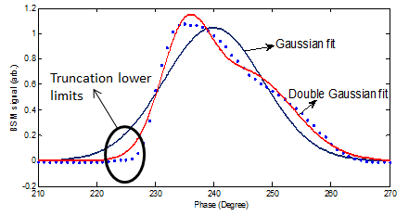
Gaussian fit V/S statistical bunch length
For Gaussian distribution of bunch (-20 to -40 degree DTL phase), Gaussian fitting is gives robust results (less dependent on truncation limits).
For other DTL phases, since the bunch is not Gaussian in time, Gaussian fitting is not good option and statistical r.m.s. bunch length calculation is more robust and logical.
Dependence of calculated bunch length on truncation limits for -55 DTL phase

Slide 15
Variation of bunch length and bunch centre with time for -30 degree DTL (control room) phase (Gaussian fit).
Beam current
Beam current V/s time
Mean phase (degree)
Mean phase V/s time
Time (µs)
Bunch length V/s time
Bunch length (degree)
Time (µs)

Slide 16
Variation of bunch length and bunch centre with time for -55 degree DTL phase (Statistical rms length).
Beam current V/s time
Mean phase V/s time
Bunch length V/s time

Slide 17
Variation of bunch length with DTL phase (control room) @ 17.1 MV

Slide 18
Thanks

