Slide 1
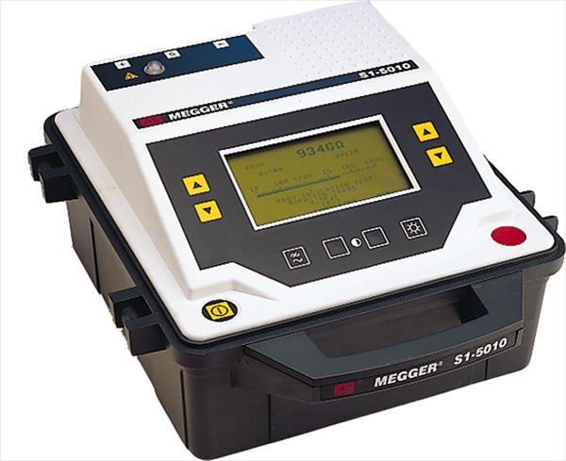
Considerations on HV requirements and impact to test stands
F. Rodriguez Mateos
CERN/TE/MPE/EE
1st Int’l Workshop on Test Stands
CERN, 13-14 June 2016

Slide 2
Outline
Introduction
Strategy to define test levels
Case study: impregnated coils
General considerations

Slide 3
Introduction
One of the main aspects in the design of superconducting circuits (magnets, leads, links, bus bars) is the monitoring of the electrical quality and integrity of the components during manufacturing, tests at stands and further during commissioning
All circuit components (magnets, bus bars, link, current leads, instrumentation), including also the warm DC distribution elements, have to be harmonised in this respect – GLOBAL APPROACH
To this aim, one has to define as soon as possible the tests and the voltage levels, in agreement with the equipment owner …
…and the test stand responsible!

Slide 4
General strategy
Definition of worst case voltages from quench modeling/model tests
Definition of conditions under which worst case voltages will show up:
ambient conditions (gas, liquid), pressure and temperature
Scaling factor
ƒ
Definition of test conditions
Definition of strategy:
i) Validation that the worst case voltages will be endured with no degradation and certain margin
ii) Looking for insulation faults

Slide 5
Defining rated and test voltages (1/3)
V_{q} = quench voltage
V_{ee} = extraction voltage
V_{pa} = power abort voltages
V_{maxr} = V_{q}+V_{ee}+V_{pa}
Rated level
V_{rated}= a * V_{maxr} + b
a and b give safety margins
(for LHC : a= 2 and b= 500 V)
E. g. 75 K, 1 bar , He (gas)
For example purposes, we take as reference 75K and 1 bar in He gas for the conditions at which the maximum voltage occurs

Slide 6
Defining rated and test voltages (2/3)
Manufacturing steps
1st test at arrival to test bench
1st test at cold in the test bench
1st test after cold test in air but possibly with He gas
VmaxrAir = f2 * Vmaxr
Vtest_Air=
a*VmaxrAir + b
f2 is an equivalence between 75 K He and 300 K air
VmaxrLHe = f3 *
Vmaxr
Vtest_LHe= a*VmaxrLHe + b
f3 is an equivalence between 75 K and
1.9 K in LHe
VmaxrAir2 = f4 *
Vmaxr
Vtest_Air2= a*VmaxrAir2 (+ b)
f4 is an equivalence between 75 K and
300 K in He
300K, 1b, AIR
300 K, 1 bar , AIR
1.9 K, 1 bar, He (liquid)
300 K, 1 bar , He (gas)
Factors f are defined as ratios of dielectric strengths at the two conditions considered

Slide 7
Dielectric strength for 0.5 mm gap
Values in [V]
V_{Air, 275 K, 1 b} | 2500
V_{LHe, 4.2 K, 1 b} | 7000
V_{GHe, 275 K, 5 b} | 700
V_{GHe, 75K, 1 b} | 600
V_{GHe, 275 K, 1 b} | 280
f2= 2500/600 = 4.2
f3= 7000/600 = 11.7
f4= 280/600 = 0.47

Slide 8
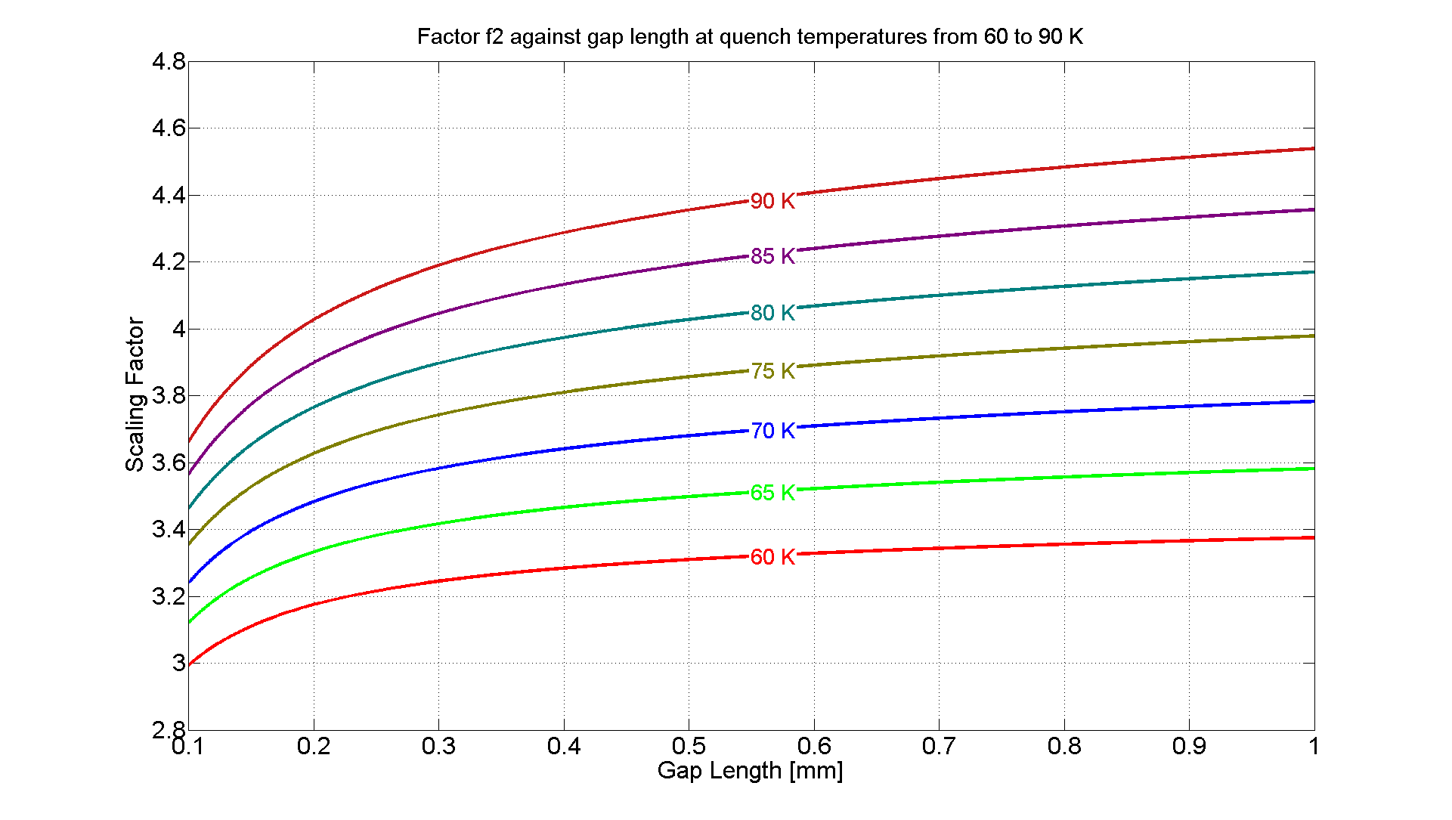
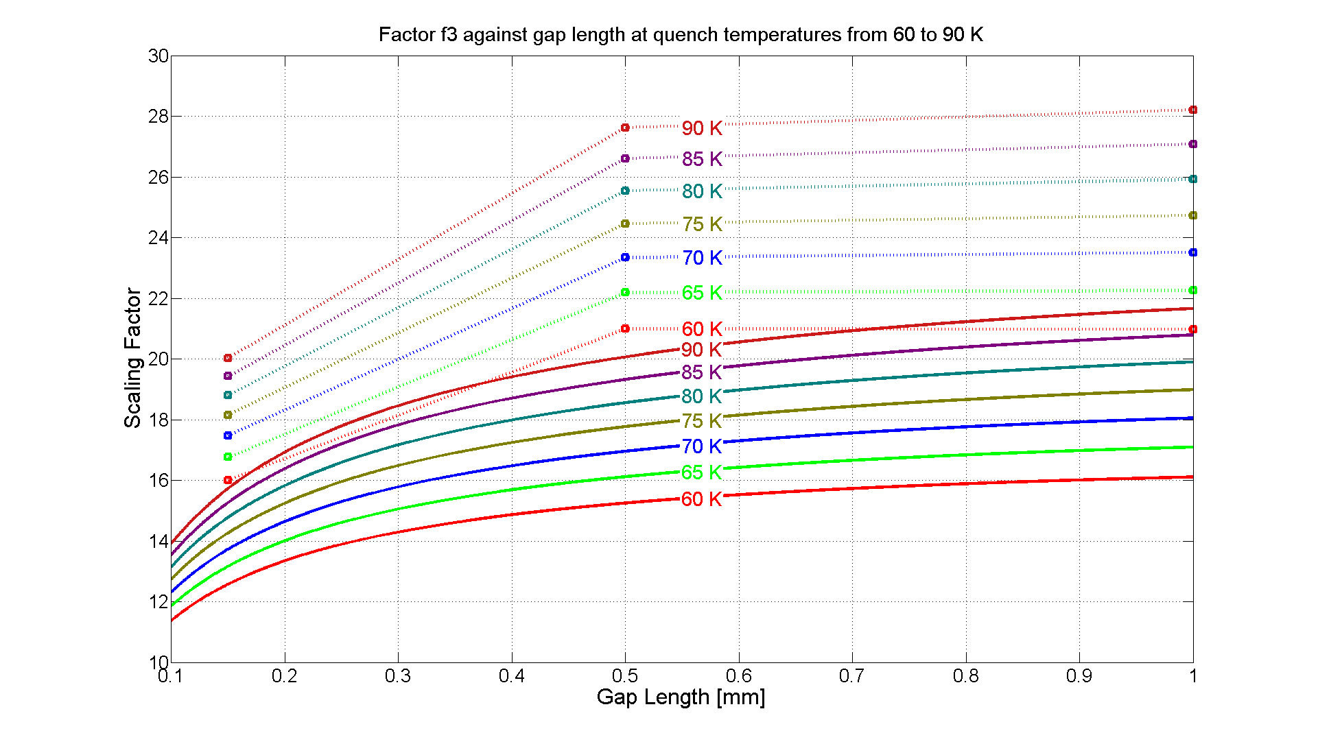
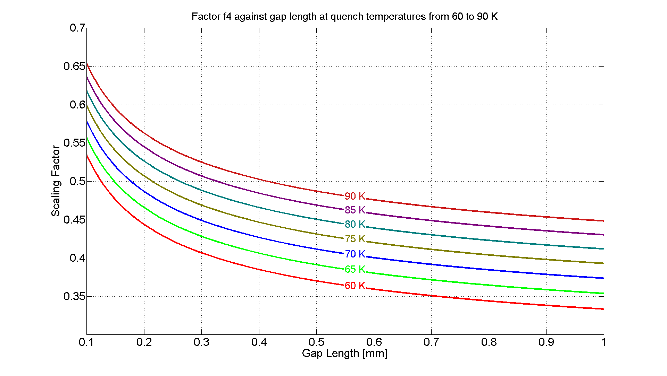
Sensitivity analysis
It is assumed that the maximum voltage is reached at temperatures between 60K and 90K
11 ≤ f3 ≤ 22 boiling LHe
16 ≤ f3 ≤ 29 non-saturated LHe
3 ≤ f2 ≤ 4.6
0.33 ≤ f4 ≤ 0.66
Distance between two active parts (e.g. turns of the same layer, turns to heater) or between active parts and ground span from 0.1 to 1 mm in QXF magnet (P. Ferracin)
Courtesy Hugo Bajas and Jose Vicente Lorenzo Gomez TE-MSC

Slide 9
Defining rated and test voltages (3/3)
Manufacturing
steps
1st test at arrival to test bench
1st test at cold in the test bench
1st test after cold test in air but possibly with He gas
VmaxrAir = f2 * Vmaxr
Vtest_Air=
a*VmaxrAir + b
f2 is an equivalence between 75 K He and 300 K air
VmaxrGHe = 1 *
Vmaxr
Vtest_GHe= a*VmaxrLHe + b
VmaxrAir2 = f4 *
Vmaxr
Vtest_Air2= a*VmaxrAir2 (+ b)
f4 is an equivalence between 75 K and
300 K in He
300K, 1b, AIR
300 K, 1 bar , AIR
75 K, 1 bar, He (gas)
300 K, 1 bar , He (gas)
If test conditions = worst case voltage conditions

Slide 10
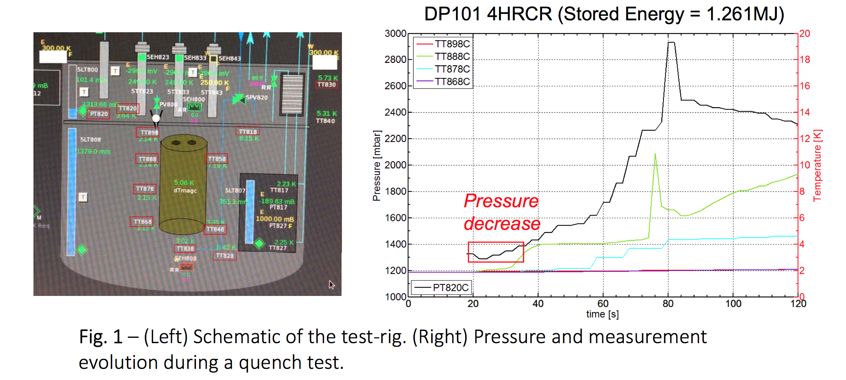
Case study : impregnated coils
It has been observed during quench tests that for impregnated coils T and p slowly move up after a quench, this would hint towards taking nominal operating conditions as the ones under which worst case voltages appear
This assumes no cracks inside the coils, only global p and T apply
Courtesy Hugo Bajas

Slide 11
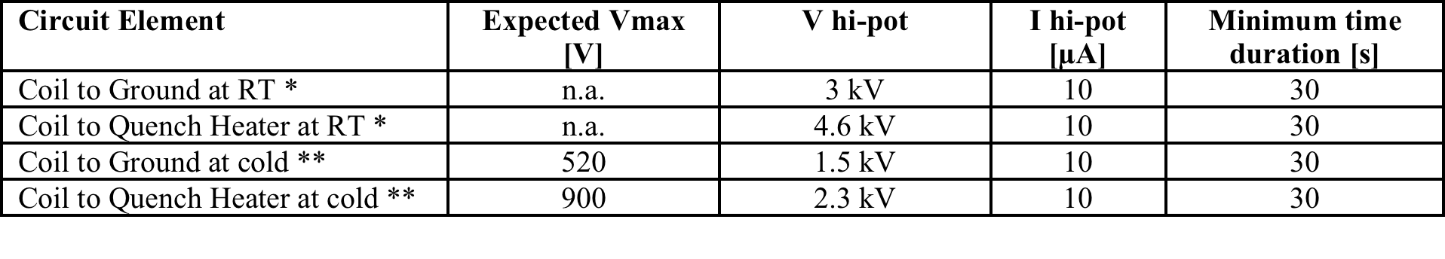
Proposed strategy for inner triplet magnets in HL-LHC
Studies have been conducted through a working group dealing with aspects related to electrical integrity and quality assurance (see HL-LHC HVWL Working Group ).
The main objective of the working group so far has been to find a formal approach in order to obtain high voltage levels from scaling and safety factors obtained starting from simulated worst case voltages (see presentation at the LARP Hi-Lumi Collaboration meeting in May 2016 at SLAC, USA: Voltage Withstand Levels).

Slide 12
General considerations
Definitions on withstand levels for test stations are to be done in thorough agreement with the programme established for magnets and other d.u.t. (leads, s.c. link and current leads)
  What margin to take for the stand w.r.t. test levels?
Studies initially focus on voltage to ground and voltages coil-to-heaters, but other issues as turn-to-turn insulation test by impulses need to be analyzed
Decisions on the HV test programme are required well in advance as to make adequate engineering of dielectric strengths at the facility in different conditions:
  Air (defined temperature and humidity)
  Nominal, cold conditions
  Intermediate temperature conditions
  Different pressure levels
  Leads disconnected
  Modified instrumentation

Slide 13
Many thanks for your attention!

