Slide 1

Quench protection on the test benches
G. Willering
On behalf of the TF section,
With special thanks for the slides to Max Chamiot-Clerc, Jerome Feuvrier, Maryline Charrondiere, Olivier Ditsch
Magnet test stand workshop, 13 June 2016

Slide 2

Events time line quench protection
Powering interlocks with programmed logic controllers (PLC)
Quench detection
  “Classic” quench protection requirements with voltages (NbTi, Nb₃Sn)
  Limitations due to flux jumps
  Developments, mainly for HTS
Security matrix
Quench protection
  Energy extraction
  Quench heaters
  CLIQ

Slide 3
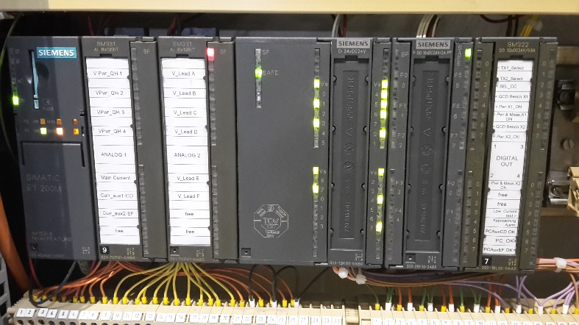
Powering interlocks PLC
PLC SAFETY MANAGEMENT
  The PLC manage each conditions as a safety interlocks, to provide the authorization to perform a test.
  In any case of interlocks, it needs a manual acknowledgement to release the interlock.
  Needs to be a reliable programmable logic.
  Messages to operator by email/sms possible.
CHARGE OF QUENCH HEATERS OK
CURRENT LEADS CRYO OK (FROM CRYO PLC)
Authorization
for powering
MAGNET CRYO OK (FROM CRYO PLC)
BENCH CONDITIONS OK (TEMP, WATER COOLING, PS…)
Losing authorization
Slow Power Abort
Example of a PLC
CERN experts on PLC present during the SM18 visit

Slide 4
Events time line quench protection
Powering interlocks with programmed logic controllers (PLC)
Quench detection
  “Classic” quench protection requirements with voltages (NbTi, Nb₃Sn)
  Limitations due to flux jumps
  Developments, mainly for HTS
Security matrix
Quench protection
  Energy extraction
  Quench heaters
  CLIQ

Slide 5
Characteristic times for detection and activitation
t_{threshold} Conductor related quench propagation and heating effect, field depend, etc.
t_{validation} Noise and fluxjump related, electronics related
t_{systemdelay} Electronics related

Slide 6
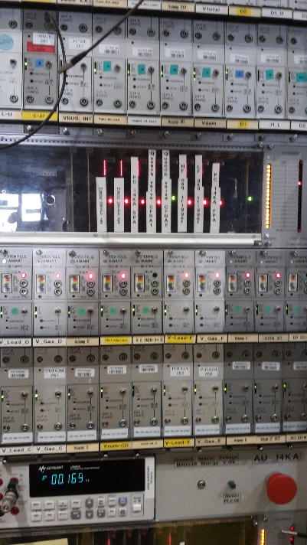
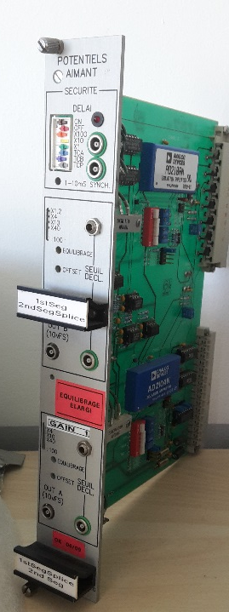
Detection: Electronics for quench detection
From reaching threshold to giving a trigger, the detection cards need 100 % reliability and preferably 0 % false triggers.
In the CERN test stations the PotAim cards are being used
  PotAim (Potential Aimant)
  New developments of PotAim crates is ongoing within the TF section
CERN experts on electronics present during the SM18 visit

Slide 7
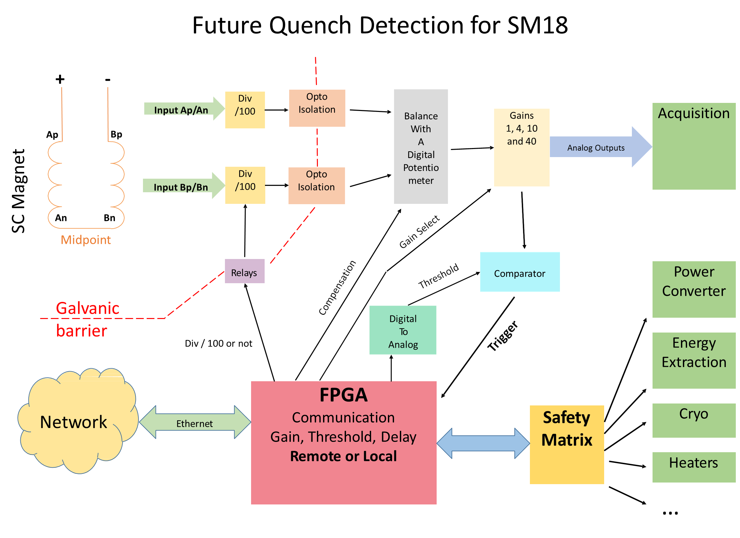
Future quench detection in SM18
Courtesy M. Chamiot-Clerc

Slide 8
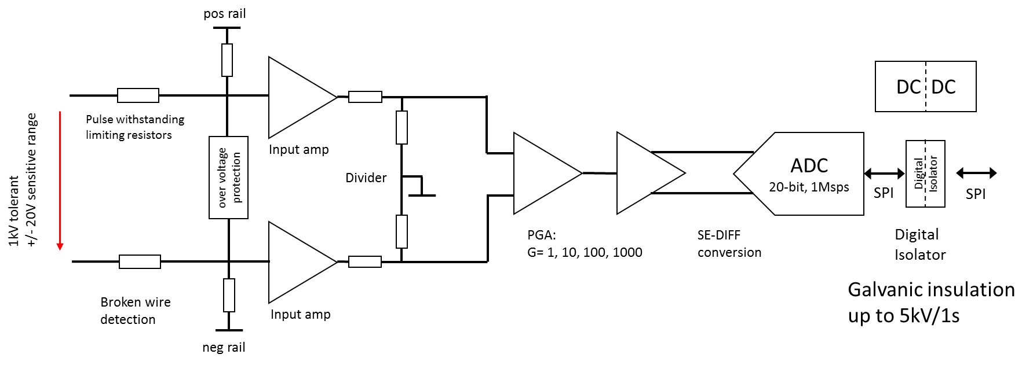
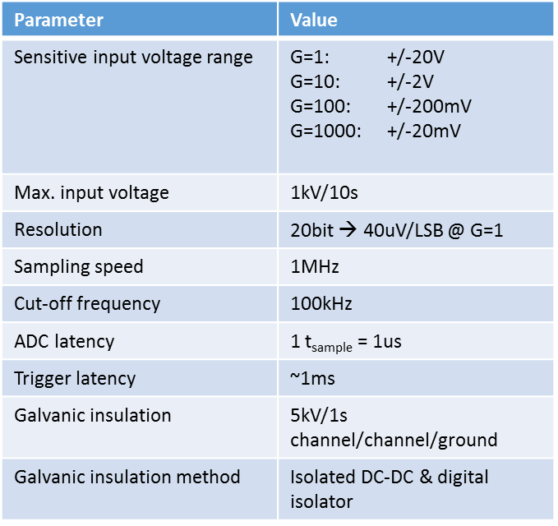
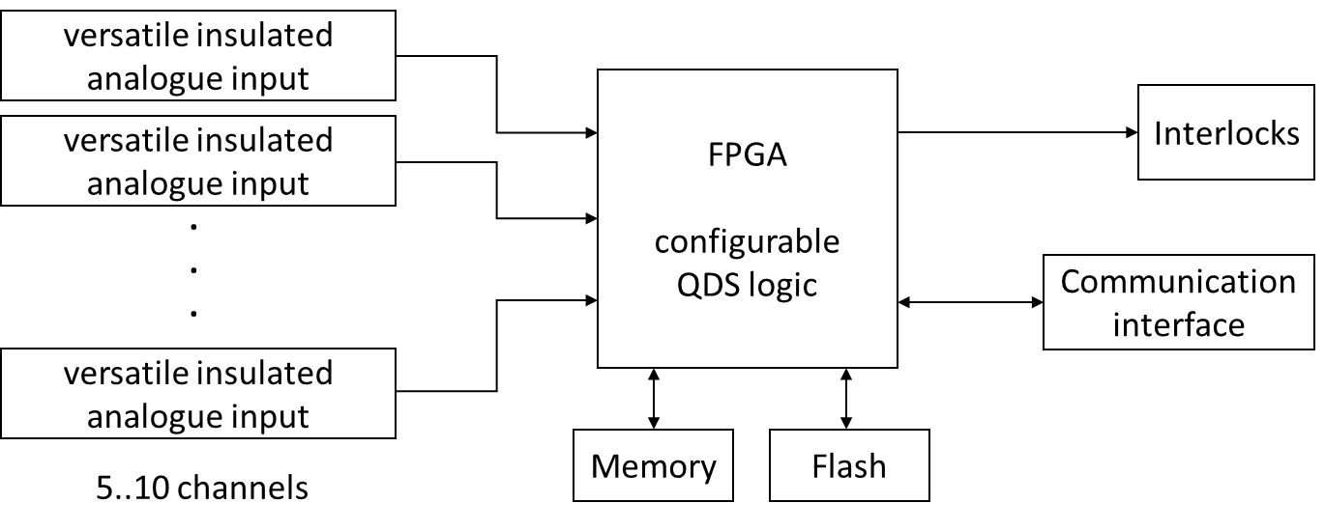
Detection: Electronics for quench detection
Analog channel block diagram
FPGA (Field Programmable Gate Array) is used for the LHC nQPS and in other test stations.
uQPS in development, can be used for current dependent threshold.
FPGA flow scheme
Courtesy J. Steckert
CERN experts on electronics present during the SM18 visit

Slide 9
Detection: From NbTi to Nb₃Sn magnets
Same principles for 11T magnets and MQXF magnets as for the LHC NbTi magnets, but:
More critical in time budget
Higher critical current density
Higher stored energy
Larger filaments: Stronger flux jumps making Quench Detection more difficult

Slide 10
Detection: From NbTi to Nb₃Sn magnets
Same principles for 11T magnets and MQXF magnets as for the LHC NbTi magnets, but:
More critical in time budget
Higher critical current density
Higher stored energy
Larger filaments: Stronger flux jumps making Quench Detection more difficult.

Slide 11
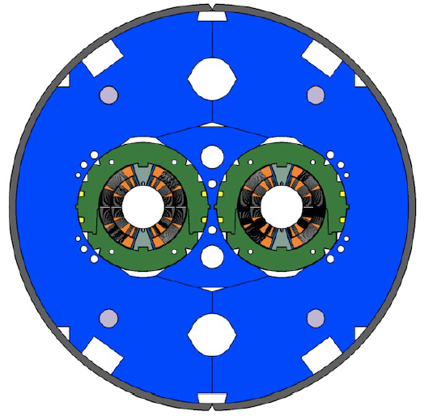
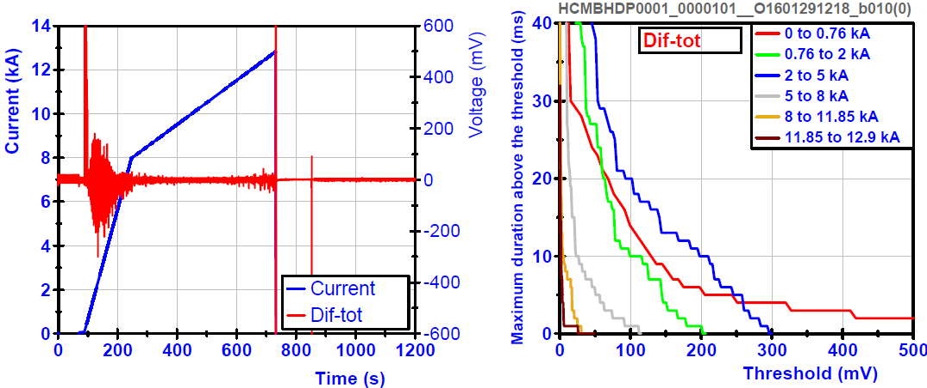
Detection: Validation time and flux jumps
Typical validation time of 10 ms weighs heavy on time budget and Quench Integral budgets.
Example DS11T magnet
Differential voltage signal between apertures (dif-tot)

Slide 12
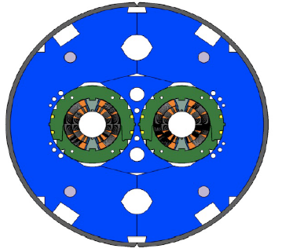
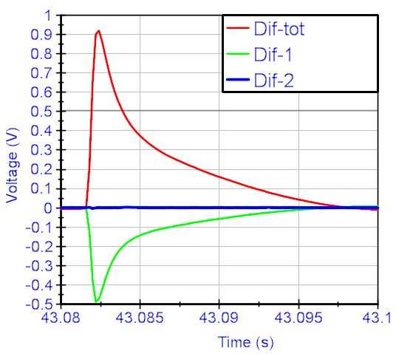
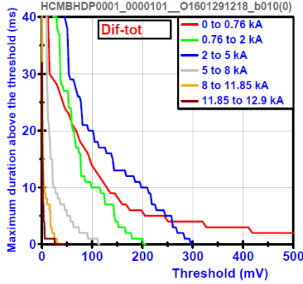
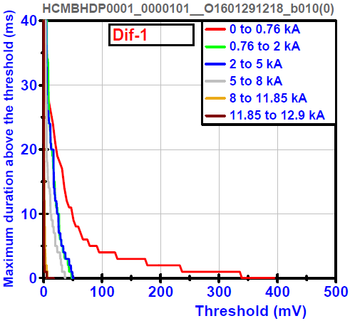
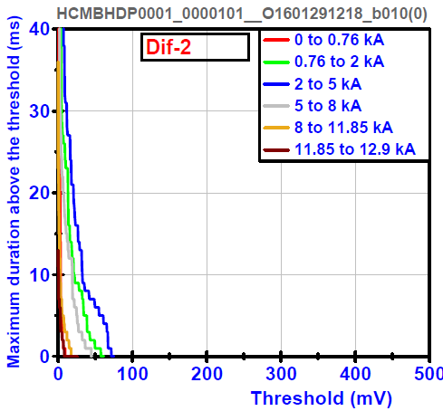
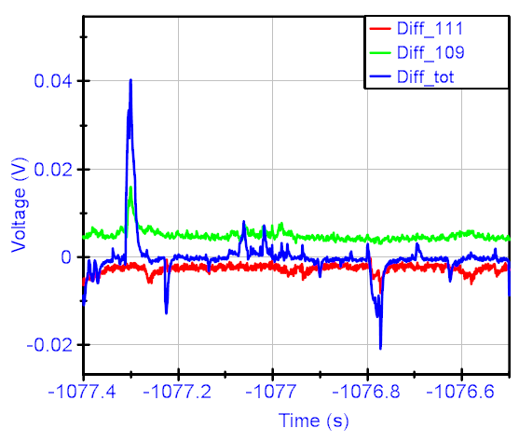
Detection: Fluxjump coupling in 2 meter 11T model
Between apertures
Between apertures
Between poles
Inter aperture
Inter pole
Inter layer
In the MBHDP101 magnet the largest and longest flux jumps measured between apertures and requires current dependent thresholds for 100 mV, 10 ms.
Flux jumps between poles about half the size
Flux jumps between the inner and outer layer again smaller.
Clear coupling of flux jumps throughout the coil.
Important for protectability of the magnets.
Between poles
Between poles

Slide 13
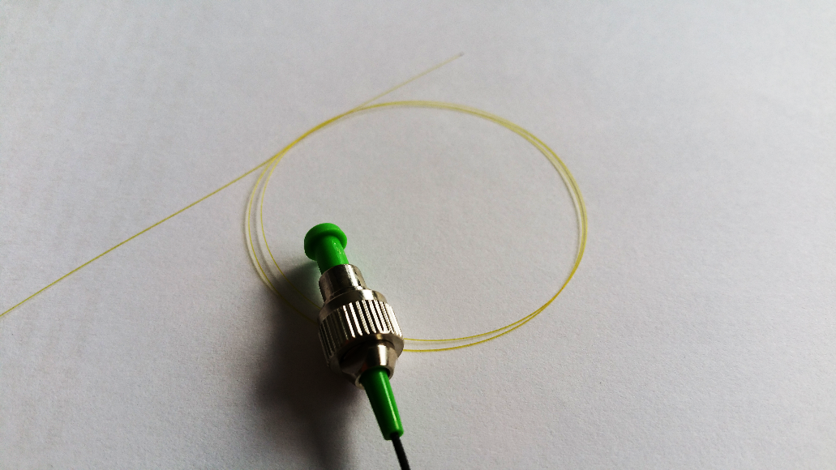
Future quench detection systems
Classic quench detection with voltage taps is more difficult in HTS due to much slower quench propagation.
Example: Fiber Optic Sensors under development at CERN
Distributed sensors for quench detection in SC link and in SC magnets.
Silica fiber
155 µm total diameter
Feedthrough
Courtesy A. Chiuchiolo
CERN experts on Fiber Optics present during the SM18 visit

Slide 14
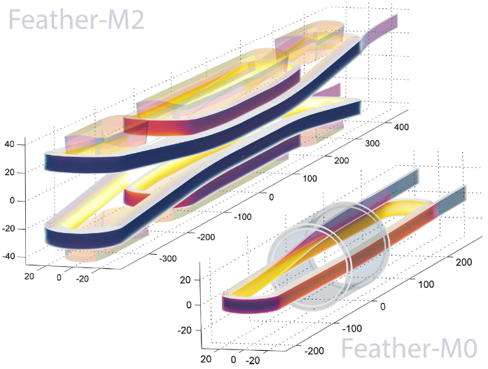
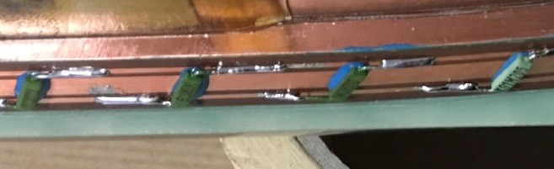
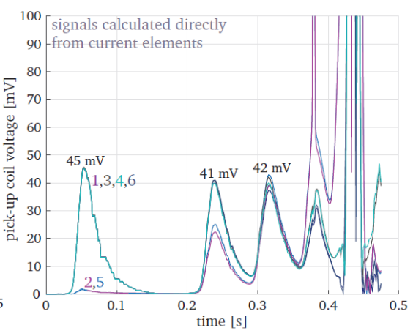
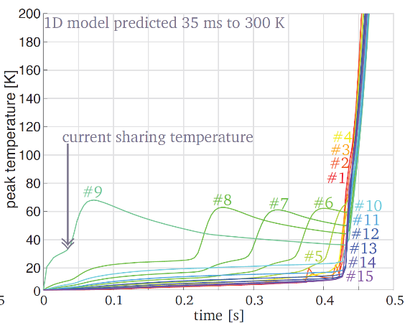
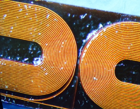
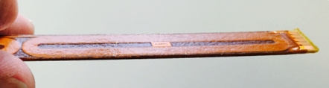


Future quench detection systems
Classical protection:
Max 0.8 mV voltage buildup in the HTS coil, difficult to pick up.
EuCARD2 WP 10 project
Courtesy G. Kirby and J. van Nugteren
5 Tesla stand alone, (18 T in 13 T background)
Roebel type ReBCO cable
40 mm aperture
10 kA class cable
Accelerator Field quality
@ 4.5K
Distributed (parallel) temperature probes on the conductor
Early quench detection
Pickup coils on roebel cable.
For now these are calculations, but may well become reality in the future
14

Slide 15
Events time line quench protection
Powering interlocks with programmed logic controllers (PLC)
Quench detection
  “Classic” quench protection requirements with voltages (NbTi, Nb₃Sn)
  Limitations due to flux jumps
  Developments, mainly for HTS
Security matrix
Quench protection
  Energy extraction
  Quench heaters
  CLIQ

Slide 16
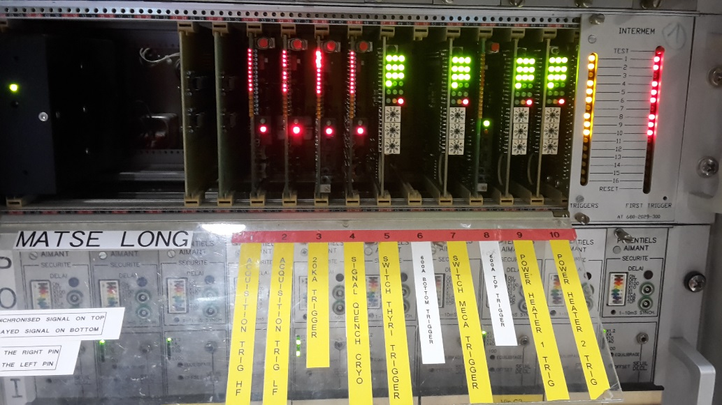
Security matrix
All triggered PotAim cards are connected through the Security matrix that will activate the protection units.
One of the recent upgrades in the security matrix is easier setting of delays for protection studies.
Redundancy in triggers is important.
CERN experts on electronics present during the SM18 visit

Slide 17
Events time line quench protection
Powering interlocks with programmed logic controllers (PLC)
Quench detection
  “Classic” quench protection requirements with voltages (NbTi, Nb₃Sn)
  Limitations due to flux jumps
  Developments, mainly for HTS
Security matrix
Quench protection
  Energy extraction
  Quench heaters
  CLIQ

Slide 18
Protection: Overview CERN test benches
 |  | Active protection
 | Detection | Energy Extraction | Quench Heater discharge | CLIQ
Horizontal benches, A, B, C, E I_max = 15 kA | PotAim | None | Available | Used, but not standard
Vertical bench Cluster G, I_max = 20 kA | PotAim | Thyristor | Available | Used, but not standard
Vertical bench Cluster D, I_max = 30 kA | PotAim | IGBT | Available | Equipped

Slide 19
Quench protection: de-energize magnet
Switch off power converter (possibly with a crowbar)
Activate the Energy Extraction (EE) switch
Discharge capacitive charge in Quench Heaters (QH)
Discharge capacitive charge in coils (CLIQ)
A combination of the above actions is quite common.

Slide 20
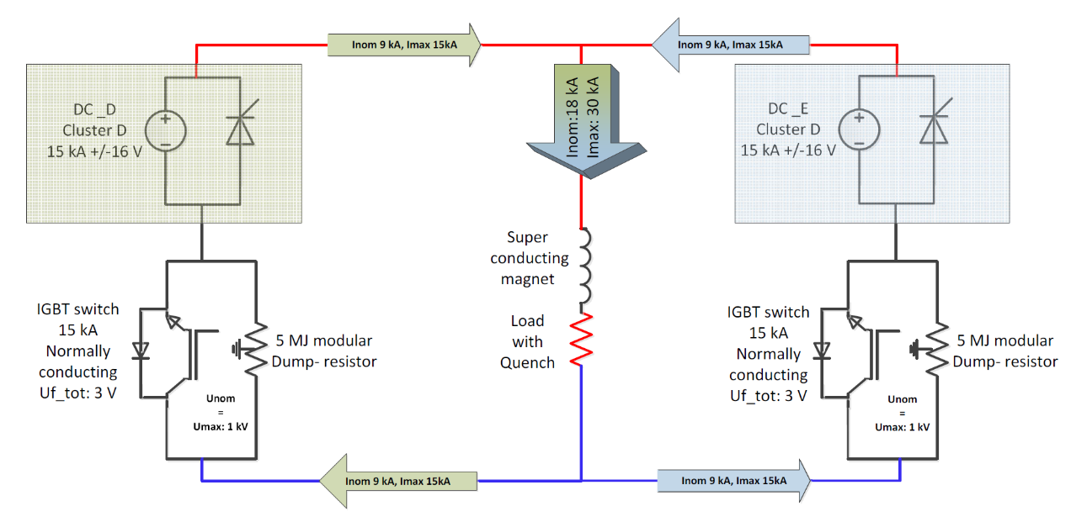
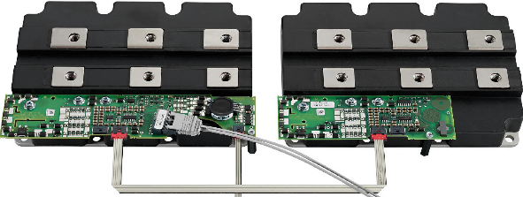
Protection: Energy extraction
Thyristor switch with modular dump resistance (5 to 120 mOhm) operational since a long time on the vertical benches at 20 kA.
Cluster D powering schematics
New technology foreseen for cluster D with 2 times I_{max} = 15 kA.
IGBT switch is already succesfully applied at BNL.
In general the limitation for the energy extraction is the maximum voltage over the switch. 1 kV for Thyristor and IGBT switch.
Courtesy GJ Coelingh
CERN expert on Energy Extraction present during the SM18 visit

Slide 21
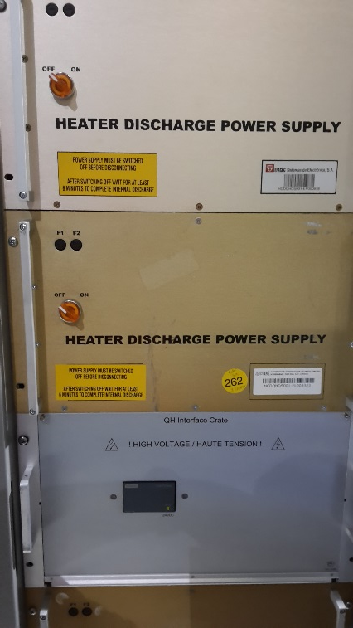
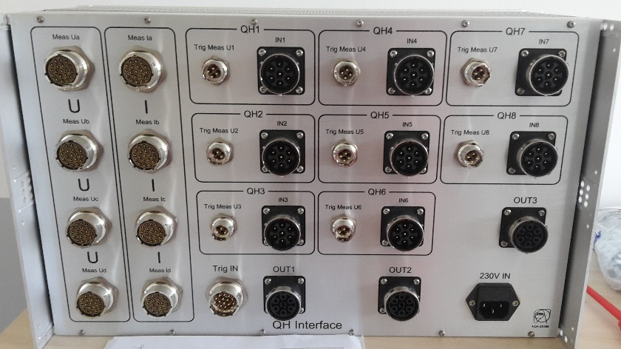
Protection: Quench heater
On all SM18 benches four 900 V (± 450 V, 2*14 mF in series) heater discharge power supplies are present, type HCDQHDS type.
In recent years the QH interface has been upgraded for better discharge current reading up to 150 A.
Electronics delay between trigger and heater firing is about 4 ms. This is due to be reduced in view of the coming Nb₃Sn magnets.
QH interface crate, by M. Chamiot-Clerc
Heater discharge power supplies
CERN experts present during the SM18 visit

Slide 22
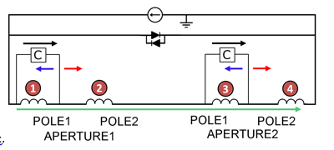
Protection: CLIQ in the test station
Experience gained with early prototypes of CLIQ in the vertical test facility on several magnets
- MQXC, MQY, HQ
Adaptations to the test facility are quickly done.
place a string of diodes across the power converter in inverse direction. (V_{fw} about 20 V)
Only a few small current feed-through are needed (~10 mm² Cu)
Trigger signals should arrive in CLIQ box
Connect CLIQ to Interlock
In 2015 a spare LHC main dipole was tested with CLIQ protection only!!

Slide 23
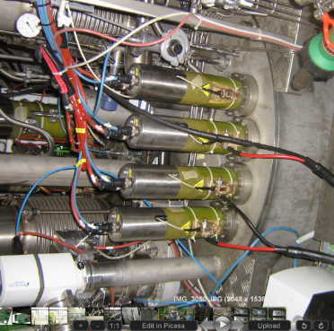
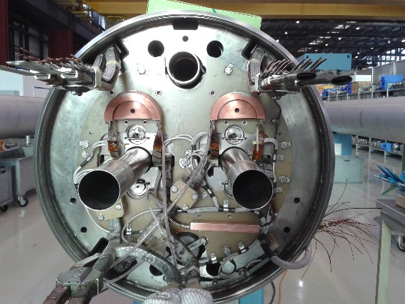
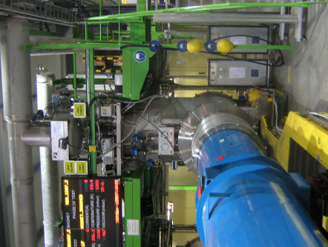
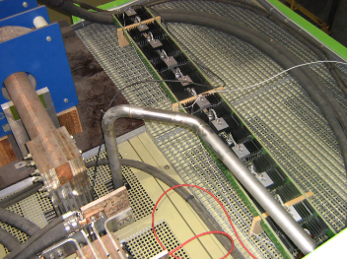
Protection: Validation of CLIQ on an LHC main dipole
With Emmanuele Ravaioli, Alejandro Fernandez Navarro
Inside the magnet 3 CLIQ leads are connected by the spool pieces, making an easy connection to the 600 A leads on the test station.
The 4th warm CLIQ lead is connected to the main 13 kA current lead.
About 10-15 m long cables
connected to the 600 A current leads
Diode string
Two first industrial quality CLIQ units tested before shipment to FNAL
2 CLIQ units of 80 mF, 500 V

Slide 24
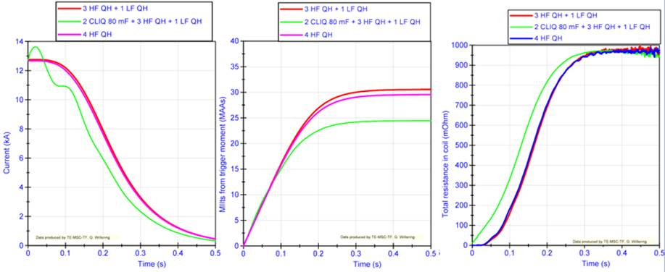
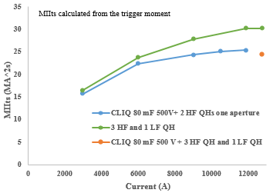
Protection: Validation of CLIQ on an LHC main dipole
With CLIQ added at high current the current decay was much faster.
An LHC spare dipole only protected by a 2-CLIQ system,
Non-optimized CLIQ unit, therefore no reduncancy in case of failure of one of the two.
The CLIQ units were tested before shipment to FNAL.
Shift in magnet resistance buildup of about 35 ms in favor of CLIQ compared to QH
CERN experts on CLIQ present during the SM18 visit

Slide 25
Protection of leads
Detection settings in the magnet:
100 mV, 10 ms for the magnet
8 mV, 10 ms for leads (Low Field, slow propagation, well cooled)
What can possibly go wrong??
Just an example of issues in the last years
Too high resistance of a clamped connection resulting in quench.
  Protected at 8 mV, 10 ms detection, but it limited the test of the magnet.
Too small NbTi current lead interconnecting coils in Nb₃Sn magnet
  Results in melted current lead.
Loss of helium level – lack of slow power abort interlock – detection failure:
  Resulted in a melted current lead

Slide 26
Thank you

Slide 27
SM18 Visit program Tuesday afternoon
13:40 – 14:20 A general tour through the magnet test facility will be given, giving an overview of the test facilities.
14:20 – 15:40 The workshop participants can walk freely in a part of the test facility and experts from CERN will be present on many locations in the hall. In some cases they will be able to show equipment and in other cases posters. Excursions into the test zones are possible to see the test station from close by.
There will be many experts and topics like
PLC/hardware security Horizontal test bench operation Power converters
high-current switches Cluster D integration Cryostat cluster D and HFM Inserts
Analysis and control Feedbox for Sclink Cryogenic infrastructure
Optic fibers Electronics for protection, Cryogenic design of inserts and CFBs
Mechanical measurements LN₂test station Data acquisition
Magnetic measurements/shafts
We hope this part will give a lively and detailed discussion between experts in the field from the various test facilities.
15:40-16:40 In the upstairs meeting room coffee is available and there is place available for further discussions.
16:40 the workshop will close out with the preparation of the action list and a close-out session.

Slide 28
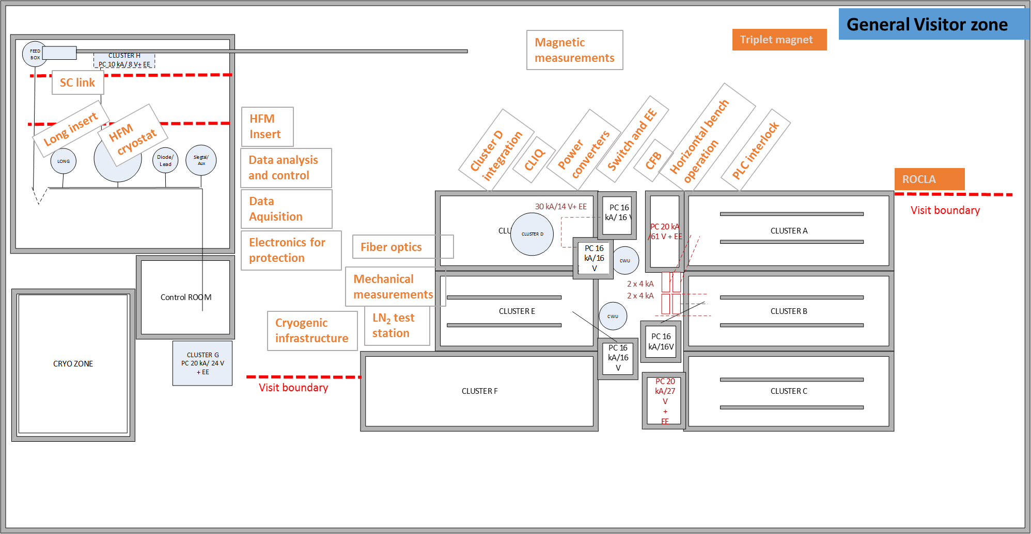
Visit program Tuesday afternoon

