Slide 1
The EuCARD2
Transnational Access
MagNet@CERN
Antonella Chiuchiolo
TE-MSC-TF
1st international workshop of superconducting magnet test stands
June 13th -14th 2016 Geneva – CERN

Slide 2


EuCARD2 – Transnational Access
International collaboration of 40 partners (laboratories, universities, industries)
13 Work Packages
WP1
.
.
.
Transnational Access Activities
WP9: HiRadMat@SPS and MagNet@CERN
To open up advanced accelerator test facilities
.
.
.
WP13
EuCARD-2 is co-funded by the partners and the European Commission under Capacities 7th Framework Programme, Grant Agreement 312453

Slide 3
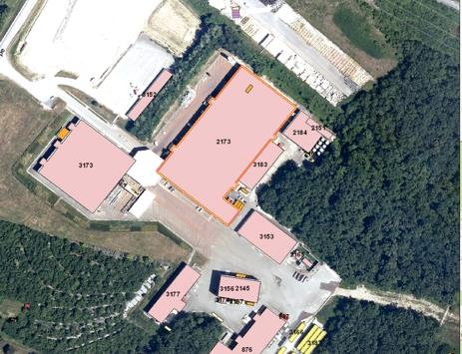
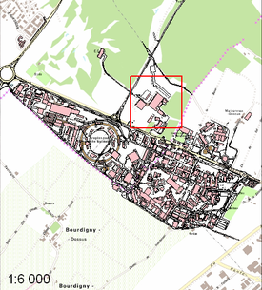
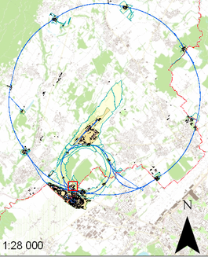
MagNet@CERN: the location
Within Transnational Access CERN extends the access to the unique cryogenic test facility SM18 (building 2173) to offer a framework to share with all researchers, to perform novel experiments and testing of superconducting magnets and/or specific low temperature instrumentation.

Slide 4
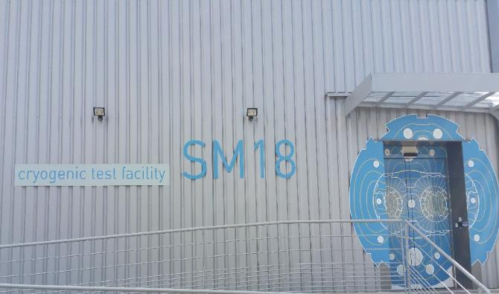
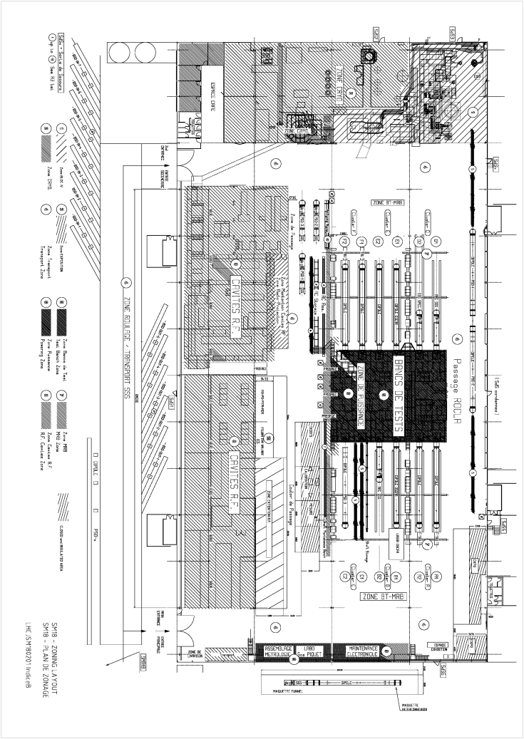
The access to SM18
The access will offer:
  Infrastructure
  Service: installation, set up and dismounting of the equipment
  Reimbursement of user travel and stay costs
SC - Link
Visitors
New vertical installation
Vertical cryostats
Visitors
Horizontal benches
Cryogenics
FOS lab
RF test area
Vertical cryostat
@ LN2

Slide 5
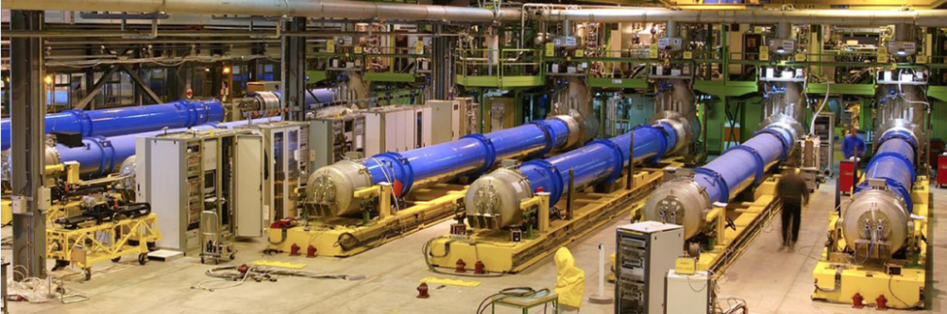
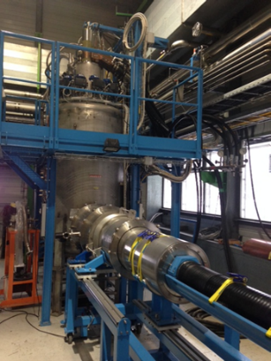
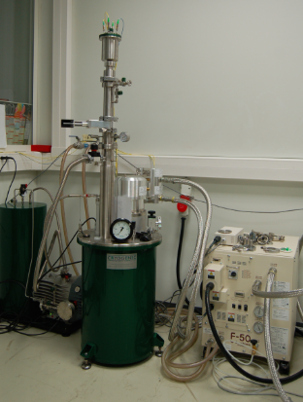
Infrastructures
Horizontal Benches
6 operational benches allowing the feeding with current up to 14 kA and coolant down to 1.9 K
Supercritical He Feed Box
with 20 kA powering capacity
The station is designed for the Sc Fast Cycled Magnet and the Sc Link.
Cryogen Free Cryostat
cooling down to 4 K with 0.5 W Pulse Tube refrigerator in a controlled environment.
Used for instrumentation.

Slide 6
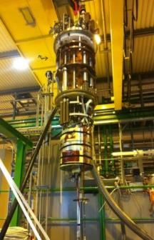
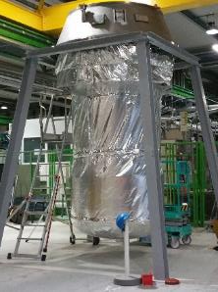
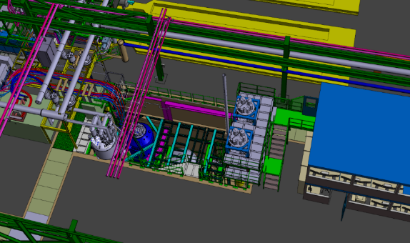
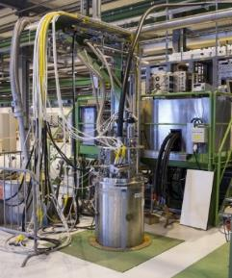
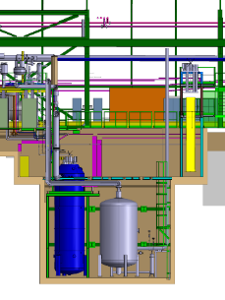
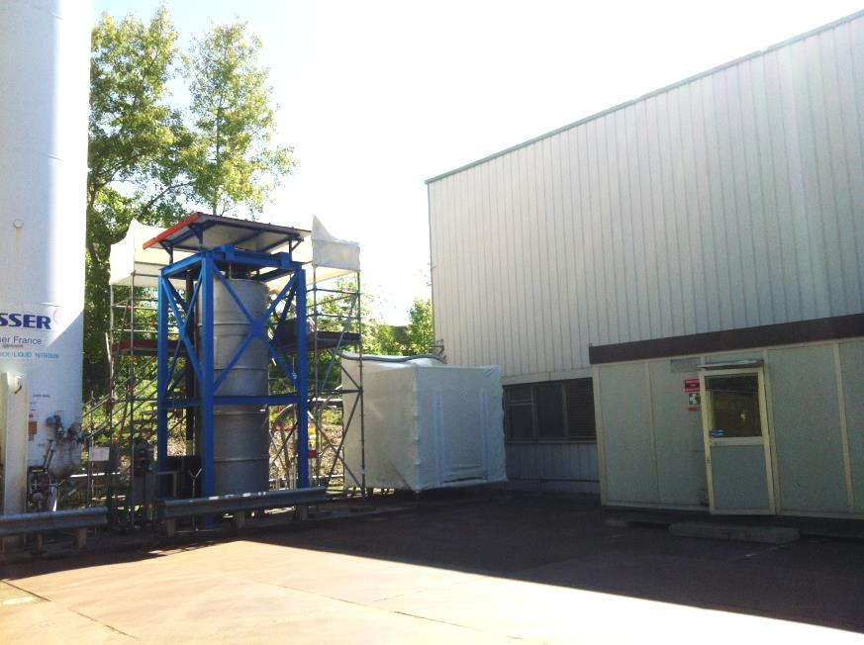
Infrastructures
Vertical cryostats
4 cryostats for
20 kA at 300 - 1.9 K
New vertical installation … on going upgrade
for testing magnets at 1.9 K with 30 kA capacity
LN2 vertical cryostat
for testing mechanical properties of large magnet structures down to 77 K

Slide 7
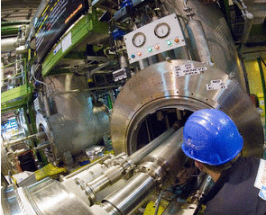
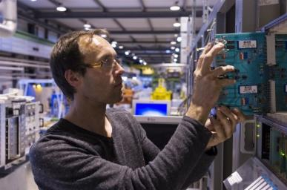
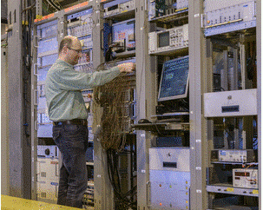
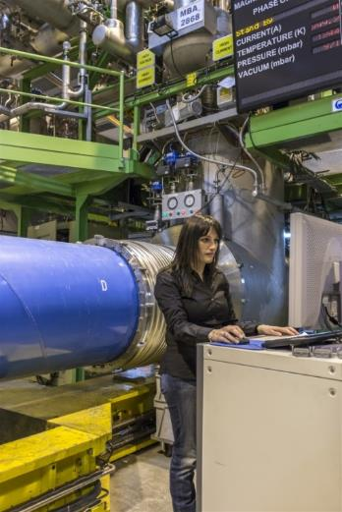
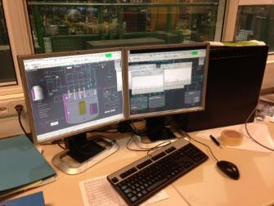
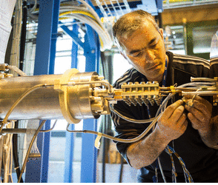
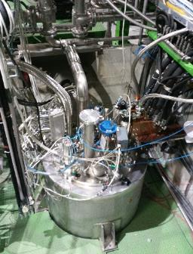
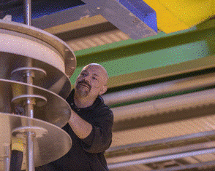

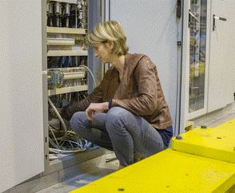
Service
CERN will offer
equipment
operation
expert support
50% test preparation
30% testing
20% data analysis

Slide 8
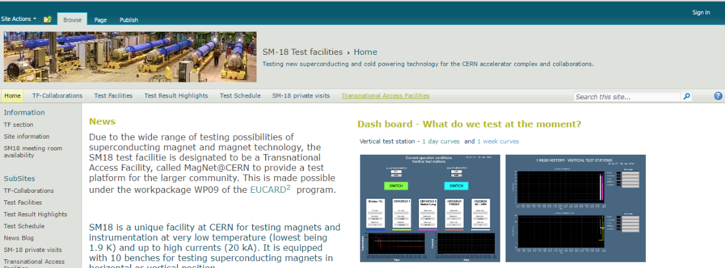
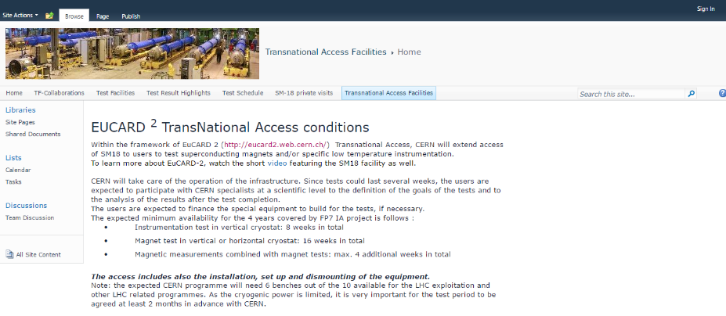

How to apply
SM18 home page: https://espace.cern.ch/te-dep-msc-tf/SitePages/Home.aspx
TransNational Access Facilities panel
Application form

Slide 9

Approval by the Selection Panel
The proposed projects will be approved by the Selection Panel composed of representatives of the facility of the EuCARD-2 project (M.Bajko) and international experts in the field of magnets and instrumentation (Dr. Luis Garcia Tabares and Dr. Vinod Chohan)
CRITERIA
Feasibility of the experiment with the existing equipment and within the proposed timeline
    The test period has to be agreed in advance with CERN taking into account the CERN needs of the installations and giving them the highest priority
Scientific value of the potential result for the community

Slide 10
Approved MagNet projects
1. FOSxCRYOs (Fiber Optic Sensors FOR CRYogenic ApplicatiOns and Superconducting Magnets)
Project leader: Dr. Andrea Cusano University of Sannio (IT)
7 members ( It + Hu)
ongoing
2. ThMo_Nb₃Sn (Numerical modelling of Nb₃Sn magnets for particle accelerators )
Project leader: Dr. Fabrizio Bellina University of Udine (IT)
5 members ( IT+ USA)
Finished
3. AMIT_Mag HeBP (AMIT Magnet Helium Bath Performance)
Project leader: Dr. Fernando Toral CIEMAT (SP)
5 members (all SP)
Finished
4. ContSysTempSens (Control System for Temperature Sensors )
Project leader: Dr. Vardaine Szarka Angela University of Debrecen (HU)
4 members (all HU)
ongoing
5. AHTDRMC (Analysis of the Heater Tests Data from the Nb₃Sn-model magnet)
Project leader: Dr. Tiina Mary Salmi (FI)
4 members (all FI)
ongoing
6. Electromagnetic and Thermal Analysis of Nb₃Sn Cables and Magnets for Particle Accelerators ( MagTin2016)
Project leader: Dr. Fabrizio Bellina University of Udine (IT)
4 members (all IT)
Coming soon

Slide 11
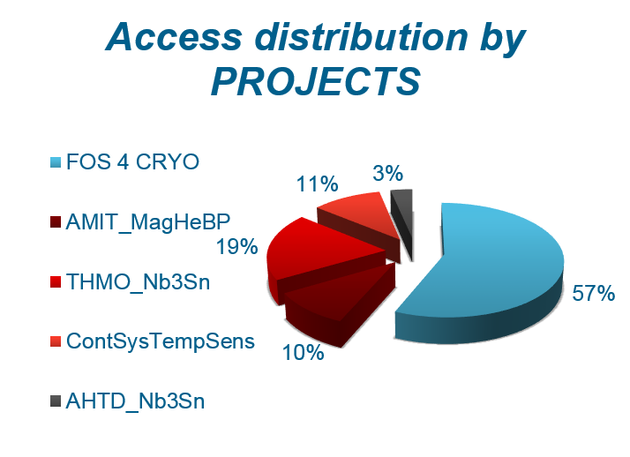
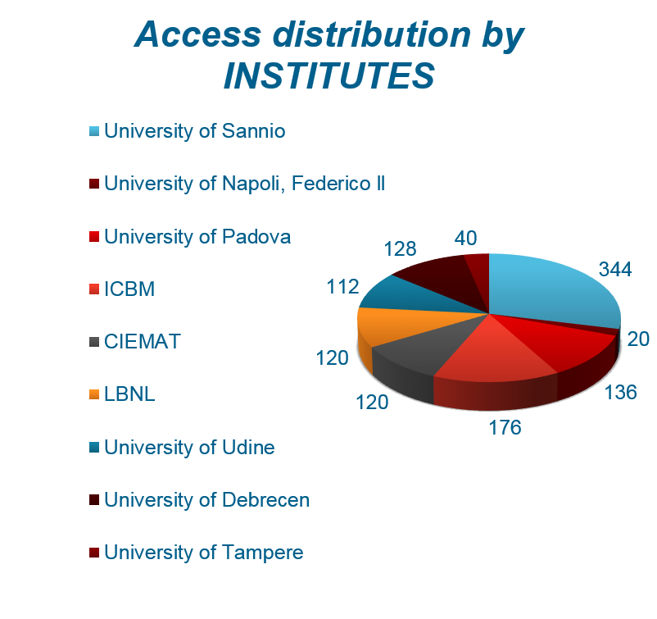
Status of the MagNet projects
1836 total accesses given over 1920!

Slide 12
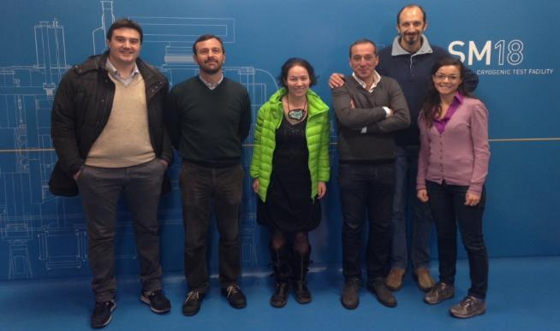
FOSxCRYOs
Fiber Optic Sensors FOR CRYogenic ApplicatiOns and Superconducting Magnets
  University of Sannio (IT)
  University of Napoli, Federico II (IT)
  University of Padova (IT)
  University of Debrecen (HU)
  Institute of Polymers, Composites and Biomedical materials (IT)
1st access granted 20th of November 2013
To develop a non intrusive technology based on FOS for strain and temperature monitoring in the new generation of superconducting magnet and cryogenic devices

Slide 13



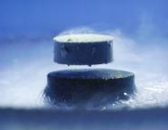




Why FOS?
Small size and lightweight
Immunity to electromagnetic interference
Intrinsic electrical insulation
Radiation hardness capability
Wide operating temperature range
Multiplexing
Cryogenic Temperature and Superconducting Magnets
Wavelength encoded
  Wiring reduction in a complex environment
      Remote sensing
        No heat-leak into the cryogenic bath
Several fields of application
Fiber Bragg Grating Sensors
Innovation: no commercial available FOS for cryogenic applications and superconducting magnets

Slide 14
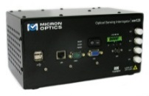
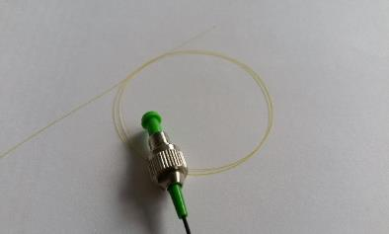

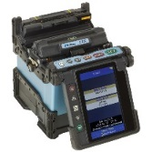
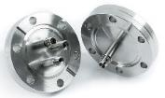



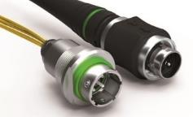

FOS for the cryogenic test facility
Sensors selection
Single Mode fiber
Commercial sensors
Customized sensors
Data acquisition system
4 channels Optical interrogators (1 kHz)
Fiber optic permanent installation in SM18
Splices and connections
Fusion splice machine
Optical feedthrough and optical connectors
4 vertical cryostats
SC – Link
Cryocooler
…to be seen during the visit in SM18!

Slide 15
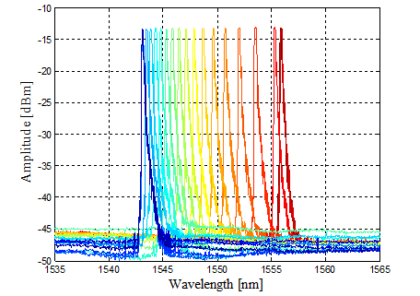

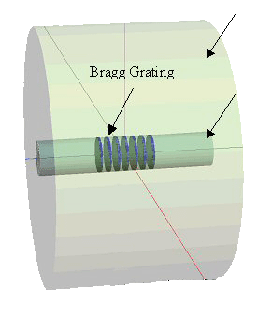


FBG working principle
Longitudinal periodic variation of the refractive index in the optical fiber core
Strain and Temperature sensitive:
Cladding
ΔλΒ (Τ, ε)
Core
Broadband light
λ_{B}: Bragg Wavelength
n_{eff} : effective refractive index of the core
Λ : grating period
Typical grating lengths: 10 – 5 mm
: photo elastic coefficient
: thermo-optic coefficient
: thermal expansion coefficient

Slide 16
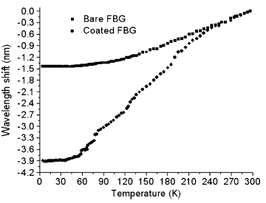

FBG for cryogenic temperature
FBG temperature sensitivity
8 - 12 pm/K @ room T
< 0.1 pm/K below 50 K
Bare FBG no suitable for cryogenic temperature!
Bare FBG
Coated FBG
Coating the FBG with a base material with a large thermal expansion coefficient at cryogenic temperature can improve the temperature sensitivity
H. Zhang, F. Deng, Q. Wang, L. Yan, Y. Dai, and K. Kim, Development of Strain Measurement in Superconducting Magnet Through Fiber Bragg Grating, IEEE Transactions on applied superconductivity, vol. 18, no. 2 (2008)

Slide 17
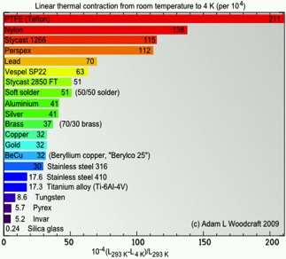
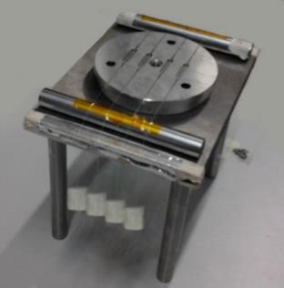

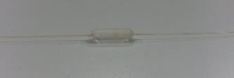

FOSxCRYOs team solution
Design and material selection
Fabrication
CTE of the material
Good adhesion for good strain transfer
Thickness and geometry of the coating
Polymers
Metals
Silica
Commercial Polyimide coated FBG
30 μm thickness
2 mm
Epoxy coated
2 mm thickness
12 mm
5 mm
PMMA coated
5 mm thickness
25 mm

Slide 18
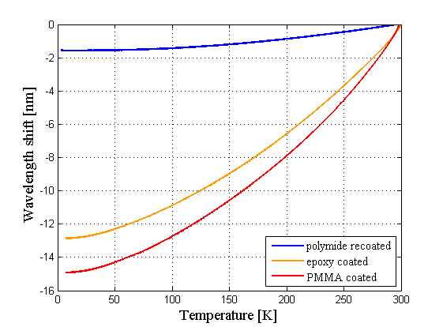
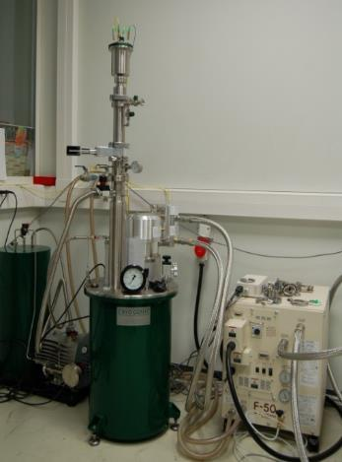
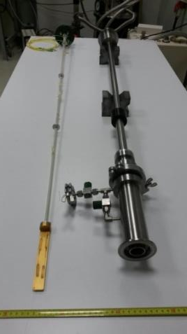
Characterization in the range 300 – 4 K
Fiber optic feedthrough
VTI
PT
Cryogen free cryostat
Dedicated cryogenic test station
Cryogen free
He gas cooling down to 4 K with Pulse Tube refrigerator
Temperature control
Sensitivity :
Polyimide ST below 40 K: 1 pm/K
Epoxy ST @ 30 K: 13 pm/K
PMMA ST @ 30 K: 15 pm/K
More materials to be studied!

Slide 19
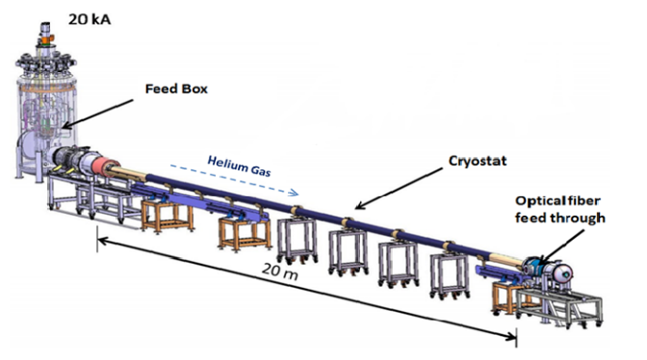
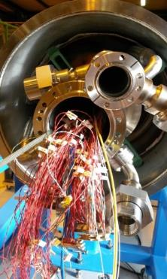

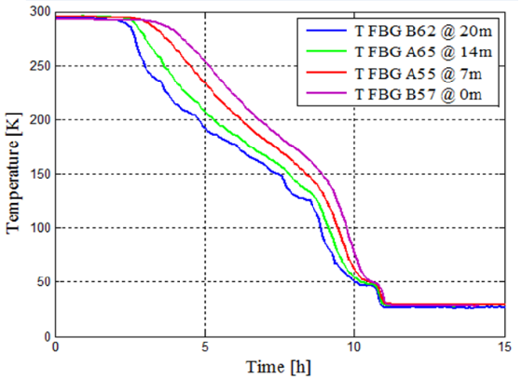
Integration in the SC - Link
Calibrated FBG coated with PMMA and epoxy arranged in 2 arrays of 20 m length for the temperature monitoring of the He gas
Connection side
Wiring reduction:
4 CCS: 16 wires
4 FBG: 2 wires
Courtesy
S. Giannelli
FBG monitoring of the cool down to 30 K
Feasibility study of the distributed FOS based on Rayleigh scattering
Agreement with CCS within
1 K @ 30 K

Slide 20
FBG for superconducting magnets
Sensors integration....
Bonded FBG on the Al structure
Embedded FBG inside the racetrack coil
...for strain and temperature monitoring during the magnet service life
Assembly
Cool down
Powering
Coil fabrication
Heat Treatment to 650 °C
Impregnation to 125 °C
Bladders and Keys
at 300 K
From 300 to 1.9 K
Up tp 20 kA
at 4.2 and 1.9 K

Slide 21
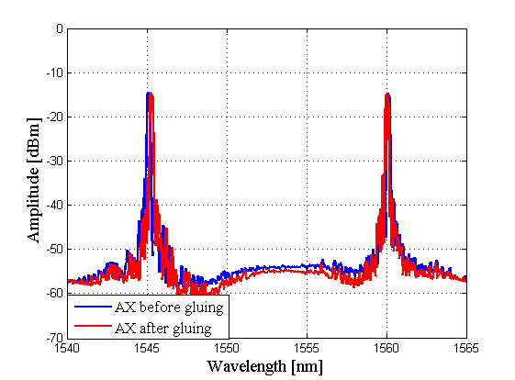
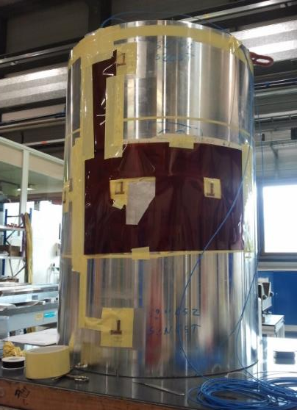
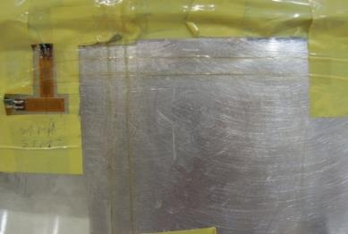
FBG integration on the magnet shell
No standard bonding process for cryogenic applications: FBG sensors glued with standard Araldite suitable for low temperatures following the bonding process used for the strain gauges.
Array configuration
FBG
FBG
Azimuthal FBGs
Strain Gauges
Magnet Dimensions: 1 m length 0.6 m diameter
Axial FBGs
Wiring reduction:
4 Strain Gauges: 16 wires
8 FBG: 4 wires
No spectra distortion
No birefringent effect

Slide 22
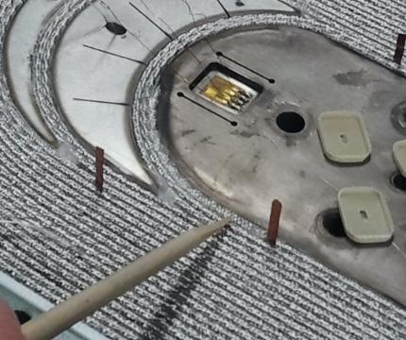



FBG integration in the racetrack coil
Integration in the coil after heat treatment, before the impregnation directly on the winding and on the Ti Pole
Strain Gauges
FBG transverse direction
(Ti Pole)
Single ended configuration
Voltage taps
FBG axial direction (Nb3Sn winding)
FBG
Fiber path
Coil after impregnation
Temperature and strain sensors in embedded configuration
Coil Dimensions: 500 x 193.6 x 31.7 mm

Slide 23







FBG monitoring of the magnet service life
Coil curing process
Magnet assembly @ 300 K
ε + Τ
Azimuthal FBGs
Τ
Magnet cooldown to 1.9 K
Powering @ 15.5 kA
FBG on winding
ε + Τ
Τ cryostat

Slide 24



TNA Journal Publications
Impact factor:
1.769
Impact factor:
2.32
Impact factor:
3.292

Slide 25
TNA Conference Publications
“Fiber Bragg Grating Sensors Based Monitoring System for Superconducting Accelerator Magnets”
A. Chiuchiolo, M. Bajko, J. C. Perez, H. Bajas, M. Consales, M. Giordano, G. Breglio, A. Cusano ; Photonics Conference, 2014 Third Mediterranean , vol., no., pp.1,3, 7-9 May 2014
“Fiber Bragg Grating Sensor as Valuable Technological Platform for New Generation of Superconducting Magnets”
  A. Chiuchiolo, M. Bajko, J. C. Perez, H. Bajas, P. Viret, M. Consales, M. Giordano, G. Breglio, A. Cusano; Proc. SPIE 9157, 23rd International Conference on Optical Fibre Sensors, 91579I (June 2, 2014)
“Fiber Optic Cryogenic Sensors for Superconducting Magnets and Superconducting Power Transmission lines at CERN”
  Chiuchiolo, M. Bajko, J. C. Perez, H. Bajas, M. Consales, M. Giordano, G. Breglio, L. Palmieri, A. Cusano, Proc. SPIE 9286, Second International Conference on Applications of Optics and Photonics, 92864B (August 22, 2014)
“Structural Health Monitoring of Superconducting Magnets using Fiber Bragg Grating Sensors”
A. Chiuchiolo, M. Bajko, J. C. Perez, H. Bajas, M. Guinchard, M. Giordano, G. Breglio, M. Consales, A. Cusano,
Proc. of EWSHM - 7th European Workshop on Structural Health Monitoring, Jul 2014, Nantes, France. (2014).
“Cryogenic temperature monitoring in superconducting power transmission line at CERN with hybrid multi-point and distributed fiber optic sensors”
  A. Chiuchiolo, L. Palmieric, M. Consales, M. Giordano, H. Bajas, A. Galtarossa, M. Bajko, A. Cusano
  Proc SPIE, 24° International Conference on Optical Fibre Sensors, Brazil (September 2015)
“Advances in Fiber Optic Sensors Technology Development for temperature and strain measurements in Superconducting magnets and devices”
A. Chiuchiolo, H. Bajas, M. Bajko , L. Bottura, M. Consales, A. Cusano, M. Giordano, J. C. Perez
IEEE Transactions on Applied Superconductivity, vol. 26, no. 4, pp. 1-5, (June 2016)
“Embedded Fiber Bragg Grating Sensors for True Temperature Monitoring in Nb3Sn Superconducting Magnets for High Energy Physics”
A. Chiuchiolo, H. Bajas, M. Bajko, M. Consales, M. Giordano, J. C. Perez, A. Cusano
Sixth European Workshop on Optical Fibre Sensors (EWOFS'2016)

Slide 26
Conclusions
Fiber Bragg Grating sensors installation in MQXF and Feather magnets
Fiber Bragg Grating sensors integration in the next
60-m-long SC- Link
Next projects to be submitted
Fiber Optic Fischer connectors qualification at 4.2 and 1.9 K for cryogenic test facilities instrumentation
Novel Fiber Bragg Grating sensors for Nb3Sn coils heat treatment monitoring

Slide 27
Thank you for your attention

