Slide 1
Magnetic measurements @ CERN
Lucio Fiscarelli
1st International WORKSHOP of the Superconducting Magnets Test Stands
13-14 June 2016, CERN Geneva (CH)

Slide 2
Outlook
Magnetic measurements on SC magnets
Role in magnet development
Challenges
Techniques
Our systems
New development for HL-LHC
Conclusions

Slide 3
SC magnet development
Development phase | Type of device under test | Required magnetic measurements
Validation of technologies | Racetrack coils | Selected magnetic figures (absolute field, magnetization…)
Demonstration of design | Short models | Geometric, saturation, persistent currents, induced currents, decays and snapback, cold/warm, other studies
Assessment of final design | Full-length prototypes | Geometric, saturation, persistent currents, induced currents, decays and snapback, alignment, other studies
Series production | Final magnets | Small set of representative tests, magnet to magnet reproducibility, QC

Slide 4
Challenges
Wide range of field levels
    Field quality at ambient temperature (~1 μT)
    Transfer function at cryogenic temperature (~10 T)
Wide range of measurement volume
    No aperture in racetrack coils
    0.1 m x 10 m for some full length magnets
“warm” and “cold”
    Ambient temperature for collared coils and cold masses at the production facility
    4.3 - 1.9 K for racetrack coils and short models without anti-cryostat
    Cold mass at cryogenic temperature but sensors at ambient temperature with anti-cryostat
DC conditions, dynamic conditions, and fast transients
    Static characterization (ambient temperature, geometric, persistent currents, saturation)
    Effect of induced currents (ramps at different rates)
    Decay-snapback (machine simulation cycles)

Slide 5
MM techniques
  Different sensors and techniques can be used
  Hall probes
  NMR probes
  Static and rotating coils
  Stretched wire
  …
  We can classify them in terms of
  Measured volume
  Measured properties (main field, homogeneity, axis…)
  Bandwidth
  Working temperature
  Accuracy

Slide 6
MM techniques
 | Volume | TF | Homogeneity | Angle | Axis | Bandwidth | Temperature | Accuracy
Hall probes | ~ mm³ | local | - | - | - | ~kHz | ambient cryogenic | <10⁻³
NMR probes | ~ cm³ | local | - | - | - | <1 Hz | ambient | <10⁻⁶
Static coils | 10 mm² 0.1 to 1 m | local integral | - | - | - | ~kHz | ambient cryogenic | <10⁻³
Rotating coils | ⌀ > 30 mm L = 0.1 to 1 m | local integral | multipoles | if calibrated | if rotation axis is known | <10 Hz | ambient cryogenic | 10⁻⁴ on main field 10⁻⁶ on multipoles < 0.1 mm on axis
AC mole | ⌀ > 30 mm L = 0.1 m | - | - | - | local | - | ambient | <0.1 mm
SSW | ⌀ > 30 mm L = 0.5 to 15 m | integral | - | integral | integral | DC | ambient | < 10⁻⁴ on main field < 0.05 mm on axis < 0.1 mrad on angle

Slide 7
MM techniques
 | Volume | TF | Homogeneity | Angle | Axis | Bandwidth | Temperature | Accuracy
Hall probes | ~ mm³ | local | - | - | - | ~kHz | ambient cryogenic | <10⁻³
NMR probes | ~ cm³ | local | - | - | - | <1 Hz | ambient | <10⁻⁶
Static coils | 10 mm² 0.1 to 1 m | local integral | - | - | - | ~kHz | ambient cryogenic | <10⁻³
Rotating coils | ⌀ > 30 mm L = 0.1 to 1 m | local integral | multipoles | if calibrated | if rotation axis is known | <10 Hz | ambient cryogenic | 10⁻⁴ on main field 10⁻⁶ on multipoles < 0.1 mm on axis
AC mole | ⌀ > 30 mm L = 0.1 m | - | - | - | local | - | ambient | <0.1 mm
SSW | ⌀ > 30 mm L = 0.5 to 15 m | integral | - | integral | integral | DC | ambient | < 10⁻⁴ on main field < 0.05 mm on axis < 0.1 mrad on angle
Hall probes: small size, cryogenic → Racetrack coils

Slide 8
MM techniques
 | Volume | TF | Homogeneity | Angle | Axis | Bandwidth | Temperature | Accuracy
Hall probes | ~ mm³ | local | - | - | - | ~kHz | ambient cryogenic | <10⁻³
NMR probes | ~ cm³ | local | - | - | - | <1 Hz | ambient | <10⁻⁶
Static coils | 10 mm² 0.1 to 1 m | local integral | - | - | - | ~kHz | ambient cryogenic | <10⁻³
Rotating coils | ⌀ > 30 mm L = 0.1 to 1 m | local integral | multipoles | if calibrated | if rotation axis is known | <10 Hz | ambient cryogenic | 10⁻⁴ on main field 10⁻⁶ on multipoles < 0.1 mm on axis
AC mole | ⌀ > 30 mm L = 0.1 m | - | - | - | local | - | ambient | <0.1 mm
SSW | ⌀ > 30 mm L = 0.5 to 15 m | integral | - | integral | integral | DC | ambient | < 10⁻⁴ on main field < 0.05 mm on axis < 0.1 mrad on angle
NMR probes: best absolute accuracy → Calibration

Slide 9
MM techniques
 | Volume | TF | Homogeneity | Angle | Axis | Bandwidth | Temperature | Accuracy
Hall probes | ~ mm³ | local | - | - | - | ~ kHz | ambient cryogenic | <10⁻³
NMR probes | ~ cm³ | local | - | - | - | <1 Hz | ambient | <10⁻⁶
Static coils | 10 mm² 0.1 to 1 m | local integral | - | - | - | ~ kHz | ambient cryogenic | <10⁻³
Rotating coils | ⌀ > 30 mm L = 0.1 to 1 m | local integral | multipoles | if calibrated | if rotation axis is known | < 10 Hz | ambient cryogenic | 10⁻⁴ on main field 10⁻⁶ on multipoles < 0.1 mm on axis
AC mole | ⌀ > 30 mm L = 0.1 m | - | - | - | local | - | ambient | <0.1 mm
SSW | ⌀ > 30 mm L = 0.5 to 15 m | integral | - | integral | integral | DC | ambient | < 10⁻⁴ on main field < 0.05 mm on axis < 0.1 mrad on angle
Static coils: bandwidth, cryogenic → Quench antennas

Slide 10
MM techniques
 | Volume | TF | Homogeneity | Angle | Axis | Bandwidth | Temperature | Accuracy
Hall probes | ~ mm³ | local | - | - | - | ~kHz | ambient cryogenic | <10⁻³
NMR probes | ~ cm³ | local | - | - | - | <1 Hz | ambient | <10⁻⁶
Static coils | 10 mm² 0.1 to 1 m | local integral | - | - | - | ~kHz | ambient cryogenic | <10⁻³
Rotating coils | ⌀ > 30 mm L = 0.1 to 1 m | local integral | multipoles | if calibrated | if rotation axis is known | <10 Hz | ambient cryogenic | 10⁻⁴ on main field 10⁻⁶ on multipoles < 0.1 mm on axis
AC mole | ⌀ > 30 mm L = 0.1 m | - | - | - | local | - | ambient | <0.1 mm
SSW | ⌀ > 30 mm L = 0.5 to 15 m | integral | - | integral | integral | DC | ambient | < 10⁻⁴ on main field < 0.05 mm on axis < 0.1 mrad on angle
Rotating coils: “what else?”→ Models, prototypes, and series magnets

Slide 11
MM techniques
 | Volume | TF | Homogeneity | Angle | Axis | Bandwidth | Temperature | Accuracy
Hall probes | ~ mm³ | local | - | - | - | ~kHz | ambient cryogenic | <10⁻³
NMR probes | ~ cm³ | local | - | - | - | <1 Hz | ambient | <10⁻⁶
Static coils | 10 mm² 0.1 to 1 m | local integral | - | - | - | ~kHz | ambient cryogenic | <10⁻³
Rotating coils | ⌀ > 30 mm L = 0.1 to 1 m | local integral | multipoles | if calibrated | if rotation axis is known | <10 Hz | ambient cryogenic | 10⁻⁴ on main field 10⁻⁶ on multipoles < 0.1 mm on axis
AC mole | ⌀ > 30 mm L = 0.1 m | - | - | - | local | - | ambient | <0.1 mm
SSW | ⌀ > 30 mm L = 0.5 to 15 m | integral | - | integral | integral | DC | ambient | < 10⁻⁴ on main field < 0.05 mm on axis < 0.1 mrad on angle
AC mole: local axis → studies on prototypes

Slide 12
MM techniques
 | Volume | TF | Homogeneity | Angle | Axis | Bandwidth | Temperature | Accuracy
Hall probes | ~ mm³ | local | - | - | - | ~kHz | ambient cryogenic | <10⁻³
NMR probes | ~ cm³ | local | - | - | - | <1 Hz | ambient | <10⁻⁶
Static coils | 10 mm² 0.1 to 1 m | local integral | - | - | - | ~kHz | ambient cryogenic | <10⁻³
Rotating coils | ⌀ > 30 mm L = 0.1 to 1 m | local integral | multipoles | if calibrated | if rotation axis is known | <10 Hz | ambient cryogenic | 10⁻⁴ on main field 10⁻⁶ on multipoles < 0.1 mm on axis
AC mole | ⌀ > 30 mm L = 0.1 m | - | - | - | local | - | ambient | <0.1 mm
SSW | ⌀ > 30 mm L = 0.5 to 15 m | integral | - | integral | integral | DC | ambient | < 10⁻⁴ on main field < 0.05 mm on axis < 0.1 mrad on angle
SSW: best accuracy for integral TF, angle, and axis → series magnets

Slide 13
Our systems
Legacy systems (> 10 years)
  DIMM and QIMM
  AC mole
  Single Stretched Wire (SSW)
Recently developed systems (last years)
  FAst Measurement Equipment family (FAME)
  New SSW
Ongoing development (next years)
  PCB coils and carbon fiber shafts
  Hall probes for racetrack coils

Slide 14
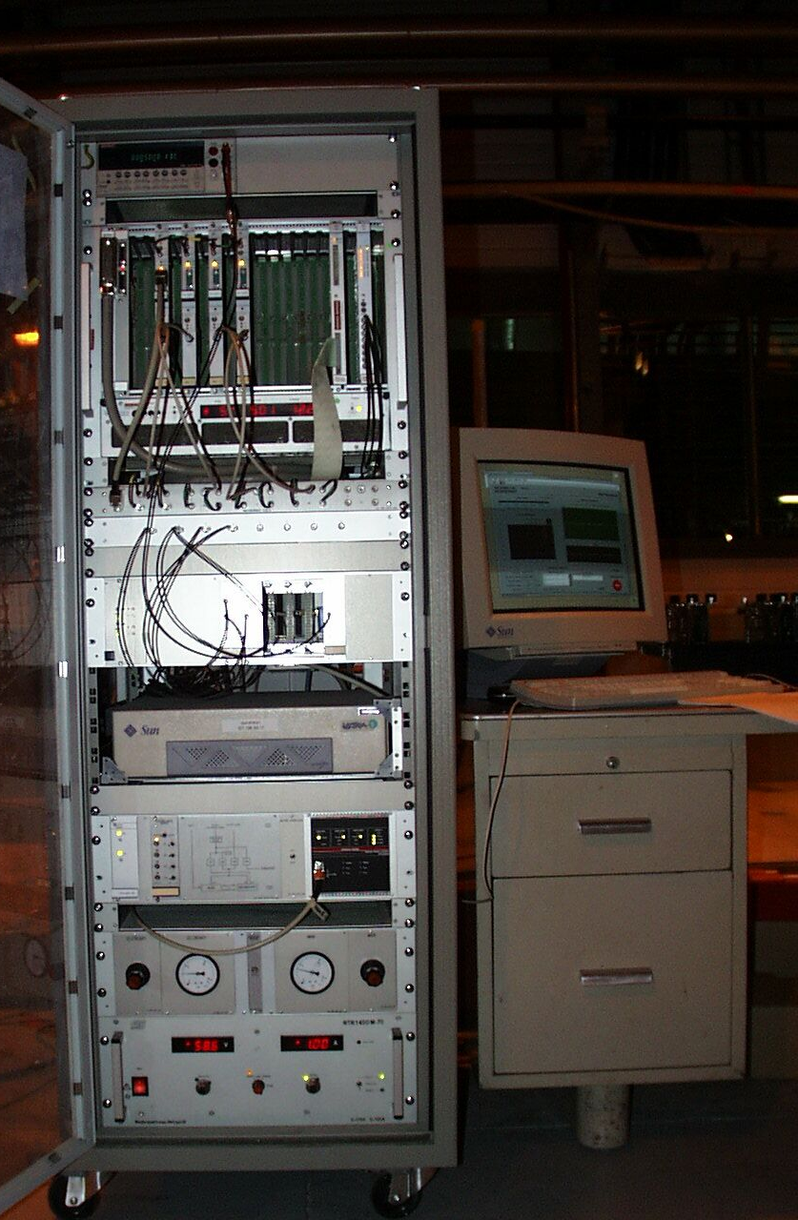
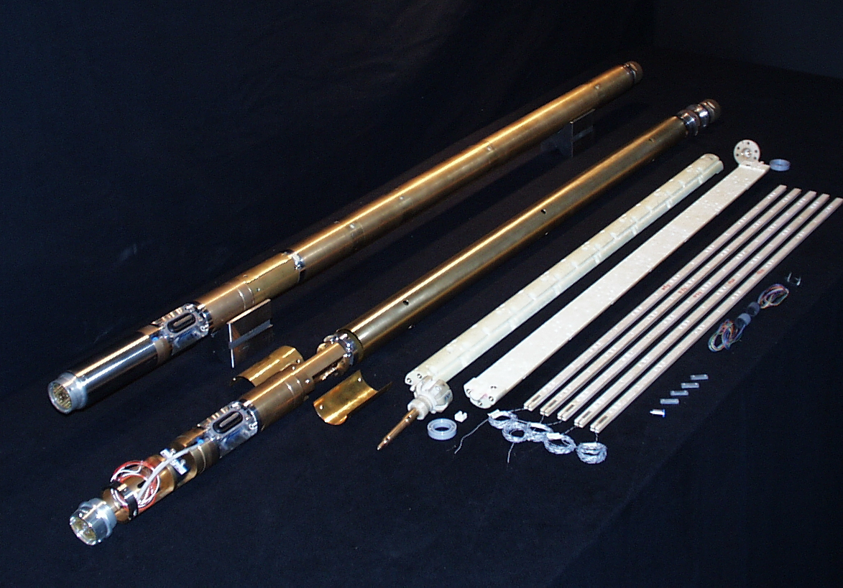
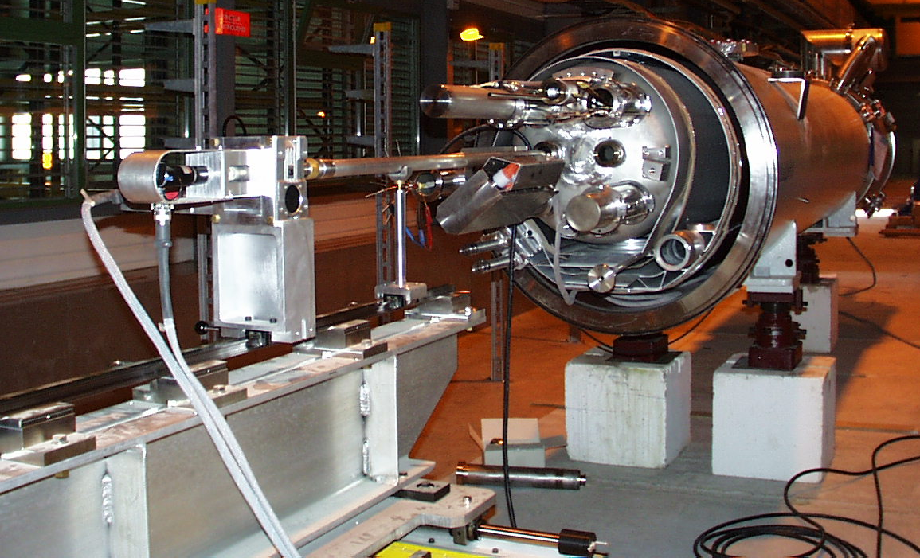
Legacy systems
  QIMM and DIMM (rotating coils)
  Compatible with standard LHC cold-bore
    Suitable for LHC spares and 11-T
  Mechanics and electronics are “oldish” but still ok
  Old software and computer
    Critical components for future use
  QIMM upgrade
    Upgrading the system aiming at compatibility with FFMM
  DIMM is not strictly required
    No series production of large number of magnets similar to LHC dipoles

Slide 15
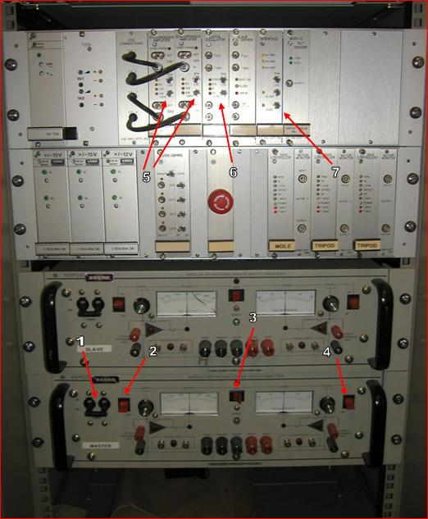
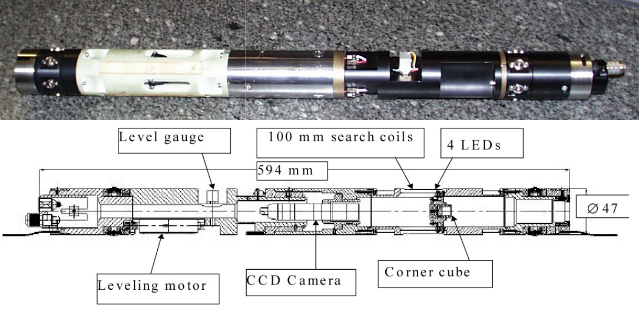
Legacy systems
  AC mole (coils in AC mode)
  Compatible with standard LHC cold-bore
    Suitable for LHC spares and 11-T
  Mechanics and electronics are “oldish”
    New acquisition cards can be used
  Old software and computer
    Critical components for future use
  Upgrade
    Basic magnetic measurement and analysis already implemented to be compatible with FFMM. Manual procedure.
    Measurement of cold-bore tube position (CCD) not yet available

Slide 16
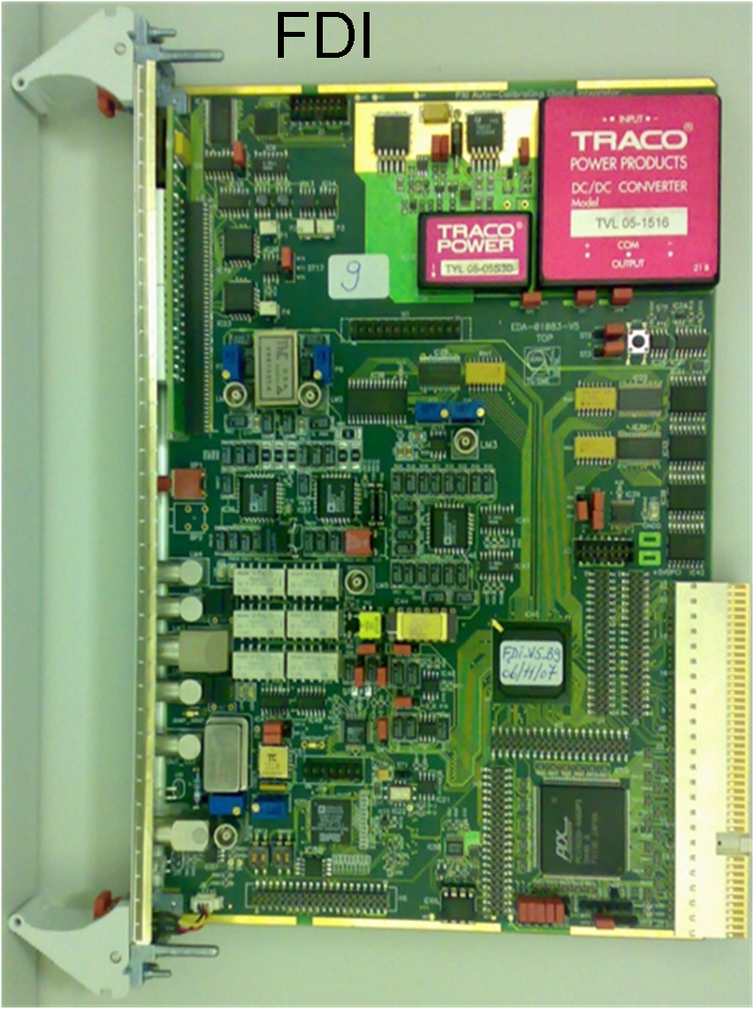
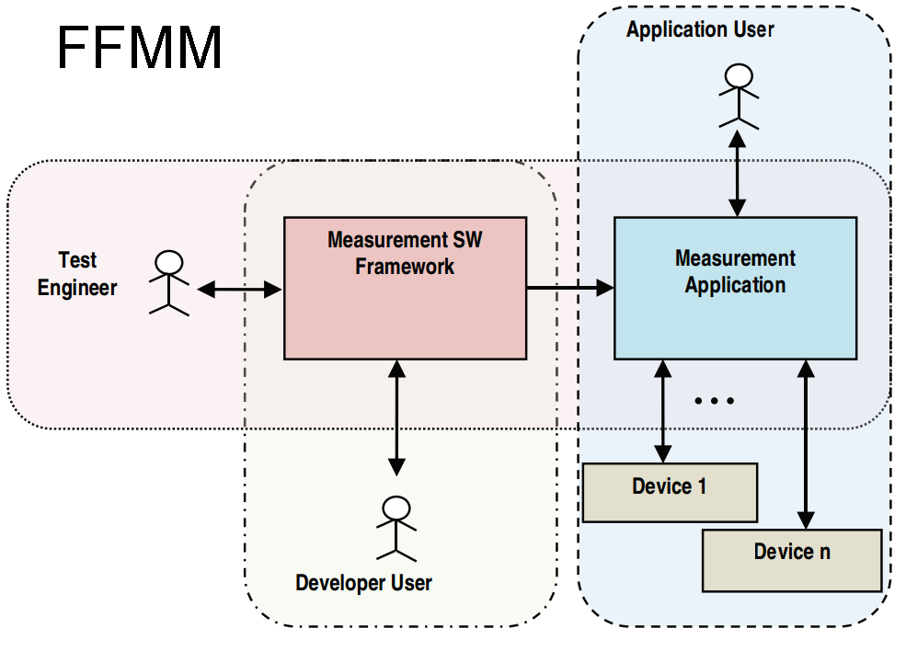
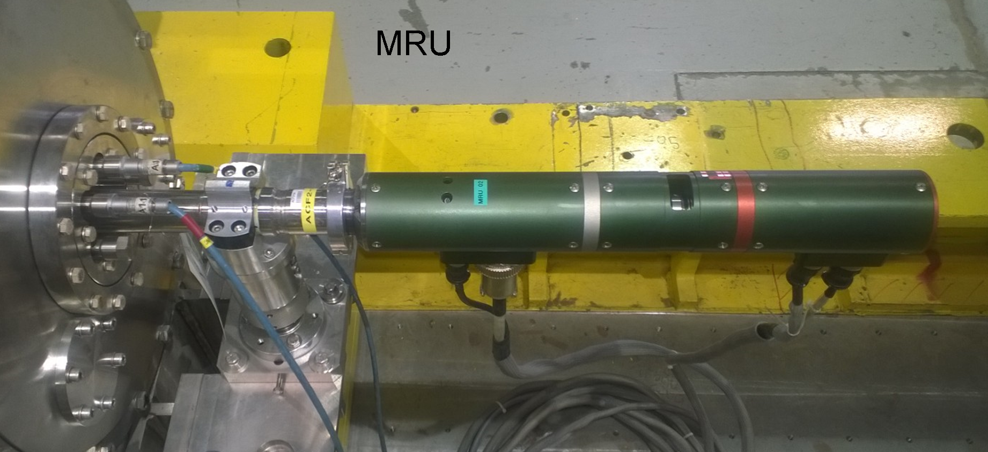
FAst Measurement Equipment (FAME)
  Flexible framework for Magnetic Measurements (FFMM)
    Library with drivers for common instruments used for MM (such as integrators, acquisition cards, motors, encoder interfaces, DMM’s…)
    Measurement procedure condensed in a short “script”
    Run-time generation of GUI for input parameters and data visualization
    Integrated post-processing with Matlab
  Fast Digital Integrator (FDI)
    Input range from ~ μV (SC magnet at “warm”) to 30 V (super-segments at “cold”)
    Fast triggering up to 10 kHz (rotating coils at 10 turns/s)
  Micro rotating unit (MRU)
    Angular encoder with 4096 steps
    Slip rings with >50 signals (long multi-segment shafts)
    DC motor + reduction for providing high torque (shaft without ball bearings)

Slide 17
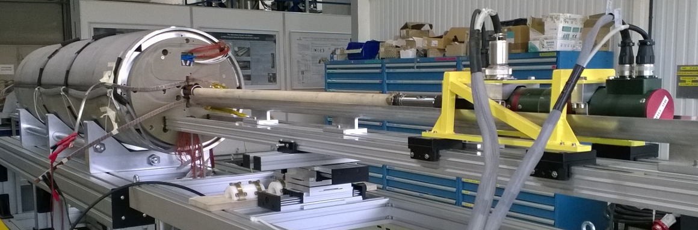
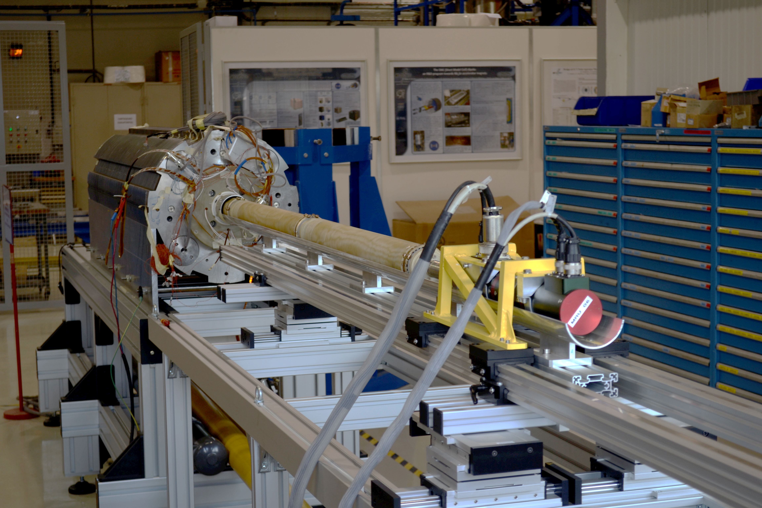
FAME for ambient temperature in 927
  Standard 19-inch rack including PXI crate, motor controller, patch panel
  PXI PC-blade running Windows7 and FFMM
  2 independent integrator channels (ABS, CMP)
  One MRU mounted on a sliding bench with 3-m span
  FuG low voltage power supply (40 V, 20 A) and DCCT Hitec MACC-plus
  Set rotating heads
      3 x 130 mm or 1200 mm rotating coil heads
      Measurement radii 22, 30, and 45 mm
      CCR targets for referring magnetic axis wrt external points
    MM at ambient temp. on short models for HL-LHC.

Slide 18
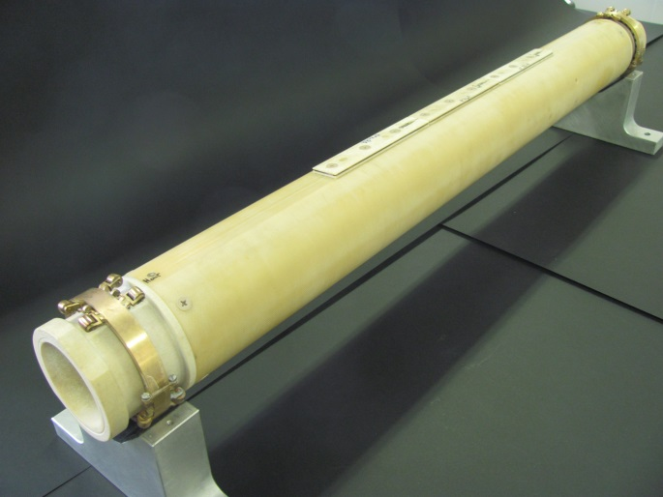
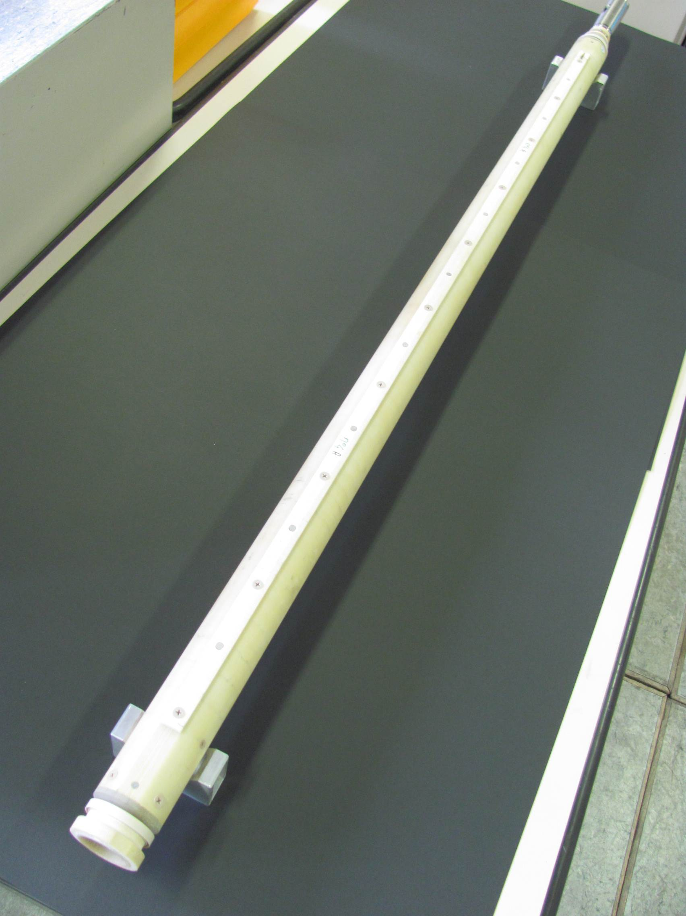
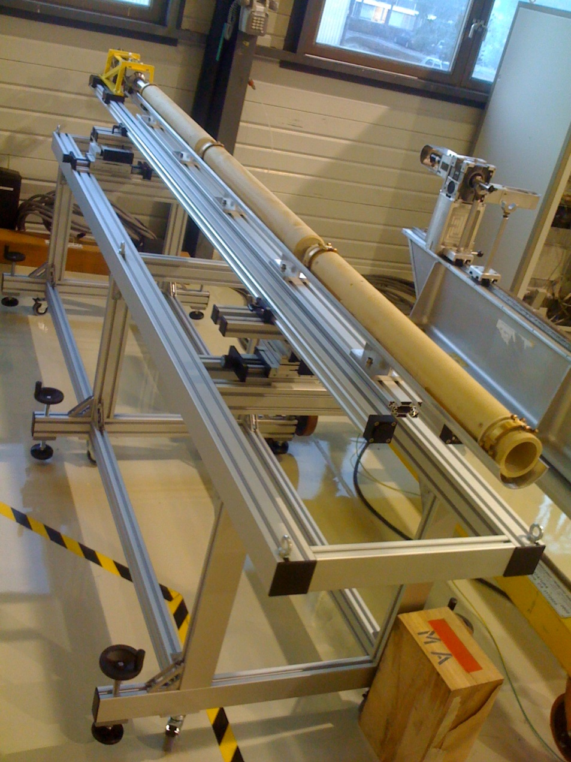
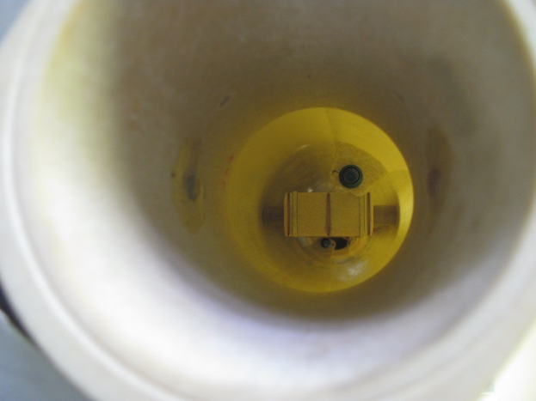
FAME for ambient temperature in 927
Non magnetic CCR for axis measurement

Slide 19
FAME for vertical benches
  Standard 19-inch rack including PXI crate, motor controller, patch panel
  PXI PC-blade running Windows7 and FFFM
  12 independent integrator channels for parallel acquisition of signals from two multi-segment rotating-shafts
  Two MRU’s with max rotation speed 8 turn/s (4 turn/s tested)
  GPS timing card for synchronization
  Multi-segment shafts without ball-bearings rotating in the helium bath
radius (mm) | length (mm) | segments | compensation
22 | 3680 | 3 | D,Q
22 | 1319 | 5 | D,Q
22 | 2120 | 7 | D
45 | 1330 | 5 | D,Q
45 | 2114 | 5 | D,Q

Slide 20
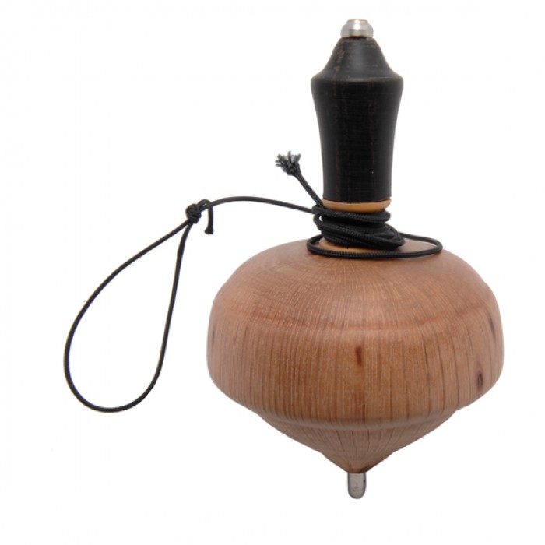
Rotating shaft in the helium bath
  Mechanics at “cold” must be kept as simple as possible

Slide 21
  Teflon ring
  Stainless steel arm
  Static shell to be fixed
  into the magnet aperture
  Rotating shaft with coils
  Pivot with spherical head
  Spherical hollow

Slide 22
L. Fiscarelli, Magnetic measurements @ CERN
22

Slide 23
L. Fiscarelli, Magnetic measurements @ CERN
23

Slide 24
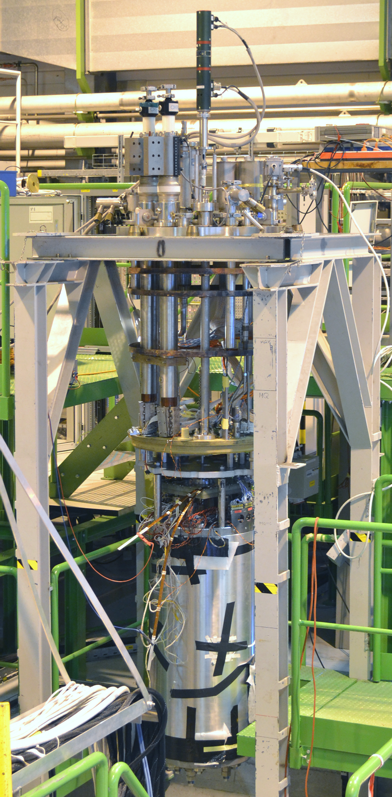
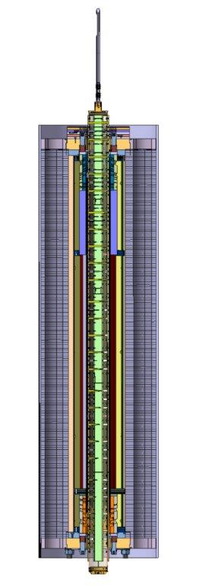
L. Fiscarelli, Magnetic measurements @ CERN
24

Slide 25
Anti-cryostat for vertical stations?
 | Shaft in the He bath |  | With anti-cryostat
Devices to be tailored to the magnet | Shaft for diameter and length | - | Shaft for diameter and length (?) Warm bore tube | - -
Space for shaft | All available space | + | Some space used for warm tube, problem in small diameter apertures | -
Heat load | No load | + | Should be taken into account | -
For double-aperture magnets | Additional shaft | - | Additional shaft (?) Additional warm bore tube | - -
Calibration | Correction for TF Ok for multipoles | - | Ok | +
In case of major fault of shaft | Thermal cycle is required | - - | Shaft can be replaced | + +
  Conclusion: differences but not clear advantages from one solution It depends on the experience of the lab

Slide 26
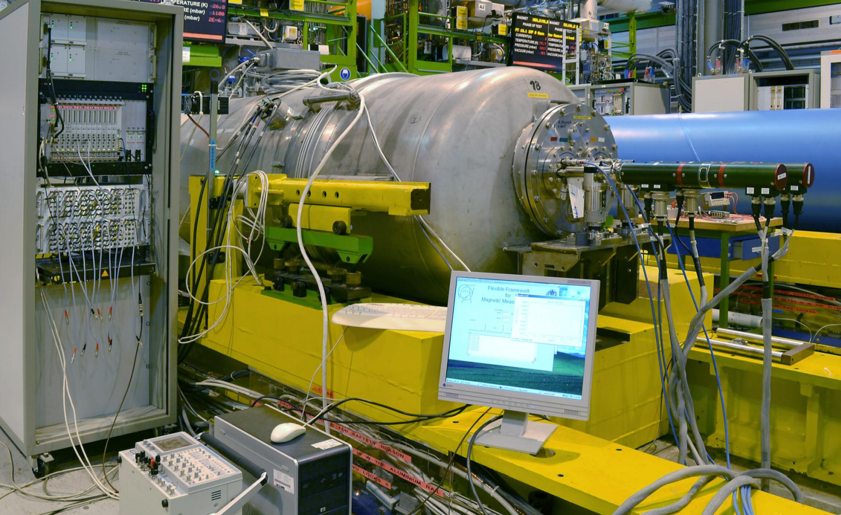
FAME for horizontal benches
  Standard 19-inch rack including PXI crate, motor controller, patch panel
  PXI PC-blade running Windows7 and FFFM
  12 independent integrator channels for parallel acquisition of signals from two multi-segment rotating-shafts
  Two MRU’s with max rotation speed 8 turn/s (5 turn/s tested)
  GPS timing card for synchronization
  Multi-segment ceramic shafts for MB, MQ, D1 with anti-cryostat
  Adaptation to DS11 dipole proto ongoing
  MB4001

Slide 27
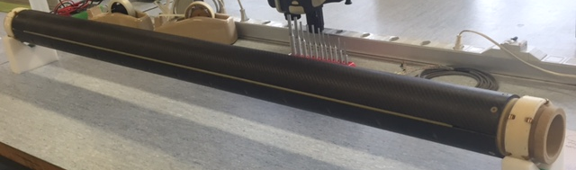
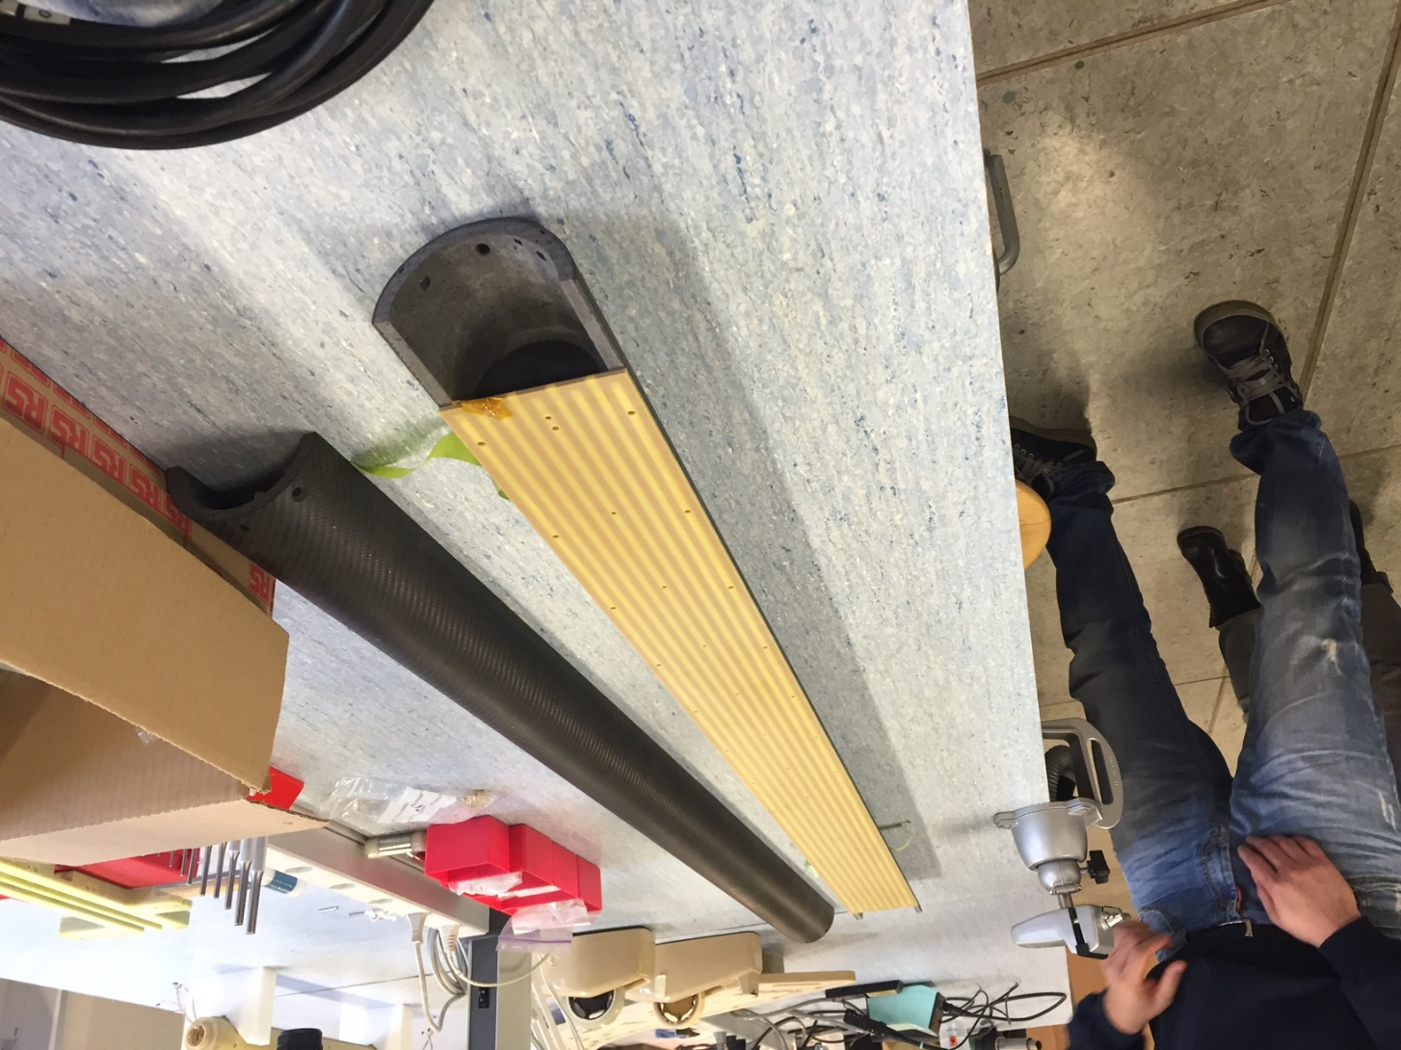
Prototype of new rotating-coil shaft
  Carbon fiber shell
  Total weight 4 kg
  Standard fiberglass 7.2 kg
  PCB
  5 radial coils
  90-mm width
  1.3-m length
  Tilt angle <0.35 mrad
  Dipole bucking ~800
  Quadrupole bucking ~600
‰
  It is the “first brick” for a long multi-segment shaft for full length HL-LHC magnets (MQXF)
27
27
27

Slide 28
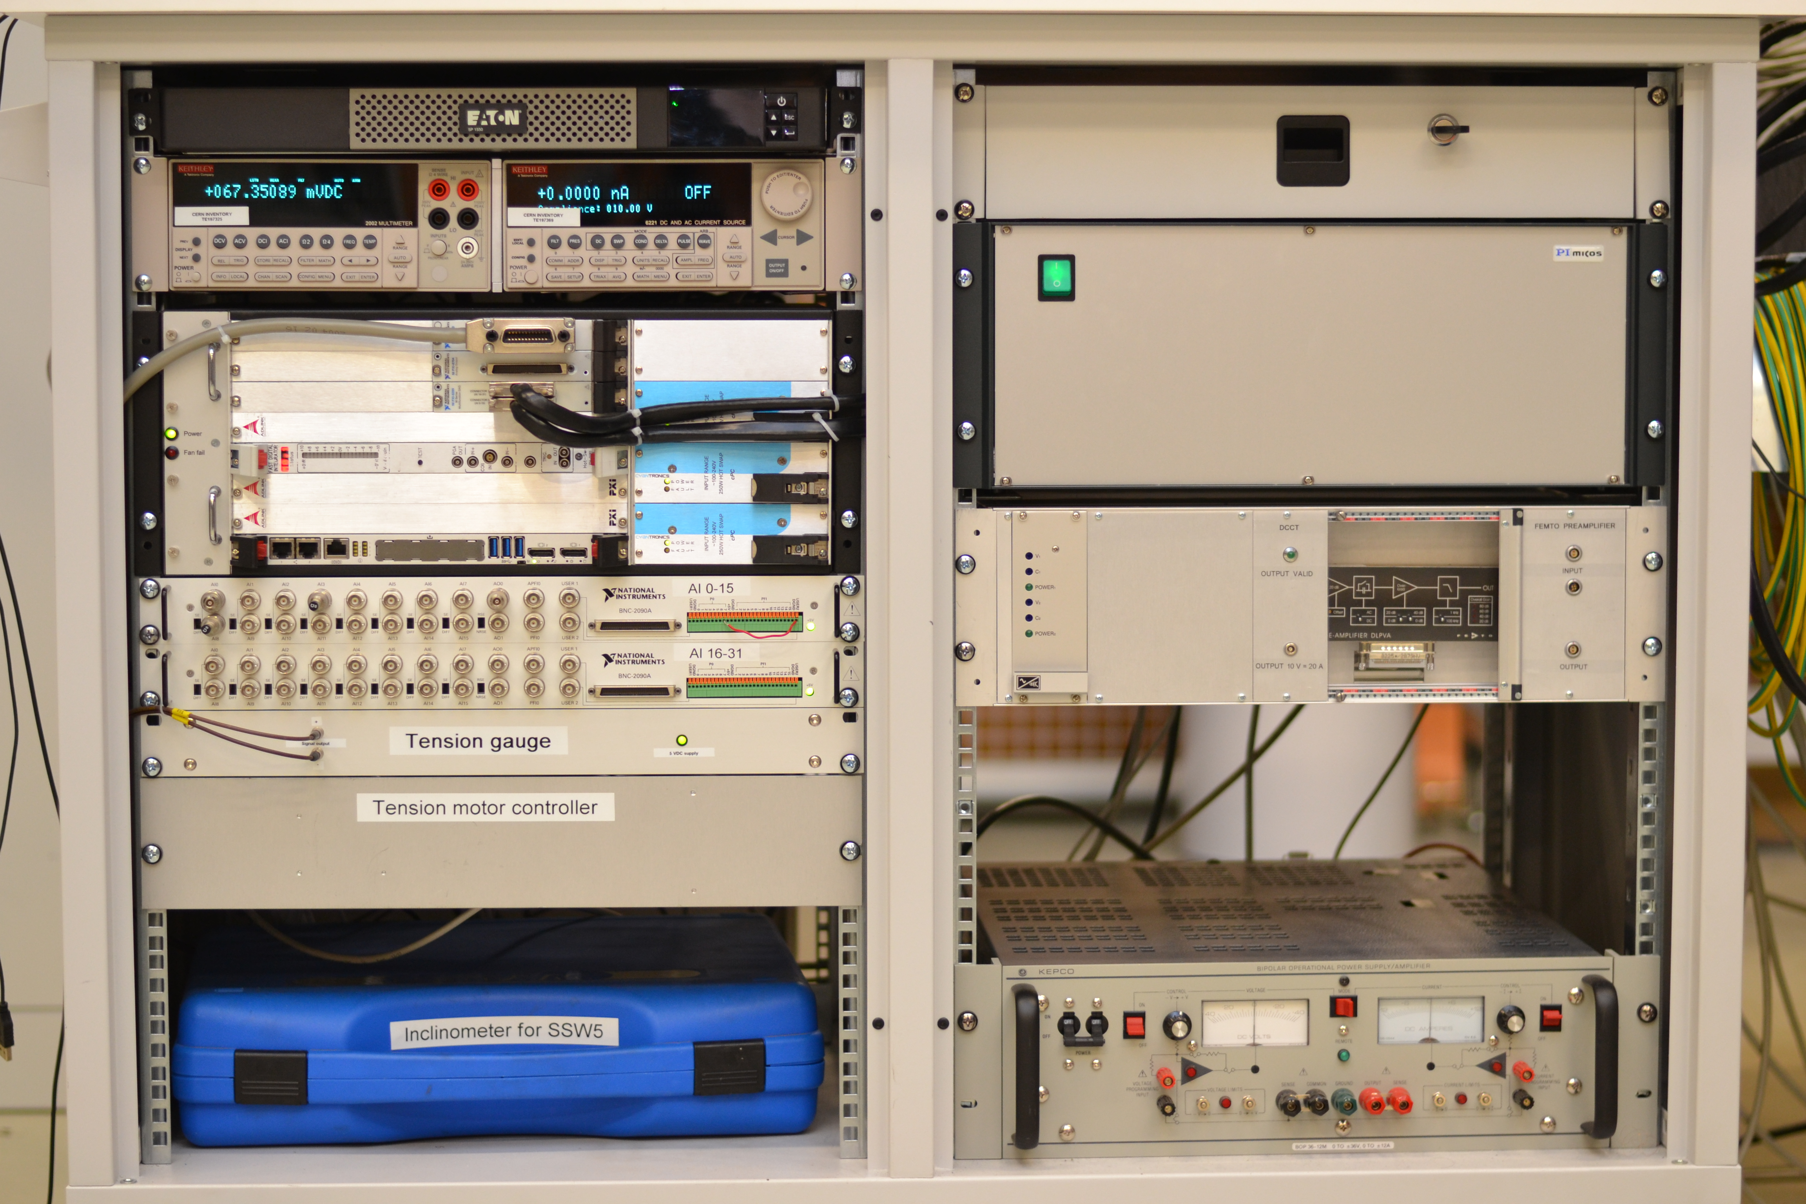
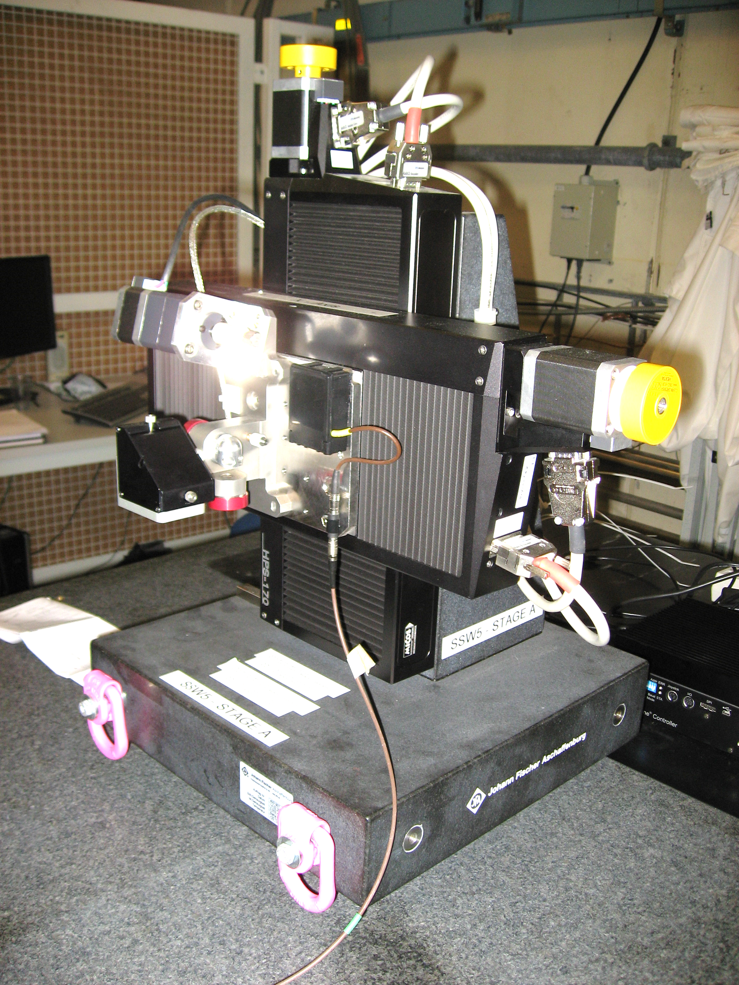
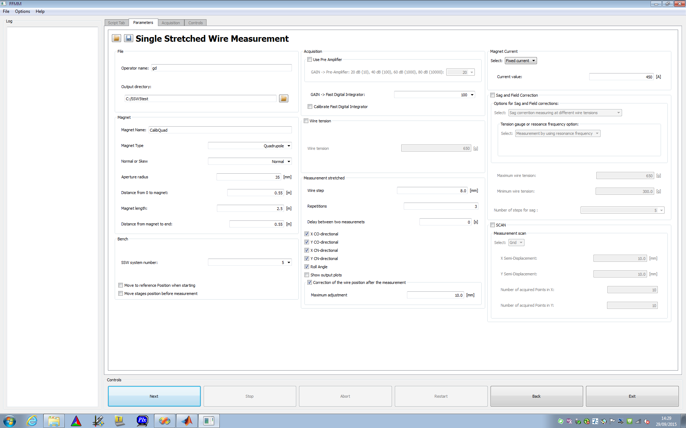
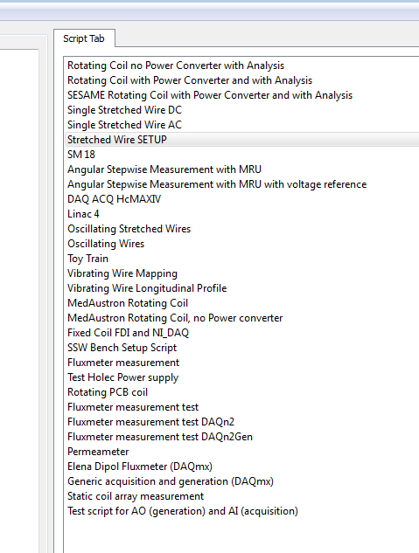
New SSW
  X-Y tables with 155-mm span
  Fast Digital Integrator
  FFMM software with user-friendly GUI
  Sensors and electronics for vibrating wire mode
7

Slide 29
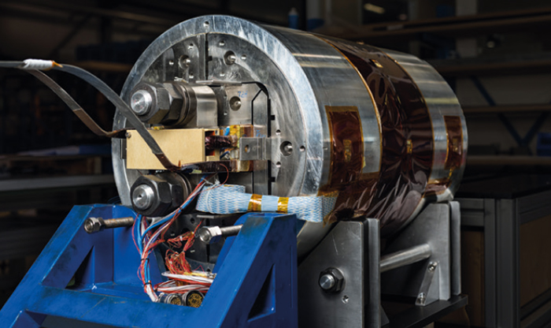
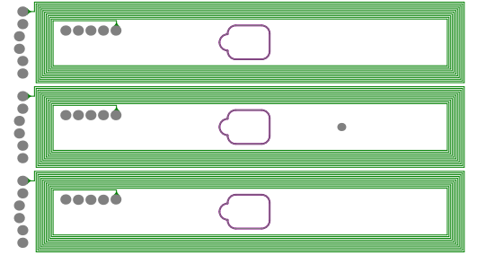
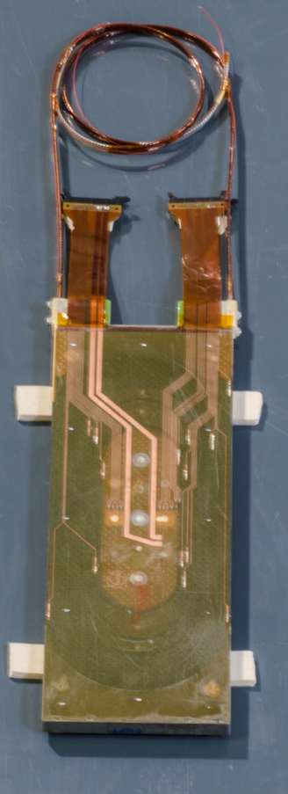
Racetrack coils
  Fixed Coils in PCB
  Dedicated design
  Precise positioning of windings
  Standard in-house production process
  Hall sensors
  Available on the market
  Large range: 0 - 30 T
  Temperature depended
  Non linear - Calibration is needed
5 x 4 x 1 mm

Slide 30
MM system operated in other laboratories
  In principle it is possible but we should not underestimate the effort
  It requires an integration study insert-magnet-shaft
  Lead time for procurement of components
    6 months for a shaft
  Training of operators (at CERN ?, in loco ?)
  In some cases, all this for a single magnet ?

Slide 31
Conclusions
  SC magnets are challenging for magnet designers
  … for test-station people as well
  Many magnet families are being developed for HL-LHC
  Many people from different laboratories are involved
  We have the technologies and the know-how for fulfilling the requirements
  … we will have no time to get bored

Slide 32
Thank you

