Slide 1
HL-LHC
Lucio Rossi
Project Leader
1st International Workshop of the Supeconducting Magnet Test Stands
CERN – Globe of innovation, 13 June 2016

Slide 2
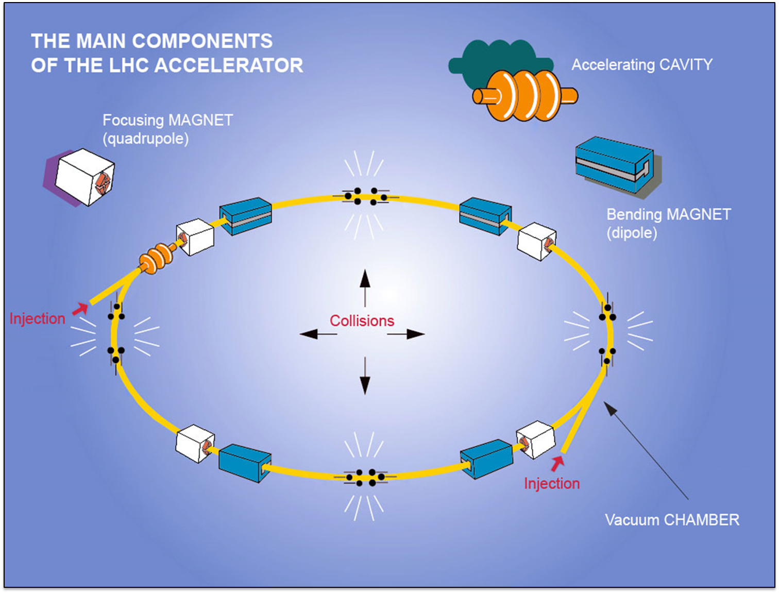
LHC

Slide 3
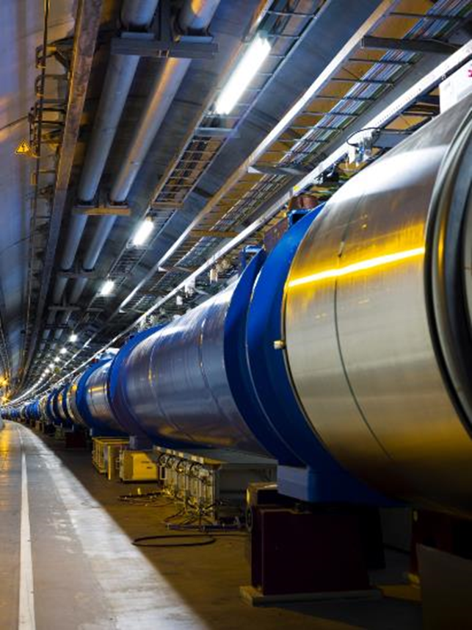
LHC the largest scientific instrument
LHC dipoles: the collider backbone
The dipole line in the LHC ring
27 km, p-p at 7+7 TeV
3.5+3.5 start, 4+4 in 2012
6.5+6.5 TeV in 2015
1232 x 15 m Twin Dipoles
Operational field 8.3 T @11.85 kA
(9 T design)
HEII cooling, 1.9 K with 3 km circuits (130 tonnes He inventory).
Field homogeneity of 10⁻⁴, bending strength uniformity better then 10⁻³. Field quality control (geometric and SC effects) at 10⁻⁵.
All fully cold tested

Slide 4
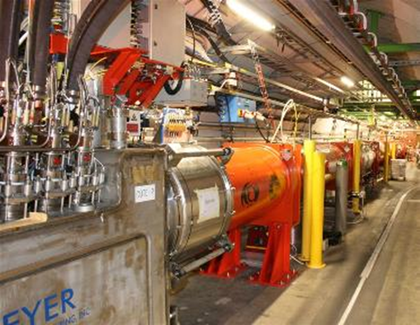
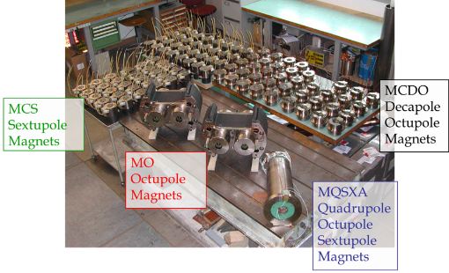
More than dipoles…
The pletora of SC magnets…
392 Main Quads Two-In-One rated for a peak field of 7 T.
About 100 other Two-in-One MQs
32 MQX (low-β) single bore for luminosity (design L=1⋅10³⁴ cm⁻²s⁻¹), 70 mm apertures, about 8 T peak field, high quality
A «zoo» of 7600 «small» Sc magnets (correctors and higher order magnets
Total: 9 MJ stored energy (at nominal)
Large detector magnets
ATLAS toroid – 25 m long 1.2 GJ
CMS solenois – 12 m long 2.5 GJ
All fully cold tested

Slide 5
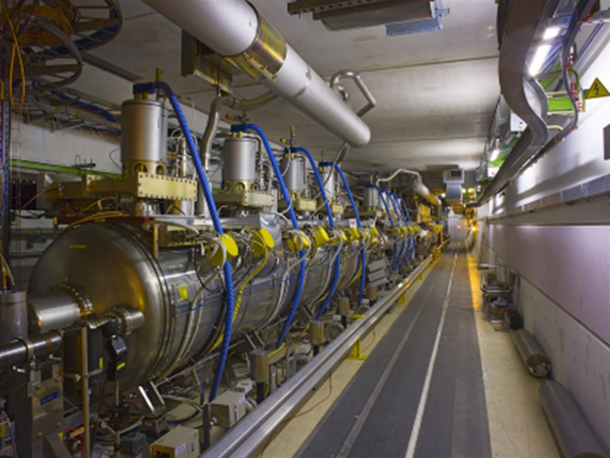
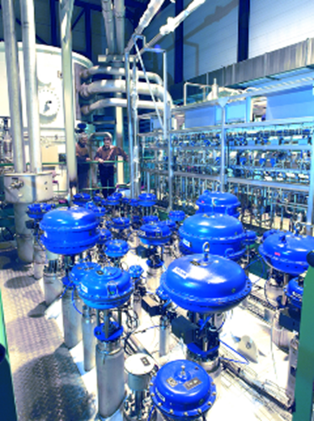
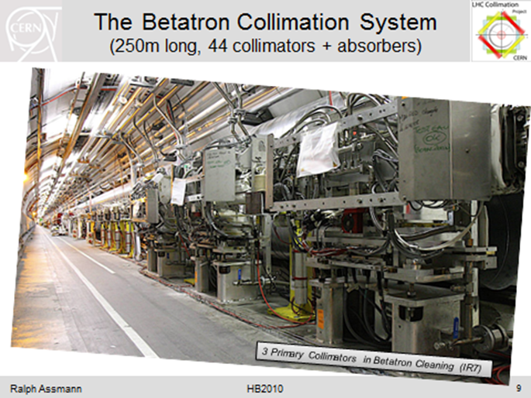
SC radiofrequency, Cryogenics,
LHC: much more than magnets…
400 MHz Standing wave RF
4 single cell cavities in cryomodule, 2 crym per beam. Total 16 cavities.
Sputtered niobium design (as LEP)
Gradient 5.5 MV/m nominal (8 MV/m available)
Nominal 2MV, up to 3 MV at 8 MV/m
Cryo : 8 x 18 kW@4.5K
Collimators: 146
All fully cold tested

Slide 6
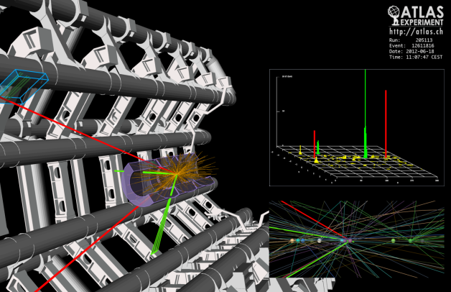
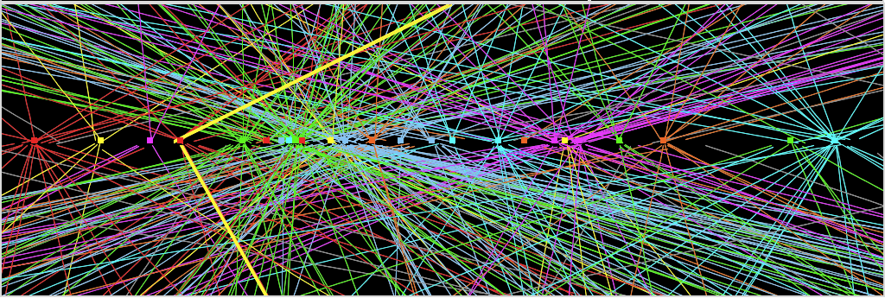
The Higgs: the needle in a haystack
luminosity: collision rate)
Z→ μμ
Z→ μμ event from 2012 data with 25 reconstructed vertices

Slide 7
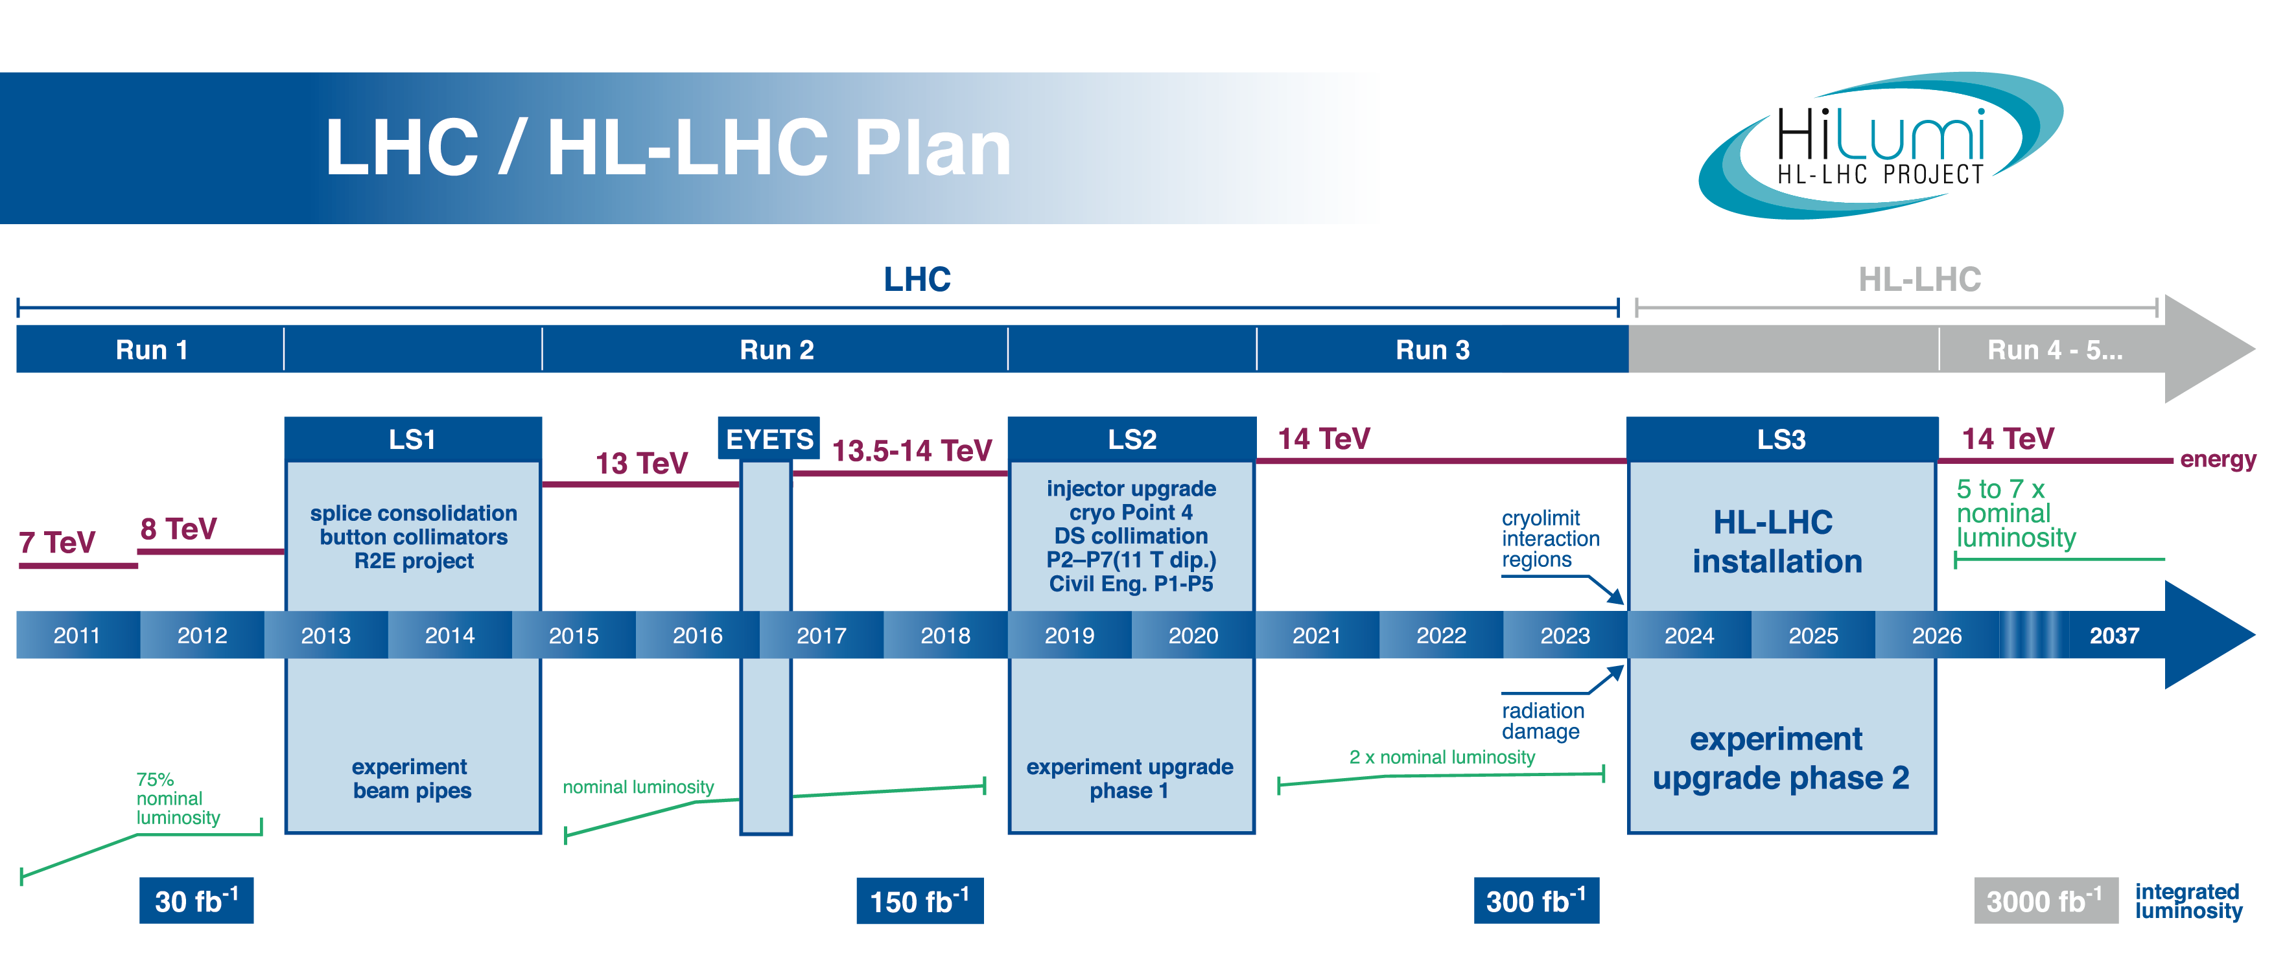
Why upgrading the LHC?
0.75 10³⁴ cm⁻²s⁻¹
50 ns bunch
high pile up ∼40
1.5 10³⁴ cm⁻²s⁻¹
25 ns bunch
pile up ∼40
1.7-2.2 10³⁴ cm⁻²s⁻¹
25 ns bunch
pile up ∼60
Technical limits to lumi increase (Machine & Experiments)
50 ⇒ 25 ns

Slide 8

The project started in 2010 as
EC-FP7 Design Study
From FP7 HiLumi LHC Design Study application
The main objective of HiLumi LHC Design Study is to determine a hardware configuration and a set of beam parameters that will allow the LHC to reach the following targets:
A peak luminosity of L_{peak} = 5×10³⁴ cm⁻²s⁻¹ with levelling, allowing:
An integrated luminosity of 250 fb⁻¹ per year, enabling the goal of L_{int} = 3000 fb⁻¹ twelve years after the upgrade.
This luminosity is more than ten times the luminosity reach of the first 10 years of the LHC lifetime.

Slide 9
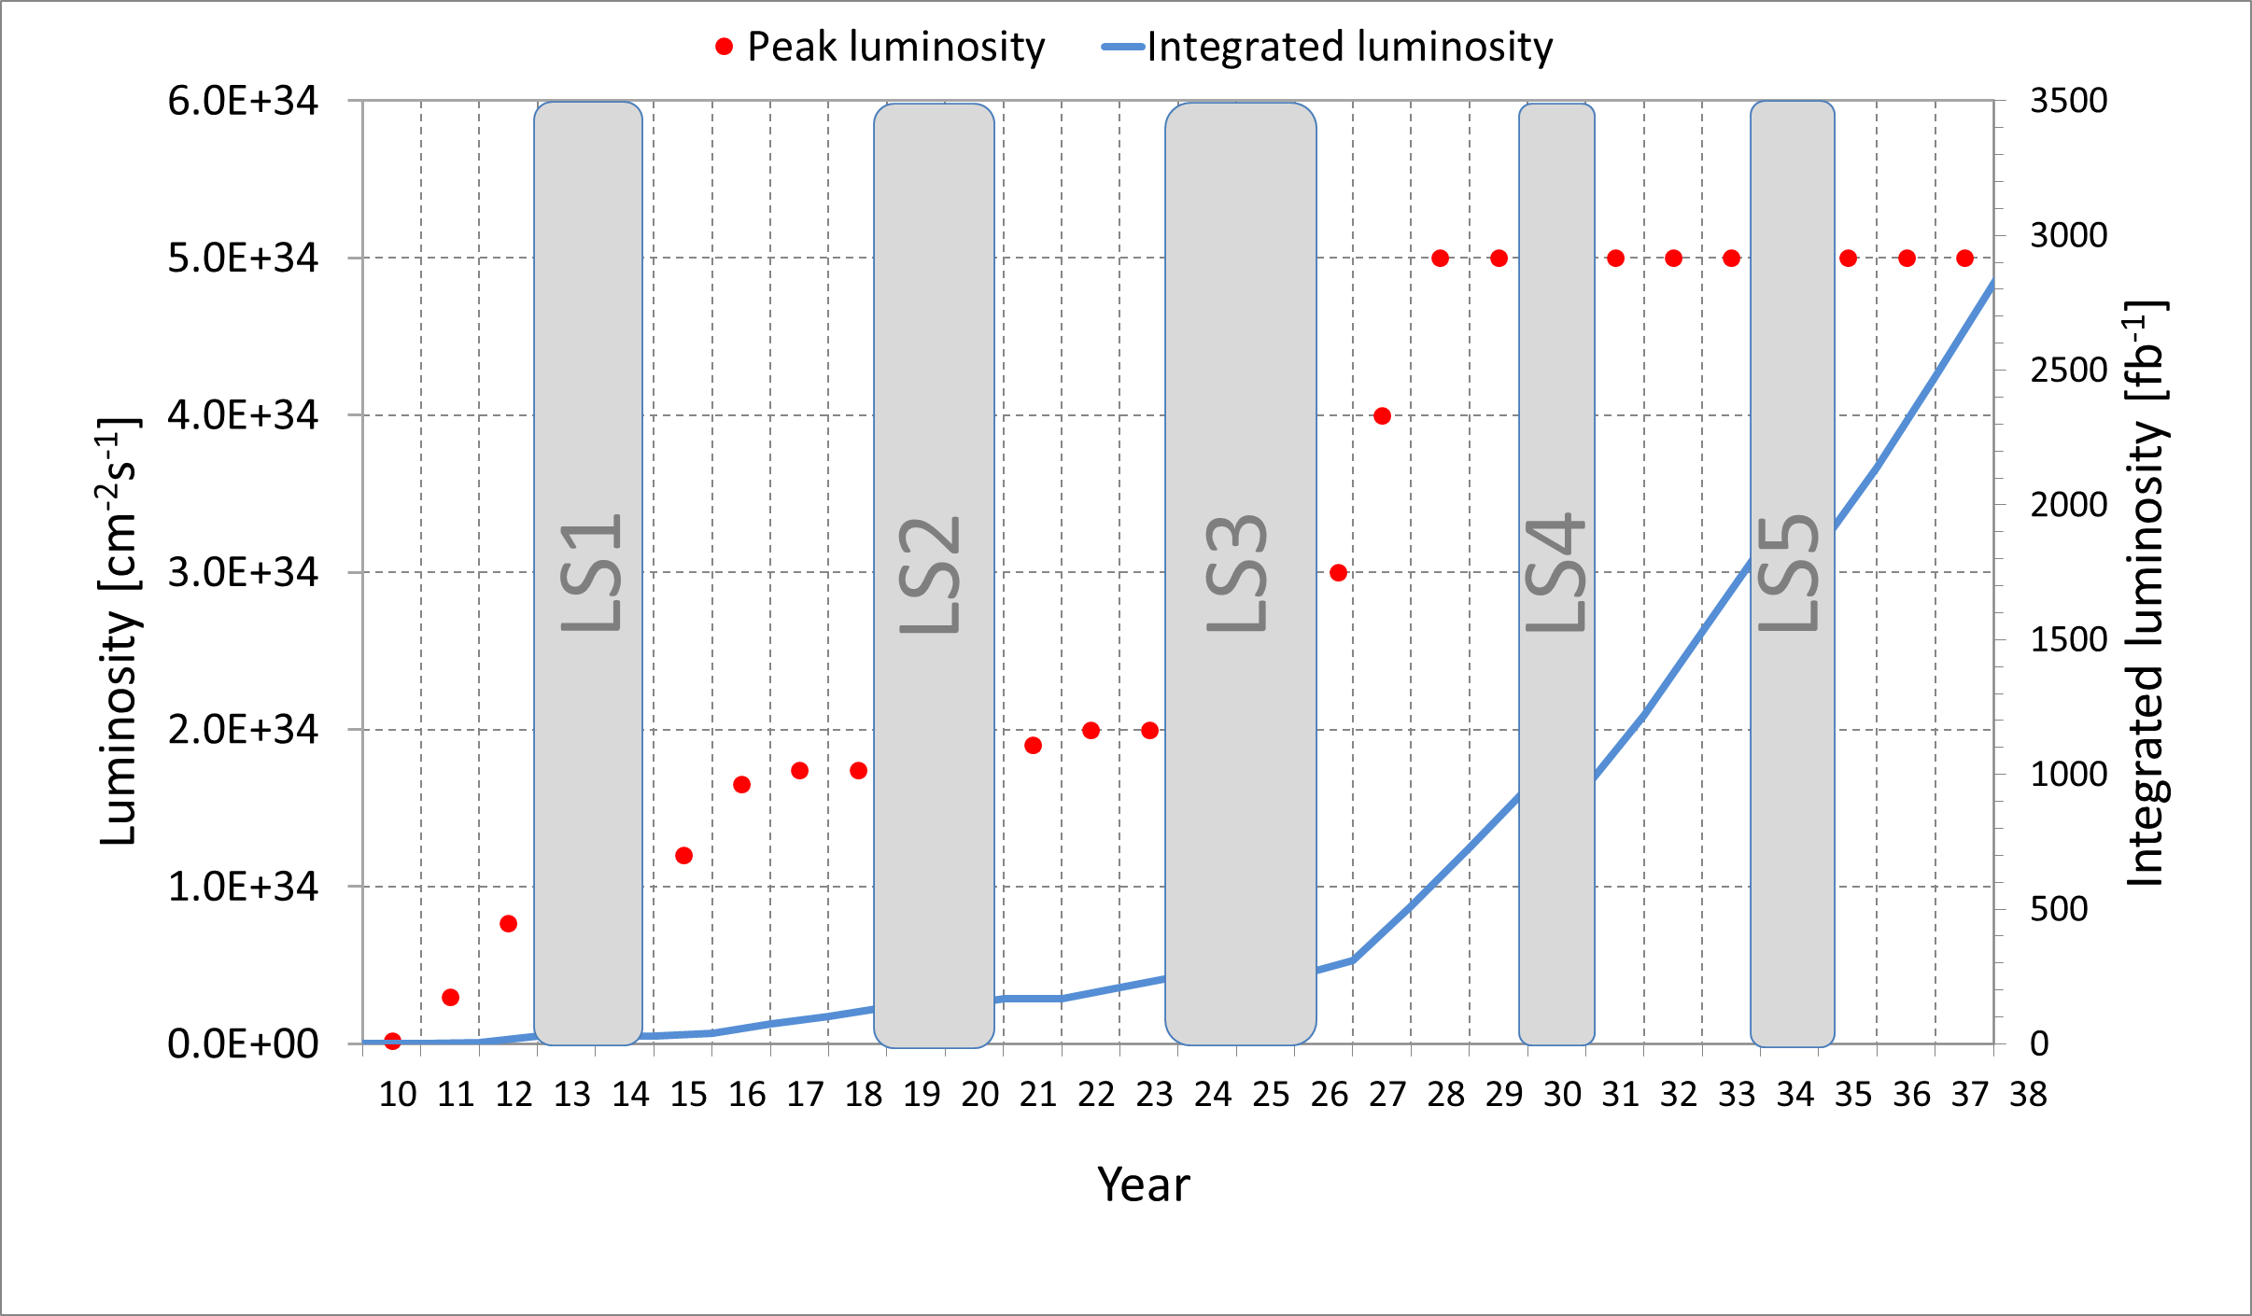
The bolt advance in luminosity

Slide 10

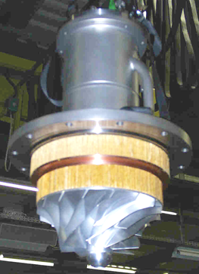

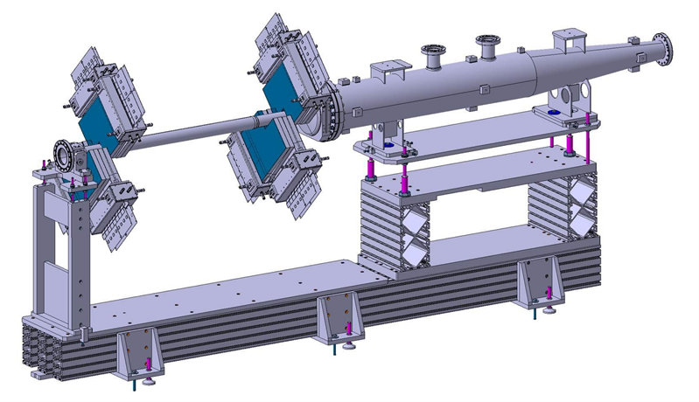
FP7-HiLumi classified as «success story» by EC
Cryo@P1-P5
Cryo@P4
New TAS and VCX
Beam diagnostics
BGV

Slide 11
HL-LHC project breakdown structure

Slide 13
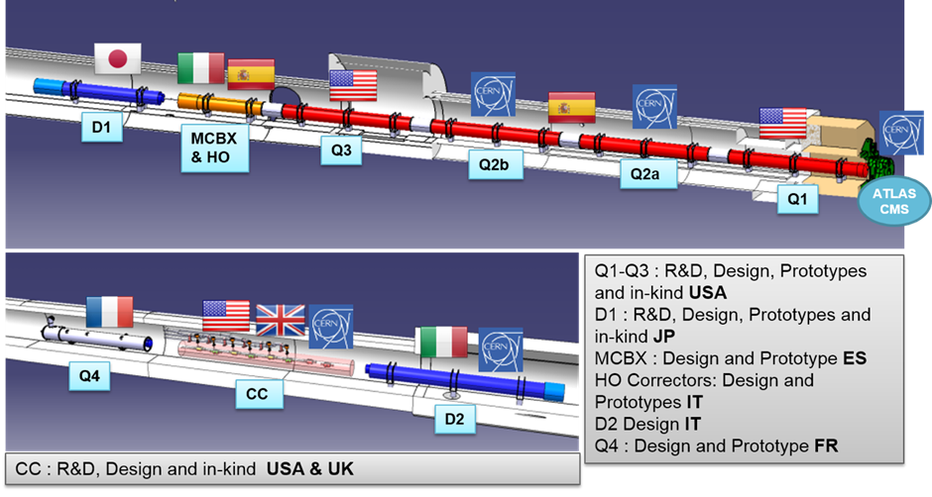
Deep changes in the Inner Triplet region (around ATLAS & CMS experiments)
International collaborations: an opportunity and a challenge, also for testing!

Slide 14
International collaboration regards also tests
SM18 @ CERN
    HiLumi has triggered the SM18 upgrade and pays about half of it.
    HiLumi IT string is in the plan since 2015 (see talk)
US/LARP-AUP : FNAL and BNL
INFN-LASA (Milano)
UPPSALA univ.
CEA ?
More?

Slide 15
HiLumi counts on cryogenic full power tests: no harware will be installed without test
First test in the chain is the strand/conductor! Try also to be synergic to these test!
A Magnet not testet is not worth anything, yet!
Testing, for HiLumi like for LHC, is integral part of the design-construction-qualification cycle:
    Validation of design & basic choice
    Verification of performance and of conformity to specs
    Most crititical acceptance,releasing payment and tranfer of properties (from Industry or Collaboration)
      → time and schedule are IMPORTANT!!!
    Anticipate HWC and operation issues (stand-alon test and especially IT string)

Slide 16
Thanks to Marta for orgnaizing this meeting and all of you for the great support to HiLumi

