Slide 1
Goal of the Workshop
Marta Bajko
1st International Workshop on Superconducting Magnet Test Stands
Geneva 13th – 14 th of June, Geneva @ CERN

Slide 2


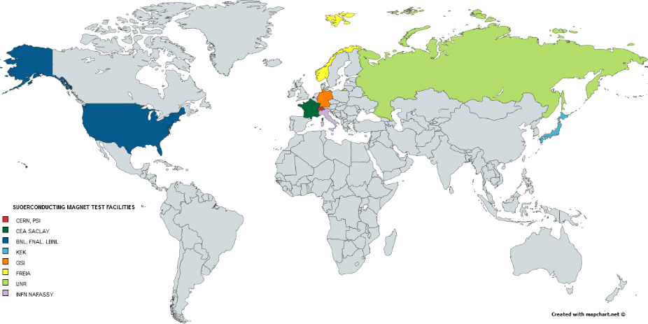









Welcome everybody!

Slide 3
The past ???
Most of you are here as you have a valuable long experience and expertise
in the superconducting magnet tests.

Slide 4
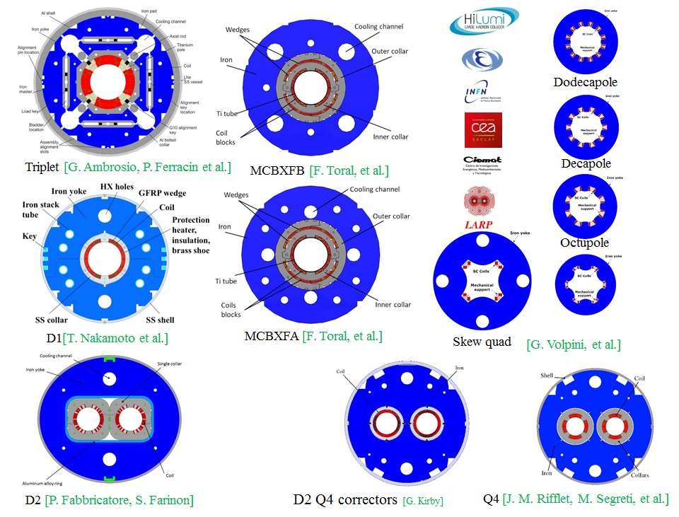
HL-LHC as a trigger for the workshop- present
The HL-LHC project with its 100 superconducting magnets to be built within a very large and international collaboration, triggered the idea of this workshop.
The goal is to HARMONIZE the tests performed in different places and to BUILD A GOOD COMMUNICATION CHANNEL between us: working in the same field at the four corners of the world.
Courtesy of E. Todesco HL-LHC WP3
See presentation of L. Rossi

Slide 5
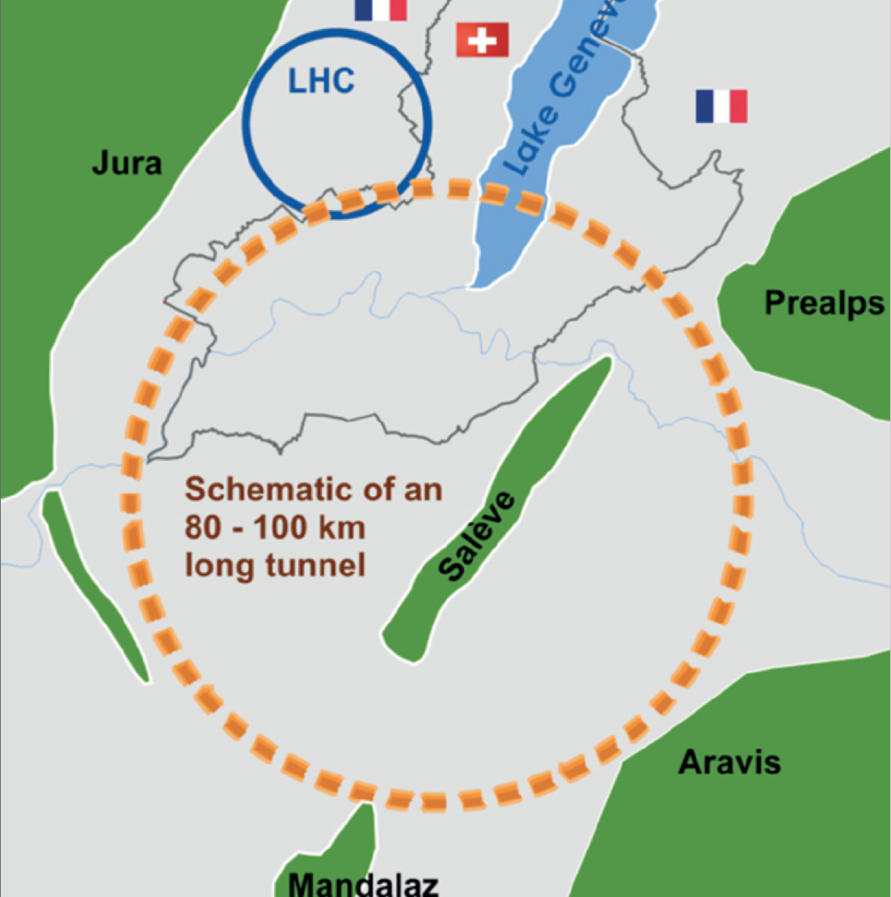
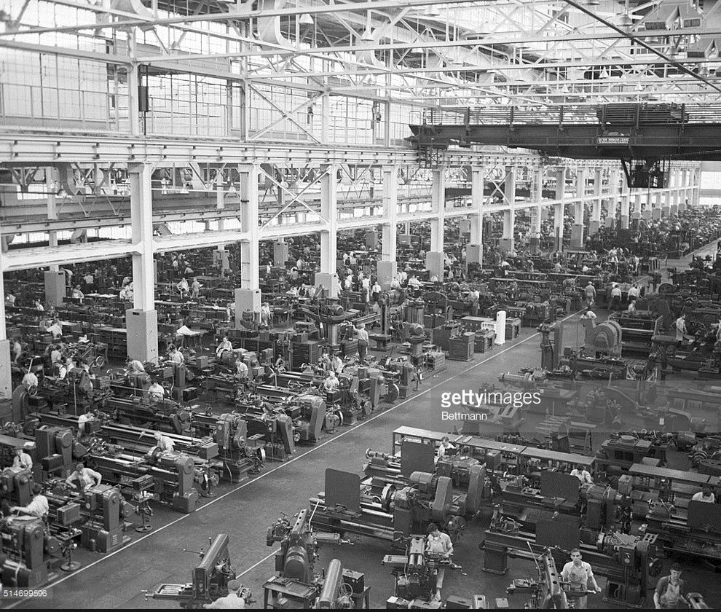
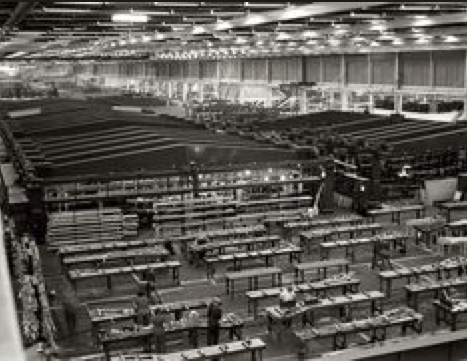
We are looking into the future
2015
2016
2017
2018
2019
2020
2025
2030
2035
2040
The SMTS Workshop would be held typically ONCE A YEAR and at the different test stations. It can be linked to events organized by HL-LHC project or conferences where the participants are usually present.
See presentation of L. Bottura
FCC production and test ?!?

Slide 6
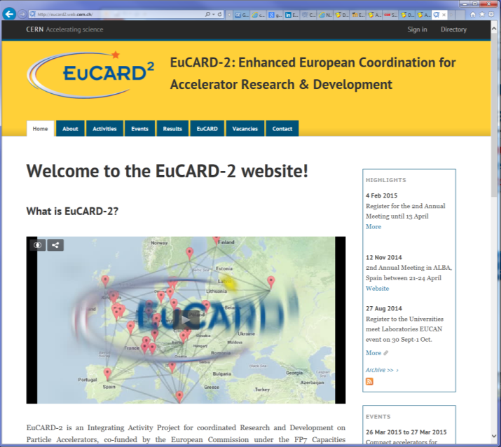
We are already sharing our test facility
Within the framework of EuCARD² Trans National Accesses CERN extended access to SM18 test facility to users for testing superconducting magnets and/ or specific instruments.
https://espace.cern.ch/te-dep-msc-tf/Transnational%20Access/SitePages/Home.aspx
See presentation of M. Vretenar

Slide 7



Thank you for participating to the workshop
Special thanks to
Carnita Hervet and Virginia Prieto
for the organisation
B. Pellequer to host us in the recently renewed
Globe of Science and Innovation @ CERN
http://home.cern/about/updates/2016/04/renovated-globe-opens-new-world-visitors
G. Willering, H. Bajas and the TF team for the organisation of the SM18 interactive visit.
To the 20 experts ready to share with you their secrets of success
https://indico.cern.ch/event/507584/page/7356-interactive-visit-of-the-sm18-test-facility
To our industrial partners for their presence and the coffee they offer us during the breaks

Slide 8
Some practical aspects of the organisation presented by Virginia

