Slide 1
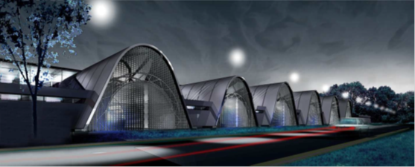
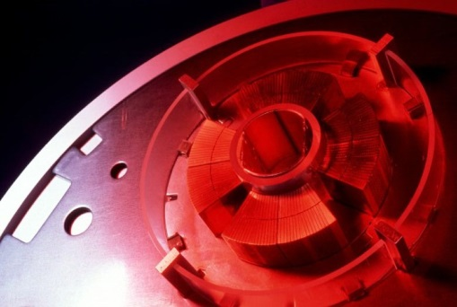
CRYOGENIC infrastructures @ CEA Saclay
R. Vallcorba, H. Felice
Workshop on the Magnet Test Stands, CERN 13-14 June 2016

Slide 2
CONTENTS
CEA test facilities
      For superconducting magnets and large size components
        In operation
          JT 60 -SA
        Under development
        « Vertical Cryostat » for MQYYM
        Required to be updated
        « Vertical Cryostat » for MQYY prototype
        « Horizontal Cryostat» SCHEMa
        Saclay facility W7X
      Under magnetic field
        Séjos
        SETH

Slide 3

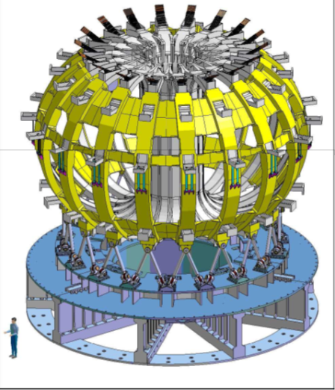
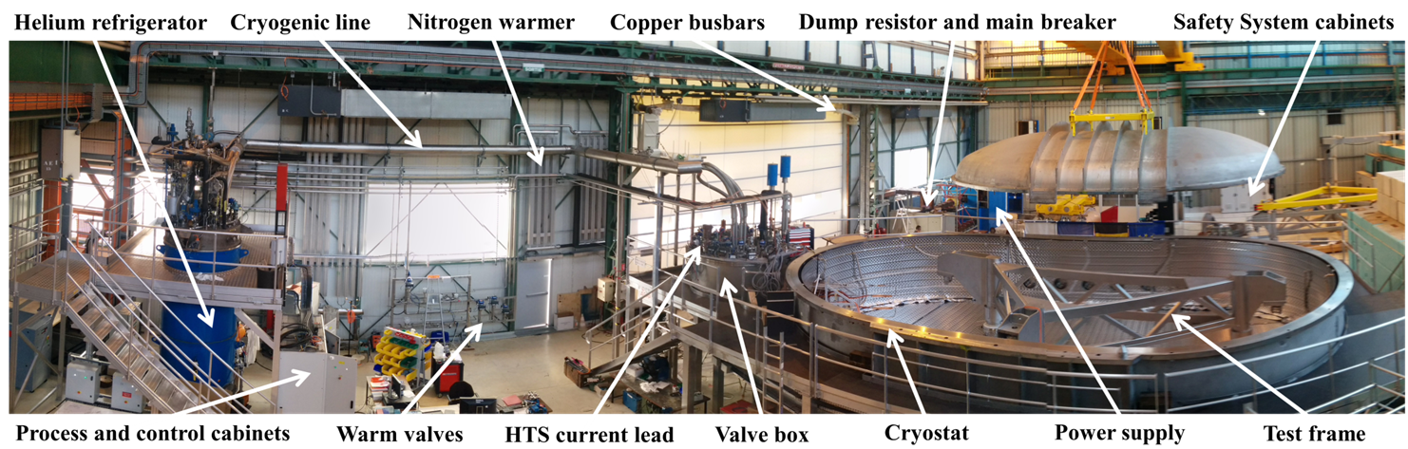



JT- 60SA Cold Test Facility 1/3
JT-60 Super Advance
The facility cryogenic system testing the 18 TF coils
As part of the agreement between Europe (F4E, Fusion For Energy) and Japan (JAEA, Japan Atomic Energy Agency), Europe is in charge of testing the 18 new superconducting toroidal coils used for the magnetic containment of plasma. CEA was in charge of the design, construction of the cold test facility and testing of these 18 coils.
Cryogenics:
Dedicated refrigerator:
500 W @ 4.5K
+ 3.6 g/s from 50 K to 300 K
Coils cooled with supercritical forced helium flow (cold circulator) between 5 K et 7.5 K.
Overview of the JT60 SA test environment

Slide 4
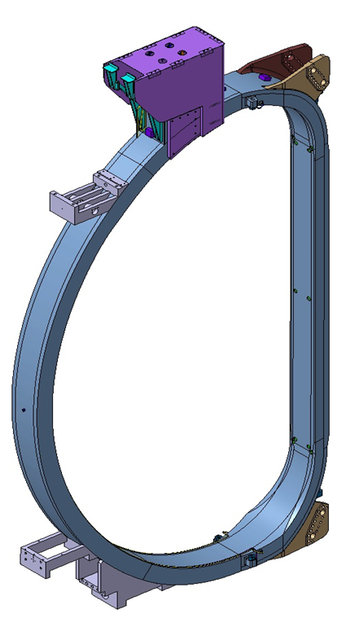
JT- 60SA TEST FACILITY: ID CARD 2/3
Location CEA Saclay (Gif-sur-Yvette, France)
Surface of the test stand Hall 126, 800 m²
Dedicated refrigerator Yes
LN2 tank 25 000 liters
Helium buffer 100 m3
Cold circulating pump centrifugal pump: working point : 600 mbar / 30 g/s
Operating temperature From 5 K to 7.5 K
Cooling phases 300–80K, 80-4.5K
Cooling capacity 500 W@4.5 K + 3.6 g/s from 50 K to 300 K
Current leads HTS / 3.6 g/s GHe at 50 K
Operating current 25.7 kA
Power supply caracteristics 25.7 kA x 10 V
Nr of cryostats 1
Capacity of cryostat 11 m useful length, x 6 m useful diameter,
Handeling tools 32 t overhead crane
Magnet Safety System Independant protection of each double pancake with redundancy
Quench antena No
Magnet measurements capability No
DAQ Cards and used soft about 300 signals / up to 20 kHz acquisition
Data acquisition for cryogenics sensors up to 10 Hz
  Heat loads : 235 W @ 5 K and 326 W @ 7.5 K
  Pressure drop in the coil : 440 mbar @ 5 K and 601 mbar @ 7.5 K
ongoing test of « the third coil»

Slide 5
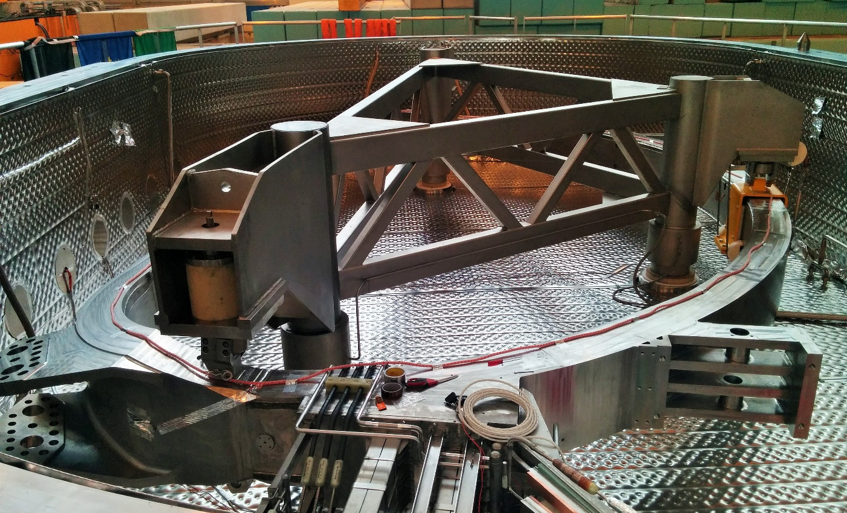
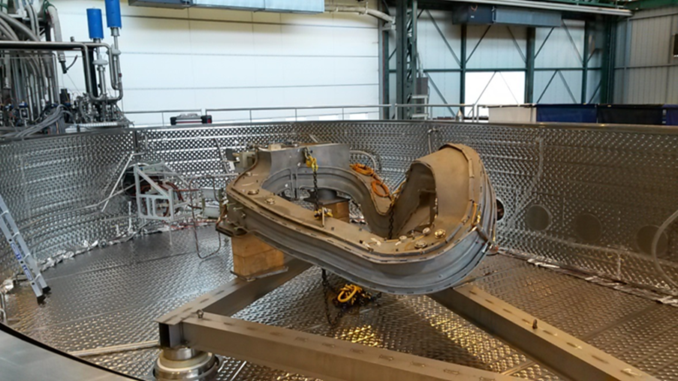
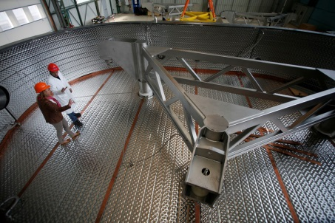
JT- 60SA Cold Test Facility 3/3
Some views
Toroidal Field Coil
in the Cold Test Facility
Study of the W7X Demo coil integration inside
the JT-60SA CTF Cryostat

Slide 6
CEA test facilities
      For superconducting magnets and large size components
        In operation
          JT 60 -SA
        Under development
        « Vertical Cryostat » for MQYYM
        Required to be updated
        « Vertical Cryostat » for MQYY prototype
        « Horizontal Cryostat» SCHEMa
        Saclay facility W7X
      Under magnetic field
        Séjos
        SETH

Slide 7
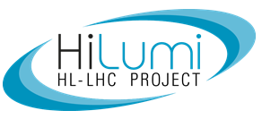
“ vertical CRYOSTAT”: ID CARD
ONGOING adaptation FOR MQYYM
MQYYM
Tests of superconducting magnets at temperature between 4.2 K and 1.9 K
(the magnetic measurement equipment is not included)
Location CEA Saclay (Gif-sur-Yvette, France)
Surface of the test stand Hall 198, aprox. 300 m²
Dedicated refrigerator Not currently avalaible
Operating temperature from 4.2 K to 1.9 K (saturated helium)
Cooling phases 300–80K, 80-4.2K, 4.2 K – 1.9 K
Shared cryogenics? Or other equipment? No, Yes helium tank 1000 l
Operating and mx. Current, max voltage 10 kA, 5 V
Current leads helium consomption 25 l/h @ 4.2 K
Nr of cryostats 1 (adjustable with dedicated tank named « chaussette »)
Capacity of cryostat 8 m useful length, 0.8 m useful diameter,
Handeling tools 10, 20 and 50 t overhead crane
Interlock safety MSS
Quench antena No
Magnet measurements No
Cards and used soft will be comunicated later on
Data acquisition for cryogenics sensors
Adaptation of the facility to the « MQYYM quadrupole »

Slide 8
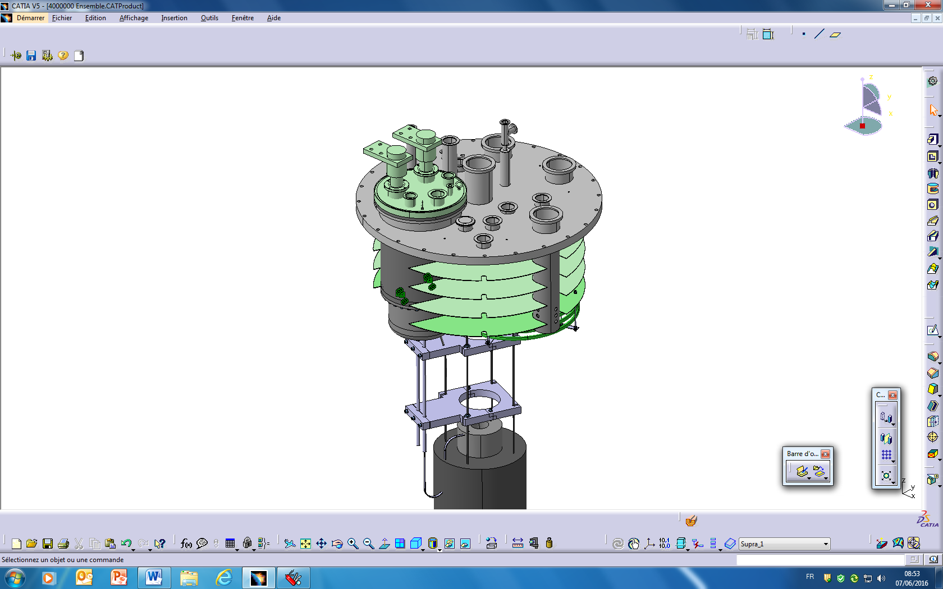
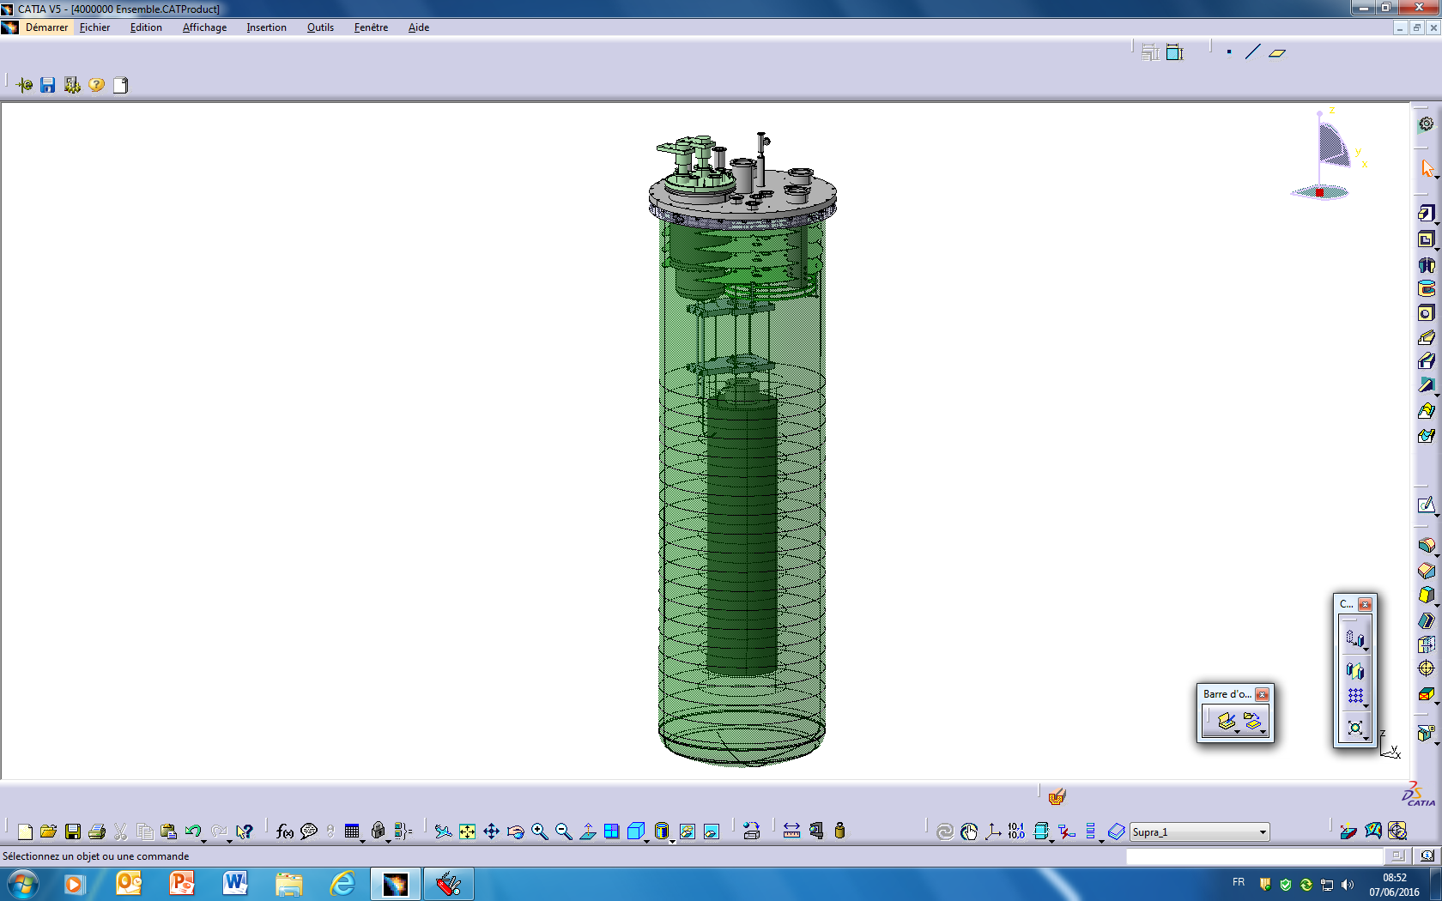
        « Vertical Cryostat » for MQYYM: 3D VIEW
Current leads
(10 kA)
Instrumentation
(MSS)
Safety valve
Magnetic measurement port
LN2 exchanger
Pot “LHe 4,2 K”
LHe level
1.9 K
Pumping tube
Magnet
3 meters tank
Mechanical support
Bus bar/ supra cable
Bus bar Ø 14 mm
superconductor cable

Slide 9
        « Vertical Cryostat » for MQYYM: SCHEMATIC
Under development
Supplied power
6 kA
Flow meter indicator
Level gauge
Heat load:
5 W (3+2 for margin) – 5.5 l/h
(needs to pay attention to the magnetic measurement system)
G he recovery
LN₂
Pumping tube
Cryogenic:
Cryostat 1.9 K@ 23 mbars ABS
LN₂ heat exchanger will be used for a pre-cooling down to 100 K
1000 l LHe required for 1 test of 8 h without quench.
Consumption in the quench mode under study
LHe (4.2 K)
Regulation
pressure
valve
G he
recovery
LN2 exchanger
LHe sat (1.9 K)
At least 8 h
Heater
Pumping system:
600 available /250 m³/h (useful)
LHe tank
(1000 l)
Pump
T° sensors
Location for magnetic
measurement

Slide 10
CEA test facilities
      For superconducting magnets and large size components
        In operation
          JT 60 -SA
        Under development
        « Vertical Cryostat » for MQYYM short model
        Required to be updated
        « Vertical Cryostat » for MQYY prototype
        « Horizontal Cryostat» SCHEMa
        Saclay facility W7X
      Under magnetic field
        Séjos
        SETH

Slide 11
“vertical CRYOSTAT” proposal FOR MQYY prototype: ID CARD
Tests of superconducting magnets at temperature between 4.2 K and 1.9 K
(the magnetic measurement equipment is not included)
Location CEA Saclay (Gif-sur-Yvette, France)
Surface of the test stand Hall 198, aprox. 300 m²
Dedicated refrigerator Yes, several option can be considered
Operating temperature from 4.2 K to 1.9 K
Cooling phases 300–80K, 80-4.2K, 4.2 K – 1.9 K
Shared cryogenics? Or other equipment? Yes or could be dedicated
Operating and mx. Current, max voltage 10 kA, 5 V
Current leads helium consomption 25 l/h @ 4.2 K
Nr of cryostats 1
Capacity of cryostat 8 m useful length, 0.8 m useful diameter,
Handeling tools 10 t, 20 t and 50 t overhead crane
Interlock safety MSS
Quench antena No
Magnet measurements No
Cards and used soft
Data acquisition for cryogenics sensors
A dedicated refrigerator could be connected to the facility.

Slide 12
CEA test facilities
      For superconducting magnets and large size components
        In operation
          JT 60 -SA
        Under development
        « Vertical Cryostat » for MQYYM short model
        Required to be updated
        « Vertical Cryostat » for MQYY prototype
        « Horizontal Cryostat» SCHEMa
        Saclay facility W7X
      Under magnetic field
        Séjos
        SETH

Slide 13
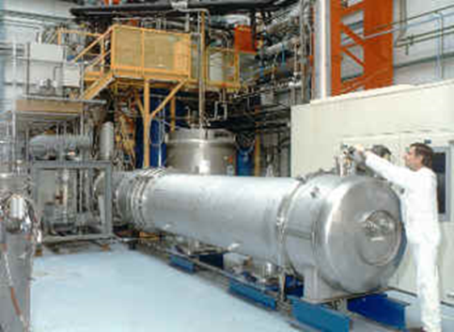
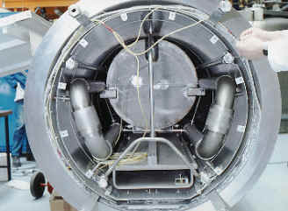
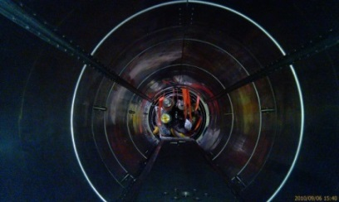
SCHEMa ID CARD
Station Cryogenique Horizontale Essais Magnetiques
Tests of cryostated superconducting magnets or magnets with helium vessel at temperature between 4.2 K and 1.8 K with magnetic measurements capability in warm bore.
Location CEA Saclay (Gif-sur-Yvette, France)
Surface of the test stand Hall 198, aprox. 400 m²
Dedicated refrigerator Not currently avalaible, could be avalaible from W7X facility
Operating temperature from 1.8 K to 4.2 K
Cooling phases 300–80K, 80-4.2K, 4.2 K – 1.8 K
Cooling capacity 450 W at 4.2 K, 25 W at 1.8 K
Shared cryogenics? Or other equipment? Yes but can be dedicated
Operating and mx. Current, max voltage 20 kA, 5 V
Nr /length of cryostats 0 (cryostated magnet) ,1 (4m), 1 (8 m)
Capacity of cryostats (util) 8 m useful length, 0.6 m useful diameter,
Handeling tools 10 t and 50 t overhead crane
Interlock safety MSS available
Quench antena Yes
Magnetic measurements Yes, at 300 K (warm bore)
Cards and used soft QNX system with homemade acquisition
Data acquisition for cryogenics sensors 160 measuring channels up to 20 kHz
Ex. 4 m configuration
Updating required
view of the horizontal cryostat opened
with a LHC bus bar measurements

Slide 14
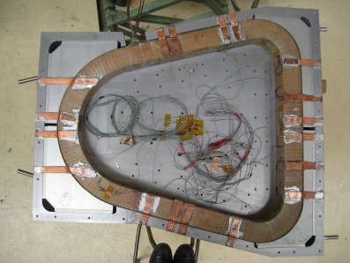
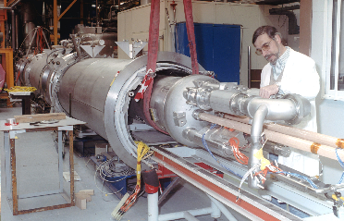
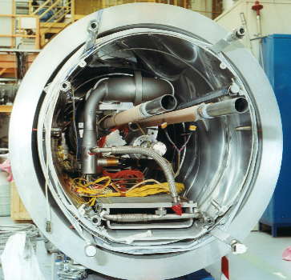
SCHEMa: TestS
Warm bore magnetic measurements (2x4 W)
Principal tests
In the past
Twin-Aperture Prototype Dipole (TAP) – Ex. cryostat de distribution
SSS5 prototype quadripoles
Race Track ATLAS (1/20)
Bus bar1 (section et forme du bus), Bus bar2 (validation du concepte de réalisation industrialisé)
Latest test into facility
R³B-Glad coil prototype
pay attention to the fact that the magnet must be either cryostated or assembled in a cold mass

Slide 15
CEA test facilities
      For superconducting magnets and large size components
        In operation
          JT 60 -SA
        Under development
        « Vertical Cryostat » for MQYYM
        Required to be updated
        « Vertical Cryostat » for MQYY prototype
        « Horizontal Cryostat» SCHEMa
        Saclay facility W7X
      Under magnetic field
        Séjos
        SETH

Slide 16
Saclay Facility ‘W7X’ ID Card
Test on current intensity, isolating voltage, mechanical stress, pressure drop and temperature for magnets cooled with supercritical helium forced flow between 4.5 K and 7.6 K
Location CEA Saclay (Gif-sur-Yvette, France)
Surface of the test stand aprox. 400 m²
Dedicated refrigerator Yes, liquefier/refrigerator Helial 4003
liquefaction capacity ~70 l/h
refrigeration capacity ~200 W at 4.2 K
Operating temperature 5 K
Cooling phases 300–80K, 80-4.2K
Cooling capacity 15 g/s liquide production
Shared cryogenics? Or other equipment? No (dedicated)
Operating and mx. Current, max voltage 20 kA
Nr of cryostats 2
Nr of experiments by cryostat 2 (for each cryostat)
Capacity of cryostats (util) 5 m useful diameter, 4.1m useful height.
Handeling tools 20 t overhead crane
Max. isolating voltage 10.4 kV
Interlock safety MSS to be upgraded,
Cards and used soft EPICS
Quality control tools to be upgraded
Data acquisition for cryogenics sensors
Data acquisition for voltage-measurements
Magnetic measurements capability No
Saclay facility « W7X »
Updating required

Slide 17
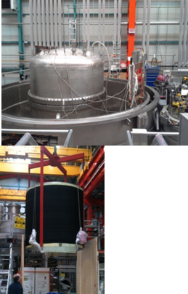
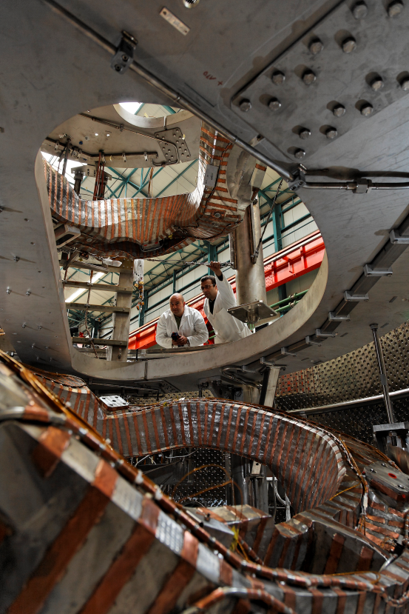
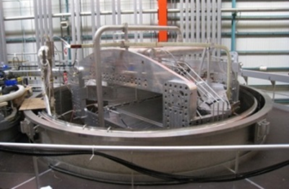
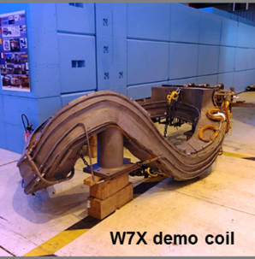
Saclay Facility ‘W7X’ tests
In the past
Principal tests
In the recent past - 2014
R³B-Glad inside the Saclay facility
      ISEULTshim coils qualified (insulation, inductance, mutual)
70 W7X superconducting coils tested at 4.5 K

Slide 18
CEA test facilities
      For superconducting magnets and large size components
        In operation
          JT 60 -SA
        Under development
        « Vertical Cryostat » for MQYYM short model
        Required to be updated
        « Vertical Cryostat » for MQYY prototype
        « Horizontal Cryostat» SCHEMa
        Saclay facility W7X
      Under magnetic field (for information)
        Séjos
        SETH

Slide 19
TEST facilities under magnetic field: SeJOS
      Séjos - Station d’Essais de JOnctions Supraconductrices (Test station for superconducting splices)
      Tests of electrical jonctions at 4.2 K
Location CEA Saclay (Gif-sur-Yvette, France)
Surface of the test stand
Dedicated refrigerator no
Operating temperature 4.2 K
Power unit 600 A, 1.2 kA, 3 kA
Maximum magnetic field 4.7 T
Magnet useful diameter 90 mm
Useful diameter of the sample cryostat 76 mm
A superconductiong transformer allows testing conductors at current intensity up to 70 kA,
Currently at CERN

Slide 20
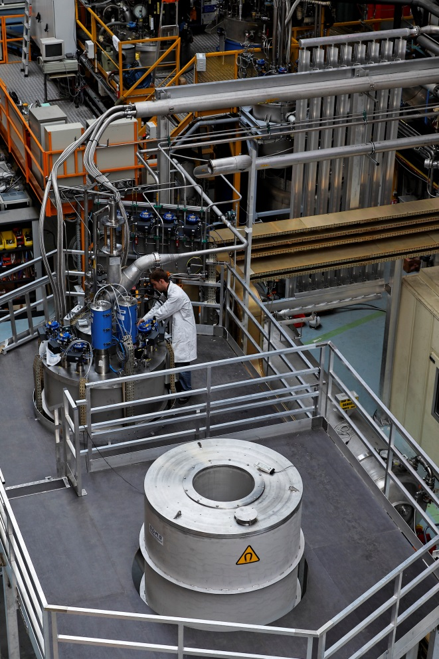
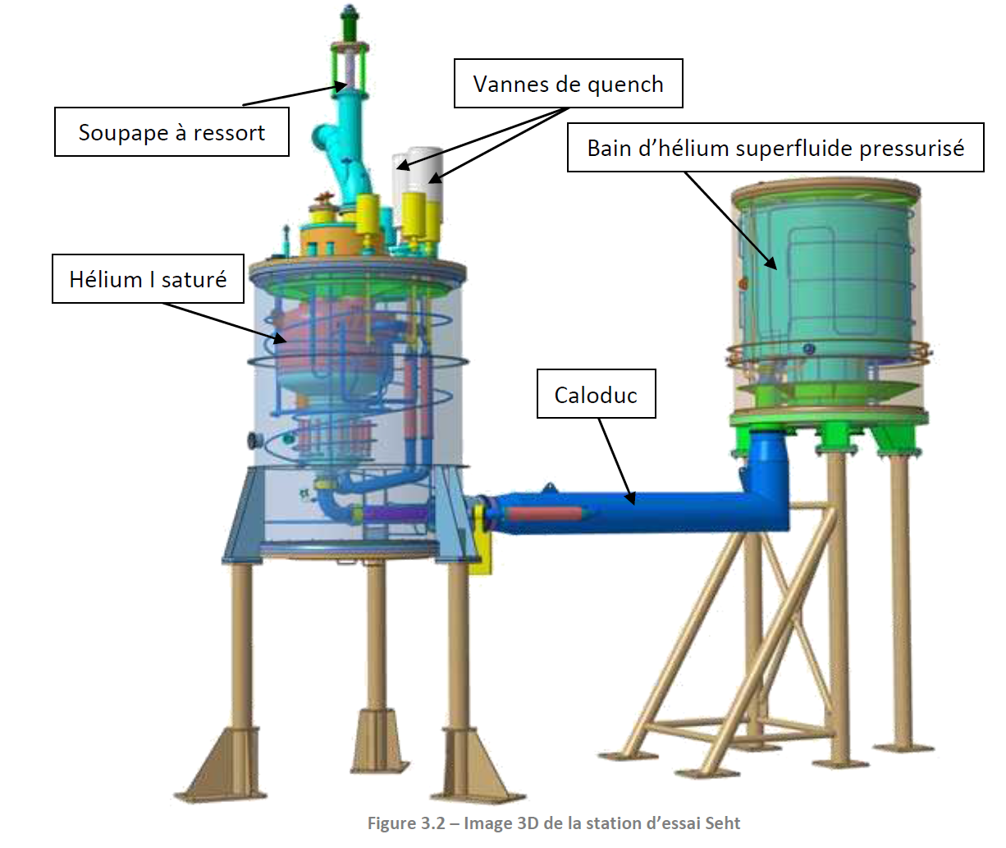
Seht – Eight tesla station
      Tests of prototypes or large scale components under magnetic field (8T)
      Useful diameter of 587 mm at room temperature.
Latest test into facility
Quench experiments were performed on an 8-T (Seht) superconducting coil cooled by a superfluid helium bath. These experiments allowed to make a detailed analysis of the physical mechanisms which drive the global pressure rise in case of quench as well as the strong coupling between this pressure rise and the normal zone propagation.

Slide 21
summary
Two large scale facilities avalaible at 4.5 K
  Saclay facility « W7X »
  JT60-SA
Two facilities for accelerator magnets from 4.2 K to 1.9 K:
  Horizontal (requiring modifications or upgrades)
  Vertical
    Vertical facility is being modified to test MQYYM
    It could be adapted to test MQYY prototypes and series
    Supported by a proven technology know-how

