Slide 1
BNL MAGNET TEST FACILITY
Joseph F Muratore
Superconducting Magnet Division
Brookhaven National Laboratory
Upton, NY 11973 USA
SC Magnet Test Stands Workshop CERN June 13-14, 2016

Slide 2
BNL MAGNET TEST FACILITY
Cryogenics Facility
2. Power Supplies and Upgrade for MQXF Tests
3. Redesigned Vertical Test Dewar for 1.8 K Magnet Tests
4. Data Acquisition
5. Quench Protection
6. Magnetic Field Measurements

Slide 3
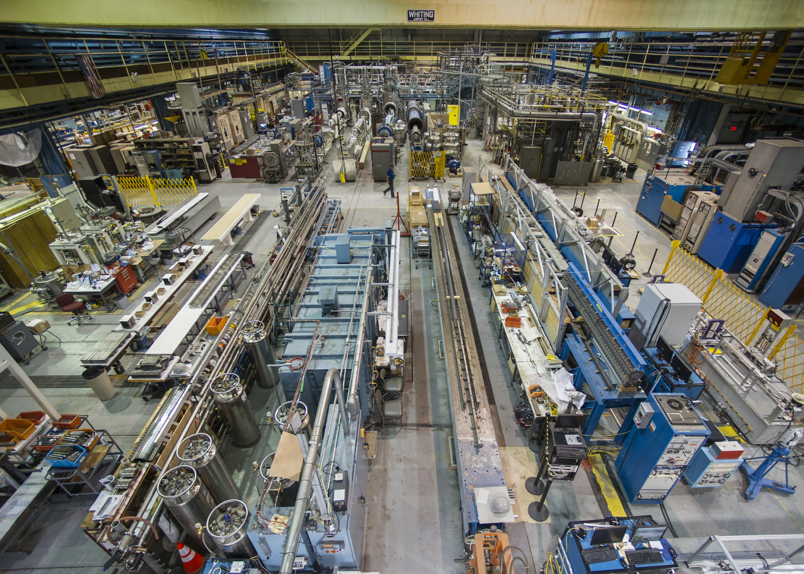
BNL MAGNET TEST FACILITY
BNL Facility North (High) Bay Area (30 t crane)
Test Facility in Background

Slide 4
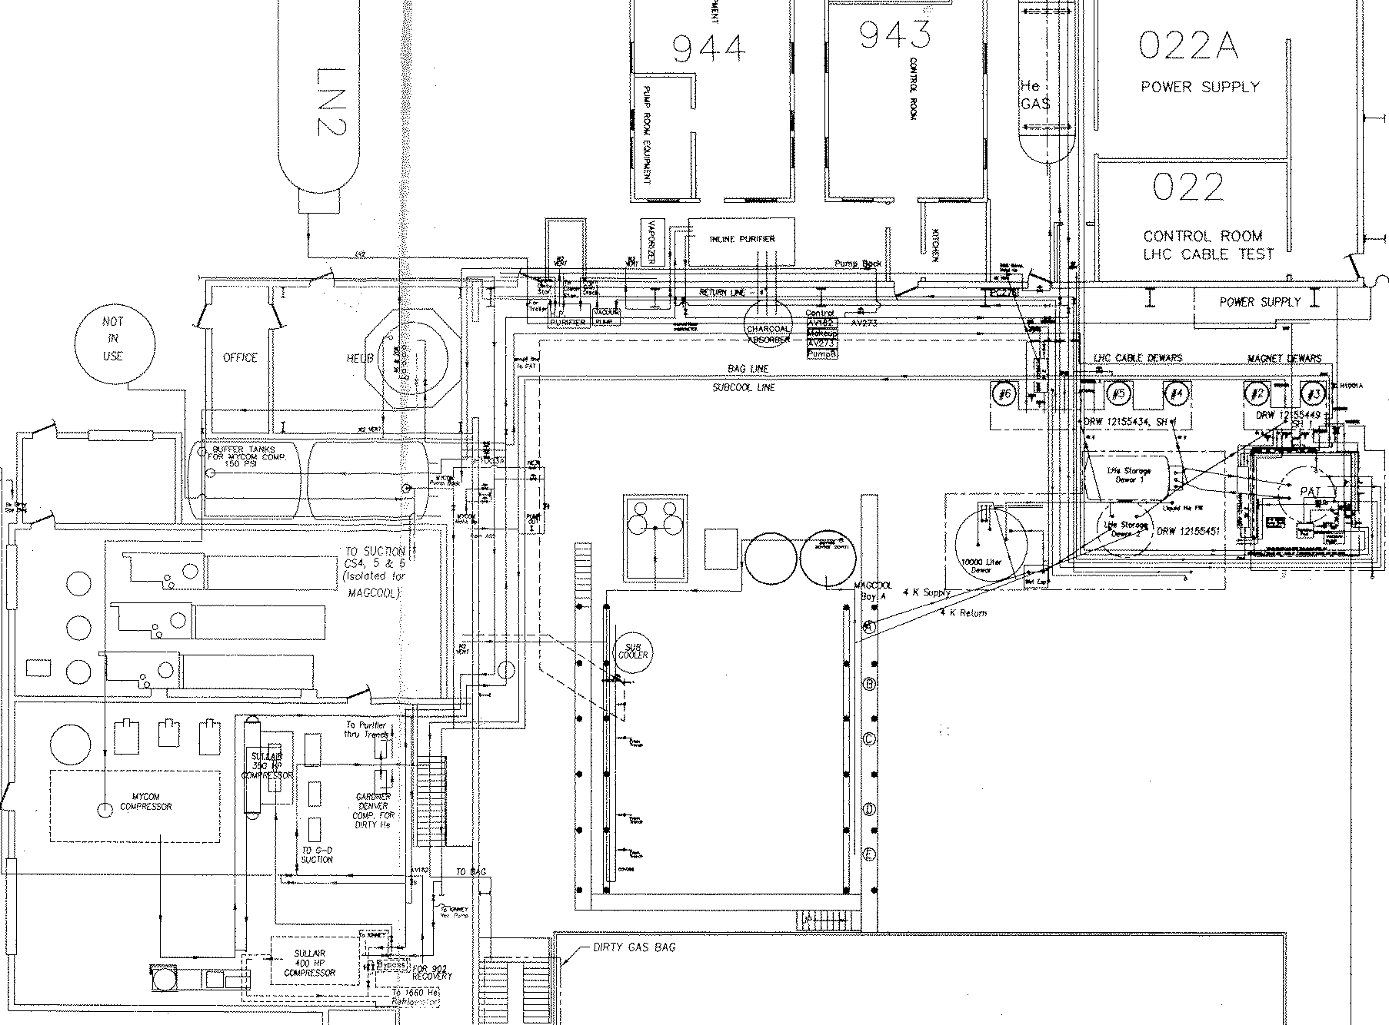
BNL MAGNET TEST FACILITY
Building 902 Test Facility Floor Plan and Overview
30 kA Power Supply
MQXF
CTI 4000 He Refrigerator
CONTROL ROOM
2.7 m Deep Test Dewars
6.1 m Magnet Deep Test Dewars
Vertical Test Dewars 2-6
CVI Air Liquide He Refrigerator
Horizontal
Test
Stands A - E

Slide 5
TEST FACILITY UPGRADES FOR MQXF
SUMMARY
The former cable test 30 kA power supply (2 x 15 kA) reconfigured to test magnets to 24 kA (2 x 12 kA) with new IGBT switch and energy extraction circuits.
1.8 K vertical magnet test dewar (4.2 m useful depth) with new 24 kA top plate, newly designed LHe vessel, 4.5 K heat shield, lambda plate, heat exchanger, and 24 kA water-cooled cables
  Diagnostic and monitoring instrumentation with PLC for CTI Model 4000 refrigerator (main liquefier) and CVI refrigerator (backup liquefier), along with hardware upgrades.
  New data acquisition, monitoring, and control software (NI LabVIEW)
  Upgraded data acquisition loggers and scanners for speed and precision
  Added new backup compressors
  New dirty gas compressor and purifier
  Other upgrades

Slide 6
BNL CRYOGENICS FACILITY
CRYO CHALLENGES
BNL Magnet Division has a large infrastructure of cryogenic test equipment, but:
  The cryogenic test facility has been operational and in use since the 1970’s, supporting SSC, RHIC, LHC, etc.
  Despite repairs as needed, equipment reliability decreases with age.
    BNL management supported funding the purchase of critical spares, preventive maintenance of critical components, and installation of backup systems to improve reliability and reduce risk for the Hi-Lumi production magnet testing program (RISK MITIGATION).
Previous 1.8 K testing was limited to superconducting cable samples (some years ago), not magnets.

Slide 7
BNL VERTICAL CRYOGENICS FACILITY
SC Magnet Test Stands Workshop CERN June 13-14, 2016

Slide 8
BNL VERTICAL CRYOGENICS FACILITY
1.8 K Process Flow Diagram
SC Magnet Test Stands Workshop CERN June 13-14, 2016

Slide 9
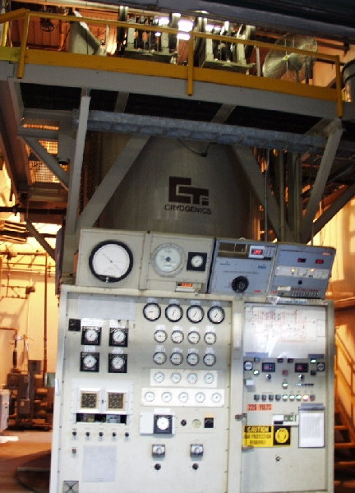
BNL CRYOGENICS FACILITY
CTI MODEL 4000 REFRIGERATOR/LIQUEFIER
Primary source of liquefaction
1500 W at 4.5K
Two reciprocating expansion engines rated at 250 rpm
70 g/s (150g/s with Creare circulator cold pump) forced flow capacity at 5 - 12 atm in HTF-Magcool
He liquefaction: 320 L/hr (with both expansion engines and a Koch Model 1600 Wet Expander running)
Recently upgraded with a new LN₂ heat exchanger, doubling the number of inline purifiers to four, rebuilt expansion engines, and new diagnostic and control software (LabVIEW).
This work was funded by BNL.
SC Magnet Test Stands Workshop CERN June 13-14, 2016

Slide 10
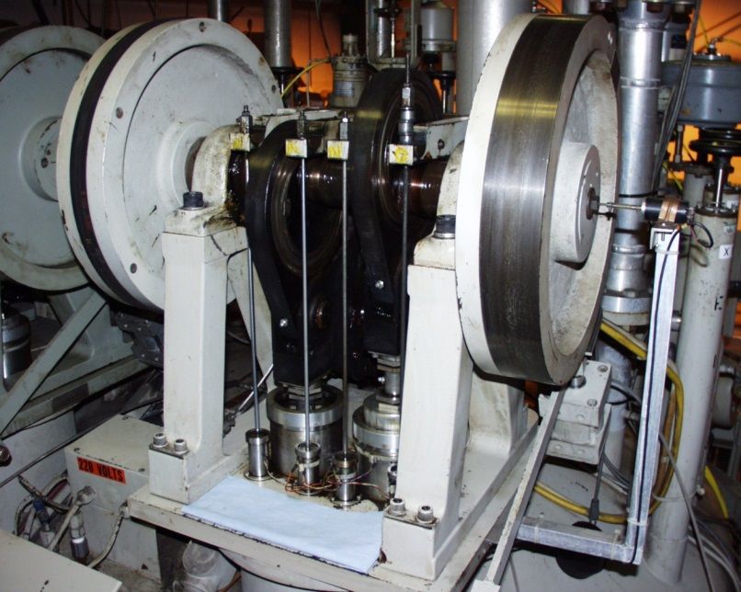
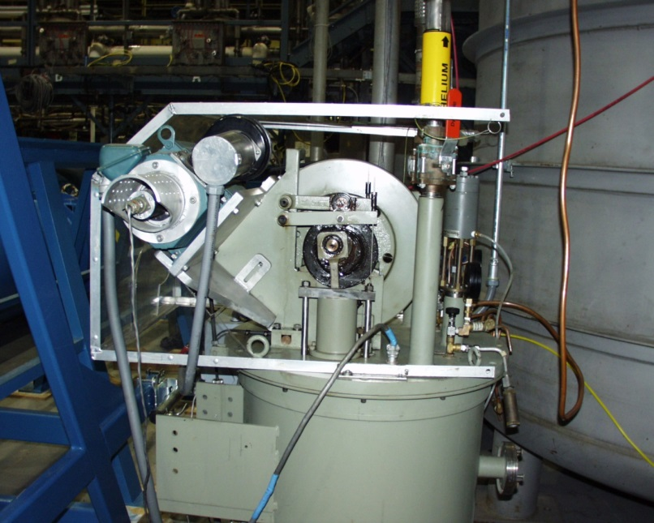
BNL CRYOGENICS FACILITY
CTI Model 4000 Refrigerator Reciprocating Expansion Engines
250 rpm
Each has two cylinders: 9.1 cm bore; 7.6 cm stroke
Largest in world (we think)
Recently rebuilt.
Koch Model 1600 Wet Expander
Has two cylinders
60 rpm
7.6 cm bore; 5.1 cm stroke
Largest in world (we think)
Recently rebuilt
This work was funded by BNL.
SC Magnet Test Stands Workshop CERN June 13-14, 2016

Slide 11
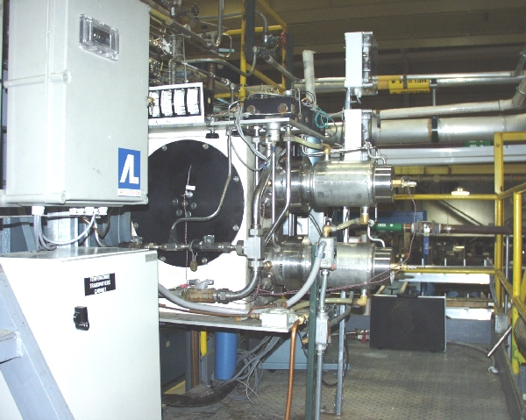
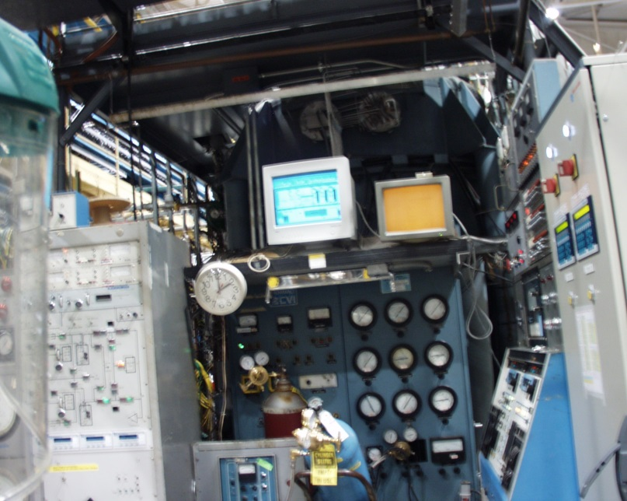
BNL CRYOGENICS FACILITY
CVI – AIR LIQUIDE He LIQUIFIER
Secondary source of liquefaction
1000 W at 4.5K (used at 700 W)
Two turbine expanders rated at 130000 rpm
In-line gas purifier
He liquefaction: 160 L/hr
Total facility LHe rate (both liquefiers): 480 L/hr
Recently upgraded for use as a back-up to mitigate risk in the event of CTI Model 4000 failure:
1) New first stage LN₂ – He heat exchanger
2) New chilled water heat exchanger
3) New and upgraded relief and isolation valves
4) Re-plumbing and new piping to increase efficiency
5) New and refurbished vacuum pumps
6) New instrumentation (including temp sensors and PLC controls) for turbine protection
This work was funded by BNL.
SC Magnet Test Stands Workshop CERN June 13-14, 2016

Slide 12
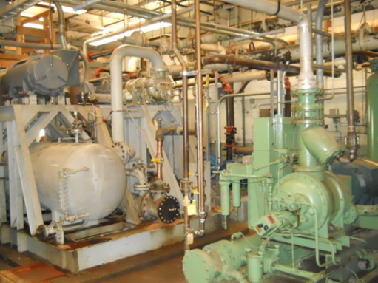
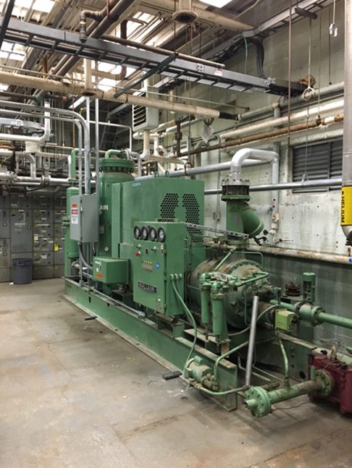
BNL CRYOGENICS FACILITY
Mycomm 800 (2-Stage)
PRIMARY UNIT
Power = 597 kW
Discharge pressure = 18 bar
Delivers 160 g/s
Purchased critical spares (BNL funded):
New 2nd stage compressor head
New 400 hp motor
New oil heat exchanger
New helium heat exchanger
All maintenance & refurbishment items completed
Sullair 500
Power = 373 kW
Discharge pressure = 18 bar
Delivers 80 g/s
Provided and installed by BNL funding.
Sullair 350
Power = 261 kW
Discharge pressure = 18 bar
Delivers 51 g/s
Purchased critical spares (BNL funded):
new compressor screw
new oil pump
COMPRESSORS (Pt 1)
Can supply either the CTI Model 4000 refrigerator/liquifier and Magcool, or the CVI liquifier
Mycomm and Sullair 350 compressors
All-purpose; recently installed & can be configured to work with Sullair 350 as a backup in the event Mycomm down.
All-purpose; presently configured to work with Mycomm to provide 210 g/s delivery. Can also be used with Sullair 500 as a backup in the event that Mycomm is down. (Risk Mitigation)
Sullair 500 compressor
SC Magnet Test Stands Workshop CERN June 13-14, 2016

Slide 13
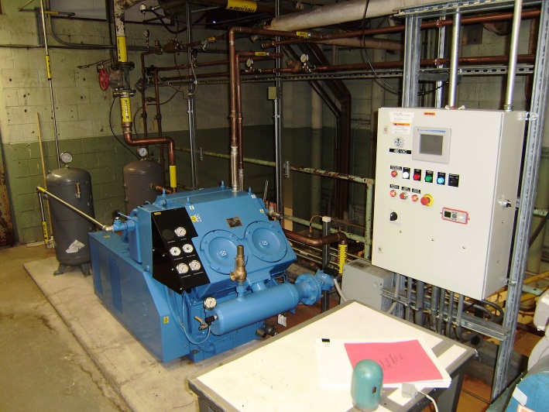
BNL CRYOGENICS FACILITY
COMPRESSORS (Pt 2)
Gardner Denver 60
Power = 44.7 kW
Discharge pressure = 17 bar
Delivers 213 m³/hr → 9.65 g/s
New Gardner Denver compressor
purchased with BNL funding.
Sullair 100 (3 units: CS4, CS5, CS6)
Power = 74.6 kW
Discharge pressure = 12 bar = 1.2 MPa
Delivers 20 g/s (80 g/s @ 8 bar input)
New Sullair 100 compressor
purchased with BNL funding.
Linde Model 500A He Gas Purifier
with dedicated compressor
All new system and commissioning contract purchased with BNL funding.
Creare circulator pumps
Pumps ‘dirty’ He gas to dirty gas bag and gas recovery tank.
Presently, only CS4 (new unit) being used, for pumping Nash 1.9 K station outlet to high pressure gas storage tanks. All three are used for horizontal testing (Magcool facility).
Cleans and recovers ‘dirty’ gas.
Presently configured for Magcool operations:
(1) Nitrogen cooldown (Cooldown I)
(2) Warmup
(3) Pump and purge
SC Magnet Test Stands Workshop CERN June 13-14, 2016

Slide 14
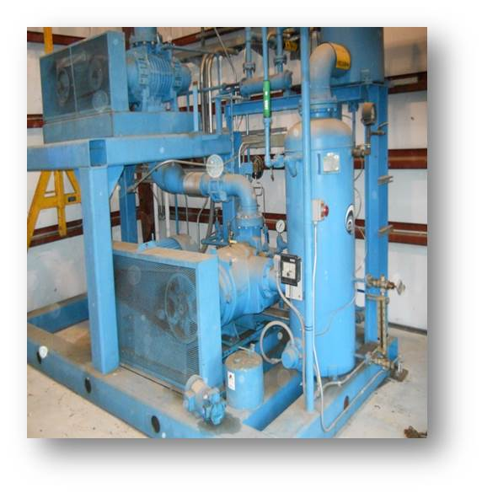
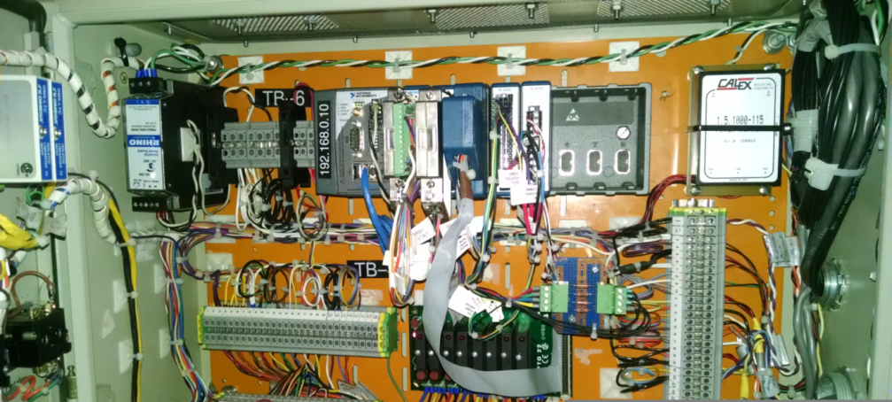
BNL CRYOGENICS FACILITY
Nash-Kinema Vacuum Pump
Power = Two stages at 74.6 kW each
Suction pressure = 0.0837 bar @ 4.5 K
Discharge pressure = 1.2 bar
Delivers 2.7 g/s @ 1.8 K
Cooling capacity = 40 W @ 1.8 K
Pumps on LHe in heat exchanger - down to 16 mbar for 1.8 K operation.
Upgrades included:
1. Reconfigured exhaust. Connected helium exhaust gas line to new Sullair 100 compressor and inline purifier, to reclaim helium gas (was previously routed to dirty gas facility).
2. Replaced legacy soldered copper water lines with welded stainless steel.
  3. Purchased new spare booster and liquid ring vacuum pumps.
4. Refurbished existing / purchased new spare chilled water heat exchangers (BNL funded).
5. Replaced drive belts.
6. Repaired service air supply line.
7. New LabVIEW controls with remote HMI panel.
8. Installed new vacuum jacketed transfer line, valve to
test dewar.
SC Magnet Test Stands Workshop CERN June 13-14, 2016

Slide 15
BNL CRYOGENICS FACILITY
LIQUID HELIUM STORAGE DEWARS
  Storage Dewar #1 3785 L
  Storage Dewar #2 3785 L
  Storage Dewar #3 10000 L
      Total liquid helium storage capacity is 17570 L.
Total He gas storage capacity is approximately 8.5 x 10⁶ L.
Liquid nitrogen storage capacity is approximately 40000 L.
SC Magnet Test Stands Workshop CERN June 13-14, 2016

Slide 16
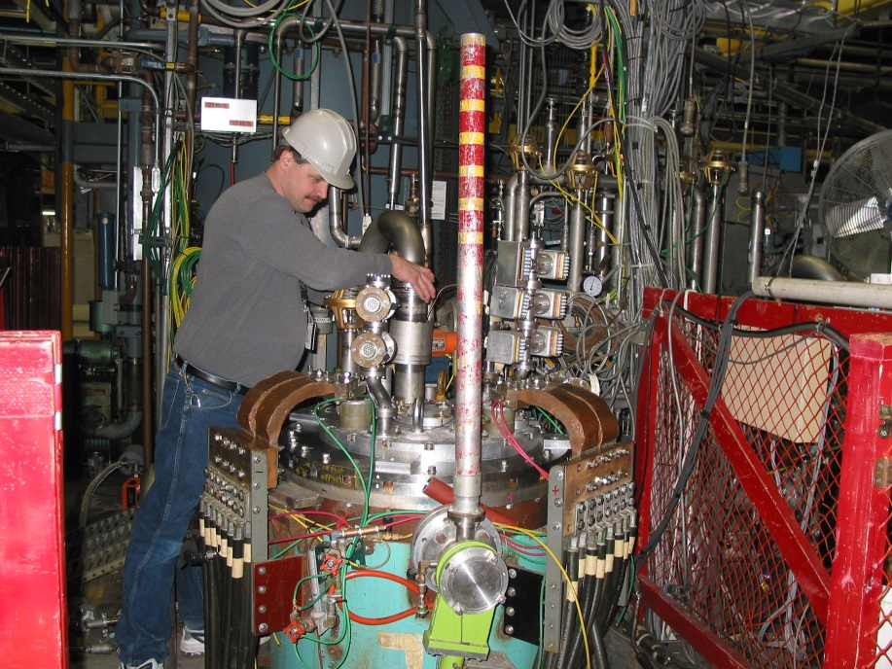
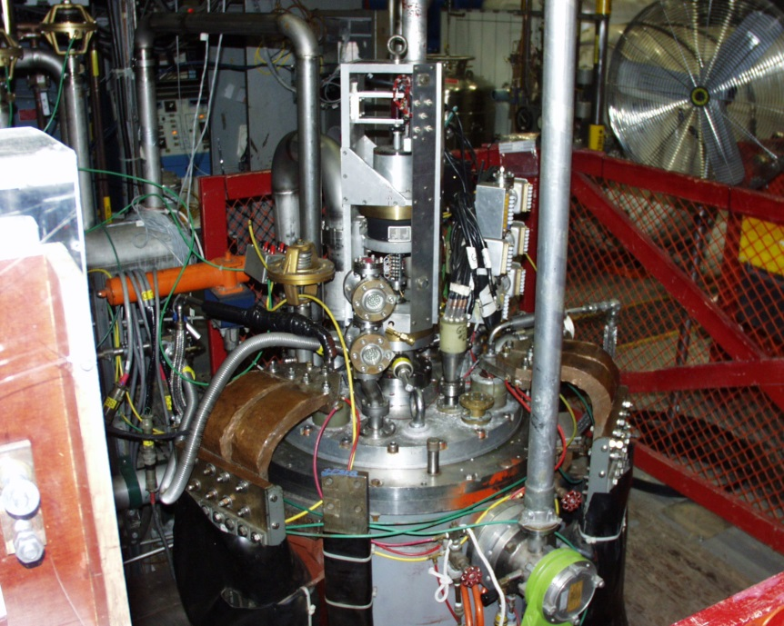
BNL CRYOGENICS FACILITY
Present Configurations:
Dewars 2 and 3: for longer magnets (4.2m)
Dewar 2 (610mm): now updated and configured for 1.8 K/1 bar operation with lambda plate, new 24 kA leads and water-cooled cabling, and hanging fixture
Dewar 3: wider (711 mm) for larger magnets 4.5K
Dewar 4: 4.5K cable testing
Dewar 5: 1.8K/1 bar cable testing
Dewar 6: common coil type magnets (Nb₃Sn and HTF) and other short magnets (2m); cable testing
VERTICAL TEST DEWARS
SC Magnet Test Stands Workshop CERN June 13-14, 2016

Slide 17
PRIMARY POWER SUPPLIES
(1) 30kA (2 x 15 kA) @ 14VDC Previously cable testing, now configured 24 kA (2 x 12 kA) MQXF operation at 1.8 K
(2) 10kA @ 20VDC “HTF”, 10VDC, 30VDC, 40VDC, 50VDC)
(3) 8.5kA (9.2kA) @15VDC “VTF”, 30VDC
(4) 8kA @ 12VDC “Short sample test facility magnets”
(5) 10kA @10VDC bipolar
(6) 7.5kA @ 25VDC “Fast Ramp”, 50VDC, 100VDC (GSI ramp rates to 7800 A/s)
(7) Dual Acme 5500A @ 125V “Room temperature field measurements and calibration magnets for measuring coils”
(8) Variety of trim power supplies (bipolar and unipolar)
All power supplies can be configured for a wide range of magnet tests.
Energy extraction is available with
SC Magnet Test Stands Workshop CERN June 13-14, 2016

Slide 18
30 kA POWER SUPPLY UPGRADE
SC Magnet Test Stands Workshop CERN June 13-14, 2016

Slide 19
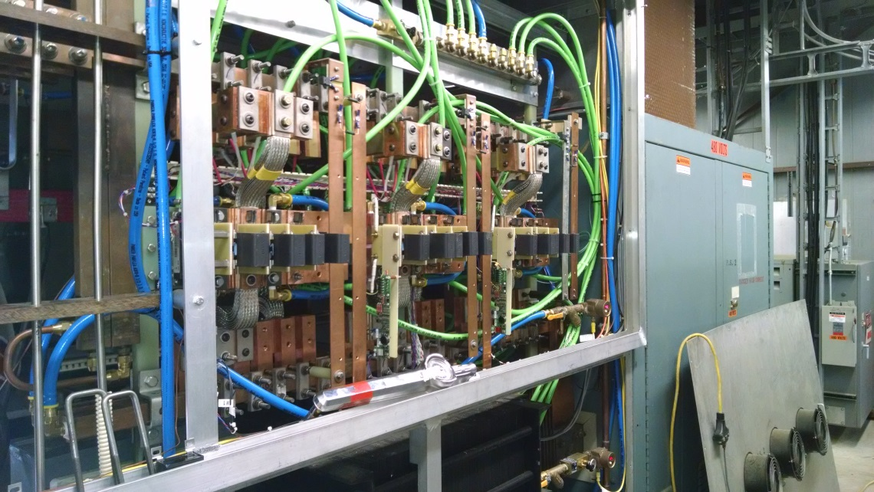
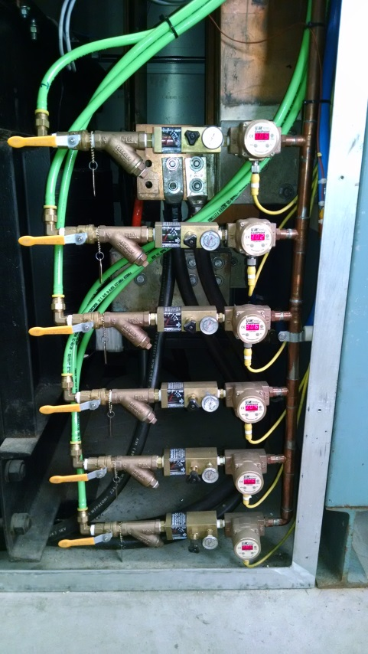
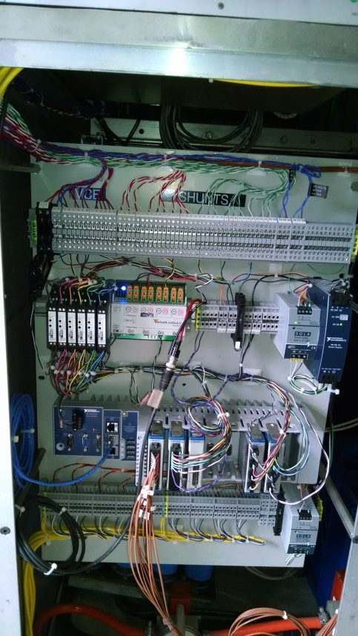
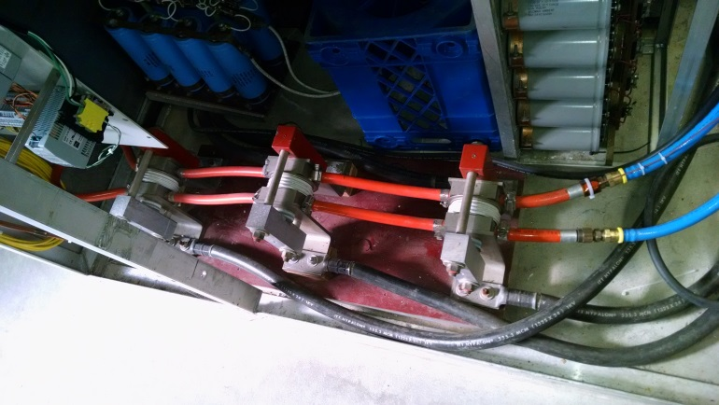
30 kA POWER SUPPLY UPGRADE
15 kA power supply switch cabinet with IGBT and snubber circuits. Each power supply is configured for 12 kA with 6 water-cooled IGBT and snubber circuits, allowing 24 kA magnet operation.
Plumbing and flow gauges with signal acquisition for IGBT water cooling and monitoring.
IGBT data acquisition and instrumentation panel
NEW: Upgrades to previous cable sample 30 kA power supply ( two 15 kA in parallel) to operate magnets to 24 kA.
Existing three water-cooled free-wheeling diodes in parallel.
SC Magnet Test Stands Workshop CERN June 13-14, 2016

Slide 20
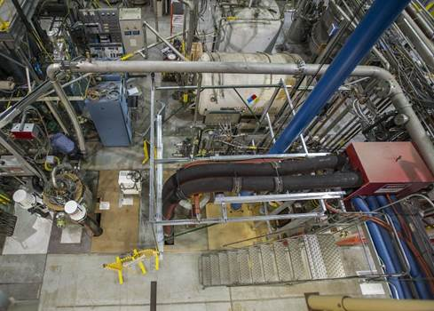
30 kA POWER SUPPLY UPGRADE
Power Supply Energy Extraction Switch
24 kA IGBT-based Energy Extraction Switch:
  Switch consists of 2 modules, each with six high power IGBTs in parallel. (One module of 6 for each 15 kA power supply.)
  IGBT rated to 3600 A per unit & at least 1200 V C-E voltage.
  IGBT current & C-E voltage will be limited 2000 A and 840 V.
  Stray and mutual inductances in the power supply circuit generated much higher switching transients than expected.
  So each IGBT has been equipped with a snubber circuit designed to limit high voltage switching transients to 600 V.
  40 channel IGBT Switch data monitoring and logging system for each module: Lab View program debugged and tested.
24 kA water-cooled cables: Finished DI water cooling circuit, installed drain outlet, and verified flow (>68 L/min) and pressure drop. 15 kA water-cooled cables flow is 30 L/min.
IGBT
Rated collector current = 3600 A
Max operating current = 2000 A
Max C-E voltage per IGBT = 840 V
(These values are with 66 mΩ dump resistor.)
Energy Extraction
66 mΩ center tapped to ground
Stainless Steel
1 MJ energy absorption rating
Existing all stainless steel 66 mΩ dump resistors will be replaced by new high power ceramic 66 mΩ 10 MJ resistors for MQXF tests.
SC Magnet Test Stands Workshop CERN June 13-14, 2016

Slide 21
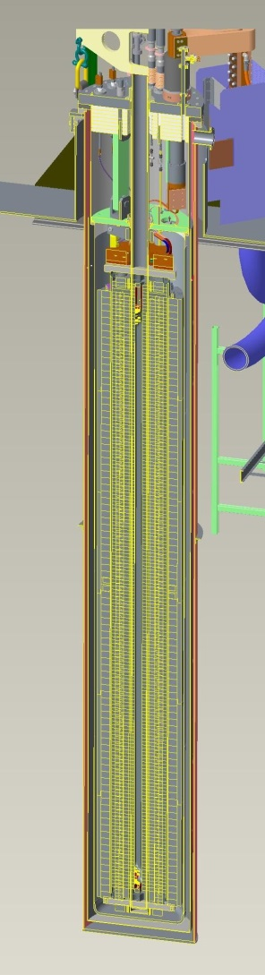
1.8 K TEST DEWAR ASSEMBLY
New Top Plate
New top plate to accommodate lambda plate and fixturing for MQXF 4.2 m quads and 24 kA vapor-cooled leads and heat exchanger for 1.8 K operation.
Lambda Plate
Top is 38.1 mm thick G10 (lower heat load)
Bottom is 19.05 mm thick 304 stainless steel (for added strength and sealing to He vessel interior flange)
Bonded together with Stycast 2850FT
Total heat load < 1.4 W
Redesigned Inner He Vessel
Rated at 5.86 bar
Existing Outer Dewar
MQXF Magnet
Components below lambda plate and internal to heat exchanger are designed for 5.86 bar,
above lambda plate for 3.45 bar.
4.5 K Heat Shield
SC Magnet Test Stands Workshop CERN June 13-14, 2016

Slide 22
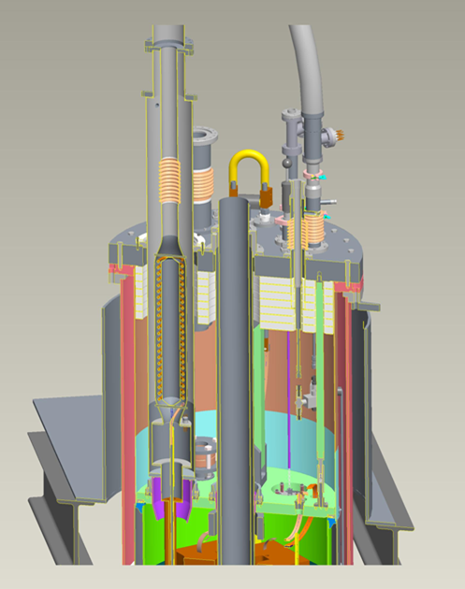
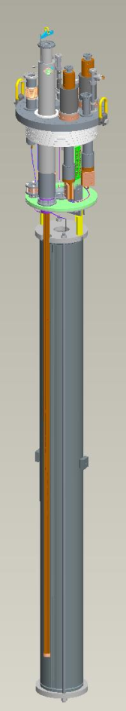
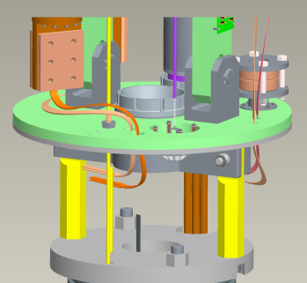
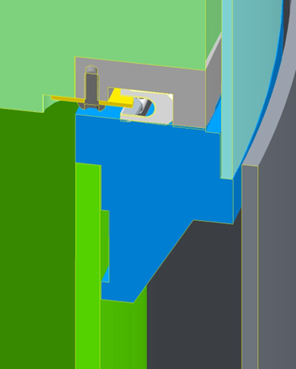
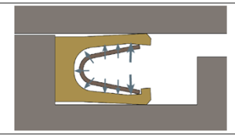
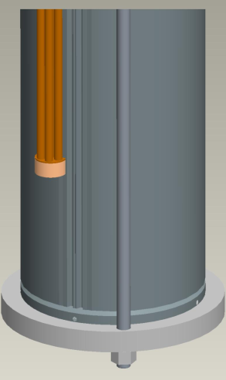
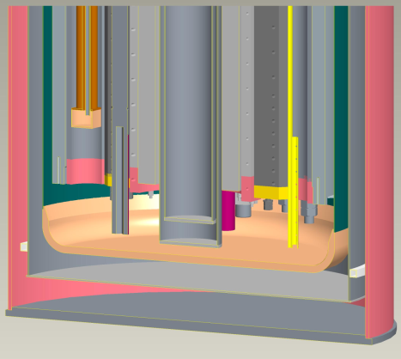
1.8 K TEST DEWAR ASSEMBLY
Test Dewar Overview
Lambda plate sealing detail
G-10/SST Lambda plate
Upper He vessel
He vessel flange
Lower He vessel
Outer 4K heat shield
Lambda Plate Spring-Energized Face Seal to He Vessel
Heat exchanger in magnet helium passage (left) and outside Mirror O.D. (right)
4K Al heat shield
2K-300K warm bore
Upper dewar assembly:
Vent and burst disc in lambda plate (for Safety Committee approval)
Gravity seal at lambda plate
Overall hanging assembly, or insert (mirror shown)
+200 mm extended helium dewar bottom
Serviced by 30 t crane with 6.79 m hook clearance height above dewar flange.
SC Magnet Test Stands Workshop CERN June 13-14, 2016

Slide 23
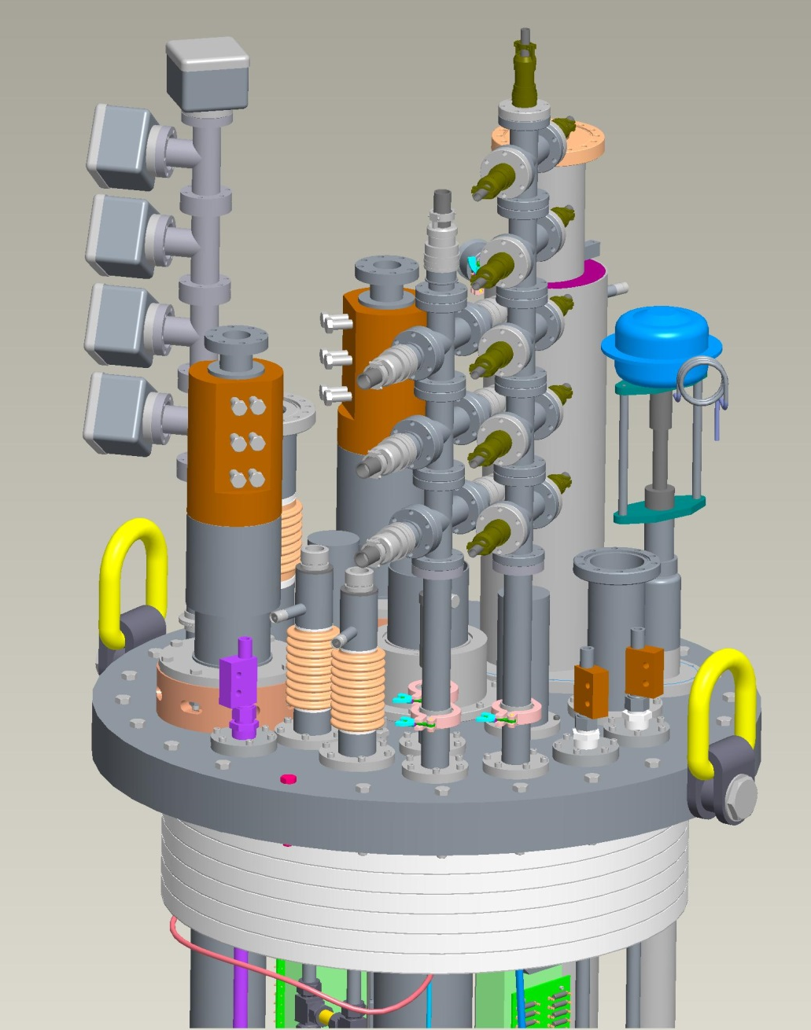
1.8 K TEST DEWAR ASSEMBLY
1.8 K Top Plate Details
(2) 24 kA main coil vapor-cooled leads
(2) 1 kA CLIQ vapor-cooled leads; port for 3rd lead provided
(3) instrumentation wiring ports
(2) helium fill lines
Heat exchanger ports, manifolds and solenoid valves under plate
Warm bore port
Helium vent port
Quench Heater Connector Tree
Heat exchanger
24 kA vapor-cooled leads
Top plate 3” (76.2 mm) thick 304 stainless steel
3rd CLIQ Lead
(if needed)
He fill lines
Connector Trees
CLIQ Leads
SC Magnet Test Stands Workshop CERN June 13-14, 2016

Slide 24
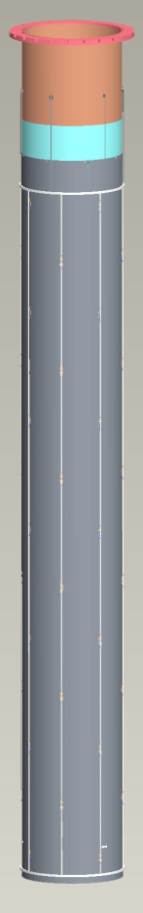
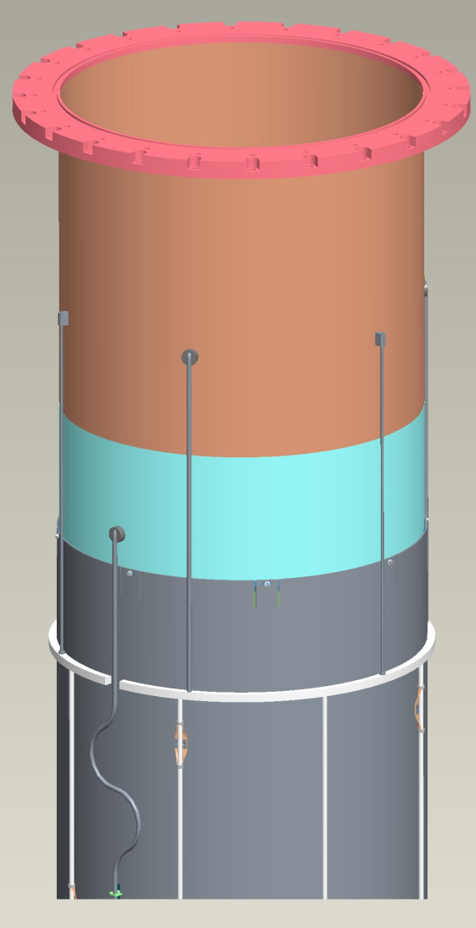
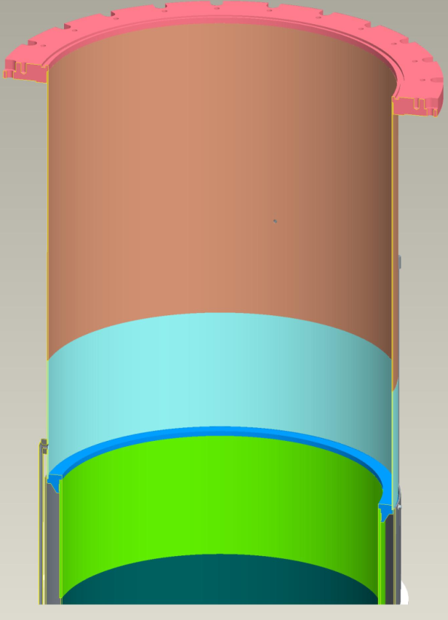

1.8 K TEST DEWAR ASSEMBLY
4.5 K Heat Shield
“blue/green” sections of helium vessel and lambda plate flange welded as a subassembly to permit precise, flat machined surface of lambda plate flange after welding (also locally thicker sections to accommodate bending stresses)
Flexible Cu connections
to Al
Helium return in gas above 4.5 K liquid
Helium supply from 4.5 K liquid
Heat shield is bolted to outside of lambda plate flange (supports weight, provides conductive cooling)
SST manifolds, pipes
SC Magnet Test Stands Workshop CERN June 13-14, 2016

Slide 25
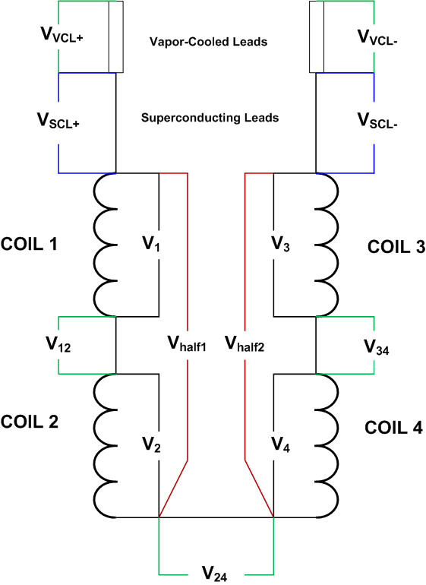
QUENCH PROTECTION
QUENCH DETECTION
The quench detection system is based on a redundant scheme which relies on a number of voltage signals. When any one of the following signals reaches its specified threshold voltage after a specified validation time, a fast discharge is instigated (current decays through dump resistor). Typical threshold voltages and validation times are listed here.
Half coil voltage V_{half1} - V_{half2} 50-100 mV 10 ms
Quarter coil voltage V₁ – V₂ 50-100 mV 10 ms
Quarter coil voltage V₃ – V₄ 50-100 mV 10 ms
Total coil voltage V_{total} 50-100 mV 10 ms
SC lead voltages V_{SCL+} and V_{SCL-} 10-50 mV 5 ms
Splice voltages V₁₂, V₃₄, V₂₄ 8-10 mV 5 ms
Current Derivative V_{total} – L dI/dt 0.1-5 V 10 ms
Note: In Nb₃Sn magnets, current-dependent thresholds as high as several volts at low currents are necessary and are set in the software. This is to avoid false QD trips due to flux jump spikes.
There are also designed into the system a number of interlocks which also rely on various signals which, if they do not meet specified conditions such as voltage threshold or on-off state, will instigate a slow discharge, with the dump resistor out of the circuit. These include:
Vapor-cooled lead voltages 80-100 mV 500-1000 ms
Strip heater capacitor bank not charged
IGBT switch temperature or voltage too high
Others
SC Magnet Test Stands Workshop CERN June 13-14, 2016

Slide 26
CONTROL, MONITORING, AND
DATA ACQUISITION SOFTWARE
RECENTLY UPGRADED WITH ALL NEW SOFTWARE
  POWER SUPPLY CONTROL PROGRAMS (LABVIEW)
  INSTRUMENTATION CONTROL PROGRAMS (LABVIEW)
  DATA ANALYSIS PROGRAMS (LABVIEW / DIADEM) include:
    DATA HANDLING, PLOTTING, AND ANALYSIS
    MULTIPLE SIGNALS DISPLAYED
    SIGNAL MANIPULATION
    WAVEFORM CALCULATOR
    ∫(I² dt) CALCULATION
SC Magnet Test Stands Workshop CERN June 13-14, 2016

Slide 27
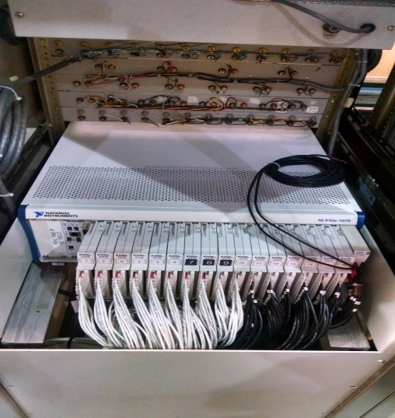
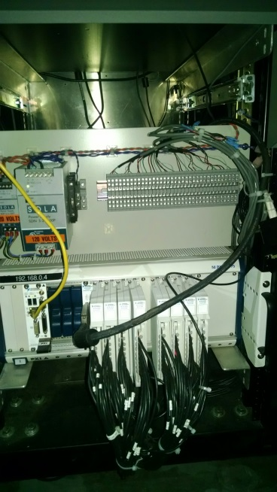
DATA ACQUISITION SYSTEMS
FAST DATA LOGGER DAQ
National Instruments PXIe-4300 (16 Units)
Number of channels = 8 differential, simultaneous sampling
Analog input = ±10 V, ±5 V, ±2 V, ±1 V
ADC resolution = 16 bit
Sampling rate = 250 kHz max per channel
Time scale resolution = 10 ns
TOTAL CHANNELS = 128 differential, simultaneous sampling
Usage = fixed (main) voltage taps and configurable (auxiliary) voltage taps
Status: Assembled and Tested
128 Channel Fast Logger
SLOW DATA LOGGER DAQ
National Instruments PXI-6289 (4 Units)
Number of channels = 16 differential
Analog input = ±10 V, ±5 V, ±2 V, ±1 V, ±0.5 V, ±0.2 V, ±0.1 V
ADC resolution = 18 bit
Sampling rate = 500 kHz max multichannel (31.25 kHz max)
Time scale resolution = 50 ns
TOTAL CHANNELS = 64 differential
Usage = monitoring of vapor-cooled lead voltages, splice voltages, SC lead voltages, temperatures, LHe levels, and other instrumentation
Status: Assembled and Tested
64 Channel Slow Logger
SC Magnet Test Stands Workshop CERN June 13-14, 2016

Slide 28
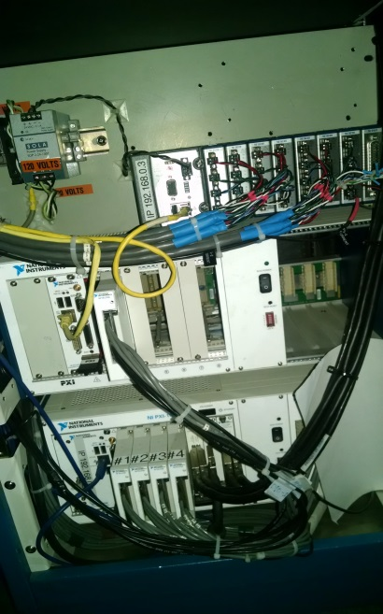
DATA ACQUISITION SYSTEMS
QUENCH DETECTOR DAQ
National Instruments PXIe-6356 (1 Unit)
Number of channels = 8 differential, simultaneous sampling
Analog input = ±10 V, ±5 V, ±2 V, ±1 V
ADC resolution = 16 bit
Sampling rate = 1.25 MHz max per channel
Time scale resolution = 10 ns
TOTAL CHANNELS = 8 differential, simultaneous sampling
Usage = signals used for quench detection, such as half coil and quarter coil voltage differences, SC lead voltages, etc.
Status: Assembled and Tested
STRAIN GAUGE LOGGER DAQ
Agilent 34970A Data Acquisition/Switching Unit (2 Units)
Number of channels = 60 differential, scanning
ADC resolution = 22 bit max
Scan rate = 250 ch/s max
TOTAL CHANNELS = 120 differential, scanning
Usage = strain gauges
8 Channel Quench Detector
Note: For mirror test, a portable Cytec scanner system will be used. All 64 channels have been assembled and tested.
SC Magnet Test Stands Workshop CERN June 13-14, 2016

Slide 29
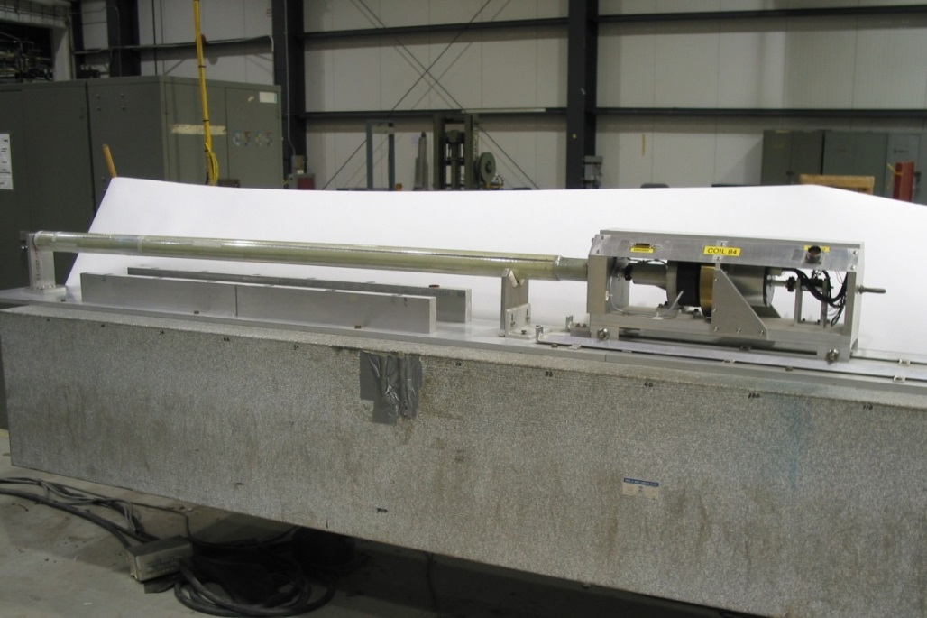
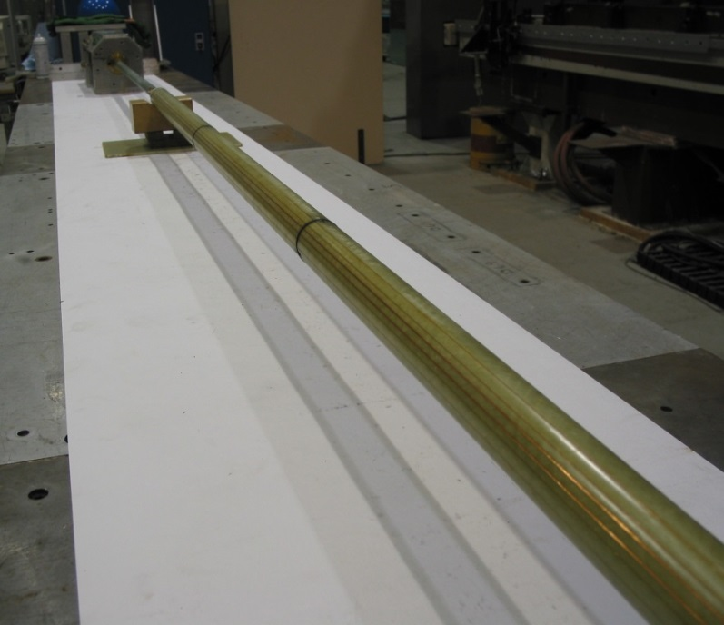
MAGNETIC FIELD MEASUREMENT
Existing inventory of over 60 magnetic field measuring coils, with variety of lengths and radii:
External drive coils, various radii and lengths, some with warm bore tubes
Moles, 1 m long and smaller, various radii, with electric (warm) or gas-driven (cold) motors
Example: Coils 84 and 86 shown below are external drive coils suited for 8 cm aperture magnets
2 radial dipole bucking windings
2 radial quadrupole bucking windings
1 tangential winding
digital bucking
Other devices: Hall probes, fluxgate magnetometers, vibrating wire
Magnetic field measuring probe designed for MQXF will not be needed for the upcoming mirror test but will be available for the testing of the prototypes starting in Feb 2017.
COIL #84
COIL #86
SC Magnet Test Stands Workshop CERN June 13-14, 2016

Slide 30
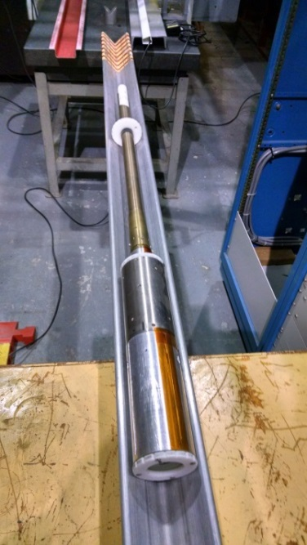
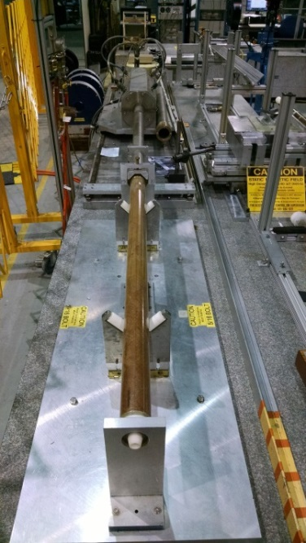
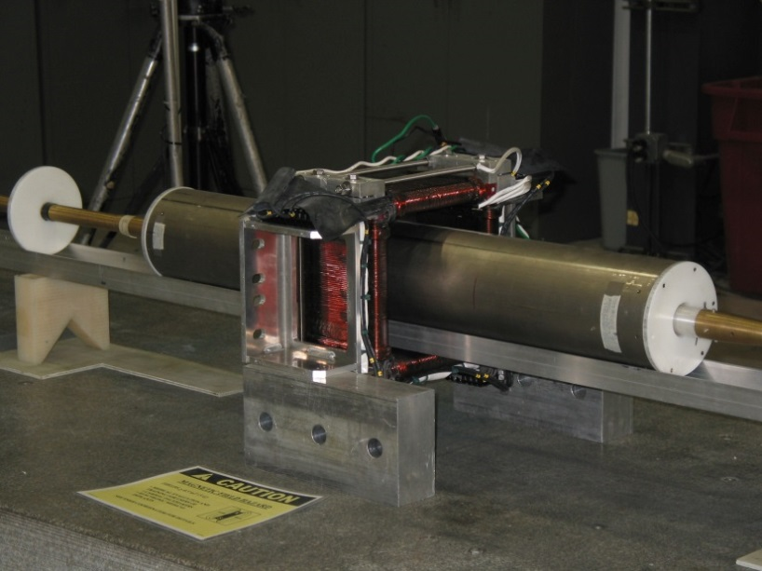
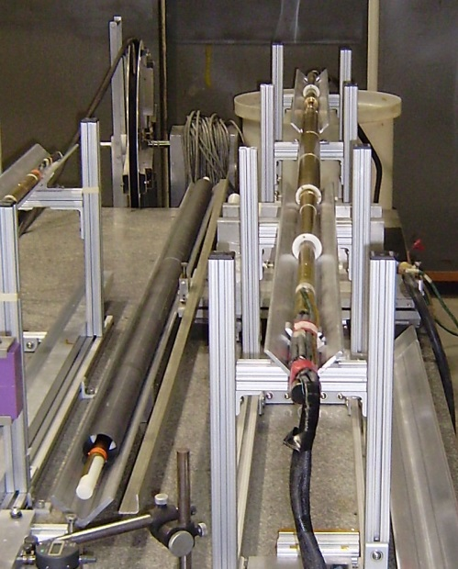
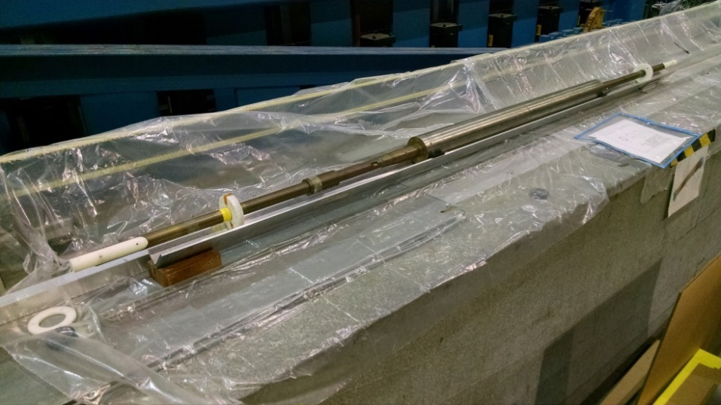
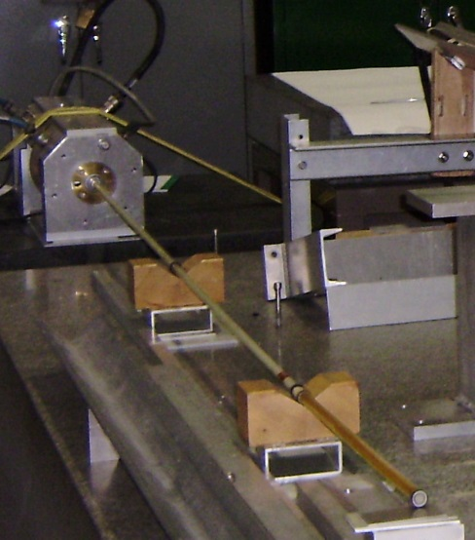
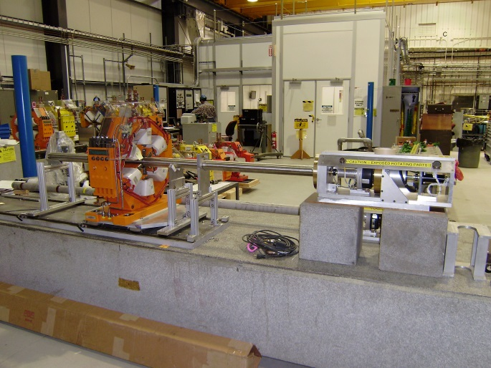
MAGNETIC FIELD MEASUREMENT
More examples of existing measuring coils
Mole RA-7
External Drive Coil 76 8 cm
Warm DX Mole in AGS Corrector Magnet
Mole RA-3
D0 Warm Mole 13 cm
Coil 96 2.54 cm
Coil 203 9-Windings 30 cm
SC Magnet Test Stands Workshop CERN June 13-14, 2016

Slide 31
SUMMARY
The cryogenics facility refrigerators, compressors, and other peripheral devices have been refurbished and re-configured to test MQXF quadrupoles at 1.8 K and 1 bar (nom).
New compressors, purifiers, critical spare parts, and other updates were provided with BNL funding. These items have been purchased to provide backup systems and mitigate risks in the event of equipment failure.
The Magnet Division 30 kA power supply (formerly used for cable testing) and peripheral systems such as energy extraction and quench heater firing units are being converted to test magnets to 24 kA and at 1.8 kA.
A completely new and redesigned vertical test facility (in an existing outer vacuum vessel) is being built to accommodate 1.8 K testing of MQXF magnets, with new inner helium vessel, 4 K heat shield, 1.8 K heat exchanger, lambda plate, new top plate with 24 kA Cu leads, and 24 kA water-cooled cables to test dewar.
The old data acquisition systems have been replaced by completely modernized and improved NI hardware and LabVIEW-based software.
The updated and reconfigured 1.8 K vertical test facility commissioning will be done with a short sample of Nb3Sn cable instrumented with taps and a spot heater. The mirror magnet will be present on the hanging fixture but not connected to the power leads until the cable test has been successfully completed.
Magnetic field measuring probe, spike detector system, and quench antenna data acquisition system are yet to be built, but will not be needed for the upcoming mirror magnet test.
SC Magnet Test Stands Workshop CERN June 13-14, 2016

Slide 32
SUMMARY
Cryogenics refrigerators, compressors, and other peripheral devices can be configured to provide for a variety of testing scenarios, including forced flow supercritical He or liquid He testing, and testing down to 1.8 K.
Magnet Division power supplies cover a wide range of testing applications for loads of various inductances and resistances, current and voltage levels, current ramp rates, and quench protection requirements.
Data acquisition systems are designed for flexibility to accommodate many magnet and instrumentation configurations.
There is a large inventory of magnetic field measuring coils of different sizes and design for a wide variety of applications.
Further upgrades of facility systems are in progress.
SC Magnet Test Stands Workshop CERN June 13-14, 2016

Slide 33
THANK YOU FOR YOUR ATTENTION
Acknowledgements for contributions to this presentation: Mike Anerella, Sebastian Dimaiuta, Piyush Joshi, Paul Kovach, Andy Marone, Bill McKeon, Jesse Schmalzle, Dan Sullivan
SC Magnet Test Stands Workshop CERN June 13-14, 2016

Slide 34
BACK UP SLIDES
SC Magnet Test Stands Workshop CERN June 13-14, 2016

Slide 35
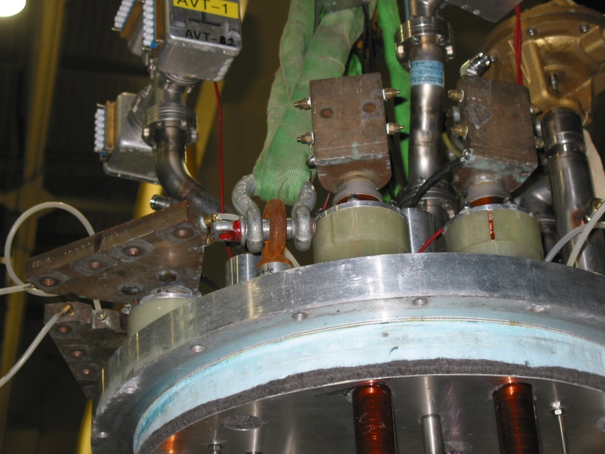
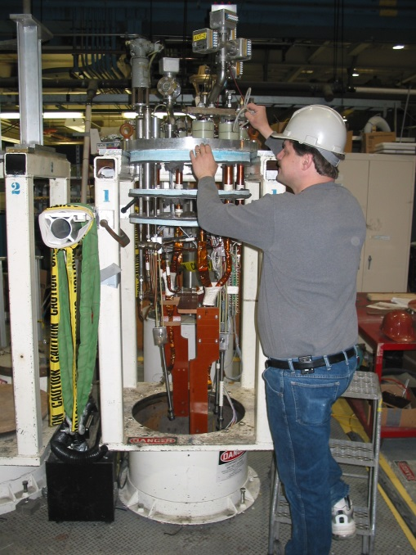
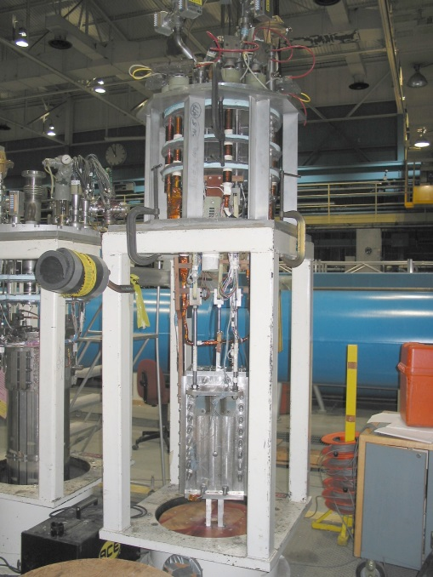
BNL VERTICAL TEST FACILITY
VERTICAL DEWAR TOP PLATES
  New top plate to accommodate MQXF 4.2 m LHC Inner Triplet quads and 24kA leads and lambda plate/fixture for 1.8K
  Magnet hanging fixtures and parts for a wide range of magnet types
  Variety of feedthroughs and instrumentation connector assemblies
  Gas-cooled and liquid-injection power leads for various power applications
  Associated temperature sensors and level probes with each top plate
  Presently eight top plates of various configurations available
SC Magnet Test Stands Workshop CERN June 13-14, 2016

Slide 36
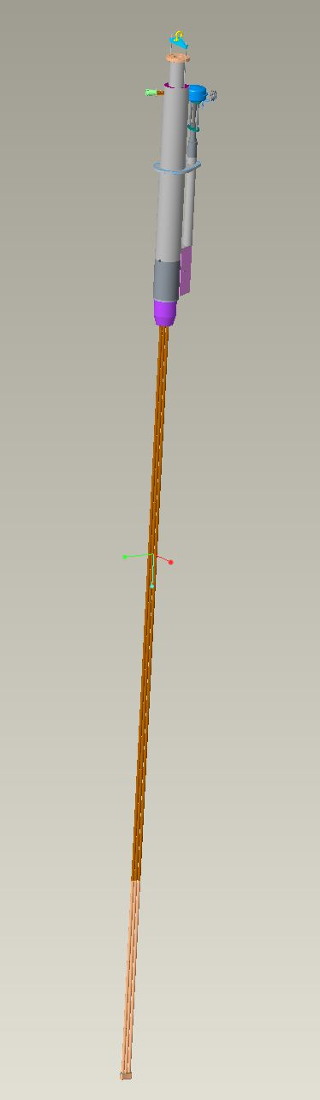
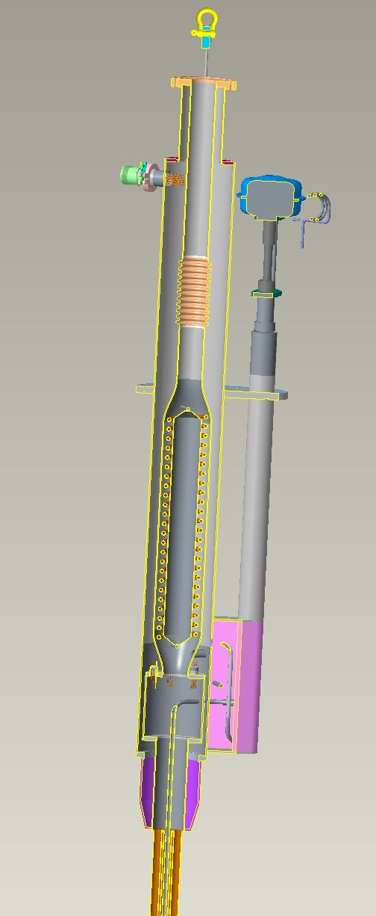
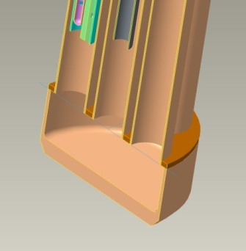
1.8 K TEST DEWAR ASSEMBLY
1.8 K Heat Exchanger
Top Plate Interface
Outer vacuum jacket above lambda plate designed for 50 psi (3.45 bar) external pressure.
All internal volume components designed for 85 psi (5.86 bar).
Lambda Plate Interface
Components below Lambda plate are designed for 85 psi (5.86 bar) external pressure.
Crescent-shaped bottom cup
SC Magnet Test Stands Workshop CERN June 13-14, 2016

Slide 37


1.8 K TEST DEWAR ASSEMBLY
Lambda Plate Relief System
2” Fike burst disc designed for subcritical flow (API 520). Venting 4150 g/s helium at 5.86 bar to 3.45 bar backpressure.
Required area is 14.8 cm². Provided area is 20.0 cm².
Certified by Fike: 2.2 bar @
74.8 K (lowest they can certify to). Calculated allowance to LHe temperature.
Relief conditions:
  3.45 bar above lambda plate
  5.86 bar below lambda plate
Service (Quench) Valve
  Designed for 750 g/s with a pressure rise of under 0.34 bar @ operating conditions (approx. 1.2 bar).
  Contains internal 1.8 K make up valve, to eliminate low pressure vapor under lambda plate.
SC Magnet Test Stands Workshop CERN June 13-14, 2016

Slide 38





1.8 K TEST DEWAR ASSEMBLY
Lambda Plate Spring-Energized Face Seal to He Vessel
Lambda plate sealing detail
“The load required to completely compress the seal is approximately 50-60 lbs per linear inch. That’s about 4200-5100 lbs. …….the difference in height between a completely compressed seal and one in the relaxed state is large enough to handle gaps if the parts are not completely flat or if the seal is not completely compressed.” P. Kovach, designer.
SC Magnet Test Stands Workshop CERN June 13-14, 2016

Slide 39


1.8 K TEST DEWAR ASSEMBLY
4.5 K Heat Shield
1/16” fillet welds (TYP)
⅛” aluminum Shell
Flexible copper attachments
Vertical tubes (white & red) ⅜” X .028” wall, seamless 304 Stainless Steel.
Header tubes (Blue) ⅝” X .065” wall, seamless 304 stainless steel.
SC Magnet Test Stands Workshop CERN June 13-14, 2016

Slide 40
QUENCH PROTECTION
Quench Protection Heater Firing Units (HFU)
PRESENT HFU SYSTEM
Number of capacitor banks 4
Number of capacitors per bank 15 units
Capacitor voltage rating 450 V
Capacitance per unit 3100 μF
Total capacitance per bank 46500 μF
Maximum energy density that can be delivered vs capacitance with present system
SC Magnet Test Stands Workshop CERN June 13-14, 2016

Slide 41

DATA ACQUISITION SYSTEMS
STATUS SUMMARY
64 Channel Slow Logger
8 Channel Quench Detector
DAQ SYSTEMS STATUS:
128 Channel Fast logger: Assembled and tested.
64 Channel Slow logger: Assembled and tested.
64 Channel Strain Gauge logger: 32 Channels tested, remaining channels to be assembled.
8 Channel Quench Detector: Assembled and tested.
Cable end connector assembly complete on dewar end.
Acquisition software written/debugged/tested.
All isolators / pre-amplifiers assembled, calibrated & tested.
(FY16) - Spike Detector & Quench Antenna Data Acquisition System to be designed & built.
128 Channel Fast Logger
DAQ-isolation amplifier cabinet
SC Magnet Test Stands Workshop CERN June 13-14, 2016

Slide 42


BNL CRYOGENICS FACILITY
“before” legacy copper lines & valves
Inline Purifiers
  Replaced Polyflow lines
Valve Boxes
  Replaced Polyflow lines
Quench Tank
  Replaced valve & legacy soldered copper lines with stainless steel welded pipe; rerouted quench recovery line to improve flow
  Replaced legacy soldered copper small diameter return manifold piping with large diameter welded stainless steel
  Purchased & installed new return manifold valves
“now”
Note: all this work is BNL funded
SC Magnet Test Stands Workshop CERN June 13-14, 2016

Slide 43



BNL CRYOGENICS FACILITY
Sullair 500* (500 hp, 94 g/s) Installation
* backup unit, risk mitigation against Mycom compressor failure
4160V transformer relocated into place – conduit/wiring installation complete
Sullair skid modified for new location
  Electrical panel removed
  Frame cut/shortened/re-welded
All electrical & plumbing installations are complete
Waiting for turn-on
Cost underrun! Surplus funds approved for use in commissioning helium dirty gas purifier system (Linde contract)
Note: all this work is BNL funded
SC Magnet Test Stands Workshop CERN June 13-14, 2016

Slide 44

BNL CRYOGENICS FACILITY
(FY17)*
Re-commission Kinney Vacuum Pump (backup to Nash Pump, 2.0 g/s He @ 1.8K)
* Pending final budget authorization
SC Magnet Test Stands Workshop CERN June 13-14, 2016

Slide 45

BNL CRYOGENICS FACILITY
Cryogenic Controls
Nash Vacuum Pump Controls : New lab View based controls tested for remote and local operation
Finished hardware and software debugging of the new Lab View based Inline Helium purifier and its associated valve system.
Helium Recovery compressor: Retrieved vendor programmed ladder logic code for modification and addition of remote control logic. initial testing revealed damaged pressure sensor (as received). Replacement ordered.
New Lab View based controls for Quench recovery valve system being tested.
Monitoring system and controls for various level sensors, temperature sensors, heaters, vacuum sensors etc. are in process of being calibration and testing.
SC Magnet Test Stands Workshop CERN June 13-14, 2016

Slide 46





30 kA POWER SUPPLY UPGRADE
24 kA water-cooled cable to dewar installation is complete
(Note also helium vacuum line)
SC Magnet Test Stands Workshop CERN June 13-14, 2016

Slide 47



1.8 K TEST DEWAR ASSEMBLY
Lambda Plate Design Details
CLIQ leads (not installed for Mirror)
Pressure relief valve with “backflow” poppet (not shown)
Note: exiting magnet leads will be cut to ~ 300 mm past splice box; is this acceptable for production magnets?
Main current lead connections to 24KA vapor cooled leads (not shown)
SC Magnet Test Stands Workshop CERN June 13-14, 2016

Slide 48










1.8 K TEST DEWAR ASSEMBLY
Test Dewar Status p.12K Heat Exchanger Assembly
ASSEMBLY COMPLETE
top hx end
bottom hx end
SC Magnet Test Stands Workshop CERN June 13-14, 2016

Slide 49




1.8 K TEST DEWAR ASSEMBLY
Helium Dewar & Outer 4K Heat Shield Status
6/10/16 –
Heat shield welded to helium vessel.
Insulation blanket installed.
Heat shield (at BNL)
SC Magnet Test Stands Workshop CERN June 13-14, 2016

Slide 50






1.8 K TEST DEWAR ASSEMBLY
Test Dewar Status p.3 Lambda Plate
Assembly underway
G-10 & stainless steel plates potted with Stycast epoxy
Components being installed
SC Magnet Test Stands Workshop CERN June 13-14, 2016

Slide 51


1.8 K TEST DEWAR ASSEMBLY
top hat detail parts being fabricated:
  24KA vapor cooled leads received
  Top hat received, being inspected
  (3) Instrumentation towers assembled
  Wiring harnesses being assembled
  Most parts promised 5/16
  Delivery issue with Ultem 24KA lead insulators, material sent to 2nd vendor, parts due 5/19
SC Magnet Test Stands Workshop CERN June 13-14, 2016

Slide 52
MAGNETIC FIELD MEASUREMENT
Inventory of measuring coils
SC Magnet Test Stands Workshop CERN June 13-14, 2016

