Slide 1
Magnet Test Stands at Fermilab
Guram Chlachidze
Fermilab
1st International Workshop of the SC magnet test stands, CERN 2016

Slide 2
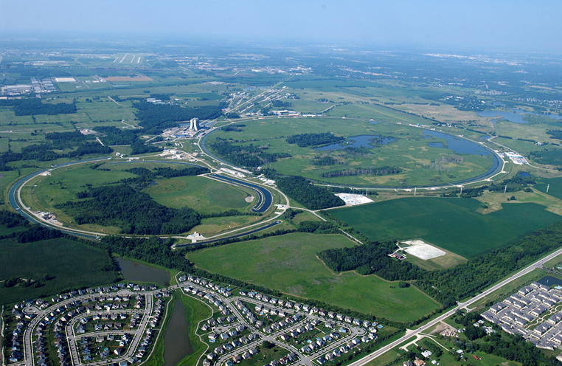
Introduction to Fermilab
National Laboratory operated by Fermi Research Alliance (FRA)
Located in Illinois, about 56 km west of Chicago

Slide 3
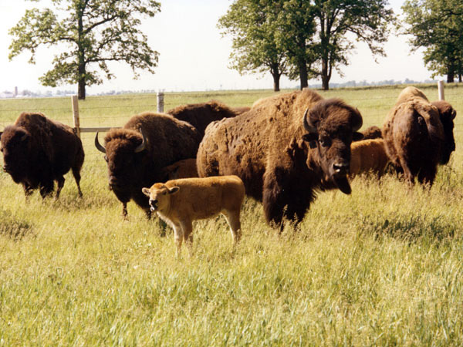
Fermilab
Particle physics and accelerator science laboratory
~27 km² park-like site
Multiple accelerators
1,700 Employees
Previously hosted Tevatron - the World’s largest and most powerful
accelerator before the LHC era
Ceased operation in
September 2011

Slide 4
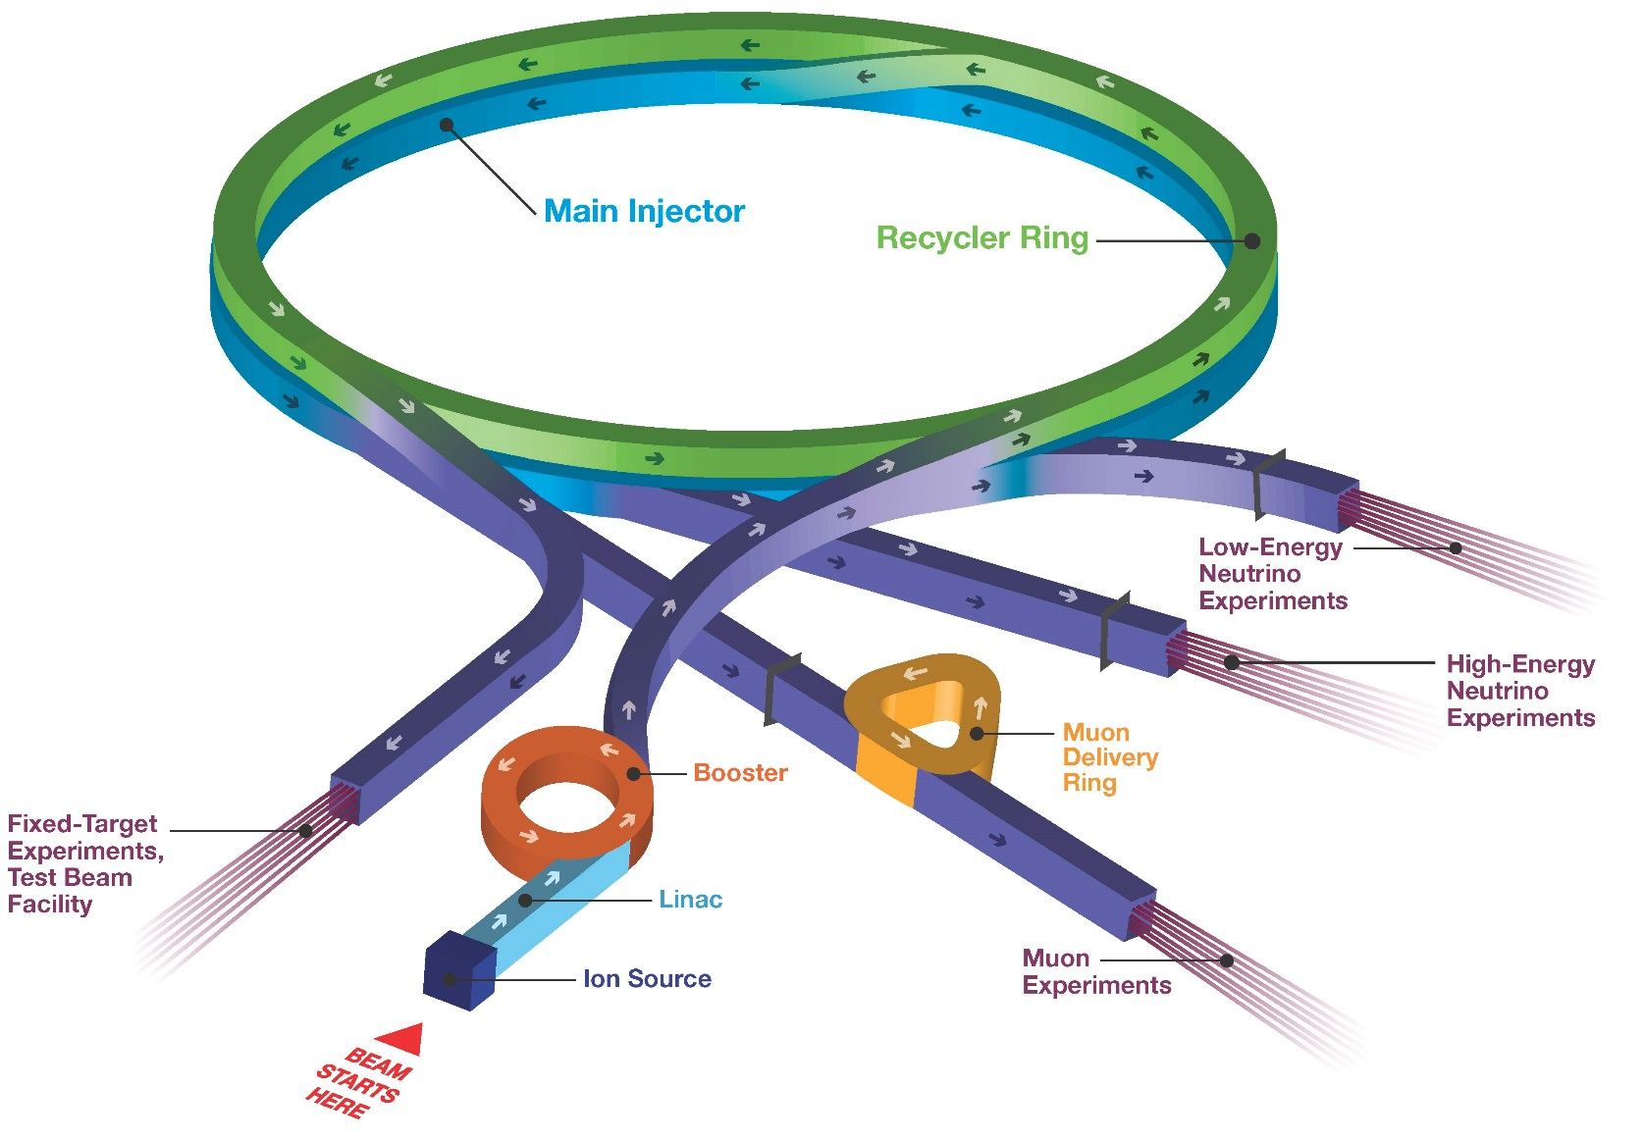
Accelerator Complex Today

Slide 5
Magnet Test Facility
Magnet test facility (MTF) originates from the Main Ring period, when the first main accelerator was built at Fermilab
First conventional magnet tests started by the end of the 1960s
Testing of the first superconducting accelerator magnets started in the late 1970s
MTF cryogenic plant in operation since 1978
Today still functional CTI-1500 liquefier installed back in 1977
Vertical Magnet Test Facility (VMTF) - the main R&D stand for the SC magnets, in operation since 1996
Vertical Cavity Test Facility (VCTS) commissioned in 2007 to support the SC RF cavity R&D program at Fermilab

Slide 6
Magnet Test Facility (cont’d)
Total area of MTF today is about 2200 m²
Two vertical (VMTF, Stand 3) and 3 horizontal test stands for the SC magnet tests (Stands 2, 4, 6)
Number of cryostats
1 cryostat at VMTF - 4 m deep, 0.65 m diameter
1 cryostat at Stand 3 for 1 m long, 0.4 m diameter magnets
3 cryostats at VCTF, each 4 m deep, 0.7 m diameter
Low Temperature Calibration Facility (LCTF)
Used for calibration of cryogenic temperature sensors
Materials Characterization and Test Facility (MCTF)
Low temperature material properties and cryogenic device studies

Slide 7
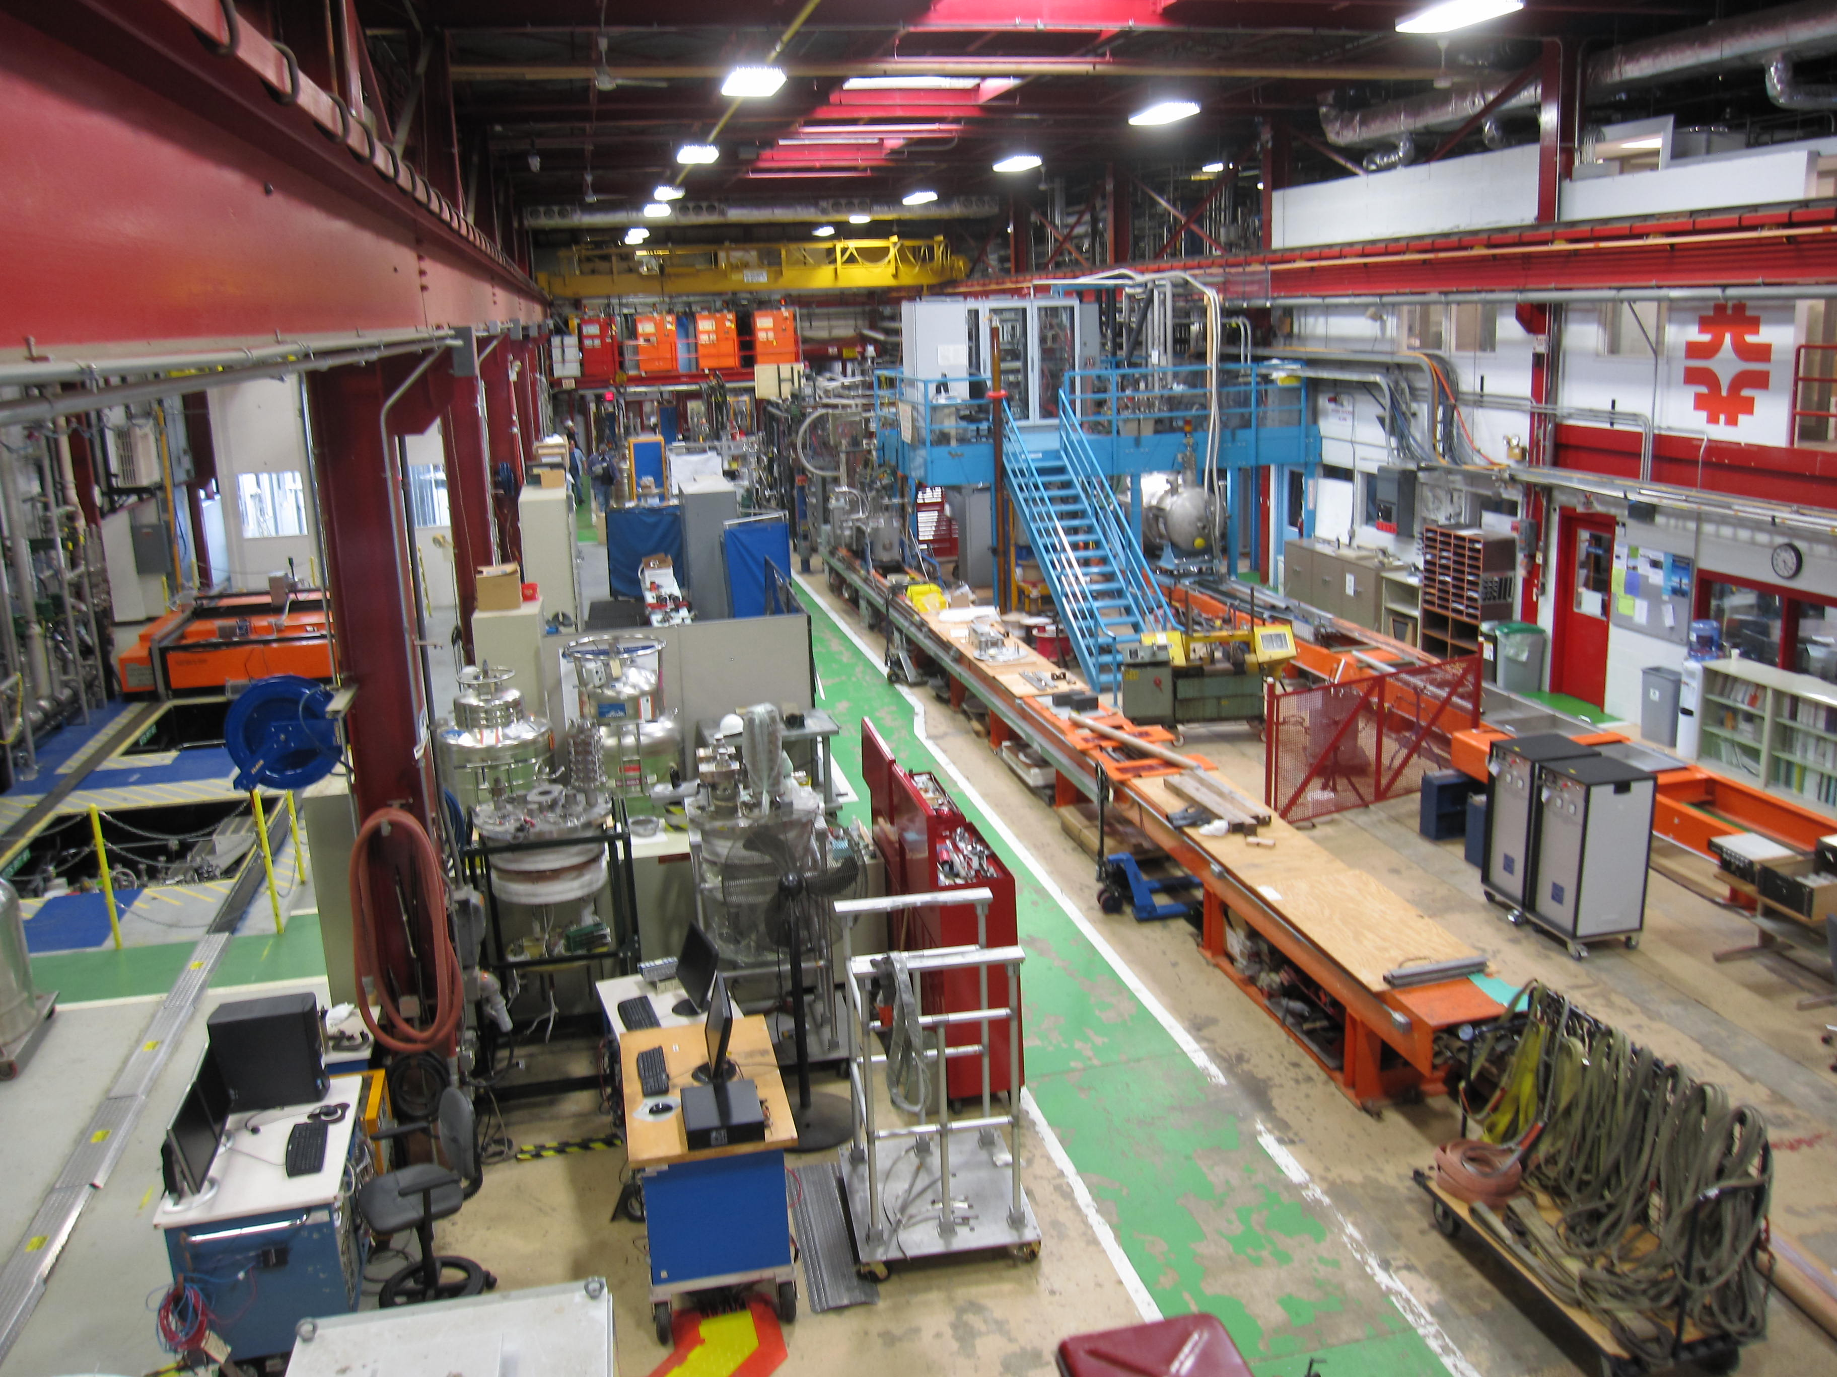
MTF at Fermilab
VCTF
Stand 4
Stand 6
VMTF

Slide 8
Horizontal Test Stand 4
Previously used for testing Q2 optical elements for the LHC IR final focus
To be upgraded for testing Q1/Q3 optical elements of the HiLumi-LHC

Slide 9
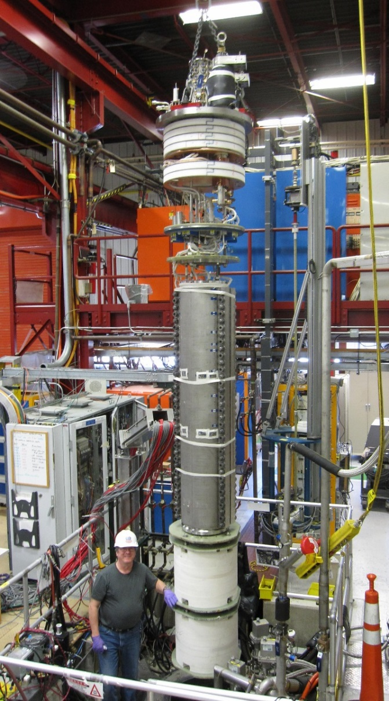
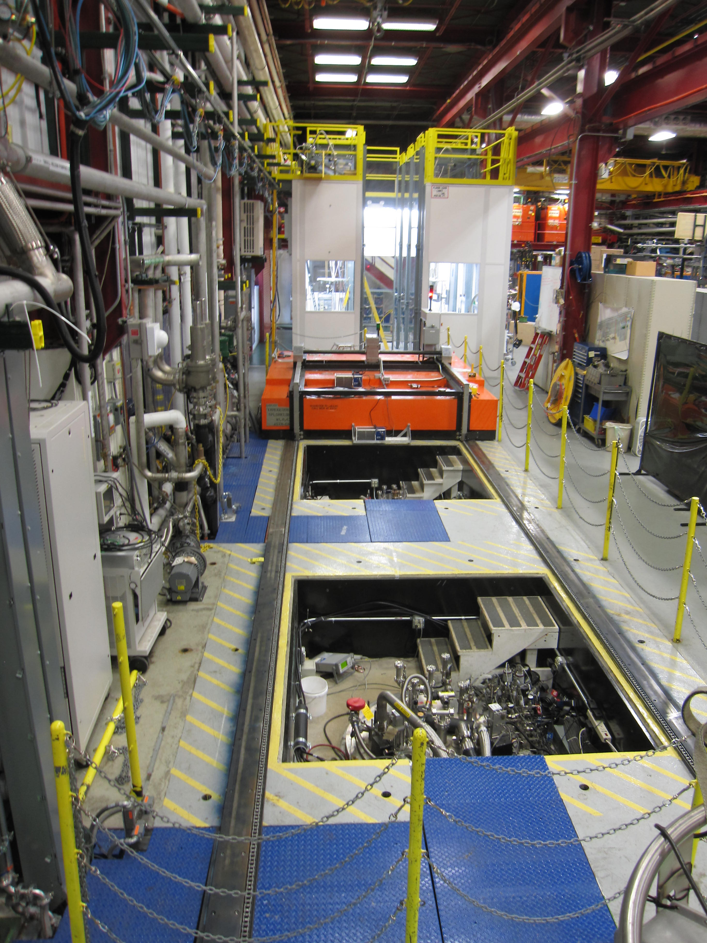
MTF at Fermilab
VMTF
VCTF #3
VCTF #2
VCTF #1

Slide 10
Magnet Test Facility
Operating temperatures:
VMTF 1.8 K - 4.5 K
VCTF 1.5 K - 4.5 K
Cooling phases: 300 to 4.5 K, 4.5 to 1.8 K
Shared cryogenics: All cryogenic stands share the same LHe storage
dewar. VMTF and VCTF also share most of the transfer lines
Lifting and Handling tools:
One 25-top crane, two 10-ton cranes

Slide 11
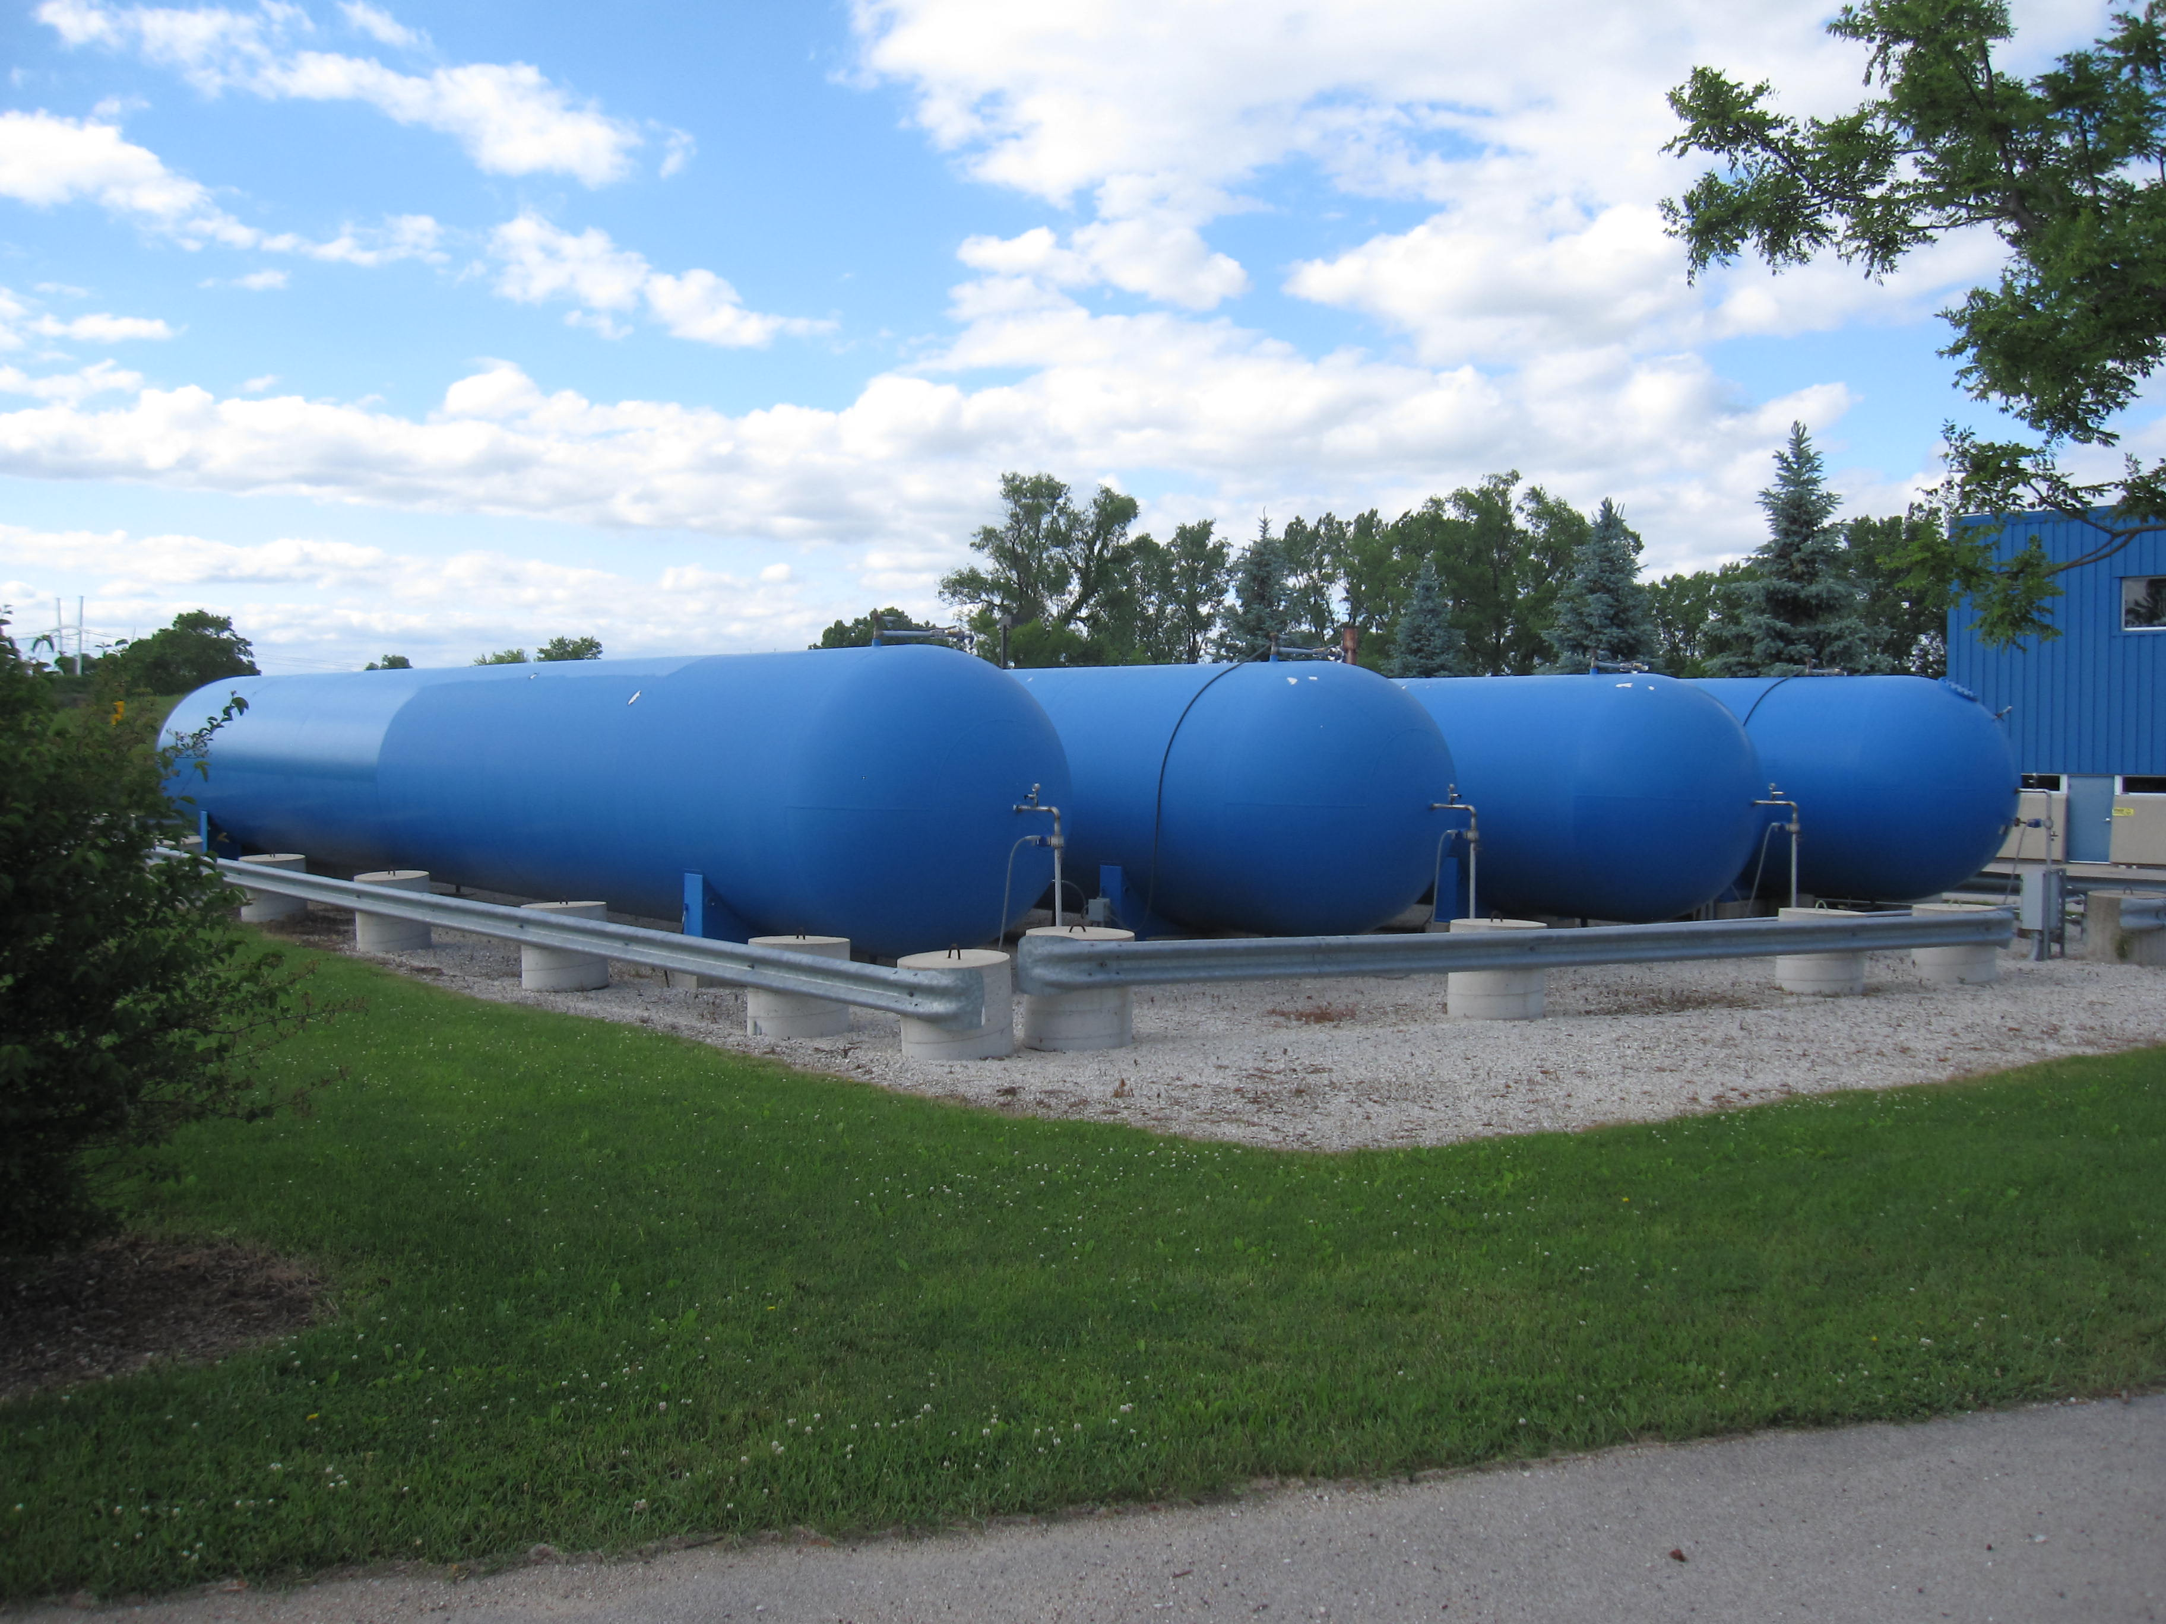
Cooling Capacity
CTI-1500 liquefier with liquefaction rate of 300 L/hour
10000 L storage dewar for the LHe
Effectively using ~7000 L of volume only due to the lower and upper limits for the LHe level in the dewar
Five 30000 Gal (~114 m³)
buffer tanks are used for
storage of helium gas

Slide 12
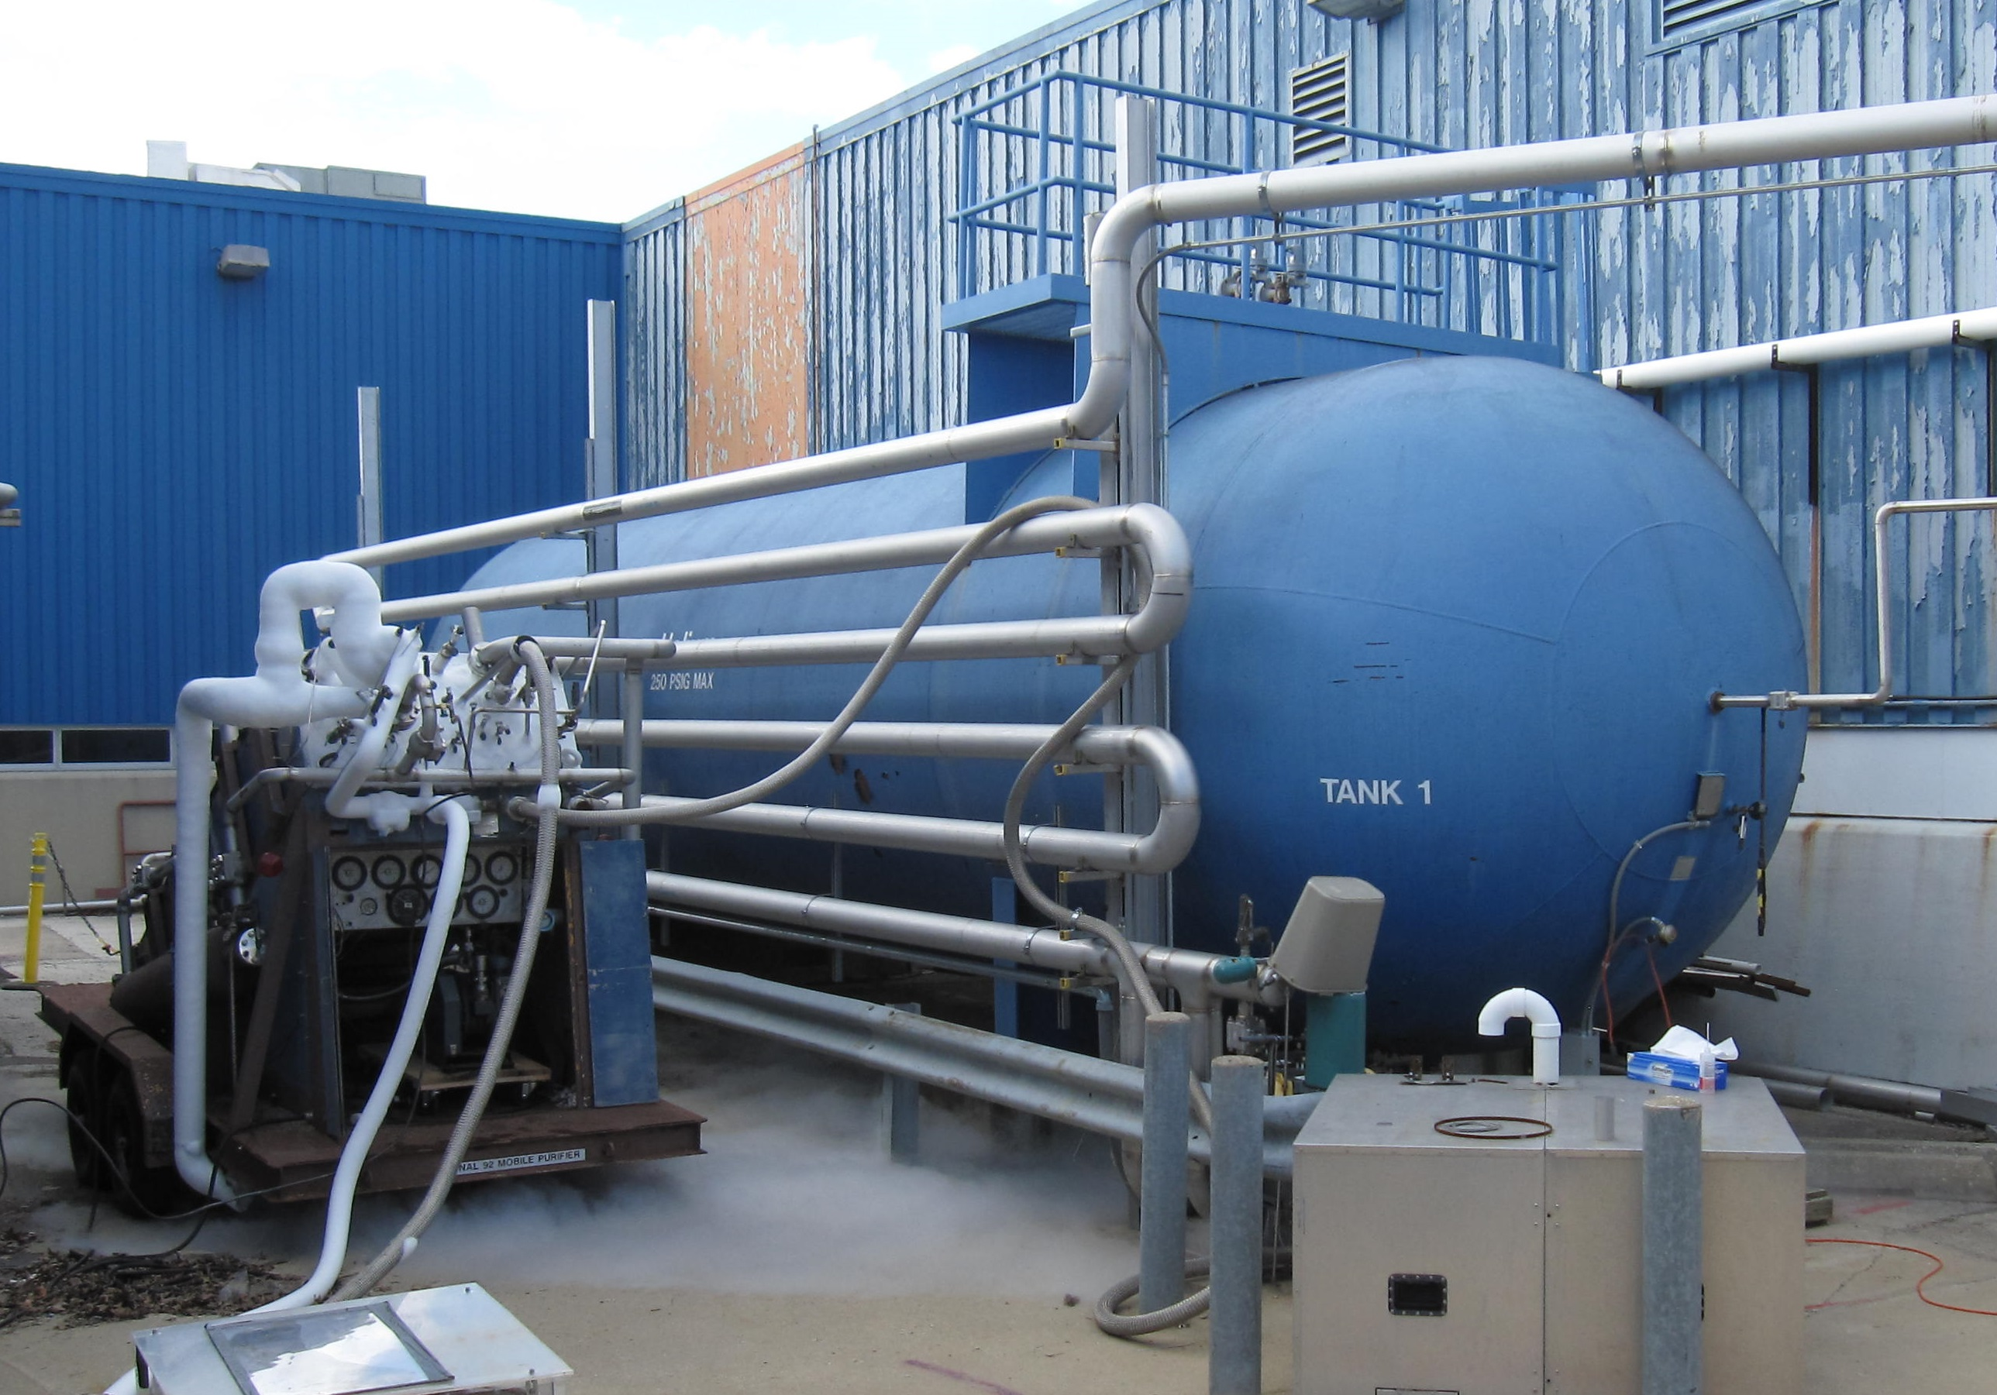
Cooling Capacity (cont’d)
Buffer tank pressure 50 to 150 psia, suction pressure 16.2 psia
1st stage compressor discharge pressure 35 psia, 2nd stage – 300 psia
One 30000 Gal buffer tank is used for the helium gas recovery after high-current quenches at VMTF
Longer transfer line helps
to warm up the GHe

Slide 13
Cooling Capacity (cont’d)
Purifier system to control contamination level of H₂O, N₂ and O₂ at different locations
10000 Gal LN₂ dewar
Filled twice a week
Dry gas in warm bore
1st stage cooling of the cold box
Industrial Cooling Water (ICW)
Feeds the low conductivity water (LCW) for cooling power supplies or conventional magnets
3 ton water chiller for operation in summer

Slide 14
Pumping Capacity
New Helium compressor skids - 4 Kinney pumps in parallel used for VMTF and VCTF
Total pumping speed of 10 g/s at 12 torr (4.5 K operation) and 15 g/s at 20 torr (1.9 K operation)
Old Helium compressor skids – 2 Kinney pumps for the Horizontal Test Stand 4
Pumping speed 2.5 g/s in
Kinney I, 1.5 g/s in Kinney II
Total 4 g/s at 12 torr, or
6 g/s at 20 torr

Slide 15
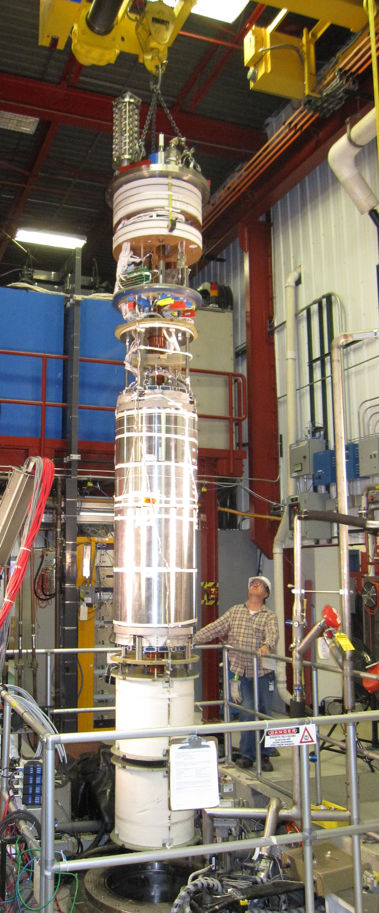
Cool down time at VMTF
Controlled cool down to 4.5 K takes 3-4 days for MQXFS magnets (2-m long, 0.6 m diameter, 4000 kg magnet)
Fillers are used for short magnets
Uncontrolled cool down of a magnet of this size
could take 1.5 days
Cool down from 4.5 K to 1.9 K takes 2-3 hours
depending on magnet size and weight
Fillers
Fillers

Slide 16
Quench Recovery at VMTF
Quench recovery is required to handle high pressure He gas after violent high-current quenches
Increased pressure automatically switches the transfer lines to the quench recovery tank
Manual handling is more efficient
Quench recovery depends on amount of stored energy - quench current and magnet inductance, as well as on operation temperature
Less recovery is required at 1.9 K compared to 4.5 K
MQXFS quenches at currents above 9 kA at 1.9 K required recovery
Average quench recovery time for MQXFS magnet was 1.5 hours

Slide 17
Power Systems
VMTF: 6 PEI-150 (150 kW) units are connected in parallel
Each PEI delivers 5 kA at 30 V
Maximum current of 30 kA at 30 V
External energy extraction system based on a solid state dump switch
SCRs mounted in water cooled heatsinks
Dump resistor configurations from 2 to 120 mΩ
Due to overheating SCRs there is a limit on continuous operation for
currents above 26 kA:
27-28 kA current can be provided for 10-15 minutes, and
above 28 kA for few minutes only
One 240 kW and two 150 kW PEIs are used for the conventional magnet stands

Slide 18
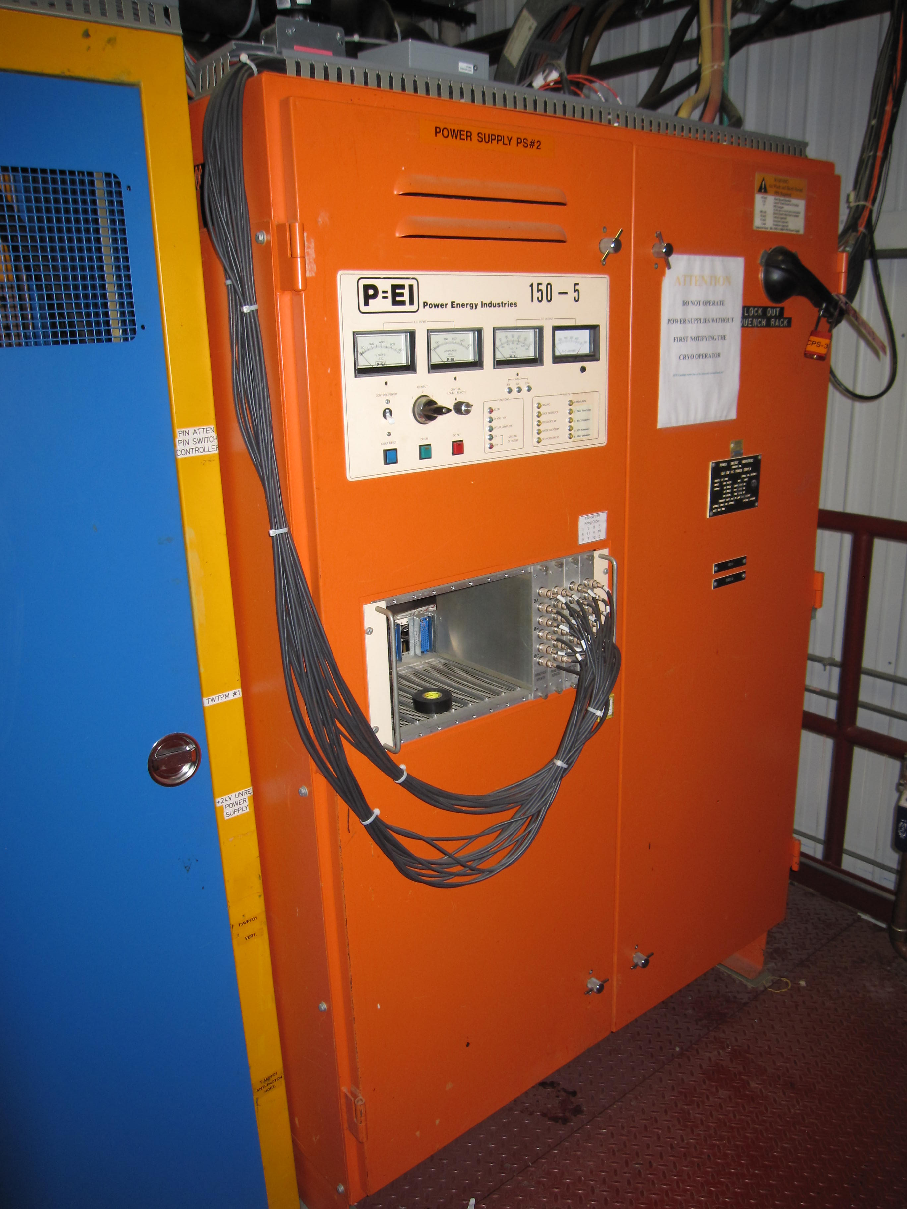
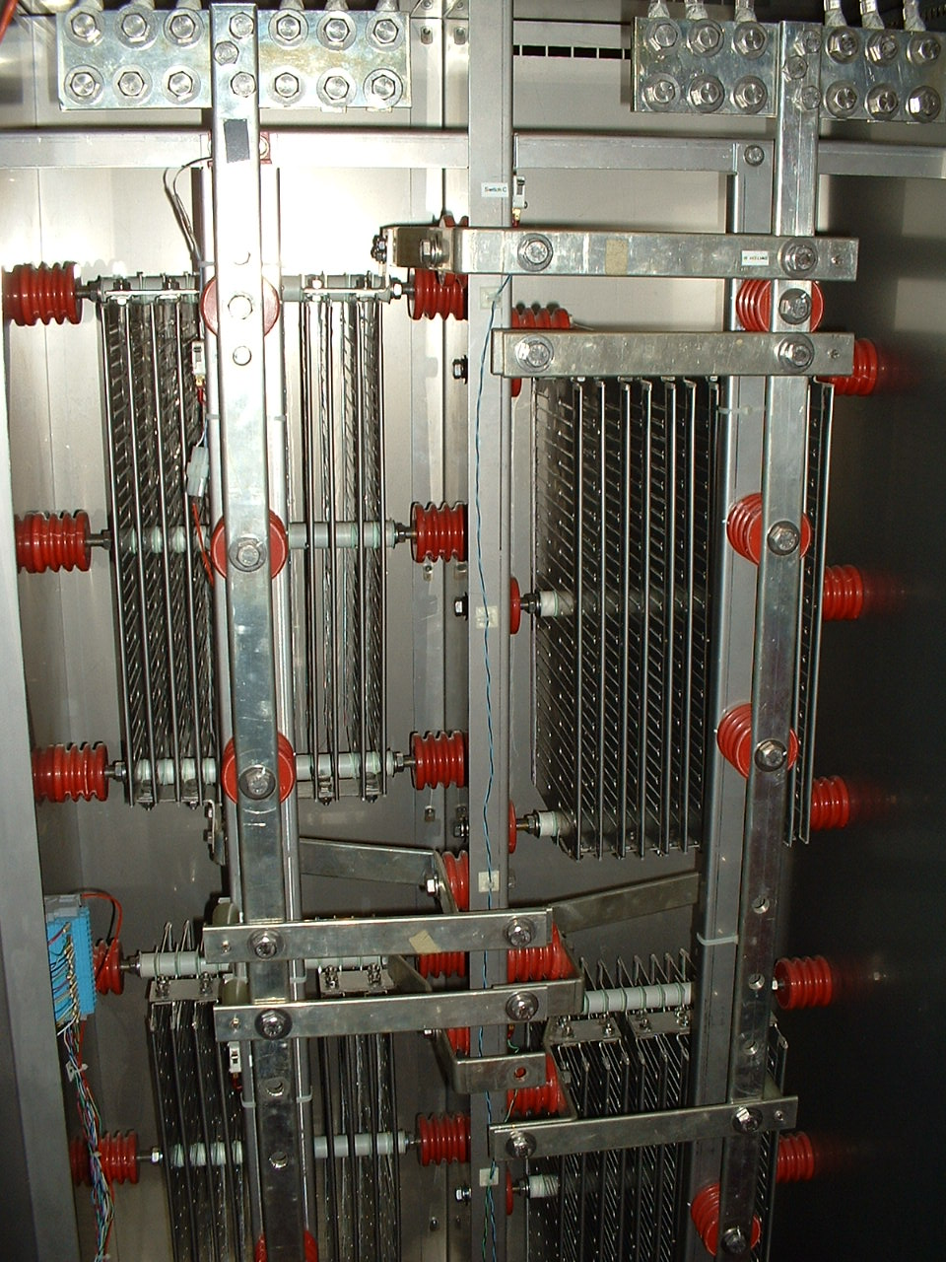
Power Systems (cont’d)
150 kW Power Energy Industries Dump Resistor Cabinet (right)
(PEI) PS module (left)

Slide 19
Magnetic measurements at MTF
Fermilab has World-recognized expertise in magnet measurement systems development
Printed Circuit Board (PCB) Probes
Developed since ~2007 for Booster BMA correctors
Different dimension probes were used for LQ, HQ and now MQXF magnets
Rapid Development/Fabrication, low cost
Self-contained Rotating Coil assembly
“FERRET” (formerly known as “MOLE”)
Warm horizontal magnet scans at different locations
All cold magnetic measurements are performed in the warm bore

Slide 20
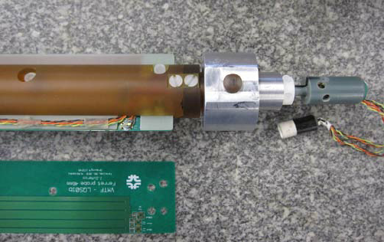
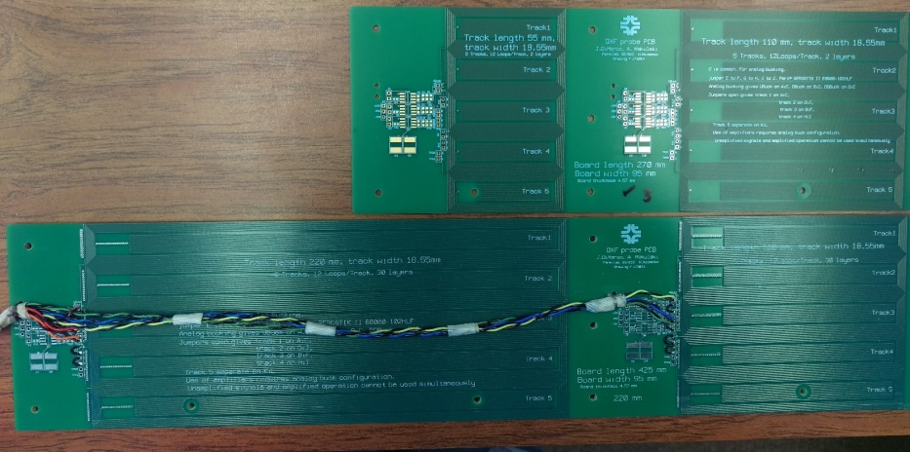
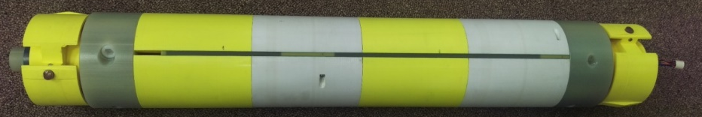
PCB probes
Probe for LQS magnet
Probe for MQXFS magnet

Slide 21
Mobile Measurement Carts
  Several generations of easily transported measurement systems developed at MTF
Metrolab’s PDI based measurement cart built 1997
PDI not available anymore
FDI very expensive
  New integrator developed at Fermilab based on commercial low noise, low drift ADC and FPGA
DSP measurement cart developed in 2002
Fast ADCs with DSP integration, for high throughput
Used for study of LHC dynamic effects, and LARP magnet measurements
SSW carts in use since 2000
Work-horse for all quadrupole magnetic axis and alignment needs

Slide 22
Thank you
Helpful information provided by D. Orris, C. Sylvester, R. Rabehl, B. Squires, J. DiMarco, M. Tartaglia, G. Velev

