Slide 1

Test stand @ CERN
Marta Bajko CERN
1st International Workshop on Superconducting Magnet Test Facilities @ CERN 13th-14th of June 2016
https://indico.cern.ch/event/507584/

Slide 2
Content
Magnet test stand layout @ CERN
Vertical cryostats : on-going upgrades
  HFM
  Cluster D
Horizontal test benches: on-going upgrades
  Cluster A
  Cluster E
Associated facilities upgrades
Summary and conclusions

Slide 3
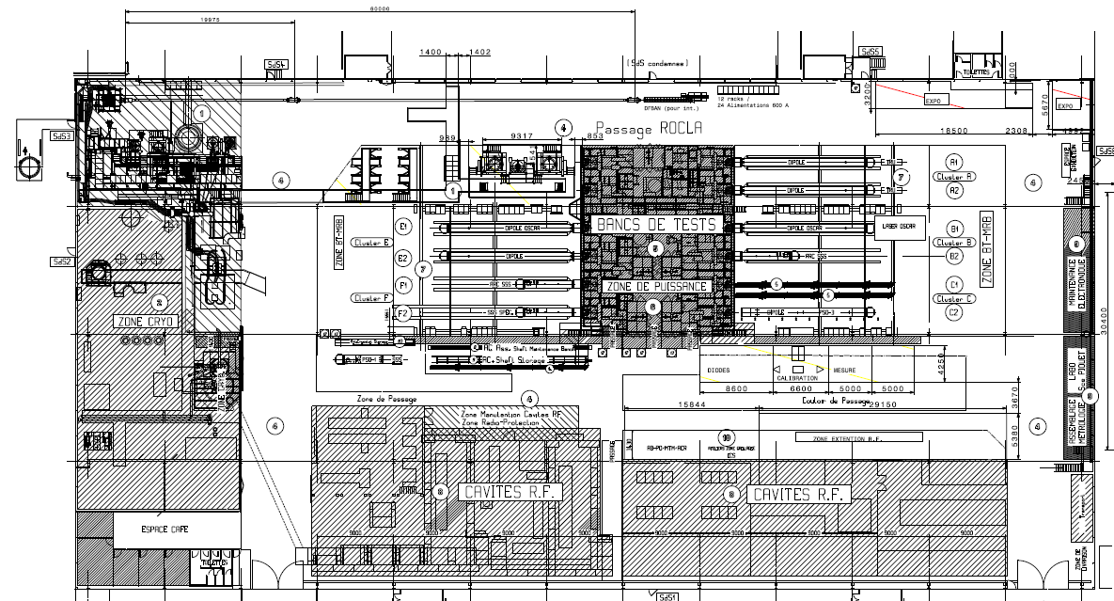
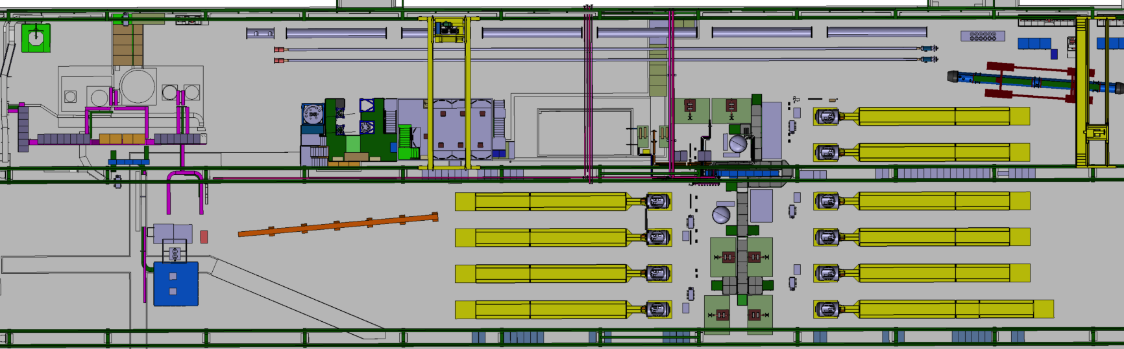
Magnet test stands layout @ CERN
THE SUPERCONDUCTING MAGNET TEST STAND AT CERN in SM18
STRING and SC LINK
Is located in a building of 7200 m² over which the test stands for magnets occupies about 50%.
CLUSTERS
F E D
HORIZONTAL BENCHES
CLUSTERS
C B A
INSTALLATIONS
3 vertical cryostats,
1 feed-box for supercritical He,
1 cryostat for LN₂,
10 horizontal benches
OPERATION
I= 0.12 kA-20 kA
T = 1.9 K to 70 K He
withstanding U = 1kV to 3 kV
CRYOGENIC ZONE
Superconducting RF CAVITY TEST ZONE
LN₂ TEST ZONE

Slide 4
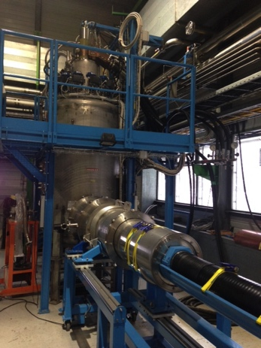
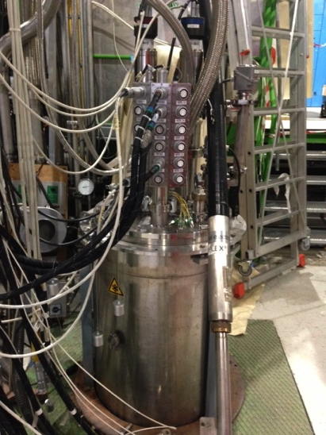
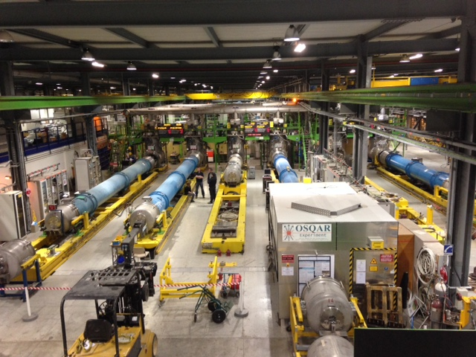
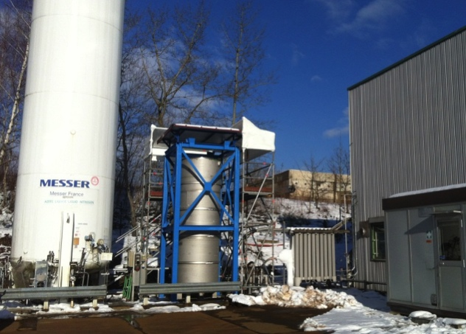
Magnet test stands layout @ CERN
INSTALLATIONS
3 vertical cryostats ,
1 feed-box for supercritical He,
1 cryostat for LN₂,
10 horizontal benches
OPERATION
I= 0.12 kA-20 kA
T = 1.9 K to 70 K He
withstanding U = 1kV to 3 kV

Slide 5
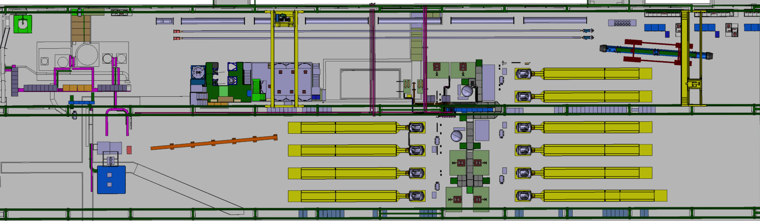
Vertical test stand upgrade
Cluster G
Cluster D
The vertical cryostats zone, called Cluster G is about 400 m² . It is under upgrade with an extra space called Cluster D of 150 m² . It will accommodate the test of larger diameter magnets @ higher operating current for HL LHC.

Slide 6
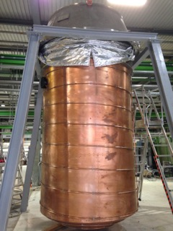
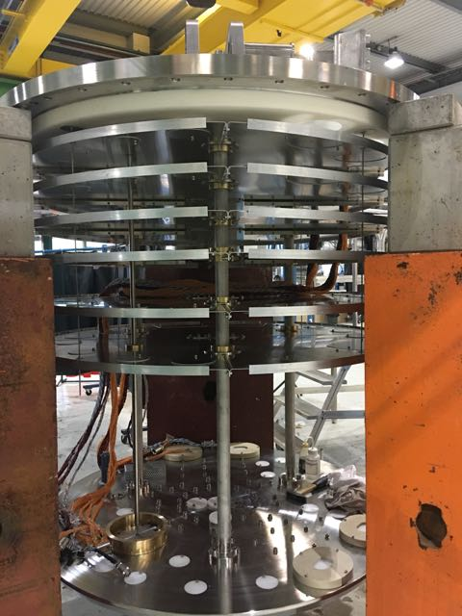
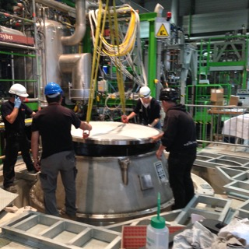
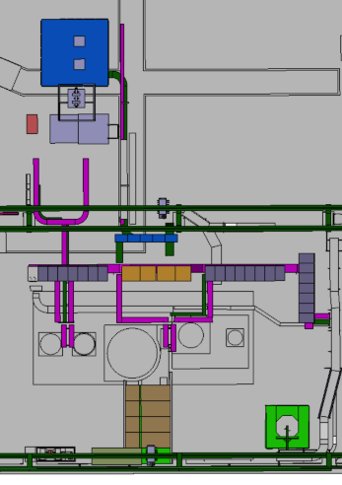
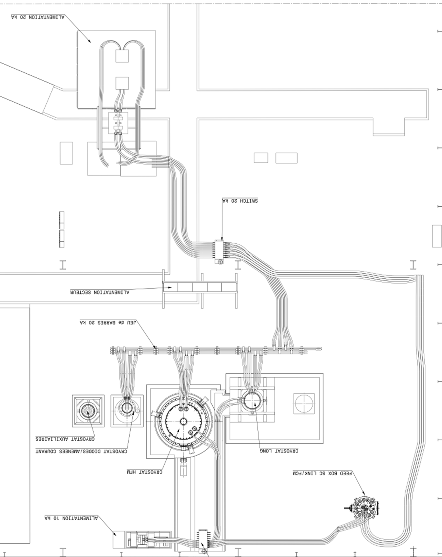
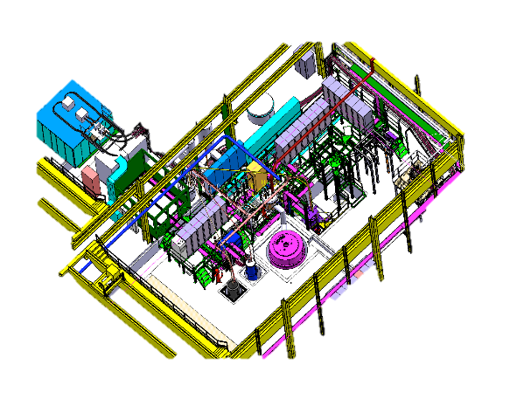
Cluster G upgrade
PRE-COOLING WITH He GAS AND QUENCH BUFFER FOR COLD He RECOVERY
20 kA POWER CONVERTER
with EE and DUMP RESISTOR
The circuit is distributing current towards vertical cryostats orto the feed box via a commutator
“DIODE/LEAD” CRYOSTAT
@ 4.2 K
“LONG” CRYOSTAT :
3.8 m long and
Φ 600 mm @ 1. 9 K
“SIEGTAL” CRYOSTAT
1.4 m long
Φ 800 mm @ 1.9 K
“HFM” CRYOSTAT for MAGNET TESTS WITH
Φ 1500 mm and 2.5 m length
CRYOGENIC
FEED BOX FOR
He 4.2-80 K
Ref. HFM cryostat is financed by EUCARD and the WP19 task of HL-LHC

Slide 7
Vertical test stand upgrade
Cluster D

Slide 8
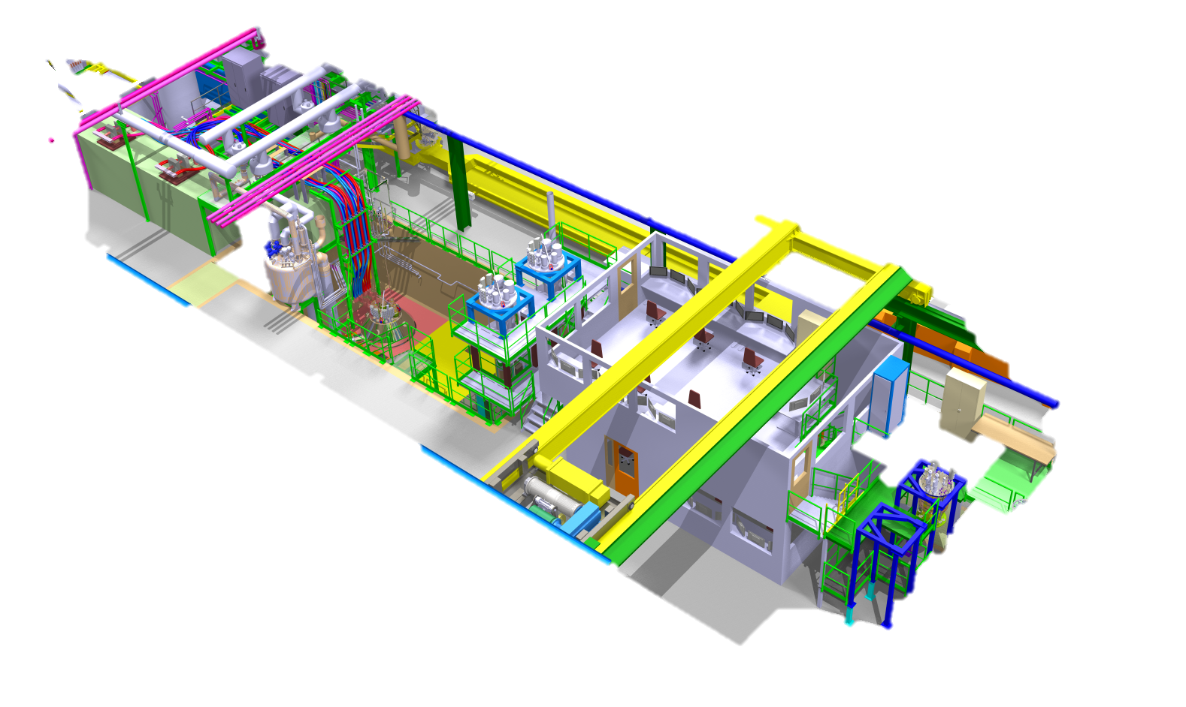
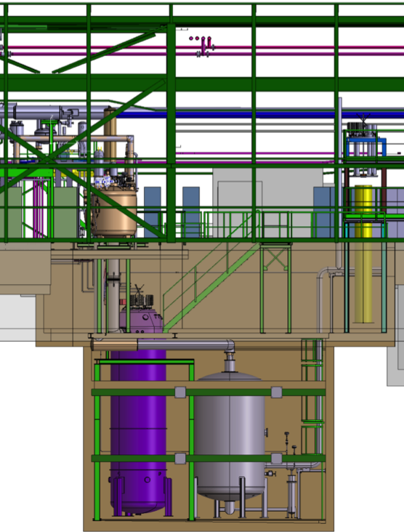
Cluster D test stand
CRYOSTAT : 4.8 m LONG AND
Φ 800 mm @ 1. 9 K
EE and DUMP AT THE 2 m LEVEL
POWER CONVERTERS30 kA AT GROUND LEVEL
PREPARATION ZONE AT 0 AND -3 m LEVEL
5.5 m
ELECRICAL AND CRYO-RACKS NEAR THE CONTROL ROOM
2 m
0 m
TWO ODH ARE IN THE -3 m ZONE ( mostly justified by presence of N₂)
-3 m
CONTROL ROOM NEAR THE CLUSTER
-10 m
COLD He RECOVERY BUFFER - 10 m³ at 5 bar, UNDER THE WORKING AREA IN CONFINED SPACE
Integration by A.Kosmicki
NEW OVERHEAD CRANE ALLOWS HADLING 25 t AND UP TO -3 m LEVEL

Slide 9
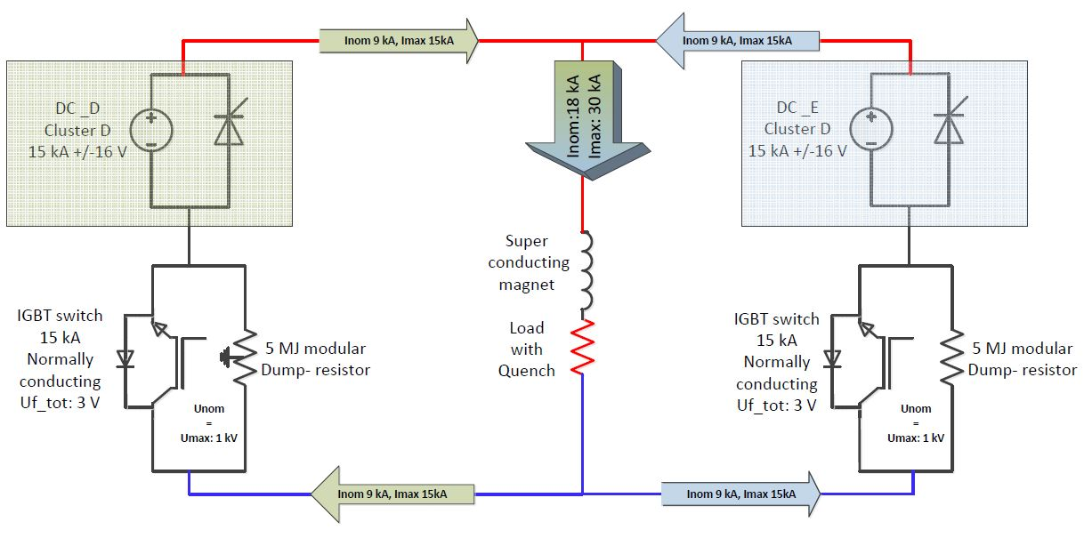
CLUSTER D: electrical circuit
EL CIRCUIT PARAMETERS
Max stored energy 10 MJ
Short Sample current 21.5 kA
Magnet inductance 8.27 mH/m
Nominal Ramp Rate 11 – 20 A/s
Max Ramp Rate 200 A/s
Max current 30 kA
Max EE voltage 1 kV
Reaction time : < 10 ms
DESIGN DRIVEN BY: cost reduction and operation optimization implying the use of two existing 15 kA power converters for the new circuit
Ref. H. Thiessen, C. Giloux, G.J. Coehling, P. Viret

Slide 10
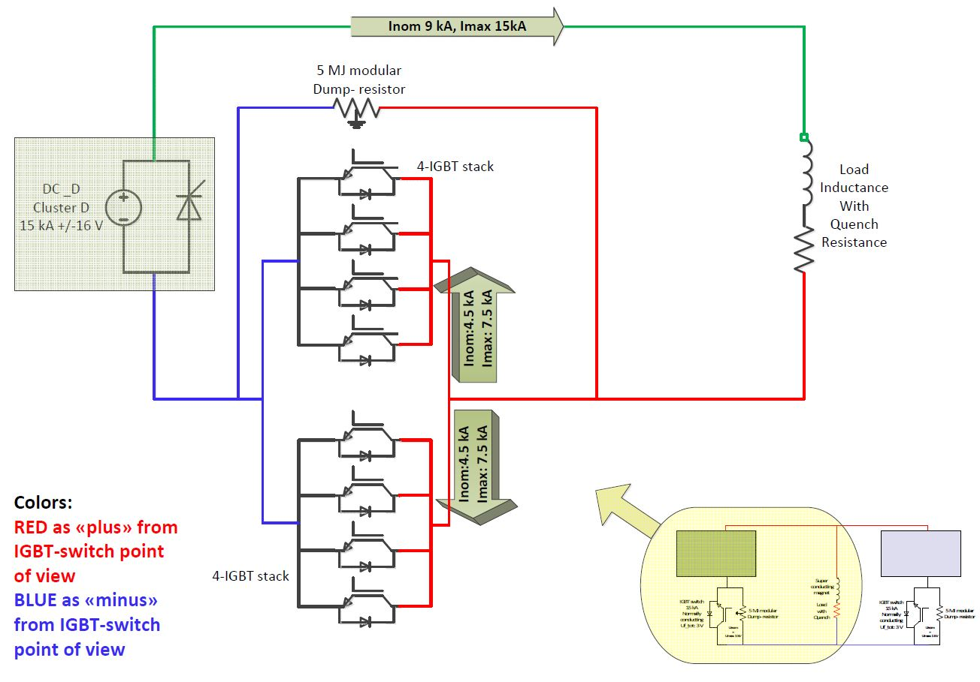
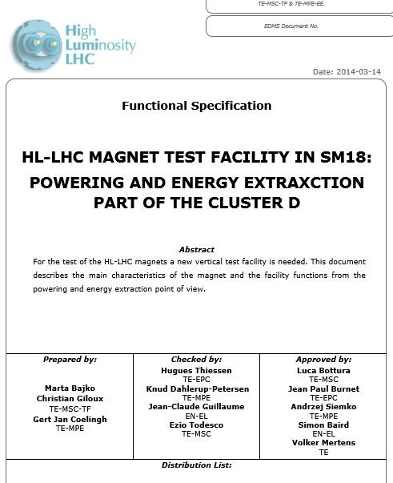
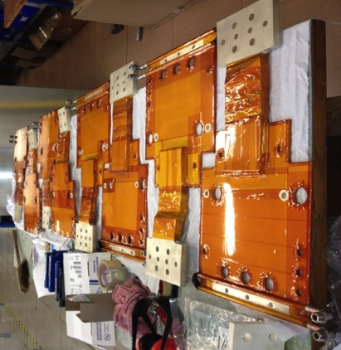
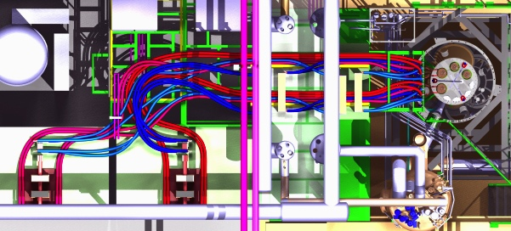
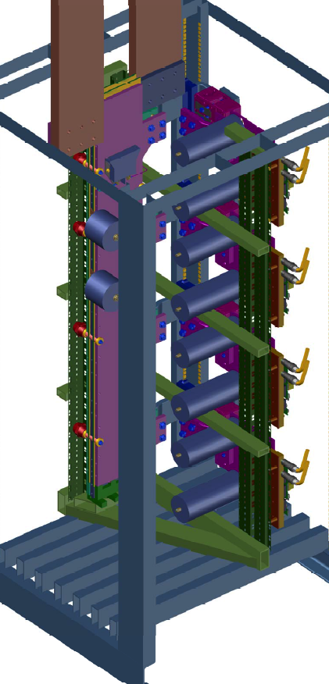
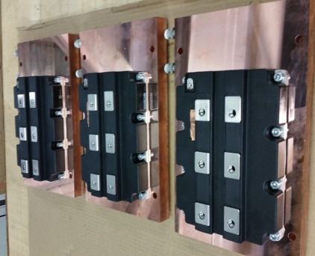
Cluster D : energy extraction
DESIGN DRIVEN BY : Reaction time < 10 ms, which implied the use of IGBTs
THE 30 kA SWITCH IS MADE WITH TWO 15 KA UNITS EACH COMPOSED BY A MODULE OF 7.5 kA
EACH UNIT OF 15 kA IS EQUIPPED WITH A DUMP RESITOR
FOR 5 MJ
DESIGN GOLAS FOR BUS BARS
Equal paths for all currents
Equal impedances
Compact and cold:
(T max 110 °C and 80 °C on junctions)
Ref. G.J. Coehling, A. Dinus, K. Petersen

Slide 11
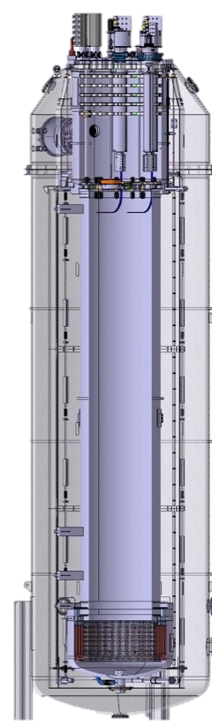
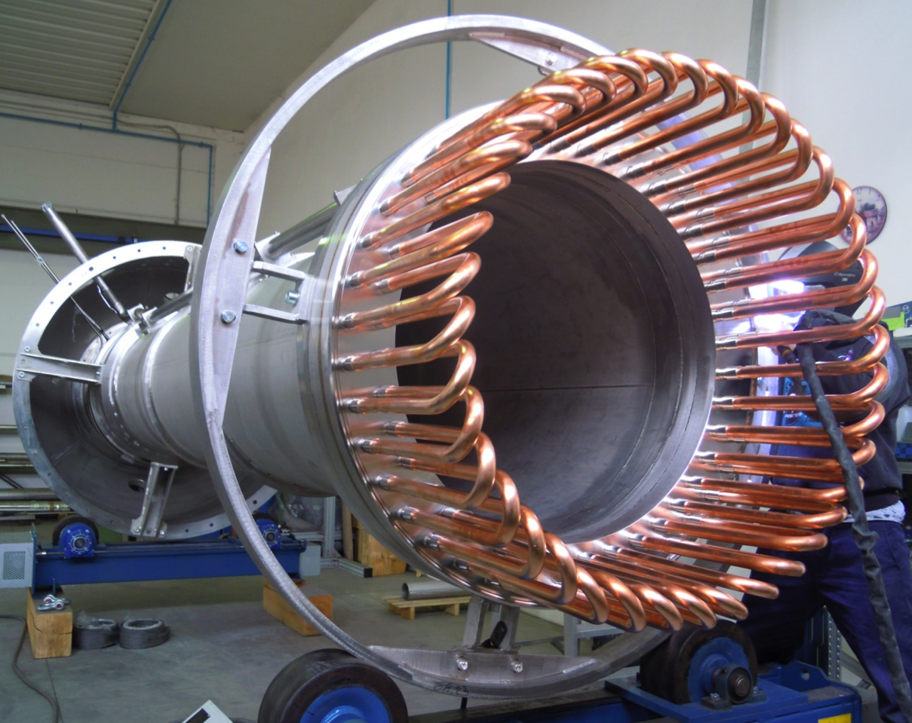
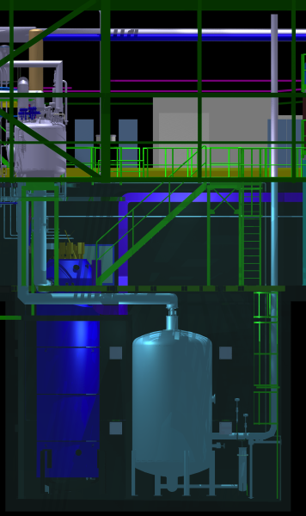
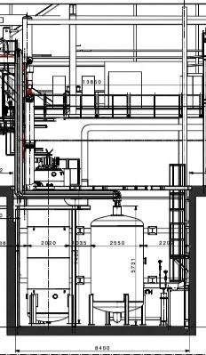
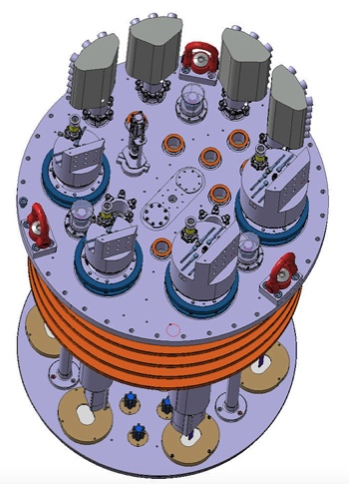
Cluster G and D: cryostat and insert
USE OF CRYOGENIC BUFFER FOR COLD He
DESIGN DRIVEN by optimization in operation
Minimizing time and risk at hydraulic connection
Minimizing the loss of He after quench
INSERT DOES NOT HAVE ANY CRYO LINE CONNECTION
CRYOSTAT PARAMETERS
(Cluster G/D)
Max internal pressure : 5 bara
Magnet temperature : 1.9 K
Useful diameter : 1500 / 800 mm
Useful length in 1.9 K bath : 2.5 / 5.2 m
Max. thermal gradient : 50 K
Magnetic measurements: yes
Estimated lifetime : 20 years
Number of thermal cycles : < 1000
Number of Quenches : < 10000
Ref. Cryostat: A. Van De Craen, M. Struik
Cryogenics: V. Beda, A. J. Lee
Insert: M. Strychalski, P. Viret

Slide 12
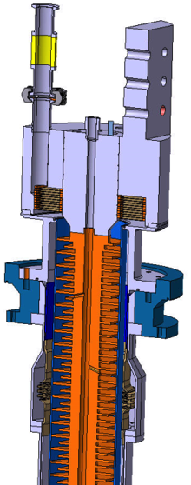
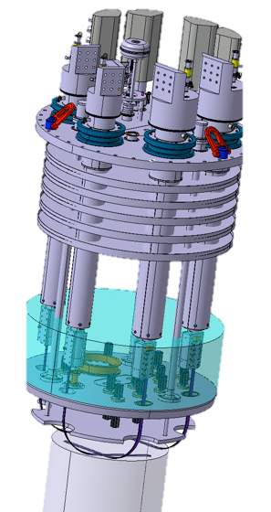
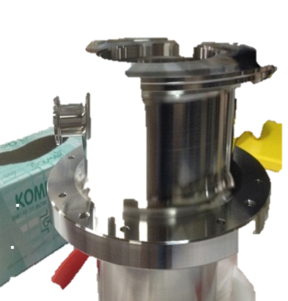
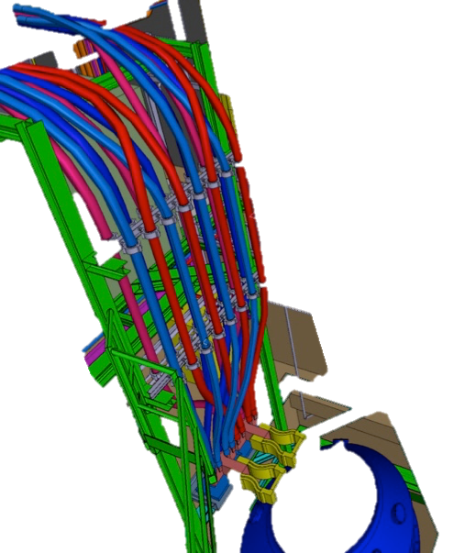
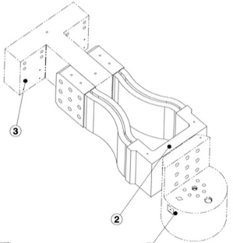
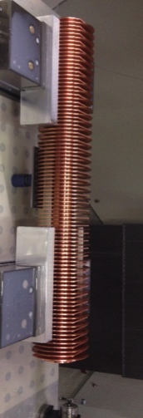
Cluster G and D : WCC and Current Leads
DESIGN DRIVEN BY Optimization in operation :
Flexible cables
Current lead operation homogenized with the rest of the test stand and minimizing the flow
CONVENTIONAL GAS COOLED Cu LEADS:
length: 1.7 - 2.1 m
top flange Φ 260 - 280 mm
connection : SC cable
Water Cooled Cables
SPECIFIED PARAMETERS
Current: 5 kA DC
Max in. temperature: 28 °C.
Pressure in operation: 16 bar.
Maximum delta T: 10 °C.
Water speed : < 2.5 ms⁻¹
Max. temperature : 50 °C.
Operating Voltage: 1 kV
(if fault to ground)
500 mm²
CABLES SECTION
He vapor flow @ 4.2 K:
20 kA lead: 0.87 g/s
30 kA lead: 1.82 g/s
15 kA lead: 0.88 g/s
Current Leads
SPECIFIED PARAMETERS
Main circuit: 20 kA / 30 kA
Secondary circuit: 15 kA
Design pressure : 5 bara
Max. Voltage to GRD: 3.5 kV
Ref. WCC: C. Gonzalves Perez
Current Leads: S. Gianelli, P. Moyret

Slide 13
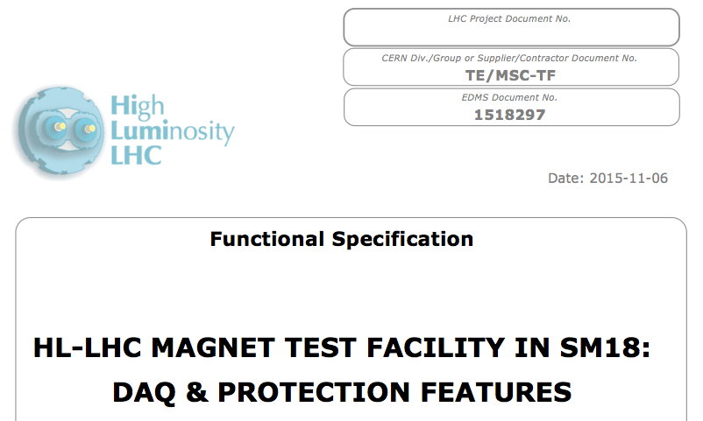
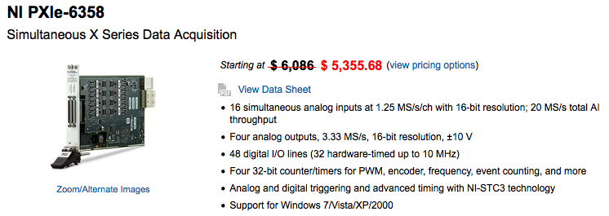
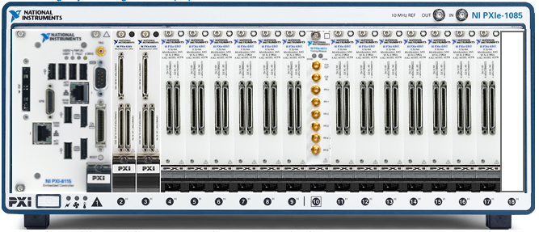
Cluster DAQ system
Example of HF system
DAQ
SPECIFIED PARAMETERS
Input channels: +/- 10 V analog
Nr of HF channels: 200 differential
HF frequency: 200 kHz
HF,MF,LF resolution: 16 bit resolution
HF,MF,LF accuracy: 1 mV
MF frequency: 50 kHz
Nr of LF channels: 144
LF frequency: 1 kHz
Timing: GMT synchronization
Data Analysis with DIADEM
Ref. DAQ: H. Reymond, M. Charrondiere, M. I. Tapani
Analysis: H. Bajas, F. Gomez de la Cruz

Slide 14
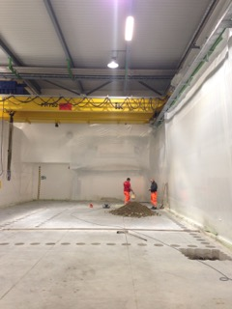
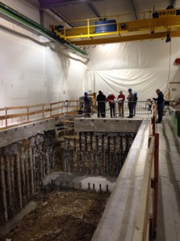
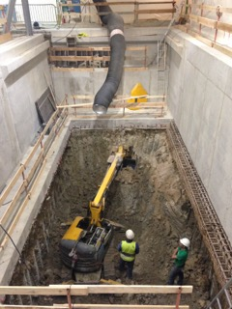
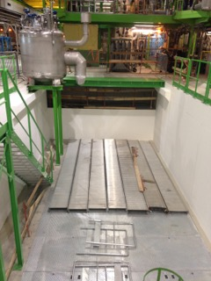
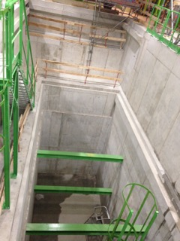
Cluster D in pictures
Ref.
Construction:
H. Botella, R. Morton, E. Perez Duenas,
Safety: E. Paulat

Slide 15
Horizontal test bench upgrade
Cluster A
Cluster E
The horizontal test zone Cluster A to F excluding D is composed by 10 benches. They are equipped with 5 independent electrical circuits allowing to test magnets up to 15 kA @ 1.9 K. Two clusters are planned to be upgraded to 20 kA capacity.

Slide 16
Horizontal test bench upgrade
Cluster A
The UPGRADE is DRIVEN by HL-LHC needs:
Cluster E
Magnet weight: 25 tonnes
Operating temperature: 4.2 K and 1. 9 K
Max. Operating current: 15 kA, 2 x 0.6 kA
Max. Pressure in the magnet in case of quench: 20 bars
Max. Test voltage: 3 kV
Magnet weight: 25 tonnes
Operating temperature: 4.2 K and 1. 9 K
Max. Operating current: 20 kA, 2 x 2 kA
Max. Pressure in the magnet in case of quench: 20 bars
Max. Test voltage: 3 kV
Target for prototype test: 90% I_{SS} ≤ 20 kA
Target for series test : 108% I_{nom} = 17.8 kA
Cluster E will have the same characteristics. Foreseen later.

Slide 17
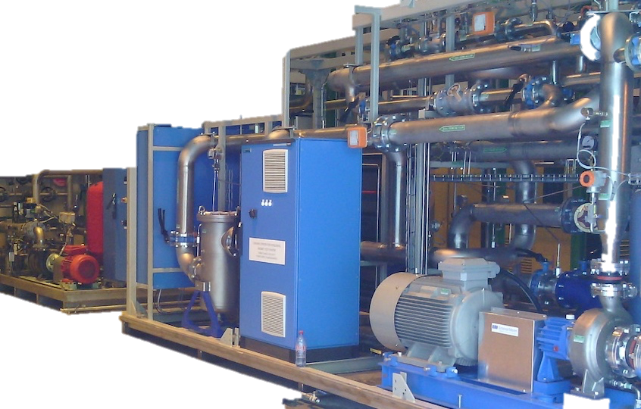
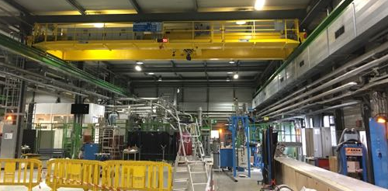
Facilities Upgrade
Remarks
UPGRADE DRIVEN BY The recommendation enabling to carry out the full test programme with no contraints
For 2019
  CRYOGENIC COOLING PRODUCTION: + 35 g/s LHe
  Needs essentially for HL-LHC IT STRING run in parallel with magnet testing
  DEMINERALISED WATER PRODUCTION: + 150 m³/h
  Needs for demineralised water entirely coming from magnet operation
  HANDLING: 25 t and longer rope
  Needs for overhead crane entirely coming from magnet operation
  nCONTROL ROOM
  Needs to extend the small control room of the vertical . Test facility to be used
  also for horizontal benches and Sc link
Operational
Operational
For mid 2016

Slide 18
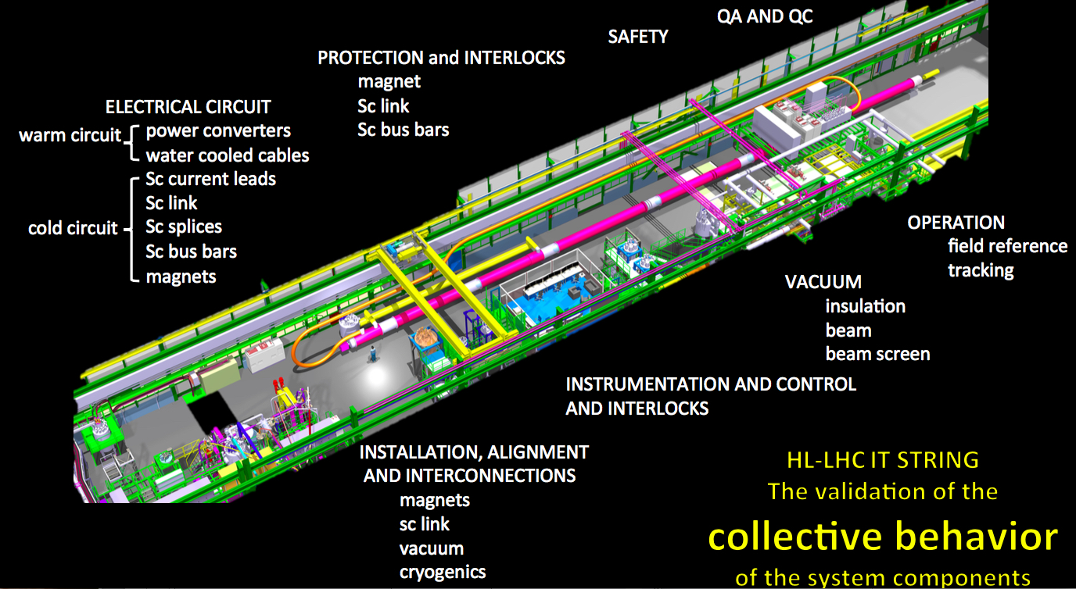
SM18 2020-2022

Slide 19
Thank you for your attention

Slide 20
Spare slides on Facilities upgarde

Slide 21
Test stands : cryogenics upgrade
An additional 35 g/s liquefier (thus bringing the total production capacity for LHe at 4.2 K to 60 g/s)
The existing total pumping capacity in SM18 at 1.8 K is 12 g/s, combining the capacity of WPU1 and 2.
If need for IR STRING a dedicated 3rd WPU shall be installed.
Ref. L. Serio
Foreseen for 2019

Slide 22
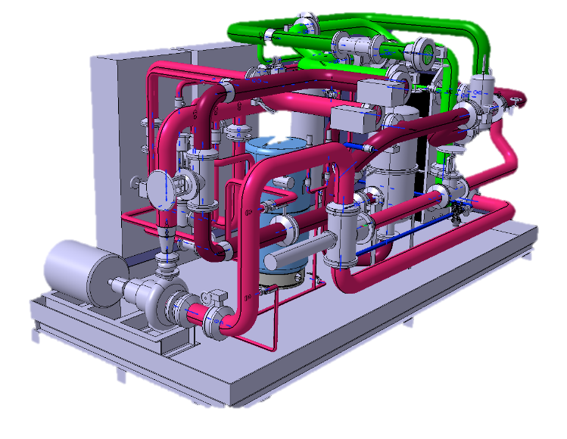
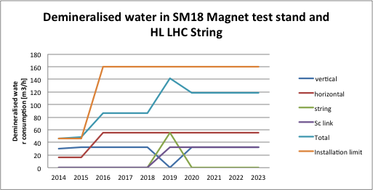
Test stands : demineralized water production
The demands for the magnet test stations, including the IT String, will rise to a peak of 1.7 MW (142 m³/h).
At present SW18 houses a demineralised water station with a thermal capacity of 800 kW limiting the operation to two test stands
Operational from April 2016
Ref. A. J. Broche

Slide 23
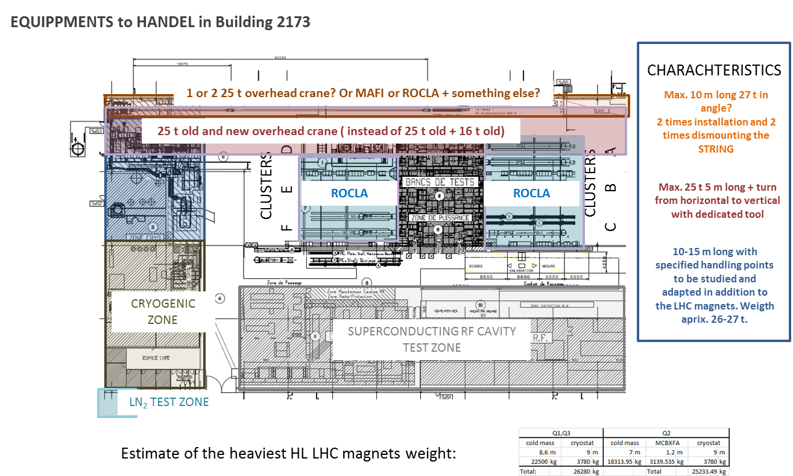
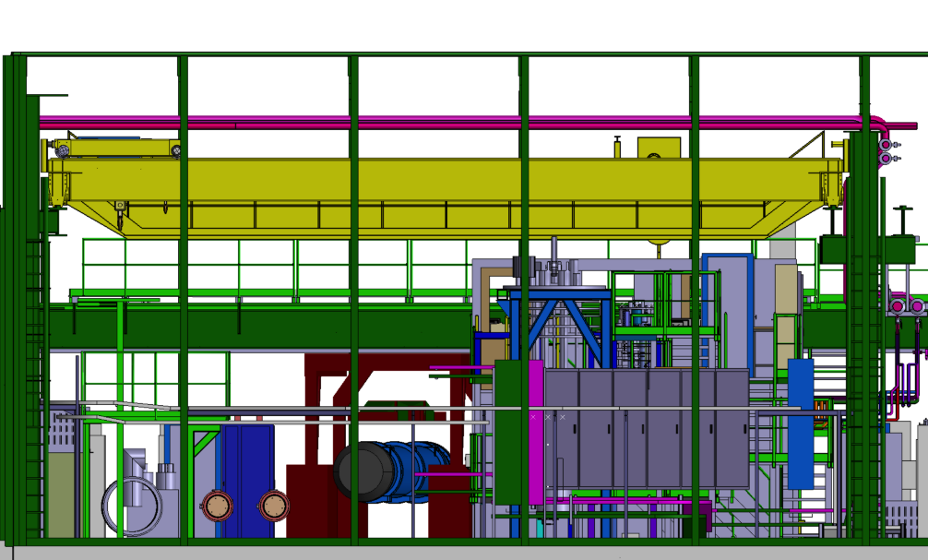
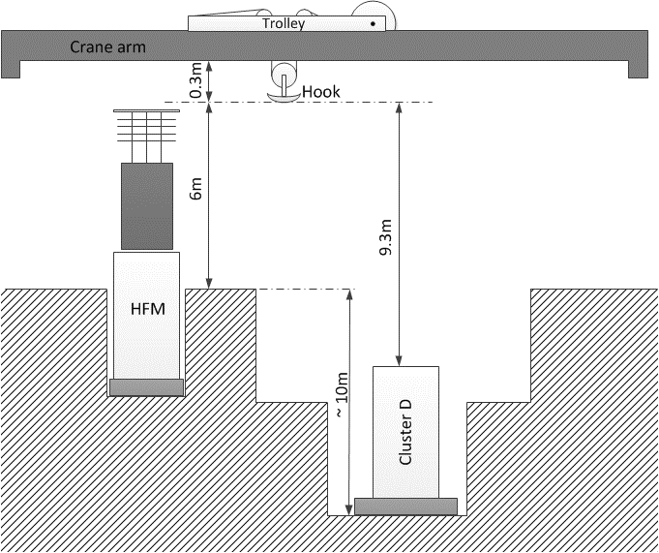
Test stand : HADLING upgarde
To enable insertion of test objects into the HFM cryostat the operating height, must be increased to 6 m (presently 5.3 m).
Cluster D, on the other hand, will be deeper than the existing vertical facilities. To handle the inserts the operation depth between the hook and the top of the cryostat must be increased to 9.3 m.
Ref. R. Rinaldesi
25 T HANDELING CAPACITY WAS KEPT
Operational from February 2016

Slide 24
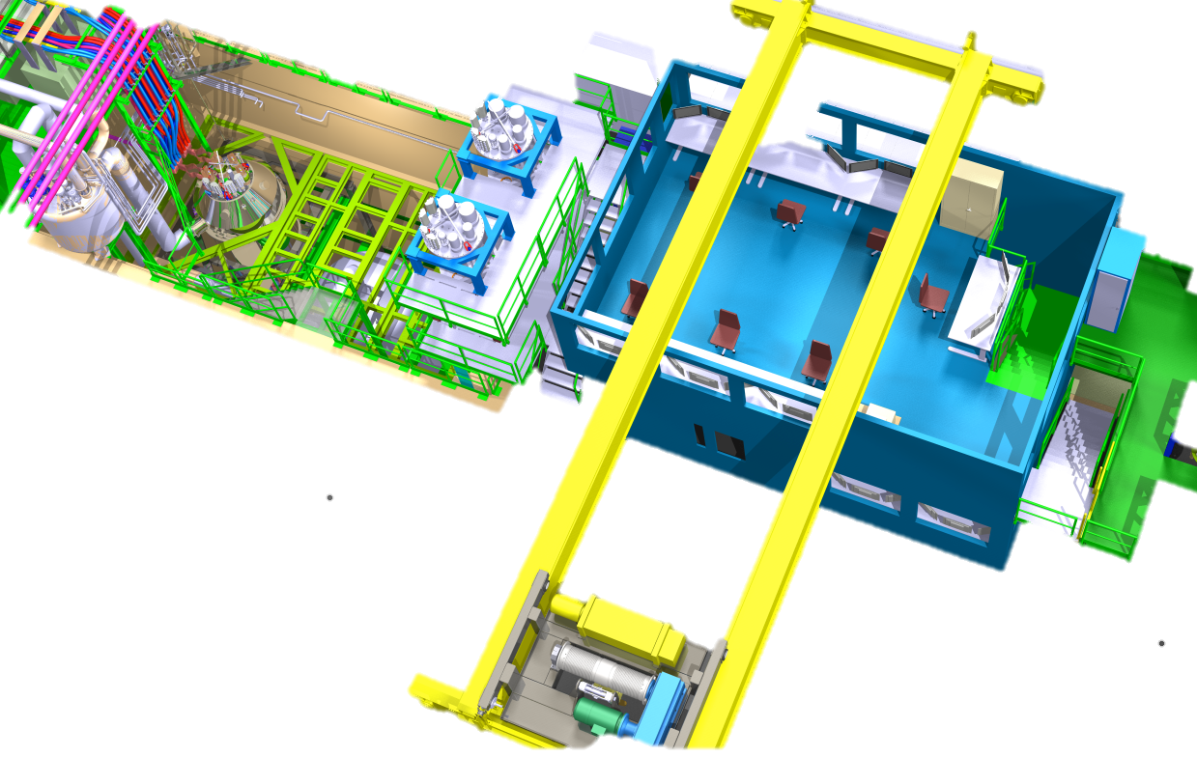




New Control room
The motivation to build a new control room is driven by:
Safety and
Working conditions
CONTROL ROOM AT THE PROXIMITY OF THE CRYOSTATS
CONTROL ROOM WITH LARGER SPACE
Foreesen for Jul 2016
Ref. M. Charrondier

