Slide 1
SC Magnet Test Stand at KEK
Tatsushi NAKAMOTO
On behalf of Cryogenics Science Center, KEK
HL LHC SC Magnets Test Stand (SMT) Workshop, 13-14 June 2016, CERN

Slide 2
Location
J-PARC (p)
KEK Tokai
KEK, High Energy Accelerator Research Organization
  Accelerator science research laboratories using high-energy particle beams and synchrotron light sources to probe the fundamental properties of matter.
Main office: Tsukuba, Ibaraki, Japan.
>>SuperKEKB
Cryogenics Science Center and Test Stand
KEK Tsukuba

Slide 3

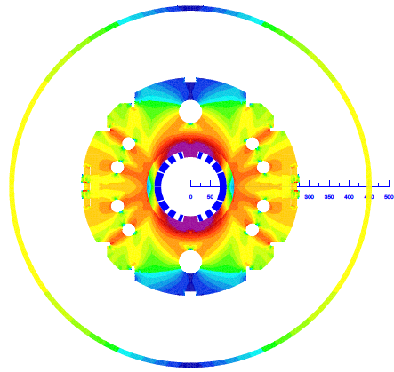
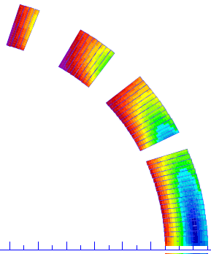

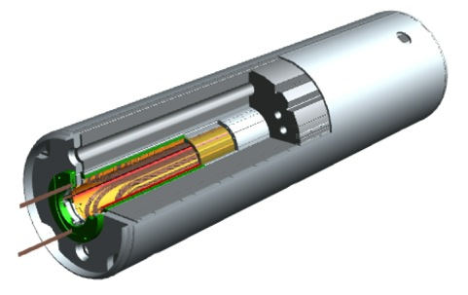
Design Parameters of D1, MBXF, for HL-LHC
Coil ID: 150 mm
Integrated field: 35 Tm (26 Tm at present LHC)
  5.59 T at 12 kA. L_{coil}=6.6 m
T_{op}: 1.9 K by HeII cooling
Op. point (2D coil): 75 %
Coil layout: 1 layer of 15.1 mm cable
  Better cooling. Saving space for iron yoke.
Conductor: Nb-Ti LHC MB outer cable
Structure: Collared yoke structure by keying
Field quality: < 10⁻⁴ at R_{ref} = 50 mm
Cold mass OD: 550 +10 x 2 = 570 mm
Cryostat OD: 914 mm, same as MB cryostat (*TBD)
Radiation, energy deposition:
135 W in total, 2 mW/cm³ at local peak, Radiation dose >25 MGy
4
8
13
44 turns
19
3

Slide 4
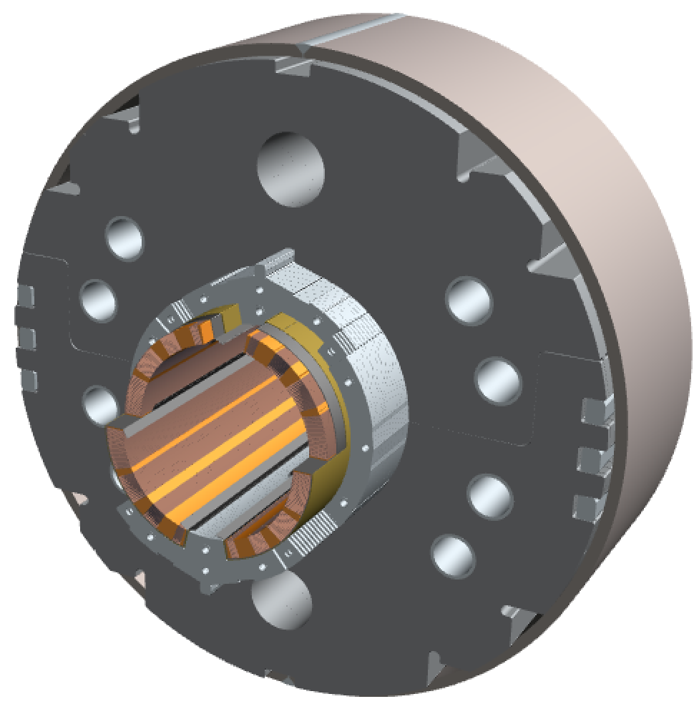
2m-long Model Magnet - Overview
Single-layer coil, 4-split spacer collars, collared yoke by keying
Notches and φ 34 mm holes for iron saturation effects
φ60 mm HX hole
HeII cooling channel
Shell: SUS304L
4 split stainless steel spacer collars: NSSC130S
Brass shoes
QPH+Insulations
Collaring keys
NbTi SC cable (LHC MB outer) + Apical insulation
Horizontal split iron yoke:
low-carbon steel (EFE by JFE steel)
Radiation resistant GFRP (S2 glass + BT resin) wedges

Slide 5
Parameters
Production Magnet
2m Model
General
Field integral | 9.8 T·m | 35 T·m
Coil aperture | 150 mm
Nominal dipole field | 5.57 T
Coil peak field | 6.44 T at center, 6.59 T at coil end
Load-line ratio | 75.4 % at center, 76.6 % at coil end
Nominal & ultimate current | 12.0 kA & 13.0 kA (~108% nominal)
Operation temperature | 1.9 K
Magnetic length | 1.73 m | 6.27 m
Stored energy | 340 kJ/m
Differential Inductance | 4.0 mH/m
Number of turns in quadrant | 44 (4+8+13+19) turns in a single layer coil
Superconducting Cable
Superconductor | Nb-Ti
Cable type | LHC MB outer cable
Strand diameter | 0.825 mm
Coating | Sn5wt%Ag
Copper to SC ratio | 1.95
Filament diameter | 6 μm
Number of filament | 6500
RRR | > 150
Critical current (9 T, 1.9 K) | > 380 A
Number of strand | 36
Cable bare width & mid-thickness | 15.1 mm & 1.480 mm
Insulation 1st & 2nd layer 3rd layer | APICAL (0.05 mm thick, 11 mm wide), 1/2 overwrap PIXEO (0.069 mm thick, 9 mm wide), adhesive, 2 mm gap wrap
2 x 2m models & 7 x 7m magnets to be tested in KEK for HL-LHC.

Slide 6
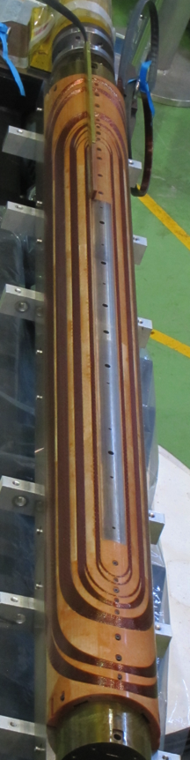
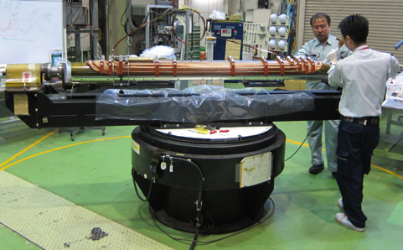
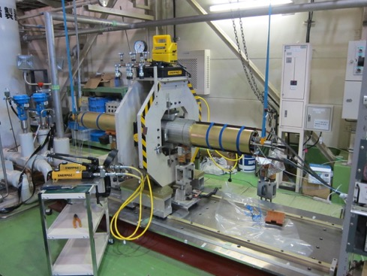
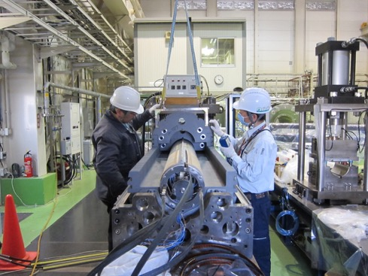
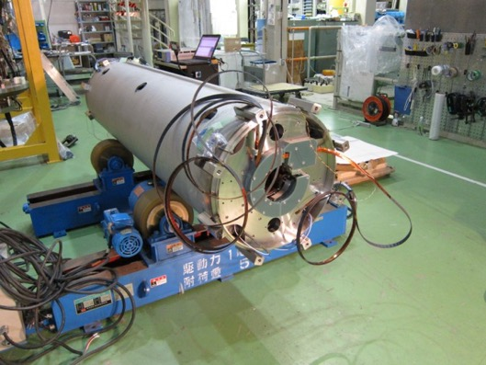
2m Model Development

Slide 7
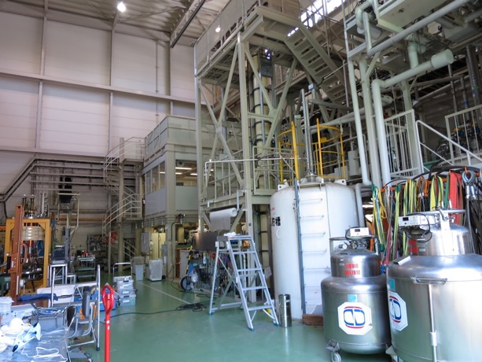
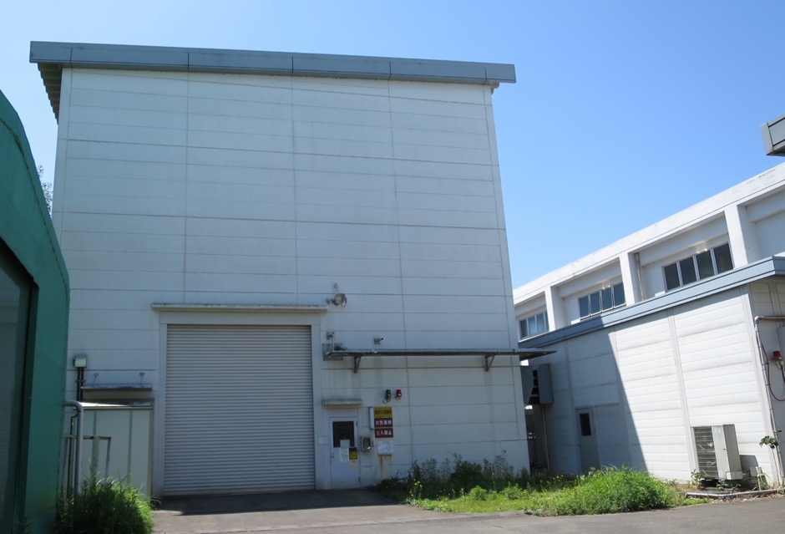
Test Stand - Buildings -
Built in 2000 for vertical cold tests of LHC-MQXA magnets.
Surface
  Test Stand: 335 m² (20 m x 15 m + 7.9 m x 4.4 m)
    Crane: 20 ton / 4.5 ton, 10.5 m in height
  Power Converter: 50 m² (10 m x 5 m)
  Pump for HeII: 40 m² (7.4 m x 5.4 m)
Test Stand Building
(Behind)
He II Pump Annex
P/C Annex
Tent for
He Gas Bag

Slide 8
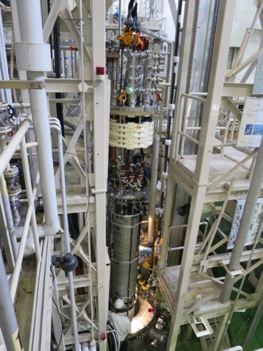
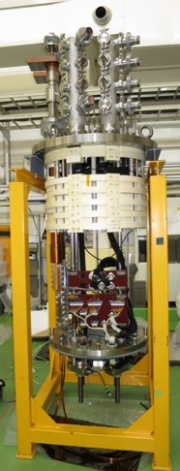
Cryostat
Manufactured by Toshiba in 2000 for vertical cold tests of LHC-MQXA magnets.
  19 LHC-MQXA (7m), 32 J-PARC SCFM (4m)
Applicable Law: Japanese High Pressure Gas Safety Act
  Operation at 1.9 K is exceptional. Category of “Designated Equipment”
Operating Temp.: 4.4K to 1.9K
Cooling
  300K to 40K by GHe, 40K to 4.4 K by LHe
  4.4 K to 1.9K by HeII Sub-cooler (55W for MQXA)
Capacity
  whole bath: 9020 mm deep, 700 mm in a diameter.
  1.9 K bath: 7524 mm deep, 700 mm in a diameter.
  Weight: 8.6 ton (MQXA). Need to check for D1.
He Cryogenic Plants (see next slide in detail)
New header for the D1 (MBXF)
  Manufactured in 2014, approval of the JHPG Safety Act in 2015.
  Anti-cryostat for field measurement: O.D. 141.3 mm
  Quench antennas: 11 arrays for 7 m long magnet
  Feedthrough: 48 poles x 10
  HVWL: 1.5 kV (present limit 0.5 kV.)
  15 kA Current Leads
    Manufactured by Fuji Electric in 2015. All copper base. (50L/h for a pair)

Slide 9
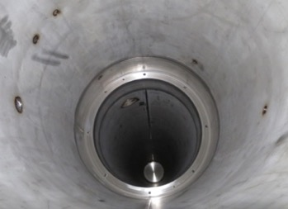
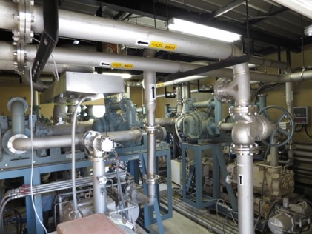
HeII Sub-Cooler
Pre-heat exchanger
  Copper spiral tube (I.D. 12mm, Spiral Dia. 42 mm)
  Fine silver-plated copper balls
  Efficiency 88%
J-T expansion valve
Main heat exchanger
  Design: ΔT=30 mK at 80 W, 1.9 K.
  Required surface area: > 3.0 m²
  4.4 m long copper tubes: 3 x φ 76.2 mm, 10 x φ 12 mm.
Pumping system
  4 parallel lines
    2 x Roots pumps: 2 x 900 m³/h
      SHIMADZU MB-1400
    1 x Oil free pump: 630 m³/h
      TAIKO MDP-1015
  Note: Current performance is limited by cooling capacity of a water chiller (old!!).
    Only 2 pumiping lines are operational.

Slide 10
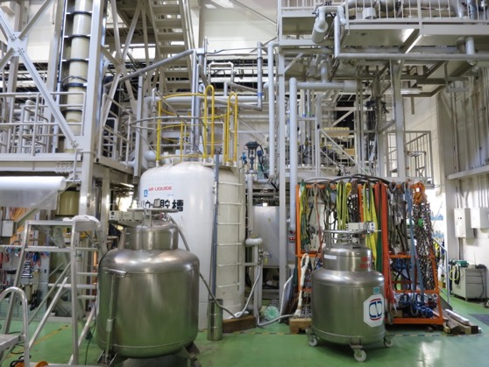
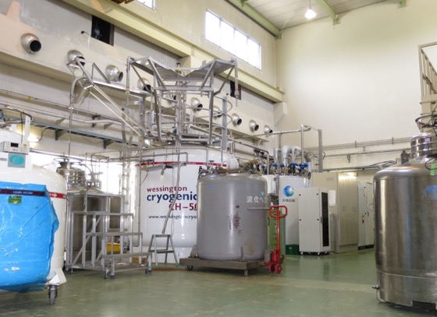
Cryogenic Plants
Refrigerator/Liquefier for Test Stand
160 L/h, 2400 L dewar
Teisan / L’Air Liquide in 1987 for the TRISTAN-AMY detector
New cold box in 2007
Backup of the primary refrigerator for LHe supply.
Neighbor refrigerator (Primary)
350 L/h, 5000 L dewar
LINDE LR280 in 2014
Mandatory to supply LHe to KEK users.
20 m long LHe transfer line to the test stand.
  In linkage operation: 510 L/h max.
Helium liquefying rate is sufficient to cover both supply for users and magnet testing.
Attention to GHe handling
  limitation in purification system
  difficulty to predict GHe recovery from KEK sites

Slide 11
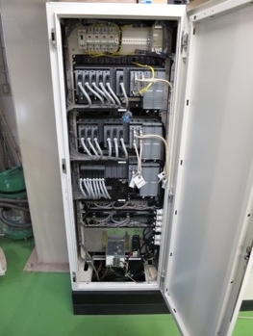
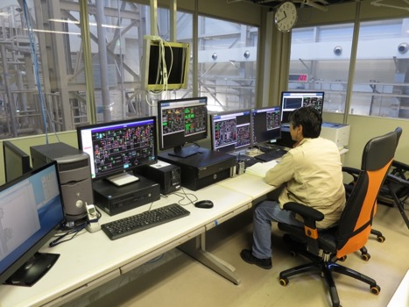
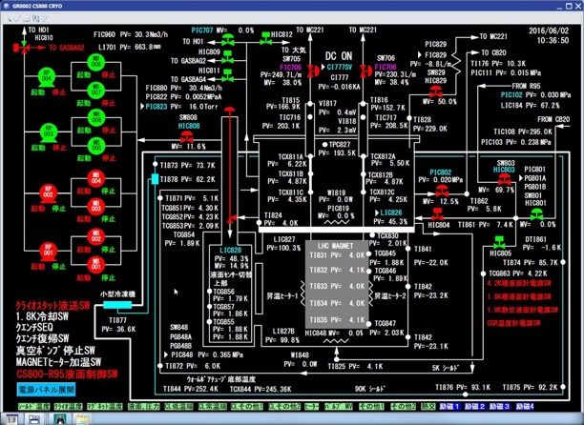
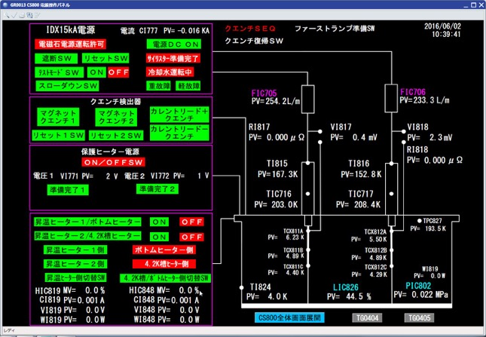
Control System
CENTUM VP, Yokogawa Electric
  A distributed control system (DCS) as a platform for automated control and operation of the cryogenic plant.
  Programmed by KEK engineers.
  Interlock for 15 kA P/C (slow down or shutoff)
    Monitor: LHe level, CL status and refrigerator
  Historical trend data
Ex) display for main cryostat control
Ex) display of interlock for 15 kA P/C

Slide 12
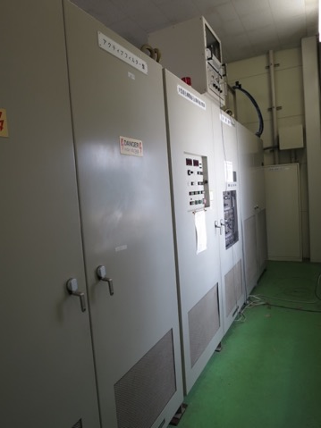
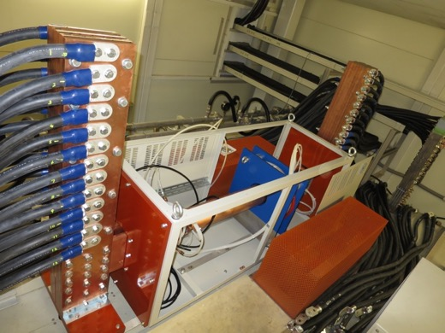
Power Converter
Manufactured by IDX in 1993 for SSC-SDC magnet development.
Nominal: 15 kA, 15V
Thyristor switch for prompt shutoff.
Dump resistor of 73 mΩ (grounding at middle point ) for the D1
  Available: 0, 12.5, 25, 50, 75 and 100 mΩ.
Water cooling: 150 L/min, 10 kg/cm2
Quench detectors
  2 x Balanced Voltage (Main)
  2 x Total Voltage
External 15 kA DCCT (Zero-Flux Current Transformer)
  Fully calibrated at CERN as a standardization of current.
  But unwanted shutoff caused by vibration during the excitation in May 2016.
  Performance degradation is concerned.
Note: some contact failures found in relays through the D1 model magnet testing.
  aged deterioration…
  Overhaul must be done be as soon as we can.

Slide 13
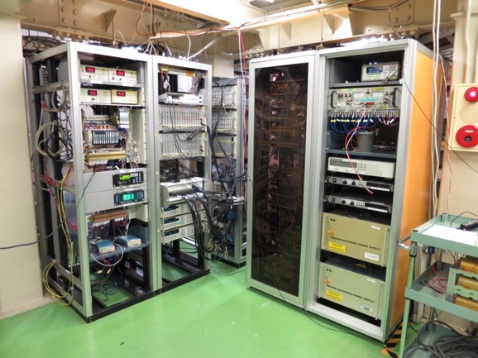
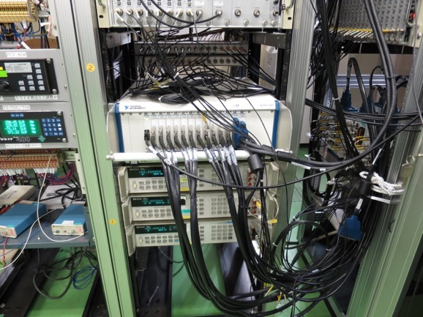
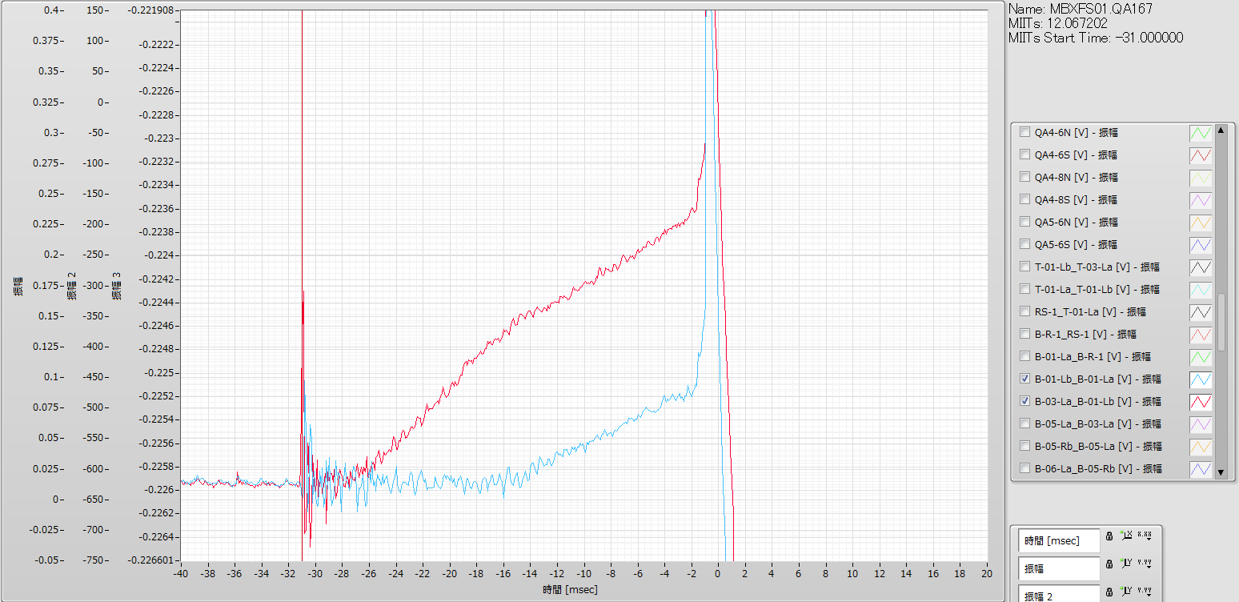
Measurement System - Present -
Isolation Amp: NF P-62A, 76 ch
Fast DAQ:
  NI PXI 1643 (16bit, 250 kS/s/ch), 88 ch
    Voltage taps, quench antennas, P/C, etc.
Slow DAQ: GP-IB
  KEYSIGHT 3458A multimeter (8.5 digit) x 3
  Kyowa UCAM-60B for strain gauge measurement, currently 30 ch (80 ch max.)
Software: Labview (& KEYSIGHT VEE only for field measurement)
3 PCs: Fast DAQ, Slow DAQ, MFM.

Slide 14
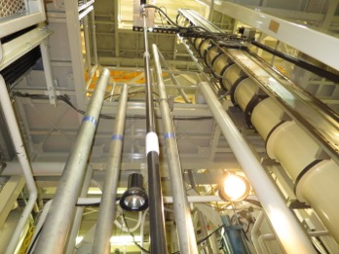
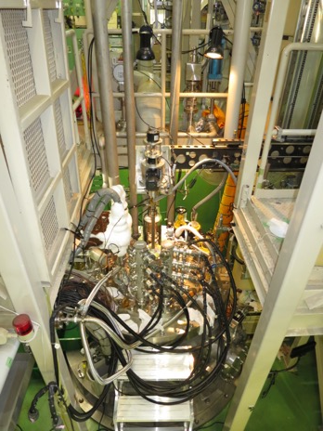

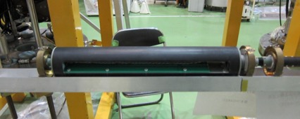
Field Measurement System
Vertical Measurement
Rotating coil in anti-cryostat (I.D. 108.3mm) at “warm” temperature.
  Printed-circuit board
  3 radial coils: B1 and analogue bucking
  Long (350mm) and short (80mm) arrays
  GN₂ flow from the end to suppress thermal shrinkage of the pipe
7 m long GFRP shaft
  not long enough for the 7 m magnet, but it can be extended.
Encoder: HEIDENHAIN RON 255
Integrator: MetroLAB PDI-5025 x 3
Magnet scale: SONY LY51
Horizontal Measurement
For warm measurements of LHC-MQXA and J-PARC-SCFM cold mass.
But the system is dismantled for the time being…
  The system will come back for the D1 magnets.

Slide 15
Operating Personnel
Operators for the cryogenic plant
  3 to 4 weeks for a test cycle.
  24 hours operation >> 3 shifts/day, 5 days/week.
  15 shifts/week: 1 shift for 8.75 hours
  10 shifts/week by outsourcing from 16:30 to 9:00 for safety reason.
  5 KEK staffs and 2 outsourcing workers
    They must be holders of “a high pressure gas production safety management”.
Operators for the magnet test
  Quench Tests: from 9h to 19h (sometimes 20h)
  Field measurement: mainly daytime, through nighttime if necessary.
  3 to 4 KEK staffs (not only dedicated to the test…)
* Staff of Cryogenics Science Center: 17 in total.
  Tsukuba: Researchers 6, Post-doc 2, Engineers 4
  Tokai: Researchers 2, Post-doc 1, Engineers 2
  Mandatory: LHe supply for users
  Projects: J-PARC (T2K neutrino, COMET, g-2, muon beam lines, etc.), HL-LHC upgrade, KAGURA (gravitational telescope)

Slide 16
Summary
KEK has been engaged in the D1 magnet (MBXF) development for the HL-LHC design study. KEK is supposed to deliver 6 magnets with cryostats for the HL-LHC.
The 9 m deep vertical test stand at KEK was originally built for the MQXA construction. The facility will be utilized for the cold tests of the D1 model and production magnets for HL-LHC.
  2 x 2 m model magnets
  7 x 7 m production magnets (incl. 2 spares and 1 prototype)
  *Horizontal cold test bench with SHe cooling (4.4K) was established for the J-PARC SCFM. But it is dismantled now.
The first D1 model magnet was tested at 4.4 K and 1.9 K in the vertical cryostat in this April to May. The new header with 15 kA CLs and a large bore anti-cryostat successfully functioned for the cold test.
  The original facility (cryogenic plant, HeII sub-cooler, power converter) has almost worked. But some malfunctions and performance limitation due to aged deterioration were found through the test …
  Adequate refurbishment/replacement must be done well in advance of starting the D1 construction.

