Slide 1
INFN magnet test stand @ University of Salerno
(NApoli FAcility for Superconducting Systems)
Umberto Gambardella, Gerardo Iannone (INFN-Napoli)
Aniello Saggese, Amedeo Ferrentino (technical associate)
Superconducting magnet test stand, CERN, June 13, 2016

Slide 2
Outline
Why we are in this business
Aims of the infrastructure
ID card and features of the test stand
First commissioning of the components
Conclusion

Slide 3

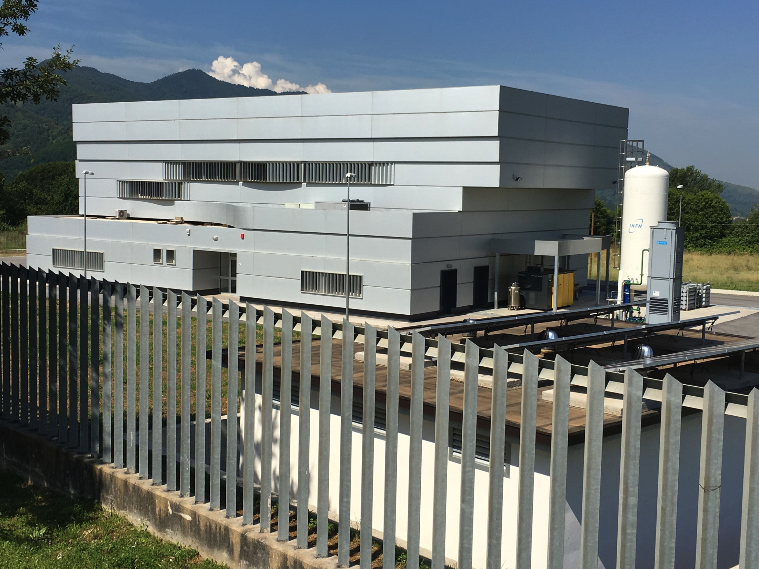
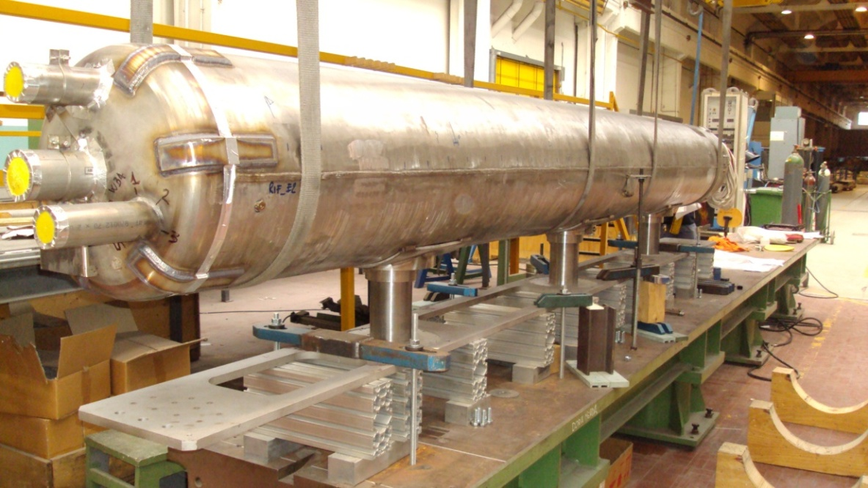
Past and future
DISCORAP project
Magnet test stand
Manufacture and test of the first s/c dipole for SIS300 ring (wide aperture 100 mm, 4.5 T, ramp rate 1T/s, bended). The dipole is at GSI, Darmstadt
Special PON funding were delivered on 2012 for setting up a new test facility of s/c power devices at 4.5 K.

Slide 4
Twofold aim of the new laboratory
Our project aimed to set up a dedicated facility for applied superconductivity programs, one in the accelerators area and the other one in the fusion area. It will include:
a large bore superconducting solenoid, called ENFASI, 7 T at 20 kA bias (ENEA, UniSA);
the INFN cryogenic system, having a cooling power up to 200W at 4.6K up to 7 bar (+500W 60-80K, + 1.5g/s for feed through);
2x10 kA +25V/-20V Power Converter to feed magnets (INFN), and 50 kA 10V power supply for critical current tests on CIC cables (ENEA);
A feed box provided with 20 kA HTS cryogenic feed through (INFN).
The building and utilities (UniSA)

Slide 5
TEST STAND ID CARD
Location: INFN-Salerno, University of Salerno (Fisciano, I)
surface of the test laboratory: approx. 450 m²
operating temperature and cooling phases: 4.5K He at 3-7 bar, two phase LHe
Cooling capacity: 120 l/h LHe production (w/o LN2 precooling) , 16 g/s 7 bar 4.5 K, 1.5 g/s 4.5K for leads, 17 g/s 80 K
Operating and max. Current, max Voltage: 2 x 10 kA +25/-20 V power converter (series/parallel operation)
One feed box with HTS 20 kA current leads
Handling tools: 20 tons overhead crane
Interlock safety: yes with each subsystem giving its own interlock signal
DAQ cards and used soft: NI PXI, LabView
Quality control tools: to be implemented
Magnetic measurement capability: only basics

Slide 6
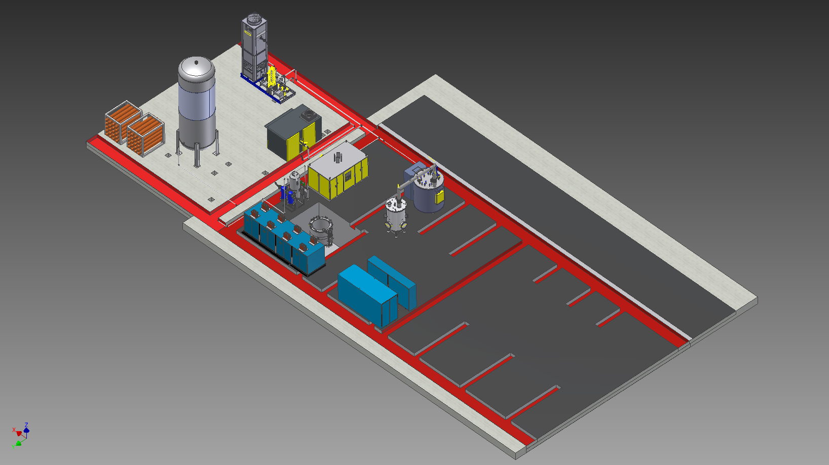
Test area layout
He gas storage: V=30m³, P=12bar
Cooling Tower: 20m³/h of water at 25ºC, 300kW
Power supply for magnet biasing:
20kA, +25V/-20V
10kA, +50V/-40V
Cold Box
200W @4.5K
500W @60K
Kaeser Compressor
feed box

Slide 7
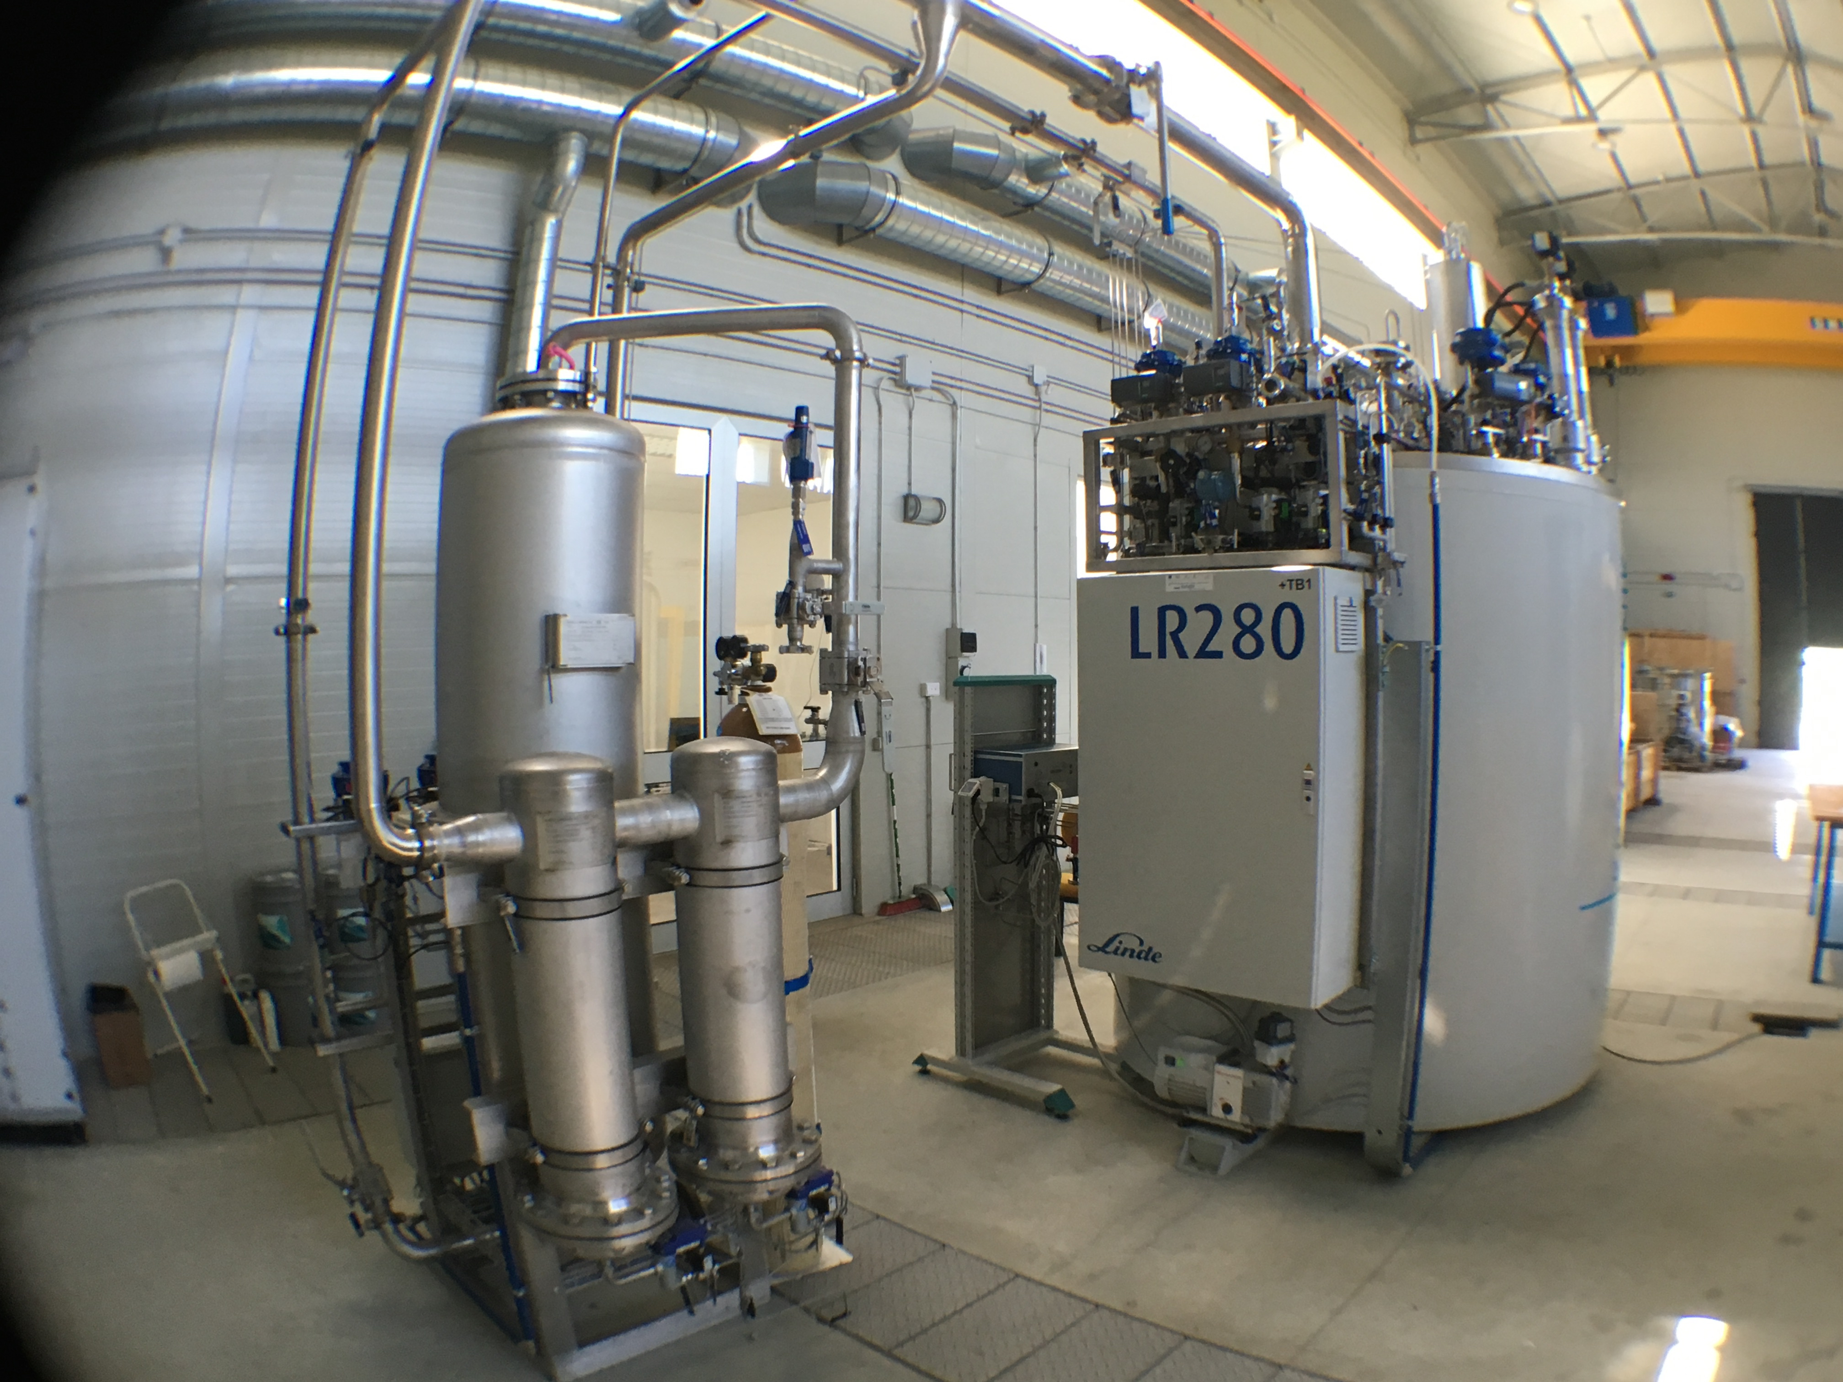
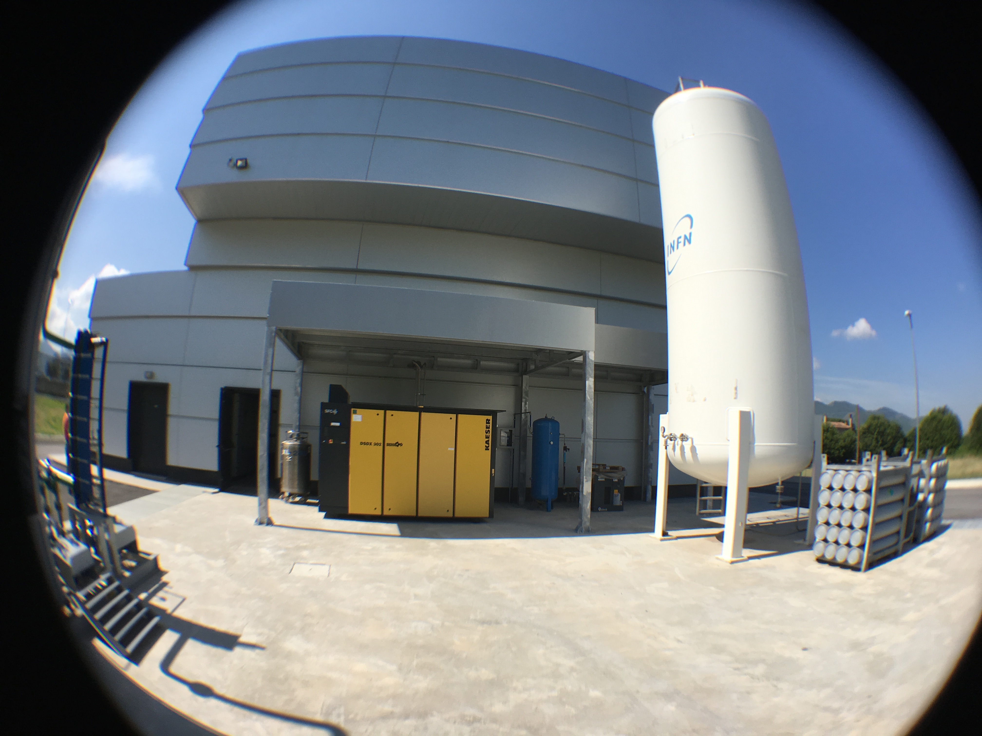
Our choice was a Linde LR280 with a 196 kW screw compressor. The procurement included the SFC for the compressor, a J-T liquid port, internal purifier, internal 80 K adsorber, He subcooler for single phase stream at 4.6 K up to 7 bar. Max 4.6 K flow is about 18 g/s.
We installed our self the components.

Slide 8
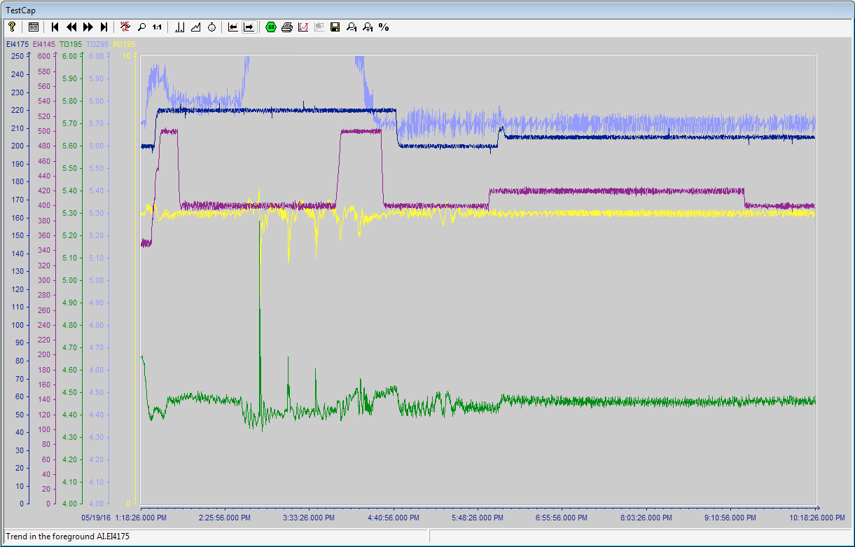
4.6 K heater
return temp.
60 K heater
pressure
supply temp.
1523 RPM compressor speed

Slide 9
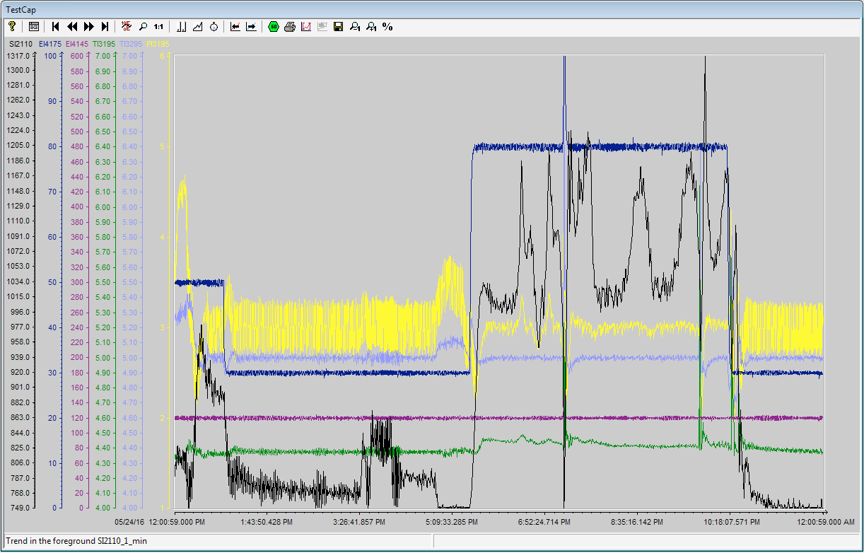
4.6 K heater
pressure
return temp.
60 K heater
supply temp.
compressor speed

Slide 10
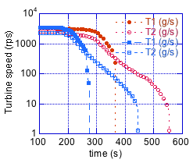
Anomalous turbine stop
Turbines were both removed for factory inspection and bench test.

Slide 11
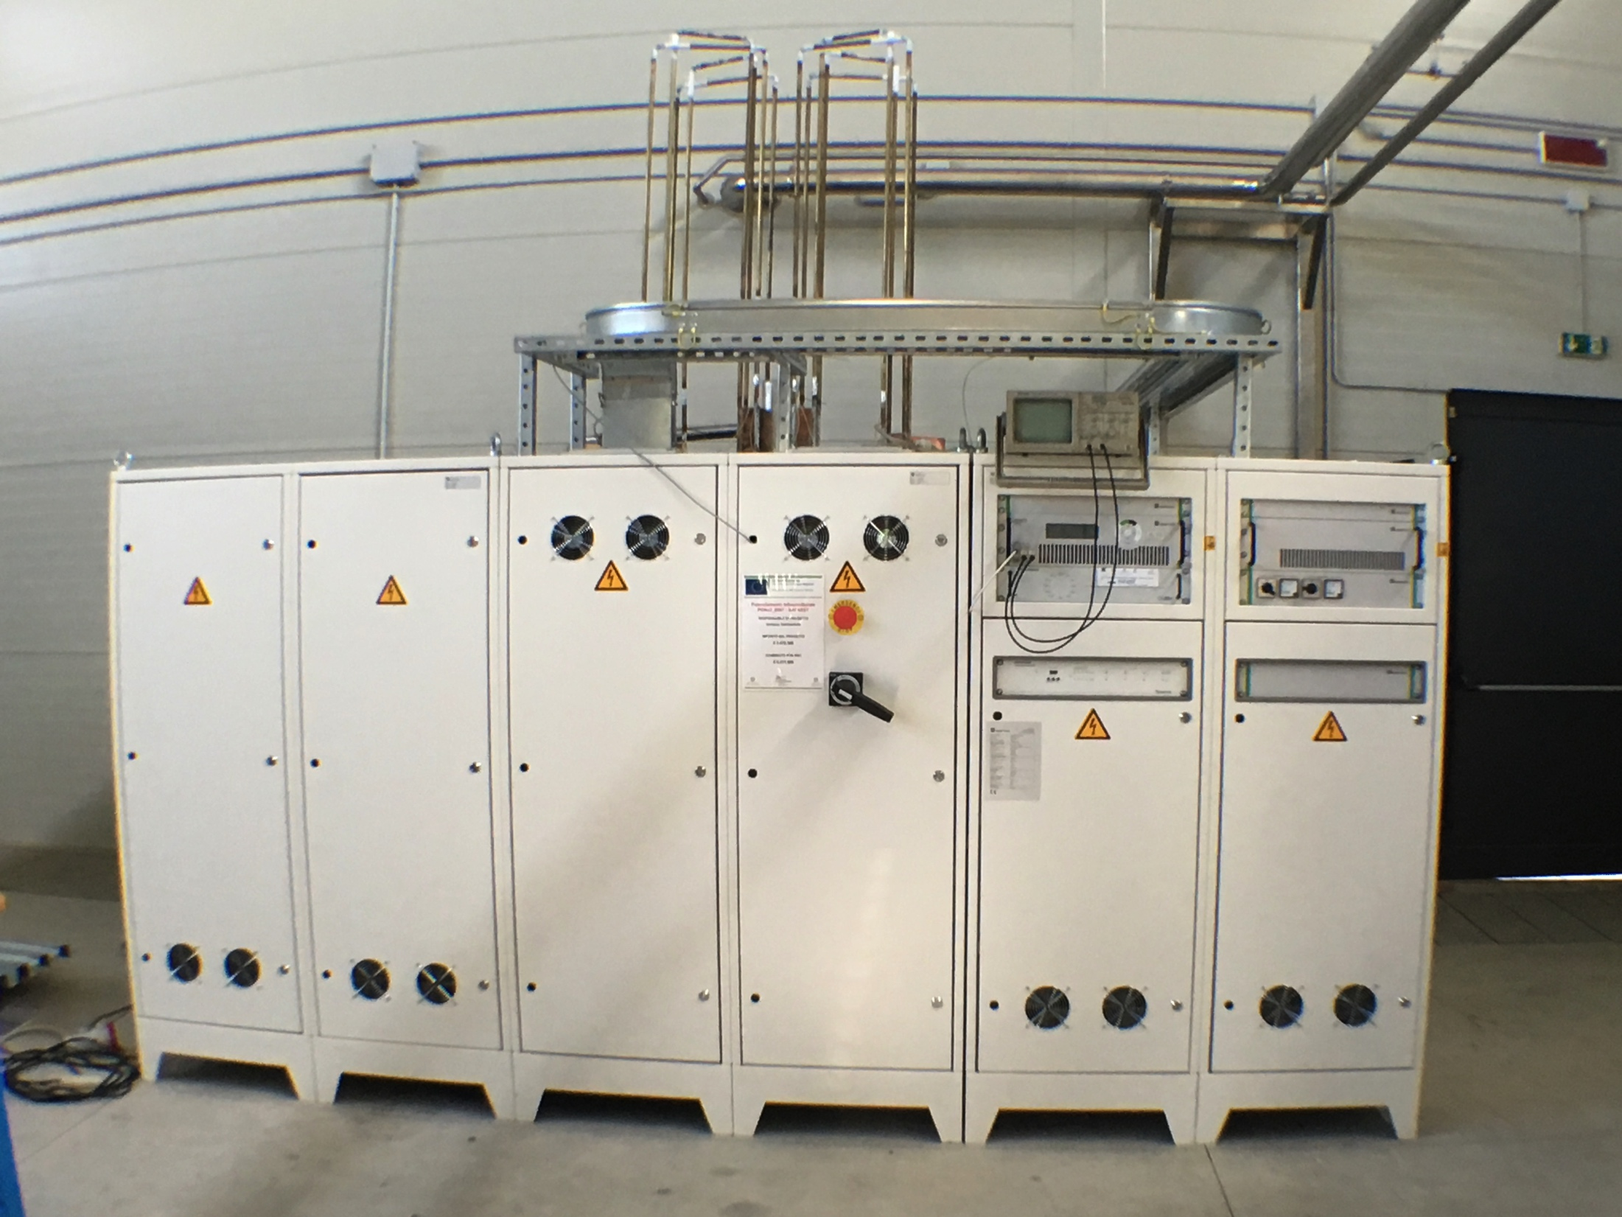
The power converter
Producer: DANFYSIK A/S DK-2630 Taastrup, DK
Outputs: 20 kA +25/-20 Volts
10 kA +50/-40 Volts
Main Input is 400 Volts ac 3 Phase
Water cooled
The power converter is made of two 10 kA converters that can be switched in series/parallel to achieve either high voltages (for SIS300 dipoles) or high currents (e.g. for the ENFASI solenoid). The controller is able to provide custom current profiles as well as subsequent cycles of a customized profile for specific applications.

Slide 12
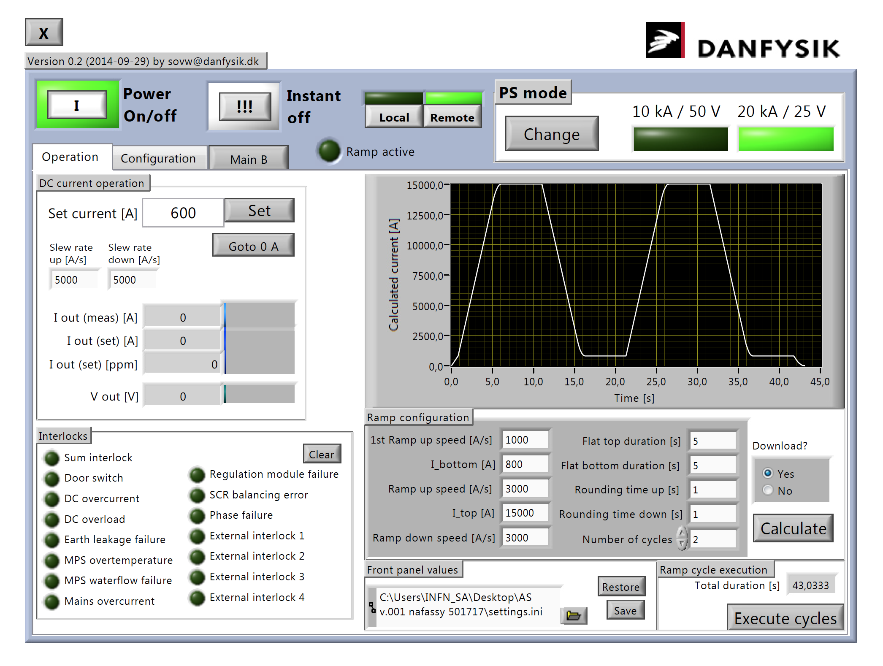
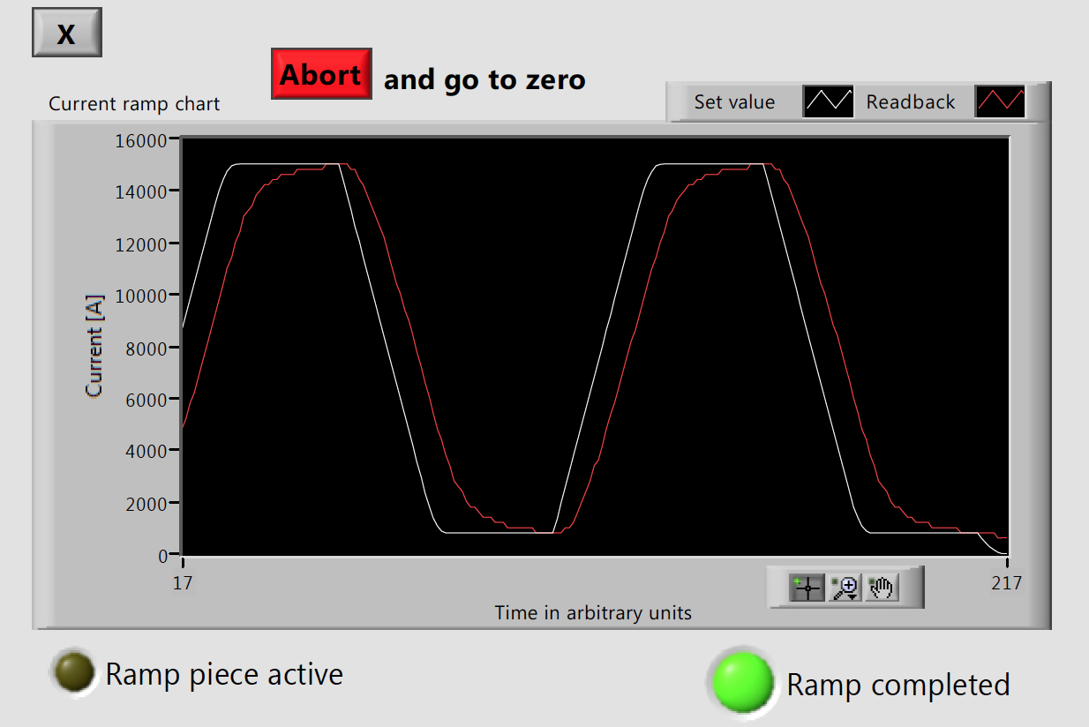
The control panel of the Power Converter, presently set for a water cooled brass resistive load (1.25 mΩ).
The output of a ramp control test, up to 15 kA, rate 3kA/s, flat top 5 s: white set profile, red measured profile.

Slide 13
The feed box
The feed box is provided with its own vacuum system (500 l/s turbomolecular pump with a 100 mc/h rough rotary pump). The sleeve connection delivers cold flow from the cold box to both current leads and magnets.
A s/c busbar (DISCORAP I rutherford cable) will short the current leads during preliminary tests.

Slide 14
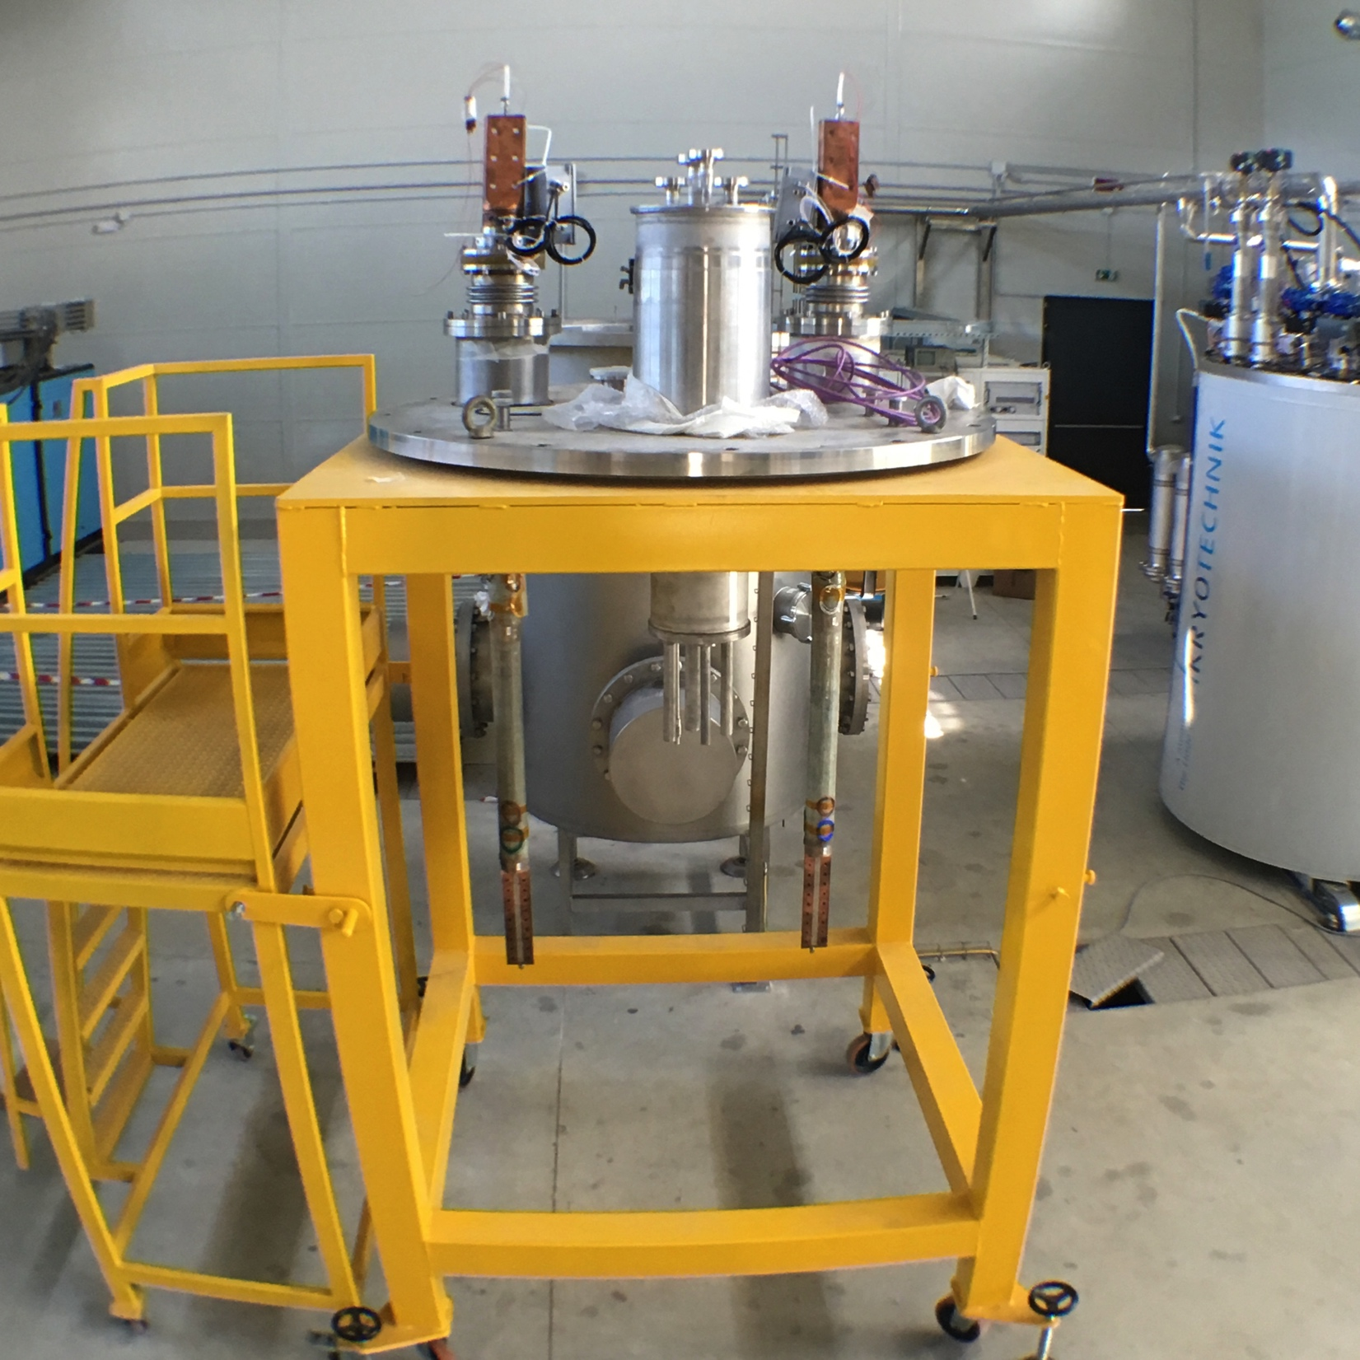
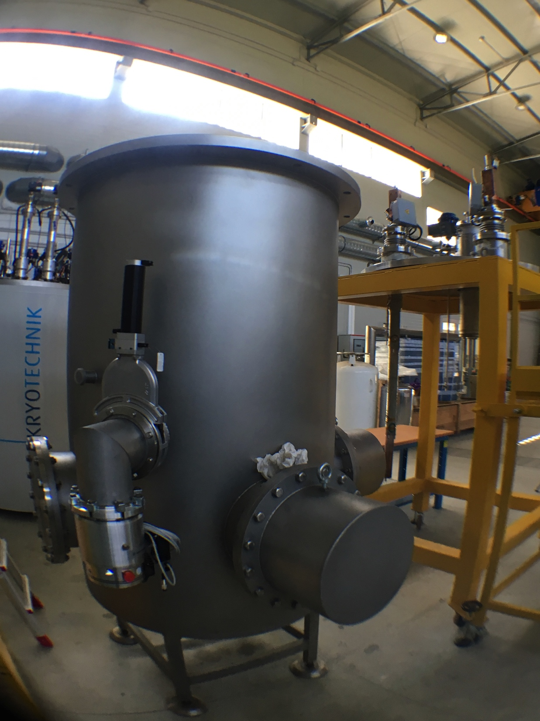

Slide 15
Conclusion: potentials of the facility
Test of devices: magnets, motors, FCL, SMES, etc.;
Critical current cable test (LTS and HTS);
insertion HTS windings for hybrid magnets
Cryogenic and insulation test

Slide 16




Thank you for your kind attention
This work has been developed under PONa3_0007 funding:

Slide 17
Spares 1
Players of the project
  INFN, € 3.472.586,20
  University of Salerno, € 2.375.634,34; further € 700.000 were assigned for young scientists training courses;
  ENEA, € 2.541.903,50;
  CRdC scarl, € 1.709.875,96

Slide 18
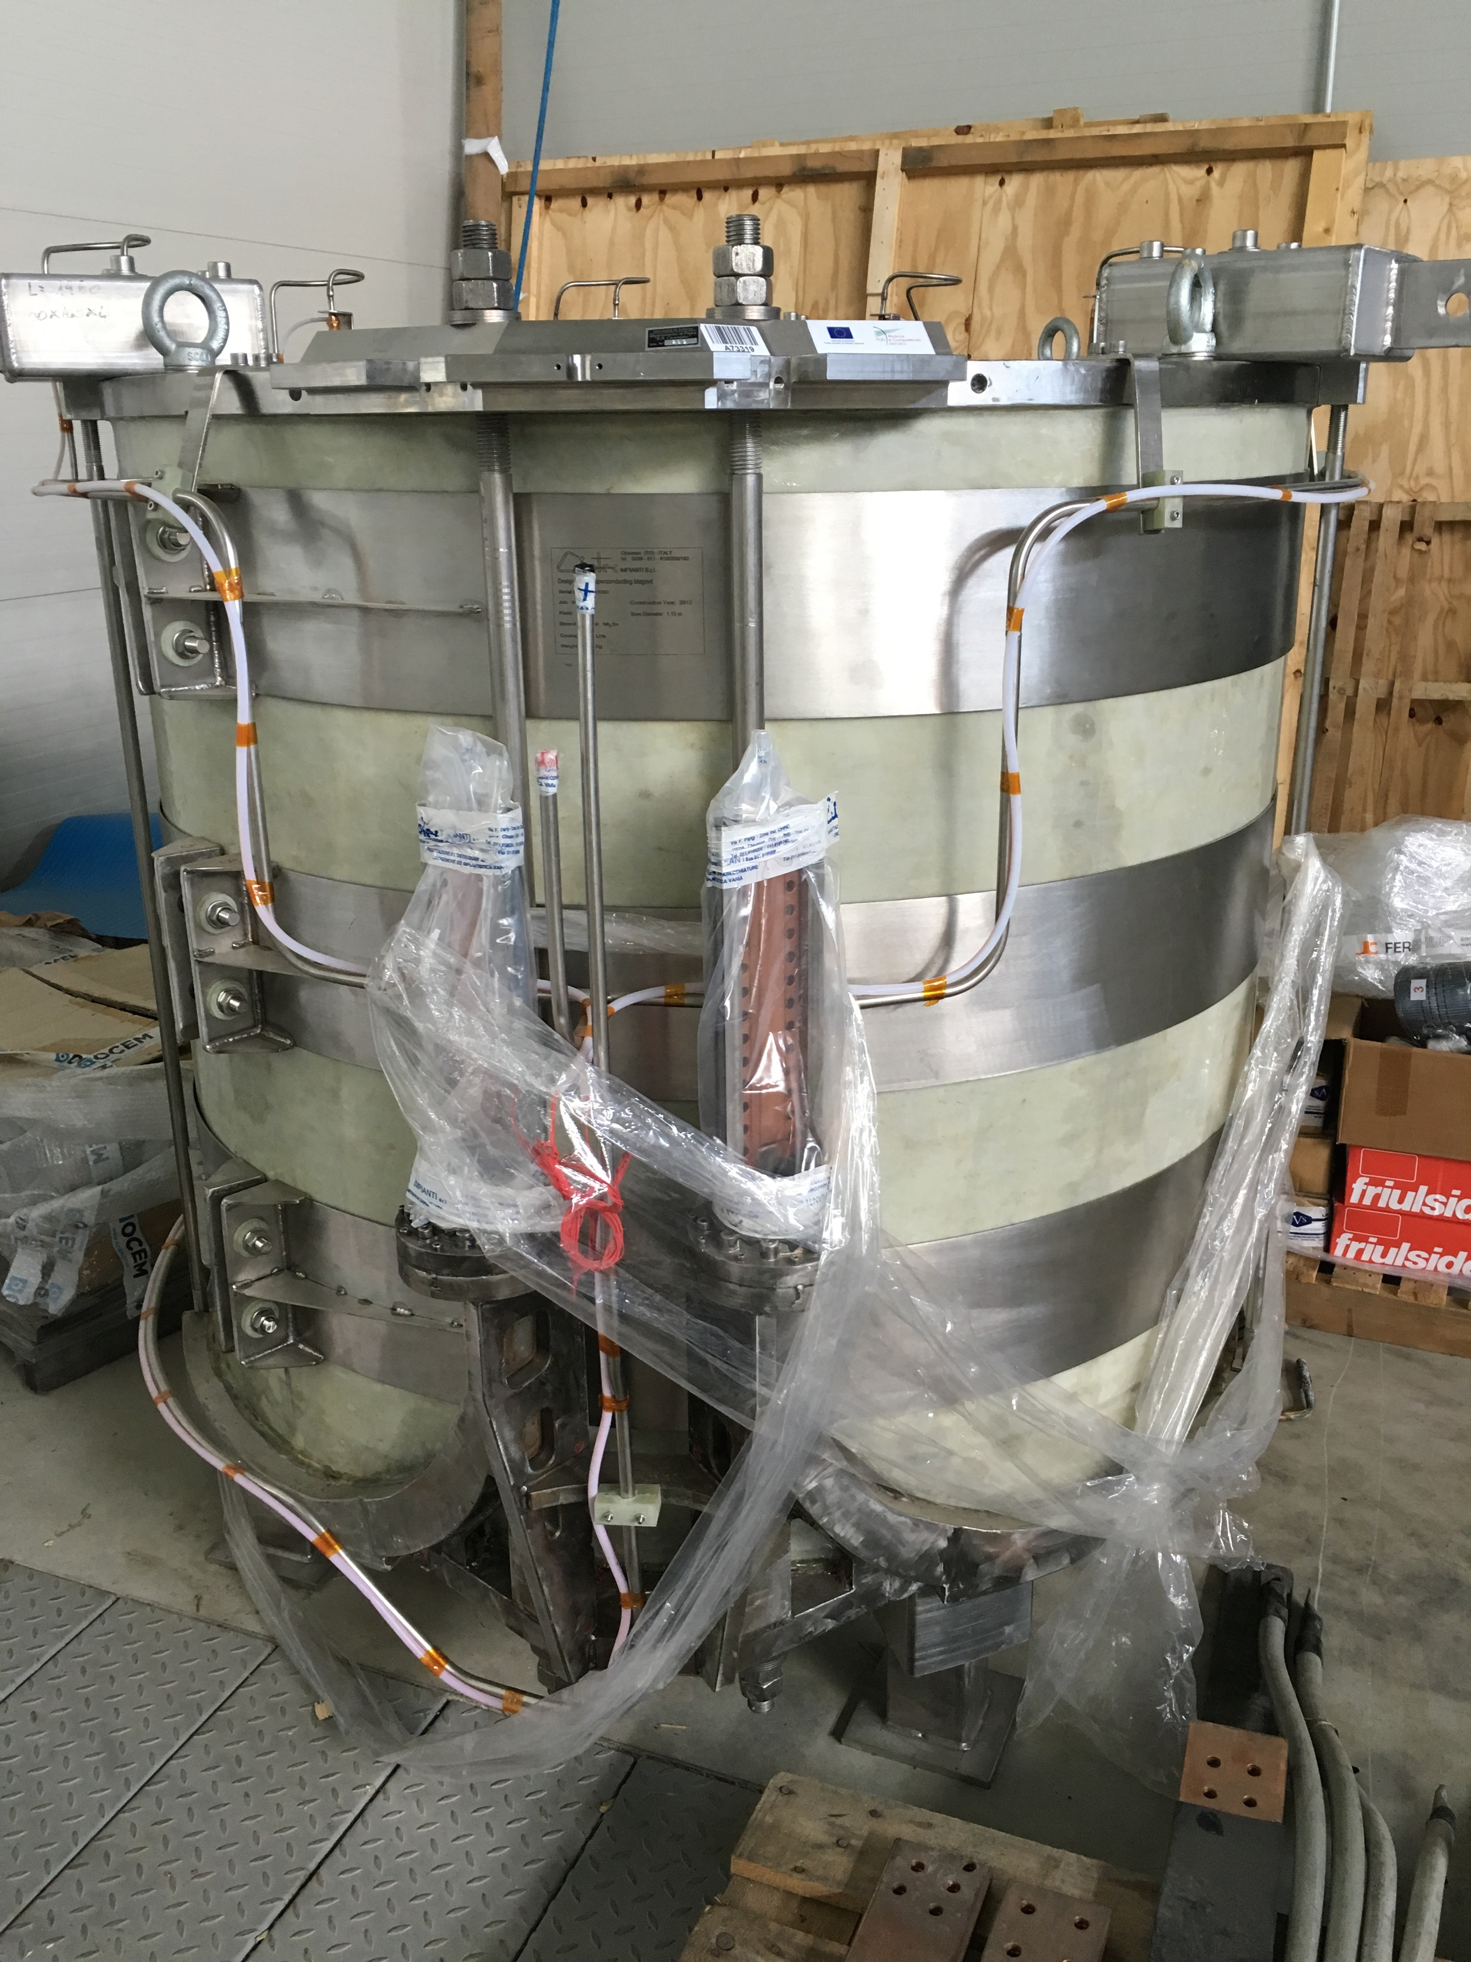
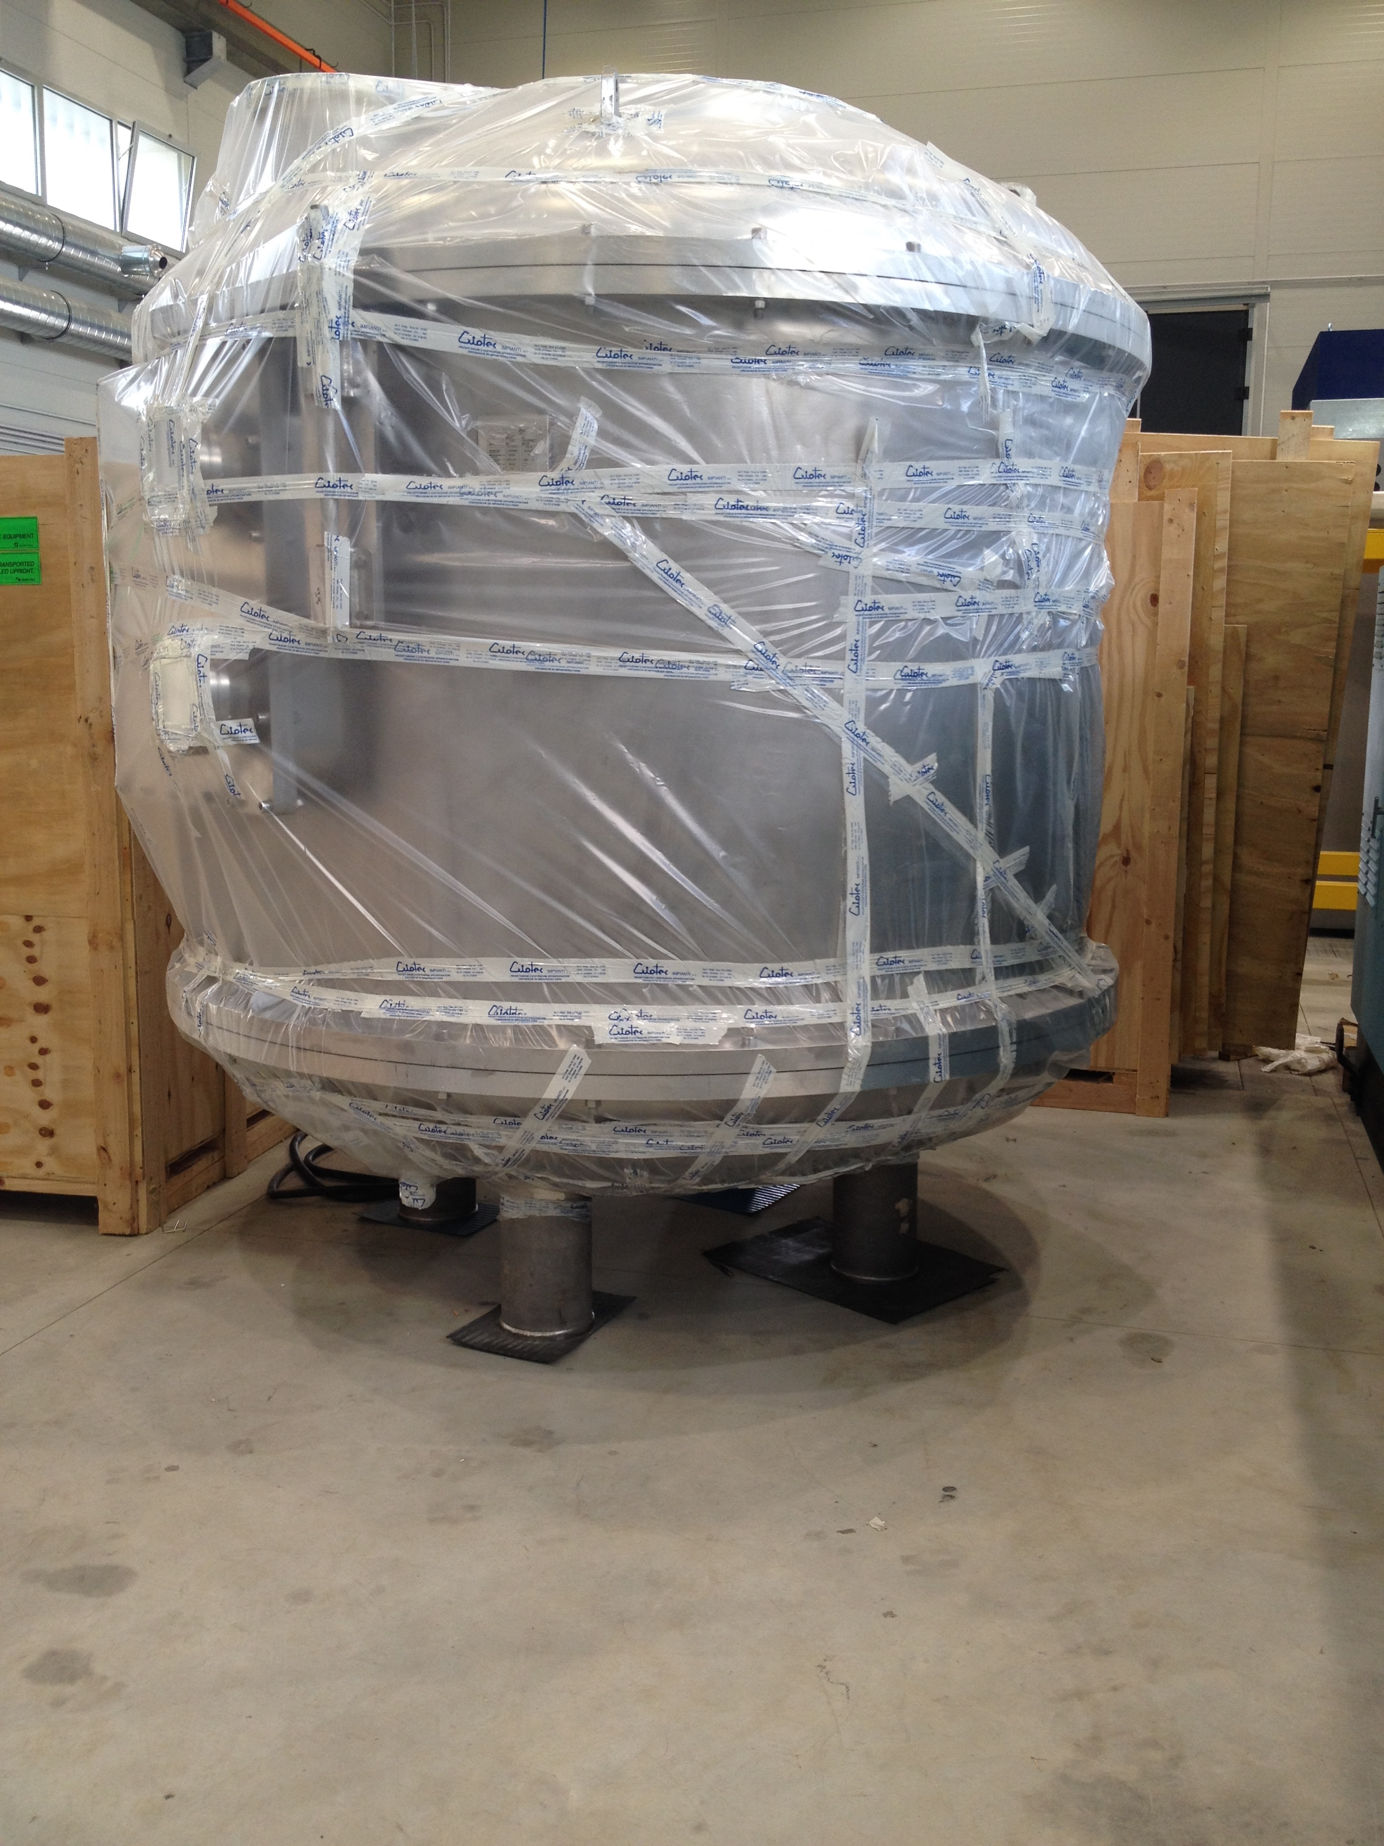
ENFASI Magnet
Spares 2
  The solenoid has been manufactured by CRIOTEC srl, as well as its cryostat.

