Slide 1

Cold powering test requirements for HL LHC: MQXF
G. Ambrosio
1st International Workshop of SC Magnet Test Stands
CERN, June 13th – 14th, 2016

Slide 2
Outline
MQXF Magnets
MQXFA Functional Test Requirements
  Test Objectives for Prototypes
  Test Requirements

Slide 3
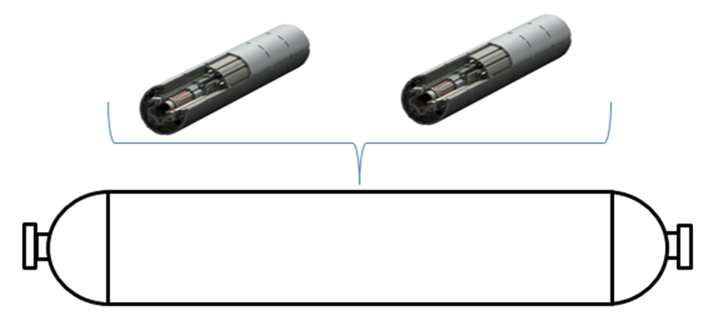
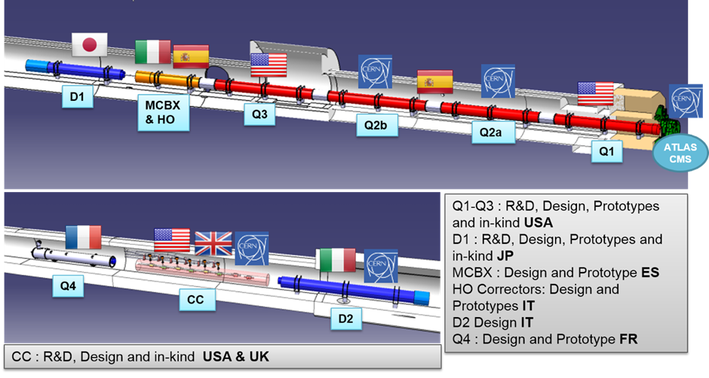
MQXFA/B: Magnets for LHC Inner Triplet Upgrade
International collaborations: an opportunity and a challenge, also for testing!

Slide 4
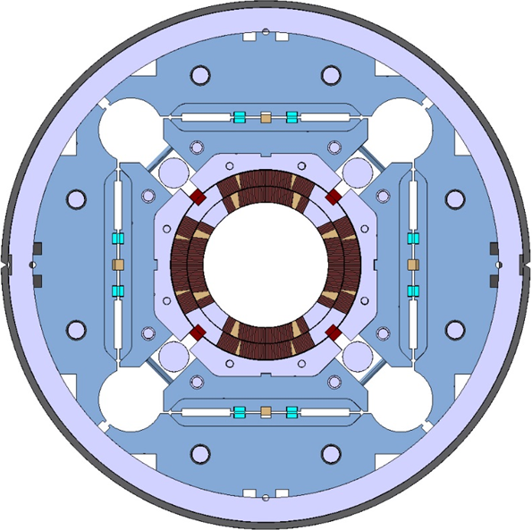
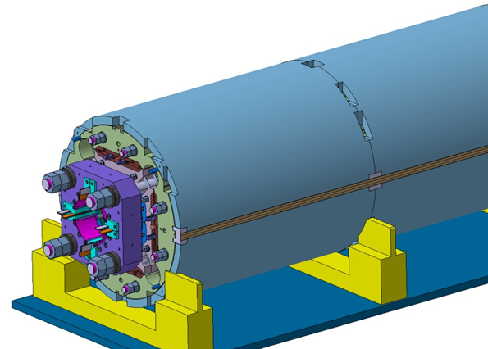
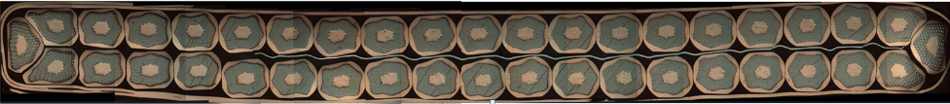
MQXFA/B Magnets
Parameter | Unit | MQXFA/B
Coil aperture | mm | 150
Magnetic length | m | 4.2/7.15
N. of layers |  | 2
N. of turns Inner-Outer layer |  | 22-28
Operation temperature | K | 1.9
Nominal gradient | T/m | 132.6
Nominal current | kA | 16.5
Peak field at nom. current | T | 11.4
Stored energy at nom. curr. | MJ/m | 1.17
Diff. inductance | mH/m | 8.2
Strand diameter | mm | 0.85
Strand number |  | 40
Cable width | mm | 18.15
Cable mid thickness | mm | 1.525
Keystone angle |  | 0.4
Design Report available on line at:
http://larpdocs.fnal.gov//LARP-public/DocDB/ShowDocument?docid=1074

Slide 5
Cold Test Requirements
MQXFA (magnet) Functional Test Requirements
  For Vertical Test
  US-HiLumi DocDB # 7

Slide 6
MQXFA Magnet Parameters
 | MQXFA
 | Quadrupole
Aperture | 150 mm
Overall Length | 4961 mm
Max Support Structure OD without/with He vessel | 614/630 mm
Magnet Weight | 6800 Kg
Operating Temperature | 1.9 K
Operating Current | 16471 A
Operating Gradient | 132.6 T/m
Peak Field at Operating Current | 11.41 T
Magnetic Length | 4200 mm
Stored Energy at Operating Current | 4.91 MJ
Inductance at Operating Current | 34.5 mH
Short Sample Gradient | 168 T/m
Short Sample Current | 21.2 A
Short Sample Peak Field | 14.5 T
Maximum Coil MIITs | 36

Slide 7
Test Objectives for Prototypes
At room temperature:
  HiPot Measurement
  Magnetic Measurements
    Rotating probe measurements
Measurements during cooldown and warmup
  RTD measurements
  Strain Gauge measurements
  Residual Resistivity Ratio (RRR) Measurements

Slide 8
Test Objectives for Prototypes
Measurements at 1.9 K:
  HiPot Measurement
  Magnetic Measurements
    Rotating probe measurements
  Quench Training
    Up to 120% operating current (19.7 kA)
  Quench Characterization
    Voltage taps measurements
    Quench Antenna measurements
  Quench Protection Studies
  Quench Propagation Studies
  Ramp Rate Dependence Measurements
  Voltage Spikes Measurements
  Energy Loss Measurements
  Splice Measurements (at 1.9 or 4.5 K)

Slide 9
Test Objectives for Prototypes
Measurements at 4.5 K:
  Assess short sample limit percentage at 4.5 K after 1.9 K training
  Ramp Rate Dependence at 4.5 K in case of issues at 1.9 K
A thermal cycle will be included to verify that the magnet retains its training.

Slide 10
Requirements
Cooldown and Warmup requirements:
  Max temperature gradient btw magnet ends < 150 K
Temperature measurement:
  Accuracy +/- 10 mK
  Precision +/- 20 mK
HiPot requirement:
  Coil-Ground and Heaters-Ground up to 3500 V
  Heaters-Coil up to 2500 V
  At room temperature in air, and at cold in LHe
  Note: MQXF High Voltage requirements TDB

Slide 11
Current requirements
  For prototypes: up to 19.8 kA
  For production magnets: up to 17.8 kA (108% I_nom)
Ramp Rate requirement:
  Max test current ramp rate is 300 A/s
  Ramp rate changeable during current ramp
Magnetic measurements requirements:
  Warm finger (anti-cryostat) for magn meas with rotating probe up to 100 mm diameter

Slide 12
Quench Protection requirements:
  Detection channels (minimal list): Whole coil, Whole coil – Idot, Half coil – Half coil;
    with current-dependent thresholds
  Quench heaters: 24 strips powered as pairs in series
    HFU voltage up to 450 V per strip
  Energy extraction: up to 50 mOhm dump
    Variable dump delay: 0-1000ms
  Power supply phase back with no delay after detection trigger
  CLIQ: 2 leads for CLIQ units

Slide 13
Quench Characterization:
  Up to 80 voltage taps
  Minimum sampling rate: 10 KHz
  Minimum time window for logging data 4 sec
Quench Antenna
  Will be installed in the warm bore
  Details TBD
Voltage Spike measurements:
  Minimum sampling rate: 100 kHz

Slide 14
Test Stand should be able to do these measurements:
Energy loss measurements
RRR measurements
Splice measurements

Slide 15
Notes
LARP & CERN have started testing short models,
  MQXFS1 tested at FNAL in Spring 2016
  MQXFS3 to be tested at CERN in August 2016
In June/July BNL is going to commission the Vertical Test Facility, and to test a single 4m QXF coil in mirror structure
Thank you!

