Slide 1
Overview HL LHC Magnets
, FCC,
of LHC,
and all kind of other
Luca.Bottura@cern.ch
TE-MSC
1st International Workshop on the Superconducting Magnets Test Stands
CERN, June 13th-14th, 2016

Slide 2
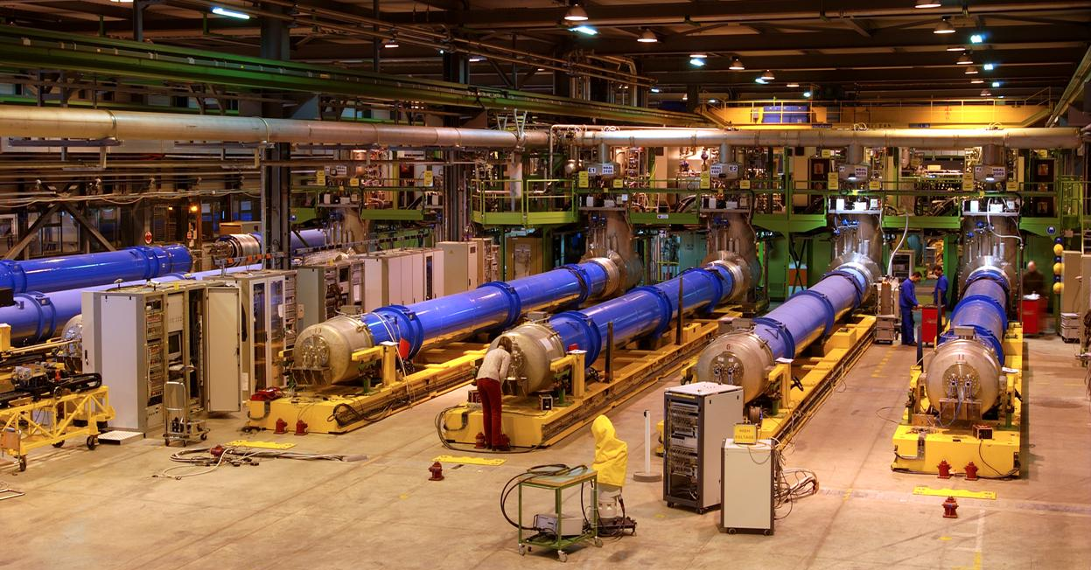
SM-18 at the times of the LHC

Slide 3
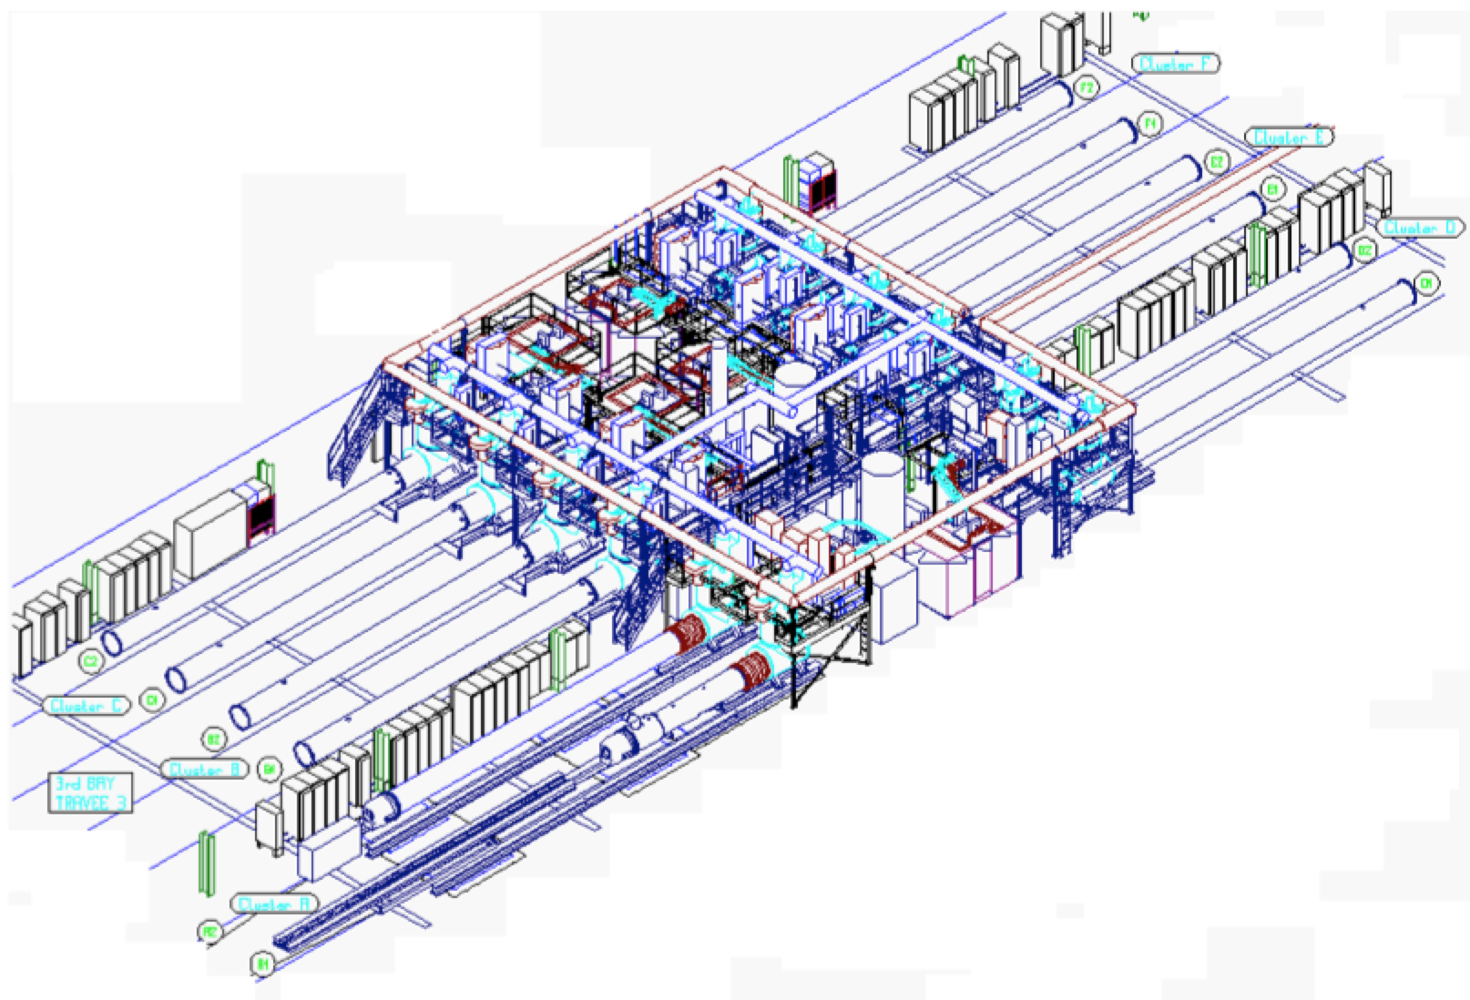
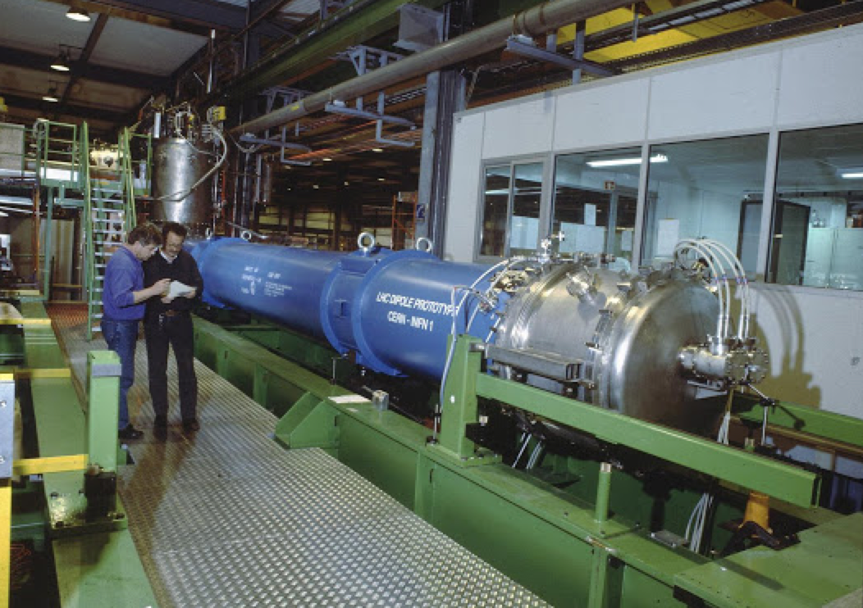
SM-18 test benches
12 fully equipped test benches arranged in 6 clusters which could run independently
All test benches capable to operate, both at 4.2 and 1.9 K
Cryomagnets could be equipped with anticryostats for:
  Magnetic Measurements
  Quench Localisation
First test bench operational in 1994
Construction of final installation started early 2003
Fully completed in May 2004
Test facility was running 24/24, 7/7, 46weeks/year
Cold tests were completed in February 2007

Slide 4
Test mission - dipoles
Dashboards by courtesy of E. Delucinge

Slide 5
Test mission - quadrupoles
Dashboards by courtesy of E. Delucinge

Slide 6
The LHC experience
About 2000 test runs in 3 and a ½ years, on approximately 1700 cryomagnet units, focused on:
  quench performance
  magnet protection
  magnetic field quality (about 20% of magnets measured: magnetic length & multipoles)
  cryogenic, vacuum, and electrical integrity
Type of NC | Total NCs | Average NC/magnet
Mechanical | 1181 | 0.95
Electrical | 583 | 0.47
Performance | 94 | 0.08
Other | 275 | 0.22
Total | 2133 | 1.71
In total 31 dipoles were rejected because of training or electrical NC’s
Statistics by courtesy of A. Siemko

Slide 7
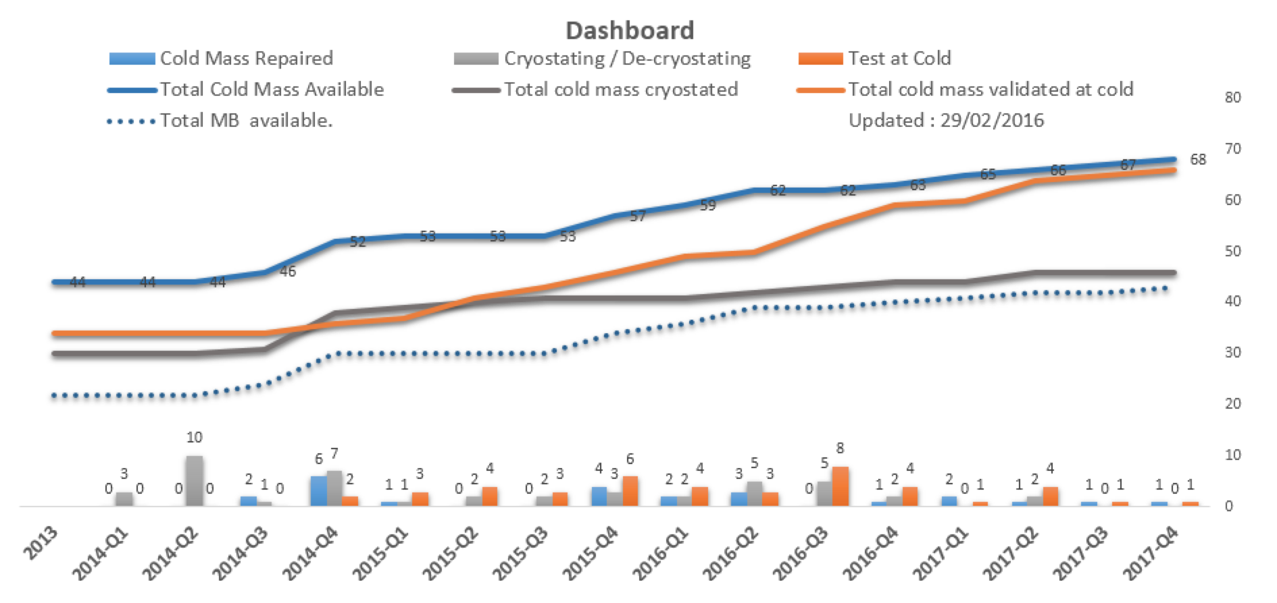
The life of the LHC
It is not unreasonable to expect that 10 to 15 cryomagnets will be exchanged every long shutdown (approximately 3 years)
In addition, some 20…40 spare magnets (MQ, MQY, MCBY, …) will be procured in the coming 5 years

Slide 8
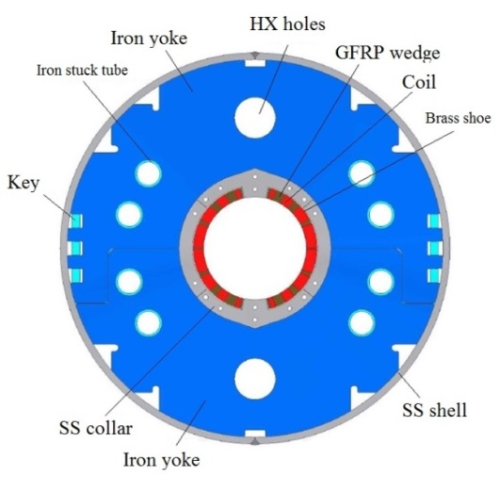
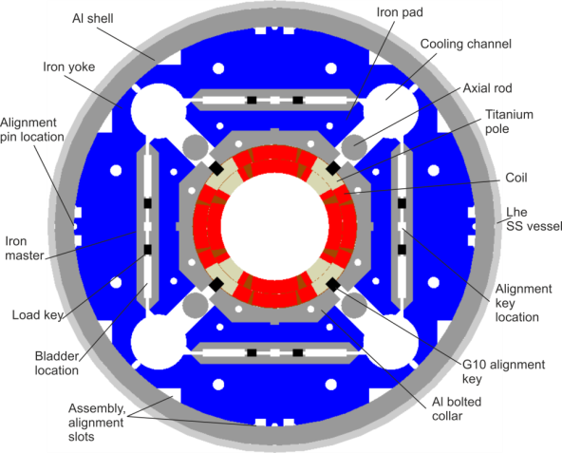
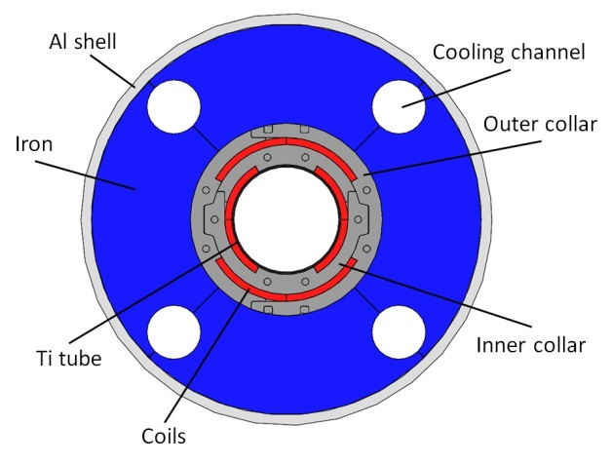
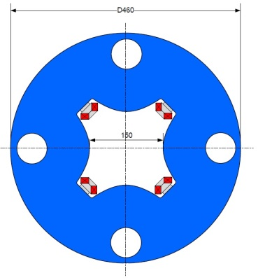
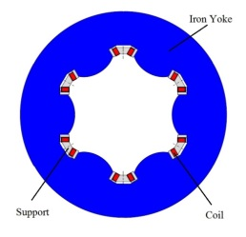
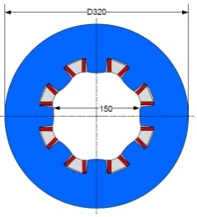
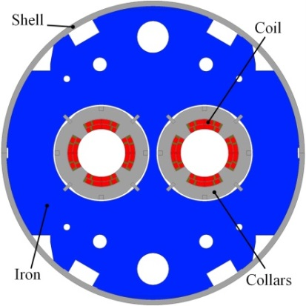
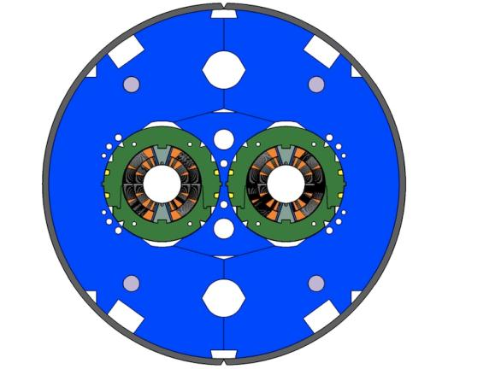
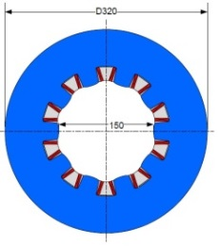
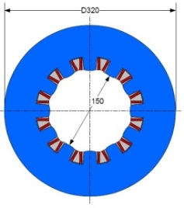
HL-LHC
Skew quadrupole corrector
(INFN)
Triplet QXF (LARP and CERN)
Orbit corrector (CIEMAT)
Separation dipole D1 (KEK)
Corrector sextupole
(INFN)
Corrector octupole
(INFN)
Recombination dipole D2
(INFN design)
Q4 (CEA)
11 T (CERN)
Cross-sections to scale
Corrector decapole
(INFN)
Corrector dodecapole
(INFN)

Slide 9
HL-LHC test mission (as we stand today)
By LS2 (≈ 2020)
By LS3 (≈ 2024)
11 T models (≈6) and prototype (1)
QXF models (5) and prototype (5)
11 T cryomagnets
  (2 units +1 spare)
MBFX (D1) models (2)
MQYY (Q4) model (1) and prototypes (2)
QXF (Q1/Q2/Q3) cryomagnets
  (16 units + 4 spares)
MBXF (D1) cryomagnets
  (4 units + 2 spares)
Corrector packages
  (4 units + 2 spares)
MBRD (D2) cryomagnets
  (4 units + 2 spares)
MQYY (Q4) cryomagnets
  (4 units + 2 spares)
Q5 cryomagnets
  (4 units)
Approximately 50 cryomagnets of very diverse geometry (supports and interfaces), characteristics (Nb₃Sn and Nb-Ti) and operating conditions, as well as more than 100 single magnets to be tested as components before assembly in a cold mass

Slide 10
The CERN HFM Program
Demonstrate the maturity of Nb₃Sn through the application in the HL-LHC, in the range of peak magnetic field of 12 T
Push Nb₃Sn magnet technology to its practical limit, with a target of 16 T dipole field as requested by the FCC
Provide a proof-of-principle for HTS magnet technology beyond the reach of Nb3Sn, with a target of 20 T dipole field
Support the above programs with the necessary general material and magnet R&D and the evolution of the manufacturing and test infrastructure
HL-LHC
FCC
EuroCirCol
EuCARD2
(ARIES)
SCM
(ORION)

Slide 11
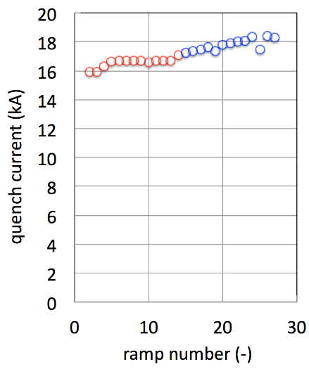
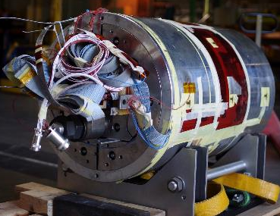
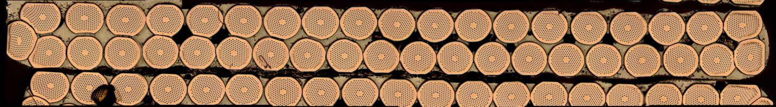
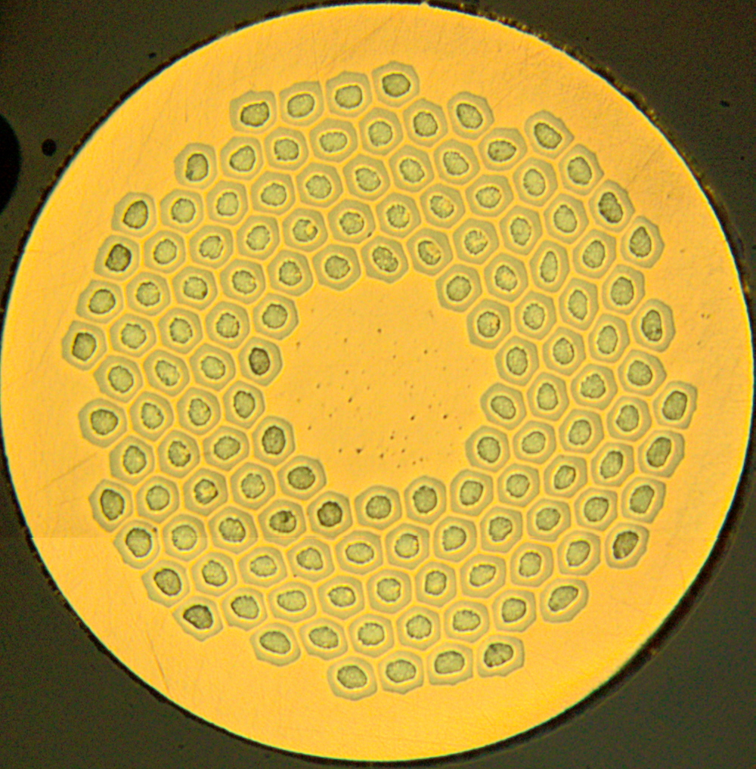

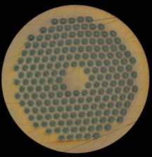

RMC_3 test record
95-97 % of strand I_{C}
95-97 % of strand I_{C}
4.3 K
1.9 K
I_{op}=18.5 kA
B_{peak}=16.2 T
Fresca 2 Dipole cable
40 Strands, Width = 20.9 mm
RRP 132/169
PIT 192
Preliminary – Not for distribution

Slide 12
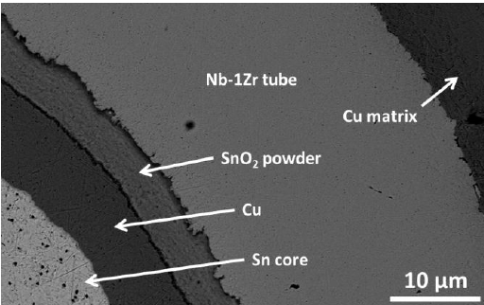
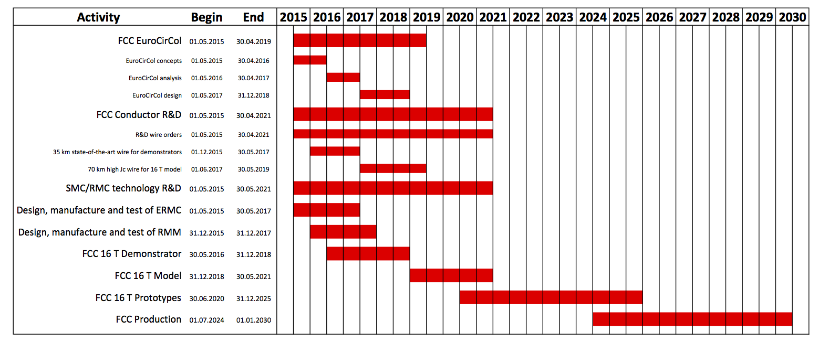

FCC plan
Pinning
Real estate
ERMC
RMM
Demo
Expect some 10 sub-scale and demonstration magnets to come in the period 2017-2021

Slide 13


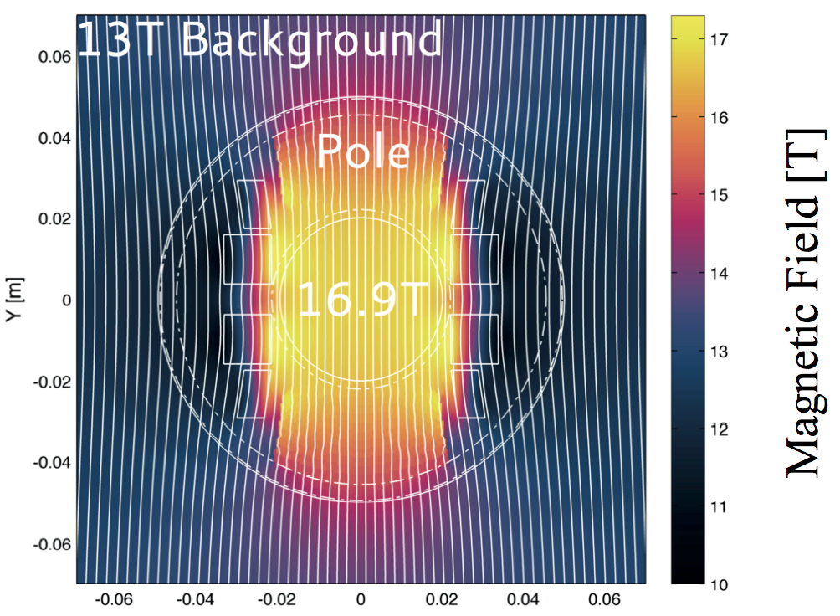
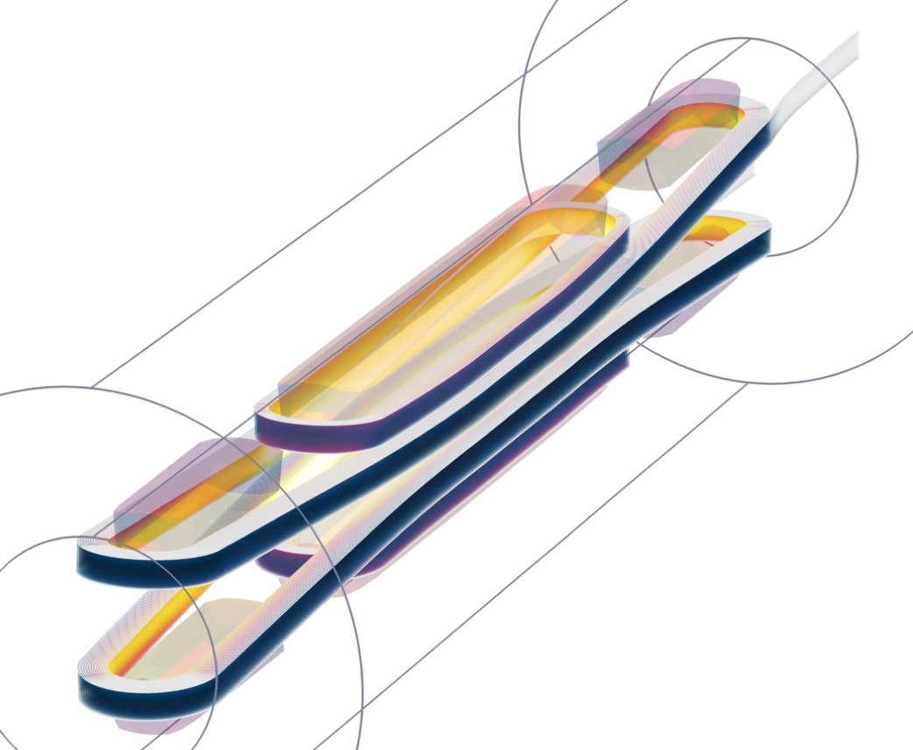
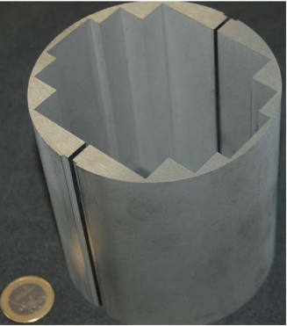
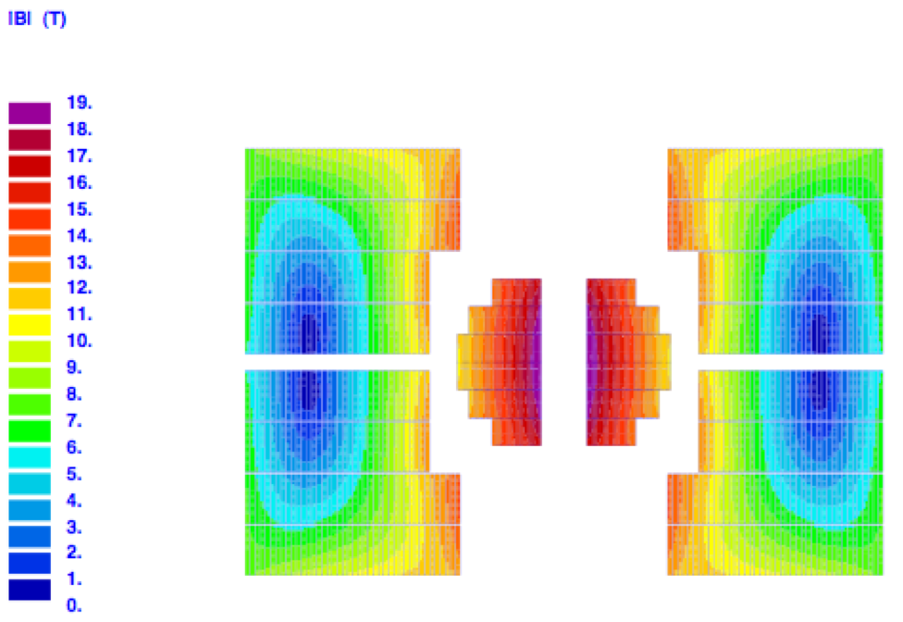
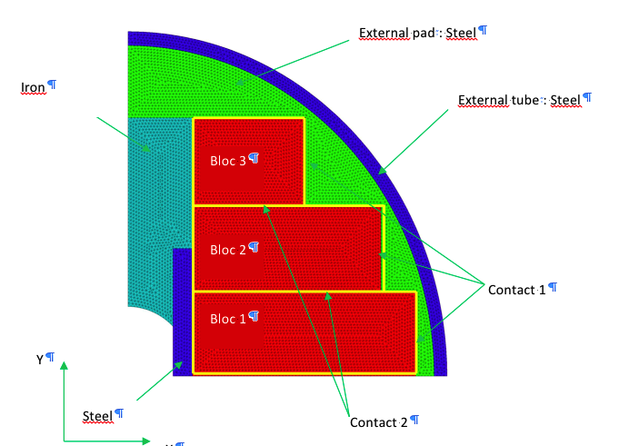
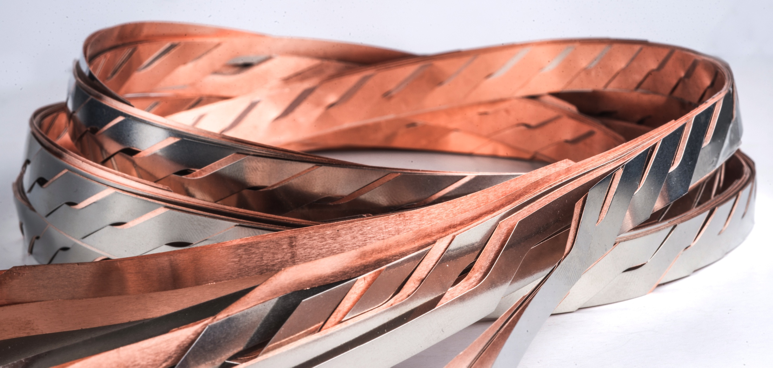
HTS for 20 T
J. Van Nugteren, G. Kirby, G. de Rijk, CERN
6 T HTS (YBCO) insert for test in FReSCa2 (no bore)
19 T
5 T HTS (YBCO) stand-alone dipole for test in FReSCa2 (40 mm bore)
J.M. Rey, CEA-Saclay

Slide 14
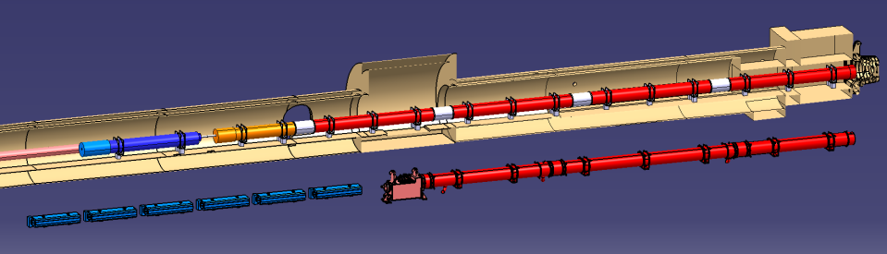
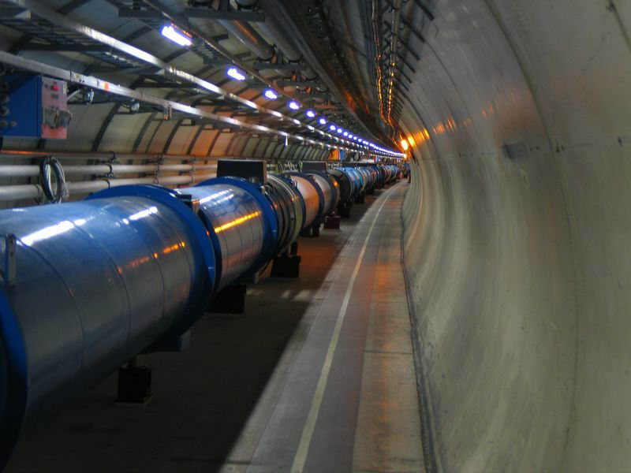
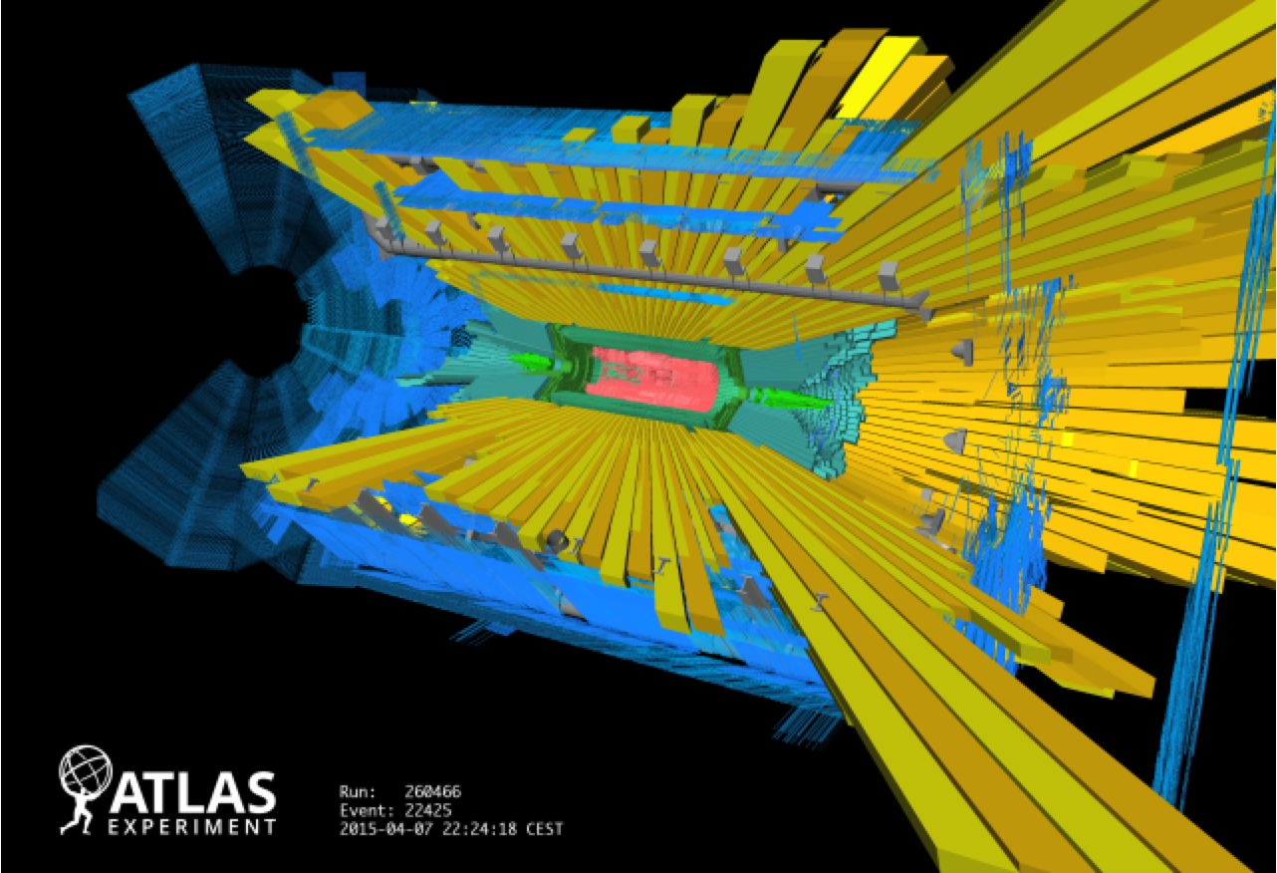
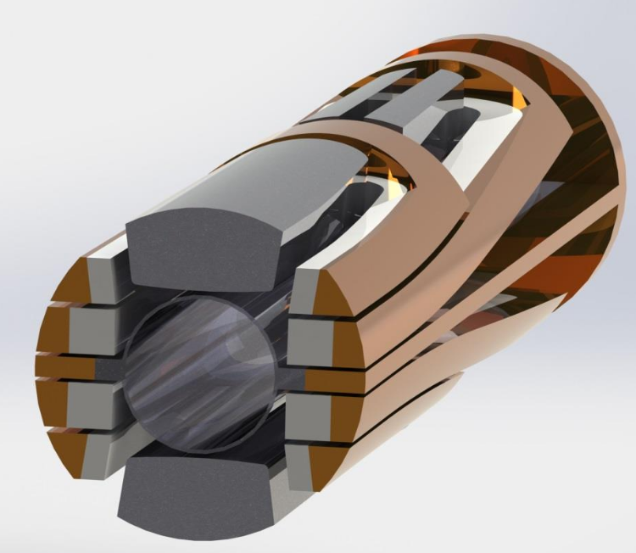

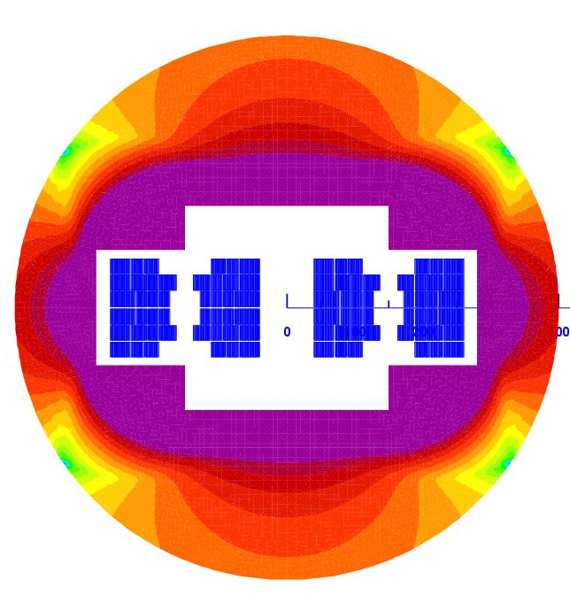
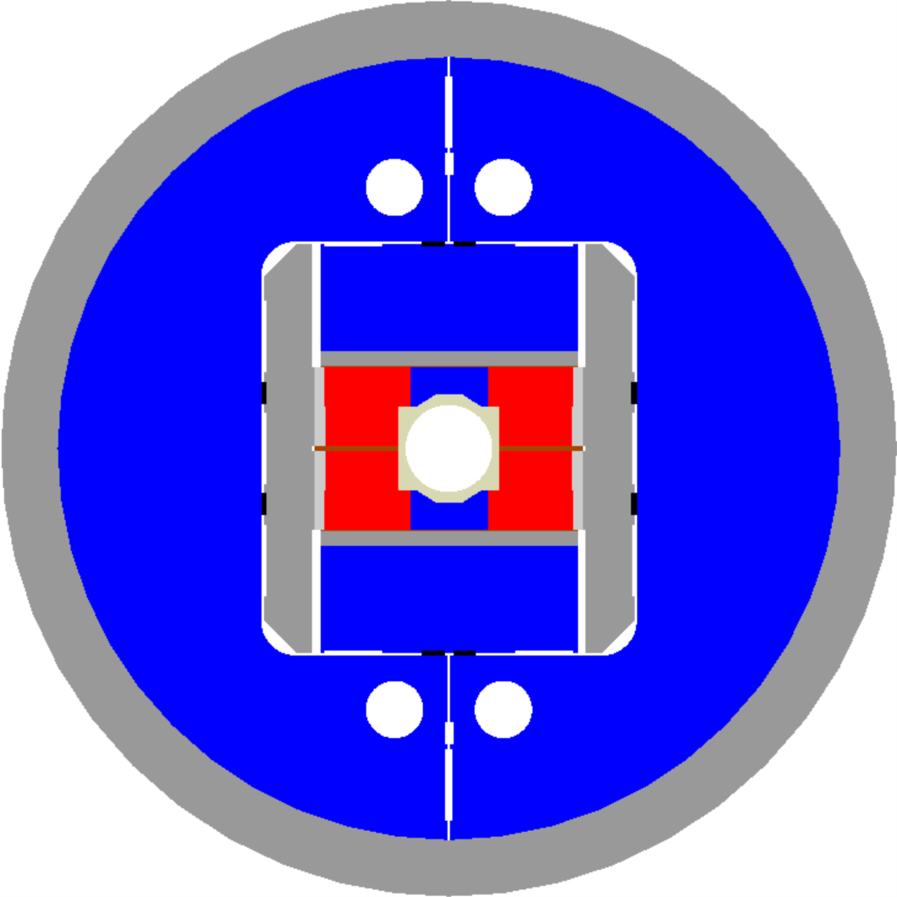

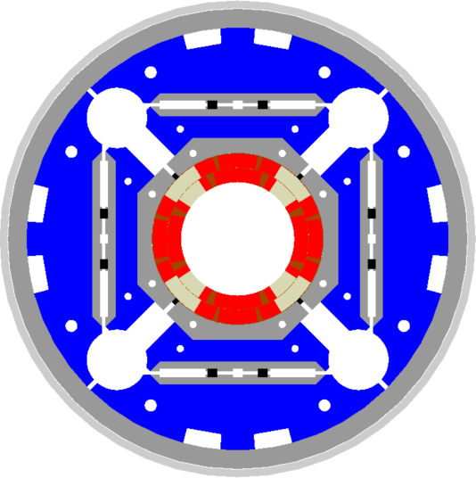
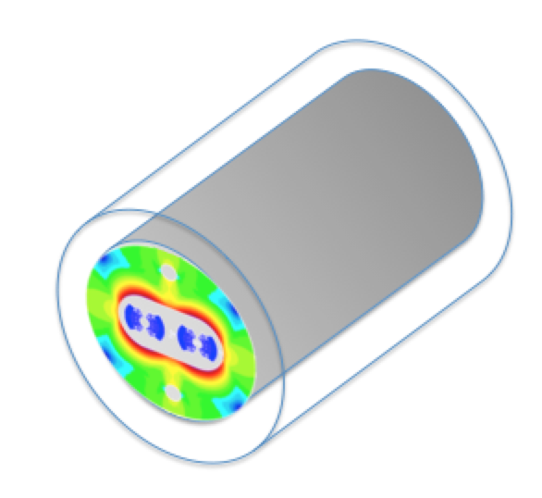
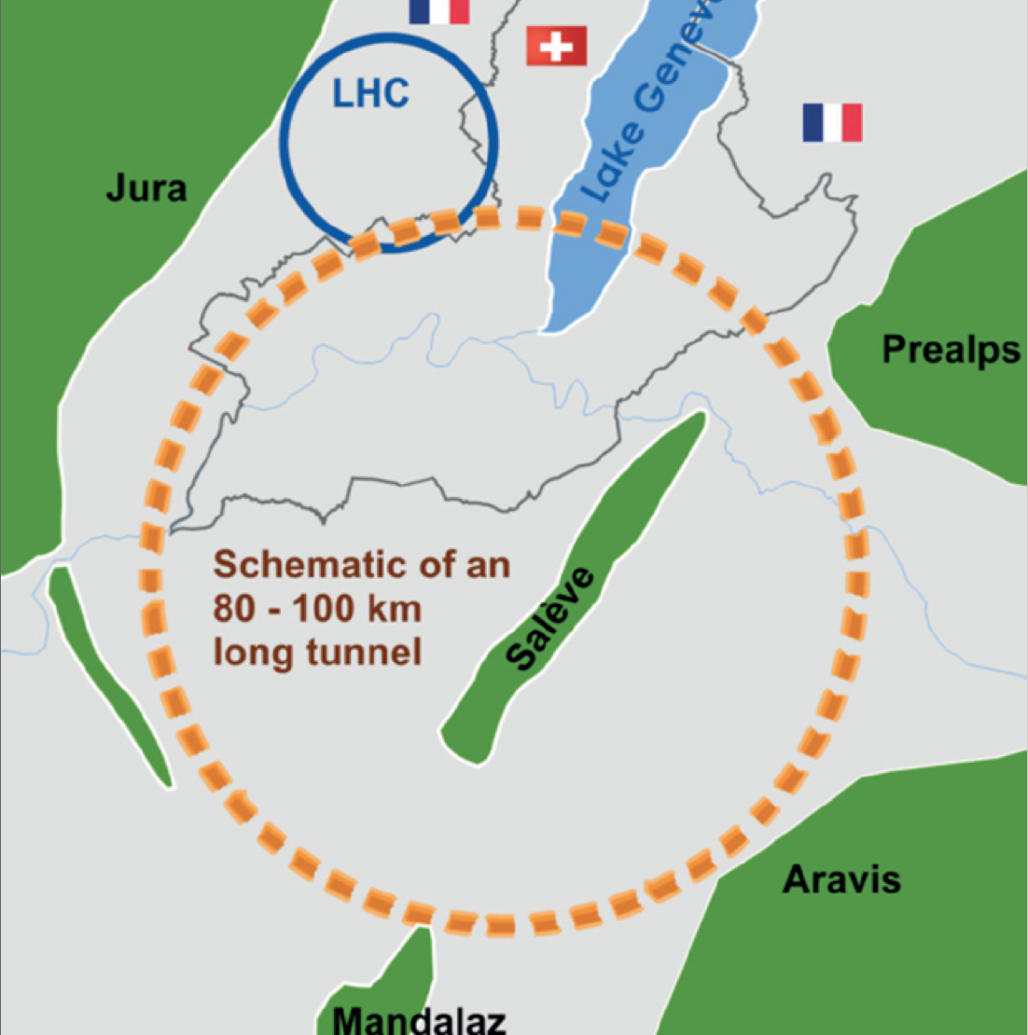


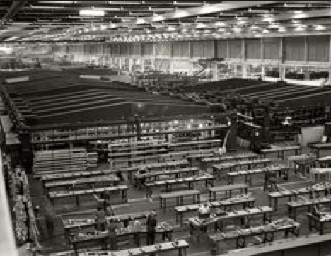
LHC Run-II provides results to define future HEP roadmap (European Strategy 2018)
HL-LHC demonstrates large-scale use of Nb₃Sn
End of LHC useful life
Accelerator-grade HTS 5 T demo
2015
2016
2017
2018
2019
2020
2025
2030
2035
2040
12 T accelerator technology
16 T magnet model(s)
20 T magnet model(s)
16 T accelerator technology
FCC CDR (EuroCirCol) propose a new energy frontier accelerator
FCC construction decision
FCC production and test ?!?

Slide 15
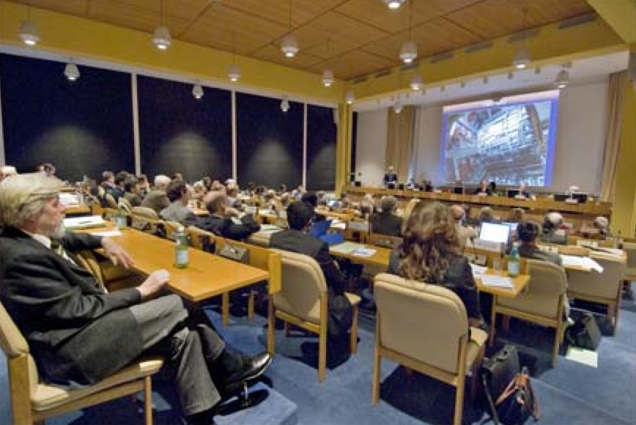
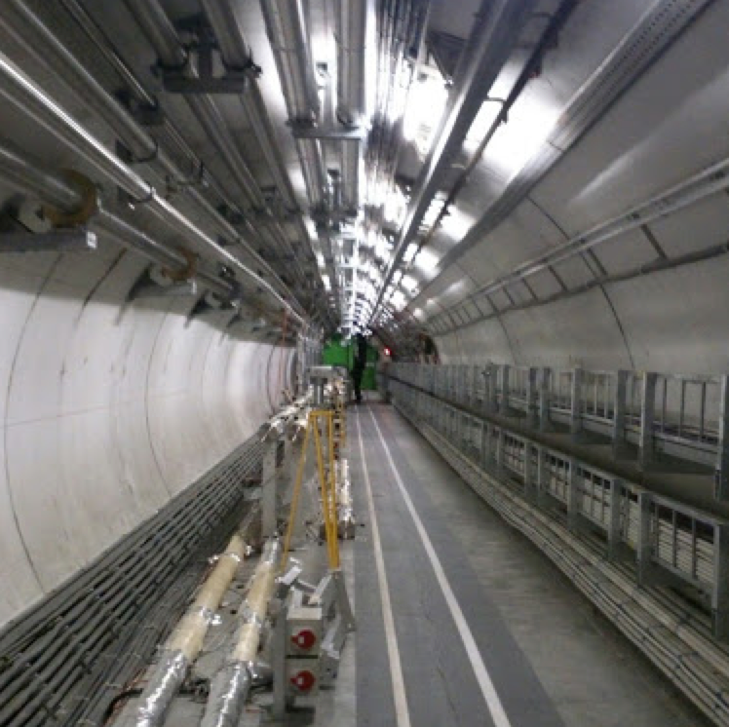
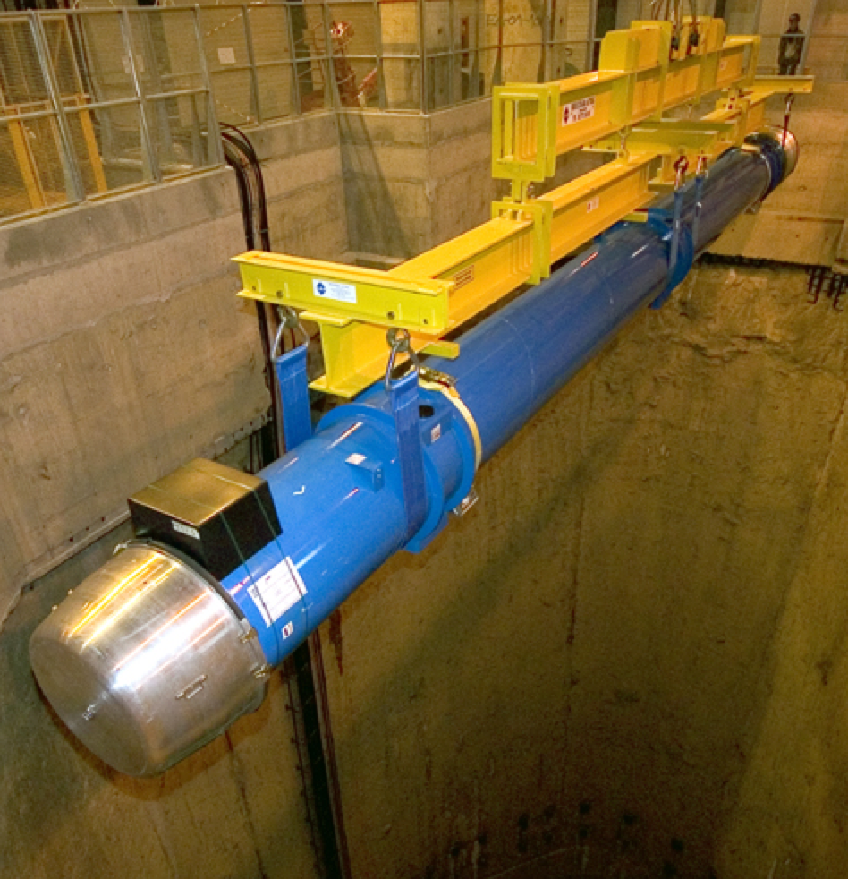
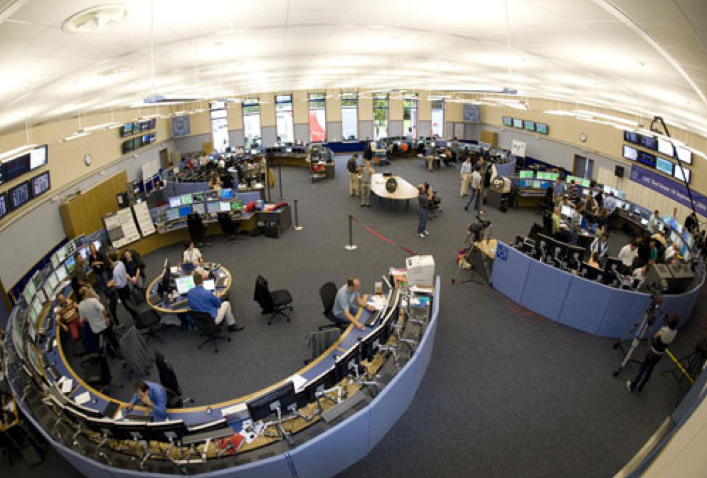

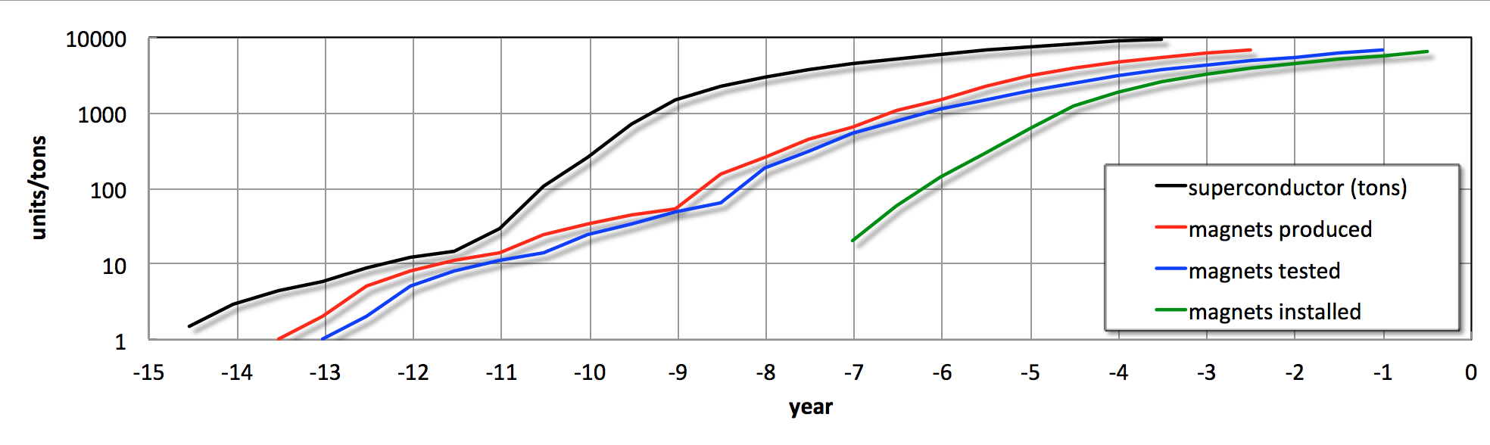
construction OK
Tunnel delivery
Installation
FCC commissioning
Year B.C.
Note 1: log scale for produced units
Qualification
Scale up
Series production
(1000 tons/y)
Superconductor
Prototypes
Pre-series
Series production
(1600 magnets/y)
Magnets
Hub 1
Series tests
(1200 magnets/y)
Cold tests
Hub 2
Hub 3
Note 2: B.C. = Before the Collider

Slide 16
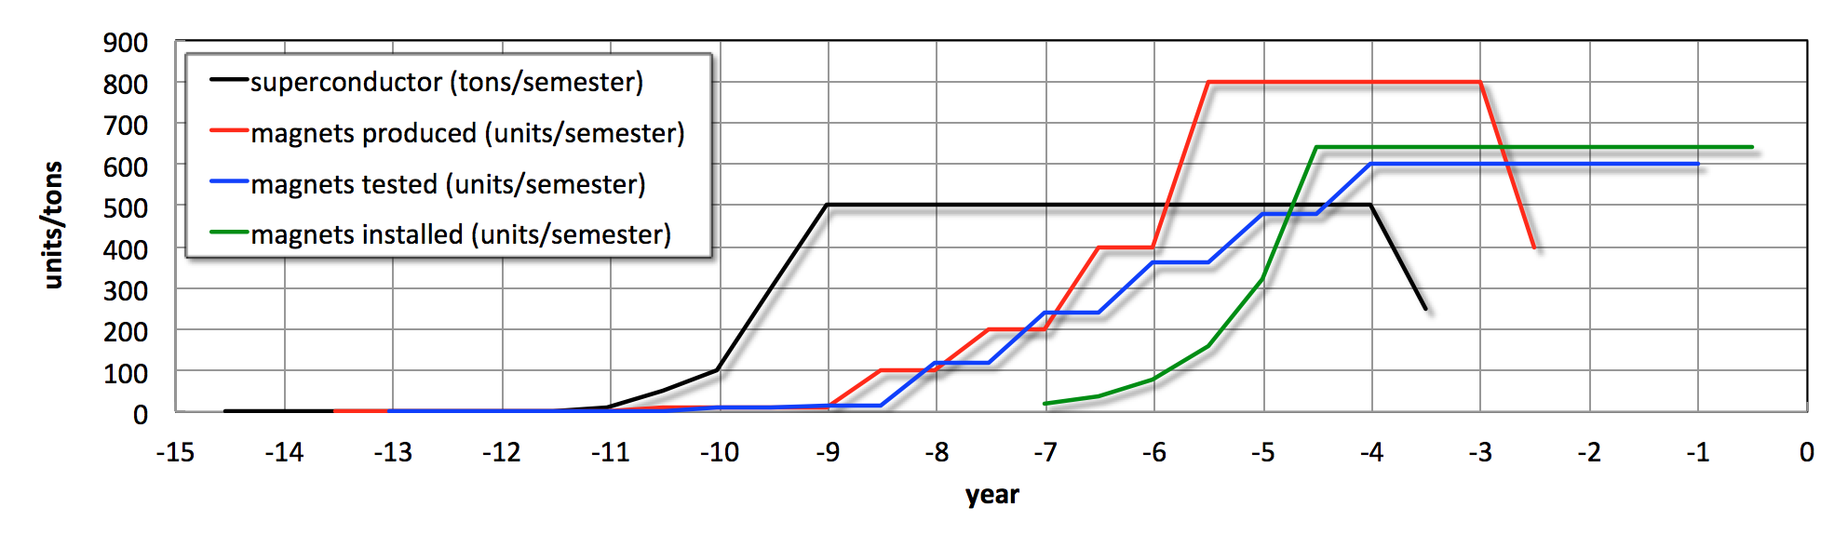
High productivity
Total magnets are 4500 MB + 1500 MQ
  Total SC quantity is 9000 tons
  Maximum SC production rate is 1500 tons/year
    1000 cable UL/year – acceptance and qualification ?!?
Maximum cold mass production is 1600 CM/year
  133 CM/month (vs. 60 CM/month during LHC times)
Maximum cold test rate is 1200 magnets/year
  100 tests/month (vs. 40 tests/month during LHC times)

Slide 17
Conclusions, and encouragements
The LHC, like a baby, requires our constant attention, pointing to the importance of a functioning test facility in support of operation
New accelerator magnet technologies (Nb₃Sn, HTS) provide a topical focus and excellent motivation for the evolution of the test capabilities
HL-LHC acts as a springboard in preparation of the scale-up for the next step (any future collider) which will require world-regional test capacity beyond what you see here at CERN

Slide 18
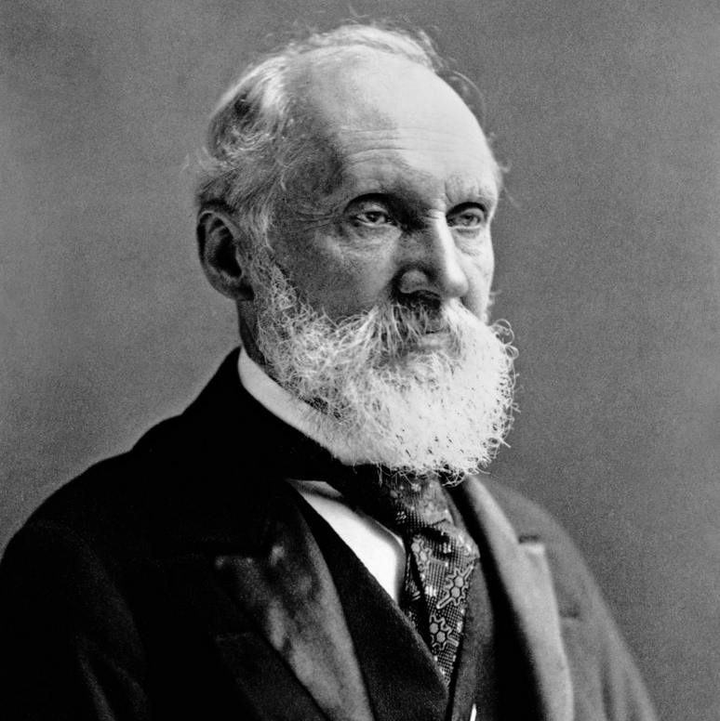
"There is nothing new to be discovered in physics now. All that remains is more and more precise measurement”.
Sir William Thomson
a.k.a. Lord Kelvin
“X-rays will prove to be a hoax”
“Radio has no future”
“Heavier-than-air flying machines are impossible”
…

