Slide 1
FREIA Laboratory
Facility for Research Instrumentation and Accelerator Development
"Gersemi" Vertical Test Stand
Roger Ruber for the FREIA Team
Dept. Physics and Astronomy
Uppsala University
SC Magnet Test Stand Workshop - CERN - 13 June 2016

Slide 2

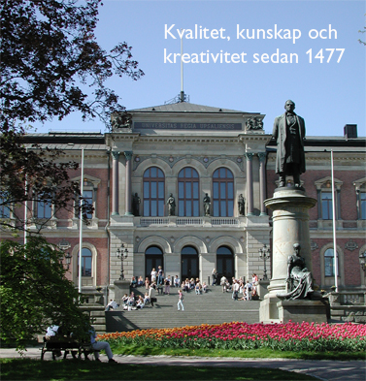
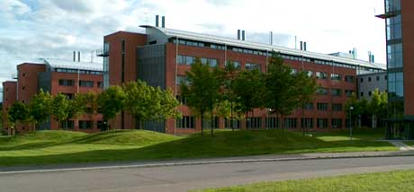
Uppsala University
Oldest university in Scandinavia (1477)
Sweden
  9.7 million (pop.), 450'000 km², 430 GEur (BNP)
Uppsala
  25'000 students, 9'000 staff, 630 MEur annual budget
  7 faculties of theology, law, medicine, pharmacy,
  arts, social sciences, languages,
  educational sciences, science and technology
  university library and hospital
Faculty of Science and technology
  10'000 students, 1'800 staff
  historical profiles: Linnaeus, Rudbeck, Celsius,
  Ångström, Siegbahn, Svedberg
  R&D areas:
    physics, chemistry, biology, earth sciences,
    engineering, mathematics, IT

Slide 3
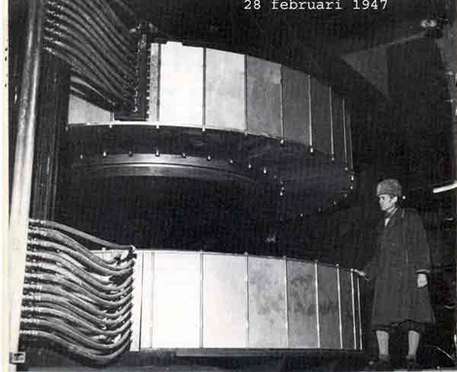
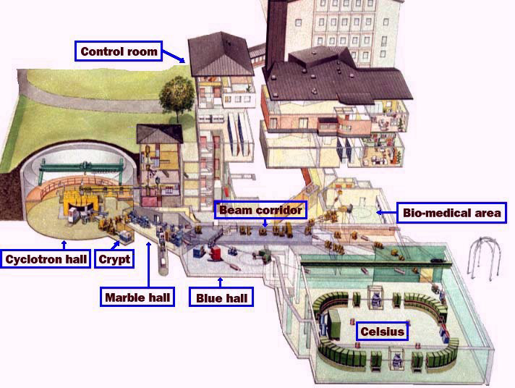
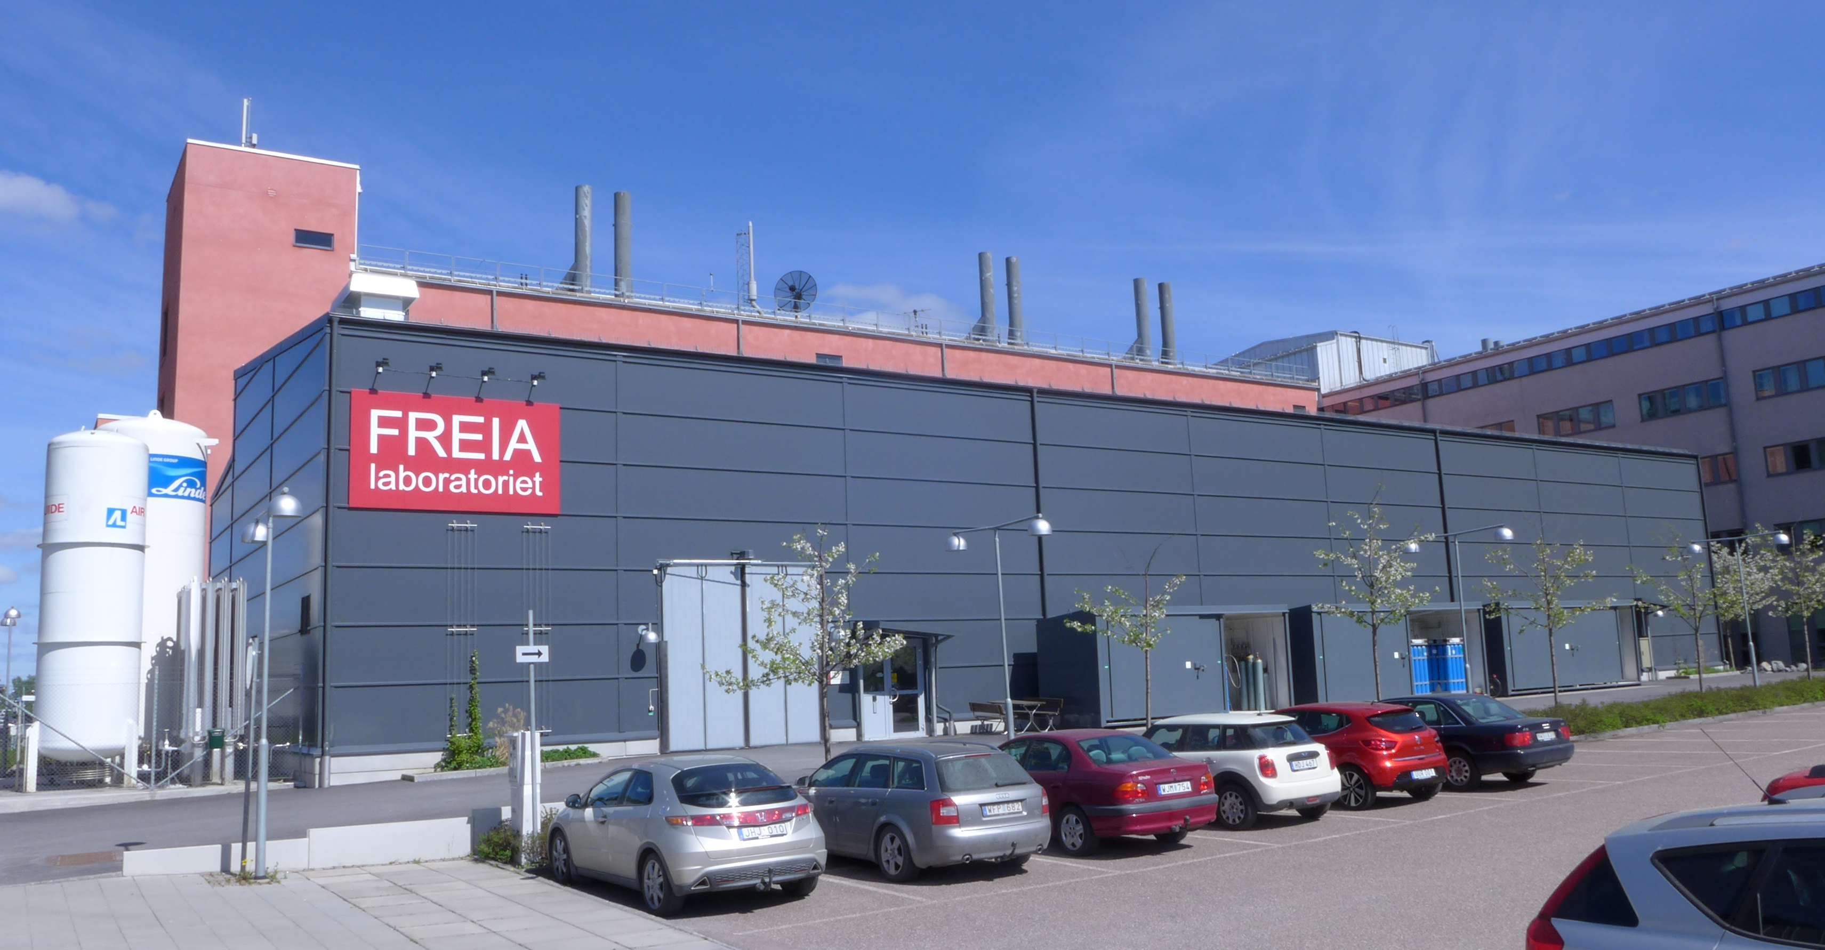
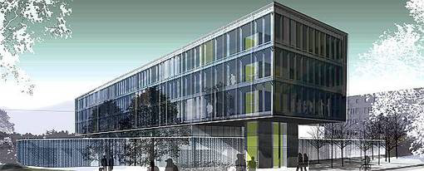
Uppsala Accelerator History
1940's: The(odore) Svedberg proposes to build a cyclotron
Gustaf Werner synchro-cyclotron (1947 - 2016)
  nuclear physics & oncology
CELSIUS ring (1984 - 2005)
  nuclear & particle physics
CTF3/CLIC (since 2005)
FLASH/XFEL (since 2008)
ESS (since 2009)
FREIA laboratory (est. 2011)
Skandion clinic (est. 2015)

Slide 4
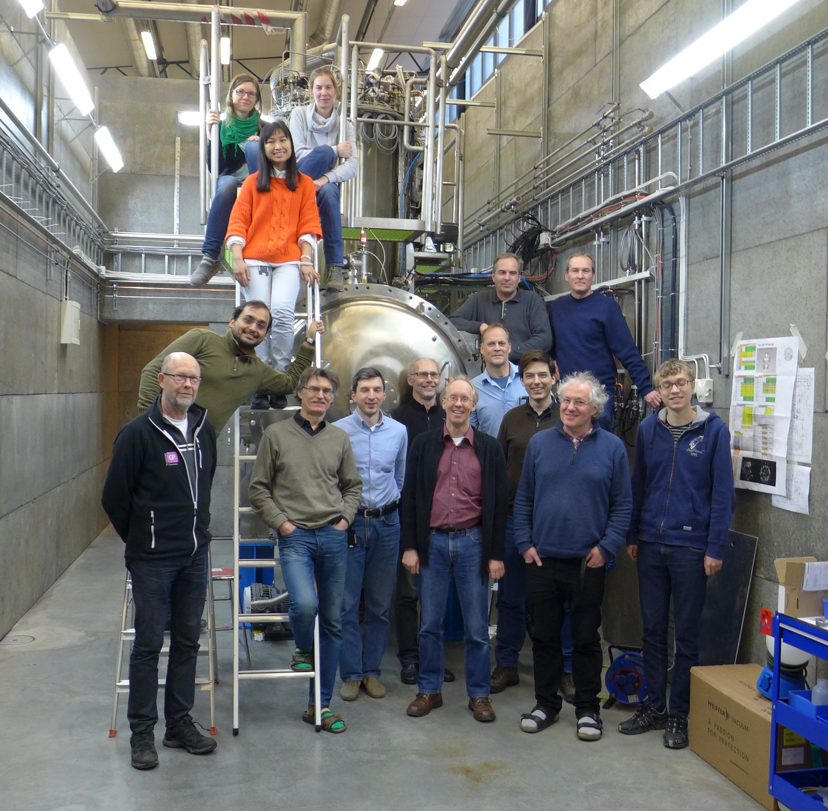
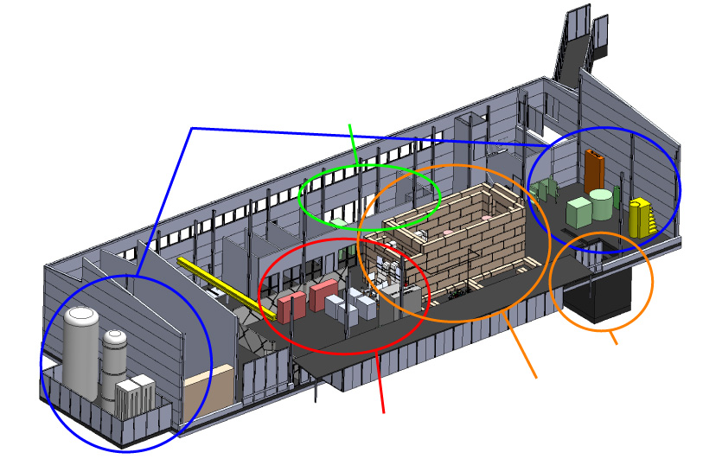
FREIA Laboratory
Facility for Research Instrumentation and Accelerator Development
cryogenics
- liquid helium
- liquid nitrogen
control room
- equipment controls
- data acquisition
Competent and motivated staff
collaboration of physics (IFA)
and engineering (Teknikum).
Funded by
KAWS, Government, Uppsala Univ.
vertical cryostat
3 bunkers
with test stands
horizontal cryostat
radio-frequency (RF) power sources

Slide 5
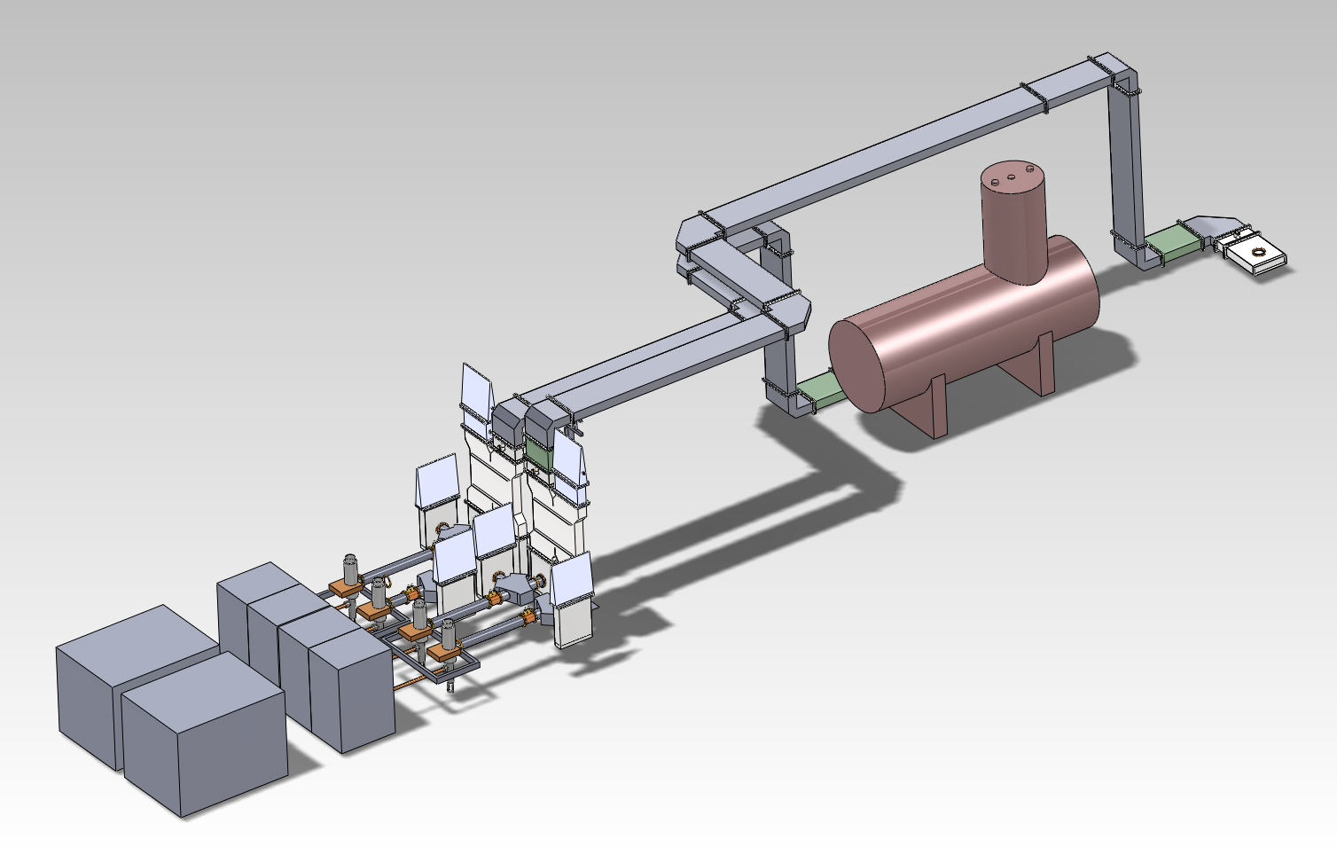
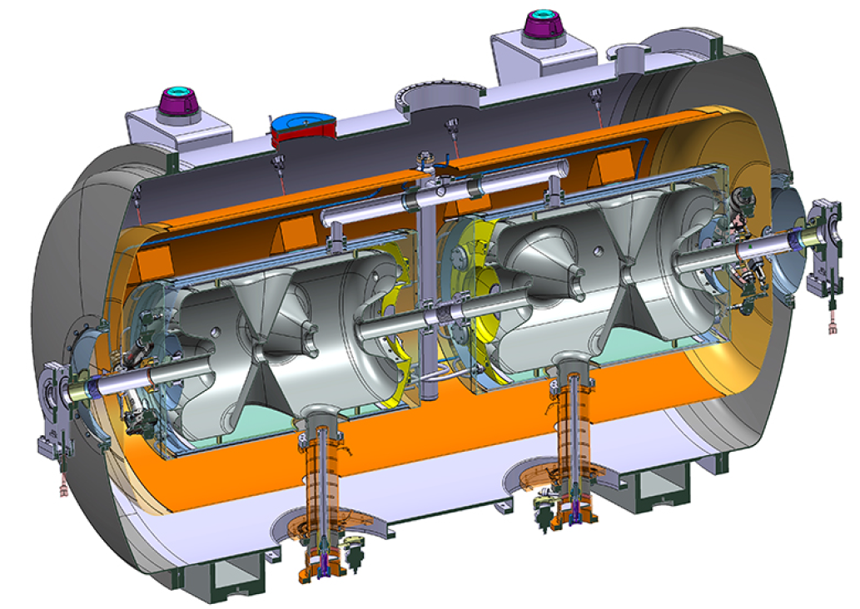
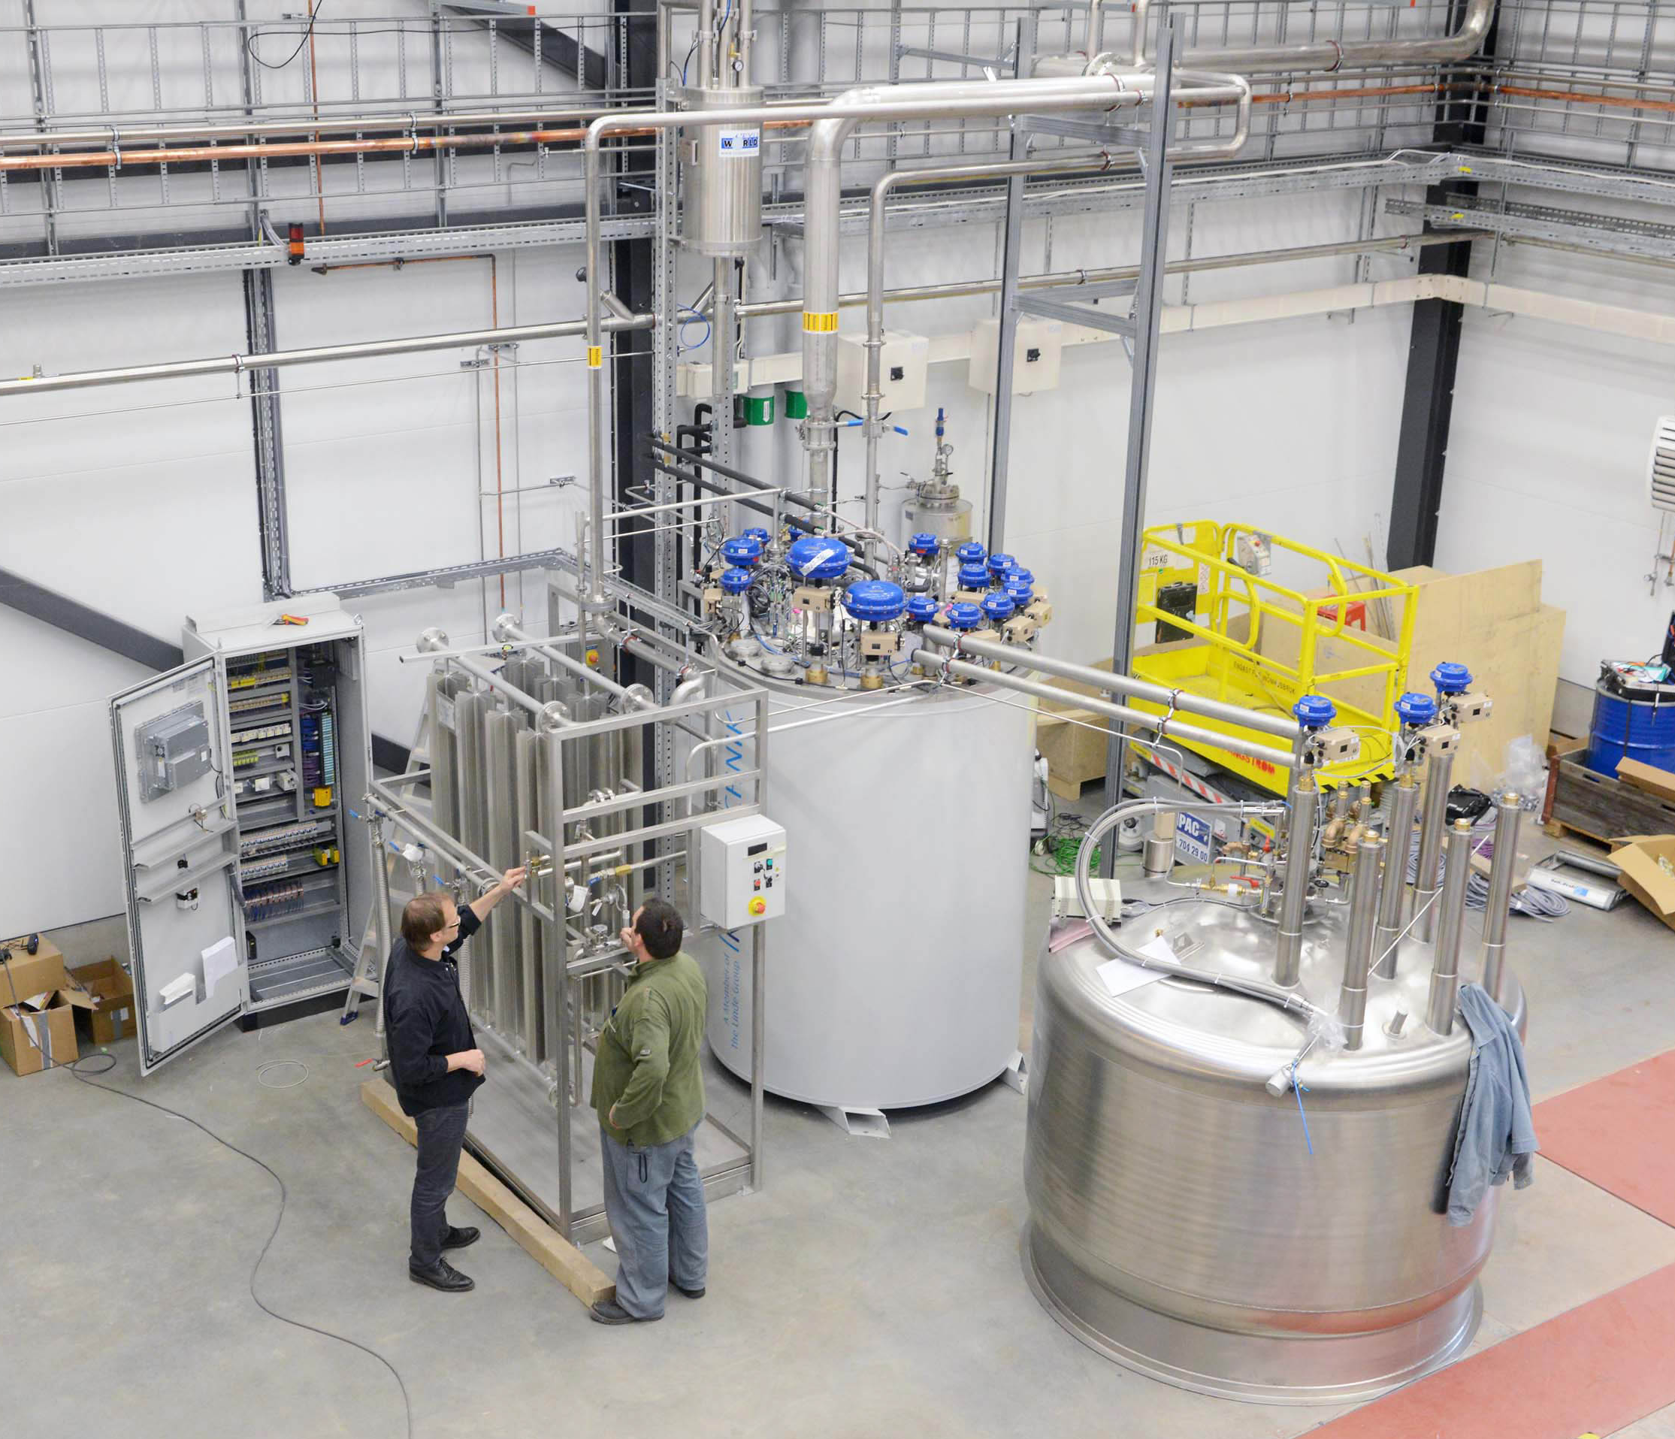
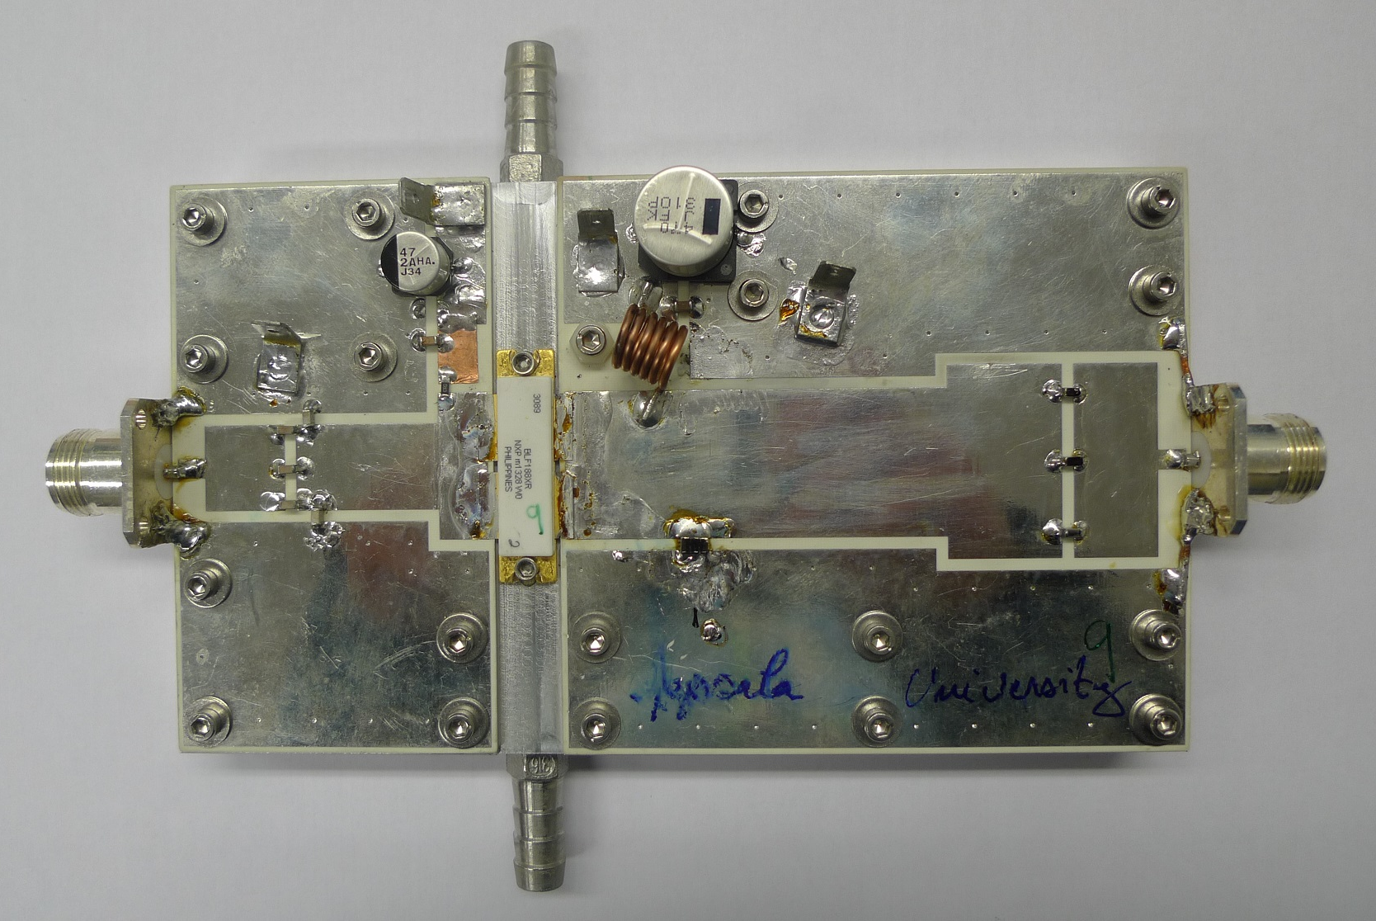
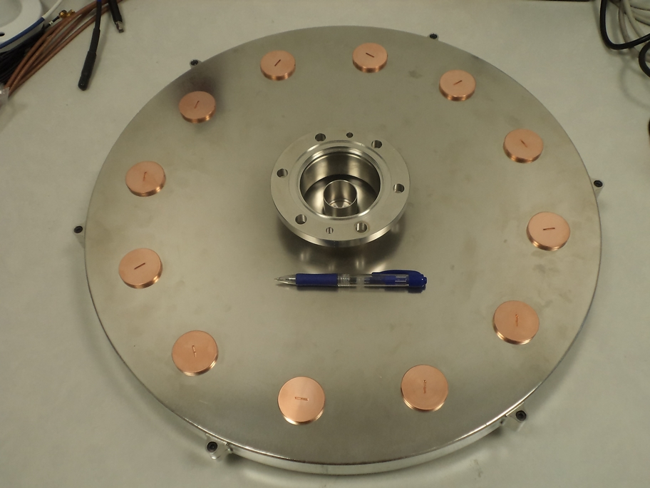
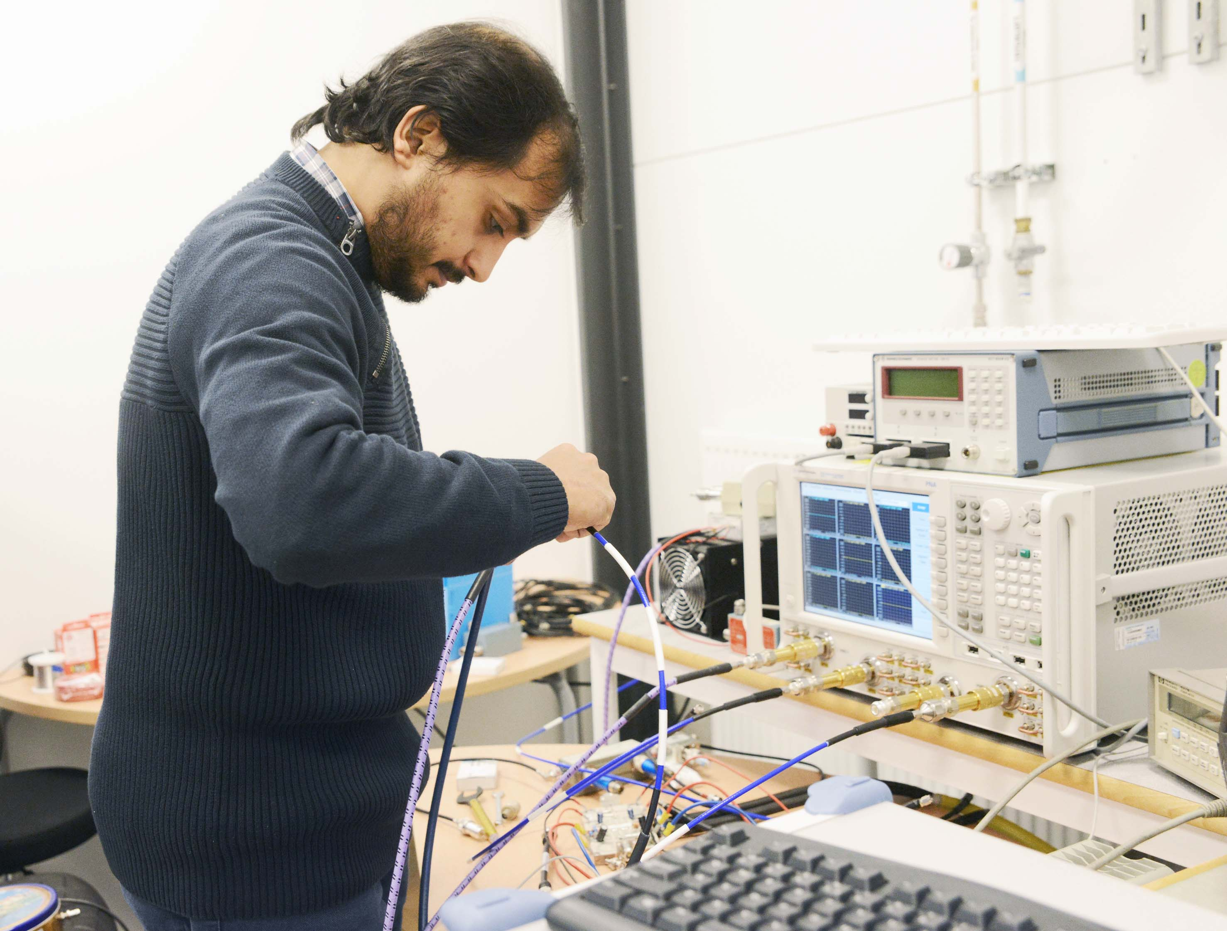
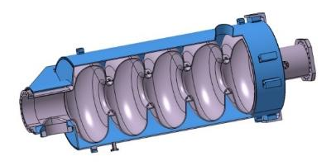
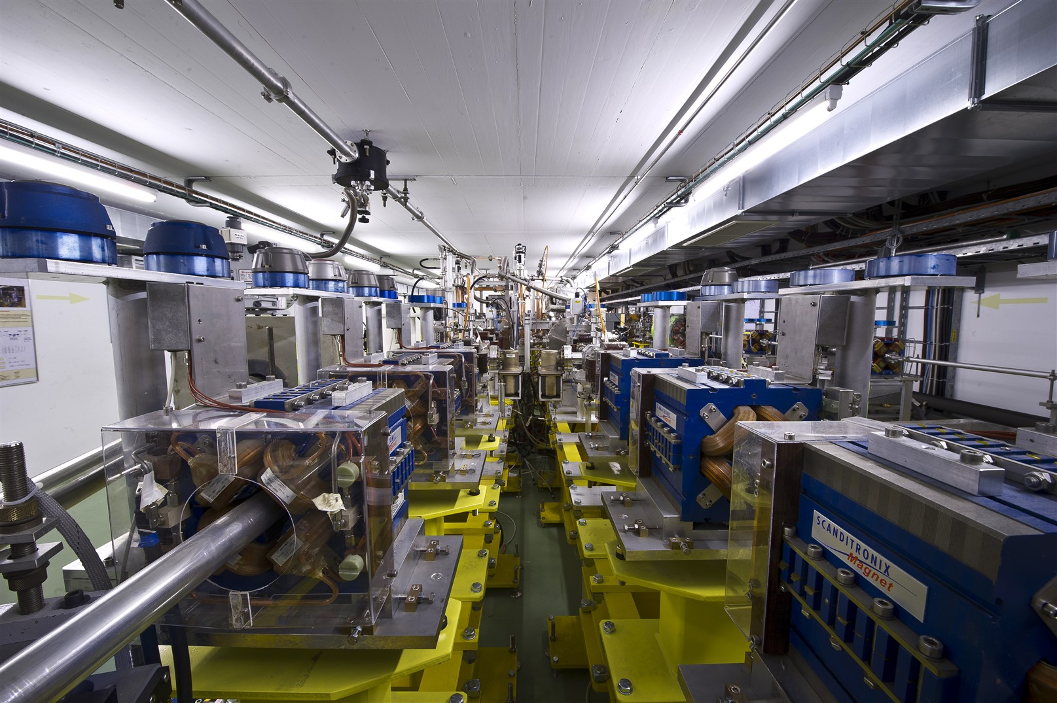
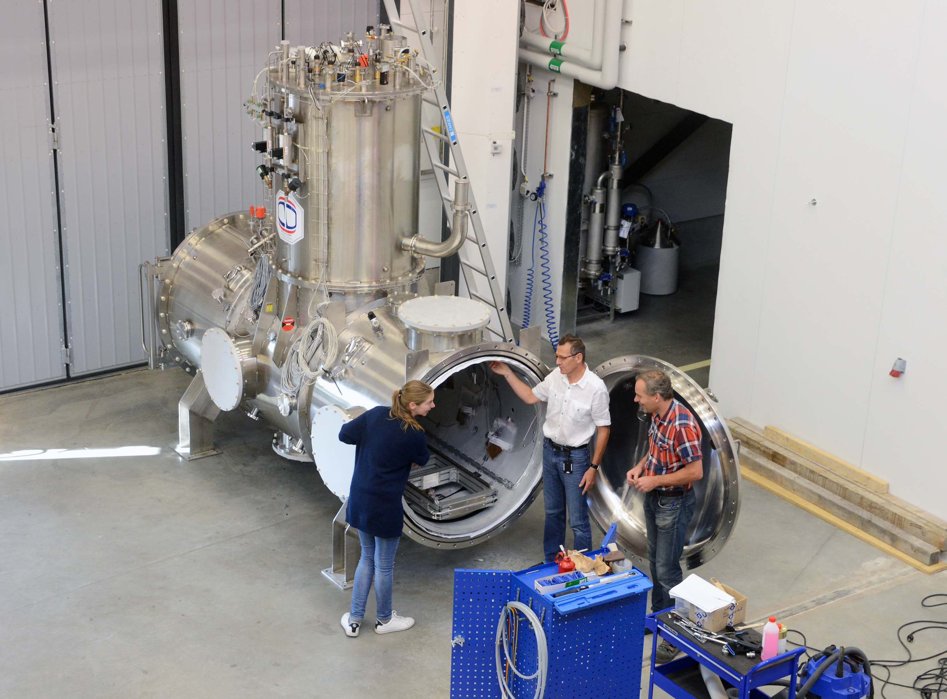
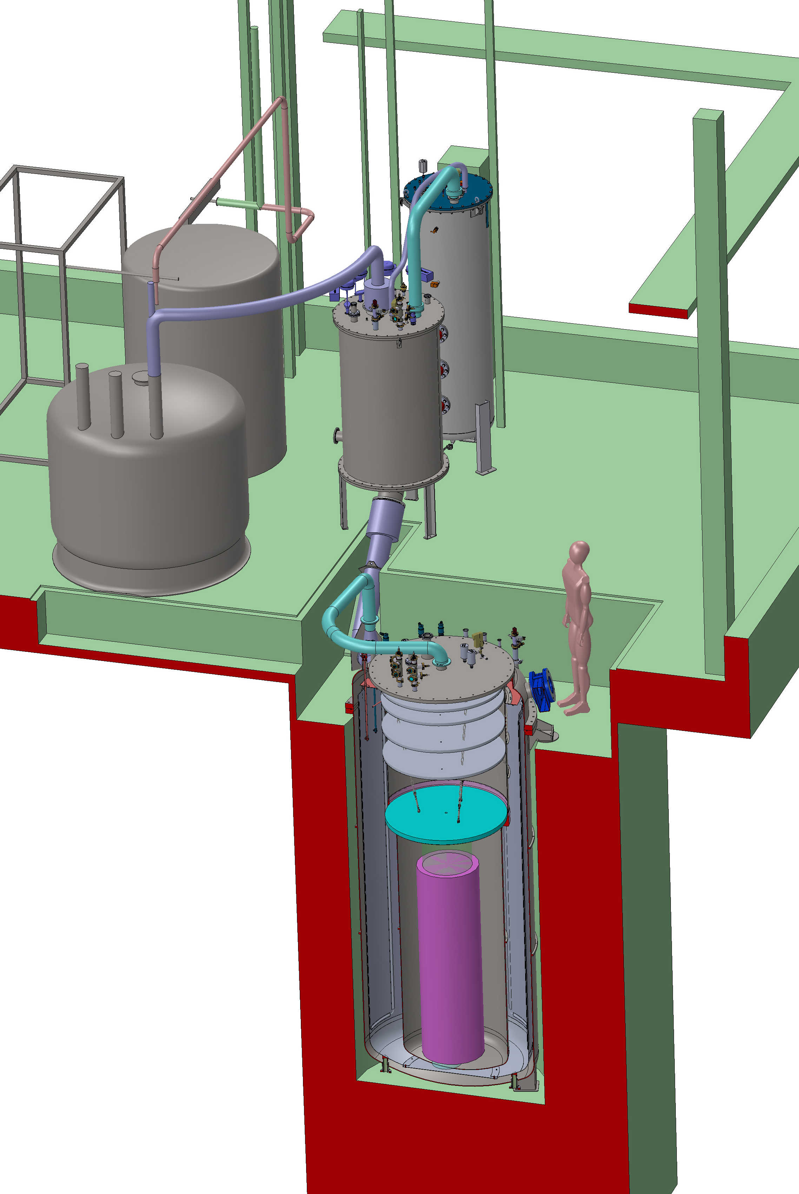
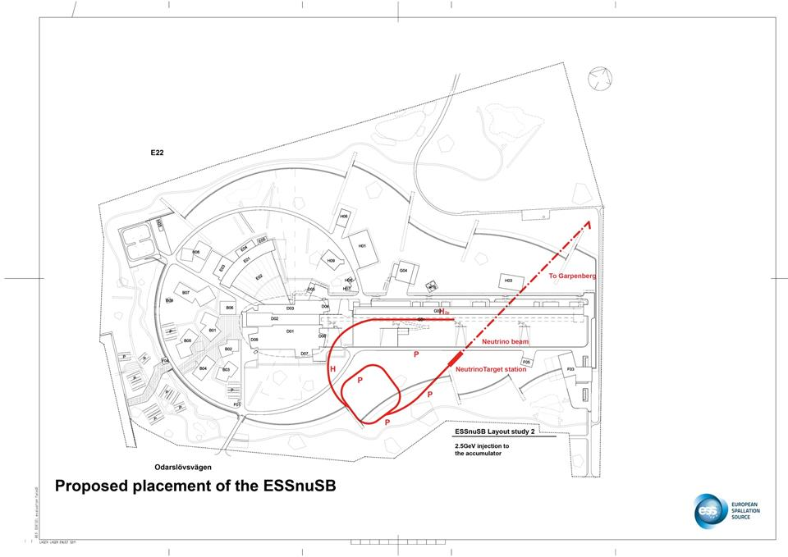
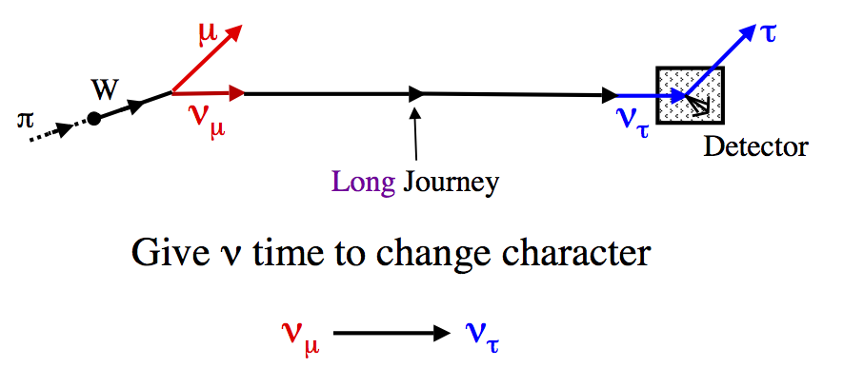
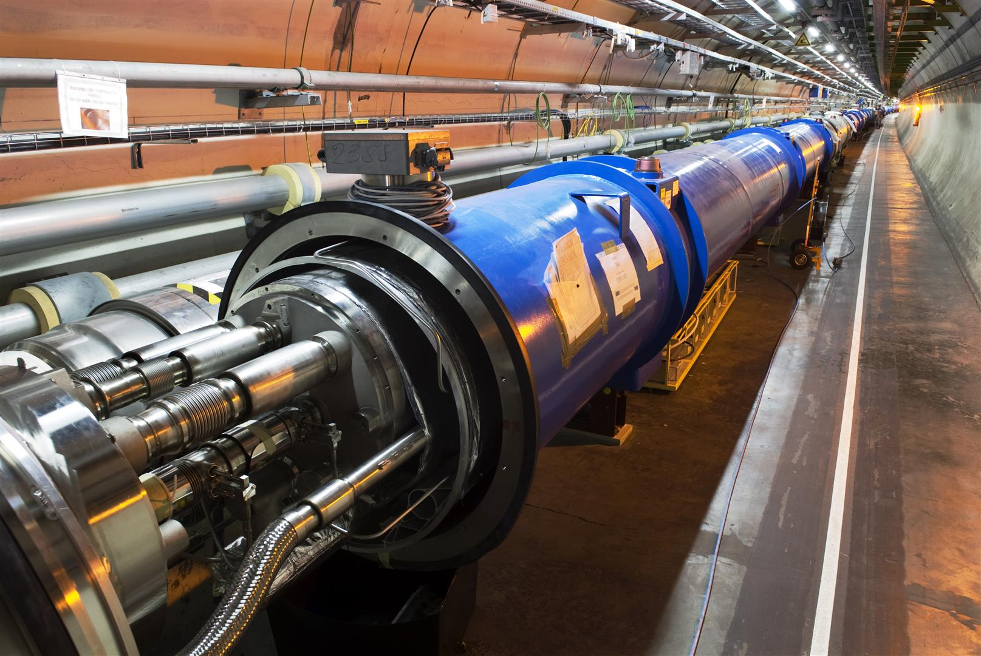
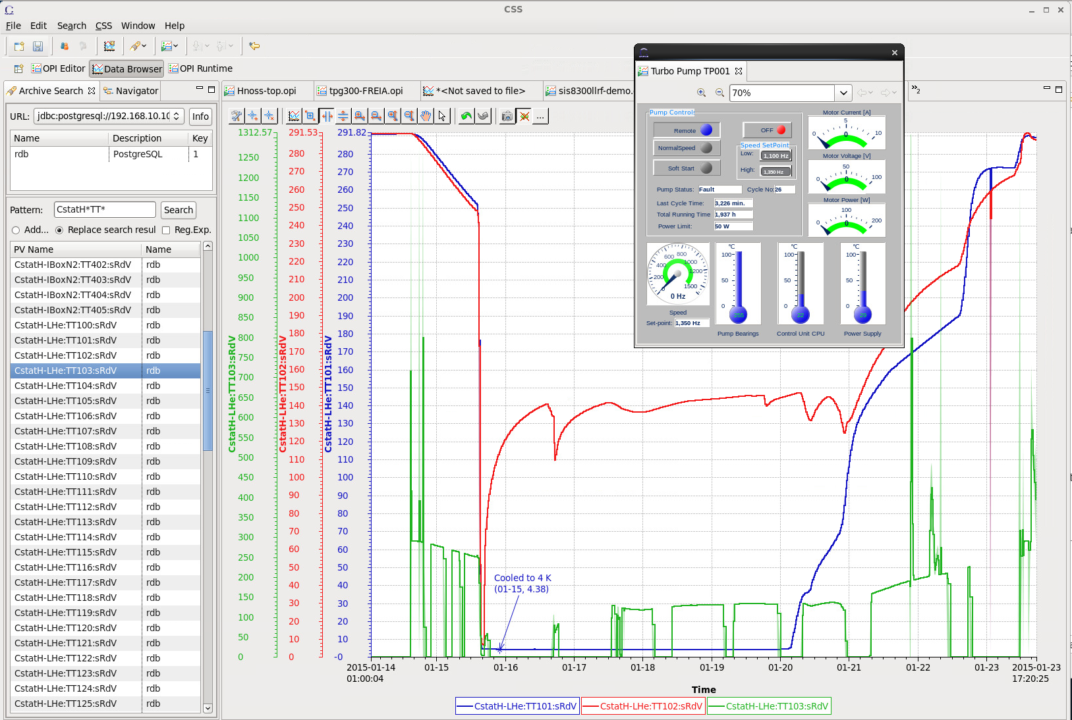
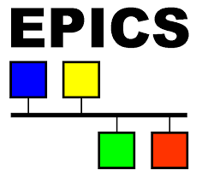
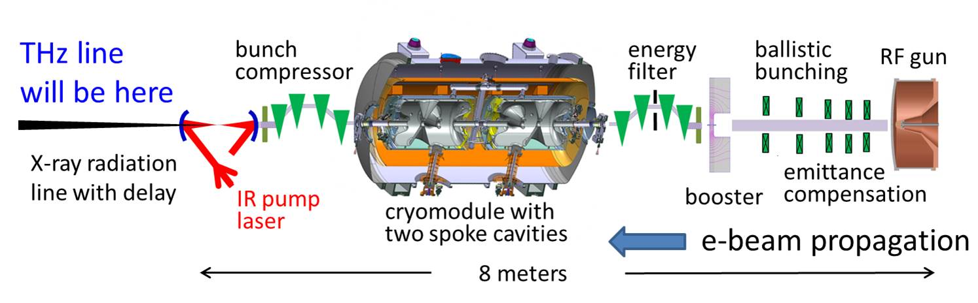
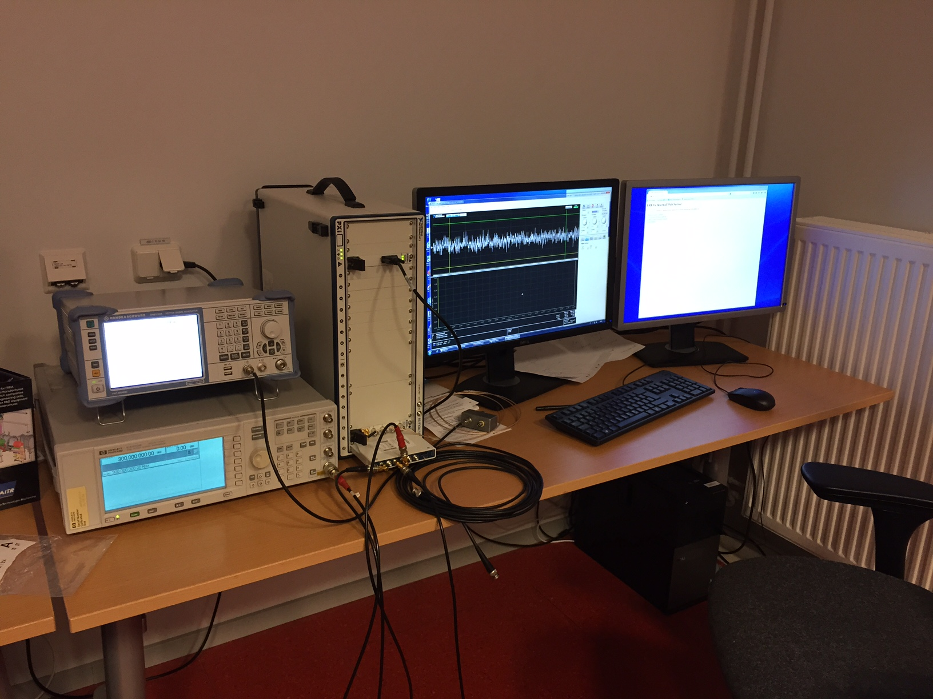
Overview of Activities
ESS SRF Linac
Cryo Distribution
High Power RF
CLIC / CTF3
Cryo Test Stands
ESS Neutrino Super-beam
HiLumi LHC
Controls & Data Acquisition
THz Coherent Light Source
RF = Radio Frequency
SRF = Superconducting RF

Slide 6
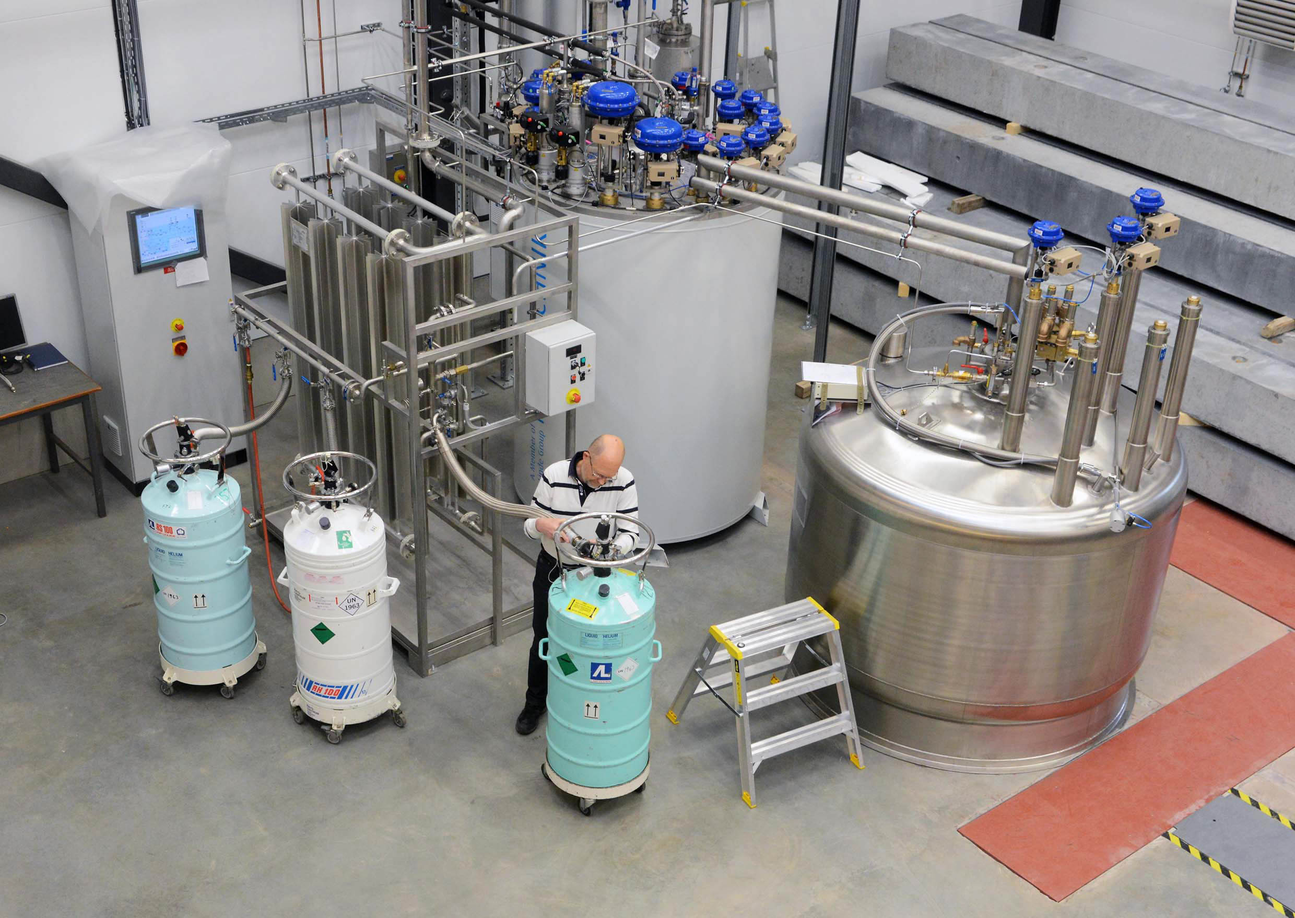
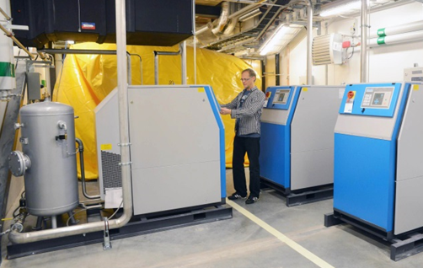
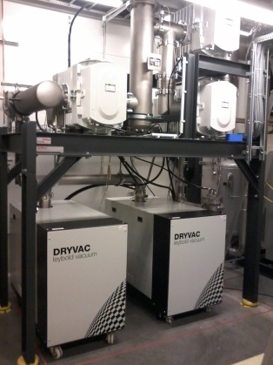
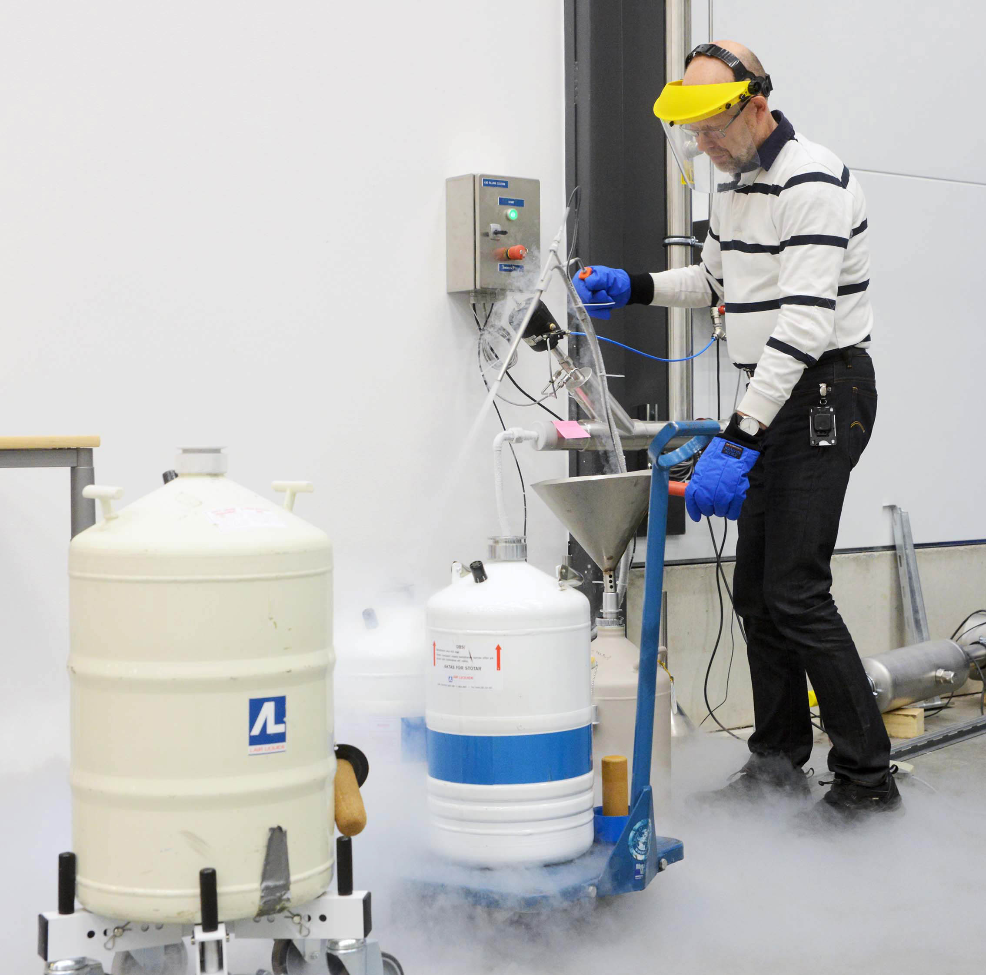
Cryogenics
Helium liquefaction
  150 l/h at 4.5K (LN2 pre-cooling)
  2000 l LHe dewar/buffer, 3+1 outlets
  cryostats connected in closed loop
Gas recovery
  100 m³ gasbag
  3x 25 m³ /h compressor
  10 m³ 200 bar storage
2K Pumping
  ~3.2 g/s at 10 mbar
  ~4.3 g/s at 15 mbar
  110(90)W at 2.0(1.8)K
Liquid nitrogen
  20 m³ LN2 tank
Helium gas recovery system
Sub-atmospheric pumping station

Slide 7
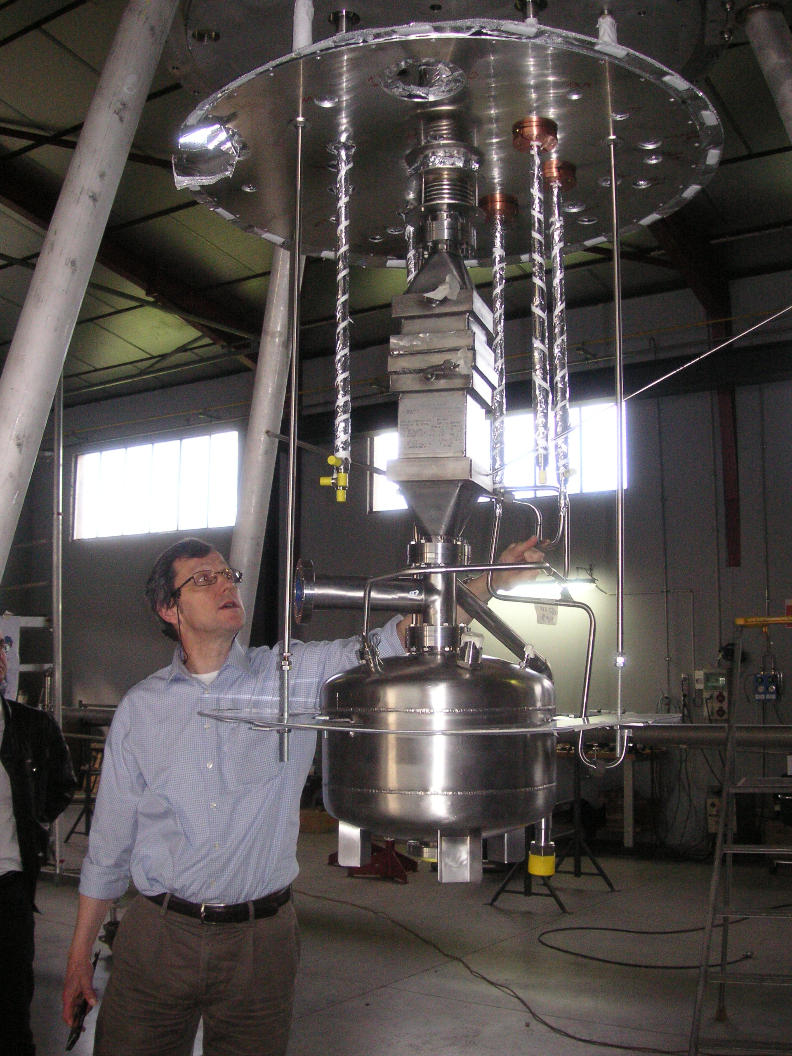
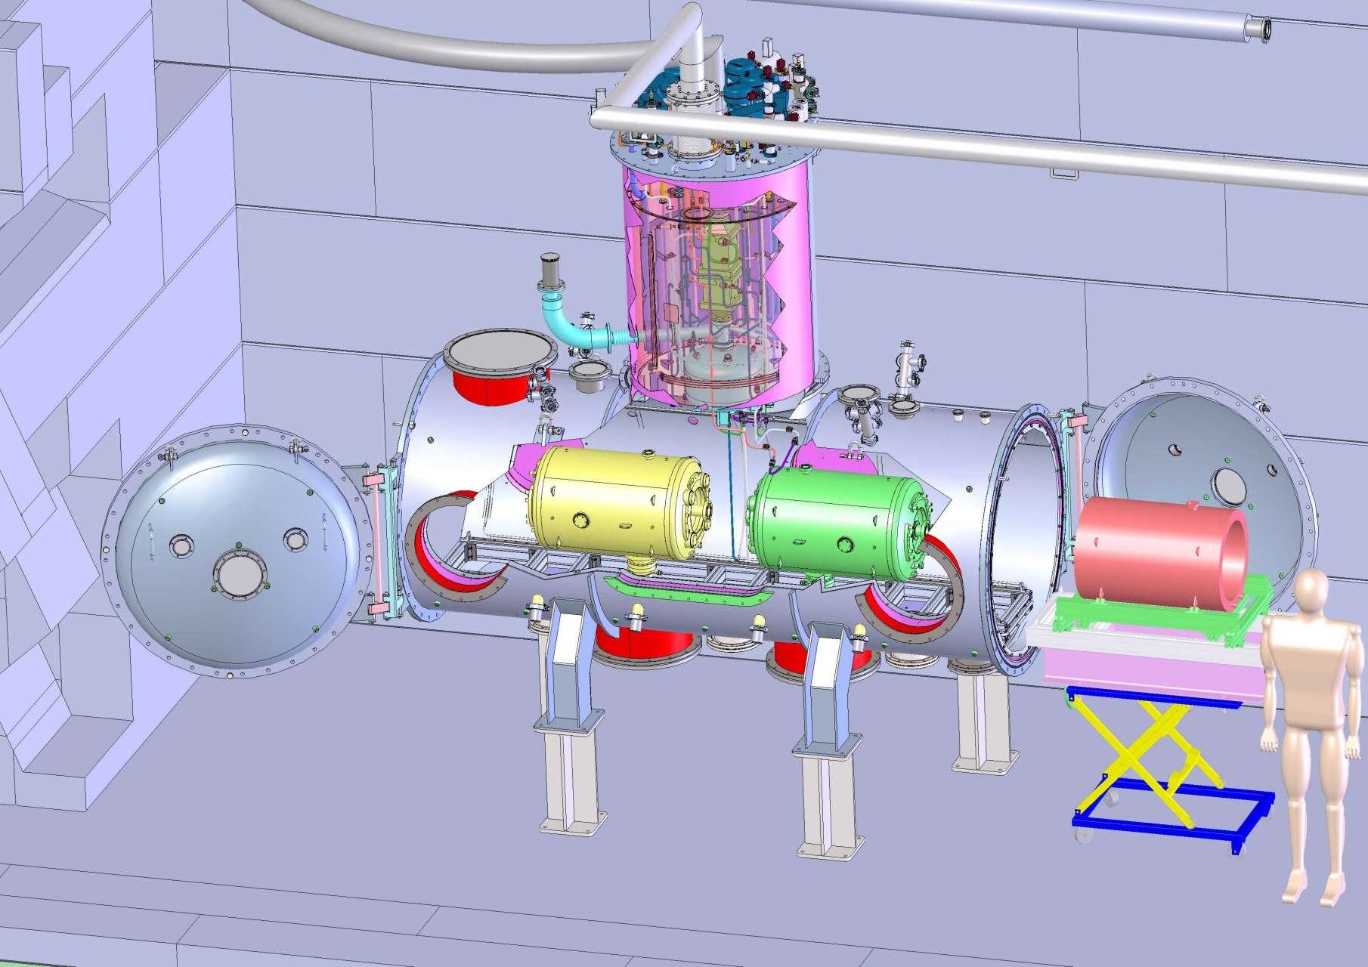
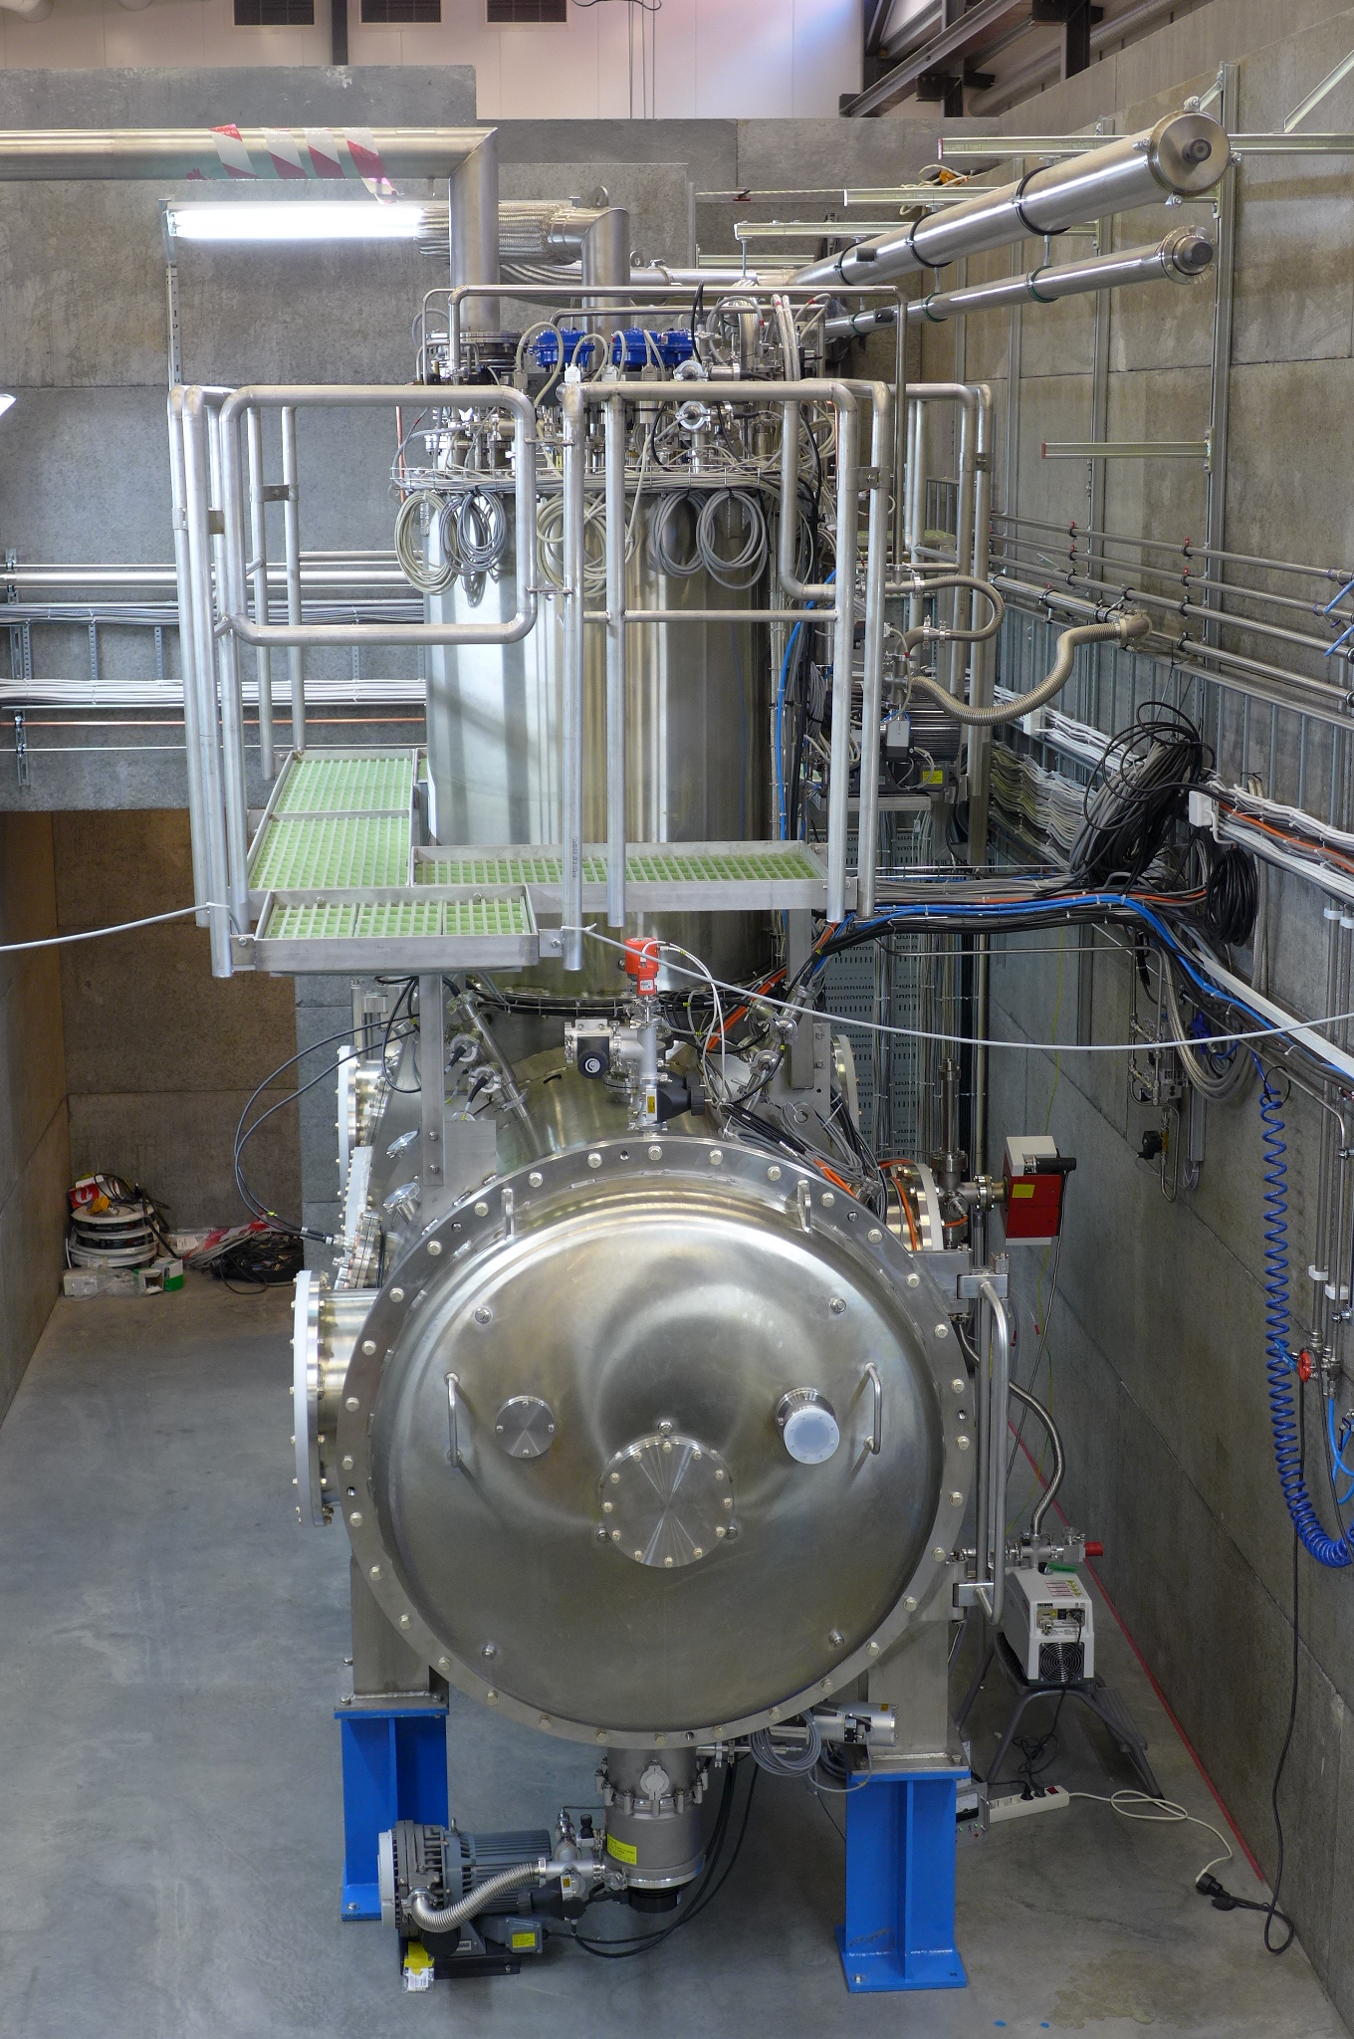
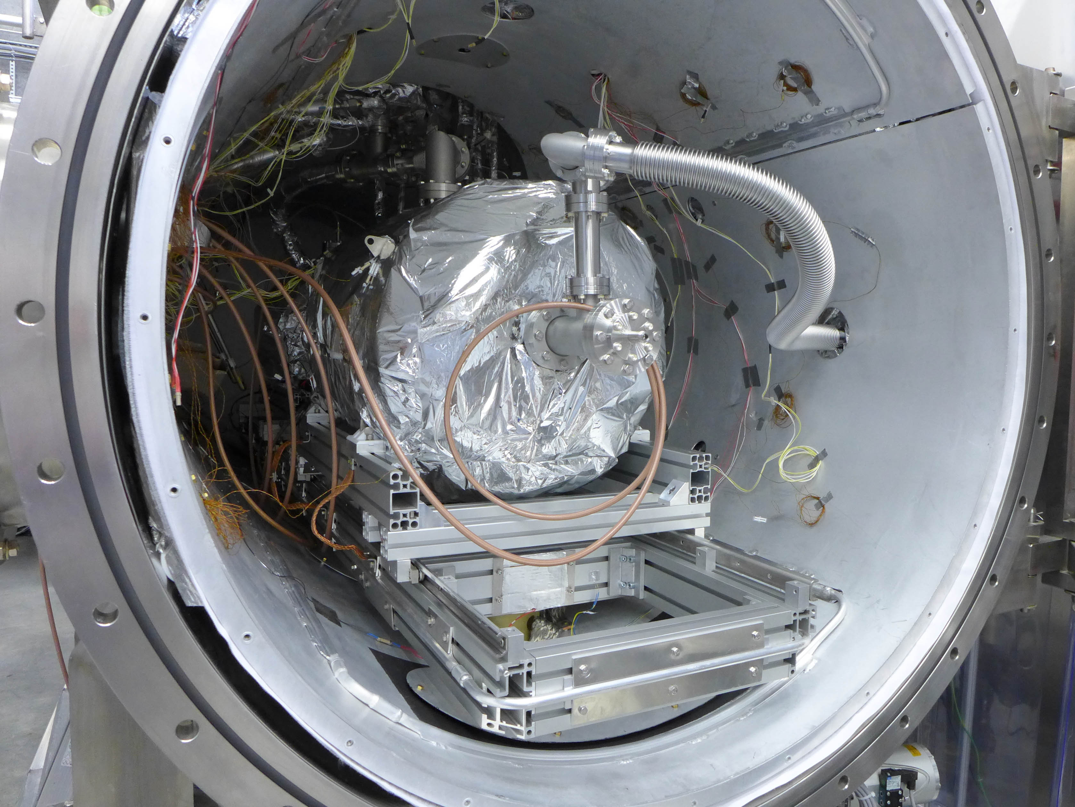
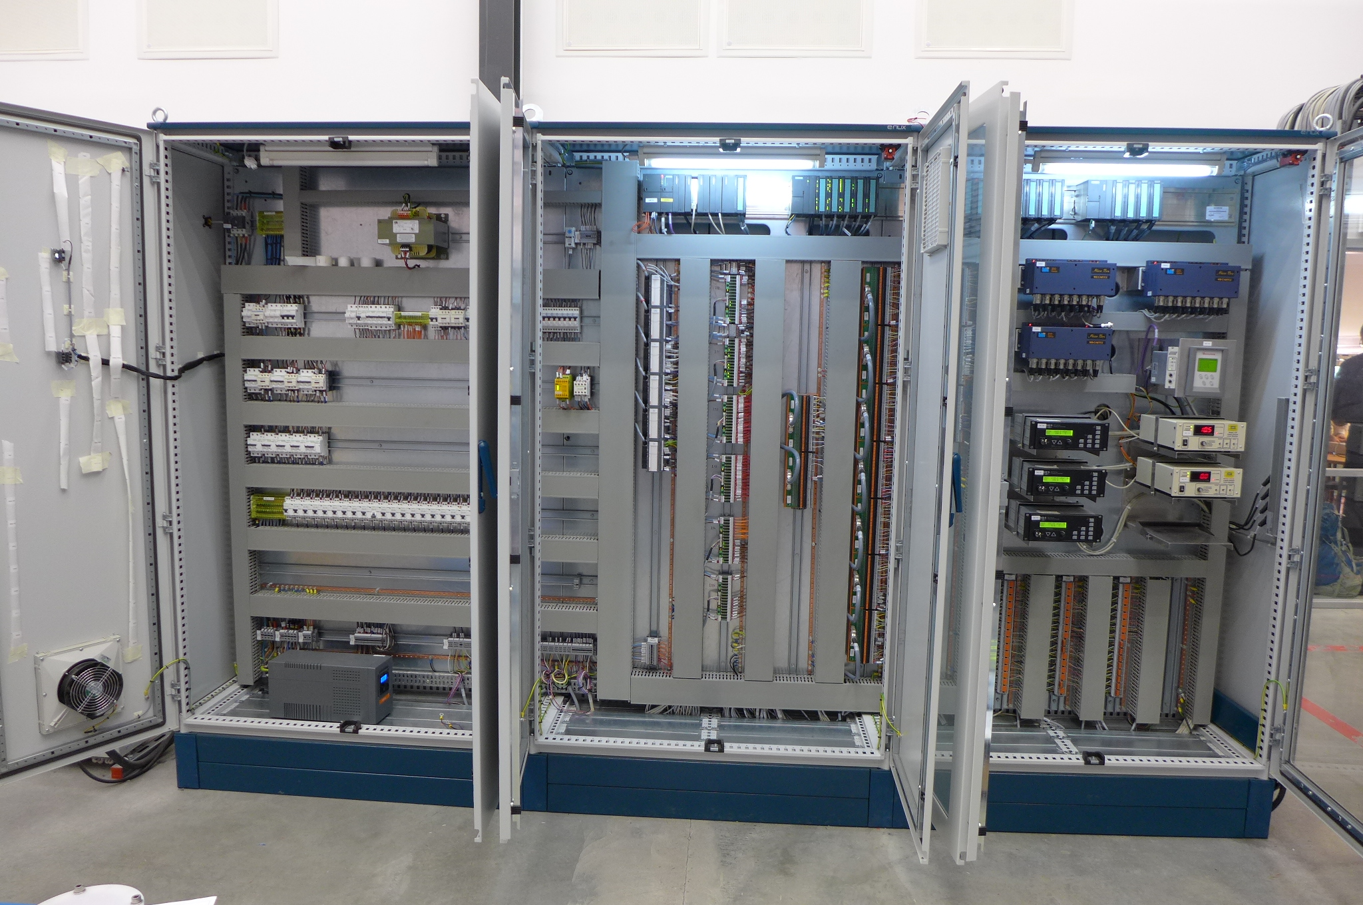
HNOSS Horizontal Cryostat
HNOSS: Horizontal Nugget for Operation of Superconducting Systems
Main Vacuum Vessel
  3240 x ø1200mm inner volume
  “beam” axis at 1600mm
Valve box (on top of main vessel)
  distribute cryogens
  4K and 2K pots, JT-valve, heat exchanger
  5K supercritical helium
LN2 and LHe transfer lines
  interconnection box to distribute cryogens to HNOSS and CM
Cold gas re-heater
Control system

Slide 8
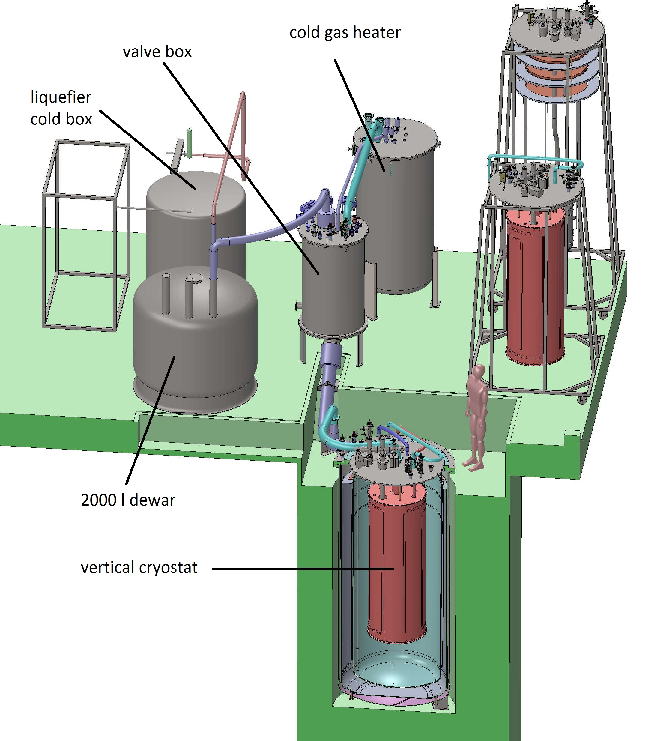
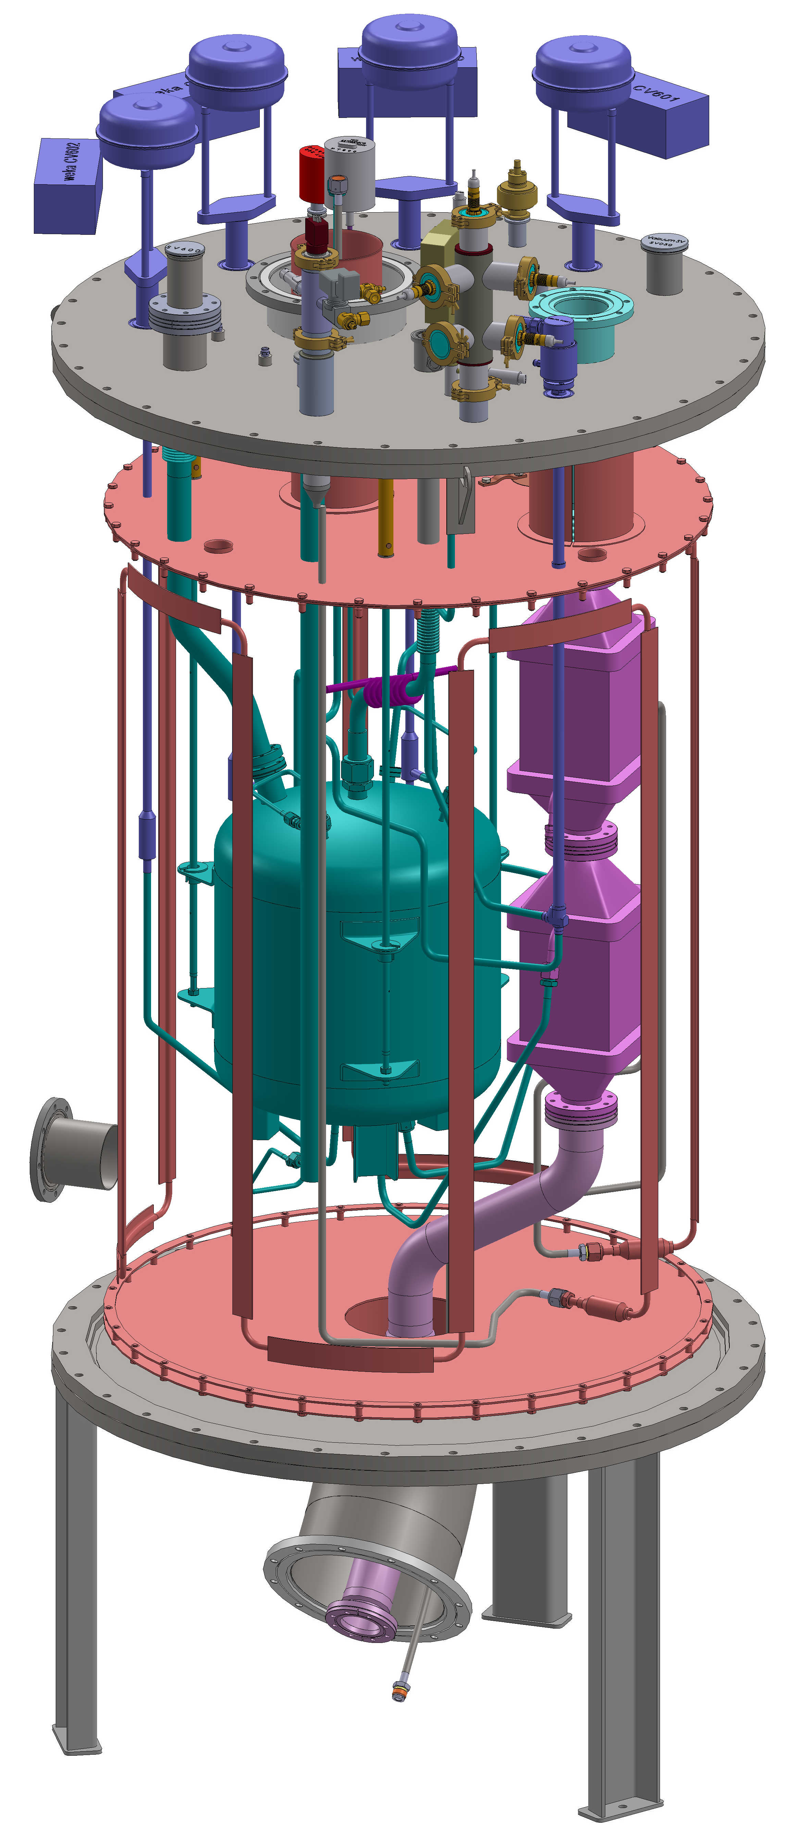
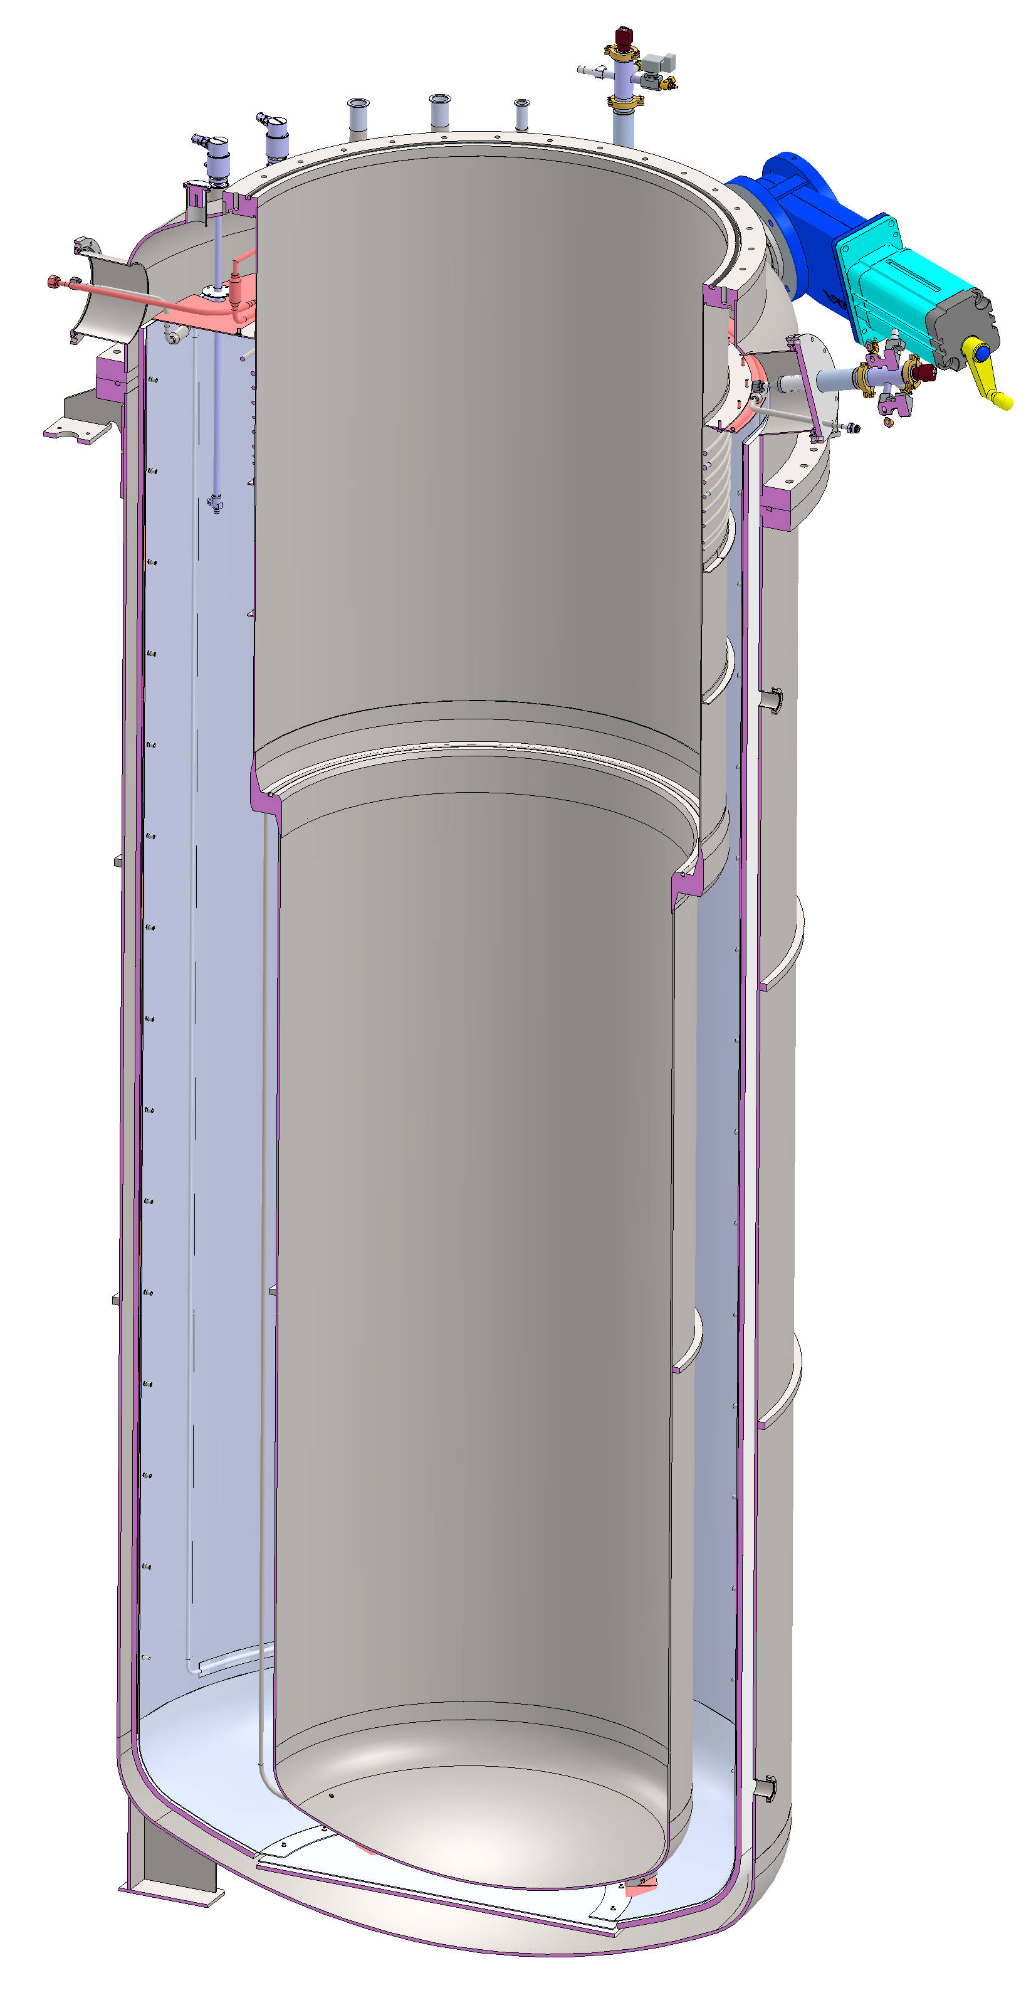
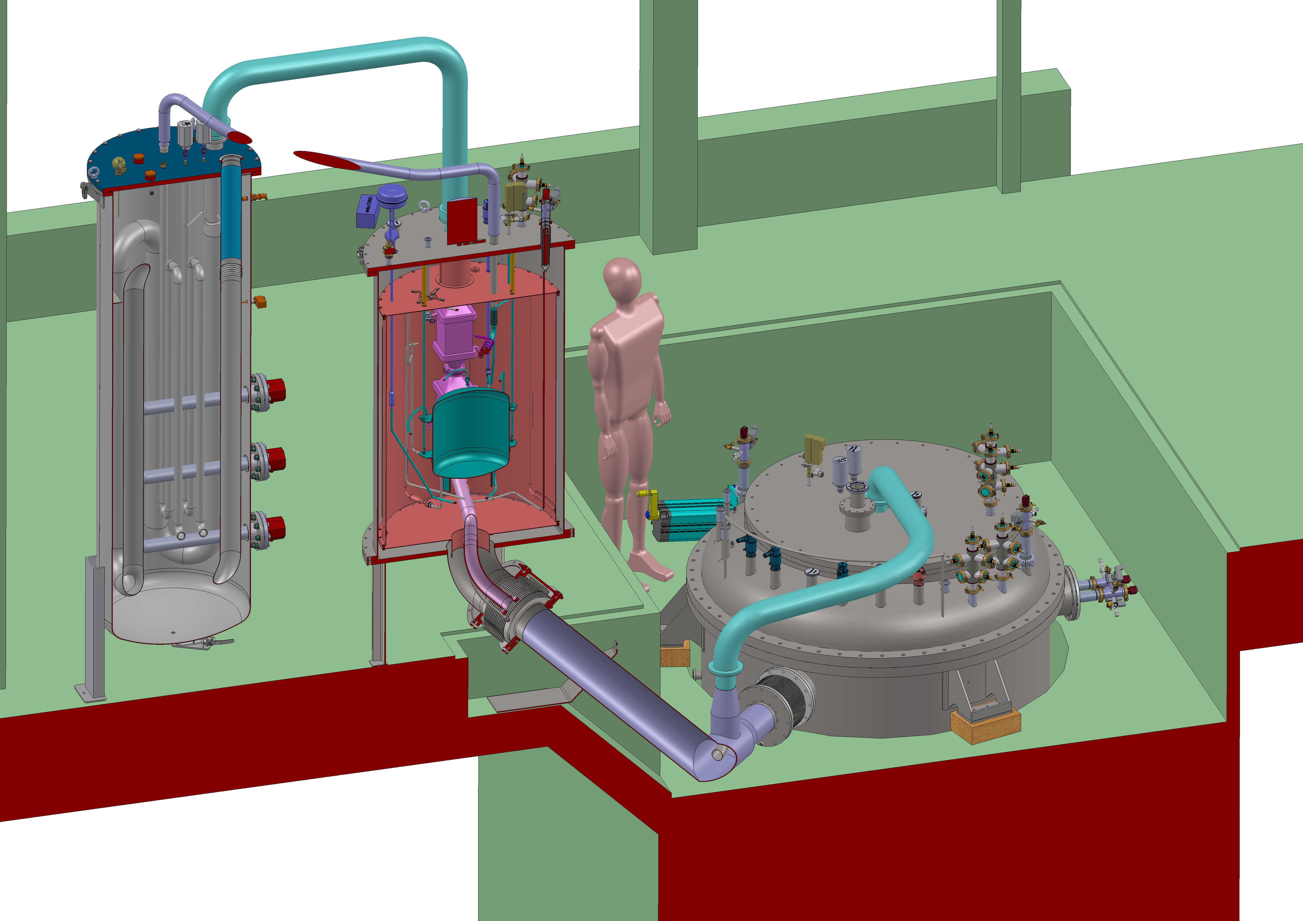
Gersemi Vertical Cryostat
Under construction
Operation modes
  vacuum
  sub-atmospheric liquid bath
  pressurized liquid bath
Main Vacuum Vessel
  4436 x ø1100mm inner volume
  2869 mm below lambda plate
Valve box
  distribute cryogens
  4K pot, JT-valve, heat exchanger
  5K supercritical helium
LN2 and LHe transfer lines
Cold gas re-heater
Control system

Slide 9
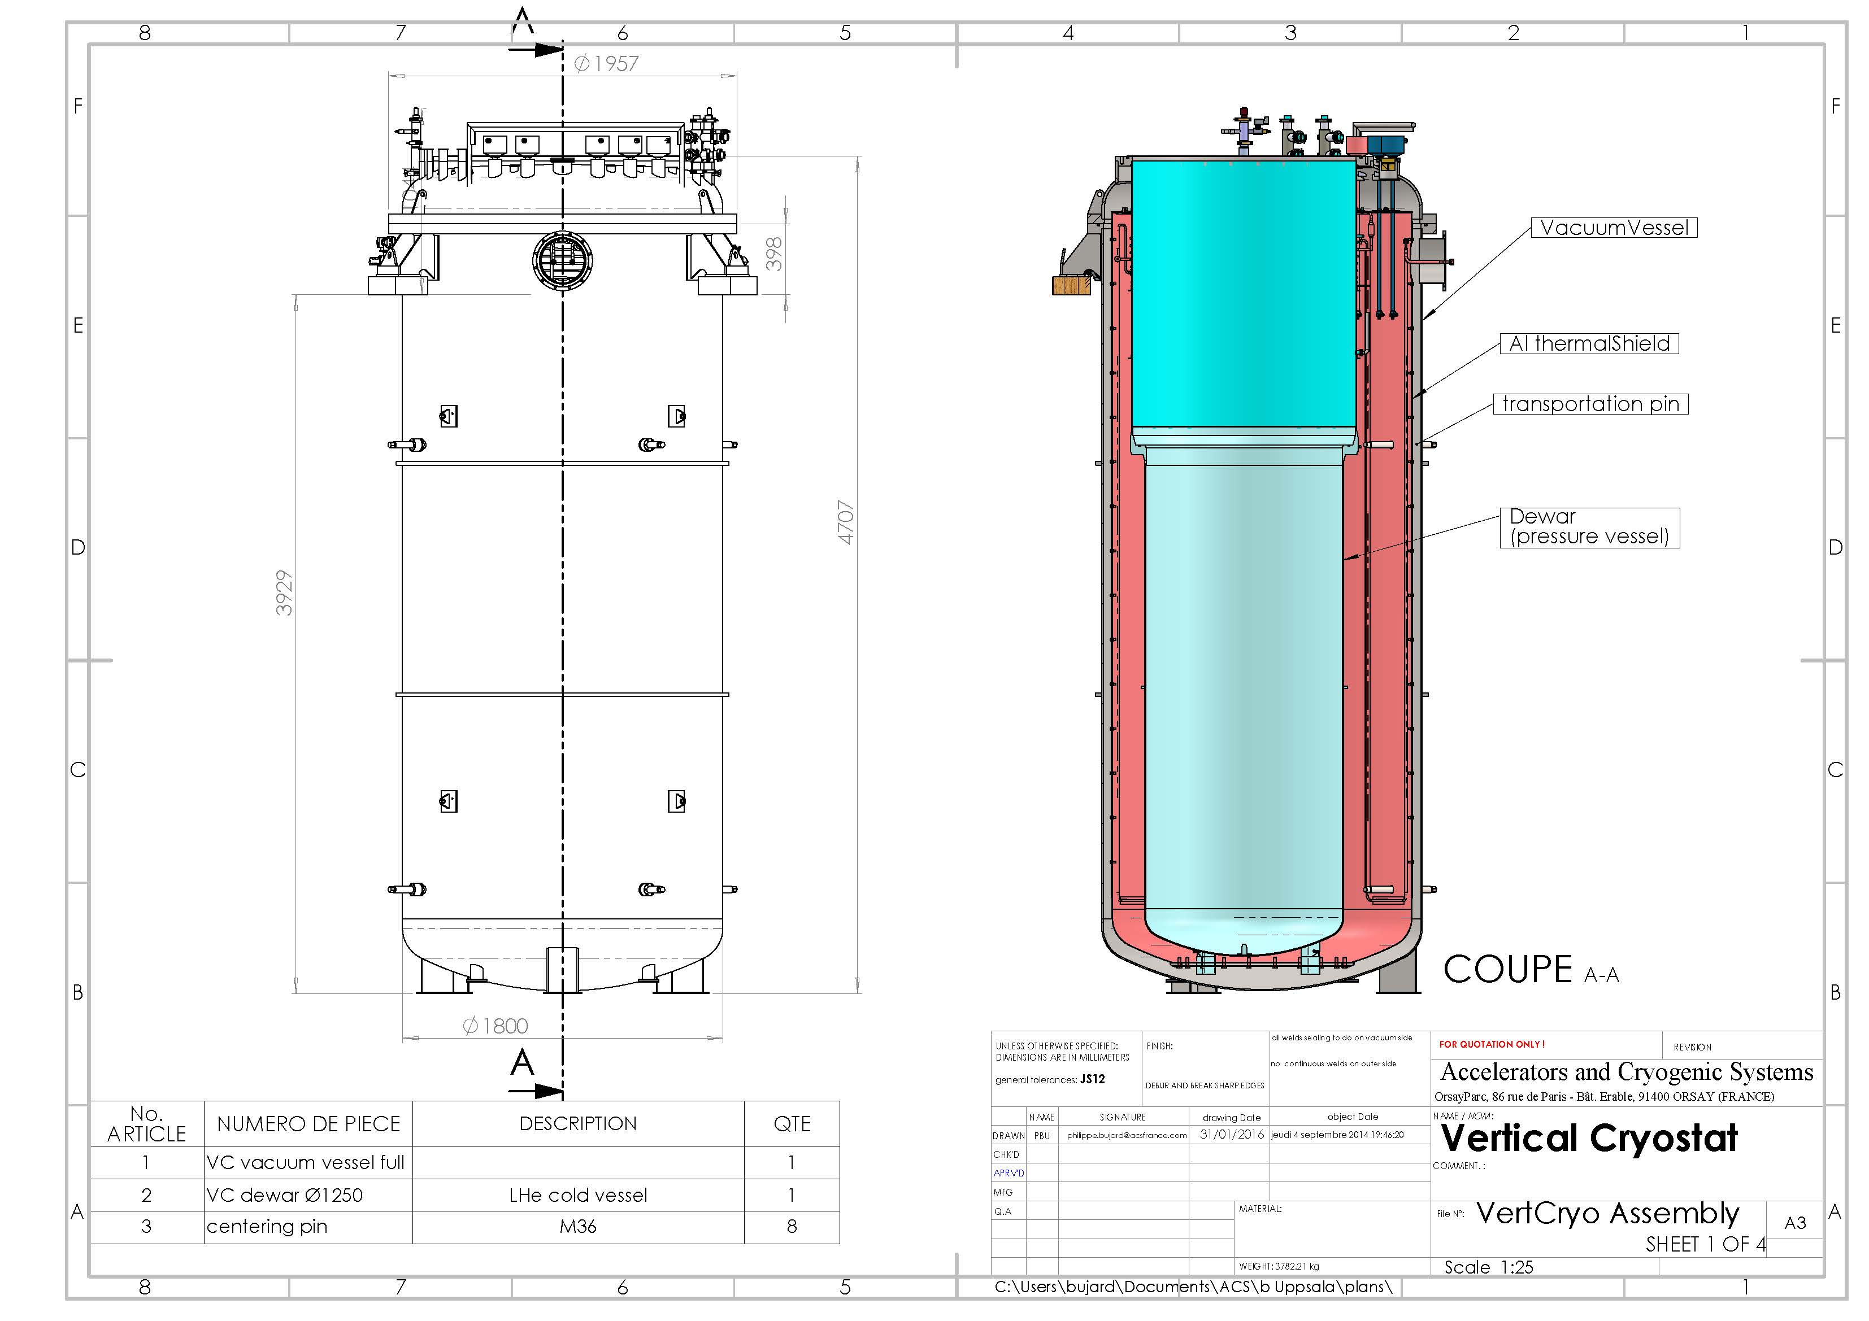
Cryostat Assembly

Slide 10
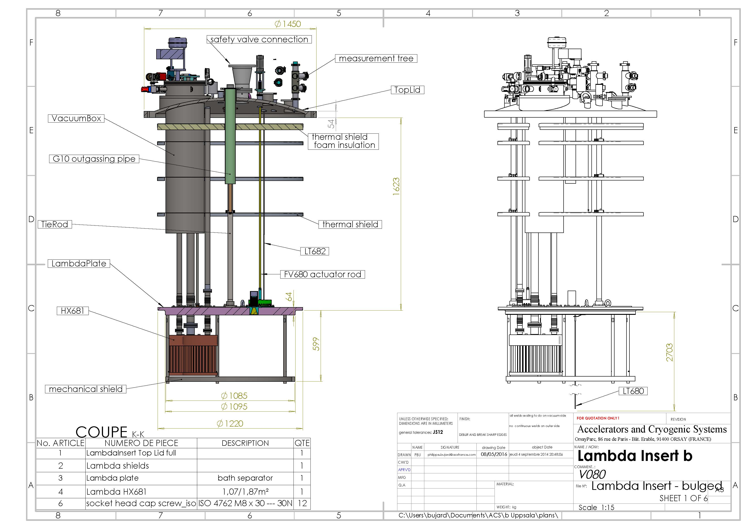
Lambda Insert

Slide 11
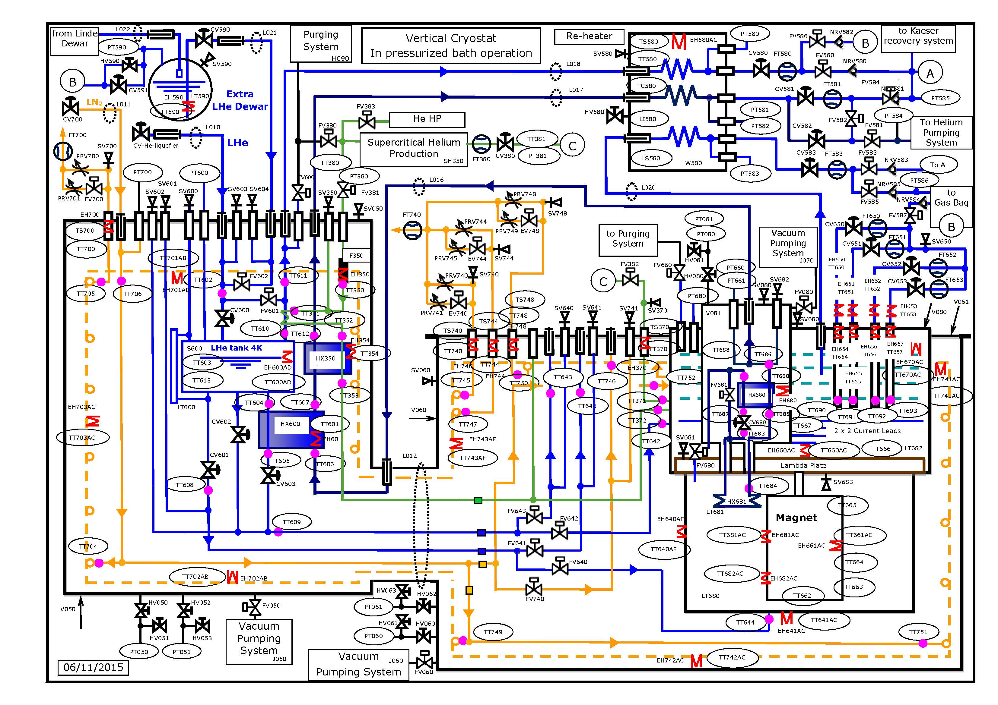
Cryogenic Operation Scheme

Slide 12
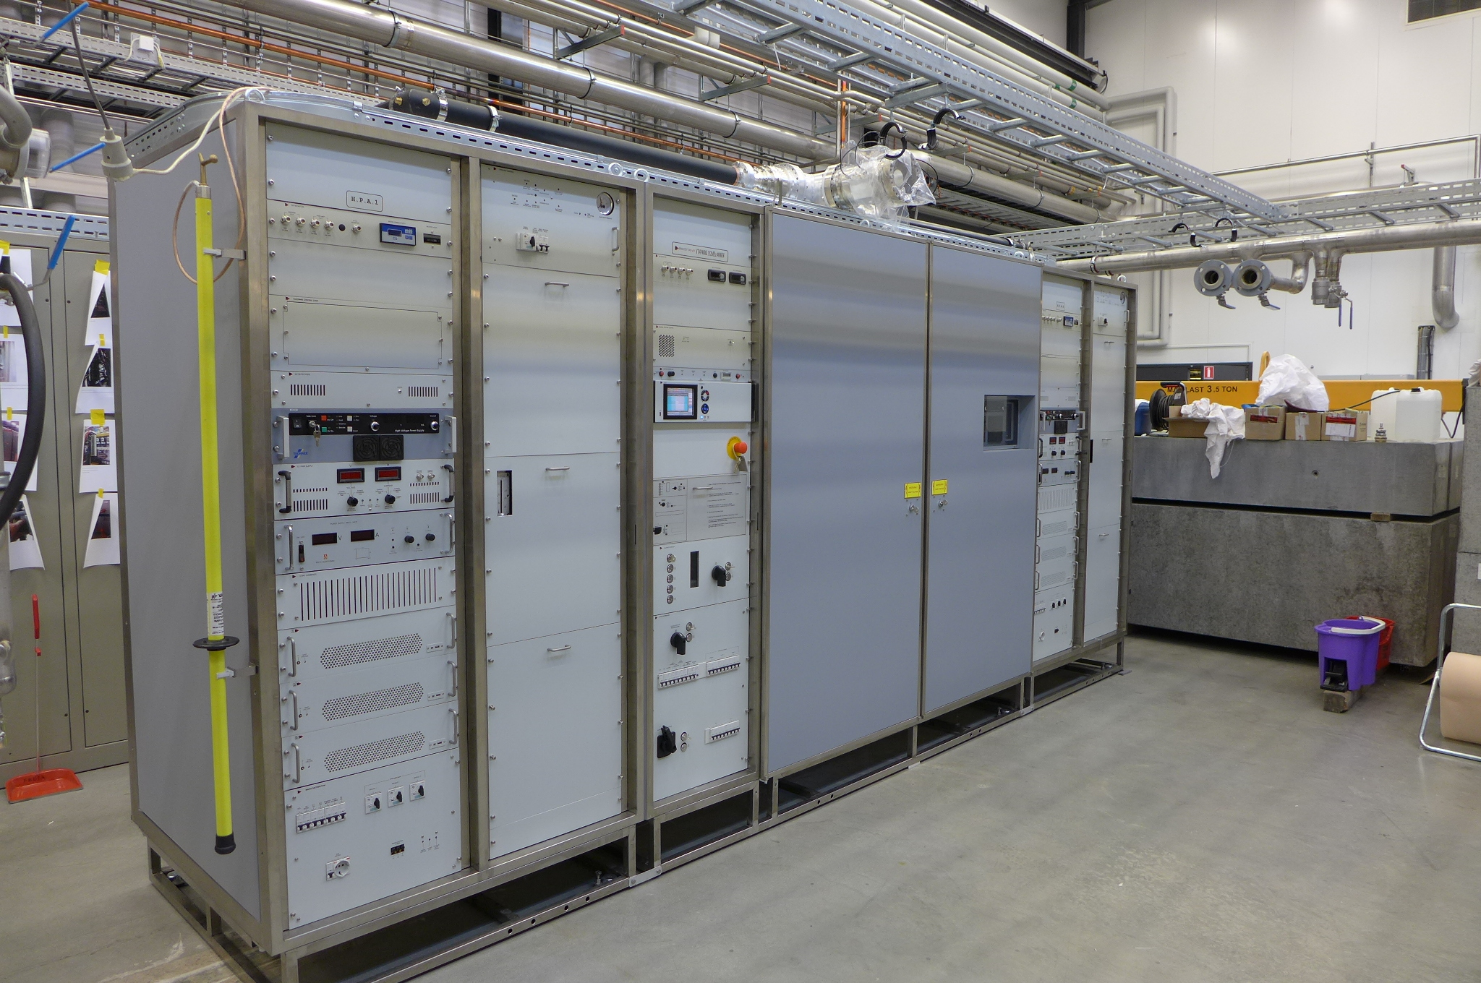
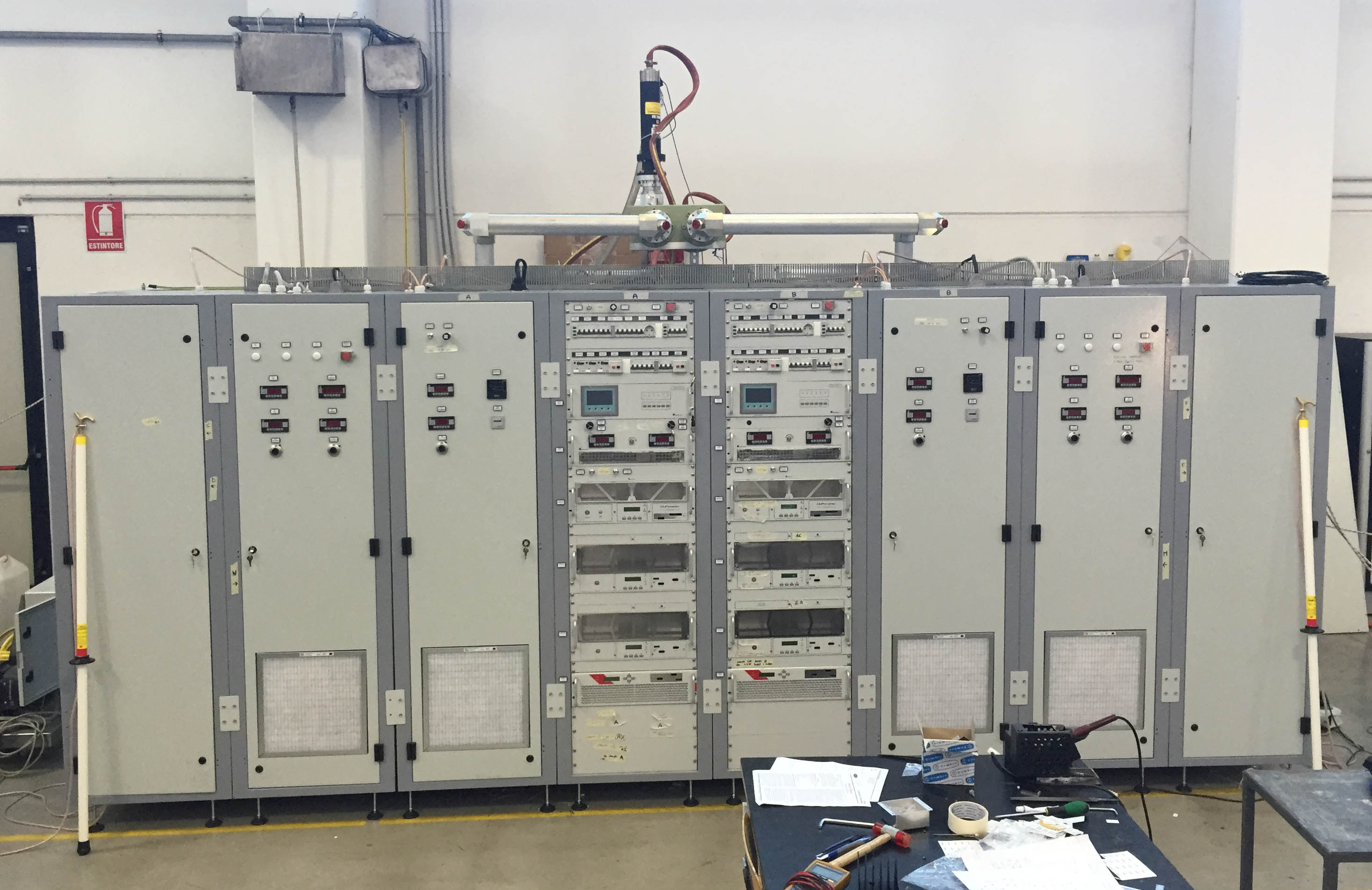
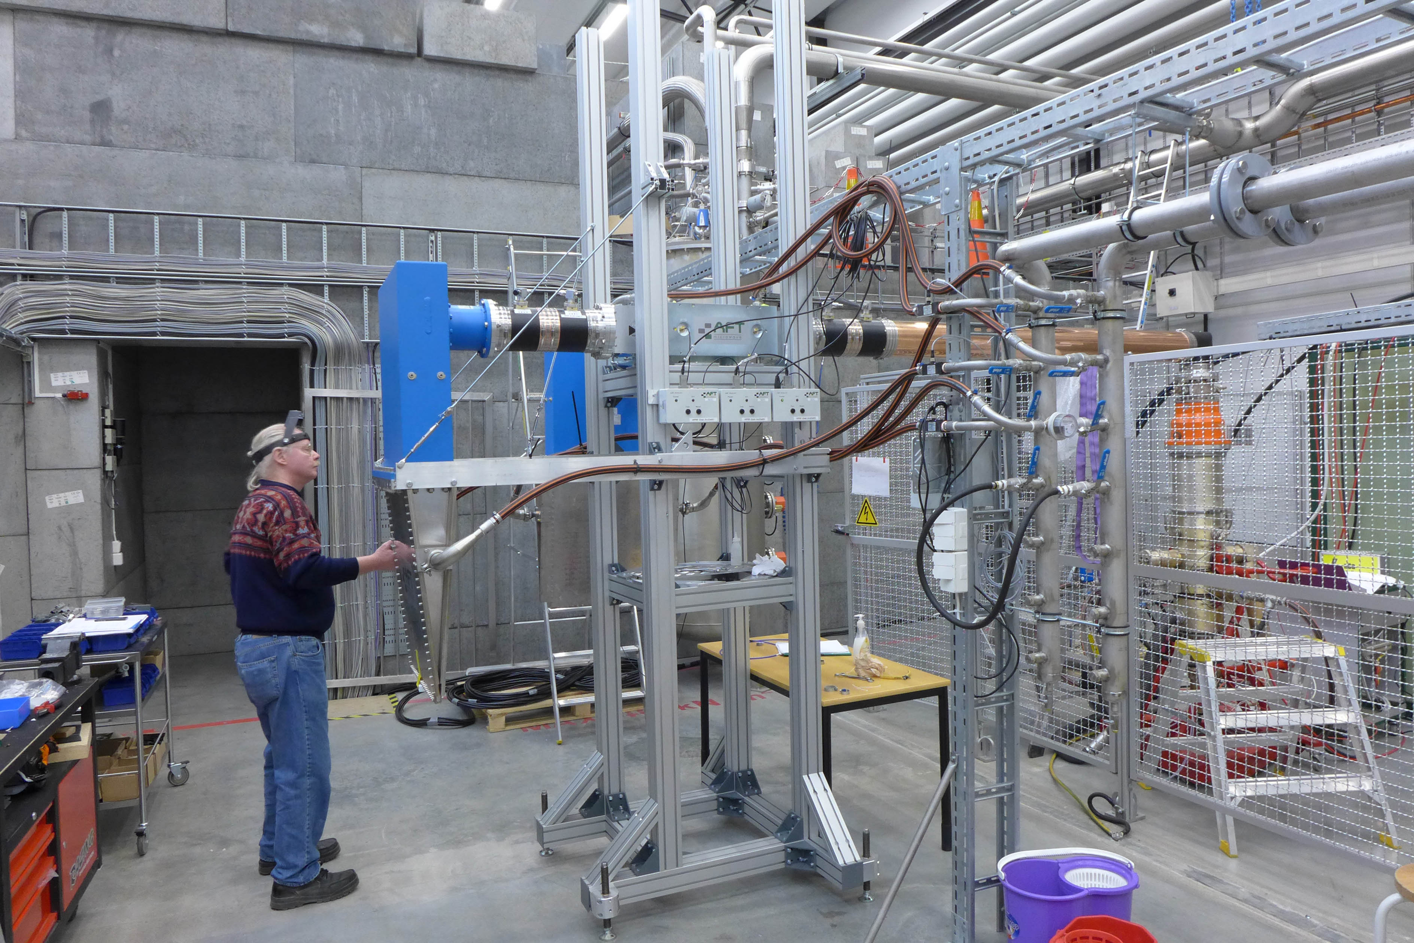
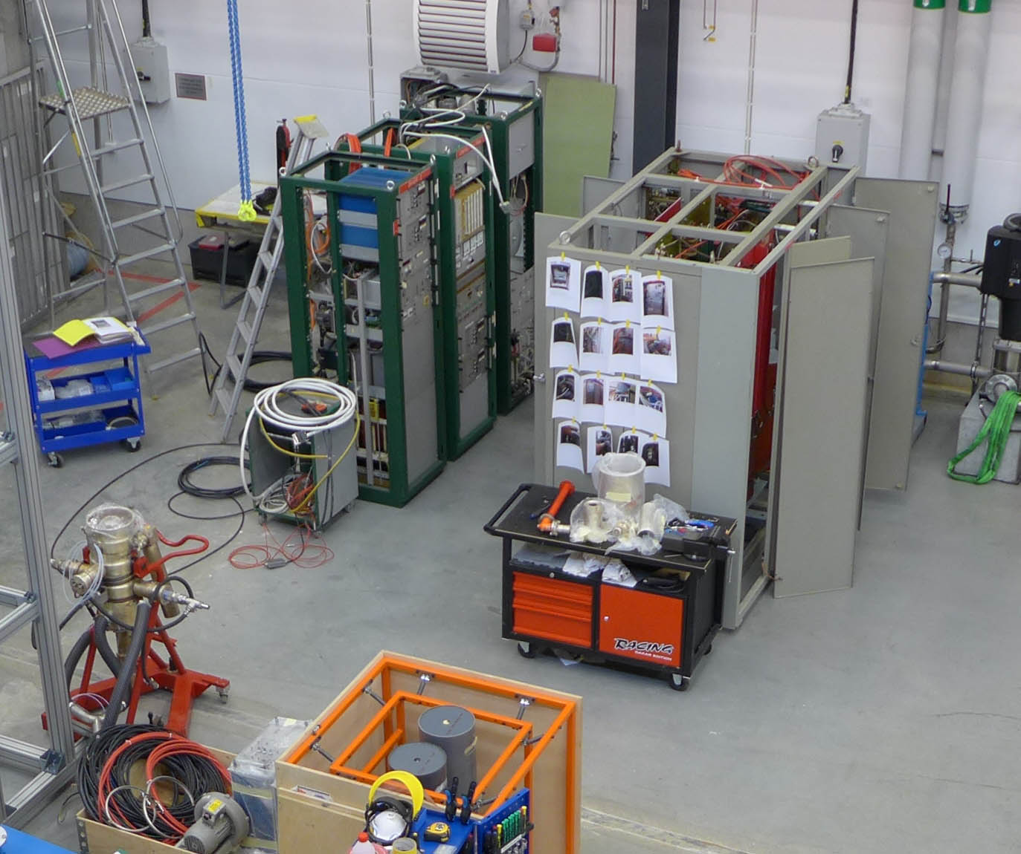
High Power RF Amplifiers
352 MHz, 400 kW, 3.5 ms, 14-28 Hz
Uppsala design
tetrode tube TH595
prototype for ESS SRF spoke linac
industrial manufacturing
  Itelco-Electrosys (Orvieto, IT)
  DB Elettronica (Padua, IT)
352 & 400 MHz, 50 kW, CW
CERN (loan since Feb.2015)
tetrode tube TH571b

Slide 13
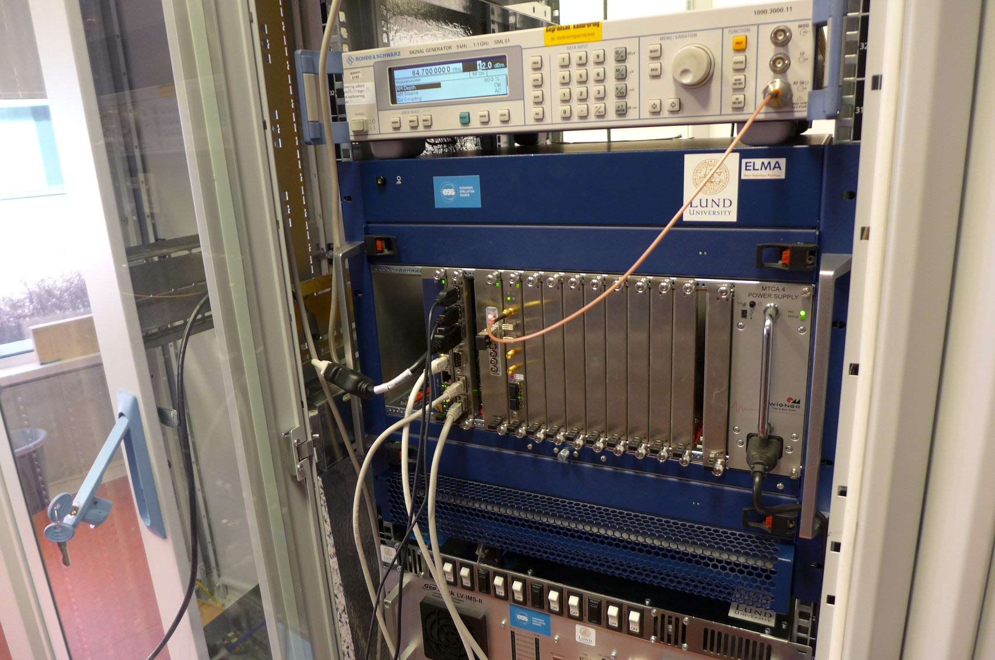
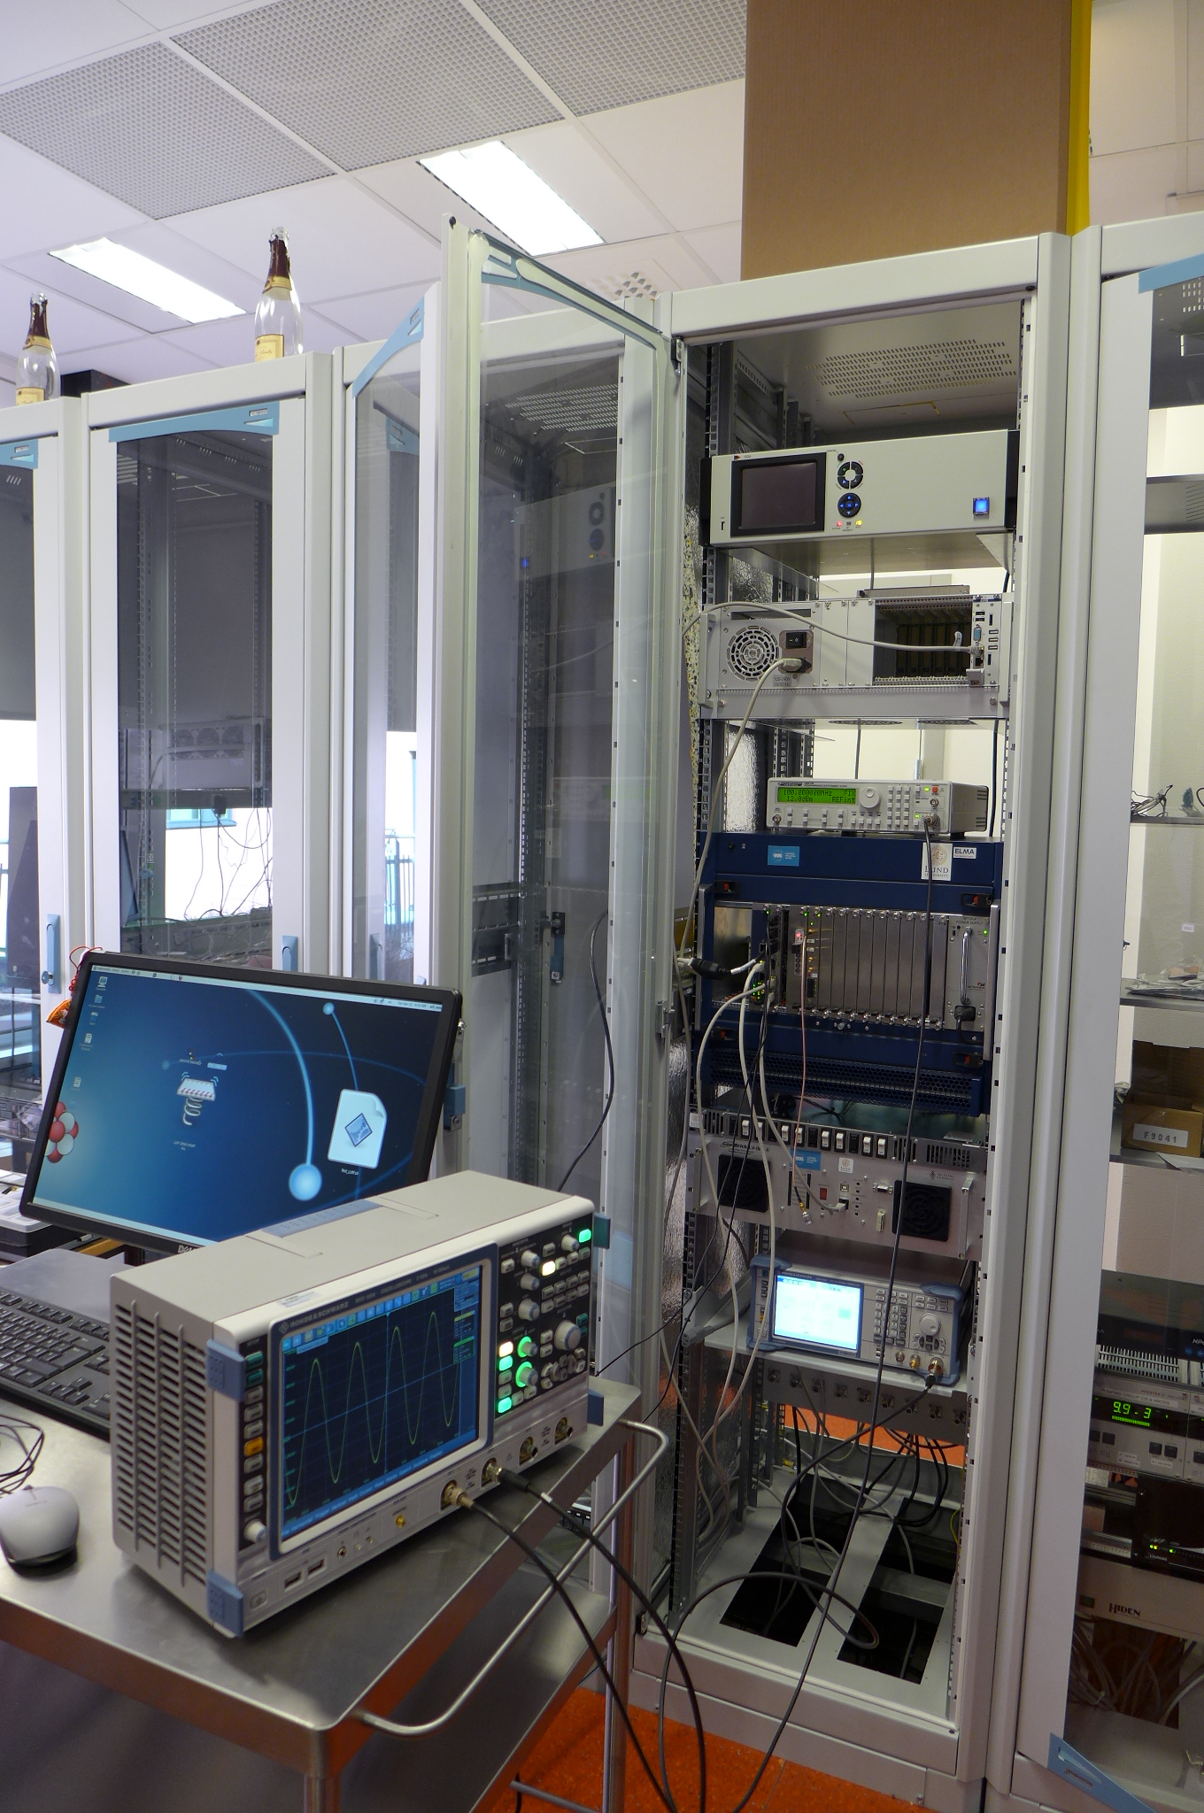
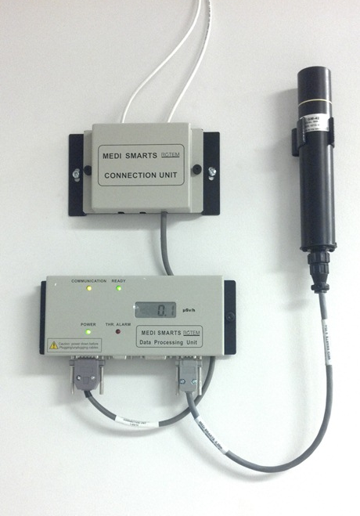
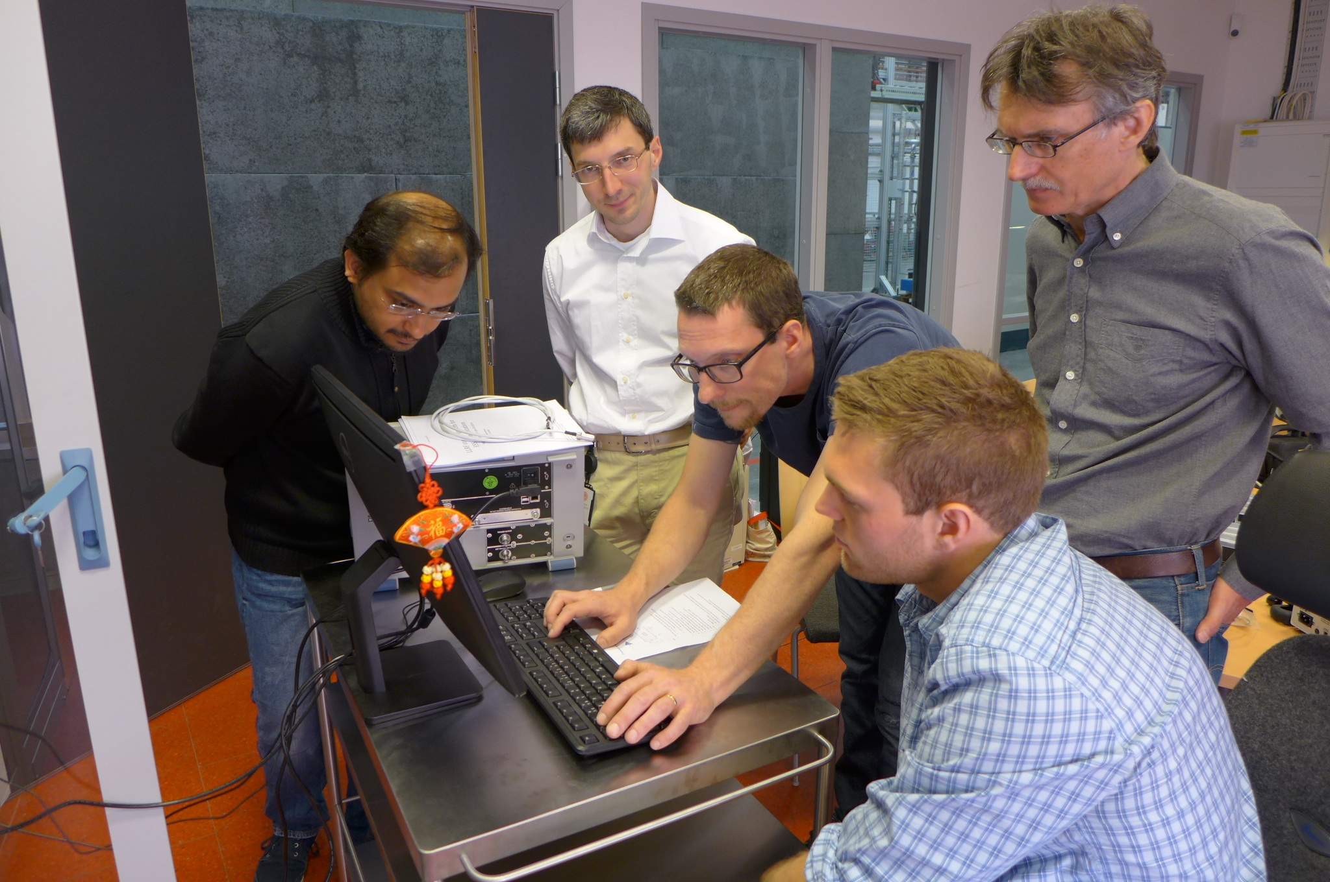
Controls
Controls and interlock systems
EPICS interface, data archiver
connecting different sub-systems
  Linde, Cryo Diffusion, Leybold
different hardware
  Siemens PLC, Nat.Instr. cRIO
Radiation monitoring system
Rotem MediSmart
2 inside, 3 outside bunker
In-house development LLRF
Nat. Instr. PXI and LabVIEW
self-excited loop with digital phase control
extended RF measurements

Slide 14
Test Stand ID Card
name FREIA Laboratory
1 location Uppsala University (Uppsala, Sweden)
number of people working at the test stand 20 (of which 6 scientists, 4 PhD students)
2 surface of the test stand approx. 1100 m2
3 operating temperature 1.8K to 4.2K (LN2 cooled thermal shield)
cooling techniques pressurized or sub-atmospheric bath, vacuum
4 cooling phases 300 - 4.2 K, 4.2 K - 1.8K
5 cooling and pumping capacity 140 l/h liquid production, 4 g/s pumping
6 shared cryogenics yes, with horizontal cryostat test stand
7 PWC max. current, max voltage ±2 kA, ±10 V (planned, CERN design)
8 HVWL
9 number of cryostats 1 vertical (Gersemi), 1 horizontal (HNOSS)
10 capacity of cryostats (useable, l x d) 2.8 m x 1.1 m [vert.], 3.6 m x 1.1 m [hor.]
11 handling tools 1 x 6.5 t overhead crane
12 interlock safety NI CompactRIO, LabVIEW
13 DAQ cards and used software NI PXI, LabView
14 quality control tools
15 magnetic measurement capability

Slide 15
This work is supported by
Knut and Alice Wallenberg Foundation,
Swedish Government,
Uppsala University
In collaboration with
Dept. Physics and Astronomy and Dept. Engineering Sciences, Uppsala University
Accelerator and Cryogenic Systems, Orsay, France

