Slide 1
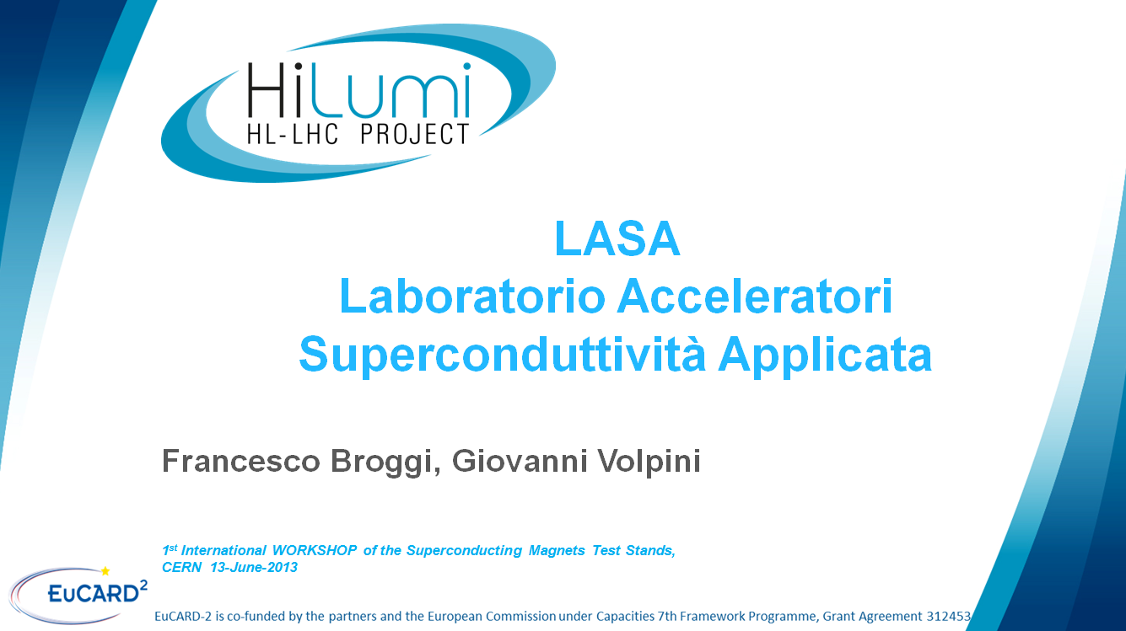

Slide 2
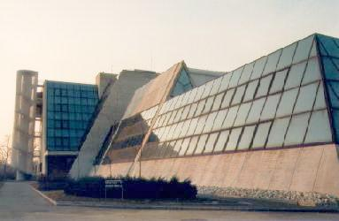


LASA Laboratorio Acceleratori Superconduttività Applicata
Francesco Broggi
francesco.broggi@mi.infn.it
francesco.broggi@cern.ch
1st International WORKSHOP of the Superconducting Magnets Test Stands

Slide 3
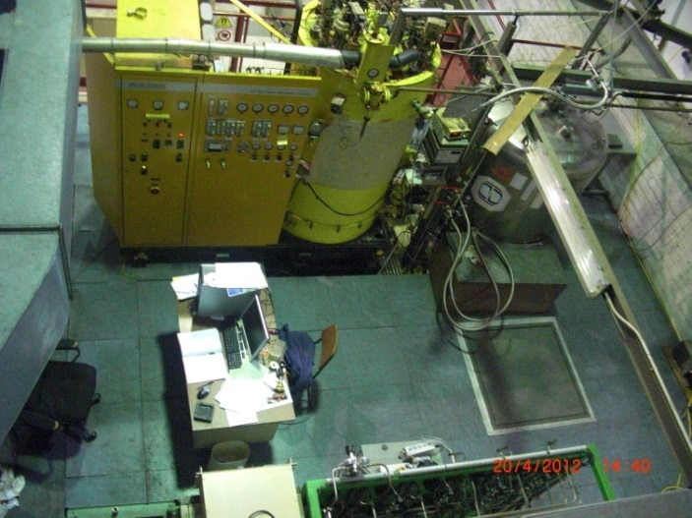
Infrastructure and people
Founded in 1987 for the Superconducting
Cyclotron K800 construction, actually
in operation at LNS Catania.
People: about 40 persons
(3 experienced researchers and 5 experienced technicians directly
involved in the magnet activities)
Infrastructure: Experimental area 2000 m², with a 50 t crane.
Helium liquefier: 40 l/h
LN distribution (10000 l dewar)
Installed electrical power: 1.6 MVA
1 Gbit/s LAN
Ultra High purity water plant (18 MΩ cm)
Machine workshop
Class II Radiochemistry Lab.
Physical measurements Lab. (α, β, γ spectroscopy )
Bunker for RF superconductive cavity tests with
700 mm diameter , 4500 mm height cryostat
Low temperature (>2K) Mechanical Measurements Lab

Slide 4

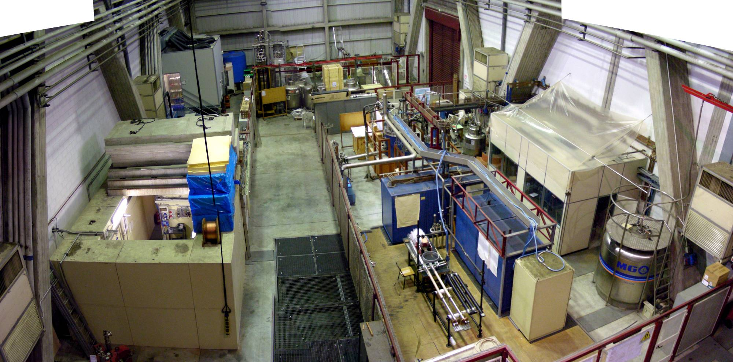
Experimental area
Ultra Pure water
Production
Clean room
class 100
& HPR
Neutron Test Area
High Field Solenoids
Control room for
high field test
Superconducting cavity
Test Area
Helium gas recovery
High current power supply

Slide 5
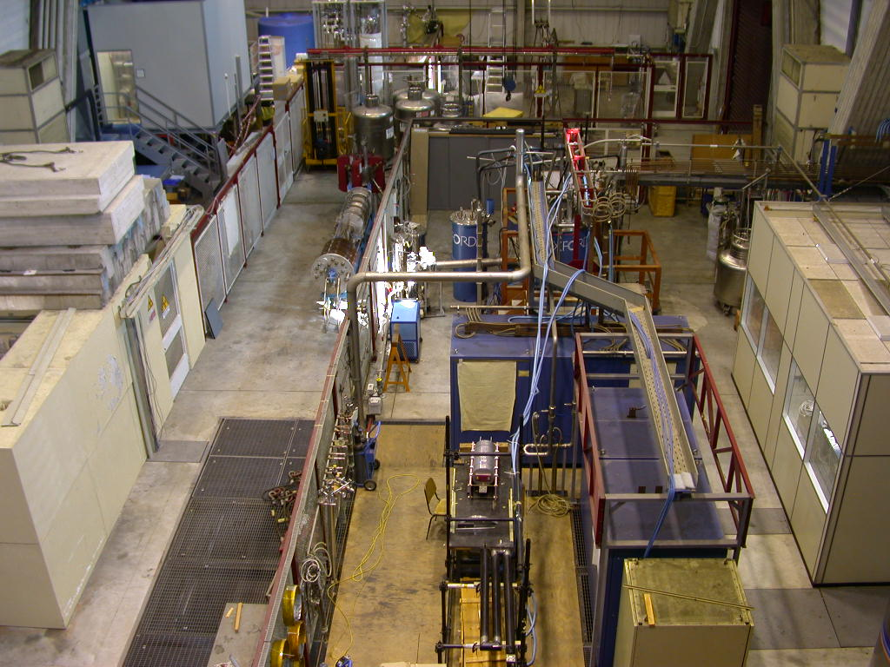
SOLEMI-1 8 T x D535 mm warm bore
Control
room
SOLEMI 2-3 15 T x D100 mm cold bore
Power supplies

Slide 6
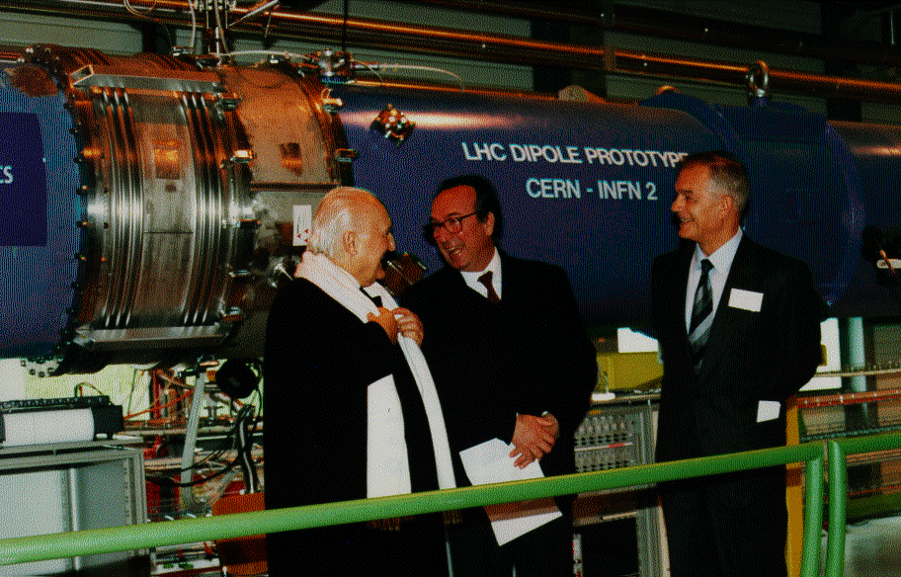
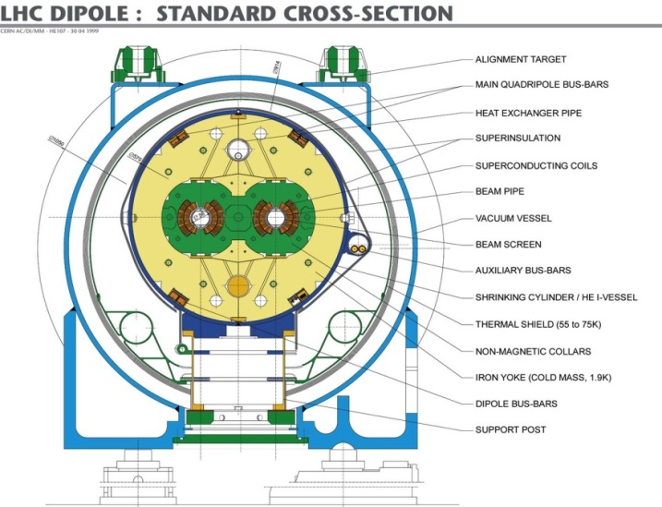
The long prototypes
of the LHC dipoles
INFN has collaborated with CERN since 1990, funding and following the construction in the Italian industries of the first two 10-m-long dipole prototypes.
Their excellent performances paved the way to the LHC project approval in 1994.

Slide 7
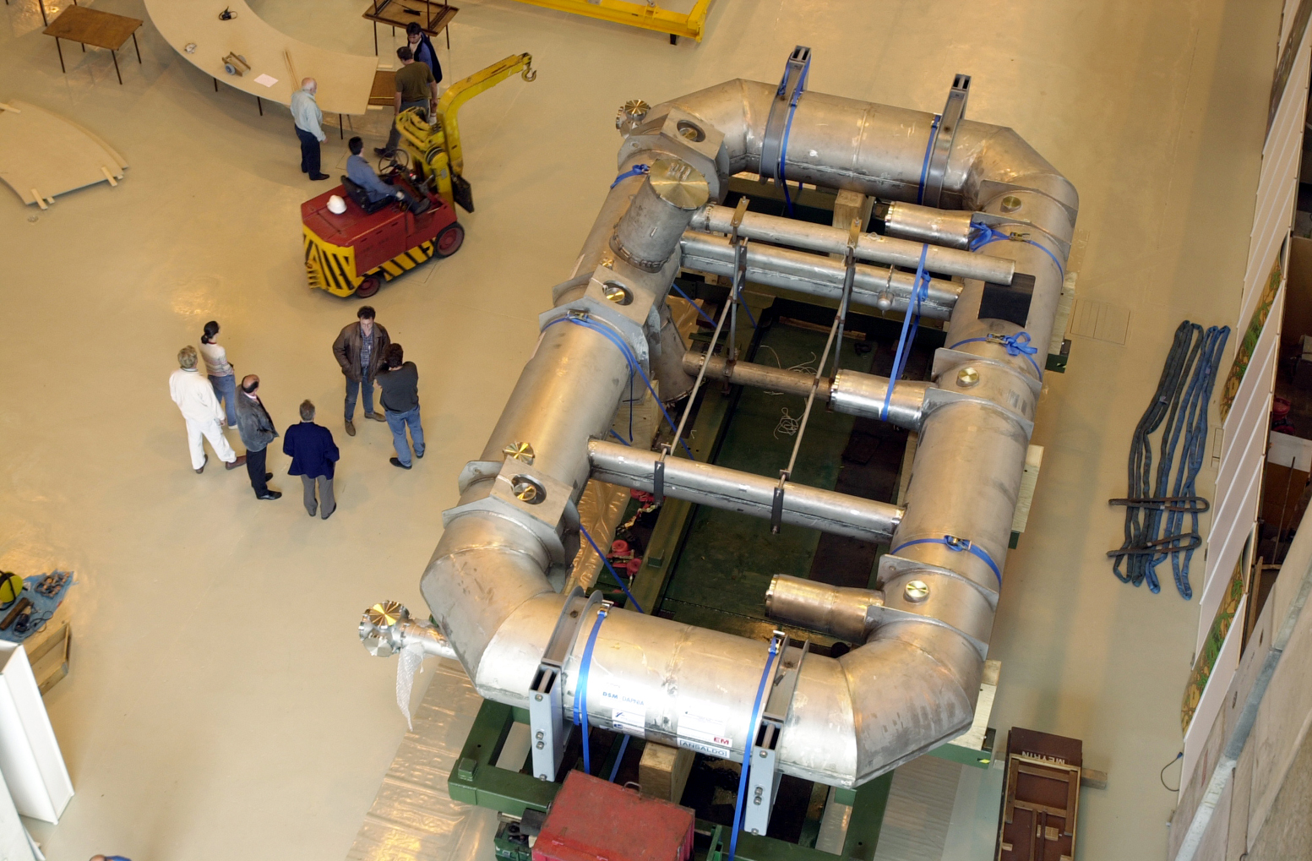
B0 is a shorter (9x5 instead of 25x5 m) working model of one of the eight coils compsing the Barrel Toroid
It exploits the same technologies
of the final BT magnet
Most components, conductor
DP winding & impregnation,
radiation screen,
vacuum vessel,
were financed under Italian
Govt’s “5%” funding program
and followed by LASA
CEA-Saclay
contributed
with design,
coil casing,
minor components &
overall assembly
B0 magnet
Construction
began in 1998
Delivered on
Oct 00 at CERN
First Cool down
started on Jun 01
Nominal operational current, 20.5 kA,
achieved on Jul 01

Slide 8
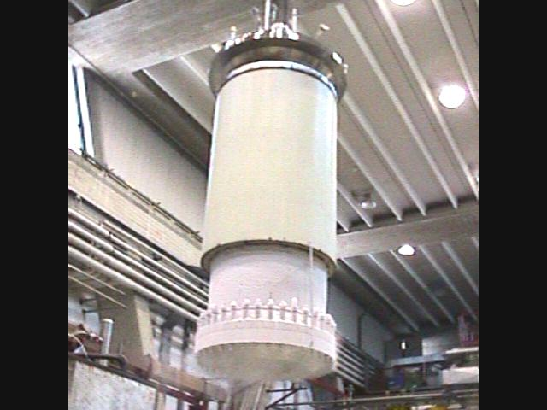
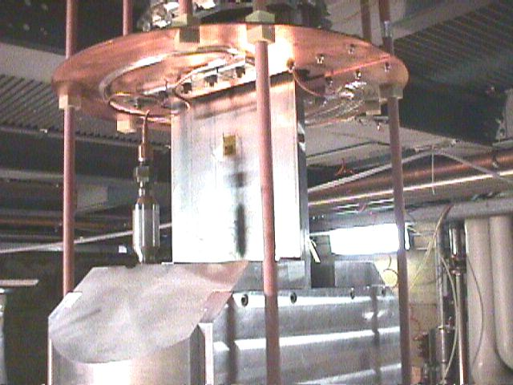
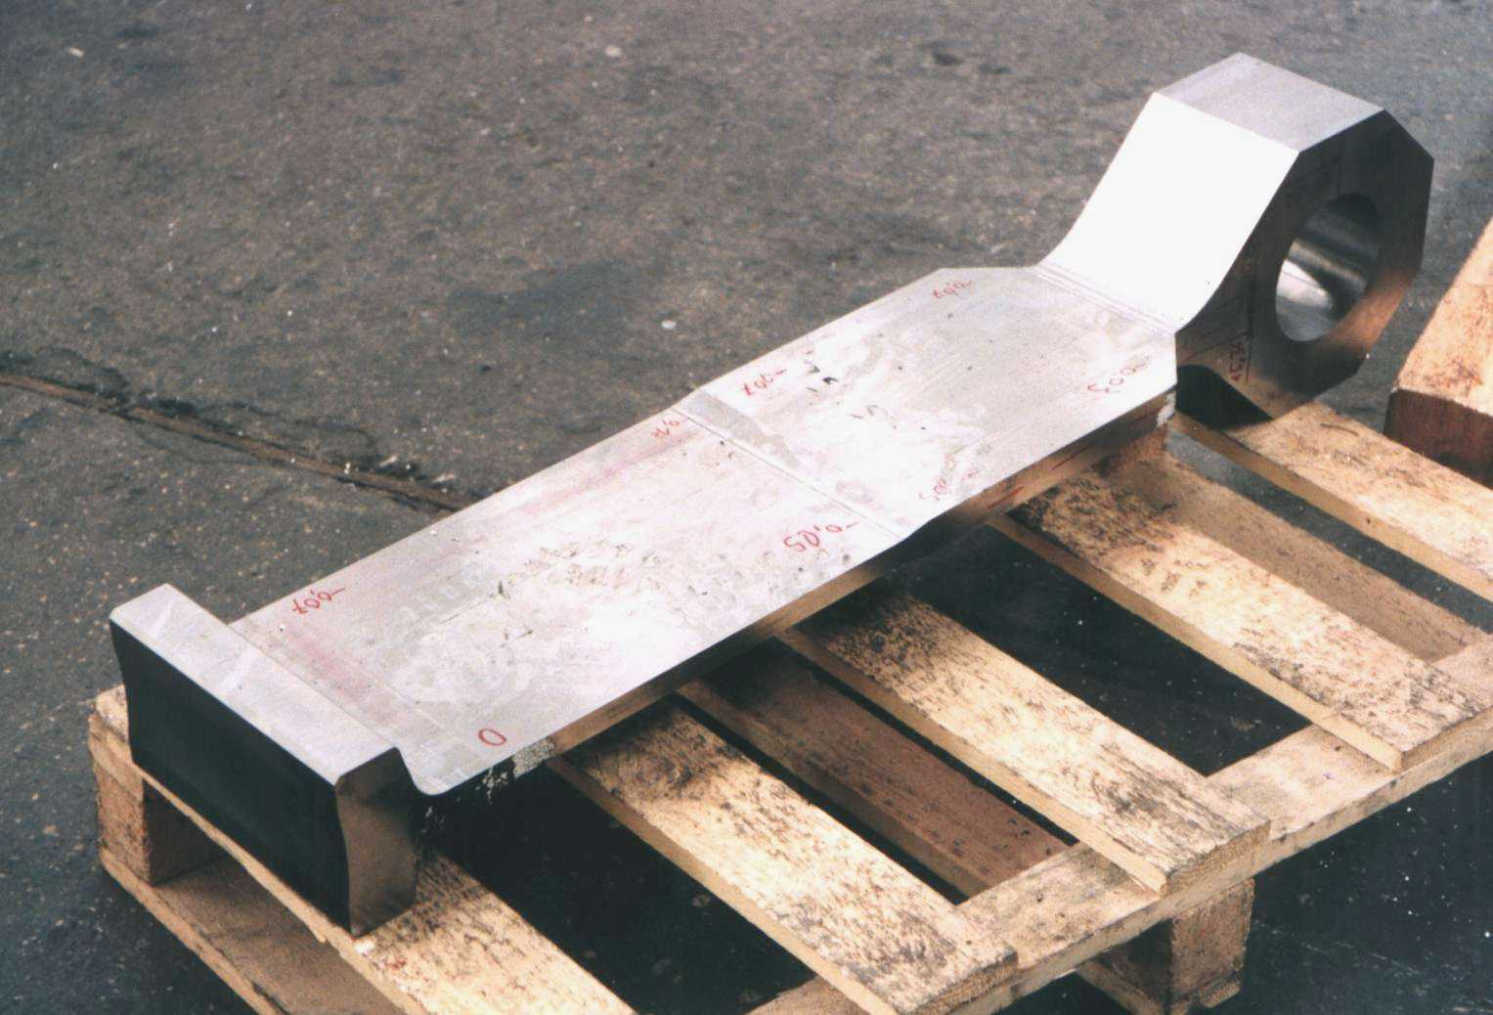
ATLAS Tie-Rod
test apparatus
Designed and
commissioned at LASA
to test B0’s Tie-Rods
upto 260 tons

Slide 9
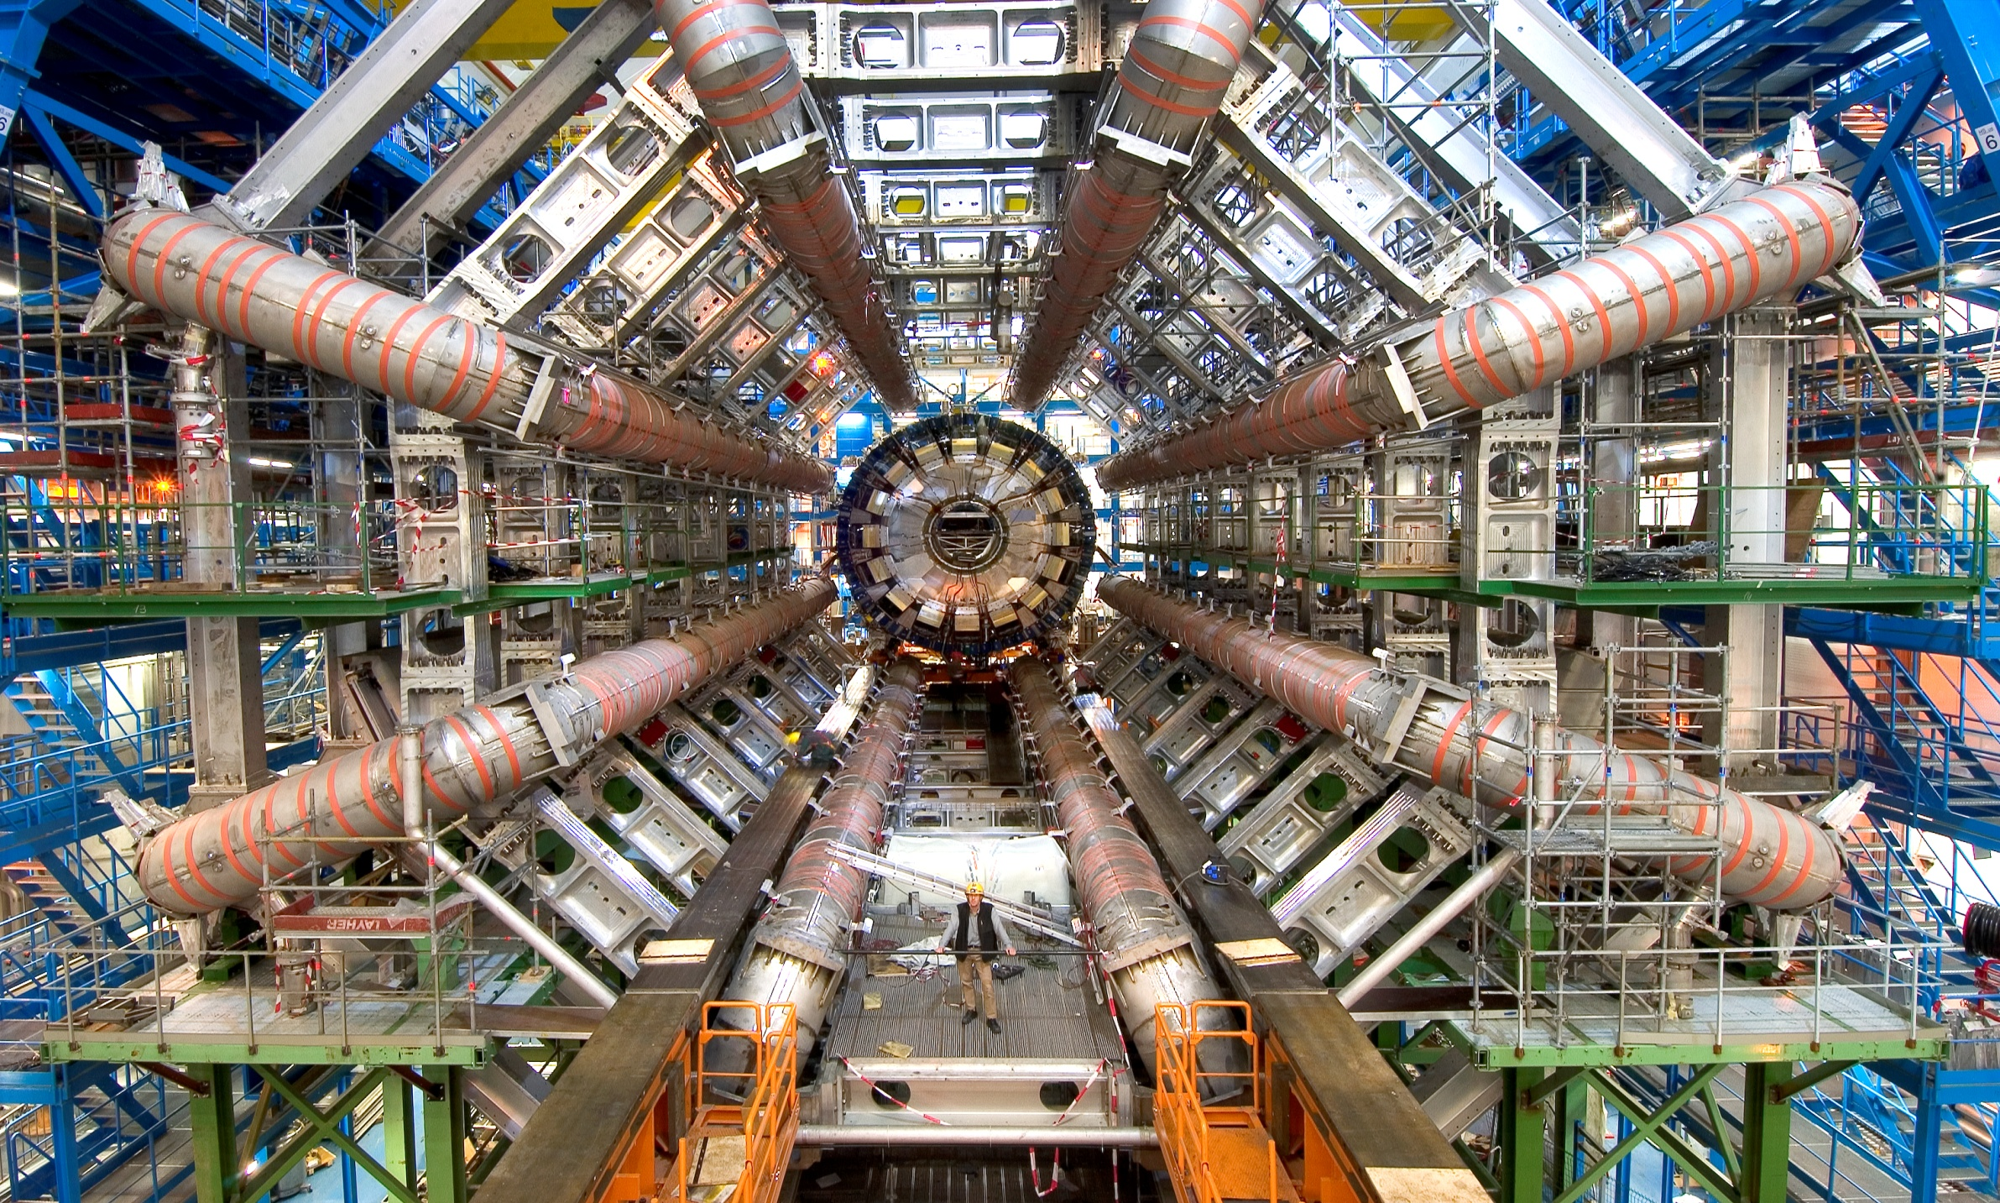
The superconducting toroidal
magnets of the ATLAS detector
INFN was co-responsible, together with CEA, of the construction of the Barrel Toroidal Magnet of ATLAS.
Full responsibility on 1/4 of the superconducting cable (EM Fornaci di Barga), of the superconducting coils (ASG Genova), of the thermal screens (Ettore Zanon, Schio), of the dump and protection system of the magnet.

Slide 10
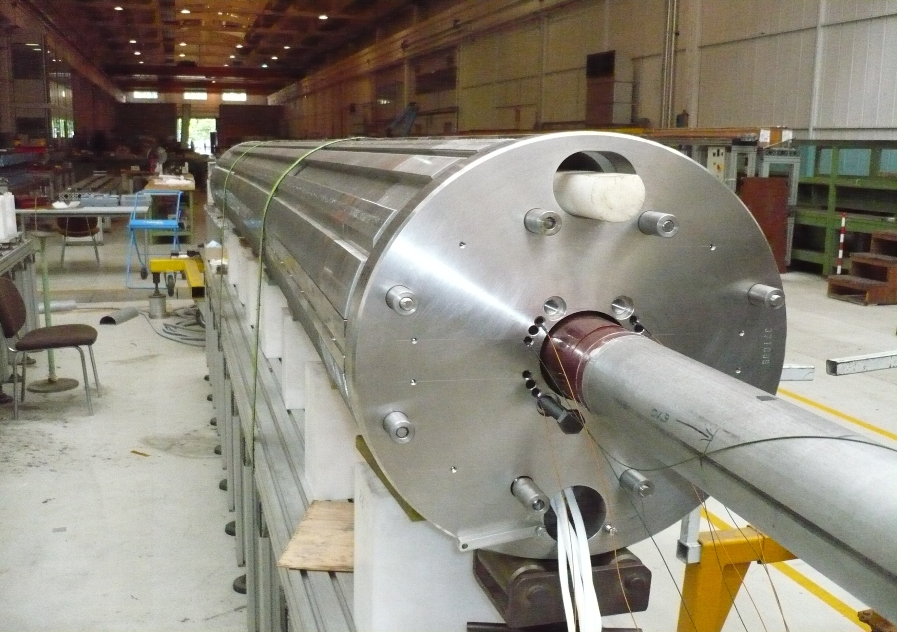
The SIS-300 pulsed dipole
An Italian collaboration (GE+LASA+LNF) performed the design, development, construction and test of the first model of the FAIR SIS300 superconducting
fast-cycled dipoles.
4.5 T x 100 mm bore; (LHC: 8.3 T x 57 mm)
1 T/s; (LHC: 0.007 T/s)
@ LASA
-> EM design (with GE), loss computation;
-> low-loss superconduting cable development ;
-> magnet test.

Slide 11
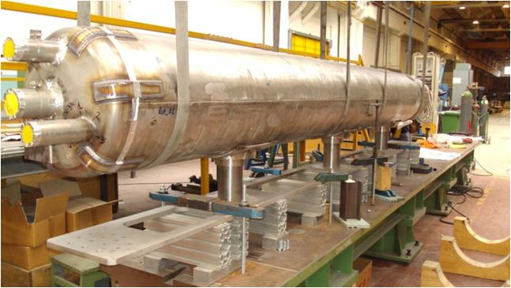
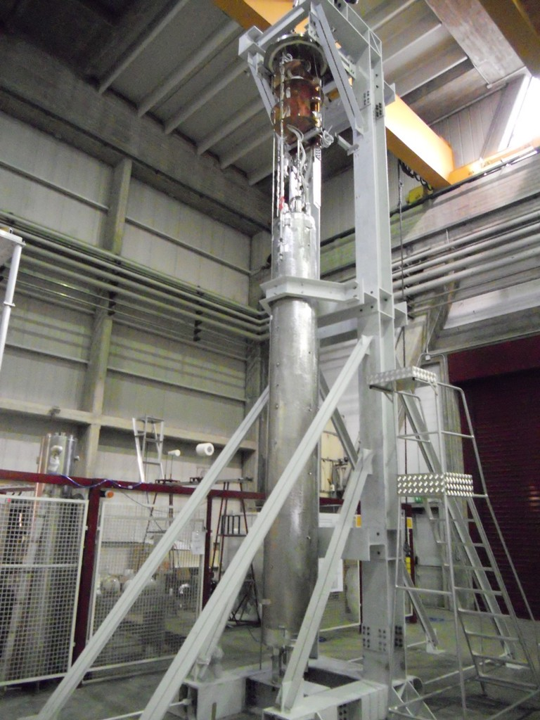
The Magnet Cold Mass

Slide 12
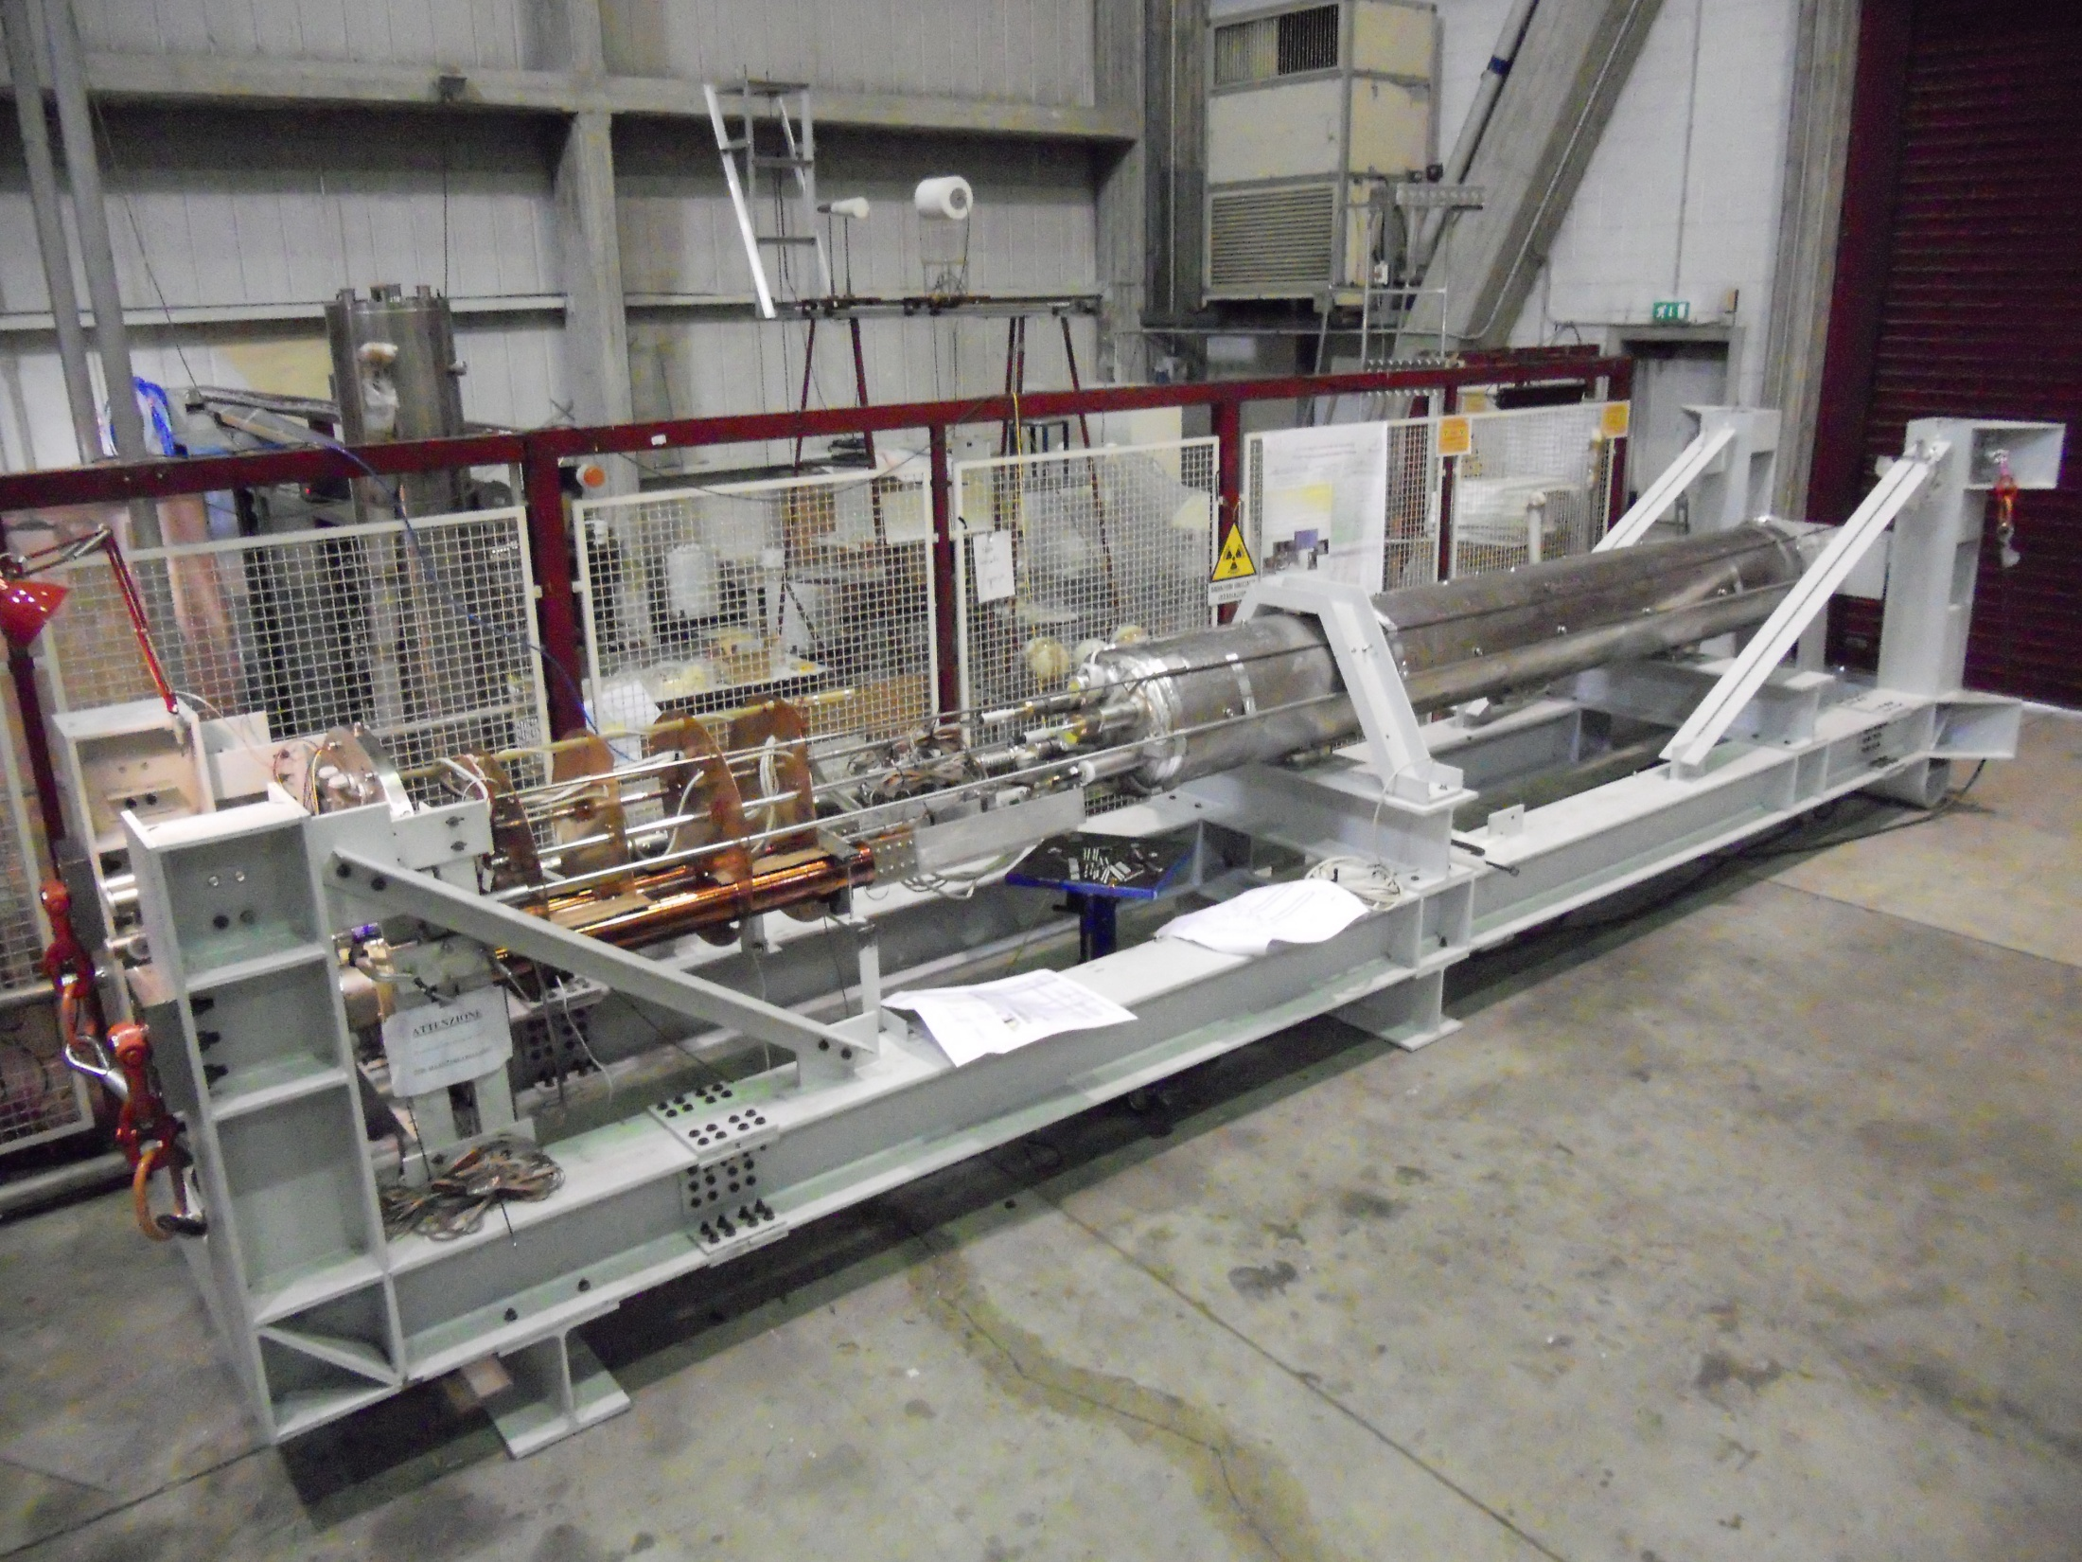
DISCORAP
In July 2012 at LASA the test on the first «fast cycled» magnet for FAIR SIS-300 have been performed

Slide 13
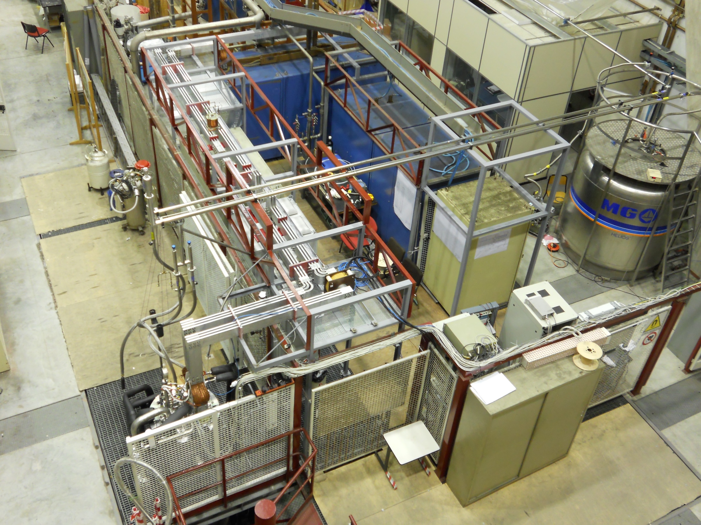
Vertical cryostat connected
to the bus bar

Slide 14
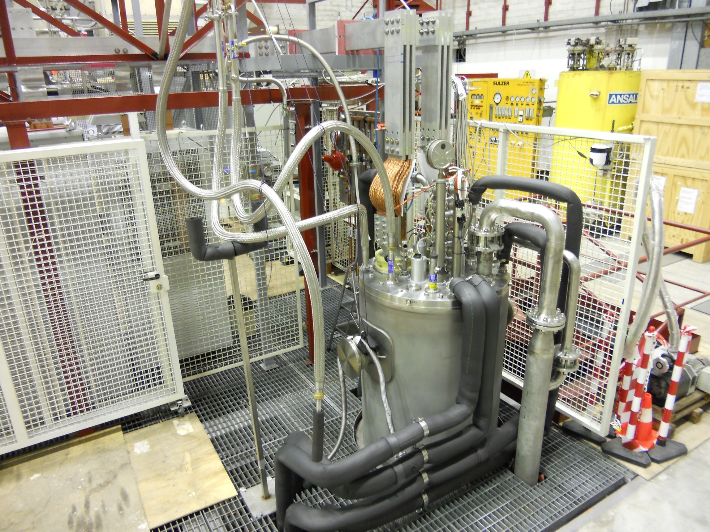
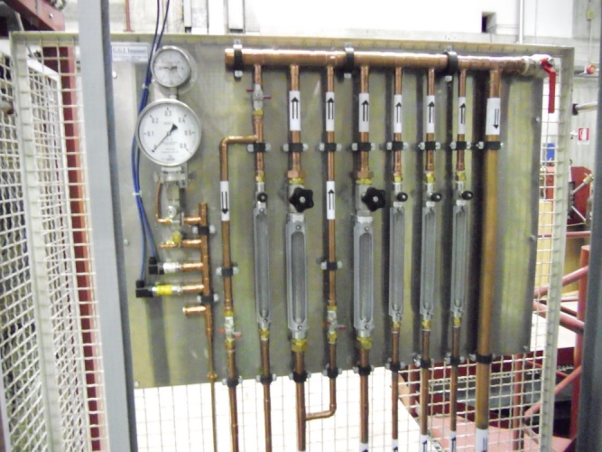
DISCORAP
Vertical cryostat
Free ID 697 mm
Max operating pressure 4.5 bar Thermal shield cooled by LN or evaporated GHe
DUT
max lenght 5 m
max weight 10 ton

Slide 15
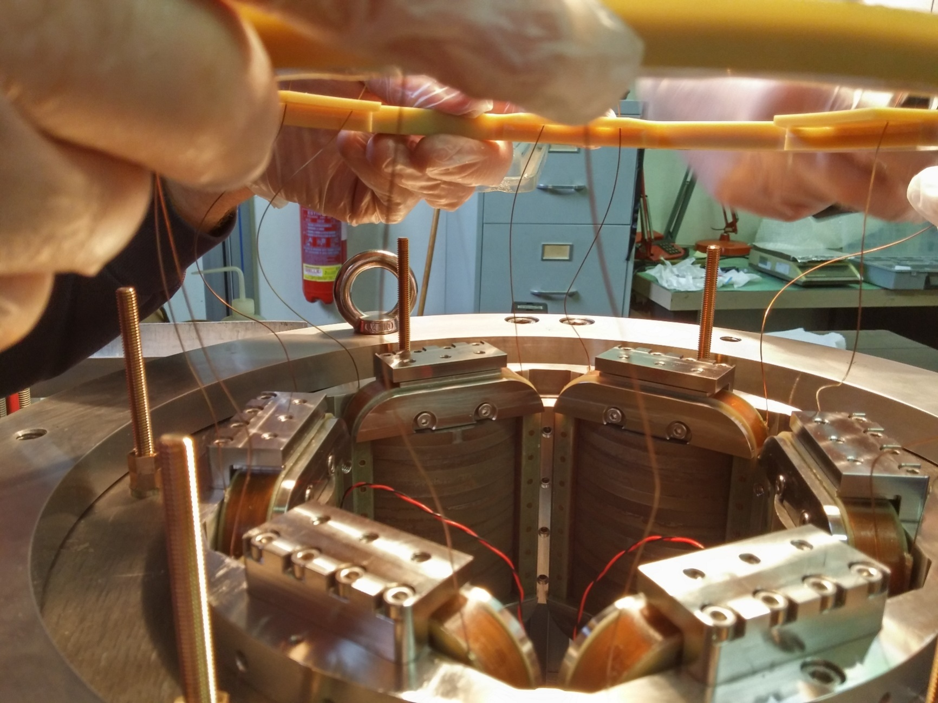
MAGIX
In February 2016 the first of the five prototypes of the super-ferric magnet for MAGIX have been succesfully tested.
(in the photo an assembly phase)

Slide 16
High Magnetic Field Laboratory
The High Magnetic Field Laboratory has the capability to provide magnetic field for research purposes, and to develop and test magnet prototypes
Research Magnets
SOLEMI 1 solenoid NbTi, 8 T, 535 mm room temperature bore
SOLEMI 2+3 solenoid Nb₃Sn, 15 T, 100 mm cold bore
75 mm cold bore in gas flow 2-300 K
Solenoid NbTi + Nb₃Sn, 13.5 T, 50 mm cold bore@ 4.2/2.2 K
Cryocooler-operated magnet 8 T, 75 mm cold bore cryogen-free
Resistive Dipole 1 T, 120 mm room temperature gap
Ancillary equipment & Prototype development tooling
Power supply up 30 kA 6V (swicthing)
“ 2 kA 4V (low noise, battery based)
Winding machine
Oven up to 700 °C in vacuum (Nb₃Sn reaction)
Oven up to 900 °C in atmosphere (HTSC reaction)
Next slide the details

Slide 17
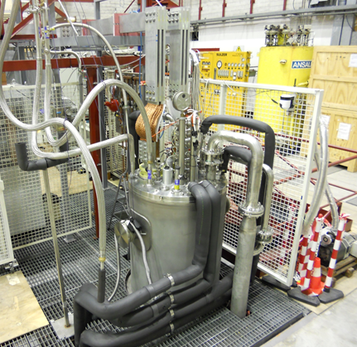
High Magnetic Field Laboratory
Vertical Test Station
Can accomodate magnets up to 700 mm dia x 6500 mm in length
Soon to be integrated by a 515 mm dia x 3300 mm vertical cryostat for medium-size magnets/samples
480 mm dia x 1200 mm, and other smaller cryostat
Power Supplies
3 x Power supply up to 10 kA, 6 V
(series and parallel operation possible)
2 x Power supply up to 1.2 kA, 36 V
1 x Power supply up to 500 A, 125 V
1 x Power supply up to 2 kA, 4V (low noise, battery based)
Magnet Protection System including discharge resistor, switch, Quench Detection Electronics

Slide 18
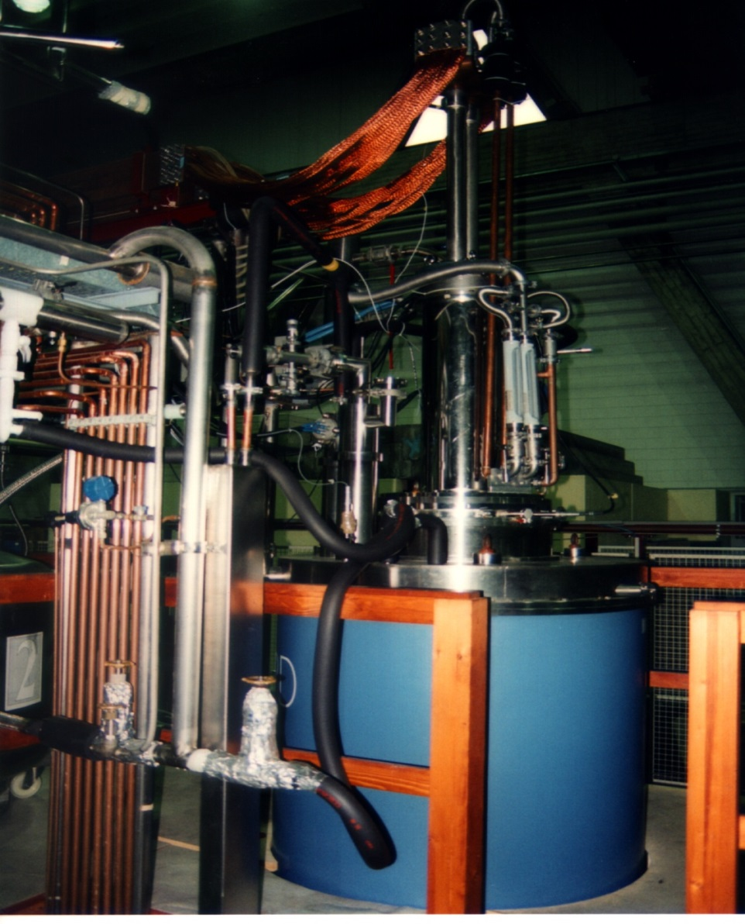
SOLEMI 1 magnet
SOLEMI
with sample holder into its bore

Slide 19
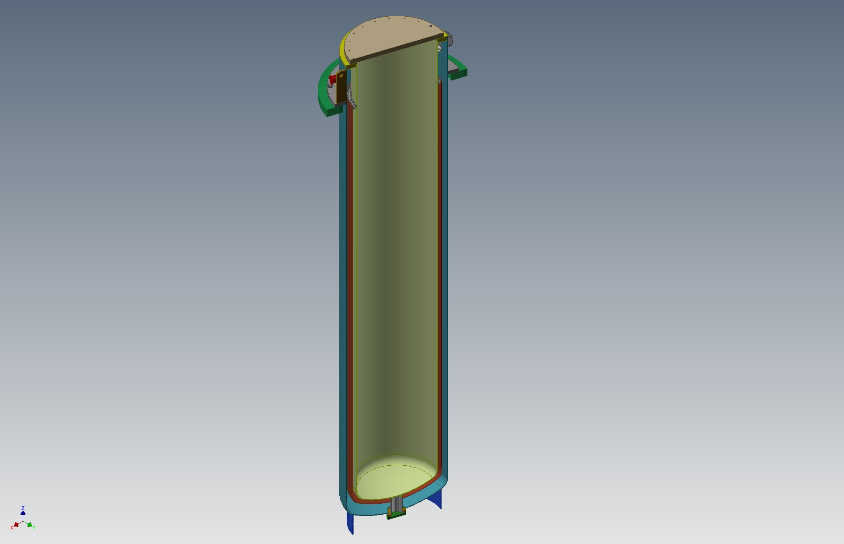
MAGIX
Cryostat
D515 x L 3000 mm
Maximum LHe level 2300 mm
Now being manufacture
Hosted within DISCORAP cryostat (which acts as a support)
Designed for 4K operation
Study for lower temperature operation, 1.9K or 2.2 K in progress
D515
3000

Slide 20
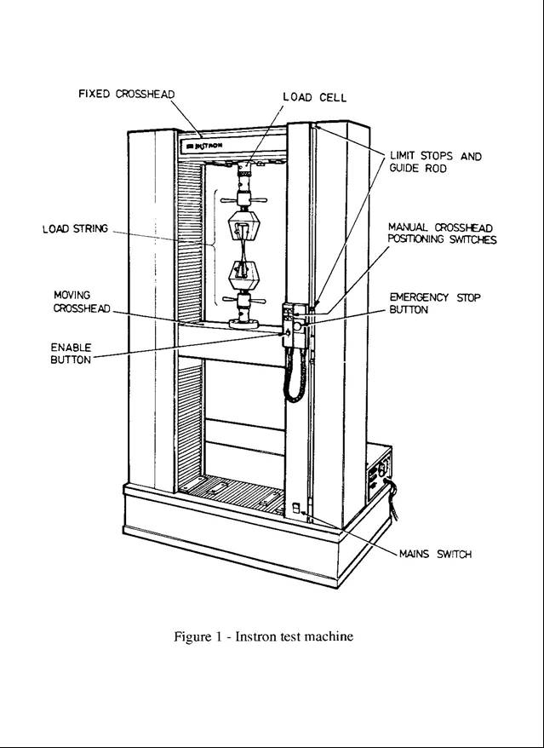
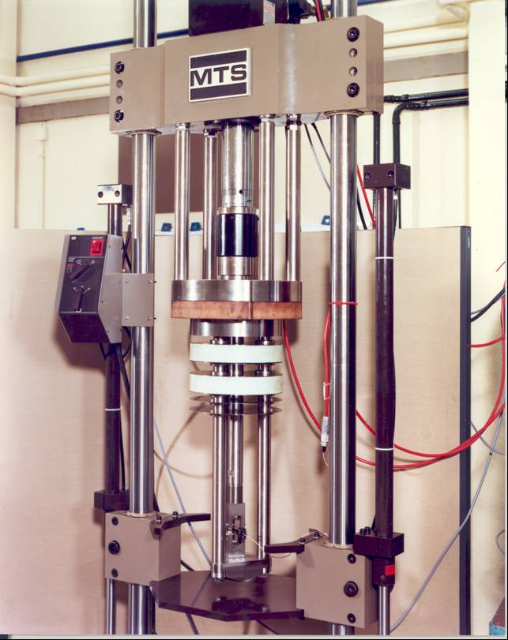
Cryo-Mechanical Lab
Goal: perform room temperature and cryogenic (down to 2K) mechanical test, both in quasistatic and cyclic conditions.
Commercial test machines have been fitted with home-designed cryostats.
Tensile and compression tests on INSTRON testing machine, model 6027.
max load, tension 100 kN
max load, compression 50 kN
temperature range 3 – 300 K ( flow of helium gas )
Tests in cyclic conditions on MTS testing machine
load +/- 125 kN
temp. range 2-300 K

Slide 21
Control & Data Acquisition Architecture
1. QDS (MSS Magnet Safety System)
Initiates a fast discharge or switches off the power supply incase some voltage thresholds on the magnet or on its electrical connection are exceeded. Includes a capacitor bank for firing quench heaters.
2. Current Control & Slow Acquisition
Two different functions, implemented in the same hardware & software system.
Slow acquisition monitors and records most important data (temperatures, current, voltage along critical items) from the cooldown to the operation. Data are avalilable to the operator and recorded at about 1 Hz.
3. Fast Acquisition
Records voltages across the magnet under test with 1 kHz sampling frequence, in coincidence with a fast discharge
4. V*I AC losses measurement system
A dedicated system which measures the AC losses by numerical integration of V*I product, measured by a couple of synchronized VMM.
It is completely independent from other systems, from the voltage taps on.
This allows to perform checks, modification on the ground, etc. without affecting other safety-critical systems.

Slide 22
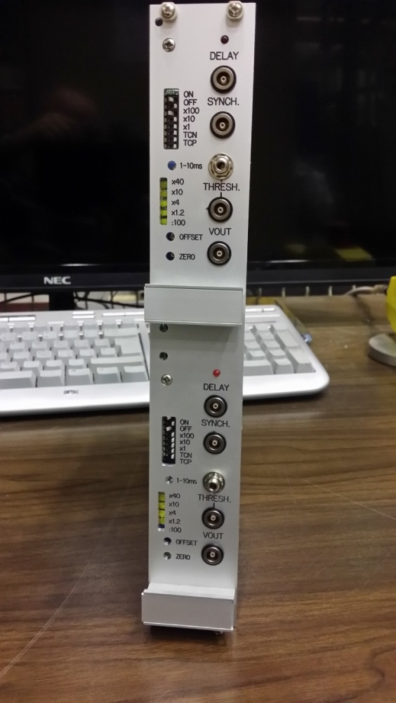
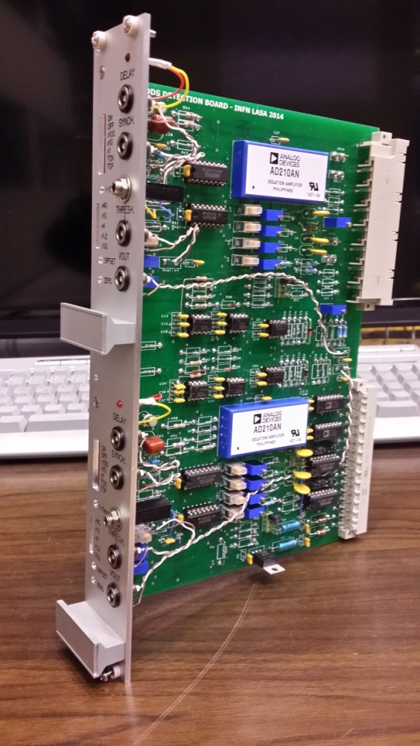
Quench Detection System
A system similar to the POTAIM cards.
Engineered and built at LASA, it has
successfully tested in field conditions
during the MAGIX test
It includes:
16 channels (may be expanded), each:
optoinsulated input,
bridge/single end
independently configurable
Voltage thresholds:
±4V, ±1.25V, ±500mV, ±100mV
Time validation ranges:
0-10 ms, 0-100 ms, 0-1 s
Input signal made available in copy
Memory of channels fired

Slide 23
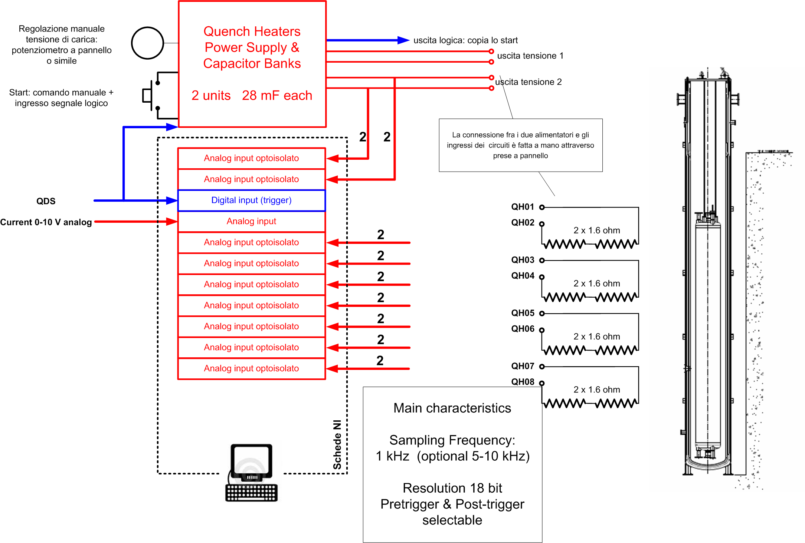
Fast Acquisition

Slide 24
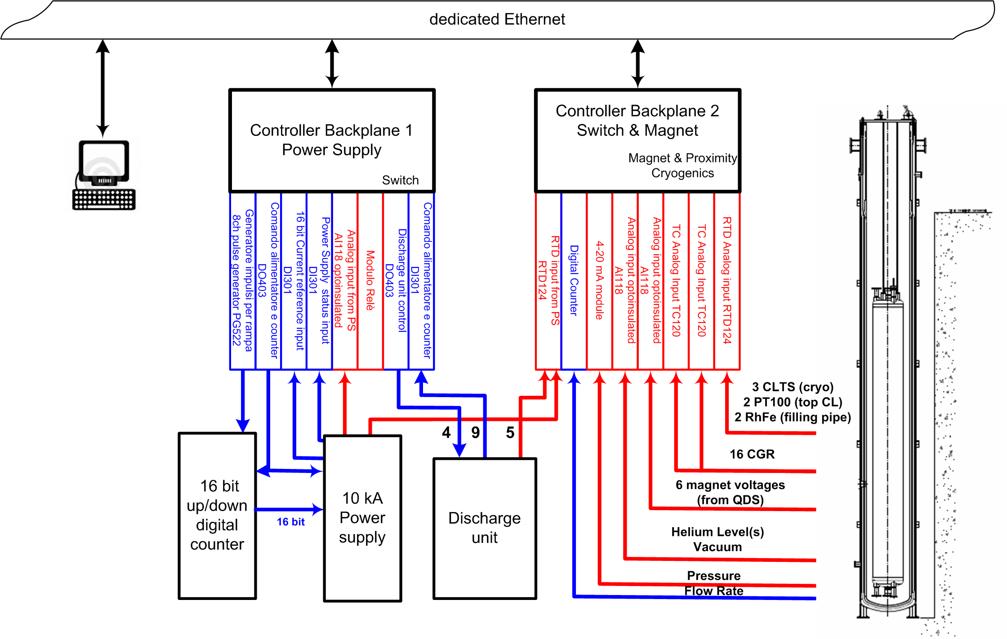
Slow Acquisition
NI
Compact Field Point

Slide 25
AC losses measurement system
Net work Q performed by the power supply on the magnet between t₀ and t₁.

