Slide 1
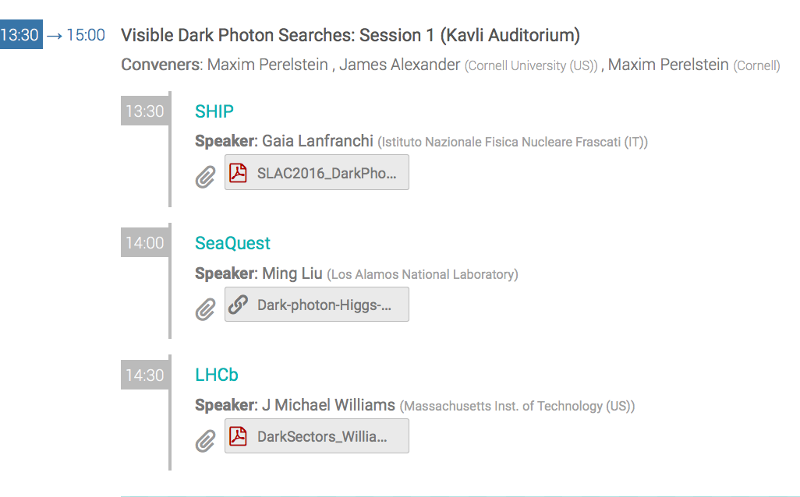
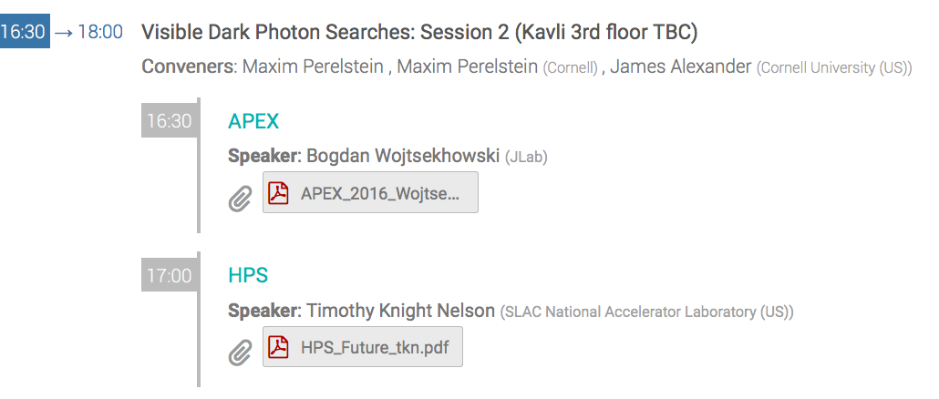
Visible Dark Photon Sessions
Thursday

Slide 2
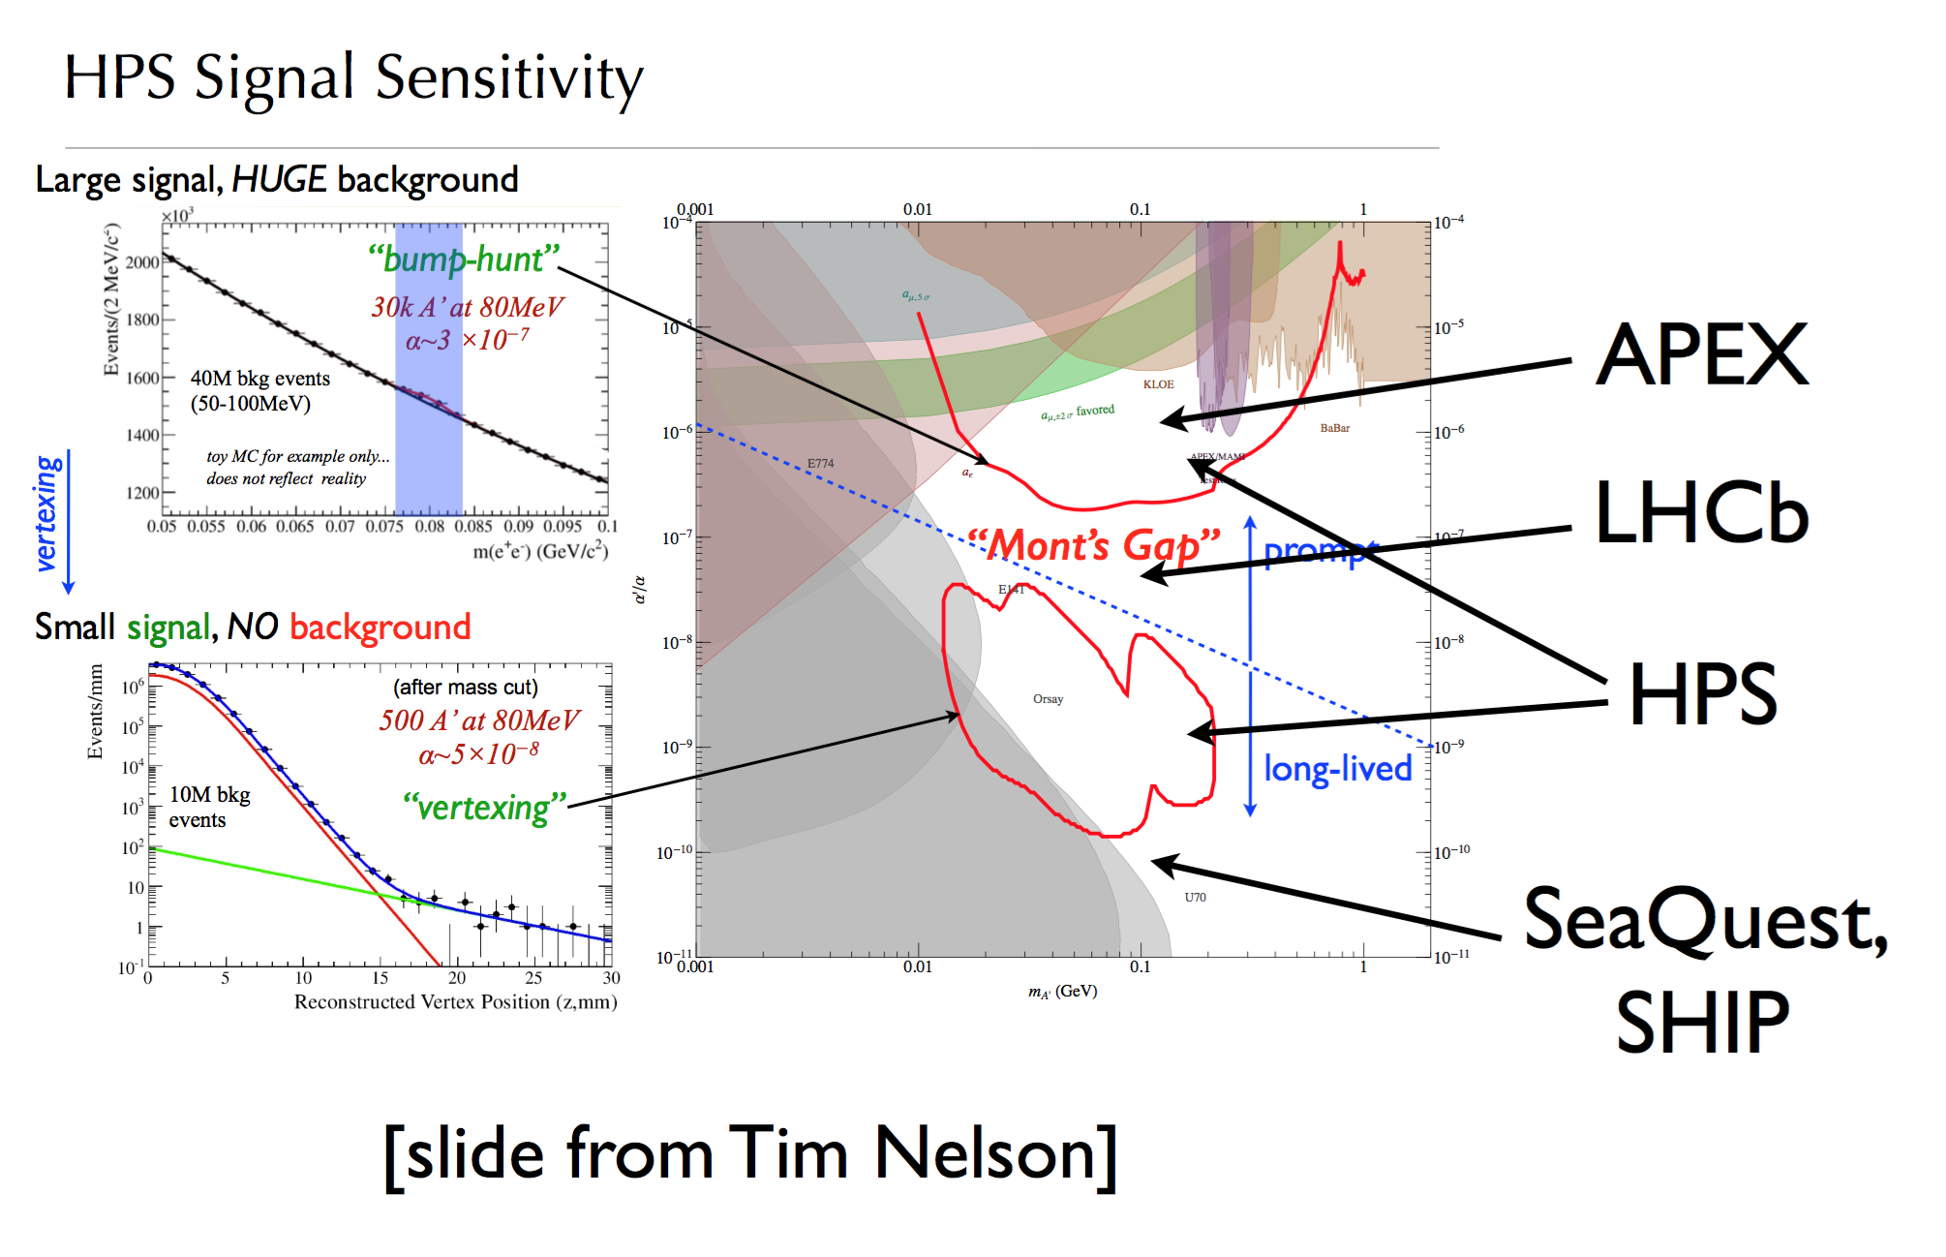

Slide 3
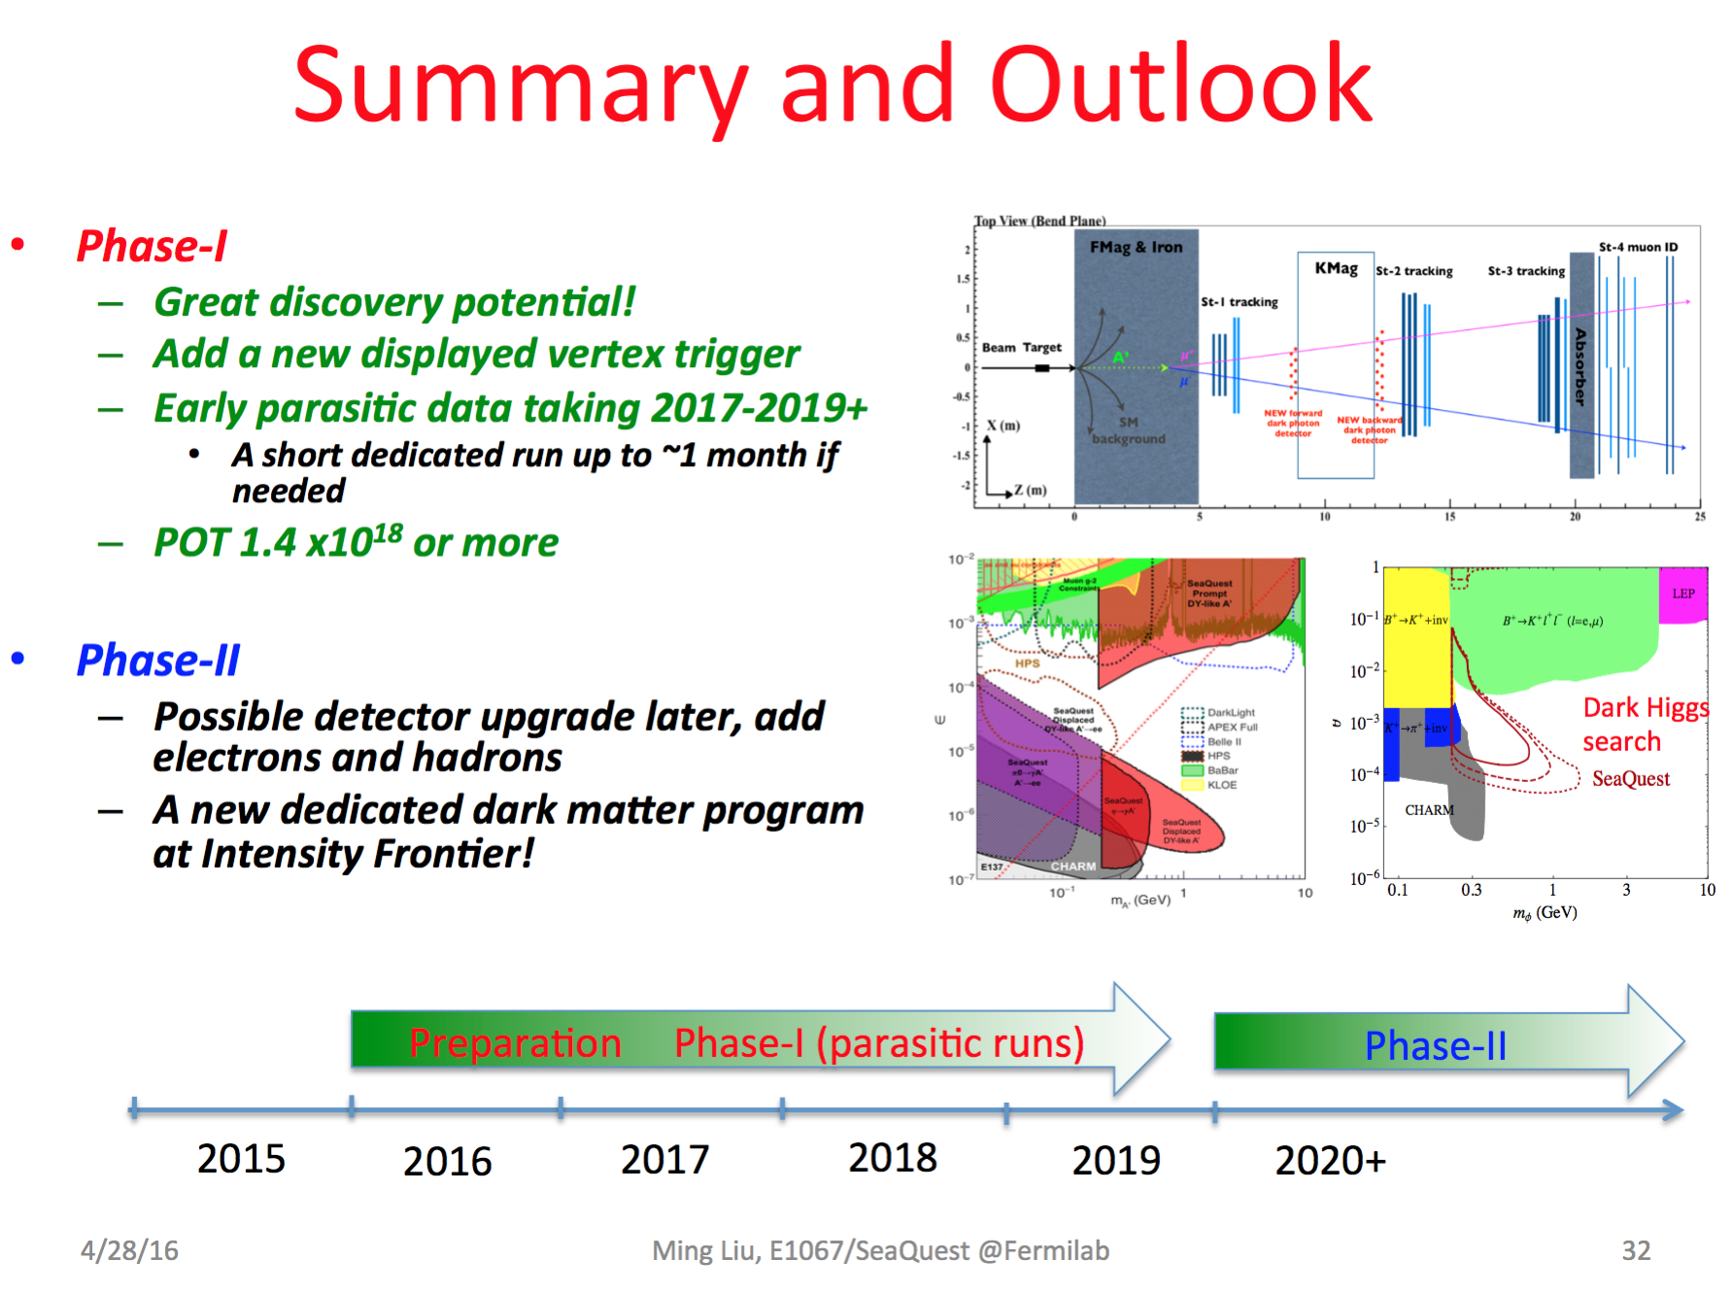
SeaQuest @ FNAL

Slide 4
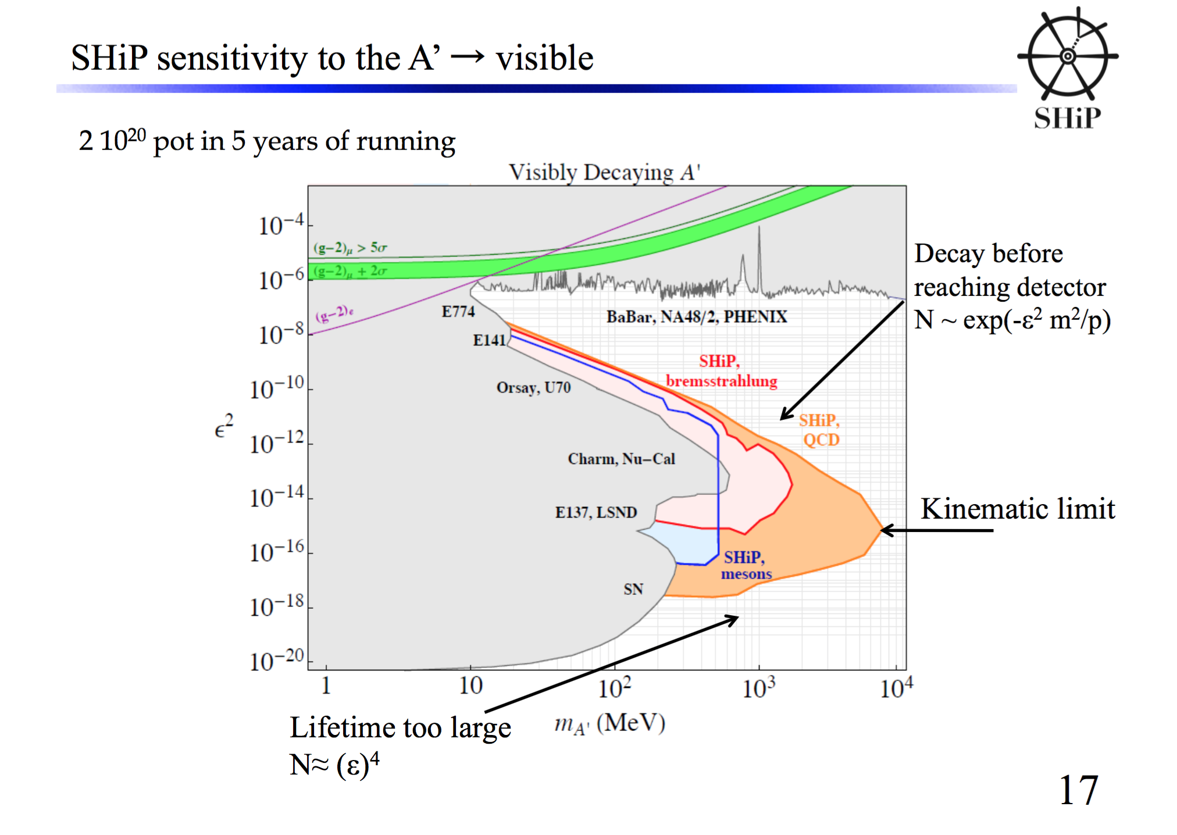
SHIP @ CERN

Slide 5
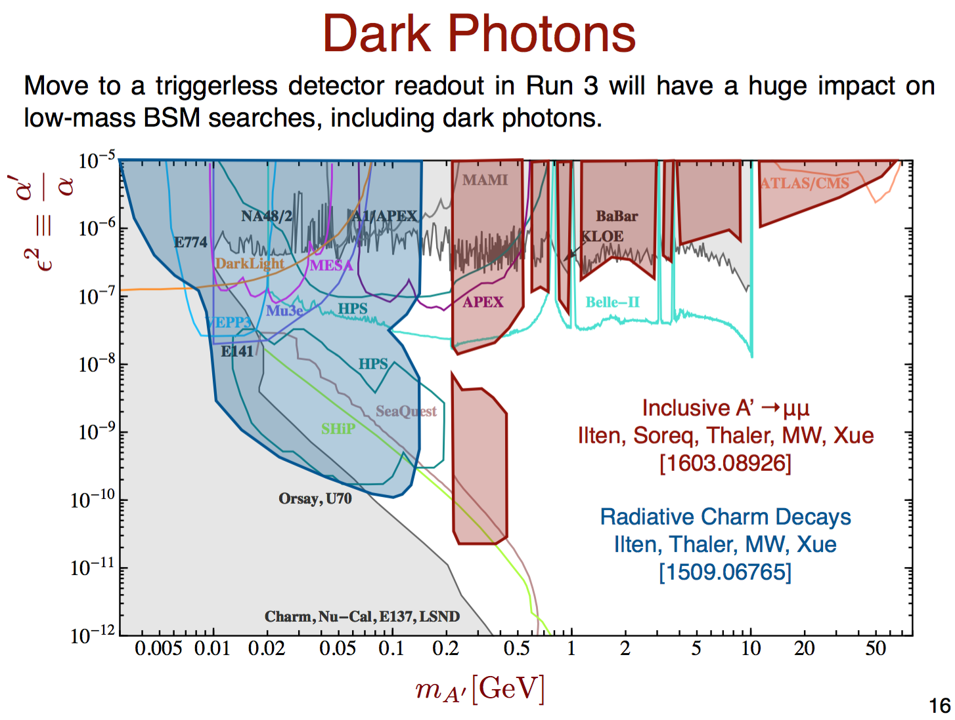
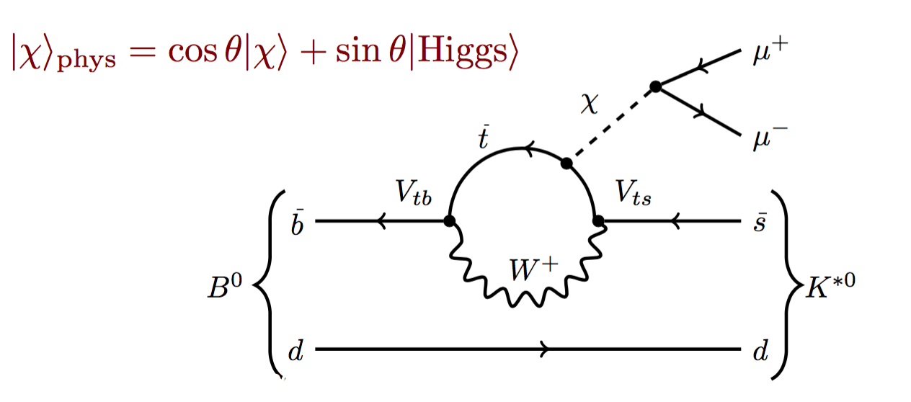
LHCb @ LHC run3
D*->D0 A’ (->ee)

Slide 6
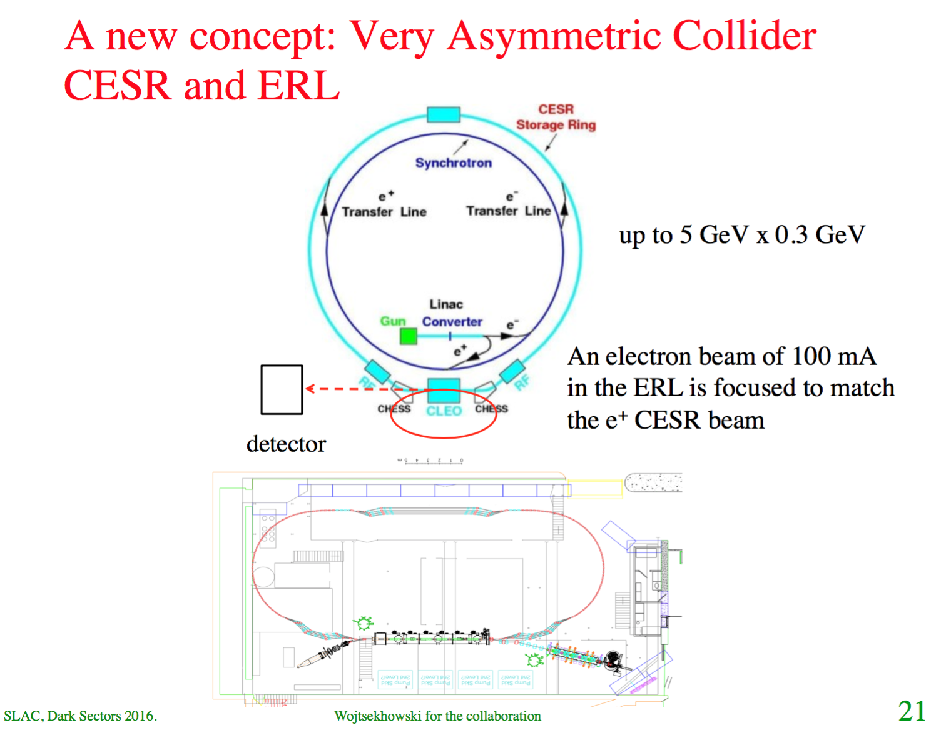
Bogdan Wojtsekhowski
APEX,
Very Asymmetric Collider

