Slide 1
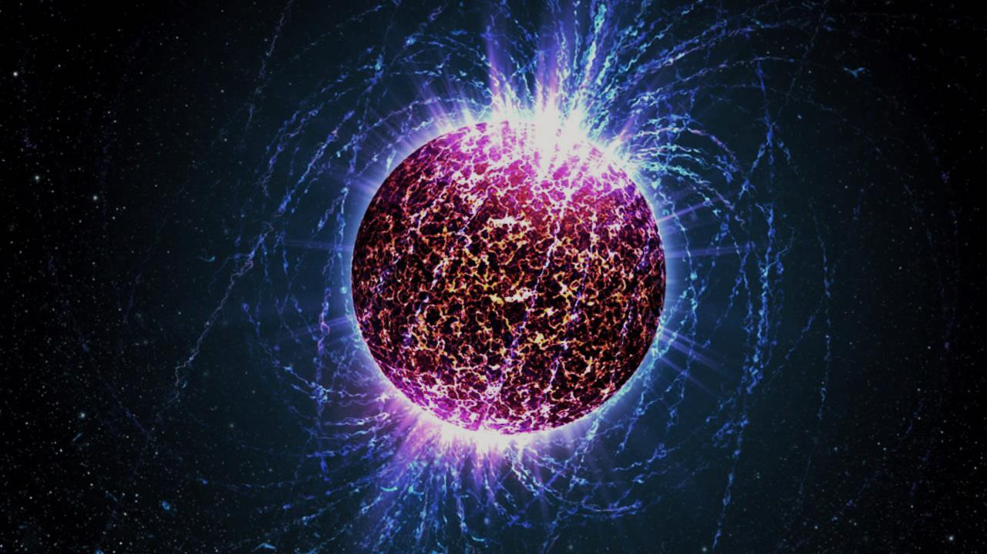
Quark matter in neutron stars: from Feynman diagrams to D-branes
Aleksi Vuorinen
University of Helsinki
Strong and Electroweak Matter 2016
Stavanger, 14.7.2016
A. Kurkela, AV, arXiv:1603.00750 (to appear in Phys. Rev. Lett.)
C. Hoyos, N. Jokela, D. Rodriquez, AV, Phys. Rev. Lett. 117, 032501 (2016), 1603.02943

Slide 2
Cool quark matter in neutron stars: from Feynman diagrams to D-branes
Aleksi Vuorinen
University of Helsinki
Strong and Electroweak Matter 2016
Stavanger, 14.7.2016
A. Kurkela, AV, arXiv:1603.00750 (to appear in Phys. Rev. Lett.)
C. Hoyos, N. Jokela, D. Rodriquez, AV, Phys. Rev. Lett. 117, 032501 (2016), 1603.02943

Slide 3
Perturbative thermodynamics of QCD matter: existing results
Perturbative thermodynamics of QCD matter: new result and its uses
Technical insight 1: IR physics
Technical insight 2: effective theory approach to all temperatures

Slide 4
Perturbative thermodynamics of QCD matter: existing results
Perturbative thermodynamics of QCD matter: new result and its uses
Technical insight 1: IR physics
Technical insight 2: effective theory approach to all temperatures

Slide 5
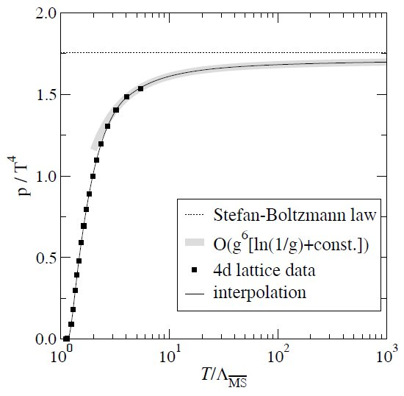
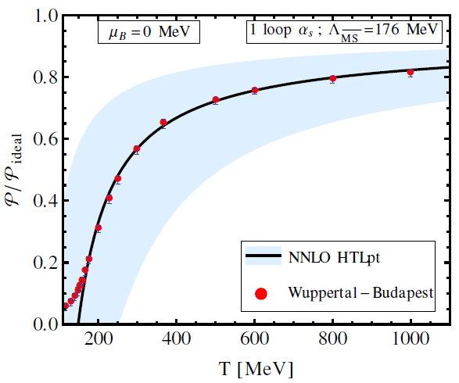

High temperature, zero density: $O\left(g^{6}\ln{g}\right)$ perturbative result for pressure, in agreement with lattice and HTLpt
Kajantie, Laine, Rummukainen, Schröder, PRD 67 (2003)
Laine, Schröder, PRD 73 (2006)
Andersen, Leganger, Strickland, Su, JHEP 1108 (2011)

Slide 6
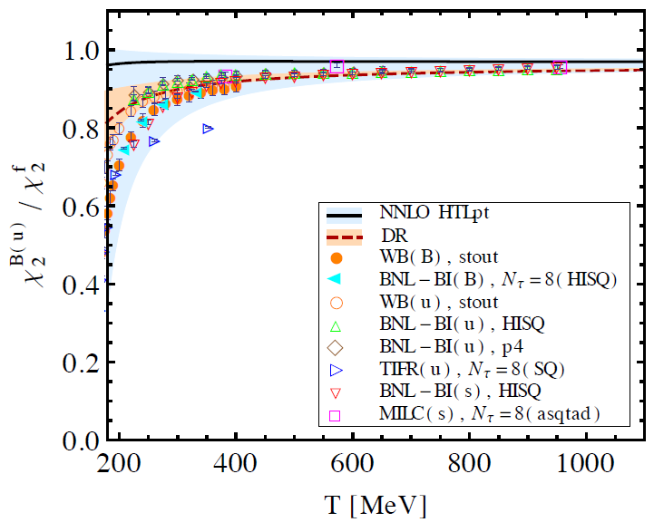
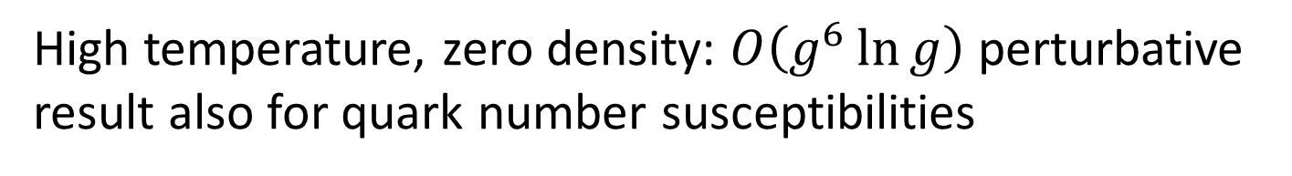
High temperature, zero density: $O\left(g^{6}\ln{g}\right)$ perturbative result also for quark number susceptibilities
AV, PRD 67, PRD 68 (2003)
Mogliacci, Andersen, Strickland, Su, AV, JHEP 1312 (2013)
Haque, Andersen, Mustafa, Strickland, Su, PRD 89 (2014)

Slide 7
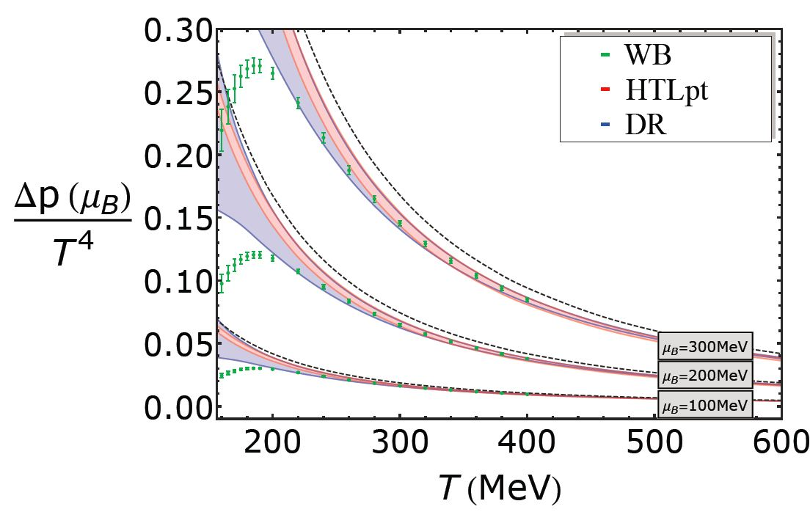
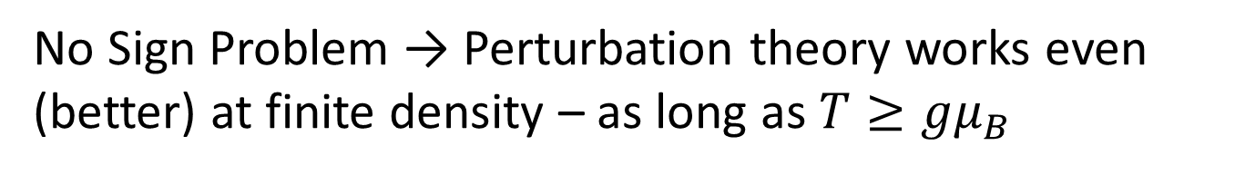
No Sign Problem → Perturbation theory works even (better) at finite density – as long as $T≥gμ_{B}$
AV, PRD 67, PRD 68 (2003)
Mogliacci, Andersen, Strickland, Su, AV, JHEP 1312 (2013)

Slide 8
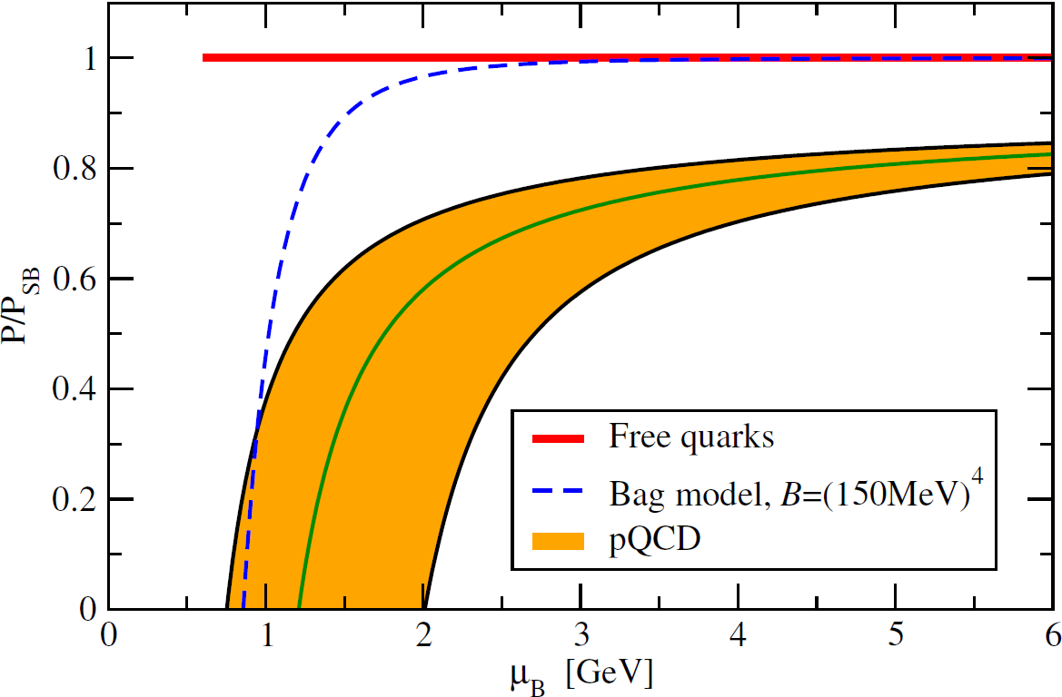
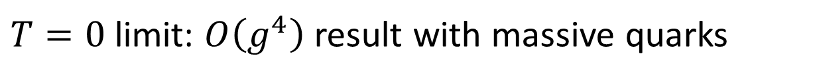
$T=0$ limit: $O\left(g^{4}\right)$ result with massive quarks
Kurkela, Romatschke, AV, PRD 81 (2010)

Slide 9
$T=0$ limit: $O\left(g^{4}\right)$ result with massive quarks
No lattice prediction!
Kurkela, Romatschke, AV, PRD 81 (2010)

Slide 10
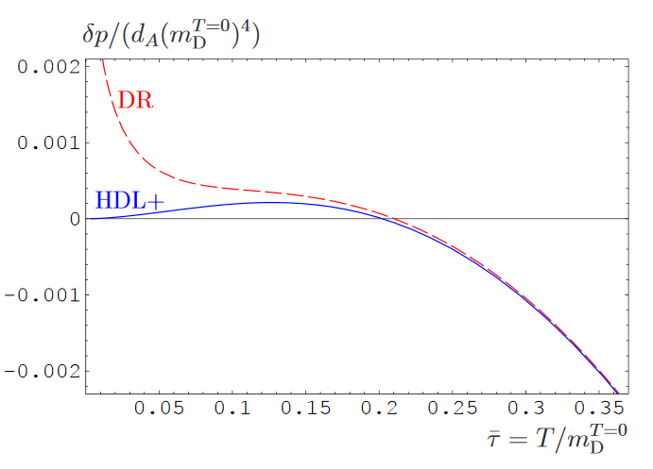
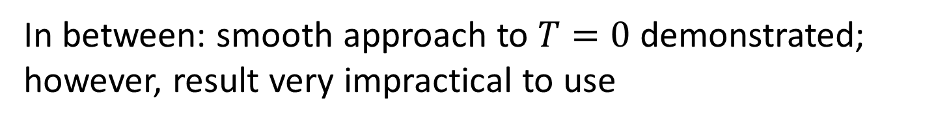
In between: smooth approach to $T=0$ demonstrated; however, result very impractical to use
Ipp, Kajantie, Rebhan, AV, PRD 74 (2006)

Slide 11
Perturbative thermodynamics of QCD matter: existing results
Perturbative thermodynamics of QCD matter: new result and its uses
Technical insight 1: IR physics
Technical insight 2: effective theory approach to all temperatures

Slide 12
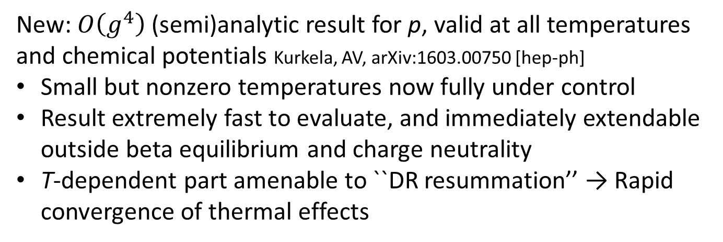
New: $O\left(g^{4}\right)$(semi)analytic result for p, valid at all temperatures and chemical potentials Kurkela, AV, arXiv:1603.00750 [hep-ph]
Small but nonzero temperatures now fully under control
Result extremely fast to evaluate, and immediately extendable outside beta equilibrium and charge neutrality
T-dependent part amenable to ``DR resummation’’ → Rapid convergence of thermal effects

Slide 13
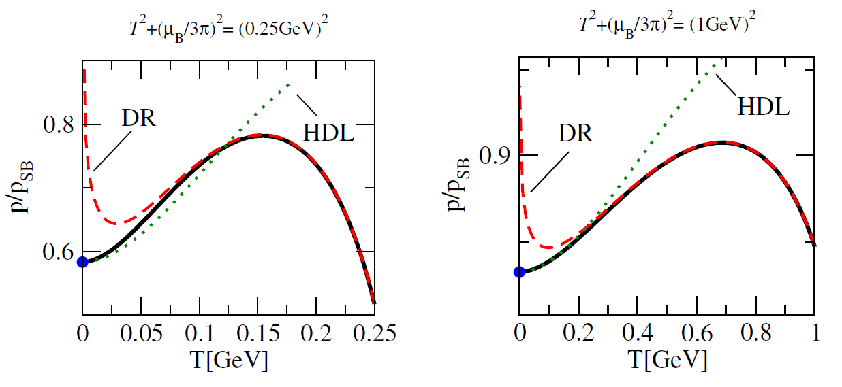
New: $O\left(g^{4}\right)$(semi)analytic result for p, valid at all temperatures and chemical potentials Kurkela, AV, arXiv:1603.00750 [hep-ph]
Small but nonzero temperatures now fully under control
Result extremely fast to evaluate, and immediately extendable outside beta equilibrium and charge neutrality
T-dependent part amenable to ``DR resummation’’ → Rapid convergence of thermal effects

Slide 14
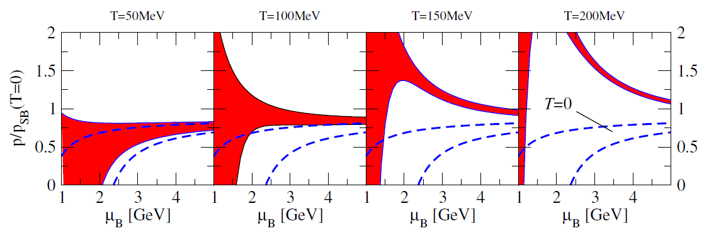
New: $O\left(g^{4}\right)$(semi)analytic result for p, valid at all temperatures and chemical potentials Kurkela, AV, arXiv:1603.00750 [hep-ph]
Small but nonzero temperatures now fully under control
Result extremely fast to evaluate, and immediately extendable outside beta equilibrium and charge neutrality
T-dependent part amenable to ``DR resummation’’ → Rapid convergence of thermal effects

Slide 15
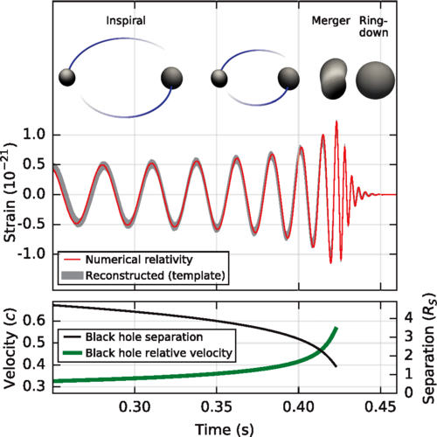
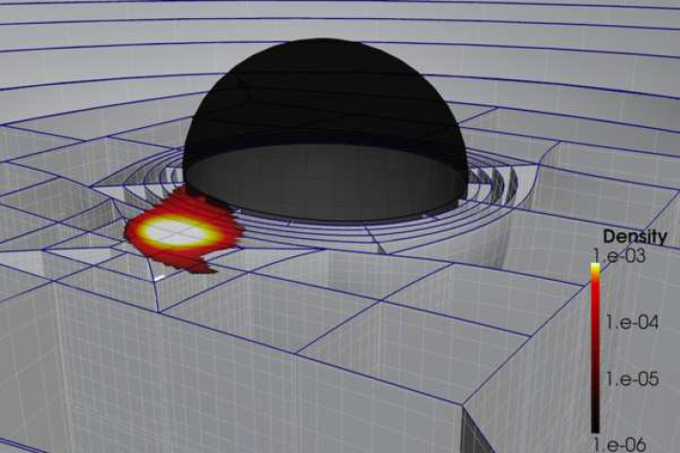
Motivation: increased interest in description of NS-NS and NS-BH mergers due to LIGO gravitational wave detection
NS disruption in a merger with a BH may lead to vastly improved radius measurements → EoS
Important: mergers involve temperatures up to 100 MeV → Need to include thermal effects!

Slide 16
Perturbative thermodynamics of QCD matter: existing results
Perturbative thermodynamics of QCD matter: new result and its uses
Technical insight 1: IR physics
Technical insight 2: effective theory approach to all temperatures

Slide 17
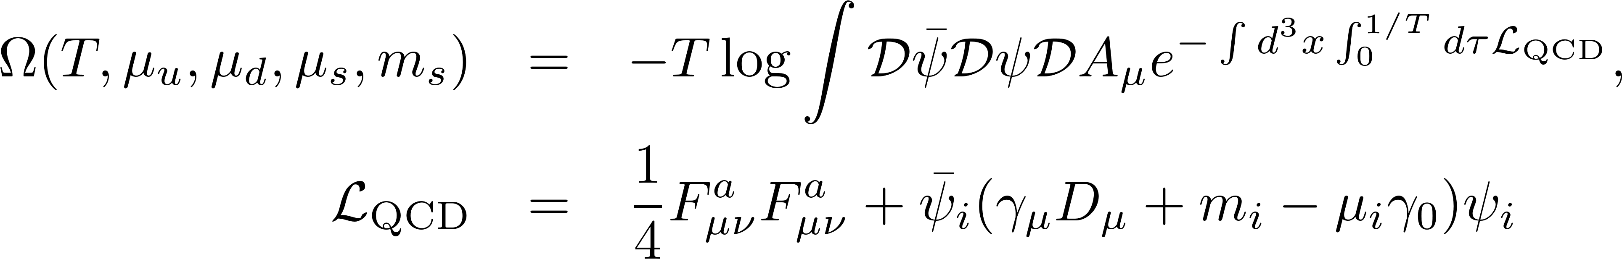
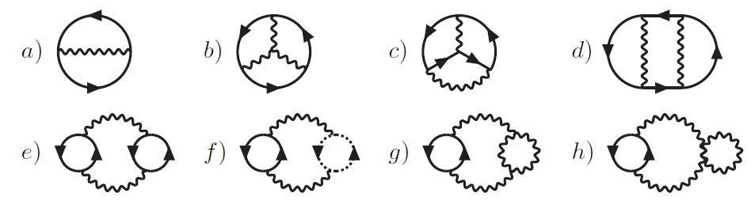
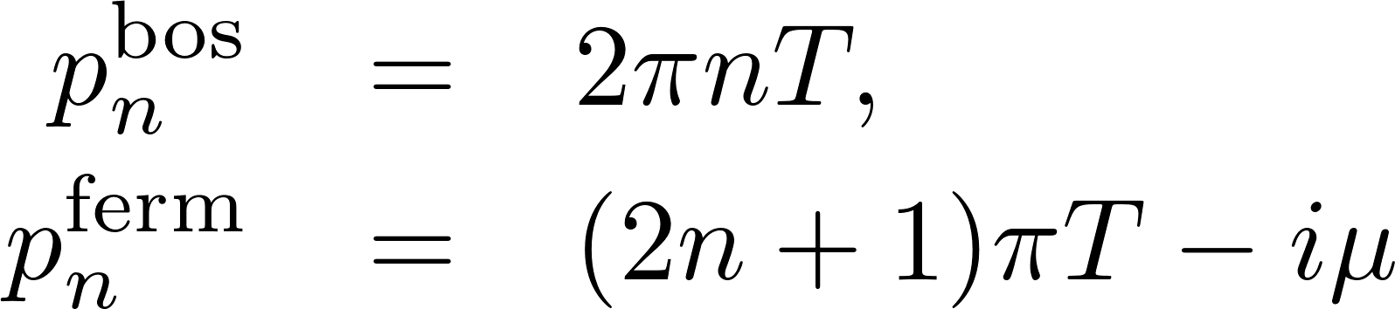
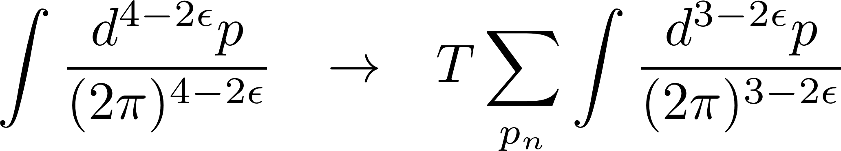
Perturbation theory: expansion of partition function in powers of gauge coupling g → Vacuum or bubble diagrams

Slide 18
Problem: infrared divergences at three-loop order from long-range gauge fields

Slide 19
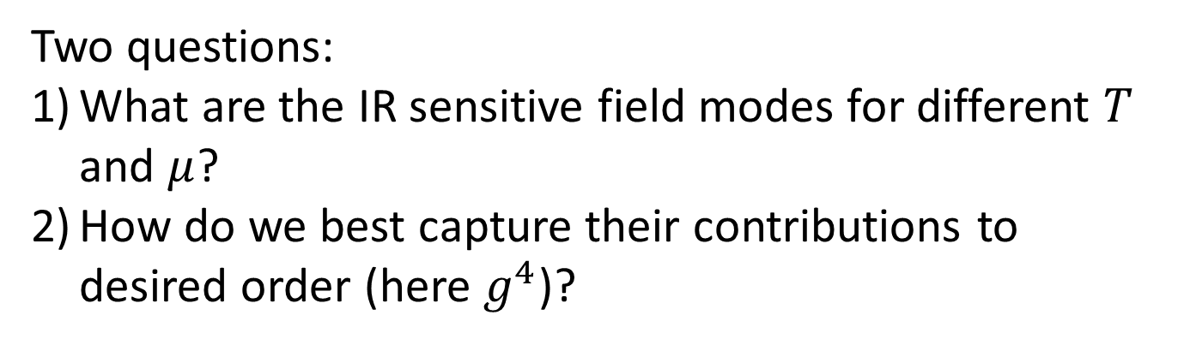
Two questions:
What are the IR sensitive field modes for different $T$ and $μ$?
How do we best capture their contributions to desired order (here $g^{4}$)?

Slide 20

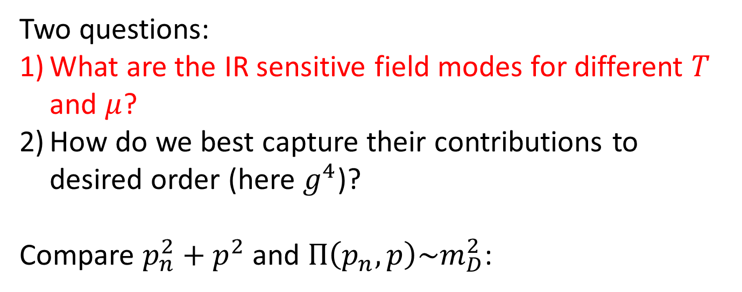
Two questions:
What are the IR sensitive field modes for different $T$ and $μ$?
How do we best capture their contributions to desired order (here $g^{4}$)?
Compare $p_{n}^{2}+p^{2}$ and $Π\left(p_{n},p\right)\sim m_{D}^{2}$:
$$\sim g\sqrt{T^{2}+μ^{2}}$$

Slide 21
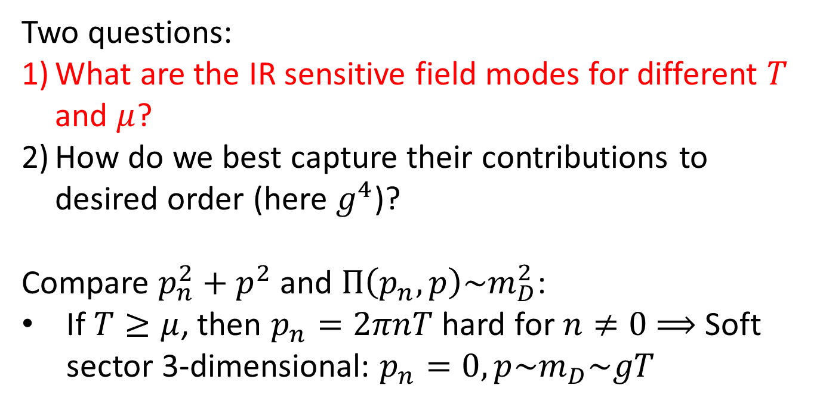



Two questions:
What are the IR sensitive field modes for different $T$ and $μ$?
How do we best capture their contributions to desired order (here $g^{4}$)?
Compare $p_{n}^{2}+p^{2}$ and $Π\left(p_{n},p\right)\sim m_{D}^{2}$:
If $T≥μ$, then $p_{n}=2πnT$ hard for $n≠0$ $⟹$ Soft sector 3-dimensional: $p_{n}=0, p\sim m_{D}\sim gT$
$$\sim g\sqrt{T^{2}+μ^{2}}$$
$${ω=ip}_{n}$$
$$m_{D}$$
$$2πnT$$

Slide 22
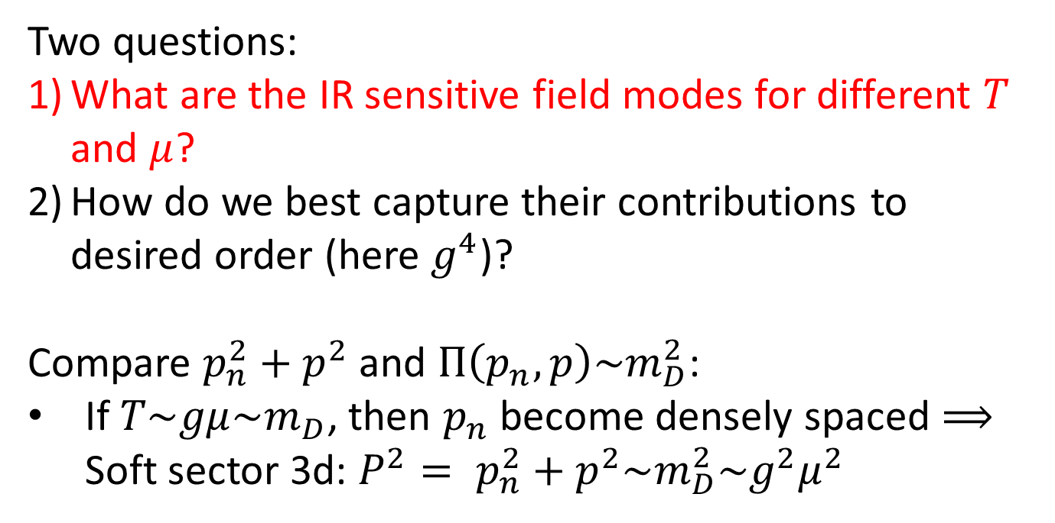
Two questions:
What are the IR sensitive field modes for different $T$ and $μ$?
How do we best capture their contributions to desired order (here $g^{4}$)?
Compare $p_{n}^{2}+p^{2}$ and $Π\left(p_{n},p\right)\sim m_{D}^{2}$:
If $T\sim gμ\sim m_{D}$, then $p_{n}$ become densely spaced $⟹$ Soft sector 3d: $P^{2}= p_{n}^{2}+p^{2}\sim m_{D}^{2}\sim g^{2}μ^{2}$
$$\sim g\sqrt{T^{2}+μ^{2}}$$
$${ω=ip}_{n}$$
$$m_{D}$$
$$2πnT$$

Slide 23
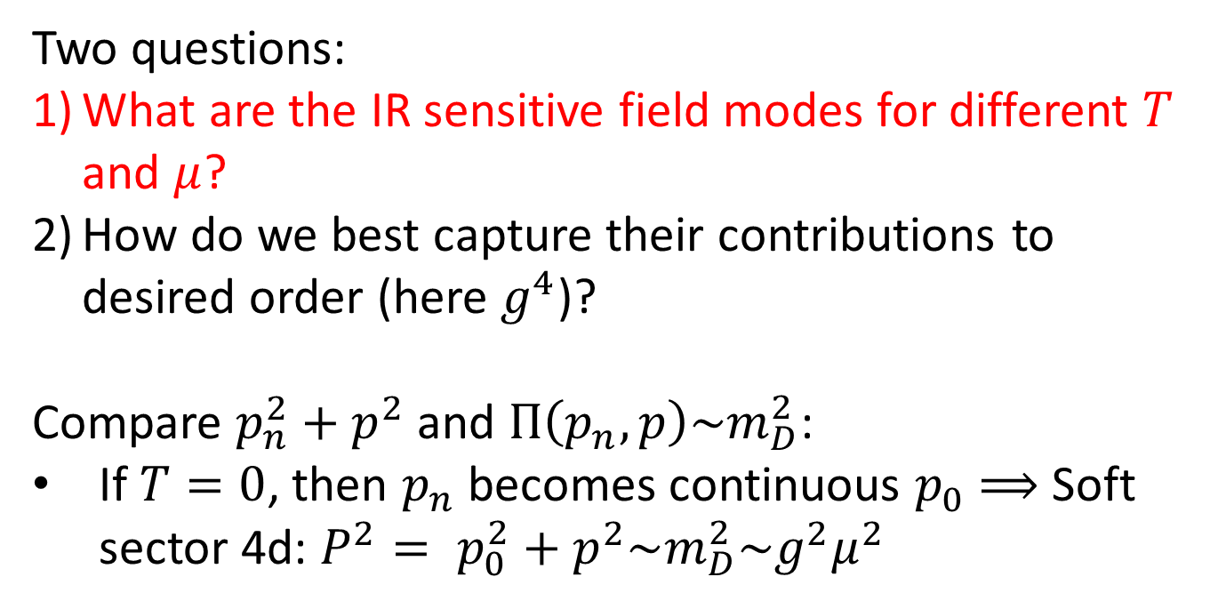

Two questions:
What are the IR sensitive field modes for different $T$ and $μ$?
How do we best capture their contributions to desired order (here $g^{4}$)?
Compare $p_{n}^{2}+p^{2}$ and $Π\left(p_{n},p\right)\sim m_{D}^{2}$:
If $T=0$, then $p_{n}$ becomes continuous $p_{0}$ $⟹$ Soft sector 4d: $P^{2}= p_{0}^{2}+p^{2}\sim m_{D}^{2}\sim g^{2}μ^{2}$
$$\sim g\sqrt{T^{2}+μ^{2}}$$
$${ω=ip}_{n}$$
$$m_{D}$$
$$p_{0}$$

Slide 24
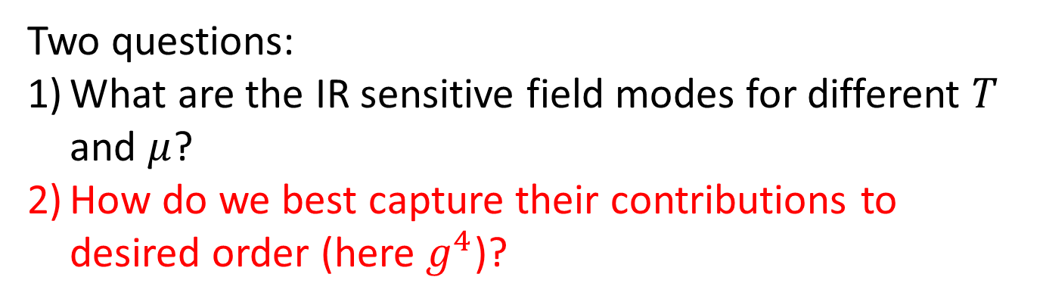
Two questions:
What are the IR sensitive field modes for different $T$ and $μ$?
How do we best capture their contributions to desired order (here $g^{4}$)?

Slide 25
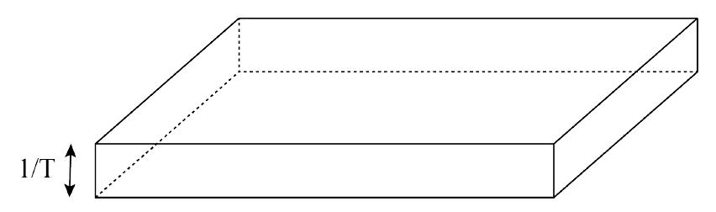
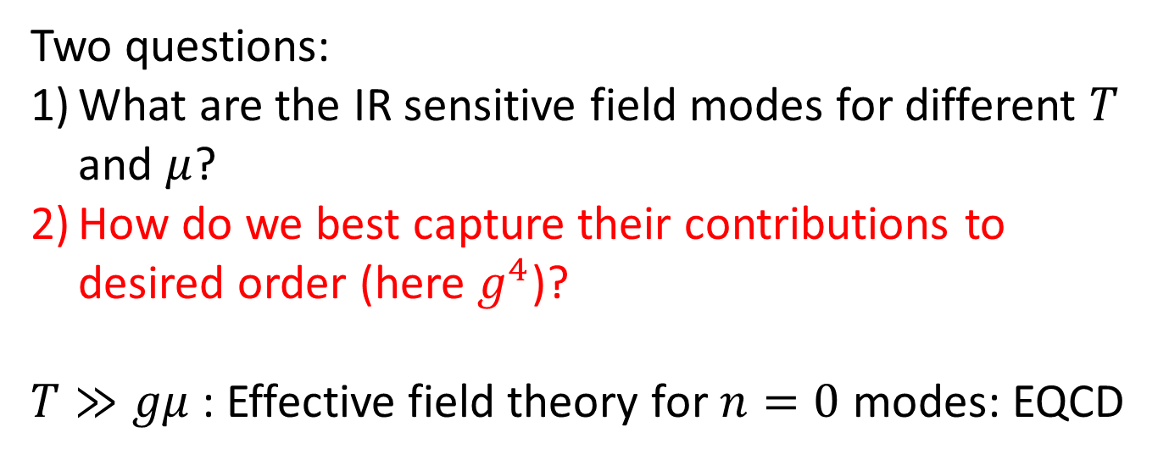
Two questions:
What are the IR sensitive field modes for different $T$ and $μ$?
How do we best capture their contributions to desired order (here $g^{4}$)?
$T≫gμ$: Effective field theory for $n=0$ modes: EQCD

Slide 26
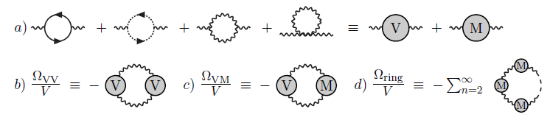

Two questions:
What are the IR sensitive field modes for different $T$ and $μ$?
How do we best capture their contributions to desired order (here $g^{4}$)?
$T≤gμ$: Traditionally direct resummation of ring diags.

Slide 27

Two questions:
What are the IR sensitive field modes for different $T$ and $μ$?
How do we best capture their contributions to desired order (here $g^{4}$)?
$T≤gμ$: Traditionally direct resummation of ring diags

Slide 28
Perturbative thermodynamics of QCD matter: existing results
Perturbative thermodynamics of QCD matter: new result and its uses
Technical insight 1: IR physics
Technical insight 2: effective theory approach to all temperatures

Slide 29
New approach: add and subtract the contributions of an (unspecified) IR sector

Slide 30
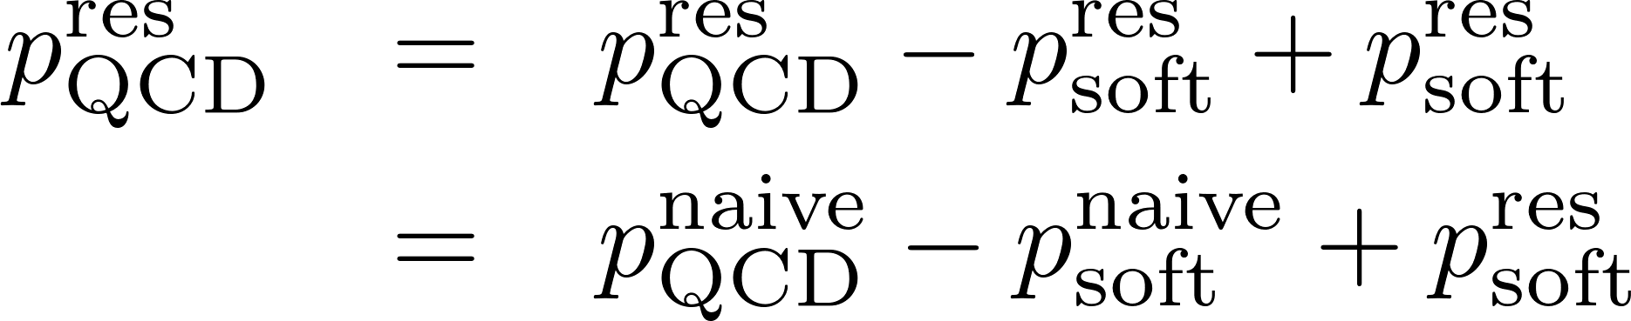
New approach: add and subtract the contributions of an (unspecified) IR sector

Slide 31
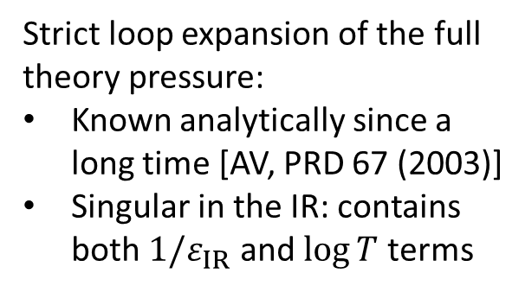
New approach: add and subtract the contributions of an (unspecified) IR sector
Strict loop expansion of the full theory pressure:
Known analytically since a long time [AV, PRD 67 (2003)]
Singular in the IR: contains both $1/ε_{IR}$ and $\log{T}$ terms

Slide 32
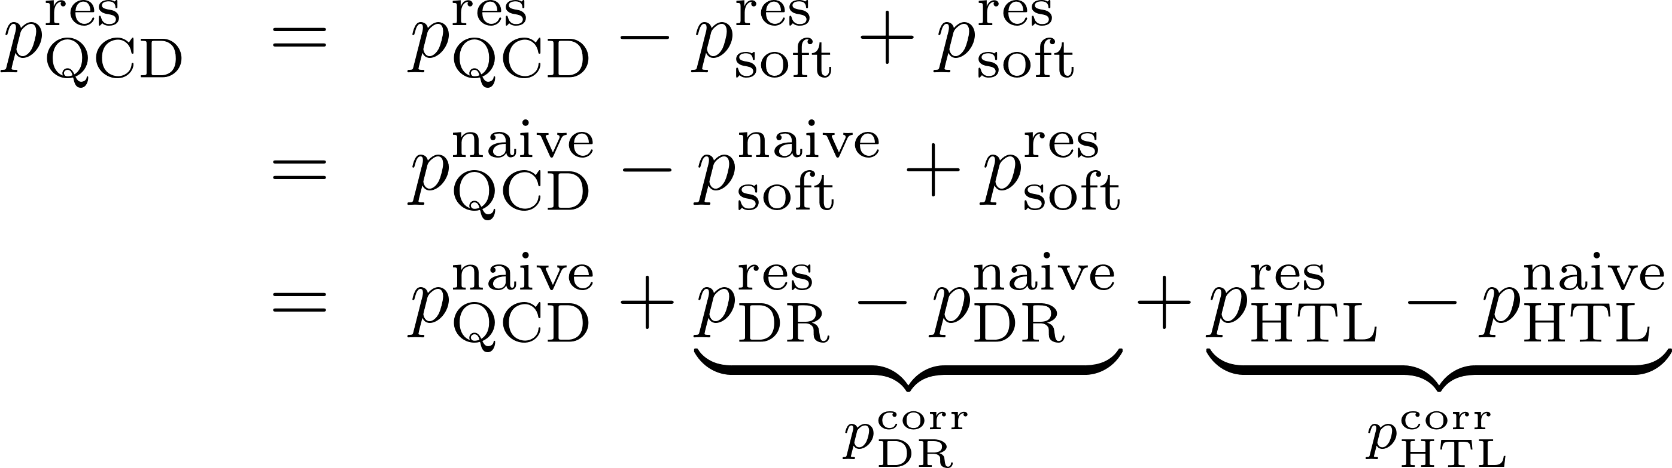
New approach: add and subtract the contributions of an (unspecified) IR sector

Slide 33
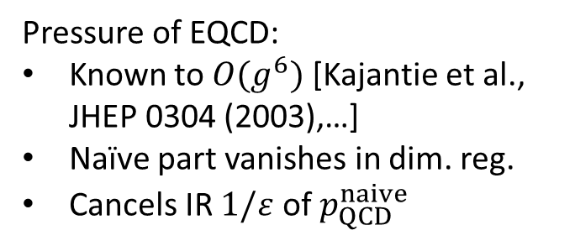
New approach: add and subtract the contributions of an (unspecified) IR sector
Pressure of EQCD:
Known to $O(g^{6})$ [Kajantie et al., JHEP 0304 (2003),…]
Naïve part vanishes in dim. reg.
Cancels IR $1/ε$ of $p_{QCD}^{naive}$

Slide 34
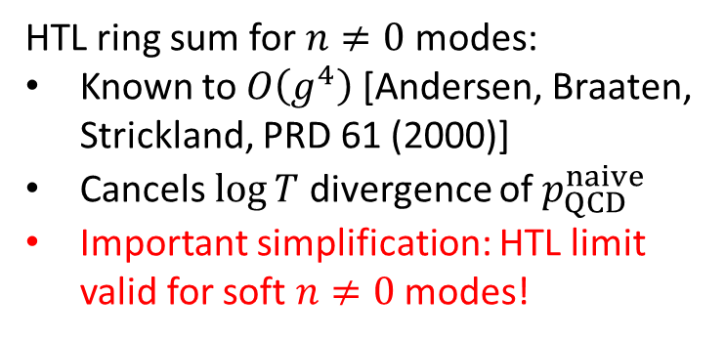
New approach: add and subtract the contributions of an (unspecified) IR sector
Pressure of EQCD:
Known to $O(g^{6})$ [Kajantie et al., JHEP 0304 (2003),…]
Naïve part vanishes in dim. reg.
Cancels IR $1/ε$ of $p_{QCD}^{naive}$
HTL ring sum for $n≠0$ modes:
Known to $O\left(g^{4}\right)$ [Andersen, Braaten, Strickland, PRD 61 (2000)]
Cancels $\log{T}$ divergence of $p_{QCD}^{naive}$
Important simplification: HTL limit valid for soft $n≠0$ modes!

Slide 36
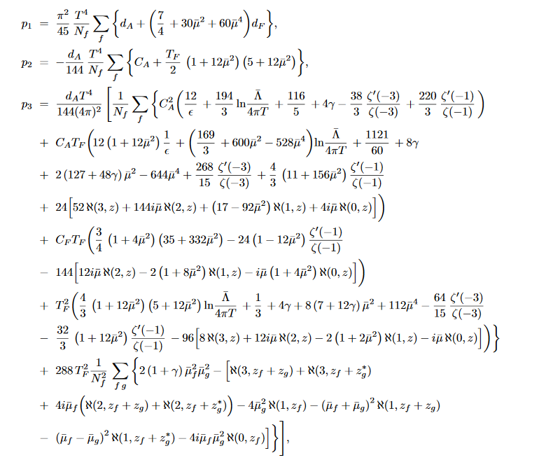

Slide 37
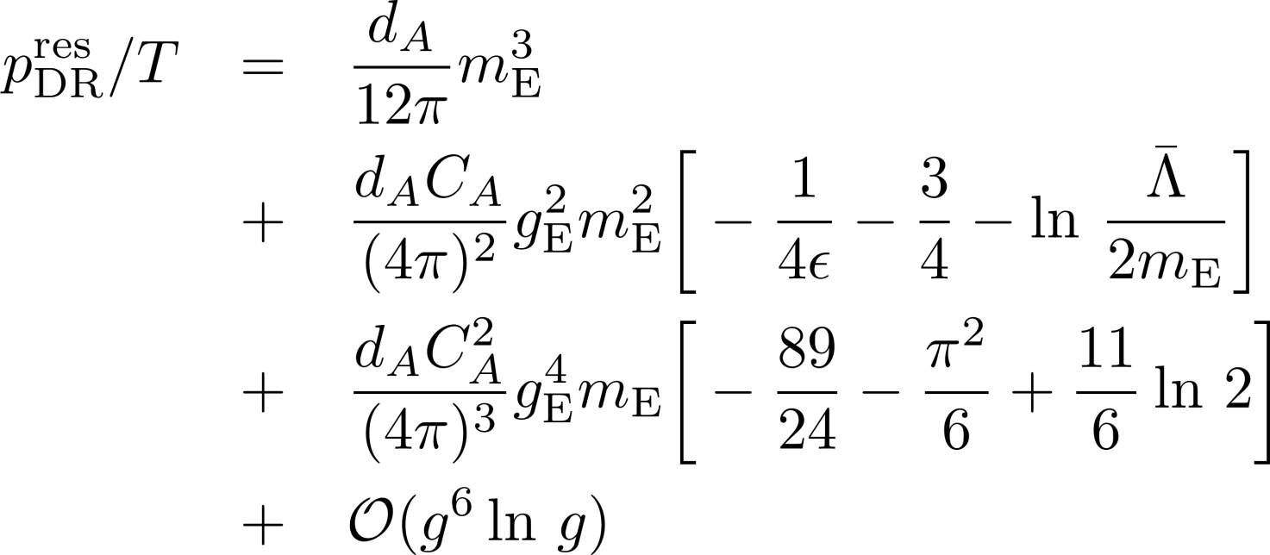

Slide 38
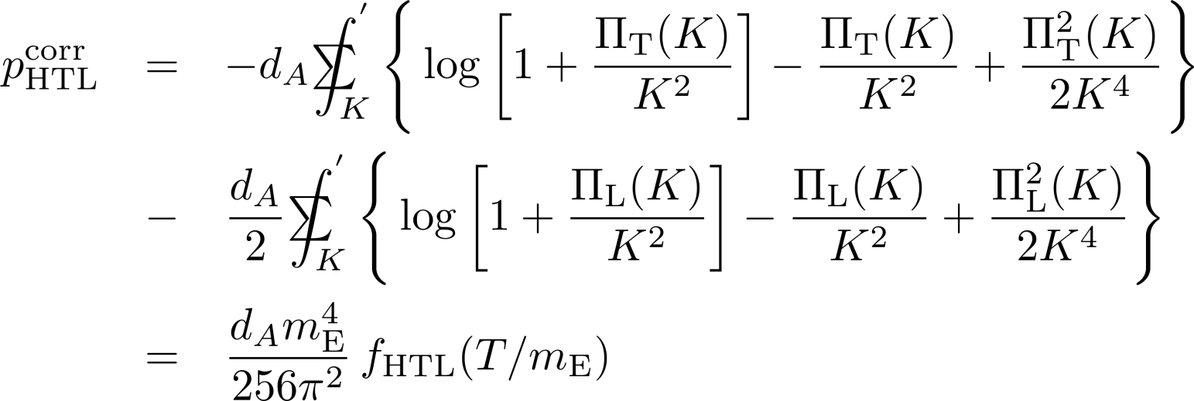
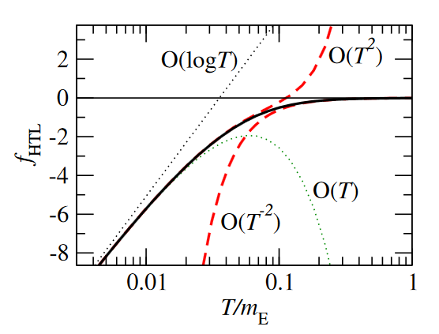

Slide 39
A. Kurkela, AV, arXiv:1603.00750 (to appear in Phys. Rev. Lett.)

