Slide 1
Barrel Tracking Group
ALICE Offline Week, 30/03/2016, R.Shahoyan

Slide 2
PWG-PP converted to two separate groups:
  Data preparation group (DPG, see presentation by Chiara):
  responsible for performing data calibration, QA, simulations etc
  Barrel tracking group (BTG):
  responsible for code development for reconstruction, calibration
Main task of BTG:
  Consolidate aliroot code for Run2 + implement missing features
  Do this in such a way to streamline porting to AliceO2
  Respond to development request from DPG
Composition:
  Small core team of people already working on tracking (Marian, RS ..?)
  Detector, HLT experts involved in specific task developments

Slide 3
Short-term tasks
Finalize TPC distortions calibration, including the p-p case and implementation of distortions simulation in MC
Misc. tasks to start 2015 (and soon 2016) data reconstruction, mostly in view of reducing output data size:
  ~30% space reduction by prescaling HLT ESDs to %5 of events: done
  Disk usage is dominated by V0’s (up to 50%) and TPC-only tracks
  (mostly from pile-up):
    Eliminate V0’s made of TPC-only tracks with DCAz>25cm and DCAr>60 cm (to be validated by PGC)
    Eliminate TPC-only tracks which would not end-up in the AOD (with some margin, e.g. DCA>5cm) if they are not used in preserved V0’s
    Suppress decay product kinematics in offline V0’s (redundant since a copy of ESDtracks): will be done only if time allows since requires tests.

Slide 4
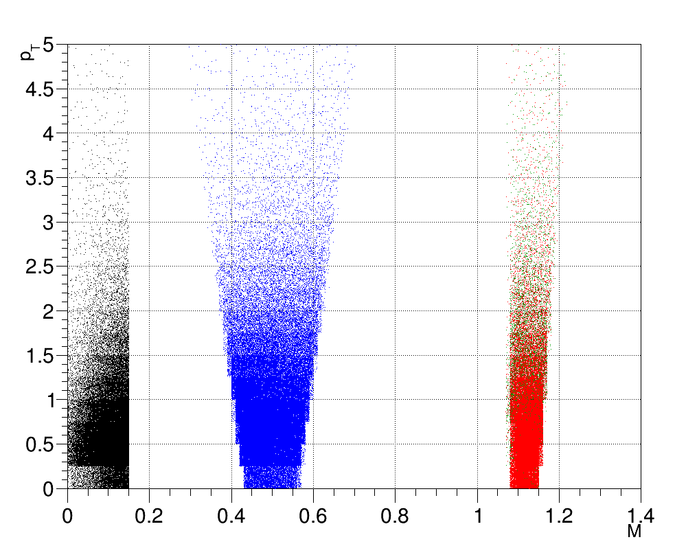
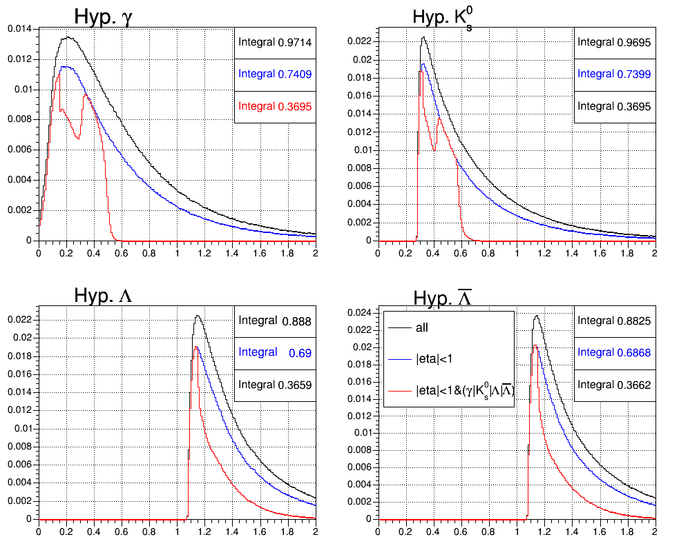
Short-term tasks
  apply ||<1 to V0’s (outside dominated by background) and remove V0’s below not matching to any of , K⁰ , ☹ ot heavy nuclei hypotheses with 20  + 50-70 MeV margin (proposed by D.Chinellato)
  In total, ~60% ESD size reduction to be achieved
cut on ||<1
mass cut

Slide 5
Middle-term tasks: TPC
Moving TPC calibration to HLT (Run2, prototype for Run3)
  Prerequisites:
  TPC HLT reconstruction to be validated in presence of distortions + mechanism to apply large corrections at sector merging
  Fast ITS standalone tracking in HLT: done
  Fast TRD tracking in HLT: to be done (development needed also for Run3)
  TOF is an option
  ITS-TPC-TRD matching procedure working in presence of distortions
Speed-up of TPC dE/dx calculation during reconstruction (currently ~20% of CPU) + eventual porting to HLT tracking (needed for Run3)
Speed-up of TPC ion-tail and cross-talk calculation (currently ~15-20% of CPU)
Finalization of TPC dE/dx calibration with “transfer function”

Slide 6
Middle-term tasks: TRD
Including TRD into global tracking:
  Prerequisites:
  [proper TPC calibration]
  Including TRD calibration into global alignment/calibration (Millepede)

Slide 7
Middle-term tasks: vertexing
More robust version of MultiVertexer with pile-up analysis capabilities for Run2 and as a prototype for Run3 (started by J. Niedziela)
  Prototyped in HLT ITS-track vertexer (part of ITS standalone reconstruction)
  Need to add:
    mean-vertex constraint
    iteration over pile-up vertices
    Bayesian analysis of pile-up probability

