Slide 1
LEGO train limits
Offline week,
31/03/2016
LB

Slide 2
Incident of 22/03/2016
A train operator has submitted 107 LEGO trains in one go
  These resulted in more than 4K master jobs (jobs that contain many sub-jobs, need to be split and optimized)
  Kept the optimizer busy for 10 hours, blocking other requests (the remaining PWGs, users, production)
The train operator was not aware of limits
  Although warned when he became one
The train were all on ESDs, making them heavier…
Not much going on these days, limited impact, only one user complained directly

Slide 3
Current train agreement
LEGO train have absolute priority (over all other jobs)
There is a gentlemanly agreement that
  Run max 30K jobs/day (not enforced, often surpassed)
  Self-imposed limits within the PWG operators on number and content of trains
  AOD trains have priority over ESD (submitted first, enforced by system) but not if a single PWG ‘grabs’ all available resources before everyone else
Single Grid user
  No need of ‘per-PWG’ job quotas (advantage)
  If one PWG does something ‘bad’, all suffer (disadvantage)
  Requires communication and respect

Slide 4

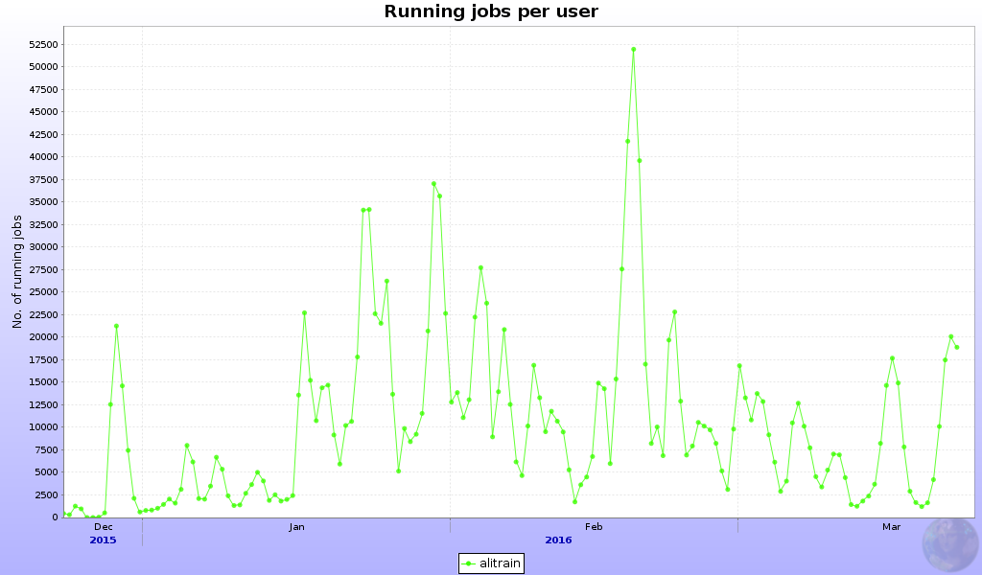
Train operation
No job limits presently, very favorable for periods of high demand
In average trains use ~16% of Grid resources
Uneven profile
Low predictability (except conferences)
Will not work well with ‘analysis facility’, i.e. steady-state analysis

Slide 5
Train limits - implementation
Already discussed and agreed last year
  Per-PWG accounts for train operation
  Per-PWG limits
This is mostly implemented but not activated as it has several disadvantages
  Will actually require to put a cap on running LEGO jobs
  Will not compensate as well as current ‘single user’ for under/overuse in case of quota not used by PWG(s) – usual principle is ‘use it or lose it’
  Will require a long and difficult discussion on quotas per PWG

Slide 6
Alternative proposal
Put caps on submission, not use
Global (or per-PWG) number of trains per day
  Advantage: will smooth train running over time - even resources use
  Advantage: avoid mistakes and system being blocked by a single operator
  Advantage: allows not to impose limits, keep current analysis priority high
  Advantage: Favors more compact AOD trains automatically (these are submitted first) + additional optimization (see ‘statistics’ later)
  Disadvantage: requires planning in case of heavy analysis programme, but only within individual PWGs

Slide 7
Alternative proposal - implementation
Limit to x the number of LEGO trains per day
  Soft limit – allows to submit all trains in one go, the excess over x is submitted and executed automatically the next day(s)
  OR
  Hard limit – if x is reached operator receives “You have reached your daily quota” error

Slide 8
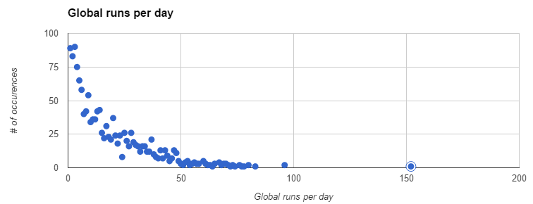
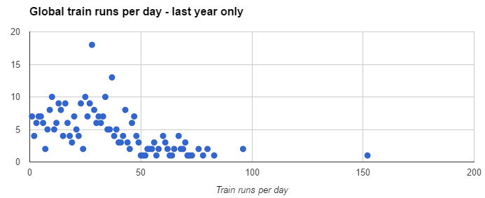
Alternative proposal - limits
Avg.19/day
Avg.30/day

Slide 9
Av. Number of wagons and runs/day
 | GA | HF | CF | DQ | JE | LF | UD | Tot.
2014-2015 | 3 w 8 r | 7.3 w 6 r | 3.2 w 5.6 r | 1.1 w 2.6 r | 9.9 w 5 r | 2.6 w 3.5 r | 0.9 w 1.4 r | 5.1 w 20.3 r
2015-2016 | 2.6 w 13 r | 6.5 w 7.6 r | 2.8 w 7.4 r | 1.4 w 4.8 r | 9.5 w 5.3 r | 10 w* 3.1 r | 0.9 w 2.3 r | 4.6 w 30.3 r
Subtracted from trains: tender/centrality/PID wagons
Overall increase of runs/day by 50%
Overall decrease of wagons/train by 10%
* biased by few 500 wagon-long tests

Slide 10
Wagons per train global
2014-2015 |  | 2015-2016
wagons | count | wagons | count
1 | 1837 | 1 | 2938 | 27.16%
2 | 1300 | 2 | 2263 | 20.92%
3 | 915 | 3 | 1891 | 17.48%
4 | 671 | 4 | 1175 | 10.86%
5 | 423 | 5 | 493 | 4.56%
6 | 345 | 6 | 448 | 4.14%
7 | 200 | 7 | 358 | 3.31%
8 | 244 | 8 | 152 | 1.40%
9 | 118 | 9 | 105 | 0.97%
10 | 211 | 10 | 102 | 0.94%
11 | 180 | 11 | 70 | 0.65%
12 | 239 | 12 | 204 | 1.89%
13 | 55 | 13 | 118 | 1.09%
14 | 54 | 14 | 55 | 0.51%
15 | 67 | 15 | 76 | 0.70%
16 | 110 | 16 | 41 | 0.38%
17 | 19 | 17 | 20 | 0.18%
18 | 40 | 18 | 21 | 0.19%
19 | 24 | 19 | 12 | 0.11%
>=20 | 218 | >=20 | 277 | 2.56%
5.13 | Average | 4.68 | Average

Slide 11
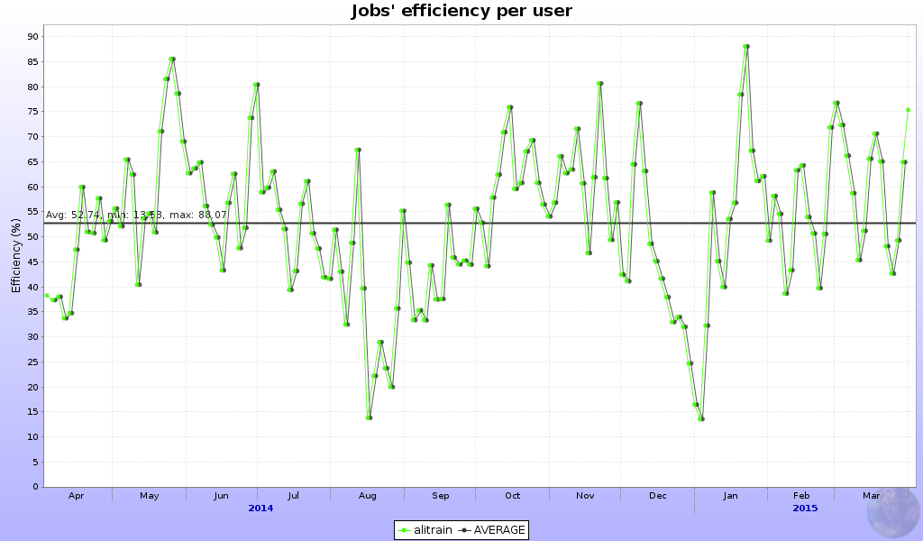
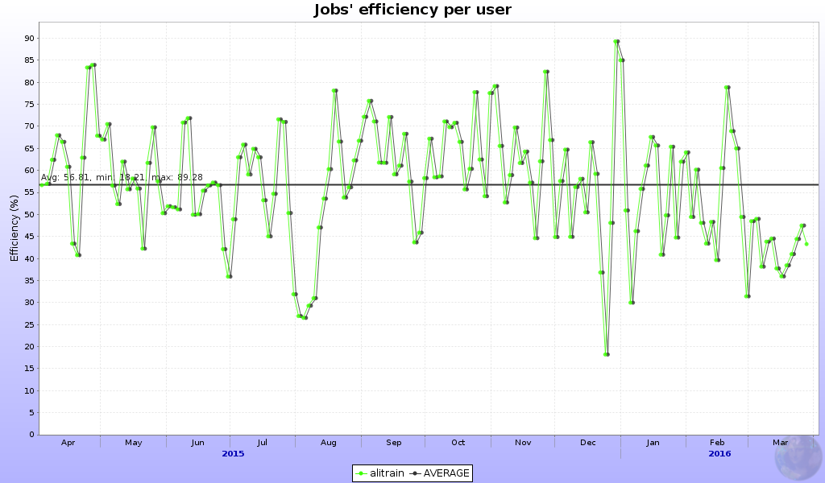
Efficiency
53%
57%

Slide 12
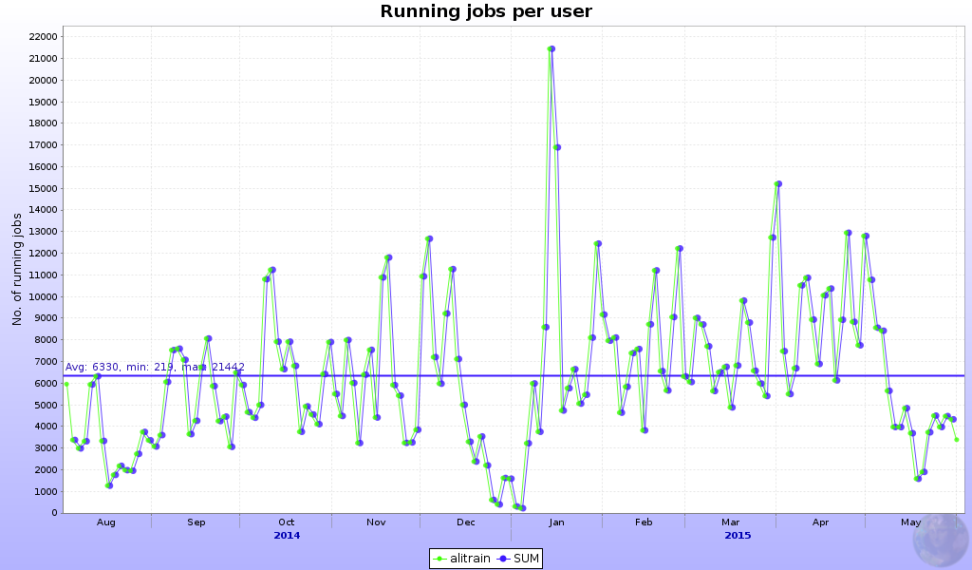
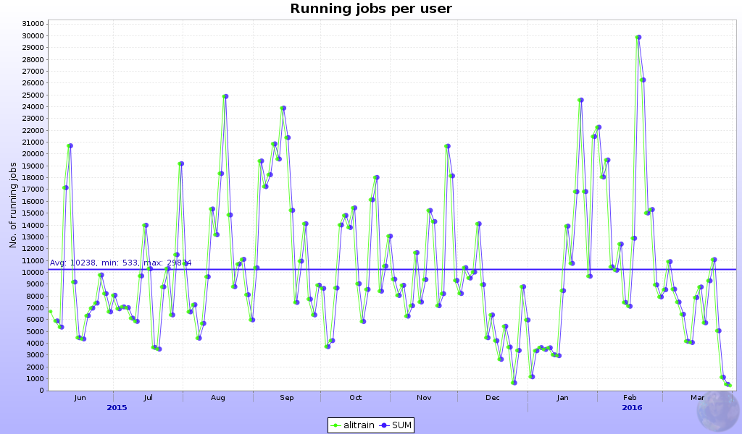
Resources
6330 jobs
Growth of Grid resources
+25% per year
10200 jobs (+60%)
Individual user analysis
9% of total in 2014-2015
6% of total in 2015-2016

Slide 13
Why now
Period of low activity – we can discuss and test limits without impact on PWG work
  PWGs can work on trains optimization
Avoid incidents in periods of high demand
  The 22/03 type incident just before QM will have larger consequences
Some limits must be imposed, as the appetite for trains grow
  Last year 50% more trains than year before, 60% more CPU
  Resources are limited, +25% CPU per year growth
Preliminary feedback is positive, but tuning is necessary and will take time

Slide 14
Summary
We have started (again) the discussion on LEGO train limits
We favor simple limit(s), easily tunable and PWG-specifics independent
  Hopefully, can be formalized and agreed upon without too much delay
  Will be fair and uniform, prevent incidental blocking
  Leave room for (as presently) cross-PWG agreements
  Will not limit the overall resources used for analysis
Will spur some optimization of the train setup and actions from PWG to fit within reasonable constraints
  Hopefully the ESD to AOD migration will receive a boost
  As well as train set optimization

