Slide 1
Grid status
ALICE Offline week
March 31, 2016
Maarten Litmaath
CERN-IT v1.1

Slide 2
VOMS-Admin saga
~1 year ago the obsolete VOMRS grid user registration service was replaced by VOMS-Admin
  Not perfect, but actively maintained and developed
Various issues then popped up ~1 year later
  Unexpected VO membership “expiration” warnings
    Should be handled better in the latest version
  AUP re-signing request flood causing load on VO admins
    Will be randomized to some degree
  Errors for users of the INFN CA
    As the CA DN had changed, they needed to re-register
  Errors for users with 2 or 3 (historic) records
    A cleanup has been done
Things should be smoother next year…

Slide 3
Site evolution
Growth e.g. thanks to 2016 pledges
Thanks & bye-bye to CSC, Madrid, NECTEC
Welcome to HIP, CBPF, Tsukuba (soon)
Welcome to the HLT clusters
  Up to 8.5k (HLT) + 750 (HLTDEV) job slots
Welcome to CERN-SIRIUS
  Shared HTCondor cluster with 15k cores
Welcome to Altaria
  Virtual site in front of cloud deployments, see page 9
New VOBOXes at CNAF, FZK, KISTI

Slide 4
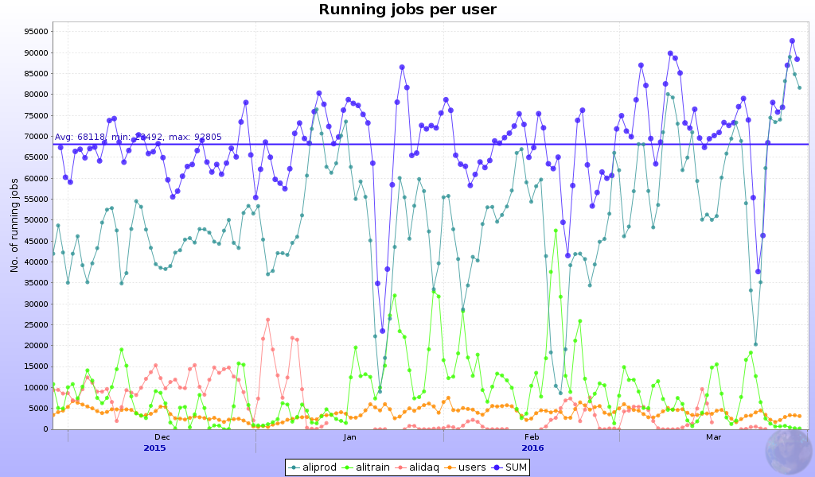

High activity
99372 concurrent jobs on March 10
99376 concurrent jobs on March 29
68k average
Nov 27 – Mar 30

Slide 5
CASTOR
Mostly stable operation during and after the heavy ion run
  A few incidents were quickly resolved
Plans for this year were discussed with the storage group in CERN-IT
The old extra HW was extended until ~mid April
New HW will be added as of late April
The resources seem sufficient
  2015 Pb-Pb and pp reco and reprocessing
  2016 data taking

Slide 6
Grid storage
EOS-ALICE was almost completely full
  Led to service instabilities
  And failures for users and jobs around the grid
  Mitigated by the admins
  Cured through cleanups
About 2.5 PB were recovered on the grid thanks to ad-hoc cleanups
Further cleanups are expected this spring
  Pending agreement on data usage and retention policy changes

Slide 7
Heavy ion reconstruction
So far the reco jobs needed at most ~2.5 GB RSS thanks to very nice code enhancements
The high-memory arrangements at CERN and the participating T1 sites were undone
  Could be reinstated per site if needed
Waiting for the big campaign to start…

Slide 8
Middleware
SL5 will be deprecated for MW this spring
  EGI have set a deadline of April 30
  Already there have been openssl compatibility issues
CentOS/EL7 will become more important
  Some services already available
  SL6 remains the default
HTCondor batch system remains on the rise
  It comes with its own CE
    AliEn can use it (currently still via a prototype)
    SAM tests to be added this spring
  The ARC CE remains an alternative

Slide 9

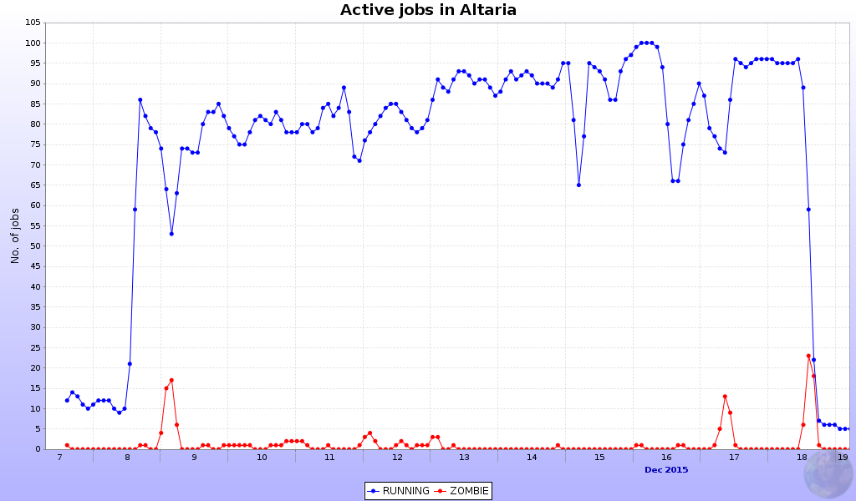
Altaria
Virtual site in front of commercial cloud resources
operated by CERN-IT
  Plus a few cloud resources at BITP
Small MC test for ~10 days in Dec
  4k jobs done OK
  4k failed, mostly validation errors
This summer a much bigger test will be done
  ~1k cores for 3 months
  I/O-intensive jobs (reco)

Slide 10
SAM
New Availability / Reliability profile based on selected MonALISA results remains not yet critical
  http://wlcg-sam-alice.cern.ch/templates/ember/#/plot?profile=ALICE_MON_CRITICAL
Its introduction was delayed because of issues with the Dashboard GUI that needed to be fixed
We intend to give the new profile a try this spring
Sites will first be alerted to compare old and new profile results
  SE test failures will reduce the A / R!
Test job submission to the HTCondor CE still to be added

Slide 11
Xrootd reminder
Sites should start planning upgrades to Xrootd >= 4.1
  Stable and well supported
  Required for IPv6 support
T1 sites are particularly concerned
  They receive raw data exported from T0
  Latest CASTOR incompatible with old xrd3cp
    Gateway hosts are being used as a temporary workaround
Communication via LCG Task Force list as usual for expert advice
SL6 hosts now can have xrootd for ALICE installed through rpms!
  http://linuxsoft.cern.ch/wlcg/
  Thanks to Adrian Sevcenco!

Slide 12
Tips for sites – thanks!
Possible issues on VOBOX, CE, WN
  CVMFS problem, CE not ready for jobs,
  myproxy running low, myproxy type wrong, …
  Absence of “system” library
    HEP_OSlibs rpm helps avoid that
Jobs may fail due to SE problem
Admins please check site issues page
  http://alimonitor.cern.ch/siteinfo/issues.jsp
Subscribe to relevant notifications
  http://alimonitor.cern.ch/xml.jsp

