Slide 1
CLIC Vertex Detector Developments
Pierpaolo Valerio
Edinei Santin
FEE MEETING 2016 - KRAKOW

Slide 2
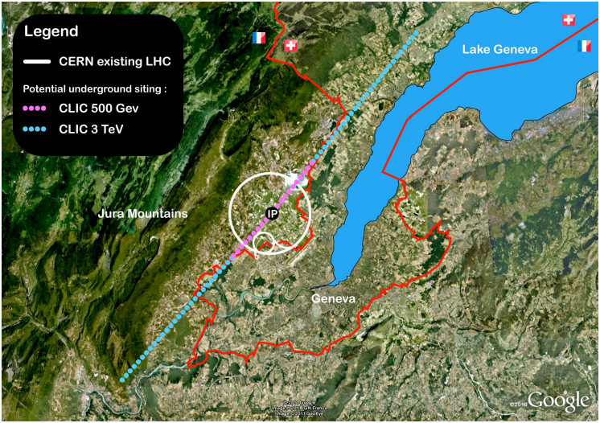
The CLIC project
The Compact Linear Collider (CLIC) is a study for a high-energy and high-luminosity collider
e+e- collider
Can be used to determine standard model parameters with a higher precision than proton colliders
Allows the detection of new particles and the testing of models as supersymmetry and Higgs strong interactions

Slide 3
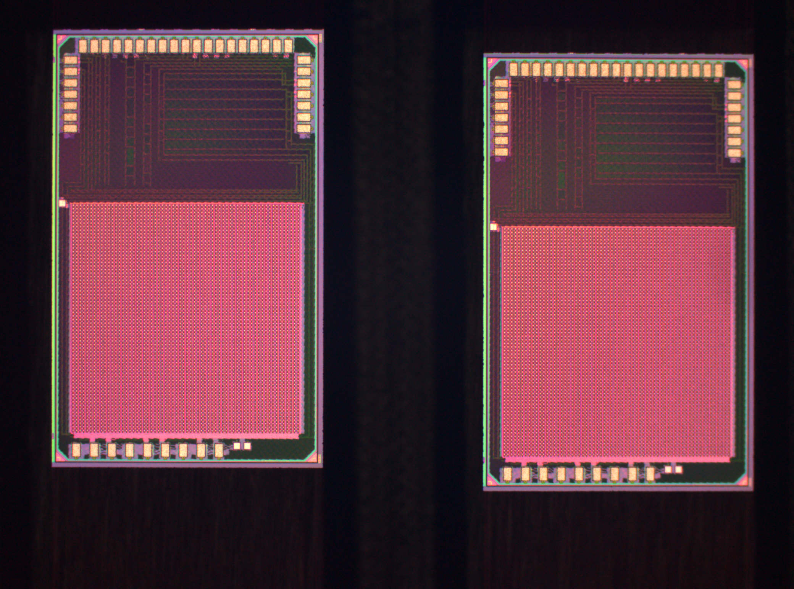
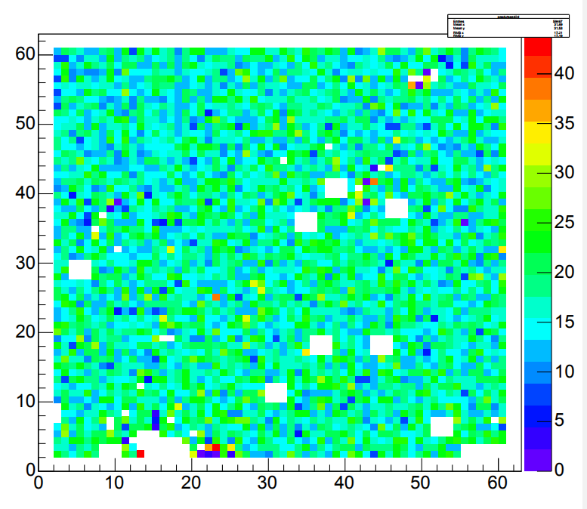
CLICpix
CLIC Work in Progress
65 nm CMOS r/o ASIC targeted to the CLIC vertex detector
Submitted in Nov./2012, tests started in Jan./2013
Based on Medipix chip family
64 x 64 pixel matrix, 1.6 x 1.6 mm2 active area
25 μm x 25 μm pixel pitch
Simultaneous time (4-bit ToA, 10 ns) and energy (4-bit ToT) measurements
Selectable on-chip data compression (pixel, super pixel, column-based)
Power pulsing enabled (Pavg < 50 mW/cm2)
Row
#hits
3 mm
Column
CLIC Work in Progress
Row
#hits
1.85 mm
Column

Slide 4
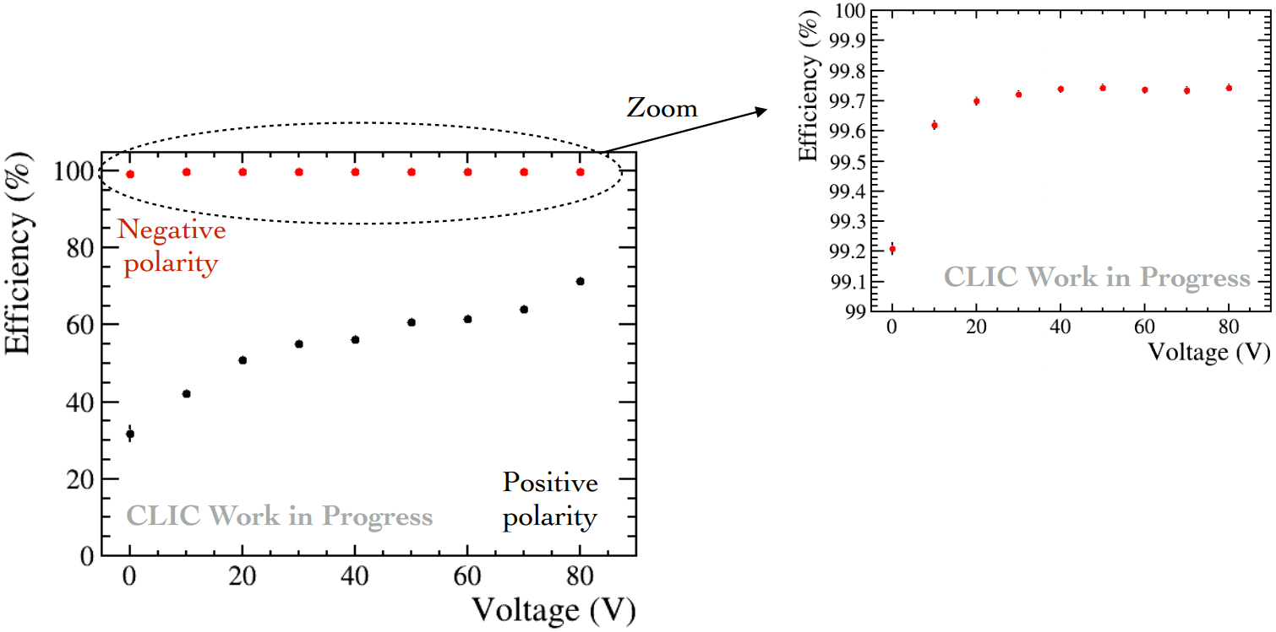
Current results
Recent results using both capacitively coupled HV-CMOS and bump-bonded Si sensors show good uniformity and detection efficiency
The chip works well and it provides a good proof-of-concept for a CLIC vertex detector built with current technology

Slide 5
Why a redesign?
A crosstalk coupling to the input pad limits the minimum threshold (a fixed pattern noise is visible in the measurements)
A small readout bug limits the performance of the data compression
The I/Os work as intended, but the interface is not very user-friendly or convenient
Limited counters length, despite meeting the CLIC specifications, makes data taking relatively slow and some measurements difficult

Slide 6
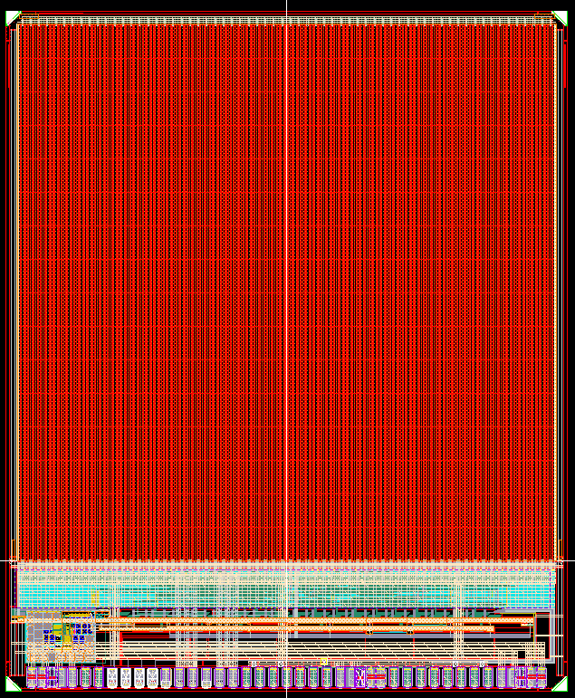
CLICpix2
3.3 mm
CLICpix2 is a redesign of CLICpix (referred to as “CLICpix1”), using the same CMOS technology
CLICpix1 was already successful as a proof-of-concept for the general architecture of the chip. Many blocks are reused with little changes
The new chip features bug fixes and “quality of life” improvements, along with a large number of minor upgrades to most blocks (too many to present them all!)
Main features:
  Longer counters for ToT and ToA to make testing more efficient
  Implement a smarter I/O protocol to allow an easier system design and a faster readout
  Bigger pixel matrix (128 by 128 pixels)
  Better noise isolation
  Integrated testing DACs
  Integrated bandgap
4 mm

Slide 7
Array architecture
Analog part of adjacent pixels share biasing lines and power distribution lines
Digital part is shared between each two adjacent pixels (including power distribution)

Slide 8
Super-Pixel
In ClicPix2, pixel clustering in 2x8 arrays allows to further compress the data for low occupancies
It also reduces the area because some of the electronics can be shared (clock distribution tree, biasing lines)
HF
Pixel Hit Flags

Slide 9
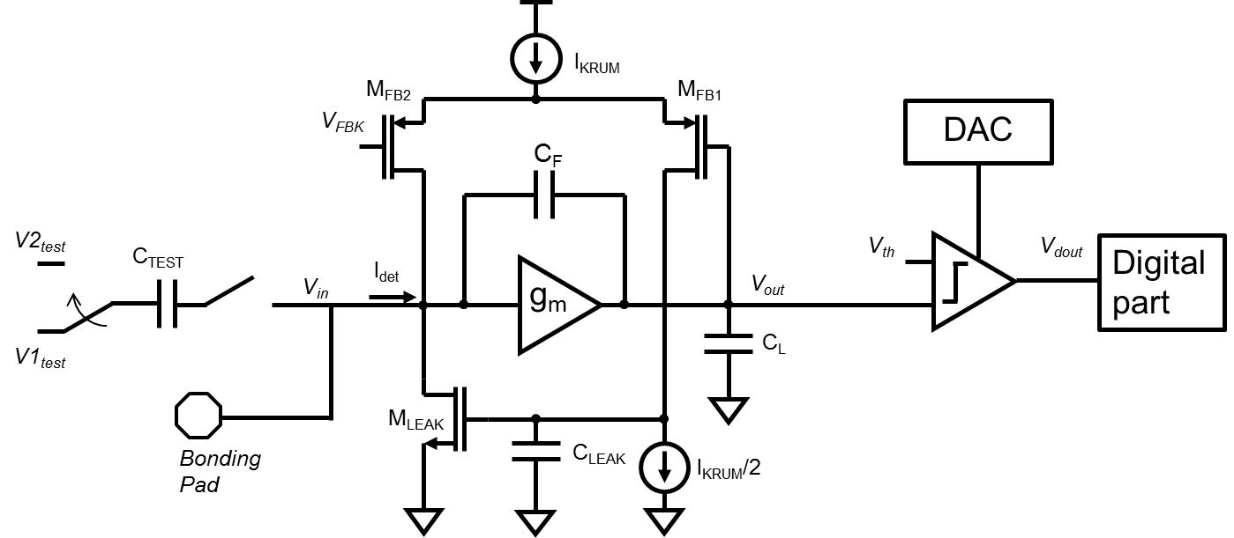
Frontend block diagram
Composed of three building blocks: charge-sensitive amplifier, comparator, and calibration DAC
Conceptually the same as CLICpix1, but many blocks were improved to have better noise immunity and make their footprint smaller!

Slide 10
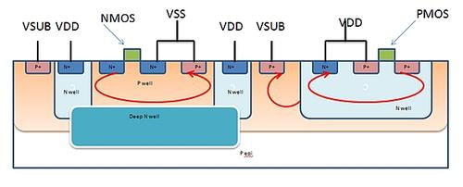
Noise Isolation
All the analog structures have now a deep n-well isolation structure, to physically separate their substrate from the noisy digital blocks
The analog pixel has a mirrored layout, making the connections to their corresponding logic shorter
More care has been put in shielding critical nodes
Power supply distribution has been optimized to improve its stability

Slide 11
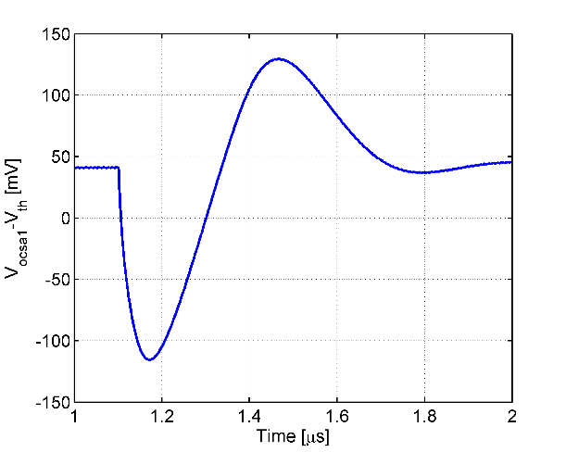
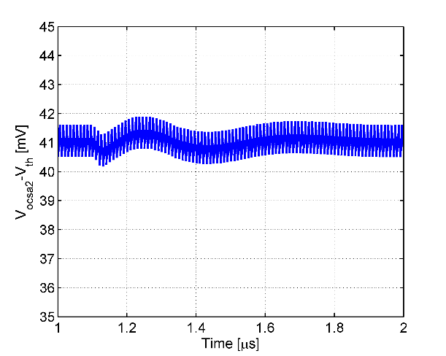
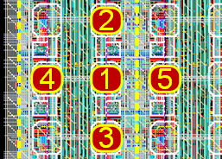
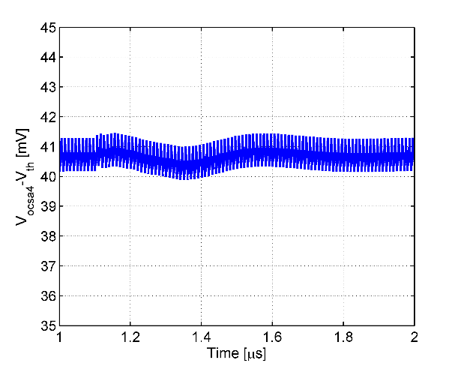
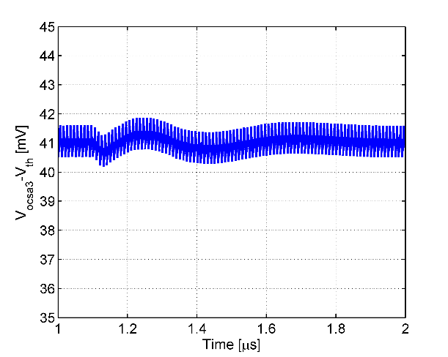
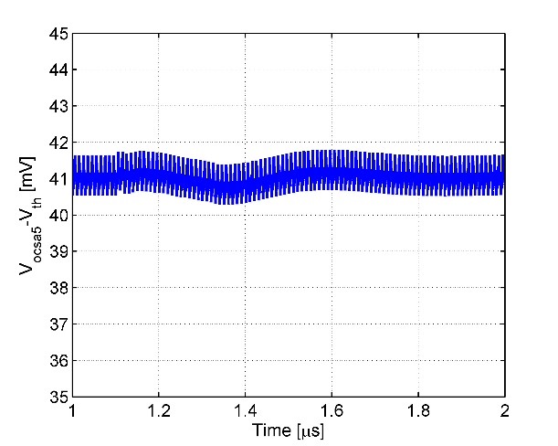
Crosstalk at the input of the comparators (xRC)
1
2
~41mV
4
3
5
Extensive simulations were performed to address potential crosstalk
Maximum error due to crosstalk is ~0.5 mV (15e-) which is ~5x lower than the noise spec (70e-)

Slide 12
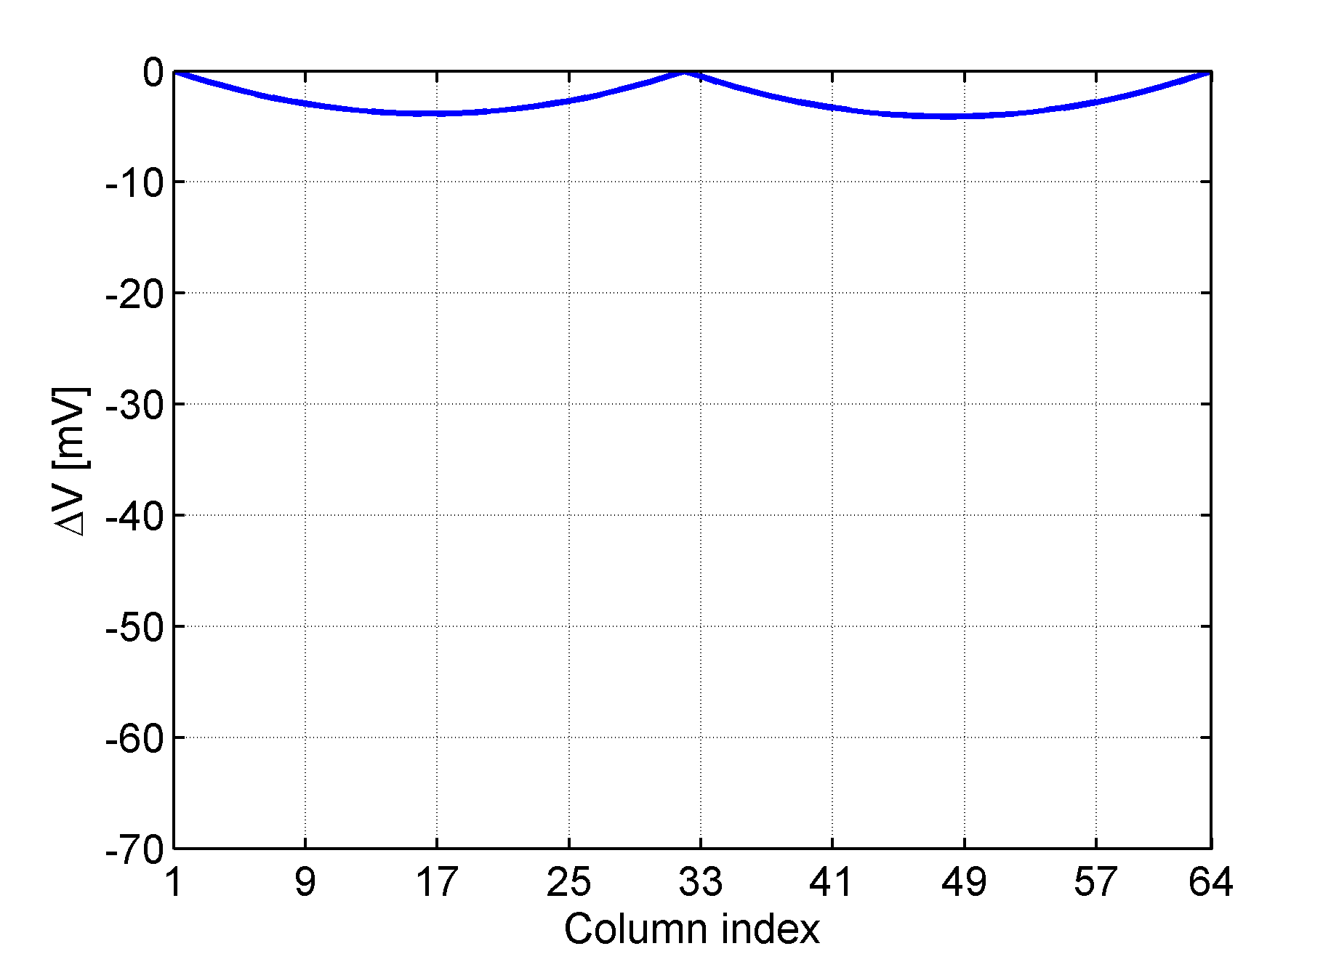
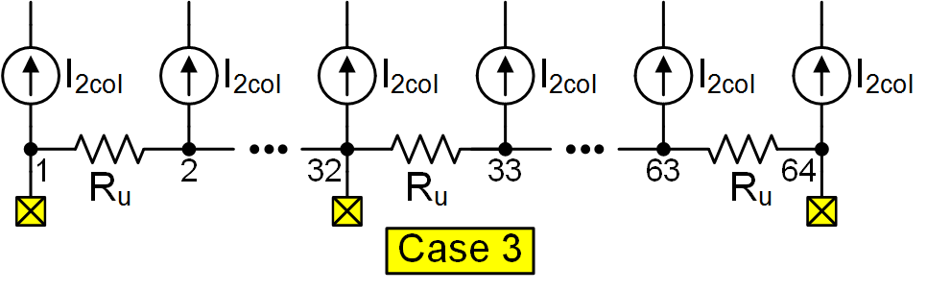
Power distribution
Power is distributed along the columns with vertical lines
  This limits the chip area! TSVs would help
Simulations were used to optimize the placement of power pads to achieve a better uniformity and to reduce drops over the matrix

Slide 13
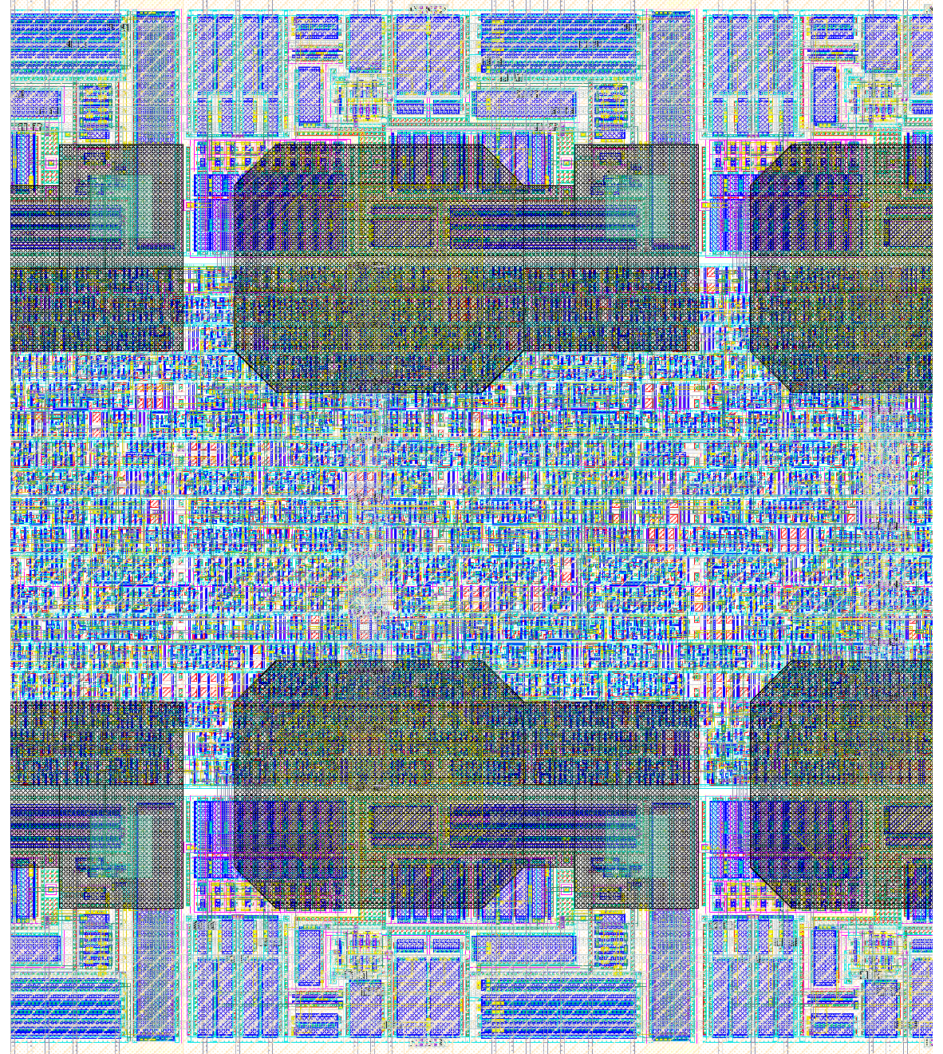
Pixel Layout
Analog Part
The matrix layout is similar to CLICpix1, as pixels are still organized in 2x8 “super-pixels”
The analog parts are now perfectly symmetrical, which should eliminate a fixed pattern noise seen in the first prototype
The pads are larger and designed to be compatible with both bump bonding and capacitively coupled sensors
Digital Part
Analog Part

Slide 14
Performance summary
Parameter (C_{det} = 20 fF) | Value
Power dissipation | 6.6 µW
CSA gain | 33 mV/ke-
CSA phase margin | 67°
ToT dynamic range | 270 ke- (holes) / 150 ke- (electrons)
ToA accuracy | < 10 ns (w/ offline calibration)
Input-referred noise | 67 e-
Input-referred mismatch error | 28 e-
Minimum threshold | 438 e- (w/ 6-sigma margin)

Slide 15
Additional Analog Blocks
Some blocks in the periphery which were missing in the previous chip were added, including:
  A Bandgap reference, which makes the chip more robust to temperature changes
  Temperature sensor
  Power supply test-point
  An electrical connection for the grounding of sensor guard-rings

Slide 16
Additional Digital Features
In the pixels:
    5 bits ToT (up from 4)
    8 bits ToA (up from 4)
    Optional 13 bits ToA instead of ToT (it can be used as event counter too)
Easier to decode and more robust data format
Faster readout with more standard protocol
Automatic test pulse generator
I/O link testing routine
Some debug features

Slide 17
Readout algorithm
In order to use clock recovery from data stream, which simplifies the readout system, we set a target bandwidth of 640 Mbit/s over a single (differential) serial link
In CLICpix1 one column at a time is read: this solution doesn’t scale with clock speed
A more general solution is to read out data from multiple columns at the same time using a slower clock and then serialize data at the output
At the same time, the clock is divided by the same ratio to match the output bandwidth
The system is entirely configurable: we can read 1/2/4/8 columns at a time and the clock divider can be configured independently

Slide 18
Parallel Readout
If the chip is configured to read more than one column at a time, the matrix is divided in equal parts (by column), reading one column from each part
The data is then serialized with the readout clock
8/10 bit encoding is added at the output to recover the clock from the data stream

Slide 19
Readout Time
Occupancy
Occupancy
Readout time (ms)
Readout time (ms)
# columns
# columns
Readout time with a 640 Mb/s serializer
Readout time with a 2 Gb/s serializer
The readout time is well within the CLIC specifications (800 µs) even with 2 parallel columns

Slide 20
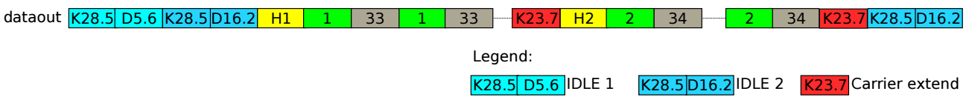
Ethernet packet encapsulation
The data packets follow the Ethernet physical specification
The data stream is properly divided into packets, each containing data from one or more double columns
Headers dividing the packets contain relevant chip settings to allow for data reconstruction without any additional information

Slide 21
Design status
The design is complete and the final simulations are ongoing
Mixed-mode simulations have validated the accuracy of the data acquisition blocks
A more comprehensive set of digital verifications are being developed to be sure to test every feature and corner case
As soon as the last verification are done, the chip will be submitted

Slide 22
Conclusions
CLICpix was a successful demonstrator for the CLIC vertex detector, leading to many interesting results within the CLICdp collaboration
Some bugs in the design warranted the development of an improved version, which could be used in a wider range of use cases
The design is complete and the last verification steps are ongoing

Slide 23
Thanks for your attention

Slide 24
BACKUP SLIDES

Slide 25
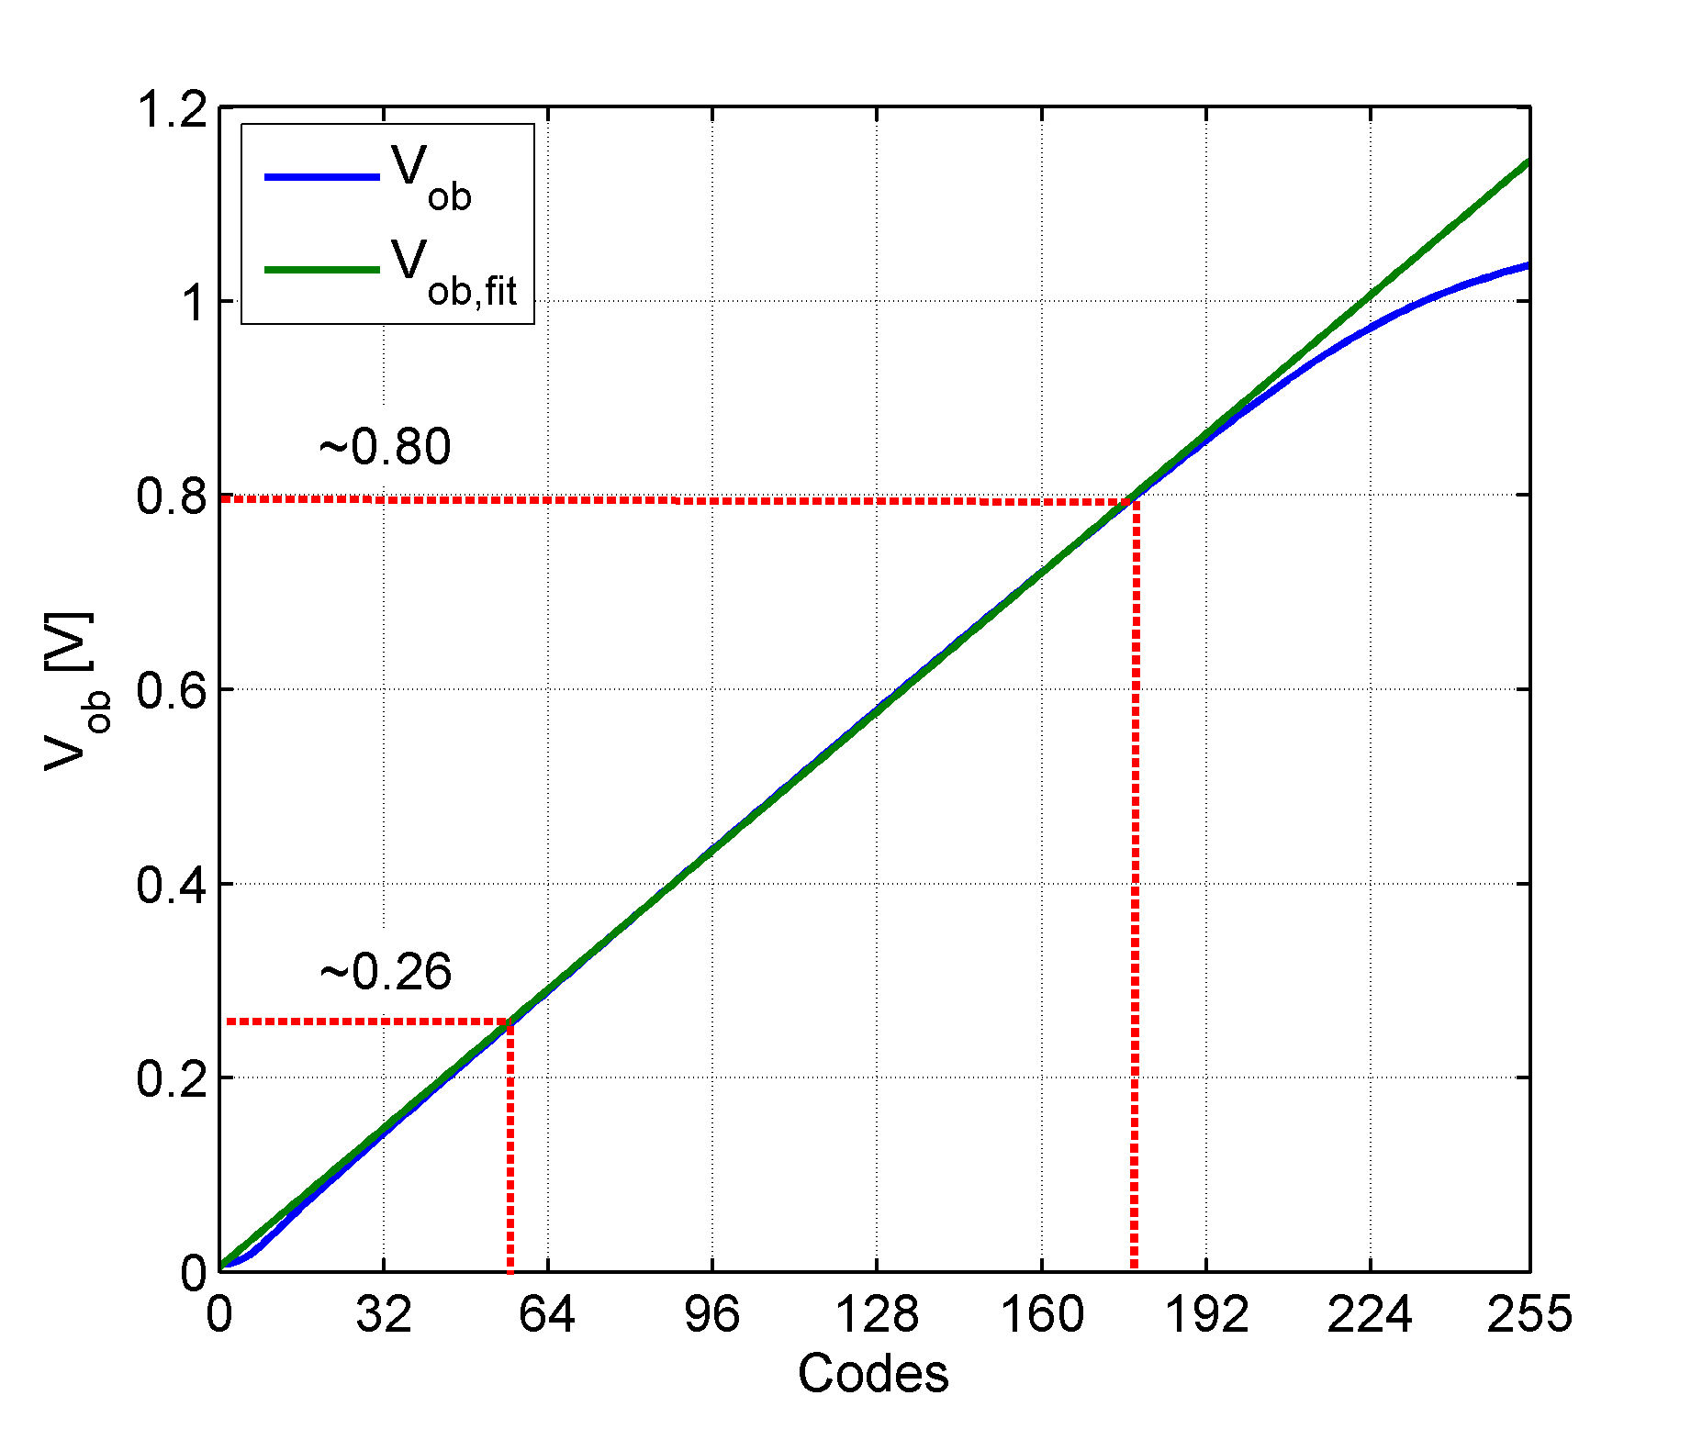
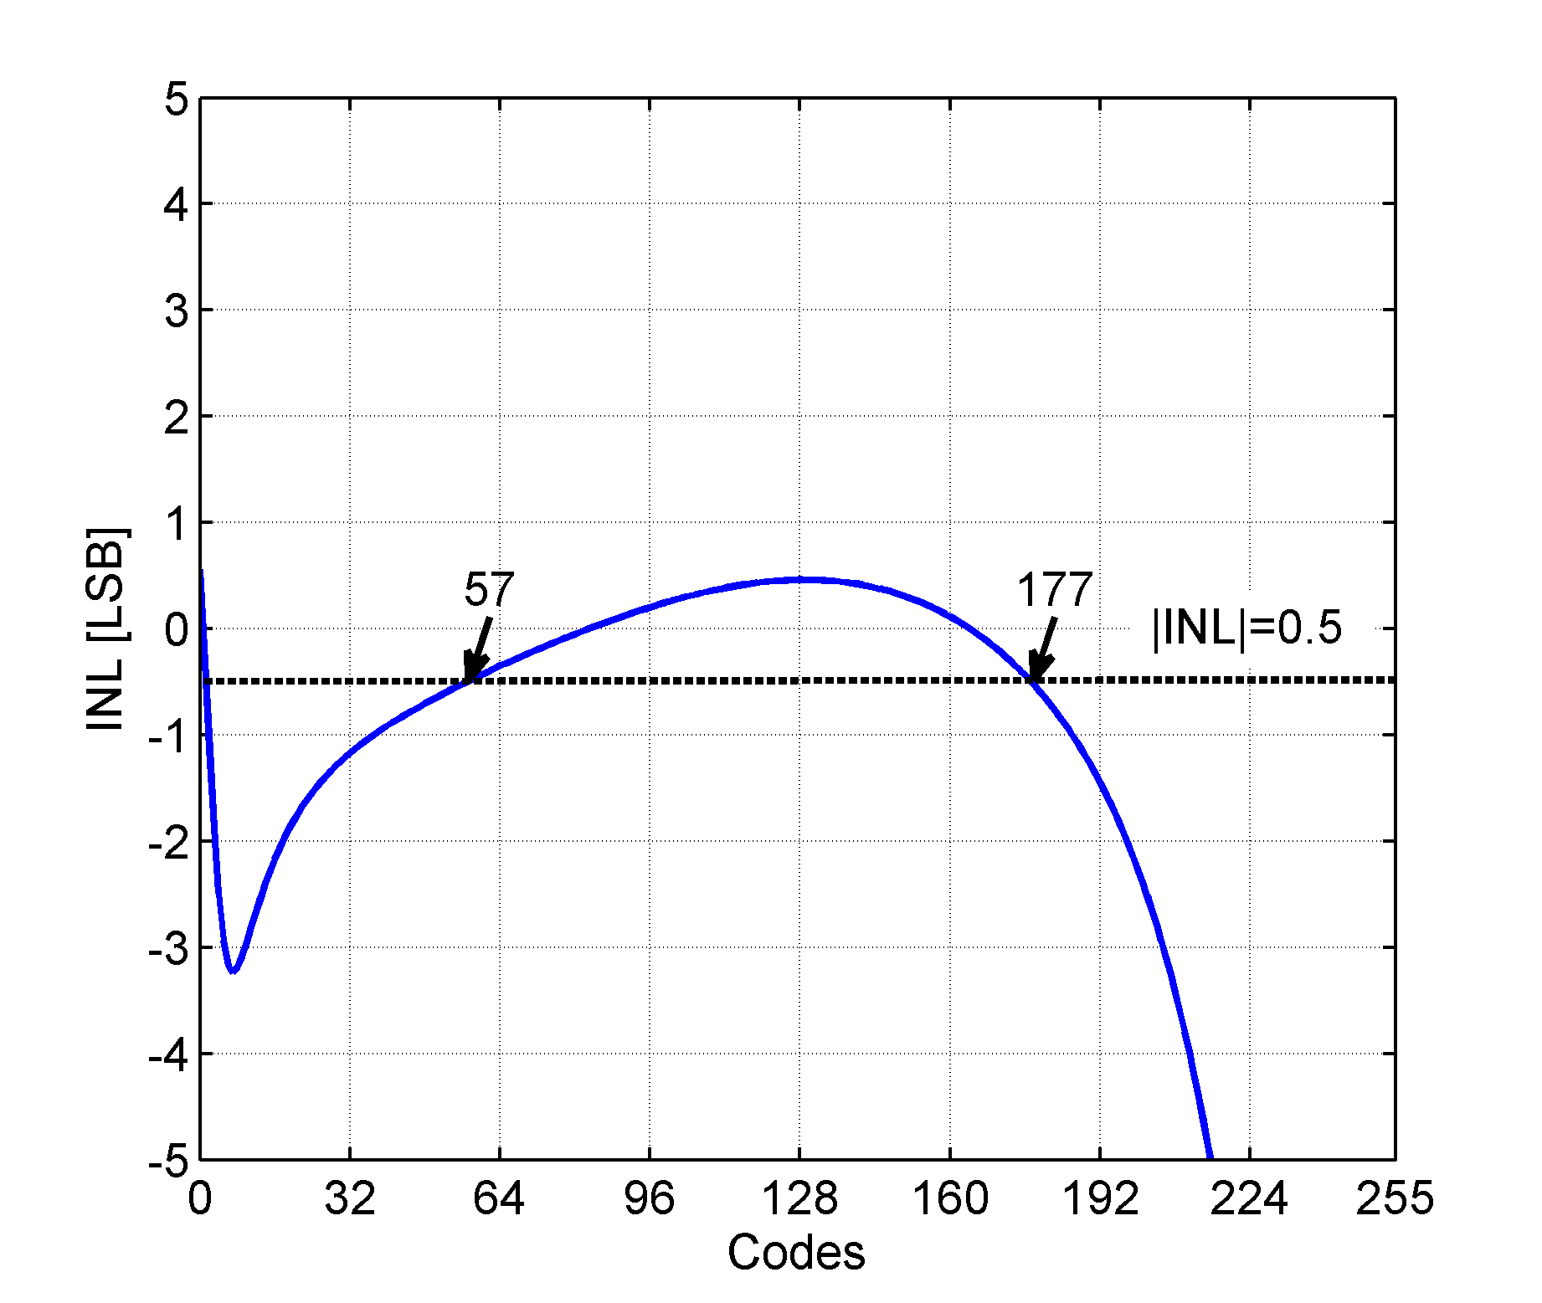
DAC linearity
The periphery DAC were adjusted to achieve a better linearity
At the lower end the linearity is limited by the output buffer, and at the higher end it is limited by the combination of the buffer and the current mirror

Slide 26
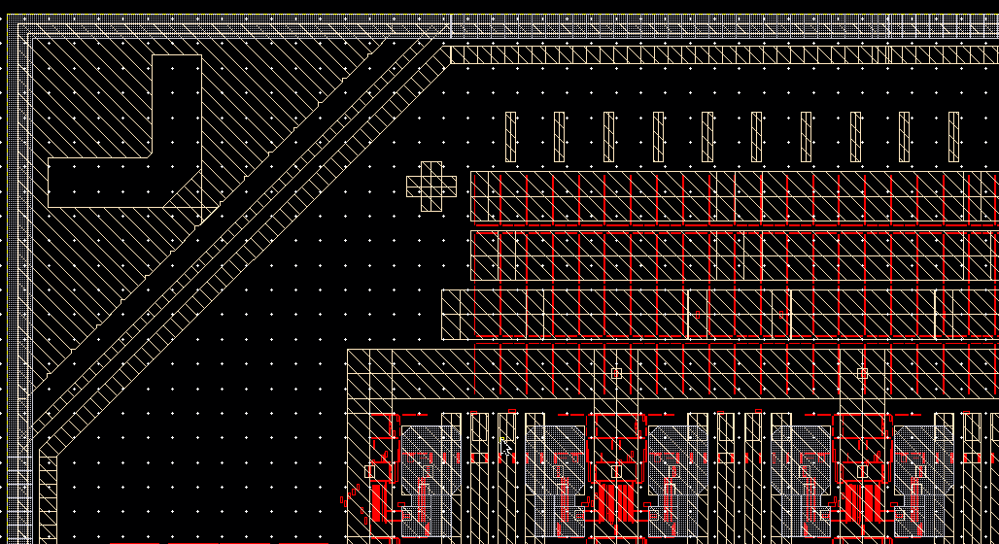
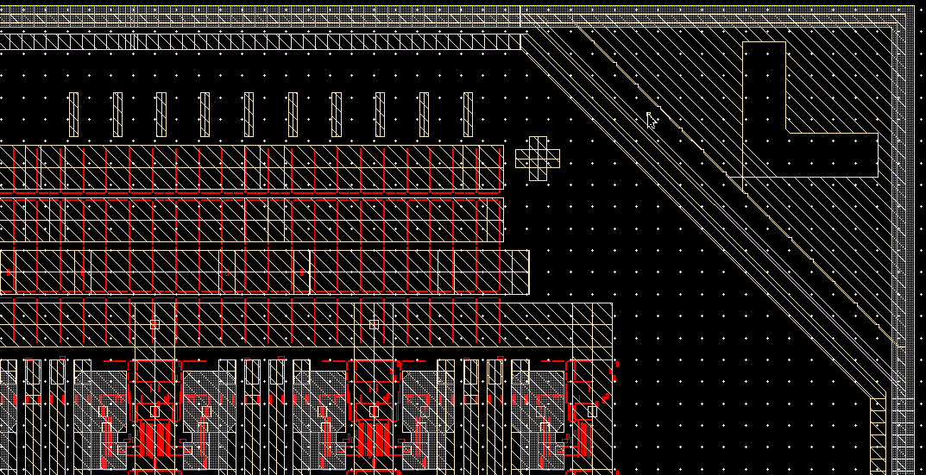
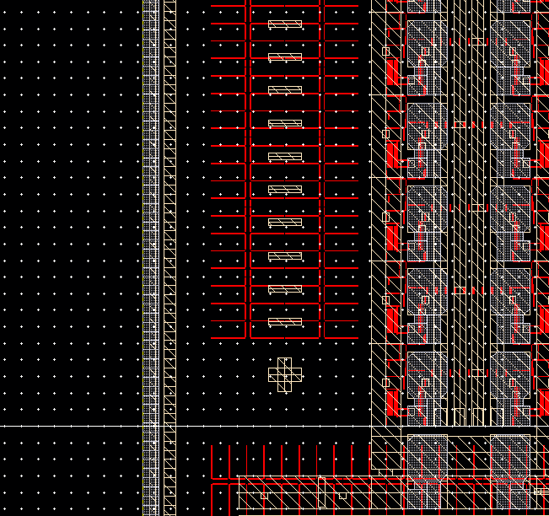
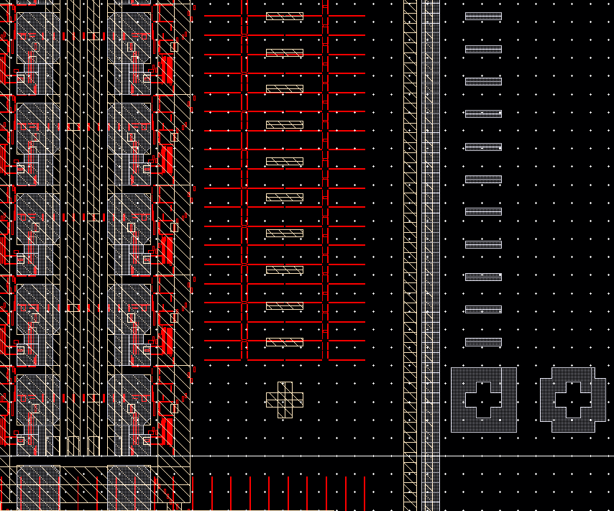
Alignment marks for easier flip-chip assembly
3175.00µm
3230.50µm
3234.75µm
CLICpix2
3261.14µm
marks on C3PD
(for illustration only)

