Slide 1

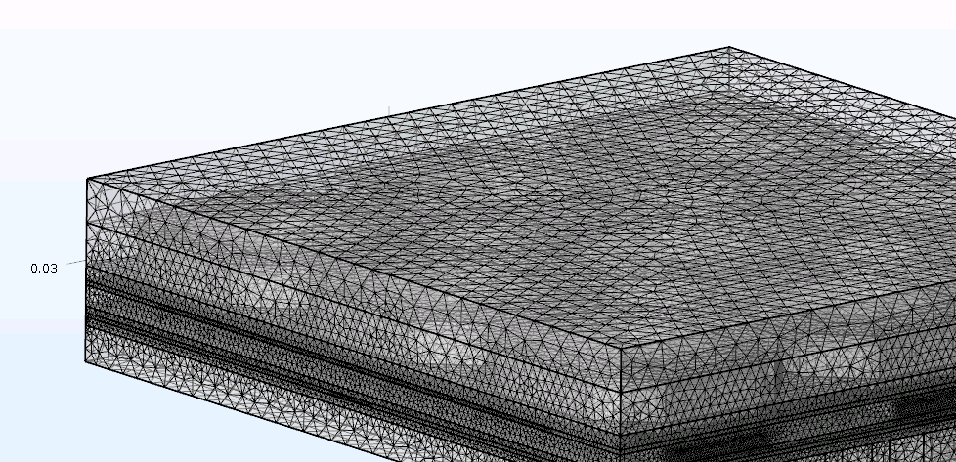
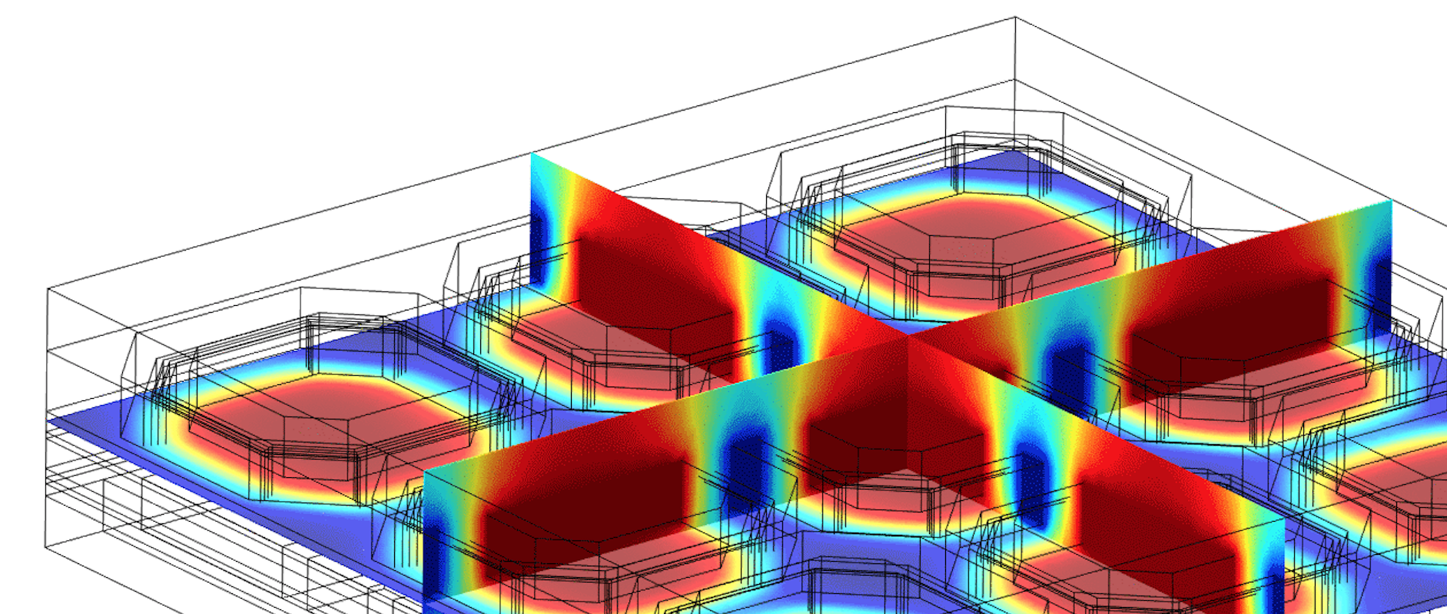

Cross Section Measurements
+ Capacitive Coupling Simulation
+ Flip-chip alignment
WG Vertex meeting
01/07/2016
Mateus Vicente

Slide 2



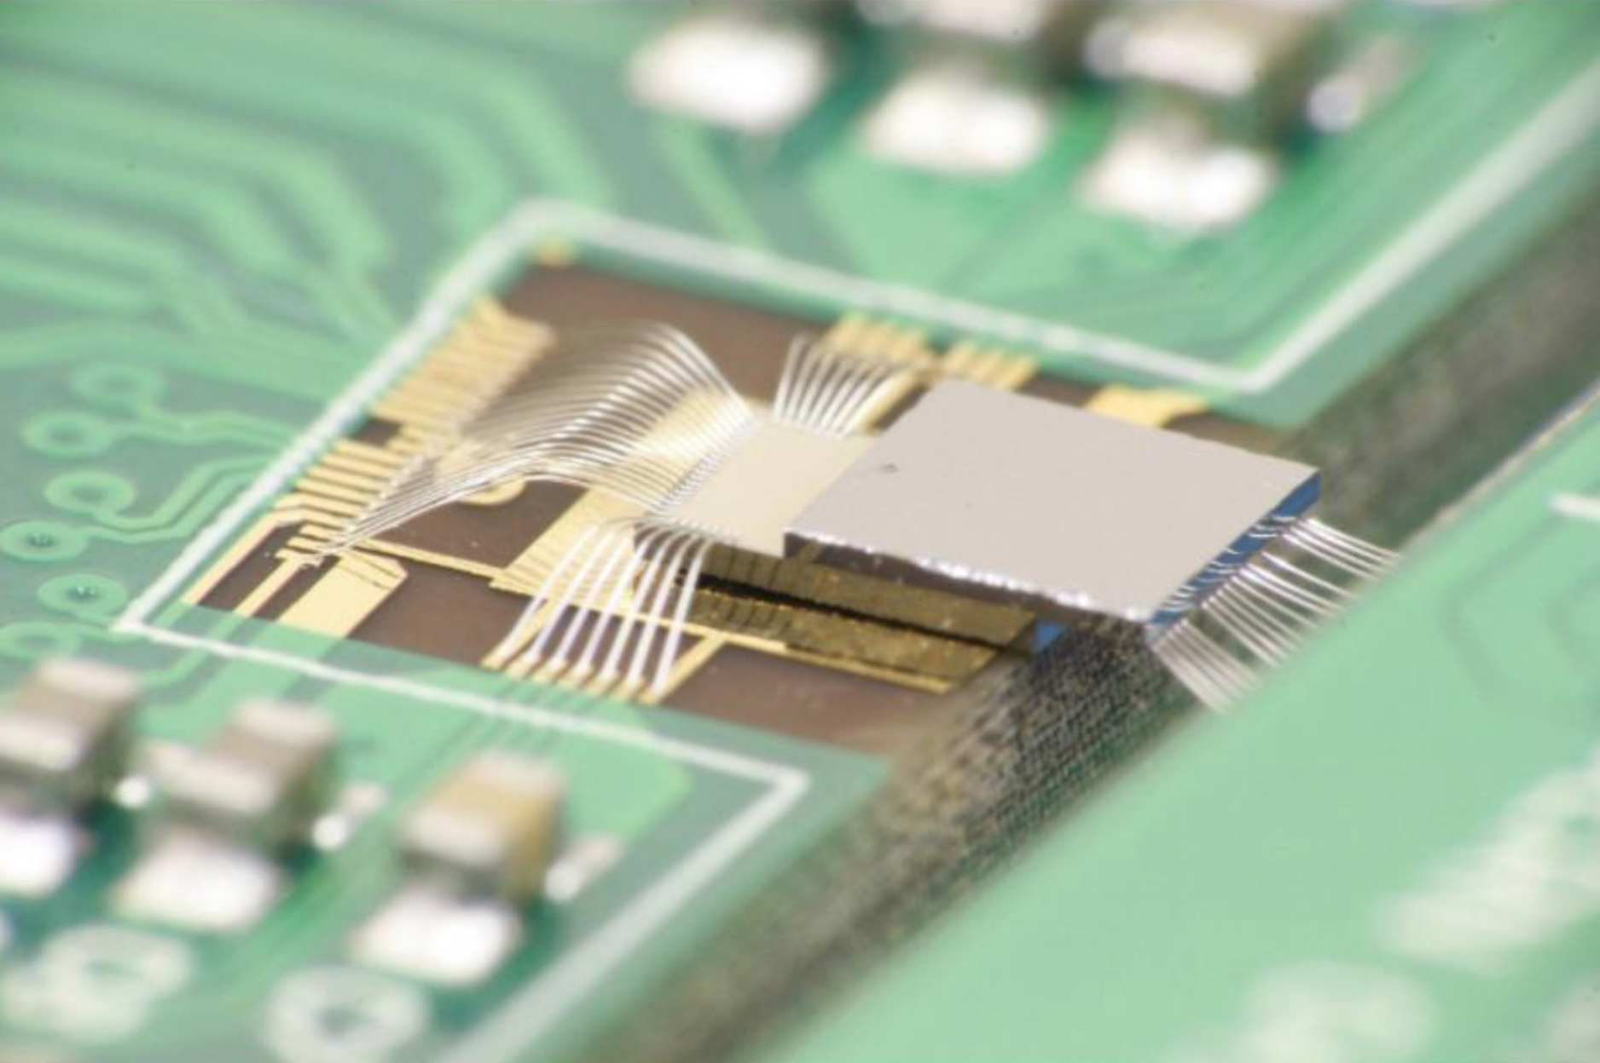


Outline
Cross Section Measurements
COMSOL simulation
  Implementation of M5 layer
  New Results
  Pixel Voltage Output
Flip-chip alignment
  Alignment software
  Measurements
Conclusions
CLICpix Coupled to CCPDv3
Notes:
ultimate track recording rate was 5 Mtracks/s and was limited only by the beam intensity that the SPS could provide

Slide 3
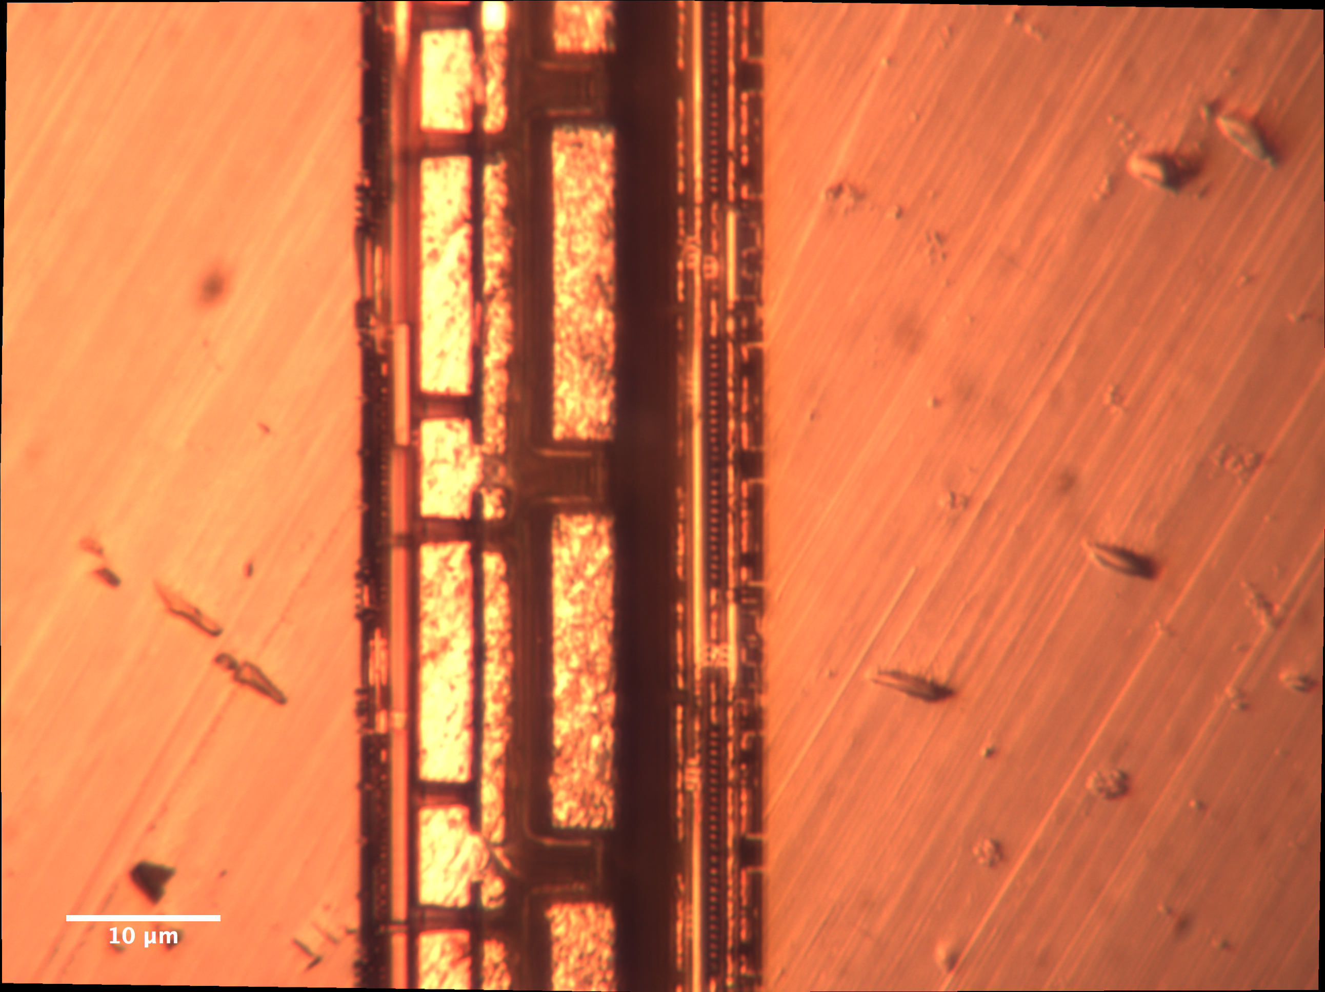
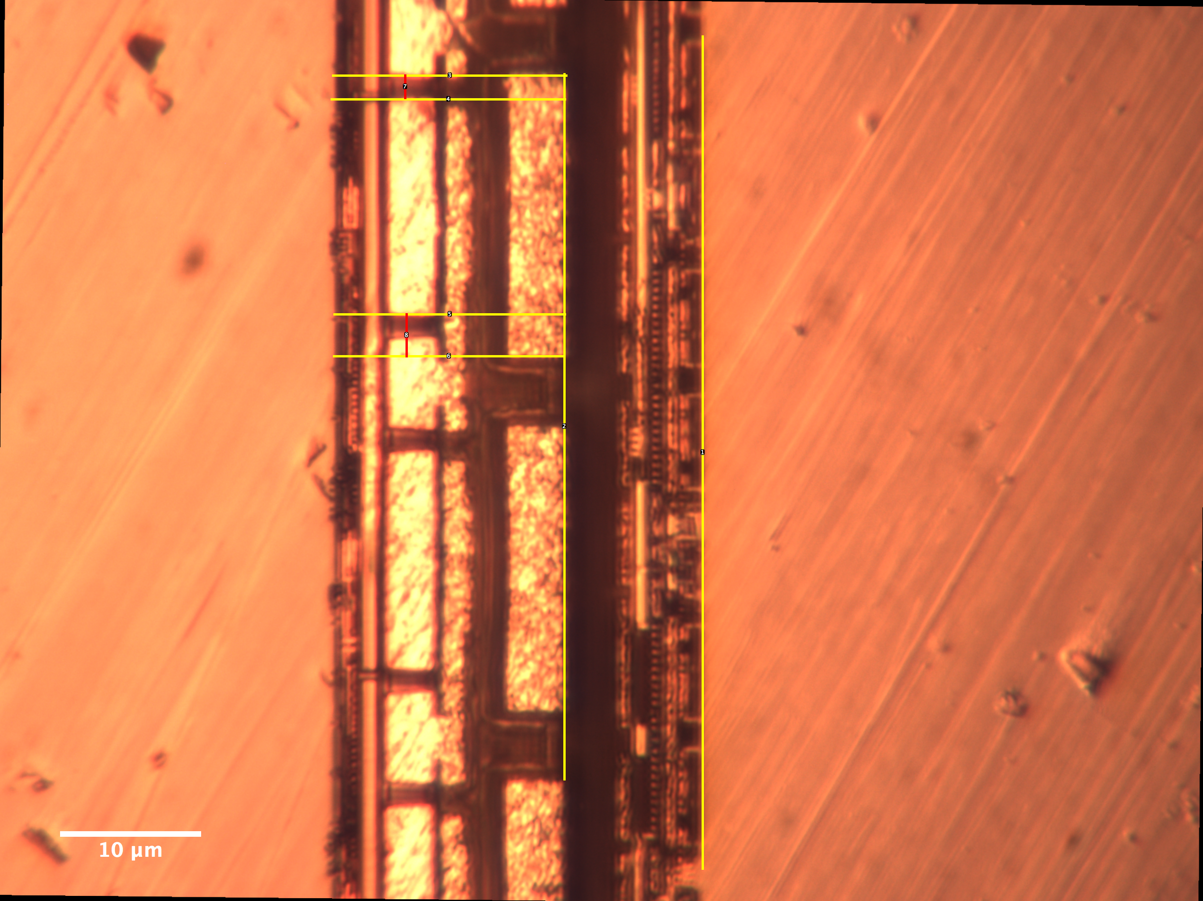
Cross Section Measurements
Optical microscope
@ Cross Section LAB
Thanks to Florian Pipper
Notes:
ultimate track recording rate was 5 Mtracks/s and was limited only by the beam intensity that the SPS could provide

Slide 4
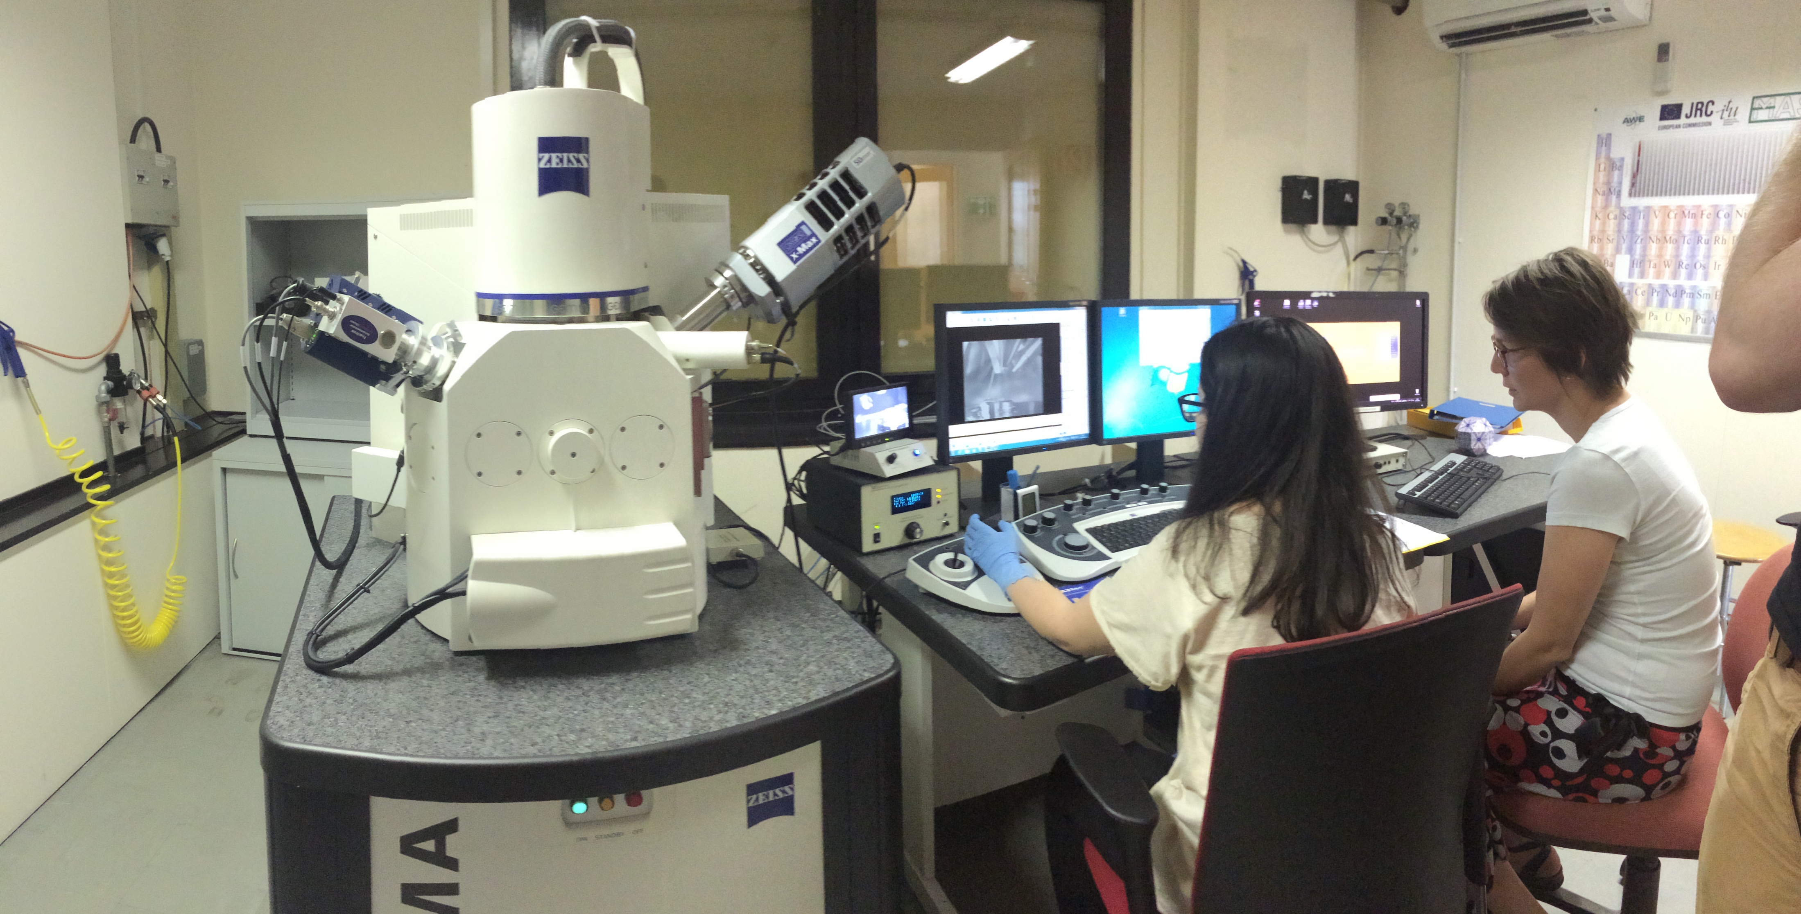
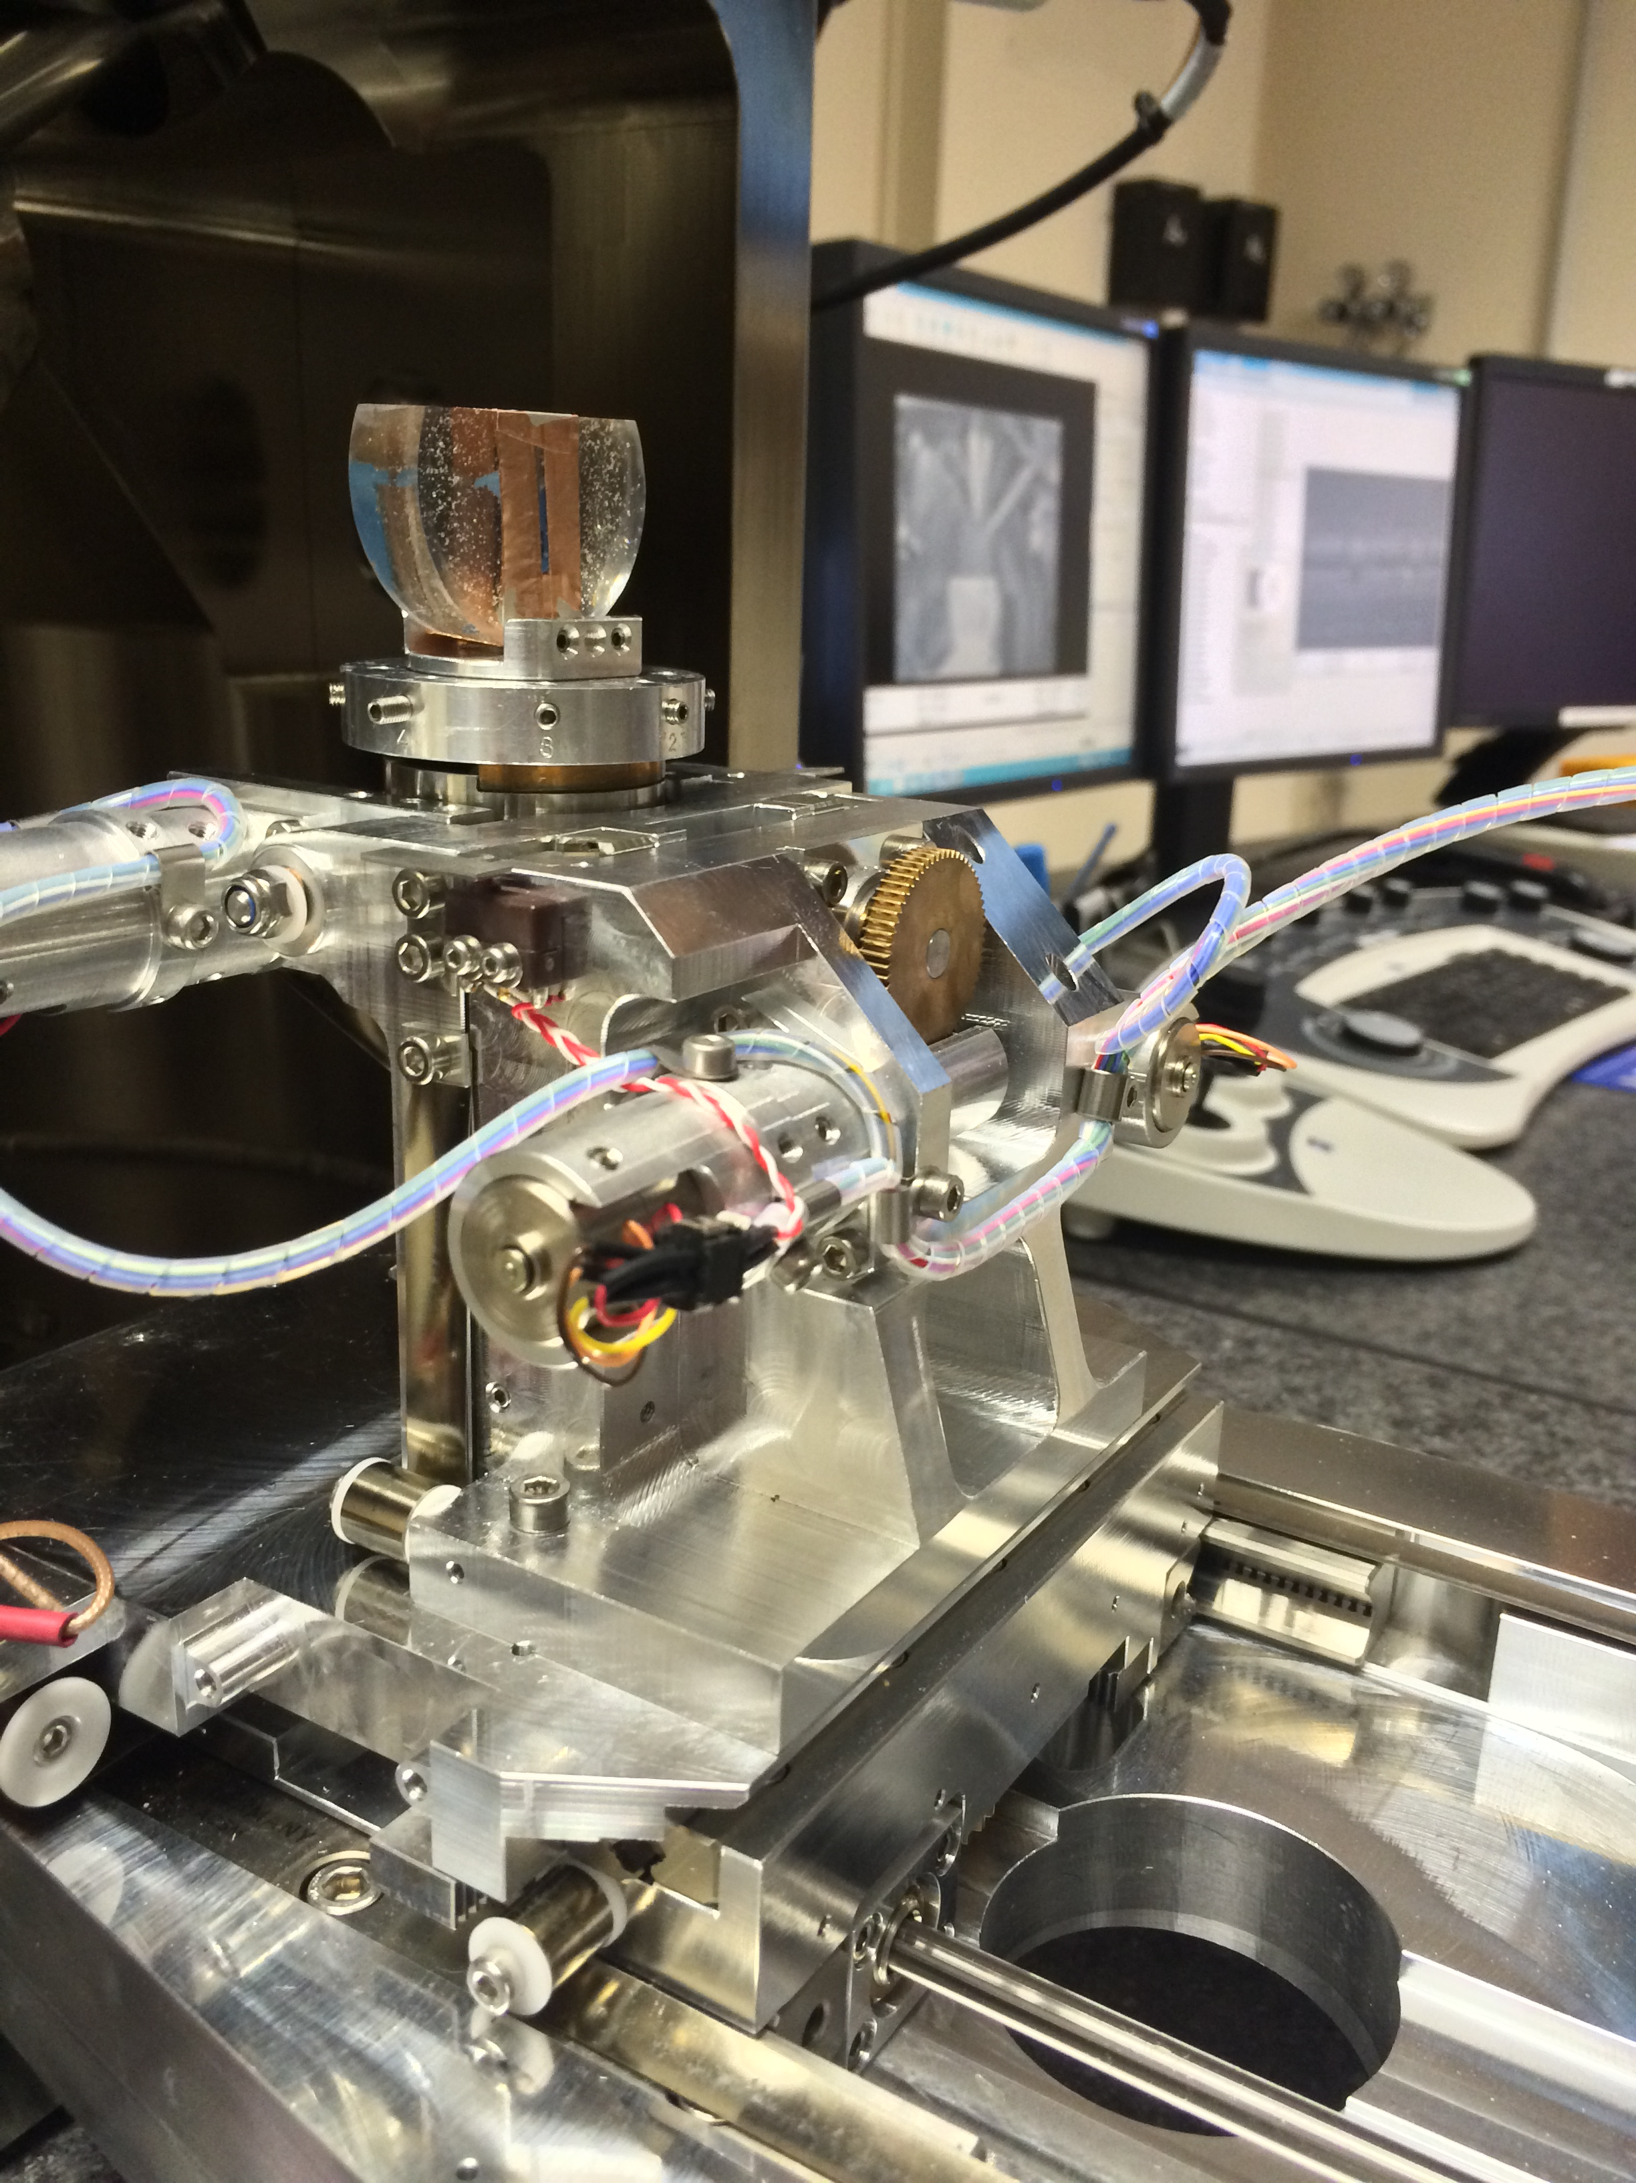
Cross Section Measurements
Scanning Electron Microscopy - SEM
Service from CERN EN-MME-MM group
Notes:
ultimate track recording rate was 5 Mtracks/s and was limited only by the beam intensity that the SPS could provide

Slide 5
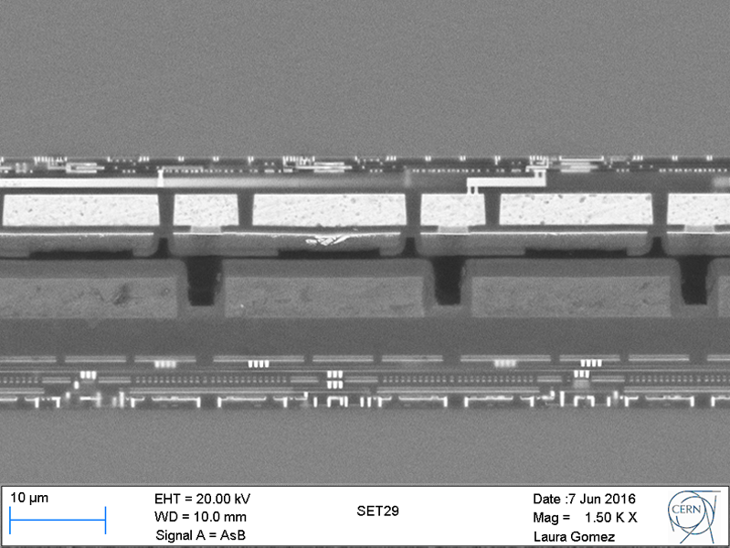
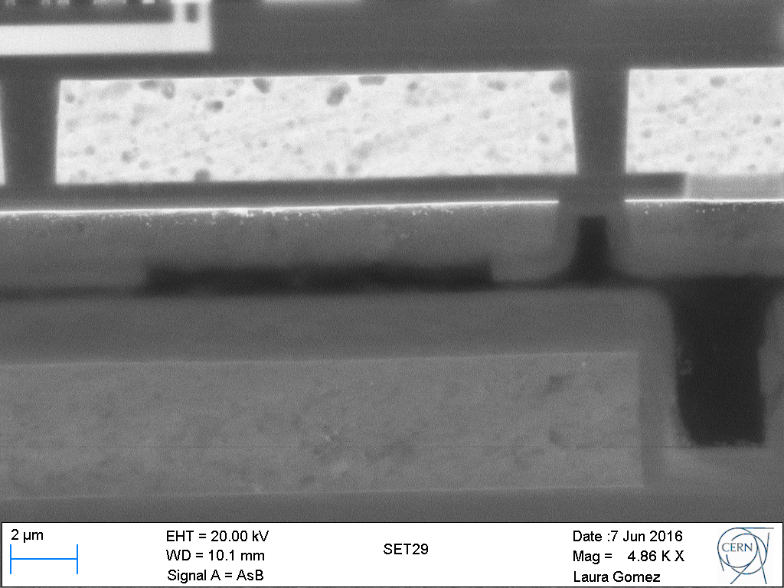
Cross Section Measurements
Scanning Electron Microscopy - SEM
Service from CERN EN-MME-MM group
Notes:
ultimate track recording rate was 5 Mtracks/s and was limited only by the beam intensity that the SPS could provide

Slide 6
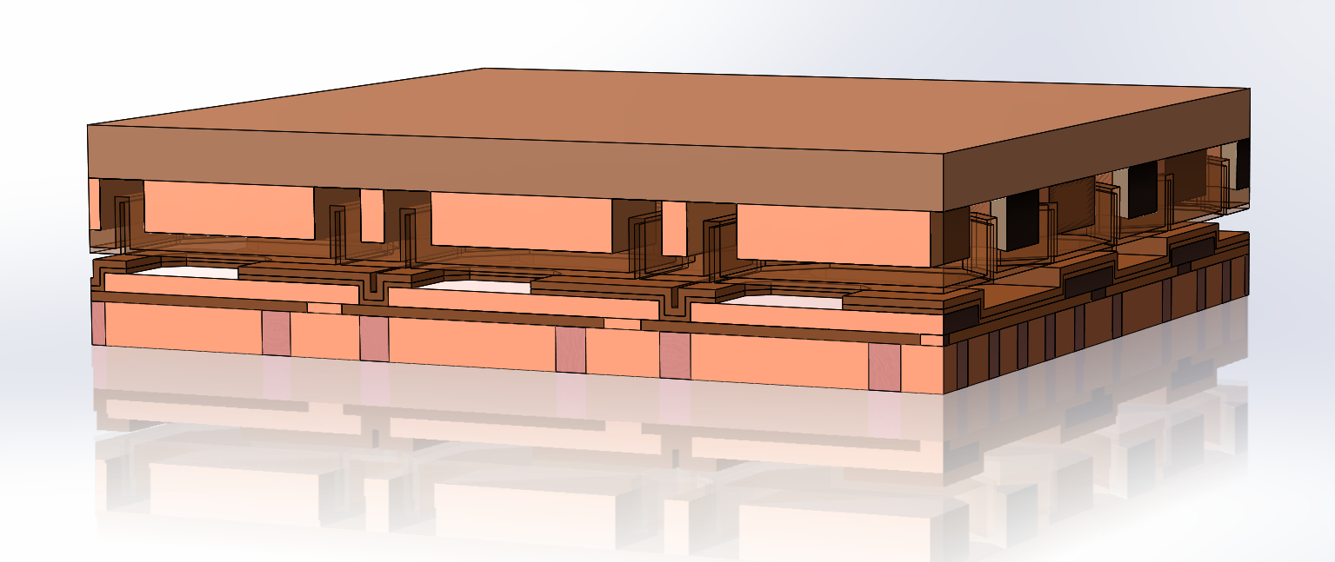
Simulation
Capacitive Coupling
Cross section of 3D model of CLICpix2 + C3PD
Notes:
ultimate track recording rate was 5 Mtracks/s and was limited only by the beam intensity that the SPS could provide

Slide 7
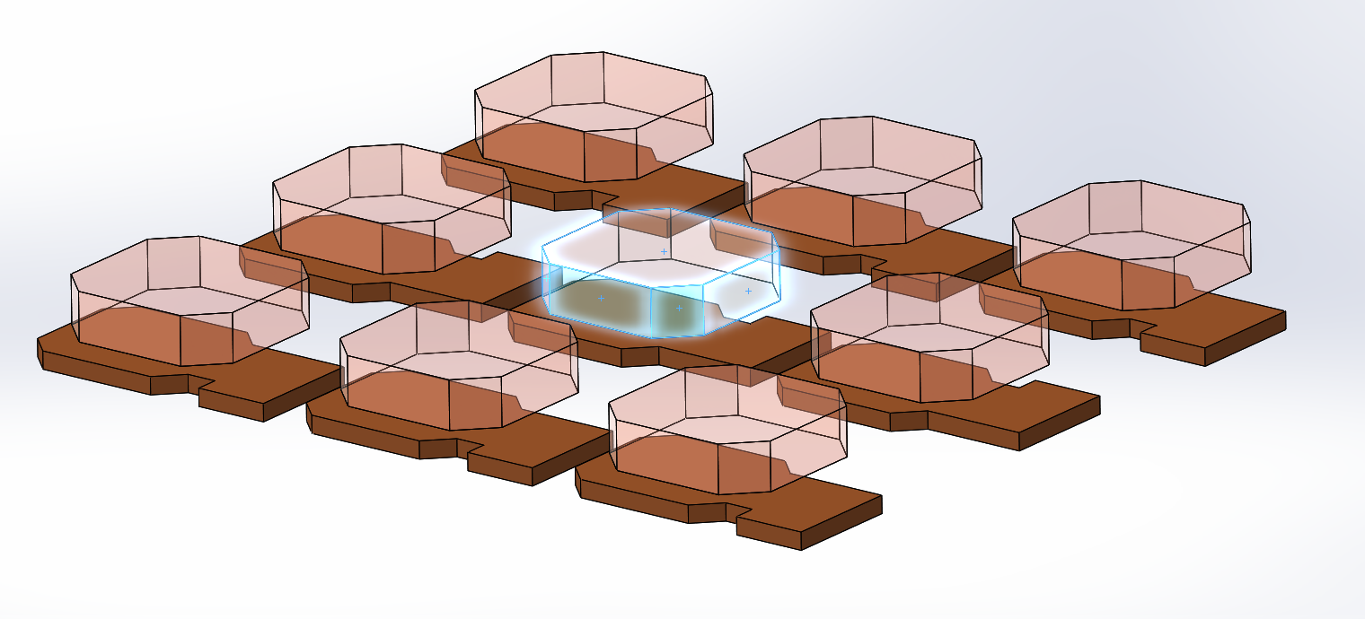
Simulation
Pixel pads
16
7
17
13
8
4
18
14
9
10
5
1
15
11
6
2
12
3
CLICpix2 and C3PD pads
Notes:
ultimate track recording rate was 5 Mtracks/s and was limited only by the beam intensity that the SPS could provide

Slide 8
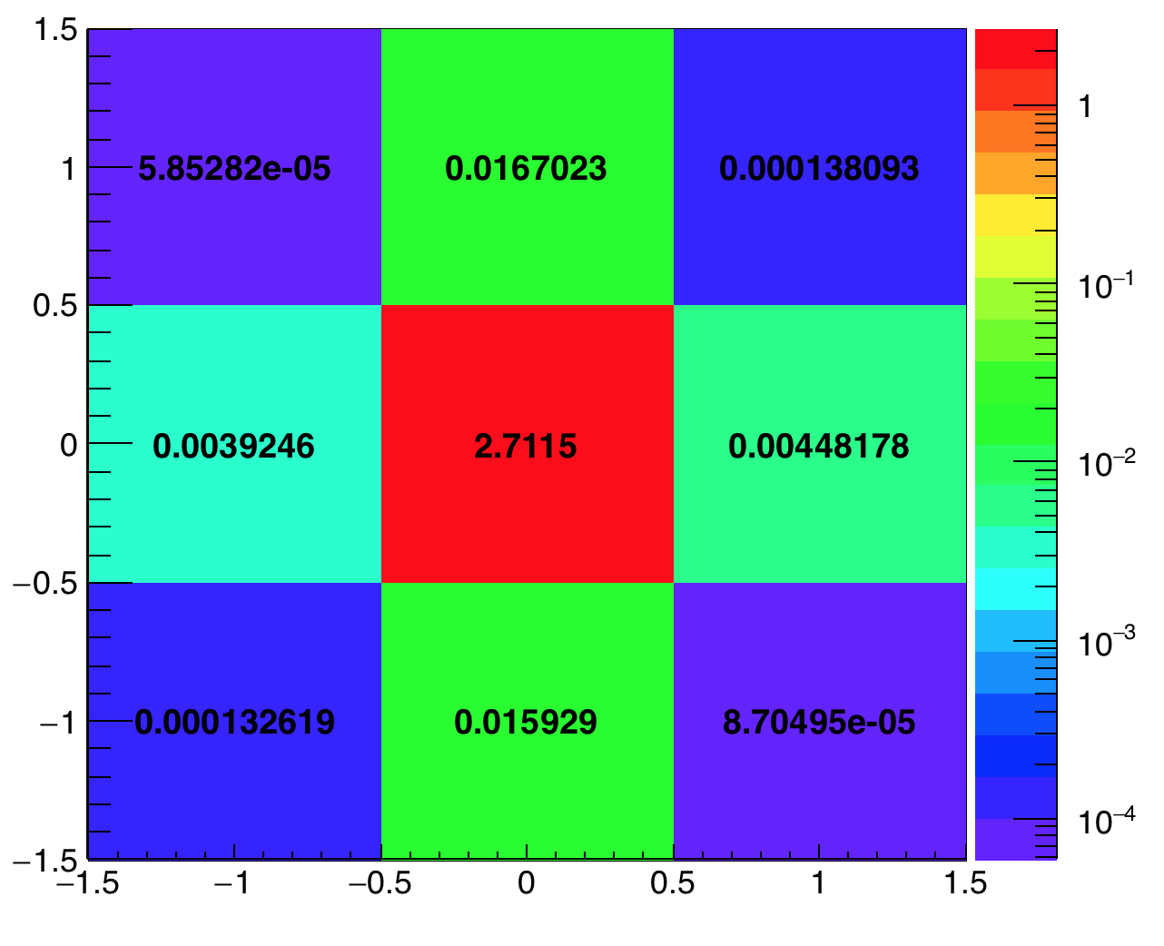
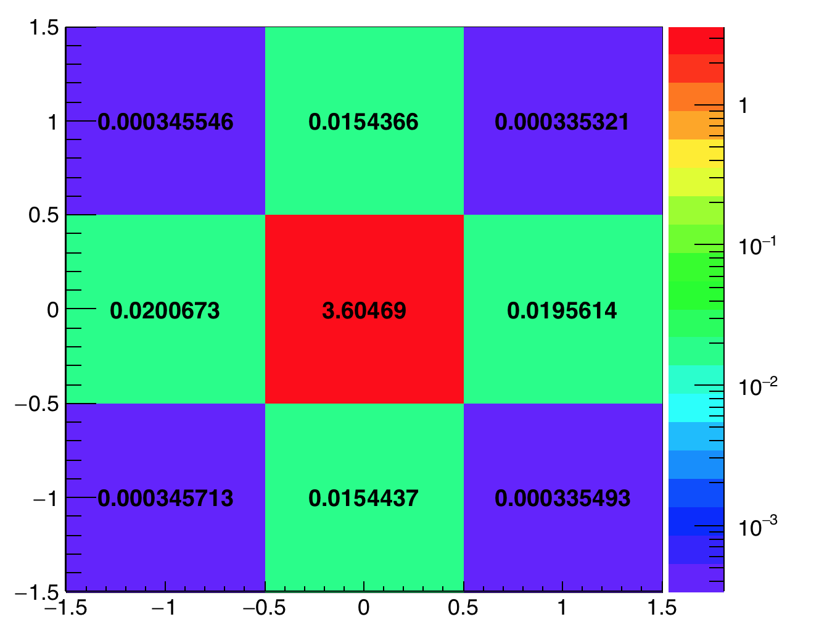
Simulation
Capacitive Coupling (gap = 0.5 um)
Central C3PD Pixel and CLIXpix2 terminals
Central C3PD Pixel and C3PD terminals
fF
fF
Notes:
ultimate track recording rate was 5 Mtracks/s and was limited only by the beam intensity that the SPS could provide

Slide 9
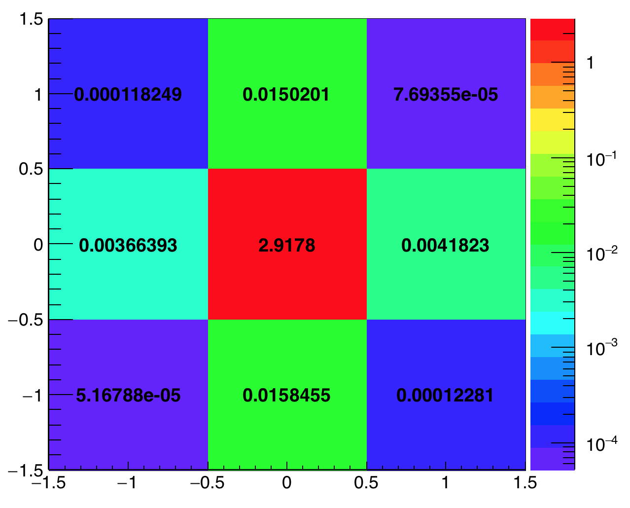
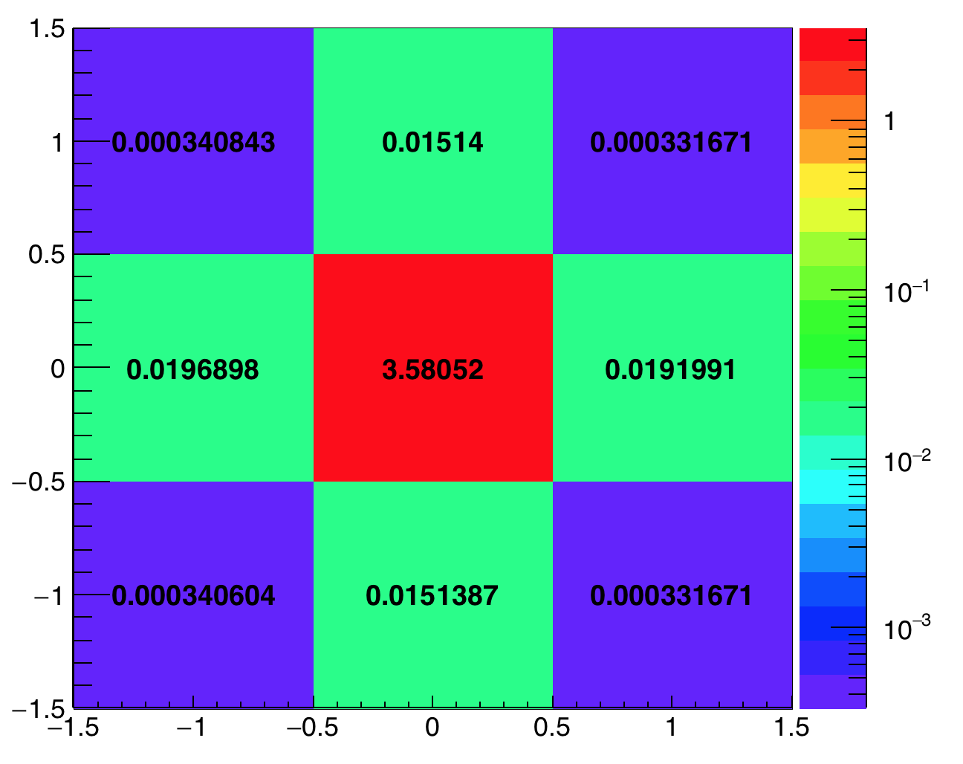
Simulation
Capacitive Coupling (gap = 0.32 um)
Central C3PD Pixel and CLIXpix2 terminals
Central C3PD Pixel and C3PD terminals
fF
fF
Notes:
ultimate track recording rate was 5 Mtracks/s and was limited only by the beam intensity that the SPS could provide

Slide 10
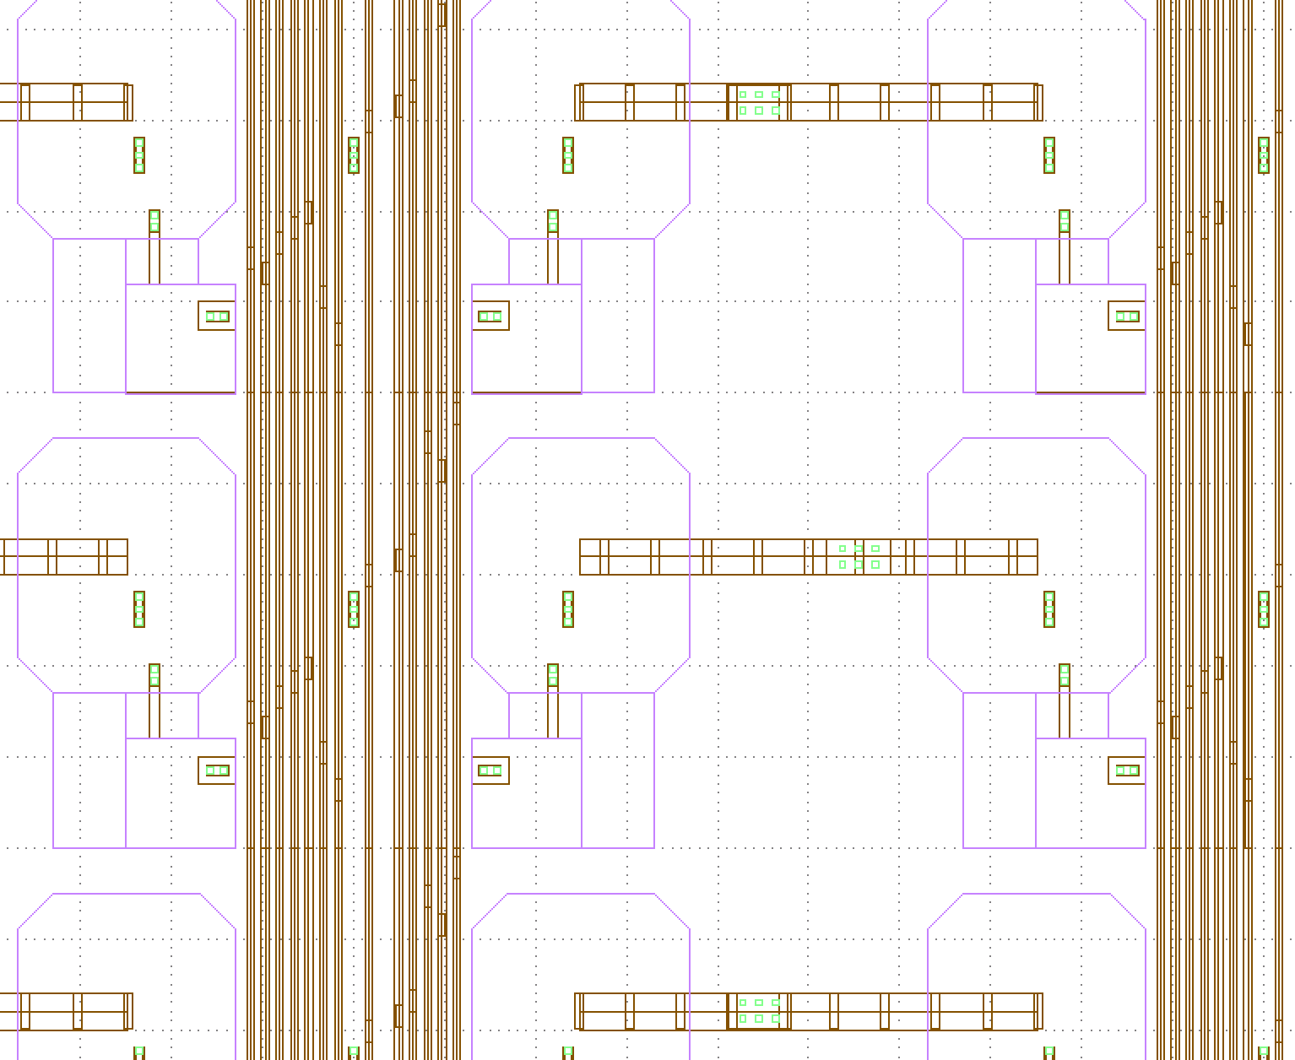
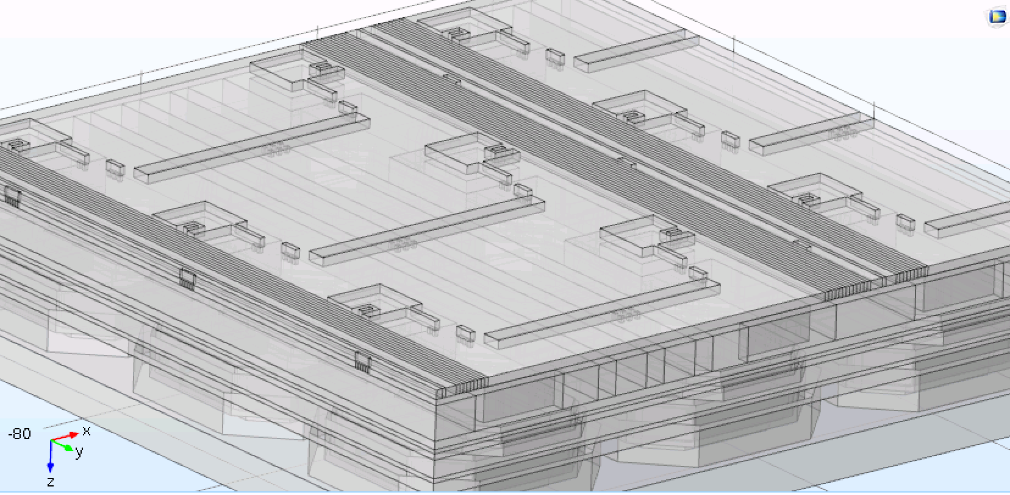
Simulation
Capacitive Coupling (with M5 layer)
Implementation of M5 layer (from GDS file) on 3D model
Notes:
ultimate track recording rate was 5 Mtracks/s and was limited only by the beam intensity that the SPS could provide

Slide 11
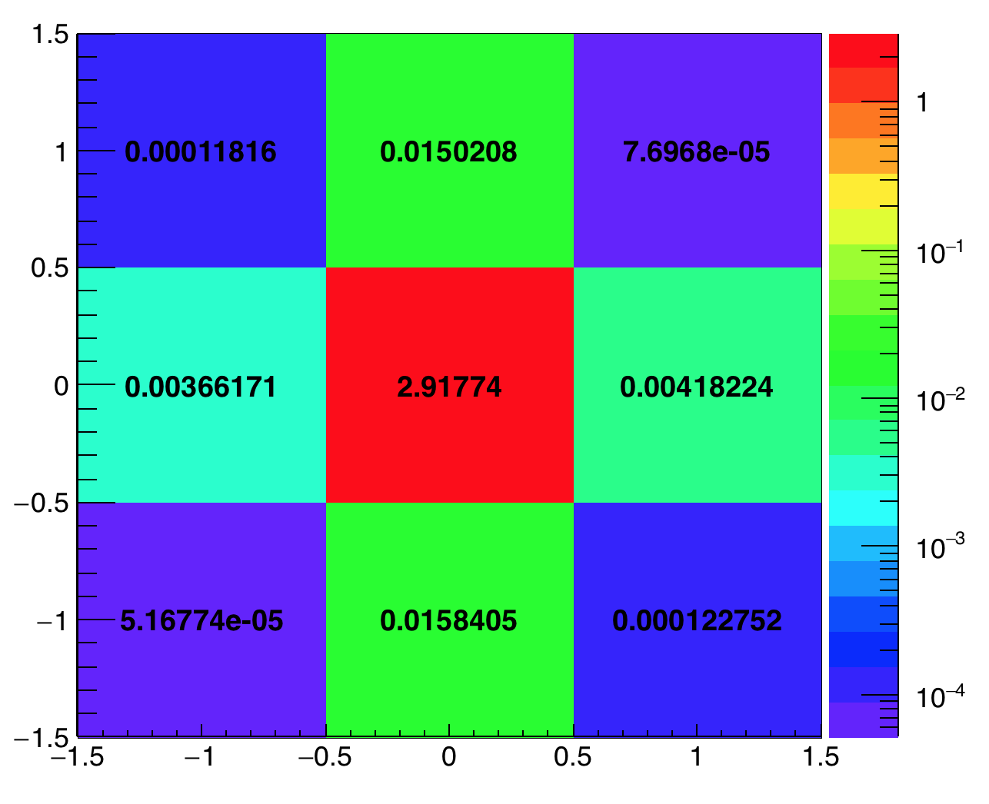
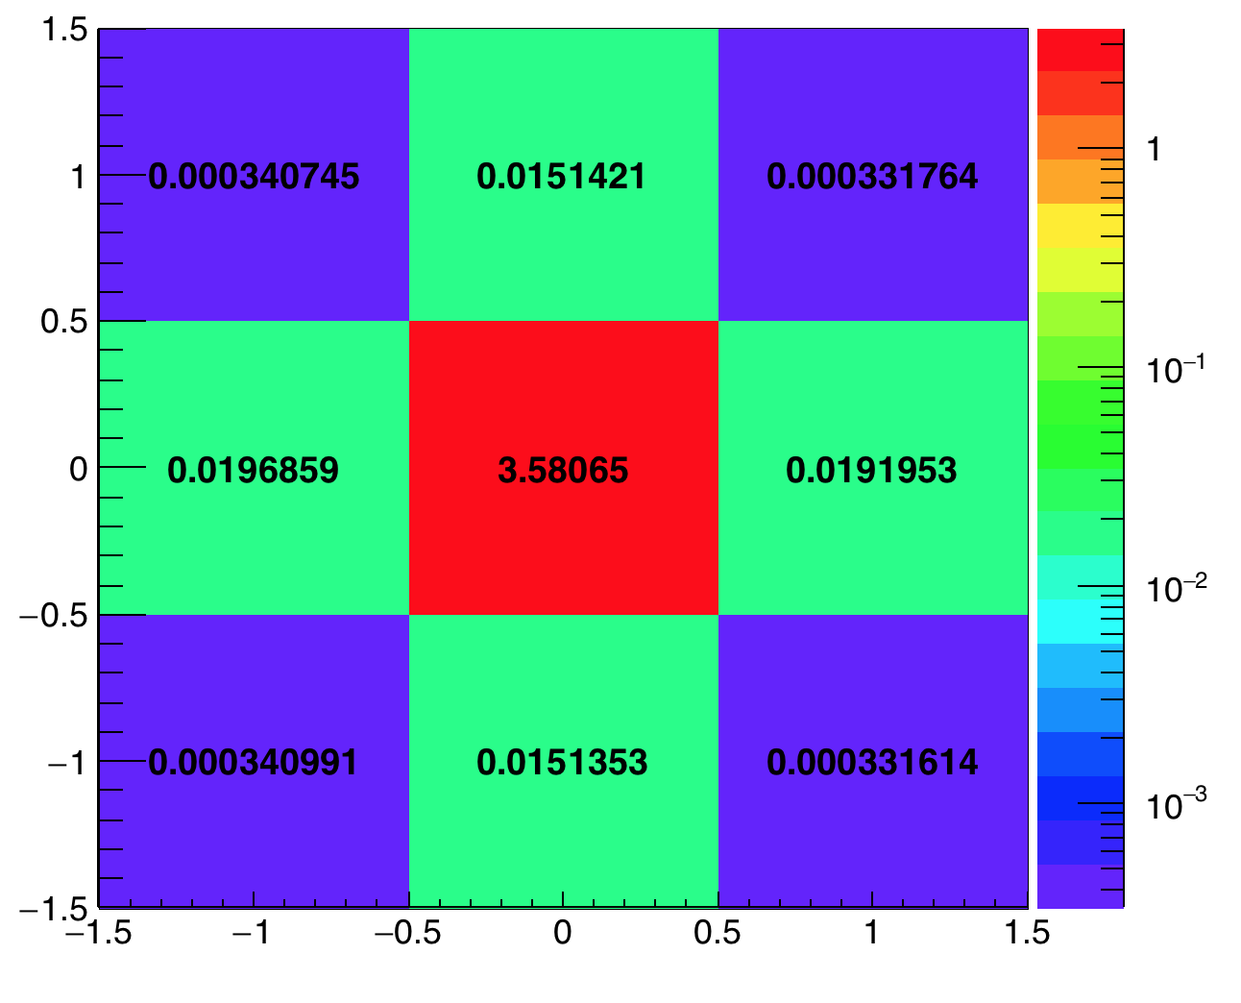
Simulation
Capacitive Coupling (with M5 layer)
Central C3PD Pixel and CLIXpix2 terminals
Central C3PD Pixel and C3PD terminals
fF
fF
Notes:
ultimate track recording rate was 5 Mtracks/s and was limited only by the beam intensity that the SPS could provide

Slide 12
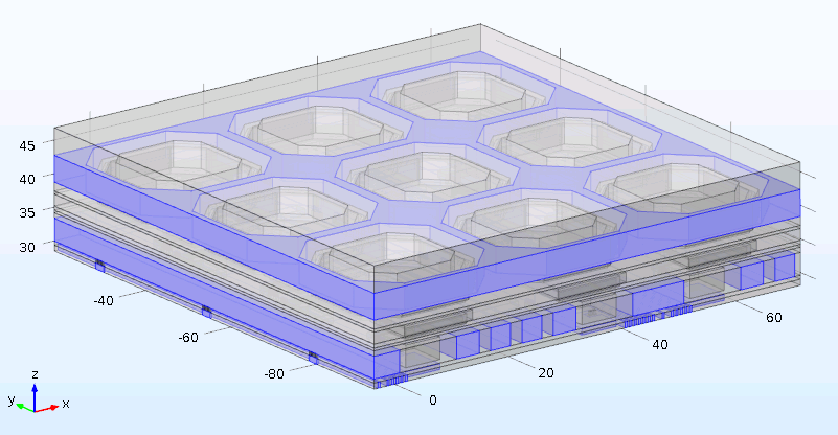

Simulation
Capacitive Coupling to other metals
Coupling of the pixels with Guard Ring and M6+M5
GR: 3.20 fF
M6+M5: 0.37 fF
Notes:
ultimate track recording rate was 5 Mtracks/s and was limited only by the beam intensity that the SPS could provide

Slide 13
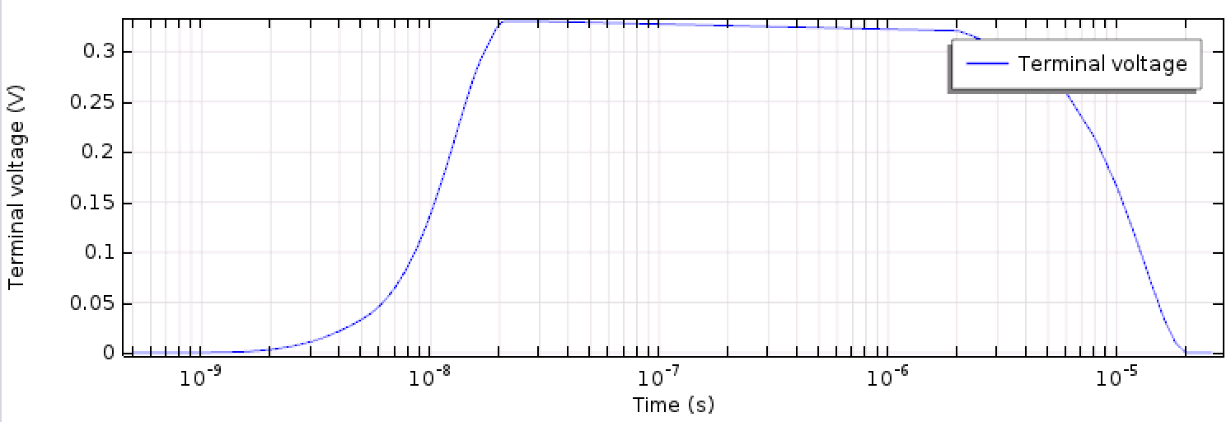
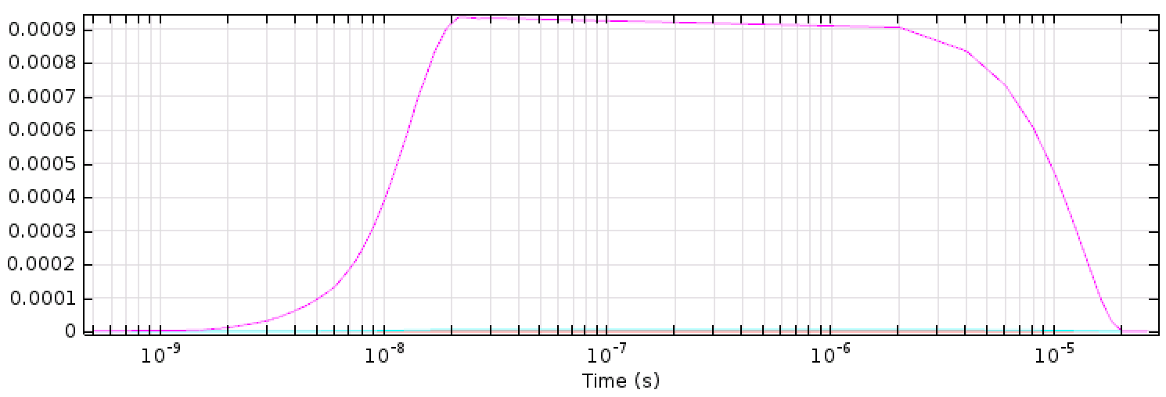
Simulation
Capacitively Coupled Signal
Simulation of a voltage pulse from C3PD pixel and measurement of the signal in the CLICpix2 pixel
  Possibility of couple the terminal to a circuit defined by a SPICE netlist
Charge [pC]
Notes:
ultimate track recording rate was 5 Mtracks/s and was limited only by the beam intensity that the SPS could provide

Slide 14
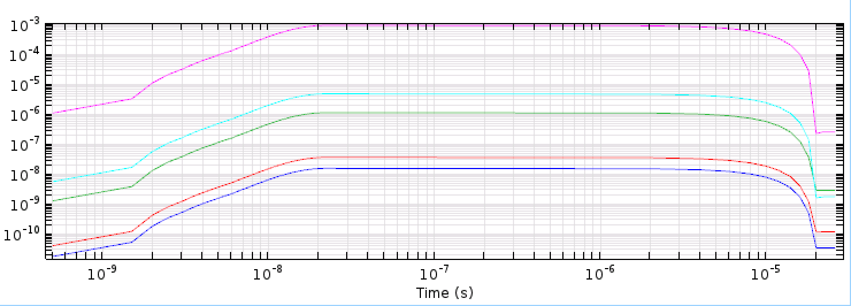
Simulation
Capacitively Coupled Signal
Simulation of a voltage pulse from C3PD pixel and measurement of the signal in the CLICpix2 pixel
  Possibility of couple the terminal to a circuit defined by a SPICE netlist
Charge [pC]
Notes:
ultimate track recording rate was 5 Mtracks/s and was limited only by the beam intensity that the SPS could provide

Slide 15
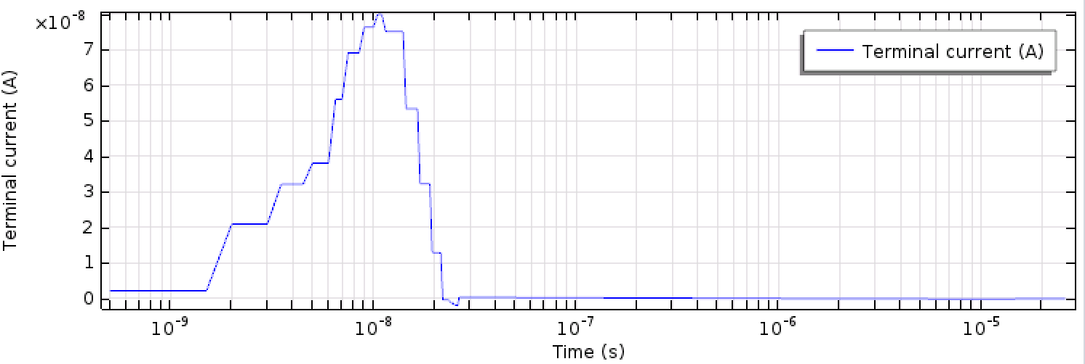
Simulation
Capacitively Coupled Signal
Simulation of a voltage pulse from C3PD pixel and measurement of the signal in the CLICpix2 pixel
  Possibility of couple the terminal to a circuit defined by a SPICE netlist
Notes:
ultimate track recording rate was 5 Mtracks/s and was limited only by the beam intensity that the SPS could provide

Slide 16
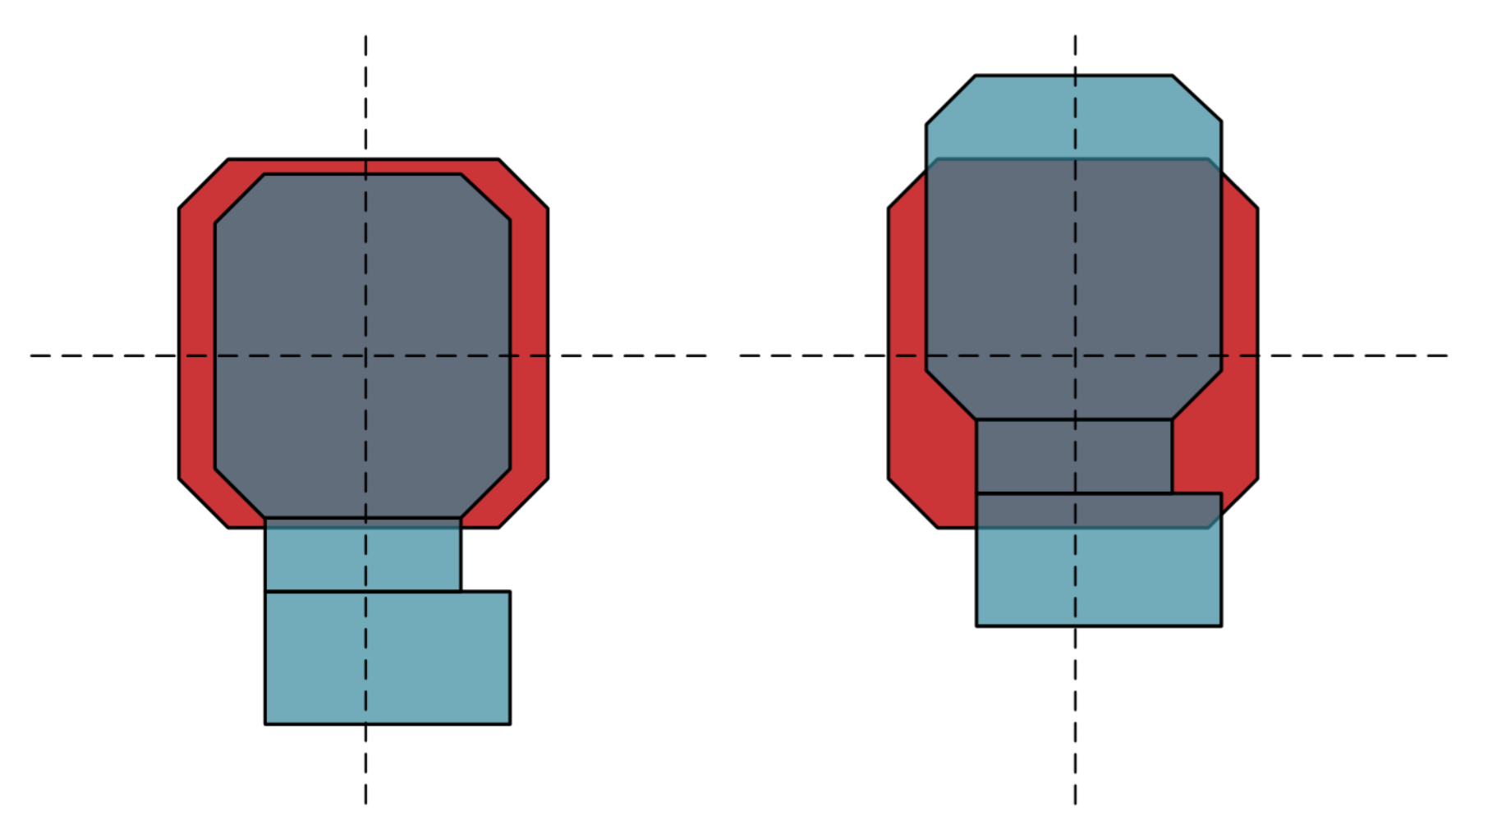
Flip-chip Alignment
Cross Section Measurement
Measurement with optical microscope (CLICpix + CCPDv3)
  Bump pads misaligned by ~ 1.1um (after gluing)
Thanks to Florian Pipper
Notes:
ultimate track recording rate was 5 Mtracks/s and was limited only by the beam intensity that the SPS could provide

Slide 17
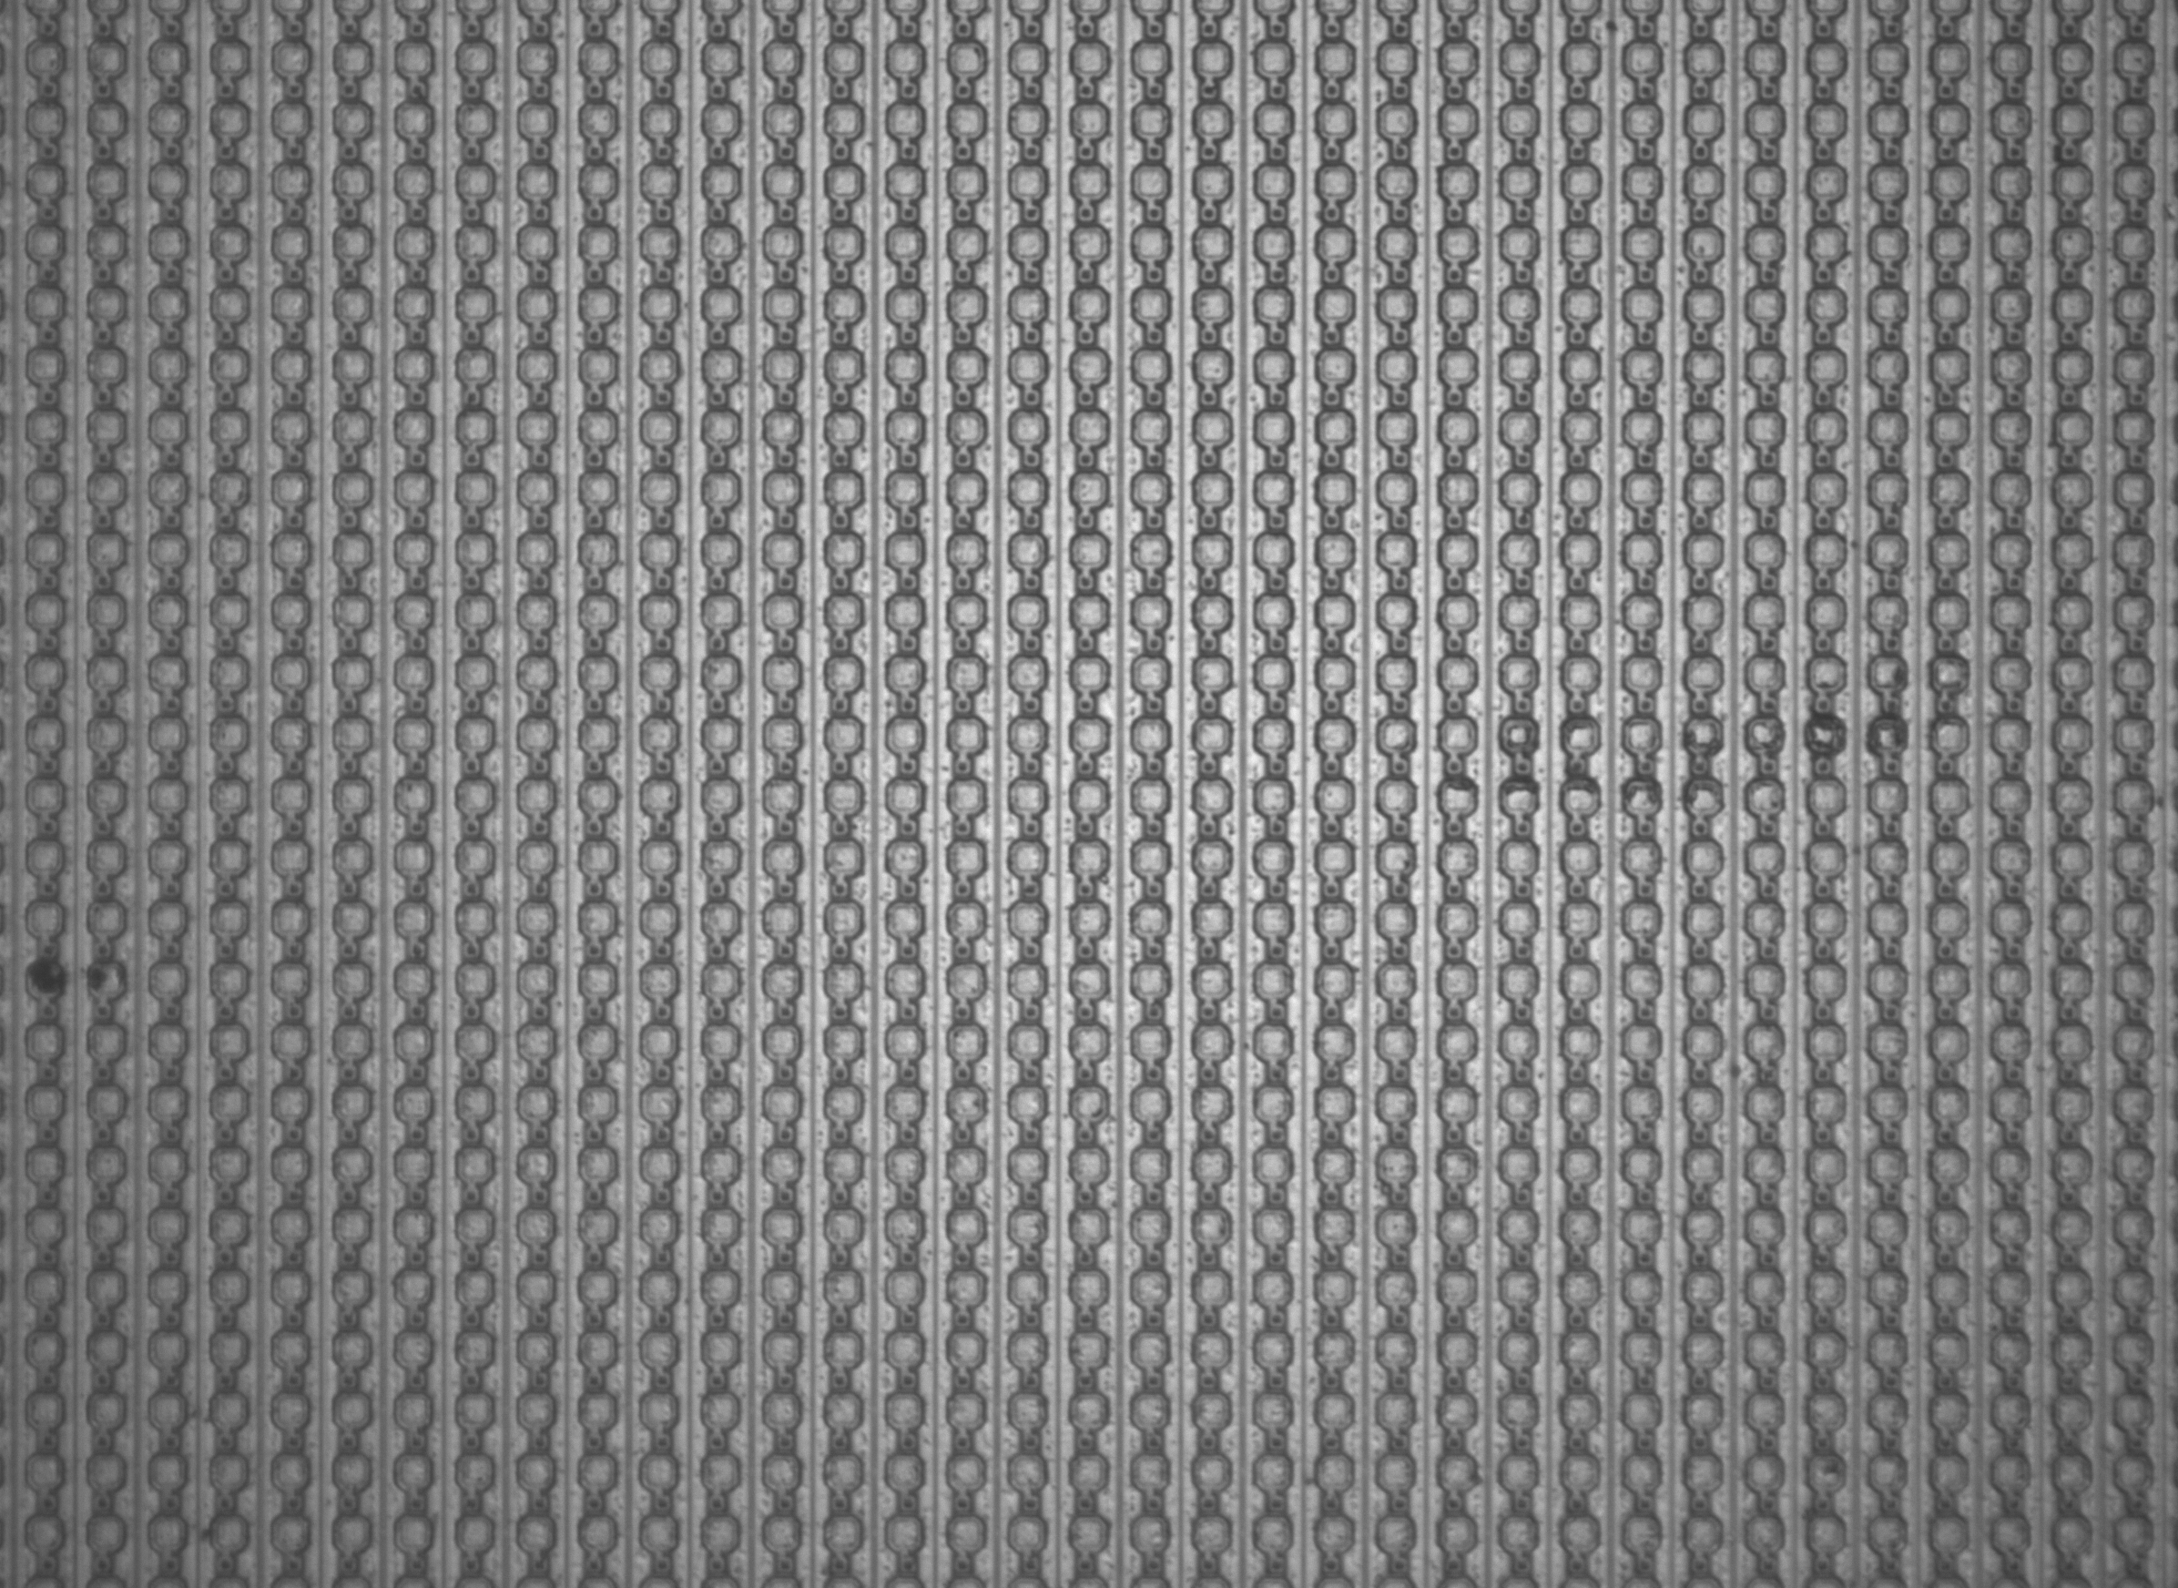

Flip-chip Alignment
Flip-chip process
Accura 100 pictures
  Two cameras (one pointing up and another pointing down) to align the chips
CLICpix
CCPDv3
Notes:
ultimate track recording rate was 5 Mtracks/s and was limited only by the beam intensity that the SPS could provide

Slide 18
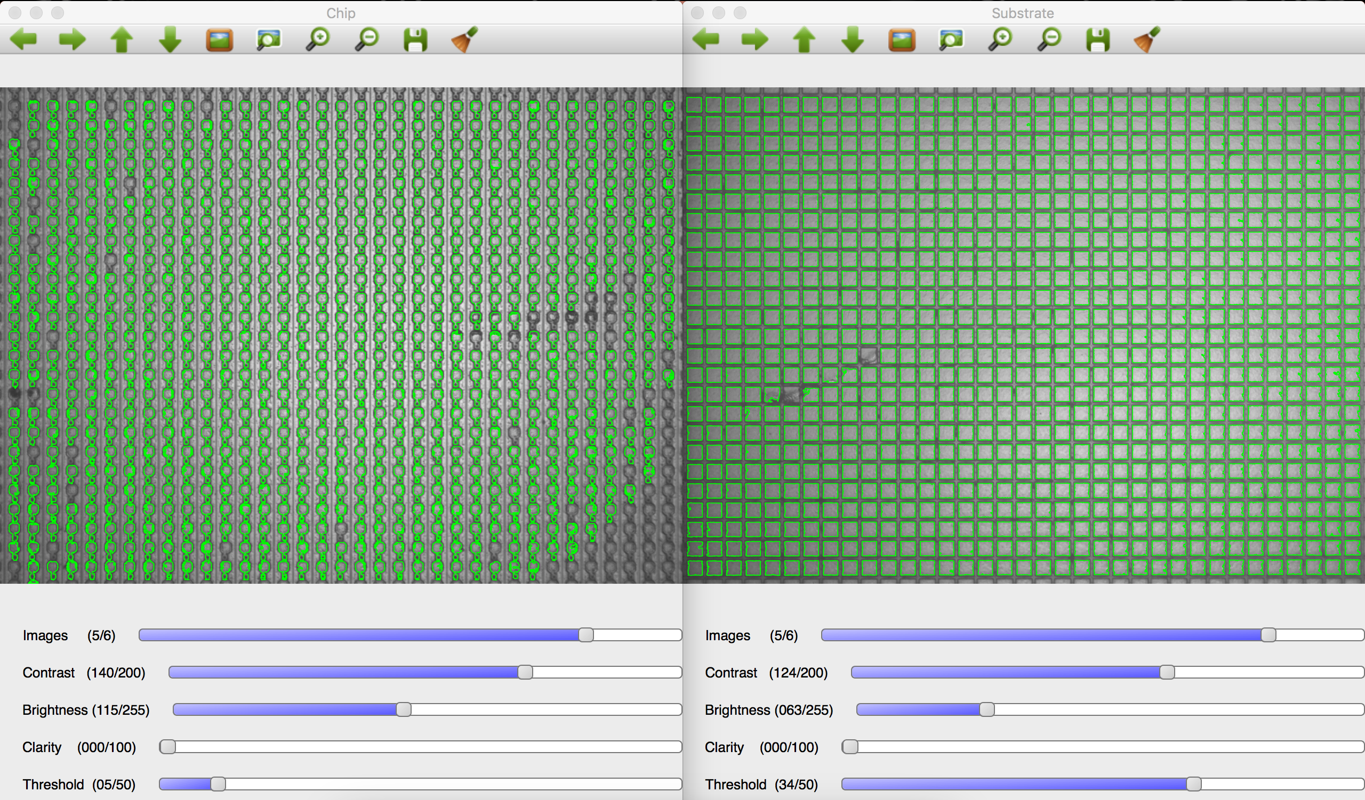
Flip-chip + PixelShop
Alignment Measurement
Pixels pattern recognition ➔ Distance between pixel pads
Thanks to Mathieu Benoit
Notes:
ultimate track recording rate was 5 Mtracks/s and was limited only by the beam intensity that the SPS could provide

Slide 19
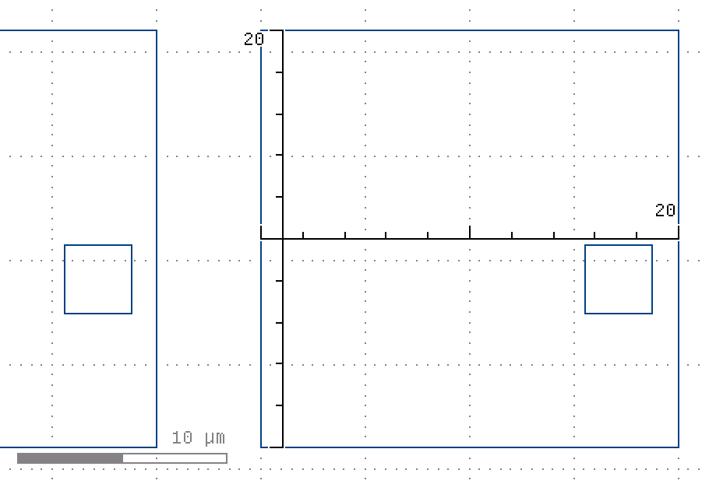
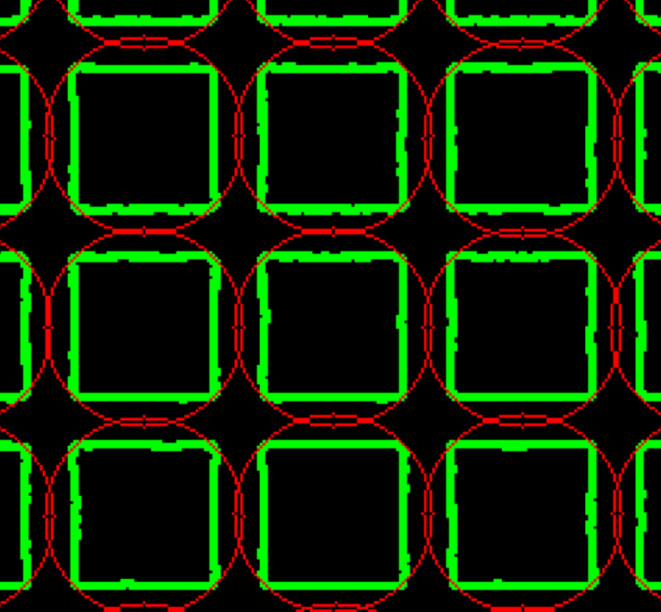
PixelShop Calibration
Alignment Measurement
CCPDv3 Pixel Pad (20 x 20 um)
Notes:
ultimate track recording rate was 5 Mtracks/s and was limited only by the beam intensity that the SPS could provide

Slide 20
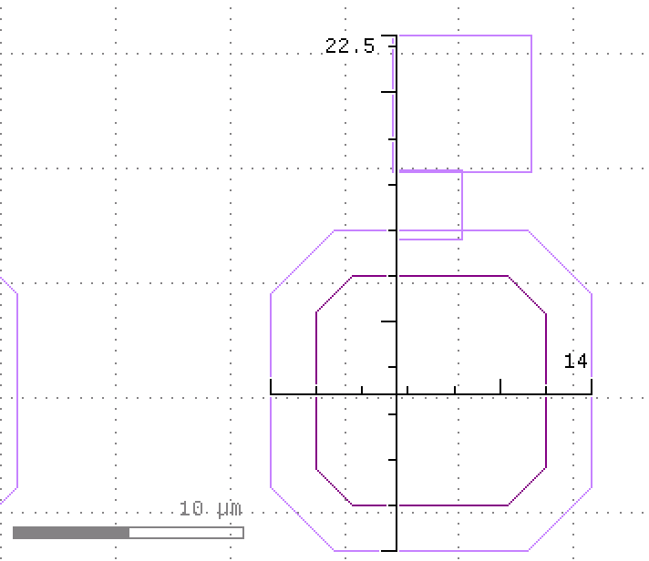
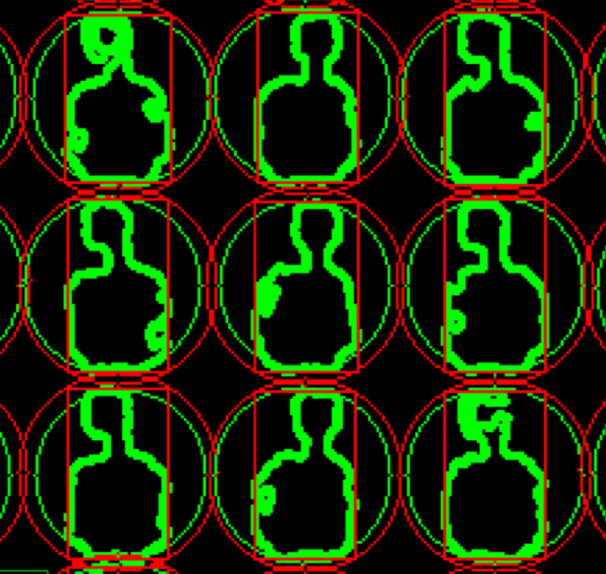
PixelShop Calibration
Alignment Measurement
CLICpix Pixel Pad (14 x 22.5 um)
Notes:
ultimate track recording rate was 5 Mtracks/s and was limited only by the beam intensity that the SPS could provide

Slide 21
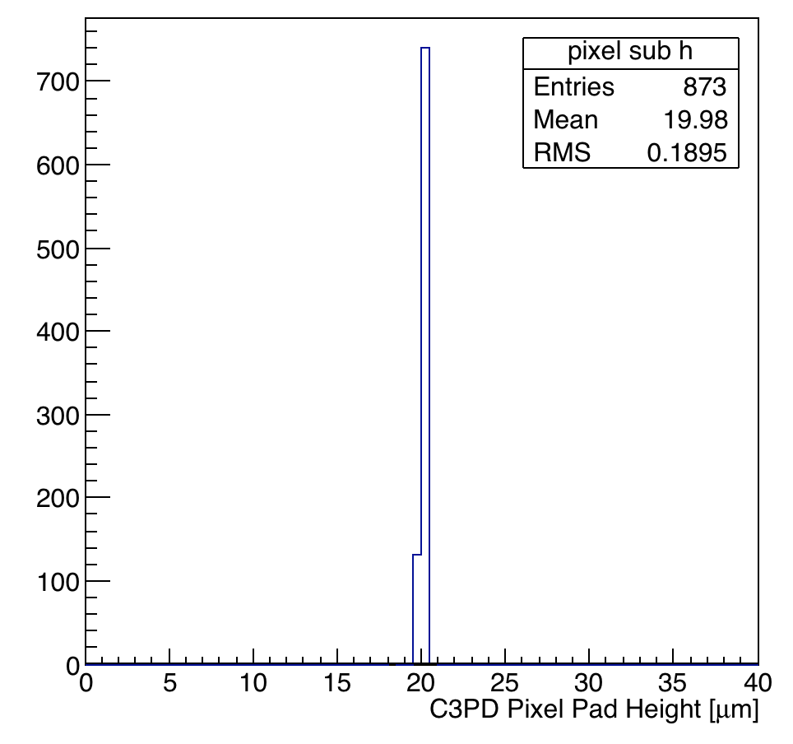
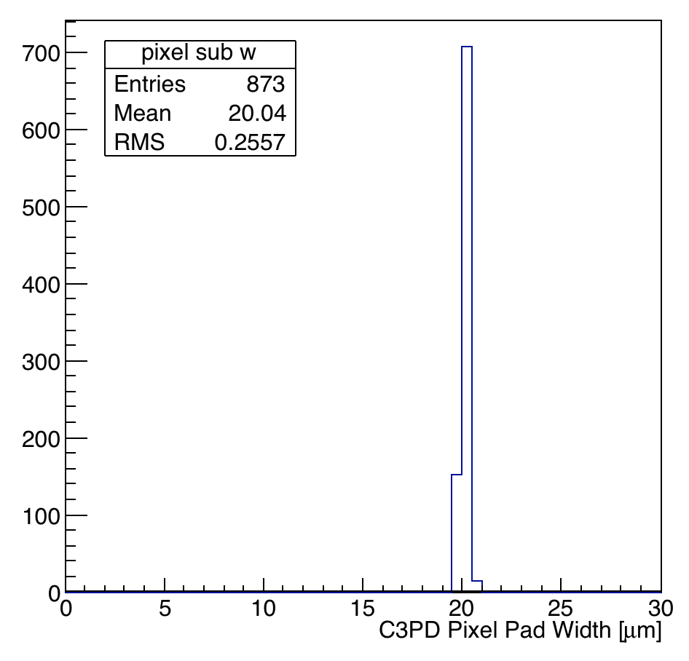
PixelShop Calibration
Alignment Measurement
Pixel to um conversion factor (default from SET = 0.47; new = 0.37)
CCPDv3 Pixel Pad: 20 x 20 um
CCPDv3
CCPDv3
Notes:
ultimate track recording rate was 5 Mtracks/s and was limited only by the beam intensity that the SPS could provide

Slide 22
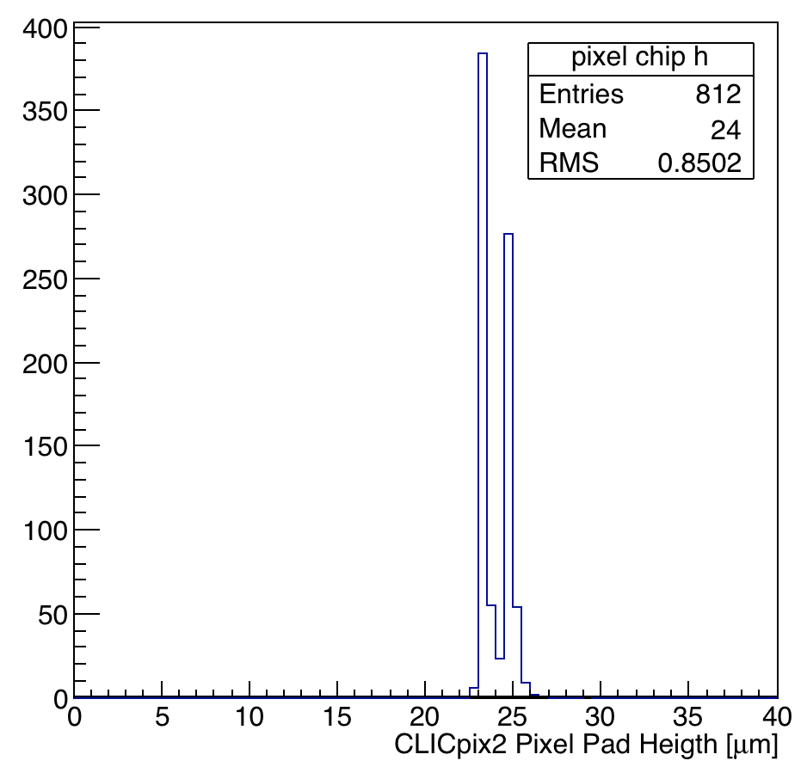
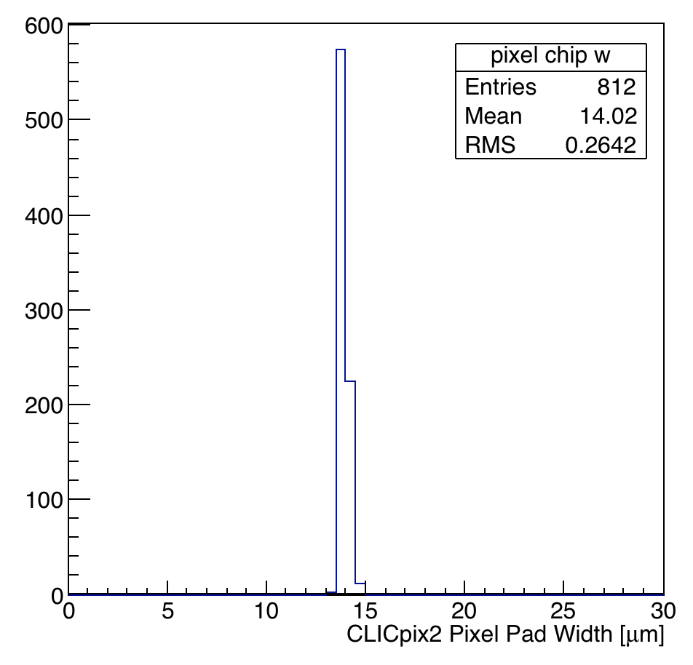
PixelShop Calibration
Alignment Measurement
Pixel to um conversion factor (default from SET = 0.47; new = 0.37)
CLICpix Pixel Pad: 14 x 22.5 um
Notes:
ultimate track recording rate was 5 Mtracks/s and was limited only by the beam intensity that the SPS could provide

Slide 23

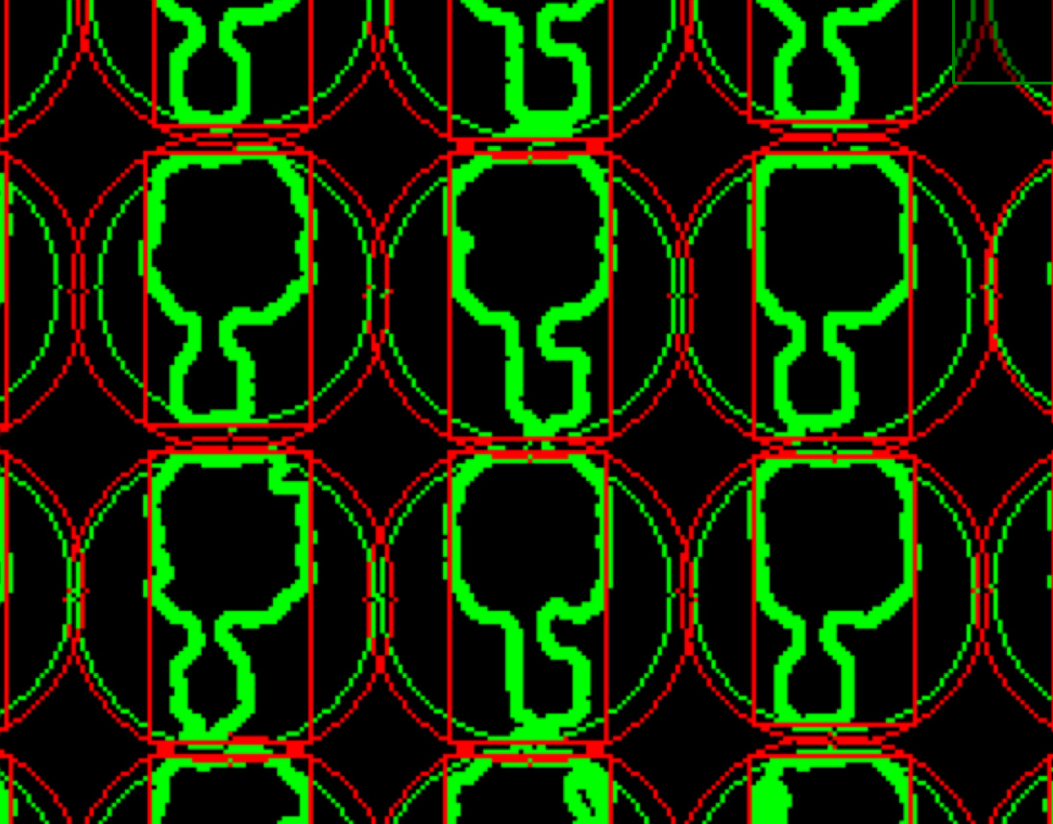
PixelShop Calibration
Alignment Measurement
Pixel to um conversion factor (default from SET = 0.47; new = 0.37)
CLICpix Pixel Pad: 14 x 22.5 um
Notes:
ultimate track recording rate was 5 Mtracks/s and was limited only by the beam intensity that the SPS could provide

Slide 24
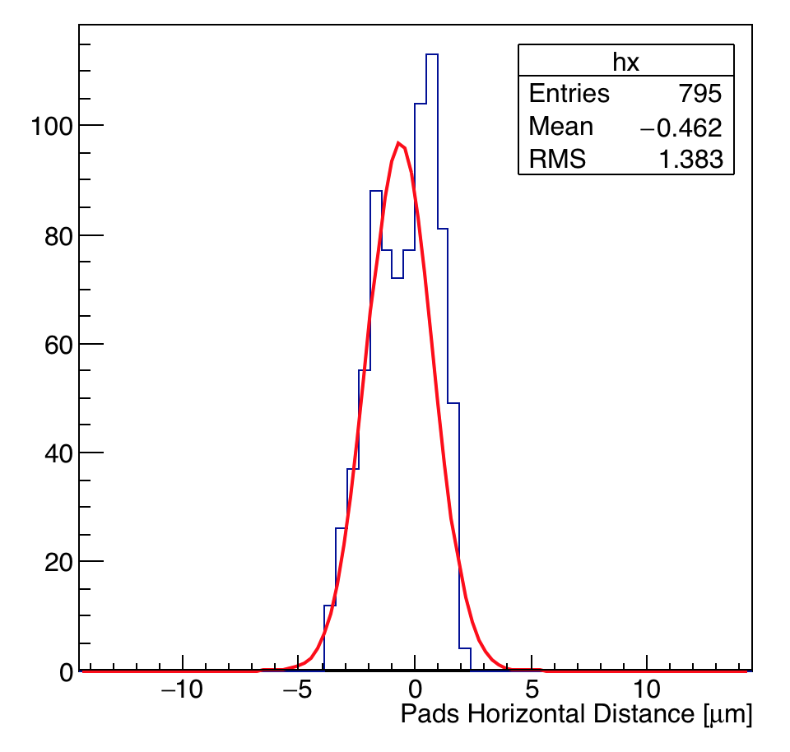
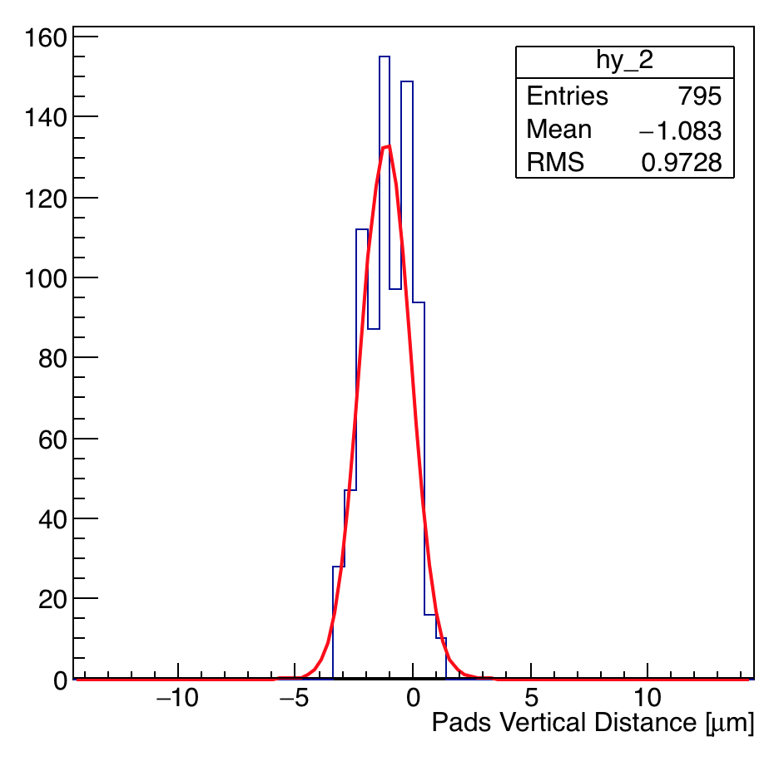
Flip-chip + PixelShop
Alignment Measurement (before gluing)
Distance between sensor and read-out chip pixel pads
  Distance (Y) after gluing ~ 1.1 um
Notes:
ultimate track recording rate was 5 Mtracks/s and was limited only by the beam intensity that the SPS could provide

Slide 25
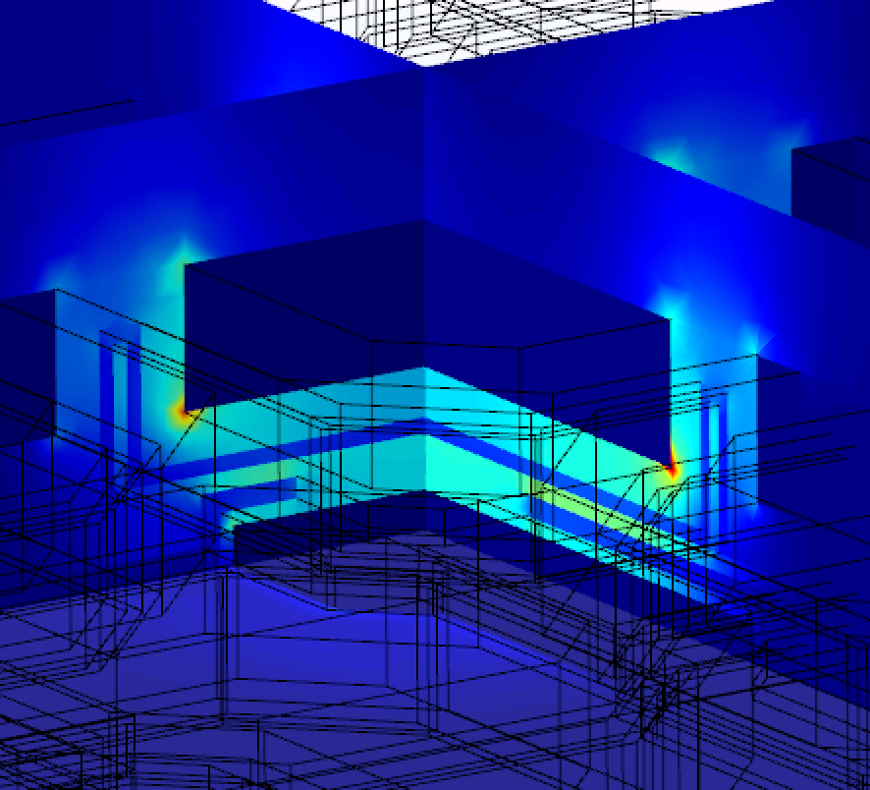
Conclusions and next steps
New cross section measurements
  Check layer thickness to update COMSOL simulation
  Verify chip alignment after gluing
New results on pixel coupling constant
  New gap between the chips
  Coupling constant to GR and metal lines
  Model ready to study systematically the effect of misalignment
  New simulation of the signal transmission
New software to help chip alignment during flip-chip
  Possibility to reach an alignment < 0.5 um
Electric Field between CLICpix2 and C3PD
Notes:
ultimate track recording rate was 5 Mtracks/s and was limited only by the beam intensity that the SPS could provide

