Slide 1





Silicon pixel-detector R&D for CLIC
Magdalena Munker (CERN, University of Bonn)
On behalf of the CLICdp collaboration
4 July 2016

Slide 2
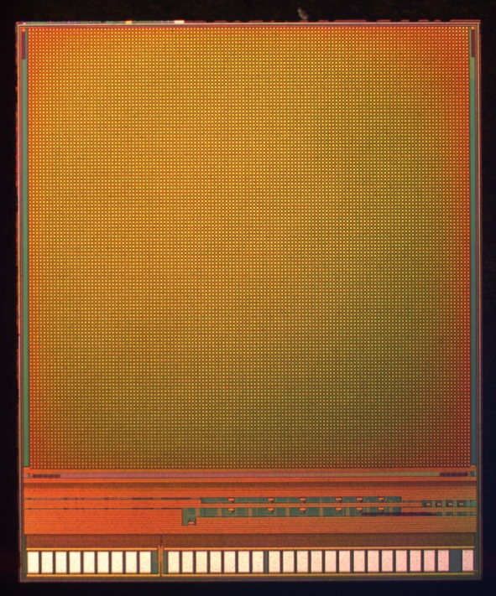
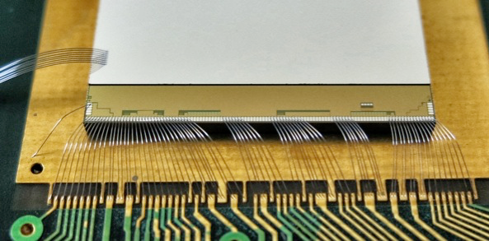
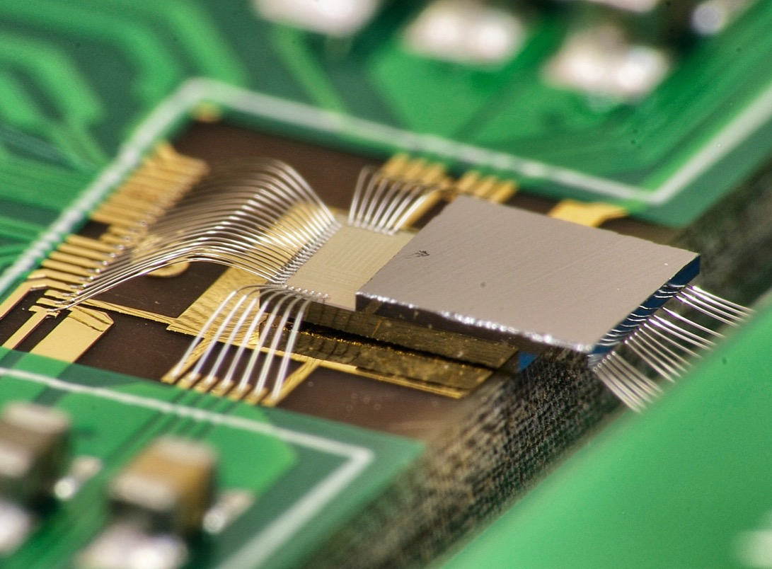
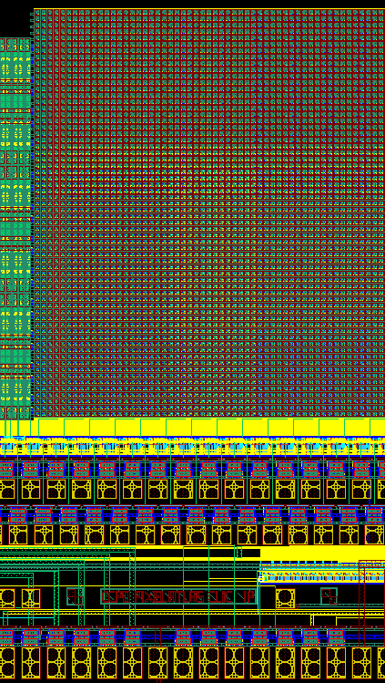
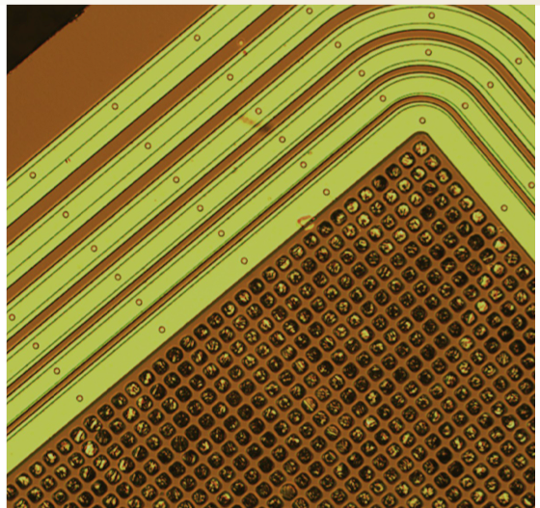
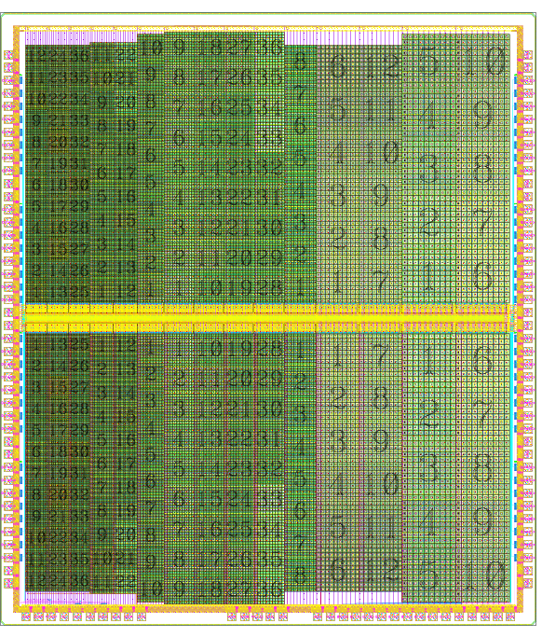
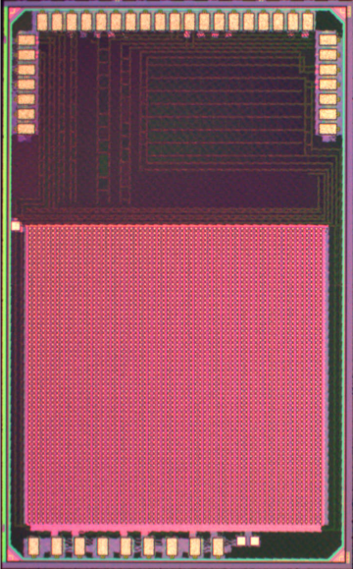
Outline
Introduction to CLIC
Requirements for the vertex and tracking detector of CLIC
R&D on sensor and readout technologies:
  Thin planar sensor assemblies
  HV-CMOS active sensors and capacitve coupling
  Integrated CMOS sensors
Summary
p. 1
p. 1

Slide 3
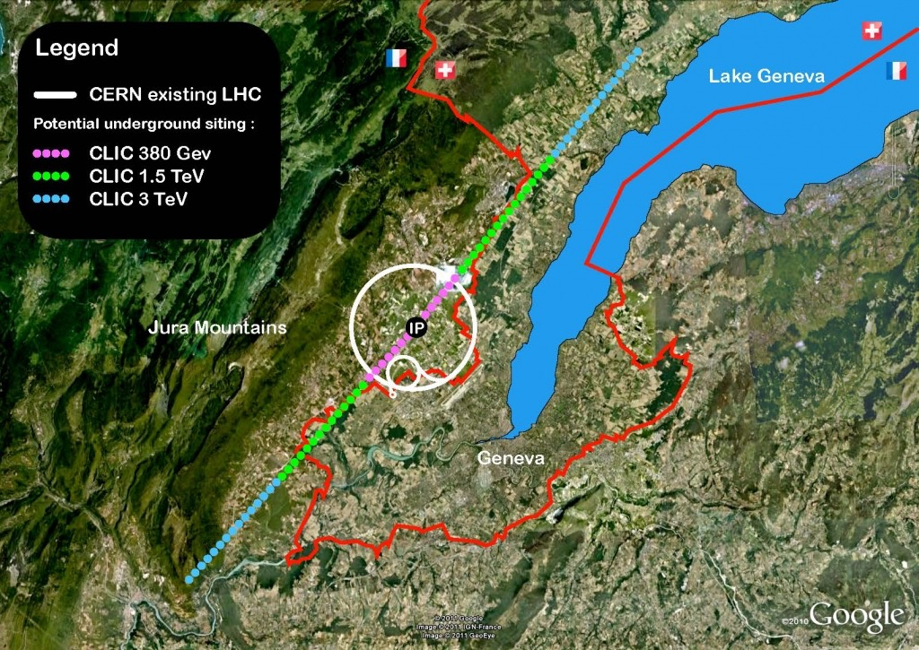
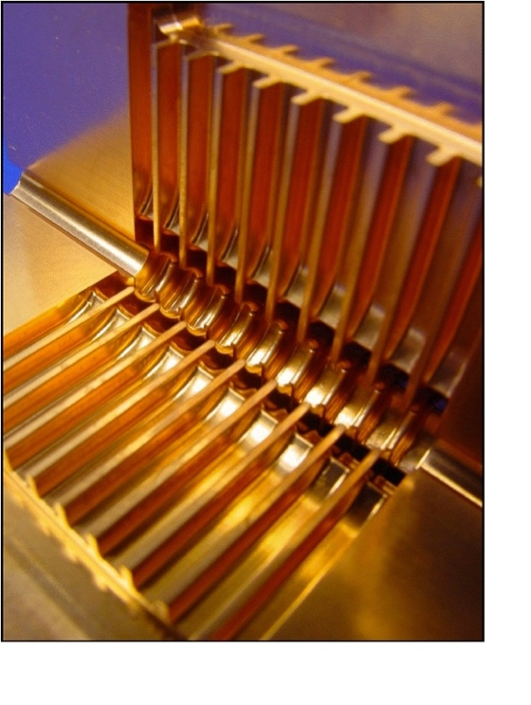
CLIC - the Compact Linear Collider
Future e⁺e⁻ linear collider concept at CERN for the post HL-LHC phase
Center-of-mass-energy range:
  A few hundred GeV up to 3 TeV (staged construction)
  Two-beam acceleration with ~100 MV/m
50.1 km tunnel at 3 TeV stage
CLIC accelerating structure
Physics goals:
  Precision measurements of Standard Model Processes (Higgs, Top)
  Precision measurements of new physics potentially discovered at 14 TeV LHC
  Search for new physics, unique sensitivity to particles with electroweak charge
Magdalena Munker (CERN / University of Bonn), 4 July 2016
p. 2
Notes:
High energy LHC -> 14 TeV LHC

Slide 4
Requirements for the vertex and the tracker
Vertex detector:
Vertex detector layout:
Efficient tagging of displaced vertices from heavy flavour quarks:
Good single point resolution of 3 μm
Small pixels with a pitch of ~ 25 μm and analogue read out
26 cm
Low material budget of ⪅ 0.2 % X0 per layer:
Forced airflow cooling & low-power electronics ( ⪅ 50 mW/cm²)
Power pulsing at 50 Hz to reduce average power consumption
Tracker detector:
Tracker detector layout:
Good momentum resolution:
Single point resolution of 7 μm pitch of ⪅ 50 μm
Low material budget of ⪅ 2 % X0 per layer:
Low-mass supports, cabling and cooling
Occupancies from beam-beam interactions constrain readout granularity:
1-10 mm strip lengths
Both:
Fast time slicing of ~ 10 ns to suppress background from beam-beam interactions
Low radiation exposure ~ 10⁴ times below LHC
Magdalena Munker (CERN / University of Bonn), 4 July 2016
p. 3

Slide 5
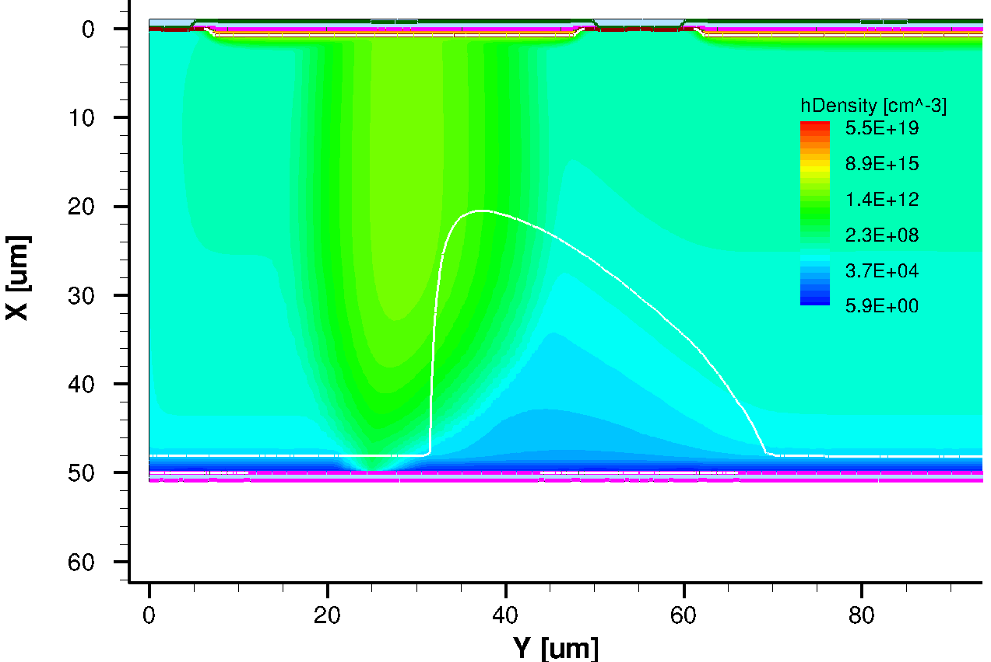
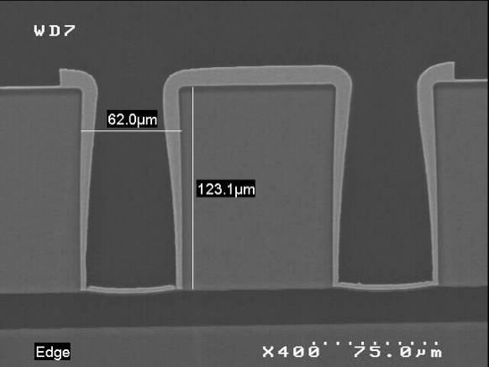
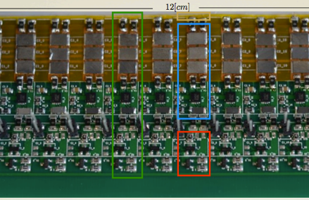
CLIC vertex and tracker R&D programme
Sensors:
Readout ASICs:
Simulations:
Interconnects (TSV)::
Powering:
Cooling:
Light-weight supports:
Integrated R&D effort, addressing vertex & tracker R&D simultaneously
Examples of sensor, simulation and readout studies presented on the following slides
Magdalena Munker (CERN / University of Bonn), 4 July 2016
p. 4

Slide 6
Medipix / Timepix hybrid readout chip family
Chip | Year | CMOS Process | Pitch [μm²] | Pixel operation modes | r/o mode | Main applications
Timepix | 2006 | 250 nm | 55x55 | ∫ToT or ToA or γ counting | Sequential (full frame) | HEP, Medical
Medipix3RX | 2012 | 130 nm | 55x55 | γ counting | Sequential (full frame) | Medical
Timepix3 | 2013 | 130 nm | 55x55 | ToT + ToA, γ counting + ∫TOT | Data driven | HEP, Medical
CLICpix/ CLICpix2 | 2013/ 2016 | 65 nm | 25x25 | ToT + ToA | Sequential (data compr.) | Test chips targeting CLIC requirements
Velopix | 2016 | 130 nm | 55x55 | ToT + ToA, γ counting + ∫TOT | Data driven | LHCb (10x Timepix3 rate)
Medipix4/ Timepix4 | tbd | 65 nm | ~35x35 | ToT + ToA, γ counting + ∫TOT | Data driven | HEP, Medical 4-side buttable
(ToT: Time over Threshold energy measurements, ToA: Time of Arrival timing measurements )
Evolution of chips with time, taking advantage of smaller feature sizes
Better performance and/or smaller pixel size
Timepix and Timepix3 used as test vehicles for tests of thin silicon sensors
Magdalena Munker (CERN / University of Bonn), 4 July 2016
p. 5

Slide 7
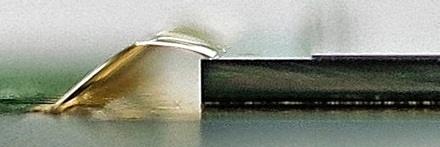
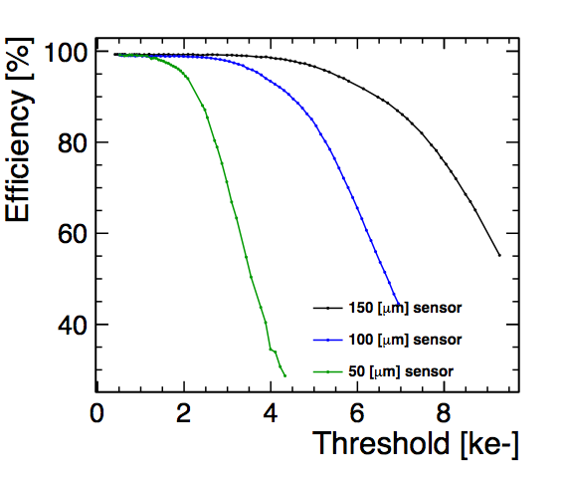
Timepix(3) thin planar sensor assemblies
Planar sensor assemblies with 55 μm pitch (Micron, Advacam)
50 - 675 μm sensor thickness, 100 - 700 μm ASIC thickness
Readout with Timepix / Timepix3
Timepix assembly:
50 μm sensor
700 μm Timepix
Timepix3
Test beam results:
Investigate efficiency for different threshold levels
Low noise allows for low detection threshold
(~ 1000 electrons)
> 99% efficiency with 50 μm thin sensor demonstrated
CLICdp
Work in progress
Resolution profits from charge sharing
Less charge sharing for thin
sensors
Limits achievable resolution
for thin sensors
Timepix
Resolution ~ 14 μm for 50 μm thin sensor
Timepix
CLICdp-Note-2016-001
Magdalena Munker (CERN / University of Bonn), 4 July 2016
p. 6

Slide 8
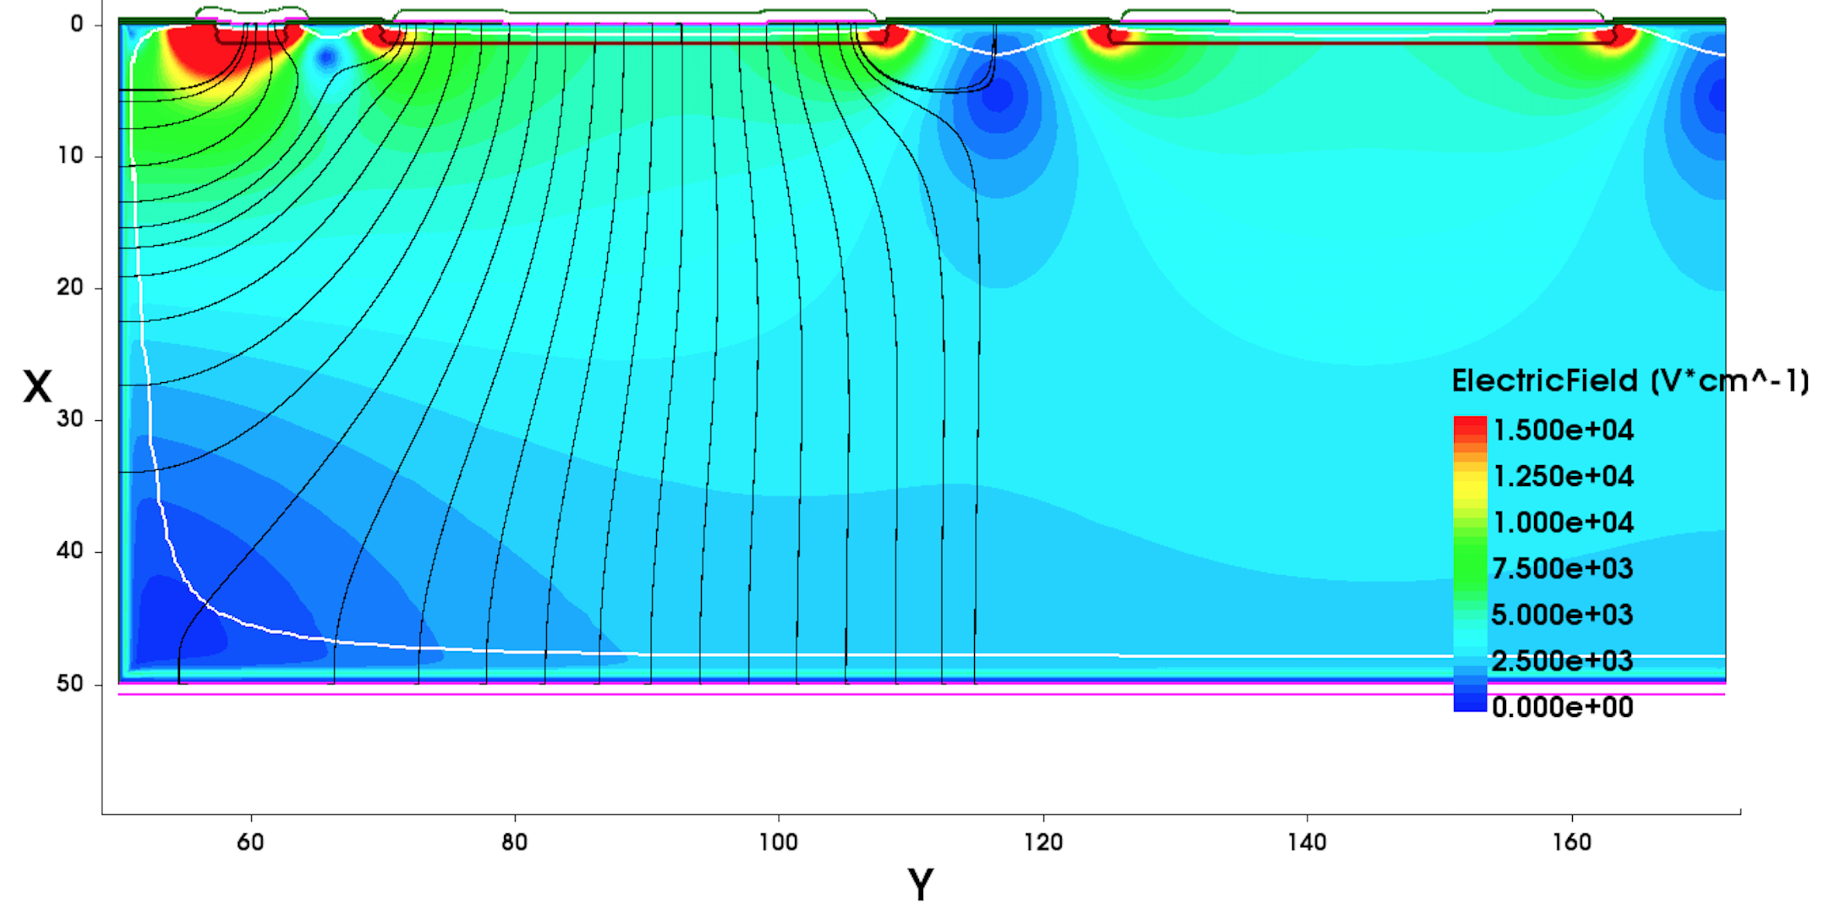
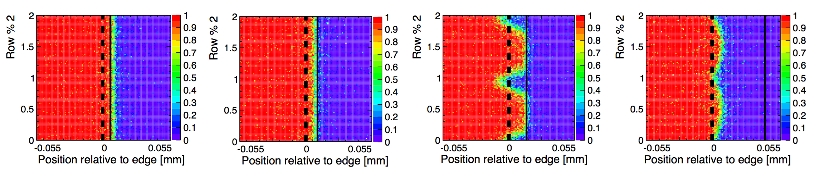
Active edge sensors
Active edge sensors provide possibility of seamless tiling
50 μm thin planar sensors with active edge and Timepix3 readout
Deep Reactive-Ion Etching process:
Extend backside electrode to the edge of the sensor
Different guard ring designs:
Create a smooth voltage drop between the last pixel
implant and the edge implantation
      TCAD simulation
      grounded guard ring:
CLICdp
Work in progress
Test-beam results:
Pixel cell
Study of edge efficiency for different guard ring (GR) layouts:
Grounded GR, small distance to edge:
Grounded GR, large distance to edge:
No GR:
Floating GR:
CLICdp
Work in progress
CLICdp
CLICdp
CLICdp
Work in progress
Work in progress
Work in progress
Work in progress
edge
pixel
border
Active-edge assemblies with no guarding or floating guard ring are efficient up to the sensor edge
Grounded guard ring leads to charge loss at the edge, well understood by transient simulation
Magdalena Munker (CERN / University of Bonn), 4 July 2016
p. 7

Slide 9
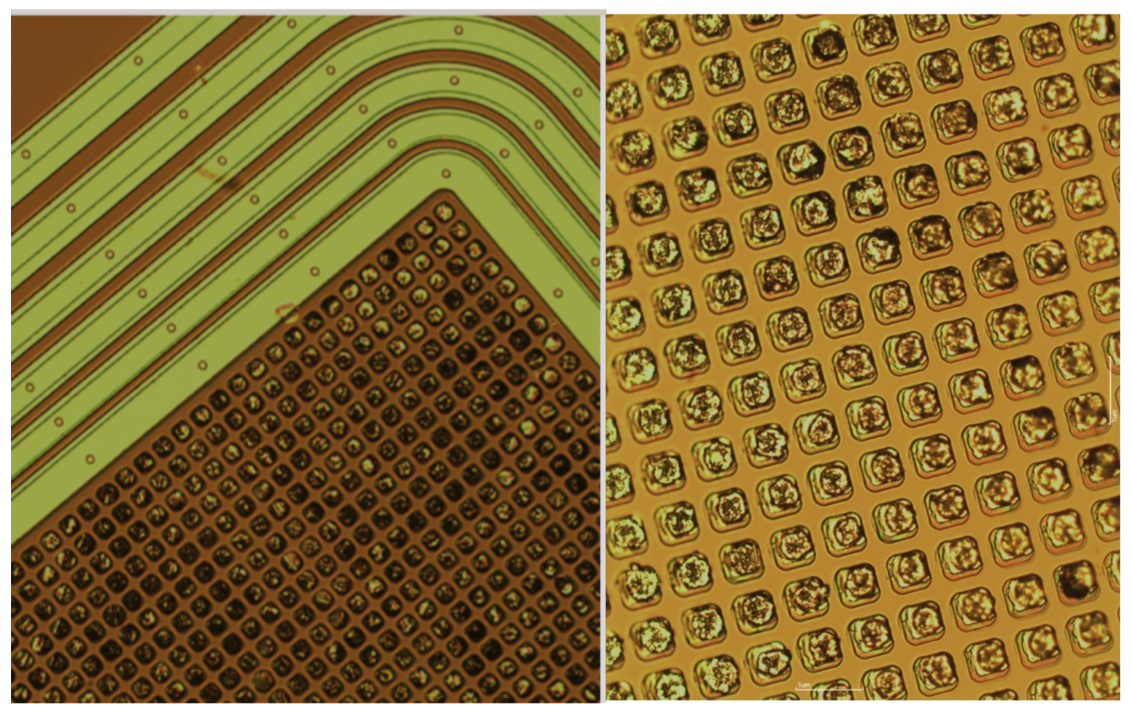
CLICpix planar sensor assemblies
CLICpix demonstrator chip:
CLICpix demonstrator chip with 64x64 pixel matrix
4-bit ToT and ToA readout
Bump-bonded to 200 μm thick planar sensors
Single-chip bump-bonding process for 25 μm pitch developed at SLAC (C. Kenney, A. Tomada)
Interconnect yield observed on 3 test assemblies:
UBM & indium
bump-bonds on sensor:
    Unconnected channels ~ 0.2 - 3 %
Shorted channels ~ 1-2%
Test-beam results:
Resolution of ~ 3 - 4 μm and efficiency of ~ 99 %
Target 50 μm sensor thickness
for CLIC
Thin CLICpix planar sensor
assemblies produced:
CLICdp
Work in progress
CLICdp
Work in progress
  Thickness of 50 and 150 μm
  Lab-testing in progress
CLICpix
CLICpix
Magdalena Munker (CERN / University of Bonn), 4 July 2016
p. 8

Slide 10
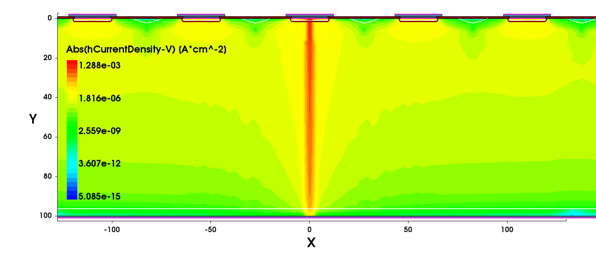
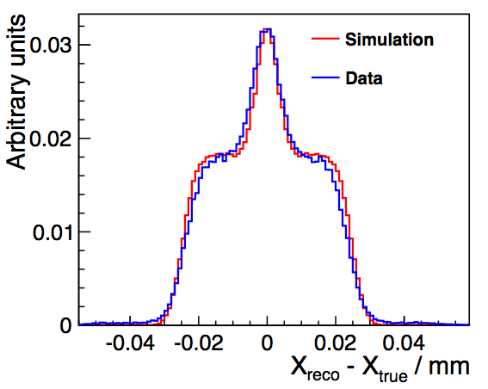
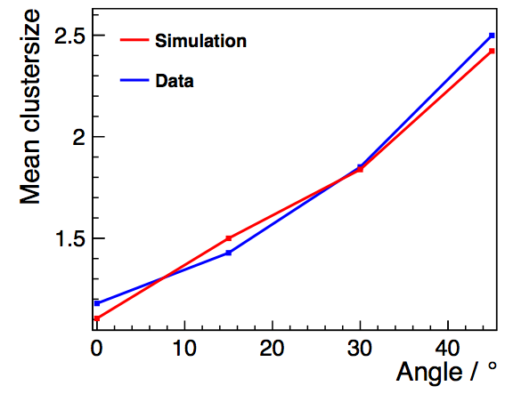
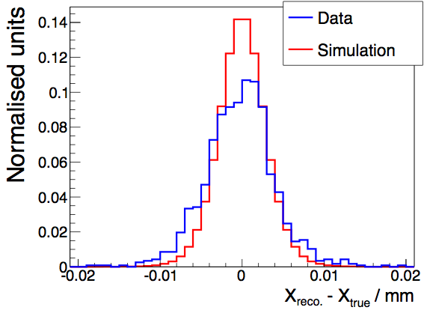
Simulation of planar sensor performance
GEANT4 simulation of energy deposit in silicon sensor
Finite element TCAD simulation of silicon sensor
Fast parametric model of front
end electronics and Landau fluctuations
Reconstruction, calculation of observables
and simulation of telescope resolution
TCAD simulation of planar sensor:
CLICdp
Work in progress
Thickness of 100 μm
Thickness of 100 μm
Comparison of simulation to Timepix
test-beam results (pitch of 55 μm):
  Simulation reproduces distribution of residual
  Simulation reproduces dependency of
charge sharing on incident angle
Mean cluster size
CLICdp
CLICdp
Work in progress
Work in progress
Residual / mm
Comparison of simulation to CLICpix
test-beam results (pitch of 25 μm) :
  Simulation reproduces distribution of residual
  Simulation reproduces dependency of
charge sharing on threshold
Thickness of 200 μm
CLICdp
CLICdp
Work in progress
Thickness of 200 μm
Work in progress
Residual / mm
Magdalena Munker (CERN / University of Bonn), 4 July 2016
p. 9

Slide 11
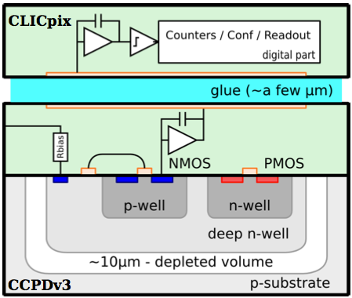
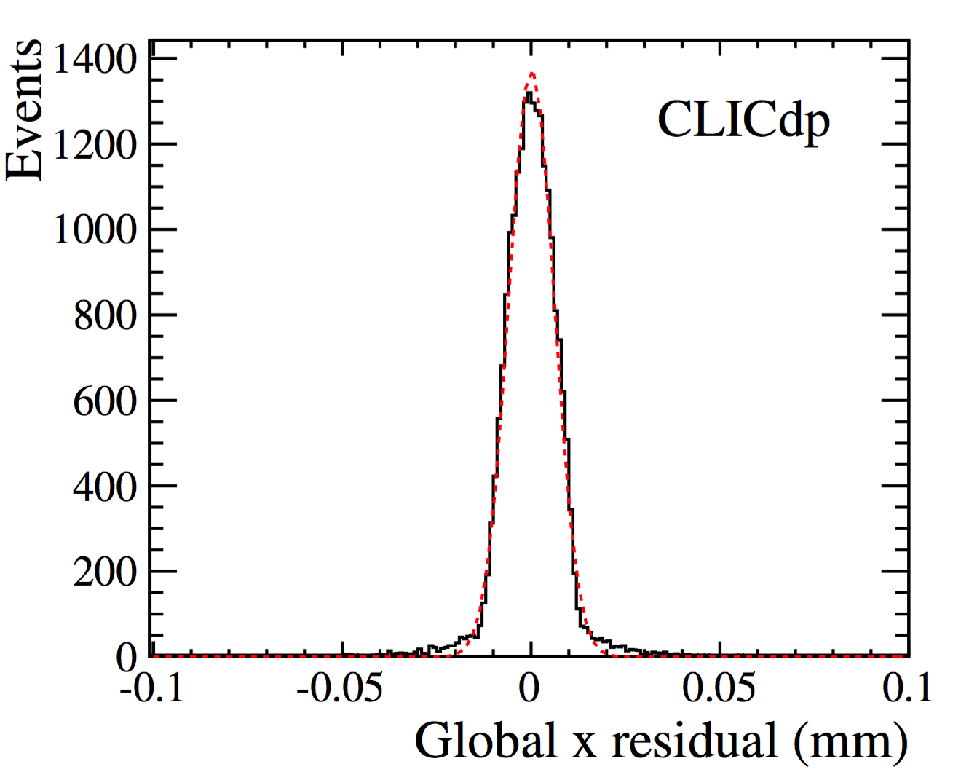
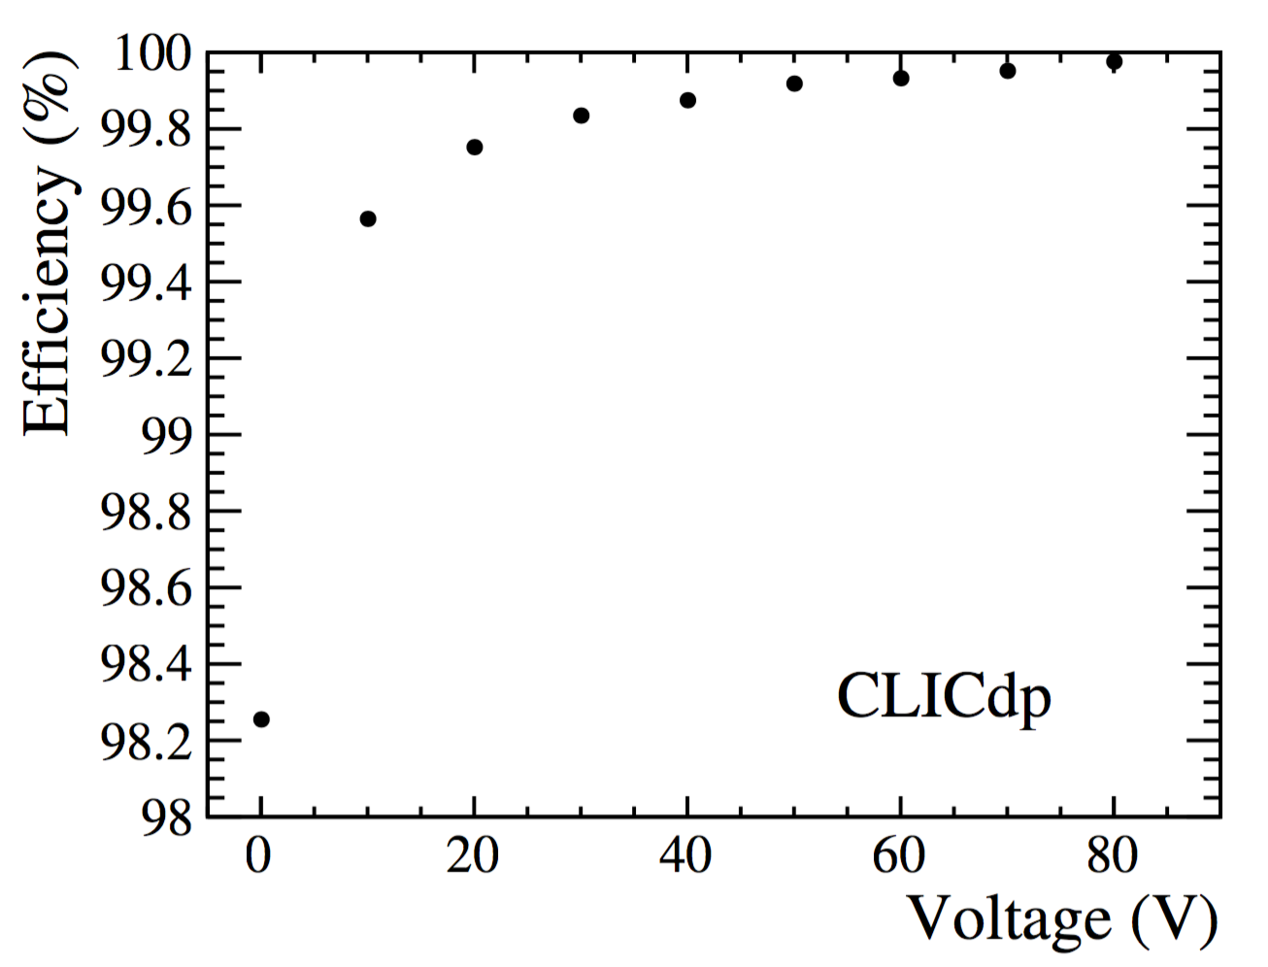
HV-CMOS active sensor assemblies
Capacitive Coupled Pixel Detector (CCPD) used as active sensor:
  Commercial 180 nm High-Voltage-CMOS process
  Deep n-well shields electronics from the substrate bias
  HV substrate bias of ~ 60 V
  Fast signal by drift due to creation of depletion layer
  Output of two-stage amplifier in pixel:
Layout CLICpix-HV-CMOS assembly:
Passivation + glue (a few μm)
    Peaking time ~120 ns
  Coupled through layer of glue to CLICpix ASIC (25 μm pitch)
  No bump bonding
Test-beam results:
CLICpix HV-CMOS
Resolution ~ 6 μm
Efficiency ~ 99.9 %
Proof of principle achieved
CLICpix HV-CMOS
Nucl. Instrum. Meth. A823 (2016) 1
CLICdp-Pub-2015-003
Simulation of HV-CMOS sensors performed: CLICdp-Note-2016-004
Magdalena Munker (CERN / University of Bonn), 4 July 2016
p. 10

Slide 12
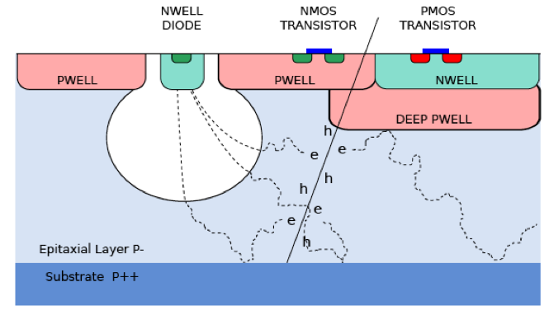
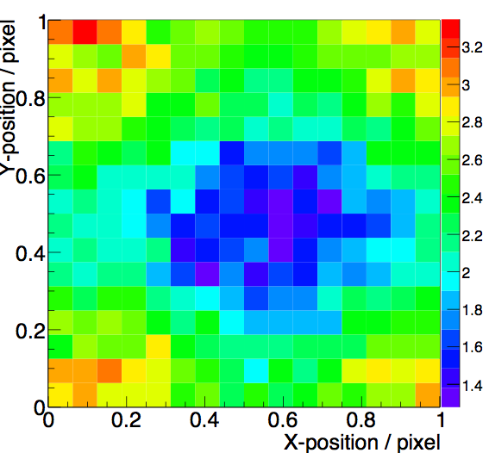
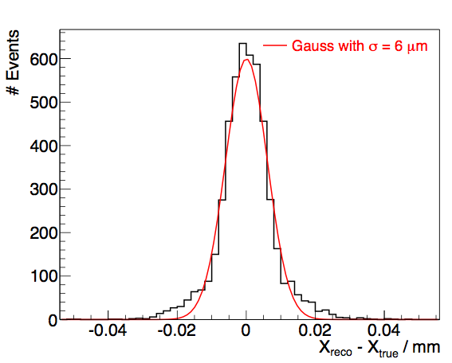
Integrated CMOS technology
ALICE INVESTIGATOR, monolithic HR-CMOS test-chip:
Developed by the ALICE collaboration to test analogue performance
180 nm CMOS process,15-40 μm / 1-8 kΩcm epitaxial layer
134 mini-matrices with different pixel layouts and 8x8 pixel matrix
Optimization of collection-diode geometry to minimize
capacitance (~2 fF) fast timing
Digitisation and readout not integrated in chip
External 65 MHz sampling ADC per pixel reads out full waveform
Cluster size in pixel cell:
CLICdp
Test-beam results, mini-matrix with pitch of 28 μm, Vbias = 6 V:
Work in progress
Gauss fit
Gauss fit
σ ~ 6 μm
σ ~ 6 ns
Work in progress
Work in progress
CLICdp
CLICdp
Residual / mm
Magdalena Munker (CERN / University of Bonn), 4 July 2016
p. 11

Slide 13
Summary
Challenging requirements for the CLIC vertex and tracking detectors
Very active integrated R&D effort for the vertex and the tracker:
  Thin planar sensors with Timepix(3) readout:
  Efficiency of > 99 % even for thin sensors of 50 μm
  Active edge sensors with Timepix3 readout:
  Study of different guard ring layouts to obtain efficiency up to the edge
  CLICpix (64x64 pixel matrix with 25 μm pitch) planar sensor assemblies:
  Developed single-chip bump-bonding process for 25 um pitch
  Performance in agreement with expectations
  HV-CMOS active sensors and capacitive coupling:
  Proof of principle by coupling of CCPD to CLICpix ASIC achieved
  Monolithic HR-CMOS test-chip from the ALICE collaboration:
  First test-beam results show attractiveness of this technology for CLIC
Thanks to everyone who provided material for this talk!
p. 12

Slide 14
BACKUP

Slide 15
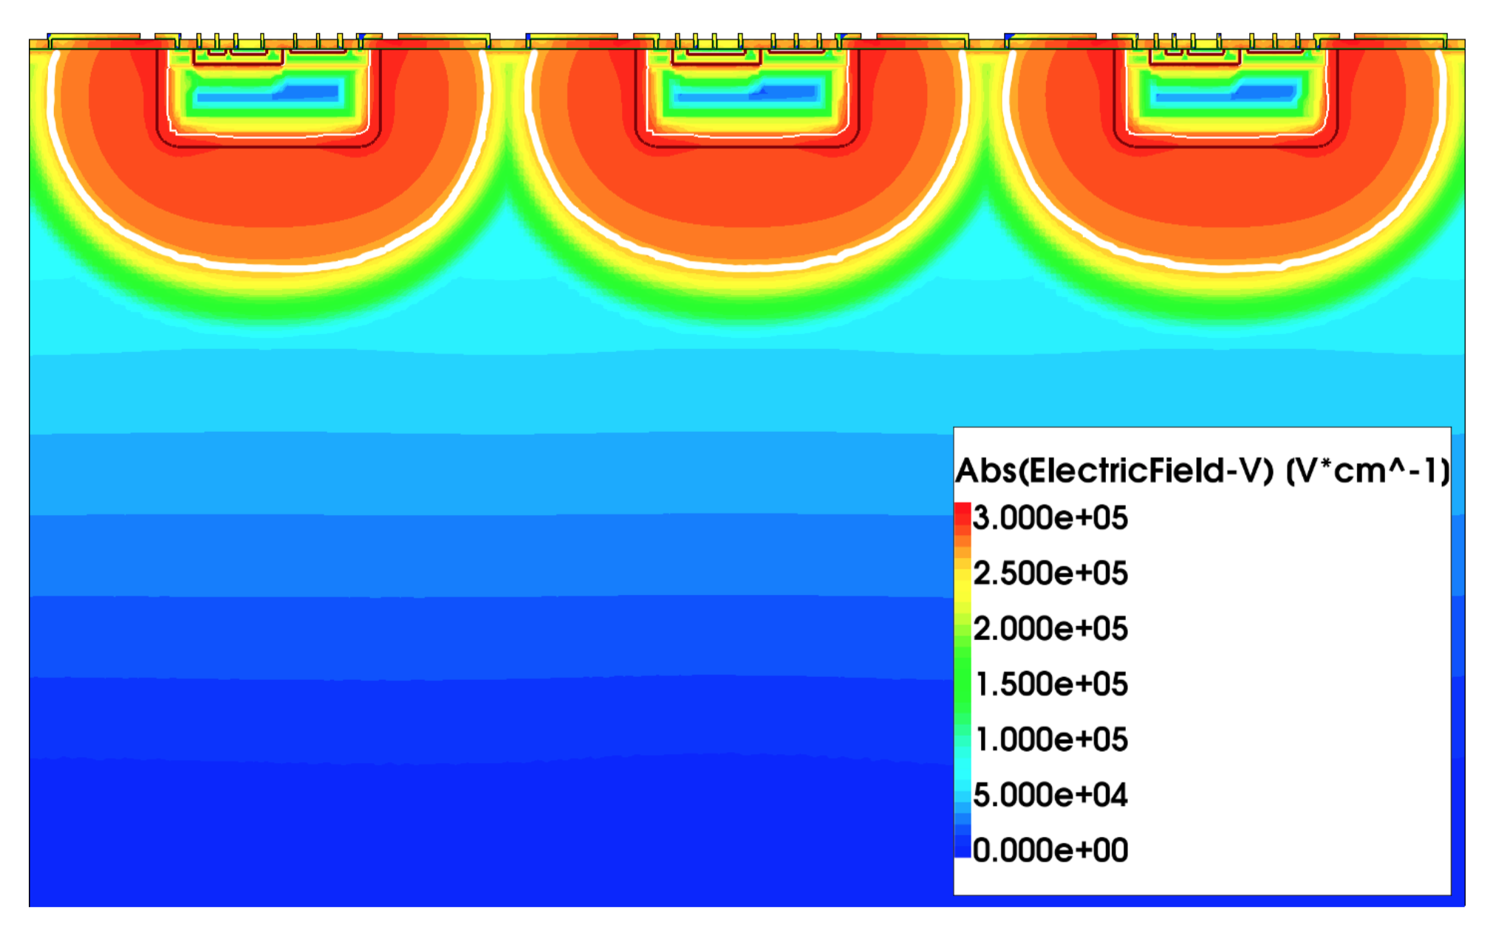
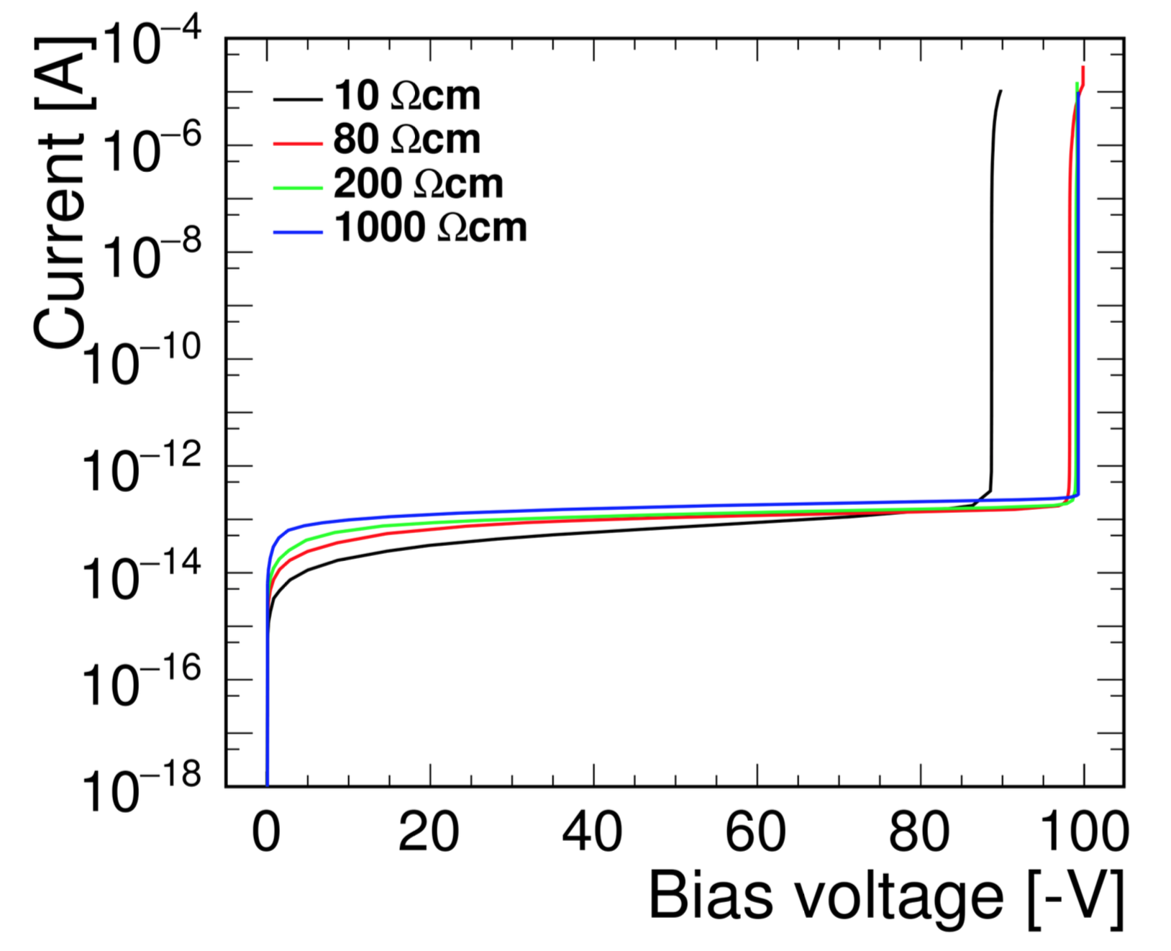
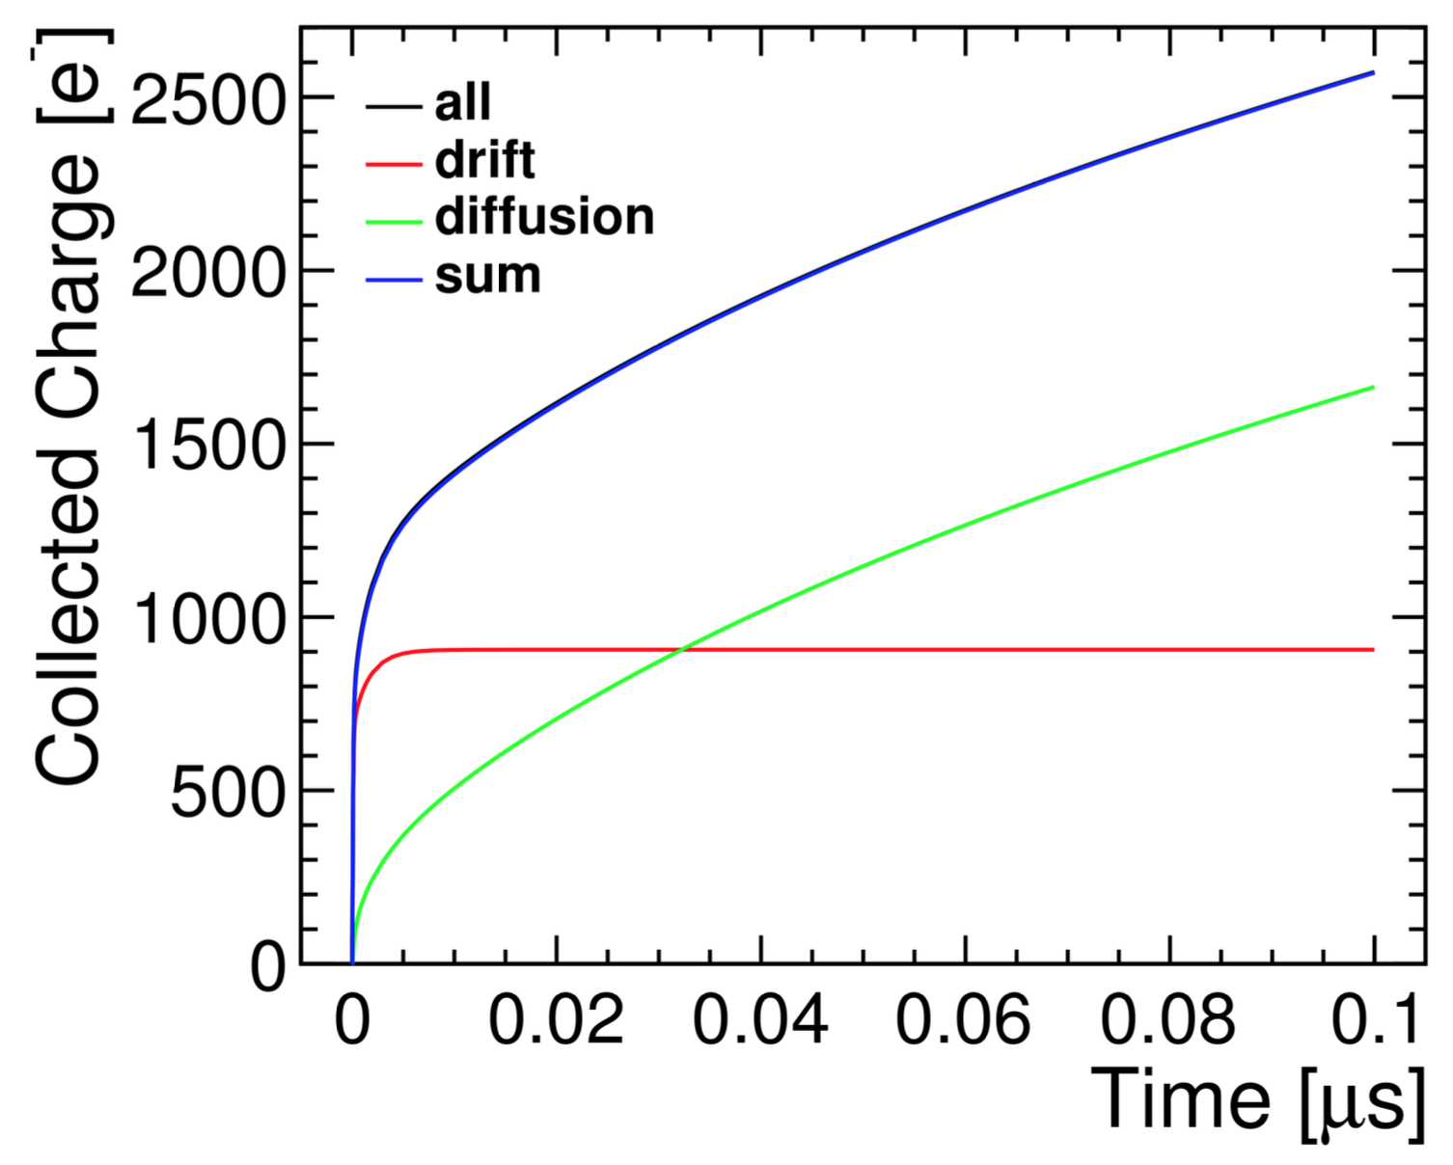
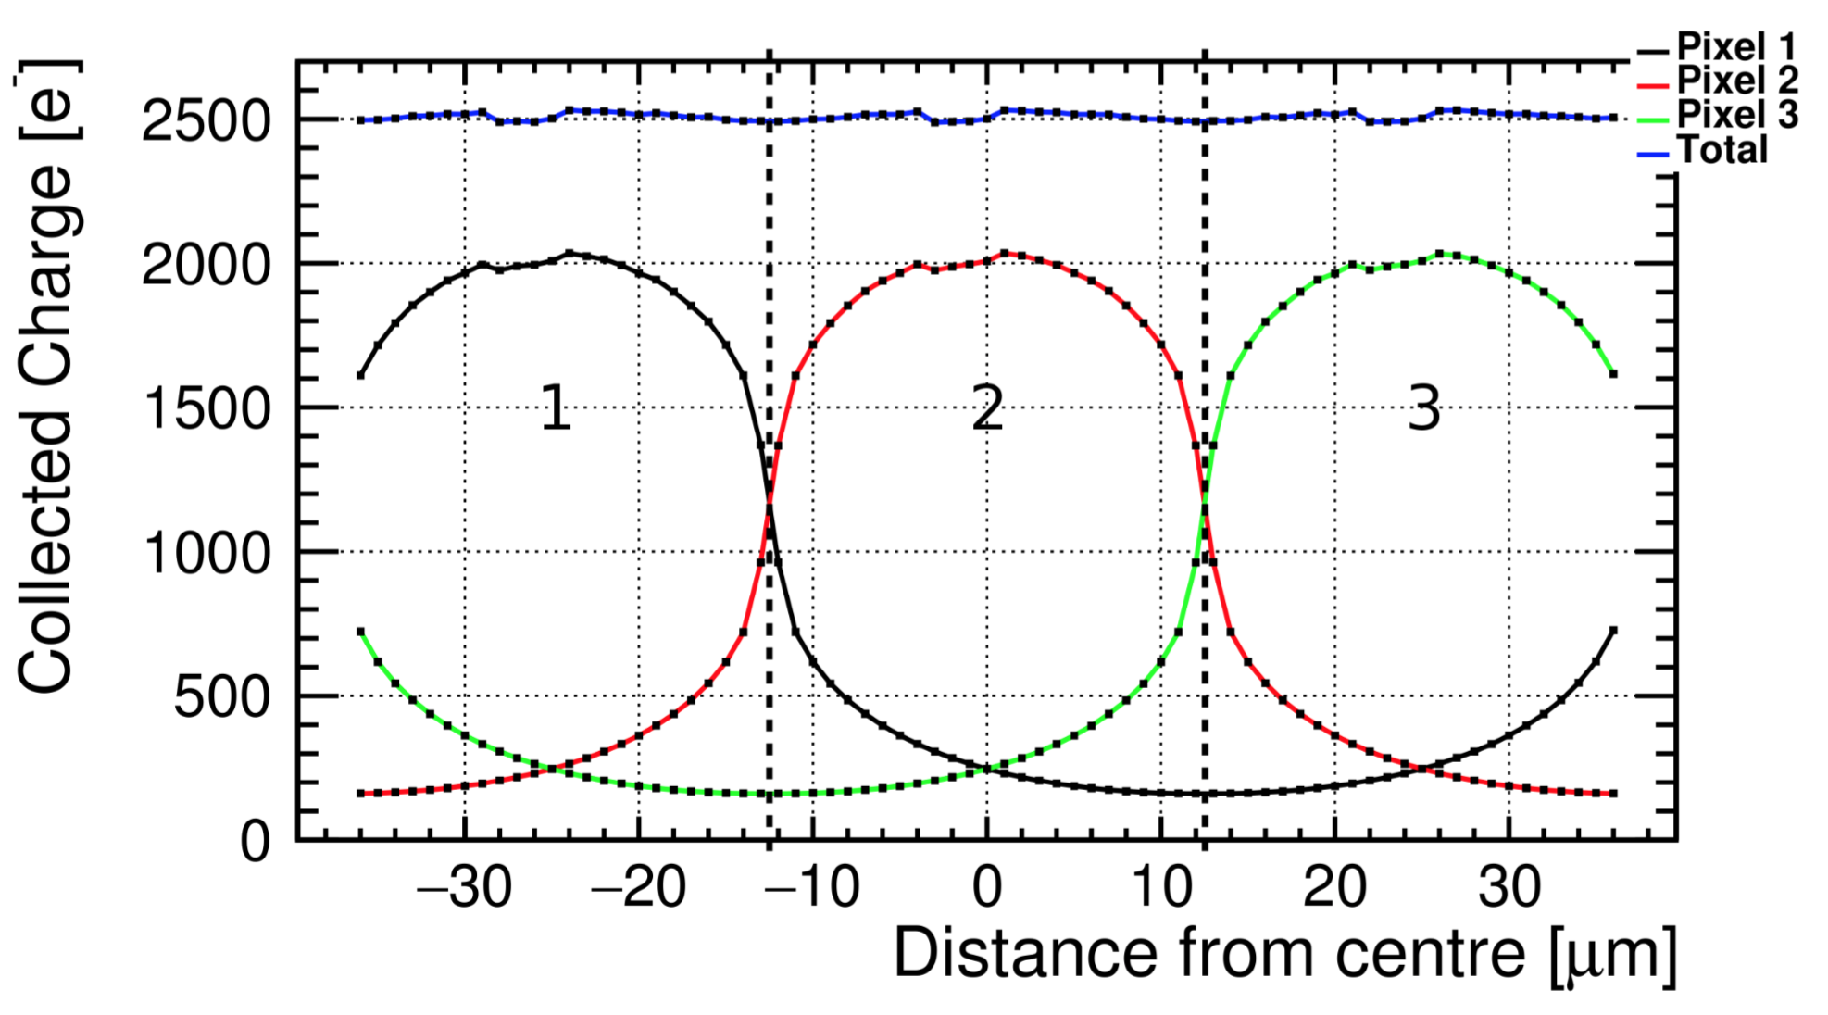
Simulation of HV-CMOS sensors
Implementation of CCPD pixel structure in TCAD:
  Simulation of leakage current to identify cause of
  early breakdown at ~ 90 V
  Used to improve next generation of CCPD
  Transient simulation of MIPs entering the sensor
  Fast rise time ~ ns of collected charge from depleted region
Significantly slower rise time of collected charge from
non depleted bulk
  Simulation of MIPs entering the sensor on different positions
  Gain understanding of charge sharing between pixels
Work in progress
Work in progress
Depleted region
CLICdp
CLICdp
CLICdp-Note-2016-004
CLICdp
Magdalena Munker (CERN / University of Bonn), 3 July 2016
p. 11
Notes:
- Leckstrom != transient!

Slide 16
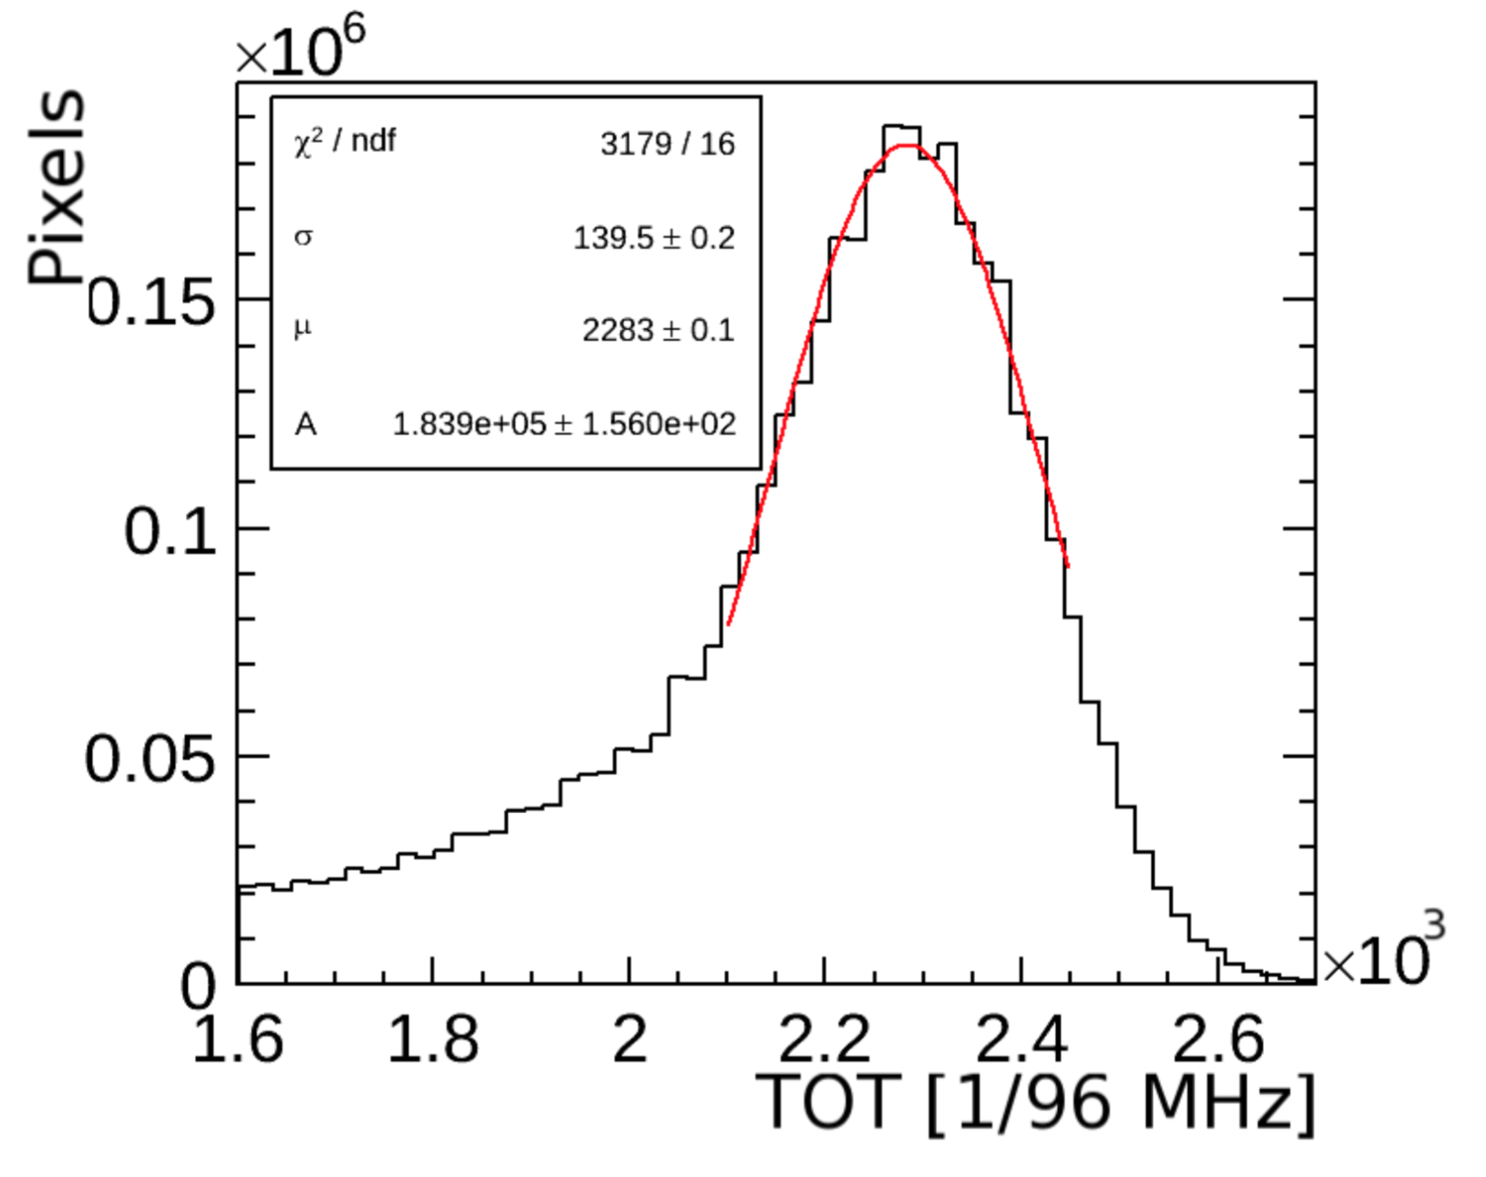
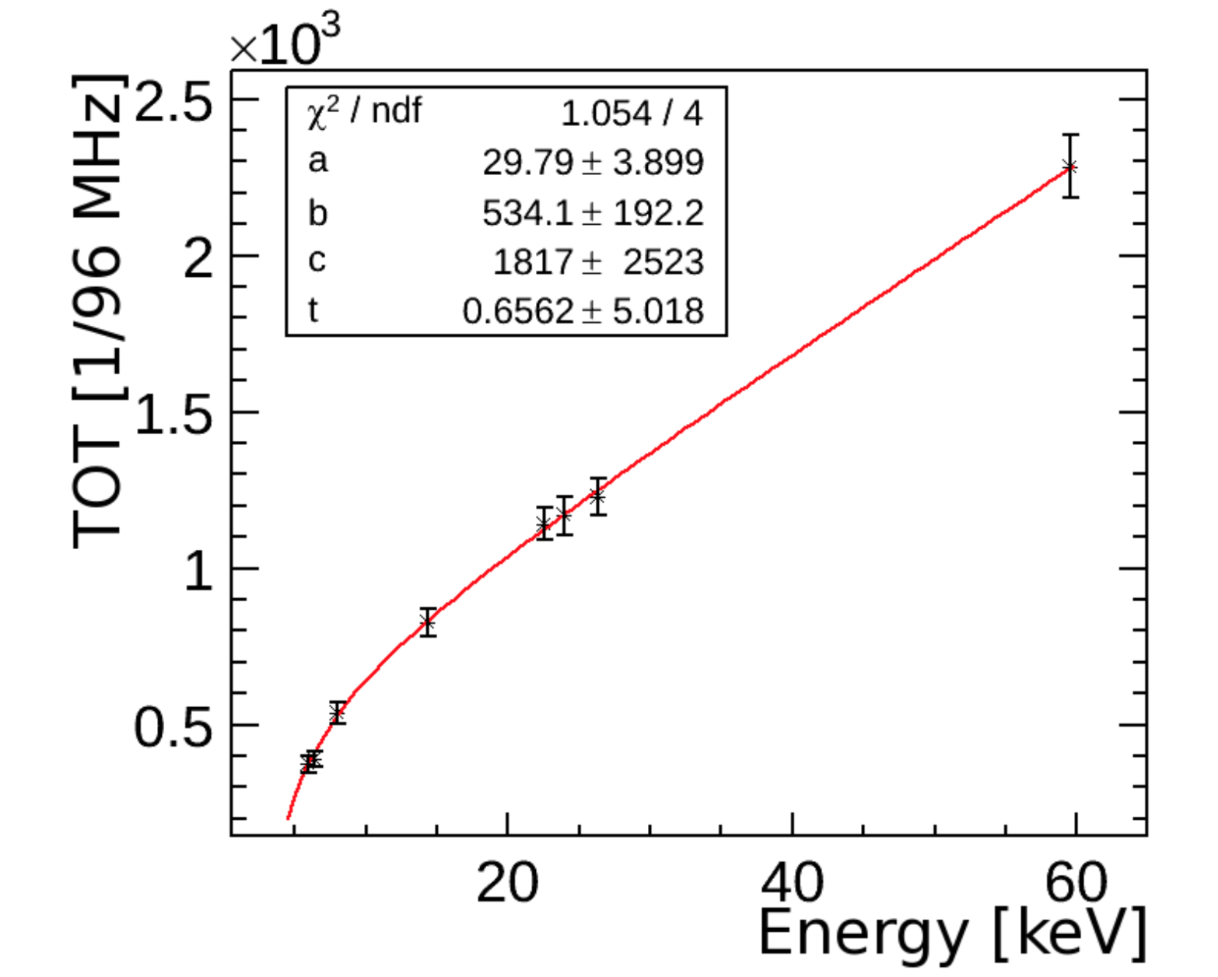
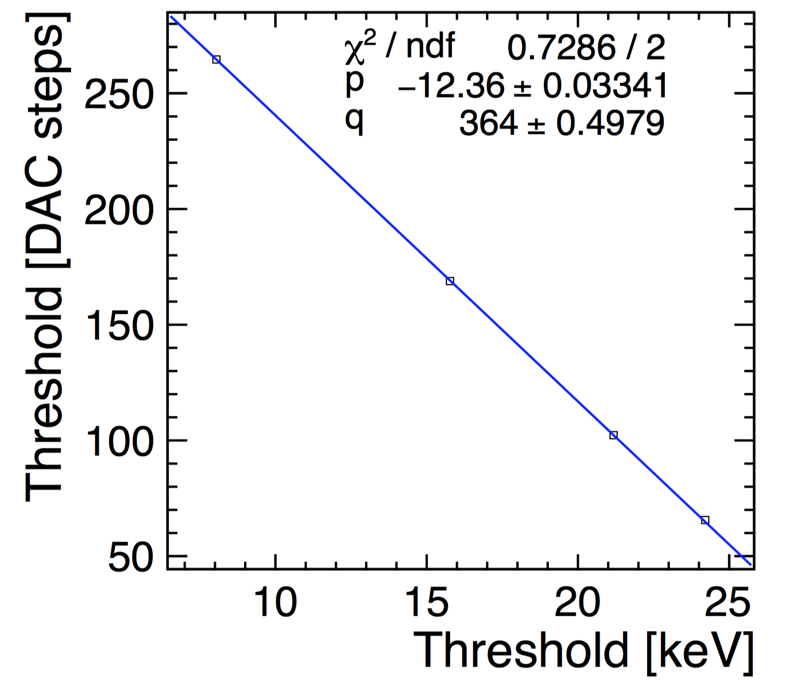
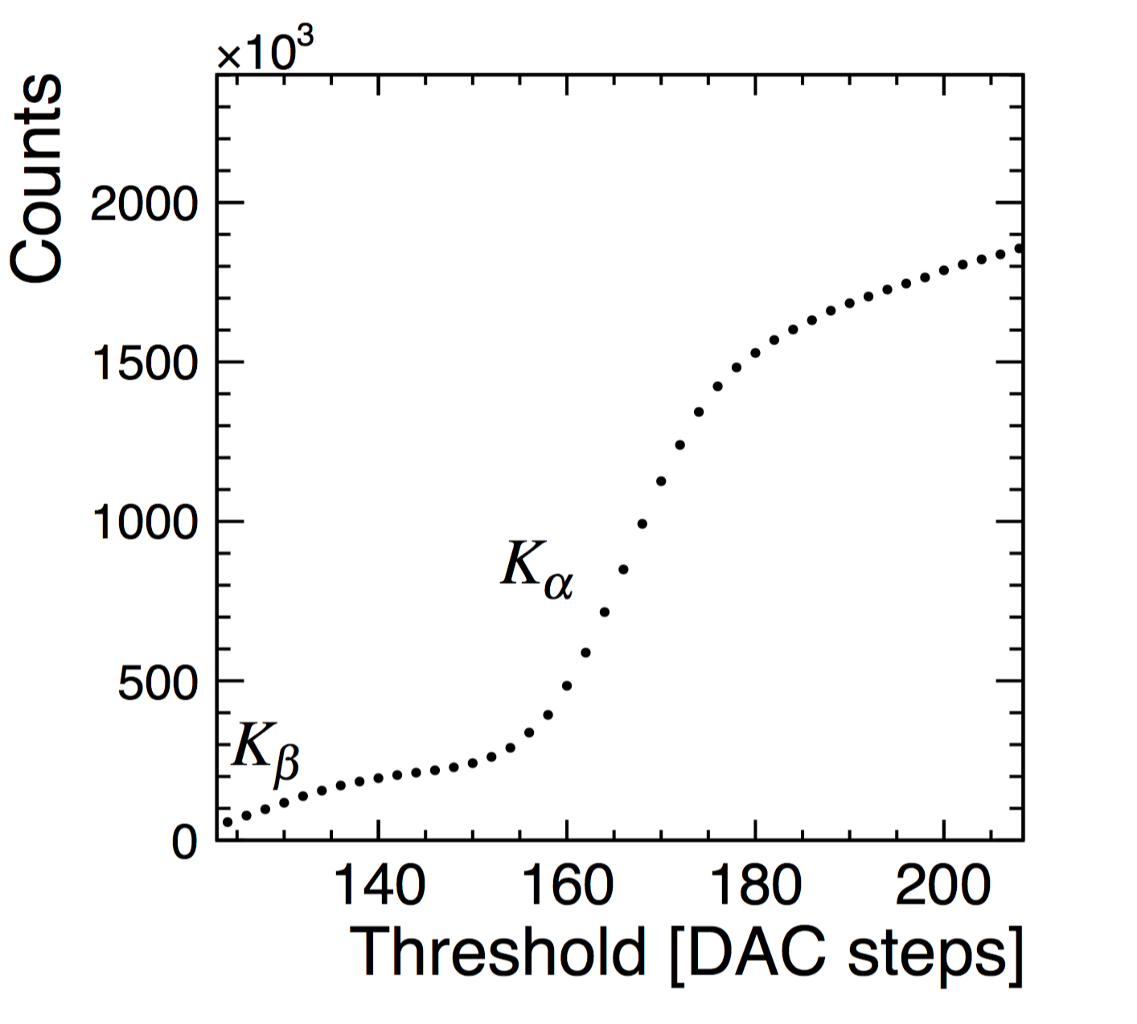
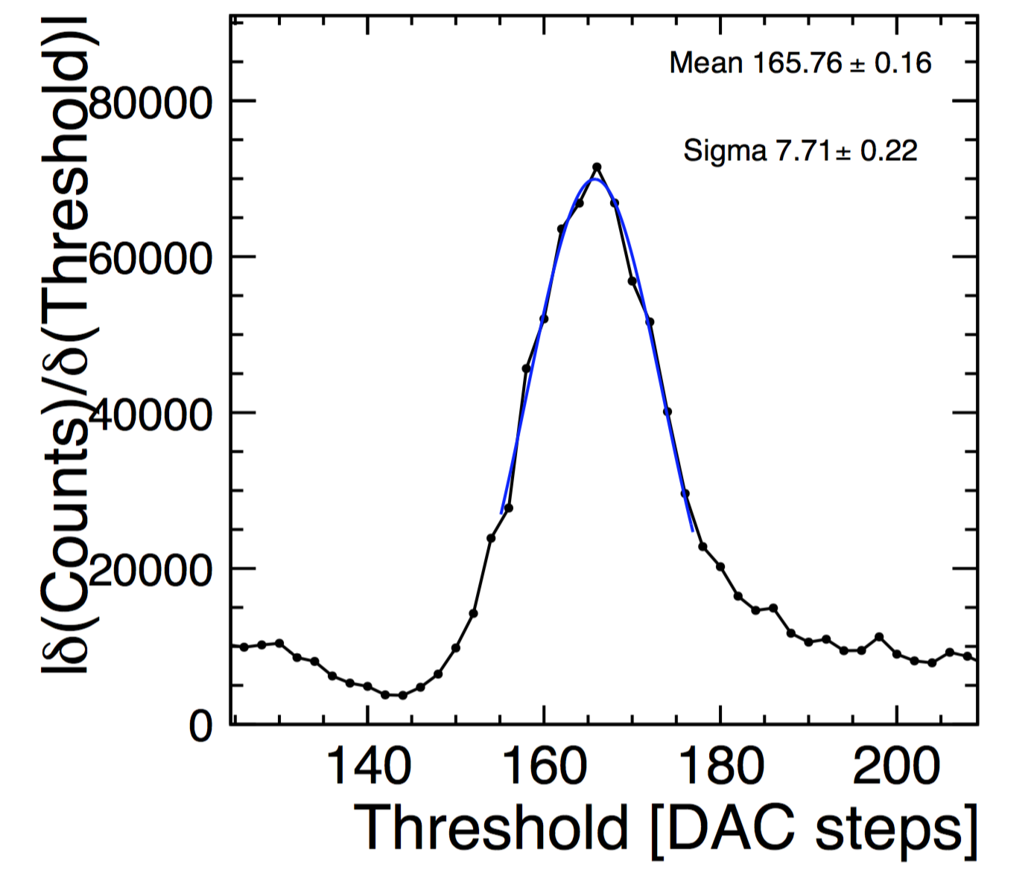
Timepix calibration
Energy calibration:
Calibration of Timepix ToT readout values
by using photons of known energy
Fit of peaks in spectrum
Determine dependency of measured
ToT on known energy
CLICdp
CLICdp
Threshold calibration:
Perform X-ray measurement in counting mode
Extract derivative of counts as function of threshold level
Determine peak threshold in spectrum of derivative
Magdalena Munker (CERN / University of Bonn), 3 July 2016
p. X

Slide 17

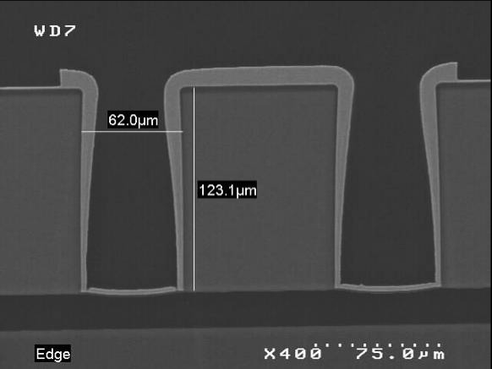
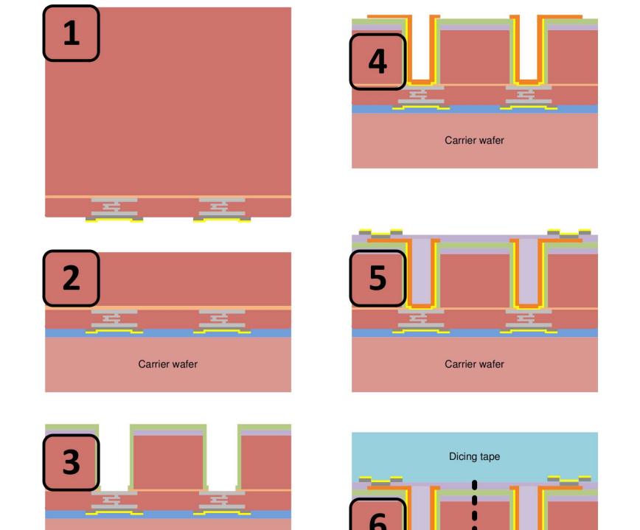
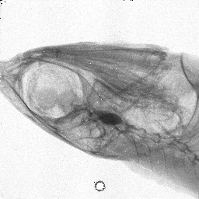
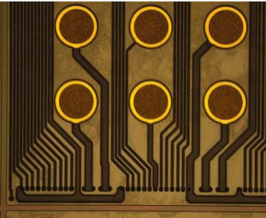
Through-Silicon Vias (TSV)
Through Silicon Via (TSV): vertical electrical connection
→ eliminates need for wirebonds
4-side buttable chips
increased reliability, reduced material budget
TSV project (ALICE, CLIC, ACEOLE, AIDA) with CEA-Leti
130 nm Medipix(RX) wafers, via-last process
1. phase: demonstrated feasibility
2. phase: demonstrated good yield
3. phase: TSV with MPX3/TPX3, 50 μm thickness (ongoing)
Cut through TSV
CEA-Leti via-last process flow
UBM deposition
Cu deposition +
patterning
60 μm TSV diameter
wafers thinned to 120 μm
5 μm copper layer for TSV
First Medipix3 image
with TSV assembly
(fish head):
Medipix3 redistribution layer
Temporary bonding,
thinning to 120 μm
backside passiv. +
UBM deposition
via etching + isolation
debonding + attachment
to dicing tape
http://iopscience.iop.org/1748-0221/6/11/C11018/pdf/1748-0221_6_11_C11018.pdf
Medipix Collaboration + CEA-Leti

Slide 18
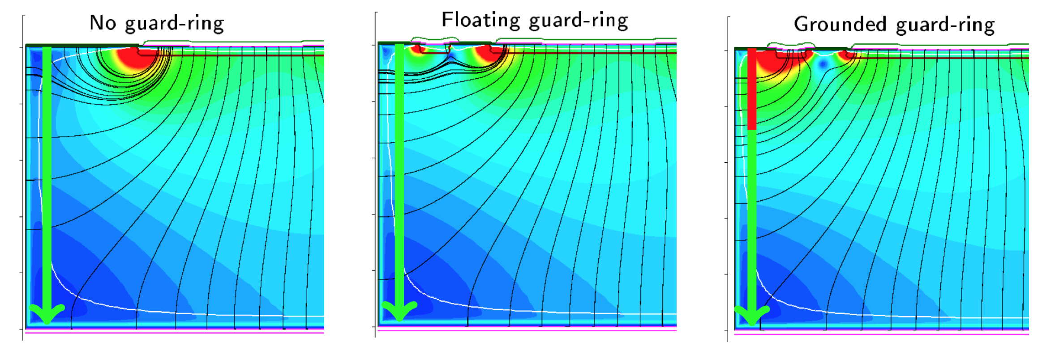
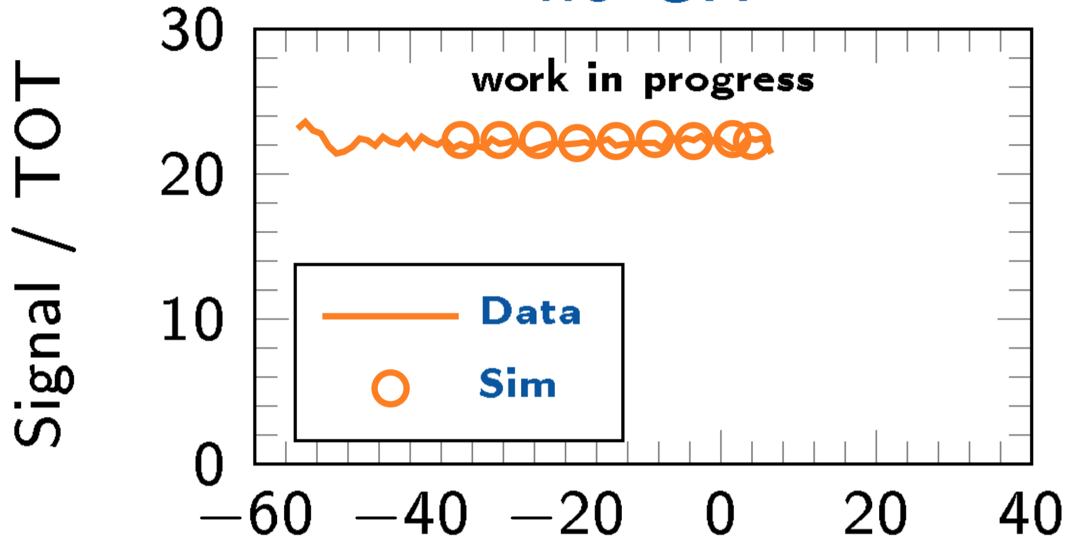
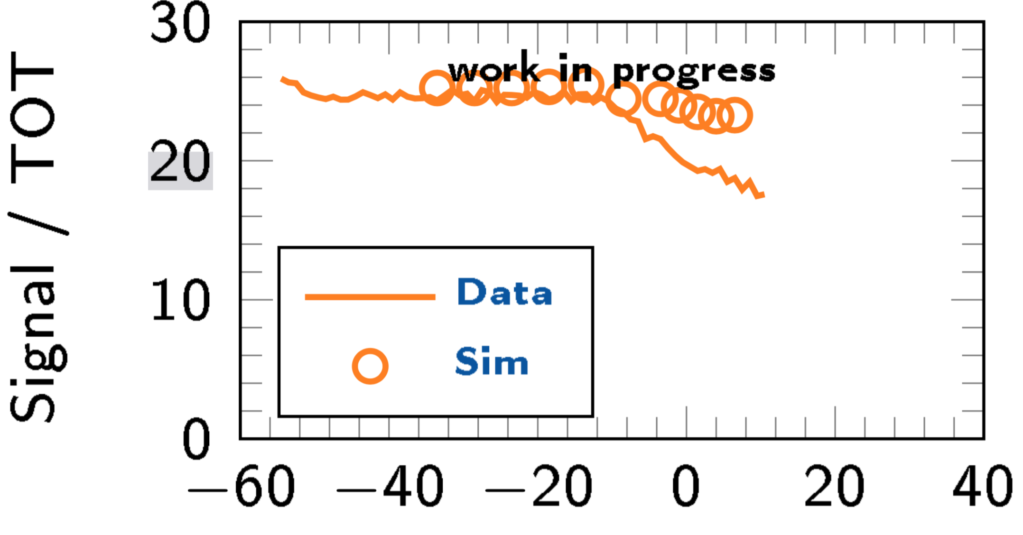
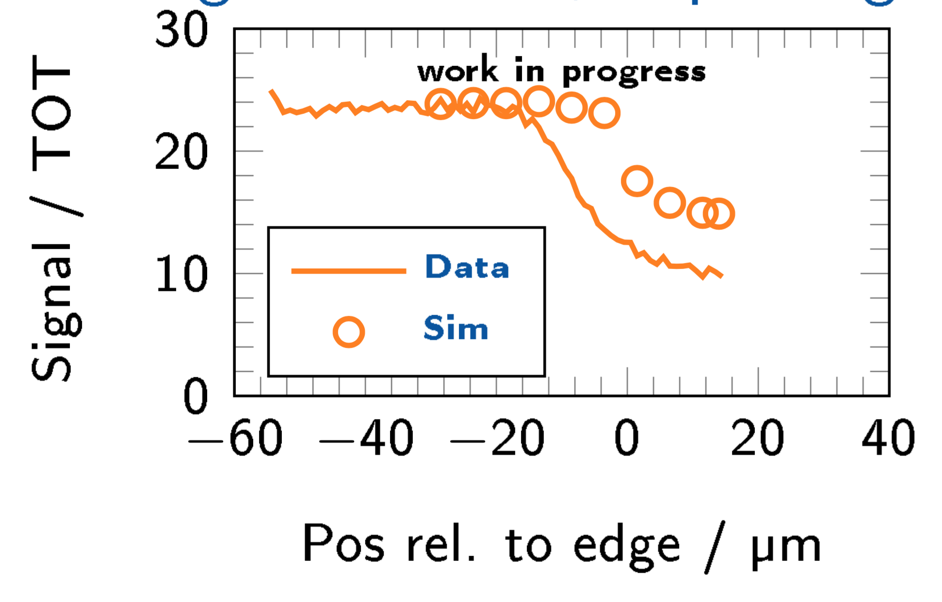
Active edge sensor simulation
Notes:
Change guard ring tcad plot or make 4 cases

Slide 19
CLIC beam structure
CLIC at 3 TeV:
L (cm⁻²s⁻¹) | 6×10³⁴
Train duration | 156 ns
Train repetition | 50 Hz
BX separation | 0.5 ns
#BX / train | 312
Duty cycle | 0.00078%
σ_{x} / σ_{y} [nm] | ≈ 45 / 1
σ_{z} [μm] | 44
Short train duration and low repetition rate
  Trigger less readout
  Power pulsing of front end electronics to reduce
  average power consumption
One train consists of 312 bunches with 0.5 ns spacing
Drives timing requirements for CLIC
Very small beam size at the interaction point
Beam induced backgrounds:
      e⁺e⁻ pairs: low pT, limits inner radius of vertex
      γγ hadrons: large pT
20 ms
CLIC beam
Not to scale !
156 ns
Magdalena Munker (CERN / University of Bonn), 01 July 2016
p. 2

Slide 20

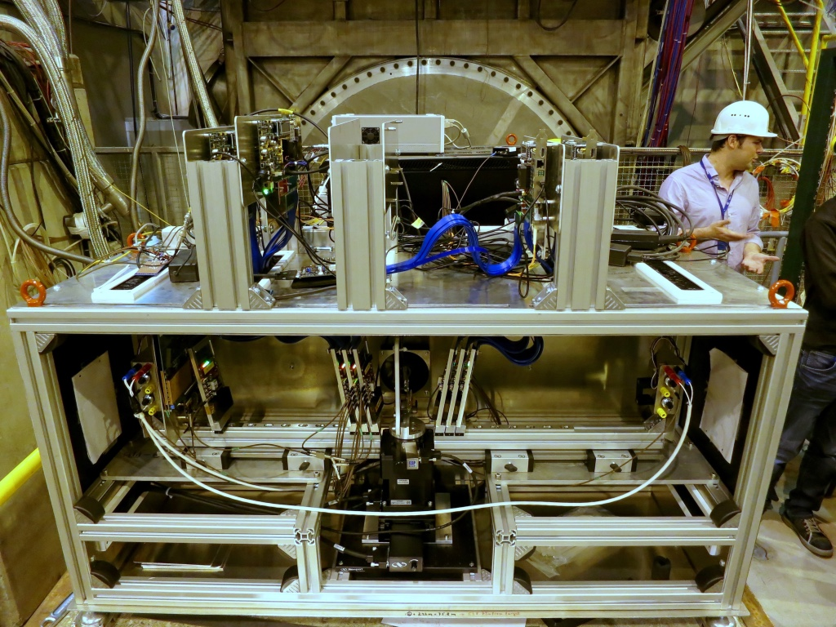
Test-beam data taking
EUDET/AIDA telescopes:
Used for initial test-beam studies
at DESY II, CERN PS and CERN SPS
Rolling-shutter r/o over ~230 μs
→ limited rate and timing capabilities
Pointing resolution at DUT ~1.6-3 μm
CERN-LCD Timepix3 telescope:
Permanent installation at CERN SPS H6B
Movement and rotation stages for automatic scans
High rate: up to 10M particles / s
Track timing with <2 ns accuracy
Track pointing resolution at DUT ~2 μm
CERN-LCD Timepix3 telescope in SPS H6B
beam
beam
June 9, 2016
CLIC vertex and tracker R&D

Slide 21
CLICpix: pixel architecture
Top pixel
Feedback network
Clock
4-bit TOT counter
TOT ASM
Clk divider
Input
CSA
TOA ASM
Threshold
4-bit TOA counter
Polarity
Configuration data:
Th.Adj, TpulseEnable, CountingMode, Mask
V_{test_pulse}
4-bit Th.Adj DAC
HF
Bottom pixel
The analog front-end shapes photocurrent pulses and compares them to a fixed (configurable) threshold
Selectable polarity (positive / negative signals)
Digital circuits simultaneously measure Time-over-Threshold and
Time-of-Arrival of events and allow for zero-compressed readout
June 9, 2016
CLIC vertex and tracker R&D

Slide 22
CLIC tracker requirements
Momentum resolution (Higgs recoil mass, H→μμ, BSM leptons):
σ(p_{T}) / p_{T}² ~ 2 x 10⁻⁵ GeV⁻¹
→ 7 μm single-point resolution
→ ~1-2% X0 per layer (low-mass supports, cabling and cooling)
few % maximum occupancy from beam-induced backgrounds
→ Time stamping with ~10 ns accuracy, to reject background
→ Readout granularity ~ 50 μm x 1-10 mm (t.b.c.: large pixels / small strips?)
Beam-induced background hits from γγ→hadrons and incoherent pairs:
Barrel
Endcaps
CLICdp
work in
progress
CLICdp
work in progress

Slide 23
CLICpix: pixel architecture
Top pixel
Feedback network
Clock
4-bit TOT counter
TOT ASM
Clk divider
Input
CSA
TOA ASM
Threshold
4-bit TOA counter
Polarity
Configuration data:
Th.Adj, TpulseEnable, CountingMode, Mask
V_{test_pulse}
4-bit Th.Adj DAC
HF
Bottom pixel
The analog front-end shapes photocurrent pulses and compares them to a fixed (configurable) threshold
Selectable polarity (positive / negative signals)
Digital circuits simultaneously measure Time-over-Threshold and
Time-of-Arrival of events and allow for zero-compressed readout
June 9, 2016
CLIC vertex and tracker R&D

Slide 24
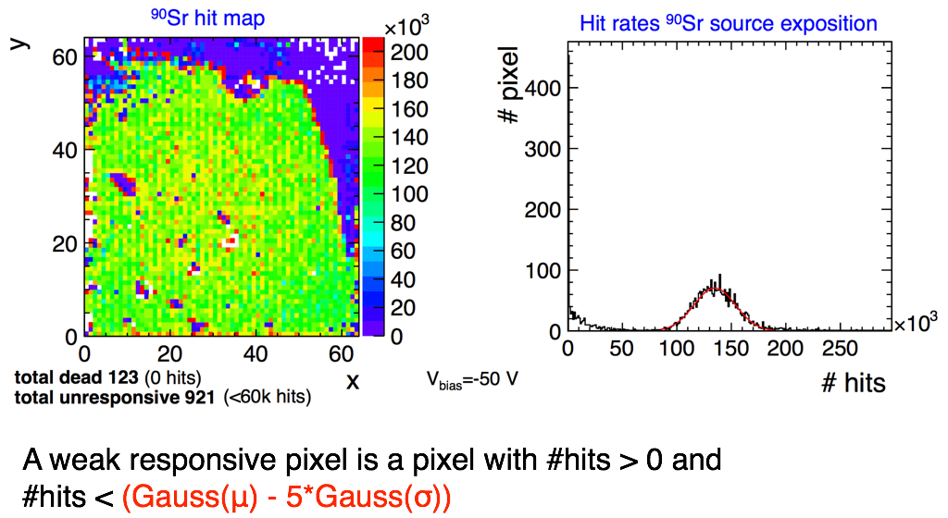
CLICpix / weak responsive pixels

Slide 25
New CLICpix version
New CLICpix2 chip soon to be submitted:
Increased matrix size to 128 ⨉ 128 pixels,
matching C3PD
Longer counters for charge (5-bit) and timing (8-bit) measurements
Improved noise isolation and removal of cross-talk issue observed in first CLICpix
More sophisticated I/O with parallel column readout and 8/10 bit encoding
Integrated test pulse DACs and bandgap
Ongoing ASIC validation using System Verilog
Universal Verification Method (UVM)
New CaRIBOu readout system with
System-on-Chip (SoC) FPGA architecture under development with Uni GE and BNL ATLAS groups
→ run slow control, calibration on CPU inside FPGA
CLICpix2
CaRIBOu
June 9, 2016
CLIC vertex and tracker R&D

Slide 26
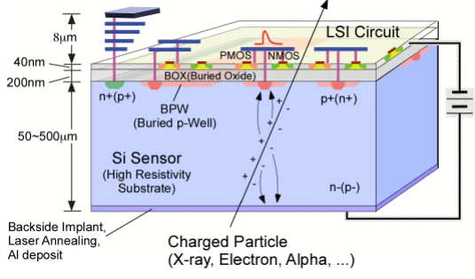
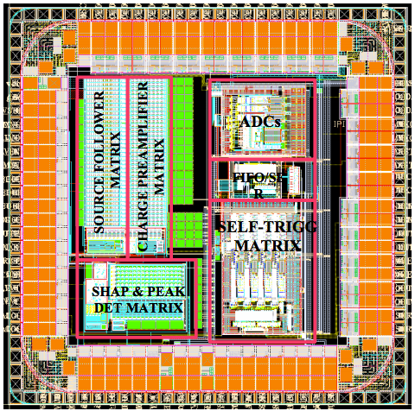
Tracker readout technology: Lapis SOI
Silicon On Insulator (SOI) technology
CMOS sensor on SOI wafers
Electronics on low resistivity wafer
separated by buried oxide from fully depleted
high-resistivity sensing layer
Allows for standard CMOS electronics
with complex functionality
Fast time stamping possible
Recent progress on radiation hardness
(double SOI, controlled discharge of surface charges)
Example: Latis 200 nm SOI process
(KEK, Osaka, AGH Cracow, others)
Complex process work flow,
limited availability and long turn-around times
Recent Linear Collider test-chip submission from AGH Cracow:
  Small matrices with pixel sizes ≥ 30 x 30 μm²
  Targeted towards CLIC requirements
  (position, amplitude and few ns timing)
  Chips tested successfully in the lab
  Integration in CLIC test-beam setup ongoing
arXiv:1507.00864
AGH SOI test chip
June 9, 2016
CLIC vertex and tracker R&D

Slide 27
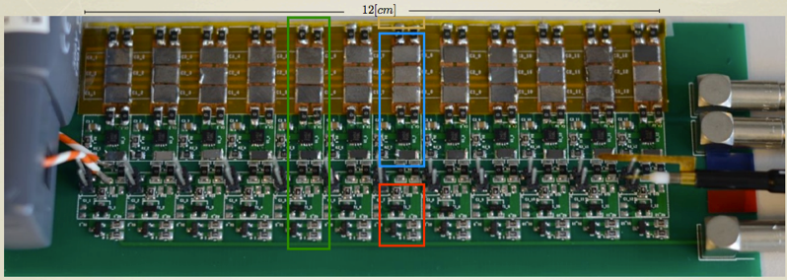
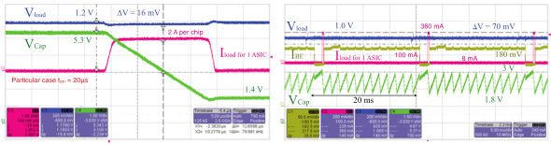
CLICpix power-pulsing + delivery results
Measurements on prototypes for digital and analog powering of ladders:
  I_{ladder}<300 mA; P<45 mW/cm²
  Voltage stability:
  ΔV~16 mV (analog), ~70 mV (digital)
  ~0.1% X₀ material contribution,
  dominated by Si capacitors
  Can be reduced to ~0.04% X₀
  with evolving Si capacitor technology:
  25 μF/cm² → 100 μF/cm²
Flex-Kapton + dummy-load setup:
Si capacitors
LDOs
loads
analog power
digital power
P_{avg} < 10 mW/cm²
June 9, 2016
CLIC vertex and tracker R&D

Slide 28


CLICpix power-pulsing + delivery requirements
Vertex-detector power consumption
Small duty cycle of CLIC machine
allows for power reduction of readout
electronics: turn off front end in gaps
between bunch trains
Challenging requirements:
Power budget <50 mW/cm² average
(air-flow cooling limit)
High peak current > 40A/ladder
Different timing analog/digital electronics
High magnetic field 4-5 T
Material budget < 0.1% X₀ for services+supports
Regulation < 5% (60 mV) for analog part
Bunch trains
CLICpix powering states
C. Fuentes, X. Llopart, P. Valerio
June 9, 2016
CLIC vertex and tracker R&D

Slide 29



CLICpix+HV-CMOS calibration
Dedicated test pixels: direct access
to CCPDv3 output signal
Used to calibrate CLICpix ToT response
Simulation of CLICpix ToT response
for different values of coupling capacitance
→ estimate coupling capacitance by
comparison of measured and simulated
response: ~10 fF
Measured CCPDv3+CLICpix response
Simulated CCPDv3+CLICpix response
¼ pixel offset
½ pixel offset
CLICdp
work in progress
CLICdp
work in progress
June 9, 2016
CLIC vertex and tracker R&D

Slide 30
New HV-CMOS active sensor
New HV-CMOS chip C3PD produced in same process:
Increased matrix size to 128 ⨉ 128 pixels
Major redesign of the full chip:
On-pixel amplification scheme significantly changed
→ reduced peaking time to some ~10 ns
Guard ring around coupling pads
→ reduced cross capacitance
Power pulsing circuitry introduced
Testpulsing of the matrix
10 Ω cm substrate
possible future submissions with
substrate resistivities of 100, 200, 1k Ω cm
First chips arrived last week
C3PD
3.3 mm
4 mm
simulation
CLICdp
work in progress
June 9, 2016
CLIC vertex and tracker R&D

Slide 31




CLICpix+HV-CMOS glue assemblies
Study of glue parameters:
  Viscosity
  Bonding force
  Alignment
  Glue-layer uniformity
Cross sections of glue assemblies
alignment precision ~1 μm
glue-layer thickness ~0.5 μm
(+2 μm polyimide passivation)
Laboratory and test-beam measurements
correlate performance with glue parameters (coupling strength, uniformity)
SEM picture CCPDv3-CLICpix assembly
viscosity: 450 Pas, F=5 N, T=100 ºC, t=10 min
pad alignment
centered alignment
½ pixel offset
CLICpix via
CLICpix pad
CCPD pad
June 9, 2016
CLIC vertex and tracker R&D

