Slide 1
Bulgarian Engineering Teachers Programme
Detector sites and systems for remote personal supervision
Dimitar mladenov

Slide 2

CERN
ATLAS

Slide 3
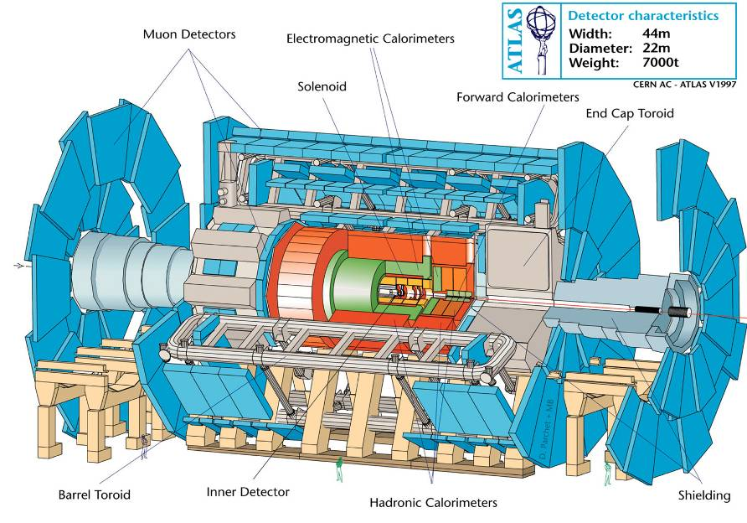

Slide 4
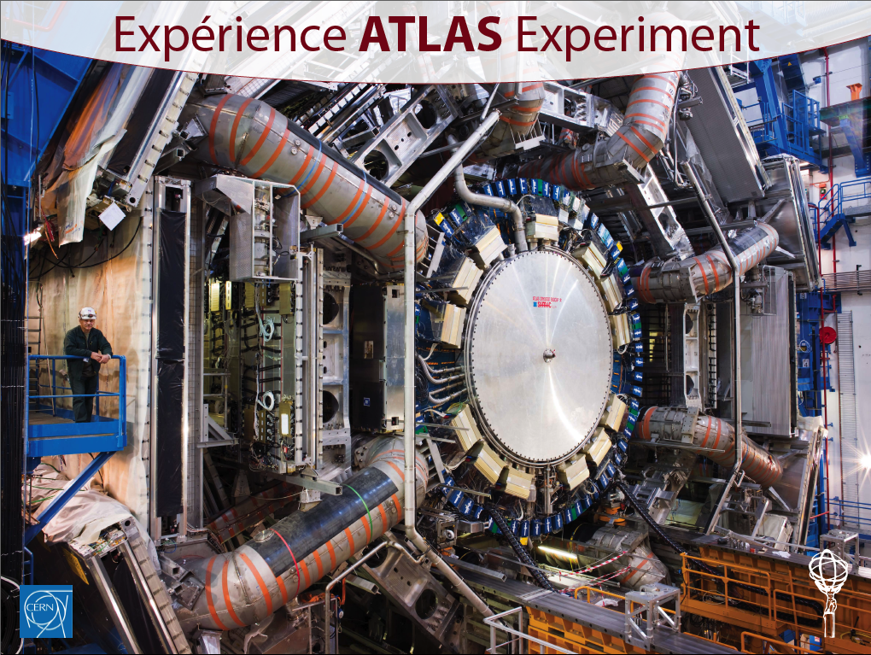
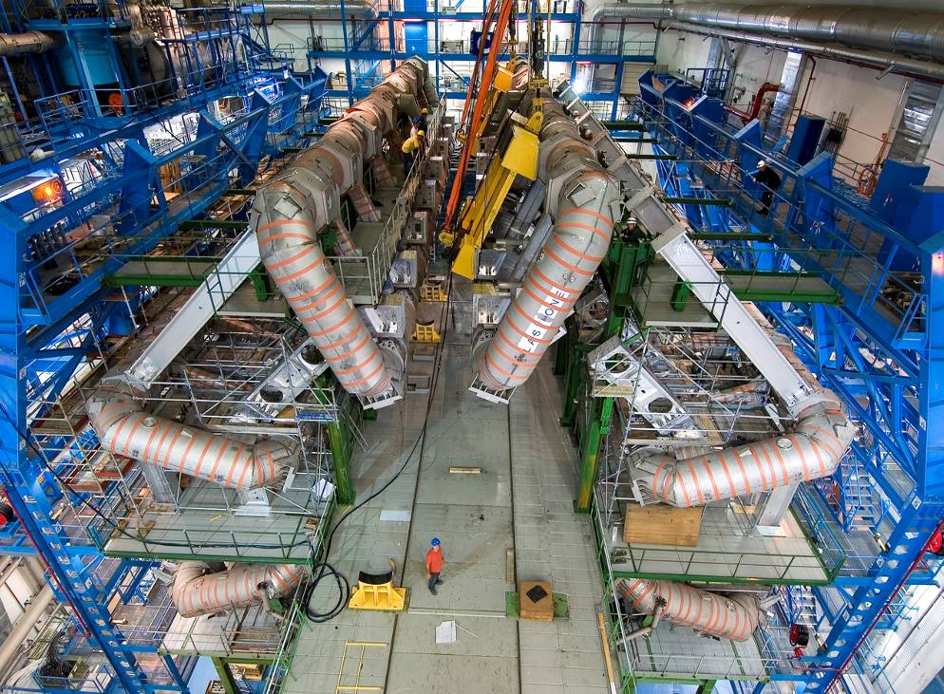
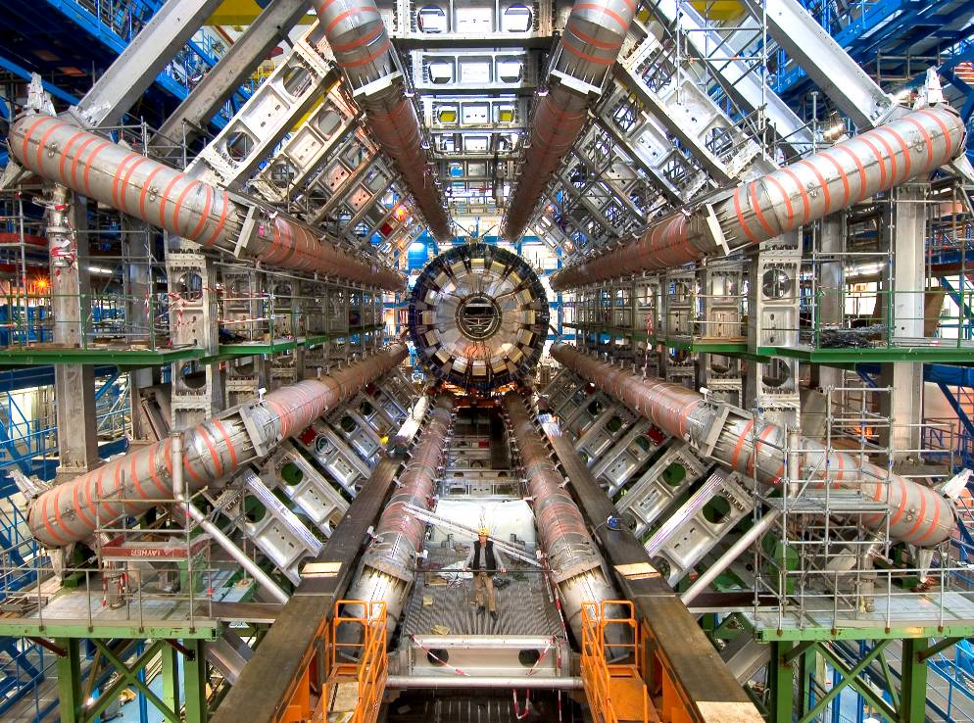
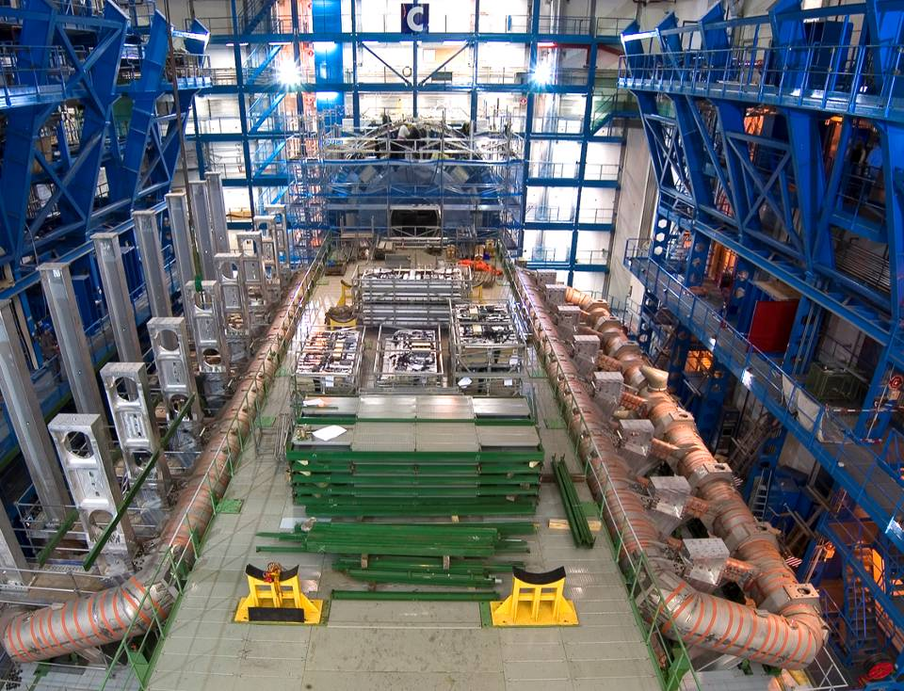
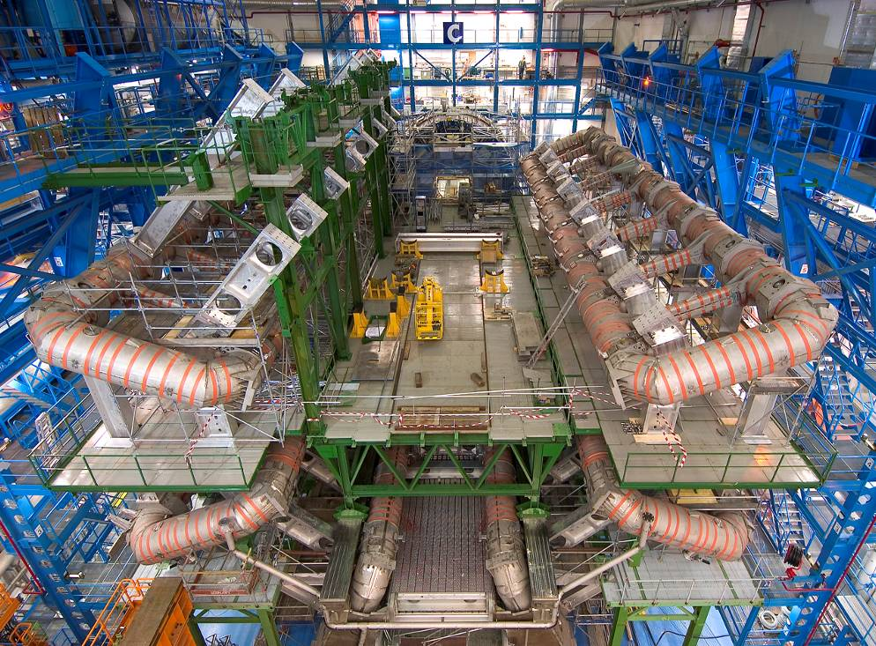
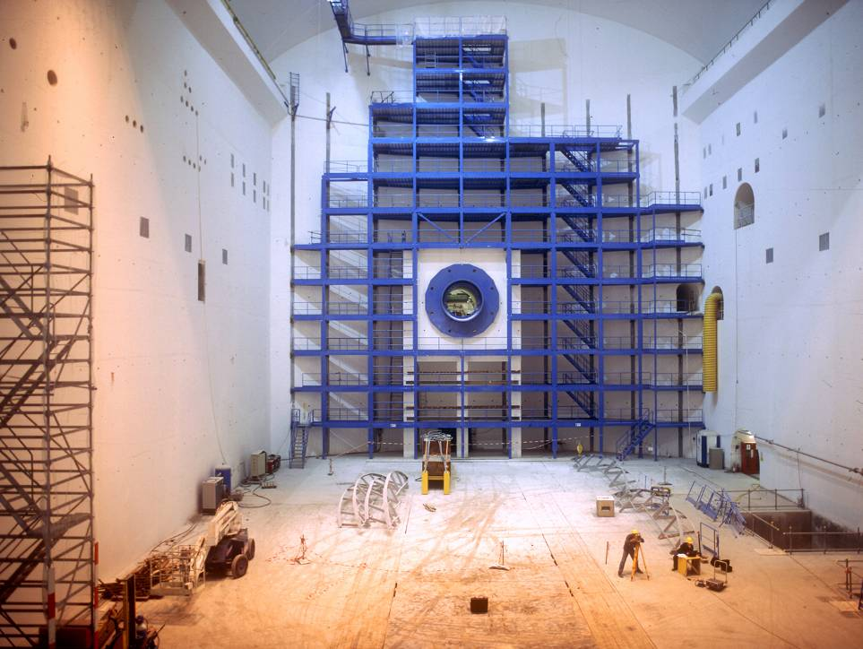
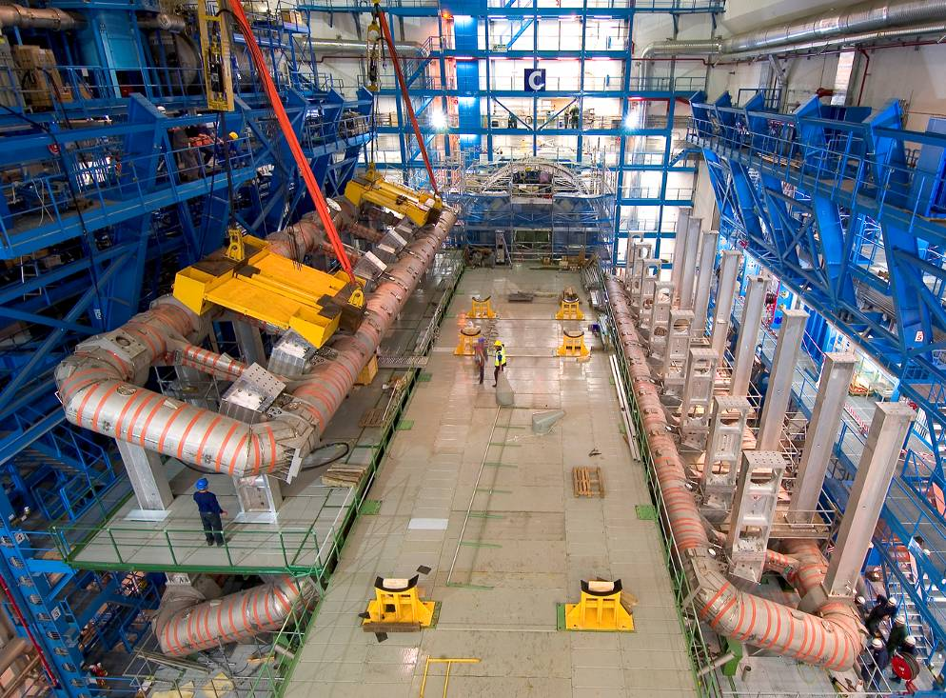
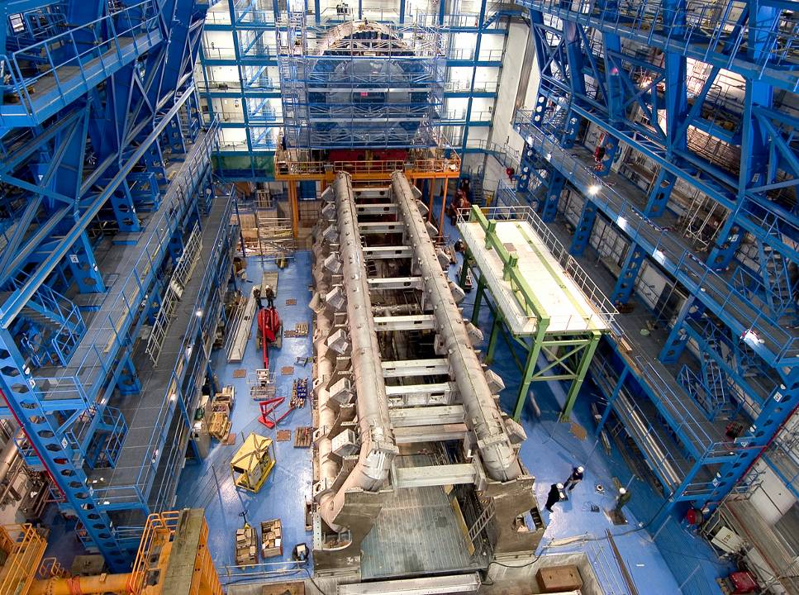
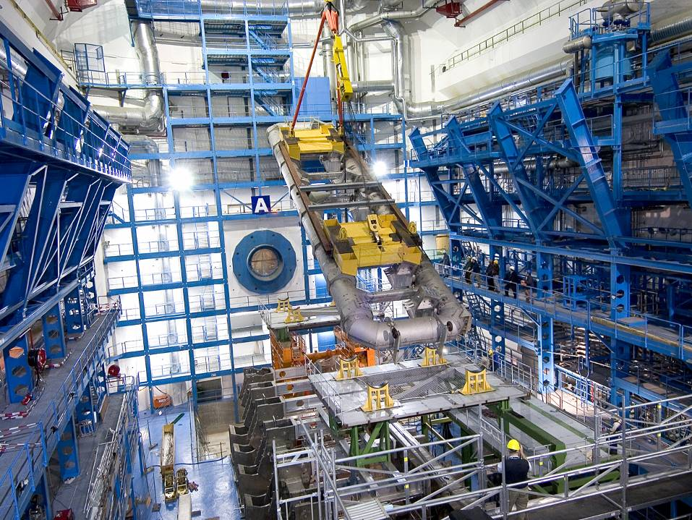
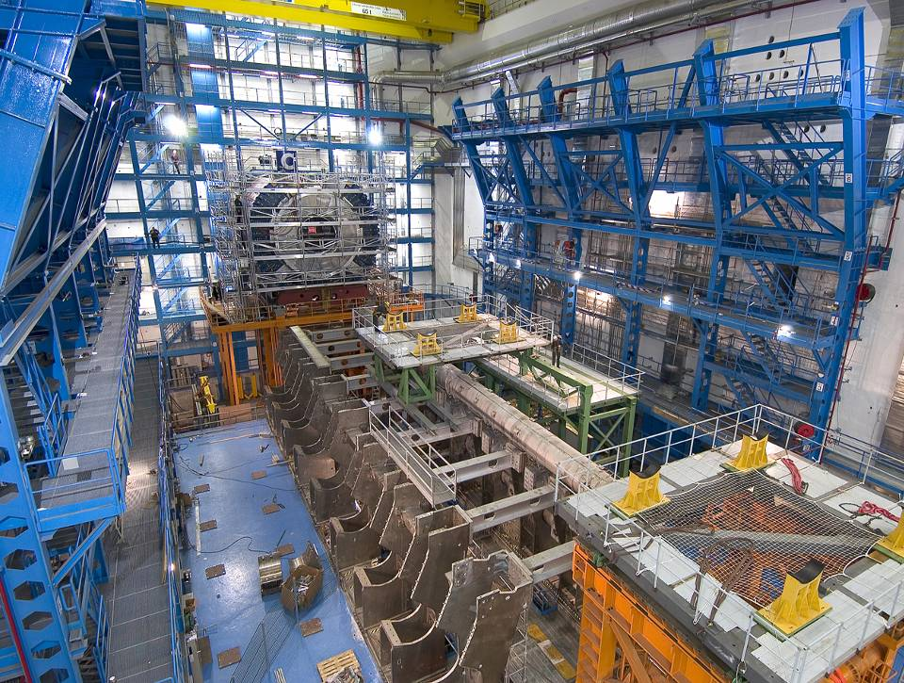
ATLAS Каверна

Slide 5
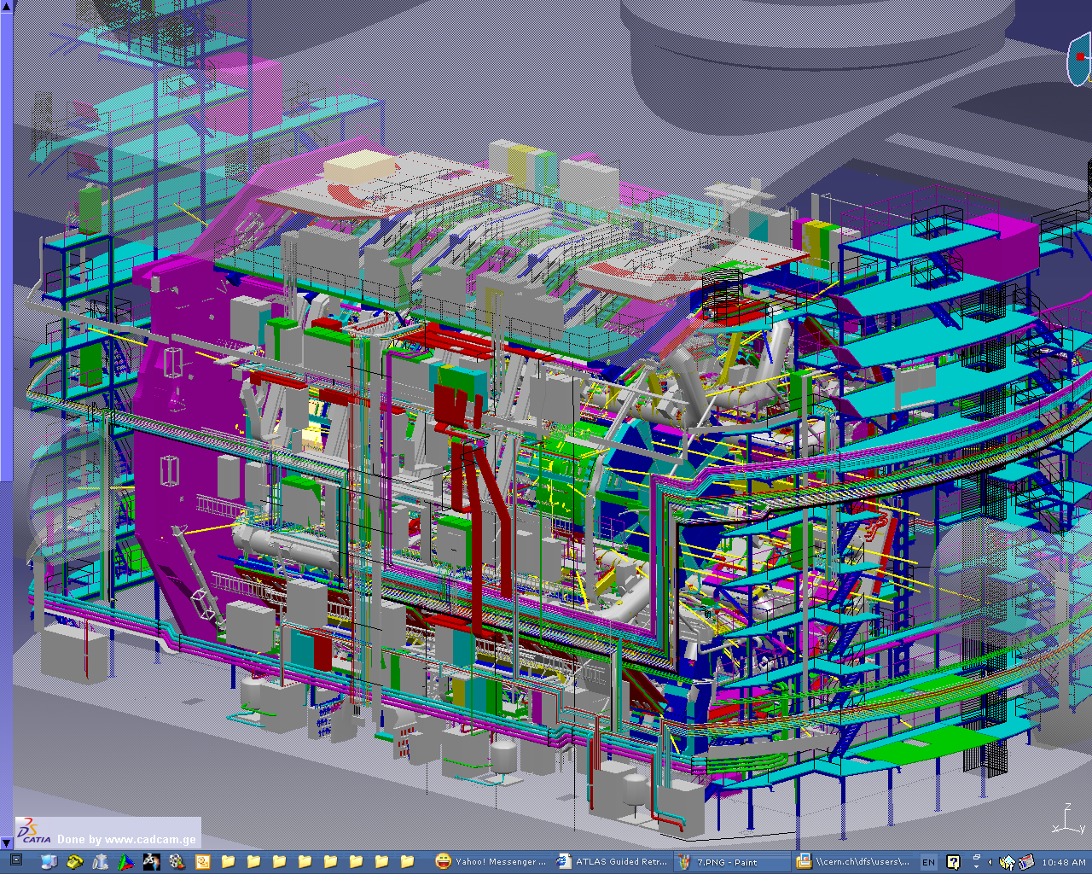

Slide 6
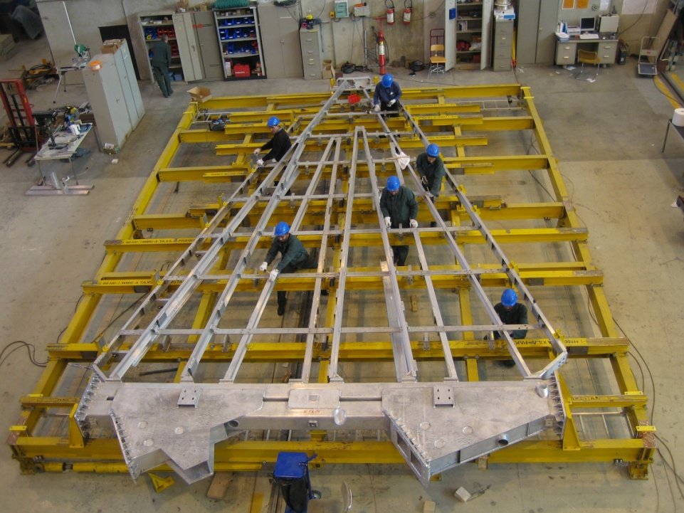
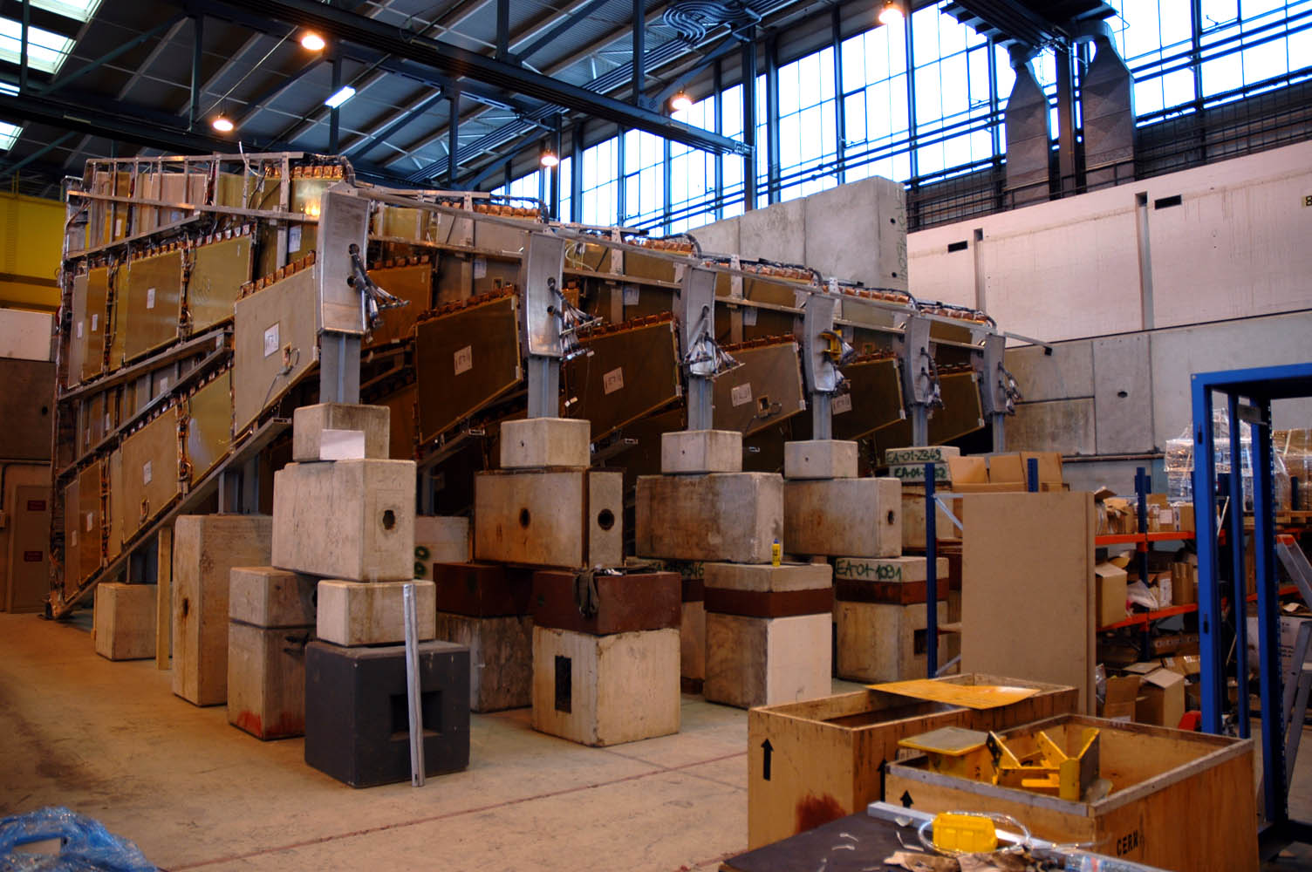
Assembly of the Big Wheels sectors
Assembly work of the 104 sectors
Team of around 50 engineers and technicians from different nationalities
(Israel, Pakistan, France, Russia, USA, China, Japan, etc.)
Safety.
  work analysis
  safety control
  scaffoldings/nacelles/personal.
Huge personal rotation:
  welcome/sent off
  integration
  professional and safety training
  link person between:
    teams in the assembly hall
    the assembly hall and the design office

Slide 7
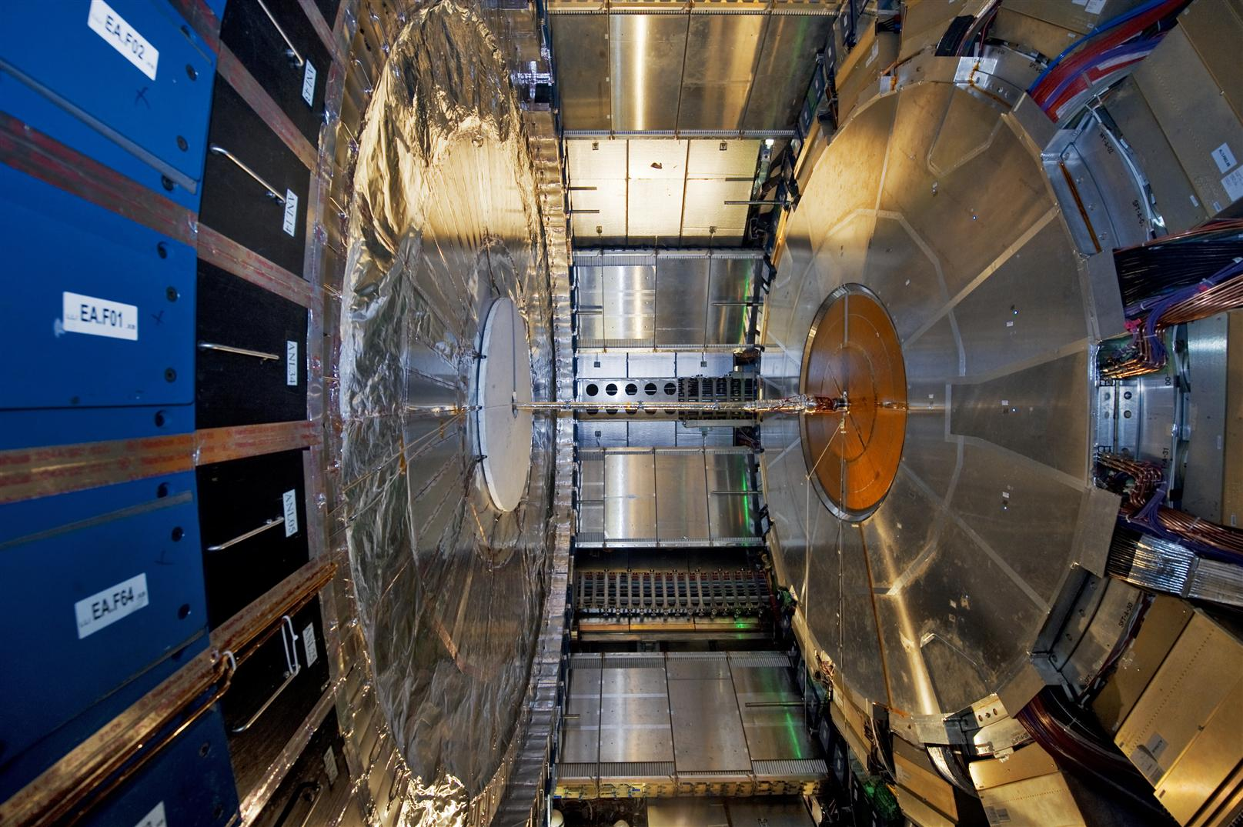
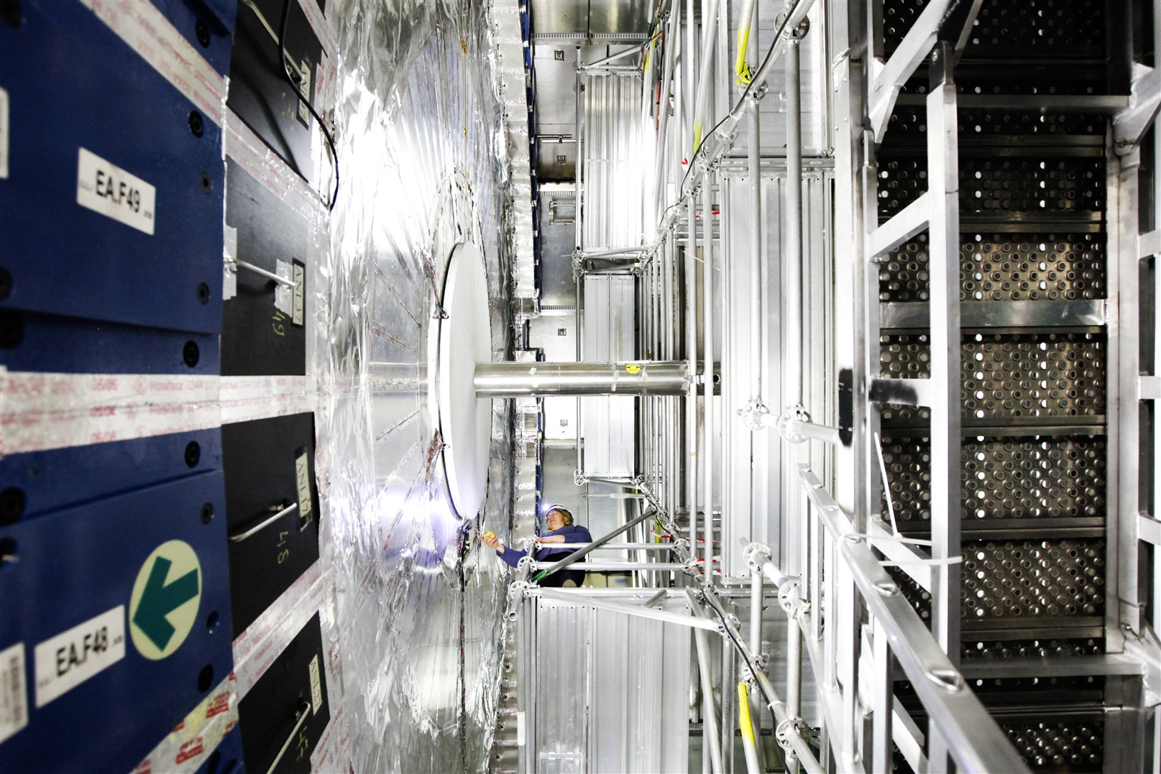
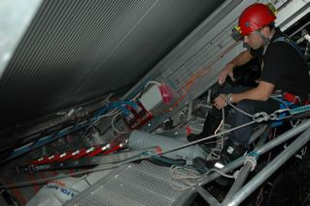
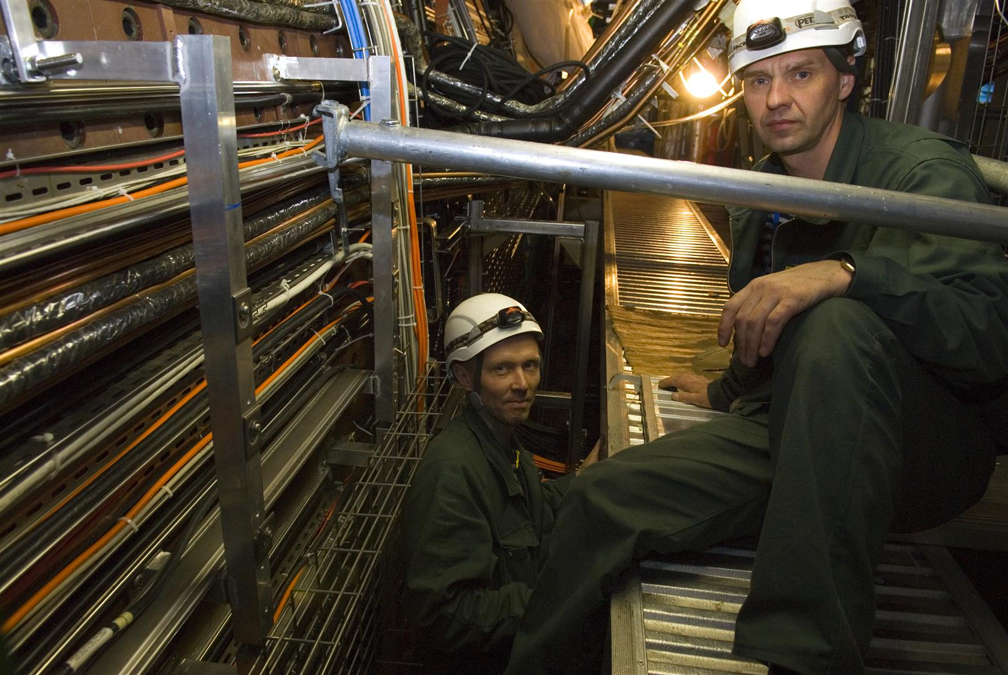
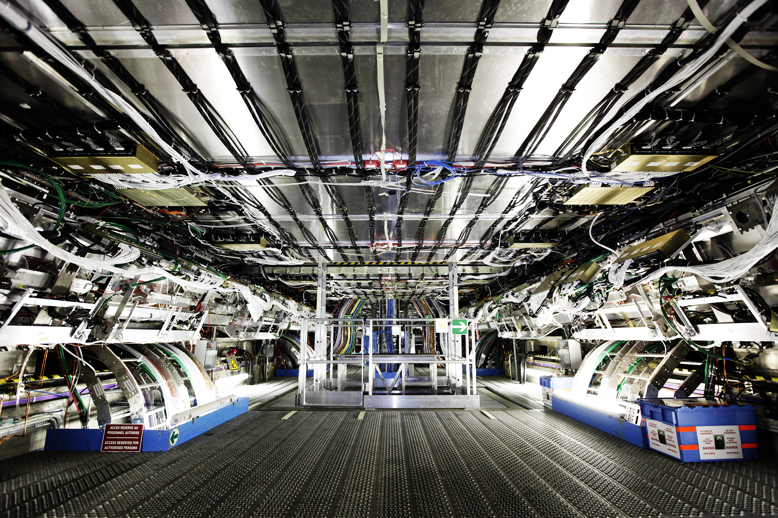
Safety!
Hundred meters of platforms, ladders, holes, etc.
Scaffoldings
Confined spaces

Slide 8
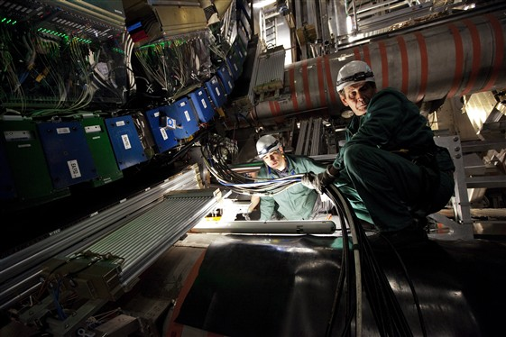
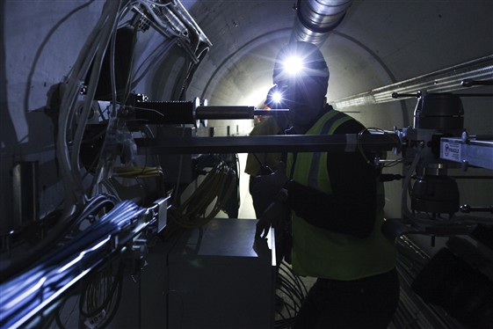
Lightening changing and not always optimum ...

Slide 9
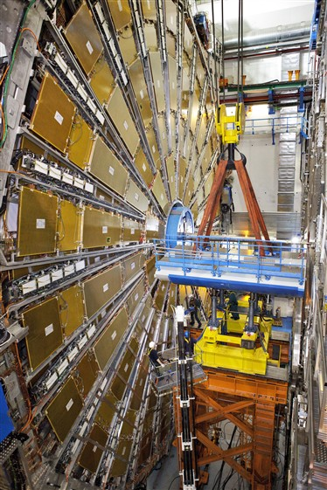
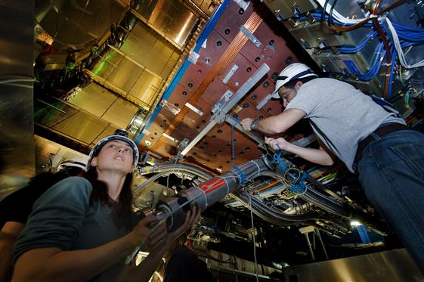
The activities are very different
from very detailed detector expertise work … to heavy loads transport

Slide 10
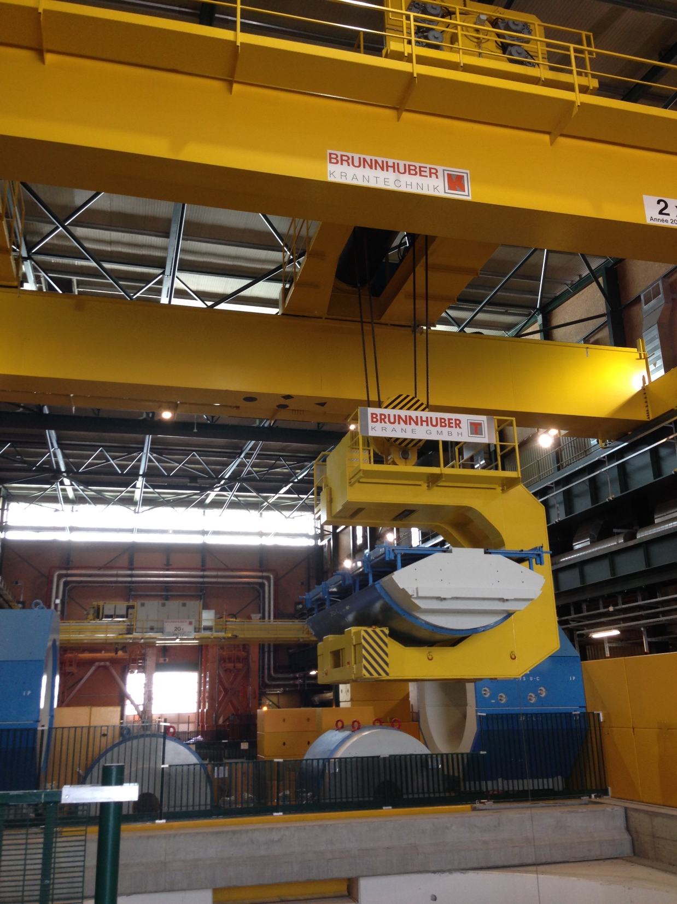

Slide 11
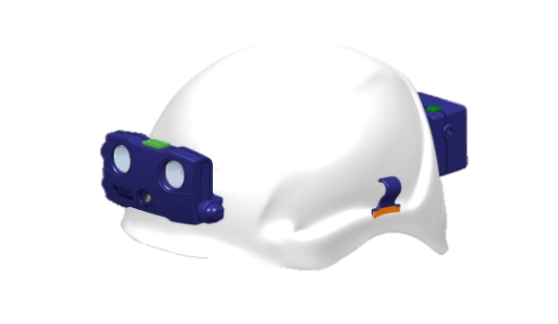


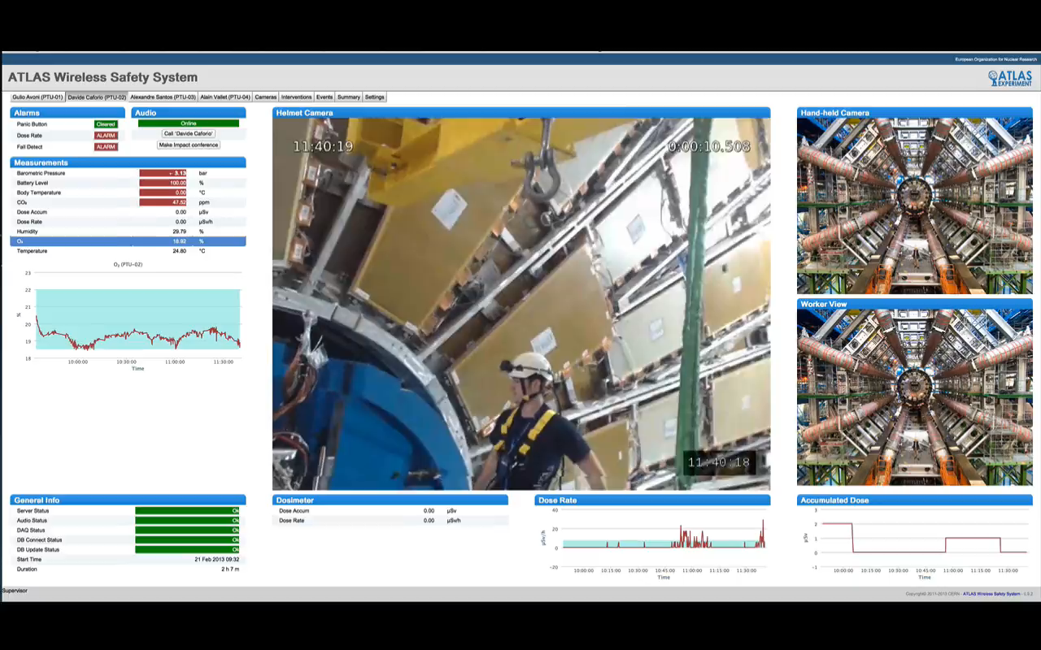
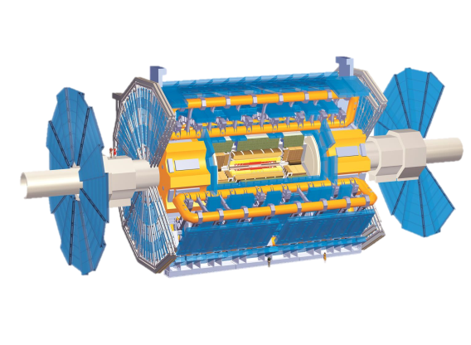


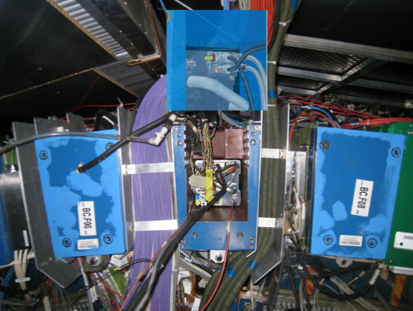
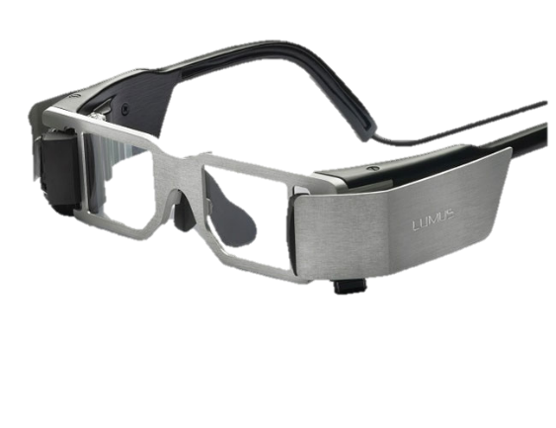

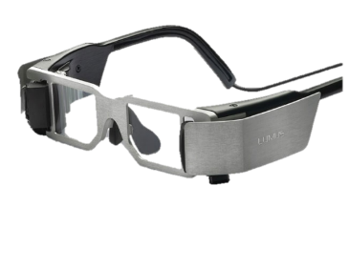
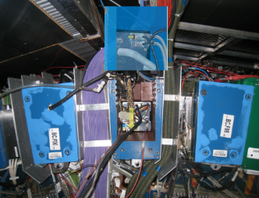
Overview of Personnel Safety System
Local worker
Remote Sup.
Current
AR devices
Powered with WRM chip
Future
Step 1.

Slide 12
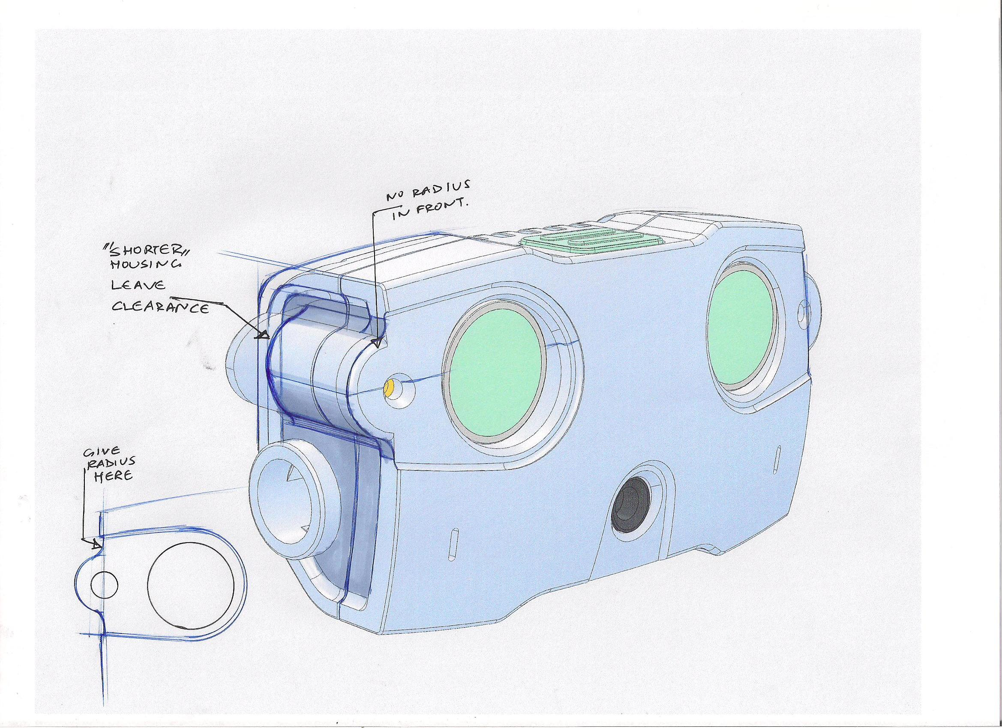
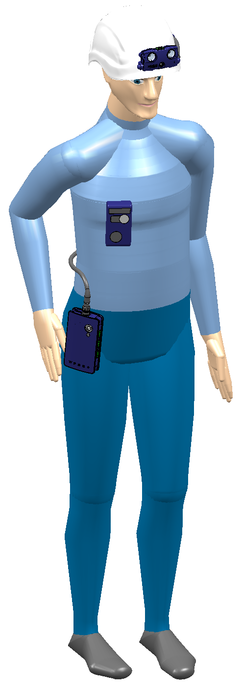
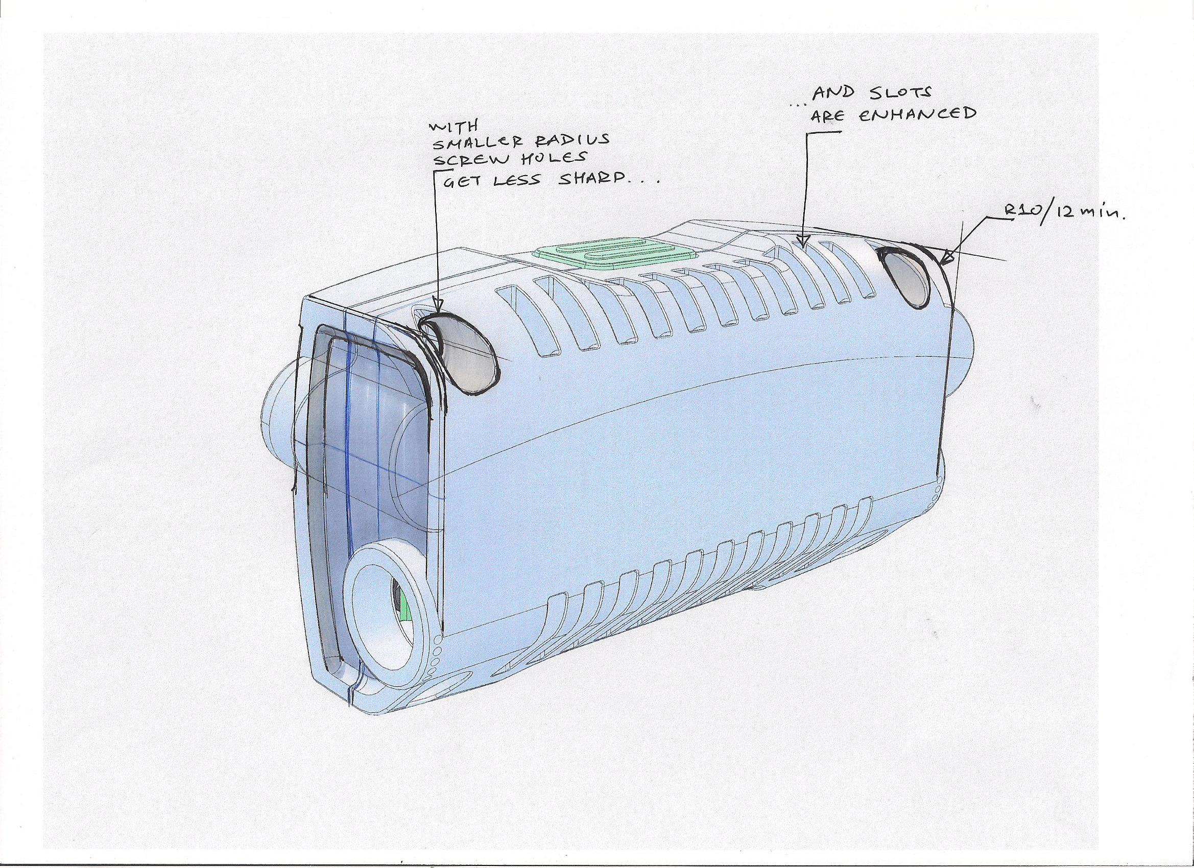
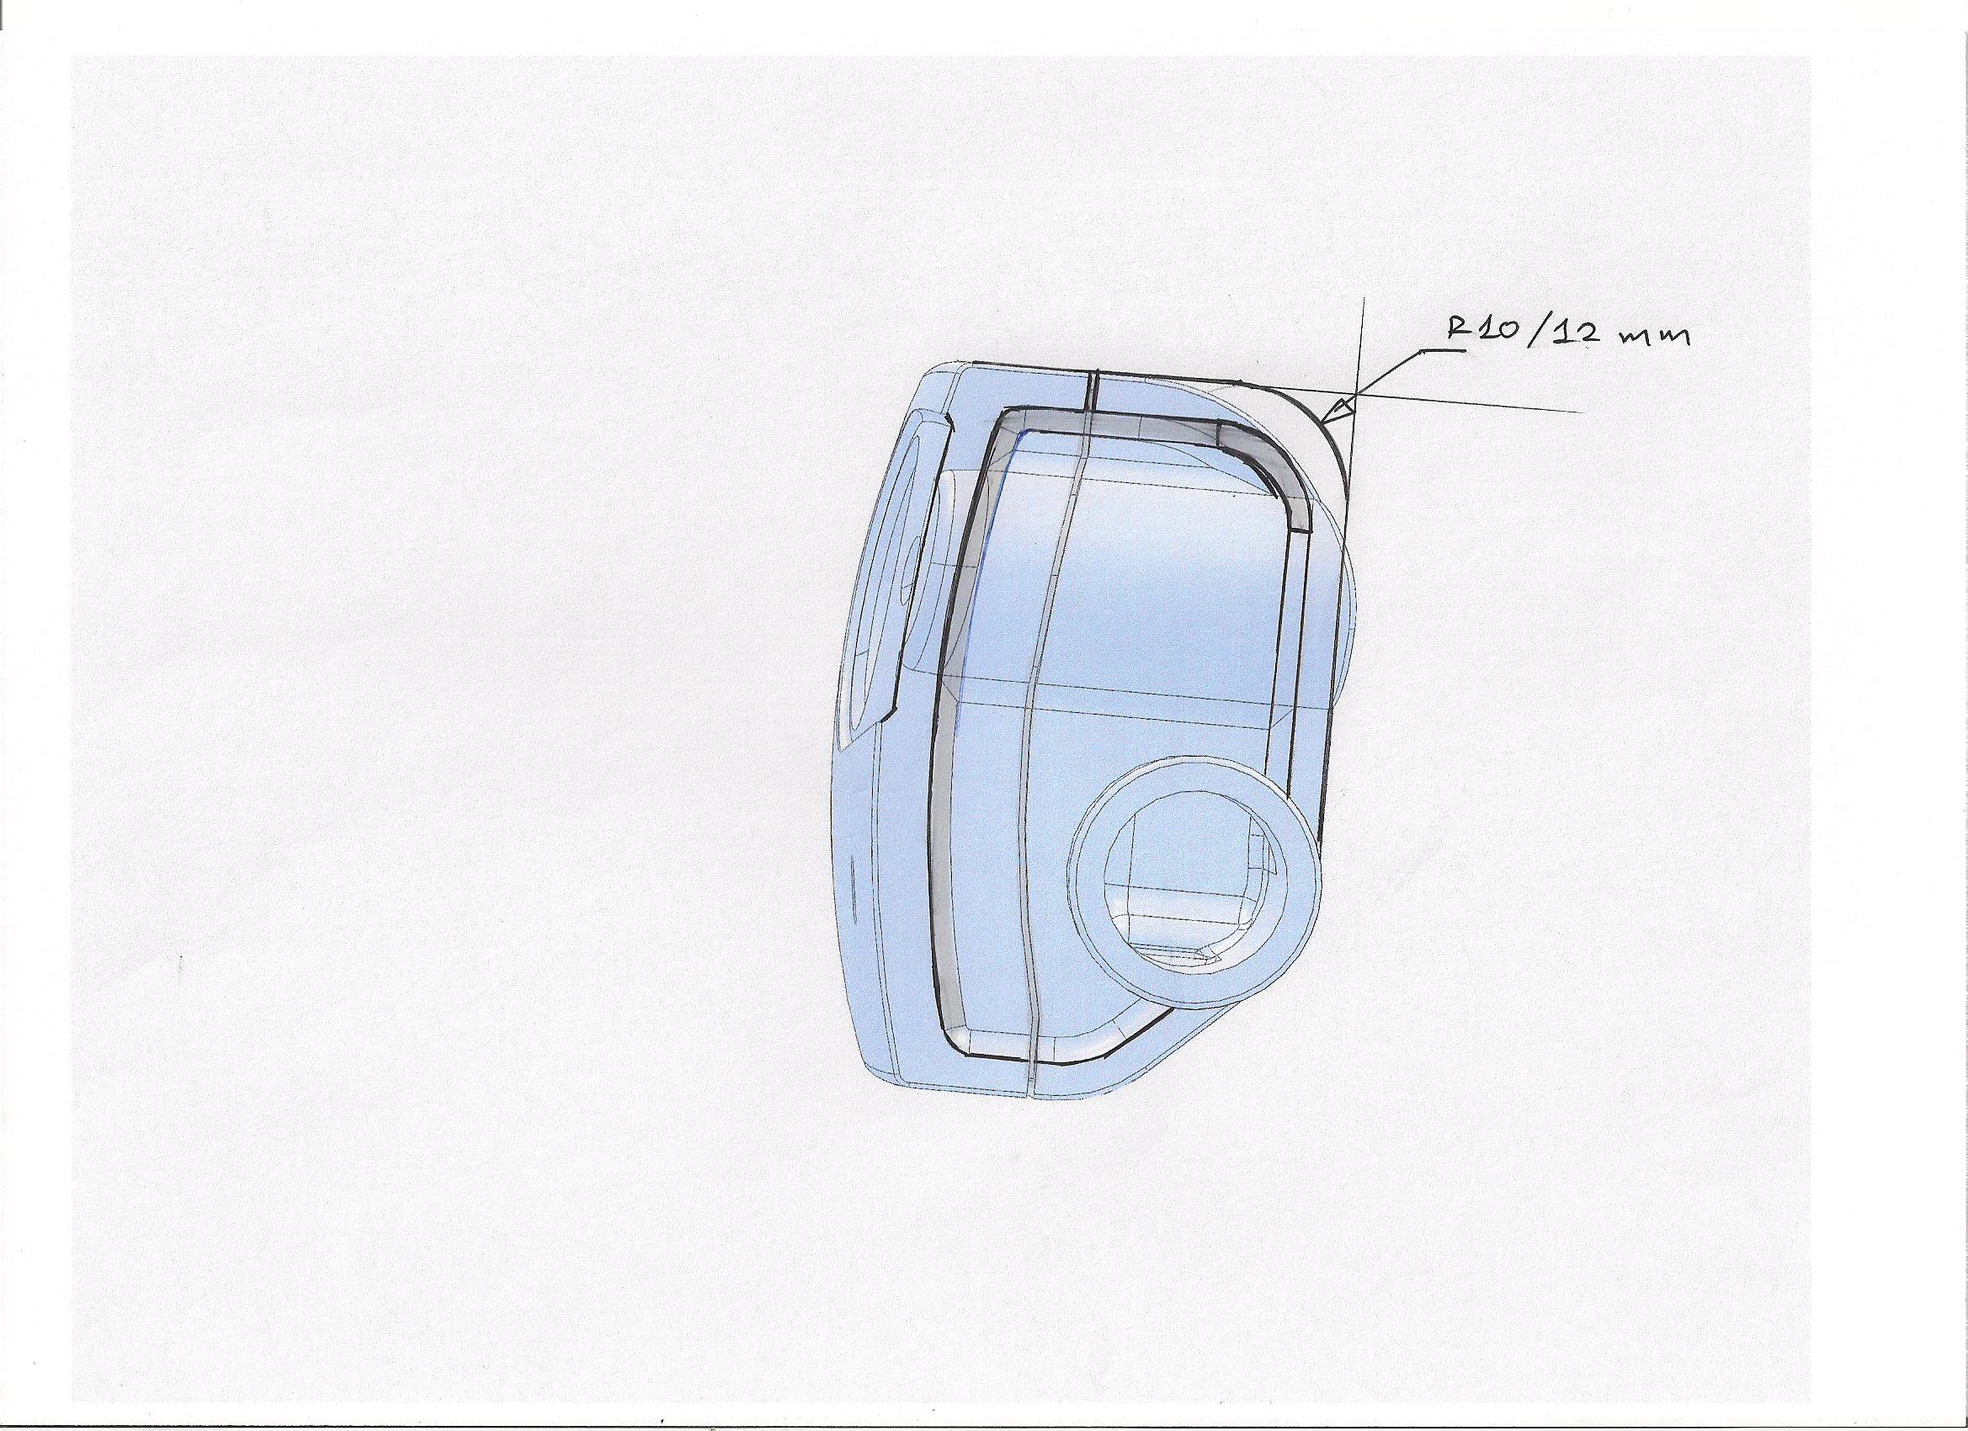
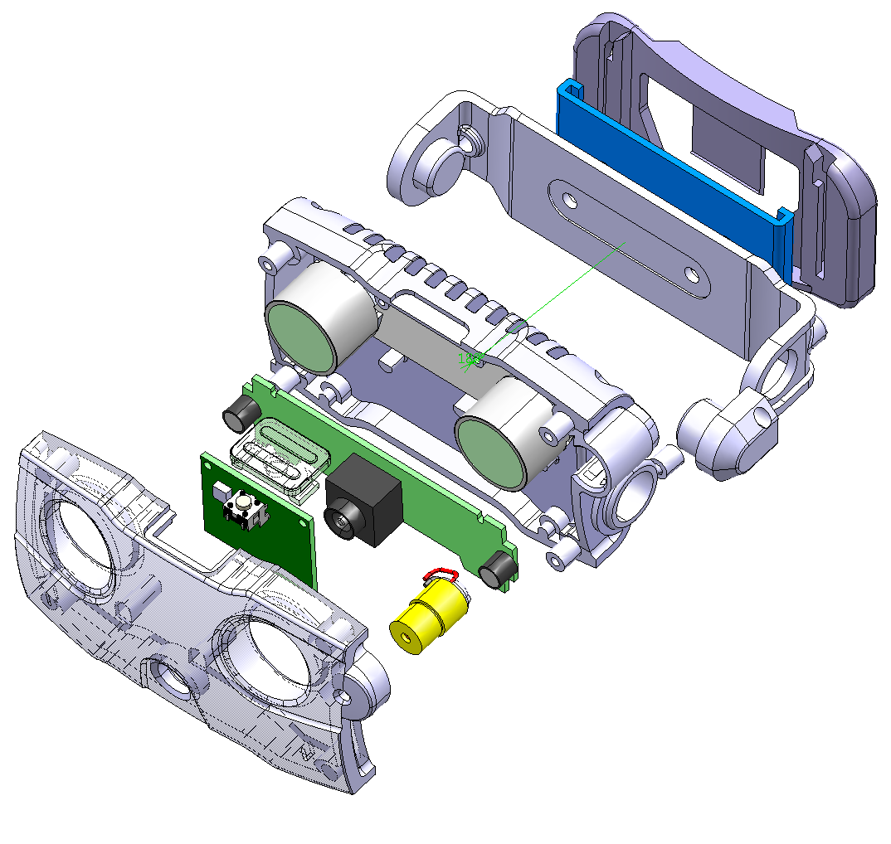
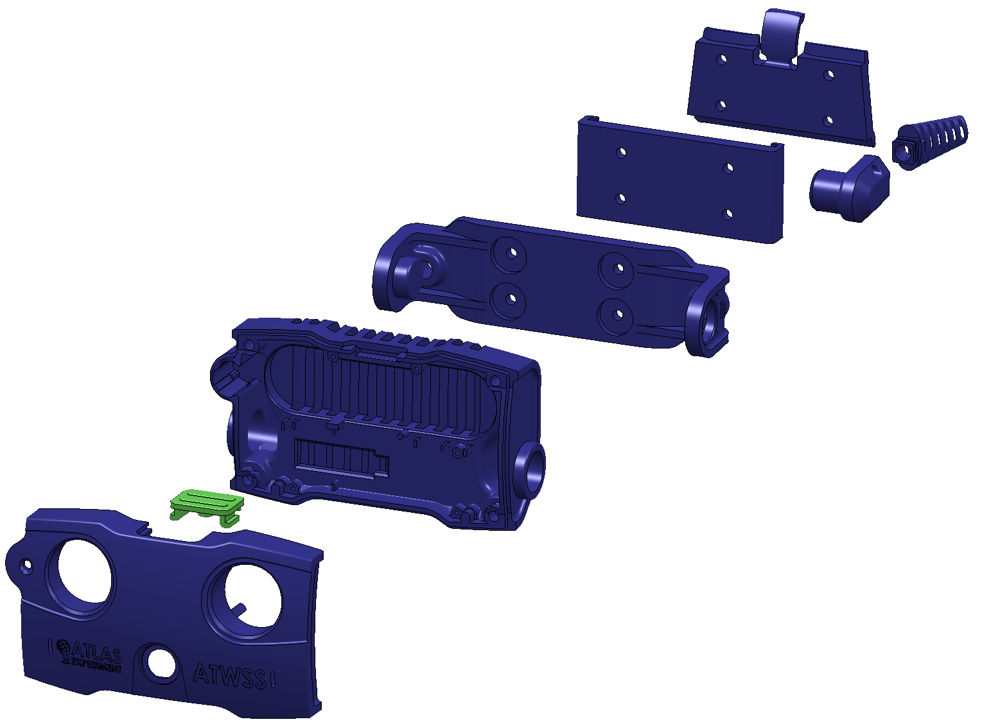

Slide 13
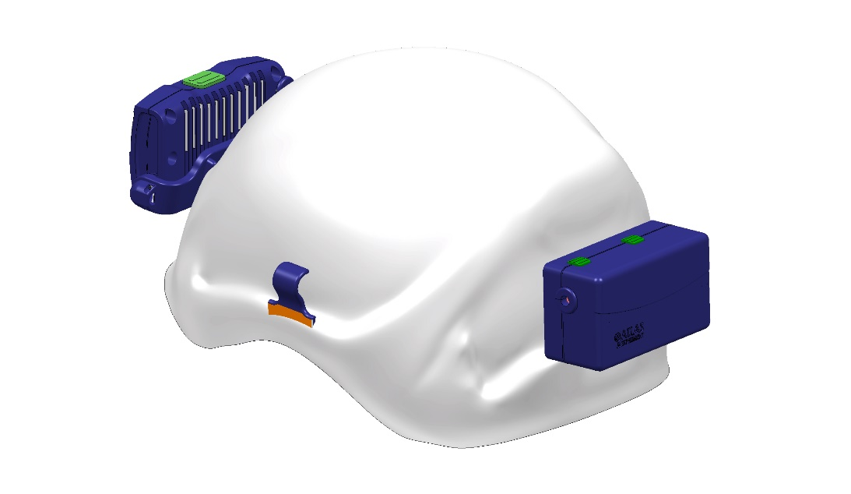
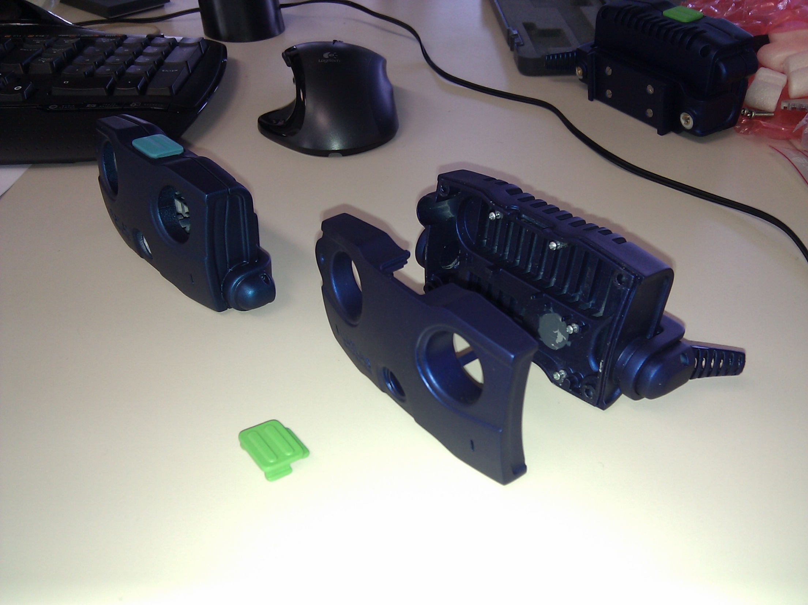
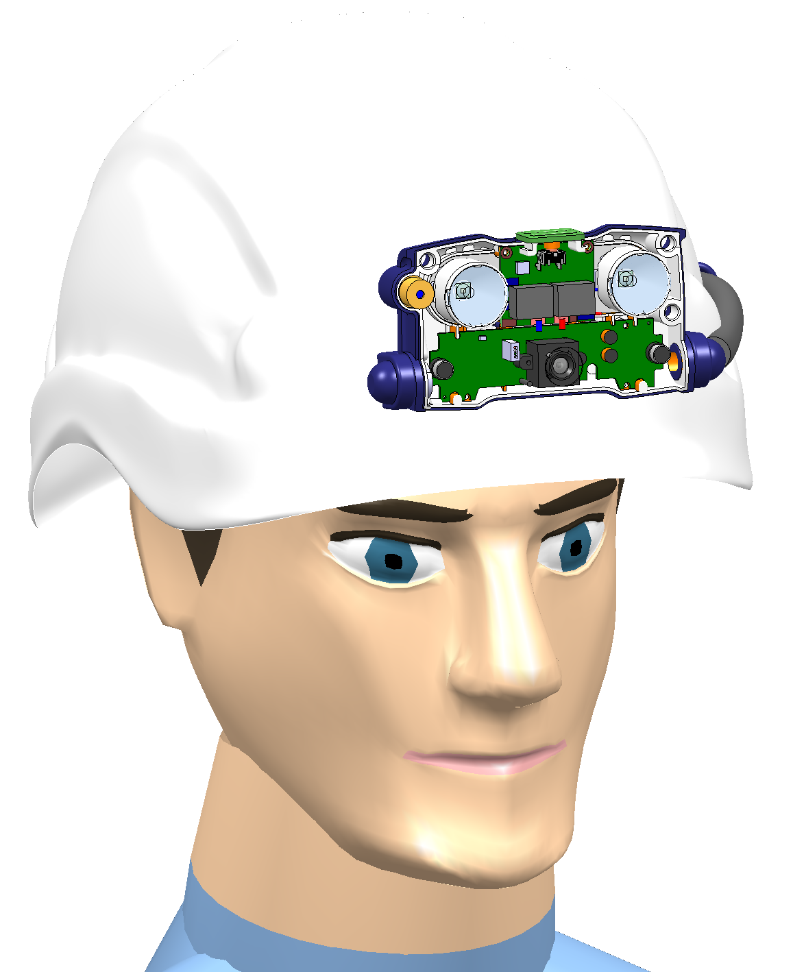
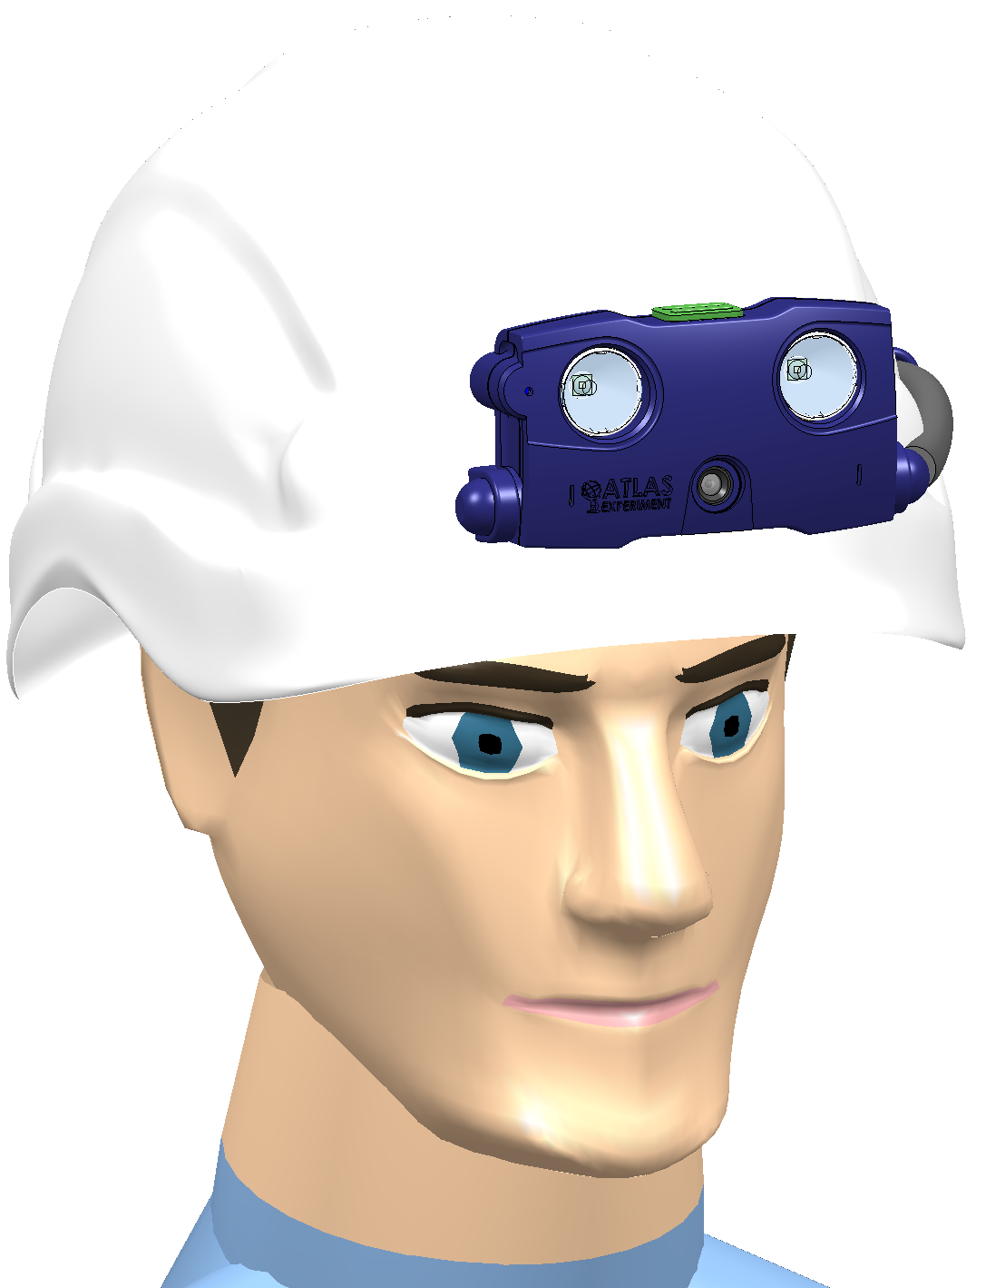
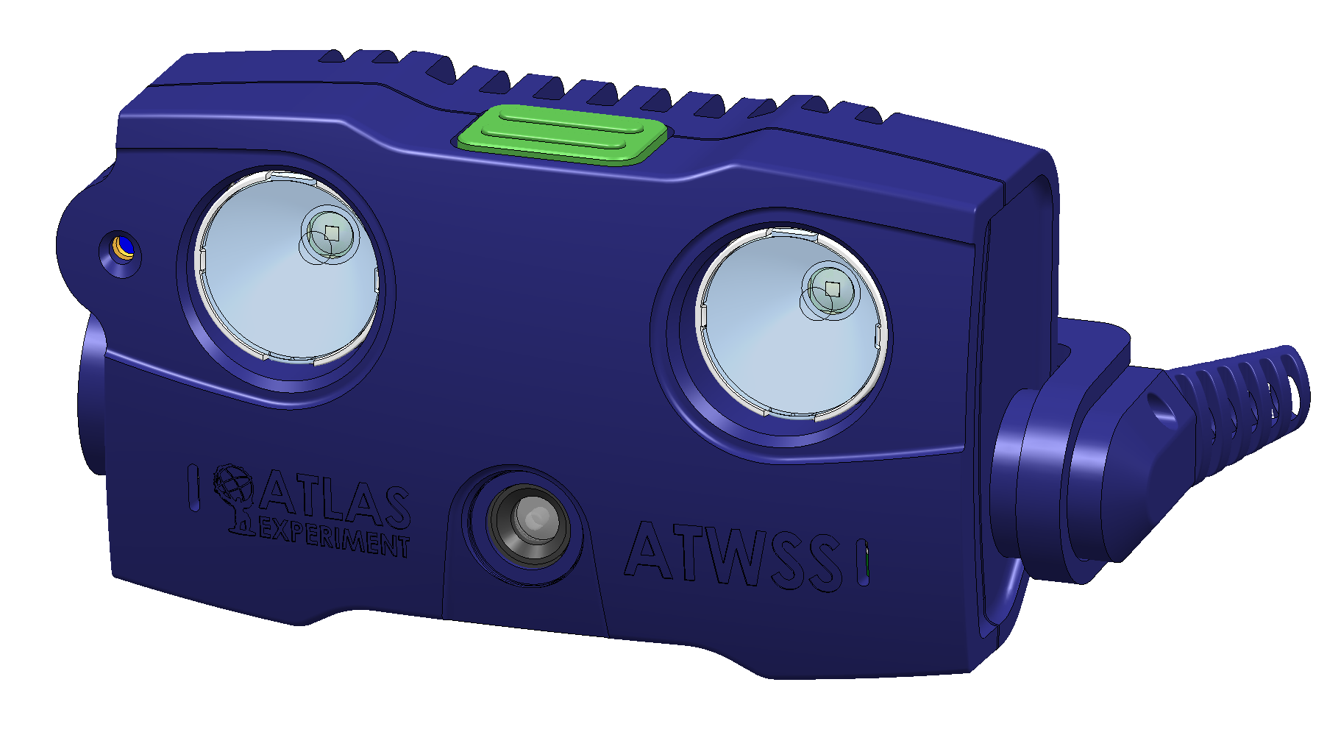
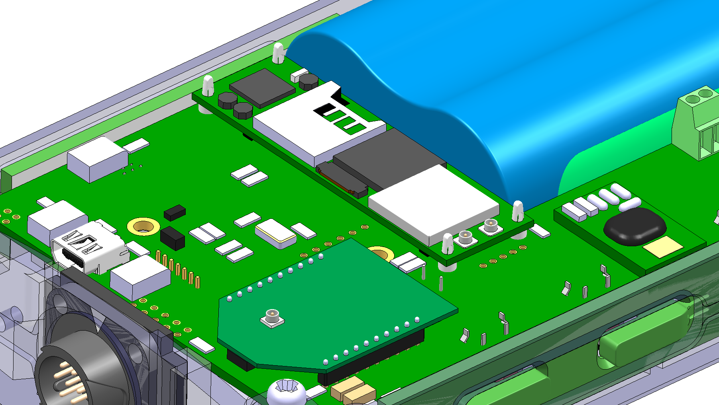

Slide 14
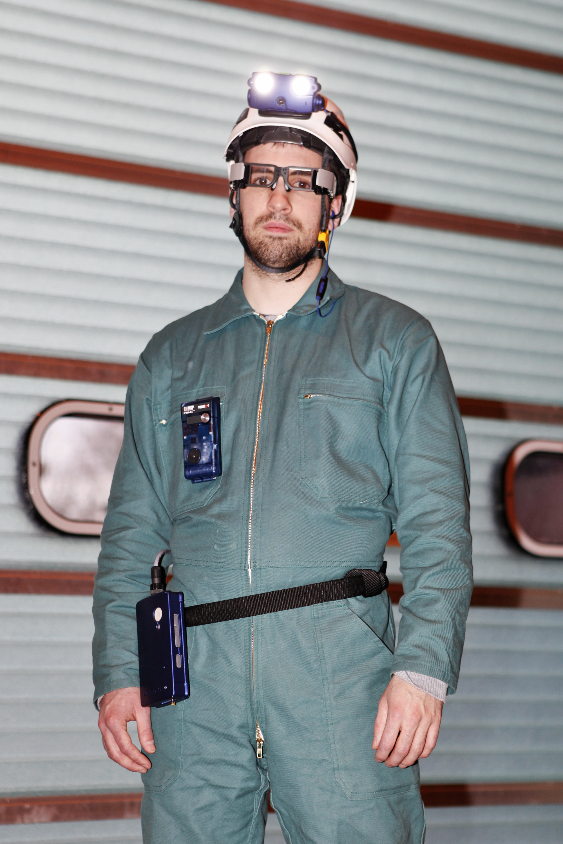
Status of the ATWPSS system development
Several prototypes configurations already
developed and tested in the ATLAS
experimental cavern.
Head Mounted Display from LUMUS
GOOGLE glasses
5 ATWPSS systems are currently in use
We have already saved radiation doses !
HOW?

Slide 15
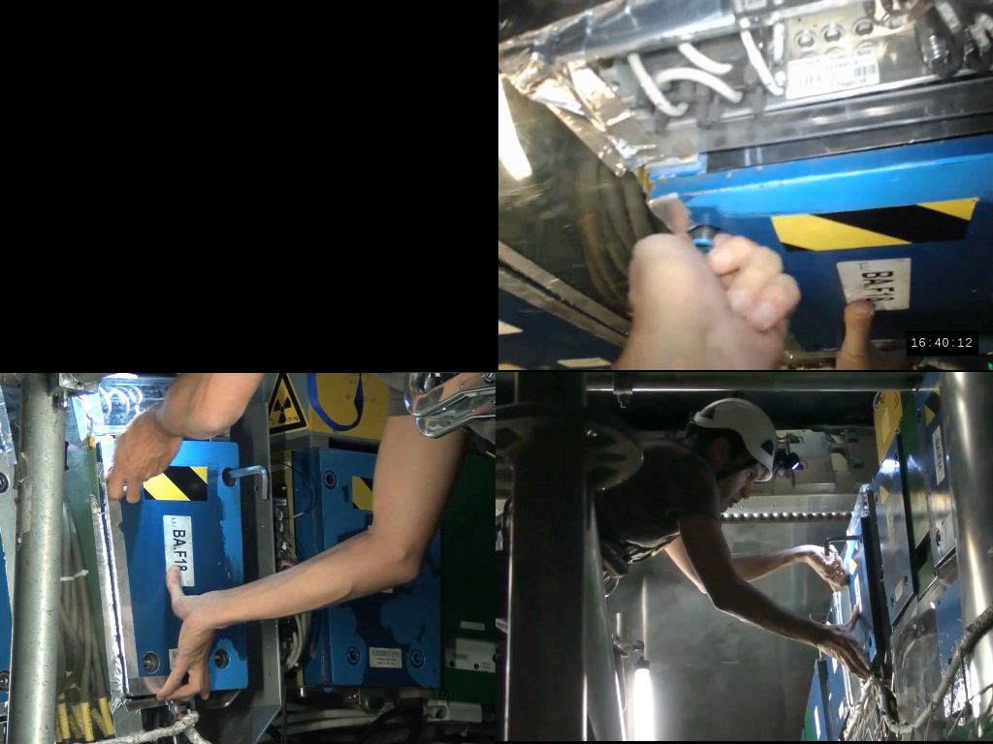
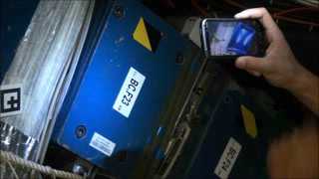
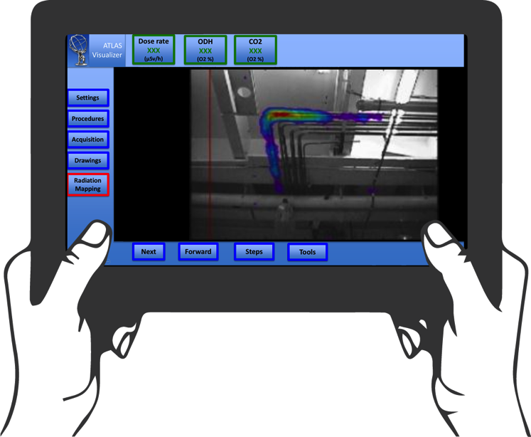
We provide Augmented and Virtual Reality information to workers: procedure of work, radiation environment
Video 1
Video 2

Slide 16
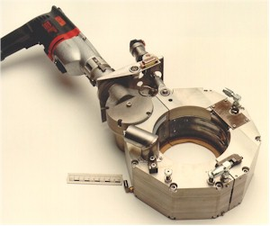
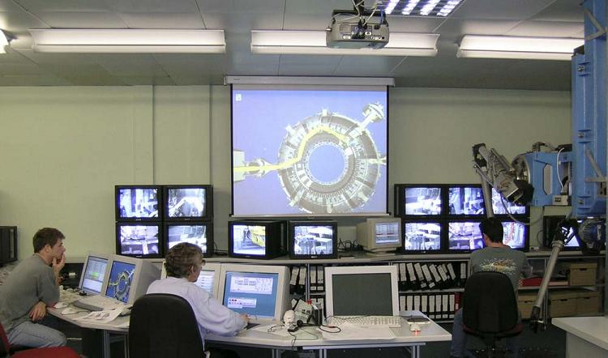
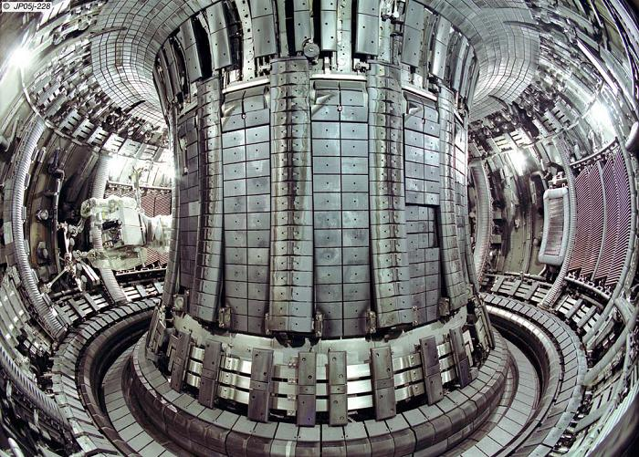
We are currently looking the best way to approach the problem
The strategy ...
1. In collaboration within CERN: LHC Machine, EN department, ISOLDE, ..
determine the most suitable company to assist us in the process
2. In parallel, we are looking for some possible EU funding to develop / adapt technologies for the “CERN cases”
3. Start a prototype in building 180 very soon (within a year) to test the technologies and get experience

Slide 17


Video 1
Video 2

Slide 18






Gamma Imaging Camera
ALARA planning using Jack and Microsoft Kinect
Notes:
At the end, we may try to combine 3D depth information from kinect like device and radiation data, to have something like this. This is a project being developed by Siemens PLM. They have a interesting Jack avatar to plan intervention task.

Slide 19


Slide 20



Slide 21





Slide 22
Neutrinos

Slide 23

Is there new physics beyond our knowledge ?
are the most abundant particles in our 4% universe
they carry no electrical charge
they have a very small mass, that we are unable to quantify
they interact very weakly with atoms
we are not sure that just 3 species exists (families)
they probably carry the mystery of why anti matter has disappeared
they oscillate in their main properties
Neutrinos are hiding new physics !!!

Slide 24


ν_{e}
ν_{μ}
Neutrinos oscillate !!
Oscillation probabilities for an initial muon neutrino
ν_{τ}
ν_{μ}
ν_{e}
ν_{μ}
ν_{e}
ν_{τ}
ν_{τ}
L/E [km/GeV)

Slide 25

Neutrinos are difficult to detect
ν_{e}
~10⁻⁹ = 0.000000001
Probability to interact with the earth matter
So we need massive detectors and very intense neutrino beams !!!!

Slide 26
How to detect Neutrinos
Neutrinos interact with the Argon Nuclei as for example in the following nuclear reaction:
ν_{e}
*
ν_{e}
Ar ⁴⁰
e
K ⁴⁰
e
+
+
The neutrino signature is in this case the appearance of an energetic electron in the bath of LAr

Slide 27

How to detect Neutrinos
In the presence of electric field
128nm VUV photons
  Argon is transparent to 128 nm
  Only Rayleigh-scattering
-
e⁻
e⁻
e⁻
e⁻
e⁻
Ar⁺
Ar⁺
e⁻
Ar⁺
Ar⁺
e⁻
Ar⁺
Ar⁺
Trajectory of ionizing particle
Ar⁺
e⁻
Ar⁺
Ar⁺
Ar⁺
+
Drift of ions: v⁺
E-field
.v⁺<<v⁻ ≈ 1.6 mm/µs @ 500 V/cm

Slide 28

How to detect Neutrinos

Slide 29

Cathode
Wire Chamber
Side B
(2001)
Wire Chamber
Side A
Drift distance
1.5 m

Slide 31


First step almost done

Slide 32

First step almost done

Slide 33

First step almost done

Slide 34

First step almost done

Slide 35


Slide 36
What do we need ?
Large cryogenic containers ~ 14’000 m³ of liquid (~96%)
Where we control the purity of the LAr at the ppt level
Stable in time, filled for ~20 years
Control temperature of the liquid at the 0.1 K level
Operating temperature : 86-89 K
Easy to install underground ( ~ 1 mile)
Two level of liquid containment (primary and secondary membrane)
Residual Heat Input (RHI) : 5 W/m² (to avoid bubbles)

Slide 37





Neutrino Long Baseline

Slide 39


Far detector @ the SURF laboratory in South Dakota (Lead)
- 1500 m

Slide 40

4 caverns, 4 detectors (TPC), 80 Ktons of LAr
Upper drifts at 4850L (green)
Central utility cavern
Lower drifts (blue)

Slide 41

4 caverns, 4 detectors (TPC), 80 Ktons of LAr

Slide 42



Slide 43

4 caverns, 4 detectors (TPC), 80 Ktons of LAr
Excavation starts in 2017
4 Cryostats assembly
2019 - 2025
Inner dimension (liquid+gas):
  L = 62.00 m
  W = 15.10 m
  H = 14.00 m
First cryostat operational in 2022

Slide 44


Design & dimensions

Slide 45

~ 6 m
~ 4.2 m

Slide 46








20’000 t
705 t
~700 t
first step
220 t
760 t
170 t
35 t
50 t
1-ph
1-ph
1-ph
1-ph LAr TPC
2-ph LAr TPC
1-ph
2-ph
CERN ν Platform
Short Baseline
NA61 Minerva ….
R&D
To succeed we need to proceed in steps (for cryostats, cryogenics and detectors)

Slide 47

First step almost done

Slide 48




Slide 49



First step done
Video

Slide 50



Slide 51

EHN1 - Extension

Slide 52



NP02 & NP04

Slide 53



Slide 54



Slide 55
First step almost done

Slide 56
Thank you!

