Slide 1
Why Accelerators?
Introduction to Accelerator Physics
by
Verena Kain CERN BE-OP

Slide 2

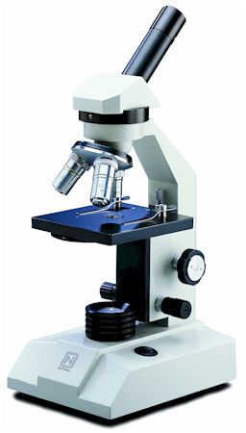
Why accelerators?
Accelerators are instruments that increase the energy of particles to study smaller and smaller structures and create heavy short-lived objects in collision with
Object | size | Radiation energy
Atom | 10⁻¹⁰ m | 0.00001 GeV
Nucleus | 10⁻¹⁴ m | 0.01 GeV
Nucleon | 10⁻¹⁵ m | 0.1 GeV
Quarks | - | > 1 GeV
Wavelength of probe radiation needs to be smaller than object to be resolved
Notes:
Accelerator is really a misnomer. Depending on the particle, if they are very light for example, you soon reach the point where you cannot increase their velocity anymore…you do not accelerate them anymore…you change their energy.

Slide 3
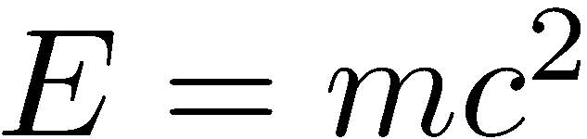
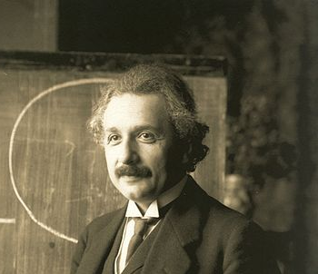
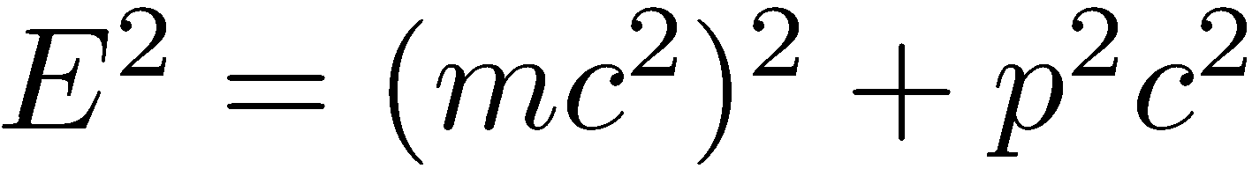
The units we are using…
Energy: in units of eV:
corresponds to the energy gained by charge of a single electron moved across a potential difference of one volt.
1 eV = 1.602176565(35) × 10⁻¹⁹ × 1 J
This comes from electrostatic particle accelerators.
Unit of mass m: we use
➔ Unit of mass is eV/c²
Unit of momentum p:
with
➔ Unit of momentum is eV/c

Slide 4
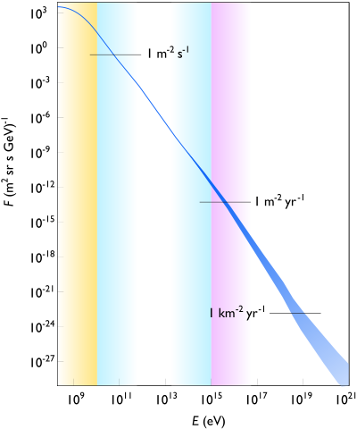
Natural Accelerators
Radioactive Accelerators
  Rutherford experiment 1911
  Used α particles tunneling through the Coulomb barrier of Ra and Th to investigate the inner structure of atoms
  Existence of positively charged nucleus, d ~ 10⁻¹³ m
  α particle kinetic energy ~ 6 MeV
Cosmic rays
  Energies up to 3 x 10²⁰ eV for heavy elements have been measured. ~ 40 x 10⁶ times what the LHC can do.
  “Ultra high energy” cosmic rays are rare…
Notes:
Cosmic rays: mostly consist of protons and other nuclei. The origin is mostly from outside the solar system. Super novae etc. Cosmic rays discovered by Victor Hess…measurements of ionization in a balloon…ionization was increasing with altitude…also measurements during eclipse…probably not from the sun. Originally it was believed that the ionization of the air was coming from radioactive elements in the ground. As the ionization increased with altitude Hess concluded that the source of the ionization was probably coming from above.

Slide 5
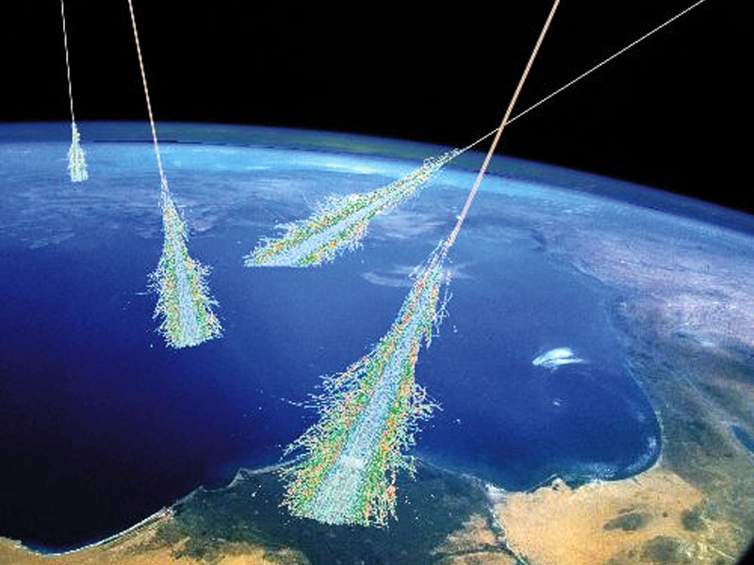
Why accelerators then….?
“Our” accelerators have the advantage:
High energies, high fluxes of a given particle species, controlled energies at a specific location where a detector can be installed.
Notes:
…where shall we put the detector.

Slide 6
How can we increase the energy of a particle?
Use electro-magnetic fields. Can increase the energy of CHARGED particles
Increase energy
The particle trajectory direction dr parallel to v
…increase of energy with electric fields
(Magnetic fields are needed for control of trajectories.)
Notes:
Need a force…not so many forces available. Need a force that does not have a very short range (strong, weak)…and that is sufficiently strong. EM

Slide 7
The basic accelerator
Electrostatic accelerator:
Charged particles go through the accelerating voltage gap once and then hit the target.
Limited by the maximum reachable voltage: ~ 10 MV
Target
Particle Source
T
Power supply
E- Field

Slide 8
Why collisions?
Conservation laws: e.g. momentum and energy conservation
Center-of-mass Frame and Center-of-mass Energy (E_{CM})
  Center-of-mass frame defined where:
  The energy available for creation of particles corresponds to E_{CM}
γ
e⁺
Photon into e⁺,e⁻ only in proximity of
nucleus. Nucleus takes part of momentum
(and part of available energy…)
Nucleus
e⁻
Notes:
Center-of-mass frame: total momentum is zero. Defined as the frame where the center of mass is at rest.
The energy of the gamma must be larger than 2xm_e because the nucleus must take part of the momentumf and hence part of the energy.

Slide 9
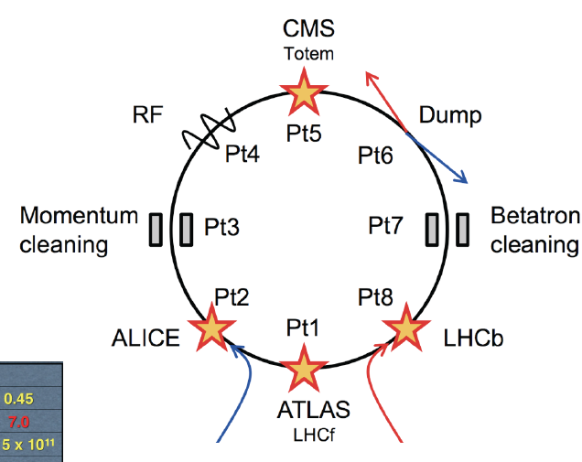
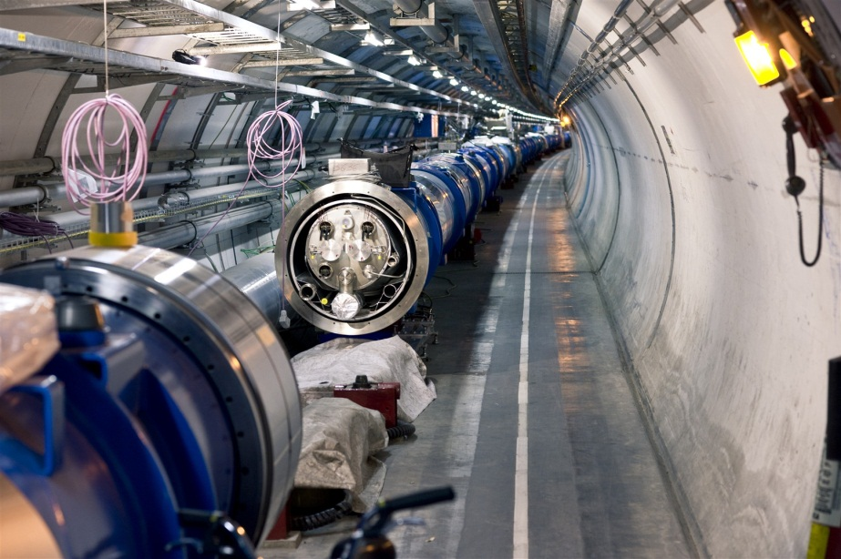
The Large Hadron Collider
It is a circular 2-beam accelerator. No targets. Collider.
Passing through accelerating gap of same voltage over and over again.
LHC protons are accelerated to 7000000 MeV
Electro Magnets
Where is the electric field?
27 km of magnets….
The limitation comes from the maximum possible magnetic field…

Slide 10
The Key Concepts for High Energy Accelerators
RF Resonant Acceleration
Strong Focusing – alternating gradient focusing
  Keep the beam size under control

Slide 11
History of Accelerators

Slide 12
Electrostatic Accelerators – 1930s
Cockcroft-Walton electrostatic accelerator
  High voltage source by using high voltage rectifier units
  High voltage limited due to sparking in air. Limit ~ 1 MV
CERN used until 1993 as ion-source: 750 kV
Notes:
Transformer generates sin voltage. The rectifier diode ensures that point A1 only gets positive voltage. Capacitor C0 charges therefore to V0 and the voltage oscillates between 0 and 2xV0 at A1 etc. etc….

Slide 13
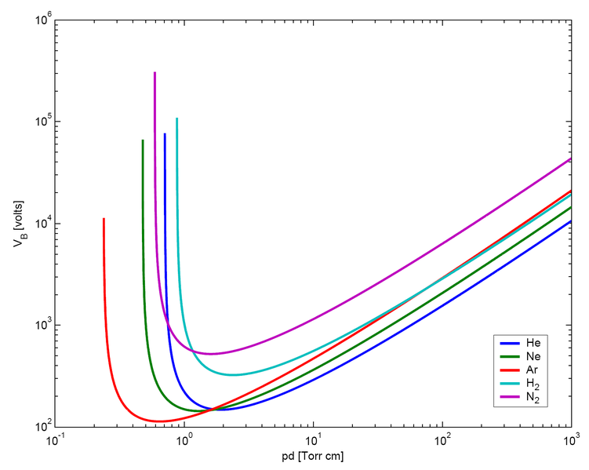
Electrostatic Accelerators
Limit of 1 MV overcome: placing the electrodes under high pressure gas. Paschen’s law
➔ Van De Graaf generator
  1 – 10 MV
Break down voltage depends on gas pressure and
gap between electrodes.
Break down voltage
Product of pressure x gap
Notes:
Very low pressure x gap: the mean free path length between electrons from ionization is long. The electrons can get high energy, but not collide often enough for starting an avalanche. Spark.
For high pressure – high density. The electrons will collide lots and lots. Each collision will take some energy out of it and it might not have enough to ionize anymore (need about 15 eV). Can therefore go to much higher voltages between the electrodes.
The belt is electrically charged by a brush or comb of electric wires connected to a DC voltage source. The amount of charge can be controlled by the voltage. It can be positive or negative charges depending on the polarity of the source. Then the charge is transported to the spherical or rounded high voltage terminal-electrode.

Slide 14
Tandem Van de Graaf Generator
…use the accelerating voltage twice
Up to 25 MV
Advantages of Van de Graaf:
  Great variety of ion beams
  Very good energy precision, small energy spread
Applications in nuclear physics, accelerator mass spectroscopy,…

Slide 15
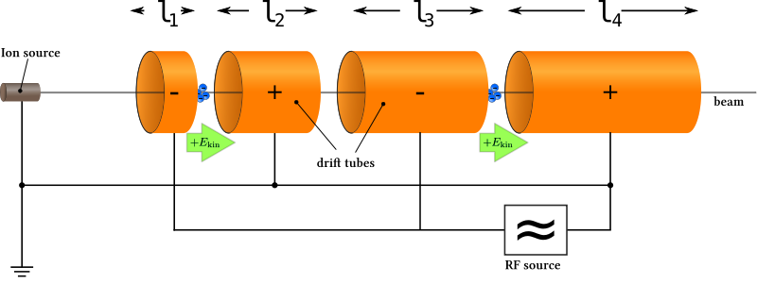
RF Acceleration – the Revolution
Electrostatic accelerator limitation: maximum voltage before sparking for acceleration over single gap
➔ pass through acceleration gap of same voltage many times (Ising)
1928 Wideroe: first working RF accelerator
Particle synchronous with field. In shielding tube when field has opposite sign. Voltage across each cell the same.
Remark: tubes have to become longer and longer, as particles become faster and faster
or higher frequency λ = c/f_{RF}
But radiation power loss: P = ω_{RF}CV_{RF}², C gap capacitance
Energy gain per gap:
E = q V_{RF}sin(φ_{s})
Φs…phase wrt to RF field
Notes:
Ising suggested it and Wideroe built the first working one. The principle of resonant acceleration. This accelerators could accelerate particles to energies above that given by the highest voltage in the system.
Angular frequency = 2pi f

Slide 16
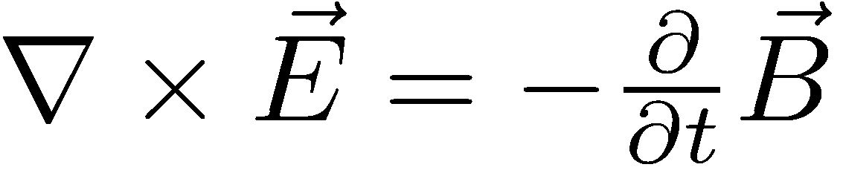
Alvarez Linac or Drift Tube Linac
Eliminate power loss: drift tube placed in cavity
  Electromagnetic field oscillating in cavity. Standing wave, TM mode ( longitudinal E-Field, transverse B-Field)
  Resonant frequency of cavity = accelerating field frequency
  Reduce power loss
  Exploit Farraday’s law:
Notes:
Store the electro-magnetic energy in magnetic field. Working typically in the MHz range
…still used at CERN at 200 MHz

Slide 17
Circular Accelerators
Linear accelerators can in principle accelerate to arbitrarily high energies.
….but become longer and longer
➔ Particles on circular paths to pass accelerating gap over and over again
➔ Cyclotron proposed by E.O. Lawrence in 1929 and built by Livingston in 1931.
Notes:
Shimming of magnets to have field decrease with r for stability.

Slide 18
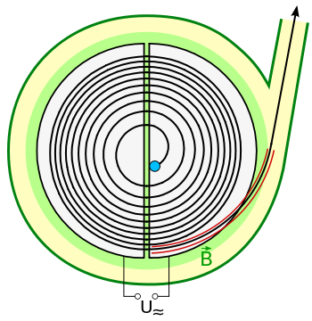
Cyclotron
Particle Source in the middle
Between the two “Dees” acceleration gap connected to RF source. ω_{RF} = ω_{cyclotron}
Vertical magnetic field to guide the particles in the horizontal plane. The radius of particle trajectory becomes larger and larger with larger energy
Particles extracted with a deflector magnet or an electrode.
Top View
Notes:
D-shaped electrodes, that provide the RF frequency

Slide 19
Cyclotron Limitation
Cyclotron frequency is constant for constant mass
For relativistic particles mass is not constant
The classical cyclotron only valid for particles up to few % of speed of light
  Not useful for electrons…already relativistic at 500 keV
Possibilities: synchrocyclotrons (change frequency (and magnetic field) with energy) or isochronous cyclotrons (increase magnetic field with r, frequency constant)
Modern cyclotrons can reach > 500 MeV (PSI, TRIUMF, RIKEN)
Notes:
Particles are relativistic as soon as their energy is in the range of their rest mass
PSI and TRIUMF: protons…Triumf also H-
Actually for high energy the synchro-cyclotron are better…can reach up 1 GeV for protons. Phase stability also counts here…need to inject at at suitable phase of the RF cycle.
Isochronous cyclotrons are for high intensity.

Slide 20
Biggest Cyclotron in the world
RIKEN, Japan
19 m diameter, 8 m high
6 superconducting sector magnets, 3.8 T
Heavy ion acceleration
Uranium ions accelerated up to 345 MeV/u
K. Yamda et al., “Status of the Superconducting Ring Cyclotron at RIKEN RI Beam Factory,
EPAC 2008
Notes:
Another big one is in TRIUMF, Canada’s national laboratory for nuclear and particle physics. 18 m diameter. H- is accelerated to make extraction easier for producing multiple beams with stripping foils. PSI cyclotron reaches energies of 590 MeV, they use it to generate muon beams in the end after the proton acceleration and extraction onto a graphite target
Watt = Joule/s

Slide 21
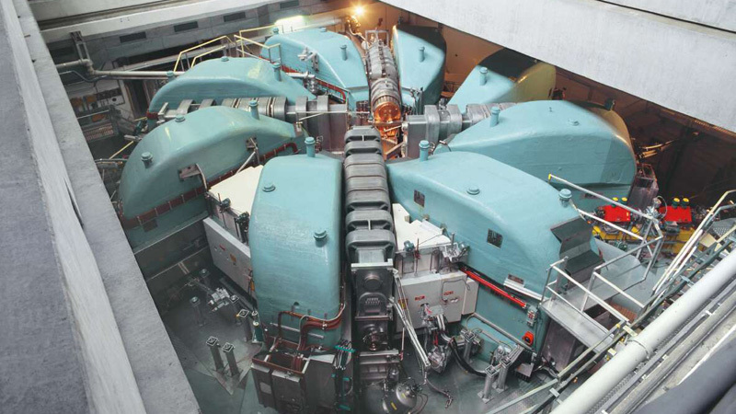
PSI cyclotron
High intensity P_{max} = 1300 kW
Notes:
Triumf is the largest normal conducting cyclotron. Peak field 0.6 T (Triumf one is about 35 years old)
PSI 15 m diameter, 2.2 mA at 590 MeV…commissioned in 1974.
Both PSI and Riken and Triumf are isochronous cyclotrons

Slide 22
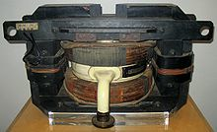
Betatron - 1940
Another early circular accelerator
Idea by Wideroe in 1923. Kerst builds the first working betatron in 1940.
Difference: constant radius and magnetic field changing with time to keep radius constant.
Accelerating E-field generated through induction, no external E-field
e⁻ accelerated to 2.3 MeV
“Betatron” for beta rays (e⁻)
1942 – 6 MeV
Notes:
Idea from Wideroe, first built by Kerst. This device is insensitive to relativistic effects. Power converters just drives the magentic field up. Perfect for elect
Highest energy betatron : 300 MeV

Slide 23
Synchrotron
Higher and higher energies – larger and larger radii, limited B fields – cannot stay compact
Fix trajectory ➔ R = constant; R can be large
Dipole magnets with field only where the beam is
  “small” magnets
R= constant ➔B field increases synchronously with beam energy
Synchrotron - all big modern machines are synchrotrons
Notes:
First principles 1945 (McMillan California, Veksler USSR. Then the first e- machines…1946 small 8 MeV synchrotron in England.

Slide 24
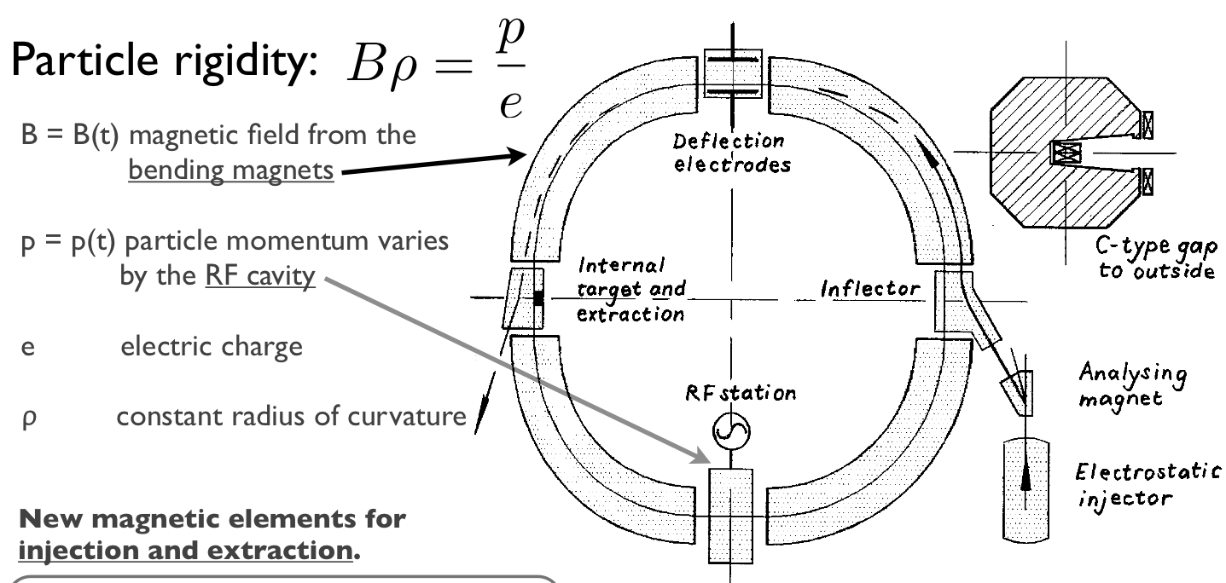
Cosmotron – BNL – 1952 – 3 GeV
3 GeV p⁺ synchrotron
Particles do many 1000 turns – trajectories have a angular spread ➔ divergence
Need focusing elements. Cosmotron weak focusing machine
Notes:
Weak focusing. Field going down with R. The limit for energy for these was believed to be about 10 GeV because of only weak focusing.

Slide 25
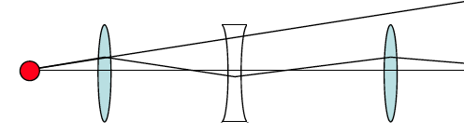
Strong Focusing
Idea by E. Courant, M. Livingston, H. Snyder in 1952 and earlier by Christofilos
Alternating gradient focusing
  Analogous to geometrical optics: a series of alternating focusing and defocusing lenses will focus.
f₁
f₂
Consider f₁=f, f₂ = - f ➔ F = f²/d > 0
In our case the lenses will be magnets with alternating gradients
QUADRUPOLES
Notes:
Originally this was done with combined function magnetics where the magnets were used to bend and focus at the same time, by simply built-in a field gradient

Slide 26
The first alternating gradient synchrotrons
Alternating gradient focusing was quickly adopted by synchrotrons and transfer lines.
- 1954: Cornell University, e⁻ accelerated to 1.5 GeV (Wilson et al.)
The following two machines are still in operation.
They use combined function magnets.
- 1959: CERN Proton Synchrotron (PS) accelerated protons to 28 GeV
- 1960: Brookhaven Alternating Gradient Synchrotron (AGS) accelerated protons to 33 GeV

Slide 27
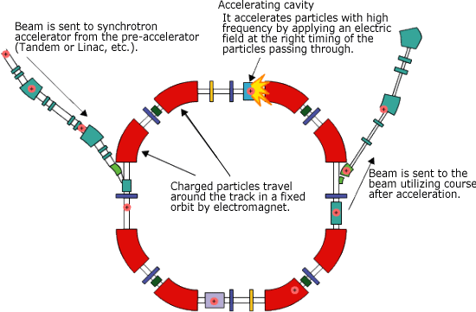
The basic Layout of a Alternating Gradient Synchrotron
Notes:
This is still to a fixed target experiment…only one beam. What about having two beams rotating in opposite direction…..colliders.

Slide 28
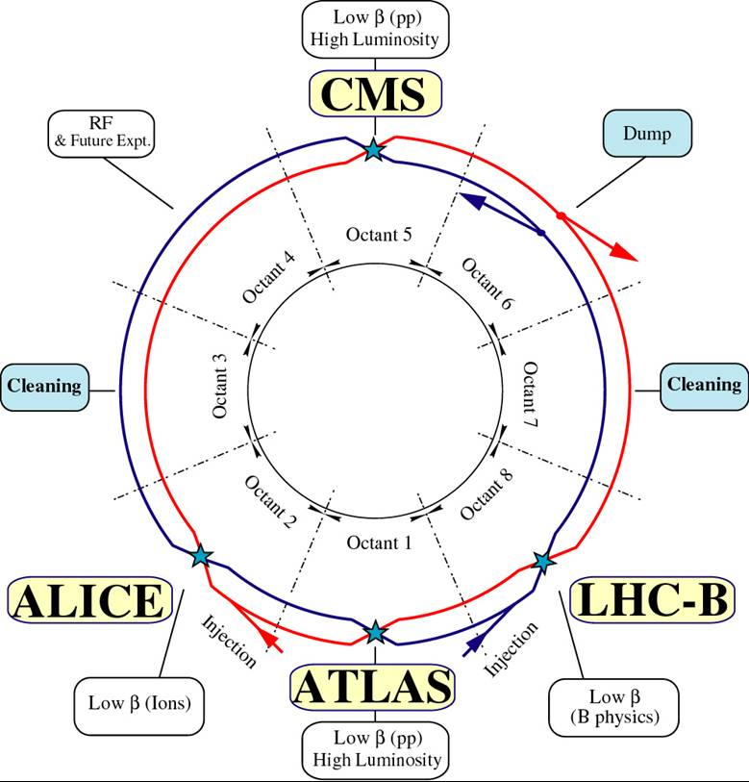
Fixed target vs. Colliders

Slide 29
Fixed target vs. Colliders – Center-of-mass Energy
Center-of-mass Frame and Center-of-mass Energy (E_{CM})
  Center-of-mass frame defined where:
  The energy available for creation of particles corresponds to E_{CM}
Notes:
Center-of-mass frame: total momentum is zero. Defined as the frame where the center of mass is at rest.
The energy of the gamma must be larger than 2xm_e because the nucleus must take part of the momentumf and hence part of the energy.

Slide 30
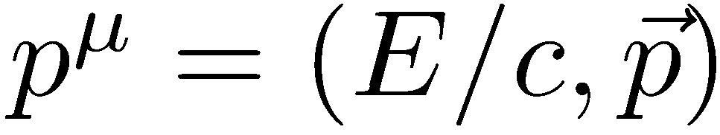
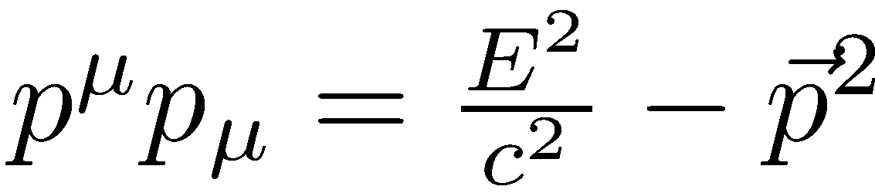
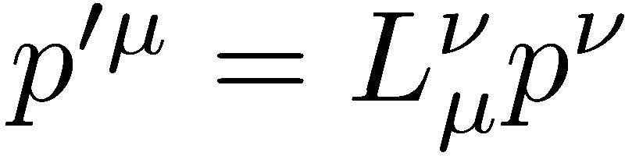
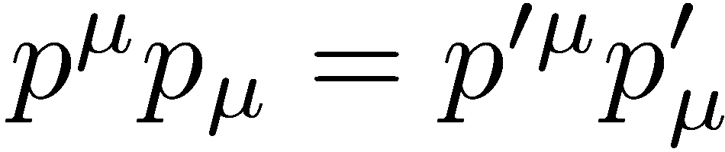
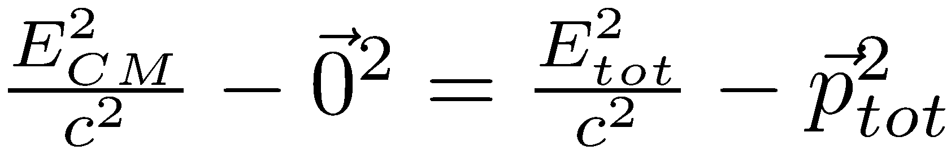
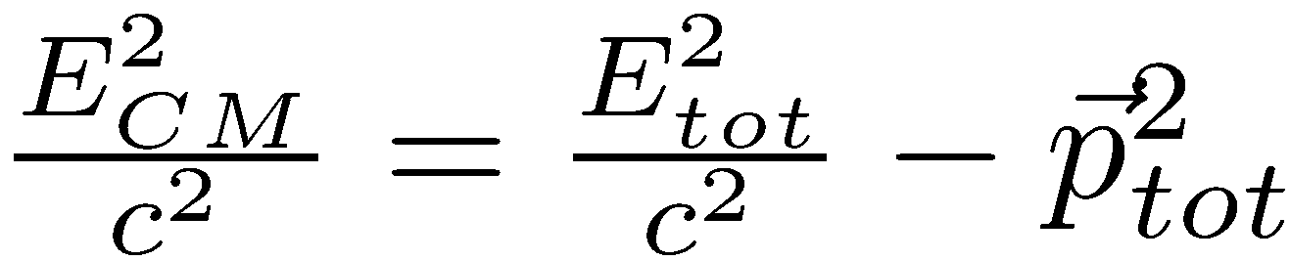
Center-of-Mass Energy
Transformation to center-of-mass frame: Lorentz transformation
4-momentum
Lorentz Transformation
The norm: is Lorentz invariant
Notes:
The four momenutm – the generalisation of the normal three-momentum to the four-dimensional space-time. Lorentz transformations – boosts, rotations.

Slide 31
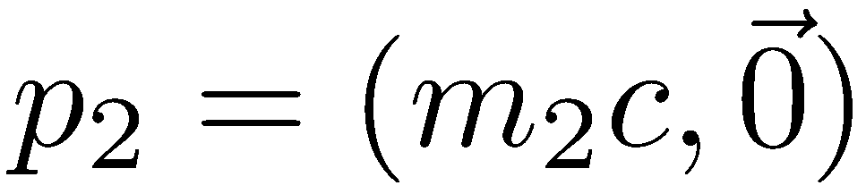
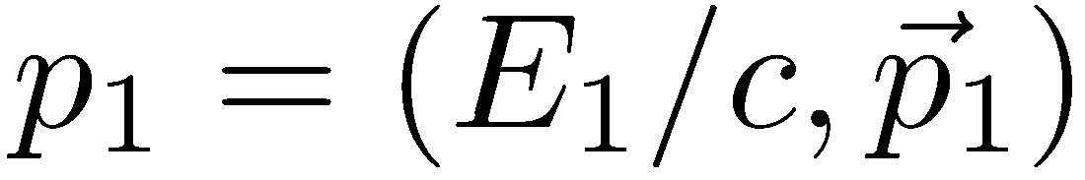
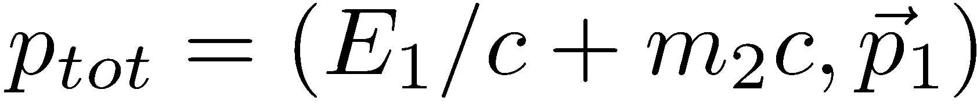

E_{CM} in Fixed Target Experiment

Slide 32
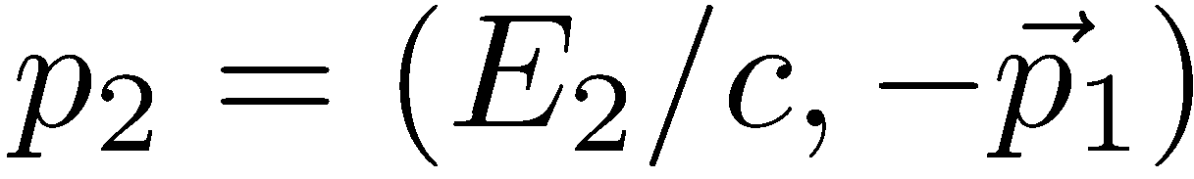

E_{CM} in Collider Experiment
Laboratory Frame = CM Frame
Collider more energy efficient;
But also more complex: two beams to be accelerated and to be brought into collision

Slide 33
The next step: storage ring colliders
Make use of all the particles’ energy. 2-beam synchrotrons.
The first one: Ada (Frascatti), 1961-64, e+,e-, 250 MeV, 3m circumference
Many examples to come at DESY, SLAC, KEK, Fermilab with the Tevatron (980 GeV), BNL with RHIC
1971-1984: ISR (CERN), p+,p+, 31.5 GeV, 948 m circumference
1981-1991: SPS running as SppS, p+, p-, 270 – 315 GeV, 6.9 km circumference; discovery of W and Z Bosons
1989-2000: LEP highest energy electron synchrotron, e+,e-, 104 GeV, 27 km circumference; three generations of quarks, gluons and leptons
2008 - : LHC highest energy proton synchrotron, p+,p+, heavy ions, 6.5 TeV (2.76 TeV per nucleon for ²⁰⁸Pb⁸²⁺); Discovery of Higgs
Notes:
LEP highest energy electron synch, LHC highest energy proton synch
ISR…26 GeV
There were several other electron machines...also two-ring ones…with e-,e-
SLAC PEPII and KEKB discovered CP violation electron positron machines…different energies for the two of them.
Now not so many are running anymore. There is the LHC, RHIC, (protons up to 255 GeV, 3.8 km ring) Daphne (electron positron), BEPC (China)3.7 GeV .And many eyes are on the LHC.
KEK: KEKB…Belle experiment. Discovered CP violation (1999 – 2009)
HERA: until 2007: e- p+…27.5 GeV on 920 GeV superconducting machine
There are more high intensity hadron accelerators – MW machines: PSI, JPARC, TRIUMF,…they are all still running…and there are the synchrotron light sources.

Slide 34
The main Magnets

Slide 35
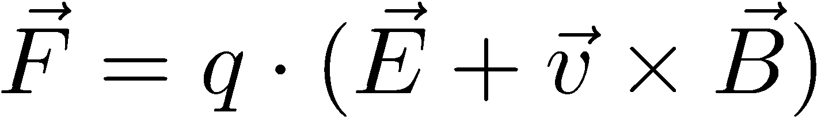
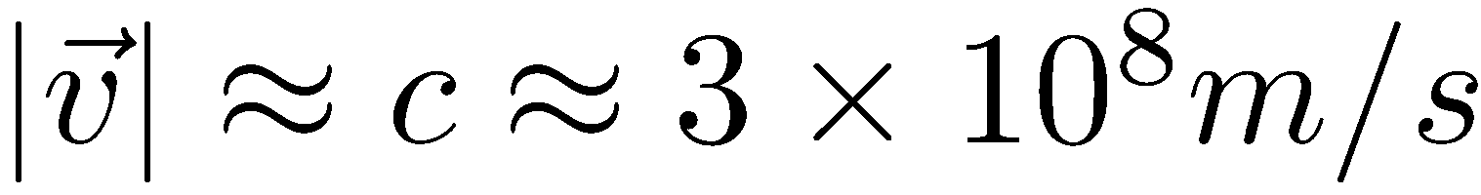
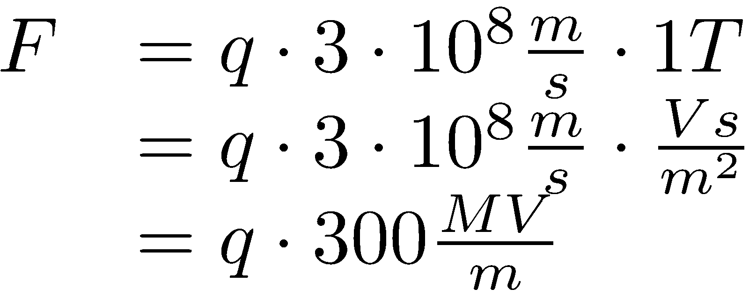
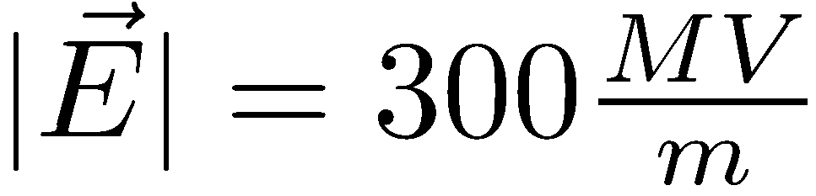
How can we keep the particles on a circular trajectory?
Usually use only magnetic fields for transverse control
What is the equivalent E field of B = 1 T?
  Ultra-relativistic:
➔ To guide the particles we use magnetic fields from electro-magnets.
Lorentz Force
Equivalent electric field!!:

Slide 36
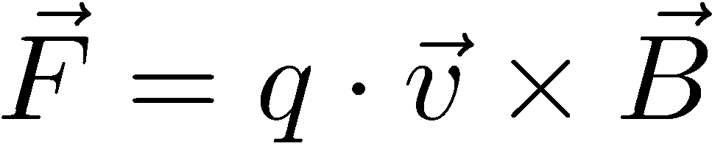
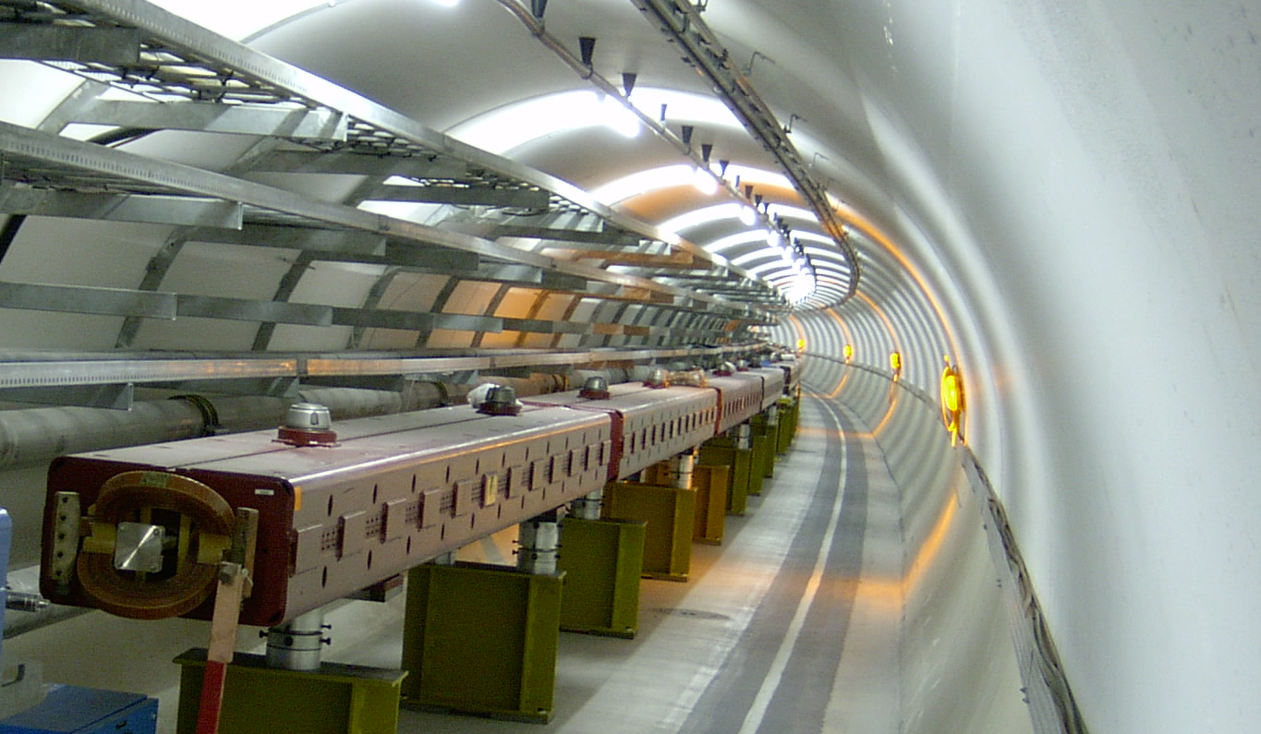
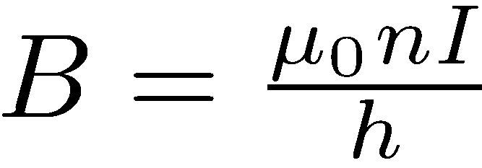
Dipole magnets: guiding magnets
Vertical magnetic field to bend in the horizontal plane
Dipole electro-magnets:
h

Slide 37

Focusing is mandatory for stability
Define design trajectory with dipole magnets
Trajectories of particles in beam will deviate from design trajectory
➔ Focusing
  Particles should feel restoring force when deviating from design trajectory horizontally or vertically
Design trajectory

Slide 38
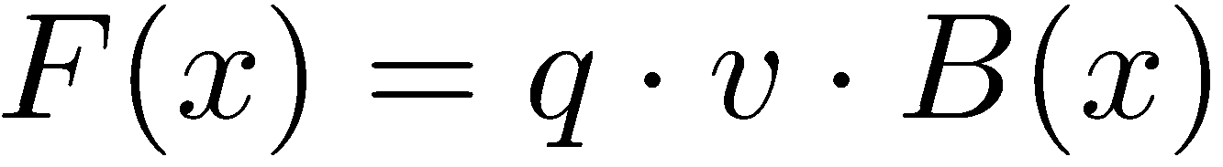
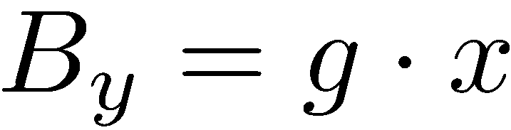
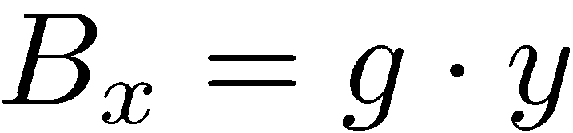
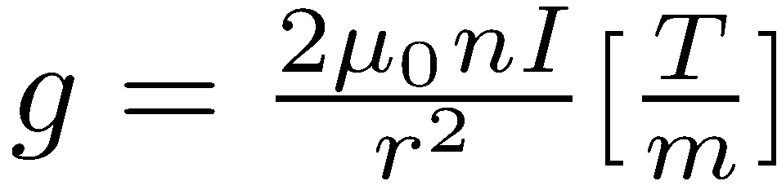
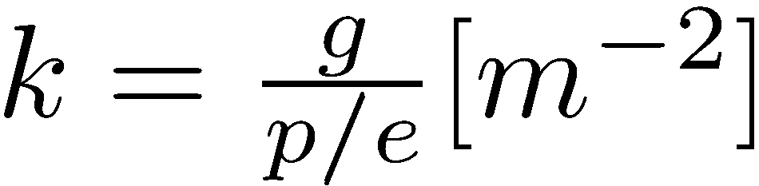
Focusing with Quadrupole Magnets
Requirement: Lorentz force increases as a function of distance from design trajectory
E.g. in the horizontal plane
We want a magnetic field that
Quadrupole magnet
Gradient of quadrupole Normalized gradient, focusing strength
The red arrows show the direction of the force on the particle
Notes:
A horizontally focusing quadruople is always defocusing in the vertical plane and the other way round.

Slide 39
Strong focusing
Initially weak focusing or constant-gradient focusing.
In early cyclotrons needed to introduce magnet shims to distort the guide field such that it was decreasing with R. A gradient.
The new idea: instead of constant-gradient: alternating gradient
allowed for smaller apertures and much, much higher energies.
Analogous to geometrical optics with light lenses.
Example: bending magnets in the Cosmotron, the first synchrotron.
Apertures very large.
Energy limit was believed to be 10 GeV.

Slide 40
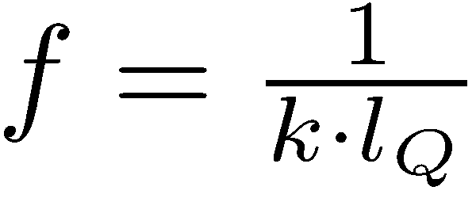
Strong focusing
Light lenses:
In a synchrotron: the lenses are the quadrupoles
Focal length of quadrupole
f₁
f₂
Consider f₁=f, f₂ = - f ➔ F = f²/d > 0
FODO Cell: F = Focusing, 0=nothing (bend, RF,..),
D = Defocusing
Foc. Quad
Dipole
Defoc. Quad

Slide 41
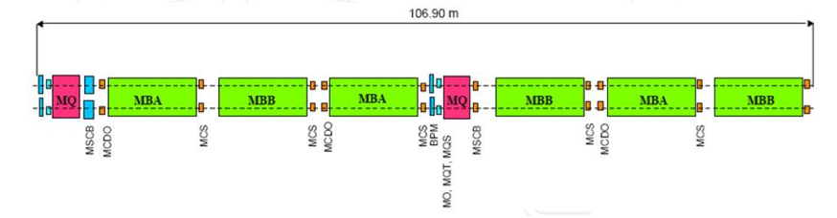
The LHC FODO cell
Each LHC arc consists of
23 FODO cells
LHC arc

Slide 42
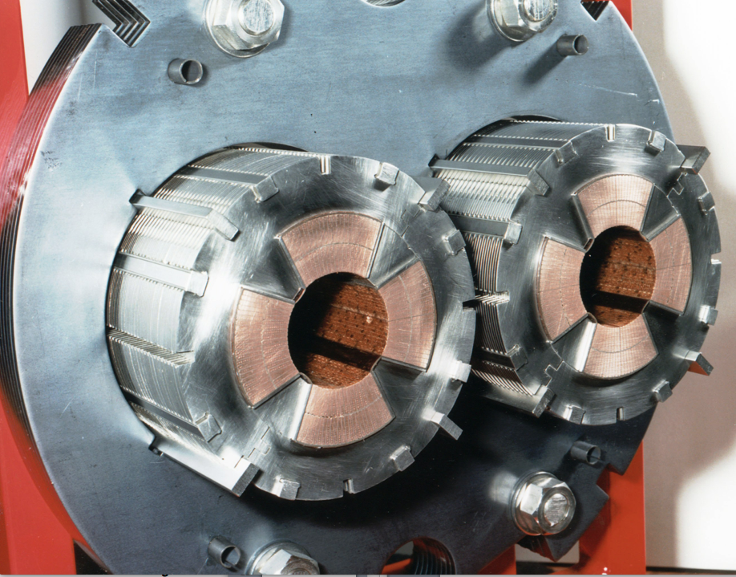
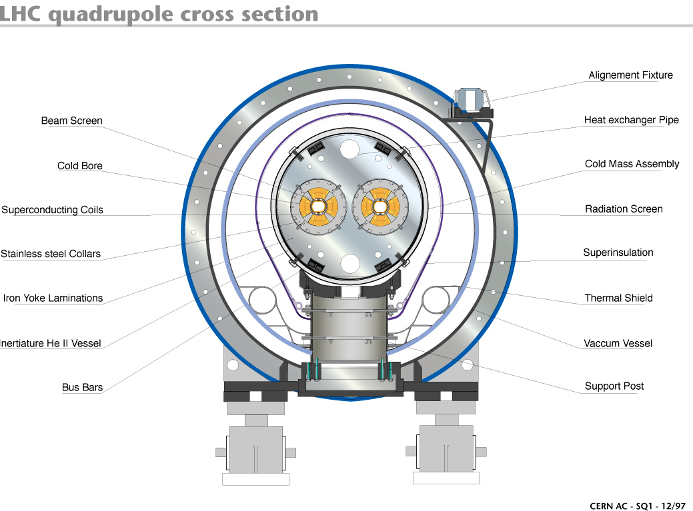
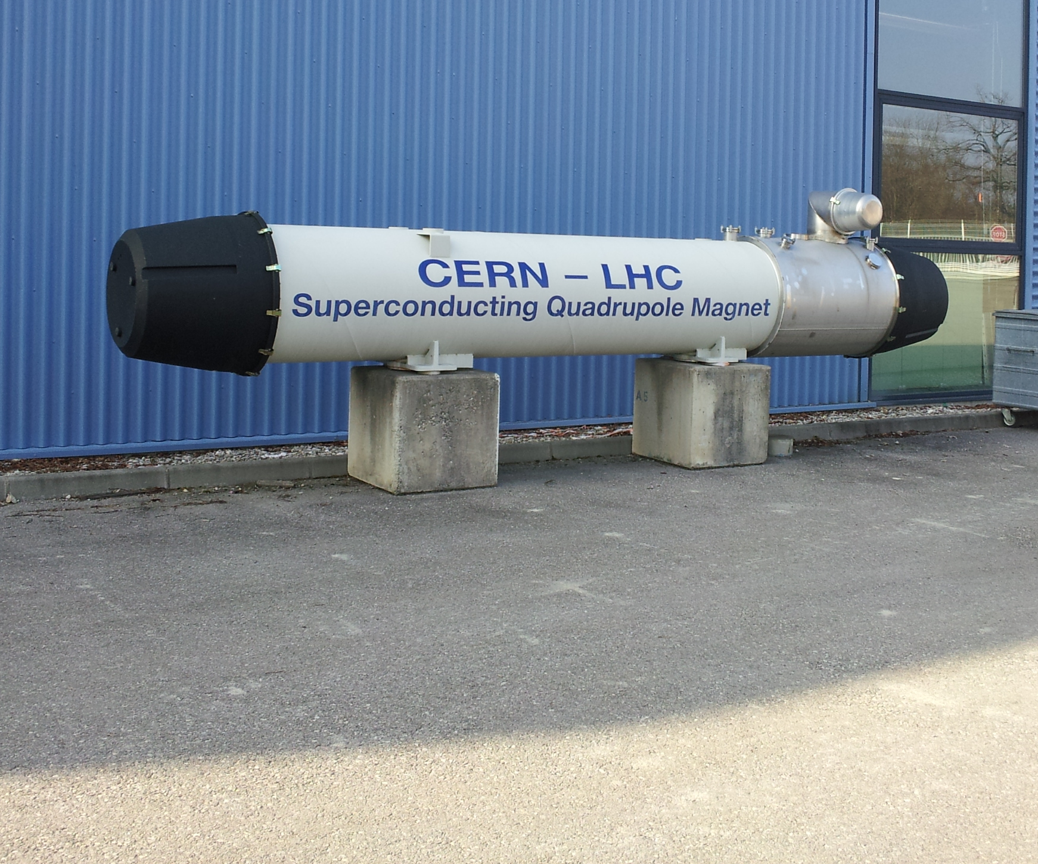
The LHC main quadrupole magnet
Length = 3.2 m
Gradient = 223 T/m
Peak field 6.83 T
Total number in LHC: 392

Slide 43
Synchrotron

Slide 44
Acceleration

Slide 45
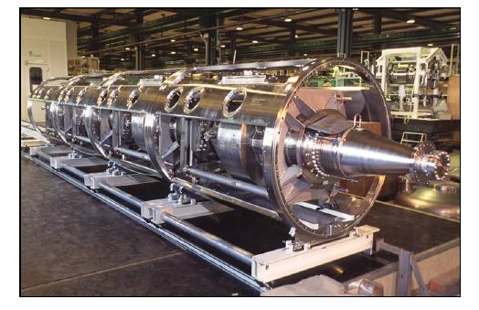
LHC superconducting cavities
8 cavities per beam in 2 cryo-modules per beam.
Can deliver 2 MV per cavity. Accelerating field 5 MV/m
RF frequency: 400 MHz.
Notes:
Why use superconducting cavities: losses in the metallic wall proportional to the resistivity in the wall due to radiofrequency surface currents. (As a second part there is also the so-called beam power= beam current times accelerating voltage). The limit in normal conducting structures is ~ 2 MV/m. The limit comes from the wall power loss and the capability of cooling the structure.

Slide 46
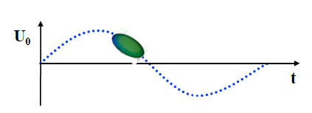
Acceleration
Using RF acceleration: multiple application of the same accelerating voltage.
Brilliant idea to gain higher energies
…but accelerating voltage is changing with time while particles are going through the RF system.
➔ Longitudinal dynamics
Not all particles arrive at the same time.
Not all particles will receive the same energy gain.
Not all particles will have the same energy.

Slide 47
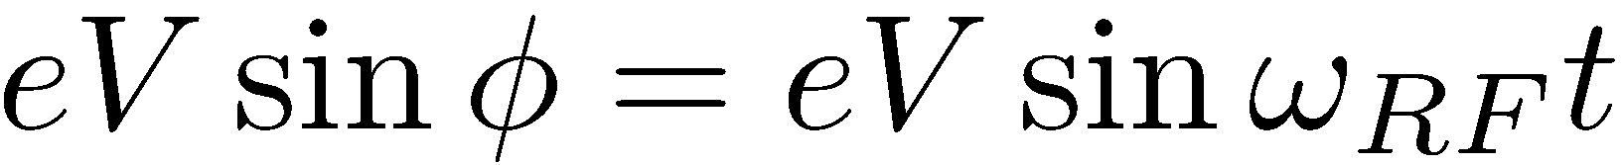
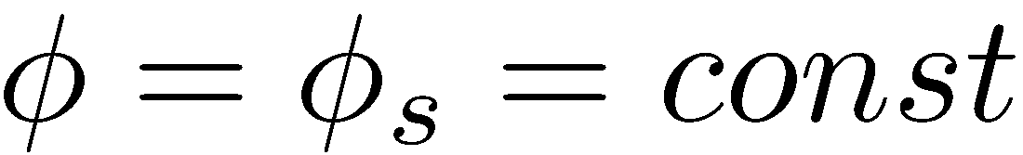

Acceleration in a Synchrotron
Synchrotron: there is a synchronous RF phase of the RF field for which the energy gain fits the increase of the magnetic field
Energy gain per turn
E
Reference particle, synchronous particle
B
Bending
magnet
RF synchronism: the RF frequency must be locked to the revolution frequency
R=C/2π
h…harmonic number
injection
extraction
ρ
constant orbit, bending radius
variable magnetic field
bending
radius
Notes:
For the synchronous particle the statement above is fulfilled.

Slide 48
Principle of Phase Stability
Assume the situation where energy increase is transferred into a velocity increase
Particles P₁, P₂ have the synchronous phase.
M₁ & N₁ will move towards P₁ => stable
M₂ & N₂ will go away from P₂ => unstable (and finally be lost)
Notes:
P1 and P2 get exactly the right energy such that the arrive next time around again with the same phase.

