Slide 1




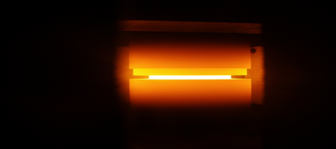
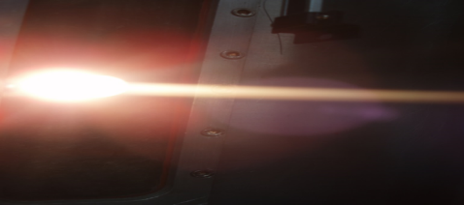
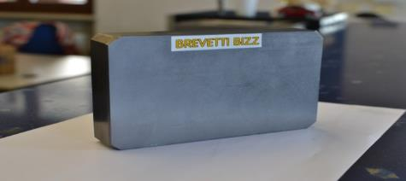
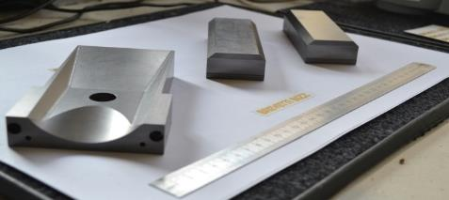
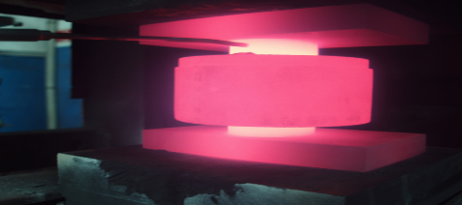
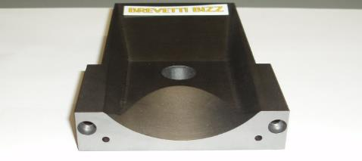
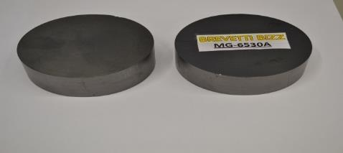
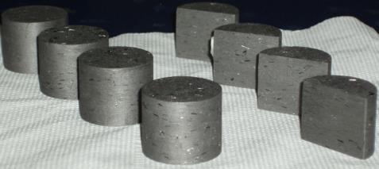
Production of novel and advanced materials: Molybdenum-graphite
Presentation of our manufacturing facilities and capabilities
J.Guardia on behalf of Stefano Bizzaro
WP11 topical meeting
University of Malta, Valletta, Malta
27-28th April 2016
Notes:
Malta 29 April 2016

Slide 2
Outline
Overview of the company
Collaborations ongoing with CERN
Material production
Machining and testing capabilities

Slide 3

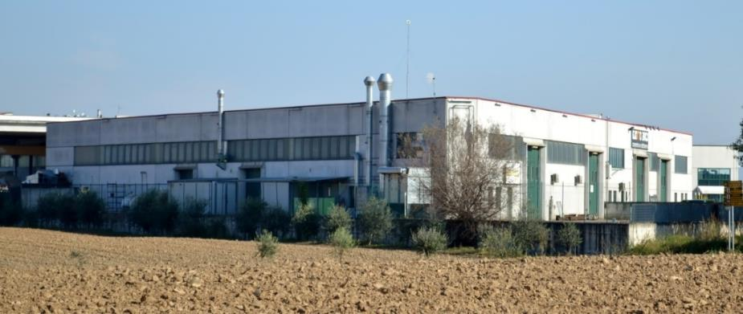
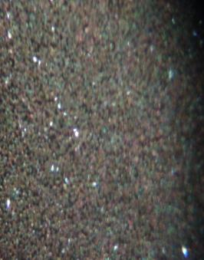
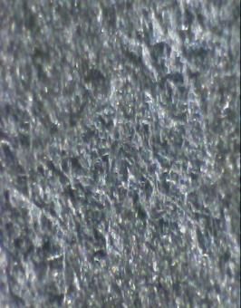
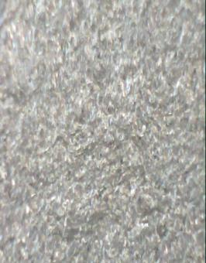
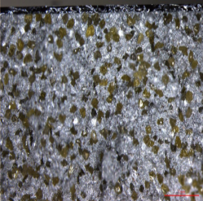
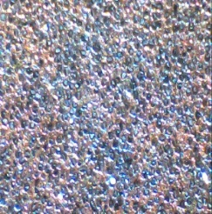
COMPANY PRESENTATION
Founded in year 2000 in the industrial area in San Bonifacio (Verona) in Italy, with an area of 1600 square meters, it represents a factory think up for design, research, development and production in technical/applied mechanical industry.
consultancy, design, research and development
special machining (ceramic and graphitic materials)
composite materials for high temperatures
High temperature thermal treatment in high vacuum
We collaborate with important suppliers, customers, laboratories, universities and research centers and we are involved in a continuous research for innovative solutions.

Slide 4
Collaborations with CERN

Slide 5
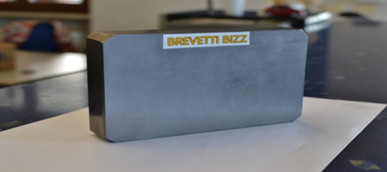
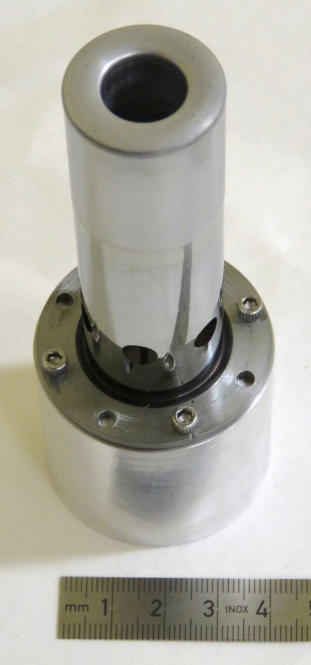
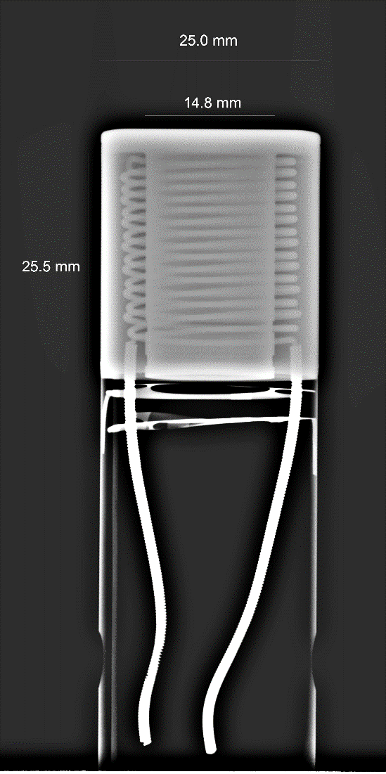

Collaborations with CERN
Absorber material for HL-LHC collimators
R&D on novel materials, on-demand processes and high-precision machining.
Cathode for CERN electron guns (HL-LHC hollow e-lens)
R&D on materials, density, doping elements and shape.
MG-6303Ga sintered plate.
Dimensions 100 x 150 x 30mm
Tapering and blocks HRMT23 experiment
Cathode pictures from Pascal Simon (CERN EN-MME)

Slide 6
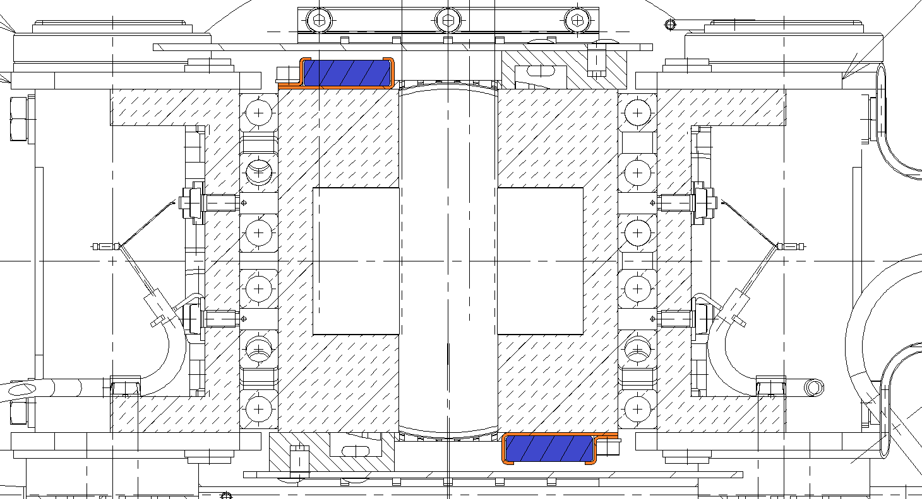
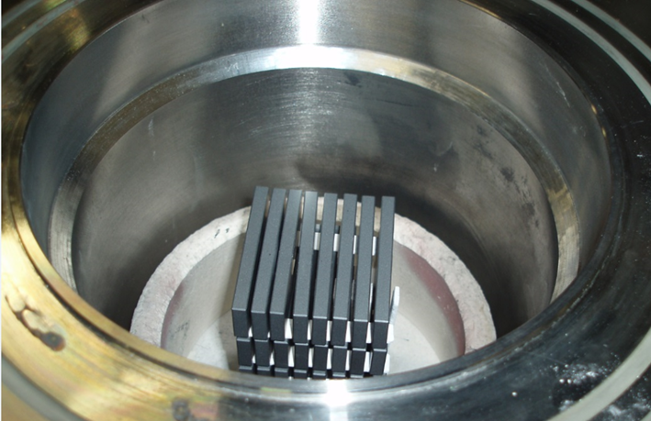
Collaborations with CERN
Thermal treatment (firing) of ferrite plates for LHC collimators
1000ºC 48h in air + 1000ºC 48h in vacuum
Total duration ≈10days
TCTP Collimator RF system
Ferrite
Supports

Slide 7
Material production

Slide 8
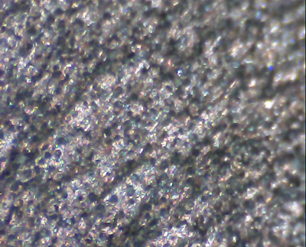
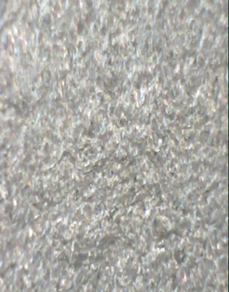
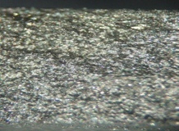
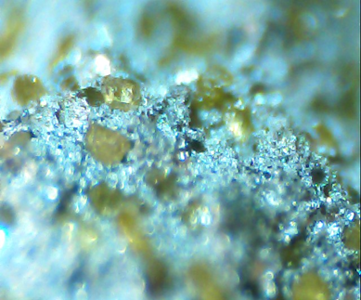
MATERIAL MG6530 Aa
MATERIAL ALUMINIUM GRAPHITE
MATERIAL ALUMINUM DIAMOND
MATERIAL MG - 6403 Ga

Slide 9
Metal/Ceramic Matrix Composites
Molybdenum-graphite:
Liquid Phase Sintering at ~2800°C and 35 MPa.
Reducing H₂-N₂ atmosphere at 10⁻⁶ mbar.
Liquid metal-carbon phase allowed to spill out of the moulds to enhance compaction and reduce final density.
Composition (Grade MG-6403-Aa)
  95.3%vol. Natural Graphite (~45µm)
  4.5%vol. Molybdenum powder (~5µm)
  0.2%vol. Titanium powder (~5µm)
Powders pre-cleaning under H₂-N₂ atmosphere
MG-6303-Ga dimensions 100 x 150 x 30mm

Slide 10
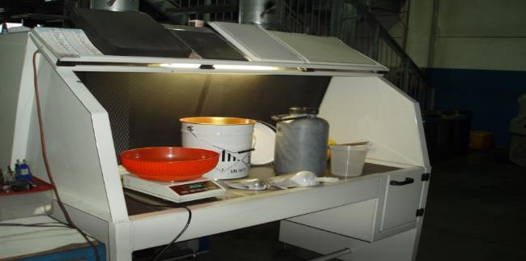
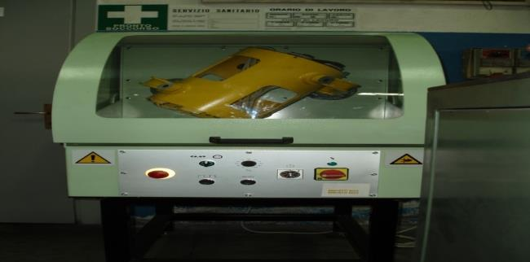
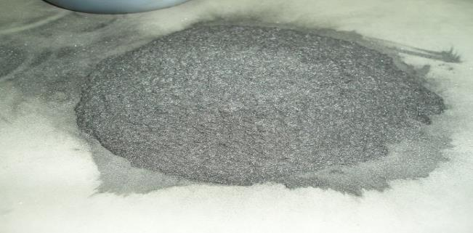

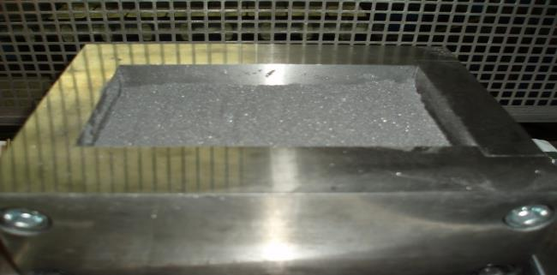
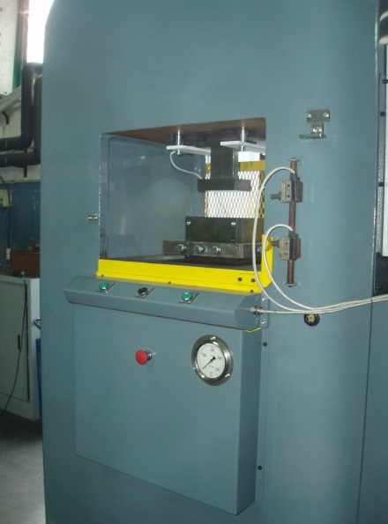
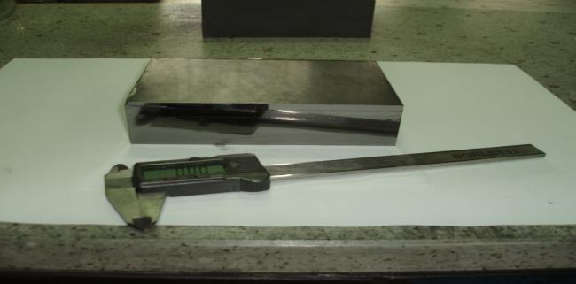
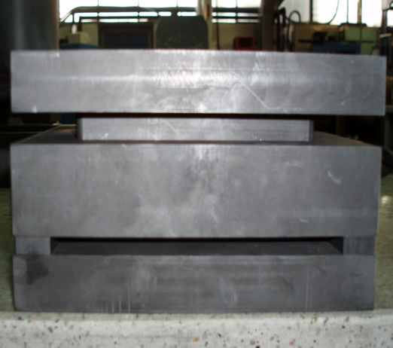
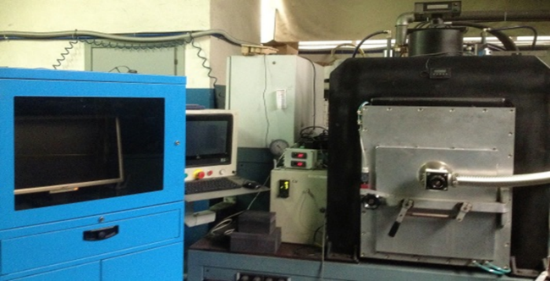
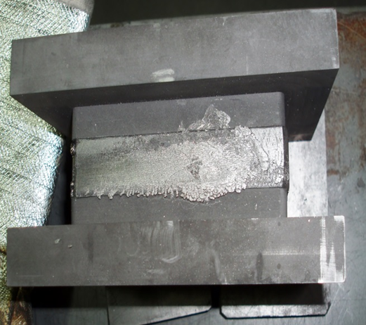


PRODUCTION PHASES OF THE COMPOSITES
POWDER PREPARATION
►
MIXED POWDER
MIXER
GREEN BODY
MOLD FOR GREEN POWDER
500 TON PRESS FOR GREEN BODY
MOLD GRAPHITE
PLATE WITH DIE AFTER VACUUM HOT PRESSING 2800 ° C 35 MPa 25 minutes.
VACUUM HOT PRESSING 150 TON
Notes:
VACUUM HOT PRESSING 150 TON

Slide 11
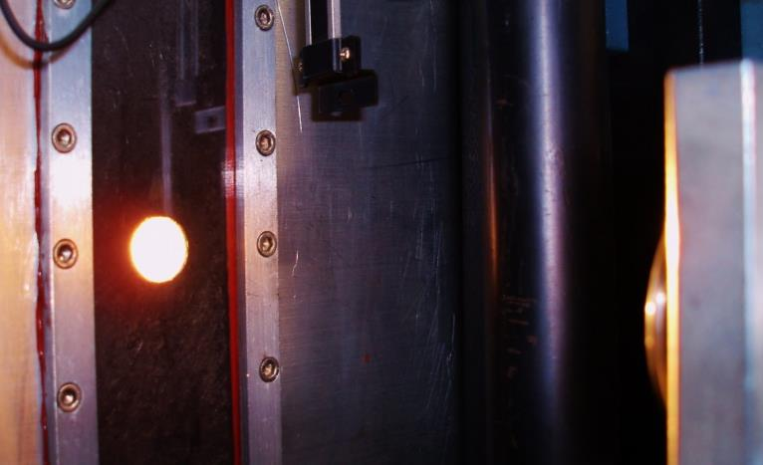


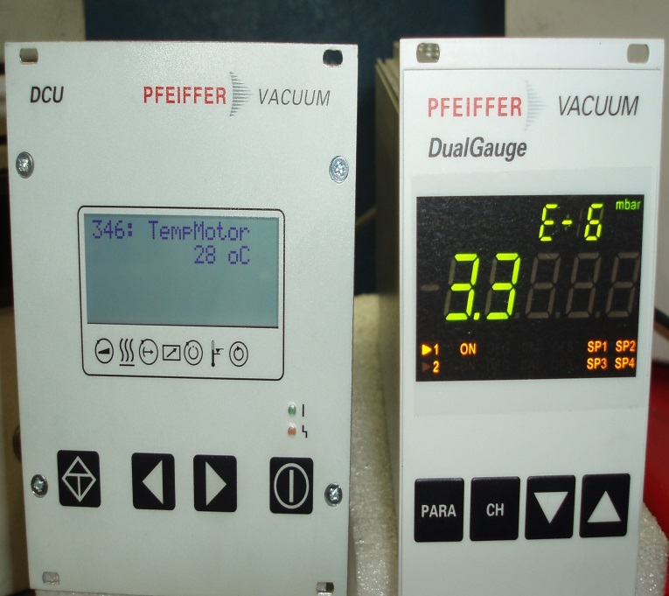

VACUUM HOT- PRESSING 150 TON
VACUUM HOT-PRESSING C°1200
VACUUM HOT-PRESSING C°2800
VACUUM
COMPOSITE FINISHED
Notes:
VACUUM HOT-PRESSING C° 2400 EL

Slide 12
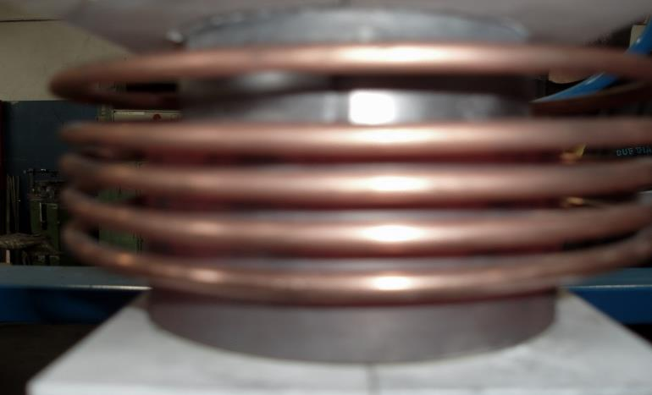
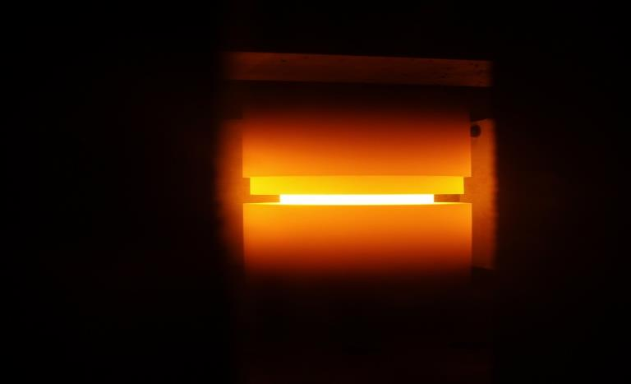
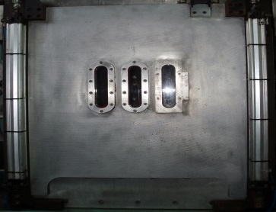
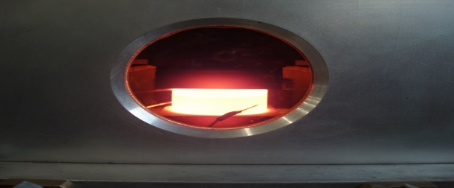
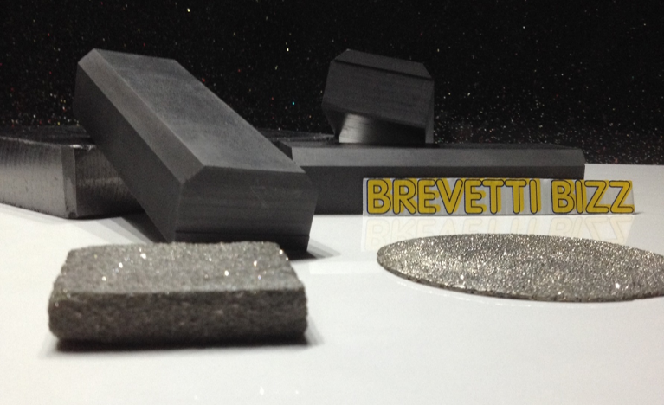
INDUCTIVE VACUUM HOT- PRESSING 150 TON 1500 C°
INDUCTION SPIRAL
INDUCTIVE VACUUM HOT PRESSING 900 C°
FURNACE CHAMBER
INDUCTIVE VACUUM HOT PRESSING 1500 C°
MATERIAL
Notes:
MATERIAL

Slide 13
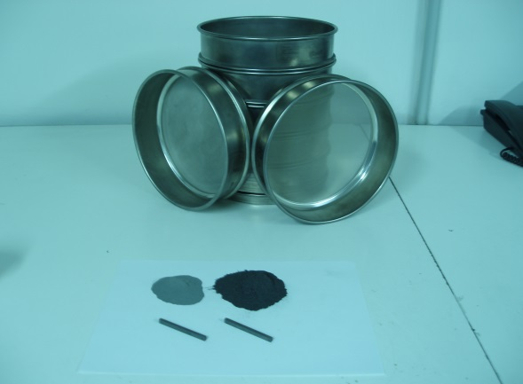

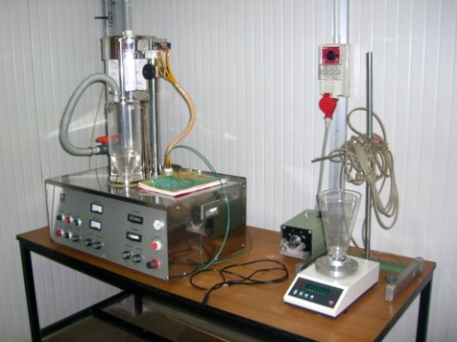
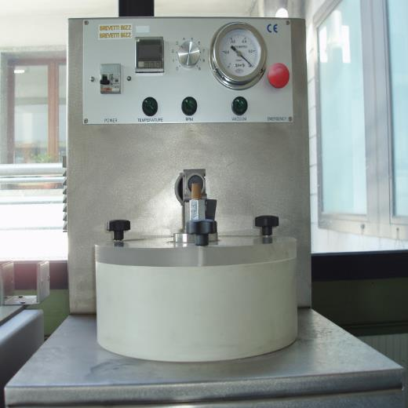
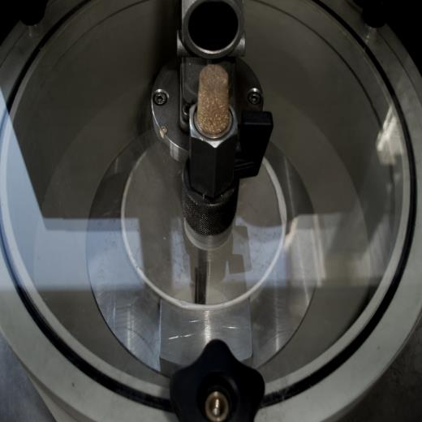
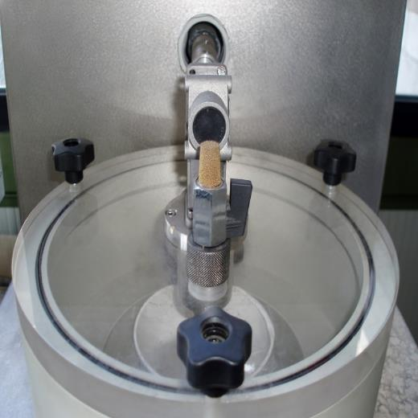
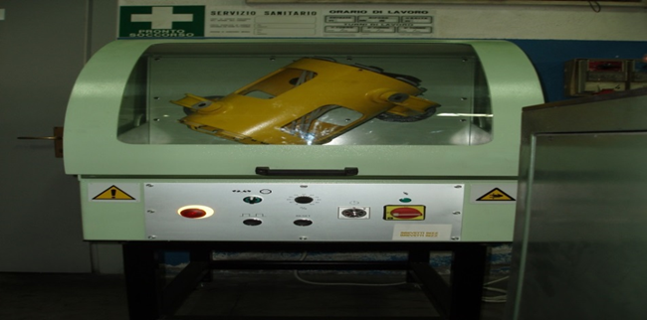

MACHINES FOR PREPARING POWDER COMPOSITES
SIEVES CALIBRATED
ASPIRATED BENCH
MACHINE FOR POWDER COATING PAUDAL
MIXER IN VACUUM AND HEAT

Slide 14
Material testing and machining

Slide 15
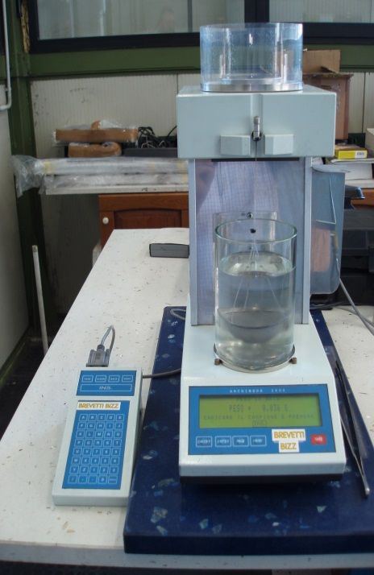
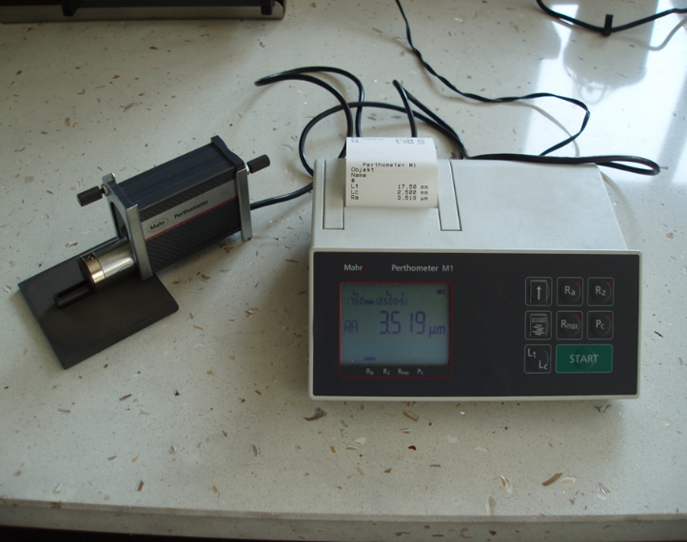
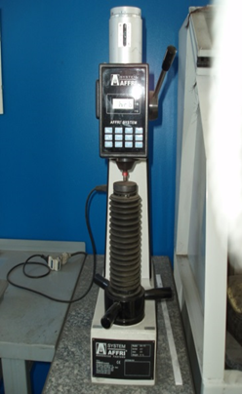
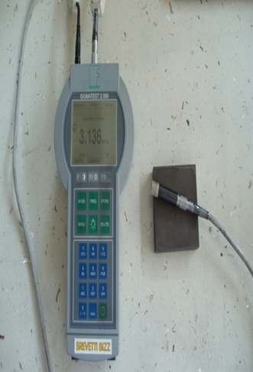
ROUGHNESS
DENSITY
DUROMETER
ELETRICAL CONDUCIVITY
Notes:
ELETRICAL CONDUCIVIT

Slide 16
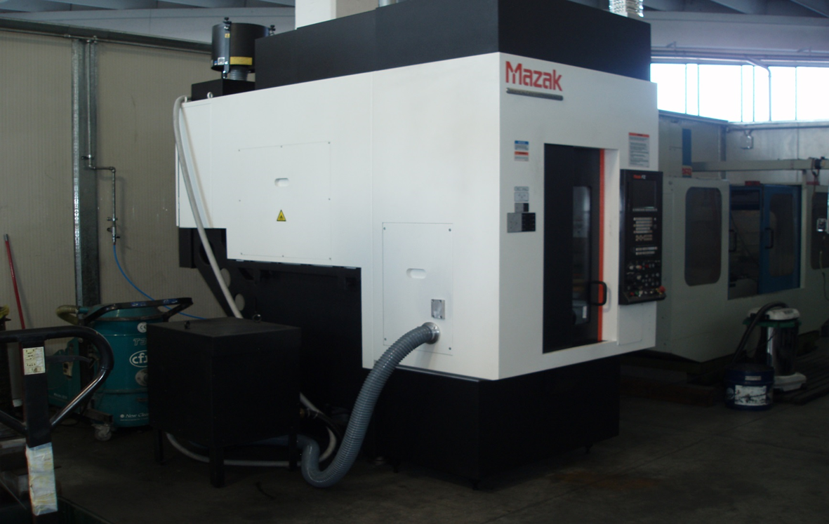



PROCESSING WITH CNC GRAPHITE
TAPERINGS - BLOCK HRMT23
PROGRAM FOR MACHINE 3D CNC
MOLD GRAPHITE
Notes:
TAPERINGS - BLOCK HRMT23

Slide 17






PROCESSING WITH CNC GRAPHITE
MOLD GRAPHITE

Slide 18




PROCESSING WITH CNC GRAPHITE
SAMPLE
SAMPLE
Notes:
SAMPLE

Slide 19
BREVETTI BIZZ SRL via dell’Industria 37047 San Bonifacio (VR) ITALY Tel.-Fax. +39 0456102718 www.brevettibizz.com – info@brevettibizz.com
Notes:
C

