Slide 2
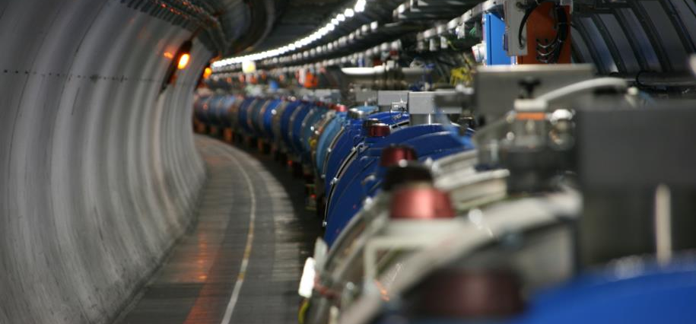
Powering tests preparation_meeting 9
Mirko Pojer and Matteo Solfaroli

Slide 3
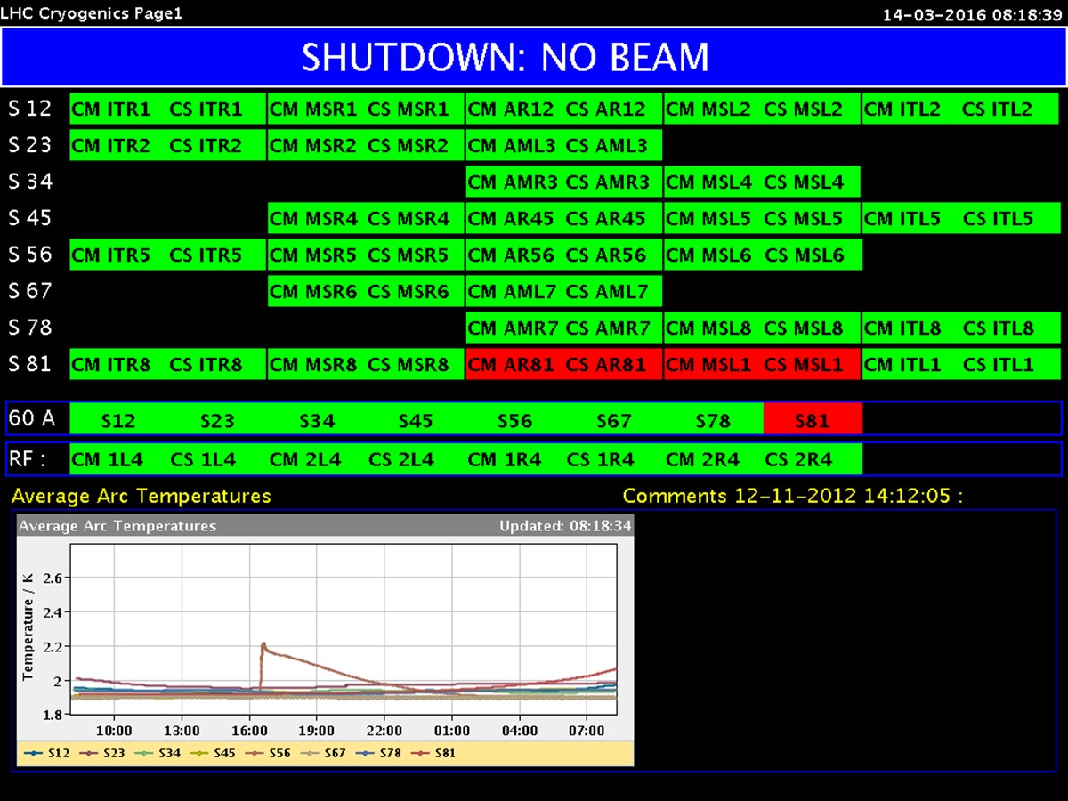
Cryogenics
Beam screen conditioning test done in
  S34
  S45
  S81 ongoing
  The others will be done during the week
Intervention completed on transformer EMT405/2U (18/3,3kV - 8MVA)-SU2
  Cryogenics for S12 and S23 is in a “unusual” configuration with both sectors cooled by the unique installation of P18
  Cold box at P2 was restarted on Fri.
  Reconnection of S23 on cold box @ P2 today
“maximum heat load” this week
  S78 from March 14th to 16th
  S23 from March 15th to 17th
2 days will be needed at the end to set S23 and S78 in Run II configuration

Slide 4
General news
New firmware deployed everywhere, but some issues in 7R (reset?)
A couple of QPS/EE issues (detailed list below):
  Many circuits tripped above 55 A (compensation?)
  Many circuits tripped during ramp-down, due to 0V-crossing (“sensitivity” of new boards?)
  Few circuits where the Z switch does not open
PID parameters changed for the IT correctors; tested in 5L, they are good but maybe not enough (330 K reached, CS lost); to be improved elsewhere
Problem of communication in L2 is understood:
  “ During components upgrade we tried latest version of CMWClient and CMWServer based in RD3: QPS-236
  We found many issues that we are now investigating: QPS-237
  We rolled-back all machines, and kept only QPS_12_DT2FL with RDA3 until beginning tests to evaluate the issues found: ENS-16724
  When we rolled-back latest project QPS_12_DT2FL, for any reason our management tool got confused reporting installed version was old one (RD2) meanwhile currently one was latestone (RD3).
  I forced the uninstall and install of RD2 version, and issue was solved. “
  Jonas Arroyo

Slide 5
Summary status
Circuit type | Completion [%]
RBs | 92% (7 commissioned)
RQs | 88% (6 commissioned)
ITs | 95% (All commissioned-sign.missing)
IPQs | 99%
IPDs | 100%
600 A | 95%
120-60 A | 98%
Total | 97% (8347 oo 8560 successful tests)

Slide 6
Status of RB circuits
RB.A12 OK
RB.A23 quenched at 11040 A (C24R2=2195, 1st quench), then OK
RB.A34 OK
RB.A45 OK
RB.A56 quenched at 11076 A (B33R5=3375, quenched in 2008)
RB.A67 OK
RB.A78 OK
RB.A81 OK

Slide 7
RQD/F tested with new current
RQD/F.A12
RQD/F.A23
RQD/F.A34
RQD/F.A45 not done
RQD/F.A56 not done
RQD/F.A67
RQD/F.A78
RQD/F.A81 tested with old value
Will have to test again at a further increased value

Slide 8
S12
XR1, LR1, ML2 and XL2 – COMMISSIONED
Missing in A12
  RSD1.A12B2: U_RES_max is slightly higher than criterion (73 instead of 70 mV)
  RQTF.A12B2: U_RES_max is 104 mV
  RQT13.R1B1: Noise in U_HTS
  RQT13.R1B2: U_Res is oscillating before quench@555A
  RQTL11.R1B1 and B2: trip on 0V crossing

Slide 9
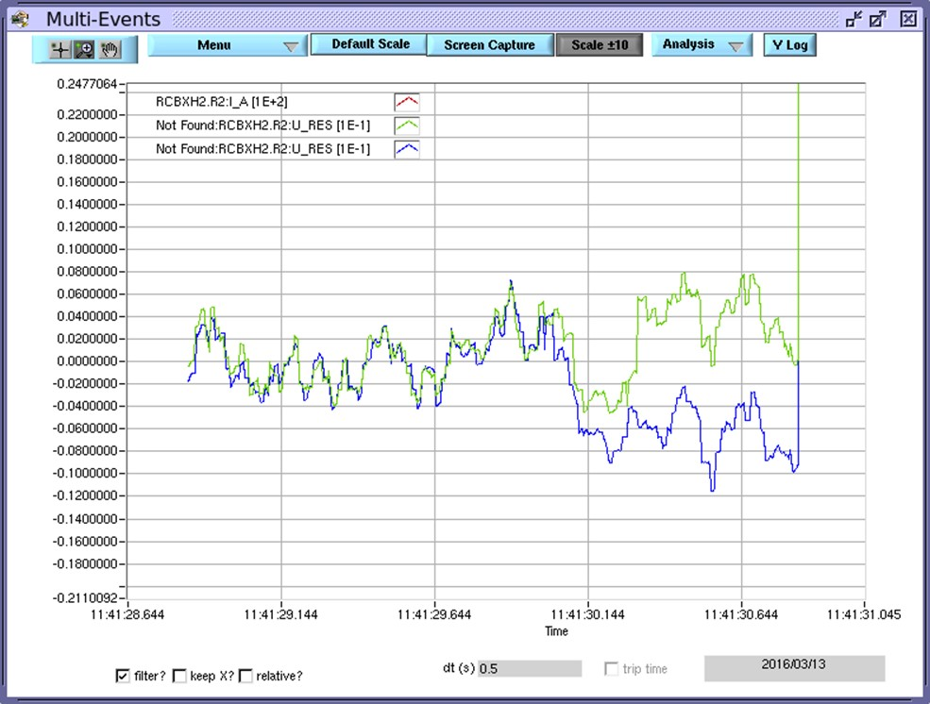
S23
Missing in XR2
  RCBXH2.R2: 3rd quench (477 A, 475 A and 470 A); is there something we don’t see?
MR2 - COMMISSIONED
Missing in A23
  Four 600 A missing the last test
  ROF.A23B1 – OK, but wrong I_DCCT reading

Slide 10
S34
Missing in A34
  RQTF.A34B1 – TT problem, circuit is super-locked; last test missing
  RCBV13.L4B2
    resistance is double the maximum: Giorgio cleaned the contacts, the connection was changed, but still not good.
Missing in ML4
  RU.L4 – Still some fine tuning missing

Slide 11
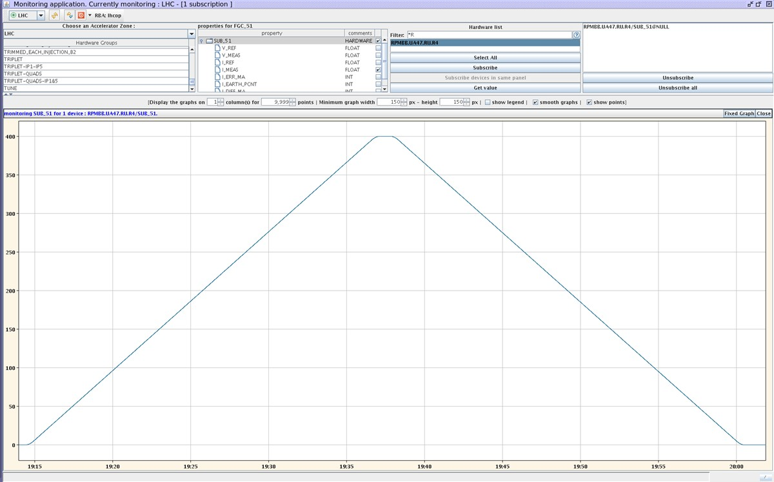
S45
Missing in MR4
  RU.R4 –was ramped twice to
  400 A with 0.3 A/s; at 0.5 A/s trips
  because of 0-V crossing!
Missing in A45
  RB.A45 commissioned, but quench loop was opened; MPE piquet did some reset, finally a hard reset fired the heaters of A26L5, C26.L5 and B27.L5
  RQD/F.A45 – Test at 2 kA was failed and flagged: some voltage feelers are not working; Q27.L5 QPS channel not working properly
  Few 600 A missing
    RQT13.L5B2 is not compensated (U_res saturated and trip at 55 A)
    ROF.A45B1 – problem with U_res
    RSD1.A45B1 – not in PMEA
    RQT12.L5B2 – last test missing
    RQTL11.L5B1 and B2 – 0V crossing trip (same parameters as in 2014/15)
Missing in LL5
  One 120 A failed PNO.d1
XL5 - COMMISSIONED

Slide 12
S56
Missing in XR5
  RCBXH1.R5 – negative cycle missing
  Three 600 A have T regulation problem (going below 290 K)
  Three 120 A have missing signatures
Missing in LR5
  RQ4.R5 – completed, but problem in lead T regulation
  RQ5.R5 – completed, but problem in lead T regulation
Missing in A56
  RQD/RF.A56 – problem with EE PM
  RQ9.R5 – one QPS file is missing
  RQS.A56B2 – Z switch did not open
  RQTL11.L6B1 – 3rd quench (-359 A, 350 A and 325 A) – MP3 to decide
  RQTL11.R5B1 – “exactly the same as yesterday”….???
  ROF.A56B2 – trip at FT
  RSD1.A56B1 – trip at FT
  RSD2.A56B1 – trip at FT
  Six 60/120 A have missing EPC signature
ML6 - COMMISSIONED

Slide 13
S67
MR6 - COMMISSIONED
Missing in A67
  ROD.A67B1 – tripping at 120 A: compensation?
  ROD.A67B2 – OK, but bad compensation
  RQ6.L7B1 and B2 – wrong dIdt (0.75 instead of 1.2) → EPC to synchronize
  RQS.A67B1 – Z switch did not open
  RQT13.L7B1 – trip at 56 A – not compensated
  RQTD.A67B2 – Failed PLI3.b1 since spikes in voltage of switch A and B
  RQTL10.L7B1 – trip at 56 A – not compensated
  RQTL10.L7B2 - 0V crossing trip
  RQTL11.L7B1 and B2 – 0V crossing trip
  RQTL7.L7B1 and B2 – 0V crossing trip
  RQTL8.L7B1 and B2 – 0V crossing trip
  RQTL9.L7B1 and B2 – 0V crossing trip
  RSD2.A67B1 – Z switch did not open
  RSD2.A67B2 – U_cap_Z far out of margin
  RSF1.A67B2 – failed because of U_CAP_A/B/Z
  RSS.A67B2 – Z switch did not open

Slide 14
S78
Missing in A78
  ROF.A78B2 – Z switch did not open
  RQ6.R7B1 – bad compensation?
  RQ6.R7B2 – trip at FT
  RQS.A78B2 – trip at FT
  RQT12.R7B1 – trip at 57 A – not compensated
  RQTL11.R7B2 – 0V crossing trip
  RQTL7.R7B2 – 0V crossing trip
  RQTL8.R7B1 – 0V crossing trip
  RQTL8.R7B2 – quench
  RSS.A78B1 – Z switch did not open
  RSS.A78B2 – trip at FT
  Four 60 A quenched during cycle; to be repeated
ML8 - COMMISSIONED
XL8 - COMMISSIONED

Slide 15
S81
Missing in XR8
  600 A – RCBXV3.R8 failed on T regulation
MR8 - COMMISSIONED
Missing in A81
  RQTL11.L1B2 – tripping on 0-V crossing
LL1 - COMMISSIONED
XL1 - COMMISSIONED

Slide 16
Accesses
CV at PM32 on Tue. 15/03
Wed. 16th March, 8h30-10h15 AM: forcing the end-of-zone door of the UJ561 in order to reach the PM56 lift for the CMS Emergency guide training course (patrol lost)
Thu. 17th March, 19h-21h: commissioning of the smoke detection of UXC55 (no personnel underground as the evacuation sirens will ring in all underground areas, LHC tunnel and CMS caverns)

