Slide 1
First Q4 cold mass engineering follow up meeting
16/03/2016
Q4 Status update
H. Felice, M. Segreti, D. Simon and JM. Rifflet

Slide 2
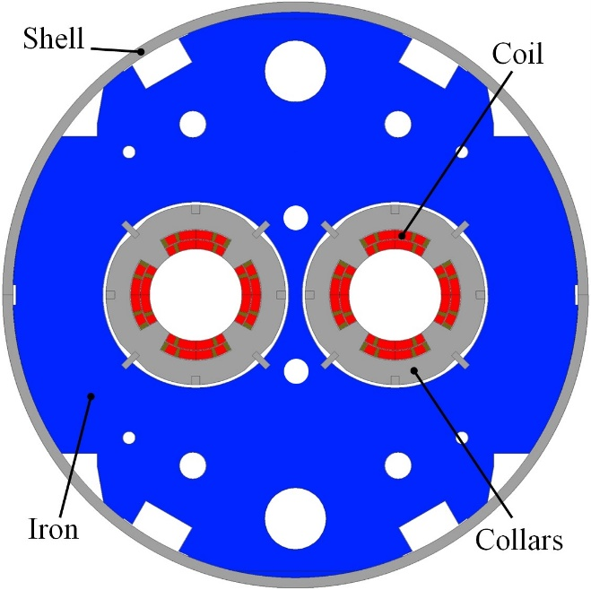
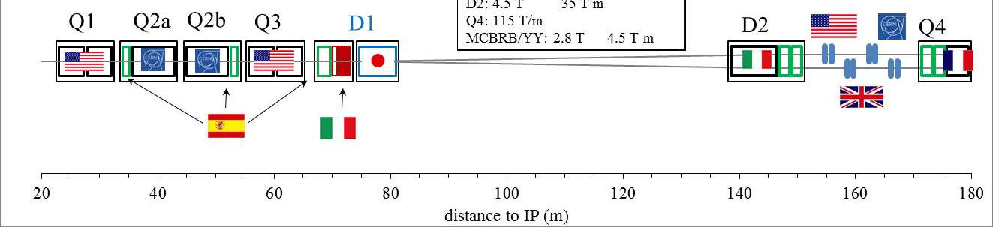
Quadrupôle Q4 pour le LHC (Hi-Lumi)
Quadrupôle en cos2θ double couche
Ouverture = 90 mm
Integrated gradient = 440 T
1,9 K Magnetic length = 3.67 m
Nominal gradient = 120 T/m
Temperature = 1.9 K
Nominal current = 4590 A
Stored energy = 0.81 MJ
3 main axis:
The single aperture short model MQYYM
The full length prototypes
The series magnets

Slide 3
Q4 Design Overview

Slide 4
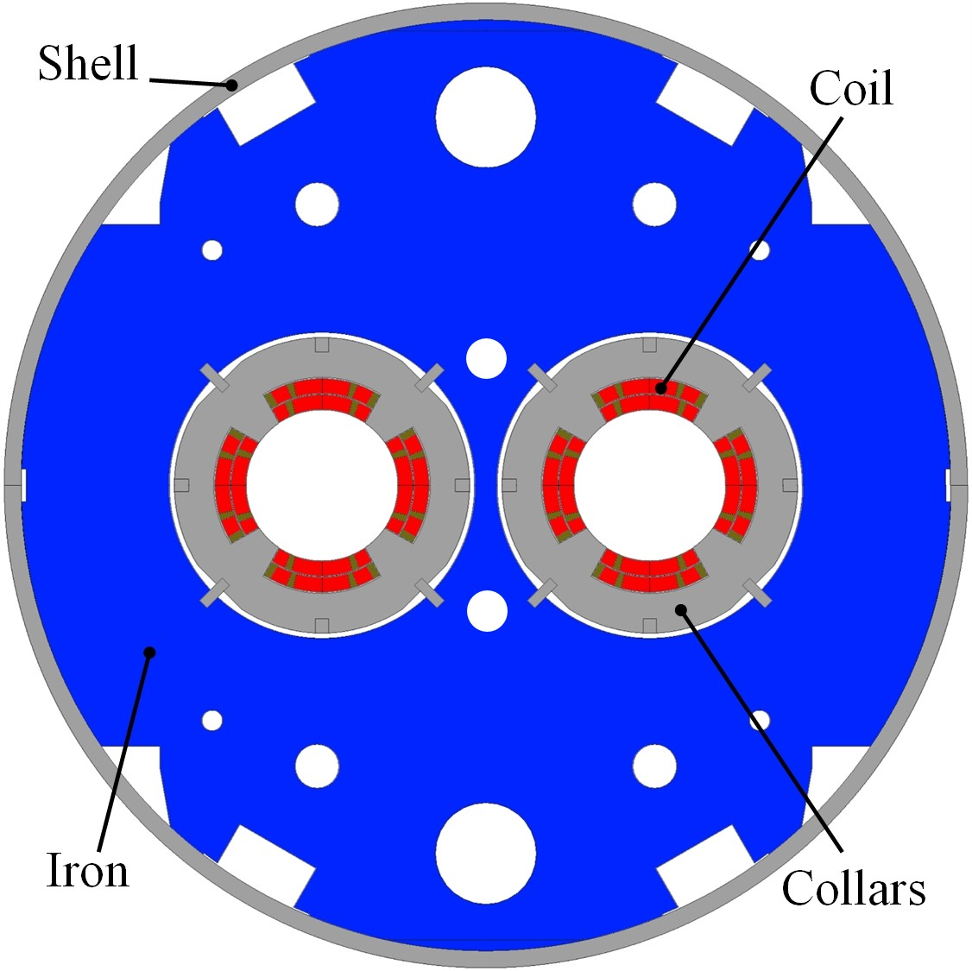
Magnetic design using MQM cable
2 layers of MQM cable
Inner blocks: 17 + 8 turns
Outer blocks: 16 +10 turns
Aperture = 90 mm (as before)
Integrated gradient = 440 T
Magnetic length = 3.67 m
Nominal gradient = 120 T/m
Loadline margin = 20 %
Temperature = 1.9 K
Nominal current = 4590 A
Stored energy = 0.81 MJ
Differential inductance = 2 × 37.5 mH
WP3 - Q4 update - 25 November 2015
| P 4

Slide 5
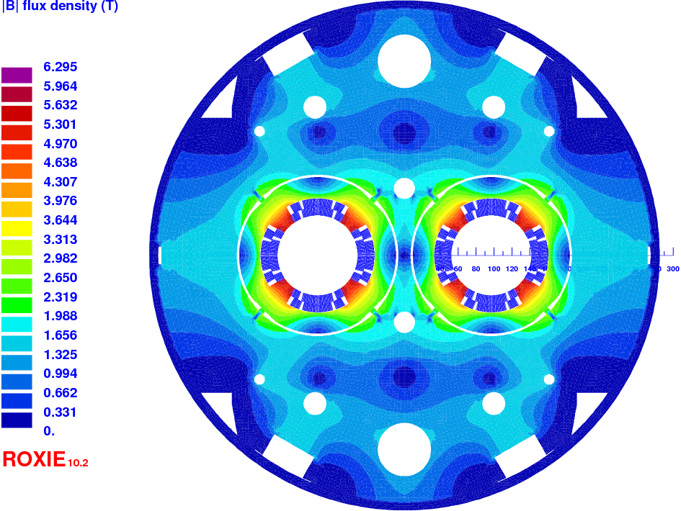
Magnetic design using MQM cable
Calculation with collars (assuming a relative permeability of 1.0025)
Re-optimized cross-section to minimize impact of collars on b6
WP3 - Q4 update - 25 November 2015
| P 5

Slide 6
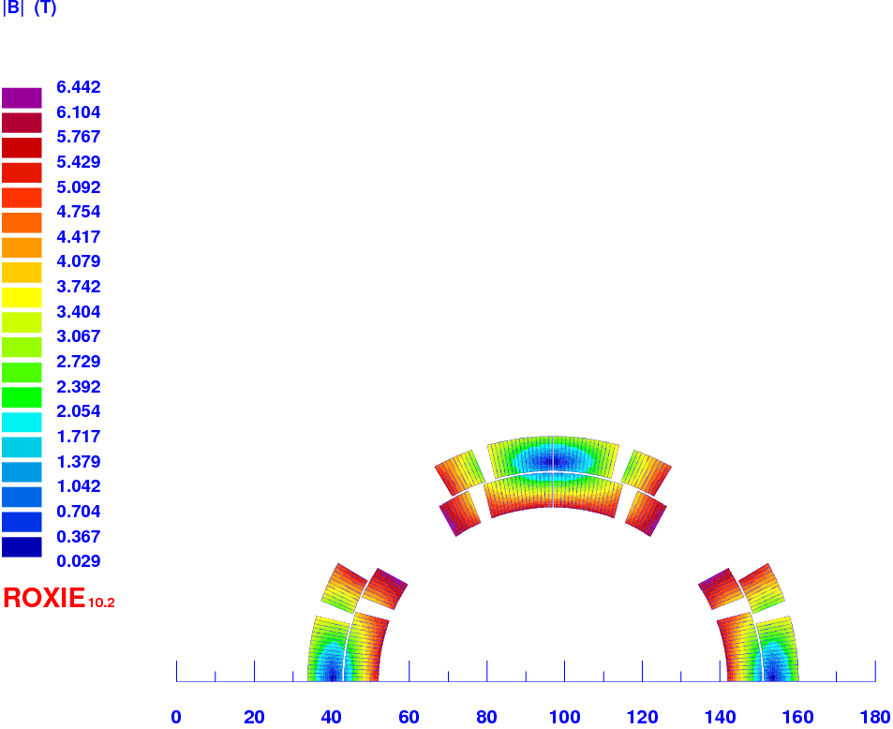
Magnetic design using MQM cable
Calculation with collars (assuming a relative permeability of 1.0025)
At 4590 A, collars increase the peak field on conductor by about 0.12 T
Peak field = 6.4 T
WP3 - Q4 update - 25 November 2015
| P 6

Slide 7
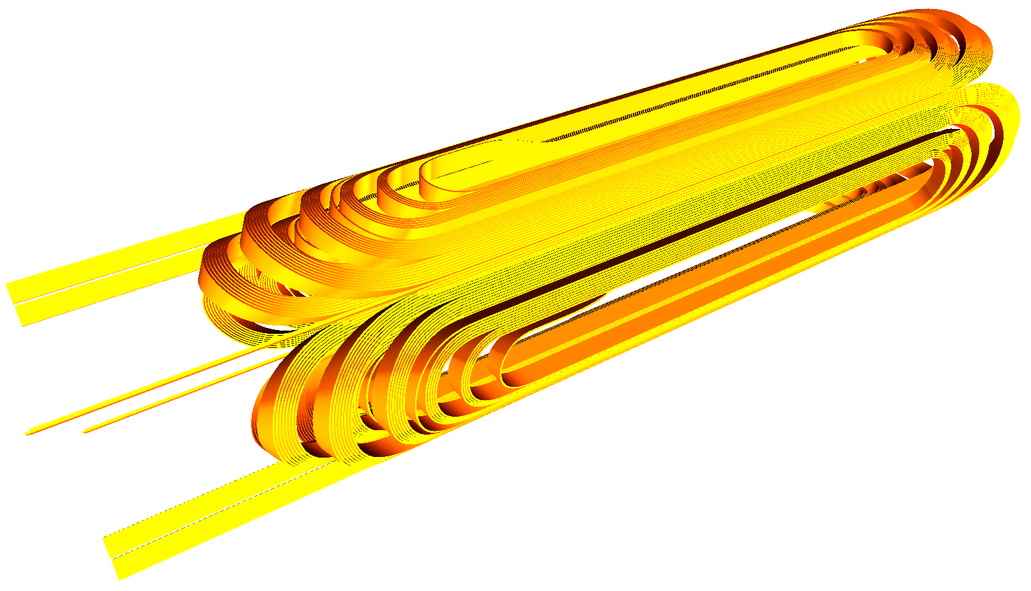
Coil ends
Return end
Lead end
View of a 600 mm long model
WP3 - Q4 update - 25 November 2015
| P 7

Slide 8
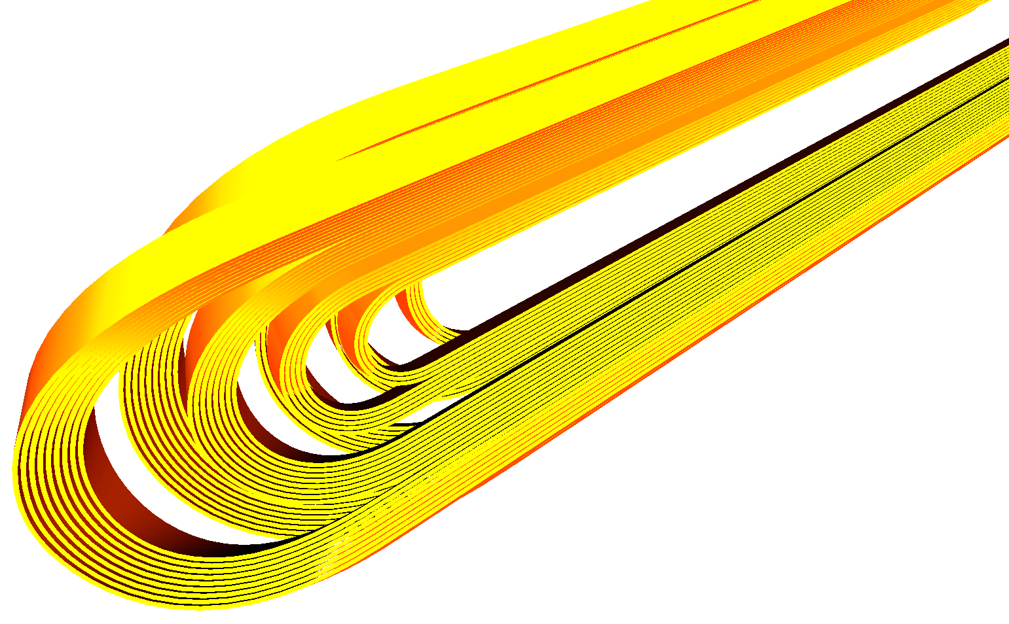
Coil ends
Localization of the peak field (6.5 T i.e. only 1 % higher than in the straight part)
WP3 - Q4 update - 25 November 2015
| P 8

Slide 9
Coil ends
Integrated b6 has been minimized
WP3 - Q4 update - 25 November 2015
| P 9

Slide 10
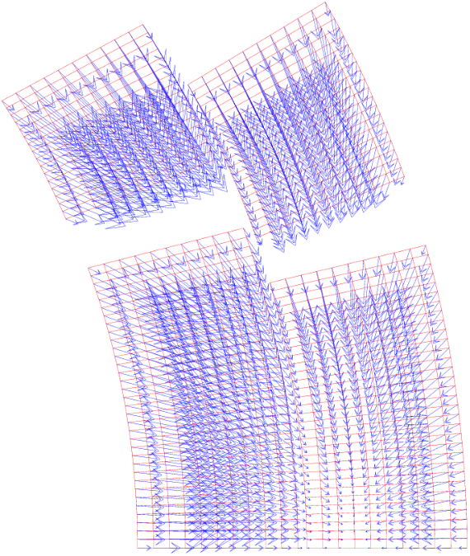
Mechanical study
Mechanical model
CAST3M
Simulation :
Collaring (key)
Insulation creep (20 %)
Cooling
Energisation at 110 % of I_{nom} → Magnetic forces are computed
at each coil node
WP3 - Q4 update - 25 November 2015
| P 10

Slide 11
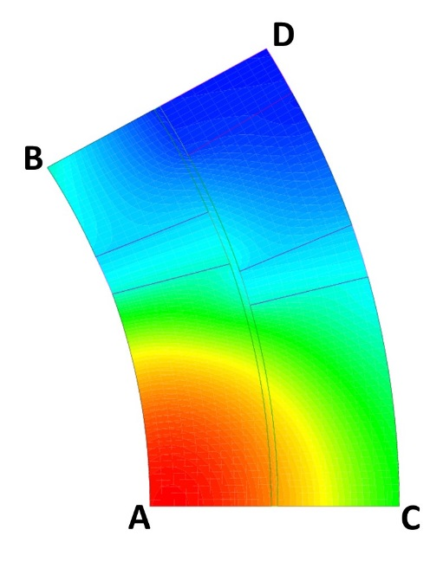
Mechanical study
The self-standing collar solution as mechanical structure is validated
WP3 - Q4 update - 25 November 2015
| P 11

Slide 12
Status of the Q4 development at CEA

Slide 13
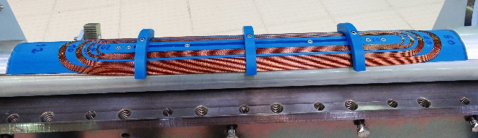
Single aperture short model MQYYM
Magnet key parameters
Single aperture
RT coil length = 1350 mm , RT Magnetic length = 1217 mm
Self supporting austenitic collars
non laminated yoke to speed up fabrication and lower cost
Time Frame
Detailed design phase: ongoing
  Drawings, Mock-ups
Procurement of tooling and components: April to Dec 2016
Coil fabrication should start in Fall 2016
Collaring at CERN with CEA team in Spring 2017
  Use of Vertical collaring press in 927
Yoking in Spring 2017, location to be defined
Test at Saclay => Summer 2017
CERN Contact persons:
Ezio Todesco for coordination
Juan Carlos Perez for specific activities: collaring, yoking and quench heaters
Rosario Principe for material: steel and stainless steel
Open questions (in discussion or not yet discussed)
Collar material availibility
Details on the press
Young modulus measuring machine modification
Protection heater fabrication

Slide 14
PROTOTYPES Magnets
Magnet key parameters
Double aperture
RT/1,9K Magnetic length = 3681 / 3670 mm
SPECIAL CONTEXT: the Pre-commercialization procurement (PCP) QUACO
EU finances 70% of the project but strong constraints on implementation
  Activity divided in 3 phases: conceptual design, engineering design, first-of-a-kind fabrication
  Firms in competition from one phase to the next: 4/3/2 firms in phases 1/2/3
NOT A BUILT-TO-PRINT
Time Frame
RFT in May 2016
Start of the work in January 2017
Prototypes delivered in Feb 2020
CERN Contact persons:
Marcello Lossaso for QUACO coordination
Ezio Todesco as WP3 leader
Arnaud Foussat on support for integration?
SOME Open questions
The choice of the mechanical solution for the support structure is open. If austenitic steel is used, the consortium commits to provide the material
Some mock-ups can be produced during QUACO, for example a slice of structure: use of the press at CERN?

Slide 15
SERIES MAGNETS
Magnet key parameters
Double aperture
RT/1,9K Magnetic length = 3681 / 3670 mm
Open questions
Transition between end of QUACO and start of the series, IP management…
Type of technical solution (mechanical solution found in QUACO can be different from the MQYYM)
Type of funding
Timeline:
4 magnets produced from 2021 to 2023
CERN Contact persons:
Ezio Todesco as WP3 leader
Arnaud Foussat on cold mass integration

Slide 16
PENDING DECISIONS and topics for discussion on integration
Yoke outer diameter: working assumption since yesterday (discussion with Ezio) 614 mm
Poisition of the cooling channel
Bus bars
Instrumentation: voltage taps, protection*
CLIQ?
Material availability for stainless steel collar: we would need some input
…

