Slide 1



4th International Workshop
on ADSR systems and Thorium
31 August 2016 to 2 September 2016
Accelerator Reliability requirements
for ADS: the MYRRHA project goals
Tomas Junquera
A.C.S. (Accelerators and Cryogenic Systems)

Slide 2
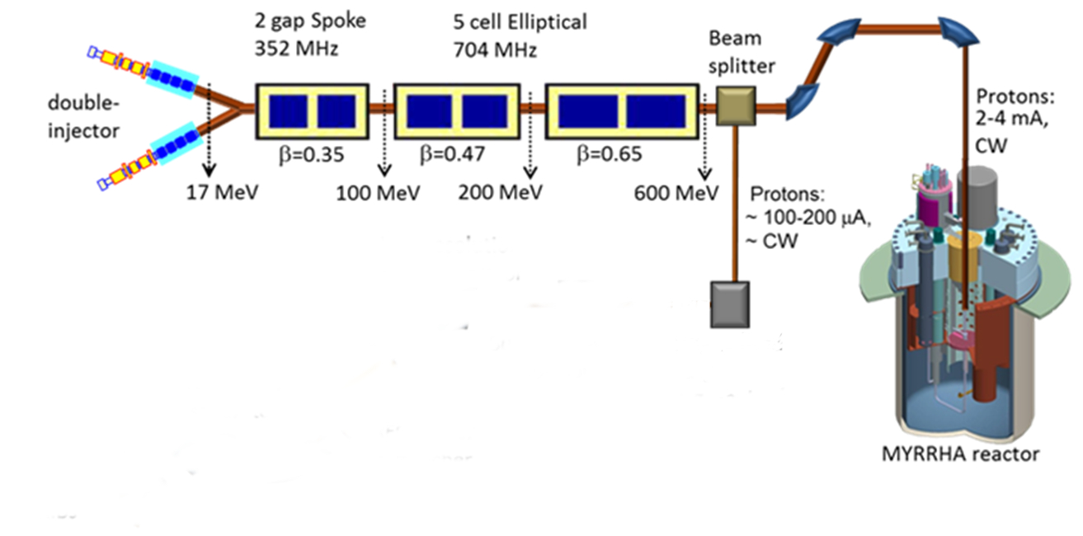
The Reference Conceptual Design of the MYRRHA accelerator was progressively introduced and developed within several Euratom projects :
PDS-XADS (2002 – 2004)
EUROTRANS (2005 – 2010)
MAX (2011 – 2014)
Proton
target
Cost optimization: 600 MeV for a MYRRHA demonstrator of 100 MWth
Beam current to control the reactor is determined by the thermal power and
the level of sub-criticality of the core. For MYRRHA (keff = 0.95) the nominal average current
is 2.5 mA corresponding to a mean beam power of 1.5 MW
4th Int. Workshop on ADSR and Thorium
T. Junquera Aug.30, 2016 2

Slide 3
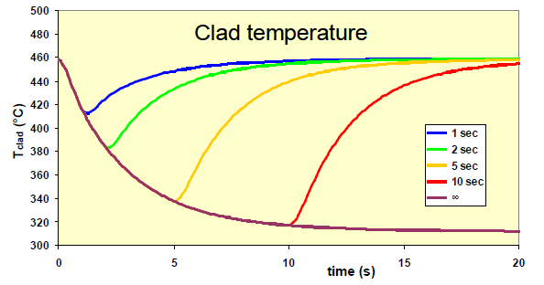
MYRRHA Accelerator Reliability requirements:
the number of beam interruptions should be limited to extremely low values
the limit was set to 10 beam interruptions per 3-month operating cycle, only interruptions of more than 3 seconds being counted, leading to a global accelerator MTBF of about 250 hours.
beam interruptions longer than a few seconds could lead, if repeated frequently, to unacceptably high thermal stresses on the highly irradiated materials of the target window, the fuel claddings and more generally on all the reactor structures
long beam interruptions will be associated with reactor shutdowns, affecting the availability of the system (restart procedures could last between 20 and 40 hours)
According to recent findings the allowable number of beam trips will be dominated by the material characteristics of the oxide layer protecting the fuel clads under LBE
4th Int. Workshop on ADSR and Thorium
T. Junquera Aug.30, 2016 3

Slide 4
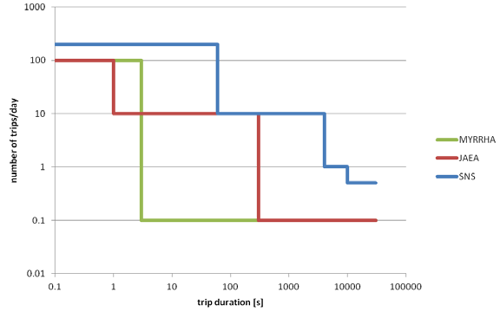
The reliability target for the MYRRHA ADS accelerator will need to be significantly higher than the actual reliability recorded worldwide on comparable accelerators in operation today, like the SNS which presently exhibits a MTBF of a few hours
SNS initial
SNS 2010-13
MYRRHA
JAEA
⇨ beam interruptions shorter than 3 seconds can be theoretically unlimited. In practice, it is proposed to limit the number of interruptions of duration inside the range 0.1ms – 3s to less than 100 per day,
4th Int. Workshop on ADSR and Thorium
T. Junquera Aug.30, 2016 4

Slide 5
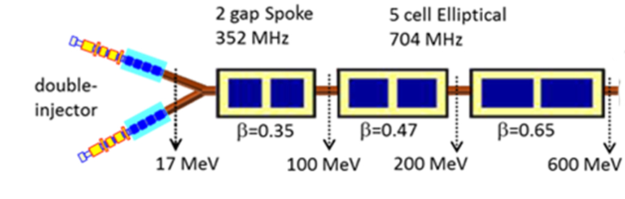
MYRRHA proposals:
To reach the reliability goal, the linac scheme will consist of 2 clearly distinct sections
A low energy section (injector or linac front end), where redundancy is applied in its parallel form, and so two similar compact injectors with fast switching capabilities are foreseen.
A medium and high energy section (main linac or independently-phased superconducting section), highly modular, based on individual, independently controlled accelerating cavities. Fault tolerance concepts (serial redundancy ) can be applied to yield a strong tolerance to faults.
4th Int. Workshop on ADSR and Thorium
T. Junquera Aug.30, 2016 5

Slide 6
The Reliability Issue: developments within the Euratom projects
FP5: PDS-XADS activities
Initial reliability studies INFN 2003
Qualitative FMEA (Failure mode and effects analysis)
RBD (Reliability Block Diagram) analysis
Assessment of (lack of) existing MTBF database
Identification of redundant and fault tolerant linac configurations
FP6: EUROTRANS activities
Linac design and R&D: modular fault-tolerant concept (2010)
Reliability analysis , MonteCarlo approach with Matlab
FP7: MAX project
Global fault tolerant beam dynamics design (2013)
Reliability model of an existing accelerator (SNS Linac) (2012)
Reliability model of the Myrrha Linac (2014)
H2020: MYRTE → work initiated in 2015
Reliability analysis of LINAC4 (CERN)
Commissioning results analysis
R&D on components for reliability enhancement
Present activities
4th Int. Workshop on ADSR and Thorium
T. Junquera Aug.30, 2016 6

Slide 7
Recent Reliability studies for Myrrha
Modelling of SNS reliability and comparison with operation results
(MAX Nov. 2012)
Reliability model for Myrrha: first estimations (MAX June 2014)
These works were developed within FP7 MAX and presently pursued in H2020-MYRTEprojects
The Work Packages were coordinated by Empresarios Agrupados (Spain), with the participation of SCK, IPNO, ACS, Thales and, more recently, with CERN
4th Int. Workshop on ADSR and Thorium
T. Junquera Aug.30, 2016 7

Slide 8
1. SNS reliability model
(developed within the MAX project by E.A. Nov. 2012)
Goal: develop an accurate reliability model of the MYRRHA accelerator using the methodology applied for nuclear power plants. A reliability model of an existing accelerator (SNS) has been developed.
SNS Logbook operational data was recorded during the period October 2011 – June 2012, and is available on the SNS website
The detailed reliability model of the SNS has been developed using Risk Spectrum, based on the fault tree built in consideration of the above-mentioned input data
Theoretical results from the model and the operational data records (real operation data) were then compared, and it was concluded that the RS model can be considered a trustworthy tool to further build the model for evaluation of the Myrrha linac reliability
4th Int. Workshop on ADSR and Thorium
T. Junquera Aug.30, 2016 8

Slide 9
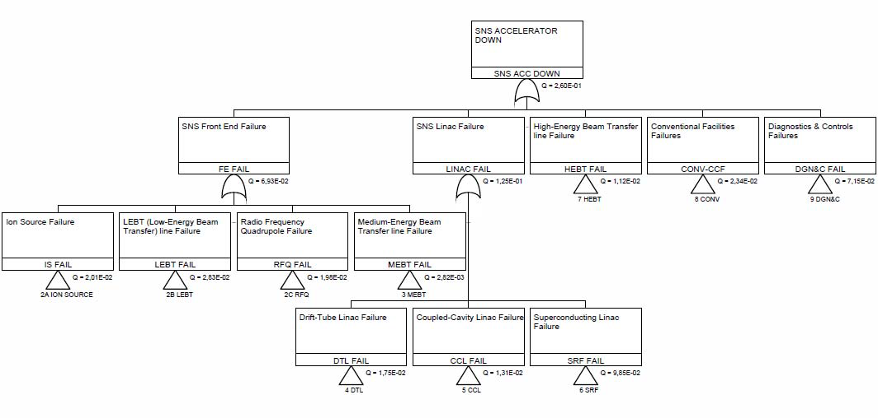
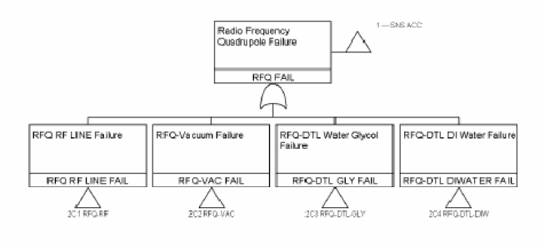
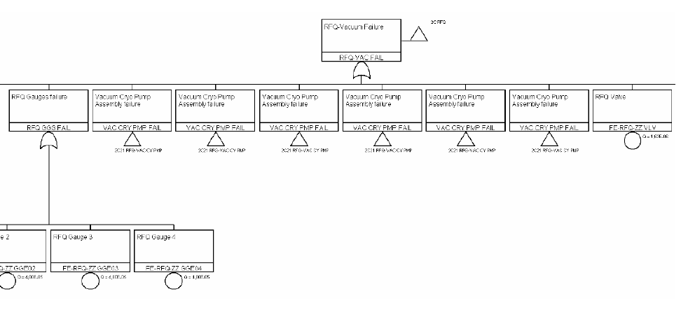
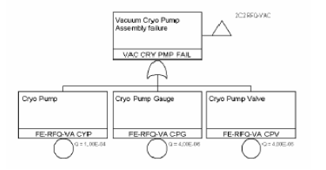
SNS fault tree
A detailed Risk Spectrum fault tree model has been developed using the methodology applied for
Nuclear Power Plants
Linac Accelerator
RFQ
Cryopump
RFQ vacuum
4th Int. Workshop on ADSR and Thorium
T. Junquera Aug.30, 2016 9

Slide 10
Component failures : basic events were modeled using the RS Repairable Model – RS model Type1
Inputs : Parameters necessary to quantify the repairable model
Failure rate, λ=1/MTBF
Mean time to repair, MTTR
Results
failure probability Q(t)
mean Unavailability (Qmean)
SNS Linac analysis results
Global Mean Availability A = 1 - Q = 73 %
with details for all system s and components
The highest values of Unavailability have been found (in this order) for:
SCL (Q=9.85E-02; A=90%)
DGN&C (Q=7.15E-02; A=93%)
Front-End (Q=6.93E-02; A=93%)
The Linac components (DTL-CCL-SCL) represents the system most affected by failures, in terms of unavailability (Q=1.25E-01; A=87.5%)
4th Int. Workshop on ADSR and Thorium
T. Junquera Aug.30, 2016 10

Slide 11
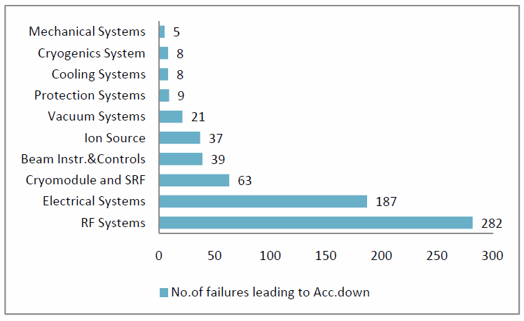
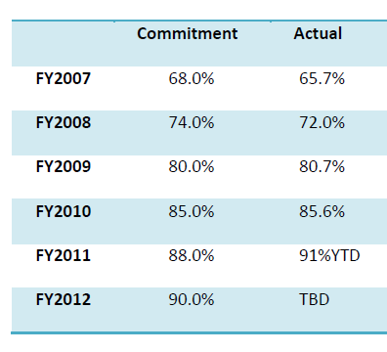
October 2011 – June 2012,
Beam Trips: 660
SNS LogBook
Year Availability
Model: 73 % in agreement with results from 2008
Better results in last years
MTTF and MTTR values used for model
quantification may be too conservative
improved operational reliability and improvements of the maintenance program
4th Int. Workshop on ADSR and Thorium
T. Junquera Aug.30, 2016 11

Slide 12
2. MYRRHA model (July 2014)
Based on the development of the SNS reliability model , a preliminary reliability model of the MYRRHA linac was developed
The MYRRHA reliability constraint (no more than 10 beam trips longer than 3 seconds
per 3-month operation cycle), may be reformulated as following: the Mean Time
Between Failures (MTBF) of the beam delivery must be > 250 h, a failure being
defined as a beam trip > 3 s.
. For the MYRRHA accelerator, the following 3 principles have been adopted
regarding the reliability goal:
Use of components far from their limits (margins)
Fault-tolerance (serial redundancy)
Redundancy/ Repairability
Input Data: The Myrrha linac Risk Spectrum model has been developed from studies in precedent Myrrha programs activity
Quantified in most part using the reliability data from SNS in terms of failure data (MTTF) and repair time data (MTTR), when high grade of similitude between SNS and Myrrha linac components and systems was observed.
4th Int. Workshop on ADSR and Thorium
T. Junquera Aug.30, 2016 12

Slide 13
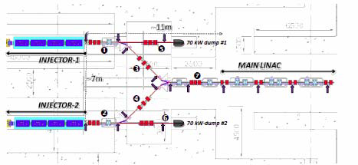
Two major design improvements for the MYRRHA Linac
1. Parallel beam redundancy at the injector In order to increase the reliability in the low energy section of the MYRRHA accelerator, the
philosophy followed consists in doubling the whole 17 MeV linac, providing a hot stand-by spare injector able to quickly resume beam operation in case of any failure in the main one.
The fault-recovery procedure is based on the use of a switching dipole magnet with laminated steel yoke connecting the two injectors through a ‘double-branch’ Medium Energy Beam Transport line.The reference scenario of injector reconfiguration, which should take not more than 3 seconds was defined
4th Int. Workshop on ADSR and Thorium
T. Junquera Aug.30, 2016 13

Slide 14
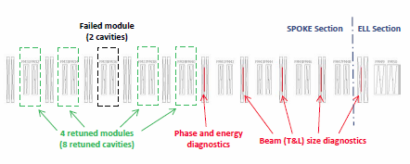
2. SC Linac Serial Redundancy: a missing element's functionality can be replaced by retuning other elements with nearly identical functionalities.
The fault tolerance can be effective if accompanied by a realistic switching time and an MTTR much shorter than the MTBF of the failing element. A switching time of three (3) s, which is the sum of the fault detection time and the reconfiguration time, could be a realistic goal in view of the performances of present day digital electronics.
Such a fault-tolerance scheme applied to RF systems or focusing element failures was already experimentally confirmed in the SNS linac.
4th Int. Workshop on ADSR and Thorium
T. Junquera Aug.30, 2016 14

Slide 15
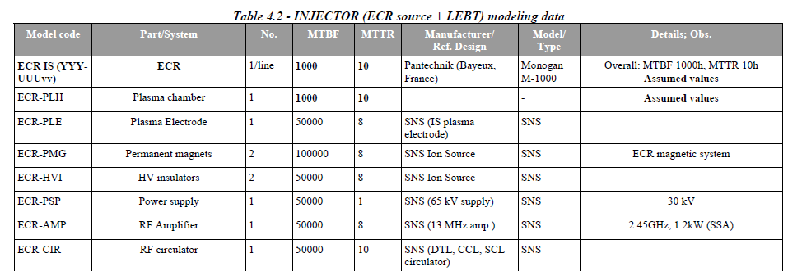
Modelling Data
Reliability data inputs for 155 types of components/systems
Number of components considered in the reliability model simulations
(examples):
150 accelerating cavities (RT and SC)
60 cryostats
150 RF amplifiers,
148 Q-poles with 148 power supplies
4th Int. Workshop on ADSR and Thorium
T. Junquera Aug.30, 2016 15

Slide 16
MYRRHA Linac reliability model results
Events: combination of events which causes the top event to occur.
⇨ Initial MYRRHA Linac Model running has been performed without considering redundancy of the front end or any failure compensation in the superconducting part.
Mean availability A = 70% (the limit availability), which is slightly worse than in the SNS case (A = 73%), due to the increased number of cavities in the SCL part with
correspondingly increased capacity and number of components of the auxiliary support systems
The initial frequency result was 550 trips/year (137 trips/3months)
Introduction of redundancy (injector and cavities fault tolerance)
Strongely reduces the beam trips number: 100 trips /year
Further optimizations on other components, and identifying all failures that could be considered compensable by parallel redundancy, lead to :
A = 97.7% and the frequency result was 38 trips/year (~ 10 trips/3 months)
4th Int. Workshop on ADSR and Thorium
T. Junquera Aug.30, 2016 16

Slide 17

Present activities
EURATOM
MYRTE program:
Reliability related Work Packages
R&D activities are strongly focused on the injector reliability:
Ion Source - LEBT (existing) & RFQ (in construction) & developments on operation
control systems (Platform for low energy proton beam dynamics)
Dedicated to reliability studies (collecting failure datas, long run tests …)
Improvements of the Fault compensation procedure:
Improvements on cavity set points , possibility to use more cavities to compensate
one failure
RF systems: solid state amplifier and digital low-level RF control system
Reliability modelling : Beam commissioning Tests with the Linac 4 at CERN
Smart and Reliable Control
4th Int. Workshop on ADSR and Thorium
T. Junquera Aug.30, 2016 17

Slide 18
Recent decisions
→ November 2015 : SCK proposal for a phased approach
  100 MeV linac / prep. 600 MeV / reactor R&D 2024
  600 MeV 2030
  ADS (2032)
→ 100 MeV + useful proton target(s)
  goal: relevant fault tolerance check
  layout: modified MAX, 1 injector + single spoke
  applications: 1 HP target + 1 ISOL target
milestone | date
ground breaking | 2018
very first beam | 2021
hold point | 2024
nominal beam | 2025
1st milestone: September 2017
  Technical Design Report
  Decision to launch construction
4th Int. Workshop on ADSR and Thorium
T. Junquera Aug.30, 2016 18

