Slide 1
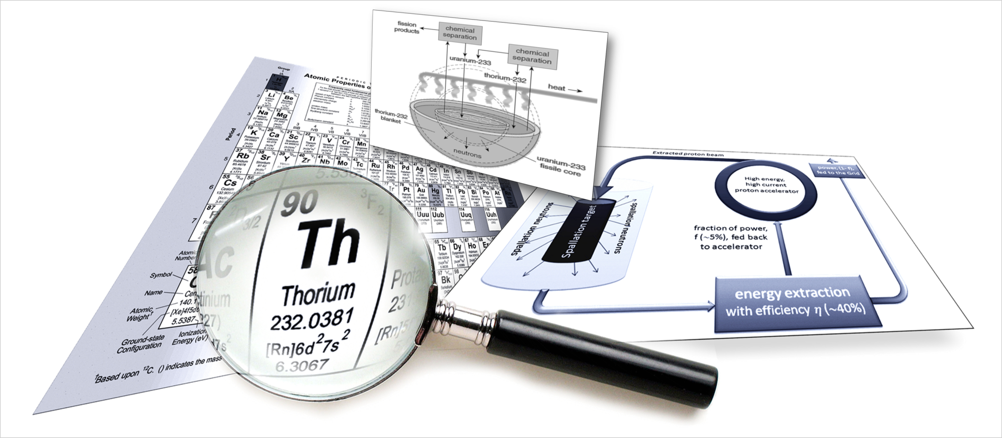
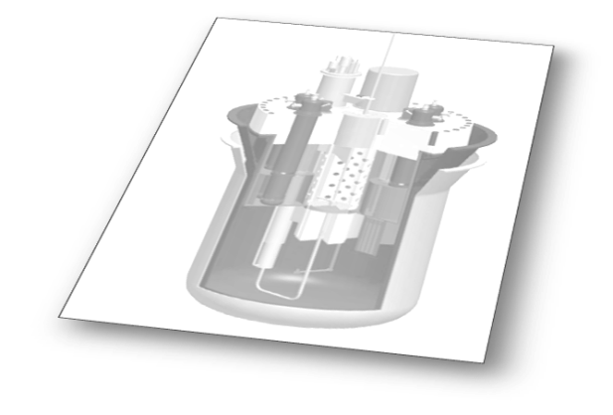
Thorium power: where are we now?
Bob Cywinski
Professor Emeritus
International Institute for Accelerator Applications
University of Huddersfield, UK

Slide 2
Thorium
γ
²³²Th
n
²³³Th
β
22 mins
²³³U
²³³Pa
β
27 days

Slide 3
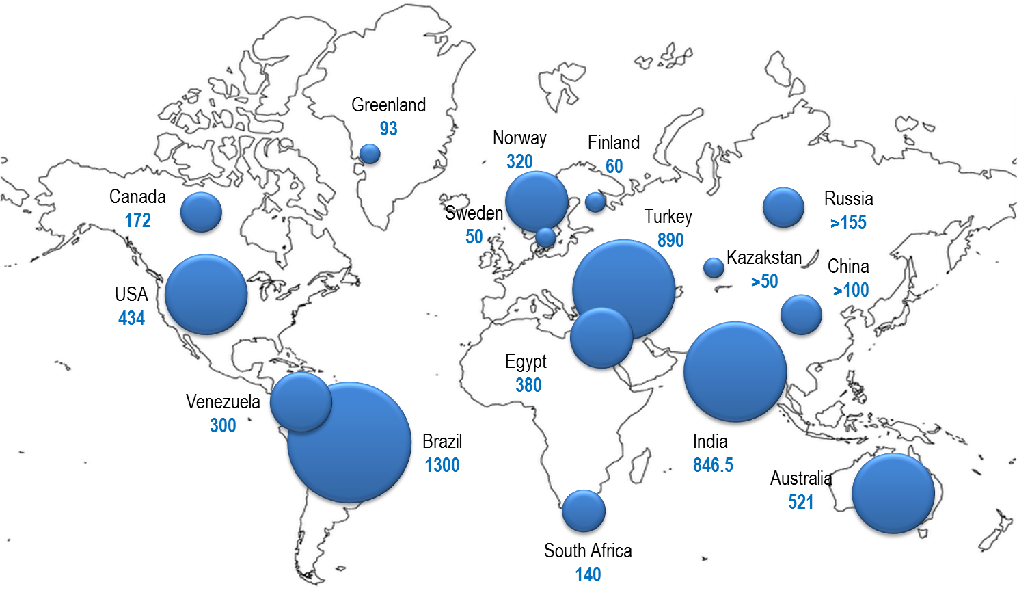

Known thorium resources (ktonnes)

Slide 4

Fighting ignorance……
“There is little chance that thorium-fuelled nuclear reactors will play a major role in meeting the UK’s future energy requirements......
.........No thorium reactor design has been implemented beyond relatively small, experimental systems”
Baroness Tina Stowell,
Government spokesman on energy and climate change
House of Lords
November 2011

Slide 5

Where were we then….
Country | Name | Type | Power | Operation | Fuel
Germany | AVR THTR | HTGR HTGR | 15 MW_{e} 300 MW_{e} | 1967-1988 1985-1989 | Th+U235, coated particles
UK (OECD/ Euratom) | Dragon | HTGR | 20 MW_{th} | 1966-1973 | Th+U235, coated particles
USA | Peach Bottom Fort St Vrain | HTGR HTGR | 40 MW_{e} 330 MW_{e} | 1967-1974 1976-1989 | Th+U235, coated particles
USA | Shippingport Indian Point 1 | LWBR PWR LWBR PWR | 100 MW_{e} 285 MW_{e} | 1977-1982 1962-1980 | Th+U233 Oxide pellets
India | Kamini Cirus Dhruva | MTR (LWR) MTR MTR | 30 kW_{th} 40 MW_{th} 100 MW_{th} | In operation In operation In operation | Al+U233, J-rod of Th&ThO₂

Slide 6
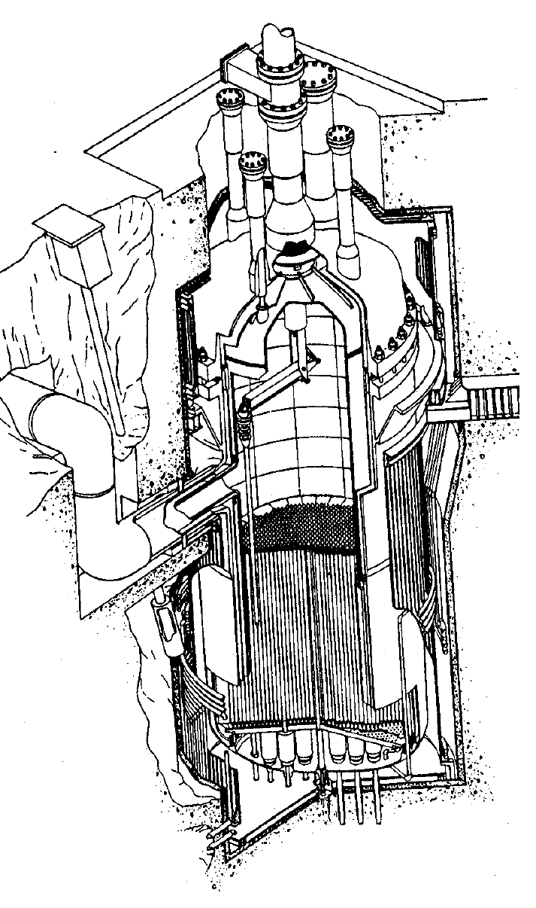
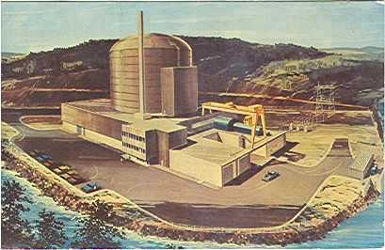
Peach Bottom, USA - HTGR
General Atomics' Peach Bottom high-temperature, graphite-moderated, helium-cooled reactor in the USA operated between 1967 and 1974 at 110 MW_{th}.
Fuel particles were highly-enriched
uranium /thorium in PyC (Briso) shells

Slide 7
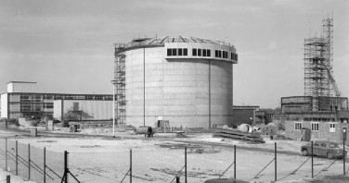
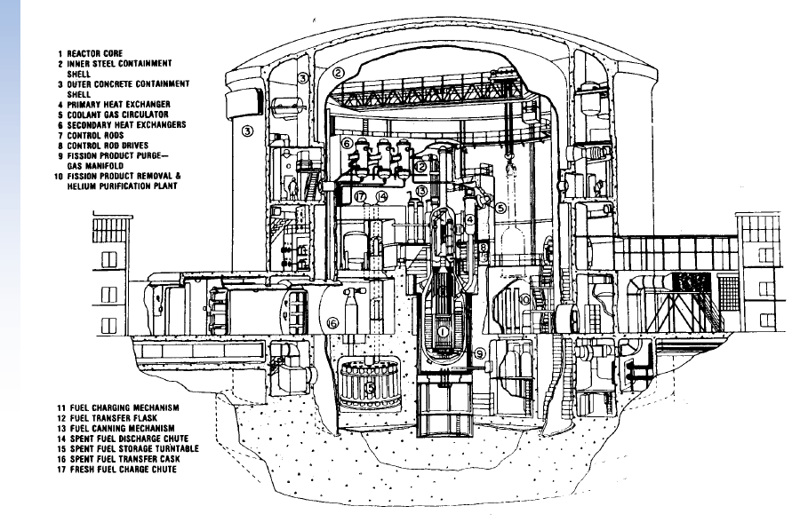
Dragon, UK (OECD/Euratom) - HTGR
Thorium fuel elements with a 10:1 Th/U (HEU) ratio were irradiated in the 20 MWth Dragon reactor at Winfrith, UK, for 741 full power days between 1964 and 1973
The Th/U fuel was used to 'breed and feed', so that the U-233 created replaced the burnt U-235 at the same rate, and fuel could be left in the reactor for about six years.

Slide 8
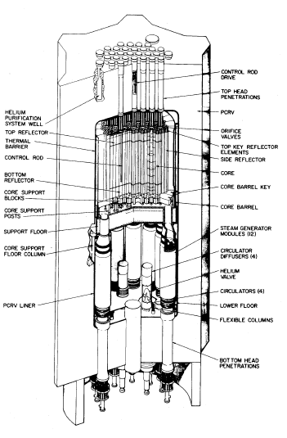
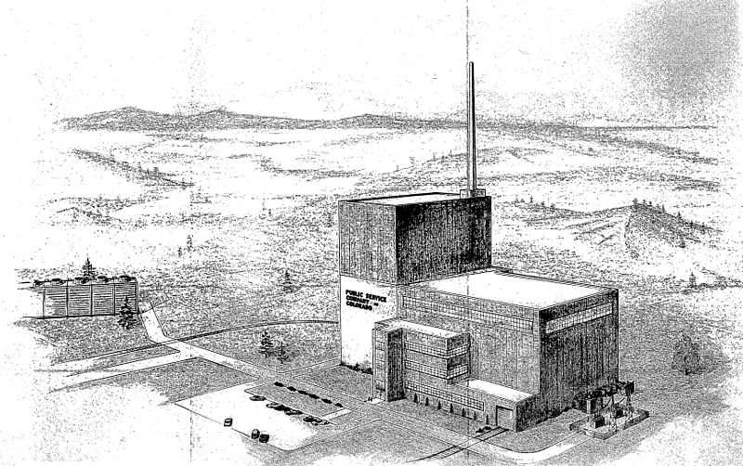
Fort St Vrain (US) - HTGR
Fort St Vrain operated between 1974-1989 as a high-temperature (700°C), graphite-moderated, helium-cooled 842 MWth (330 MWe)
~25 tonnes of thorium was used in fuel for the reactor in prismatic configuration, achieving 170,000 MWd/t burn-up.

Slide 9
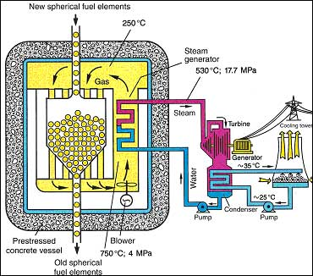
AVR (Germany) - HTGR
The Helium cooled AVR (Atom Versuchs Reaktor) experimental pebble bed reactor at Jülich, Germany, operated between 1967 and 1988, for over 750 weeks at 15 MWe, about 95% of the time with thorium-based fuel.
Approximately 100,000 billiard ball-sized fuel elements were used.
Overall a total of 1360 kg of thorium was used, mixed with high-enriched uranium (HEU). Burnups of 150,000 MWd/t were achieved.

Slide 10
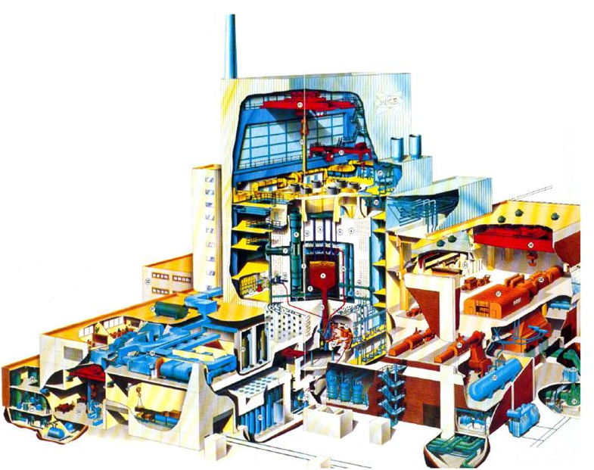
Thorium HTR (Germany) - HTGR
The 300 MWe THTR (Thorium High Temperature Reactor) operated between 1983 and 1989.
THTR was fuelled with 674,000 pebbles, over half containing Th/HEU fuel (the rest graphite moderator and some neutron absorbers).
The fuel pellets were continuously recycled with the fuel passing through the core an average of six times.

Slide 11
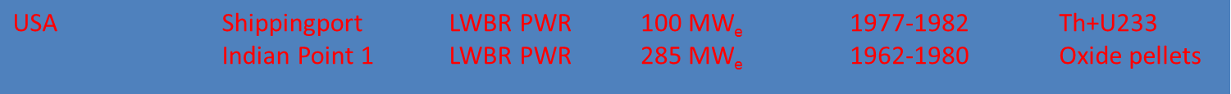
Where were we then….
Country | Name | Type | Power | Operation | Fuel
Germany | AVR THTR | HTGR HTGR | 15 MW_{e} 300 MW_{e} | 1967-1988 1985-1989 | Th+U235, coated particles
UK (OECD/ Euratom) | Dragon | HTGR | 20 MW_{th} | 1966-1973 | Th+U235, coated particles
USA | Peach Bottom Fort St Vrain | HTGR HTGR | 40 MW_{e} 330 MW_{e} | 1967-1974 1976-1989 | Th+U235, coated particles
USA | Shippingport Indian Point 1 | LWBR PWR LWBR PWR | 100 MW_{e} 285 MW_{e} | 1977-1982 1962-1980 | Th+U233 Oxide pellets
India | Kamini Cirus Dhruva | MTR (LWR) MTR MTR | 30 kW_{th} 40 MW_{th} 100 MW_{th} | In operation In operation In operation | Al+U233, J-rod of Th&ThO₂

Slide 12
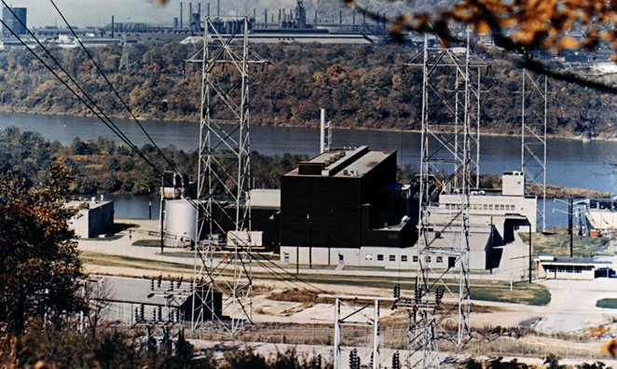
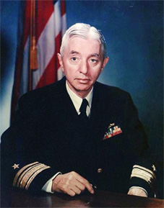
Shippingport LWBR

Slide 13
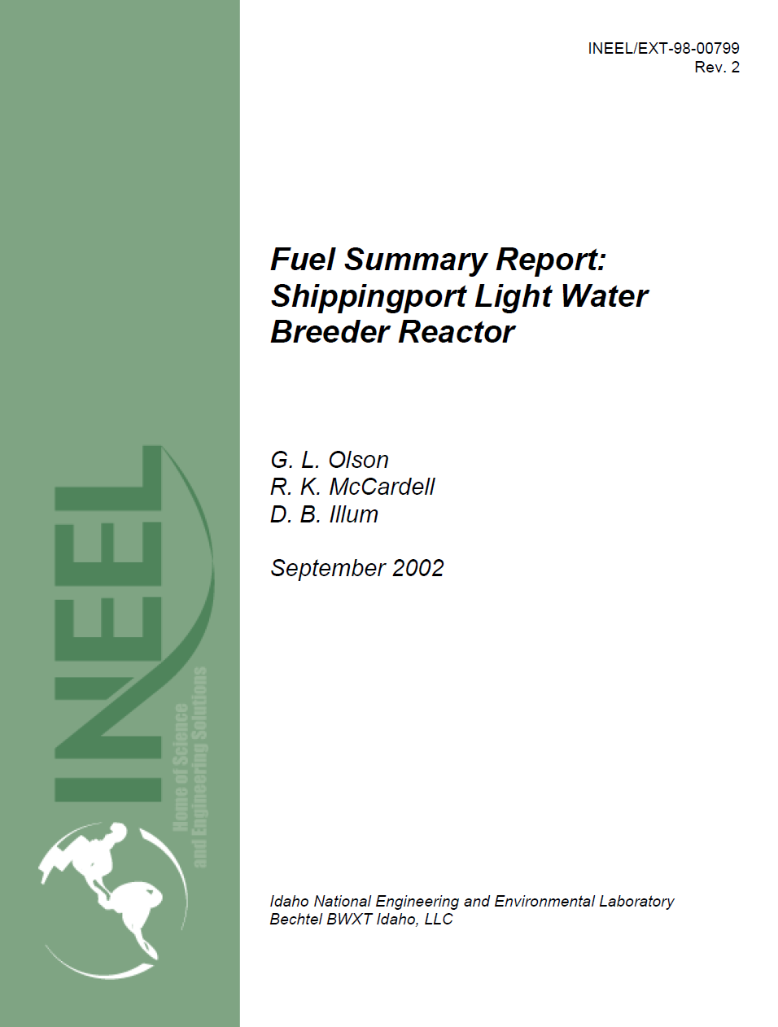
Shippingport LWBR
The Shippingport 100MW_{e} Light Water Breeder Reactor (LWBR) was developed by Bettis Atomic Power Laboratory to demonstrate the potential of a water-cooled, thorium oxide fuel cycle breeder reactor.
The LWBR core operated for 29,000 full power hours between 1977–1982 The fuel and fuel components suffered minimal damage during operation, and the reactor testing was deemed successful.
Extensive destructive and nondestructive postirradiation examinations confirmed
that the fuel was in good condition with minimal amounts of cladding deformities
and fuel pellet cracks.

Slide 14
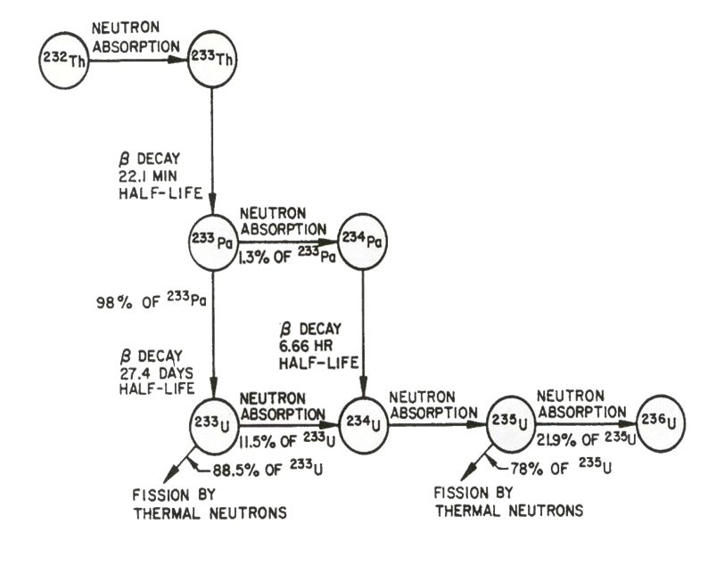
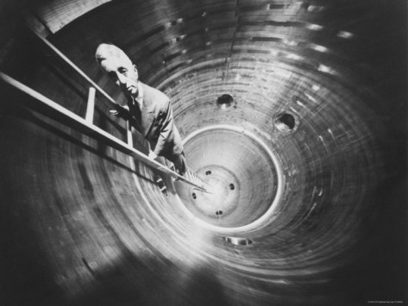
Shippingport LWBR
The Shippingport LWBR project was deemed a technical success:
After 5 years and 2.5x10⁹ kWh of electrical power it showed no sign of reaching the end of its useful life, but was closed in 1982 because of budgetary constraints and the need to determine whether breeding occurred
Approximately 1.3% more fissile material than at the start of operation was found in the core
But …..there was no follow through:
There was little effort to promote the technology.
The assembly of the core modules required excessive manual labour implying a high production cost
No effort to develop other U/Th reactors in an effort to help spread the fixed costs
The program was seen as Admiral Rickover’s pet project.

Slide 15
Shippingport LWBR
“Uranium-233/thorium cores can be designed and built, can be operated in existing LWR plants to produce electricity, and can breed enough fissile fuel to overcome modest losses in reprocessing and refabrication.
For the United States in particular, this means that the plentiful domestic supply of thorium, a material with no other significant use, can become an important energy source.
This resource can provide about 50 times as much energy as the domestic supply of uranium used in current LWRs. The light-water breeder thus has an energy potential that could meet the entire electrical needs of the United States for centuries.”
J. C. CLAYTON
WESTINGHOUSE ELECTRIC CORPORATION
1993

Slide 16
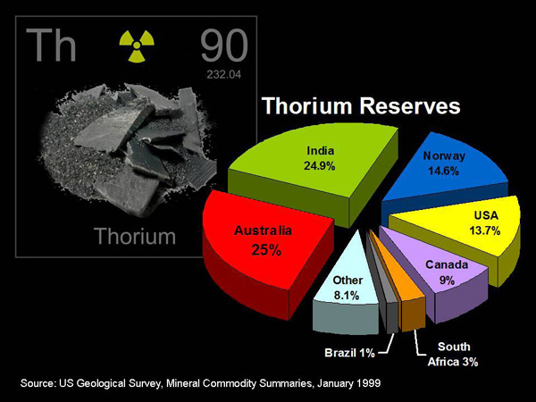
Initial drivers for thorium deployment (60s, 70s)
An alternative fuel cycle in anticipation of a projected rapid growth in nuclear power and possible shortage of natural uranium.
Thorium’s abundance in nature
The price for uranium reached $40.00/pound by the mid-1970s
The absence of uranium resources but large amounts of identified thorium resources in some countries having an ambitious civil nuclear program
A good in-core neutronic and physical behaviour of thorium fuel
A lower initial excess reactivity requirement (higher thermal conversion factor) of thorium based cores with particular configurations.

Slide 17
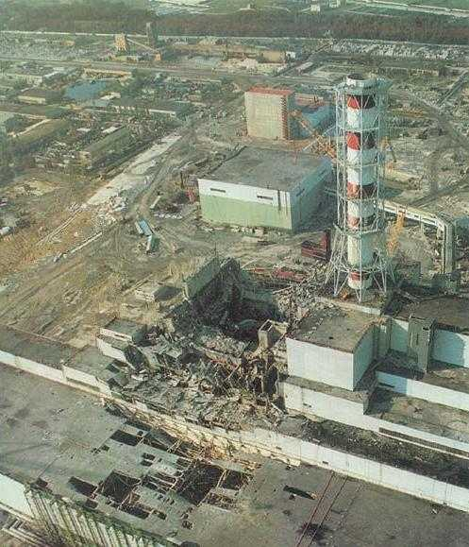
Brakes on thorium deployment (80’s)
Interest in the nuclear option waned significantly, and public support for nuclear power dramatically declined following TMI and Chernobyl.
Low priced uranium was available in the early 1980s and for over two decades,
introduction to the market of down-blended uranium obtained from nuclear weapon disarmament programs
The absence of reprocessing capability in the U.S for recovery and recycling of fissile U233 (stopped by Carter and Ford)
Proliferation concerns with a HEU thorium cycle: HEU chemically separable from thorium

Slide 18

Current drivers for thorium deployment
All the drivers from the 60s and 70s plus
The potential for the low production of Pu and minor actinides in thorium based-fuel cycles
The capability of destroying plutonium by fissioning it in a plutonium/thorium cycle in thermal reactors. (LWRs, HTRs, MSRs, ADS )
The transmutation of higher actinides and destruction of legacy waste
The possibility of breeding fissile isotopes
More recently, the dramatic increase in the price of uranium that is tied to the perceived shortage

Slide 19
CO₂ emissions and electricity production
Grams of CO₂ per kW.hr
Average of ~500g CO₂ per kW.hr

Slide 20
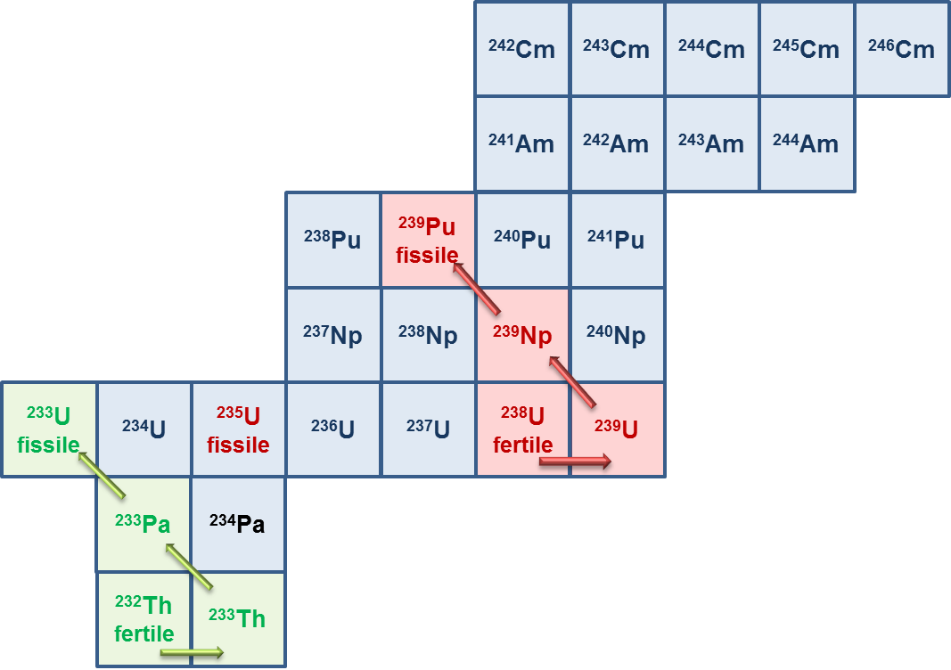
Uranium and Thorium fuel cycles

Slide 21
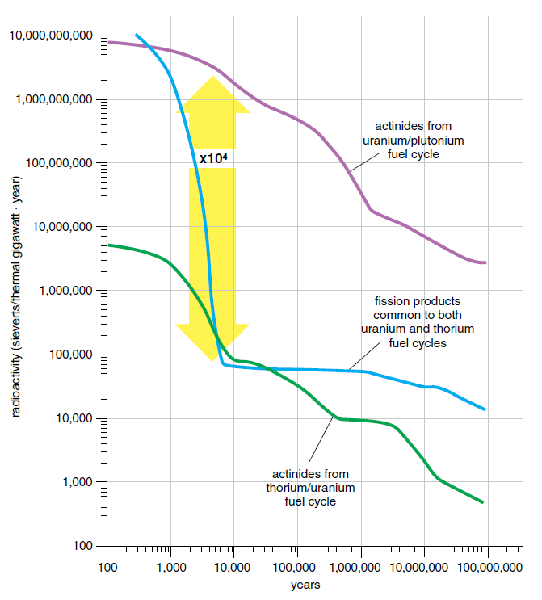
Nuclear waste: U and Th fuel cycles
1,000,000,000
100,000,000
10,000,000
1,000,000
100,000
100,000
10,000
1,000
100
100
100
10
10
100
1,000
10,000
100,000
1,000,000
10,000,000

Slide 22
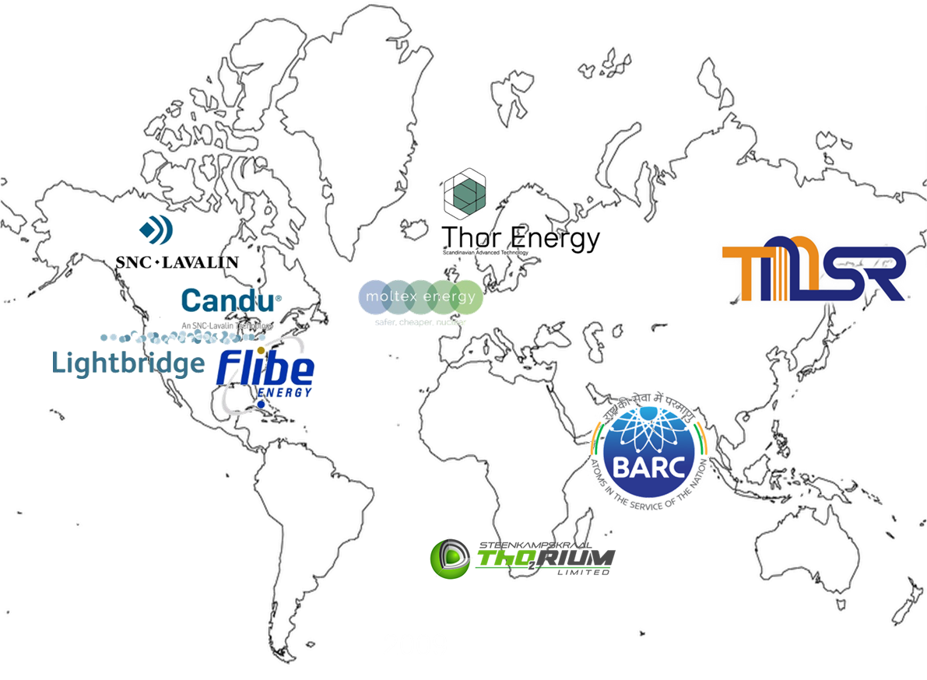
Current industrial global interest

Slide 23

Political interest
“In the future, new technologies may bring with them the possibility of improved technical features in nuclear reactors, for example through enhanced safety or through use of waste materials.
We heard that there are a number of advantages of switching to a thorium fuel cycle.
The UK must remain an active participant in thorium research and development
We recommend that the Government commission a study to confirm the potential benefits of thorium in the longer-term and how potential barriers to its use might be overcome”

Slide 24
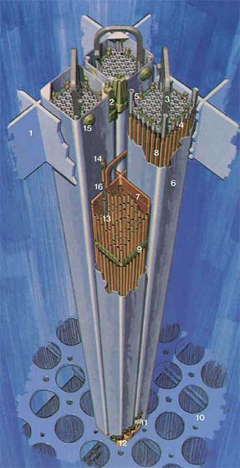
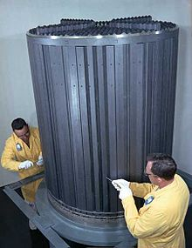
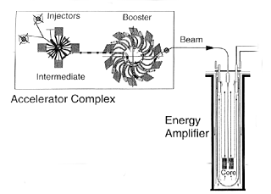
Thorium deployment
1.
Conventional Systems
(LWR, PWR, HTGR)
2.
Molten Salt Reactors
After Weinberg’s
Oak Ridge MSRE
3.
Accelerator Driven Subcritical
Reactors (ADSRs)
After Rubbia’s Energy Amplifier Concept

Slide 25
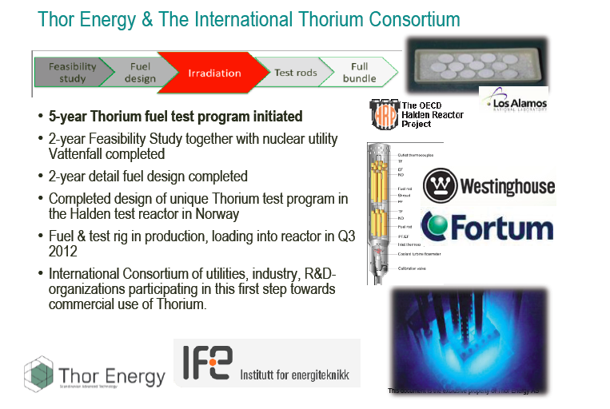
1. Conventional reactors

Slide 26
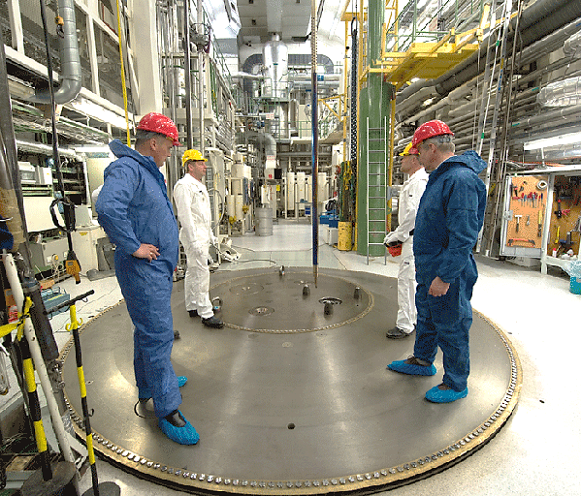
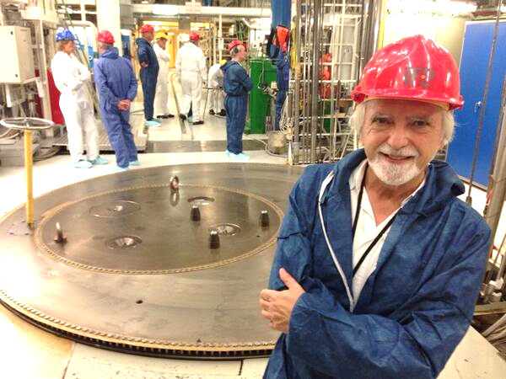
Thorium in the 25MW BWR Halden Reactor

Slide 27
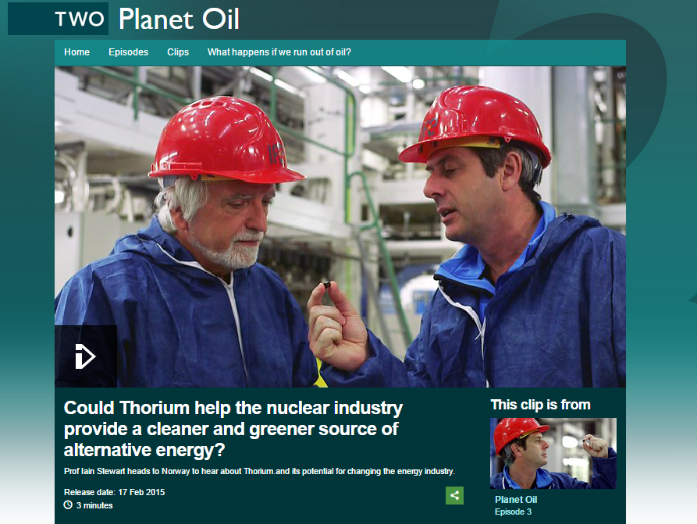
Thorium in the 25MW BWR Halden Reactor
BBC2 “Planet Oil” with
Professor Iain Stewart

Slide 28
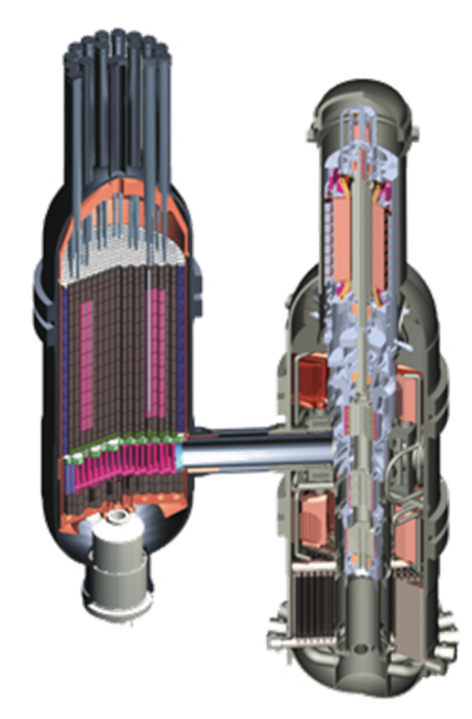
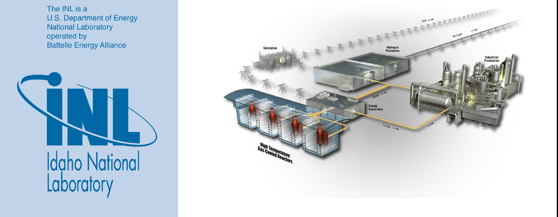
The future: Th-fuelled HTG modular reactors?
eg Areva’s Antares HTGR system

Slide 29
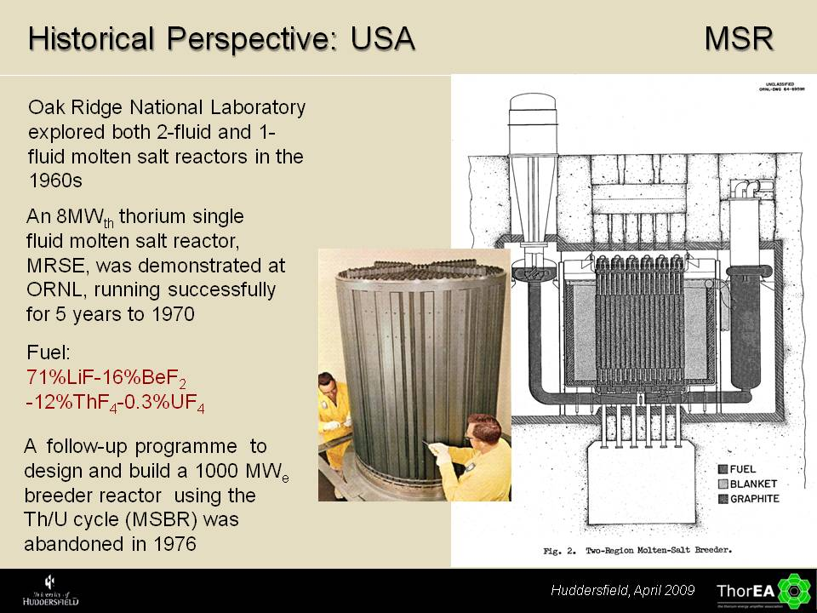
2. Molten salt reactors

Slide 30
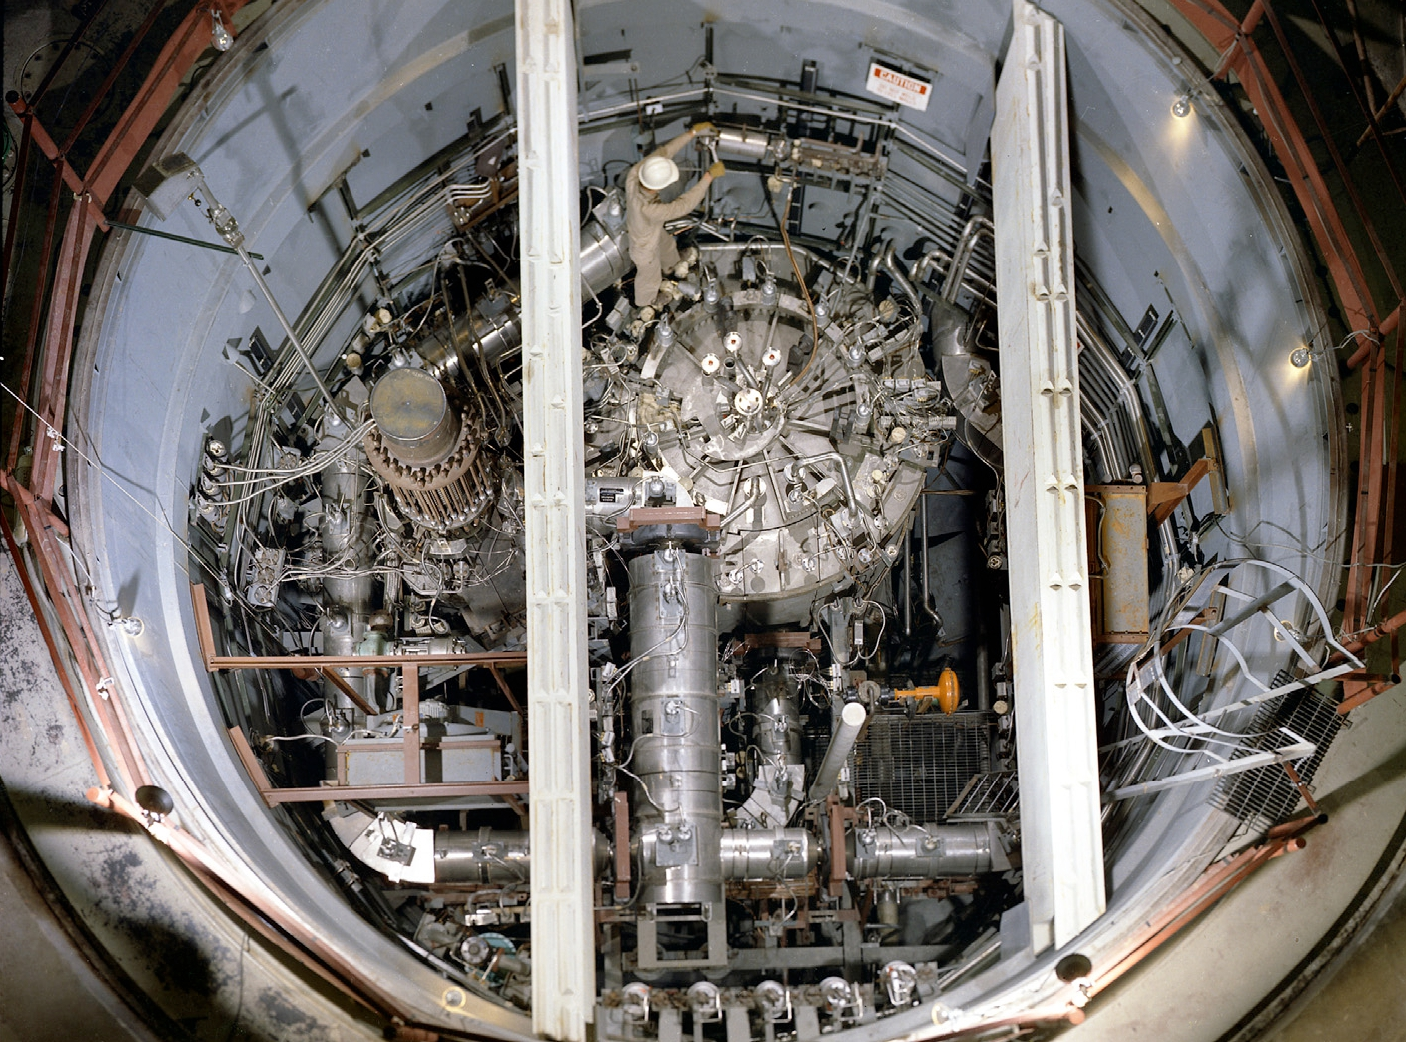

Weinberg’s MSR

Slide 31
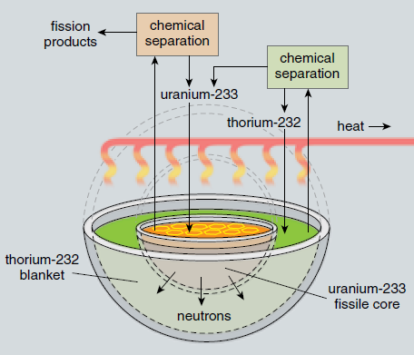
A two fluid MSR

Slide 32
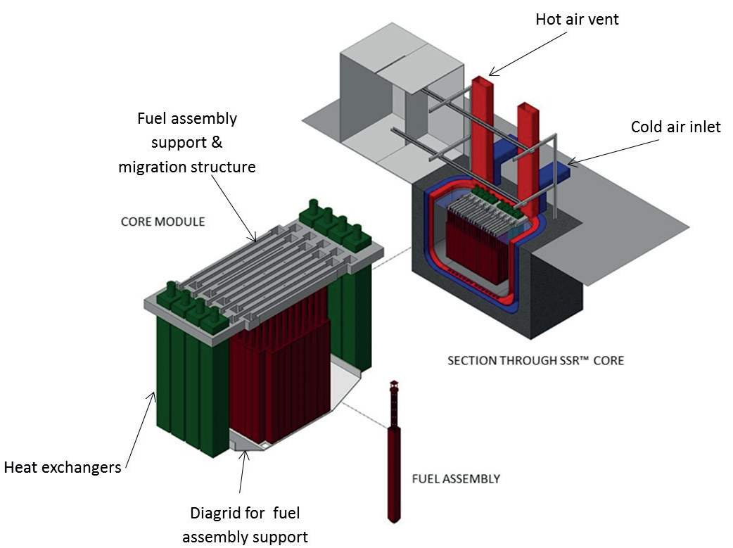

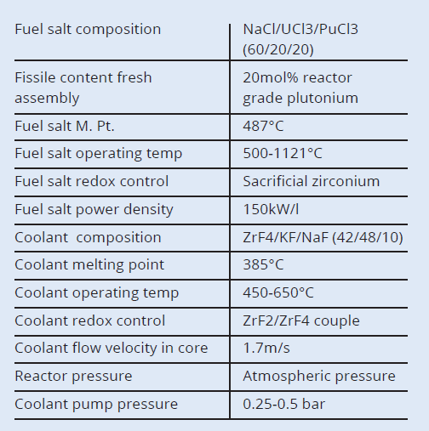
Moltex 150MW modular Stable Salt Reactor

Slide 33
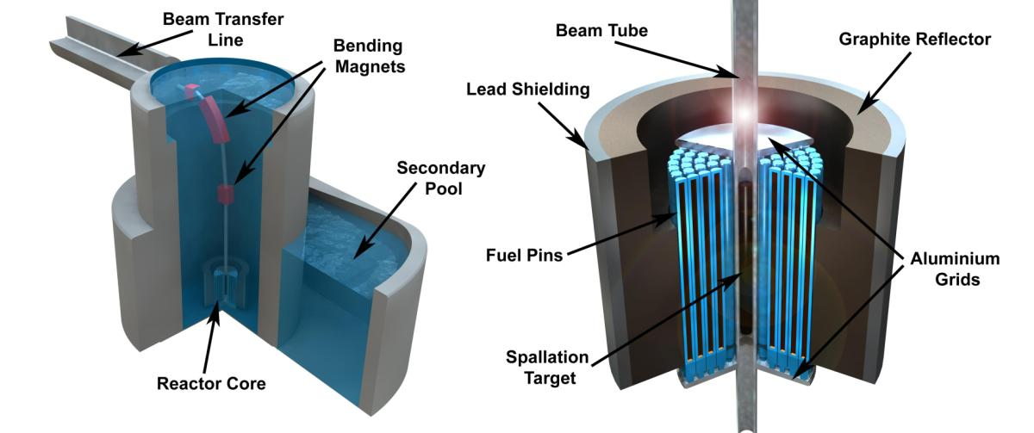
3. Accelerator driven subcritical reactors

Slide 34
The Energy Amplifier
The (thermal) power output of an ADSR is given by
with N = number of spallation neutrons/sec
E_{f} = energy released/fission (~200MeV)
ν = mean number of neutrons released per fission (~2)
k_{eff}= criticality factor for the reactor core (<1 for ADSR)
Remembering that N varies approximately linearly with energy of the protons, delivering
~24 neutrons per proton at 1 GeV for a lead spallation target, and noting
P_{acc} (MW) = I_{P} (mA) x E_{p} (GeV) and P_{el} ≈ 0.4 x P_{th}
or

Slide 35
ADSRs : accelerator power
ADSR?
ESS
PSI
SNS
J-PARC

Slide 36
Time dependence of k_{eff}
decay of ²³³Pa to fissile ²³³U
k_{eff} = 0.9895
k_{eff} = 0.9898
k_{eff} = 0.990
k_{eff} = 0.991
After G.Parks et al, Cambridge

Slide 37
Subcritical ADSR operation
Control rods essential
ADSR?
ESS
PSI
SNS
J-PARC

Slide 38
Delayed neutrons
Fissile nucleus | ν_{d} (neutrons/100 fissions)
²³³U (thermal) | 0.667±0.003
²³⁵U (thermal) | 1.621±0.05
²³⁸U (fast) | 4.39±0.10
²³⁹Pu (thermal) | 0.628±0.038
²⁴⁰Pu (fast) | 0.95±0.08
²⁴¹Pu (thermal) | 1.52±0.11
²⁴²Pu (fast) | 2.21±0.26

Slide 39
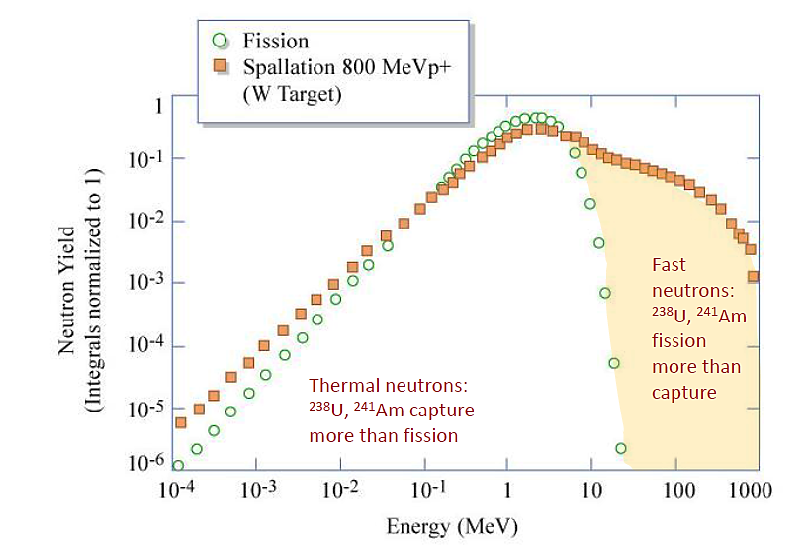
Spallation neutron vs fission neutrons
Nuclide | fiss/abs Thermal | fiss/abs Fast
²³⁹Pu ²⁴⁰Pu ²⁴¹Pu ²⁴²Pu | 63% 0.34% 23% 1.4% | 79% 43% 82% 36%
²³⁷Np ²³⁸Np ²³⁹Np | 1.9% 91% 3.9% | 17% 84% 19%
²⁴¹Am ²⁴²Am | 1.3% 83% | 12% 84%
²⁴²Cm ²⁴⁴Cm ²⁴⁶Cm | 8.9% 6.0% 18% | 33% 32% 53%

Slide 40
Cross-Progeny
LWR
Depleted U
Spent Fuel Store
Fuel fabrication
Depleted U + ²³³U
²³³U
Depleted U
Reprocessing
Pu
Fuel Fabrication
Th + Pu + Ma
Reprocessing
Pu
ADS
FPs
FPs
+LLFPs
W-
Pu
Th

Slide 41
Transmutation of LLFPs
The energy required to transmute a fraction of long lived fission products (ie ⁹⁹Tc, ¹²⁹I, ¹³⁵Cs, ¹²⁶Sn…) q_{fp}, in an ADSR is given by
with
and η_{b} and η_{T} are the efficiencies of converting electricity into the proton beam (~0.5) and converting heat into electricity (~0.4) respectively. N_{p} is the number of spallation neutrons emitted by a proton of energy E_{P}
For a positive energy balance we therefore require:
(for a lead target)

Slide 42
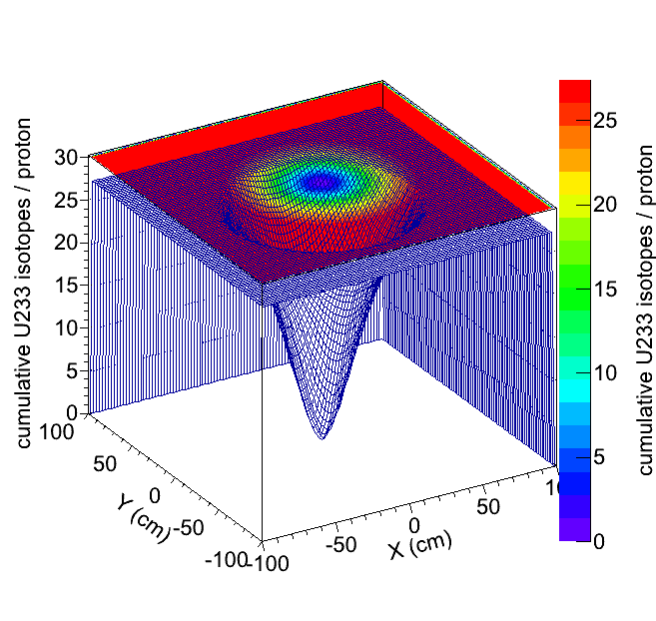
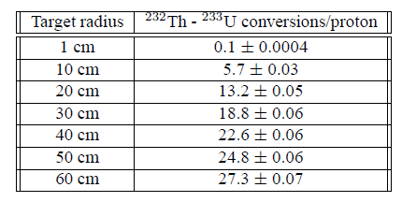
Fertile to fissile conversion ?
Our GEANT4 calculations show that conversion of ²³²Th to ²³³U directly by spallation is possible:
1 GeV protons incident on a large (60cm diameter 120cm long ) cylinder of ²³²Th will generate up to 27 ²³³U nuclei per proton
After 300 days of irradiation with a 1mA, 1 GeV proton beam the mass fraction of ²³³U is 0.2% (1.8% needed for criticality)
This is unlikely to be an economic process for producing ²³³U for conventional reactor systems
“Cross-Progeny” may be a more appropriate and cost effective route
Bungau, Cywinski, Barlow, Bungau

Slide 43
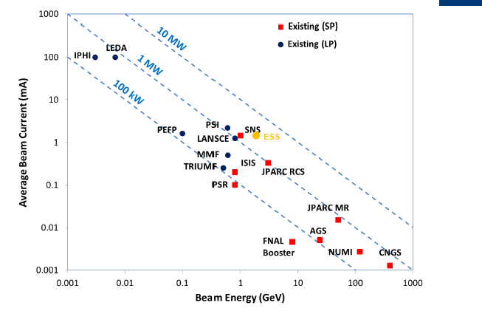
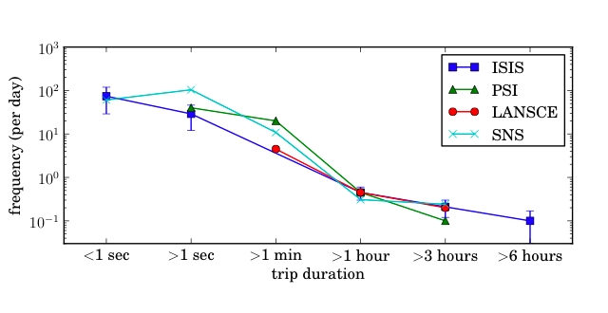
But……
….do we have the appropriate accelerator technology to drive an ADSR for power generation and/or cross progeny and FP transmutation in terms of
(a) Capital cost?
(b) Energy, current and footprint?
(c) Reliability?

Slide 44

New ns-ffag accelerator technology
Huddersfield led the international £7.5M ns-ffag project to develop and build a new type of particle accelerator

Slide 45
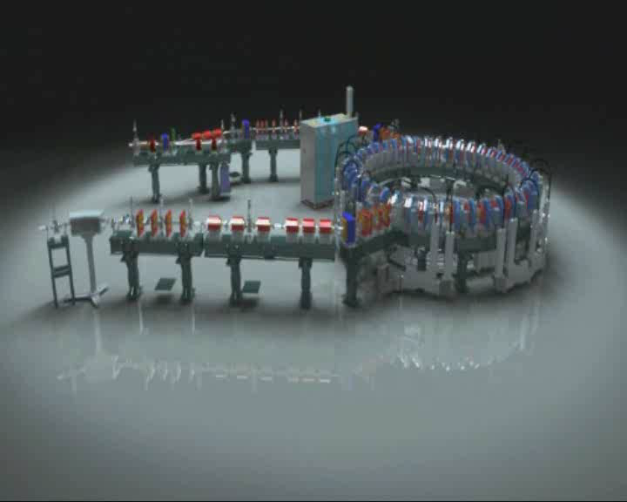
EMMA – world’s first electron ns-ffag

Slide 46
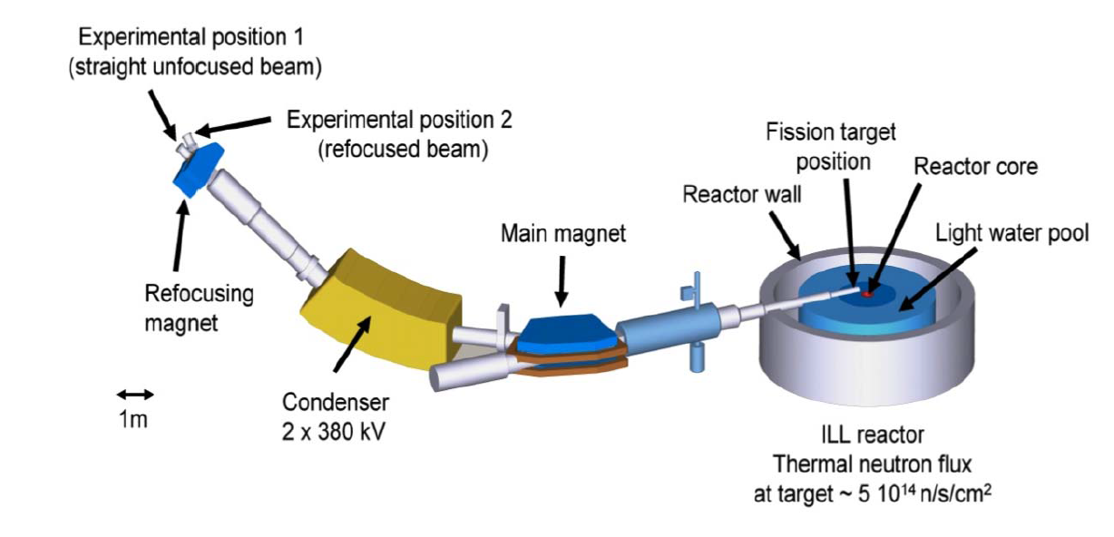
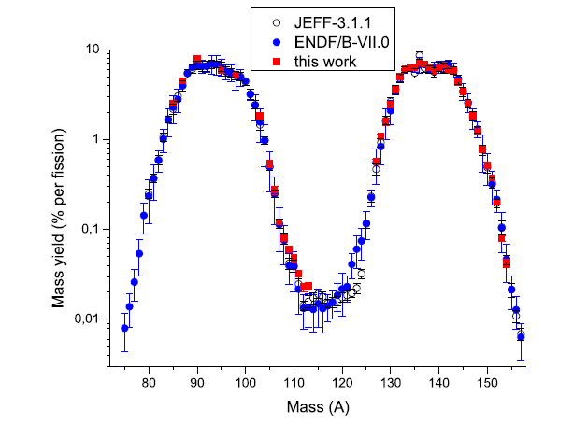
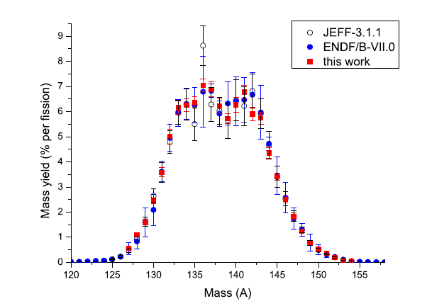
²³³U Fission Cross-sections
Measurement of the mass and isotopic yields of the ²³³U(n_{th},f) rection at the Lohengrin Spectrometer (ILL, Grenoble)
Fission fragments deflected electrically and magnetically (to give A/Q and E/Q)
International team led by Kessedjian (Grenoble)
Published in :
Advancements in Nuclear Instrumentation Measurement Methods and their Applications (ANIMMA), 2011
DOI:10.1109/ANIMMA.2011.6172920

Slide 47
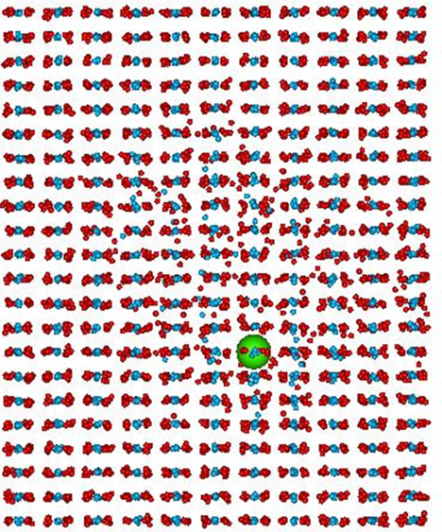
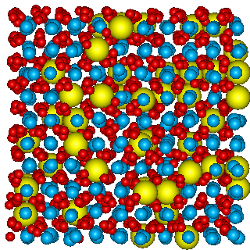
Molecular dynamics simulations
Molecular dynamics have been used to investigate the thermal expansion, oxygen diffusion, and heat capacity of pure thoria and uranium doped (1-10%) thoria between 1500 K and 3600 K.
Effects of radiation damage, oxygen vacancies and U substitution have been simulated
Results indicate that the thermal performance of the thoria matrix, even when doped with
10%U, is comparable to, and possibly better than, that of UO₂
Simulations are now being extended to molten thorium salts (LiF, BeF₂ and ThF₄ with ThF₄ content of 10% - 20%) to better understand MSR fuels.
Martin, Cooke and Cywinski, Journal of Applied Physics 112, 073507 (2012)

Slide 48

Conclusions
Thorium has been used successfully in the past and could now provide an alternative, sustainable, safe, low waste and proliferation-resistant fuel for nuclear power generation
Thorium has been used successfully for many years for power generation in HTGR and LWBR reactors. We have the technology to deploy it now
Thorium could be the fuel of choice in next generation modular reactor systems
There is a resurgence of interest in molten salt reactors which are well suited to the deployment of thorium-based fuel
MAs and Pu can be mixed with thorium and burnt as fuel, reducing radiotoxicity by orders of magnitude and turning a liability into an asset in reactors and MSRs, but particularly in ADS systems
Thorium fuelled ADSRs can also efficiently transmute fission products

Slide 49
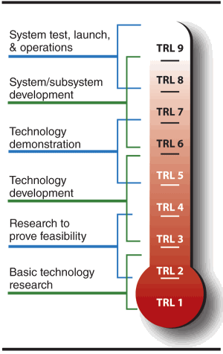
Thorium technology readiness levels
LWBR, HTGR
(eg Shippingport,
Fort St Vrain)
MSR
(eg Oak Ridge)
ADS
(eg KURRI)

Slide 50
Thank you

