Slide 1
Preliminary Look at a
FCC-ee IR Layout
M. Sullivan
for the FCC-ee optics meeting
Mar. 11, 2016

Slide 2
Outline
Introduction
Machine parameters
Initial IR layout
Initial SR study
Discussion points
Summary
Conclusion

Slide 3
Introduction
The interaction Region is always one of the more challenging parts of a new accelerator
  Detector requirements
  Accelerator requirements
Conflicting requirements mean compromises
Everyone has to succeed

Slide 4
Machine parameters used in following very Initial IR tt design
Beam Energy 175 GeV
β_{x}*/β_{y}* 1000/2 mm
ε_{x}/ε_{y} 1.3x10⁻⁹/2.5x10⁻¹² m-rad
σ_{x}/σ_{y} 36 μm /71 nm
L* 2.2 m
Crossing angle ±15 mrad
Beam current 6.632 mA
e/bunch 1.71x10¹¹
# bunches 81

Slide 5
Final Focus parameters
Magnet L (m) Z face (m) G (T/m)
Q1C1 1.6 2.2 97
Q1C2 1.6 3.8 97
Q2C1 1.25 5.7 61.5
Q2C2 1.25 6.95 61.5
Beam pipe aperture 24 mm dia.
SR masks 20 mm dia.

Slide 6
Final Focus SR study
BSC used in FF (half aperture)
  20 σ_{x} (about 11 mm at back end of QC2)
  60 σ_{y} (about 5 mm in middle of QC1)
    B factories had ½ ε_{tot} x β_{y} x 10 (>20 mm)
Beam tail distribution (halo)
Ray tracing out to (half aperture):
  15 σ_{x}
  50 σ_{y}

Slide 7
Beam tail distributions

Slide 8
IR Layout

Slide 9
Close up of IP Area

Slide 10
Hits/crossing FF quads only
Location Photons that hit each location
Tot >1 MeV >4 >10 >50
a 3132 1462 728 293 5
b 4.03e5 1.78e5 8.32e4 7.99e4 320
c 3.74e5 1.62e5 7.35e4 2.56e4 209
d 1.82e6 7.59e5 3.29e5 1.07e5 609
Notes:
  All γs are from beam particles that are 40-50σ in the vertical
    Very high energy γs. These numbers are MeV photons.
  Hits at points b and c are with a 10 mm radius beam pipe
  No hits at b and c if the beam pipe radius goes to 15 mm
  Drawing shows a 20 mm radius beam pipe

Slide 11
Hits/crossing FF + last bend
Location Photons that hit each location
Tot >1 keV >10 >50 >250 >1000
a 5.63e9 1.98e9 1.44e9 8.22e8 1.78e5 1.78e5
b 2.32e10 8.13e9 5.91e9 3.38e9 7.73e8 1.50e7
c 4.82e9 1.69e9 1.23e9 7.03e8 1.61e8 3.08e6
d 1.74e6 1.63e6 1.51e6 1.34e6 1.07e6 7.23e5
  Numbers are for 10 mm radius beam pipe
  No hits if inner beam pipe radius goes to 15 mm but then
  Downstream QC1 face gets ~1000x more photons
d 5.93e9 2.08e9 1.51e9 8.67e9 1.89e8 4.44e6

Slide 12
Downstream Face of FF quad
There are enough hits on the downstream quad face to cause a significant backscatter rate to the IP beam pipe
  About 1.3% backscatter
  The SA fraction of the IP beam pipe from the quad face is about 1.76×10⁻⁵
  The result is about 700 photons/crossing go through a 2 mm Be beam pipe with an average energy of 200 keV for each beam

Slide 13
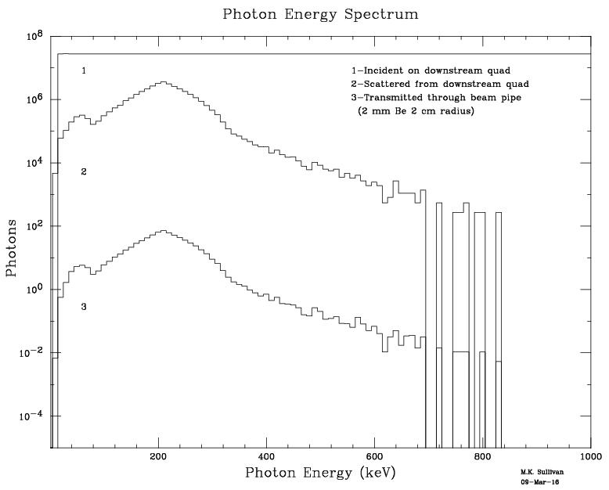
Tot Inc/xing = 2.72x10⁹
Tot scat/xing = 3.57x10⁷
Tot Thru Be/xing = 700

Slide 14
Upstream Mask of FF quad at 2.2 m
There are also enough hits on the upstream quad face to cause a significant backscatter rate to the IP beam pipe
  About 13% forwardscatter
  The SA fraction of the IP beam pipe from the quad face is about 1.34×10⁻⁵
  The result is about 8300 photons/crossing go through a 1 mm Be beam pipe with an average energy of 500 keV for each beam

Slide 15
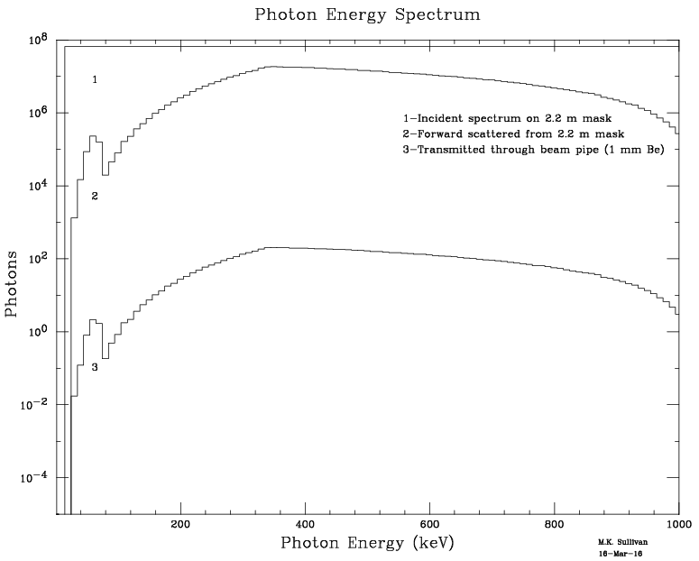
Tot Inc/xing = 6.48x10⁹
Tot scat/xing = 7.30x10⁸
Tot Thru 1 mm Be/xing = 8300

Slide 16
Shielding around the IR beam pipes
Based on the backscatter rate from the downstream quad faces, without shielding there is a high rate of photons into the central detectors near the IP beam pipe
For a backscattered photon hitting the beam pipe 0.5 m from the quad face the angle of incidence is ~40 mrad
Using this angle on various Ta layers one gets the following rates/xing through the Ta

Slide 17
Beam pipe shield

Slide 18
Backscattered rates through Ta shield
We study the beam pipe shield using Ta from 0.5 m to 1.5 m from the IP (within 0.5 m of the source)
Ta thickness Rate thru Ta shield/xing
3 mm 3.8
2 mm 11.7
1 mm 47.9
0.5 mm 127.9

Slide 19
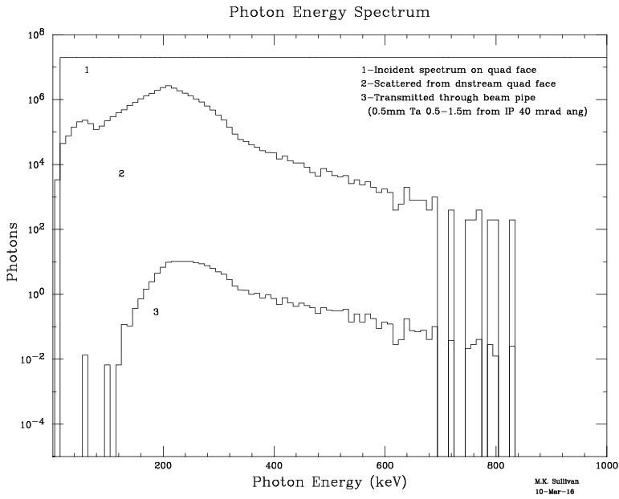
Energy spectrum for 0.5 mm Ta shield

Slide 20
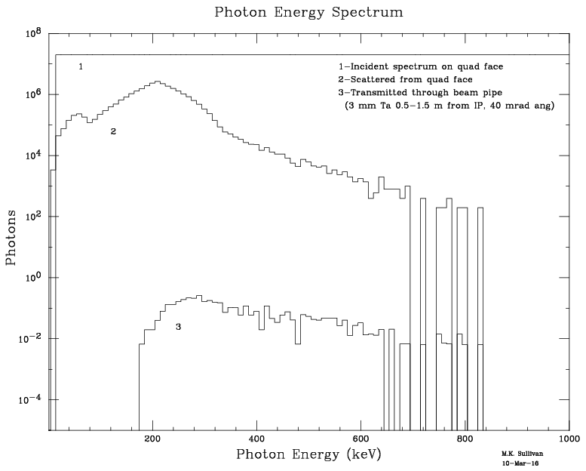
Energy spectrum for 3mm Ta shield

Slide 21
Questions/Issues
What is a good BSC?
  In X? Probably at least 15σ
  In Y? PEP-II B-factory had ~35σ with 5% coupling
  FCCee tt has 0.1% coupling so 50σ starts to sound small
  Small vertical aperture means harder to beta squeeze (it will determine the lowest βy*)

Slide 22
More Issues
What is the beam particle density at high σ_{x} and σ_{y}?
  Need to find out what dynamic aperture studies show
  Where do instabilities start to come in
  Where do we need to collimate
Why are bending magnets so close to IP?
  Tunnel size issue?
  PEP-II HER bends were 80m away for 9 GeV beam
  LEP soft bends were ~200m upstream

Slide 23
Still more issues
FF magnet bores too small?
  Same magnets for all running conditions? (presumably)
Question about soft bend field
  For tt the soft bend is 49 Gauss
  For Z the soft bend is 12 Gauss. Is this OK?
Same IR for all cases?
  What about Higgs running?
    Beam currents are higher
    Luminosity is higher
  What about Z running?
    Currents are even higher
Critical energy goes down, but currents go up. Need to see how this IR design works and what the SR rates into the detector are.

Slide 24
Present working assumptions
Assume present BSCs are OK
Tail particle density at high sigma (lifetime)
Detector needs for precision lumi monitor
  Primarily Z running
Size of IP beam pipe is 20 mm radius
  15 mm is just OK. There is no margin and no orbit distortions

Slide 25
What to do next
Do a forward scatter simulation ✓
Check what a higher field soft bend does
    Try this at the Z
Look at Z machine parameters
Look at Higgs machine parameters

Slide 26
Summary
Very preliminary IR design for tt machine
  Checked backgrounds from backscattered and forward scattered photons
    Multiply numbers shown by about 4 to include forward scatter sources and two beams
  Other backgrounds (BGB, Coulomb, Lumi, etc.)
    What collimation is needed
    What more shielding is needed
  Get some understanding of Higg’s and Z running issues with this design
    High beam currents may generate new issues

Slide 27
Conclusion
A small start
As always, much more to do…
Thanks!

