Slide 1
Alternative layout of the IR region
M. Koratzinos
IR brainstorming meeting
Wrednesday, 16/3/2016

Slide 2
The problem
Emittance blow up is a steeply varying function of magnetic fields and dispersion
Moving elements by a few centimetres is enough to change the emittance blow up by factors of 2 or more.

Slide 3
Presented baseline

Slide 4
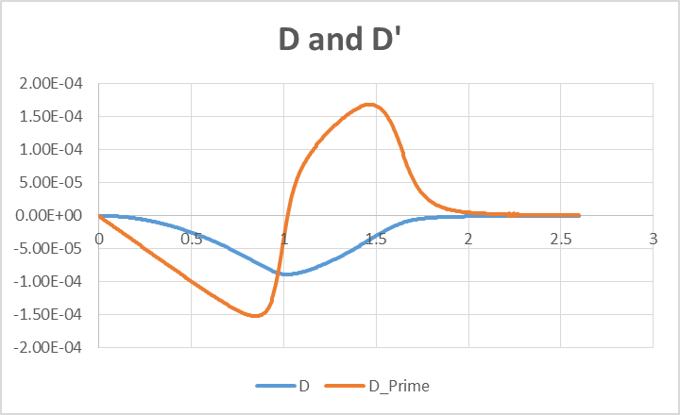
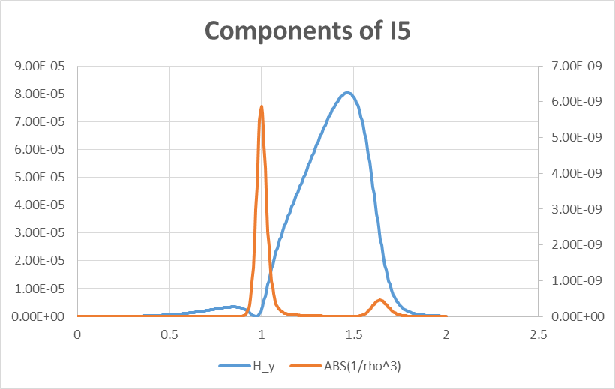
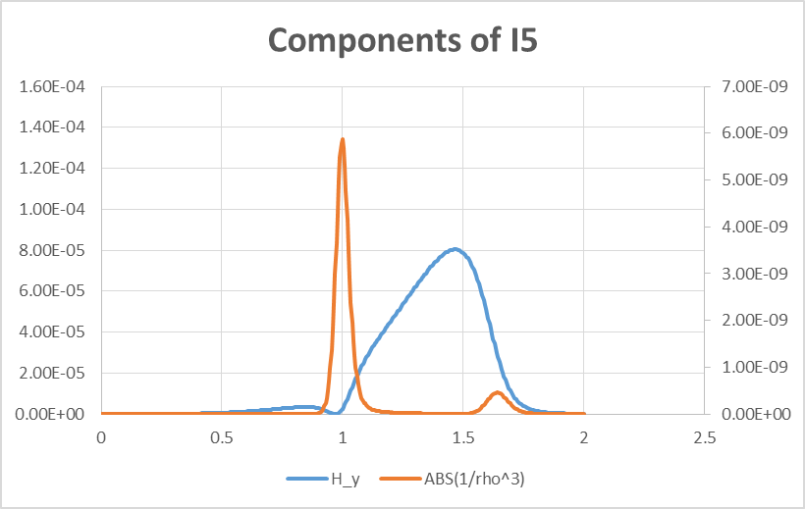
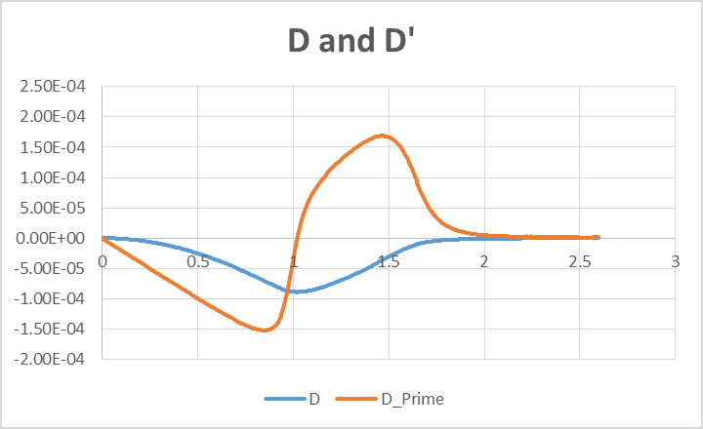
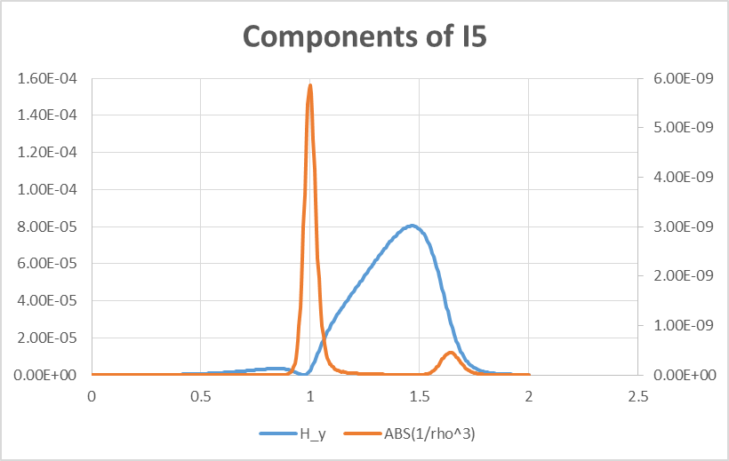
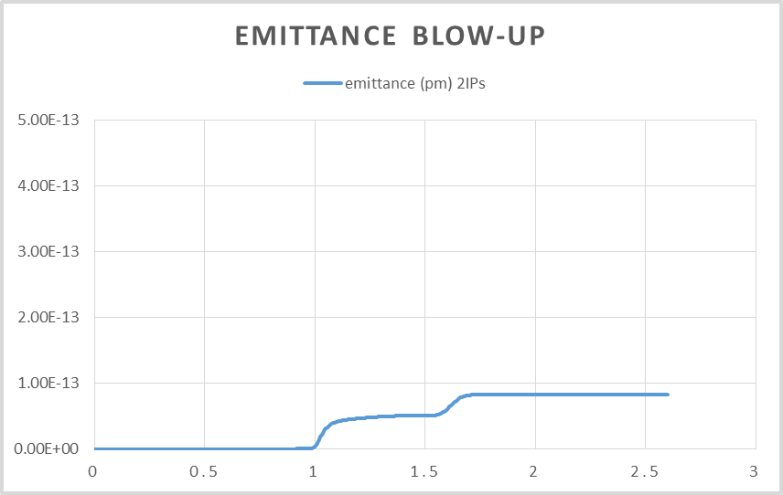
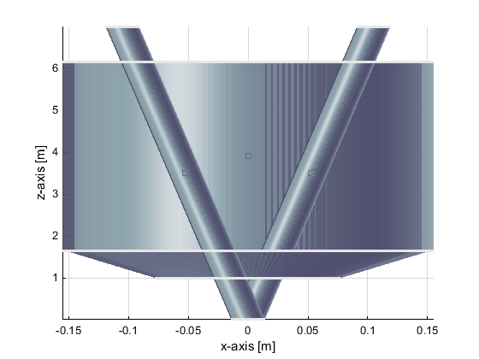
Presented baseline, 100mrad cone, solenoids start at 1.0m
31cm
50%
of budget

Slide 5
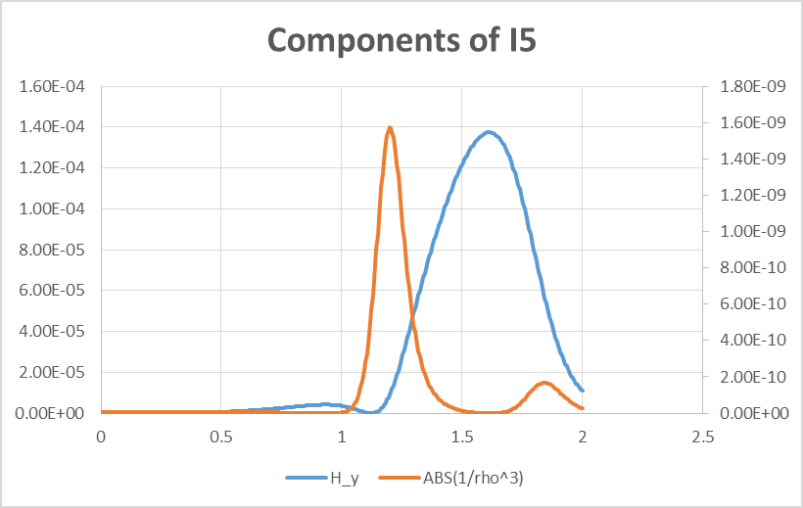
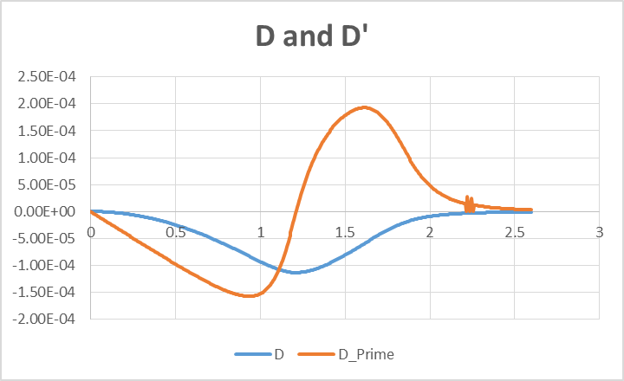
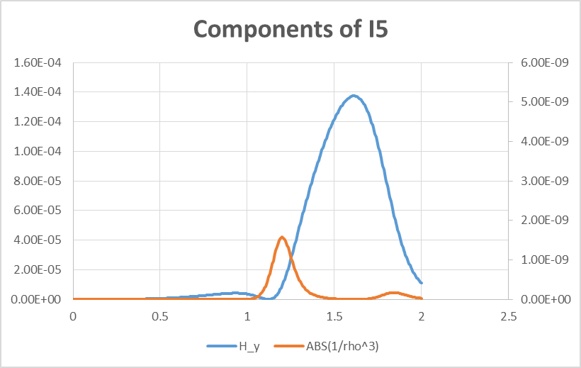
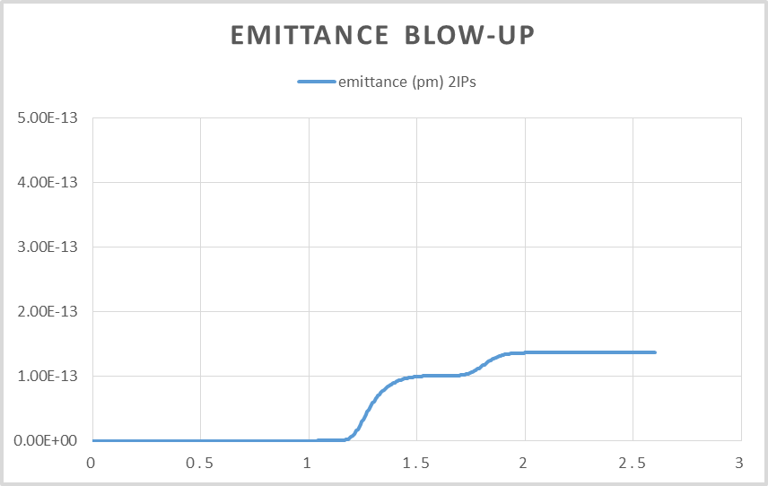
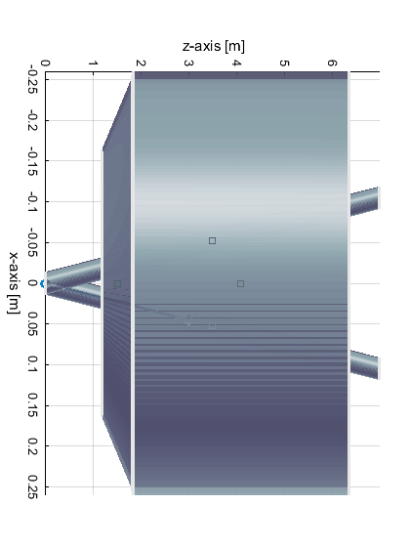
New proposal, 140mrad cone, solenoids start at 1.2m
52cm
50%
of budget

Slide 6
Extra slides

Slide 7
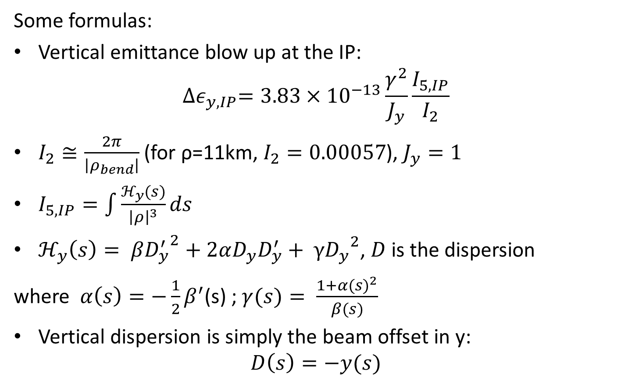
Emittance blow up
More important at low energies!
Some formulas:
Vertical emittance blow up at the IP:
$${∆ε}_{y,IP}=3.83×{10}^{−13}\frac{γ^{2}}{J_{y}}\frac{I_{5,IP}}{I_{2}}$$
$I_{2}≅\frac{2π}{\left|ρ_{bend}\right|}$ (for ρ=11km, $I_{2}=0.00057$), $J_{y}=1$
$I_{5,IP}=\int{\frac{ℋ_{y}(s)}{{\left|ρ\right|}^{3}}ds}$
$ℋ_{y}\left(s\right)= β{D_{y}^{′}}^{2}+2αD_{y}D_{y}^{′}+ γ{D_{y}}^{2}$, $D$ is the dispersion
where $α\left(s\right)=−\frac{1}{2}β^{′}$(s) ; $γ(s)= \frac{1+{α(s)}^{2}}{β(s)}$
  Vertical dispersion is simply the beam offset in y:
  $$D\left(s\right)=−y(s)$$

